Slide 1

Preprocessing: Realigning and Unwarping
Methods for Dummies, 2015/16
Sujatha Krishnan-Barman
Filip Gesiarz

Slide 2
What this talk covers
Preprocessing in fMRI : Why is it needed?
Motion in fMRI
Realignment
Unwarping
How this all works in SPM
Suze
Filip
Notes:
In this talk we’re going to start with just some basic information on what you actually get out of the scanner, and why you need to preprocess.
Specifically, I’ll (Suze) talk about motion in fMRI: How to prevent it, and, because it’s not entirely preventable, how to correct for it. This brings us to realignment, which is an important step in preprocessing, and then Filip is going to talk about Unwarping, and hopefully how this works in SPM.

Slide 3
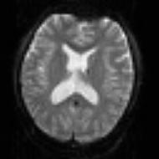


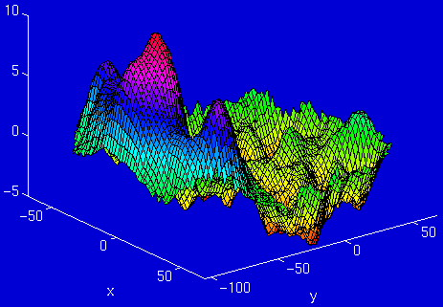
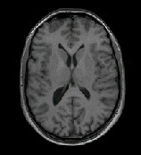
Stages in fMRI analysis
Scanner Output
Preprocessing
Statistical analysis
Today’s talk
Motion correction (and unwarping)
Design matrix
fMRI time series
Smoothing
General Linear Model
Statistical Parameter Map
Spatial normalisation (including coregistration)
Structural MRI
Parameter estimates
Notes:
In practical terms, you usually run 3-4 scans in the scanner: A localiser to find out where the brain is, a fieldmap, a structural scan and your actual task (a functional scan) – however many runs that involves. Functional 3rd, before structural, so ppts less tired. Fieldmap more important for higher field strengths – at 1.5T in the BUCNI scanner we don’t often collect fieldmaps.

Slide 4
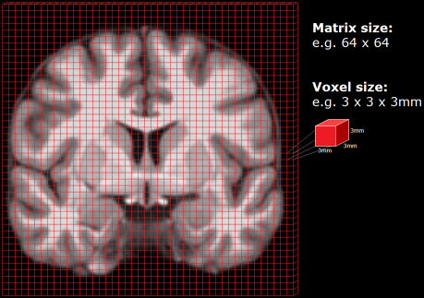
Preprocessing: Why is it needed?
fMRI analysis involves looking at a 3D matrix of voxels repeatedly sampled over time
Changes in activation are then correlated with experimental task
For this to work, in theory:
Each voxel must represent a unique and unchanging location in the brain
All voxels must be acquired simultaneously
In practice:
The last slice is acquired TR seconds after the first slice
There is always some movement which means voxel position is not unchanging
Notes:
To answer this, first must go back to how fMRI works: We look at intensity of activation in a voxel at a given point of time. We plot this along with various tasks, and if activation varies with the task, we can correlate brain function.
To do this, first step we must ensure we are looking at same brain region over time.
QN: Do we need to talk about slice timing? I understand this in theory: There’s a TR (usually 3s?) gap between acquisition of the first slice and the last slice in each scan. And we have various methods of interpolating the images to ensure this timing gap doesn’t affect data. But is this a step we do in SPM? And if so when is it done – before realignment or after?
Regarding slice-timing, I'd mention the fact that there can be motion of one slice relative to another due to the delay, and the fact that the realignment model cannot correct this motion, which is one reason for wanting to include realignment parameters in the linear model. I don't think you need to discuss slice-timing-correction itself, since this will probably be discussed in the talk on event-related fMRI. The choice of whether to have STC before or after realignment (or not at all) is still a matter of debate, depending on some subtle things like whether the slices are acquired with an "interleaved" sequence or not, and how much motion there is (probably too much detail to get into in MfD).

Slide 5
Motion in fMRI: What does it mean?
Even a small movement (< 5mm) can mean that voxel location is not stable throughout the time series
This movement can be caused by a number of factors:
  Physiological: heart beat, respiration, blinking
  Task-related: moving to press cursors (Can correlate with task conditions)
  Actual movement of the head
Voxel A - Inactive
Small (<5mm) movement
Voxel A - Active

Slide 6
Motion in fMRI: Why is it bad?
Movement of voxel position through the task can lead to false activations
These movement-induced variances can often be much larger than experiment-induced variance
The movement induced by the task (pressing a cursor, moving joystick) can often correlate with conditions
These movements increase noise, lowering signal-to-noise ratio
Our objective in motion-reduction and motion-correction is to remove the uninteresting variability and improve the SNR

Slide 7
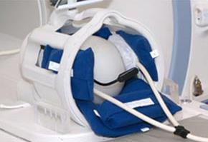
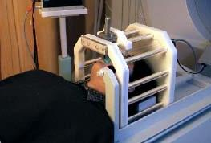
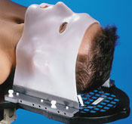
Motion in fMRI: How to prevent it
Make volunteer comfortable
Schedule short scanning sessions
Provide instructions not to move head
Constrain volunteer’s movement
  Padding: Soft padding, expandable foam
  Bite bars, contour masks
Soft padding
Bite bar
Contour mask
However, none of these methods is perfect, and motion artefacts are inevitable
Notes:
QN: What’s a good length of time that we can scan for?
Regarding length of scanning sessions, I'm not very well placed to answer, because I haven't done a lot of scanning. It's also very much dependent on what group you are scanning (e.g. children, elderly or patients might only tolerate shorter sessions). I'd probably aim for less than 10 minutes per run, though perhaps I'm being over-conservative there (I think the HCP scan for longer), and for no more than 90 mins total time in the scanner, ideally less than 60.

Slide 8
Motion in fMRI: How to correct for it
Raw scans
Realign time-series of images
  By removing effect of movement we can increase the sensitivity (or SNR) of the data
  However, subject movement may correlate with task, therefore realignment may reduce sensitivity
Steps involve registration and transformation
Motion corrected
Mean functional
Notes:
*QN: I’m not sure how exactly this works

Slide 9
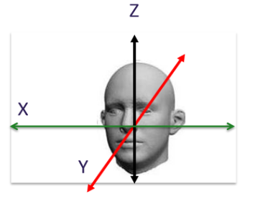
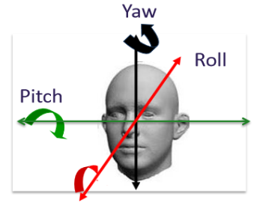
Realigning: Registration & Transformation
A reference image is chosen (usually first image)
A rigid-body transformation is performed which assumes that shape and size of brain images do not change
Images are then spatially mapped
  3 translations (x, y, z)
  3 rotations (degrees)
These transformations are applied to the functional images to correct them
  Each image is matched to reference image
  Mean of these aligned images is used to generate mean functional scan**
Translation
Rotation
Notes:
QN: Is reference image always the first image? Are there times you’d use a different image?
Regarding the details of realignment itself, the reference is usually the first image, though SPM also offers a two-pass strategy that first registers to the first image, then registers to the mean image, with the motivation being that the mean should be more representative of the whole time-series.
QN: Any issues with this assumption?
The main issues with the rigid-body transformation assumption are (a) between slice motion, mentioned above, (b) non-rigid deformation due to susceptibility-induced distortion, which will be discussed in the unwarp section of the talk.
QN: What else is mean functional scan used for?
The mean functional can be useful for coregistration, and/or for segmentation/bias-correction if necessary.
Motion correction uses a correction cost function: measures variance to see if images are a good match. Smaller variance = better match (least squares). The realigning process is iterative: Image is moved a bit at a time until match is worse.

Slide 10
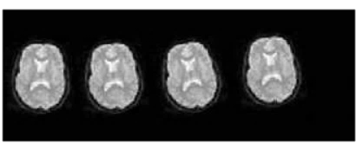
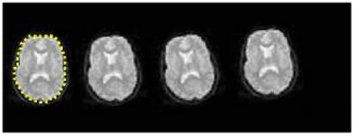
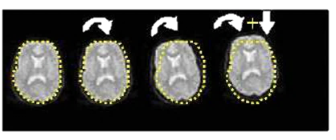
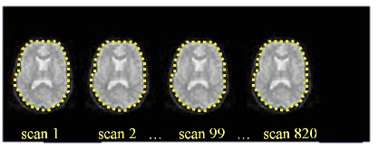
Realigning: Registration & Transformation
Series of scans with head movement
Calculate position of brain for first slice (Reference Image)
Estimate transformation parameters based on Reference Image
Apply transformation parameters on each slice

Slide 11
Realigning: Interpolation
 | Raw data | After re-alignment
Brain area
Scanned slices
t = 1
t = 2
t = 3
t = 4
t = 5
t = 6
Missing data
We now need to fill in the gaps after transformation, using interpolation
Notes:
If all that has gone to plan, each slice will now map onto the same brain area throughout the time series
Now we need to resample each image based on the voxel grid of the reference image, so that each voxel maps onto the same brain area
There will be gaps

Slide 12
Realigning: Interpolation
Interpolation involves constructing new data points based on known data
Simple interpolation:
  Nearest neighbour: Take value of closest voxel
  Tri-linear: Take weighted average of neighbouring voxels
B-Spline interpolation
  Improves accuracy – SPM uses this as standard
There may still be residual errors…
Notes:
QN: Do you think I need to explain what B-spline interpolation is? One way of thinking about it is that it's fitting curves rather than just fitting a line, like tri-linear interpolation is doing, but the details are rather complicated.
Even after realignment a considerable amount of the variance can be accounted for by effects of movement
This can be caused by e.g.:
Movement between and within slice acquisition
Interpolation artefacts due to resampling
Non-linear distortions and drop-out due to inhomogeneity of the magnetic field (unwarping!)
Incorporate movement parameters as confounds in the statistical model

Slide 13
References and further reading
Slides from previous years of the MfD course
(http://www.fil.ion.ucl.ac.uk/mfd/)
MRC CBU Cambridge, Imaging Wiki
(http://imaging.mrc-cbu.cam.ac.uk/imaging)
Nipype Beginner’s guide to neuroimaging
(http://miykael.github.io/nipype-beginner-s-guide/neuroimaging.html)
Andy’s Brain blog
(http://andysbrainblog.blogspot.co.uk/2012/10/fmri-motion-correction-afnis-3dvolreg.html) Also has cool video showing the 3 translations and 3 rotations.
Huettel, S. A., Song, A. W., & McCarthy, G. (2004). Functional magnetic resonance imaging. Sunderland: Sinauer Associates.
Notes:
Found it a bit easier to go back to slides from two years ago – before this race to extreme mathematics began.

Slide 14
After realignment
Even after realignment there is considerable residual variance in fMRI time series that covary with, and is most probably caused by, subject movements.
Result:
Loss of sensitivity (false negatives)
Mistaking movement induced variance for true activations (false positives)
Notes:
Even after realignment there is considerable variance in fMRI time series that covary with, and is most probably caused by, subject movements.
It is also the case that this variance is typically large compared to experimentally induced variance.
In fact, in severe cases up to 90% of the variance after realignment can be caused by movement.

Slide 15
Known issues
Spin-history effects: In a typical FMRI design, the TR is not much larger than the T1, and so the spins will not relax back completely by the time the next acquisition arrives. If there is a sudden motion in the subject half way through a scan, a particular slice may correspond to a different part of brain than it did last time. It will be in a different degree of excitation, and the signal intensity will be different.
Slice-to-vol effects: The rigid-body model that is used by most motion-correction (e.g. SPM) methods assume that the subject remains perfectly still for the duration of one scan (a few seconds) and that any movement will occurr in the few μs/ms while the scanner is preparing for next volume.
Notes:
During each acquisition of a slice spins are excited, and then gradually relax back into line with the magnetic field with a rate determined by the T1 constant.

Slide 16
Known issues
Susceptibility-distortion-by-movement interaction: susceptibility induced field inhomogenity will cause distortions of the image
Susceptibility-dropout-by-movement interaction: The susceptibility induced field inhomogenity will cause signal loss due to through-plane dephasing

Slide 17
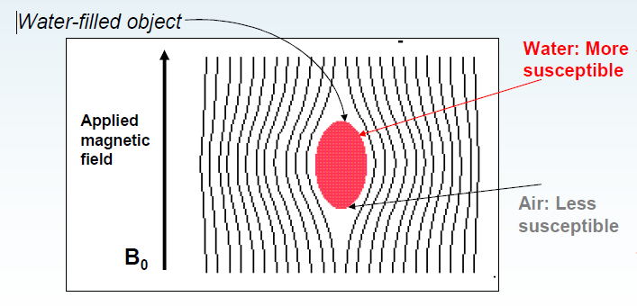
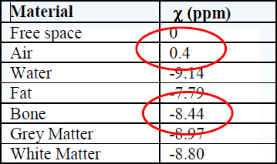
Inhomogenity of magnetic field
Magnetic susceptibility (χ) - degree of magnetization of a material in response to an applied magnetic field.
If χ is positive, a material can be paramagnetic - the magnetic field in the material is strengthened by the induced magnetization.
If χ is negative, the material is diamagnetic - the magnetic field in the material is weakened by the induced magnetization.

Slide 18
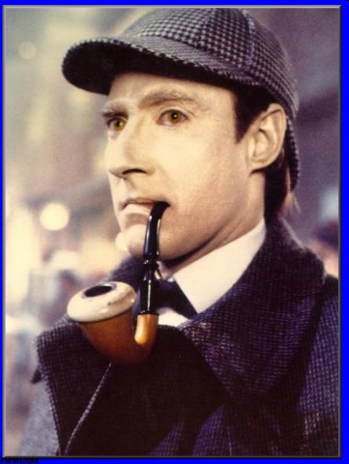
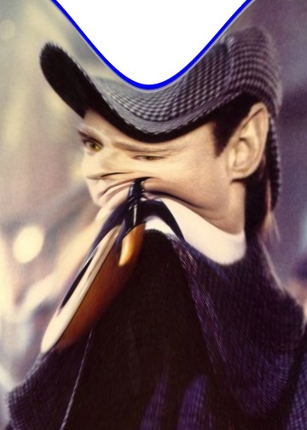
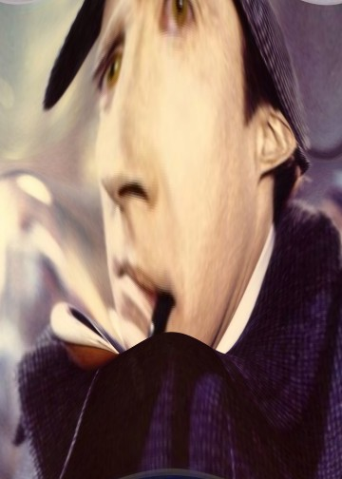
Warping
Form of the geometric distortions in EPI is dependent on the position of the head in the magnetic field

Slide 19
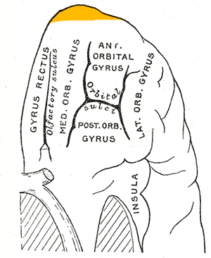
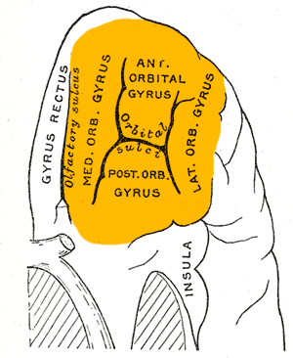
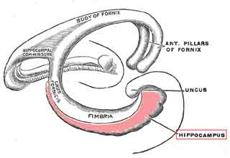
Brain regions particularily susceptible
Frontal pole
Orbito-frontal cortex
Medial temporal lobe (especially hippocampus)

Slide 20
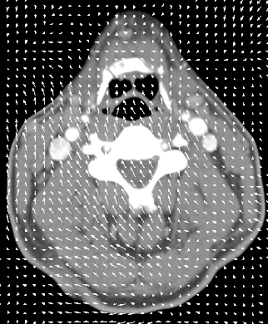
Rigid and non-rigid transformation
Rigid transformation - the same linear transformation is applied to all voxels between each scan (realigning)
Non-rigid transformation – different transformation is applied to each voxel between each scan (unwarping)

Slide 21
Unwarping
For given time series and subject’s changes position we observe variance in signal (after realignment)
Given observed variance and subjects changes in position, what is the change in deformation?
Notes:
Assume that we know how the deformations change when the subject changes position (i.e. we know the derivatives of the deformations with respect to subject position). That means that for a given time series and a given set of subject movements we should be able to predict the "shape changes" in the object and the ensuing variance in the time series.
It also means that, in principle, we should be able to formulate the inverse problem, i.e. given the observed variance (after realignment) and known (estimated) movements we should be able to estimate how deformations change with subject movement.

Slide 22
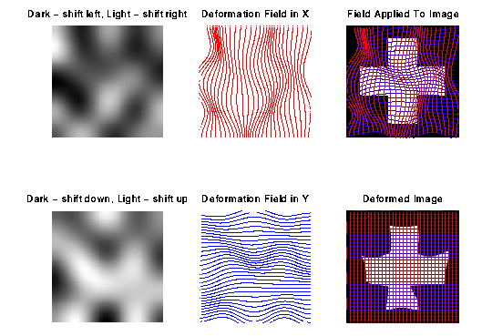
Deformation field
A deformation field indicates the directions and magnitudes of location deflections throughout the magnetic field with respect to the real object (Vectors indicating distance & direction)

Slide 23
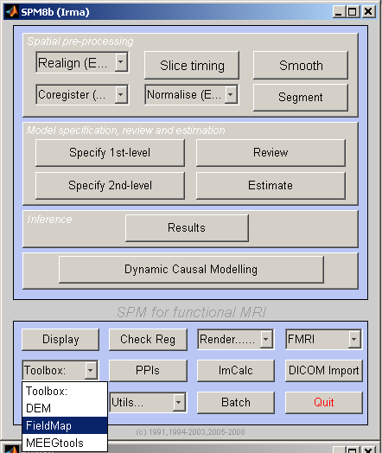
SPM
Choose Toolbox/Fieldmap from SPM’s menu window.

Slide 24
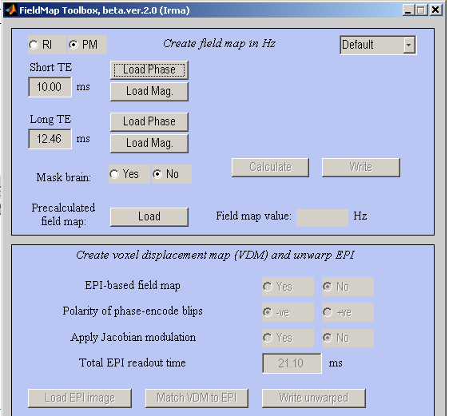
SPM
Press ‘Load Phase’ and choose your phase image. You will be asked if you want to have this scaled to radians – select Yes. A new version of the fieldmap will be created that has an intensity range of –pi +pi (Siemens data is initially in the range -4096..+4096).
Press ‘Load Mag.’ and select one of your magnitude images

Slide 25
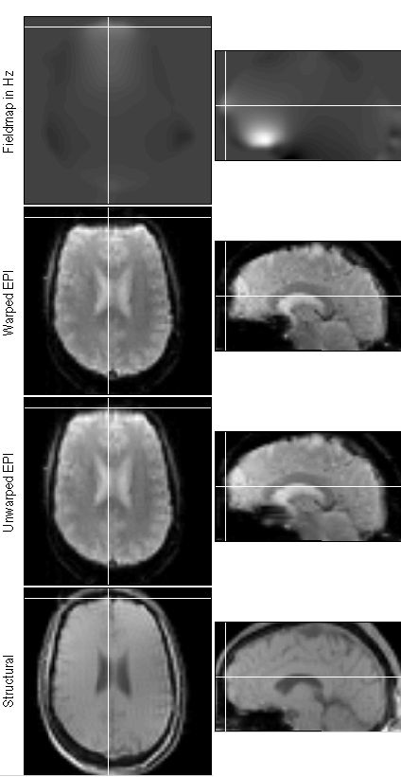
SPM
Make sure to set your ‘Short TE’ and ‘Long TE’ to the correct values
You can check your other defaults (mask the brain)
Press ‘Calculate’ – after a couple minutes a fieldmap is displayed. You can interactively click on the display and the amount of inhomogeneity for that voxel will appear in the ‘Field map value Hz’ field. Several new image files are created, including a voxel displacement image (VDM).

Slide 26
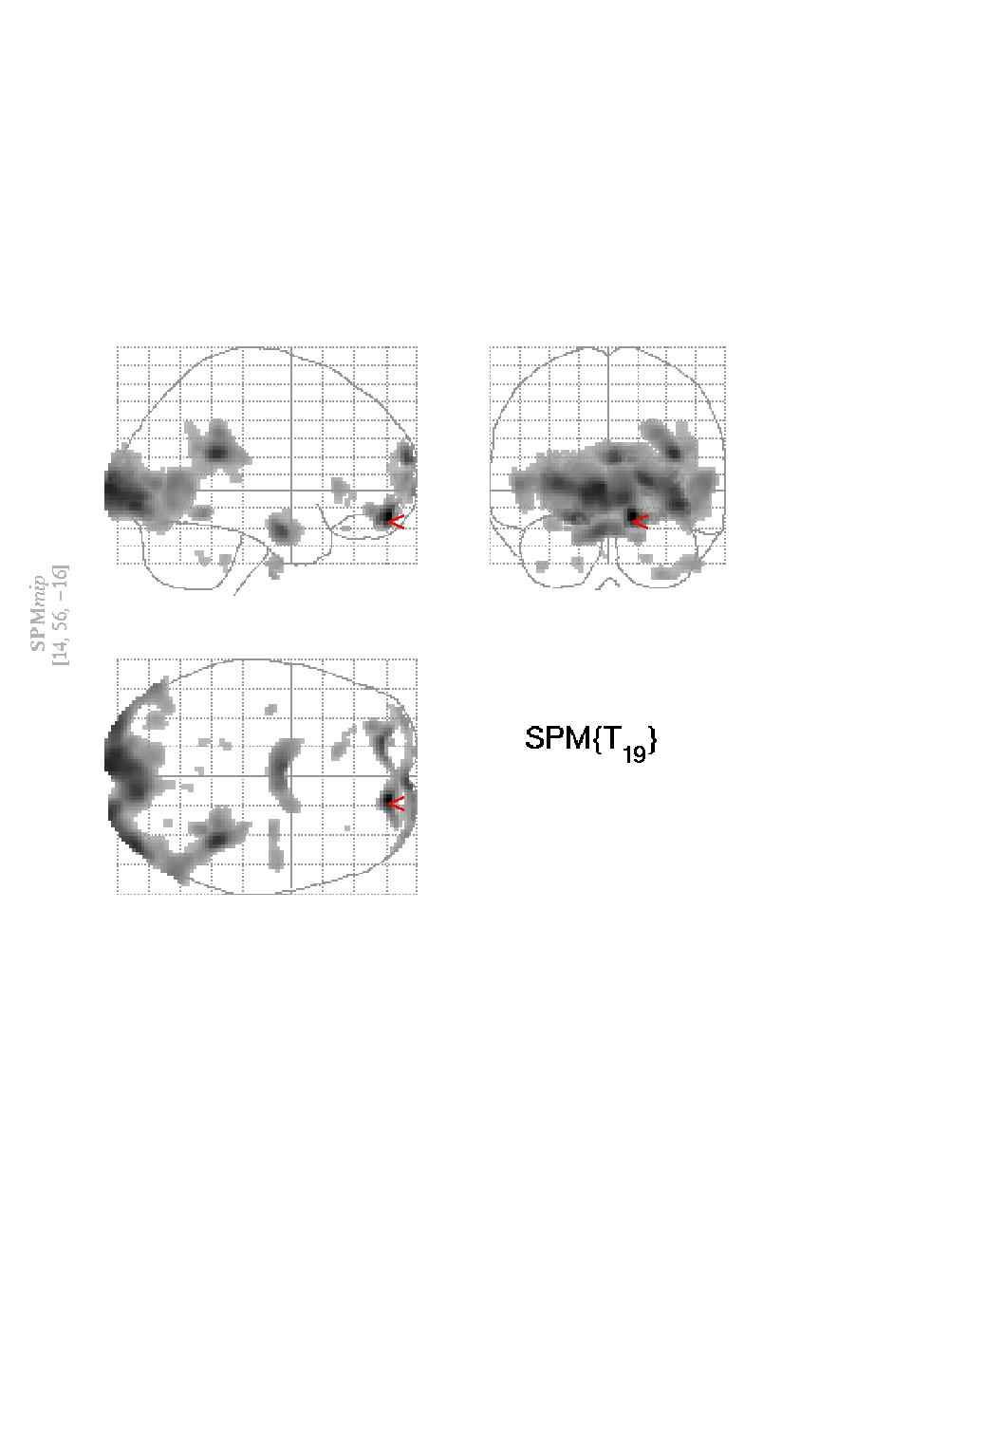
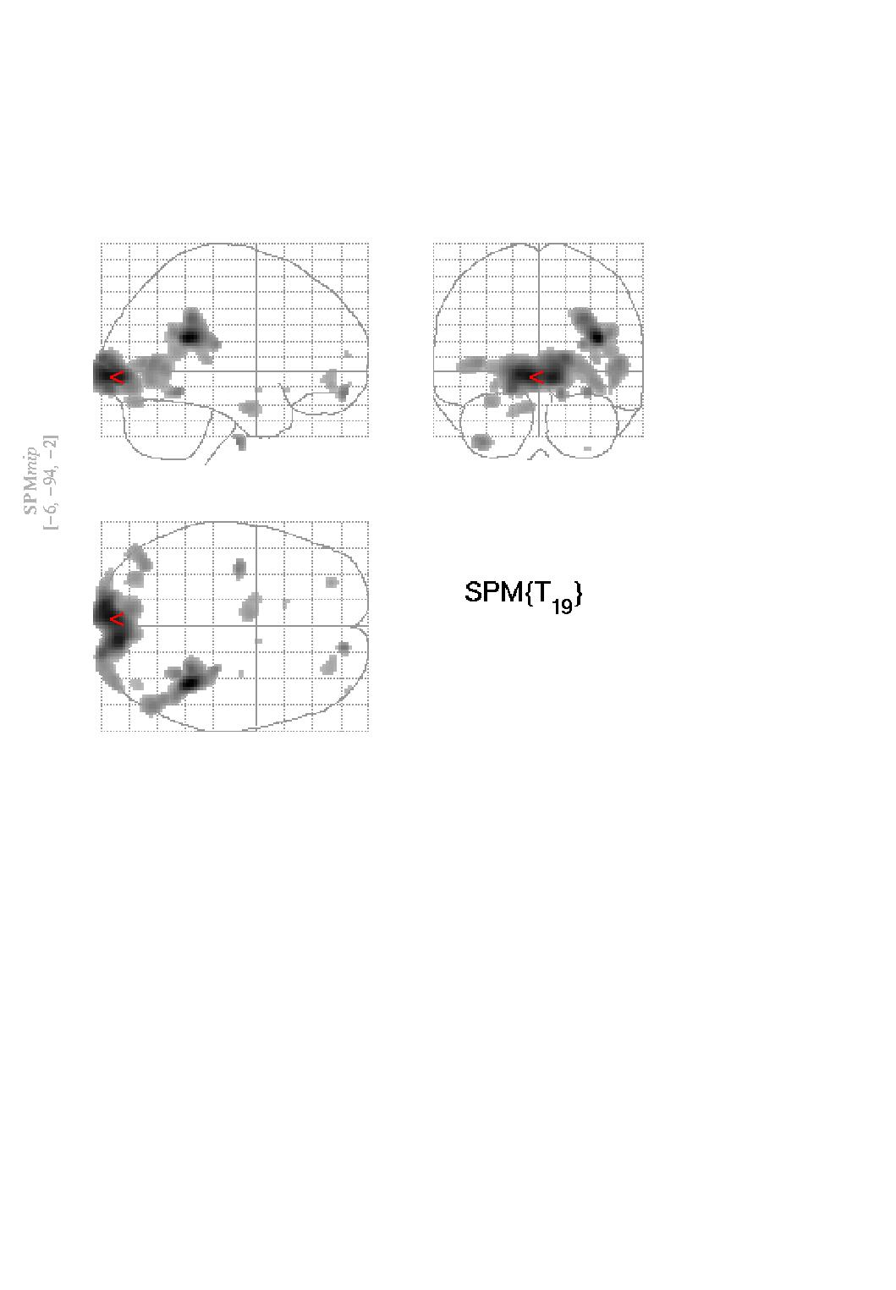
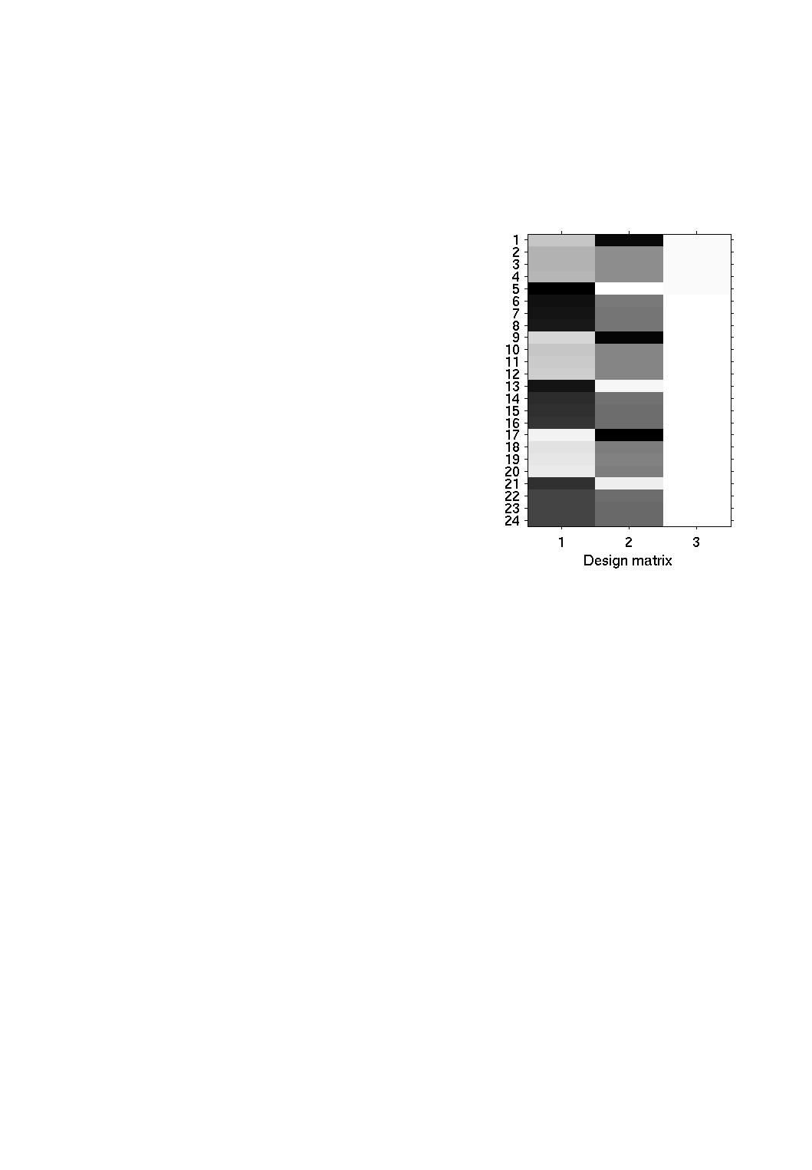
SPM
Press ‘Load EPI image’ and select your functional data, and make sure the Total EPI readout time is set correctly.
Press ‘Load structural’ and select one of your magnitude images
Press ‘Write unwarped’ – a new undistorted image is created
No correction
Correction by Unwarp

Slide 27
SPM
The image on the left shows the SPM graphics window at this stage – the ‘Unwarped EPI’ should have a more similar shape to the ‘Structural’ then the ‘Warped EPI’. If the error is worse, change -ve to +ve.

Slide 28
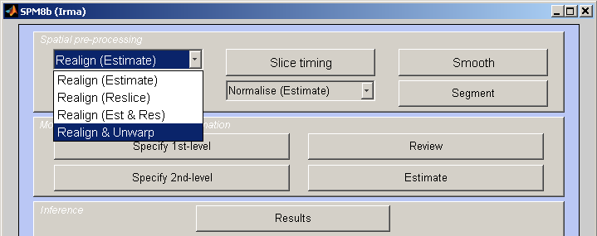
SPM
You can now preprocess your MRI data. At this stage you will want to do your motion correction using the ‘realign and unwarp’ option, selecting the vdm file you created.

Slide 29
Advantages and disadvantages
For ‘problematic’ brain regions the reduction of unwanted variance can be quite dramatic (>90%).
If movements are task related unwarping will remove unwanted variance without removing all your "true" activations.
Can be computationally intensive… so take a long time
Only deals with susceptibility-distortion-by-movement interaction problem

Slide 30
When should you do it?
If there is little movement in your data to begin with this method will do you no good.
If on the other hand there is appreciable movement in your data (>1mm or >1deg) it will remove some of that unwanted variance.
When you are focusing on problem areas (Frontal pole, orbito-frontal cortex, medial temporal lobe)

Slide 31
References and further reading
Jezzard, P. and Clare, S. 1999. Sources of distortion in functional MRI data. Human Brain Mapping, 8:80-85
Andersson JLR, Hutton C, Ashburner J, Turner R, Friston K (2001) Modelling geometric deformations in EPI time series. Neuroimage 13: 903-919
Previous years MfD slides.
SPM website/ SPM manual

