Slide 1
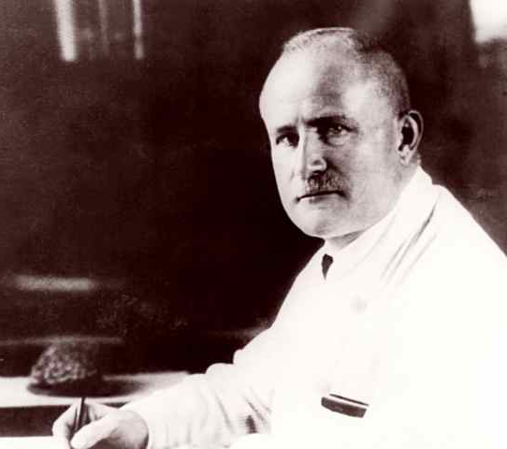
Methods for Dummies:
Study Design and Pre-processing
Tim West & Vanessa Meitanis
Hans Berger- Inventor of EEG
Notes:
I will talk about the design of experiments for EEG/MEG
– how to collect data and test a hypothesis.
Good experimental design yields good quality data
If you think about confounding factors and technical issues before you start collecting data you can avoid a lot of problems in the future
Hans Berger – developed EEG in attempt to find the source of “Psychic Energy”

Slide 2
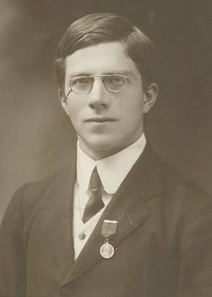
Idealised Experimental Design: Fisher
Analyse Data to Reach Conclusions
Make an Observation
“Pre-milked tea was not detectable above chance ”
“Tea tastes better when you add the milk first”
Design an Experiment and Collect Data
Formulate a Hypothesis
“A seasoned tea drinker should be able to determine a superior tea at a level higher than chance”
“Present a random selection of prepared teas to the expert in a blind test”
Fisher, The Design of Experiments, 1935
Notes:
RA Fisher laid out his ideas in a book entitled “The design of Experiments” in 1935
Summarised his form of experimental design in his experiment “the lady tasting tea”
How to design,test and analyse data to answer a hypothesis
Observe, formalise, design and perform a test, analyse, conclude
Good science will drive the generation of new hypotheses for further testing

Slide 3
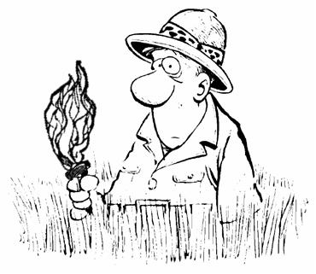
If you don’t know where to look…
Exploratory research
Keep potential dimensions for results broad – Run a large battery of tasks, record using multiple modalities
Be wary of spurious results – the nature of the research results in large numbers of tests and the risk of a false positive is high
Try to set your “researcher’s degrees of freedom” prior to testing – predesignate sample sizes, criteria for trial rejections, independent variables to test prior to conducting experiments.
Exploratory research produces hypotheses – should be followed up by more rigorous, formal testing
For a critique of false-positives and potential pitfalls of exploratory research see: Simons et al. (2011)

Slide 4
Experiments involving
Humans
Repeated Measures
Subjects receive all treatments – so less subjects needed
Within subject dependencies- “order” effects
Independent Measures
Subjects randomly assigned to groups
Ensures independence between treatments – avoids “order” effects
High number of subjects needed
1
2
3
1
2
VS
2
3
1
Randomised Block Design
Subjects grouped by characteristics
Treatments randomly applied within each group
2
1
3
3
1
2
3
Notes:
Testing humans – expensive, noisy, variable,
Independent measures- random assignment
Ensures independence between treatments
Avoids order effects – i.e fatigue over trials
Expensive
Experiments are often done blind such that different conditions are not known by participants
Double blind in which experimenter is also blind to the experimental condition

Slide 5
MEG/EEG Requires Different Study Designs to fMRI
Temporal Resolution
fMRI– 1-2s
MEG – < 1ms
EEG - <1 ms
Spatial Resolution
fMRI– 1-2mm
MEG – ~cm’s
EEG – ~cm’s
Notes:
The difference in the type of questions answerable by the methods means study design must be altered.
fMRI studies deal in slow changes but small areas of the brain
EEG/MEG show responses on a much faster scale

Slide 6
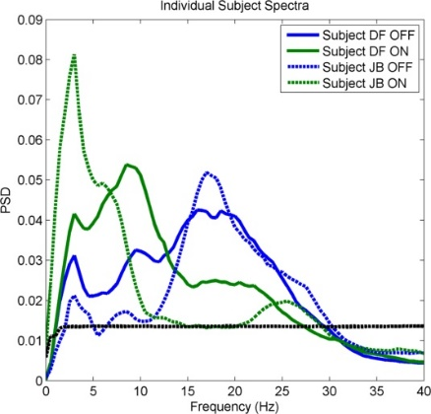
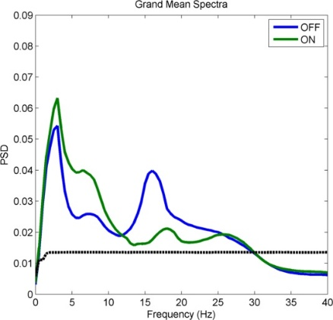
Looking for effects in EEG/MEG
Time Domain:Event Related/ Evoked Potentials
Frequency Domain: Steady-State Oscillations
Time/Frequency:Event related Synchronisation/ Desynchronisation
+ lots more!!
Spatial effects
Connectivity
Notes:
Event related potentials- multiple trials time locked to stimulus- average over trials and waveform is revealed
Averaging effectively low pass filters- high frequencies tend not to be phase-locked
Steady state oscillations – Look for changes in the oscillatory structure
Assumes “stationarity” – you have a constant oscillation occurring across trials
Pick out spectral components
ERS/ERD – Time frequency analysis
Can average across time frequency plots as the activity is not determined by respective phase
Allows you to look across a wide range of frequencies – resolution is determined by the length of your respective windows
Uncertainty principle – trade off between time and frequency resolution
Lots more:
Connectivity analysis – look at how two signals compare

Slide 7
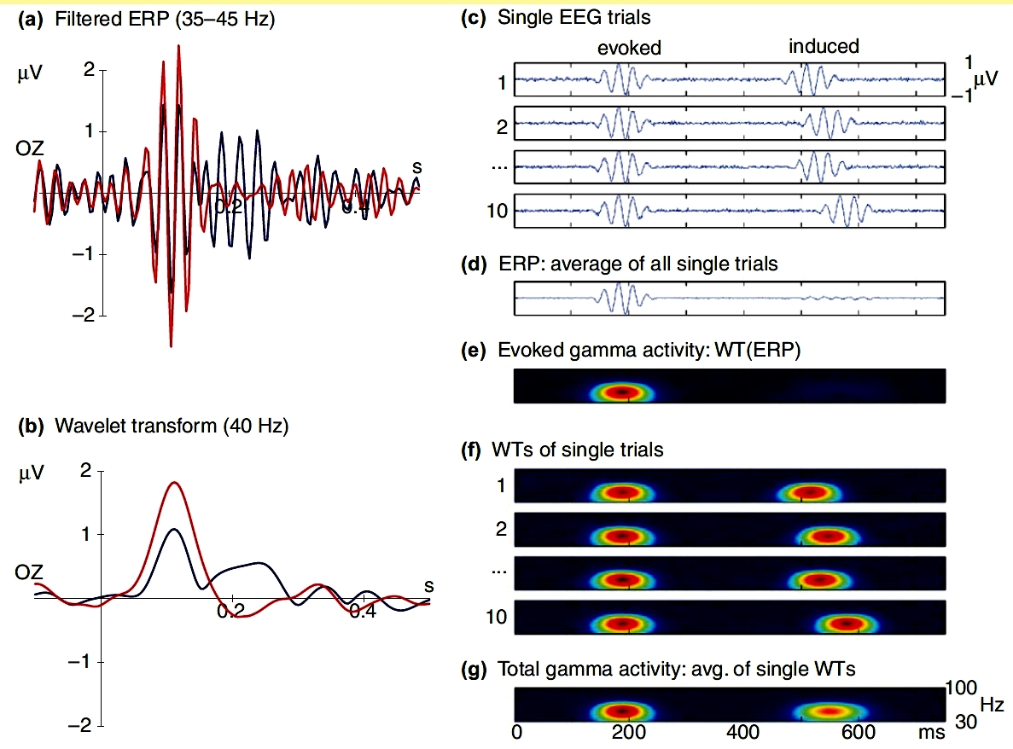
Stimulus Related Events –
Event Related/Evoked –
phase locked to stimulus
Induced –
Not phase locked
Average
Time domain averaging will lose effect – time-frequency analysis
Longer latency (100-600ms)
Higher amplitudes (10-100 μV)
Cognitive/higher level processes?
Time locked response
- averaging in time domain
Short latency (<100ms)
Small amplitudes (< 1μV)
Sensory/stimulus related
Notes:
Evoked – time locked – phase locked so can average
Sensory processing?
Induced – not phase locked
Modulation of oscillations
Averaging will lose effect
Usually attributed to cognitive/higher order processes

Slide 8


How many realisations to acquire an ERP
Typically interested in a short period of time (0.5 – 5 seconds).
Number of repetitions required depends on your ERP ~120 realisations of stimulus/response trials is typical.
Know your signal/noise (SNR) ratio: weaker signals will need more realisations –set your n prior to study.
Account for loss of trials due to artefacts
$$R_{average}=\frac{1}{√N}×R_{trial}$$
Thus to quadruple your SNR you need 16 trials.
$$SNR=\frac{R_{average}}{R_{trial}}=\frac{1}{√N}$$
Luck, S. J. (2005).
Notes:
Short period of time so you can take a lot of trials – no need to be conservative
Depends on the ERP
Account for loss of trials due to artefacts/ bad recordings
Equation – R is the amount of noise, N is the number of trials
The amount of noise in the average trial Raverage decreases with the square root of N
Therefore – to quadruple your SNR you need 16 trials

Slide 9
Sources of noise in EEG/MEG
Endogenous EEG
  e.g. alpha waves
  response related activity (button press)
Trial-by-trial variation
Artefactual bioelectric activity
  Saccadic eye movements, swallowing, EMG, ECG contamination, muscle tension in head or neck
External electrical activity
  Monitors, speakers, projectors all need to properly shielded
Head movement
  Moving EEG leads
  Head location coils track head movements within MEG
Notes:
Reducing source of noise result in an improved quality of data
- Require less trials and your effect will be more apparent
Strategy is to be aware of source of noise
Minimise noise source if possible
Detect sources of noise – record EOG, ECG and then can at least know where problems are occuring
Correct for noise source – (preprocessing)

Slide 10
Considerations for an electrophysiological study
Good synchronisation of recording equipment/stimuli is required to ensure everything is precisely time locked
  Some experiments use a common input e.g. white noise source in order to temporally align different recordings.
Ensure sampling frequency is greater than 2 x the highest frequency of interest
  The Nyquist limit determines highest frequency contained in a signal that can be properly resolved.
Source localization needs several things:
  A structural MRI/ CAT scan is required for co-registration
  Good number of channels distributed across the scalp
EEG/MEG require referencing, ideally this should be kept constant across subjects

Slide 11
Limitations of EEG/MEG Studies
Signal distorted by scalp morphology
Recording from subcortical regions is not often possible
Poor spatial localization in comparison to MRI
  Now possible to combine fMRI and EEG
Long duration recordings can be difficult due to equipment impairing movement/sleep
Subjects with metallic implants will disrupt MEG recordings
MEG is blind to radial sources at the top of the gyri
  Though this effect has been shown to be negligible
Highly susceptible to noise and artefacts – requires preprocessing to get data in a useable state.
Notes:
Problems with differences in scalp morphology and conductivity can complicate analysis
Patients with burr holes and deformation can alter EEG signal
The depth at which MEG/EEG can be recorded is limited – EEG can go a bit deeper

Slide 12
References
Luck, S. J. (2005). Ten simple rules for designing ERP experiments. In T. C. Handy (Ed.), Event-related potentials: a methods handbook. Cambridge, MA: MIT Press.
Fisher, R.A. (1935). The Design of Experiments. Macmillan
Salsburg, D. (2002). The Lady Tasting Tea: How Statistics Revolutionized Science in the Twentieth Century. Henry Holt and Company.
Thanks to our expert Bernadette Van Wijk and the previous years’ presenters!!

Slide 13
Experimental Design | Data collection | Pre-Processing | Statistical Analysis

Slide 14
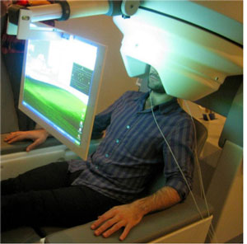
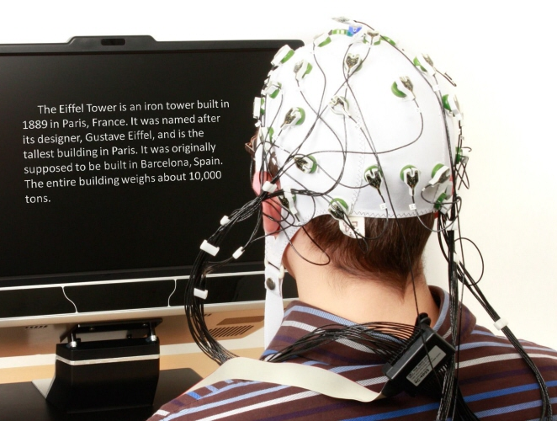
Experimental Design | Data collection | Pre-Processing | Statistical Analysis

Slide 15
Experimental Design | Data collection | Pre-Processing | Statistical Analysis
Data conversion
Downsampling
Montage
Epoching
Filtering
Artefact detection and removal

Slide 16
Data conversion
Conversion of raw M/EEG data into matlab based format
*.bdf *.mat
*.fif *.dat
*.eeg
*.meg4
Notes:
Biosemi is one software system for eeg recording
.mat header file –containing= settings of recording, sampling rate, types of channel
.dat data file – containing digitized data

Slide 17
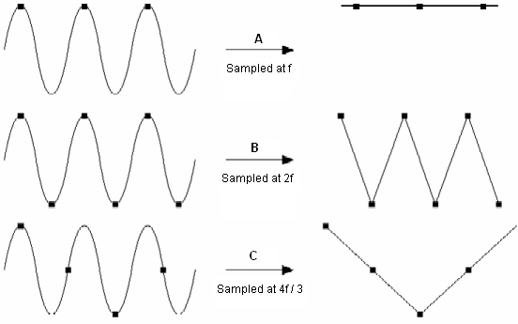
Downsampling
M/EEG signal usually sampled at 2048Hz (2048 samples/ sec), 64 channels (EEG) or ~306 (MEG)
Reduce sampling rate to reduce file size and increase processing speed while preserving data quality
Nyquist frequency: minimum sampling frequency needs to be greater than twice the maximum frequency of any analogue signal likely to be present in the EEG
Notes:
EEG signal is an anologe signal that varies continuously over time. This must be converted into a set of discrete samples. EEG signal sampled at 2048Hz (2048 per second) = large datafile
Nyquist frequency: minimum sampling frequency needs to be greater than twice the maximum frequency of any analogue signal likely to be present in the EEG.
If you sample at lower than that rate you will introduce artefacts (and change the signal)
To sample at high enough rate you need to know the frequency content of the signal you are recording. If you are interested in ERP’s that mainly contain power below 30 Hz. But you might still record signals (not necessarily linked to brain activity) that is higher so standard practice is to sample at 2048 and then downsize to 512 or 200 Hz

Slide 18
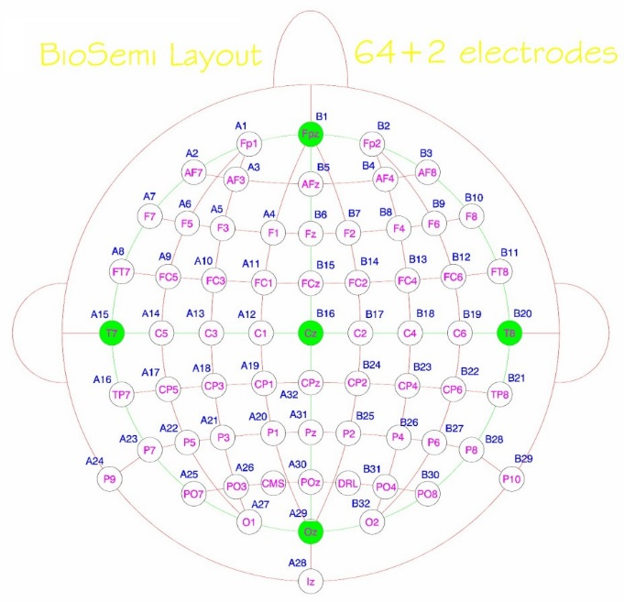
Montage
Montage refers to the placement of electrodes
Convert data from a fixed reference to an average reference
Types of montage:
  Mastoid
  Average
  Laplacian
Notes:
rom fixed or common reference (for example, from a common earlobe or other channel reference) to 'average reference' is advocated by some researchers. The advantage of average reference rests on the fact that outward positive and negative currents, summed across an entire (electrically isolated) sphere, will sum to 0 (by Ohm's law). = less noise
Single electrode reference: free from neural activity of interest
Average reference: Output of all amplifiers are summed and averaged and the averaged signal is used as a common reference for each channel
The choice of the reference may differ depending on the purpose of the recording. Ideally, this electrode would be affected by global voltage changes in the same manner as all the other electrodes, such that brain unspecific activity is subtracted out by the referencing (e.g. slow voltage shifts due to sweating). Also, the reference should not pick up signals which are not intended to be recorded, like heart activity, which would be "subtracted in" by the referencing.
it is common to compute the "average reference", i.e. to subtract the average over all electrodes from each electrodes for each time point. This distributes the "responsibility" over all electrodes, rather than assigning it to only one of them.
Systems with active electrodes (e.g. BIOSEMI Active Two), may record data reference-free. In this case, a reference be must be chosen post hoc during data import
Laplacian esp useful for source localization

Slide 19
Epoching
Split continuous M/EEG data into fixed epochs of a fixed length
Segments data into pre-stimulus and post-stimulus
Need to know:
  when stimulus occurred (triggers)
  the timing of the event you are interested in (300 ms after stimulus onset)
  type of event triggered (condition A, condition B, control)
Baseline correction using pre-stimulus signal
Notes:
Baseline correction = Subtract the average prestimulus volatage (so this is voltage naturally occurring without the stimulus from the voltage that is recorded after the stimulus. Therefore already reducing noise

Slide 20
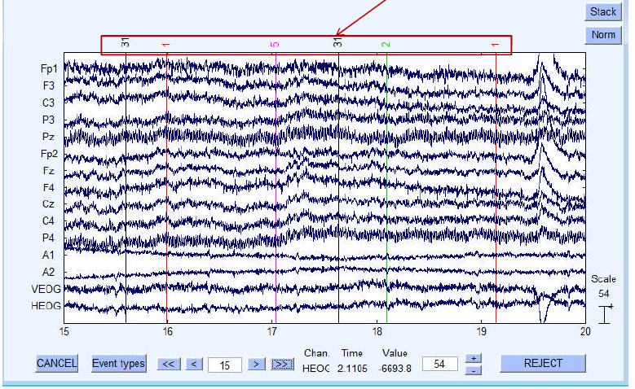
Notes:
Example of continuous EEG data

Slide 21
Epoching cont.
For example:
  Interested in P3/P300 (ERP component) which has time onset at approx. 300ms after stimulus presentation
  Epoch: -200ms baseline, 800ms trial
Notes:
P300 is thought to reflect processes involved in stimulus evaluation or categorization. Occurs between 250-500ms
usually select a baseline of 200 ms (min. 100 ms) and 800 of post-stimulus. total trial time 1000 ms

Slide 22
Filtering
Filters out noise at specific frequencies
Types of filters:
  Low-pass filter ~ 30 Hz: removes high frequency noise e.g. muscle activity
  High-pass filter 0.5Hz: reduces slow drifts e.g. sweat artefact
  Notch filter 50/60 Hz: electrical line noise
  Band-pass: passes signal through only at a specific frequency range
Too much filtering can alter the data and lose temporal precision
Notes:
Low pass filter high frequency (low-pass setting at 30 Hz) activity which are not relevant to your interest
high-pass filter (filter that passes freq above your cut-off and suppresses low frequencies
0.5Hz: reduces slow drifts (slower than 2 seconds, due to non-cerebral origin (e.g., sweating), or long-term cerebral processes (e.g., anticipation),
Notch filter : filters out specific frequencies, usually used to filter out electrical signal from wires

Slide 24
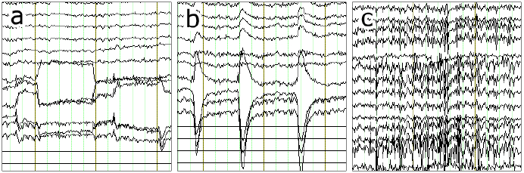
Artefact Detection and Removal
Artefacts are physiological and non-physiological noise that can distort M/EEG signal
  Blinking, eye movement, skin potentials (sweating), muscle movement, heart beat, alpha
Notes:
Artifact detection/rejection is ordinarily performed on epoched EEG data. However, it is sometimes useful to delete "crazy" sections of the continuous EEG (e.g., prior to performing ICA
eye movement b) eye blink c) and muscle tension
Eye closed = alpha waves (also occur when subject gets sleepy, bored)
Sweating: It can react with the electrodes altering their impedance and producing an unstable baseline

Slide 25
Artefact Detection and Removal cont.
Inspect data and determine a rejection threshold
  Trials that exceed threshold are deleted
‘Moving Window Peak-to-Peak’ function:
Independent component Analysis (ICA):
  Removes artefacts
  Useful for blinks muscle activity
  Record EOG to remove eye movement artefact from signal
Notes:
Step look at data and determine threshold
Moving window:
Peak-to-peak amplitude is the difference between the most positive and most negative voltages within a window. A moving window peak-to-peak amplitude function computes the peak-to-peak amplitude within a series of windows within each epoch. The routine would find the largest peak-to-peak amplitude from these windows for a given epoch of data, compare that largest value with a threshold value, and mark the trial for rejection if the largest value exceeds the threshold.
ICA: Computational method for decomposing a complex dataset into independent sub-part
Heartbeat artifacts, effects are typically removed using ICA
In most (but not all) cases, artifacts will have a fixed scalp distribution, Blinks usually lasts 200ms
Monitor how many trials have been rejected

Slide 26
Ways to avoid some of these artefacts:
Constant cool temperature in testing room to reduce sweat artefacts
Include breaks so participants remain alert (less alpha waves) and have time to blink and move
Comfortable chair/environment and fixation cross to limit movement artefacts
Notes:
Sweat artifacts It can react with the electrodes altering their impedance and producing an unstable
Baseline
Impedance = is the measure of the opposition that a circuit presents to a current when a voltage is applied
Try reduce session time and maybe split into 2 sessions

Slide 27
Thanks for listening and
Thanks to our expert Bernadette Van Wijk

