Slide 1
Bayes for Beginners
Stephanie Azzopardi & Hrvoje Stojic
Supervisor: Dr Peter Zeidman
7th December 2016

Slide 2
What is Bayes?
Frequentist statistics – p values and confidence intervals
Bayesian statistics deal with conditional variability.
Apply variable parameters to fixed data – update our beliefs based on new knowledge
Wide range of applications
Notes:
So, you can have frequentist, or traditional, statistics which will calculate probability based on data without taking into account any previous data or knowledge. Prior knowledge is therefore ignored.
<number>

Slide 3
Probability
Probability of A occurring: P(A)
Probability of B occurring: P(B)
Joint probability (A AND B both occurring): P(A,B)
Notes:
<number>

Slide 4
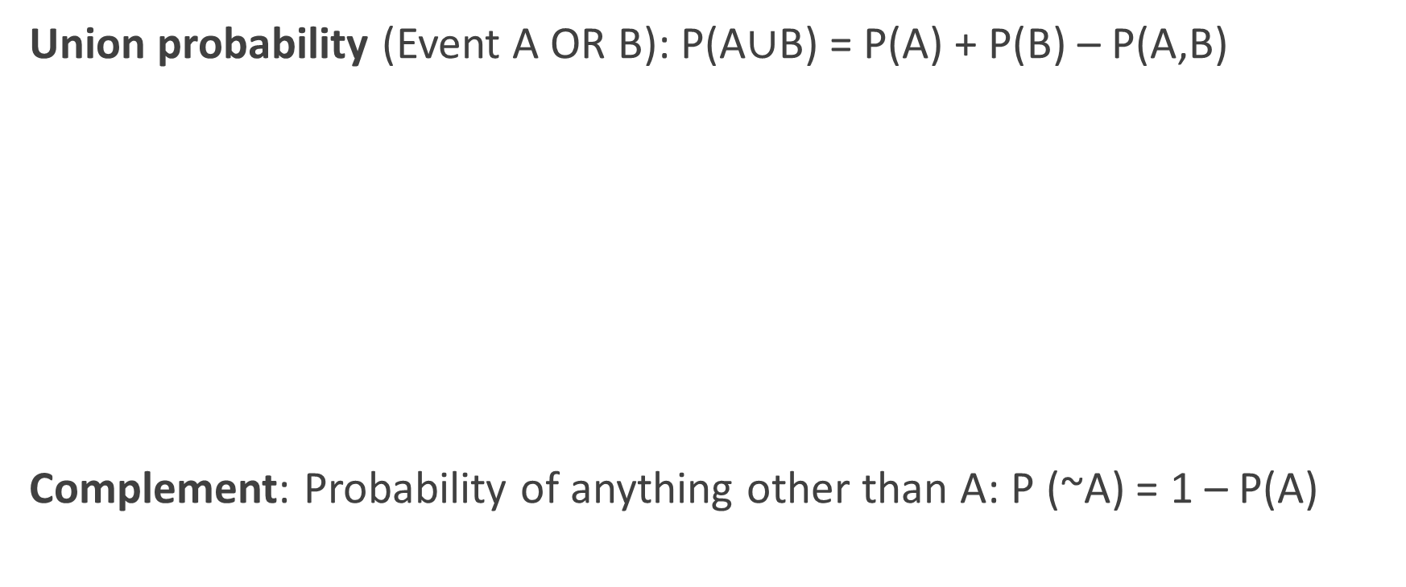

Slide 5
Marginal Probability
 | Diabetes | No Diabetes
Neuropathy | 0.3 | 0.1
No neuropathy | 0.1 | 0.5
Notes:
Say you study a particular ward population. You will categorise patients into 4 distinct groups. Note that the total sum of probabilities must always be one.
<number>

Slide 6
Marginal Probability
What are the chances of a patient having neuropathy?
P(neuropathy) = 0.4
P(neuropathy) = ∑ P(neuropathy , diabetes)
^{diabetes}
P(A) = ∑ P(A , B)
^{B}
Joint Probability
P(diabetes,neuropathy) = 0.5
Notes:
Comma denotes a joint probability
Marginality = removed a variable, e.g removed dependence from X
You can inference the marginal probability from the joint probability using the following equation. Sum rule.
<number>

Slide 7
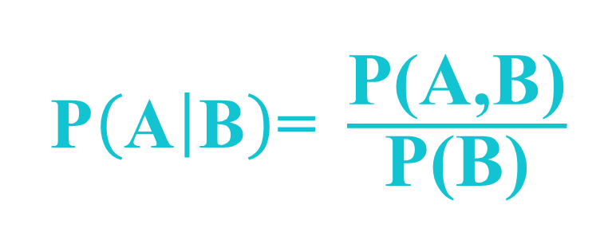
Conditional probability
What is the probability of a patient having neuropathy, given that he has diabetes?
Probability of A given B?
Notes:
I.E you calculate the joint probability of A and B occurring
<number>

Slide 8
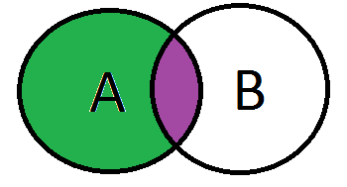
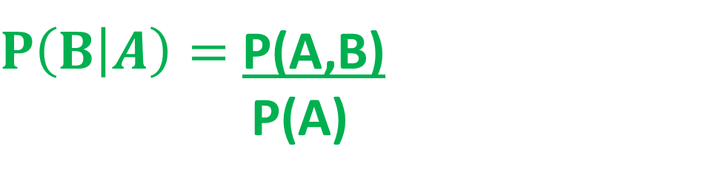
Conditional Probability
This also works in reverse, i.e.
Joint probability can be expressed as:
P(A,B) = P(A|B)*P(B)
P(A,B) = P(B|A)*P(A)
P(A,B)
P(A)

Slide 9
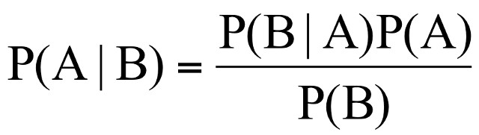
Bayes’s equation
Likelihood
Prior
Posterior
Denominator
Notes:
First, prior knowledge is quantified in the form of a prior probability distribution for every parameter. Prior knowledge for various parameters can be based either through quantifying the knowledge of experts (expert elicitation) as well as from published studies or other sources (e.g., textbooks). Second, the prior gets updated by how likely the raw data are, called likelihood. Likelihood function is the Bayesian term for the results from analyzing the new data with a certain model (ie given that value of A, what is likelihood of reaching B?). This new knowledge is again expressed as a probability distribution. Third, updating priors with likelihood yields a posterior probability distribution, which is our final probabilistic estimate for the parameters of interest. Posterior expresses our beliefs.
<number>

Slide 10
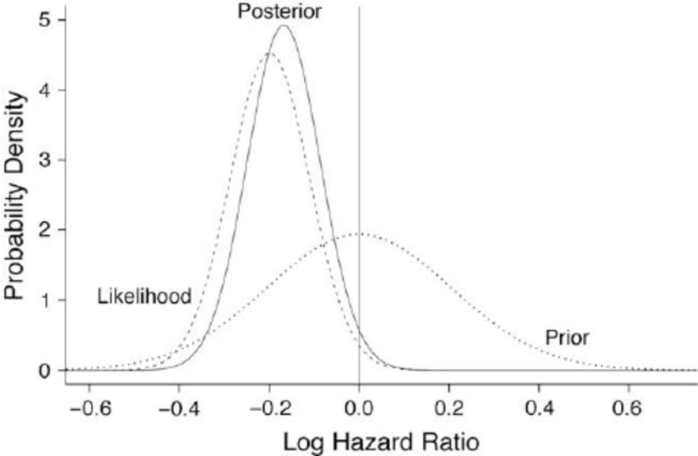
Notes:
Posterior probability distribution is the combination of the prior and likelihood probabilities using Bayes’ formula. When we do not have plenty of data the posterior distribution is overwhelmed by the prior distribution. In contrast, when we have a lot of new information, the new data take the leading role in the formation of the posterior distribution.
<number>

Slide 11
Example 1
10% of patients in a clinic have liver disease. Five percent of the clinic’s patients are alcoholics. Amongst those patients diagnosed with liver disease, 7% are alcoholics. You are interested in knowing the probability of a patient having liver disease, given that he is an alcoholic.
P(A) = probability of liver disease = 0.10
P(B) = probability of alcoholism = 0.05
P(B|A) = 0.07
P(A|B) = ?
(A|B) = (0.07 * 0.1)/0.05 = 0.14
In other words, if the patient is an alcoholic, their chances of having liver disease is 0.14 (14%)

Slide 12
Example 2
A disease occurs in 0.5% of population
A diagnostic test gives a positive result in:
  99% of people with the disease
  5% of people without the disease (false positive)
A person receives a positive result.
What is the probability of them having the disease, given a positive result?
Notes:
<number>

Slide 13
P(disease|positive test result) = P(positive test/disease) x P (disease)
P(positive test)
We know:
P(positive test/disease) = 0.99
P(disease) = 0.005
P(positive test) = ???
Notes:
<number>

Slide 14
P(B) = P(B|A) * P(A) + P(B|~A) * P(~A)
= (0.99 * 0.005) + (0.05 * 0.995)
= 0.055
Where:
P(A) = chance of disease
P(~A) = chance of not having the disease. Remember: P (~A) = 1 – P(A)
P(B|A) = chance of positive test given that disease is present
P(B|~A) = chance of positive test given that the disease isn’t present
Notes:
In this case you calculate the denominator using the following variation on Bayes’s theorem.
<number>

Slide 15
Therefore:
P(disease/positive test result) = 0.99 x 0.005 = 0.09 i.e. 9%
0.055
Notes:
<number>

Slide 16
Bayesian Statistics
Provides a dynamic model through which our belief is constantly updated as we add more data.
Ultimate goal is to calculate the posterior probability density, which is proportional to the likelihood (of our data being correct) and our prior knowledge.
Can be used as model for the brain (Bayesian brain), history and human behaviour.

Slide 17
Frequentist vs. Bayesian statistics

Slide 18
Frequentist models in practice
Model: y = Xθ + ε
Data, X, is random variable, while parameters, θ, are fixed.
Hence, we assume there is a true set of parameters, or true model of the world, and we are concerned with getting the best possible estimate.
We are interested in point estimates of parameters given the data.
Notes:
<number>

Slide 19
Bayesian models in practice
Model: y = Xθ + ε
Data, X, is fixed, while parameters, θ, are considered to be random variables.
There is no single set of parameters that denotes a true model of the world - we have parameters that are more or less probable.
We are interested in distribution of parameters given the data.
Notes:
<number>

Slide 20
Bayes rule – slightly different form
Likelihood
Prior
P(X|θ) x
P(θ)
Posterior
P(θ|X)
=
P(X)
Marginal
How good are our parameters given the data
Prior knowledge is incorporated and used to update our beliefs about the parameters
Notes:
<number>

Slide 21
Coin flipping model
Someone flips coin.
We don’t know if the coin is fair or not.
We are told only the outcome of the coin flipping.

Slide 22
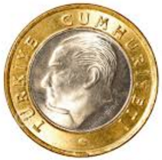
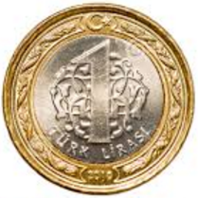
Coin flipping model
1st Hypothesis: Coin is fair, 50% Heads or Tails
2nd Hypothesis: Both side of the coin is heads, 100% Heads

Slide 23
Coin flipping model
1st Hypothesis: Coin is fair, 50% Heads or Tails
2nd Hypothesis: Both side of the coin is heads, 100% Heads
P(A = fair coin) = 0.99
P(-A = unfair coin) = 0.01

Slide 24
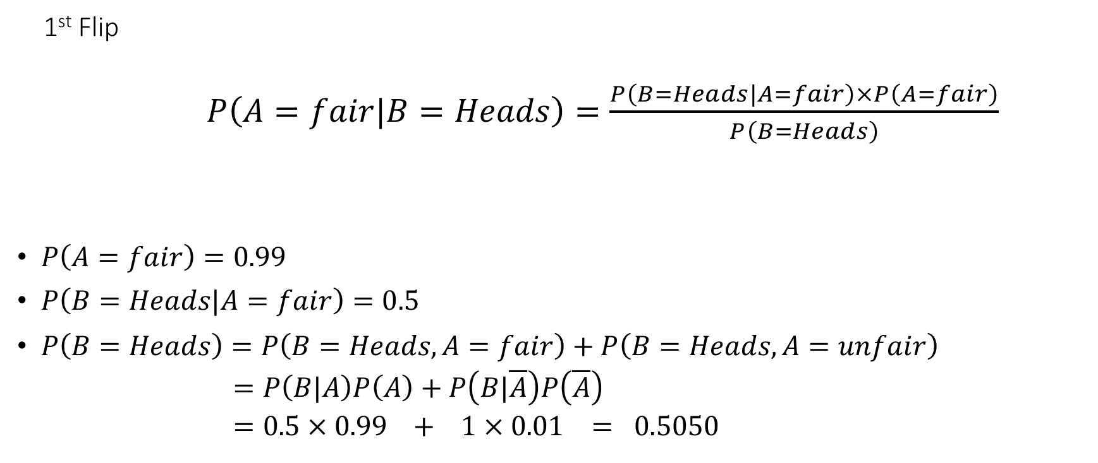
Coin flipping model

Slide 25
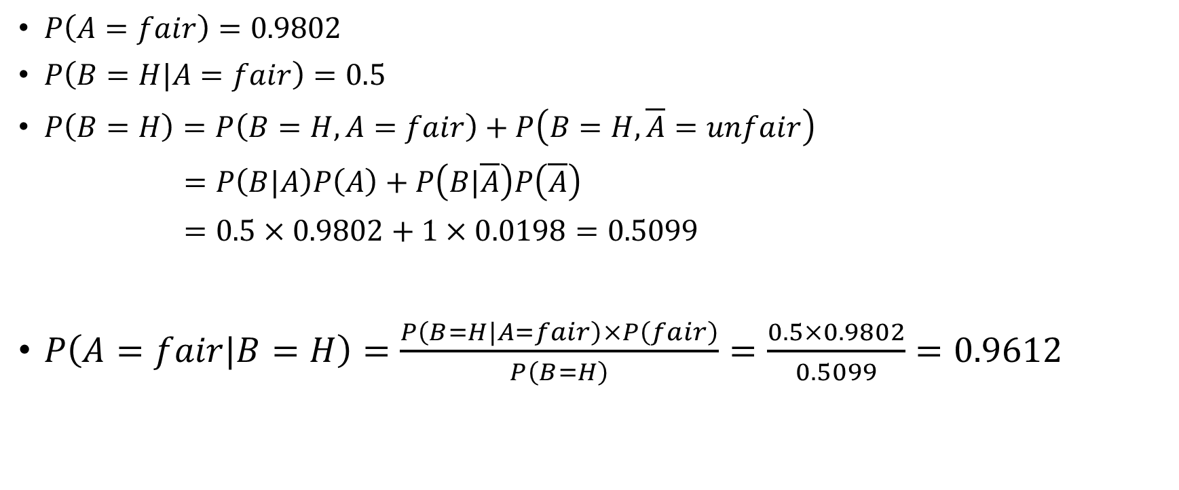
Coin flipping model

Slide 26
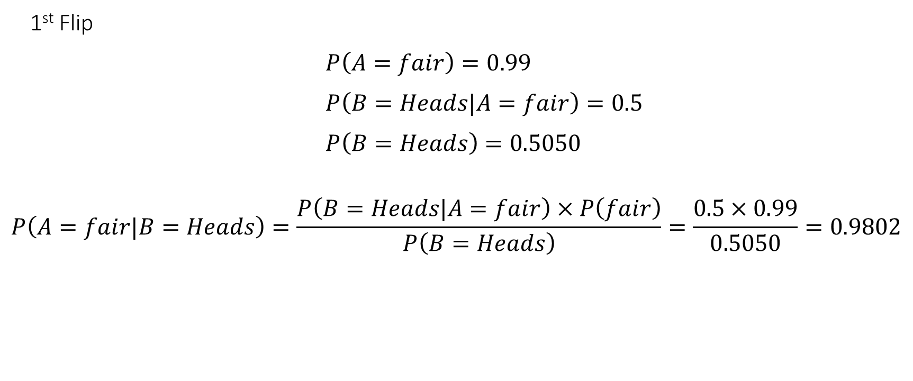
Coin flipping model

Slide 27
Coin flipping model
Coin is flipped a second time and it is heads again.
Posterior in the previous time step becomes the new prior!!

Slide 28
Coin flipping model

Slide 29
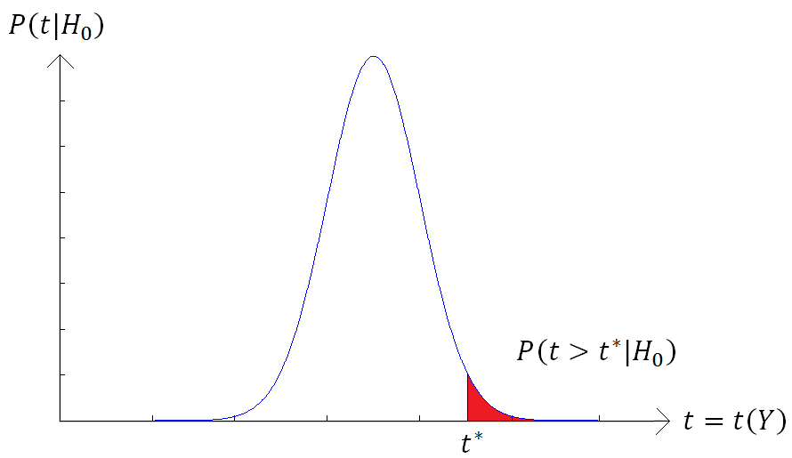
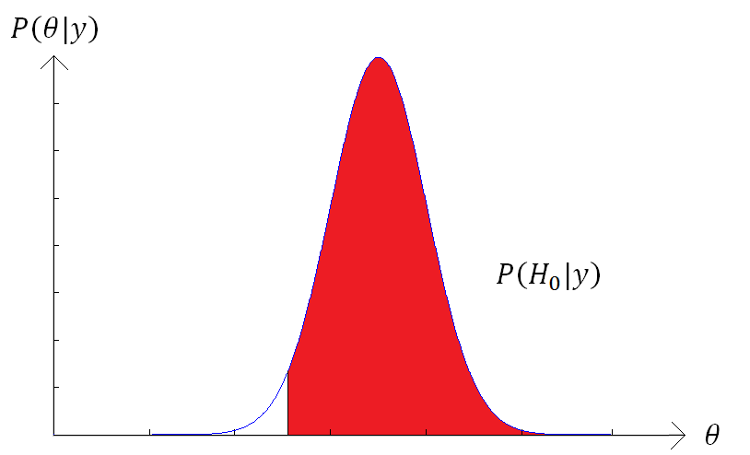
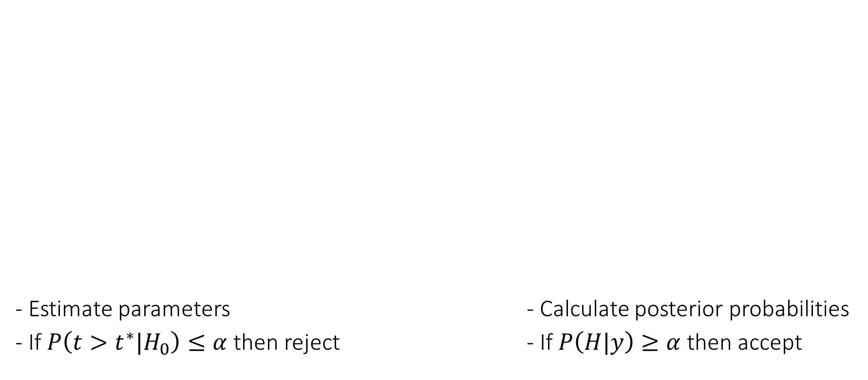

Hypothesis testing
Classical
Define the null hypothesis
H0: Coin is fair θ=0.5
Bayesian Inference
Define a hypothesis
H: θ>0.1
0.1

Slide 30
Model Selection

Slide 31
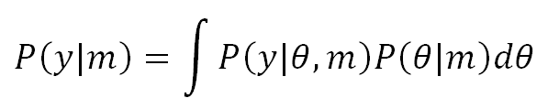
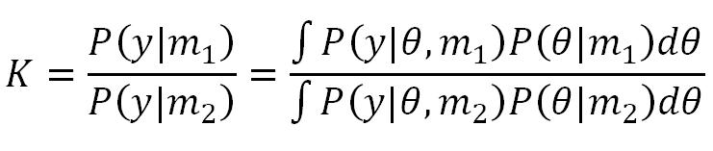
Model Selection
Marginal likelihood
Bayes Factor

Slide 32
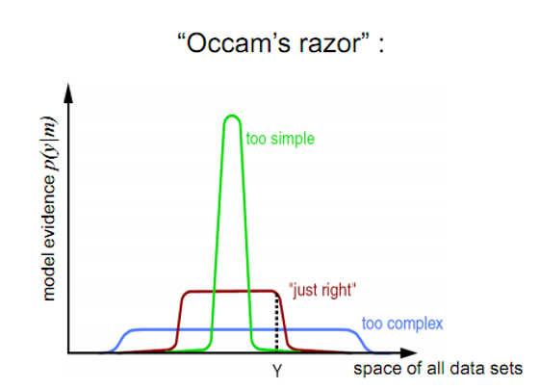
Model Selection

Slide 33
Bayesian Models of Cognition

Slide 34
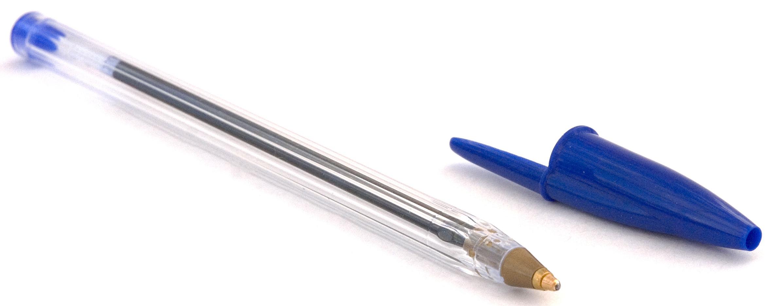
Multi-modal sensory integration
How wide is the pen?
The pen is 8 mm wide
There is a 95% chance that the pen is between 7.5 and 8.49 mm wide
Probability density function (PDF)
Represents both the average estimate of the quantity itself and the confidence in that estimate
Probability
precision
O’Reilly et al, EJN 2012(35), 1169-72

Slide 35

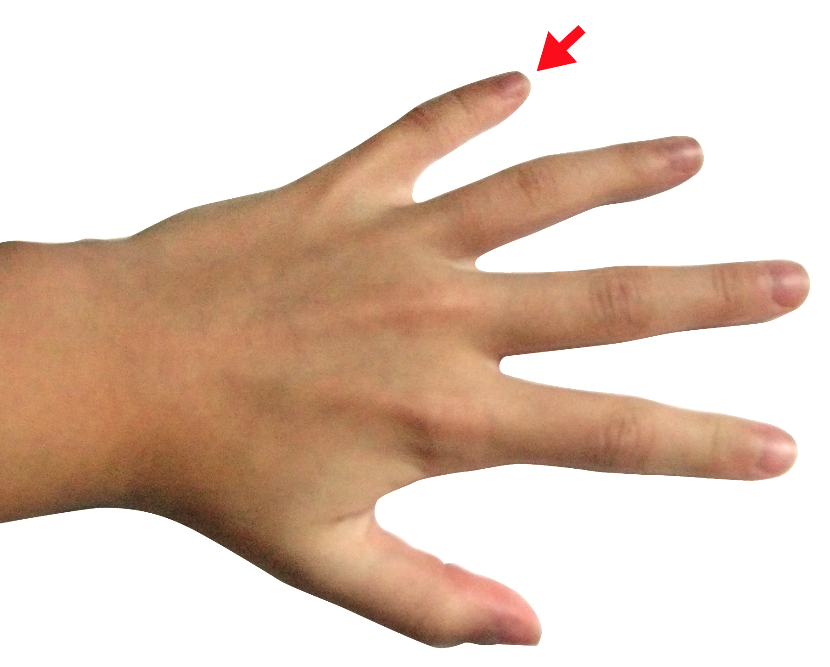
Multi-modal sensory integration
Humans do show near-Bayesian behaviour in multi-sensory integration tasks
Non-optimal bias to give more weight to one sensory modality than another
VISION
PROPRIOCEPTION
Van Beers et al, Exp Brain Res 1999;125:43-9

Slide 36
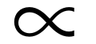
Multi-modal sensory integration
P(width|touch, vision) P(touch, vision|width) * P(width)
The posterior estimate is biased towards the prior mean
Prior permits to increase accuracy, useful considering uncertainty of observations
Posterior
Observed
Prior
5 7
Width (mm)
O’Reilly et al, EJN 2012(35), 1169-72

Slide 37
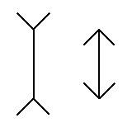
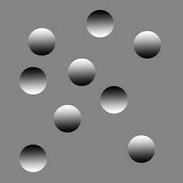
Multi-modal sensory integration
The Muller-Lyer Illusion
Priors could be acquired trough long experience with the environment
Some others priors seem to be innate

Slide 38
References
Previous MfD slides
Bayesian statistics: a comprehensive course – video tutorials https://www.youtube.com/watch?v=U1HbB0ATZ_A&index=1&list=PLFDbGp5YzjqXQ4oE4w9GVWdiokWB9gEpm
Bayesian statistics (a very brief introduction) – Ken Rice
http://www.statisticshowto.com/bayes-theorem-problems/

