Slide 1
DCM for ERPs/EFPs
Clare Palmer & Elina Jacobs
Expert: Dimitris Pinotsis

Slide 2
Outline
DCM:Theory
Introduction
DCM
Neural mass model
Bayesian Model Comparison
DCM :Practice
SPM analysis
Pre processing

Slide 3
ERPs/ERFs
Event-Related Potential
  Measured using EEG
  Waveform which describes the polarity and latency of electrophysiological response to a stimulus.
  Many trials averaged together
Event-Related Fields
  MEG equivalent of ERPs

Slide 4
Dynamic Causal Modelling (DCM)
DCM aims to understand coupling among brain regions
DCM for ERP/ERFs is used to:
  Estimate effective connectivity between brain regions
  Affect of experimental perturbations on coupling among brain region

Slide 5
Neural Mass Model
Physiological information used to model hidden state variables
Used to estimate expected state of large neuronal populations i.e. the neural mass
  MICRO-SCALE = basic computing element (neurons) – level at which information is exchanged between neurons
  MESO-SCALE = explains how neural elements interact within micro/cortical-columns
  MACRO-SCALE = whole brain dynamics – interactions between cortical regions

Slide 6
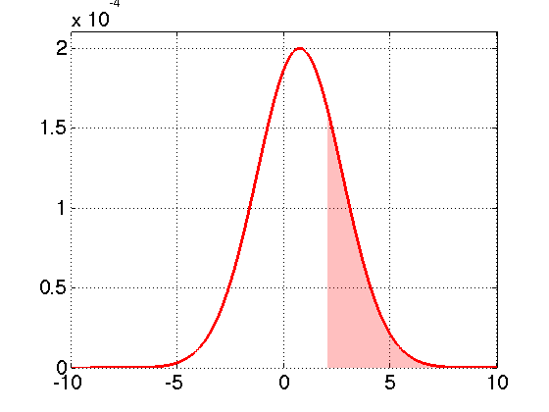
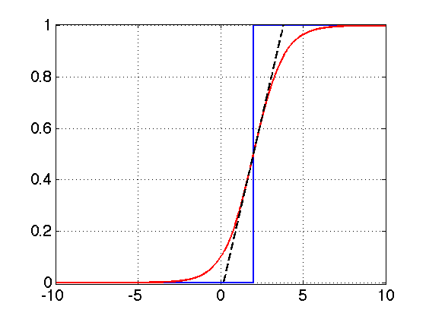
From MICRO to MESO scale
ensemble density p(x)
mean firing rate (Hz)
S(x)
H(x)
S(x)
membrane depolarization (mV)
mean membrane depolarization (mV)
Mean membrane potential & synaptic kinetics = used to describe ensemble dynamics of subpopulation of neurons within a source (cortical region)
Images from Jean Daunizeau’s ‘DCM for ERPs’ presentation - http://www.fil.ion.ucl.ac.uk/spm/course/video/#MEEG_DCM_ERP

Slide 7
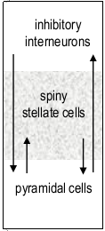
MESO scale
Jansen and Rit (1995) model - describes the intrinsic inhibitory and excitatory connections within a source using three neural subpopulations, each assigned to one of three cortical layers:
Infra-granular
layer
Excitatory pyramidal cells in infra-granular layer receive INPUT from:
  Excitatory interneurons (spiny stellate cells) found in layer IV (granular layer)
  Inhibitory interneurons found in supra-granular layer
Granular
layer
Supra-granular
layer

Slide 8
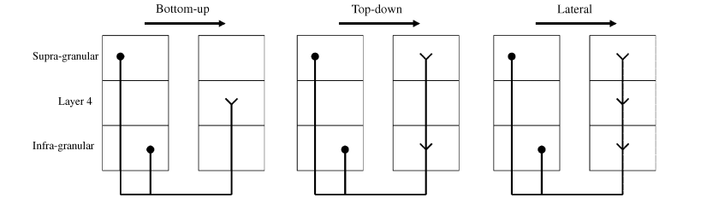
MESO to MACRO scale
Bottom-up or forward connections
originate in agranular layers and terminate in layer IV
Top-down or backward connections
connect agranular layers
Lateral connections
originate in agranular layers and target all layers
Source 1
Source 2
Source 1
Source 2
Source 1
Source 2
FORWARD
BACKWARD
LATERAL

Slide 9
Interim Summary
Ensemble dynamics of neuronal sub-population described by mean membrane potential + synaptic kinetics at micro-scale
Ensemble dynamics used to explain source activity at meso-scale through intrinsic connections between 3 sub-populations of neurons within different cortical layers
Sources (cortical regions) within a network are connected extrinsically at a macro-level via forward, backward and lateral connections

Slide 10
Forward Problem
Propagation of source activity
This is what we try to measure with EEG/MEG
  Take into account that signals go through meninges and the scalp, model this with another linear function
  How you get the predicted EEG/MEG response
Notes:
Now we’ve got a physiologically plausible model of what is going on in the brain, so the next step is to relate this to what it’s going to look like when we measure it with EEG/MEG

Slide 11
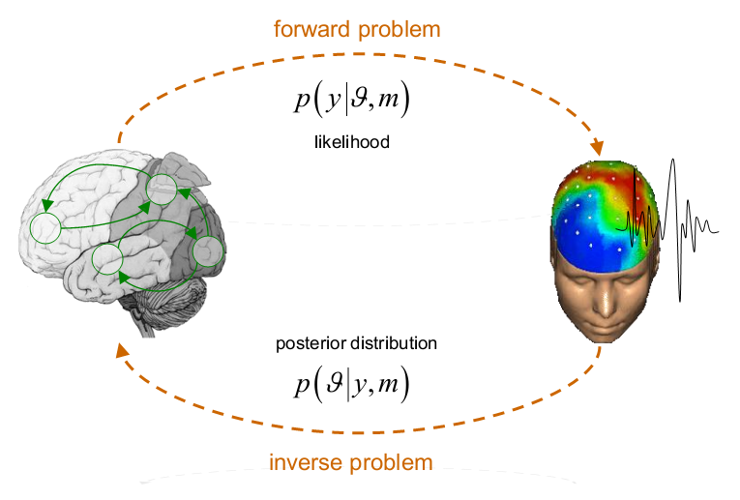
Forward vs Inverse Problem
Notes:
Forward: what is my data going to look like if I had these parameters in this model
Posterior distribution:
How likely are the parameters given the data and the current model
Likelihood function contains all biophysical parameters we put into the model, so conduction delays, population activity, convolution kernels?
Prior are the information we have about parameters before we have the model,
Priors more or less tight depending on what they are

Slide 12
Bayesian Inference
Compute model
Compare the model to actual data
Expectation Maximisation Algorithm
  Aims to minimise the mismatch between model and data by solving inverse problem
Notes:
Compute the model, ie get the expected EEG/MEG signal from your model

Slide 13
Bayesian Model Comparison
For each model you get
  Posterior distribution
  (Parameter estimation)
  Model evidence
  (How good model is)
Notes:
Parameter estimation: how likely are your parameters, given the data and your model
Model evidence: how likely is your data given the model

Slide 14
Model comparison for group studies
Fixed effects vs Random effects
  One model explains Different subjects
  all subjects require different models
Notes:
This is an important specification

Slide 15
DCM for ERP/ERF: Practice
Different kinds of DCM
Focus on ERP
Need experimental perturbation
Notes:
As touched upon in the introduction:
Explain that you need a modulation and what you want to do using DCM is how this modulation changes the connectivity between different parts of the brain

Slide 16
Model Specification
What kind of models can be tested?
Models that involve different brain areas
    Look at which different brain areas might be connected and involved in generating signal
Models that look at different connectivities between brain areas
    Look at how brain areas are connected
    One-way connection: Forward, Backward
    Two-way connection: both Forward-Backward
Base both brain areas and connectivities on previous studies and existing literature!

Slide 17


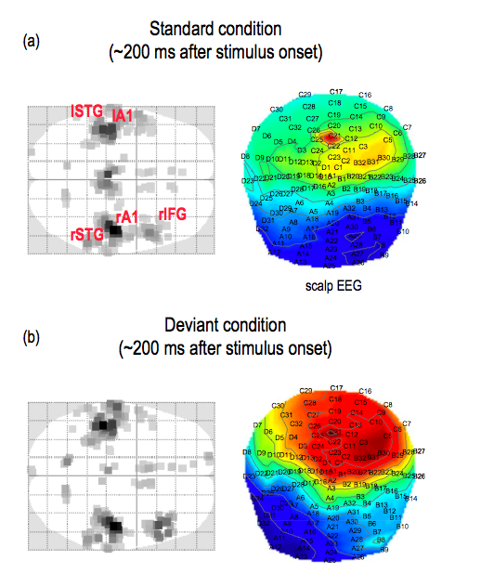
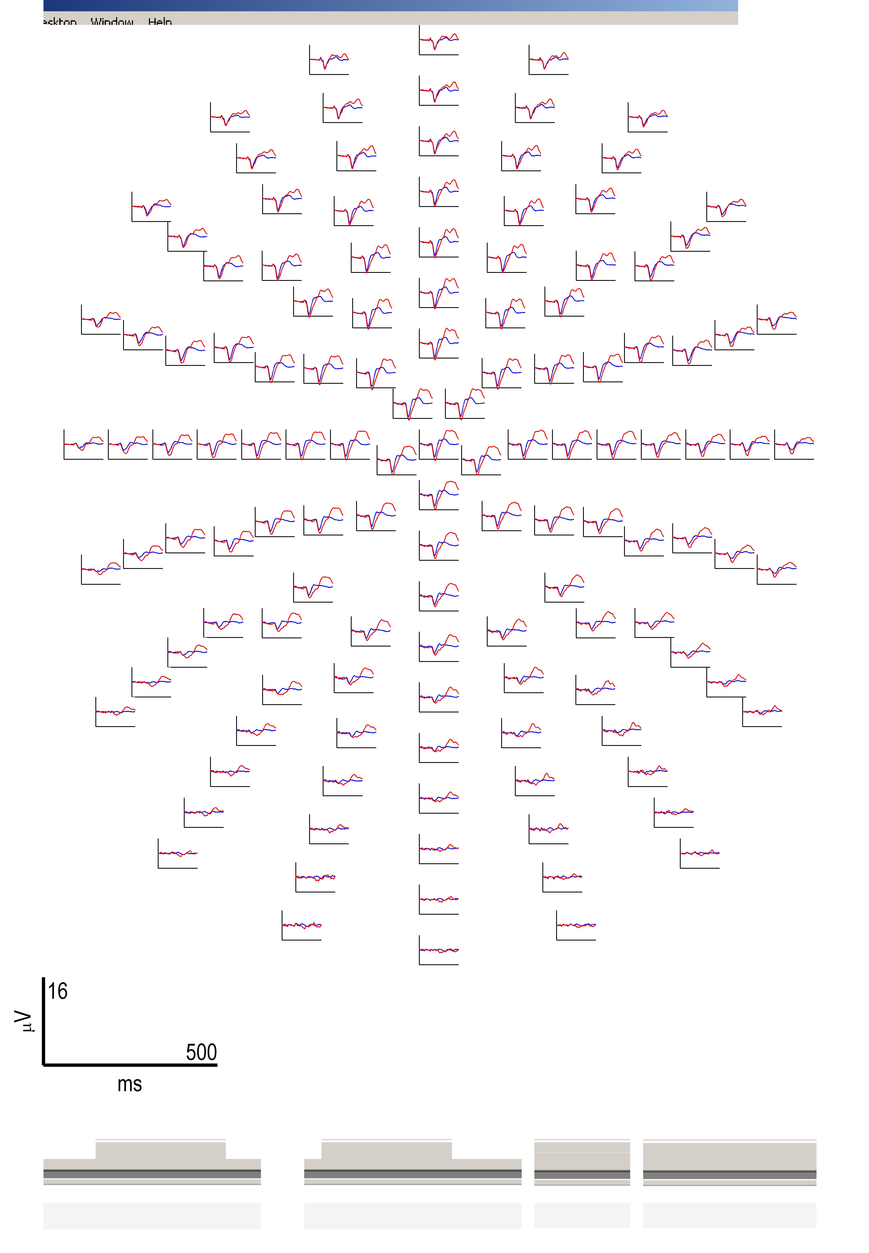
Example:
Auditory Mis-match Negativity (MMN)
sequence of auditory stimuli
…
…
S
S
S
D
S
S
S
S
D
S
standard condition (S)
+
Deviant ERP
Standard ERP
amplitude (μV)
0
deviant condition (D)
-
0
200
time (ms)
t =200 ms
Garrido et al., (2007), NeuroImage

Slide 18
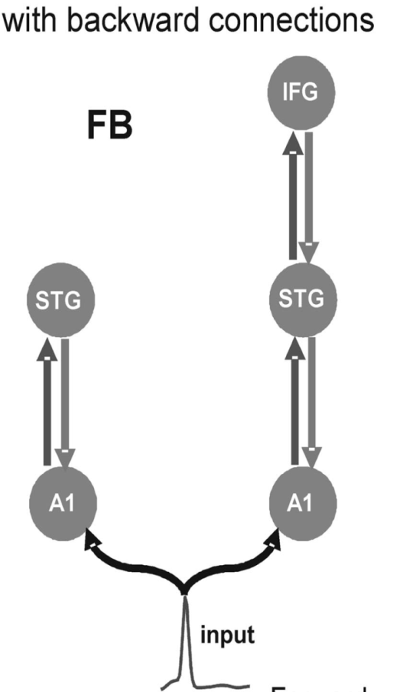

Example:
Auditory Mis-match Negativity (MMN)
Garrido et al., (2007), NeuroImage
Notes:
A lot of previous studies, well-known phenomenon, both fMRI and EEG experiments
That’s how you knew which brain areas are involved, there were different theories to explain the phenomenon, one of them was a feed forward and backward connection that drives the response to deviant condition, but couldn’t test that with traditional imaging methods → exactly what DCM is for

Slide 19
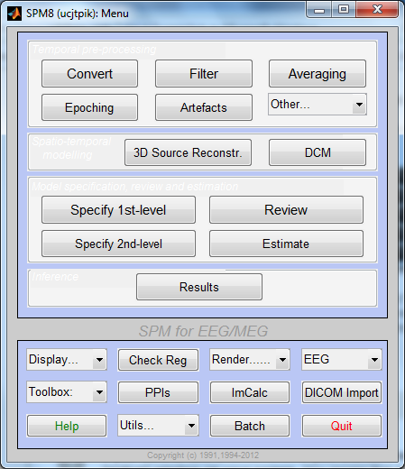

Slide 20
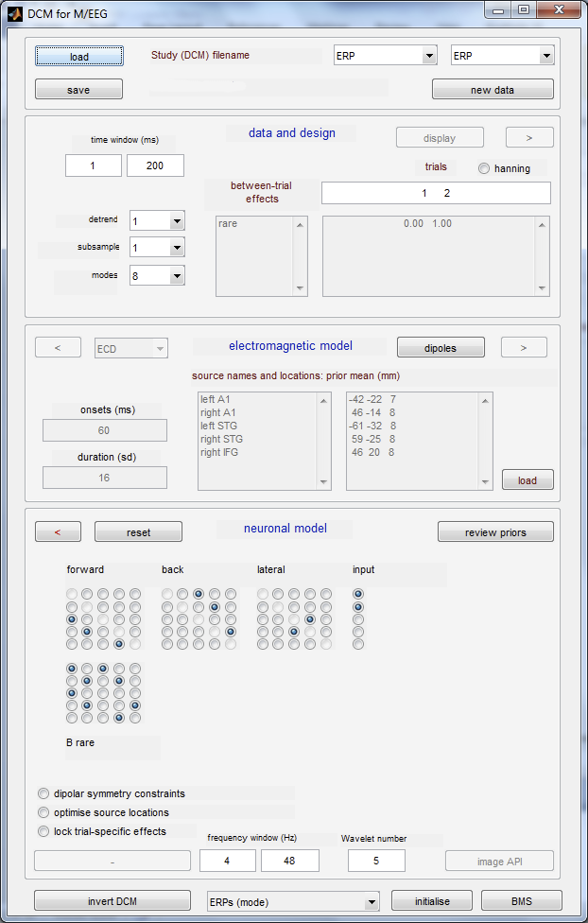

Slide 21
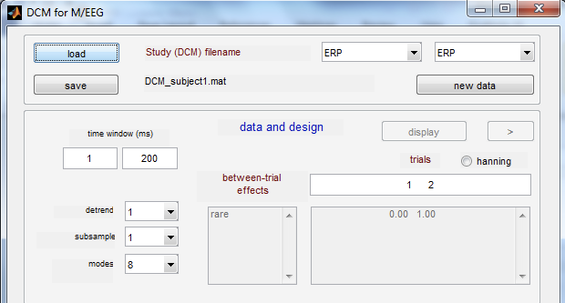
Choose the neural model
(ERP, CMC, ...)
Choose the type of DCM

Slide 22
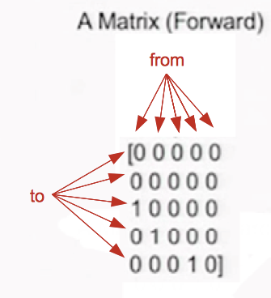
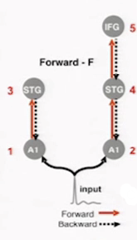
Notes:
We have 5 regions that we want to look at in our model → 5 x 5 matrice
In the matrice we specify which areas we want to connect

Slide 23
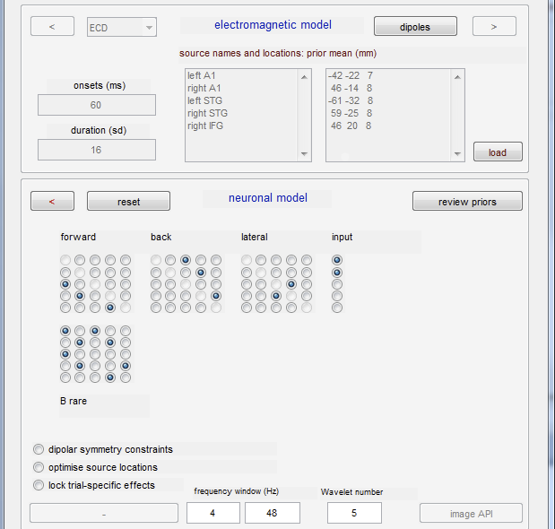
Name the sources
Insert the coordinates of the
sources (in MNI coordinates)
Specify the connections
Notes:
Bottom matrice: which connections you allow to be dynamic, ie changing during the mismatch response
If only selected forward ones, would be creating a model in which the mismatch would be explained by changes in the connectivity between the forward connections only, but here can see that both forward and backward ones are selected, so here we are creating a model in which we’re allowing both connections to change in response to the deviant condition

Slide 24
Run the model inversion

Slide 25
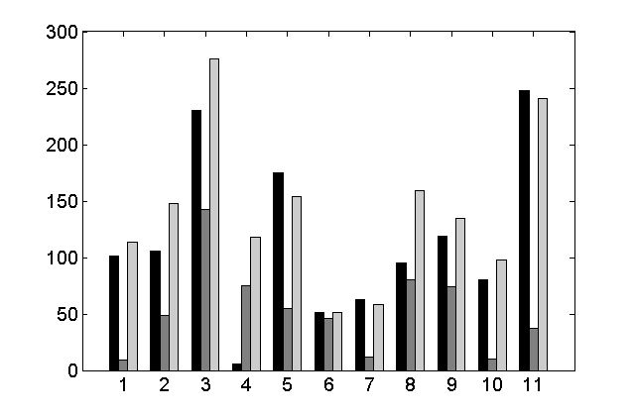
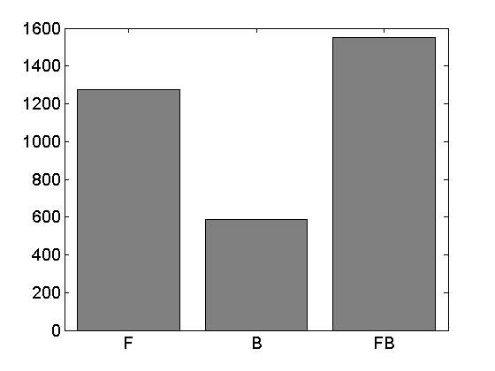
Bayesian Model Comparison
Bayesian Model Comparison
Group level
log-evidence
subjects
Forward (F)
Backward (B)
Forward and Backward (FB)
Garrido et al., (2007), NeuroImage
Notes:
Just say that you use bayesian model comparison to compare the different models and pick out which one is more likely

Slide 26
Conclusion
DCM can tell you which is the best model of the ones you provide
  Can’t know whether it is the “actual” model!
  Important to use physiologically plausible parameters

Slide 27
THANK YOU!
To our very helpful expert Dimitris
To previous MfD and FIL SPM course slides
Questions?

Slide 28
References
David, O., Kiebel, S.J., Harrison, L.M., et al., (2006), Dynamic causal modeling of evoked responses in EEG and MEG, Neuroimage, 30-4, p.1255-1272
Garrido, M. I., Kilner, J. M., Kiebel, S. J., Stephan, K. E., & Friston, K. J. (2007). Dynamic causal modelling of evoked potentials: a reproducibility study. Neuroimage, 36, 3, 571-80
Kiebel, S. J., Garrido, M. I.,; Moran, R. J., et al., (2008), Dynamic causal modelling for EEG and MEG, Cognitive Neurodynamics, 2-2, p.121-136
Stephan, K. E., Penny, W. D., Moran, R. J., den, O. H. E. M., Daunizeau, J., & Friston, K. J. (2010). Ten simple rules for dynamic causal modeling. Neuroimage, 49, 4, 3099-3109.
SPM8 Manual (2013)
Daunizeau, J. (2012, May). DCM for evoked responses. Talk given at SPM course London.
Bastos, A. & Dietz, M., (2012, May). Demo - DCM. Talk given at SPM course London.

