Slide 1
M/EEG statistical analysis

Slide 2
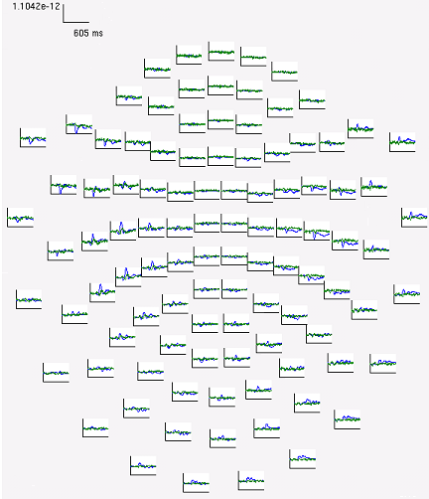
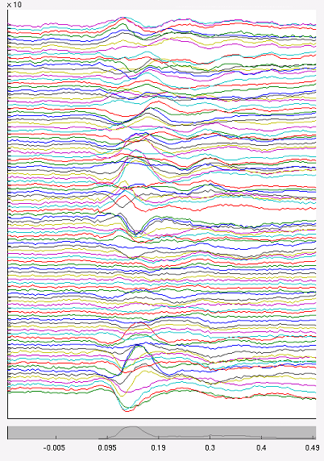
M/EEG data
Time-varying modulation of signal amplitude (or frequency-specific power) at each electrode or sensor in a peristimulus time period

Slide 3
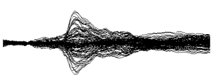
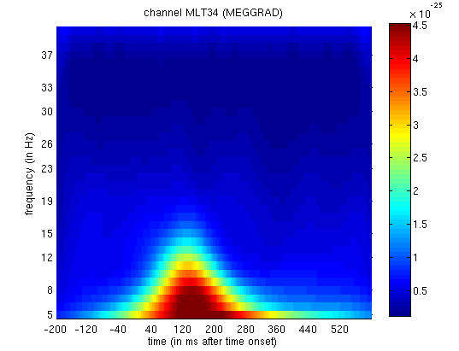
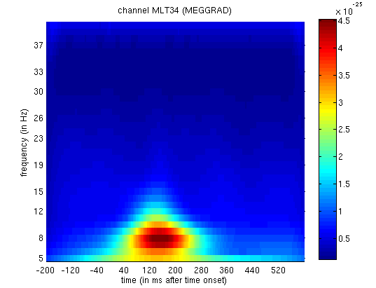

Statistical significance: when, where and/or at what frequency
frequency
time
time
When is there an effect in time (1D)?
When / at what frequency is there an effect in time/frequency (2D)?

Slide 4
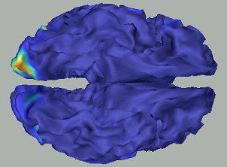
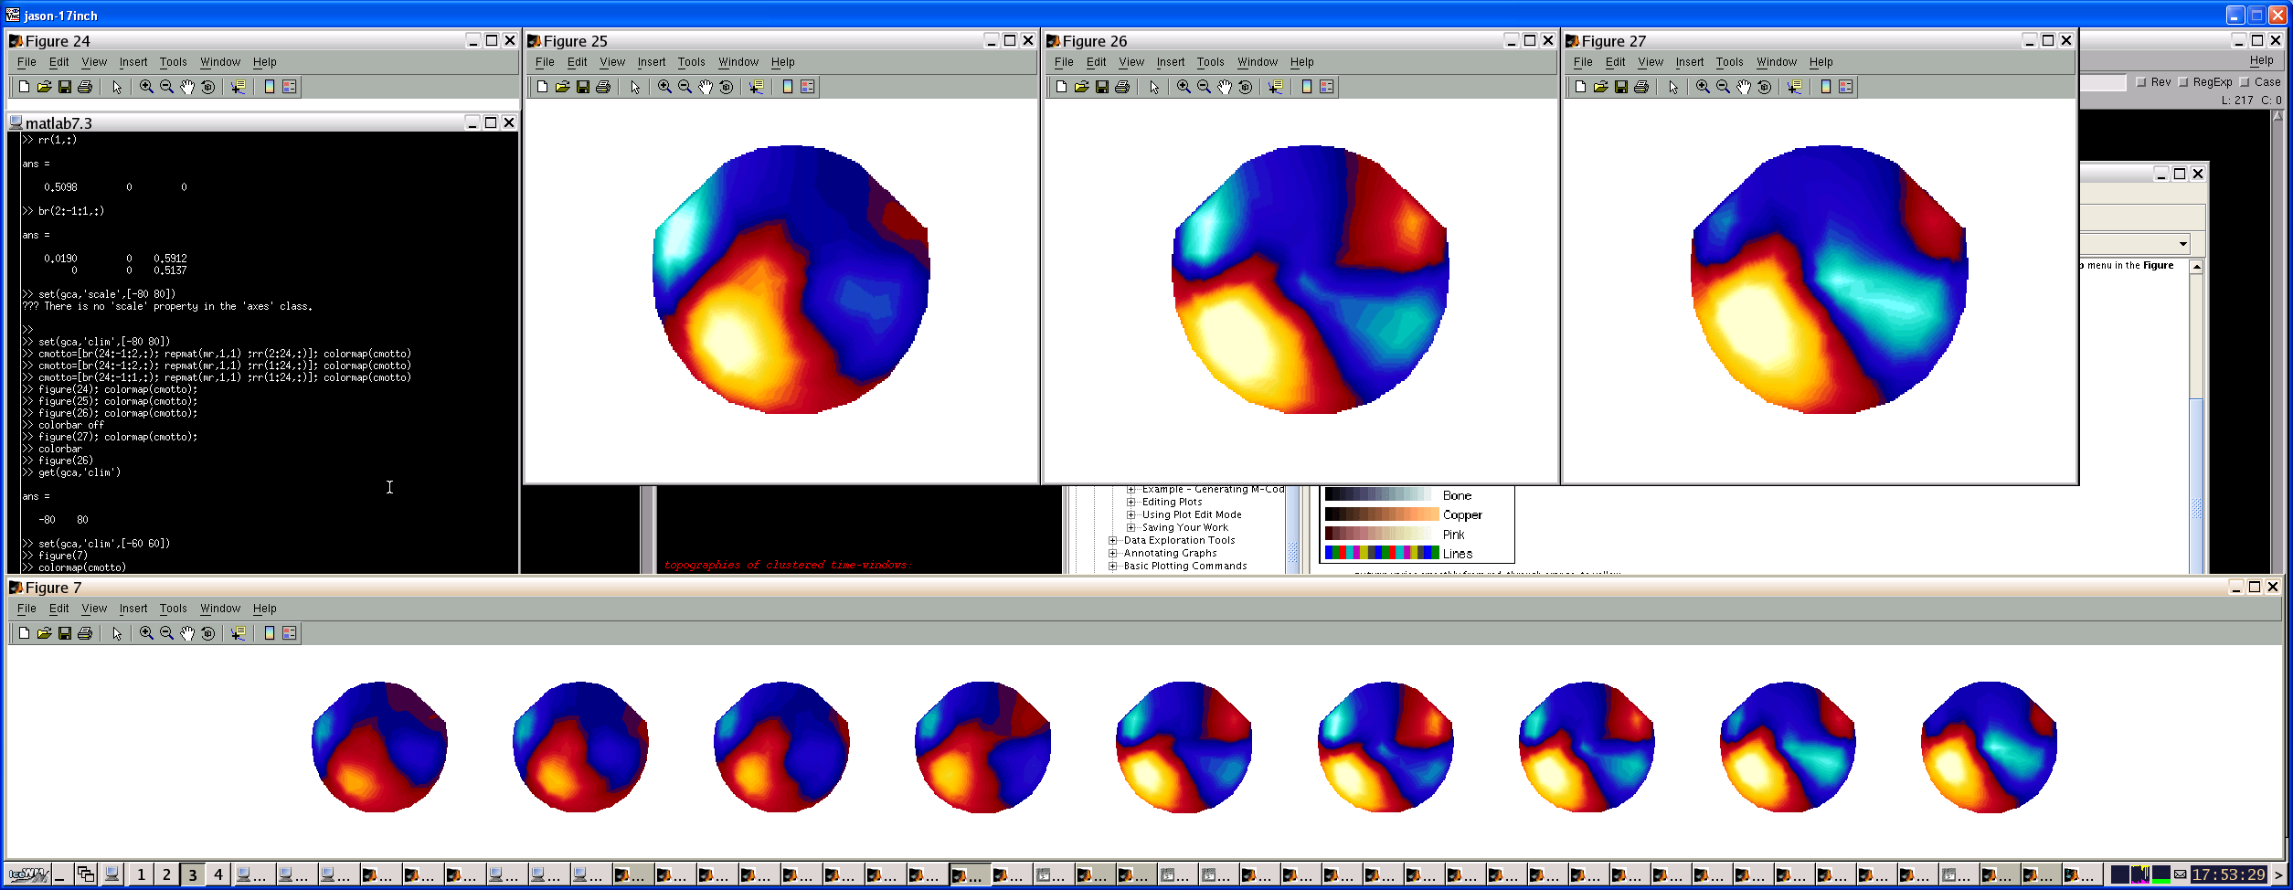
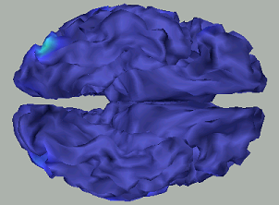
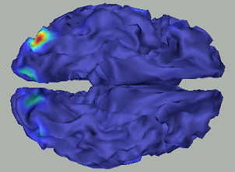
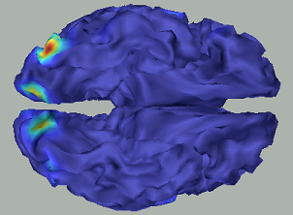
Significance: when, where and/or at what frequency
x
y
time
x
z
y
time
When / where is there an effect in sensor-topography space/time (3D)?
When / where is there an effect in source space/time (4D-ish)?

Slide 5
Sensor-level analysis
The curse of too much data?

Slide 6
Multiple comparisons problem
The more comparisons conducted, the higher chance of a Type 1 error (false positive)
Statistical significance for condition-specific effects must correct for the number of statistical tests performed
Control for Family Wise Error Rate
Bonferroni too conservative: neighbouring observations are not independent in M/EEG data

Slide 7
Circumventing the MC problem
a priori specification
Restrict the search space prior to inference > only 1 test per repeated measure
Average data over prespecified sensors and time bins of interest = 1 summary statistic per subject per condition
Problem: situations where location of evoked or induced responses is not known a priori, or cannot be localised independently

Slide 8
Topological inference
Implemented in SPM based on Random Field Theory
RFT adjusts p-values taking into account neighbouring sensors are not independent
Smooth data = RFT adjustment less severe (more sensitive)
M/EEG data transformed to image files (NIfTI) > procedurally identical to PET . VBM data, or 2nd level analysis in fMRI
One summary statistic image per subject per condition or level

Slide 9
How? Conversion to images
M/EEG sensor data as input > generate an image for each unrejected trial
Averaged dataset: a single image per condition
  Can compare across subjects
Epoched dataset: an image per trial and multiple images per condition
  Can perform within-subject statistical tests
  Can take further summary images (contrasts of parameter estimates from the within-subject models)

Slide 10
Time-frequency images
In principle, possible to apply topological inference to multiple dimensions
SPM limited to 3D or less, so necessary reduce the data dimensionality from 3D (space x space x time x frequency) to either 3D (space x space x time) or 2D (time x frequency)
  Average over channels
  Average over frequencies

Slide 11
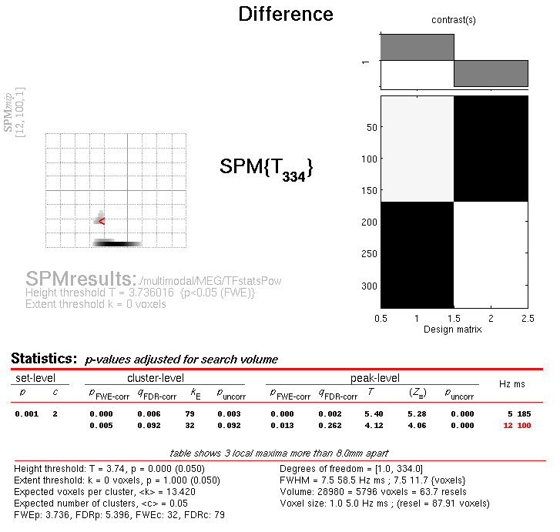
Significance in time-frequency
1 subject (1st-level analysis)
1 MEG channel
1 image per trial
Faces
Scrambled
Kilner et al., 2005, Nsci Letters

Slide 12
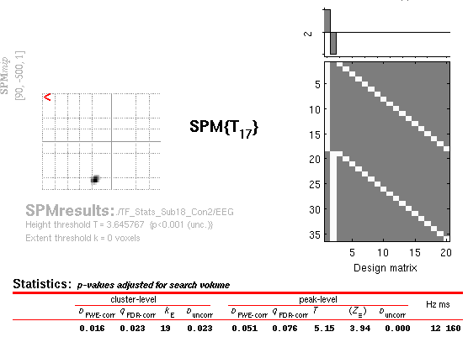
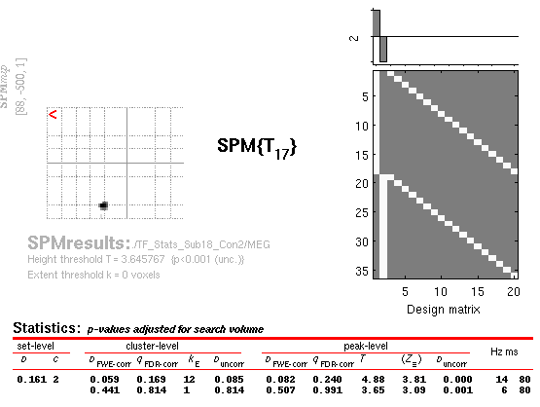
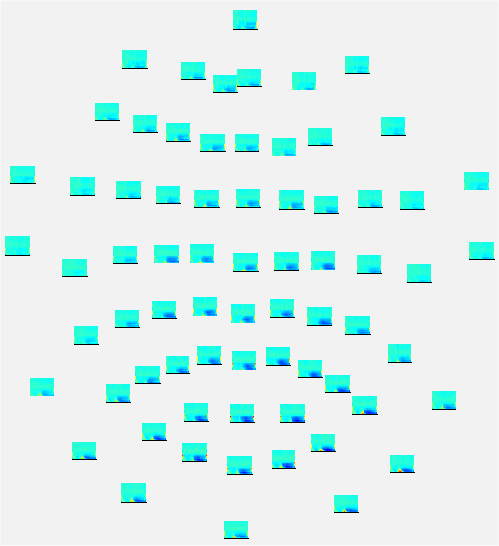
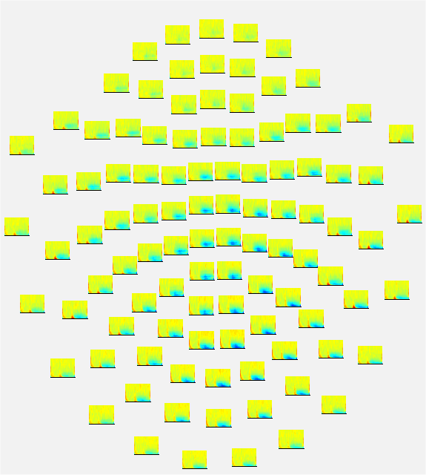
Significance in time-frequency
18 subjects
1 channel
(2nd-level analysis)
EEG
MEG (Mag)
Faces > Scrambled
100-220ms
8-18Hz
6 90
6 90
Freq (Hz)
Freq (Hz)
-500 +1000
-500 +1000
Time (ms)
Time (ms)

Slide 13
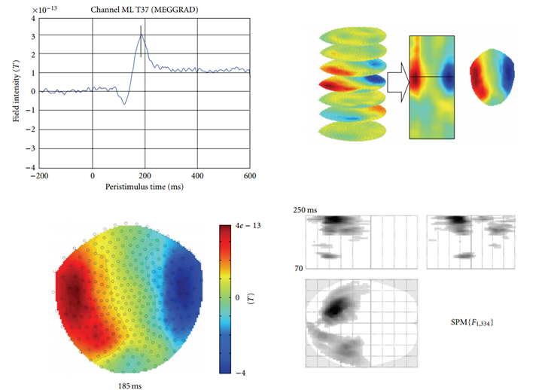
Images over time
Data in time-domain: converted into an image by generating a scalp map for each time frame and stacking scalp maps over peristimulus time
3D image files: space (x, y) and time (z)
Average > single image
Epoched > image per trial

Slide 14
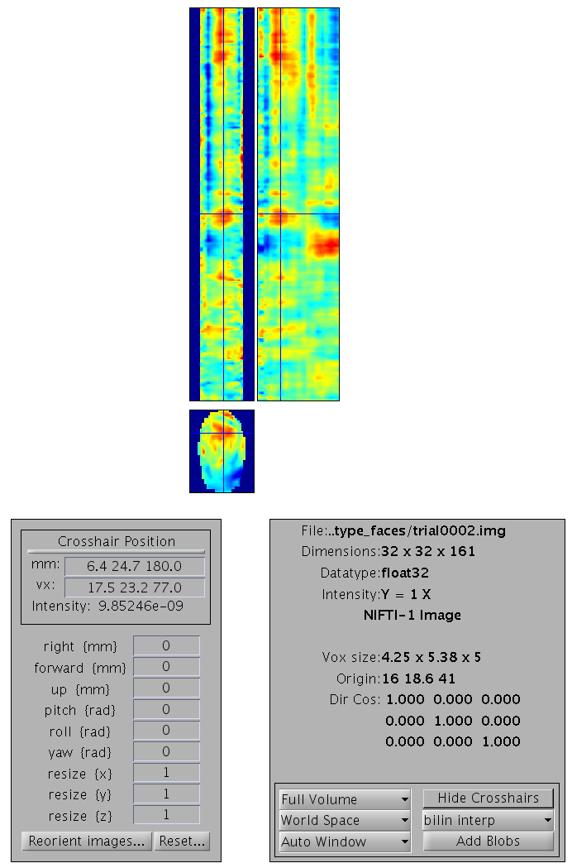
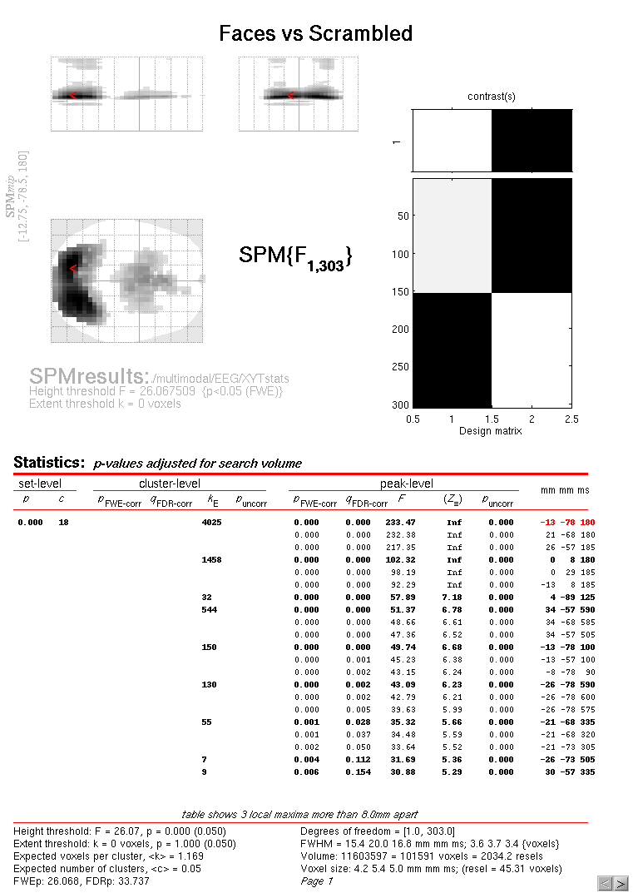
Significance in sensor-time
1 subject
ALL EEG channels
Each trial, Topographic projection (2D) for each time point (1D) = topo-time image volume (3D)
Faces vs Scrambled
3D
Topography-x-Time
Image volume (EEG)
time
y
x
Notes:
At every timepoint, interpolate data into a topography
Stack data = sliced bread
1 trial
3D image of what happens in epoch

Slide 15
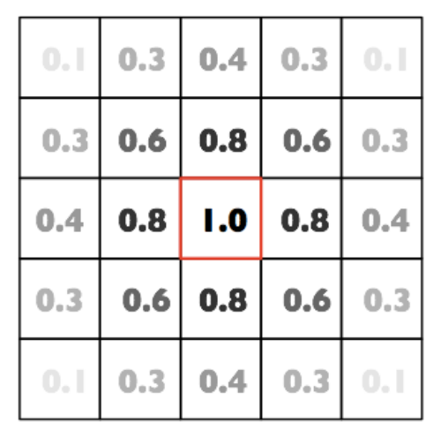
Smoothing
Multidimensional convolution with a Gaussian kernel, prior to 2nd level analysis
Accommodate spatial/temporal variability
over subjects and ensures the images
conform to the assumptions of the
topological inference approach
How much to smooth? Matched filter
theorem. Issues: rarely know activation
size in advance, varies across brain regions
A 2-D Gaussian kernel

Slide 16
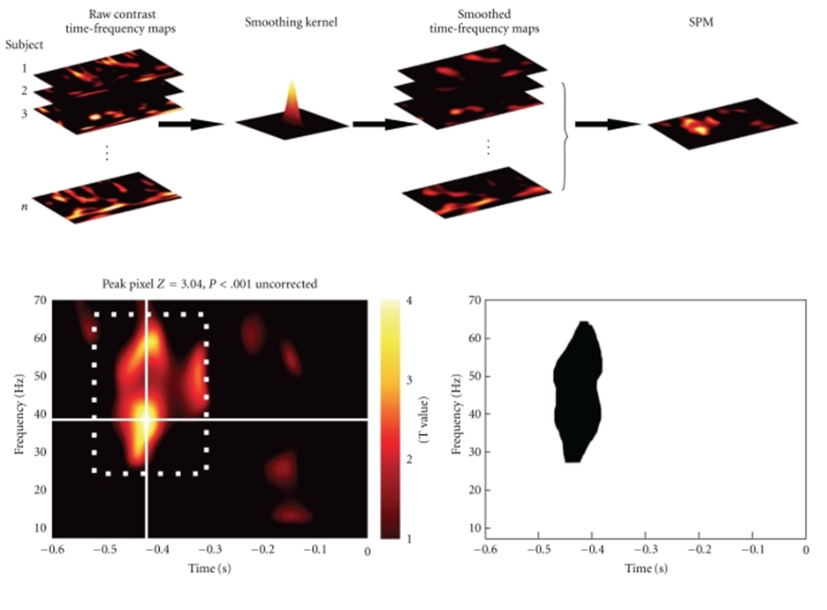

Slide 17
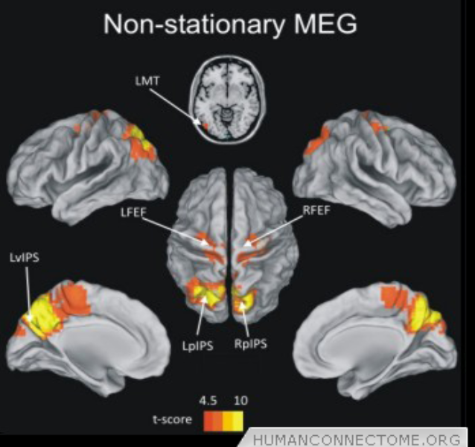
Source Reconstuction
Estimation of the cortical current distribution, which gives rise to the externally measured electromagnetic field.
Assumes groups of 10^4 neurons can be modelled as equivalent current dipoles

Slide 18
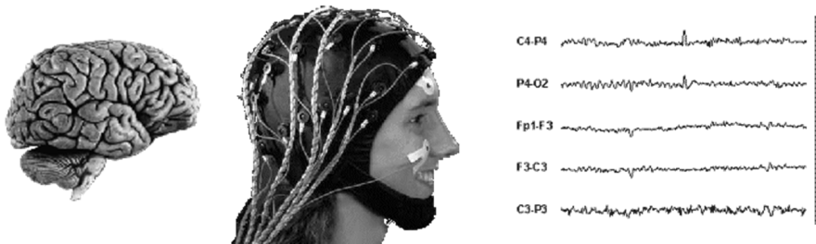
Forward/Inverse problems
Forward model:
Gives information about Physical and Geometric head properties.
Important for modeling propagation of electromagnetic field sources.
Approximation of data from Brain to Scalp.
Backward model/Inverse Problem:
Scalp data to Brain
FORWARD PROBLEM
INVERSE PROBLEM

Slide 19
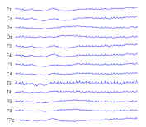
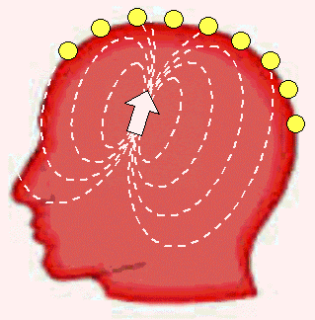
The Inverse Problem
Inverse problem is ill-posed
Any field potential vector can be explained with an infinite number of possible dipole combinations.
If we do not constrain our search in someway - there is no unique solution
Not possible to perfectly construct neural activity - but can produce a probability distribution
Smearing and distortion
A well-posed problem:
1. A solution exists.
2. The solution depends
continuously on the data.
3. The solution is unique

Slide 20
Constraints (priors)
Types of Constraints:
1. Mathematic Constraints( e.g., minimum norm, maximum
smoothness, optimal resolution, temporal independence)
2. Anatomical Constraints (e.g., Normally use the subject’s MRI scan, if not, it is possible to use standardized MRI brain atlas (e.g., MNI) can be be warped to optimally fit the subject's anatomy based on the subject's digitized head shape.)
3. Functional Constraints (e.g., frequency band)

Slide 21
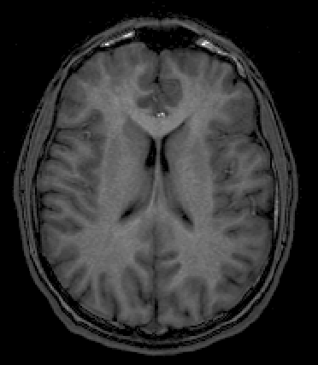
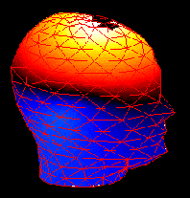
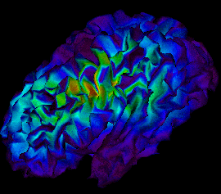
Approach for solving the inverse problem
Constrain data set with prior assumptions
Anatomical
constraints
Final Product: Reconstructed Source
ill-posed inverse problem
EEG/MEG
Data
Functional
constraints

Slide 22
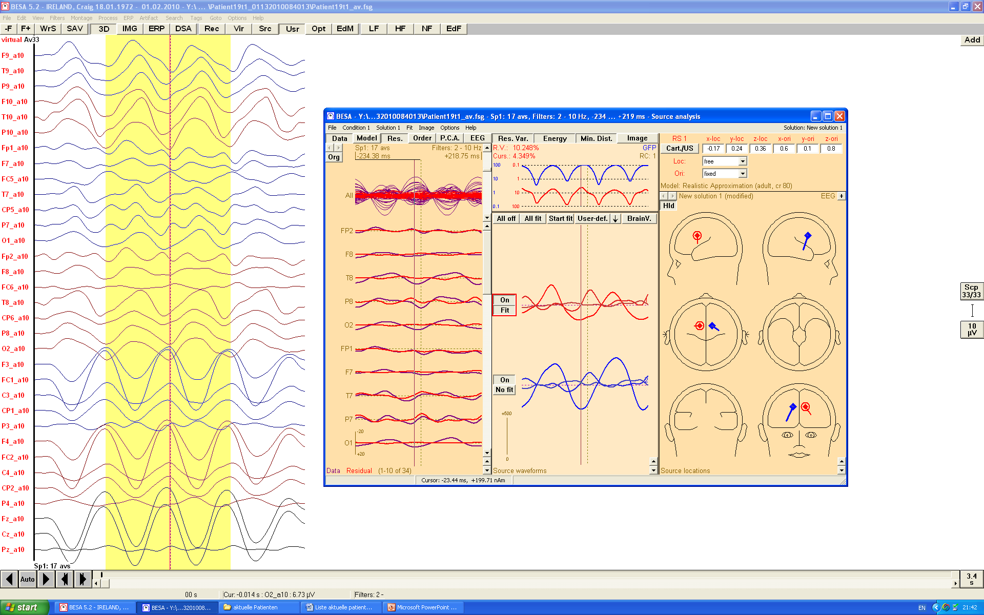
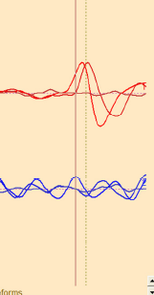
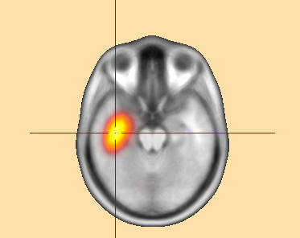
Discrete source analysis | Distributed source analysis
Current dipole represents an extended brain area | Each current dipole represents one small brain segment
Number of sources < number of sensors | Number of sources > number of sensors
The leadfieldmatrix has more rows (number of sensors) than colums (number of sources) | The leadfieldmatrix has more colums than rows
Result: Source model and source waveforms | Result: 3D Volume image for each time point
Discrete approach(Assumes a small number of activated regions of arbitrary location and orientation e.g. VB-ECD)
Distributed approach (Populate the source space with a large number of dipoles distributed at fixed locations and orientations and estimate their amplitude e.g. GS)
Some algorithms able to determine which is best to use depending on data (e.g. Multiple Sparse Priors)

Slide 23
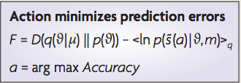
Getting Bayesian….
Parametric Empirical Bayesian Approaches are used to implement constraints
PEB imposes flexible constraints in form of source priors, in a source covariance matrix.
For any given dataset, most likely priors are those that maximise model evidence in terms of free energy (calculated using ReML - better models minimise this free energy function)
Model Complexity
Model Accuracy

Slide 24
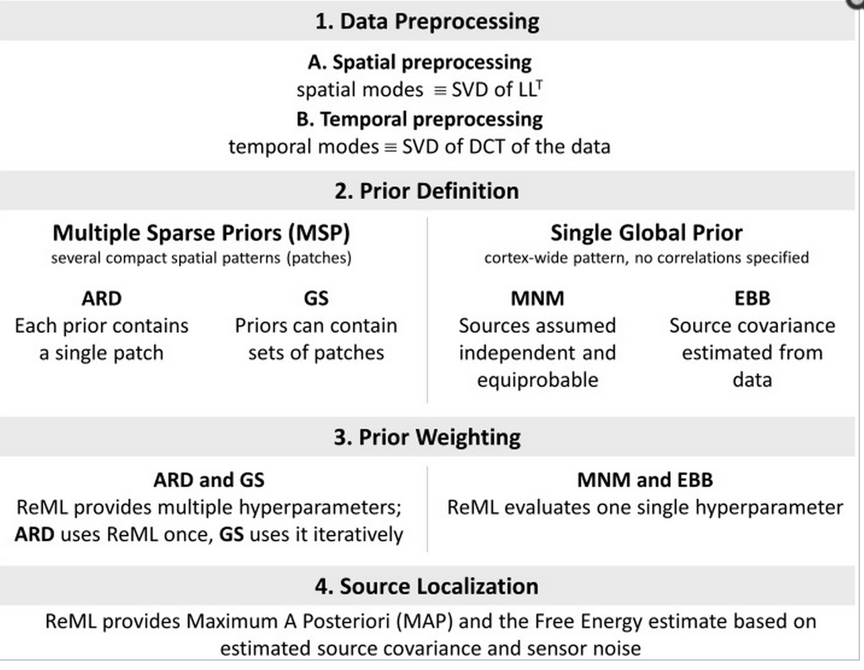

Slide 25
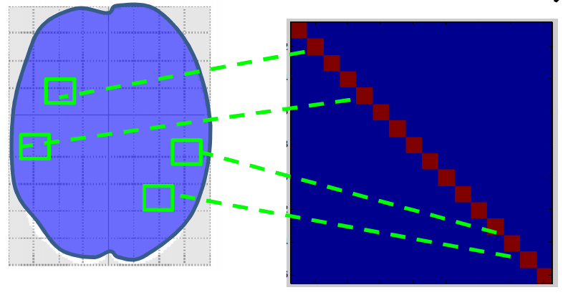
MNM (IID in SPM12)
Minimum Norm Model.
Simplest a priori assumption
practical assumptions:
All sources are considered equally probable
All sources are un correlated from one another
Source covariance matrix = identity matrix

Slide 26
Variational bayesian- ECD
Priors (dipole number) for source locations must be specified.
Estimates expected source location and its conditional variance.
Model comparison can be used to compare models with different source covariance matrices
Each dipole described in a six-dimensional space, therfore number of ECDs should not exceed [No. channels/6]
ASSUMPTIONS
Only few sources are simultaneously active (<5)
Sources are focal

Slide 27
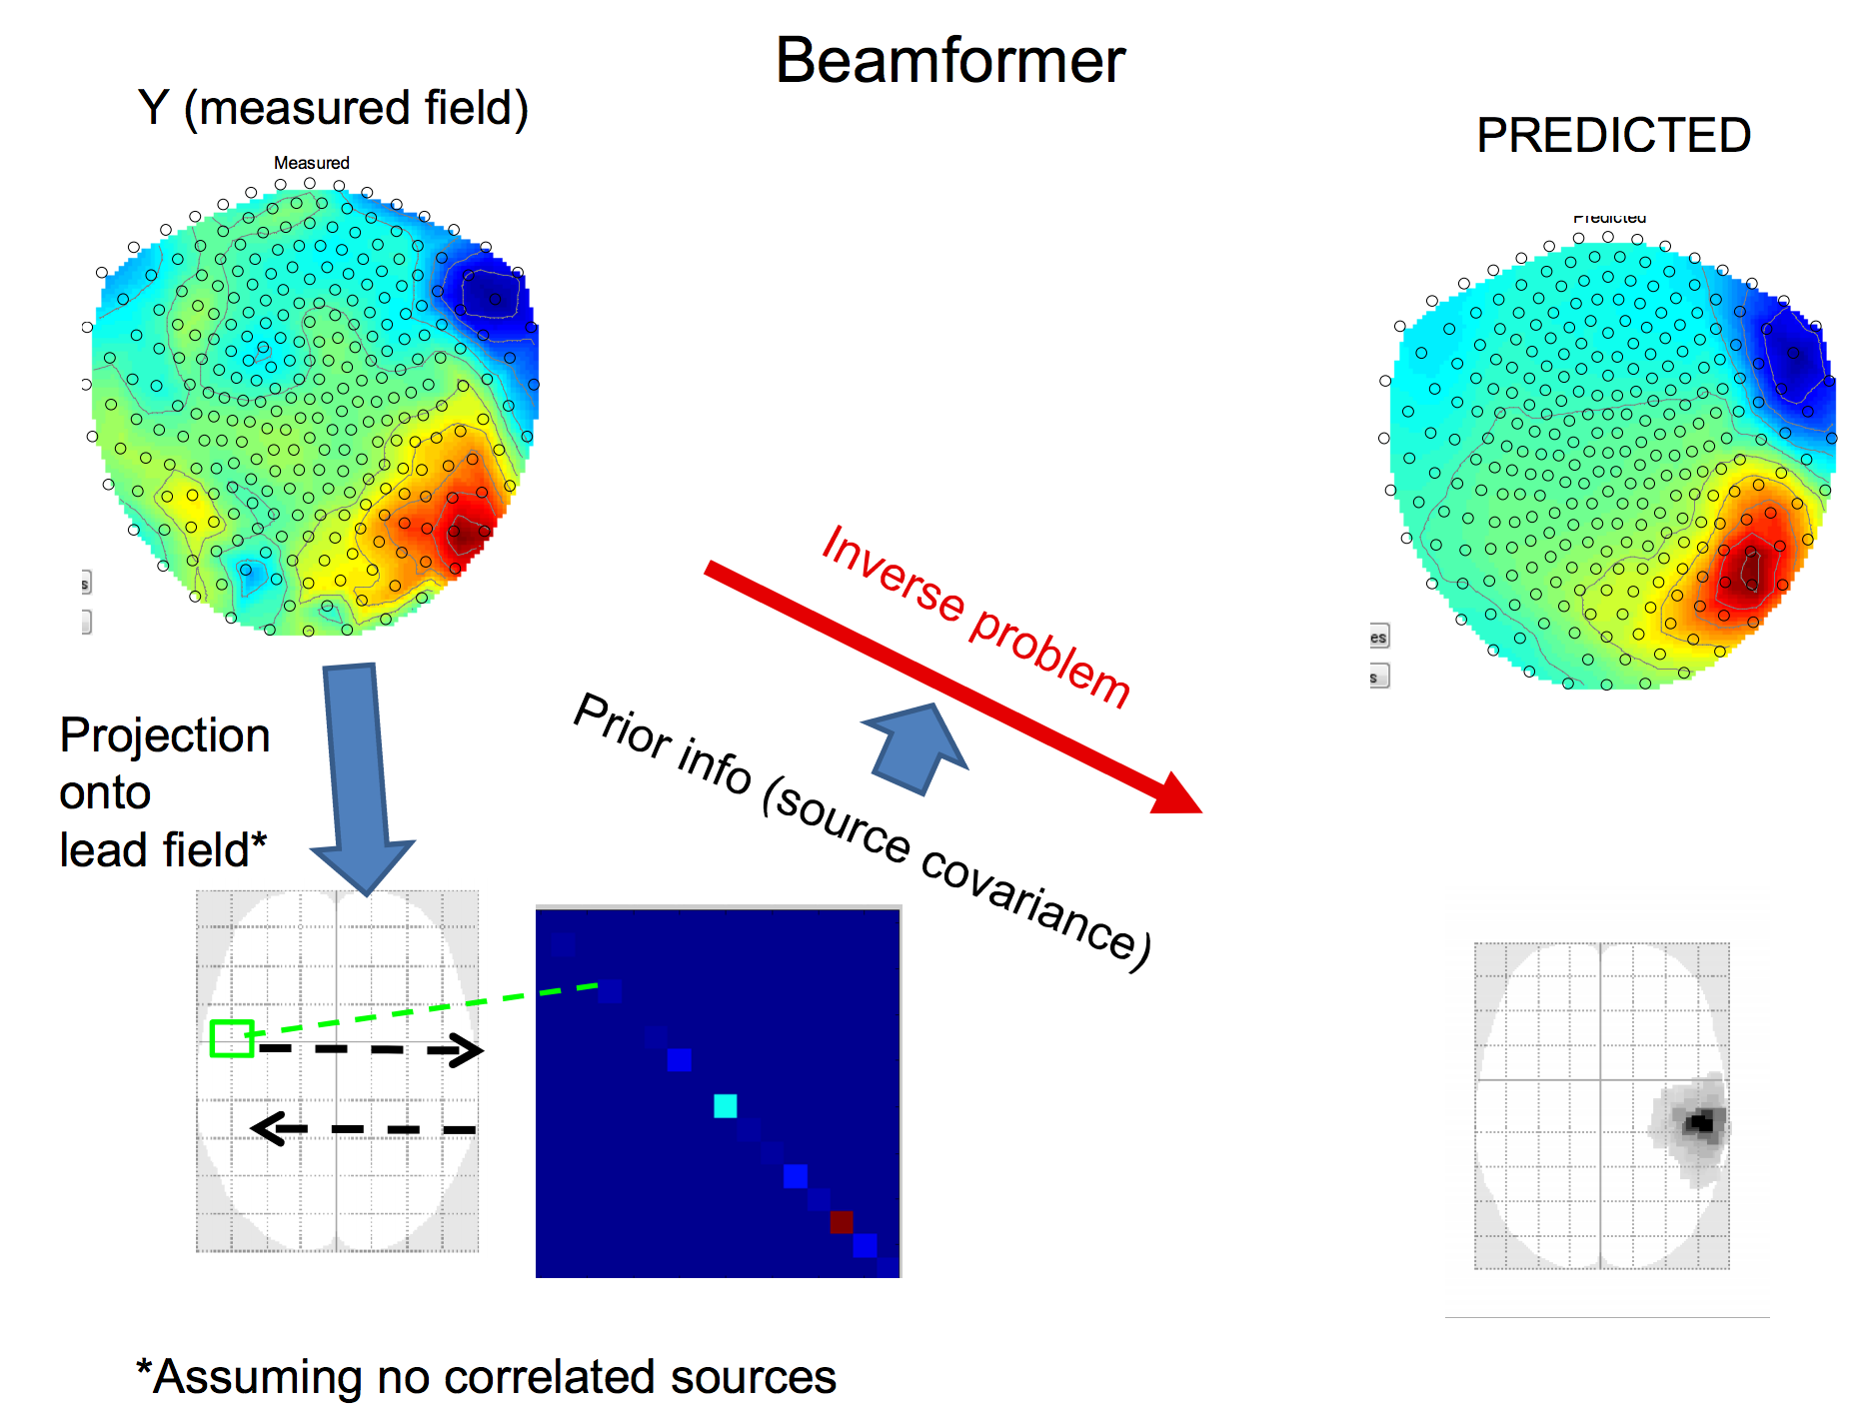
EBB
Based on LCMV beam former
Uses single covariance prior with strong temporal, but no spatial constraints
A solution for the inverse problem is obtained by imposing prior constraints derived from the sensor-data covariance

Slide 28
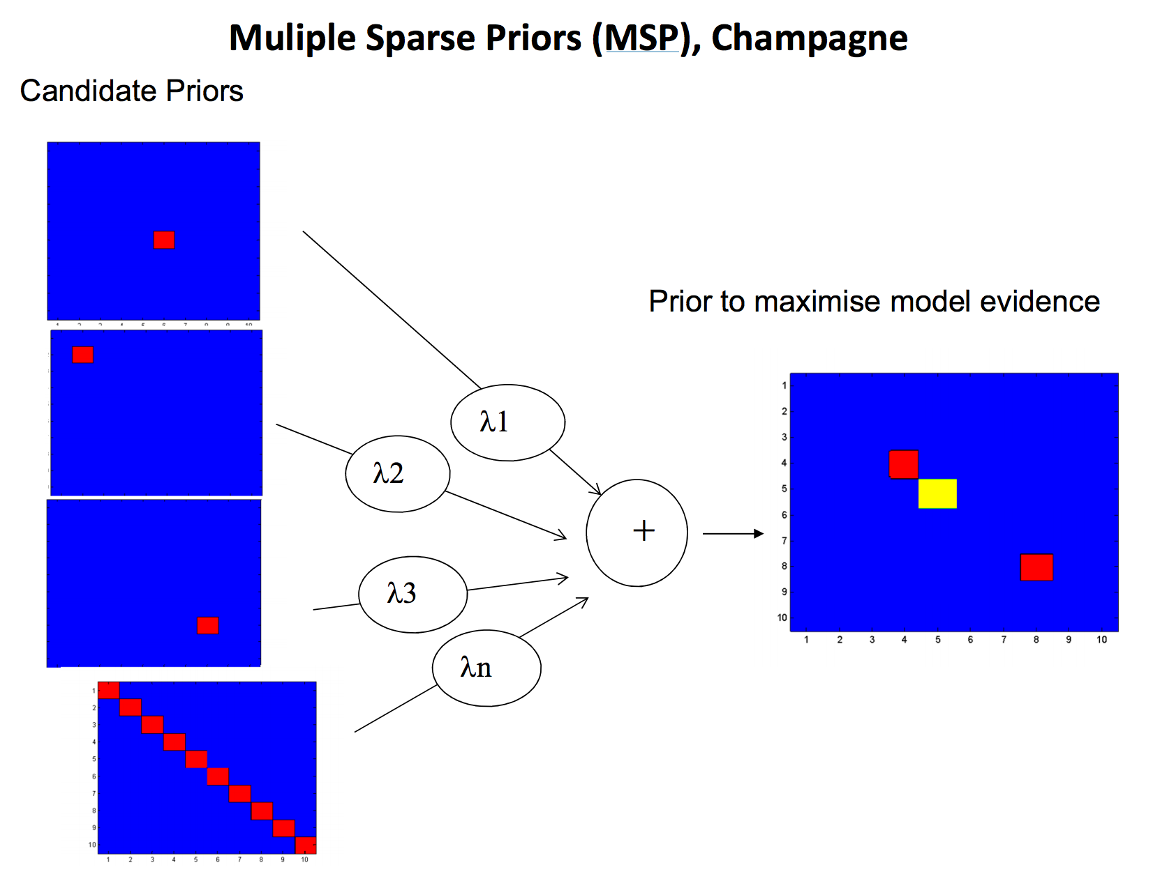
MSP
Uses a library of several user-defined compact spatial patterns
Rests on the assumption that cortical currents exhibit some local coherence within a distance of few millimeters.
The prior library is based on an arbitrary anatomical parcellation.
Additionally, no temporal constraint is imposed on the possible form of source activity.
It is assumed that all priors are equally likely to be active.
The hyperparameters connected to the priors are iteratively updated using a Restricted Maximum Likelihood (ReML) routine.
The free energy F is the objective function of ReML, providing an approximation to the model evidence
Fewer patches = better (model complexity argument)

Slide 29
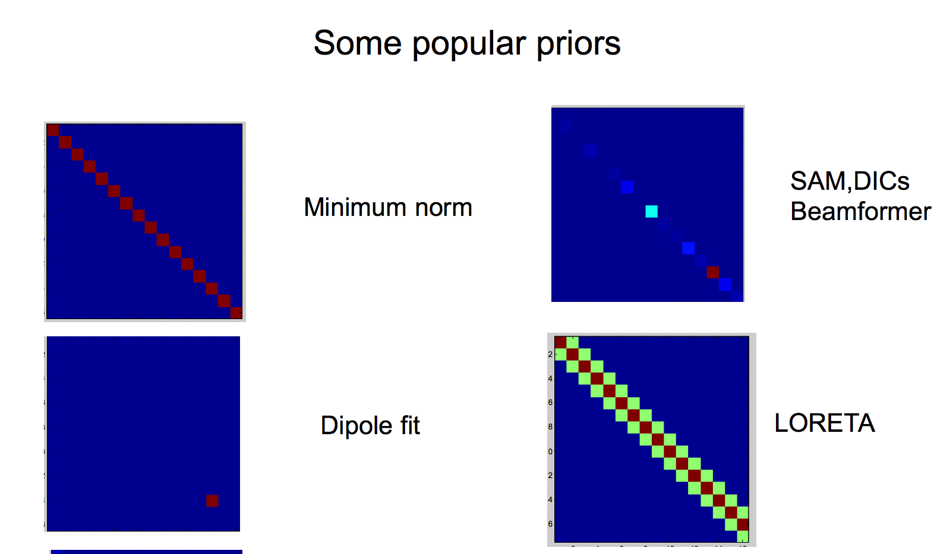
All prior knowledge encapsulated in a source covariance matrix.
Can test between priors (or develop new priors) using cross validation or Bayesian framework
Different inversion algorithms (LORETA, MNM etc) Just have a different prior source covariance structure

Slide 30
Poor unless SNR is high
Robust to Noise
However:
too many patches - too computationally intensive

Slide 31
Practically speaking
MEG/EEG data fitted to MRI (recommended for MEG) or Structural Mesh (recommended for EEG)
Coregistration (landmark [specify on MRI or select] or surface matching)
Forward computation (computes effect on sensors for each dipole in the cortical mesh - leads to lead field matrix)
Inverse Reconstruction (MSP by default)

Slide 32
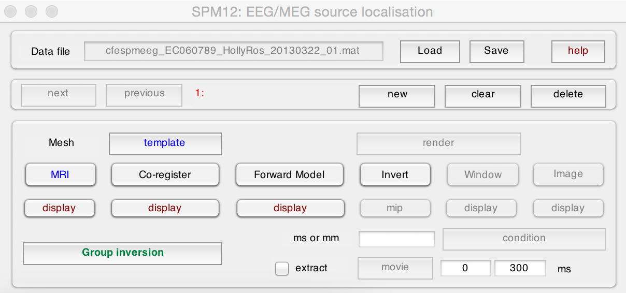

Slide 33
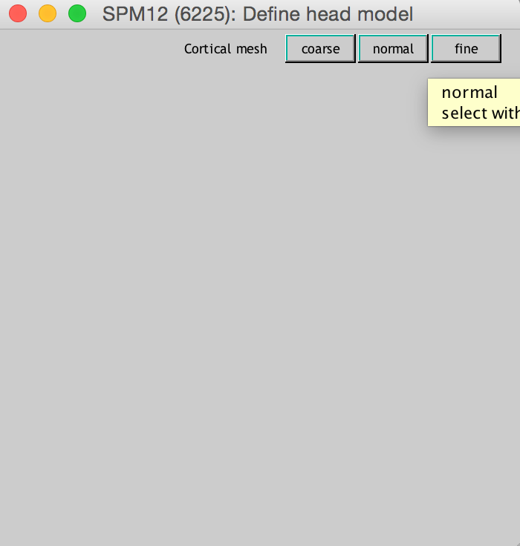
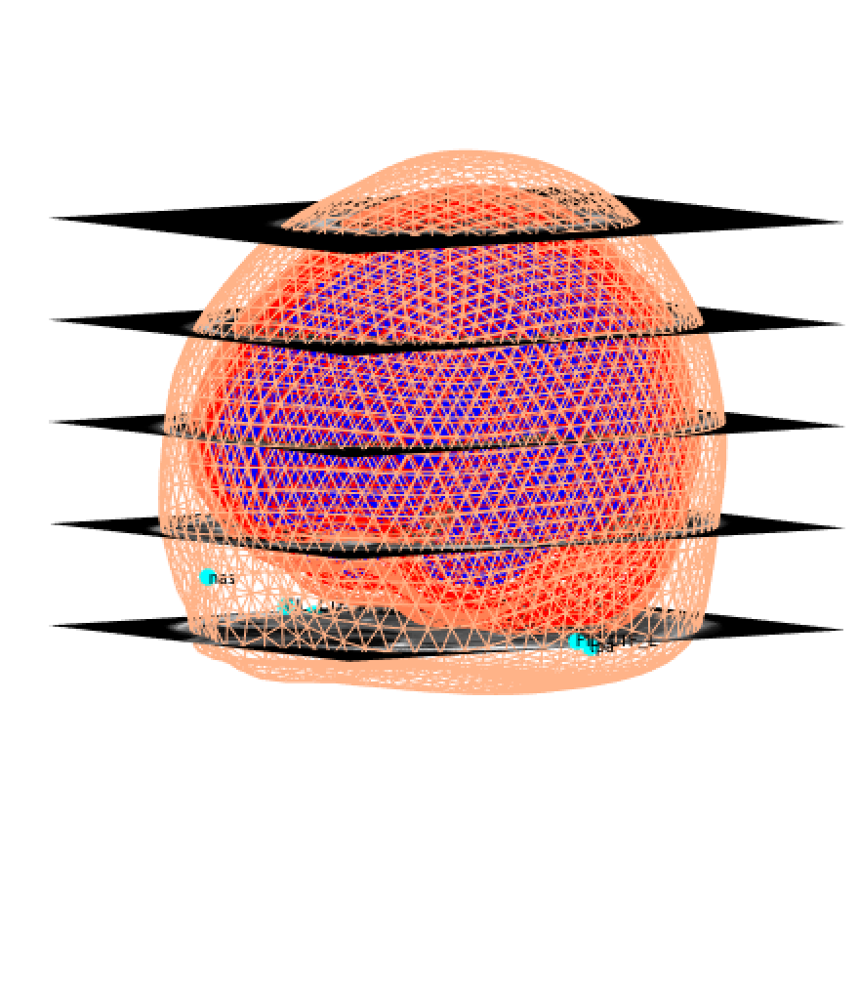

Slide 35
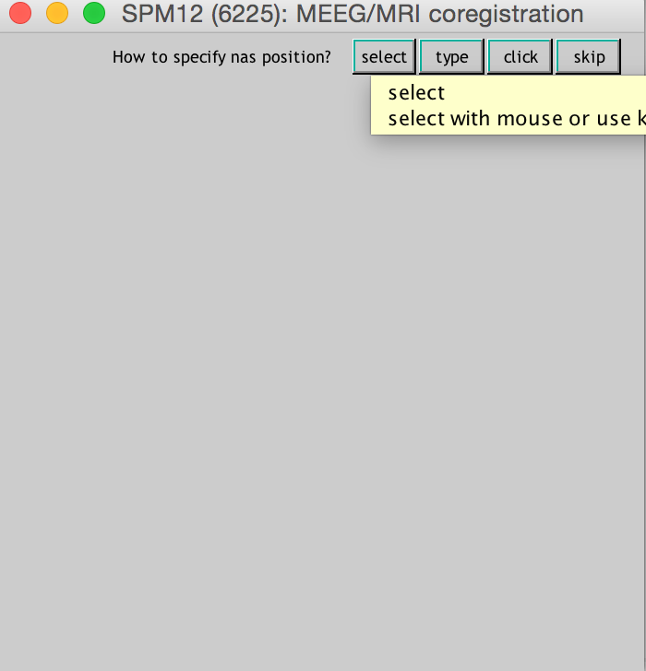
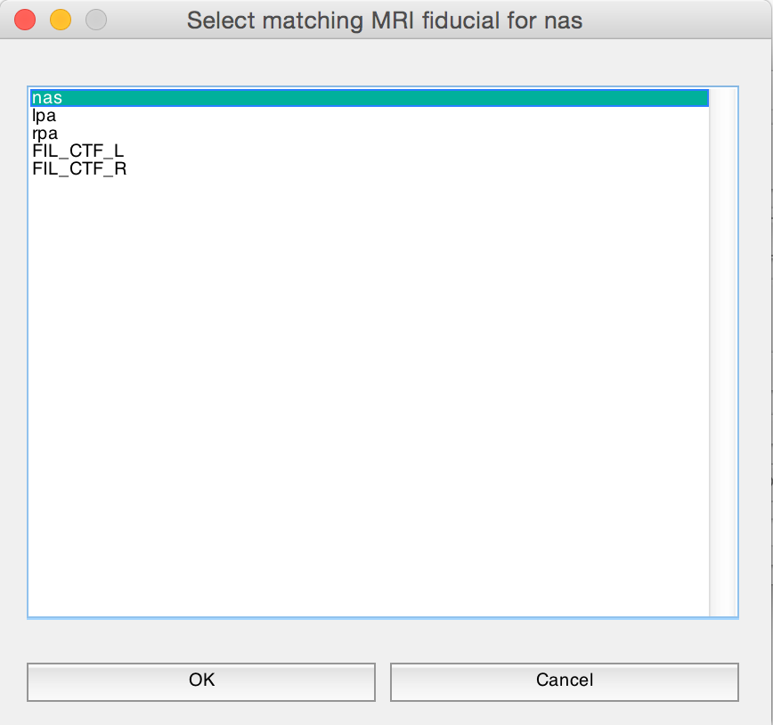
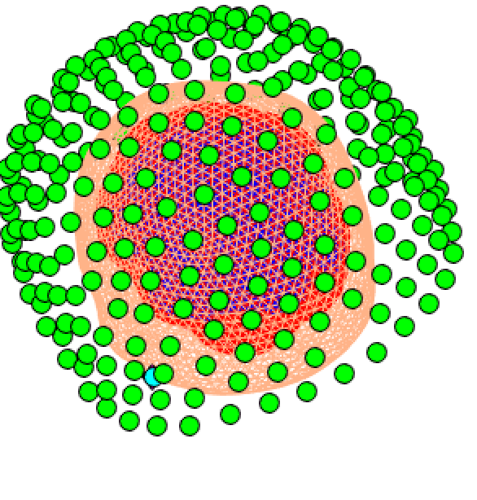

Slide 37
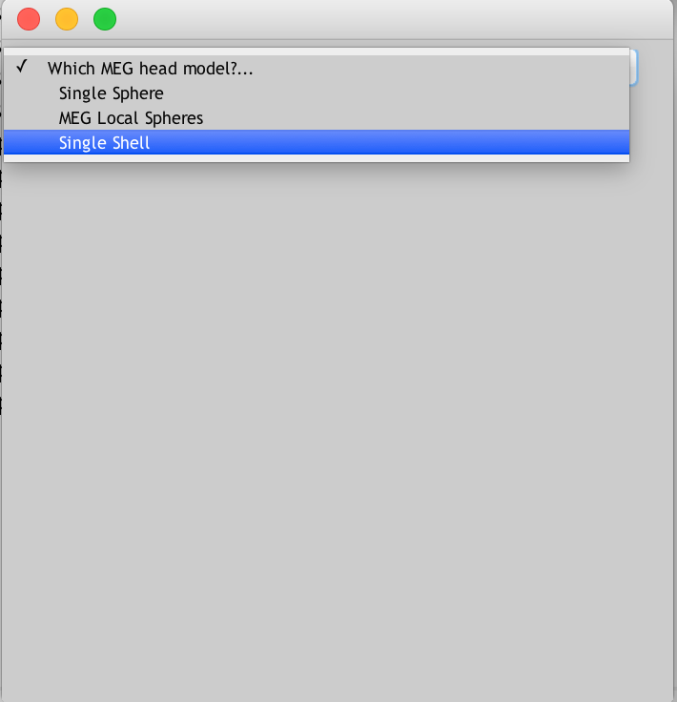
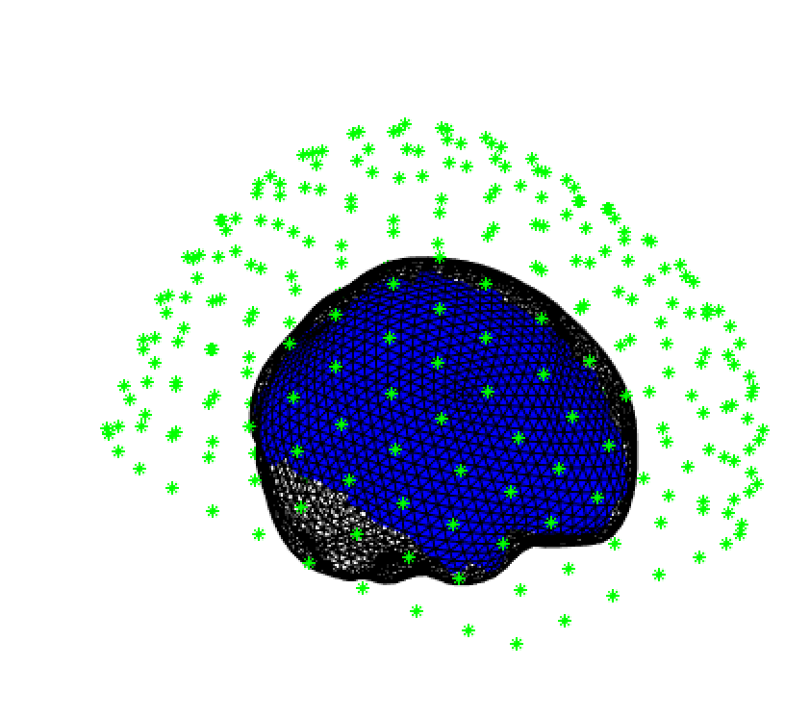

Slide 39
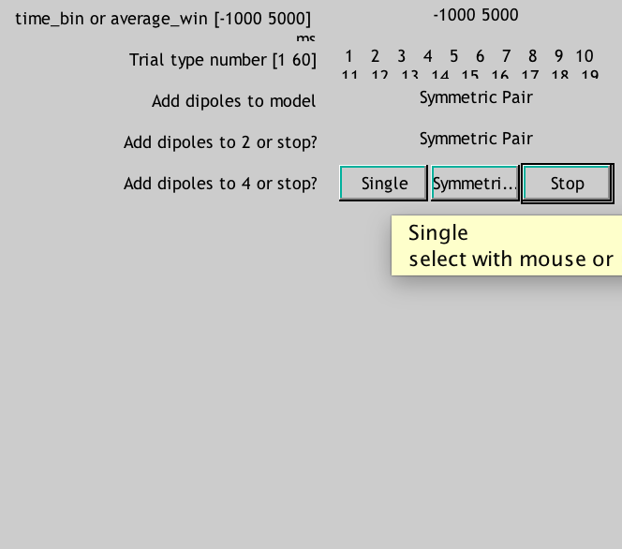
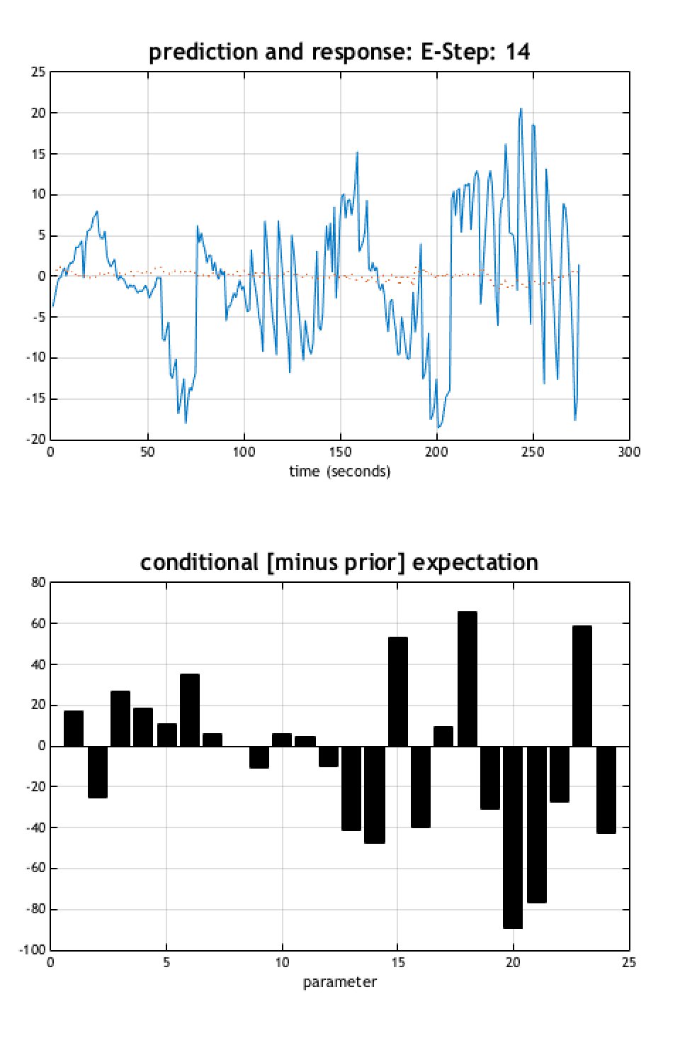
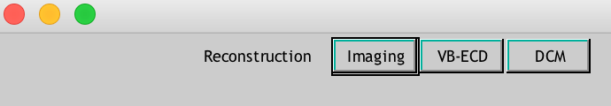

Slide 40
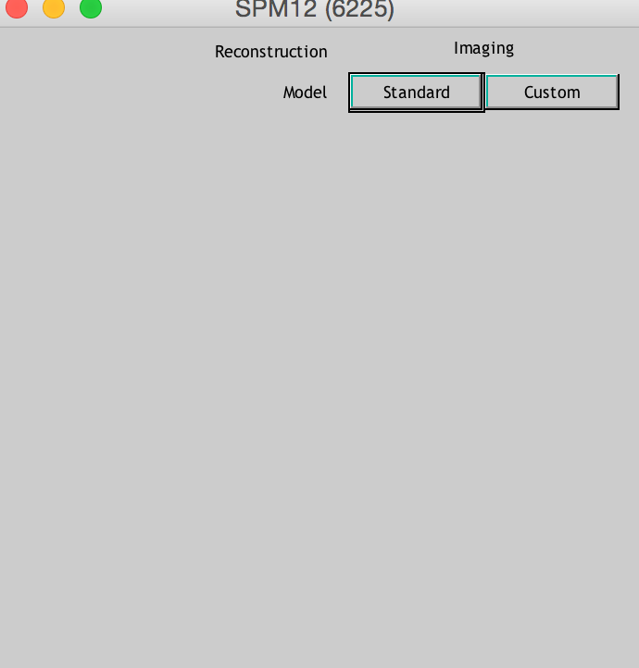


Slide 41
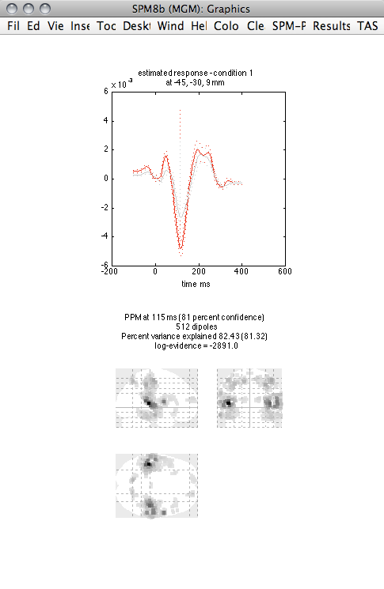
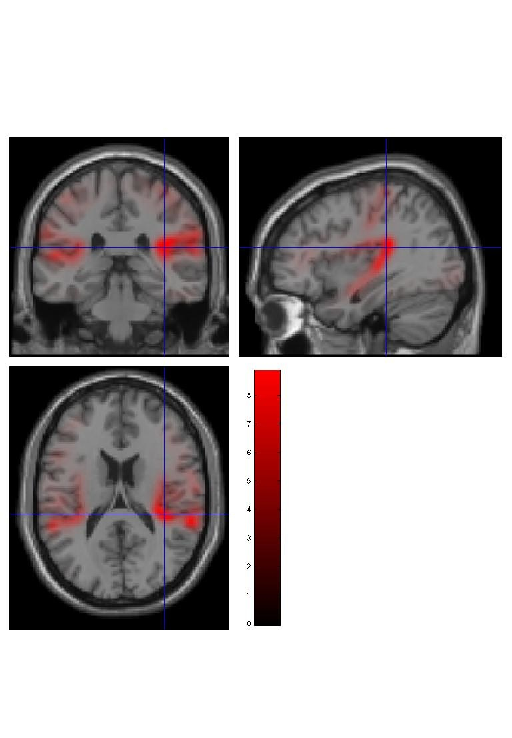


Slide 42



Slide 43


Slide 44
Thanks!
Gareth Barnes and his presentation slides
Jason Taylor’s SPM course slides
Litvak et al. (2011) EEG and MEG Data Analysis in SPM8. Computational Intelligence and Neuroscience.
Belardinelli et al. (2012) Source Reconstruction Accuracy of MEG and EEG Bayesian Inversion Approaches. PloS one
Lopez et al. (2012) SINGLE MEG/EEG SOURCE RECONSTRUCTION WITH MULTIPLE SPARSE PRIORS AND VARIABLE PATCHES. Dyna.
Joe Devlin’s fMRI course slides
To all of you beautiful people for showing up

