Slide 1
Study design
& EFFICIENCY
By Mandy Ho & Max Rollwage
MfD18-01-2017

Slide 2
Study Design Overview
Subtraction
Conjunction
Factorial
Parametric
Stimulus presentation strategies
  Blocked
  Event-related
  Mixed

Slide 3
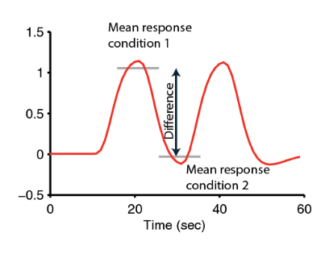
Goal of design
Isolate functional processes of interest
BOLD signal is relative – choose stimulus conditions and timings that maximise BOLD signal contrast
Avoid confounding physiological and psychological artifacts
Collect as much data as possible
Measure behaviour
      Based on Huettel (Chapter 9)

Slide 4
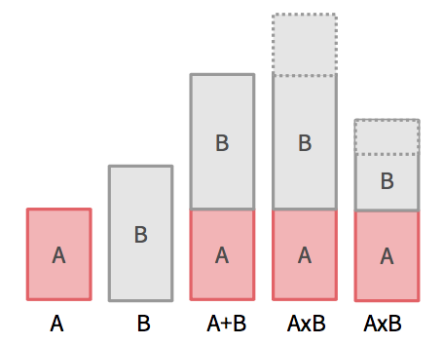
Subtraction
Two task conditions differing in the process of interest
  Task condition 1: evokes process of interest
  Task condition 2: evokes all but the process of interest
Challenge -> Finding a good control task
Assumption of ‘pure insertion’
  Two (or more) conditions can be cognitively added with no interactions among the cognitive components of a task (Amaro & Barker, 2006)
Notes:
Two challenges with subtraction

Slide 5
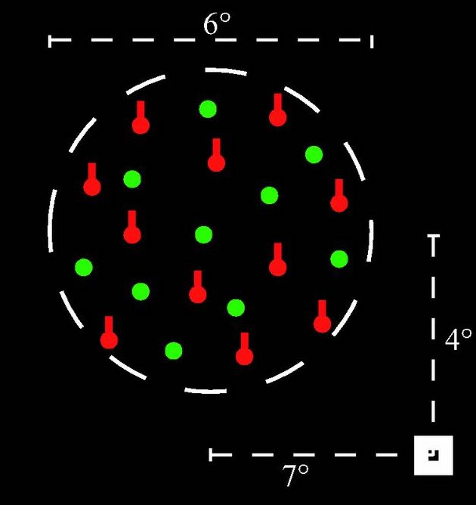
Problem with Subtraction
Example (taken from Friston et al., 1996)
V5 activation in response to motion; enhanced by selectively attending to motion.
Imagine an experiment…
-> Motion presented with and without
selective attention
-> Found V5 activation!
-> Fallaciously conclude V5 role in selective attention for
motion (when it actually represents an interaction)
Notes:
Selectively attending to just one attribute ‘motion’, as opposed to divided attention among many attributes (e.g. colour, shape, motion)
Fallaciously conclude V5 role in selective attention for motion though it represents an interaction
Image taken from:
Effects of task and attentional selection on responses in human visual cortex (Runeson et al., 2013)

Slide 6
Conjunction
Isolate process of interest by finding commonalities between task conditions
  Task pair 1: subtraction isolating A & B
  Task pair 2: subtraction isolating A & C
For example:
‘Which structure support selective attention network regardless of sensory modalities?’
Task pairs:
Visual stimulus with/without selective attention
Auditory stimulus with/without selective attention
… etc
A = process of interest
Notes:
Example

Slide 7
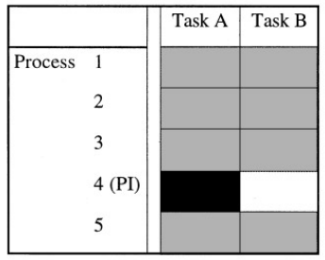
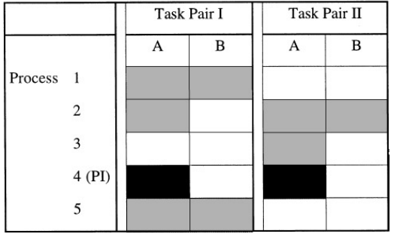
Conjunction
Subtraction
Conjunction
  A = activation task; B = baseline task; PI = process of interest
Minimise baseline problem with subtraction
Area identified = jointly significant in all subtraction pairs & not significantly different (discounts interaction)
  Too conservative?
      (Price & Friston, 1997)
Notes:
- Baseline challenge for substraction (left)
Context-sensitive effect (i.e. interactions) will not come up
Subtraction assumes interaction does not exist; conjunction discounts interaction
(Conjunction does assume different interactions do not activate the same area to the same degree)

Slide 8
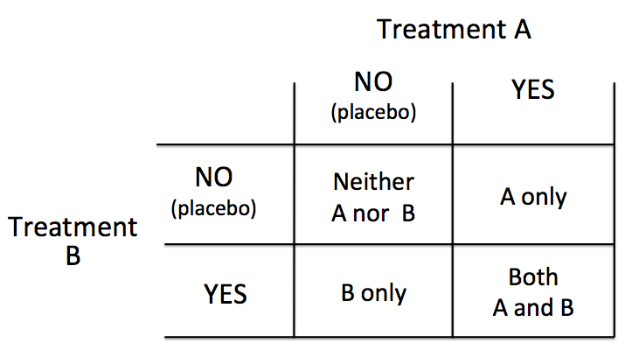
Factorial
Two or more variables (or factors) and the different levels of each variable are matched
Test for interactions explicitly
‘…perform a task where the cognitive components are intermingled in one moment, and separated in another instance of the paradigm’ (Amaro & Barker, 2006)
2 factors x 2 levels = 4 conditions

Slide 9

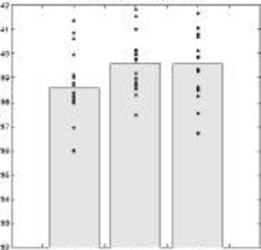

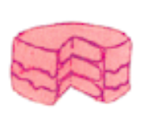
Subtraction approach
‘Is the inferotemporal region implicated in phonological retrieval during object naming?’ (Friston et al., 1997)
[1] Say ‘yes’ when you Results:
see an abstract image
(visual analysis, speech)
[2] Say ‘yes’ when you see
an object (visual analysis,
speech, object recognition)
[3] Name the object
(visual analysis, speech,
object recognition, phonological retrieval)
Subtraction: [2] – [1] = object recognition
[3] – [2] = phonological retrieval
[1]
[2]
[3]
Assumes object recognition activates IT to the same degree independent of phonological retrieval
Notes:
Conclude IT is involved in object recognition, but not in phonological retrieval

Slide 10
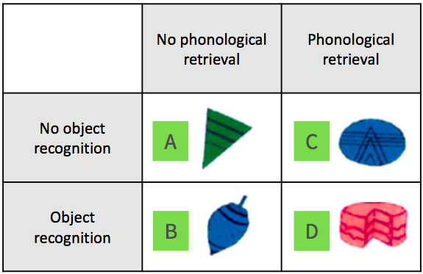
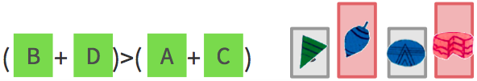
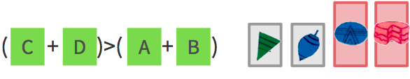
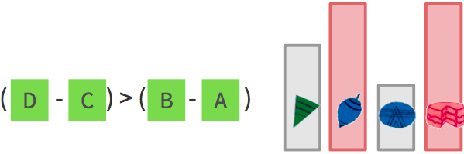
Factorial approach
Slides from 2016 SPM course
Vary object recognition & phonological retrieval independently
  Add condition: [4] Name the colour of the presented shape (visual analysis, speech, phonological retrieval)
  Main effect:
  Object recognition
  Phonological retrieval
  Interaction:
In the absence of object recognition, phonological retrieval deactivates IT
Notes:
Check interaction by comparing: Activation due to object recognition in the absence of phonological retrieval (B-A)
VERSUS
Activation due to object recognition in the presence of phonological retrieval (D-C)
(Pure insertion requires them to be the same)
Conclusion: In the absence of object recognition, phonological retrieval deactivates IT
(C-A) vs. (D-B)?

Slide 11
Parametric
Based on the idea that cognitive demand of task vary systematically with BOLD signal
  Incrementally increase difficulty of task; relate to BOLD signal
Allow dissociation between areas functionally associated with task & other ‘maintenance’ areas
e.g. Working memory task (Seidman et al., 1998)
  Baseline: respond to all letters
  Task 1: respond if A preceded by Q (e.g. QA)
  Task 2: respond if A preceded by Q, separated by three letters (e.g. QrctA)
However, other circuits may be recruited at higher cognitive demand
Notes:
Parametric with factorial?
Paper:

Slide 12
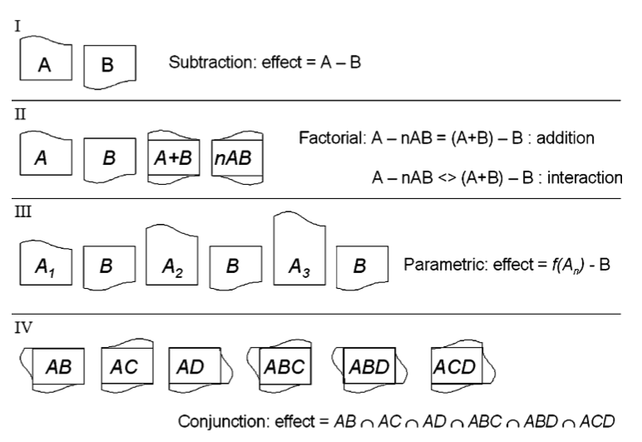
Summary
Amaro & Barker (2006)

Slide 13
Study Design Overview
Subtraction
Conjunction
Factorial
Parametric
Stimulus presentation strategies
  Blocked
  Event-related
  Mixed

Slide 14
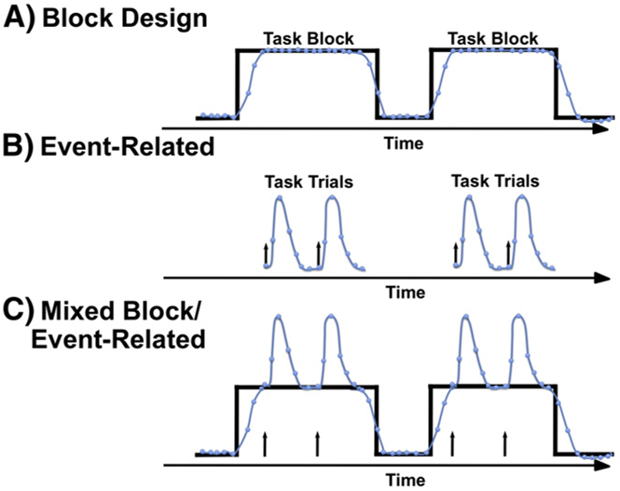
Presenting stimulus
How to present your stimulus?
Detection: knowing which voxel is active (spatial resolution)
Estimation: time course of active voxel (temporal resolution)
Petersen & Dubis (2012)

Slide 15
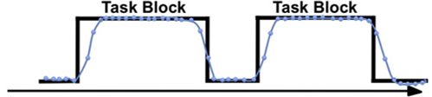
Block design
Alternating between task conditions
e.g. [ Task A rest Task B rest Task A rest Task B rest ]
Strong detection/statistical power
  Maximise data variability due to experimental manipulation (between-conditions variability)
  Minimise other sources of data variability (within-conditions variability)
However…
  Insensitive to shape and timing of hemodynamic response
  Expectancy effect
  Based on Huettel (Chapter 9)
Notes:
Easy to analyse

Slide 16
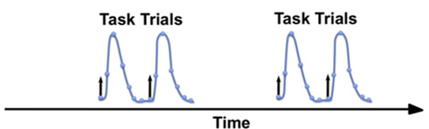
Event-related design
Evoke process of interest transiently by brief presentation of individual stimuli
Task order randomised
Better estimation of HRF shape and timing
Allow trial-by-trial sorting based on subject response
However…
  Evoke smaller changes in BOLD signal
  Larger switching cost between tasks?
  Based on Huettel (Chapter 9)
Notes:
Block -> reflect brain state
Event-related -> measure transient changes associated with a discrete stimuli

Slide 17
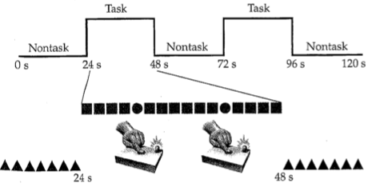
Mixed designs
Combination of blocked and event-related designs
Stimulus present in regular blocks; >1 types of events per block
Analysis of IVs on different time scale
  Block -> state-related processes (e.g. attention)
  Event -> item-related processes (e.g. button press)
Memory retrieval: Donaldson et al. (2001) found brain areas associated with ‘retrieval mode’ (state) and ‘retrieval success’ (item).
Example of a mixed design:
Within task block, subject pressed button in response to infrequent target circles, ignoring non-target square.

Slide 18
Design Efficiency

Slide 19
General advices
For group-level inference larger sample sizes are better
  If you have 40 hours of scanning: rather 40 person 1 hour than 10 person 4 hours
Run each scan as long as possible (40-60 min)
Keep subject as busy as possible
Fewer conditions/contrasts are better
Efficiency is not the same for every contrast!!!!! (optimize efficiency for the most important contrast)
Notes:
The greater the between subject variance in comparison to within subject variance, the more important sample size becomes. But depends on question, for example if you are interested in individual differences the within subject variability is more important
Of course not scanning longer than the subject can show satisfactory behavior

Slide 20
Technical considerations
A good fMRI experiment needs 2 things:
Induce subject to do or experience the psychological state that you want to study (psychological)
Effectively detect brain signals related to those psychological states (statistical)
You can have a great psychological experiment with huge neuronal response, but be completely unable to detect this in fMRI-signal

Slide 21
Reminder GLM
General Linear Model:
Y = X . β + ε
Data Design Matrix Parameters error
Efficiency(e) is the ability to estimate β, given the design matrix (X) for a particular contrast (c) and the given noise variance (σ²)
  e (c, X) = inverse (σ² c^{T} Inverse(X^{T}X) c)
The efficiency for each contrast is different
We can calculate the efficiency just based on the contrast and design matrix before we have seen any data!
Notes:
We can directly influence our efficiency by spacing and sequencing our events

Slide 22
Timing Issues

Slide 23
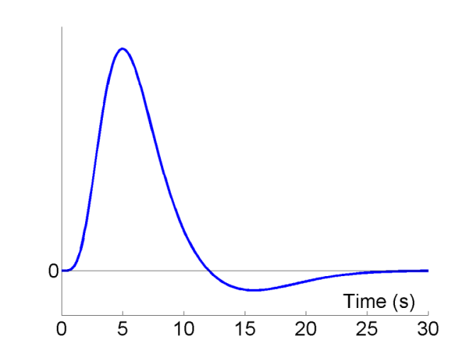
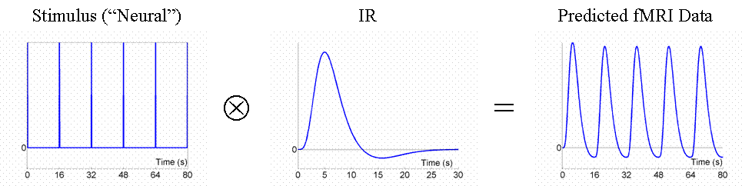
Simplest case: one condition against baseline
2 difficulties in fMRI:
BOLD response is very sluggish
Low frequency drifts in fMRI signal, need to be filtered out by high-pass filter
HRF
Fixed SOA 16s
HRF
Notes:
Maximizing efficiency is equivalent to maximizing energy of the signal (sum of squared signal value at each scan) that is proportional to the variance of the signal.
To best detect a signal in presence of background noise, we want to vary the signal as much as possible-> a signal that varies little will be difficult to detect
If we present only one stimuli and let the signal then return to baseline, the magnitude of signal will be rather small, and thus it might be difficult to detect an effect

Slide 24
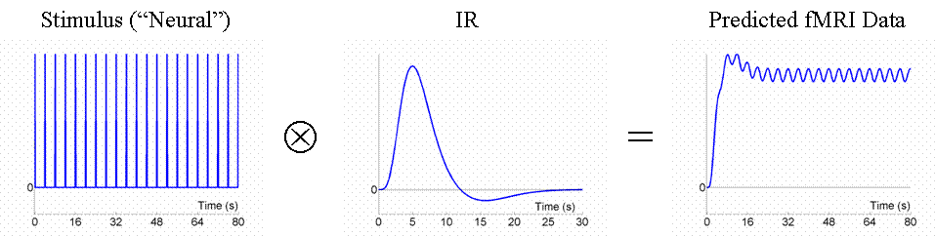
Fast event presentation-> not efficient
Fixed SOA 4s
HRF
Notes:
Although overall signal is high, the variance is low, so that most of the signal will be lost after high-pass filtering
Because the IRs to successive events now overlap considerably, we end up an initial build-up (transient) followed by small oscillations around a "raised baseline".

Slide 25
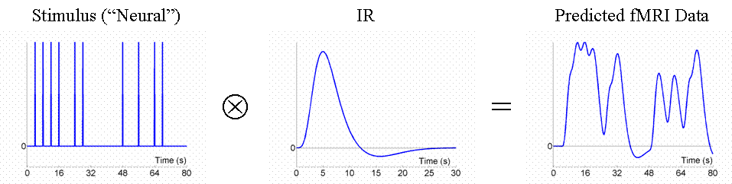
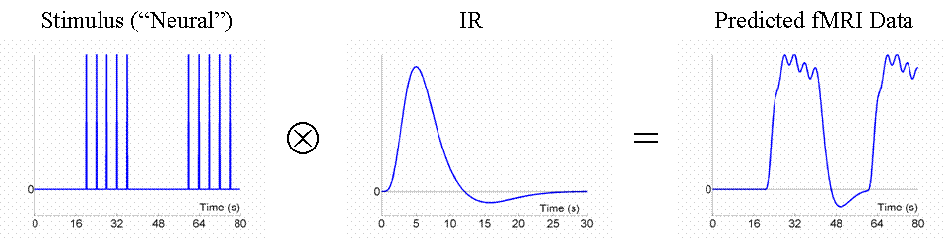
Stochastic and blocked event presentation ->very efficient
Random SOA minimum 4s e.g. event-related: larger variability in signal
HRF
Blocked, SOA 4s: larger variability in signal
HRF
Notes:
Though we only use half as many stimuli as in Fig 3, this is a more efficient design. This is because there is a much larger variability in the signal (and we know how this signal varies, even though we generated the event sequence randomly, because we know the specific sequence that resulted).

Slide 26
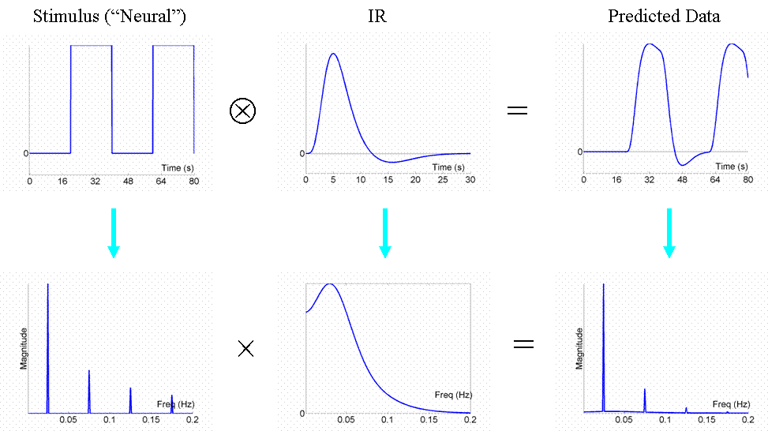
Fourier Transformation
HRF
Waves can be described as the sum of a number of sinusoidal components
FT helps to see which components will pass the HRF filter
Notes:
Stimulus function can be seen as original data and the HRF as a temporal filter. Too high frequencies are filtered out, since the BOLD response is not that fast. Low pass filter.
What we want is that the majority of the signal is ‘passed’ by the HRF and not filtered out
To achieve this, the used stimulus frequency should be best aligned with the dominant frequency of the HRF (.04 Hz).
The frequency of change of the stimulus should correspond to the dominant frequency of change of the HRF

Slide 27
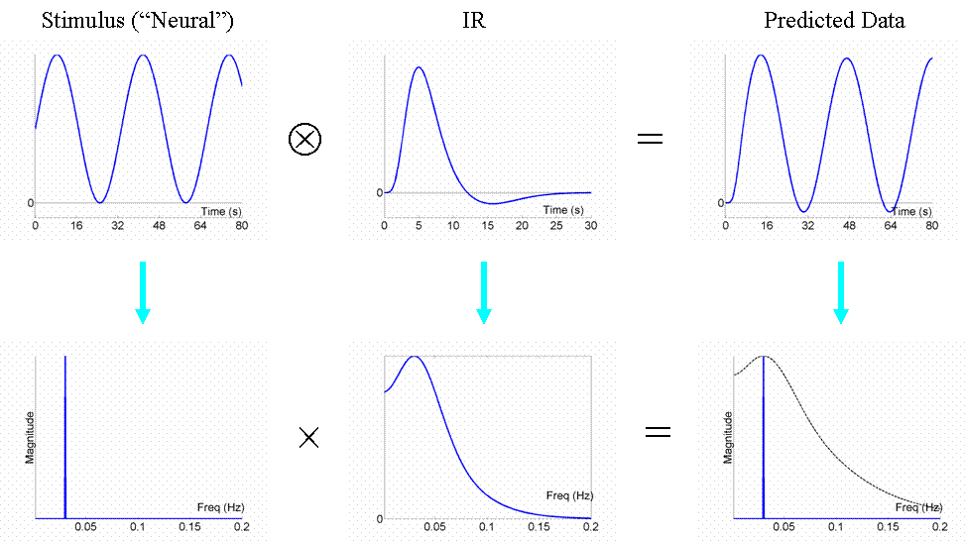
Most efficient design
HRF
The most efficient design has a stimulus frequency that matches the maximum frequency amplitude of the HRF -> Most of the neuronal activity can be detected in the BOLD signal
Notes:
A sinusidoial function of .3 Hz is perfect for retaining most of the signal

Slide 28
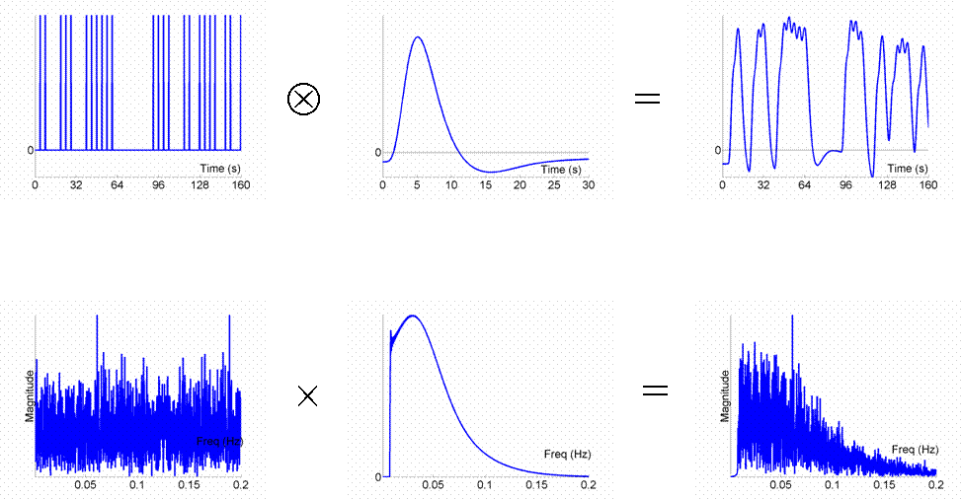
Stochastic design -> efficient
Stochastic designs spread frequency energy across wide range of frequencies, from which much is passed through

Slide 29
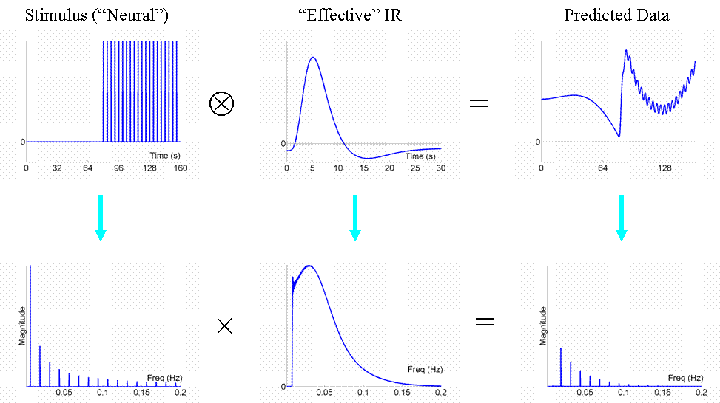
High-pass filtering
Low frequency noise in fMRI (e.g. scanner drifts)
High-pass filter cut-off in SPM 0.01Hz
Don’t design blocks of too much length (not longer than 50 sec), because high pass filtering would remove most of the signal
Don’t contrast conditions too separate in time
High-pass filter

Slide 30
2 or more conditions
Things get more complicated….

Slide 31
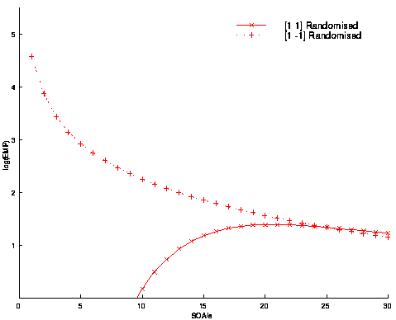
Different efficiency for different contrasts
Short SOA’s are optimal for the differential effect (A-B)
But they are really bad for the main effect (A+B)
Differential Effect (A-B)
Efficiency
Common Effect (A+B)
SOA

Slide 32
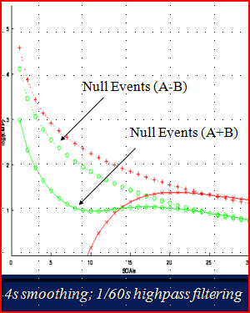
Jitter or Null-events for good trade-off
Introduce Null-events helps to estimate the baseline-> better efficiency for main effect (A+B)
Efficient for differential and main effects at short SOA

Slide 33
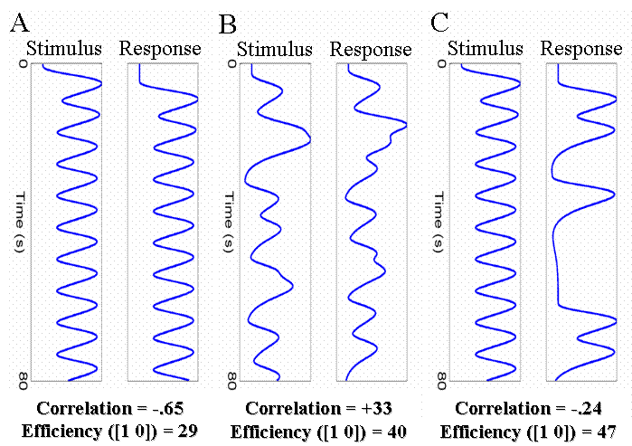
Correlation between regressors
Fixed SOA
Jitter SOA
Response only in 50% of trials
High correlation between regressors can reduce efficiency
If 2 events (e.g. stimulus and response) are highly correlated, you can’t determine which of both caused the BOLD signal
“Orthogonalising” regressors with respect to each other in SPM won’t help to solve this issue!!!!
Notes:
In some cases we need to design experiments where there is necessarily some degree of correlation between regressors. For example, when trials consist of two events, one of which must follow the other as in a working memory design (a trial consists of stimulus, short retention interval and a response). With short SOAs between each event type, the regressors for the stimulus and response will be negatively correlated as shown in A. Solutions could be: B -- Randomly vary (jitter) the time between successive stimuli and responses (assuming this is possible). C -- Keep stimulus-response interval fixed at 4s, but only require a response on a random half of trials. Effect of both: Reduced correlation between the regressors, increases efficiency for separating the brain’s activity to stimuli and to responses.

Slide 34
Conclusion
Optimal design for one contrast might not be optimal for another
Block design (short block length ~16sec) are most efficient
Block designs are often psychological not possible: stochastic designs with jittered SOA or null-events are also very efficient
Don’t have too long blocks/ contrast too separate in time, since it will be filtered out by high-pass filter

Slide 35
References
SPM course slides (2016)
Scott A. Huettel. (2004). Functional Magnetic Resonance Imaging. Chapter 9.
Friston, K. J., Price, C. J., Fletcher, P., Moore, C., Frackowiak, R. S., & Dolan, R. J. (1996). The trouble with cognitive subtraction. NeuroImage, 4(2), 97–104.
Price, C. J., & Friston, K. J. (1997). Cognitive conjunction: a new approach to brain activation experiments. NeuroImage, 5(4 Pt 1), 261–70.
Amaro, E., & Barker, G. J. (2006). Study design in fMRI: Basic principles. In Brain and Cognition (Vol. 60, pp. 220–232).
Seidman, L. J., Breiter, H. C., Goodman, J. M., Goldstein, J. M., Woodruff, P. W., O’Craven, K., et al. (1998). A functional magnetic resonance imaging study of auditory vigilance with low and high information processing demands. Neuropsychology, 12, 505–518.
Petersen, S. E., & Dubis, J. W. (2012). The mixed block/event-related design. NeuroImage.
Donaldson, D. I., Petersen, S. E., Ollinger, J. M., & Buckner, R. L. (2001). Dissociating state and item components of recognition memory using fMRI. NeuroImage, 13(1), 129–142.
https://mediacentral.ucl.ac.uk/Player/2897
https://www.coursera.org/learn/functional-mri-2/lecture/zVWBb/module-7a-advanced-experimental-design-i-fundamentals-of-design-efficiency
http://imaging.mrc-cbu.cam.ac.uk/imaging/DesignEfficiency

