Slide 1
Methods for Dummies Overview and Introduction
Chamith Halahakoon and Akshay Nair

Slide 2
Overview
What is MfD?
How to prepare your presentation
Where to find information and help

Slide 3
What is Methods for Dummies
Aim of MfD: to provide a basic introduction to human brain imaging analysis methods, focusing on fMRI and M/EEG
Wednesdays 1200-1300 hrs in 4th floor seminar room
Each talk will be given by two presenters and last about 30 min + 15 minutes for questions. Generally it should introduce the relevant theory and be followed by a demo using SPM12 interface.

Slide 4
How to Prepare
Read the Presenter’s Guide
Prepare the slides with your Partner
Meet with your Expert
Remember your audience are not experts

Slide 5
Where to find information
Go to the MfD homepage → Resources
http://www.fil.ion.ucl.ac.uk/mfd/
Previous years’ slides
Human Brain Function Textbook (online)
SPM course slides
Cambridge CBU homepage (Rik Henson’s slides)
Methods Group Experts
Monday Methods Meetings (4th floor FIL, 12.30)
SPM email list

Slide 6
Brief course overview
We will cover principle concepts involved in analysing functional neuroimaging data with a focus on SPM

Slide 7
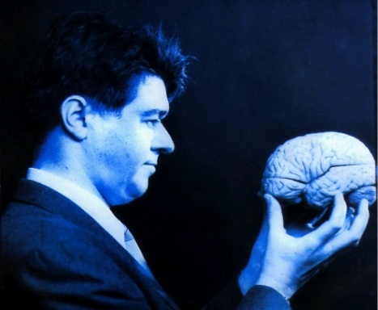
SPM
Statistical Parametric Mapping
Invented at the FIL
A software package designed for the analysis of brain imaging data in fMRI, PET, SPECT, EEG & MEG
It runs in Matlab… just type SPM at the prompt and all will be revealed
The SPM website has a manual and datasets available for playing around with

Slide 8
fMRI overview
Notes:
GLM describes the data at each voxel: mass univariate approach
Takes into account Experimental and confounding effects…
and residual variability
GLM used in combination with a temporal convolution model
Once you have carried out your pre-processing you can specify your design and data
The design matrix is simply a mathematical description of your experiment
E.g. ‘visual stimulus on = 1’ ‘visual stimulus off = 0’

Slide 9
fMRI overview
Notes:
GLM describes the data at each voxel: mass univariate approach
Takes into account Experimental and confounding effects…
and residual variability
GLM used in combination with a temporal convolution model
Once you have carried out your pre-processing you can specify your design and data
The design matrix is simply a mathematical description of your experiment
E.g. ‘visual stimulus on = 1’ ‘visual stimulus off = 0’

Slide 10
Other techniques
Notes:
GLM describes the data at each voxel: mass univariate approach
Takes into account Experimental and confounding effects…
and residual variability
GLM used in combination with a temporal convolution model
Once you have carried out your pre-processing you can specify your design and data
The design matrix is simply a mathematical description of your experiment
E.g. ‘visual stimulus on = 1’ ‘visual stimulus off = 0’

Slide 11
Other techniques

Slide 12
Other techniques

Slide 13
Final points
Course only works if everyone chips in
Allocations come out later today
Some of the topics seem hard but please don’t worry
Rules for swaps:
There will be a reserve list – please email

