Slide 1
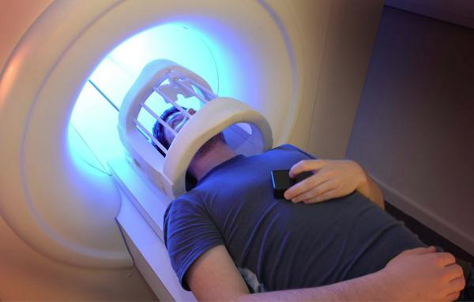
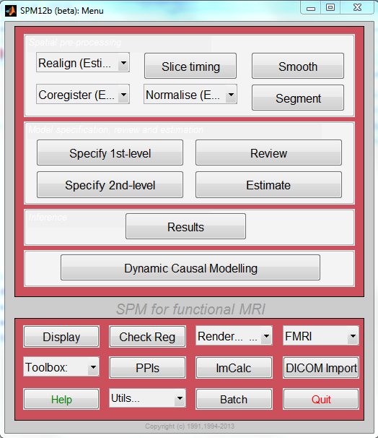
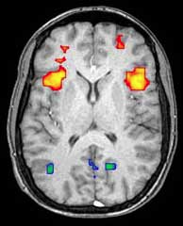
Issues with analysis & interpretation
Marion Oberhuber
& Richard Daws.

Slide 2

Notes:
fMRI is very popular, it is amazing technology. In comparison, the number of papers published using EEG is near negliable. Of interest is the slights rise, which a friend of mine commented that this is due to the combined EEG/fMRI studies.

Slide 3
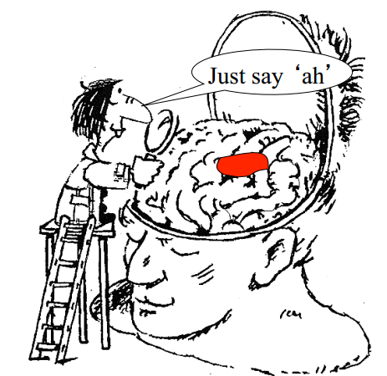
Notes:
This is the ideal situation for neuroscientists,

Slide 4
Recap - Hypothesis testing
H₀: con1 = con2
H_{A}: con1 ≠ con2
The Test Statistic T
Computed at each voxel
Summarises evidence about H₀
Null Distribution of T
⇨ We need to know the distribution of T under the null hypothesis
Notes:
Research question is framed as a hypothesis.
We are testing difference in BOLD signal between two (or more) conditions.

Slide 5
Significance level α
Set a priori (e.g. 0.05)
choose threshold u_{α} to obtain acceptable false positive rate α
u_{α}
α
P-value
A p-value summarises evidence against H₀
This is the chance of observing value more extreme than t under the null hypothesis.
Null Distribution of T
t
P-val
The conclusion about the hypothesis
We reject H₀ in favour of H₁ hypothesis if p(H₀) < u_{α}
Null Distribution of T
Notes:
Threshold u_{α} controls the false positive rate
Test statistic t, a realisation of T
P-value: states probability for test statistics that difference between conditions arose by chance
Is p(H₀)< α i.e. can we reject the H0?

Slide 6
Type I/type II error
Each voxel can be classified as one of four types
 | Truly active | Truly inactive
Declared active | ✔ | Type I error
Declared inactive | Type II error | ✔
False positives u_{β}
False negatives u_{α}
specificity: 1- u_{α}
= proportion of actual negatives which are correctly identified
sensitivity (power): 1- u_{β}
= proportion of actual positives which are correctly identified

Slide 7
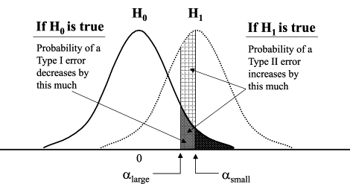
Effect of shifting α
Notes:
Probablility of committing different error types depends on choice of alpha

Slide 8
Multiple comparisons
u_{α}
u_{α}
u_{α}
u_{α}
u_{α}
α
α
t
α
t
t
α
t
α
t
“Using the same threshold for datasets with 10.000 voxels and datasets with 60.000 voxels would mean to accept the same probability/proportion of false positives - cannot be appropriate”
Bennett et al. 2009
“Naive thresholding of 100000 voxels at 5% threshold is inappropriate, since 5000 false positives would be expected in null data”
Nichols et al. 2003
Notes:
fMRI – lots of voxels, lots of t-tests

Slide 9
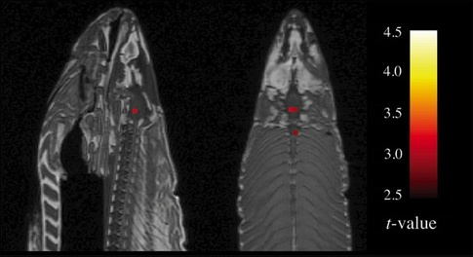
Multiple comparisons
Studies published in 2008 who reported multiple comparisons correction:
NeuroImage 74% of the studies (193/260)
Cerebral Cortex 67.5% (54/80)
Social Cognitive and Affective Neuroscience 60% (15/25)
Human Brain Mapping 75.4% (43/57)
Journal of Cognitive Neuroscience 61.8% (42/68)
Poster sessions less consistent
Bennett 2010
Notes:
Salmon paper Bennett

Slide 10
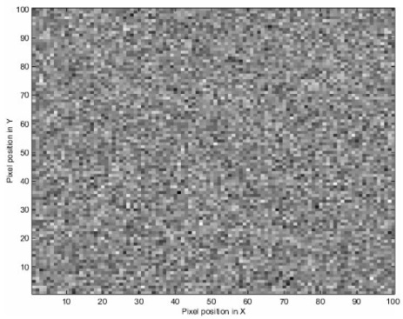
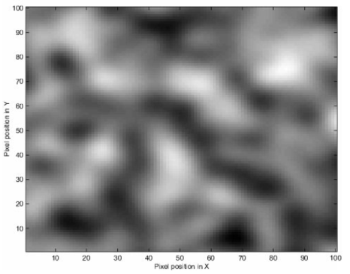
Limiting family-wise-error-rate (FWER)
FWER of 0.05 – 5% chance of 1 or more false positives across the whole set of statistical tests
Bonferroni: α=P^{FWE}/n
Divides desired p-threshold by the number of tests
Assumes spatial independence between voxels
BUT # independent values < # independent voxels
Loss of statistical power
Random Field Theory (RFT): α = P^{FWE} ≒ E[EC]
Applied to smoothed data (Gaussian kernel, FWHM)
Default option when using “corrected p-threshold” in SPM
Notes:
This type of correction prevents Type I error across the whole family of tests you're doing - a familwise error correction, or FWE correction.
Bonferroni: does not take into account spacial correlation between voxels. CONSERVATIVE
Rft: by grouping into Resels we restore independence of data
FEW correction is conservative - most researchers correctly assume there's enough noise in every stage of the process to make a few voxels here and there look active just by chance

Slide 11
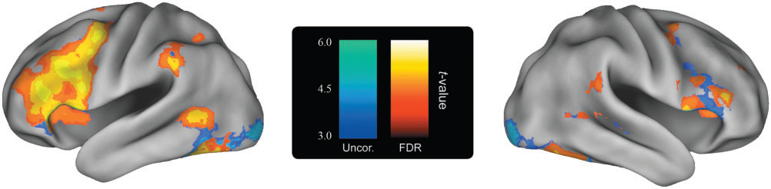
Limiting false discovery rate (FDR)
FDR of 0.05 – no more than 5% of the detected results are false positives (=controlling fraction of false positives)
FDR control adapts to level of signal that is present in the data
Benjamini & Hochberg, 1995
Blue: areas significant under uncorrected threshold of
p < 0.001 with 10 voxel extent criteria.
Orange: corrected threshold of FDR = 0.05.
Bennett 2009
Notes:
We don’t know which voxels might be falsely active, and we don’t know if there are any – but it’s not more than 5%.
BIG advantage of FDR is that is adapts to the level of signal present in the data (independent of number of voxels or smoothness). With small signal, the correction is very liberal. With huge signal, it's relatively more severe.
Not the point to make correction for corrections sake – but to be aware what the false positive rate is

Slide 12
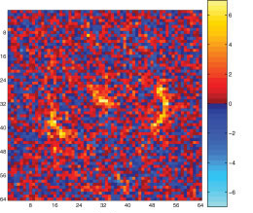
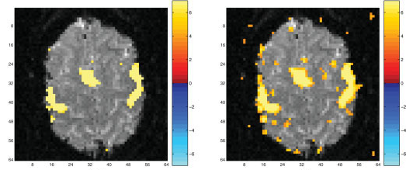
Raw data
Bonferroni correction (2 voxel FWHM gaussian kernel)
FDR correction
Logan et al., 2008
a. b. c.

Slide 13
Multiple comparisons correction
Large volume of imaging data
Multiple comparison problem
Mass univariate analysis
Uncorrected p value
FWER CORRECTION
FDR CORRECTION
Bonferroni
Corrected p value
FDR
Less conservative than FWE
Better balance between multiple comparisons correction and statistical power
Too many false positives
Never use this.
RFT
Corrected p value
Simultaneous correction
Control probablility of EVER reporting false positives
Selective correction
Control proportion of false positives
Notes:
RF methods are good for highly-smoothed data only and are best for single-subject data.
For unsmoothed (or low-smoothed), single-subject data, FDR corrections are the best. They have very high sensitivity while still providing good control of false positives, even with low degrees of freedom.

Slide 14
The “costs” of focussing on controlling type I error
  Increased Type II errors
  Bias towards studying large effects over small
  Bias towards sensory/motor processes rather than complex cognitive/affective processes
  Deficient meta-analyses
  Liebermann 2009
Notes:
Unintended negative consequences of “single-minded devotion” to avoiding Type I errors
Measures to control Type I errore increase disproportionally the type II error in studies on higher order cognitive processes
Liebermann et al. argue that making type II error is far from being catastrophic and more useful for a young discipline such as neuroscience

Slide 15
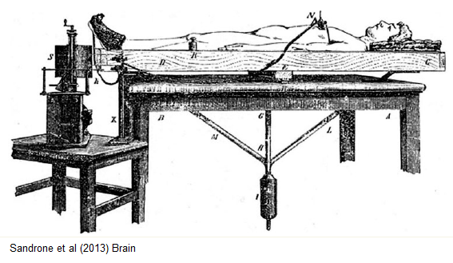
It’s all about balance…
Larger # of subjects/scans
Taking replication and meta-analyses into account
Careful designing of tasks
  Liebermann 2009

Slide 16
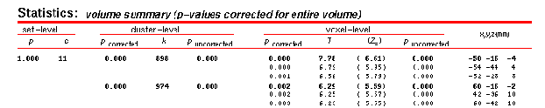
Ways of assessing statistic images

Slide 17
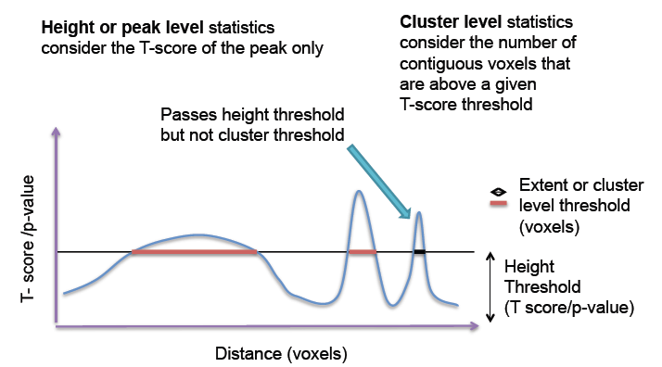
Notes:
Voxel level inference gives best spatial specifity. H0 at specific voxel can be rejected
Cluster based thresholding most commonly used. Not correcting for false positives at voxel level but at cluster level. 2step process:
1) Voxel level primary threshold defines clusters 2) cluster-level extent threshold measures units of activated voxels (controls for FWER, i.e. less stringent than voxel based multiple comparison correction – accounts for the fact that individual voxel activations are not spatially independent from neighbours). Better sensitivity but worse spatial specifity

Slide 18
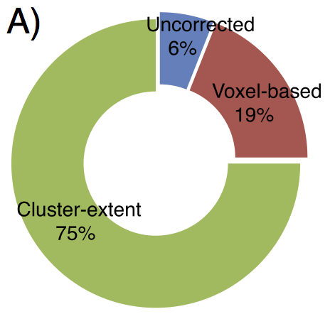
Cluster-Extent Based Thresholding
Woo et al., 2013

Slide 19
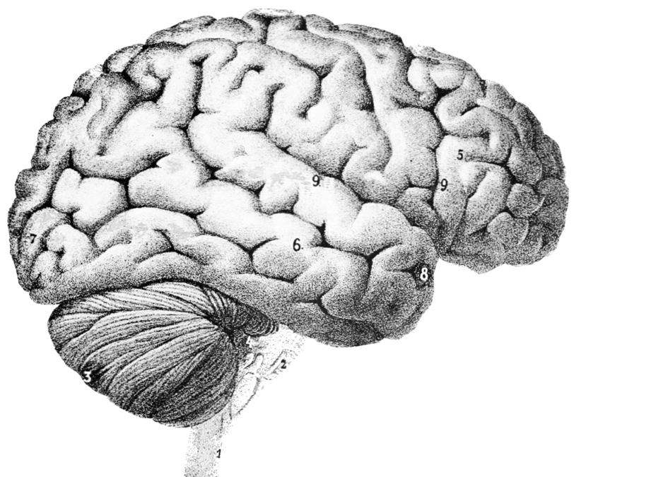
Woo et al., 2013
Notes:
When rejecting Ho, we can only say “somewhere” in that cluster is activation – Problematic if primary voxel level threshold to define clusters is liberal (e.g. p<0.01!)…then clusters are big!
Large clusters that span multiple anatomical regions provide us with poor spatial resolution and neuroscientific interpretability (readers might believe activation is present in ALL voxels but there is high number of false positives!
).

Slide 20
Some suggestions
Think about choice of thresholding method (cluster extent based thresholding good if moderate effect/sample size. For studies with good power voxel-wise corrections such as FWER and FDR better)
Primary threshold
Reporting strategies
Lower threshold as default in analysis packages
Woo et al., 2013

Slide 21
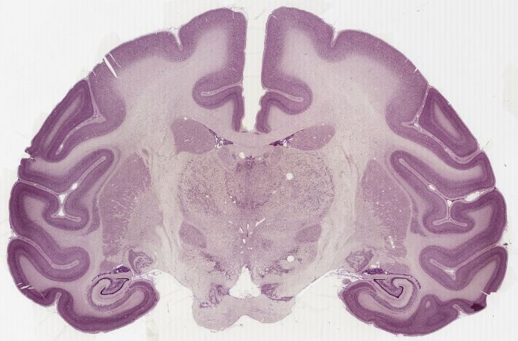
Notes:
What is a voxel? This monkey brain to show an example of the scale of voxels used in MRI acquisition.

Slide 22
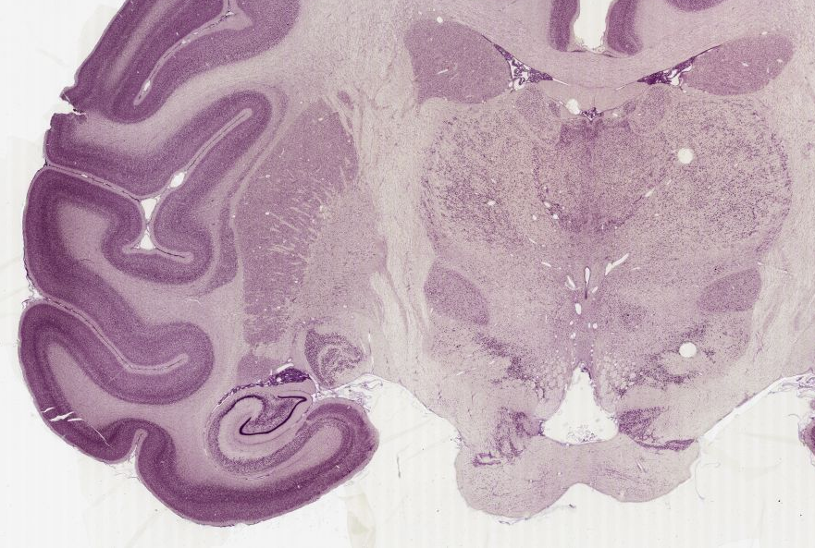

Slide 23
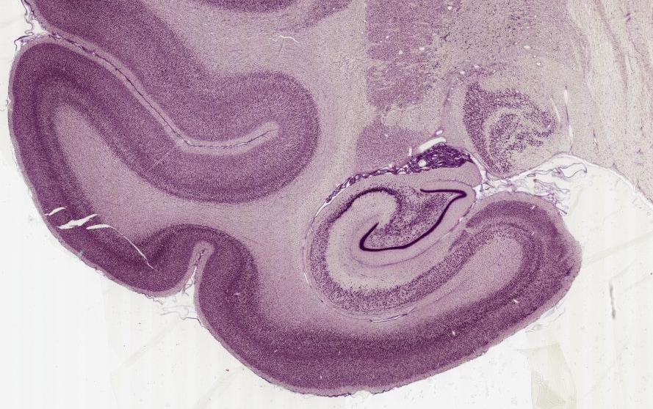

Slide 24
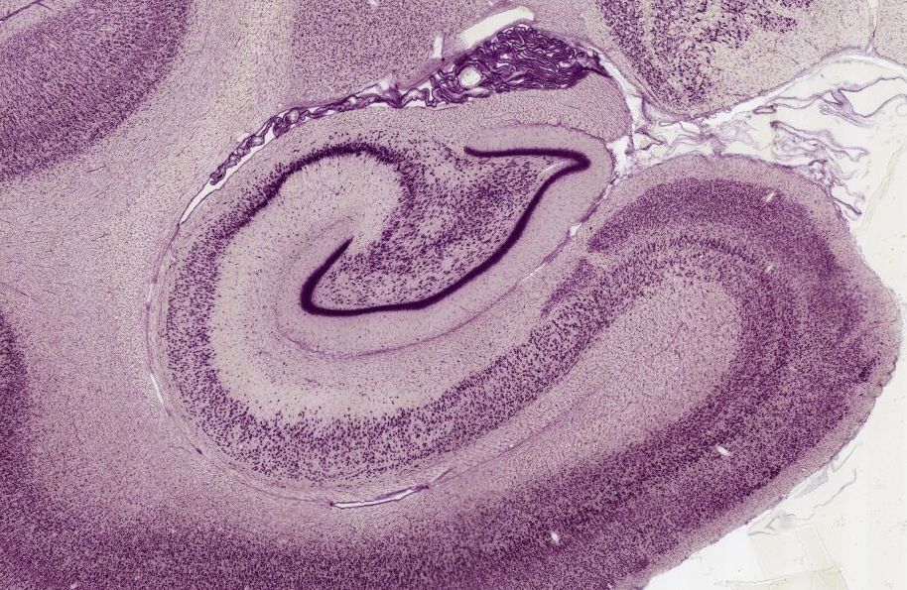
Notes:
If we zoom into the hippocampus

Slide 25
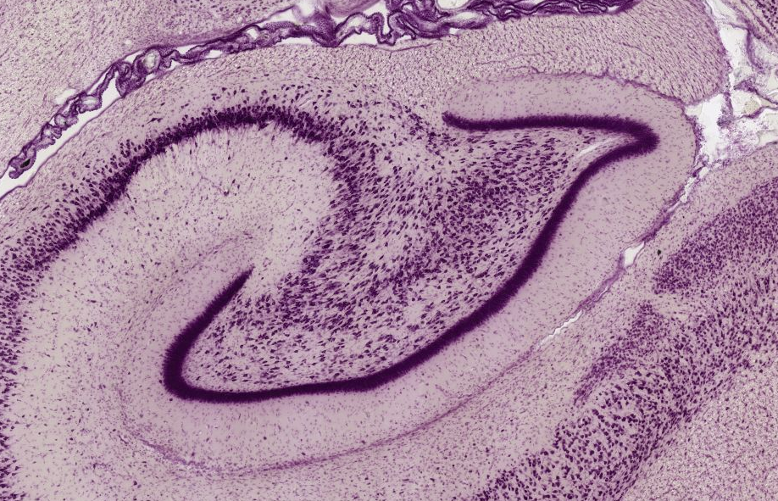

Slide 26
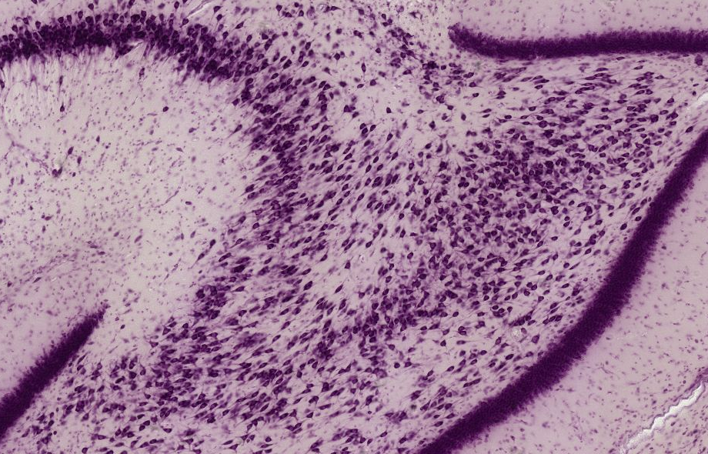

Slide 27
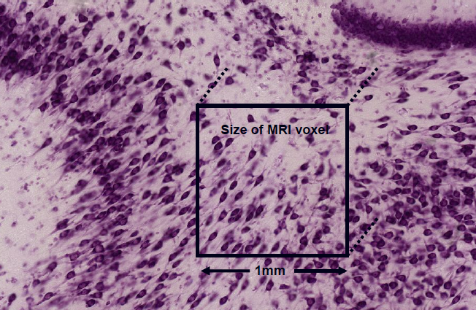
3mm fMRI Voxel
Notes:
This relates to a structural image voxel, however a functional voxel is typically much bigger and in the region of 3mm in width. Clearly we are looking at mass action of neuronal populations.

Slide 28
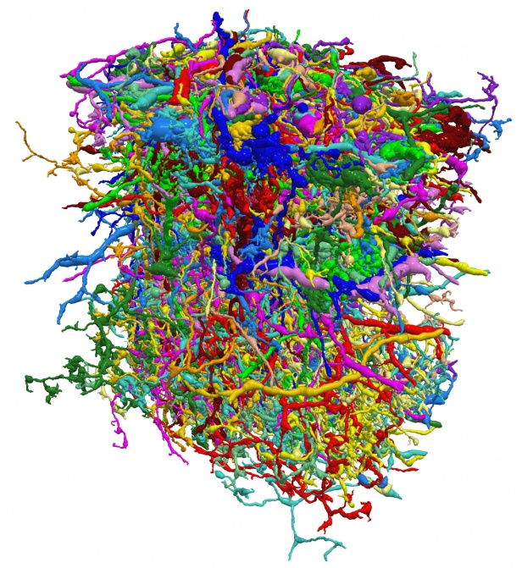
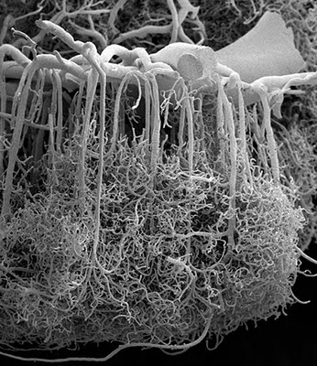
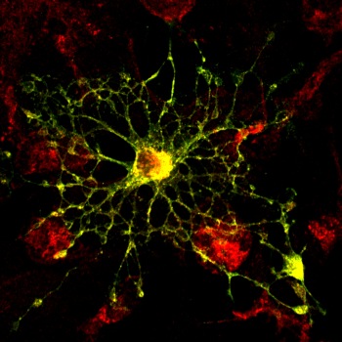
What is inside an fMRI Voxel?
Neurones:
~630,000
~4 x Glial cells:
3 mm
Blood Vessels
3 mm
3 mm
http://miny.ir/EAaZv
Notes:
We already know that what we are measuring but the point here is to remind you that what we measure is the result of a complicated metabolic process and that a voxel is representing the mass action of not just neuronal populations but a large number of supporting cells aswell.
But this sort of detail is like reading a newspaper with a microscope, so lets zoom out a little bit

Slide 29
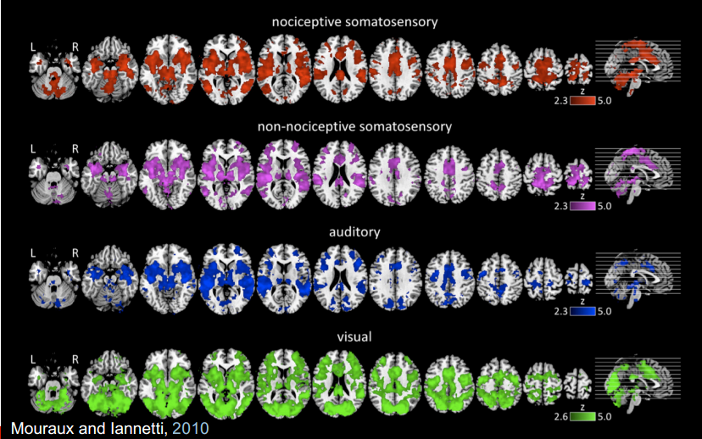
What are we seeing?
Notes:
This highlights the importance of hypothesis testing. This figure is taken from a paper investigating the pain matrix
Each of these four colours represents brain activations evoked from four different stimuli. Can you tell me which is a response evoked from a painful stimuli?
Painful stimuli
Non painful tactile
Auditory
Visual
How does a relatively static anatomical structure perform so many different functions?
Drives home the importance of what Marion was saying about clearly defining your hypotheses because it is your hypothesis that contextualise your brain activations.

Slide 30
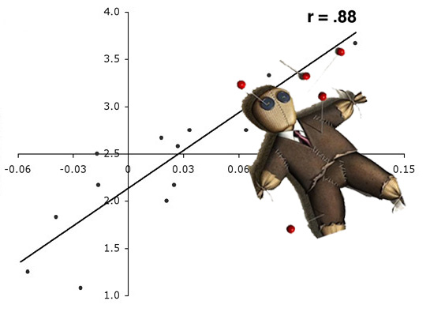
Non-independent selective analysis
Testing H1
2. Find an active region
3. Draw a ROI around
activation
Perform Secondary
Statistical Analysis
5. Correlate with task
Associated beh. measure
Vul et al. (2009); Kriegeskorte et al. (2010)
Notes:
What to do now you have your blob maps? A lot of groups have gone ahead and tried to model the relationship between the strength of activation and a behavioural measure.
So they
1
2
3
4
5 – In our pain example, we could use pain intensity, for example.
This has almost always lead to double dipping.

Slide 31
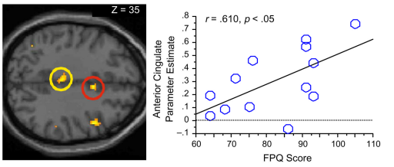
Double dipping / Non-independent selective analysis.
Non-Independent analysis: Activations presented on a blob map are voxels that already correlate with your model!
Computing secondary statistics on active voxels is problematic due to intrinsic noise favouring the correlation.
Double dipping gives the illusion of providing an extra result.
Resulting scatter plot is biased, inflated and cannot inform of the true neuronal relationship, if one exists.
Vul et al. (2009)
Ochsner et al. (2006)
Notes:
So why is this method bad?
Activations from every voxel are present because they have a certain t-statistic score that passes a certain threshold multiple comparison correction. Anything present, including noise, favours the correlation.
Due to this inherent noise you’re secondary correlational analyses are going to represent largely inflated r scores.
Next slide

Slide 32
How have so many double dipping papers been published?
Eisenberger, N.I., Lieberman, M.D., & Williams, K.D. (2003). Does rejection hurt? An FMRI
study of social exclusion. Science, 302, 290-292.
Hooker, C.I., Verosky, S.C., Miyakawa, A., Knight, R.T., & D'Esposito, M. (2008). The
influence of personality on neural mechanisms of observational fear and reward learning.
Neuropsychologia, 466(11), 2709-2724.
Takahashi, H., Matsuura, M., Yahata, N., Koeda, M., Suhara, T., & Okubo, Y. (2006). Men
and women show distinct brain activations during imagery of sexual and emotional in.delity.
Neuroimage, 32, 1299-1307.
Canli, T., Amin, Z., Haas, B., Omura, K., & Constable, R.T. (2004). A double dissociation
between mood states and personality traits in the anterior cingulate. Behavioral Neuroscience,
118, 897-904.
Canli, T., Zhao, Z., Desmond, J.E., Kang, E., Gross, J., & Gabrieli, J.D.E. (2001). An fMRI
study of personality influences on brain reactivity to emotional stimuli. Behavioral
Neuroscience, 115, 33-42.
Eisenberger, N.I., Lieberman, M.D., & Satpute, A.B. (2005). Personality from a controlled
processing perspective: an fMRI study of neuroticism, extraversion, and self-consciousness.
Cognitive, Affective & Behavioral Neuroscience, 5, 169-181.
Takahashi, H., Kato, M., Matsuura, M., Koeda, M., Yahata, N., Suhara, T., & Okubo Y.(2008). Neural correlates of human virtue judgment. Cerebral Cortex, 18(9), 1886-1891.
Sander, D., Grandjean, D., Pourtois, G., Schwartz, S., Seghier, M.L., Scherer, K.R., &
Vuilleumier, P. (2005). Emotion and attention interactions in social cognition: Brain regions
involved in processing anger prosody. Neuroimage, 28, 848–858.
Najib, A., Lorberbaum, J.P., Kose, S., Bohning, D.E., & George, M.S. (2004). Regional brain
activity in women grieving a romantic relationship breakup. American Journal of Psychiatry,161, 2245–2256.
Amin, Z., Constable, R.T., & Canli, T. (2004). Attentional bias for valenced stimuli as afunction of personality in the dot-probe task. Journal of Research in Personality, 38(1), 15-23.
Ochsner, K.N., Ludlow, D.H., Knierim, K., Hanelin, J., Ramachandran, T., Glover, G.C., &
Mackey, S.C. (2006). Neural correlates of individual differences in pain-related fear and
anxiety. Pain, 120, 69-77.
Goldstein, R.Z., Tomasi, D., Alia-Klein, N., Cottone, L.A., Zhang, L., Telang, F., & Volkow,
N.D. (2007a). Subjective sensitivity to monetary gradients is associated with frontolimbic activation to reward in cocaine abusers. Drug and Alcohol Dependence, 87(2–3), 233-240.
...

Slide 33
Vul et al. (2009):
Why is this overwhelming trend present in fMRI?
This sort of analysis would not be tolerated in behavioural science papers.
This overwhelming trend in fMRI is/was a new technique.
Reviewers unfamiliarity with the techniques & complexity of the analyses.
Notes:
Wrote the Puzzlingly High correlations paper
They say...
Now that these statistical errors have been highlighted, you would dearly struggle to publish a paper using this non-independent method.

Slide 34
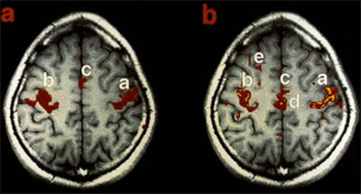
Resting state fMRI
It’s free-thinking, not rest.
Consistent Instructions.
Task hangover effects.
Method reviews
Murphy et al. (2013)
Duncan et al. (2012)
Biswal et al. (1995)
Notes:
So far we have been talking about task-based fMRI were we explicitly provoke a response with a stimulus of some kind. However we resting state fMRI, there are slightly different things to consider when critiquing papers.
In brief, resting state fMRI allows an exploration of functional connectivity between spatially segregated regions of the cortex. It exploits an interesting phenomena of the brain first reported in the mid 90’s by Biswal, where spontaneous fluctuations of the BOLD signal were found to temporally correlate between regions that typical show functional cooperation during tasks. For example the BOLD signal was found to be temporally correlated between the L and R precentral gyrus and the supplementary motor cortex at rest.
However, the name resting state is slightly misleading because the subject is just there in the scanner staring at a fixation cross. Your thoughts are allowed to wonder, so one subject particularly anxious about being in the scanner, or another particularly hungry is not exactly showcasing a brain at rest. I, and others, would argue that Free-thinking fMRI is more appropriate.
When reading your papers, do the authors inform you of the order of task-based vs. Free-thinking acquisition? Previously, the rest session was normally acquired after the task data this introduces the concept of prior task hangover effects, where for example, scary or disturbing stimuli is presented before the free thinking acquisition.

Slide 35
General things to bear in mind
What was the H1?
Is the task appropriate for the H1?
How many people involved?
Acquisition.
Do the findings allow an appropriate discussion?
Notes:
What are they trying to address with functional imaging?
Does the task really provide the means to tap into the cognitive phenomenon under question?
Are their enough people involved, or were the studies groups appropriately defined and selected for?
Is the acquisition appropriately set up to model the BOLD signal? E.g. Appropriate slice thickness
Is the data being appropriately interpreted? Do the results stand up to the authors interpretation?

Slide 36
All models are wrong,
but some are useful.
George Box
Notes:
The results of a study should be appropriately contextualised by the limitations of its methods. This helps to prevent going beyond data’s explanatory power during your interpretations.

Slide 37
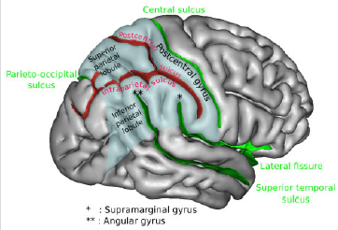
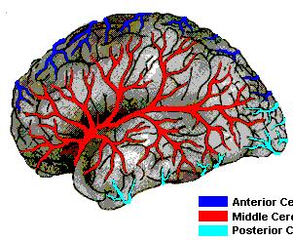
Emily Martin
Asks, ‘Why has the blood gone missing?’
She criticises neuroscientists using fMRI for not providing enough emphasis on blood flow.
She argues the importance of neurovasculature being considered a part the brain
.
Martin (2013)
Notes:
The bottom left of the slide is the typical image presented in cognitive neuroscience textbooks and indeed in papers this is the sort brain presented to us. Yet in reality, the brain looks more like the image on the right. Emily Martin asks, why is this? What’s happened to the blood in neuroscience?
She insists that the neurovasculature of the brain is not being appropriately considered in neuroscience. I’m not sure how much I agree with this, but I think she does make an interesting point.

Slide 38
Emily Martin interviewing anon Neuroscientist
EM: [Why is it that 999 out of 1,000 pictures of the brain don’t show anything about the blood?]
Neuroscientists couldn’t care less about the blood.
EM: [Why not?]
If you were to show pictures of a city and all of the things taking place – the mayor’s office, the policemen’s office, the schools, all the activities everybody is doing that make up the sort of neural network of the city – would you show the water supply and the sewer supply?
Notes:
For example an interview with a neuroscientist

Slide 39

Media

Slide 40
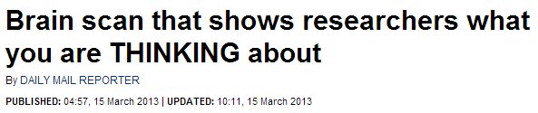
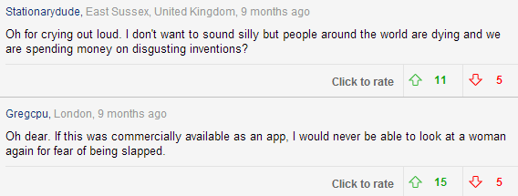
Notes:
Daily Mail search using the word ‘Brain’ brings up an array of articles that would even trouble an undergraduate.
I like to think of published, peer reviewed, papers as the news for the everyday scientist. The job of a paper is to report the reason, method and importance of an experiment in a comprehensive and transparent nature.
I have definitely read many papers that have gone way over my head. As beneficiaries of public money, we are duty bound to openly disseminate the findings of our research in order to improve the world we live in
A journalist has to boil down all of the information that appropriately contextualises and frames the results and interpretations of the experiment in order to produce a headline. They want things that are easy to report like, “The God Spot”, in the brain. Of course we now that the assumptions of a spot in the brain paints a mal-informed picture. The brain is not made up of various islands, no region performs computations in isolation . The field is moving from a functional localisationist approach to a connectionist approach.

Slide 41
Just like every fMRI experiment, every media article on “neuro – X” should come with a caveat.
Especially if printed by the mail...

Slide 42
Thank you for your attention…
And thanks to Tom FitzGerald!

Slide 43
References
Bennett, C. M., Wolford, G. L. and Miller, M. B. (2009). "The principled control of false positives in neuroimaging." Soc Cogn Affect Neurosci 4(4): 417-422.
Lieberman, M. D. and Cunningham, W. A. (2009). "Type I and Type II error concerns in fMRI research: re-balancing the scale." Soc Cogn Affect Neurosci 4(4): 423-428.
Logan, B. R., Geliazkova, M. P. and Rowe, D. B. (2008). "An evaluation of spatial thresholding techniques in fMRI analysis." Hum Brain Mapp 29(12): 1379-1389.
Nichols & Hayasaka (2003), "Controlling the familywise error rate in functional neuroimaging: a comparative review," Statistical Methods in Medical Research 12, 419-446
Woo, C. W., Krishnan, A. and Wager, T. D. (2014). "Cluster-extent based thresholding in fMRI analyses: Pitfalls and recommendations." Neuroimage.
Previous MfD slides
http://imaging.mrc-cbu.cam.ac.uk/imaging/PrinciplesMultipleComparisons
Calculating contents of fMRI voxel http://miny.ir/EAaZv
Biswal, B., Zerrin Yetkin, F., Haughton, V. M., & Hyde, J. S. (1995). Functional connectivity in the motor cortex of resting human brain using echo‐planar mri.Magnetic resonance in medicine, 34(4), 537-541.Martin (2013) Blood and the Brain. J Royal Anthropological Institute
PracticalfMRI.blogspot.co.uk
Mouraux A, Diukova A, Lee MC, Wise RG, Iannetti GD. A multisensory investigation of the functional significance of the "pain matrix". Neuroimage. 2011 Feb 1;54(3):2237-49.
Murphy, K., Birn, R. M., & Bandettini, P. A. (2013). Resting-state FMRI confounds and cleanup. NeuroImage.
Ochsner, K. N., Ludlow, D. H., Knierim, K., Hanelin, J., Ramachandran, T., Glover, G. C., & Mackey, S. C. (2006). Neural correlates of individual differences in pain-related fear and anxiety. Pain, 120(1), 69-77.
Vul, E., Harris, C. R., Winkielman, P., Pashler, H. (2009) Puzzingly high correlations in fMRI studies of emotion, personality, and social cognition. Perspectives on Psychological Science, 4(3), 274-290.

