Slide 1
EEG / MEG:
Experimental Design & Preprocessing
Denisa Jamecna
Sofie Meyer
(Archy de Berker(

Slide 2
Outline
Experimental Design
fMRI M/EEG
Analysis
  Oscillatory activity
  EP
Design
Inferences
Limitations
Combined Measures
Preprocessing in SPM12
Data Conversion
Montage Mapping
Epoching
Downsampling
Filtering
Artefact Removal
Referencing

Slide 3
Combining Techniques- Why?
Converging evidence
  Combination of different information from different experiments
Notes:
Converging evidence
This is simply the combination of different information originating from different experiments, and possibly different fields, to permit better interpretation. A vast majority of studies use converging evidence within modalities, but also across modalities
Generative models
The most ambitious and possibly most fruitful direction is to establish generative models for which parameters are estimated from data of different nature or provenance
correlate something happening in eeg something happening in fmri
eg. gamma oscilations
-use fmri data as a prior for eeg study
prior for source localisation
I go from here

Slide 4
Combining Techniques- Why?
Converging evidence
  Combination of different information from different experiments
Generative models
  Establish generative models for which parameters are estimated from data of different nature.
    Using fMRI data as a prior for MEG source reconstruction
    Or M/EEG as regressors for fMRI….
Notes:
Converging evidence
This is simply the combination of different information originating from different experiments, and possibly different fields, to permit better interpretation. A vast majority of studies use converging evidence within modalities, but also across modalities
Generative models
The most ambitious and possibly most fruitful direction is to establish generative models for which parameters are estimated from data of different nature or provenance
correlate something happening in eeg something happening in fmri
eg. gamma oscilations
-use fmri data as a prior for eeg study
prior for source localisation
I go from here

Slide 5
Combining Techniques
fMRI & M/EEG are complimentary
BOLD activity can occur without M/EEG.
Notes:
Different kind of information
-BOLD activity can occur without EEG or MEG activity (MEG/EEG silent sources). Specific spatial configurations of the cells or of the sources may annihilate signals at the surface of the scalp. Electric signal synchronization is needed for MEG/EEG detection, but not necessarily for BOLD detection.
-MEG/EEG activity can occur in the absence of BOLD activity (fMRI silent sources) because synchronization may not necessarily consume enough energy to be seen in BOLD.
-The two activities are not necessarily spatially congruent. Many studies have found discrepancies between EEG dipolar localization and fMRI (in Bagshaw et al., 2005, up to 60 mm, but see also the differences reported for the early SI response in Kober et al., 2001; Stippich et al., 1998). These values can be regarded as alarmingly large in the first instance. However, the discrepancy can potentially be caused not only by the variability in the cell types and neuronal activities producing each particular signal of interest, but also by the approximate modeling of dipolar activities.
M/EEG – increased resolution - improved localization is due to the different properties of the two imaging modalities (rather than number of channels)
meg eeg the same or not?
Simultaneous acquisition or not
Cost.

Slide 6
Combining Techniques
fMRI & M/EEG are complimentary
BOLD activity can occur without M/EEG.
M/EEG activity can occur in the absence of BOLD
Notes:
Different kind of information
-BOLD activity can occur without EEG or MEG activity (MEG/EEG silent sources). Specific spatial configurations of the cells or of the sources may annihilate signals at the surface of the scalp. Electric signal synchronization is needed for MEG/EEG detection, but not necessarily for BOLD detection.
-MEG/EEG activity can occur in the absence of BOLD activity (fMRI silent sources) because synchronization may not necessarily consume enough energy to be seen in BOLD.
-The two activities are not necessarily spatially congruent. Many studies have found discrepancies between EEG dipolar localization and fMRI (in Bagshaw et al., 2005, up to 60 mm, but see also the differences reported for the early SI response in Kober et al., 2001; Stippich et al., 1998). These values can be regarded as alarmingly large in the first instance. However, the discrepancy can potentially be caused not only by the variability in the cell types and neuronal activities producing each particular signal of interest, but also by the approximate modeling of dipolar activities.
M/EEG – increased resolution - improved localization is due to the different properties of the two imaging modalities (rather than number of channels)
meg eeg the same or not?
Simultaneous acquisition or not
Cost.

Slide 7
Combining Techniques
fMRI & M/EEG are complimentary
BOLD activity can occur without M/EEG.
M/EEG activity can occur in the absence of BOLD
Spatial incongruence
Notes:
Different kind of information
-BOLD activity can occur without EEG or MEG activity (MEG/EEG silent sources). Specific spatial configurations of the cells or of the sources may annihilate signals at the surface of the scalp. Electric signal synchronization is needed for MEG/EEG detection, but not necessarily for BOLD detection.
-MEG/EEG activity can occur in the absence of BOLD activity (fMRI silent sources) because synchronization may not necessarily consume enough energy to be seen in BOLD.
-The two activities are not necessarily spatially congruent. Many studies have found discrepancies between EEG dipolar localization and fMRI (in Bagshaw et al., 2005, up to 60 mm, but see also the differences reported for the early SI response in Kober et al., 2001; Stippich et al., 1998). These values can be regarded as alarmingly large in the first instance. However, the discrepancy can potentially be caused not only by the variability in the cell types and neuronal activities producing each particular signal of interest, but also by the approximate modeling of dipolar activities.
M/EEG – increased resolution - improved localization is due to the different properties of the two imaging modalities (rather than number of channels)
meg eeg the same or not?
Simultaneous acquisition or not
Cost.

Slide 8
Combining Techniques - remember
fMRI & M/EEG are complimentary
BOLD activity can occur without M/EEG.
M/EEG activity can occur in the absence of BOLD
Spatial incongruence
Play to their strengths!
Notes:
Different kind of information
-BOLD activity can occur without EEG or MEG activity (MEG/EEG silent sources). Specific spatial configurations of the cells or of the sources may annihilate signals at the surface of the scalp. Electric signal synchronization is needed for MEG/EEG detection, but not necessarily for BOLD detection.
-MEG/EEG activity can occur in the absence of BOLD activity (fMRI silent sources) because synchronization may not necessarily consume enough energy to be seen in BOLD.
-The two activities are not necessarily spatially congruent. Many studies have found discrepancies between EEG dipolar localization and fMRI (in Bagshaw et al., 2005, up to 60 mm, but see also the differences reported for the early SI response in Kober et al., 2001; Stippich et al., 1998). These values can be regarded as alarmingly large in the first instance. However, the discrepancy can potentially be caused not only by the variability in the cell types and neuronal activities producing each particular signal of interest, but also by the approximate modeling of dipolar activities.
M/EEG – increased resolution - improved localization is due to the different properties of the two imaging modalities (rather than number of channels)
meg eeg the same or not?
Simultaneous acquisition or not
Cost.

Slide 9
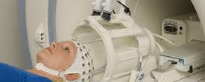
Simultaneous EEG/FMRI

Slide 10
Simultaneous EEG/FMRI
Interleaved / continuous

Slide 11
Simultaneous EEG/FMRI
Interleaved / continuous
Setup
  Silver chloride / gold electrodes
  Thin carbon fibre / copper wires
  Digitize, then use fibre-optic cable

Slide 12
Simultaneous EEG/FMRI
Interleaved / continuous
Setup
  Silver chloride / gold electrodes
  Thin carbon fibre / copper wires
  Digitize, then use fibre-optic cable
Precise localisation of unusual EEG events e.g. interictal events in epilepsy

Slide 13
Technical M/EEG Considerations
Amplifier and filter settings
  50 Hz Notch
  Gain of 10 000
Notes:
impedance of the skull
MEG
-Faraday cage
-Shield from any external electric charges that could interfere with the magnetic signal
-Practically like fMRI, anything magnetic should be removed, otherwise it

Slide 14
Technical M/EEG Considerations
Amplifier and filter settings
  50 Hz Notch
  Gain of 10 000
Sampling frequency
Notes:
impedance of the skull
MEG
-Faraday cage
-Shield from any external electric charges that could interfere with the magnetic signal
-Practically like fMRI, anything magnetic should be removed, otherwise it

Slide 15
Outline
Experimental Design
fMRI M/EEG
Analysis
  Oscillatory activity
  EP
Design
Inferences
Limitations
Combined Measures
Preprocessing in SPM12
Data Conversion
Montage Mapping
Epoching
Downsampling
Filtering
Artefact Removal
Referencing

Slide 16
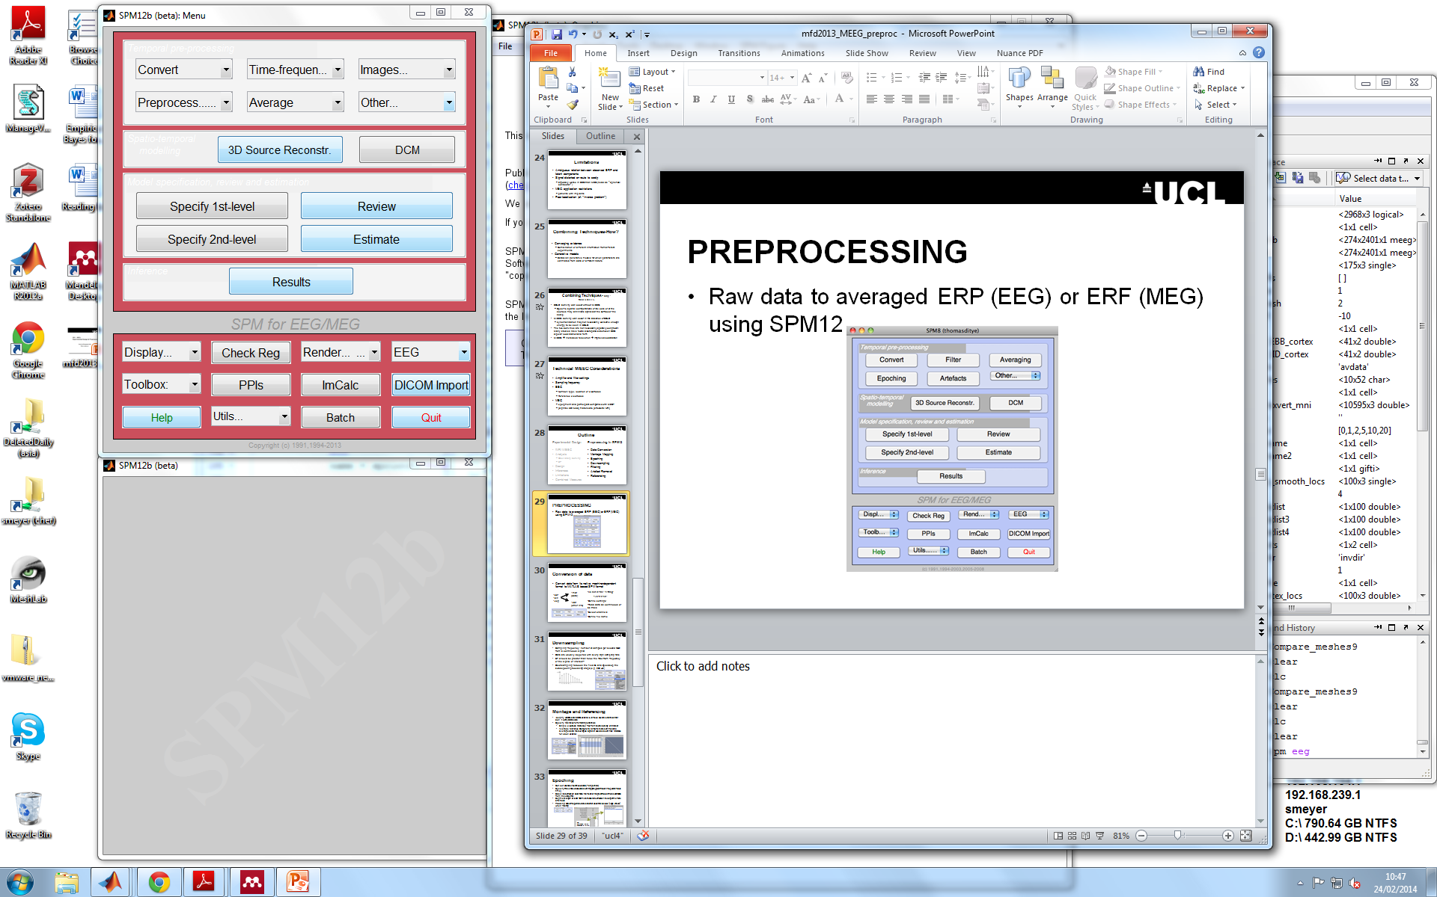
PREPROCESSING
Goal: get from raw data to averaged ERP (EEG) or ERF (MEG) using SPM12

Slide 17
Conversion of data
Convert data from its native machine-dependent format to MATLAB based SPM format
*.mat
(data)
*.bdf
*.bin
*.eeg
*.dat
(other info)
Notes:
‘Just read’: without questions-spm converts whole dataset preserving as much data as possible
‘yes’: controlling features of conversion
Is machine-dependent data already divided into trials/conditions?
Refining number and type of channels needed for further processing

Slide 18
Conversion of data
Define settings:
  Read data as continuous or as trials (is raw data already divided into trials?)
  Select channels
  Define file name
  Don’t opt for ‘just read’
Notes:
‘Just read’: without questions-spm converts whole dataset preserving as much data as possible
‘yes’: controlling features of conversion
Is machine-dependent data already divided into trials/conditions?
Refining number and type of channels needed for further processing

Slide 19
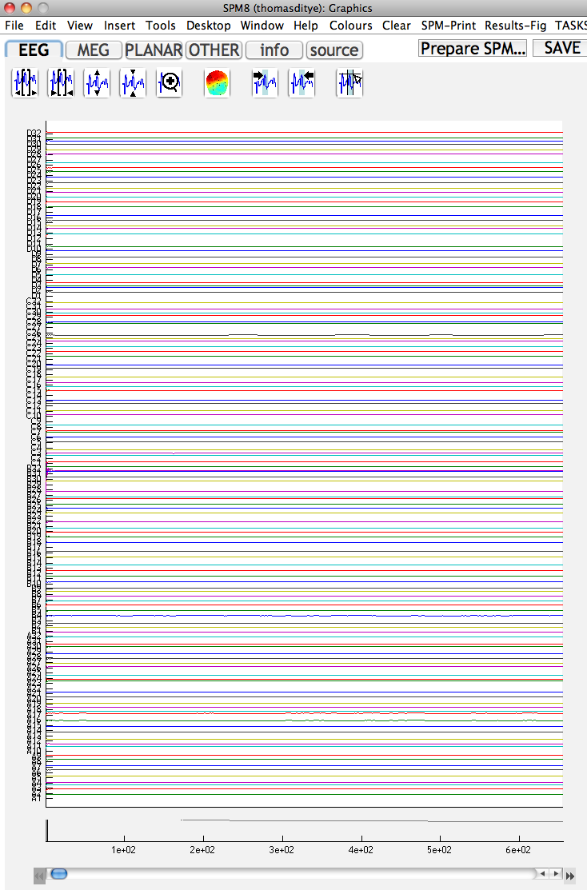
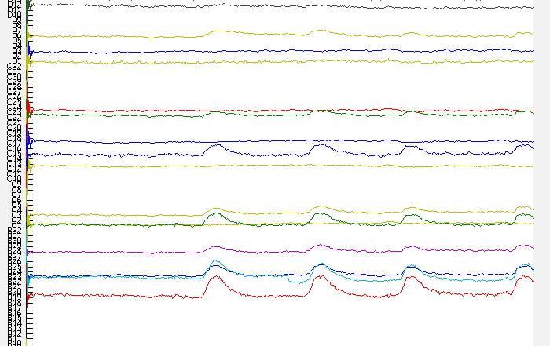
Example
128 channels selected
Unusually flat because data contain very low frequencies and baseline shifts
Viewing all channels only with a low gain
*.mat (data)
*.dat (other info)
Notes:
‘Just read’: without questions-spm converts whole dataset preserving as much data as possible
‘yes’: controlling features of conversion
Is machine-dependent data already divided into trials/conditions?
Refining number and type of channels needed for further processing

Slide 20
Downsampling
Sampling frequency: very high at acquisition (e.g. 2048 Hz)
Sampling Frequency > 2 x maximum frequency of the signal of interest = The Nyquist frequency
Notes:
Useful if data acquired at higher sampling rate than one needs for making inferences about low-frequency components, for example, resampling from 1000Hz to 200 Hz = reduction of 20%
Sampling at high frequencies necessary to get good quality digital conversions of analogue signals
Nyquist frequency: minimum sampling frequency needs to be greater than twice the maximum frequency of any analogue signal likely to be present in the EEG.
New sampling rate must be smaller than original value!
Graph right bottom: example for good sampling frequency, each dot is recording of value of the wave (at different time points)

Slide 21
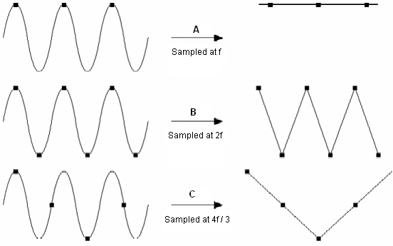

Slide 22
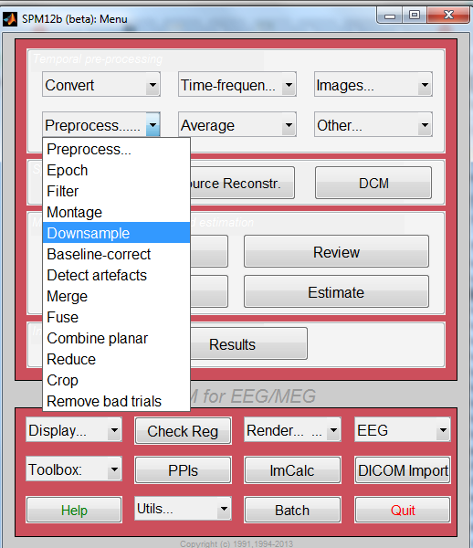
Downsampling
Downsampling reduces the file size and speeds up the subsequent processing steps
e.g. 1000 to 200 Hz.
Notes:
Useful if data acquired at higher sampling rate than one needs for making inferences about low-frequency components, for example, resampling from 1000Hz to 200 Hz = reduction of 20%
Sampling at high frequencies necessary to get good quality digital conversions of analogue signals
Nyquist frequency: minimum sampling frequency needs to be greater than twice the maximum frequency of any analogue signal likely to be present in the EEG.
New sampling rate must be smaller than original value!
Graph right bottom: example for good sampling frequency, each dot is recording of value of the wave (at different time points)

Slide 23
Montage and Referencing
Identify vEOG and hEOG channels, remove several channels that don’t carry EEG data.
Notes:
Vertical and horizontal electrooculogram
Refine the number and types of chanels used for further processing
average reference: “virtual electrode”; less susceptible to bias; used for source analysis and DCM is it better?
Single electrode reference: e.g. behind the ear, nose
Graph right bottom: review channel mapping

Slide 24
Montage and Referencing
Identify vEOG and hEOG channels, remove several channels that don’t carry EEG data.
Specify reference for remaining channels:
  Single electrode reference: free from neural activity of interest
  Average reference: Output of all amplifiers are summed and averaged and the averaged signal is used as a common reference for each channel, like a virtual electrode and less biased
Notes:
Vertical and horizontal electrooculogram
Refine the number and types of chanels used for further processing
average reference: “virtual electrode”; less susceptible to bias; used for source analysis and DCM is it better?
Single electrode reference: e.g. behind the ear, nose
Graph right bottom: review channel mapping

Slide 25
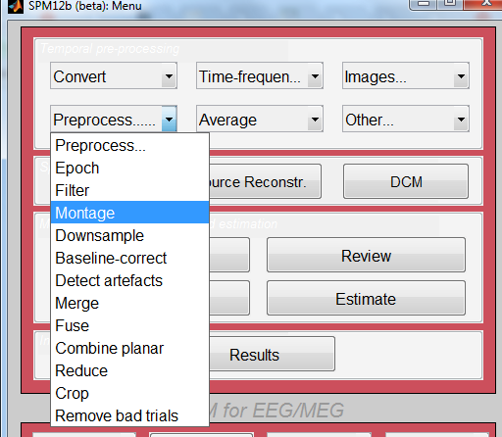
Montage and Referencing
Notes:
Vertical and horizontal electrooculogram
Refine the number and types of chanels used for further processing
average reference: “virtual electrode”; less susceptible to bias; used for source analysis and DCM is it better?
Single electrode reference: e.g. behind the ear, nose
Graph right bottom: review channel mapping

Slide 26
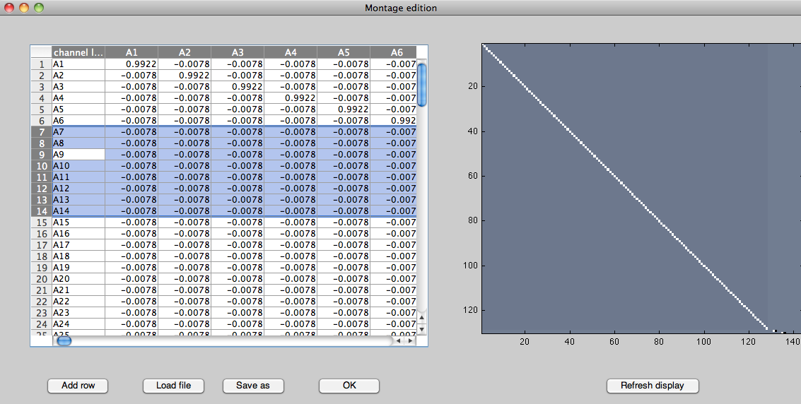
Montage and Referencing
Review channel mapping
Notes:
Vertical and horizontal electrooculogram
Refine the number and types of chanels used for further processing
average reference: “virtual electrode”; less susceptible to bias; used for source analysis and DCM is it better?
Single electrode reference: e.g. behind the ear, nose
Graph right bottom: review channel mapping

Slide 27
Epoching/splitting into single trials
Cut out chunks of continuous data (= single trials, referenced to stim onset)
EEG1
EEG2
EEG3
Event 1
Event 2
Notes:
Epoching splits the data into single trials, each referenced to stimulus presentation
For each stimulus onset, the epoched trial starts at some user-specified pre-stimulus time and ends at some post-stimulus time, e.g. from 100 ms before to 600ms after stimulus presentation.
The longer interval, the greater chance to include artefacts!
Padding: will add time points before and after each trial to allow the user to later cut out this padding again
filter all data and then epoch it to avoid edge effect
(longer trials .e.g. -300 to 1s is the interst? do -500 to 2s)
high pass and then low pass

Slide 28
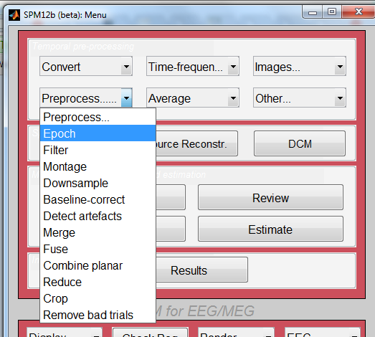
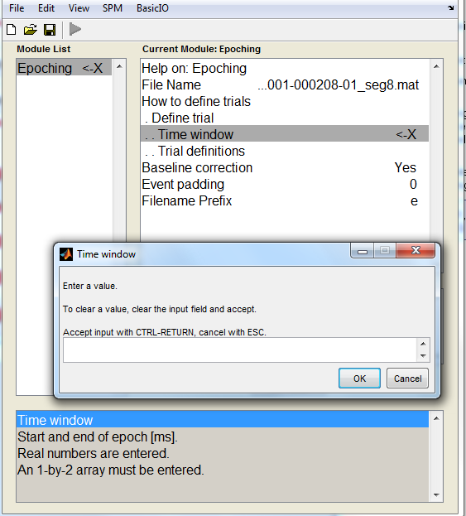
Epoching/splitting into single trials
Notes:
Epoching splits the data into single trials, each referenced to stimulus presentation
For each stimulus onset, the epoched trial starts at some user-specified pre-stimulus time and ends at some post-stimulus time, e.g. from 100 ms before to 600ms after stimulus presentation.
The longer interval, the greater chance to include artefacts!
Padding: will add time points before and after each trial to allow the user to later cut out this padding again
filter all data and then epoch it to avoid edge effect
(longer trials .e.g. -300 to 1s is the interst? do -500 to 2s)
high pass and then low pass

Slide 29
Epoching/splitting into single trials
Specify time
e.g. 100 ms prestimulus - 600 ms poststimulus = single epoch/trial
Baseline-correction: automatic; mean of the prestimulus time is subtracted from the whole trial
Padding: adds time points before and after each
trial to avoid ‘edge effects’ when filtering
Notes:
Epoching splits the data into single trials, each referenced to stimulus presentation
For each stimulus onset, the epoched trial starts at some user-specified pre-stimulus time and ends at some post-stimulus time, e.g. from 100 ms before to 600ms after stimulus presentation.
The longer interval, the greater chance to include artefacts!
Padding: will add time points before and after each trial to allow the user to later cut out this padding again
filter all data and then epoch it to avoid edge effect
(longer trials .e.g. -300 to 1s is the interst? do -500 to 2s)
high pass and then low pass

Slide 30
Filtering
EEG data consist of signal and noise
Notes:
Choose between low-(attenuating high frequencies), high- (low frequencies), band- (attenuate both) or stop- (takes everything except data within a specified range) filter
Any filter distorts at least some part of the signal but reduces file size
50/60 Hz is the power line contamination
band pass stop/ specific frequency

Slide 31
Filtering
EEG data consist of signal and noise
Noise of different frequency; filter it out
Notes:
Choose between low-(attenuating high frequencies), high- (low frequencies), band- (attenuate both) or stop- (takes everything except data within a specified range) filter
Any filter distorts at least some part of the signal but reduces file size
50/60 Hz is the power line contamination
band pass stop/ specific frequency

Slide 32
Filtering
EEG data consist of signal and noise
Noise of different frequency; filter it out
Non-neural physiological activity (skin/sweat potentials); drifts – high pass filter takes care of that; noise from electrical outlets (bandstop around 50/60 Hz)
Notes:
Choose between low-(attenuating high frequencies), high- (low frequencies), band- (attenuate both) or stop- (takes everything except data within a specified range) filter
Any filter distorts at least some part of the signal but reduces file size
50/60 Hz is the power line contamination
band pass stop/ specific frequency

Slide 33
Filtering
EEG data consist of signal and noise
Noise of different frequency; filter it out
Non-neural physiological activity (skin/sweat potentials); drifts – high pass filter takes care of that; noise from electrical outlets (bandstop around 50/60 Hz)
SPM12: Butterworth filter
  High-, low-, band-pass or bandstop filter
Notes:
Choose between low-(attenuating high frequencies), high- (low frequencies), band- (attenuate both) or stop- (takes everything except data within a specified range) filter
Any filter distorts at least some part of the signal but reduces file size
50/60 Hz is the power line contamination
band pass stop/ specific frequency

Slide 34
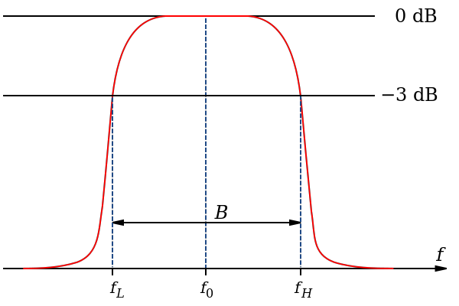

Slide 35
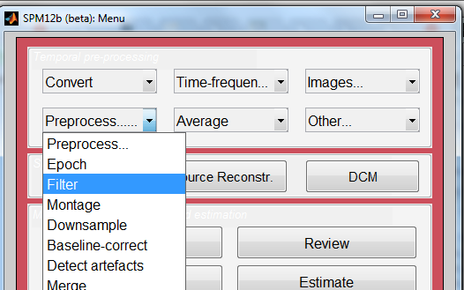
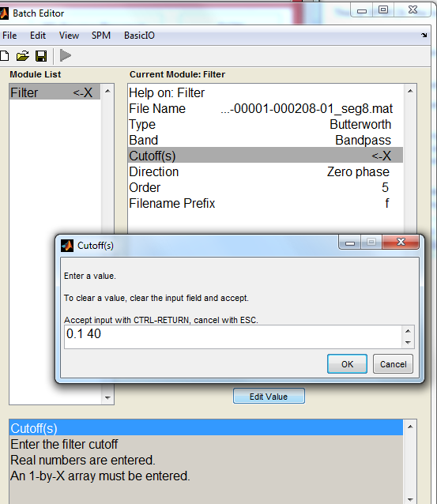
Filtering
Notes:
Choose between low-(attenuating high frequencies), high- (low frequencies), band- (attenuate both) or stop- (takes everything except data within a specified range) filter
Any filter distorts at least some part of the signal but reduces file size
50/60 Hz is the power line contamination
band pass stop/ specific frequency

Slide 36
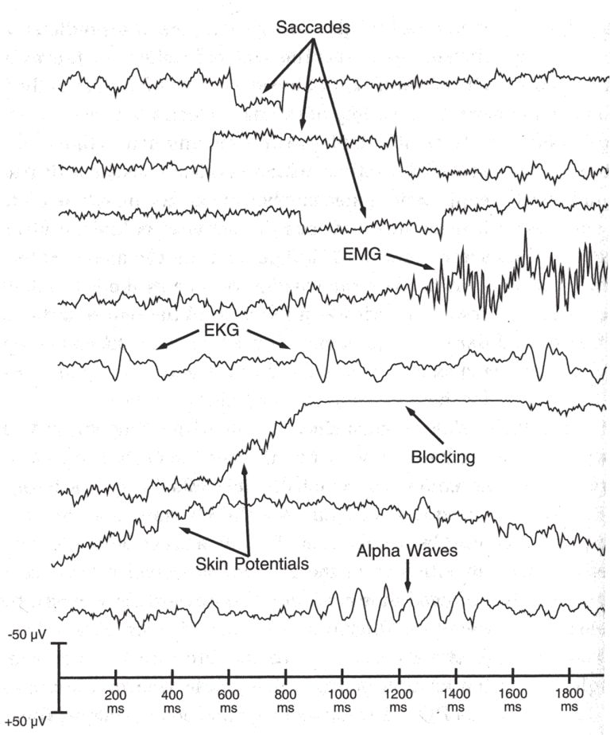
Artefacts
Notes:
Eye movements/eye blinks: Moving the eye itself actually changes the electrical gradients observable at the scalp, making them more positive in the direction the eye has moved towards. Also moves stimulus across retina, this generates unwanted visual ERPs. Less important over areas further away from the eye. If auditory task, justified to ignore eye artefacts
Muscle activity is characterised by bursts of high frequency activity in the EEG (eg swelling)
ECG reflects activity of the heart. This can intermittently appear in your data
Skin potentials are only really a problem for EEG. They reflect changes in skin impedence, this could happen if the subject starts to sweat more as the experiment progresses. They look like slow drifts.. Sometimes if they drift far enough, they cause saturation of the amplifier - a flat ‘blocking’ line.
Alpha waves are actually generated by the brain. They’re slow repetitive waves of about 10 hz which are unlikely to be of any interest to you if you’re looking at cognitive processes.

Slide 37
Artefact Removal
EASY
Removal
  Hand-picked
  Automatic SPM functions:
      Thresholding (e.g. 200 μV)
        1st – bad channels, 2nd – bad trials
        No change to data, just tagged
Notes:
The function only indicates which trials are artefactual of clean and subsequent processing steps (e.g. averaging) will take this information into account, no data is actually removed from the file
Robust averaging: approach that estimates weights between 0 and 1 that indicate how artefactual a particular sample in a trial is. Later on, when averaging to produce evoked responses, each sample is weighted by this number e.g. if sample weight close to 0, it doesn’t have much influence in the average and is effectively treated like an artefact.

Slide 38
Artefact Removal
EASY
Removal
  Hand-picked
  Automatic SPM functions:
      Thresholding (e.g. 200 μV)
        1st – bad channels, 2nd – bad trials
        No change to data, just tagged
Robust averaging: estimates weights (0-1) indicating how artefactual a trial is
Notes:
The function only indicates which trials are artefactual of clean and subsequent processing steps (e.g. averaging) will take this information into account, no data is actually removed from the file
Robust averaging: approach that estimates weights between 0 and 1 that indicate how artefactual a particular sample in a trial is. Later on, when averaging to produce evoked responses, each sample is weighted by this number e.g. if sample weight close to 0, it doesn’t have much influence in the average and is effectively treated like an artefact.

Slide 39
Artefact Removal
HARDER
Use your EoG!
  Regress out of your signal
Notes:
The function only indicates which trials are artefactual of clean and subsequent processing steps (e.g. averaging) will take this information into account, no data is actually removed from the file
Robust averaging: approach that estimates weights between 0 and 1 that indicate how artefactual a particular sample in a trial is. Later on, when averaging to produce evoked responses, each sample is weighted by this number e.g. if sample weight close to 0, it doesn’t have much influence in the average and is effectively treated like an artefact.

Slide 40
Artefact Removal
HARDER
Use your EoG!
  Regress out of your signal
Use Independent Component Analysis (ICA)
  Eyeblinks are very stereotyped and large
  Usually 1st component
Notes:
The function only indicates which trials are artefactual of clean and subsequent processing steps (e.g. averaging) will take this information into account, no data is actually removed from the file
Robust averaging: approach that estimates weights between 0 and 1 that indicate how artefactual a particular sample in a trial is. Later on, when averaging to produce evoked responses, each sample is weighted by this number e.g. if sample weight close to 0, it doesn’t have much influence in the average and is effectively treated like an artefact.

Slide 41
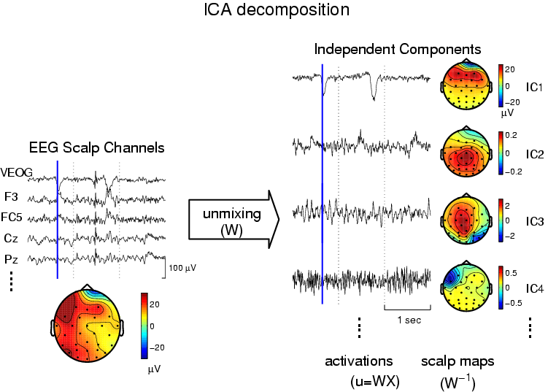

Slide 42
Special thanks to our expert
Vladimir Litvak
(and apologies to Sofie for any muck-ups on my part)

Slide 43
References
Ashburner, J. et al. (2010). SPM8 Manual. http://www.fil.ion.ucl.ac.uk/spm/
Hansen, C.P., Kringelbach M.L., Salmelin, R. (2010) MEG: An Introduction to Methods. Oxford University Press,
Hermann, C. et al. (2004). Cognitive functions of gammaband activity: memory match and utilization. Trends in Cognitive Science, 8(8), 347-355.
Herrmann, C. S., Grigutsch, M., & Busch, N. A. (2005). EEG oscillations and wavelet analysis. In T. C. Handy (Ed.), Event-related potentials: A methods handbook (pp. 229-259). Cambridge, MA: MIT Press.
Luck, S. J. (2005). Ten simple rules for designing ERP experiments. In T. C. Handy (Ed.), Event-related potentials: a methods handbook. Cambridge, MA: MIT Press.
Luck, S. J. (2010). Powerpoint Slides from ERP Boot Camp Lectures. http://erpinfo.org/Members/ldtien/bootcamp-lecture-pptx
Otten, L. (2012, November 21). EEG/MEG Acquisition, Analysis and Interpretation, MSc Cognitive Neuroscience, UCL
Otten, L. J. & Rugg, M. D. (2005). Interpreting event-related brain potentials. In T. C. Handy (Ed.), Event-related potentials: a methods handbook. Cambridge, MA: MIT Press..
Sauseng, P., & Klimesch, W. (2008). What does phase information of oscillatory brain activity tell us about cognitive processes? [Review]. Neuroscience and Biobehavioral Reviews, 32(5), 1001-1013. doi: 10.1016/j.neubiorev.2008.03.014
http://sccn.ucsd.edu/~jung/artifact.html
MfD slides from previous years

