Slide 1
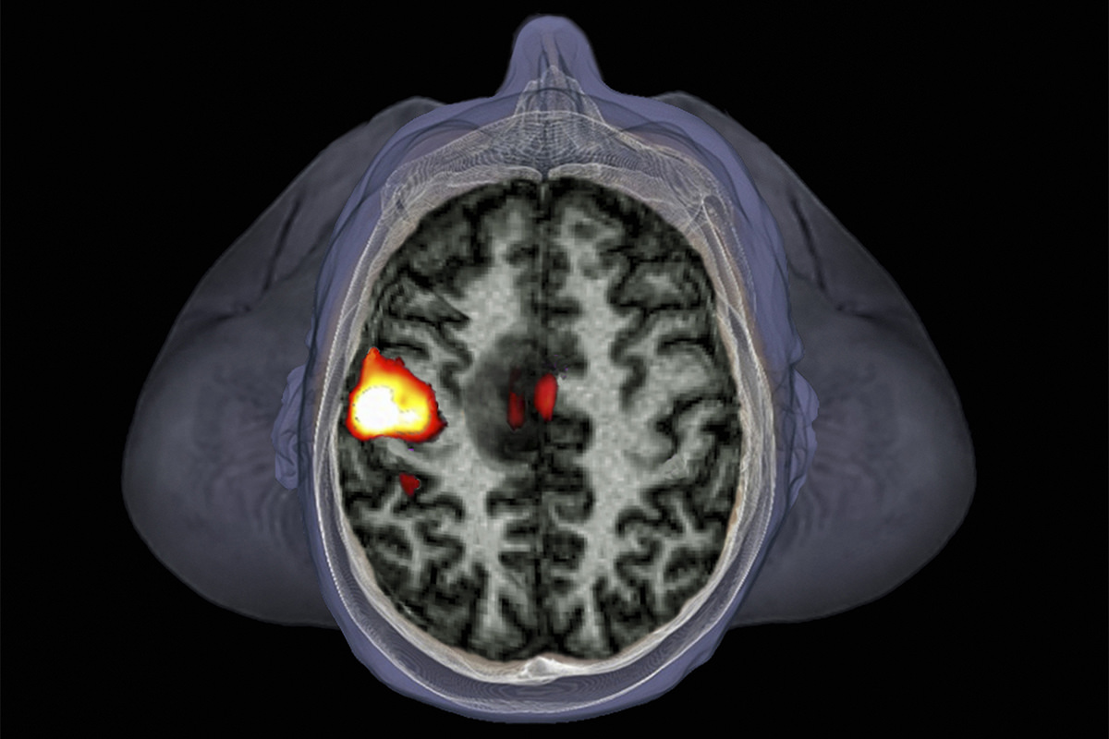
Basis of the BOLD signal
Zephyr/Science Photo Library
Jialin yuan
Wen Wen

Slide 2
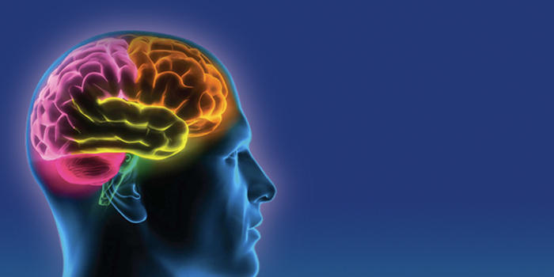
thought
emotion
intelligent
consciousness

Slide 3
functional magnetic resonance imaging, fMRI

Slide 4
MRI
Underpinned by nuclear magnetic resonance (NMR)
fMRI looks at MRI signal changes associated with functional brain activity.
The most widely used method is BOLD:
blood oxygen level dependent
Notes:
Underpinned by magnetic resonance imaging (MRI).
Based on magnetic properties of hydrogen atoms
fMRI assesses brain function by looking at MRI signal changes associated with functional brain activity.
The most widely used method is BOLD (blood oxygen level dependent)
Based on hemodynamic and metabolic sequalae of neuronal responses.

Slide 5
Outline
Basis of MRI: Jialin Yuan
BOLD signal: Wen Wen

Slide 6

The MRI Scanner
  Earth’s magnetic field: 0.00003 Tesla Clinical MRI: 1.5 - 7 Tesla
Notes:
To recap:
MRI based on how hydrogen nuclei respond to magnetic fields
fMRI is a specialised MRI technique which tracks oxygen to image blood flow
MRI produces a magnetic field much stronger than Earth’s magnetic field
An MRI scanner is a giant magnet which produces a magnetic field much stronger than Earth’s magnetic field.
The scanner is in a specially shielded room which blocks out Radiofrequency energy, e.g. from radio stations, which would otherwise drown out the energy emitted by the protons you want to capture.

Slide 7
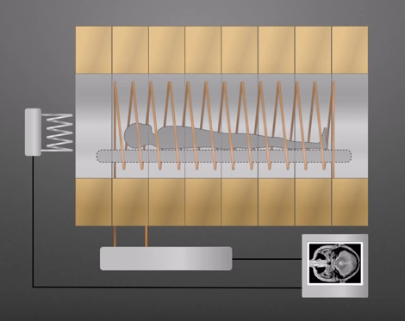
Powerful magnet
RF coil
Gradient coil
RF generator and receiver
Computer and monitor

Slide 8
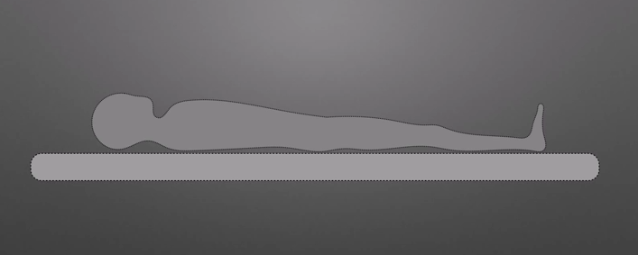
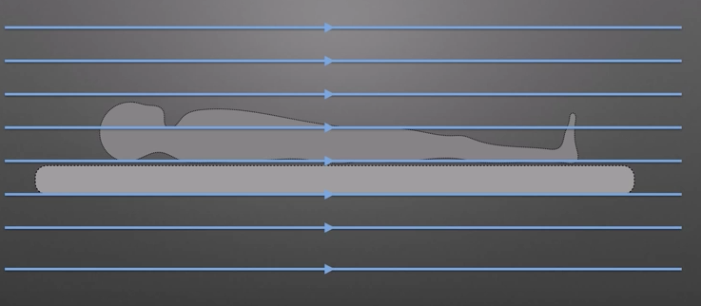
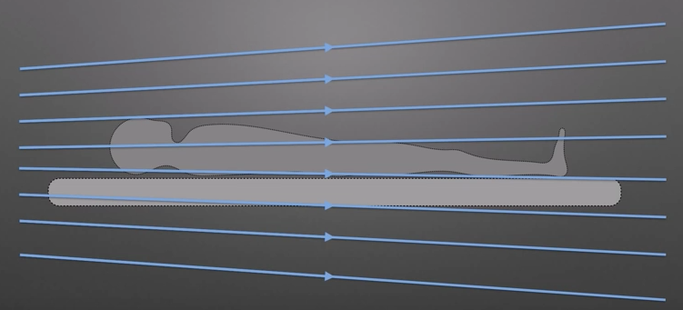

Slide 9
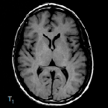
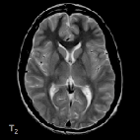
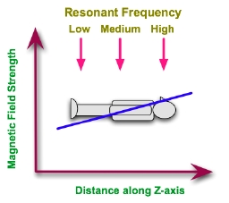
Gradient coils: x, y, z
Alter the strength of the primary magnetic field
Change the precession frequency between slices
Allow Spatial encoding for MRI images
Notes:
For spatial localisation.
A 90º pulse applied in conjunction with a magnetic field gradient will rotate spins which are located in a slice or plane through the object.
Frequency discrimination can be achieved by arranging for RF emissions from the patient to have slightly different frequencies depending on their origin.
Furthermore, phase discrimination can also be applied so that the phase of the RF emissions can be related to locations within the patient.
The magnetic field of the magnet in an MRI scanner is therefore supplemented by small fields introduced using gradient coils so that a linear gradient, for instance, in the field can be established.
With such a gradient applied along the patient's Z-axis, we can expect the resonant frequency of hydrogen protons to be different for planes along this axis,

Slide 10
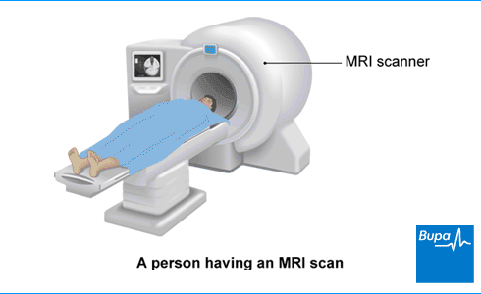
Z B₀ longitudinal axis
X
Y
Notes:
Planes.

Slide 12
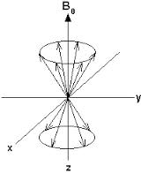
Hydrogen Ions
Human tissue contains many hydrogen ions.
  Fat
  Water:
  A trillion, trillion, trillion water molecules in the human body.
Hydrogen atoms are tiny magnets
Notes:
MRI is based on the properties of hydrogen ions. These are found in abundance in the body, for example in water and fat.
Atoms consist of protons, neutrons and electrons.
If there is an uneven number of protons or neutrons or both in an atom, the nuclei possesses nuclear spin. This is it’s natural state, and can be thought of as a tiny magnetic field.
Nuclei that possess a nuclear spin can be pictured as small rotation magnets, which spin around their own axis.
The spin is referenced against axis points, where B0 is the magnetic field (for example the giant magnetic field in the scanner), and Y and X are the transverse planes.
The important thing to remember is that in their natural state, the hydrogen protons spin either in parallel or antiparallel alignment with the Z axis.
So… MRI can essentially be thought of as hydrogen imaging.

Slide 13
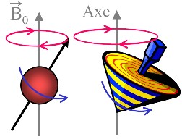
Nuclear spin: precession
In nuclear spin, the proton spins around the long axis of the primary magnetic field. Never truly aligned!
The proton gyrates as it spins into alignment.
= precession
Notes:
In addition to spin, the proton also takes another important motion. This is called gyration, and it descrbes how the proton wobbles as it spins around the axis.
Never truly aligned – like spinning top.
This examples shows one proton spinning around its axis.

Slide 14
Larmor Equation
Precession is calculated by the Larmor equation:
  ω₀ = γ Β₀
  ω₀ resonant frequency (e.g., 63.87 Hz for 1.5 T scanner)
  γ gyromagnetic ratio (42.58Hz for Hygegon)
  Β₀ magnetic field strength (1.5-7 T)
Lamour Frequency is the specific precessional frequency of protons in the MRI scanner.
Notes:
The process of precession is defined by the Lamour Frequency equation, which is a very important concept in MR imaging.
This describes the rate at which spins wobble when placed in a magnetic field.
The Larmor requency is directly proportional to the strength (B0) of the magnetic field.
The precessional frequency ω(omega)0= B0 x λ (lambda)
Where B0 is the magnetic field strength
And λ is the gyro magnetic ratio

Slide 15
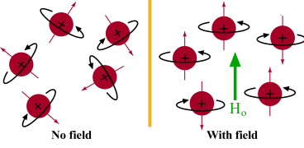
Nuclear spin: precession
Normally:
Magnetic fields are randomly aligned
In magnetic field of MRI:
Spinning nuclei align to B₀ field
Notes:
So, what happens to hydrogen ions in the MRI scanner?
As we saw before, the hydrogen ions are randomly aligned normally in earths magnetic field.
Net magnetisation is therefore 0.
Inside the scanner, the magnetic field is very strong.
The spinning atoms align to the strong magnetic field, either into parallel and antiparallel directions with the Z axis..
Remember, they are like little magnets, or like the points of a compass needle.
However, because the up spin direction is energetically more favourable, more protons align in the parallel direction with the B0 axis.
This leads to a net magnetization value, due to the difference in their spin up and spin down states.
The energy difference between the two spin states, Is proportional to the strength of B0.
With a stronger magnetic field, more spins will be in the parallel state, leading to a stronger net magnetisation. This means a stronger signal.
This is why the MRI scanner has a very strong magnetic.
To recap: the magnetic field is used to align the tiny hydrogen atoms so they are in the same direction, and they align to the longitudianal axis of the scanner. The net difference in magnetisation between the two up/down alignments is what creates the MR signal.

Slide 16
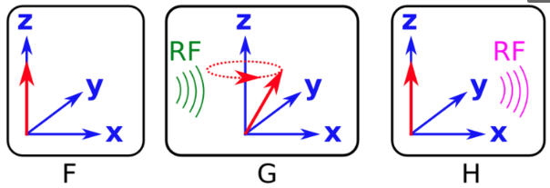
Spinning nuclei align to B field(Z-axis)
RF "kick" the nuclei to an excitation state
Nuclei flip back

Slide 17
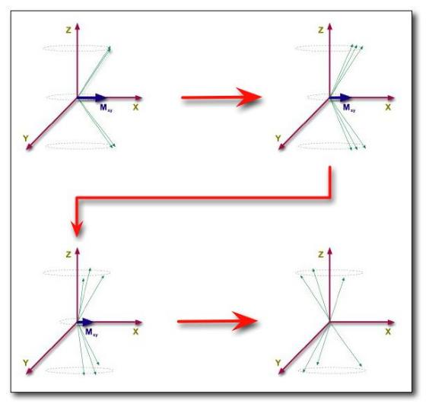

Nuclear spin: radio frequency pulse
  Precession back towards B0 longitudinal field (T1 recovery)
  De-phasing of spins
  (T2 decay)
Notes:
When the RF pulse ceases, we can look to what happens along both the Z and XY planes.
Along the Z axis, there is longitudinal relaxation, also known as spin recovery. The protons emit the RF energy they have absorbed, returning to their natural lower energy state.
This diagram represents what happens to phase coherenece:
Along the transverse plane, transverse relaxation occurs, also known as phase decay. Previously, the protons were precessing in phase with each other. Now, they gradually lose their coherence, and the XY magnetisation returns to 0.
Each individual spin is a little ‘magnet’ that creates its own magnetic field.
Each spin therefore experiences a specific field due to the influence of its neighbors: spin-spin interactions
Since spins precess at a frequency given by the local value of the magnetic field, they gradually get out of phase: the detected MR signal is reduced with time due to T2 relaxation

Slide 18


Relaxation
time
Switch off RF pulse
Receive signal

Slide 19
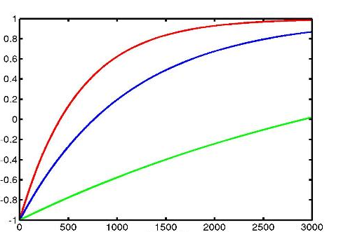
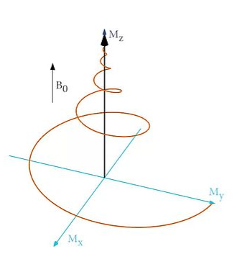
T1 recovery
Different tissue types have different T1 and T2 characteristics.
This creates contrast in imaging.
WM
GM
CSF
Notes:
These forms of relaxation are also known as T1 and T2 characteristics.
These are important in MRI, because they are crucial for producing contrast in imaging.
Different tissue types have different T1 and T2 characteristics, because the rate at which the protons release their absorbed energy depends on the tissues composition.
This means that you can create high contrast images of brain strucutres.
Here you can see the T1 recovery curve for different tissue types.
white matter indeed gives us the highest signal, which is shown bright in the image,
and CSF (Cerebrospinal fluid) a low signal, shown dark in the image.

Slide 20
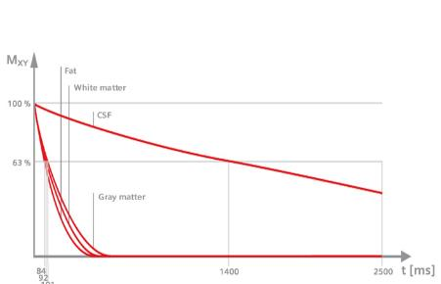
T2 decay
Different tissue types have different T1 and T2 characteristics.
This creates contrast in imaging.
Notes:
For fMRI, we are most interested in T2 relaxation, of loss of phase coherence.
Here you can see the T2 recovery curve of different tissue types and the resulting T2 image
because spins dephase slower in CSF, CSF has a higher and brighter value
Gray and white matter have a much lower value.
De-phasing is affected by:
External magnetic effects (I.E. scanner)
Spin Echo imaging corrects for this
Internal magnetic effects
(I.E. interactions with neighbouring molecules)
T2 = the true ‘natural’ decay time of the tissues
T2* = predicted decay based on natural atomic and molecular mechanisms (an ‘observed’ T2).
Is faster than T2 decay due to natural inhomogeneities in the main magnet

Slide 21
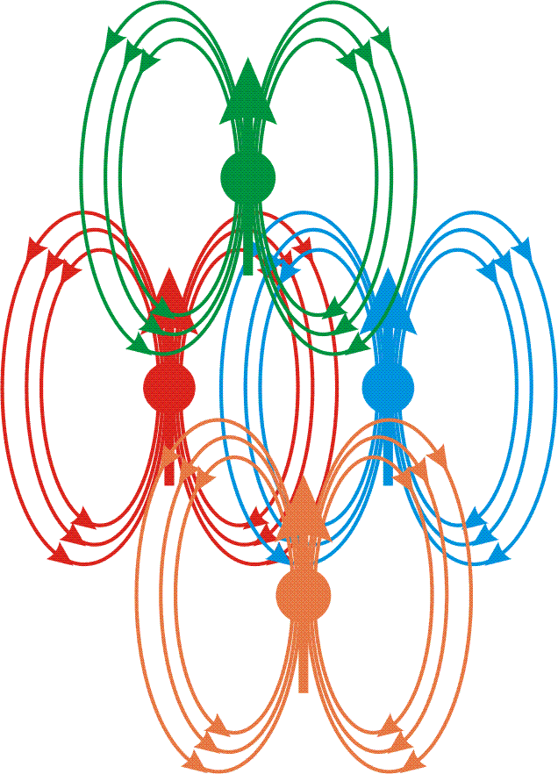
T2 and T2*
T2 = the true ‘natural’ decay time of the tissues
T2* = de phasing is faster than T2 due to inhomogeneities, which affect spin dephasing, and lead to signal decrease.
In BOLD fMRI:
T2* affected by neural activity
Gradient echo techniques used to enhance signal
B
B
B
Spin-spin interactions
B
Notes:
T2 and T2* represent slightly different things in MRI
T2 is the natural decay time of tissues which would occur in a perfect homogenous environment.
T2* reflects the decay which is impacted by inhomogeneities in magnetisation.
This is particularly relevant for fMRI.
The reasons are twofold:
firstly, there are natural scanner wide variations in the giant magnet of the scanner.
Secondly, there are inhomogenties due to spin-spin interactions. Spin spin is where the phases begin to spin out pf phase with each other due to interactions with neighbouring protons.
This is particularly relevent for the BOLD response. This is because there are things like iron present in the blood, which can locally alter magnetic fields.

Slide 22
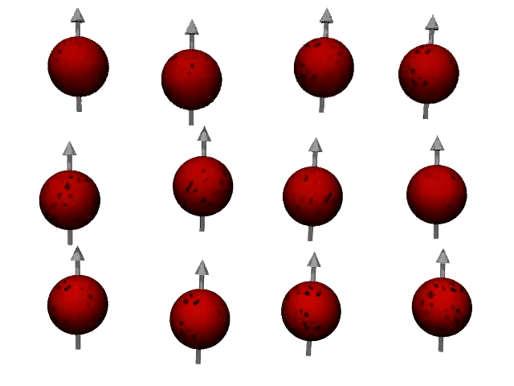
https://www.youtube.com/watch?v=0YBUSOrH0lw

Slide 23
The BOLD Signal

Slide 24
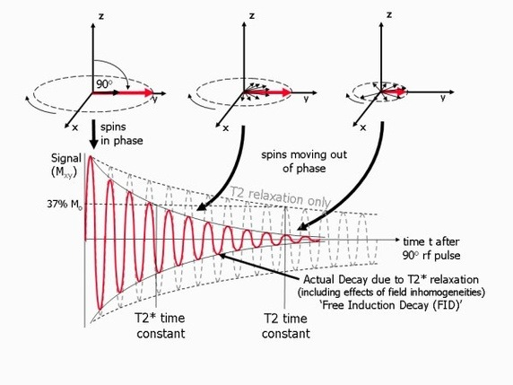
T2 and T2*
Blood with oxygen
-> slower decay
Blood without oxygen
-> faster decay
Source: www.jcmr-online.com - Figure.

Slide 25
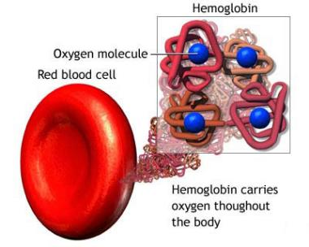
Hemoglobin (Hb)
Deoxyhemoglobin (dHb) -> Paramagnetic
Oxyhemoglobin (Hb) -> Diamagnetic
Notes:
Here I am going to explain why blood containing oxygen increases BOLD signal. As you know, hemoglobin in blood carries oxygen for us.

Slide 26
Oxygenated Hb
B₀
voxel
Vessel
Tissue
Deoxygenated Hb
26
Dr. Samira Kazan
Notes:
So let’s look at that in a bit more detail. The top image is of a hypothetical vessel near inactive neurons, so there’s plenty of oxygenated hemoglobin in it. Now you’ve turned on the MRI scanner and you get this green magnetic field. It’s hard to tell but there are very small differences in the field- if you can see it, it’s a bit yellower in some places- however overall, the field around the blood vessel is very uniform.
The image on the bottom is of a vessel that has lots of deoxyhemoglobin present in it. The color differences represent changes in the strength of the magnetic field because of the presence of dHb.
Now we’ll zoom in on one small voxel in each image. You can clearly see the difference in the magnetic field in the deoxygenated case.
So, with the initial RF pulse, all the protons are lined up and in phase and we have a strong signal.
If we look a few milliseconds later the protons are coming out of phase with each other and the signal is weakening.
And even a few milliseconds later and the signal has decayed much more.
Because the magnetic field is so much more inhomogeneous when there is deoxyhemoglobin around the protons come out of phase much faster and the signal decays a lot faster.
So, you would expect a weaker BOLD signal when neurons are activated compared to when they’re at rest.

Slide 27
Oxygenated Hb
B₀
voxel
Vessel
Tissue
Deoxygenated Hb
27
Dr. Samira Kazan

Slide 28
Oxygenated Hb
B₀
voxel
Vessel
Tissue
Deoxygenated Hb
28
Dr. Samira Kazan

Slide 29
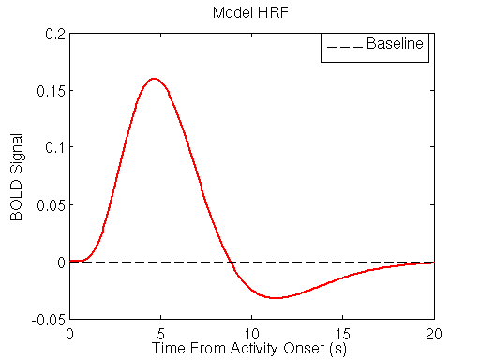
How does this relate to neural activity?
Difference in T2* decays between deoxyhemoglobin and oxyhemoglobin results in BOLD signal
M_{xy}
Signal
M_{o} sinθ
T₂* task
T₂* control
S_{task}
S_{control}
ΔS
TE_{optimum}
time
Notes:
More or less deoxyhemoglobin distorts the signal more or less, but we still measure protons and their T2* decay. T2* is just decaying faster or slower depending on how much deoxyhemoglobin is around!
Task: relatively more oxyhaemoglobin; less field inhomogeneity; slower T2* contrast decay; stronger signal
Control: relatively more deoxyhaemoglobin; more field inhomogeneity; faster T2* contrast decay; weaker signal

Slide 30
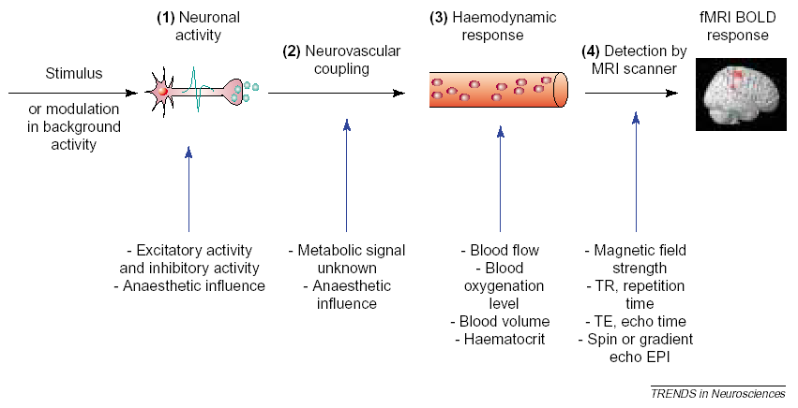
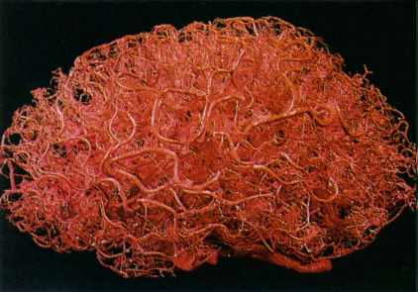
Stimulus to BOLD
What we want to measure but can’t
What we actually measure with fMRI
Source: Arthurs & Boniface, 2002, Trends in Neurosciences
Vessels

Slide 31
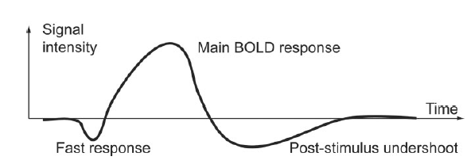
Neurophysiology
Typical hemodynamic response to single short stimulus
Norris, JMRI, 2006
~5 - 6 sec
~4 sec
~10 - 30 sec
<1 sec
Norris, JMRI 2006
Fast response: increase in metabolic consumption
Main BOLD response: increased local blood flow
Post-stimulus undershoot: metabolic consumption remains elevated after blood flow subsides
Notes:
Okay, so this is a typical hemodynamic response to a short stimulus.
In the first 1-2 seconds you see a fast initial drop in signal intensity- that’s due to the increased use of oxygen by activated neurons, before the blood vessels can respond.
Then, after about 2 seconds you get blood flow change and you get a big signal intensity increase that peaks around 5 or 6 seconds post-stimulus.
Eventually that signal fades, as the neurons return to resting and you sometimes see a post-stimulus undershoot, that’s poorly understood.

Slide 32
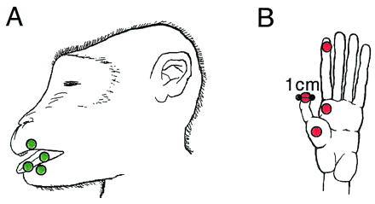
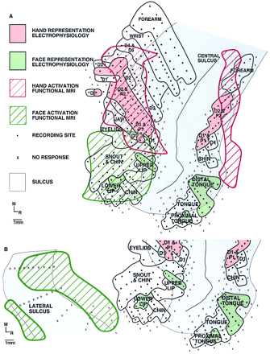
Comparing Electrophysiology and BOLD
Disbrow et al., 2000, PNAS
BOLD makes sense

Slide 33
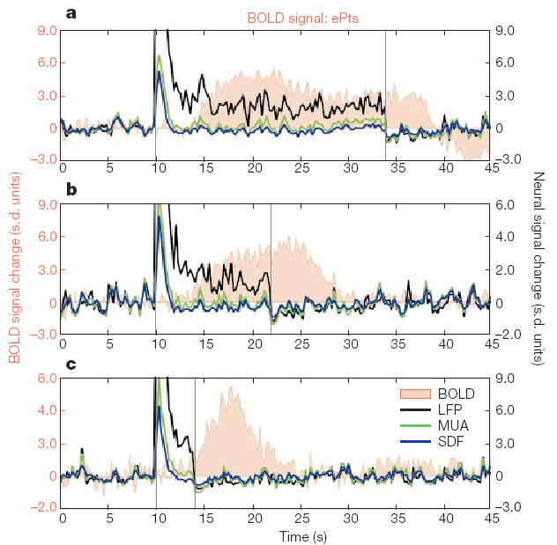
BOLD Correlations
24 s stimulus
Local Field Potentials (LFP)
reflect post-synaptic potentials
Multi-Unit Activity (MUA)
reflects action potentials
Logothetis et al. (2001)
found that BOLD activity is more closely related to LFPs than MUA
12 s stimulus
4 s stimulus
Source: Logothetis et al., 2001, Nature

Slide 34
Advantages of BOLD
High spatial localisation
Non-invasive
Increasing availability
Enables visualising of entire brain areas/networks engaged in specific activities

Slide 35
Disadvantages of BOLD
Indirect measure of oxygen consumption (Blood flow ≠ Neural activities)
Difficult to differentiate between excitation/inhibition and neuromodulation (all need oxygen and glucose)

Slide 36
Thank you for you attention

