Slide 1
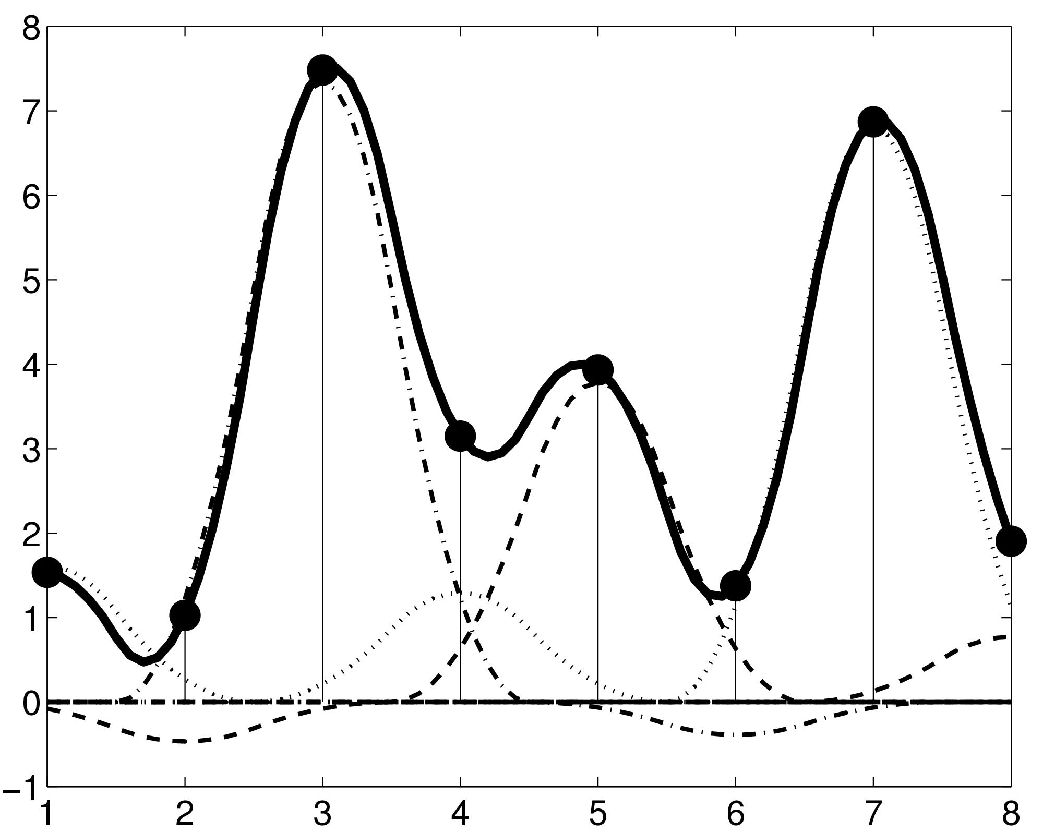
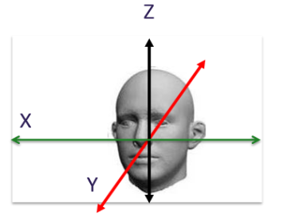
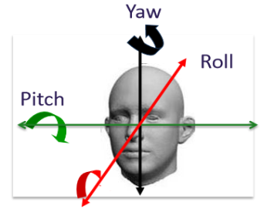
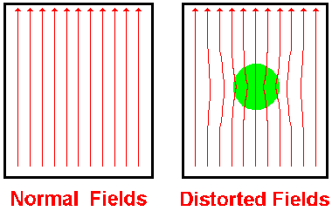
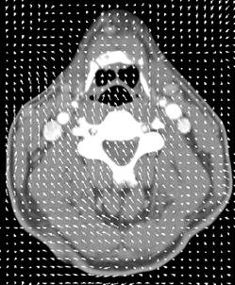
Paul Zeun
Realigning and Unwarping
MfD - 2017

Slide 2
What this talk covers
Preprocessing in fMRI : Why is it needed?
Motion in fMRI
Realignment
Unwarping
How this all works in SPM

Slide 3
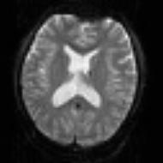


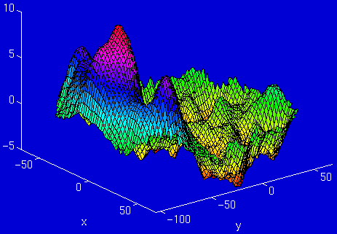
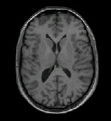
Stages in fMRI analysis
Scanner Output
Preprocessing
Statistical analysis
Today’s talk
Motion correction (and unwarping)
Design matrix
fMRI time series
Smoothing
General Linear Model
Statistical Parameter Map
Spatial normalisation (including coregistration)
Structural MRI
Parameter estimates
Notes:
Overview

Slide 4
Preprocessing: Why is it needed?
fMRI:
  returns a 3D array of voxels repeatedly sampled over time
  Changes in activation in each voxel correlated with experimental task
Key Assumptions:
  all voxels must be acquired simultaneously
  the voxels need to come from the same part of the brain
Notes:
In fMRI We look at intensity of activation in a voxel at a given point of time. We plot this along with various tasks, and if activation varies with the task, we can correlate brain function.
To do this, first step we must ensure we are looking at same brain region over time.

Slide 5
Violation of assumption 1:
  - all voxels must be acquired simultaneously
  the last slice is acquired TR seconds after the first slice
  → there can be motion of one slice relative to another
Solution:
  slice-timing correction: include realignment parameters in the model
  will (hopefully) be discussed in event-related fMRI
Notes:
The problem of different slice scanning times stems from the fact that a functional volume (e.g. whole brain) is usually not covered at once but with a series of successively measured 2D slices. For a functional volume of 30 slices and a volume TR (repitition time )of 3 seconds, for example, the data of the last slice is measured almost 3 seconds later than the data of the first slice
there can be motion of one slice relative to another due to the delay, and the fact that the realignment model cannot correct this motion, which is one reason for wanting to include realignment parameters in the linear model.
This can be solved by slice time correction which will be covered in a later talk on event-related fMRI.
The choice of whether to have STC before or after realignment (or not at all) is still a matter of debate, depending on some subtle things like whether the slices are acquired with an "interleaved" sequence or not, and how much motion there is (probably too much detail to get into in MfD).

Slide 6
Violation of assumption 2:
  - the voxels need to come from the same part of the brain
  - small movement (< 5mm) means that voxel location is not stable throughout the time series
Voxel A - Inactive
Voxel A - Active
Notes:
Head movement is the largest source of variance in fMRI data If a participants moves, the fMRI image corresponding to Voxel A may not be in the same location throughout the entire time series.
The aim of pre-processing for motion is to ensure that when we compare voxel activation corresponding to different times (and presumably different cognitive processes), we are comparing activations from the same area of the brain.

Slide 7
Causes of head movement:
    Actual movement of the head
    Physiological: heart beat, respiration, blinking
    Task-related: moving to press buttons
      artificially creates variance in voxel activation that correlates with task ➔ serious confound
Why is this a problem?
- this variance is often much larger than experiment- induced variance
→ False activations
- lowers the signal-to-noise ratio
Notes:
Major cause of head movement is actual head movement but important to also consider task-related.
Physiological is a more minor cause.
To limit this We can either try to prevent motion from occurring or correct motion after it’s occurred
Mathematically, the SNR is the quotient of the (mean) signal intensity measured in a region of interest (ROI) and the standard deviation of the signal intensity in a region outside the anatomy of the object being imaged (i.e. a region from which no tissue signal is obtained) or the standard deviation from the noise distribution when known (e.g. the background noise in magnitude data follows a Rician distribution

Slide 8
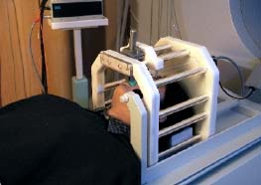
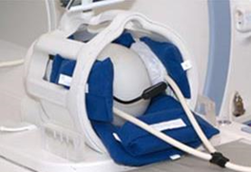
Motion Prevention in fMRI
  Constrain the volunteer’s head (soft padding)
  Give explicit instructions to lie as still as possible, not to talk between sessions, and swallow as little as possible
  Try not to scan for too long*
  Make sure your subject is as comfortable
Notes:
The more you can prevent movement, the better.

Slide 9
Realignment
Realignment involves two stages:
Registration
  Estimate the 6 parameters that describe the rigid body transformation between each image and a reference image
2. Transformation
  Re-sample each image according to the determined transformation parameters
Notes:
However despite this You cannot prevent all motion in the scanner – subjects will always move!
Therefore motion correction of the data is needed – registration where we estimate how the brain has to be moved to fit the reference image and then transformation where we resample the realigned image
This adjusts for an individual’s head movements to creates a spatially stabilized image

Slide 10
Realignment:
Rigid body transformation
To correct for both rotation and translation, we will compute 6 parameters
Translation
Rotation
Translations
Pitch
about X axis
Roll
about Y axis
Yaw
about Z axis
Notes:
In 3 dimensional space the head can move in 6 directions.
Rigid body transformation assumes size and shape of 2 objects are identical (ok because it’s the same brain) and one can be superimposed on the other via 3 translations and 3 rotations
Pitch is rotation around the x axis up and down, like nodding ‘Yes’
Yaw is rotation around the z axis, side to side, like ‘No’
Roll is ration around the y axis, like ‘Maybe’
These directions will become parameters where movements in x/y/z are known as translations and pitch yaw roll as rotations and using these paremeters we will transform (i.e. move or realign) the images to match the reference image
In realignment SPM will create a translation and rotation matrix where numbers in the matrix denoting coordinate points on the grid (voxels to mm) and for each point in an image affine mapping can be defined into coordinates of another shared (eulicdean space) and then map back to reference image.
and will then do an iterative search to find the best set of parameters that provide the best match to the reference image….
The way it finds the best set of parameters is;

Slide 11
Optimisation - cost function
quantifies how (dis-)similar the images are after a spatial transformation has been applied
Minimise sum of squared difference ‘Least squares’ between consecutive images
Notes:
To identify the set of parameters that provide the best match to the reference volume. (nb optimisation for intramodal only)
This is termed optimisation where one determines the optimum parameters for the transformation (coordinates).
Optimal parameters are those that minimise the sum of squared differences ‘least squares method’ between the image and the reference image. (cost function = sum of squared difference between consecutive image)
After an initial estimate of this cost function, the algorithm will iteratively try different combinations in order to find minimum sum of square difference (i.e best match to reference or quantification of how well image matches the reference – the perfect co-registration would yield a difference of 0)
In other words ‘optimisation’ - we are minimising the sum of squared differences (residuals – residual being a difference between observed value and the fitted value provided by the model) between the transform and real world data. To minimise this difference the alogrithm will takes an initial estimate, compute ‘how different’ that transform is to the ref image and iteratively searches from there – at each iteration model is evaludated and Xsquared computed before next iteration.

Slide 12
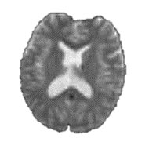
Realigning:
2. Interpolation
Original image
Resampled image
After having realigned, we need to determine the intensity of each new voxel
Realign
Original voxels
New voxels to determine after realigning
For example, want to determine this voxel
3 types of interpolation possible:
  Nearest Neighbour
  Trilinear
  B-Spline
Original voxel
New voxel to identify
Notes:
Is below correct?
So, in the registration process each of the images are matched to the first image of the time series and a mean of these aligned images is generated.
Then each of the individual images is matched to this mean image by applying the transformation parameters.
After determining a set of realignment parameters, the original data have to be resampled in order to estimate the values that would have been obtained in case of no head motion. This process is called interpolation.
Interpolation defined as constructing new data points from a set of known data points (i.e. voxels). NB also referred to as reslicing and transformation
The intensity of each voxel in the transformed image must be determined from the intensities in the original image.
In SPM there are different interpolation options to choose from.
In order to realign images with subvoxel accuracy, the spatial transformations will involve fractions of a voxel. Requires an interpolation scheme to estimate the intensity of a voxel, based on the intensity of its neighbours.
All images are acquired and stored as a collection of discrete points set on a spatial grid. However, in order to carry out the image transformations the intensity at positions between grid points needs to be calculated. This process is called interpolation.

Slide 13
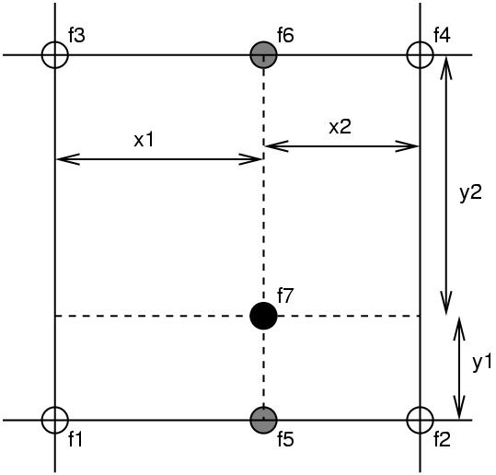
Simple Interpolation
Nearest neighbour
  Takes the value of the closest voxel
Tri-linear
  Weighted average of the neighbouring voxels
    f₅ = f₁ x₂ + f₂ x₁
    f₆ = f₃ x₂ + f₄ x₁
    f₇ = f₅ y₂ + f₆ y₁
Notes:
The simplest one is to take the value of the nearest neighbour. This is fastest but not recommended for image realignment (and not included in spm12)
A rather better option is tri-linear interpolation (illustrated here in 2 dimensions, so it’s bi-linear interpolation) but it’s easier to explain.
The white circles represent original voxels (f1, f2, f3, f4) and the black circle (f7) represents the point we’re trying to sample
So, we take the weighted average intensity of these 2 values (f1 and f2) and we get f5
We also take the weighted average of f3 and f4 to get f6
Finally, we take the weighted average of f5 and f6 to get f7.
This would generalize into 3 dimensions
This method is not really optimal because by taking the weighted average of the neighbouring voxel we are introducing smoothness into the resampled image. It’s a bit messy and you will lose information.
There are better ways of doing interpolation, although such methods could be slower.

Slide 14
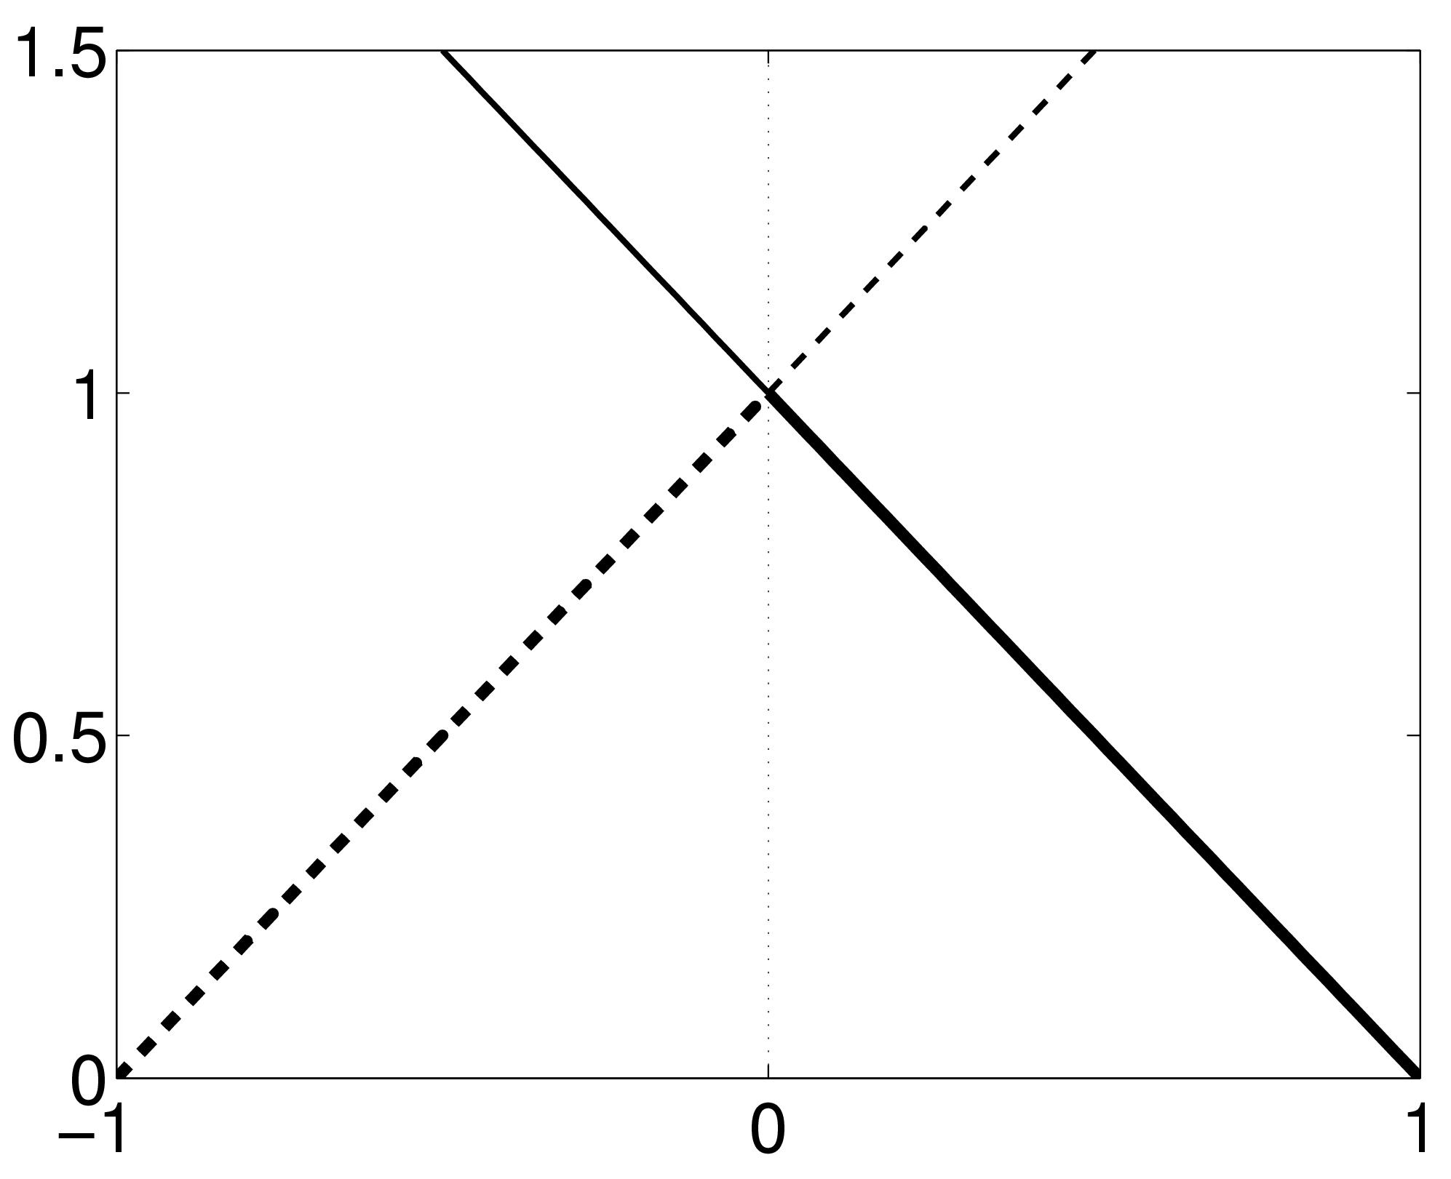
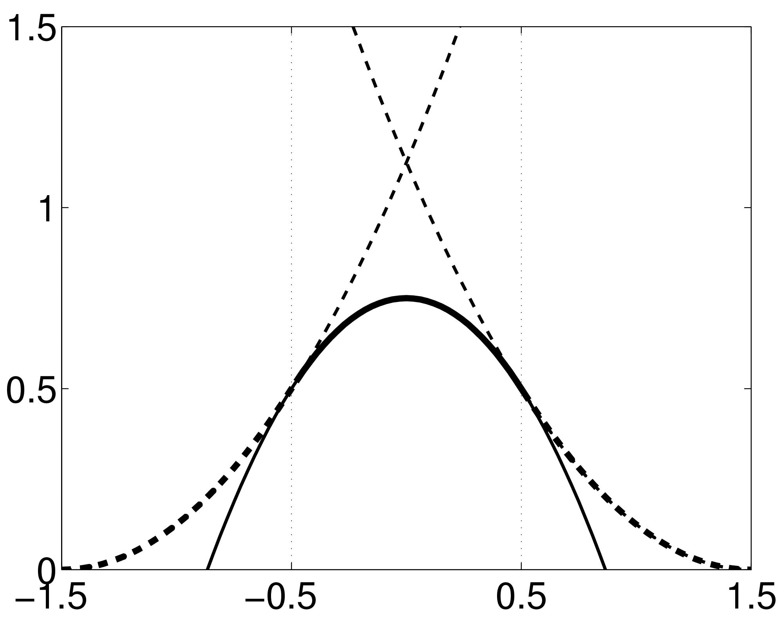
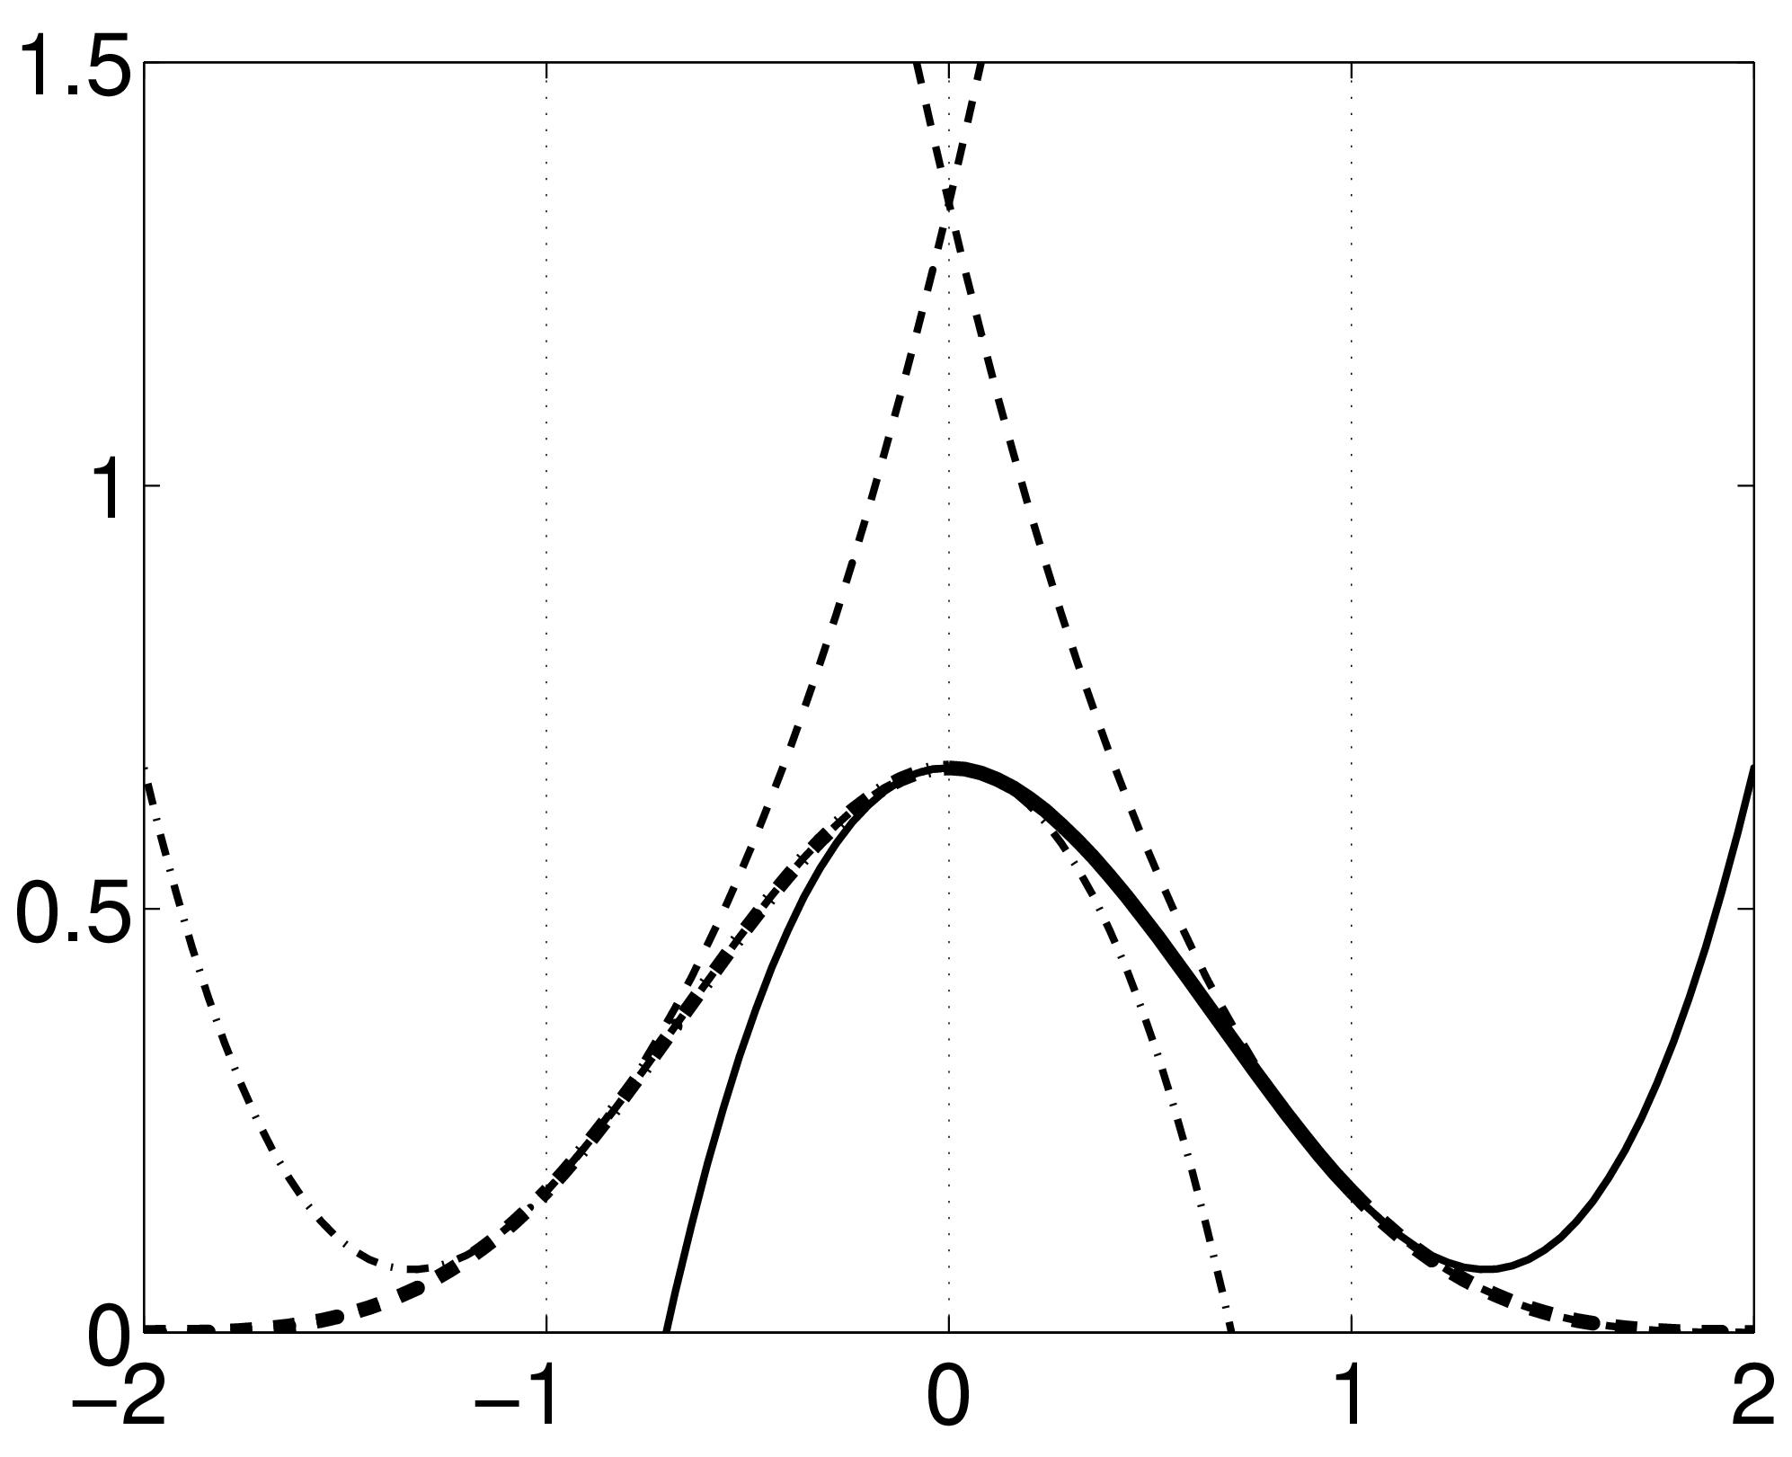
B-spline Interpolation
A continuous function is represented by a linear combination of basis functions
Notes:
ISo, a better method of interpolation is B-spline (default in SPM) B-spline interpolation – improves accuracy, has higher spatial frequency.
In this graph, the perpendicular thin lines represent the value of individual voxels in the original image and the black line is interpoling the smooth function between voxels (linear combination of basis functions – bit like a localised GLM). When we want to sample a new value, we just take the height of the black line.
(This black line consists of the linear combination of these gaussian shaped basis functions)
There are a few options of B-spline interpolation in SPM. I’ll try to explain some:
We have a function that is a little triangle shape and this is a 1st degree b-spline, which is identical to a bilinear / tri-linear interpolation
2nd degree b-spline is slightly more sophisticated. This function consists of some polynomials that are stuck together. There’s a gaussian shape here which consists of a bit of this curve (left) a bit of the right curve and a bit of the top curve which are stuck together.
3rd degree b-spline uses a few more curves .
This is how they would appear in 2D, there’s also a 3D version as well.
Bottom line without the maths:
B-spline interpolation uses more information in the hope of improving results and the higher the order the more information (neighbouring voxels) is being used to generate accurate interpolation
Spline is the interpolant – a piecewise polynomial

Slide 15
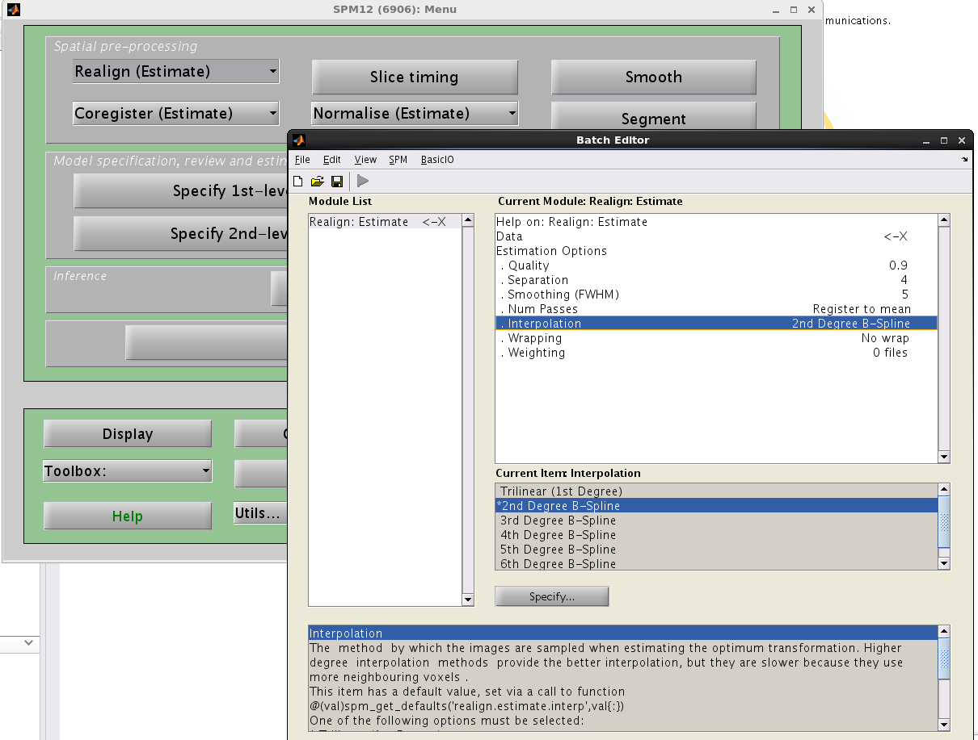
Notes:
Practical
1st degree b-spline identical to trilinear interpolation and so spm does not have 1st degree b spline as option.
Most accurate methods are higher order b-splines (2-7).
Higher orders provide better results/interpolation but they are slower because they use more neighboring voxels.

Slide 16
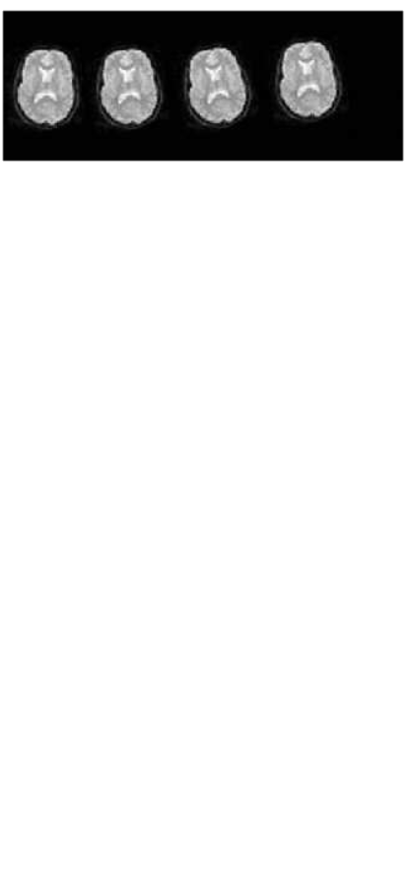
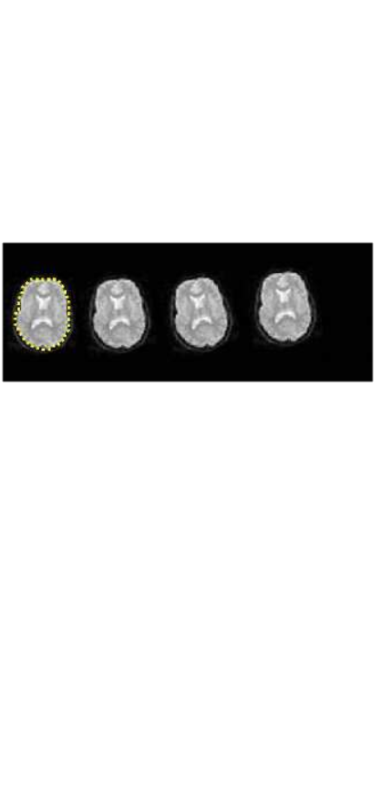
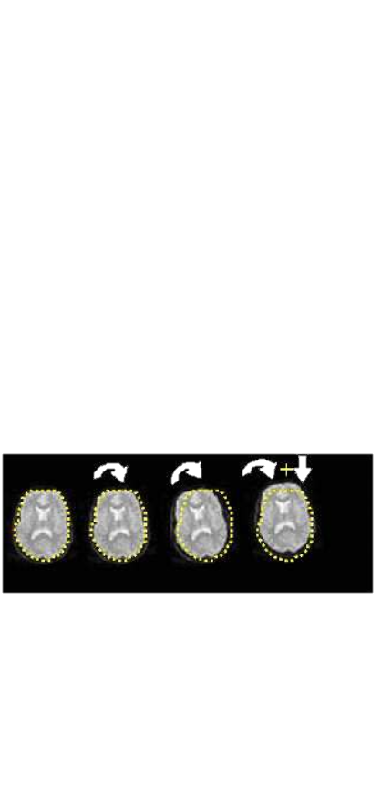
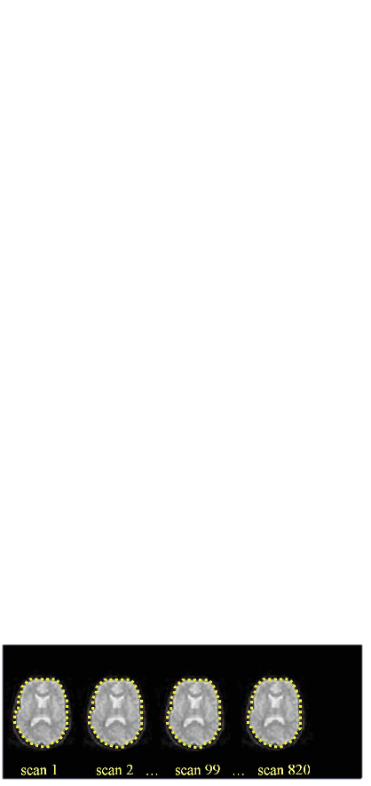
Realigning:
Head movement
Calculate position of the brain for the 1st slice
Estimate transformation parameters based on 1st slice
Apply the transformation parameters on each slice

Slide 17
Summary so far
Motion can reduce sensitivity + increase residual variance
Try to minimise movement with practical steps
Motion correction via realignment
- Each volume rigidly registered to reference
- Least squares objective function
Realigned images must be resliced (interpolation) for analysis
Notes:
Because each reslicing slightly degrades the images, this may be postponed until the normalisation step. It is useful, however, to create a mean image to determine parameters from at the normalisation stage (2.4) or to coregister to a structural MR (2.3). Select Coregister & Reslice, Trilinear or Sinc interpolation (trilinear is probably sufficient and much faster) and Mean Image Only. The other images will have only their *.mat files updated.

Slide 18
Residual Errors in Realigned fMRI
Even after realignment a considerable amount of the variance can be accounted for by effects of movement
This can be caused by e.g.:
  Movement between and within slice acquisition
  Re-sampling can introduce Interpolation errors
  Non-linear distortions and drop-out due to inhomogeneity of the magnetic field
Incorporate movement parameters as confounds in the statistical model
Notes:
Realignment solves the voxel correspondence problem – the same voxel now contains the same bit of the brain over the entire time series. Doesn’t solve all movement related problems though.
Talked about slice time correction earlier which will come again in a later talk
When we resample one can get interpolation artefacts – (why should not resample more than once) – ((can be minimised by improved cost function techniques))
. In particular interactions between movement and field inhomogeneity remain. This is where unwarping comes in.
(Functions of the estimated motion parameters can be modelled as counfounds in subsequent analysis)
(This can lead to two problems, especially if movements are correlated with the task. Loss of sensitivity (we might miss “true” activations). Loss of specificity (we might have false positives In particular interactions between movement and field inhomogeneity remain. These artifacts negatively affect the accuracy of registration by producing local optima, altering the gradient, shifting the global optimum, and making rigid registration asymmetries. In fact, in severe cases up to 90% of the variance after realignment can be caused by movement.)

Slide 19
Registration
realignment
  = registration that uses a linear transformation
  that preserves shape
unwarping
= registration using non-linear transformation
that modifies shape

Slide 20
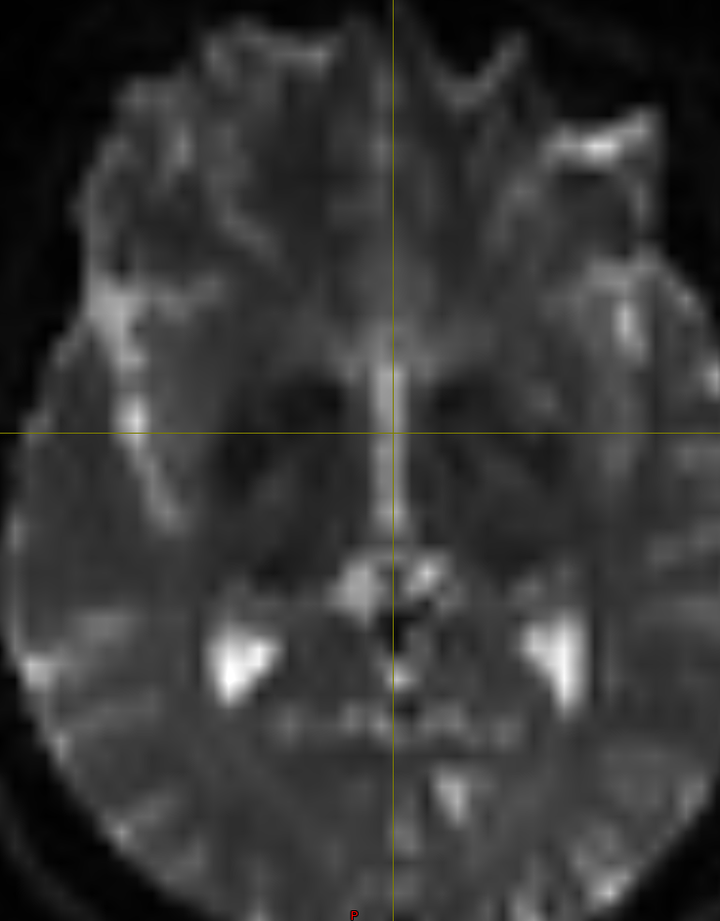
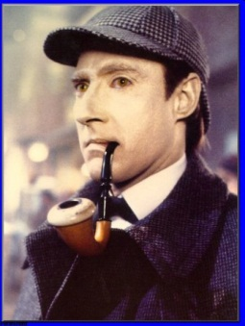
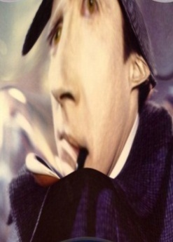
Unwrap tackles non-linear distortion from magnetic field inhomogeneities (movement by inhomogeneity interaction)
Different substances in the brain are differentially magnetised susceptible to magnetization
2) Inhomogeneity of the magnetic field
3) Distortion of the image
Notes:
Is fairground mirror analogy correct -
When placed in a large magnetic field, tissues are temporarily magnetized, with the extent of the magnetization depending on the magnetic susceptibility of the tissue.
The brain has different types such as grey/white matter, and substances such as CSF, Blood and so on which have slightly different magnetization. This alters the local magnetic field.
Local magnetic fields tend to take on different configurations around these interfaces, and introduces geometric distortion into the resultant images.
These distortions occur along the phase encoding direction (A to P)
This distortion is especially noticeable at air-tissue or bone–soft tissue boundaries (e.g.orbitofrontal cortex/anterior medial temporal lobes), because air and bone have much lower magnetic susceptibility.
These distortions will vary with subject position. Thus is known as movement by inhomogeneity interaction
In these areas like a funny mirror at fair ground anlogy where the mirror represents the unevenness of the magnetic field whereby if you move forward the distortion will be different and if we were to take different snapshots at each position then realignment would not suffice to bring into a common space because of the warping.
EPI images are not particularly faithful reproductions of the object, and in particular there are severe geometric distortions in regions where there is an air-tissue interface (e.g. orbitofronal cortex and the anterior medial temporal lobes). In these areas in particular the observed image is a severely warped version of reality, much like a funny mirror at a fair ground. When one moves in front of such a mirror ones image will distort in different ways and ones head may change from very elongated to seriously flattened. If we were to take digital snapshots of the reflection at these different positions it is rather obvious that realignment will not suffice to bring them into a common space.
The situation is similar with EPI images, and an image collected for a given subject position will not be identical to that collected at another. Hence, even after a "successful" realignment there will be residual variance caused by the object having different shape at different time points. We call this effect susceptibility-by-movement interaction. "Unwarp" is predicated on the assumption that the susceptibility-by-movement interaction is responsible for a sizeable part of residual movement related variance.
The situation is similar with EPI images, and an image collected for a given subject position will not be identical to that collected at another. Hence, even after a "successful" realignment there will be residual variance caused by the object having different shape at different time points. We call this effect susceptibility-by-movement interaction. "Unwarp" is predicated on the assumption that the susceptibility-by-movement interaction is responsible for a sizeable part of residual movem nt related variance.

Slide 21
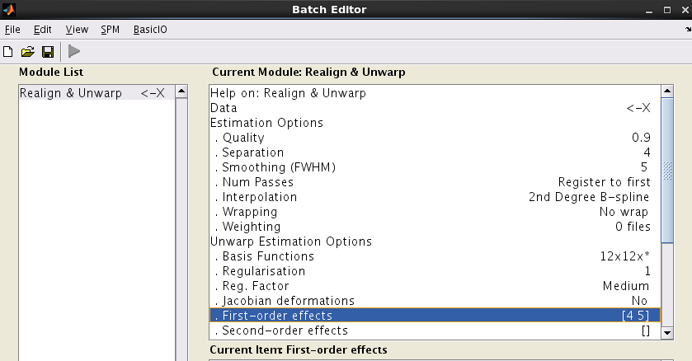
Movement parameters influencing field
Notes:
Because one would expect field to depend only on subject out of plane rotations (pitch and roll) ; in SPM these are the only parameters used in unwarping as standard (4+5) so that is used unless good reason otherwise – leaving second order effects blank) – so you don’t use second order parameters (X+Y+Z + Yaw)

Slide 22
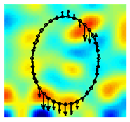

Field Maps
Measure field inhomogeneity using a field map
Using this map derive a deformation field (how voxels in volume are deflected due to distorted field)
Notes:
Unwarp can estimate changes in distortion from movement by estimating how the deformations change when the subject changes position.
We can explicitly measure the field inhomogeneity using a field map.
Dedicated scan before the start of experiment to measure this
Using this map we can derive a deformation field, which details how the voxels in the volume are deflected due to the distorted field. (i.e. little vectors at each position in space showing how that particular location has been deflected)
By applying the inverse of this deformation field, voxel displacement due to inhomogeneity is undone
This is done by formulating the inverse problem, i.e. given the observed variance (after realignment) and known (estimated) movements, we can estimate how deformations change with subject movement.
To do this we iterate: 1) estimate movement parameters, 2) estimate deformation fields, 1) re-estimate movement …and so on..
We have made an attempt at formulating such an inverse model, and at solving for the "derivative fields". A deformation field can be thought of as little vectors at each position in space showing how that particular location has been deflected. A "derivative field" is then the rate of change of those vectors with respect to subject movement. Given these "derivative fields" we should be able to remove the variance caused by the susceptibility-by-movement interaction. Since the underlying model is so re tricted we would also expect experimentally induced variance to be preserved. Our experiments have also shown this to be true. Indeed one particular experiment even indicated that in some cases the method will reintroduce experimental variance that had been obliterated by movement related variance.

Slide 23

Measure deformation field (FieldMap).
Estimate new distortion fields for each image
Unwarp time series
Estimate rate of change of field with respect to current estimate of pitch & roll
Estimate movement parameters
Δϕ
+Δθ
Notes:
In unwarping we calculate a deformation field from a single field map at the beginning of the series, then use the pre-calculated (from the realign procedure) rigid movement parameters to estimate the warping of that field map for each time point in the series.
(distortion parameters are first order effects – one would expect field to depend only on subject out of plane rotations (pitch and roll) so that is used unless good reason otherwise – leaving second order effects blank)
1) Measure the distortion field with Fieldmap, dedicated scan at start which measures field inhomogeneity. Dedicated scan before the start of experiment to measure this. Using this map we can derive a deformation field, which details how the voxels in the volume are deflected due to the distorted field. (i.e. little vectors at each position in space showing how that particular location has been deflected)
Observe subject motion parameters (observed from realignment)
Change in deformation field with subject movement estimated via iteration
Gives estimate of distortion at each time point and unwarps the time series (?apply inverse)
(equation denotes change in distortion field with respect to change in parameters)
http://www.fil.ion.ucl.ac.uk/spm/toolbox/unwarp/#Rationale
Assume that we know how the deformations change when the subject changes position (i.e. we know the derivatives of the deformations with respect to subject position). That means that for a given time series and a given set of subject movements we should be able to predict the "shape changes" in the object and the ensuing variance in the time series. It also means that, in principle, we should be able to formulate the inverse problem, i.e. given the observed variance (after realignment) and known (esti ated) movements we should be able to estimate how deformations change with subject movement.
We have made an attempt at formulating such an inverse model, and at solving for the "derivative fields". A deformation field can be thought of as little vectors at each position in space showing how that particular location has been deflected. A "derivative field" is then the rate of change of those vectors with respect to subject movement. Given these "derivative fields" we should be able to remove the variance caused by the susceptibility-by-movement interaction. Since the underlying model is so re tricted we would also expect experimentally induced variance to be preserved. Our experiments have also shown this to be true. Indeed one particular experiment even indicated that in some cases the method will reintroduce experimental variance that had been obliterated by movement related variance.
In theory it should be possible to estimate also the "static" deformation field, yielding an unwarped (to some true geometry) version of the time series. In practice that doesn't really seem to work, hence the method deals only with residual movement related variance induced by the susceptibility-by-movement interaction.
Combined use with FieldMap
This means that the time-series will be undistorted to some "average distortion" state rather than to the true geometry. If one wants additionally to address the issue of anatomical fidelity one should combine Unwarp with a measured field-map. A field-map in the format that Unwarp expects can be created using the FieldMap toolbox.
The description above can be thought of in terms of a Taylor expansion of the field as a function of subject movement. Unwarp alone will estimate the first (and optionally second, see below) order terms of this expansion. It cannot estimate the zeroth order term (the distortions common to all scans in the time series) since that doesn't introduce (almost) any variance in the time series. The measured fieldmap takes the role of the zeroth order term. Refer to the FieldMap toolbox and the documents FieldMap.man and FieldMap_principles.man for a description of how to obtain fieldmaps in the format expected by Unwarp.
A deformation field indicates the directions and magnitudes of location deflections throughout the FOV with respect to the real object.

Slide 24
Practicalities of unwarping
Particularly useful when the movements correlate with activation of interest as can remove unwanted variance without removing “true” activations.
Can dramatically reduce variance in areas susceptible to greatest distortion (e.g. orbitofrontal cortex and regions of the temporal lobe).
Useful when high field strength or long readout time increases amount of distortion in images
Notes:
Unwarp is of use when variance is due to large movement.
Useful particularly when movements correlated with activations of interest which is why using movement parameters as confounds in the statistical model of activations is not advised
Can also be computationally intensive.
Limitations
It doesn’t remove movement-related residual variance coming from other sources, such as spin-history effects and slice-to-volume effects

Slide 25
Summary
Importance of motion in fMRI
Corrected by using realignment and rigidly registering each volume to a reference
Then reslice – interpolate images to match reference voxels
Movement by distortion interaction corrected by unwarping
Notes:
Covariation: could include the movement parameters as confounds in the statistical model of
activations. However, this may remove activations of interest if they are (heavily)
correlated with the movement, and can only account for linear transformations.
In the end you get is resliced copies of your images (with the letter ‘u’ appended to the front) that have been
realigned (to correct for subject movement) and
unwarped (to correct for the movement-by-distortion interaction) accordingly*.
These images are then taken forward to the next preprocessing steps (next week!).

Slide 26
References
SPM 12 Manual - www.fil.ion.ucl.ac.uk/spm/doc/manual.pdf
SPM course slides - www.fil.ion.ucl.ac.uk/spm/course/
Previous MfD slides

