Slide 1

fMRI Study Design & Efficiency
Alexandra Hopkins
Notes:
It is important to design fMRI experiments that are sensitive to (efficient for) a specific hypothesis (i.e, have an appropriate statistical planned comparison or "contrast").
The properties of the BOLD signal measured by fMRI—particularly its temporally rubbish nature—can make the design of efficient experiments a bit intractable to intuition.

Slide 2
Part I - Study Design

Slide 3
Study Design
“The strategy in an fMRI (and indeed any) experiment is based on an intervention in a system (brain) and observation of the modulation of the system response (BOLD effect) resulting from this ‘provocation’ (cognitive task, or in this context, paradigm)” - Amaro & Barker 2006 (Brain & Cognition)
i.e. have to manipulate the participants’ experience and behaviour in some way that is likely to produce a functionally specific neural response and make inference about that response
Does our design allow us to test our hypothesis?
Notes:
I’d like to start off with a quote by Amaro and Barker, which I think sums up nicely what we are trying to achieve when we design a study in order to investigate a hypothesis. )
So in other words, in order to understand what the brain does, we have to manipulate the participants’ experience and behaviour in some way that is likely to produce a functionally specific neurovascular response and make inference about that response.
It is kind of like how throwing a stone into a lake and observing the ripples allows us to understand more about the properties of the lake and of water itself.
A key question we need to ask when considering how we design our study is can we actually test what we want to test with the design we are using. Does this design allow us to make the inference we want to make.
In addition, the behaviour needs to be measurable within a realistic time period (most subjects can only handle about an hour).
Theoretically, longer scans are better, of course, because the power of statistical inference depends primarily on the number of degrees of freedom (df).
The df's depend on the number of scans (volumes).
Hypothetically, reducing the TR (inter-scan interval) will also increase power. However, the "effective" df's depend on the temporal autocorrelation of the sampled data
(in other words, 100 scans rarely == 100 independent observations). There is, therefore, a limit to the power increase afforded by shorter TRs.

Slide 4
What can we manipulate?
Stimulus type, e.g. visual/auditory/tactile
Stimulus properties
  Physical properties e.g. the frequency of a tone
  Cognitive properties e.g. whether a stimulus is associated with reward or not
Stimulus timing, e.g. inter-stimulus interval
Notes:
We can manipulate many different things in order to understand whatever process we are interested in, we can manipulate the type of stimulus we use – visual, auditory, tactile. We can also manipulate the properties of that stimulus, either in a physical way, for example, the frequency of a tone or in a cognitive way, for example, whether a stimulus is associated with reward or not.
We can also manipulate the timing between stimuli, which as we will see is an aboslutely essential part of designing an fmri experiement effectively. Because stimulus timing is heavily constrained by the physics of the BOLD response and this aspect of the design is especially important so I am going to talk a lot about stimulus timing later on in the talk. If the timing of the stimuli are not correctly presented, this can lead to errors in inference.

Slide 5



STUDY DESIGN
Statistical parametric map (SPM)
Image time-series
Kernel
Design matrix
Realignment
Smoothing
General linear model
Statistical
inference
Gaussian
field theory
Normalisation
Template
p <0.05
Parameter estimates
Notes:
Your study design plays an essential role in the processing hierarchy. Your design determines what the design matrix looks like, what parameters you can estimate, what contrasts you can compute and what questions you can answer at the level of inference.
A good study design gives you results that are straightforward and easy to interpret

Slide 6
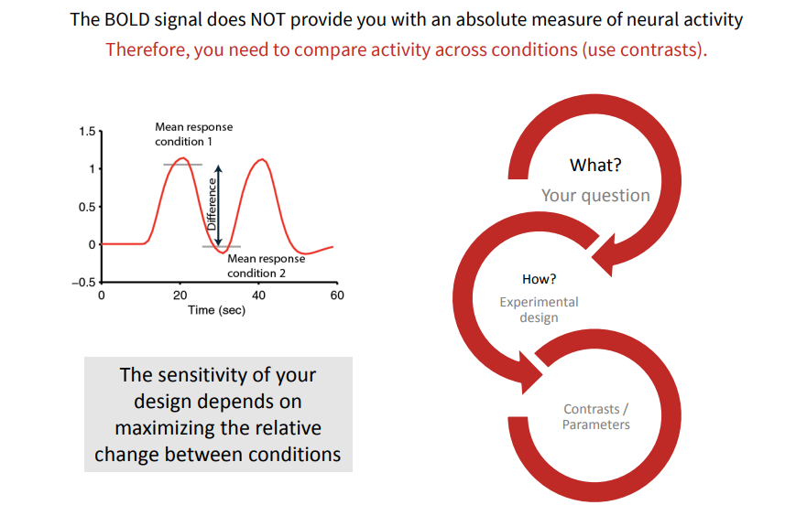
Contrasts
Notes:
An important thing to consider with any experimental design is that the BOLD signal does not provide an absolute measure of neural activity, you need to compare activity across conditions using contrasts. The sensitivity of your design depends on maximising the relative change between conditions. So we are always making a relative comparison.

Slide 7
Comparison Strategies
Subtraction
Factorial
Parametric
Notes:
There are different ways of making that relative comparison, which you need to consider when designing your experiment.
Choices for experimental paradigm:
– Subtraction / hierarchical
– Factorial
– Parametric
– Conjunction
– Adaptation

Slide 8
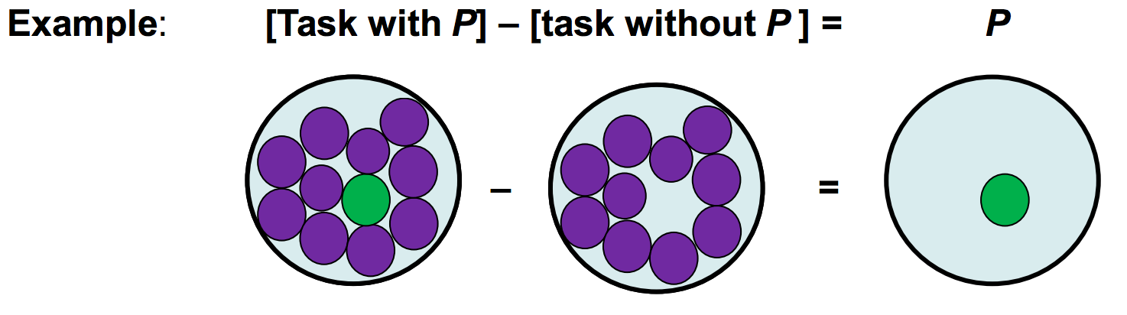
Subtraction
Compares neural signal from task that activates process of interest and a second task that controls for all but the process of interest
Any BOLD signal difference between images (above set statistical limits) is assumed to represent all brain regions involved in that task
Notes:
Most simple design. Compares neural signal from task that activates process of interest and a second task that controls for all but the process of interest
For example, here we have an image taken from our task with process p and we subtract an image taken from a control task without process p, with the aim of isolating and being able to identify the neuronal structures that just underly process p. Any BOLD signal difference between images (above set statistical limits) is assumed to represent all brain regions involved in that task.
More on pure insertion: Insertion of a single cognitive process does not affect any other processes. Interactions between two cognitive processes would invalidate subtraction analysis Violation of Pure Insertion would mean results uninterpretable.
Example of failure of PI: Jennings, et al., 1997, Comparison of semantic and letter judgment tasks using three different modalities: mouse, vocal, and covert (silent/mental). Interaction between modality and task in left inferior prefrontal cortex
Cannot distinguish whether change due to modality or task.
Subtraction analysis assumes pure insertion holds - baseline/control task does not engage any other processes
Example
Subtraction of word naming from verb generation
Word naming does not require semantic processes
What if this control condition automatically engages these processes anyway

Slide 9
However….
CHALLENGE → Very hard to find a good control task
  ‘pure insertion’ – assumes that adding more cognitive components does not affect other processes in the task – asserts no interactions
  This assumption is false most of the time (if not always!) – better at low level processes
Notes:
However, there is a problem in that is is very difficult to find a good control task and your experimental condition is only as good as what your control condition is.
There is a problem in that it relies on the assumption of ‘pure insertion’ – assumes that adding more cognitive components does not affect other processes. Asserts there are no interactions among the cognitive components of a task. So in this diagram we assume that adding this green component P here in our experimental condition, doesn't’t affect all these other purple components.

Slide 10
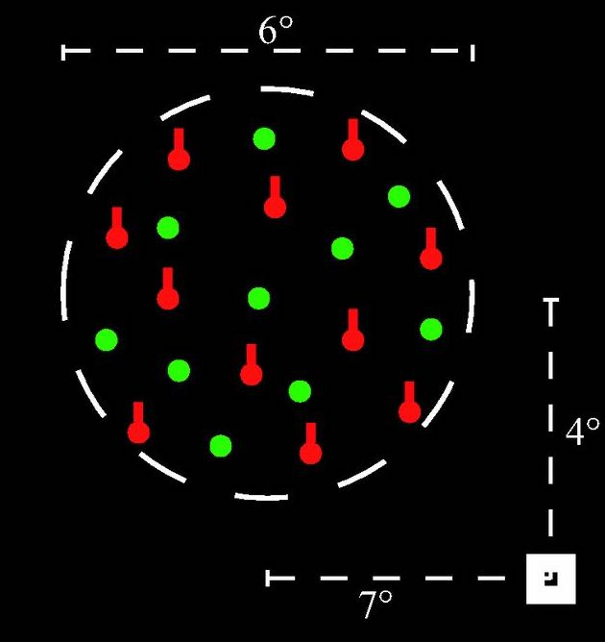
Problem with Subtraction
Example (taken from Friston et al., 1996)
Imagine an experiment…
-> Visual stimuli that are in motion
→ Selectively attend to motion or not
[Selective attention – no selective attention]
→ Found V5 activation!
-> Conclude V5 is activated when asked to attend to motion
Actually represents interaction!
→ V5 activation in response to motion; enhanced by selectively attending to motion.
Notes:
Imagine an experiment where we have some perceptual stimuli that are moving. Subjects are either asked to selectively attend to the motion of the stimuli or to divide their attention between other aspects of the stimuli e.g. colour, shape etc. so we would have a subtraction contrast of selective attention – no selective attention. And we find V5 activation in in the presence of selective attention. So we conclude from that that V5 must have a role in selective attention to motion. So what this means is that if I am being asked to look out for motion in the environment, that will activate V5 area. HOWEVER this is an erroneous conclusion because this effect is actually dependent on the presence of the motion itself, so it actually is representing an interaction. The fact that I am being asked to look out for motion in the environment only activates my v5 area BECAUSE there is motion in the environment. However, because we did not explciity test this we have no way of knowing. So this highlights the difficulty in interpretation that arises from these kinds of analyses. Having said that, there are advantages such as the fact that it is very simple to analyse and therefore leads to reproducible data
Image taken from:
Effects of task and attentional selection on responses in human visual cortex (Runeson et al., 2013)

Slide 11
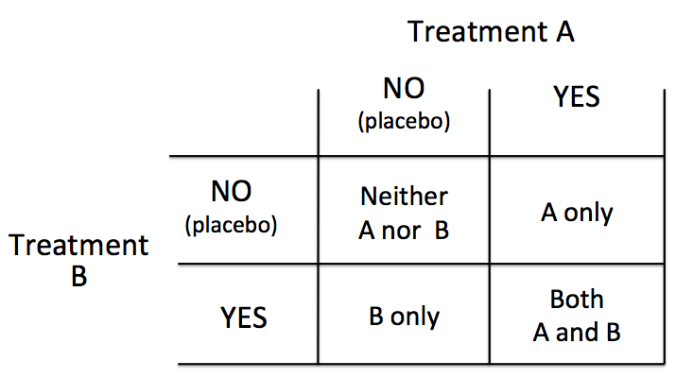
Factorial
Two or more variables (or factors) and the different levels of each variable are matched
Test for interactions explicitly
‘…perform a task where the cognitive components are intermingled in one moment, and separated in another’ (Amaro & Barker, 2006)
2 factors x 2 levels = 4 conditions
Notes:
A factorial design is where two or more variables and the levels of each variable are matched – this allows us to test for interactions explicitly. What we end up with are 2 factors with 2 levels each to make 4 conditions in total. So we end up with a task where cognitive components are intermingled in one moment and separated in another.

Slide 12
Factorial approach
->With subtraction – erroneously concluded that V5 is activated when being asked to attend to motion
Extra conditions --> task X stimuli interaction
→ v5 activate to motion and enhanced activation to motion with selective attention
→ No v5 activation to no motion with selective attention
Now we can see that being asked to selectively attend to motion only activates V5 area if visual motion is actually present
 |  | Task
 |  | Attend to motion | Do not attend to motion
Stimuli | Visual Motion | Interaction | Main effect motion
 | No Visual Motion | Main effect attention | Neither
Notes:
So if we revisit the earlier example, with subtraction we erronously concluded that v5 is always activated when being asked to attend to motion.
With a factorial design, we have some extra conditions to allow us to explicitly test whether this effect depends on motion or not.
The results indicate v5 activates to motion, an interaction between motion and attention BUT no main effect of attention. Now we can actually see that being asked to selectively attend to motion only activates v5 area if visual motion is actually present

Slide 13
Parametric
Vary parameter of interest along continuum and relate to BOLD signal
Can incrementally increase difficulty of task
Any changes in BOLD between trials would imply a heavy association between active regions and parameter being manipulated
e.g. Working memory task (Seidman et al., 1998)
  Baseline: respond to all letters
  Task 1: respond if A preceded by Q (e.g. QA)
  Task 2: respond if A preceded by Q, separated by three letters (e.g. QrctA)
However, other circuits may be recruited at higher cognitive demand, still assumes that parameter of interest is only thing changing
Notes:
Until now we have only discussed categorical analyses. Sometimes we might want to look at an effect of interest in a continuous fashion. Parametric designs allow us to vary a parameter of interest along a continuum and relate that to increase in BOLD signal. A nice thing to do is incrementally increase difficulty of task and relate this to BOLD signal which provides convincing evidence of the brain regions importance in that task.

Slide 14
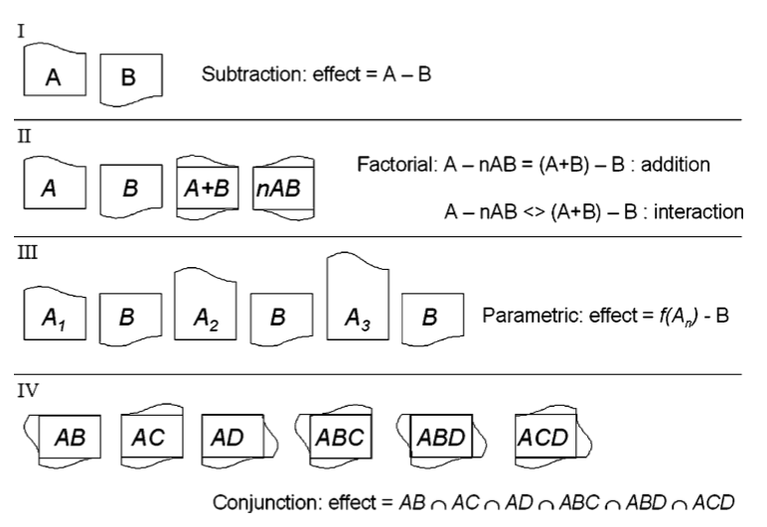
Summary
Amaro & Barker (2006)

Slide 15
Stimulus presentation strategies
Blocked
Event Related
Mixed
Notes:
We have talked about study design in relation to comparison strategies. Now I will discuss stimulus presentation strategies and here we need to be aware of the physiology of the BOLD signal.

Slide 16
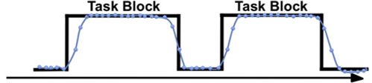
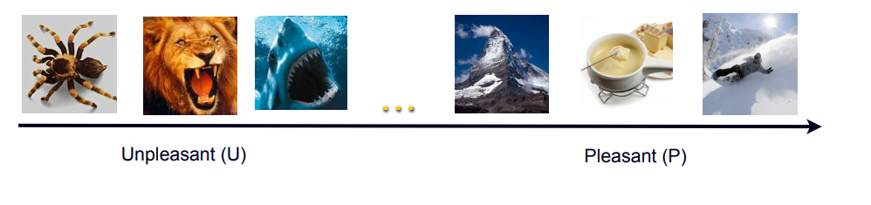
Block design
Alternating between task conditions
e.g. [ Task A rest Task B rest Task A rest Task B rest ]
  Typically 20-60 seconds, optimally around 20 seconds
  Ignore details of HRF and set up steady state of neuronal change
  Based on Huettel (Chapter 9)
Notes:
Easy to analyse. Typically 20-60 seconds. Optimal is 20 seconds. The idea is to ignore the details of the temporal characteristics and set up a ‘steady state’ of neuronal and hemodynamic change. Tom’s: 24s.
Typically about 30 seconds with three or four complete cycles of the two contrasting tasks
This signal increase (the positive BOLD eVect) is proportional to the underlining neural activity (Logothetis & PfeuVer, 2004) and eventually reaches a plateau if the stimulus is maintained for a sufficient time
The alternation of two conditions is known as an ‘AB block’ design, in which a ‘cycle’ corresponds to two epochs of each condition. This design dominated the Wrst years of fMRI experimentation, adopting a subtraction comparison strategy

Slide 17
CONS:
Not all hypotheses can be probed in this manner, e.g. the ‘oddball’ paradigm
Habituation/expectancy effects
Might be cumulative effects on mood
PROS:
Simple and easy to analyse
Strong detection/statistical power
Don’t need to have accurate estimation of HRF
Notes:
Largely linear response characteristics

Slide 18
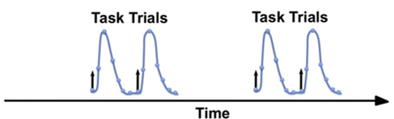
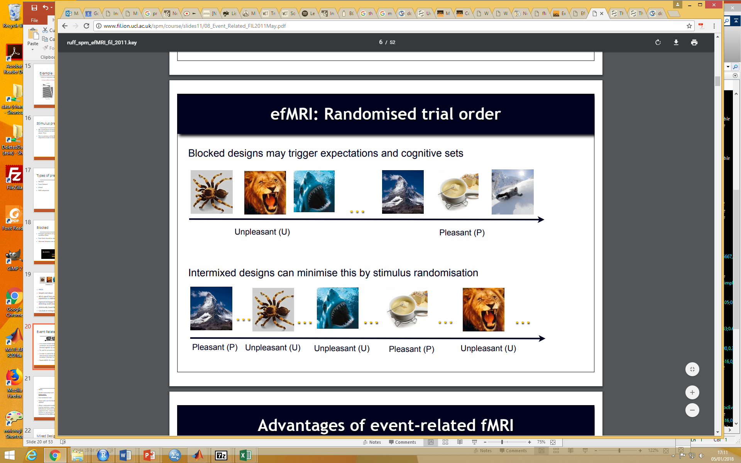
Event Related Design
Evoke process of interest transiently by brief presentation of individual stimuli
Trials presented in a randomised order, rather then being blocked together by condition
Takes into account HRF shape and timing
Notes:
Makes use of temporal response pattern in the hemodynamics, e.g. brain regions correlated to the task can have different HRF
Rapid erfMRI with interstimulus intervals varied between 4 and 6 seconds considered optimal
er fMRI – event related fMRI
Can vary ISI
Ability to detect transient variations in hemodynamic responses, allowing the temporal characterization of BOLD signal changes: the HRF introduced above
ITI: inter-trial interval

Slide 19
PROS:
Can randomize trials - Avoids expectation and habituation
Allows post-hoc classification - to differentiate trials not defined at the time of scanning e.g. encoding strength to memory performance
Some tasks cant be blocked e.g. oddball
CONS:
More complex design and analysis (especially timing issues)
Reduced statistical power
  Smaller evoked changes in BOLD signal
  Larger switching cost between conditions?
Notes:
CONS: If conditions have large switching costs then may be unsuitable

Slide 20
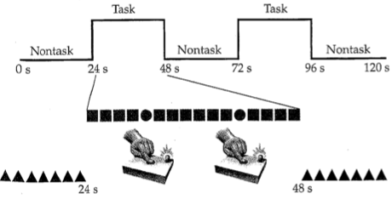
Mixed designs
Combination of blocked and event-related designs
Stimulus present in regular blocks; >1 types of events per block
Analysis of IVs on different time scale
  Block -> state-related processes (e.g. attention)
  Event -> item-related processes (e.g. button press)
  Difficult analysis! – very sensitive to errors in HRF modeling
Example of a mixed design:
Within task block, subject pressed button in response to infrequent target circles, ignoring non-target square.
Notes:
Combination of blocked and event related design. have stimuli in blocks, with more than one event type per block. allows you to look at IVs on two different time scales. for example, within each task block a subject presses buttons in response to infrequent target circles ignoring non-targets. Might want to look at the effect of attention, which is a more state related process but also the effect of the task on top of that, so pressing the button. So a mixed design allows you to dissociate between these things, but it is quite difficult to analyse and Misattribution of the BOLD signal across components can greatly affect one's results and conclusions. VERY sensitive to errors in HRF modeling.

Slide 21
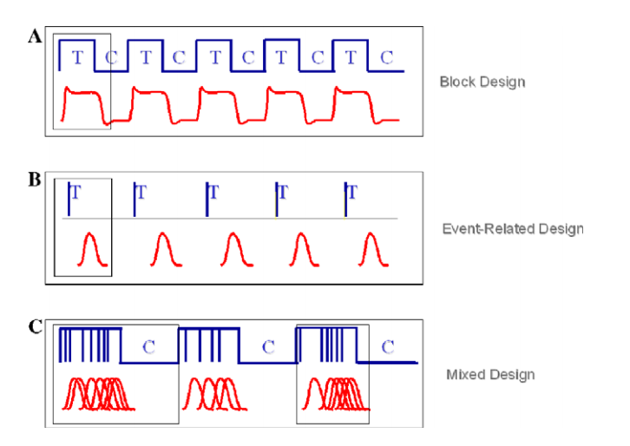
Notes:
From Amaro et al (in bibliography)

Slide 22
Part II: Efficiency and optimisation of fMRI designs
Notes:
It is important to design fMRI experiments that are sensitive to (efficient for) a specific hypothesis (i.e, have an appropriate statistical planned comparison or "contrast").
The properties of the BOLD signal measured by fMRI—particularly its temporally rubbish nature—can make the design of efficient experiments a bit intractable to intuition.

Slide 23
General advice
For group-level inference larger sample sizes are better
  Power depends more heavily on number of subjects than number of scans per subject
Run each scan as long as possible (40-60 min) – increase power due to higher number of scans
Keep subject as busy as possible
Fewer conditions/contrasts are better – easier and more power
Notes:
First some general advice from Rik Henson, who put together a really comprehensive guide on study efficiency. The greater the between subject variance in comparison to within subject variance, the more important sample size becomes. But depends on question, for example if you are interested in individual differences the within subject variability is more important
Of course not scanning longer than the subject can show satisfactory behavior

Slide 24
Technical considerations
A good fMRI experiment needs 2 things:
Induce subject to do or experience the psychological state that you want to study (psychological)
Effectively detect brain signals related to those psychological states (statistical)
You can have a great psychological experiment with huge neuronal response, but be completely unable to identify this in fMRI-signal
Notes:
Because you have designed your task in such a way that you cannot dissociate the BOLD signal

Slide 25
Reminder GLM
General Linear Model:
Y = X . β + ε
Data Design Matrix Parameters error
Efficiency(e) is the ability to estimate β, given the design matrix (X) for a particular contrast (c) and the given noise variance (σ²)
  e (c, X) = inverse (σ² c^{T} Inverse(X^{T}X) c)
The efficiency for each contrast is different
We can calculate the efficiency just based on the contrast and design matrix before we have seen any data!
We can directly influence our efficiency by manipulating the timing and sequence of stimuli
Notes:
So what do we mean when we talk about efficiency? Efficiency(e) is the ability to estimate β, given the design matrix (X) for a particular contrast (c) and the given noise variance (σ²).
The efficiency for each contrast is different – need to optimise depending on most important one
We can calculate the efficiency just based on the contrast and design matrix before we have seen any data!
We can directly influence our efficiency by spacing and sequencing our events
β = relative contribution that each regressor has, the larger the β value = the greater the contribution

Slide 26
Stimulus timing
Simplest case: one condition against baseline
Notes:
The next few slides will discuss statistical efficiency from the perspective of stimulus timing.

Slide 27
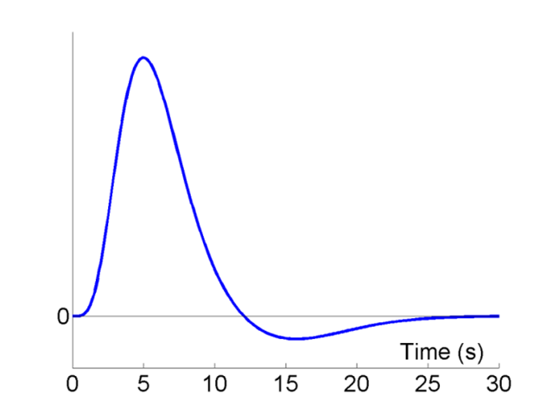
BOLD response
HRF
The relation between a burst of neuronal activity and the BOLD signal is captured by Haemodynamic Response Function (HRF)
2 difficulties for design timing:
BOLD response is very sluggish
Low frequency drifts in fMRI signal, need to be filtered out by high-pass filter
Peak
Undershoot
Rik Henson’s SPM guide:
http://imaging.mrc-cbu.cam.ac.uk/imaging/DesignEfficiency
Alessandro G. Allievi et al. Cereb. Cortex 2015
Notes:
The relation between a burst of neuronal activity and the BOLD signal is captured by Haemodynamtic Response Function (HRF)the max BOLD signal peaks after 6 seconds, returns to baseline, and then undershoots between 10-25 s, and goes back to 0 after 25-30 sec; it’s a very slow response.
So we have some difficulties. Firstly that the BOLD response is sluggish
Because the BOLD is delayed and spread out relative to the underlying neuronal activity and that means that the regressors you want to put in design matrix must be delayed and spread out as well or they won’t fit the data.
and secondly, due to noise artefacts, we get low frequency drifts in fMRI signal, need to be filtered out by high-pass filter
HRF ACTS AS FILTER

Slide 28
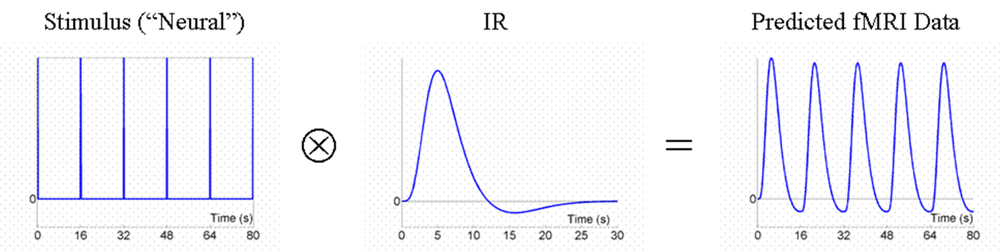
Fixed stimulus onset asychrony (SOA)= 16s
Detection of signal in background noise works best if variability of neural signal is maximised
Signal that varies little will be difficult to detect → not particularly efficient design
Rik Henson’s SPM guide:
http://imaging.mrc-cbu.cam.ac.uk/imaging/DesignEfficiency
Notes:
So keeping in mind our HRF, how should we present our stimuli in order to maximise efficiency? Manipulate the stimulus onset asynchrony - the time between the onsets of stimuli.
To be best able to detect the signal in the presence of background noise, we want to maximize the variability of that signal. Maximising efficiency is maximising the signal variance.
A signal that varies little will be difﬁcult to detect BECAUSE THERE WONT BE ANY CONTRAST BETWEEN HIGH AND LOW ACTIVITY. Larger signal variance has larger signal amplitude.
This example (with a ﬁxed SOA of 16 s) is not particularly efﬁcient, although there is some variability in the signal, we might get a more efficient design faster
To obtain predicted fMRI time series: Convolve stimulus function with a haemodynamic response
Maximizing the efﬁciency of a design is equivalent to maximizing the ‘energy’ of the predicted fMRI time-series, i.e. the sum of squared signal values at each scan (equal to the variance of the signal, after mean correction).

Slide 29
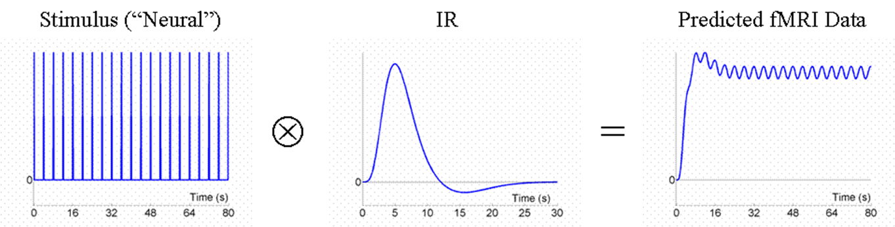
Fixed SOA = 4s
Rik Henson’s SPM guide:
http://imaging.mrc-cbu.cam.ac.uk/imaging/DesignEfficiency
Because the responses to events now overlap considerably, we see an initial build up followed by small oscillations around a ‘raised baseline’.
Overall signal is high, but variance is low → less efficient design
Notes:
So, what if we present the stimuli much faster, say every 4 s?
Because the responses to successive events now overlap considerably, we see an initial build up (transient) followed by small oscillations around a ‘raised baseline’.
Although the overall signal is high, its variance is low. If variance is low there wont be enough signal to use as a comparison – wont have the contrast between high and low activity – NO BASELINE TO COMPARE IT TO
So this is an even less efﬁcient design.
HAD HIGH FREUENCIES REMOVED BY HRF
and the majority of stimulus energy will be lost after highpass ﬁltering (particularly after removal of the mean, i.e. lowest frequency).

Slide 30
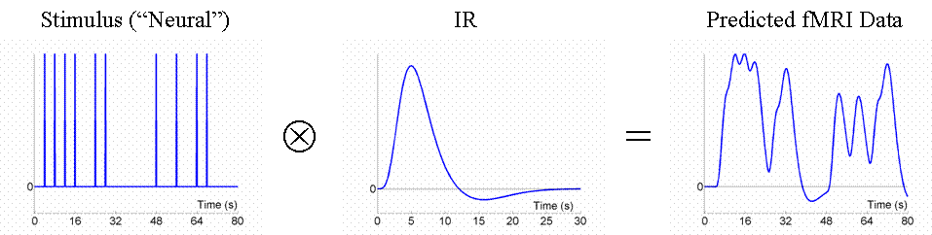
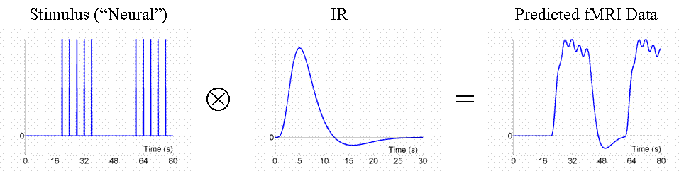
Stochastic and blocked event presentation ->very efficient
Random SOA minimum 4s e.g. event-related: larger variability in signal
HRF
Blocked, SOA 4s: larger variability in signal
HRF
Notes:
We don;t have to use a fixed SOA. Here we are using a random SOA with a minimum of 4 seconds apart – introduced jitter/null events. Though we only use half as many stimuli as in Fig 3, this is a more efficient design. This is because there is a much larger variability in the signal (and we know how this signal varies, even though we generated the event sequence randomly, because we know the specific sequence that resulted). SAMPLING FROM WHOLE RANGE OF FREQUENCIES
CAN ALSO VARY SOA IN SYSTEMATIC FASHION. HAVE RUNS OF EVENTS FOLLWOED BY RUNS OF NO EVENTS in 20 second blocked epochs. this corresponds to blocked design. this is most efficient design. losing very little signal.
THIS IS BEST PRACTICE FOR THE EVENT AND BLOCK DESIGN

Slide 31
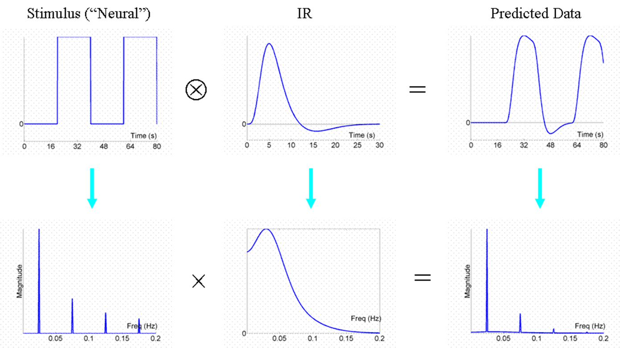
Fourier transform
HRF acts as low pass filter and removes high frequencies
FT converts time function into sum of sine waves of different frequencies – represent signal in frequency space
FT helps to see which components will pass the HRF filter
Rik Henson’s SPM guide:
http://imaging.mrc-cbu.cam.ac.uk/imaging/DesignEfficiency
Notes:
Since the HRF is very slow, The HRF ITSELF ACTS AS FILTER Too high frequencies are filtered out, this is called a low pass filter. This is why a lot of information was lost in the SOA = 4 design.
FT WAY OF representing a signal in frequency space. FT converts time function into sum of sine waves of different frequencies and allows us to see which frequencies will pass the HRF filter. You can see here that there is some signal drop off at the higher frequencies due to the slow BOLD Response.
The FT does not affect the data or conclusions, so why bother? It offers a slightly different perspective.
Foremost, a convolution in time is equivalent to a multiplication in frequency space.
In this way, we can regard the stimulus function (the neural activity) as our original data and the HRF (IR) as a ‘ﬁlter’.
One can see immediately from the shape of the FT of the HRF that this ﬁlter will ‘pass’ low frequencies, but attenuate higher frequencies (this is why it is sometimes called a ‘low-pass ﬁlter’ or ‘temporal smoothing kernel’). This property is why, for ex., much high-frequency information was lost with the ﬁxed SOA of 4 s.
In the present epoch example, the result of multiplying the amplitude spectrum of the stimulus function (neural data) by that of the ﬁlter is that some of the higher-frequency harmonics are attenuated, but the amplitude of the fundamental frequency is not (or not much). In other words, the majority of the signal is ‘passed’ by the HRF ﬁlter.

Slide 32
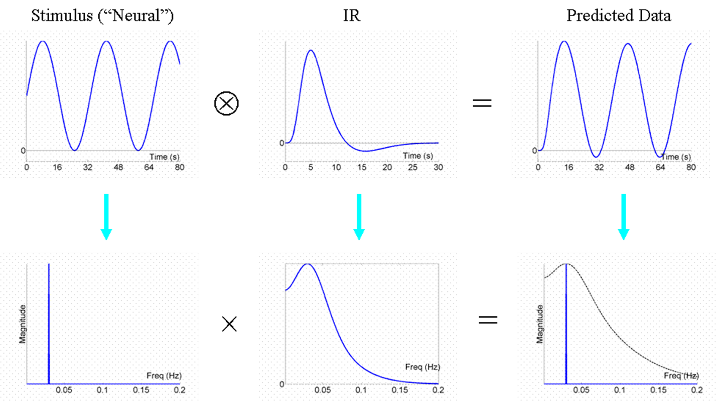
Most efficient design
Want majority of signal to be let through by HRF
The most efficient design has a stimulus frequency that matches the maximum frequency amplitude of the HRF
Modulate neural activity in sinusoidal fashion e.g. sinusoidally vary luminance of visual stimuli
Rik Henson’s SPM guide:
http://imaging.mrc-cbu.cam.ac.uk/imaging/DesignEfficiency
Peak of the amplitude spectrum of the HRF filter (0.03 Hz)/30 seconds
Notes:
FT allows us to find out what would be the most efficient design of all
In an ideal world, what we want is that the majority of the signal is ‘passed’ by the HRF and not filtered out. To achieve this, the stimulus frequency should be best aligned with the dominant frequency of the HRF (.03 Hz) or about 32 seconds. The frequency of change of the stimulus should correspond to the dominant frequency of change of the HRF. Can see the predicted data is almost the same as the signal you wanted to induce.
A sinusidoial function of .3 Hz is perfect for retaining most of the signal (about 32 seconds). Placing all the energy at one frequency. This is not possible for most designs because you have discrete events rather than modulated changes.

Slide 33
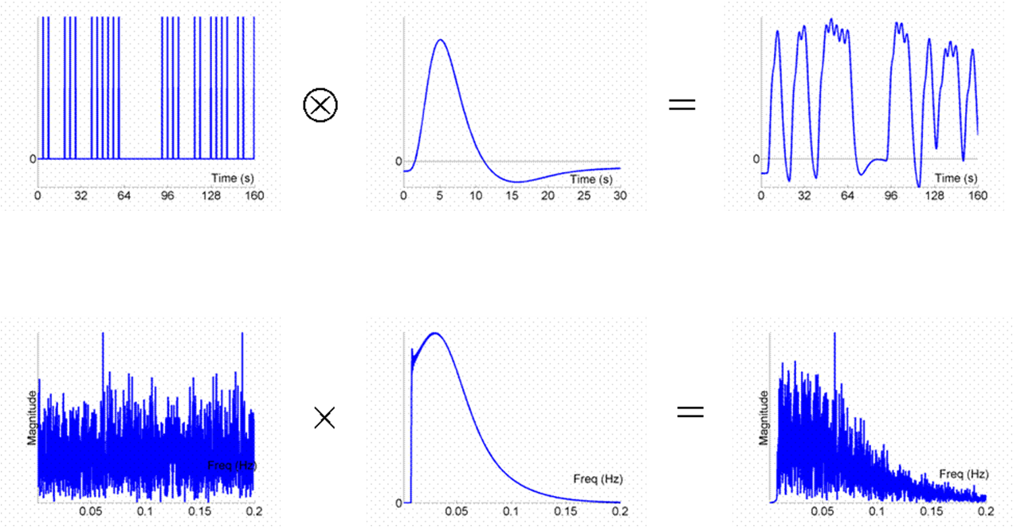
Revisiting stochastic design, SOA = min 4
Randomise onset
Signal is spread across a range of frequencies
Some signal is lost due to filtering, but a lot of it is passed
Best practice for event related designs
Rik Henson’s SPM guide:
http://imaging.mrc-cbu.cam.ac.uk/imaging/DesignEfficiency
Notes:
THIS IS THE SAME AS SHOWN EARLIER, JUST WITH FOURIER TRANSFORM VIEW. Finally, we can return to consider what happens in a stochastic design like that we saw previously.
The effect of the randomized SOA is to ‘spread’ the signal energy across a range of frequencies.
Some of the high- and low-frequency components are lost to the effective HRF (IR bandpass) ﬁlter, but much is passed, making it a reasonably efﬁcient design.
(for the fixed SOA=4s version, much more signal will live at high frequencies viz multiples of 0.25Hz and so will be lost).

Slide 34
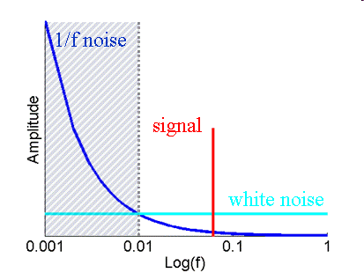
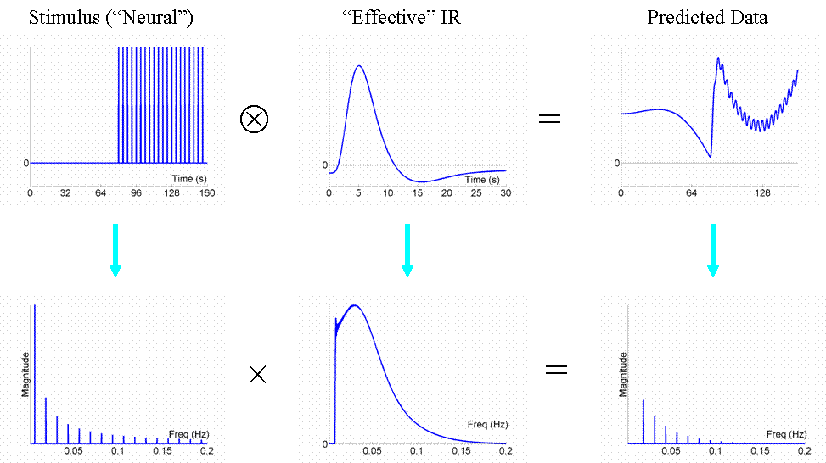
High-pass filtering
Low frequency noise in fMRI (e.g. scanner drifts)
High-pass filter cut-off in SPM 0.01Hz
Don’t design blocks of too much length (not longer than 50 sec), because high pass filtering would remove most of the signal
Don’t contrast conditions too separate in time
High-pass filter
Notes:
We can now also turn to the question of highpass ﬁltering. A high pass temporal filter is to remove any bias resulting from low frequency noise like scanner drift or gradual changes in ambient temperature. Low frequency changes in MR signal are collectively known as drift. Scanner drift is defined as slow changes in voxel intensity over time. high pass filter cuts off frequencies below a certain threshold. High pass filters are a reason why you should design blocks that are too long, as the filter would remove most of the signal at the low frequencies.
Don’t design blocks of too much length (not longer than 50 sec), because high pass filtering would remove most of the signal
HRF put constraints on it being too short, this constrains it from being too long.

Slide 35
2 or more conditions
Things get more complicated….

Slide 36
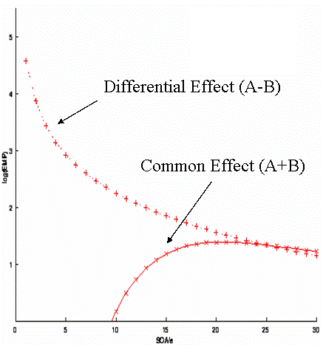
Different efficiency for different contrasts
Randomised design 2 events:
Common effect e.g. faces vs baseline
Differential effect e.g. sad vs happy faces
Optimal SOA for main effect (A+B): long SOA
Optimal SOA for differential effect (A-B): short SOA
Trade off!
Rik Henson’s SPM guide:
http://imaging.mrc-cbu.cam.ac.uk/imaging/DesignEfficiency
Notes:
A fully randomized design with two event-types (A and B, let’s say happy and sad faces).
We may want to ask
where in the brain is there a response to faces vs. Baseline (regardless of expression) --> common effect (the +1+1 contrast), and
where, within those regions responsive to faces (i.e., using a mask or functionally defined ROIs from the first contrast), is there a difference between happy and sad faces --> differential effect (the +1-1 contrast).
For this randomised design, the efficiency for both the differential and the common effect is shown in this figure. The SOA clearly differs for the two contrasts.
As I mentioned earlier, efficiency depends on the contrast of interest. Short SOA’s are optimal for the differential effect (A-B). But they are really bad for the main effect (A+B). We have a trade off.
WHY – BECAUSE WITH A SHORT SOA, THE SIGNAL NEVER RETURNS TO BASELINE, THEREFORE THERE WILL BE NO CONTRAST BETWEEN HIGH AND LOW ACTIVITY DUE TO LOW VARIABILITY. WE CAN STILL COMPARE BETWEEN CONDITIONS THOUGH, AND BECAUSE WE HAVE HIGH SIGNAL HERE, THIS IS OPTIMAL.

Slide 37
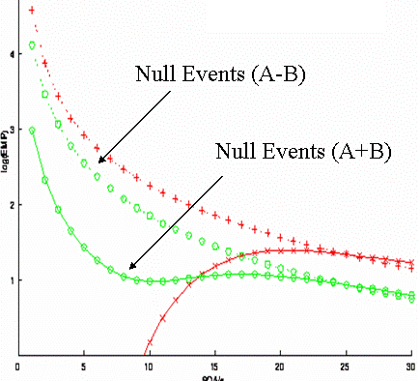
Timing: Null events
Convenient way of creating a stochastic design by randomising the SOA between the components of interest
Null events not different from baseline
Efficient for main AND differential effects at short SOAs – reduces trade off between contrasts
(A-B)
Efficiency
(A+B)
SOA (s)
Rik Henson’s SPM guide:
http://imaging.mrc-cbu.cam.ac.uk/imaging/DesignEfficiency
Notes:
Null events are a convenient way of creating a stochastic design by randomising the SOA between the components of interest. They are essentially like a fixation cross. Here you can see that this reduces the trade off between the two contrasts. Slightly impairs differential effect but at least can look at main effect now.
A further design concept concerns ‘null events’. These are not real events, in that they do not differ from the baseline and hence are not detectable by subjects (so are not generally modelled in the design matrix).
They were introduced by Dale and Buckner (1997) as ‘ﬁxation trials’, to allow ‘selective averaging’.
In fact, they are simply a convenient means of creating a stochastic design by shufﬂing a certain proportion of null events among the events of interest (producing an exponential distribution of SOAs).
In other words, null events provide a convenient way of randomising the SOA between the events of interest.
From the perspective of multiple event-type designs, the reason for null events is to buy efﬁciency for both the main effect and differential effect at short SOAs (at a slight cost to the efﬁciency for the differential effect).

Slide 38
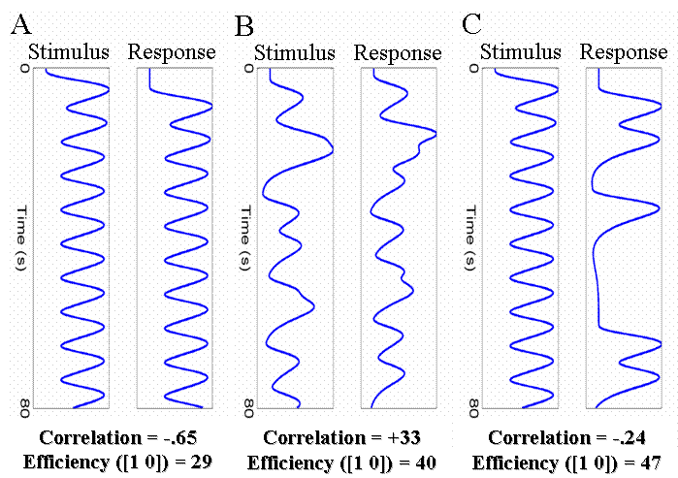
Correlation between regressors
High correlation between regressors can reduce efficiency to separate brain activity
If 2 events (e.g. stimulus and response in working memory paradigm) are highly correlated, you can’t determine which of both caused the BOLD signal
Fixed SOA
Jittered SOA
Fixed with half of trials
Notes:
The conception of efﬁciency in terms of correlations can help with the design of experiments where there is necessarily some degree of correlation among regressors.
WHERE YOU CAN’T RANDOMISE THE ORDER
Two main experimental situations where this arises are:
1--when trials consist of two events, one of which must follow the other: as in a working memory design (a trial consists of stimulus, short retention interval and a response).
2--blocks of events in which one wishes to distinguish ‘item-’ from ‘state-’ effects (i.e. transient from sustained responses).
With short SOAs between each event type (e.g. 4 s), the regressors for the stimulus and response will be negatively correlated as shown in A.
Solutions could be:
B -- Randomly vary (jitter) the time between successive stimuli and responses (assuming this is possible and that this variation is large, 1-8 s). So that the response doesn’t always occur at the same point after the stimulus
C -- Keep stimulus-response interval fixed at 4s, but only cue a response on a random half of trials.
Effect of both: Reduced correlation between the regressors, increases efficiency for separating the brain’s activity to stimuli and to responses.
The second case of experiment is not shown here but the separation of transient and sustained effects requires modelling blocks of trials in terms of both individual events within blocks and sustained epochs throughout the blocks. In an example with high correlations between event and epoch dregressors, the efficiency for detecting sustained and transient effects is low.
However, using the same total number of events per block, but with a pseudo-randomized design in which the events are randomly spread over the block with a minimal SOA of 2 s, the correlation is reduced and efﬁciency increased.
(A perverse consequence of having to introduce some long SOAs between events within blocks in such ‘mixed designs’ is that subjects may be less able to maintain a speciﬁc cognitive ‘state’.)

Slide 39
Conclusions
Optimal design for one contrast might not be optimal for another
Block design (short block length ~20sec) are most efficient
Block designs are often psychological not possible: stochastic designs with jittered SOA or null-events are also very efficient
Don’t have too long blocks/ contrast too separate in time, since it will be filtered out by high-pass filter
Estimate efficiency before experiment!

Slide 40
References
Rik Henson’s SPM guide:
http://imaging.mrc-cbu.cam.ac.uk/imaging/DesignEfficiency
Amaro Jr., E., & Barker, G. J. (2006). Study design in fMRI: Basic principles. Brain and Cognition, 60, 220-232. doi: 10.1016/j.bandc.2005.11.009
Calamante F. et al. (1999) Measuring cerebral blood flow using magnetic resonance techniques. J Cereb Blood Flow Metab 19, 701-35.
Dougherty D., Rauch S., Rosenbaum JF. (2004). Essentials of Neuroimaging for Clinical Practice
Huettel S., Song A., McCarthy G. (2009). Functional Magnetic Resonance Imaging McRobbie D. et al. (2008). MRI From Picture to Proton
Previous MfD slides
Thanks to our expert Tobias Hauser
19

Slide 41
MISC SLIDES

Slide 42
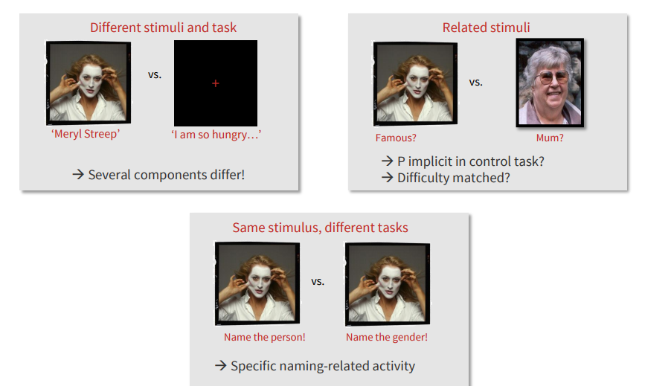
Modelling the BOLD response is simple (comparatively)
Leads to reproducible and ‘statistically confident’ data
Notes:
Example of a blocked design with visual stimulation. Reprinted in the Calamante paper from Kwong et al. [1992] Dynamic magnetic resonan::e imaging of human brain activity during primary sensory stimulation . Proc Nat! Acad Sci USA 89:5675-5679
An example problem for this subtraction method is what if lights off or on didn’t only differ by this property, what if subjects psychologically associated lights off with a particular thing/memory
A baseline image acquired during darkness (upper left) was subtracted from subsequent images. Eight of these subtraction images are displayed and were chosen when the image intensities reached a steady-state level , during darkness (OFF), and during 8Hz photic stimulation (ON).

Slide 43
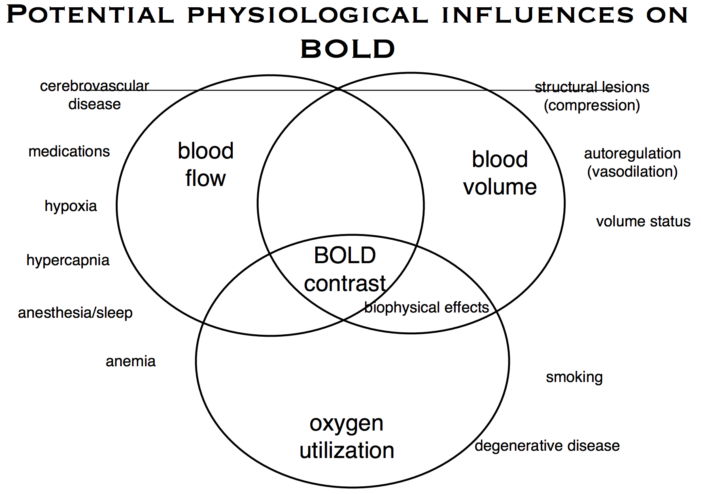
Don’t forget BOLD is a signal based in physiology…
Notes:
It is important to design fMRI experiments that are sensitive to (efficient for) a specific hypothesis (i.e, have an appropriate statistical planned comparison or "contrast").
One thing we do need to consider though, is that the properties of the BOLD signal measured by fMRI—particularly its temporally rubbish nature—can make the design of efficient experiments a bit intractable to intuition and with fMRI, we’re not just measuring neuronal activity.
We also pick up neuronal activation NOT under experimental control (e.g. what subject is thinking about, unconscious processing, processing relating to environment, e.g. ambient light). So any study needs be carefully designed in order to account for these effects.
Non-task related neuronal activation (ends up in error term E, an effect not in the design matrix):
Arterial pulsations: signal due to heart beat, changes in amount of oxygenated:deoxygebated blood, affects BOLD signal. As blood moves up and down due to ppulsation, changes in amt blood ratio. If you beat at about 18bpm to 120, signal will be0.8 Hz or 1.2 Hz, that ‘s also going into the error.
Effective breathing: when you breathe you change the amount of oxygen in the blood, changes periodically, so fMRI picks up the effect of breathing
Vasomotor oscillators (automatic lower freq oscillations, how blood supply coupled to neuronal activity, signal due to heart beat is an example
These sources make errors temporally autocorrelated.

Slide 44
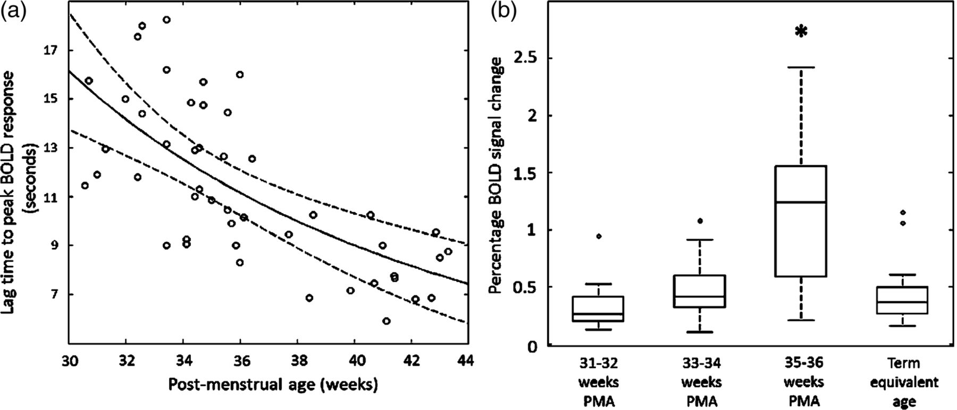

Maturational changes in the temporal characteristics and amplitude of the identified functional brain activity (a).
Alessandro G. Allievi et al. Cereb. Cortex 2015;cercor.bhv203
© The Author 2015. Published by Oxford University Press.
Notes:
Maturational changes in the temporal characteristics and amplitude of the identified functional brain activity (a). The lag time to the positive peak of the identified response decreases systematically with increasing PMA (data shown with robust regression line with prediction error bands). (b) The amplitude of BOLD signal change within the identified clusters of activity are significantly higher at the conclusion of the third trimester (35–36 weeks PMA) in comparison to younger infants and those at term equivalent age (line represents data median; box represents data lower and upper quartile; *P < 0.05 Mann–Whitney U-test with Holm–Bonferroni correction).
Also, psychiatric populations frequently found to have a marked increase in variance in fMRI results (Dougherty et al Neuroimaging for Clinical Practice)

Slide 45
Categorical
Comparing the activity between stimulus types
e.g: being presented with different nouns and deciding whether each is animate or inanimate
goat
bucket
Stimulus

Slide 46
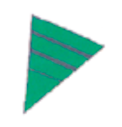
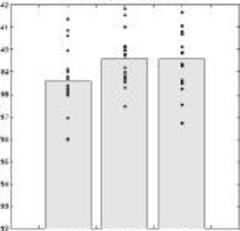

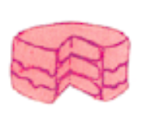
Subtraction approach
‘Is the inferotemporal region sensitive to both object recognition and phonological retrieval of object names? (Friston et al., 1997)
[1] Say ‘yes’ when you Results:
see an abstract image
(visual analysis, speech)
[2] Say ‘yes’ when you see
an object (visual analysis,
speech, object recognition)
[3] Name the object
(visual analysis, speech,
object recognition, phonological retrieval)
Subtraction: [2] – [1] = object recognition
[3] – [2] = phonological retrieval
[1]
[2]
[3]
Assumes object recognition activates IT to the same degree independent of phonological retrieval
Notes:
Conclude IT is involved in object recognition, but not in phonological retrieval
Started off with 3 conditions, say yes when see abstract image (have object recognition) , say yes when see object, see object and name object (here have object recognition AND phonological retrieval)
See differences between 1 and 2, so area sensitive to object recognition. See no difference between 2 and 3 so assume area not sensitive to phonological retrieval.
However, this ignores potential interactions between objects recognition and phonological retrieval.

Slide 47
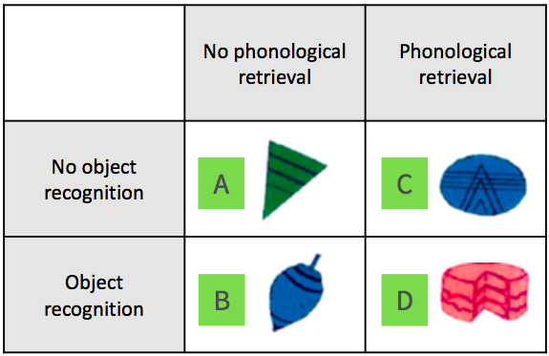
Factorial approach
Slides from 2016 SPM course
Vary object recognition & phonological retrieval independently
  Add condition: [4] Name the colour of the presented shape (visual analysis, speech, phonological retrieval)
‘Say yes’ (Object vs Non-objects)
interaction effect
(Stimuli x Task)
Phonological retrieval (Object vs Non-objects)
In the absence of object recognition, phonological retrieval deactivates IT
Notes:
Check interaction by comparing: Activation due to object recognition in the absence of phonological retrieval (B-A)
VERSUS
Activation due to object recognition in the presence of phonological retrieval (D-C)
(Pure insertion requires them to be the same)
Conclusion: In the absence of object recognition, phonological retrieval deactivates IT
(C-A) vs. (D-B)?

Slide 48
Main considerations before starting…
METHOD OF ANALYSIS AND CONTRAST
The simpler the better
Test hypotheses generated from animal research and prior human work
Within-subject or between subjects (e.g. matched healthy controls)
Need a resting baseline to compare tasks to
Notes:
Endogenous contrast agent – deoxyhemoglobin which is strongly paramagnetic and distorts the magnetic field locally. The combination of increased oxygenated haemoglobin and increased blood flow results in a decrease in the instantaneous concentration of deoxyhemoglobin on the venous side of the capillaries. Deoxygenated blood has a shorter T2 and hence lower MR signal than fully oxygenated blood. When neuronal activity occurs, although it deoxygenates red blood cells, you also get a big delivery of oxygenated blood to you actually see a reduction in deoxyhemoglobin and T2 increases as does MR signal.
Areas with high concentration of oxyhemoglobin give a higher signal (a brighter image) than areas with low concentration
In fMRI we detect blood oxygenation changes in the draining veins, i.e. downstream from the actual activation site.
Higher field strength, thinner slices and more timepoints will give more power to detect change, e.g. on an individual rather than group analysis
Need a resting baseline to compare tasks to because otherwise, if task 1 and task 2 different for example, how do you know whether it’s because 1 activates or the other inhibits brain regions?
Hard to be sure the participant is carrying out the task properly

Slide 49
Multimodal integration
Can potentially integrate results with MEG or EEG – tools with greater temporal resolution

Slide 50
An example
Motion (Low) A | No motion (Low) B
Motion (High) C | No Motion (High) D
Simple Main effect: A-B simple main effect of motion V no motion under context of low cognitive load
Main Effect: (A+B) - (C+D) Main effect of low cognitive load vs. high cognitive load, irrelevant of motion
Interaction effect: (A-B) - (C - D) Investigates whether the interaction effect of motion (vs. no motion) is greater under high or low cognitive loads

Slide 51
General advice
From Rik Henson:
Scan for as long as possible and keep subject as busy as possible
If group study, number of subjects more important than time per subject (though additional set-up time may encourage multiple experiments per subject)
Do not contrast trials that are far apart in time
Randomise the order, or SOA, of trials close together in time
18
Notes:
Longer is better because the power of a statistical inference depends primarily on the number of degrees of freedom (df), and the dfs depend on the number of scans (volumes). Usually, participants can function satisfactorily and comfortably for 40-60 min in scanner environment. ITIs should be kept as short as possible (even within blocks of trials). The only situation where you might want longer ITIs (or blocks of rest) is if you want to measure the baseline.
If you are interested in group results (i.e., extrapolating from a random sample of subjects to a population), then the statistical power normally depends more heavily on the number of subjects than the number of scans per subject. You are likely to have more power with 100 volumes on 20 subjects than with 400 volumes on 5 subjects, particularly given that inter-subject variability tends to exceed inter-scan variability.
Problem with fMRI is that there is a lot of low-frequency noise. Any signal (induced by your experiment) that is low-frequency may be difficult to distinguish from low-frequency noise. Analysis packages high-pass filter fMRI data and since contrasts between trials that are far apart in time correspond to low-frequency effects, they can be filtered out. In SPM typical high-pass cut-off is 0.01 Hz. In the context of blocked designs the implication is not to use blocks that are too long. It also means that one should avoid using many conditions of which the important contrasts only involve a subset.
In order to be sensitive to differences between trials close together in time (e.g., less than 20 sec), one either uses a fixed ITI but varies the order of different trial-types (conditions) OR constraints their order but varies the ITI. Thus, a design in which two trials alternate every 4 sec is very inefficient for detecting the difference between them.

