Slide 1
Dynamic Causal Modelling for fMRI:
Theory & Practice
Presented by: Tara P. Sani & Reyhan E. Yunus
Expert: Dr. Peter Zeidman

Slide 2

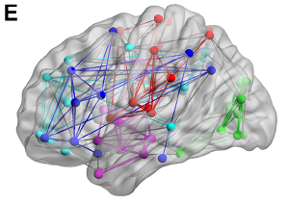
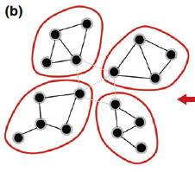
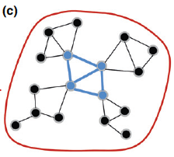
Connectivity Basics
Functional Segregation
Functional Integration
Certain function was carried out by certain areas in the brain, they could be anatomically separated
interactions among specialised neuronal populations

Slide 3
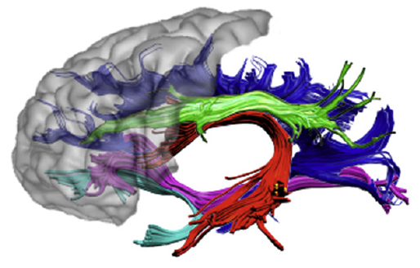
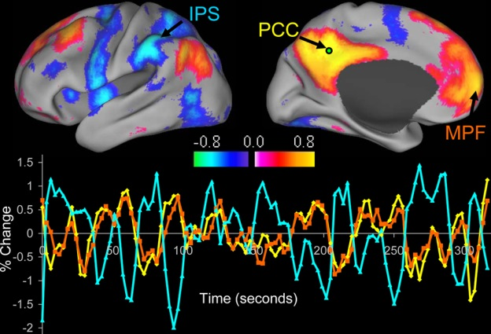
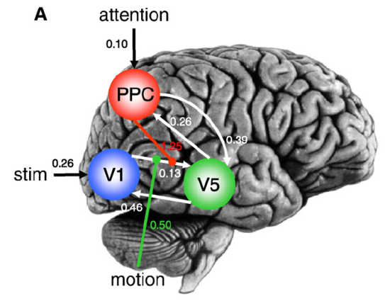
Structural, Functional and Effective Connectivity
large-scale anatomical infrastructures that support effective connections for coupling
Structural connectivity
statistical dependencies among remote neurophysiological events
Functional connectivity
Effective connectivity
influence that one system exerts over another
Notes:
Anatomical connectivity
Anatomical layout of axons and synaptic connections
Which neural units interact directly with each other
Functional connectivity
Correlation among activity in different brain areas
Statistical dependencies between measured time series
Effective connectivity
Causal influence of one neuronal system over another
At synaptic or neuronal population level

Slide 4
Dynamic Causal Modeling
Generic Bayesian framework for inferring hidden neuronal states from measured brain activity
Introduced by Friston, Harrison & Penny (2003), Neuroimage
Part of the SPM package
One way of modeling effective connectivity → Others: regression models (e.g. PPIs), Volterra Kernels, Granger Causality
Notes:
Generative = models how the data was generated = based on given assumptions, which models is most likely to generate this signal?
Can be contrasted with discriminative models, which are not interested in how data was generated but only with categorizing the signal.
We use it to model inversion.
We can describe hidden dynamics - how any particular neuronal state translates into a measurement (BOLD) – if we can describe this, we can invert the model (fit to the data) and reconstruct the posterior distribution i.e. identify parameters which make the best fit to the data

Slide 5
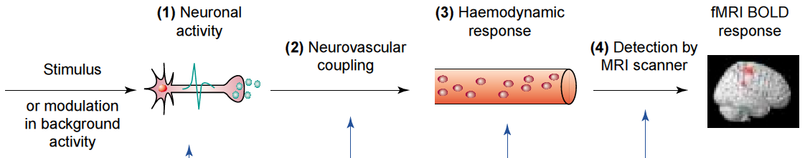
Key features:
Dynamic
Causal
Neurophysiologically plausible/interpretable
Make use of a generative/forward model (mapping from consequences to causes)
Bayesian in all aspects
Notes:
Dynamic = using linear or nonlinear differential equations to describe hidden neuronal dynamics
Causal = describe how dynamics in one area cause dynamics in another area, and how these interactions are modulated by experimental manipulations
Neurophysiologically interpretable - Hypotheses are constrained by the underlying biological model
Use a biophysically motivated and parameterized forward model to link the modeled neuronal dynamics to specific features of measured data
Bayesian = each parameter is constrained by prior distribution – see later for how to specify these

Slide 6
Brain as input-state-output system
Inputs: experimental manipulations
  External input on brain, e.g. visual stimuli
  Context, e.g. attention
State variables: neuronal activities in the brain
Outputs: electromagnetic or hemodynamic responses over brain regions
  Measured in scanner
Notes:
Inputs: experimental manipulations
External input on brain, e.g. visual stimuli
Context, e.g. attention
State variables: neuronal activities in the brain
Outputs: electromagnetic or hemodynamic responses over brain regions
Measured in scanner

Slide 7
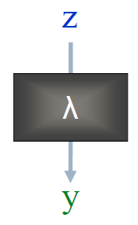
Hemodynamic Forward model
Neuronal dynamics (z) transformed into BOLD-signal (y) via hemodynamic response function (λ)
DCM: Use this specific model to estimate parameters at neuronal level
  Such that modelled and measured BOLD signal maximally similar
For details see Stephan et al., 2007…
Notes:
We remember that the effective connectivity is the influence that one neuronal system do over another
The problem is we cannot directly observe neuronal activity
Through the hemodynamic forward model we can model how neuronal synaptic activity transformed into measured response in fMRI
This is the key difference to other methods of assessing connectivity
So Z is the neuronal activity, which we can’t directly observe.
This is transformed into y (the BOLD-signal which we can assess), through the hemodynamic response function (delta)
DCM use this model to estimate parameters at neuronal level

Slide 8
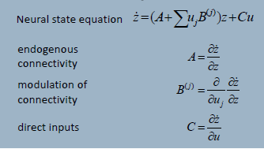
What is DCM modelling?
Forward model:

Slide 9


Neuronal model
Aim: model temporal evolution of set of neuronal states z_{t}
Important: not interested in neuronal state itself, but its rate of change in time
  Due to experimental perturbation in system
Expressed in differential equation:
current state
external input
Intrinsic connectivity
Notes:
The aim of neuronal model is to model temporal evolution of set of neuronal states z at the timepoint t
It is not interested in the neuronal state itself, but in its rate of change in time, related to experimental perturbation in the system (u)
It is expressed in this differential equation:
Z at a timepoint is a function of current neuronal state, external input, and intrinsic connectivity

Slide 10
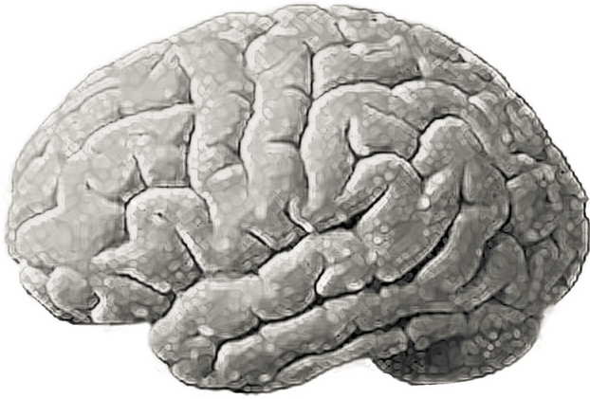


General State Equation
$$\frac{dz}{dt}=F(z,u,θ)$$
z₂
z: current state of system
z₃
u: external input to system
Z₁
θ: intrinsic connectivity
Notes:
For example there is a sound stimulus (u)
Z is the current state of system
Theta is the intrinsic connectivity between involved areas

Slide 11
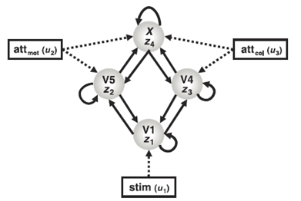
Neural State Equation in DCM
Example: attention to motion or colour of visual stimulus (Chawla, 1999)
Neural system consisting of:
  4 nodes (regions)
  Connections
    Within regions
    Between regions
  External input
    Stimulus
    Context
Taken from: Stephan, 2004

Slide 12
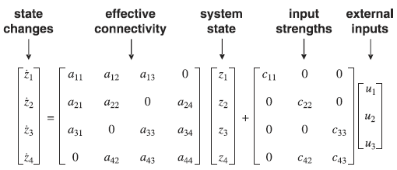

Neural State Equation in DCM (Linear)
Notes:
Self-connectivity = self-decay = always negative - every excitatory neuron sends to inhibitory neurons which feed back and dampen the activity -> self-extinction with some time constant
Dot = derivative in time

Slide 13
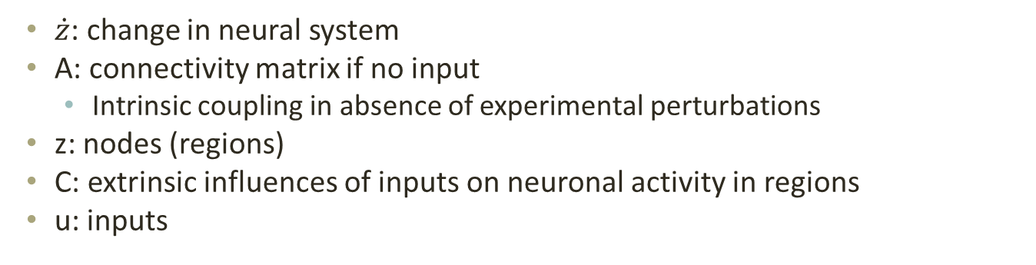
Neural State Equation in DCM
Problem: want to account for changes in connectivity due to input…
$\dot{z}$: change in neural system
A: connectivity matrix if no input
  Intrinsic coupling in absence of experimental perturbations
z: nodes (regions)
C: extrinsic influences of inputs on neuronal activity in regions
u: inputs
Notes:
Linear
Columns: outgoing connections
Rows: incoming connections
Neuronal model does not assume direct connection between regions, just that they are causally connected (so don’t have to model intermediate regions)

Slide 14
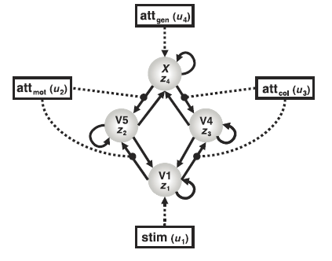
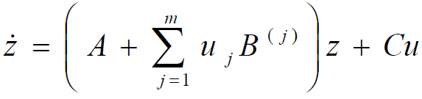
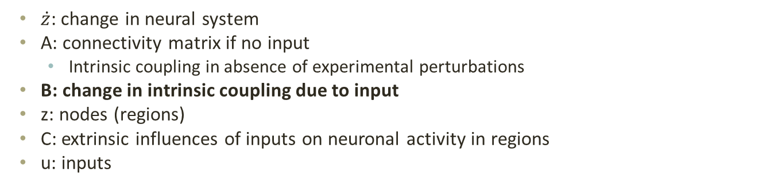
Neural State Equation in DCM (Bilinear)
$\dot{z}$: change in neural system
A: connectivity matrix if no input
  Intrinsic coupling in absence of experimental perturbations
B: change in intrinsic coupling due to input
z: nodes (regions)
C: extrinsic influences of inputs on neuronal activity in regions
u: inputs
Allowing for interactions between input and activity in region (i.e. nonlinearities)
Notes:
We can model additive changes in connectivity strength as a function of some controlled variable - how context variables change this connection?

Slide 15

Neural State Equation in DCM
Having established this neural state equation, we can now specify DCMs to look at:
  Intrinsic coupling between regions (A matrix)
  Changes in coupling due to external input (B matrix)
    Usually most interesting
  Direct influences of inputs on regions (C matrix)
Notes:
m = number of inputs
It’s additive – we add the extra element if modulation predicted to be exerted on that part of the system
A = endogenous coupling
B = bilinear term, modulatory effect – context-dependent change in connectivity
C = driving effect / direct inputs – extrinsic influences of inputs on neuronal activity

Slide 16
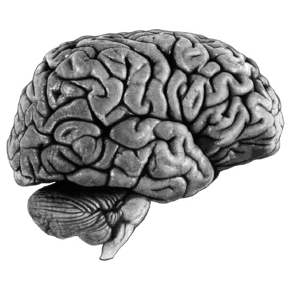
Neuronal model: Nonlinear
attention
SPC
stim
V1
V5
motion
Notes:
Keep it briefly!
Non-additive
Coupling changes as a function of state of activity in another region
Attention enables the connectivity V1 -> V5 to become stronger
Non-linear state equation: extra term D

Slide 17
Recap
Define system and specify connections based on prior knowledge of anatomical connectivity
Specify where the perturbations happen (e.g. visual input)
Specify which of the connections are modulated, e.g. by attention

Slide 18
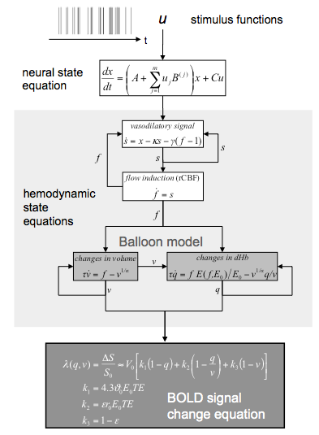
Hemodynamic model
Neural state
Change in vasodilatory signal
Change in blood flow
Change in blood volume and deoxyhemoglobin volume
Bold signal
Notes:
Cognitive system is modelled at its underlying neuronal level (not directly accessible for fMRI). The modelled neuronal dynamics are transformed into area-specific BOLD signals by a hemodynamic model
Combining the neural and hemodynamic states gives the complete forward model.
An observation model includes measurement
error e and confounds X (e.g. drift).
Bayesian parameter estimation
Result:
Gaussian a posteriori parameter distributions, characterised by
mean η_{θ|y} and
covariance C_{θ|y}.

Slide 19
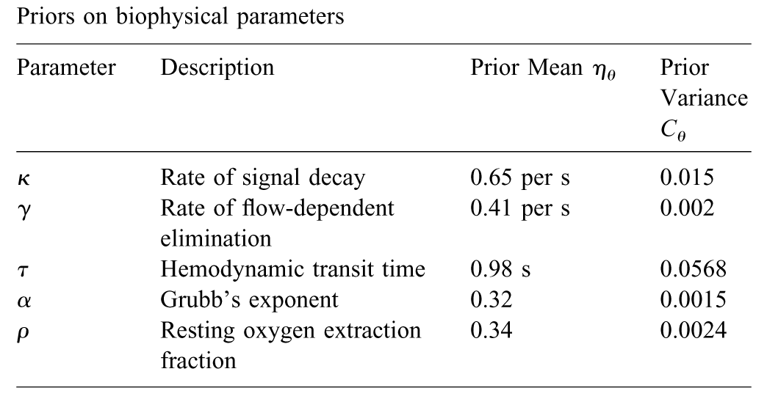
Notes:
Empirically determined a priori distribution
Computed separately for each area (like the neural parameters).

Slide 20
Inference in DCM
Bayesian Inference
Relying on prior knowledge about connectivity parameters
Our a priori beliefs about the range our parameters are ‘supposed’ to be:
  Empirical
  Principled
  Shrinkage
Bayesian model selection to find model with highest model-evidence
  Most likely connections & influences of inputs
Important: trade off between model fit and complexity (e.g., parameters in model)
  Overfitting (i.e., explaining noise as well) if only aiming at best fit
Notes:
How do we estimate the parameters?
Priors = each parameter is constrained by prior distribution which reflects empirical knowledge about the range of possible parameters,
principles considerations (e.g. some parameters can’t have negative values, e.g. blood volume), or a conservative attitude (shrinkage priors = assume that the coupling parameters are zero)
The “posterior” probability of the parameters given the data is an optimal combination of prior knowledge and new data, weighted by their relative precision.

Slide 21
DCM in practice
Notes:
Let’s start to see in practice how to perform DCM

Slide 22
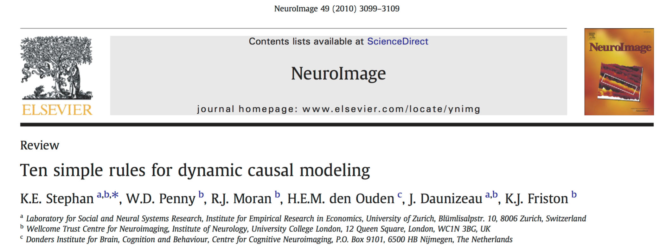
DCM is increasingly used in the analysis of a wide range of neuroimaging and electrophysiological data.
Given the relative complexity of DCM, compared to conventional analysis techniques, a good knowledge of its theoretical foundations is needed to avoid pitfalls in its application and interpretation of results.
By providing good practice recommendations for DCM, this article could serve as a helpful tutorial for the growing community of DCM users.
Notes:
I decided to start with one of the most famous paper about DCM in practice.
As our expert said when I showed him this slide, this is actually “a lie!”, because these rules are not really simple to be followed and apply them to your own data can be trick sometimes.
But anyway, this is one the main paper that explain the theory beyond DCM and how to apply this technique to your data

Slide 23
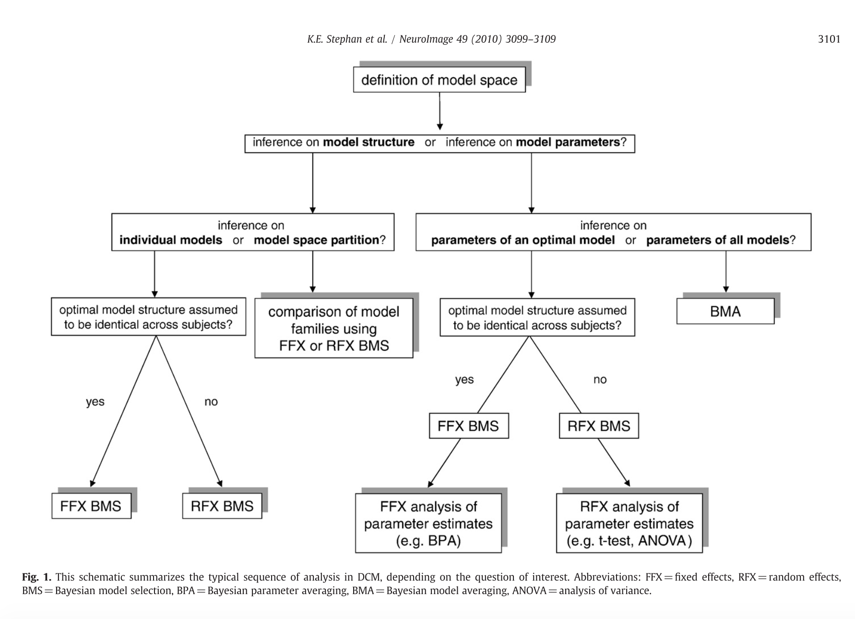
Notes:
This scheme summarise the ideal process used to define DCM analyses.
In particular we can see that the process should start with the definition of the model we would like to explore. From that you can decide to analyses the structure of the model or the strength of the parameters (connections) and we can see in details it later.

Slide 24
Interest for the model structure per se, with no reference to any model parameters
→ whether context-sensitive modulation of connectivity concerns forward or backward connections or whether the modulatory mechanism is linear or nonlinear
Interest for neurophysiological mechanisms encoded by specific parameters in a given model
→ one might want to infer whether a specific connection is more likely to exert an excitatory or an inhibitory effect on its target region.
BMS = bayesian model selection
BMA = bayesian model average
Notes:
As I said before, you start from the definition of the model in terms of areas involved in your network.
To do that you can decide to focus your interest on the model structure per se. Moreover, in addition to that you can analyse the strength of the parameters that define the connections

Slide 25
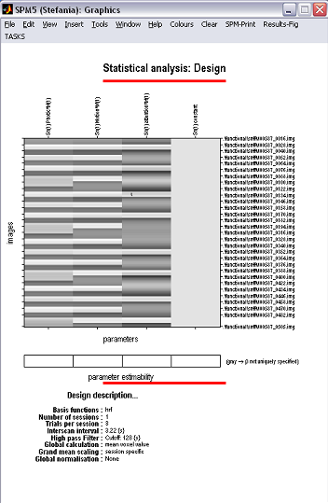
data set available from the SPM web site:
http://www.fil.ion.ucl.ac.uk/spm/data/attention/
1. Starting from standard GLM
4 CONDITIONS FROM THE STANDARD GLM, 2X2 DESIGN:
STATIC
FIXATION
No attention
No motion/ no attention
Motion /
no attention
No motion/ attention
Motion / attention
Attention
Notes:
The first step is starting from the general GLM, so after the general preprocessing you would do to analyse general functional activations of your data.
Let’s hypotize we have a 2x2 design.
The subjects are asked for watching some dots on the screen: we have one condition that is attention/non attention, and the other is static/fixation

Slide 26
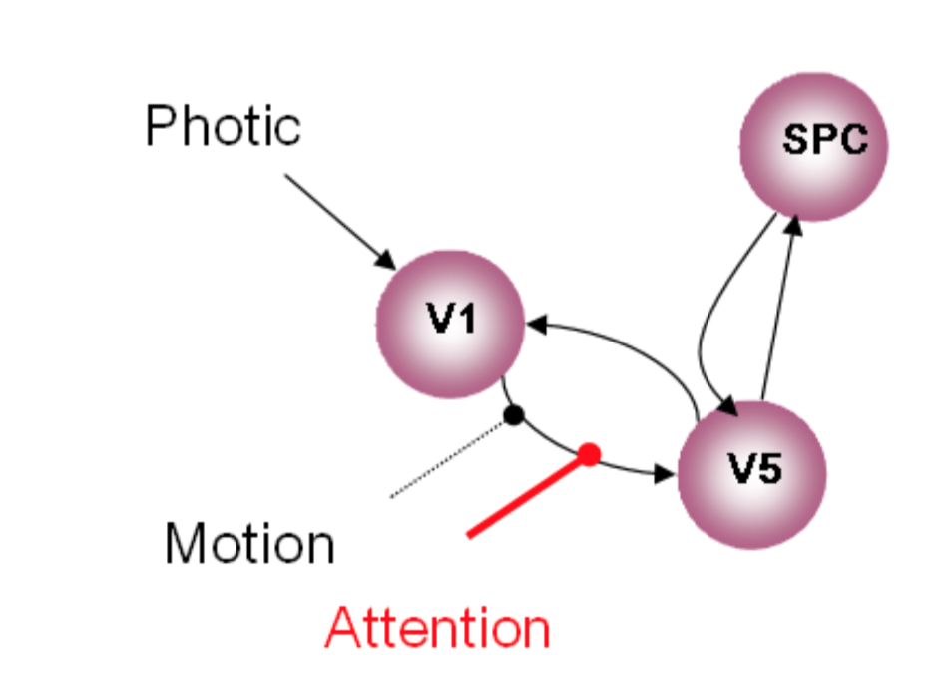
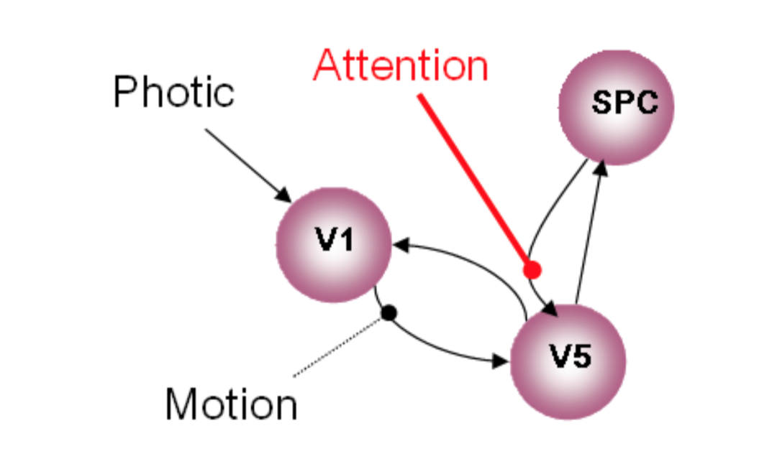
1 HP: DCM with attentional modulation of forwards connection
2 HP: DCM with attentional modulation of backwards connection
Notes:
As my colleague said, one of the strength of DCM is that you can test connectivity also in relation to the task, so how actually a specific condition affect connectivity between regions.
These are the two hypothesis that we can test, so whether the attention condition can affect connectivity backwards or forwards

Slide 27
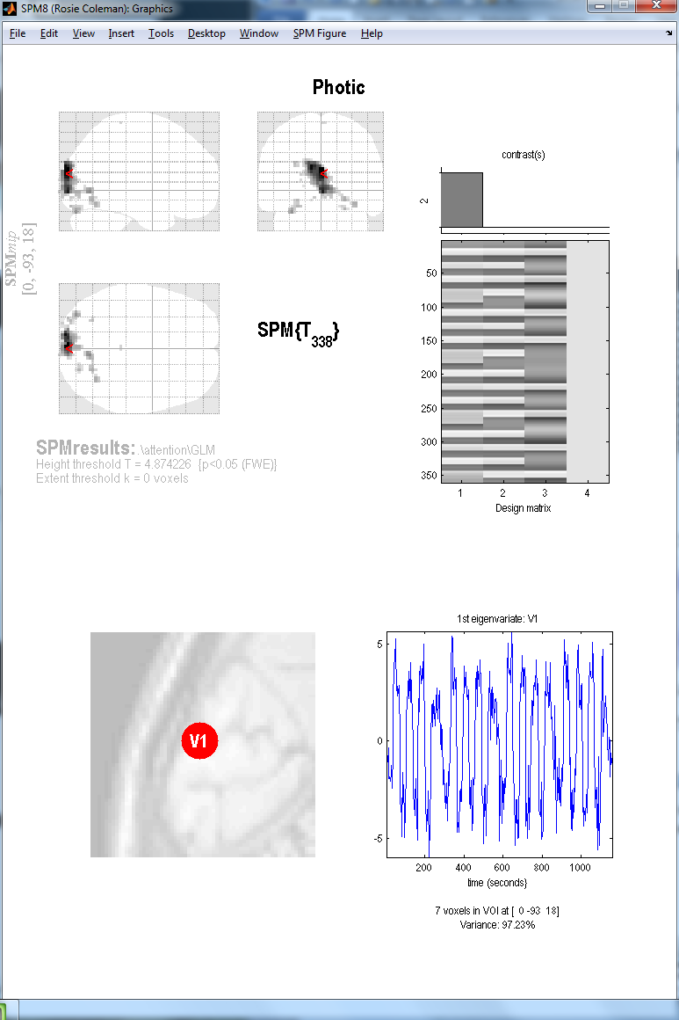
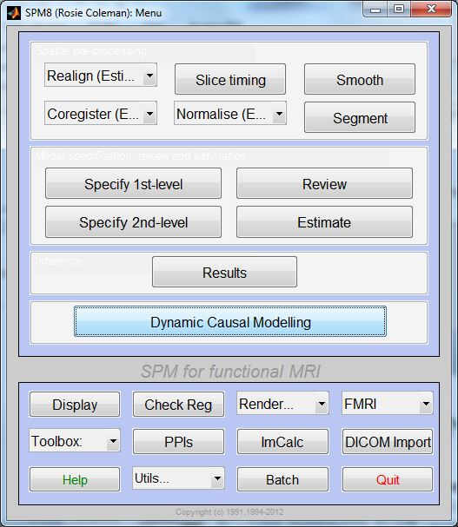
2. Extracting time series
Notes:
From the general GUI of SPM, from the results option we can extract the ROI we want to test in our model, so in this case V1, V5 and the superior parietal cortex.

Slide 28
3. Defining the model space
The models that you choose to define for your DCM depend largely on your hypotheses.
Based on:
Activations from GLM
Literature
Anatomical and computational knowledge
DCM IS NOT AN EXPLORATORY TECHNIQUE!!
  well-supported predictions
  inferences on model structure (BMS)
  no strong indication of network structure
  inferences on connection strengths (BMA)
  can define a small number of possible models
  may be useful to define all possible models
Notes:
After defined the ROI that are going to be involved in my network, I have to define my hypothesis f connection between these areas.
The areas you choose and the possible way to connect them should be largely depend on your hypothesis.
We have to bear in mind that DCM is not born to be an exploratory technique, so I can’t explore effective connectivity in one task without no idea of areas involved and how these are related each other.
Generally, it’s good to define the models based on the activation that I got from the standard GLM, from literature, and anatomical knowledge (of course it should be ideal if I can prove all these three sources together).
Of course the more precise and well supported are my prediction, the less number of model I need to specify, and I can focus my interest on the investigation of the structure of the network. On the other hand, if I have less evidence about the structure of the network, I am going to define more possibilites and probably it’s more ideal to focus myself connection strength investigation.

Slide 29
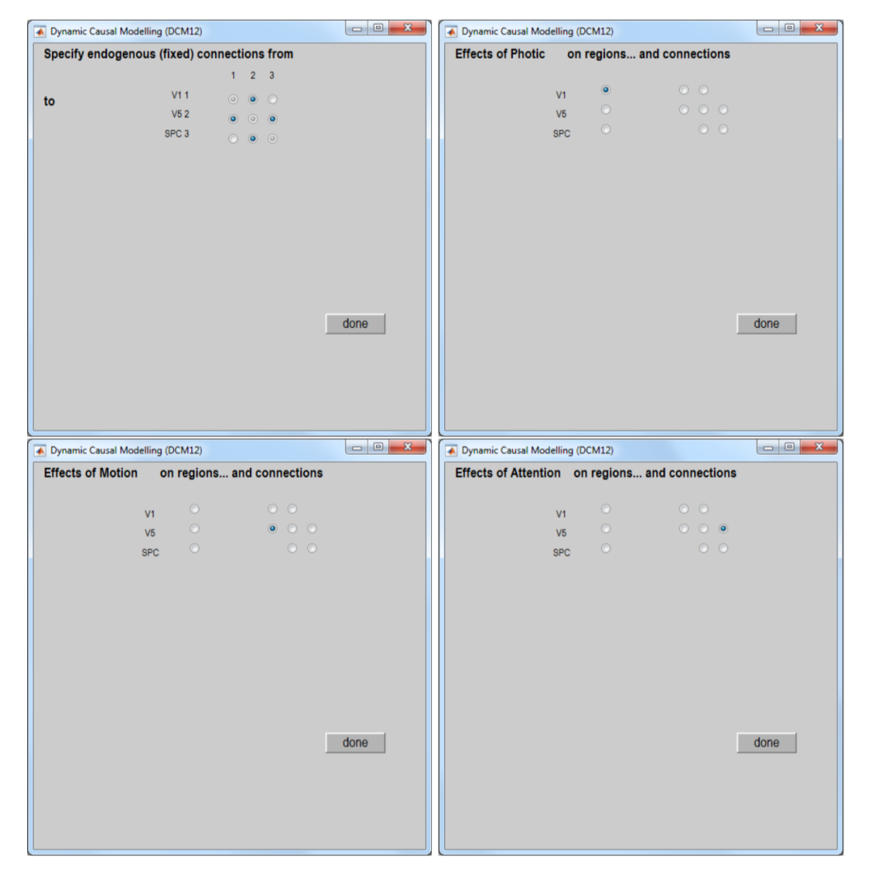
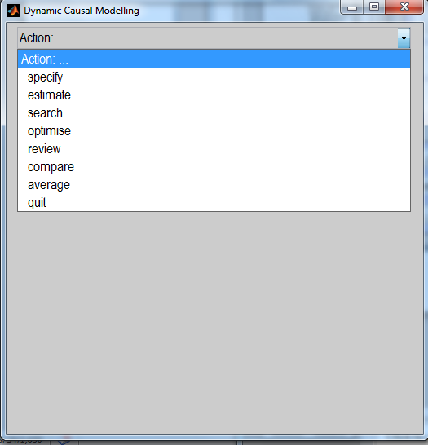
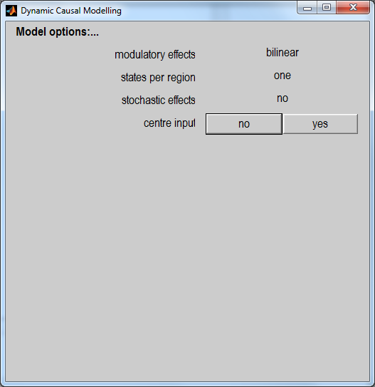
How to specify the model in the DCM toolbox
At this stage, you can specify various options.
MODULATORY EFFECTS: bilinear vs non-linear
STATES PER REGION: one vs. two
STOCHASTIC EFFECTS: yes vs. no
CENTRE INPUT: yes vs. no
Notes:
From the DCM option you can specify the structure of your model, with the connections from – to and also you are asked for defining some parameters that my colleague already a=explained you in theory before (such as…)

Slide 30
4. Model estimation
We fit the predicted model to the data.
The dotted lines represent the real data whereas full lines represent the predicted data from SPM: blue being V1, green V5 and red SPC.
Bottom graph shows your parameter estimations
Notes:
After I specified all the model I think can match all the possible hypothesis to explain the network, I can estimate all of them

Slide 31
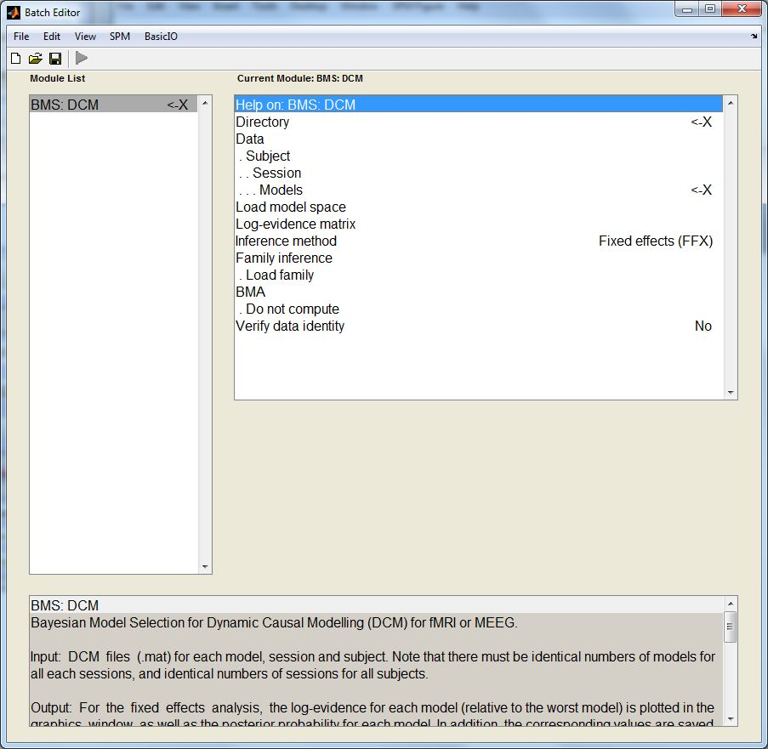
5. BMS
We choose directory
Load all models for all subjects (after being estimated)
Then, choose FFX or RFX – Multiple subjects with possibility for different models = RFX
    Optional:
    Define families
    Compute BMA
Notes:
Now that I have all the possible model created for all the subjects, I can start to compare the structure or the parameters strenght.
As I have already said, with the BMS we compare all the possible structures hypnotised for all the subjects to see whether there is a specific structure that can “win”.
Here I am asked also for specifying if I think that the effect would be fixed or can change across all the subjects (and the default possibility is RFX).
Here I can choose to perform also the BMA, so the estimation of the parameters.

Slide 32
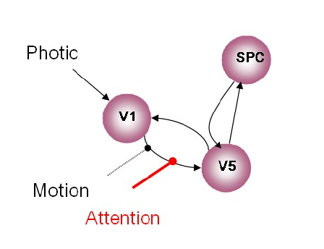
WINNING MODEL
Notes:
After performing the BMS, I got the result of the winning model, that in our case is the model where attention modulate connectivity forwards, so from V1 to V5.

Slide 33
Modulatory Connections
Intrinsic Connections
Notes:
From the review option, you can easily revisit the fit of the model related to both the intrinsic connection and the modulatory effect for example

Slide 34
FAMILY-LEVEL INFERENCE
It could be that there isn’t one model that is an overwhelming ‘winner’.
In these circumstances, we can group similar models together to create families.
By sorting models into families with common characteristics, you can aggregate evidence.
We can then use these to pool model evidence and make inferences at the level of the family.
Notes:
It could be that from the BMS you can’t get a model that clearly wins over the others.
The program allows you in this circumstance to divide your model hypothesis into families regarding one specific characteristic. After that, you can compare the families, so he group of models, instead of the model itself and so understanding at least whether the characteristic you chose to driven the selection of your famlyes is present or not in the model.
Of course after that you could discard all the models present in the loosing families and then perform BMS among the ones present in the winning family, but you have to pay attention to not fishing too much your analyses and so create false positive.

Slide 35
6. BMA
→ It calculates the mean parameter values, weighted by the evidence for each model
Parameter Level
BMA can be calculated based on an individual subject, or on a group-level.
You can export the parameters extracted (A, B, C) in your statistical software (i.e. : SPSS) and then use T-tests and ANOVA to compare connection strengths (between groups and between conditions)
Within Groups
parameter > 0 ?
parameter 1 > parameter 2 ?
Does connection strength vary by performance/symptoms/other variable?
Notes:
Lastly, you can perform the averaging of the parameter values with the BMA.
What this option is doing is averaging across all subjects all the parameters (connections) explored in the models weighted for the results of the BMS → this means that BMA take into account which is defined to be the winning model in terms of structure
After that, you can easily export directly from Matlab the values of the strength of all the parameters (A,B,C) and then perform the usual statistical analyses.

Slide 36
Notes:
This is the final slide, to remind us how connectivity investigation could be consider as a cycle, as research in general.
So starting with hypothesis, I can arrive at generating model or parameters strength and from here starting again in thinking about hypothesis of network functioning.

Slide 37
Thank you!
And special thanks to our expert: Dr. Peter Zeidman

Slide 38
References
Friston, K.J., Harrison, L., & Penny, W. (2003). Dynamic Causal Modelling. Neuroimage, 19, 1273-1302.
Marreiros, A. C., Kiebel, S. J., & Friston, K. J. (2008). Dynamic causal modelling for fMRI: A two-state model. NeurImage, 39, 269-278.
Stephan, K. E., Penny, W. D., Moran, R. J., den Ouden, H. E. M., Daunizeau, J., & Friston, K. J. (2010). Ten simple rules for dynamic causal modelling. Neuroimage, 49, 3099-3109.
Stephan, K. E., Kasper, L., Harrison, L. M., Daunizeau, J., den Ouden, H. E. M., Breakspear, M., & Friston, K. J. (2008). Nonlinear dynamic causal models for fMRI. NeuroImage, 42, 649-662.
Razi, A.(2017, March). Brain Connectivity. Lecture given in UCL ION.
Stephan, K. E., Penny, W. D., Moran, R. J., Den Ouden, H. E. M., Daunizeau, J., & Friston, K. J. (2010). Ten simple rules for dynamic causal modeling. NeuroImage, 49(4), Stephan, K. E., & Friston, K. J. (2010). Analyzing effective connectivity with fMRI. Wiley interdisciplinary reviews. Cognitive science, 1(3), 446–459. doi:10.1002/wcs.58
Daunizeau, J., Preuschoff, K., Friston, K., & Stephan, K. (2011). Optimizing experimental design for comparing models of brain function. PLoS Computational Biology, 7(11)
Penny, W. D., Stephan, K. E., Daunizeau, J., Rosa, M. J., Friston, K. J., Schofield, T. M., & Leff, A. P. (2010). Comparing families of dynamic causal models. PLoS Computational Biology, 6(3)
Seghier, M. L., Zeidman, P., Neufeld, N. H., Leff, A. P., & Price, C. J. (2010). Identifying abnormal connectivity in patients using dynamic causal modeling of FMRI responses. Frontiers in systems neuroscience, 4(August), 1–14
Campo et al. (2013). Network reconfiguration and working memory impairment in mesial temporal lobe epilepsy. NeuroImage, 72, 48-54.
Previous MfD slides
Notes:
Friston, K.J., Harrison, L., & Penny, W. (2003). Dynamic Causal Modelling. Neuroimage, 19, 1273-1302.
Marreiros, A. C., Kiebel, S. J., & Friston, K. J. (2008). Dynamic causal modelling for fMRI: A two-state model. NeurImage, 39, 269-278.
Stephan, K. E., Penny, W. D., Moran, R. J., den Ouden, H. E. M., Daunizeau, J., & Friston, K. J. (2010). Ten simple rules for dynamic causal modelling. Neuroimage, 49, 3099-3109.
Stephan, K. E., Kasper, L., Harrison, L. M., Daunizeau, J., den Ouden, H. E. M., Breakspear, M., & Friston, K. J. (2008). Nonlinear dynamic causal models for fMRI. NeuroImage, 42, 649-662.
Razi, A.(2017, March). Brain Connectivity. Lecture given in UCL ION.
Stephan, K. E., Penny, W. D., Moran, R. J., Den Ouden, H. E. M., Daunizeau, J., & Friston, K. J. (2010). Ten simple rules for dynamic causal modeling. NeuroImage, 49(4), Stephan, K. E., & Friston, K. J. (2010). Analyzing effective connectivity with fMRI. Wiley interdisciplinary reviews. Cognitive science, 1(3), 446–459. doi:10.1002/wcs.58
Daunizeau, J., Preuschoff, K., Friston, K., & Stephan, K. (2011). Optimizing experimental design for comparing models of brain function. PLoS Computational Biology, 7(11)
Penny, W. D., Stephan, K. E., Daunizeau, J., Rosa, M. J., Friston, K. J., Schofield, T. M., & Leff, A. P. (2010). Comparing families of dynamic causal models. PLoS Computational Biology, 6(3)
Seghier, M. L., Zeidman, P., Neufeld, N. H., Leff, A. P., & Price, C. J. (2010). Identifying abnormal connectivity in patients using dynamic causal modeling of FMRI responses. Frontiers in systems neuroscience, 4(August), 1–14
Campo et al. (2013). Network reconfiguration and working memory impairment in mesial temporal lobe epilepsy. NeuroImage, 72, 48-54.
Previous MfD slides

