Slide 1
Methods for Dummies Overview and Introduction
Magda Dubois & Alexandra Hopkins
Wellcome Trust Centre for Neuroimaging, UCL
Max Planck UCL Centre for Computational Psychiatry and Ageing Research

Slide 2
Methods for Dummies Overview and Introduction
Benjamin Chew
Magda Dubois & Alexandra Hopkins
Wellcome Trust Centre for Neuroimaging, UCL
Max Planck UCL Centre for Computational Psychiatry and Ageing Research

Slide 3
What is Methods for Dummies
Aim: provide a basic introduction to human brain imaging analysis methods (fMRI and M/EEG)
Wednesdays 1200-1300 hrs in 4th Floor Seminar Room
Register online: HERE
Each talk:
2 presenters
Lasts about 40 minutes + 20 minutes for questions.
Should introduce the relevant theory and be followed by a demo using SPM12 interface.

Slide 4
How to Prepare
Read the Presenter’s Guide
Prepare the slides with your partner
Meet with your expert
Remember your audience are not experts

Slide 5
Where to find information
MfD website: http://www.fil.ion.ucl.ac.uk/mfd/
Previous years’ slides
Human Brain Function Textbook (online)
SPM course slides
Cambridge CBU homepage (Rik Henson’s slides)
Methods Group Experts
Monday Methods Meetings (4th floor FIL, 12.30)

Slide 6
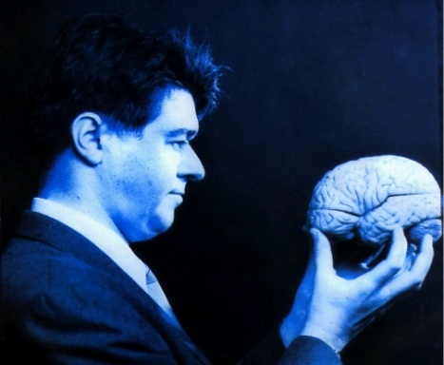
SPM
Statistical Parametric Mapping
Invented at the FIL
A software package designed for the analysis of brain imaging data in fMRI, PET, SPECT, EEG & MEG
Just type SPM in MATLAB and all will be revealed…
SPM website has a manual + datasets available to play around
Softwares:
MATLAB: https://swdb.ucl.ac.uk/
SPM12: http://www.fil.ion.ucl.ac.uk/spm/software/

Slide 7
fMRI

Slide 8
fMRI Overview

Slide 9
fMRI Overview
PREPROCESSING

Slide 10
fMRI Overview
GENERAL LINEAR MODEL

Slide 11
fMRI Overview
STATISTICAL INFERENCE

Slide 12
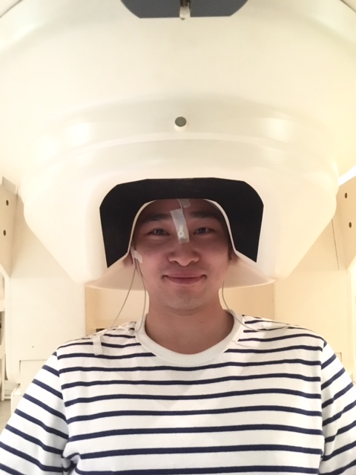
Other Techniques

Slide 13
Other Techniques

Slide 14
Optional Topics
Deep learning
Graph theory for MRI
Computational Psychiatry
...

Slide 15
Final Points
Course only works if everyone chips in
Requirement for the MfD certificate: 70% attendance
→ Sign the attendance sheet
E-mail us back ASAP to confirm your allocations
Rules for swaps: Ask your friends or e-mail the mailing list
Some of the topics seem hard but please don’t worry
“I have no idea what 90% of these words mean” (Anonymous, 2017)
Send us the slides so we can post them

