Slide 1
M/EEG Statistical Analysis & Source Localization 2018-2019
Alisa Loosen & Matthew Nour
Expert: dr Tim Tierney
Methods for Dummies 2018/19

Slide 2
Review: What have we done with ERP?
Stage 1
EEG Signal Capture
Stage 2
Pre-processing
Stage 3
Statistical Analysis

Slide 3
SENSOR SPACE ANALYSIS

Slide 4
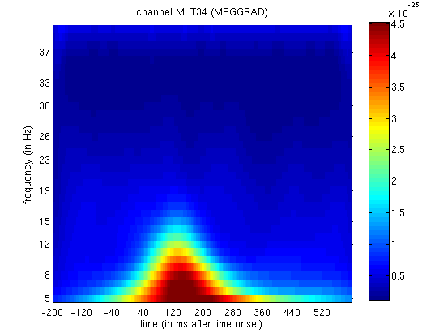
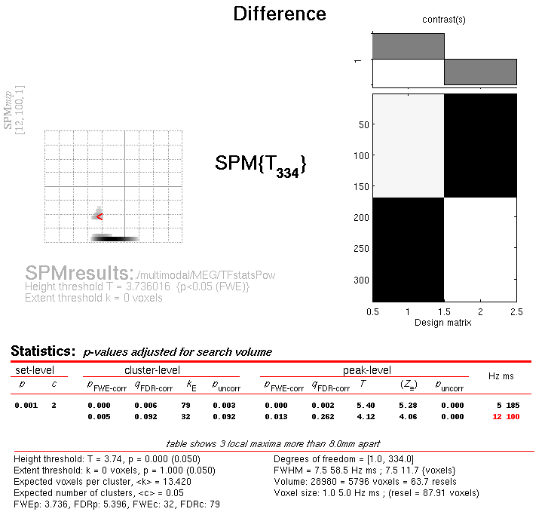
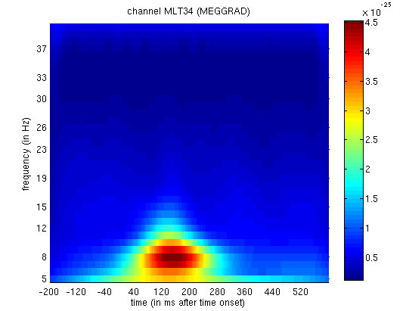
Statistical analysis in sensor space 2D Time-Frequency (within-subject)
Faces > Scrambled
Faces
Scrambled
Kilner et al., 2005, Neuroscience Letters;
Taylor, 2012

Slide 5
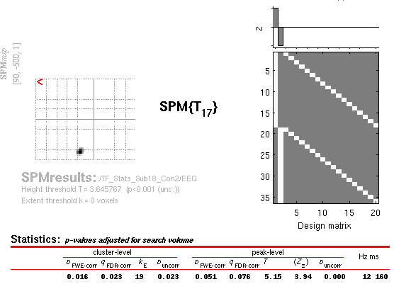
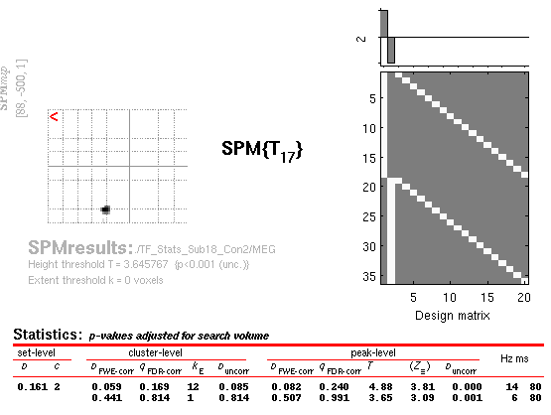
Statistical analysis in sensor space Contrast over subjects
EEG
MEG (Mag)
frequency
frequency
Taylor, 2012
-500 +1000
-500 +1000
Time (ms)
Time (ms)

Slide 6
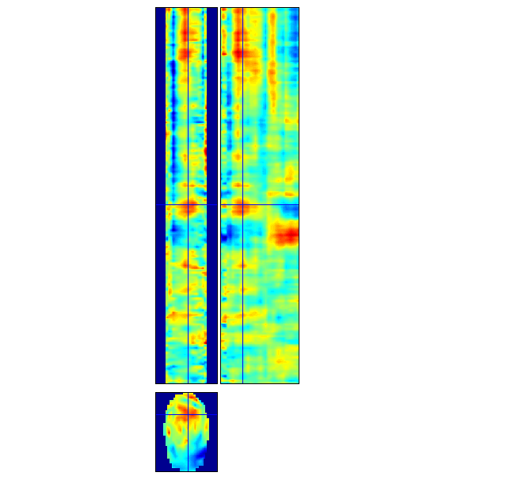
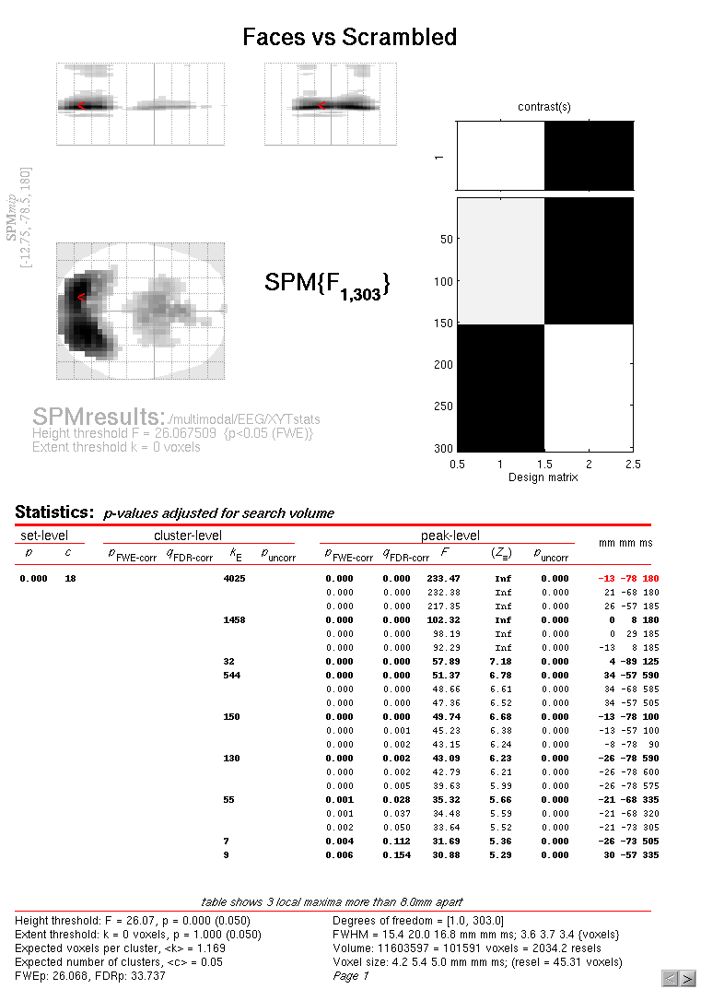
Statistical analysis in sensor space 3D Topography by time (between-subjects)
3D topography x-time image volume
time
mm
mm
Kilner et al., 2005, Neuroscience Letters;
Taylor, 2012

Slide 7
Multiple comparison problem
Comparisons = Type I errors (false positives)
Must consider Familywise Error Rate

Slide 8
Statistical corrections
Bonferroni Correction
Too conservative
Random Field Theory is a method to correct for multiple statistical comparisons with N-dimensional spaces
Takes smoothness in the image into account
Implemented in SPM

Slide 9
SOURCE SPACE ANALYSIS

Slide 10
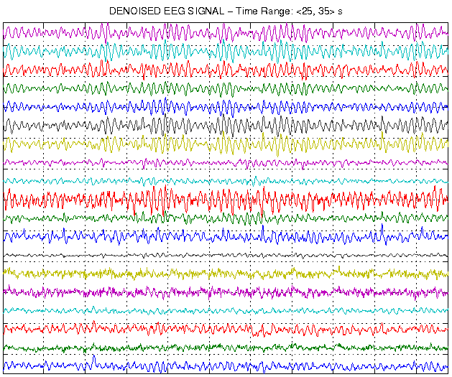
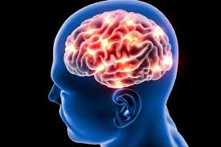
Source-space Analysis
Forward Problem
Inverse Problem

Slide 11
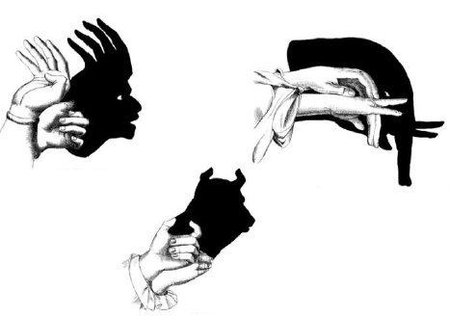
Analogy (Forward Model)

Slide 12
Analogy (Inverse Model)

Slide 13
Inverse Problem
Also known as ill-posed problem
Too many possible solutions to explain measured current distributions
Source-Space Analysis

Slide 14
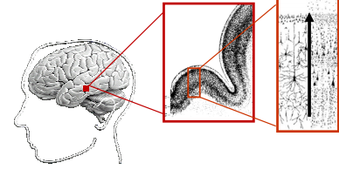
General procedure for source-space analysis (distributed source imaging)
Load pre-processed sensor-level data into SPM
Define Forward Model (sources->data)
Source space modelling (in MNI space)
Define cortical mesh , using individual subject T1 MRI or SPMs head template model. Defines locations of possible sources (dipoles) in the skull (orientations are Normal to mesh surface)
Dipole

Slide 15
General procedure for source-space analysis (distributed source imaging)
Load pre-processed sensor-level data into SPM
Define Forward Model (sources->data)
Source space modelling (in MNI space)
Define cortical mesh , using individual subject T1 MRI or SPMs head template model. Defines locations of possible sources (dipoles) in the skull (orientations are Normal to mesh surface)
Data co-registration (maps sensors to MNI coordinates)

Slide 16
General procedure for source-space analysis (distributed source imaging)
Load pre-processed sensor-level data into SPM
Define Forward Model (sources->data)
Source space modelling (in MNI space)
Define cortical mesh , using individual subject T1 MRI or SPMs head template model. Defines locations of possible sources (dipoles) in the skull (orientations are Normal to mesh surface)
Data co-registration (maps sensors to MNI coordinates)
Forward computation
Computes the gain matrix, describing the effect of activity at each cortical dipole (n = no. mesh vertices) on each MEG sensor. Computed using Maxwell’s equations, making assumptions about properties of the head. The lead field is the projection from dipole each source to scalp sensors (columns of gain matrix)

Slide 17
General procedure for source-space analysis (distributed source imaging)
Inverse reconstruction – solves the inverse problem
Uses empirical Bayesian approach (standard inversion uses ‘multiple sparse priors’ algorithm).
Can add anatomical prior knowledge from literature or other imaging modalities to further constrain inversion.
NB. Option of ‘group inversion’ also exists in SPM – adds a prior that the same cortical sources are engaged by all subjects.
Time course of source with maximal activity
Maximum intensity projection at time of maximal activity

Slide 18
General procedure for source-space analysis (distributed source imaging)
Results visualisation
Generate 3D NIfTI file of summary statistic images in terms of contrasts (mixtures of parameter or activity estimates to address experimental hypotheses)
Proceed to GLM-based 2nd level statistical analysis in usual way (involves specifying time-frequency window of interest for each contrast image)

Slide 19
Equivalent Current Dipole (ECD)
‘Distributed’ reconstruction methods consider all possible source locations (vertices) on the cortical mesh simultaneously to generate the sensor data, allowing for distributed sources.
An alternative is the ‘equivalent current dipole’ (ECD) approach, which assumes a small number (e.g. <5) of focal sources are active simultaneously to generate the sensor data.
Number dipoles defined a priori (based on empirical knowledge). May be optimised – model comparison.
Number of dipoles should be << no. channels/6
Parameterisation of model (location, orientation and signal amplitude at each dipole) optimised with nonlinear Variational Bayes

Slide 20
ECD vs. Distributed Dipoles

Slide 21
Dynamic Causal Modelling (DCM)
Augments the forward model
measured data are explained by a network of a few sources, which are dynamically coupled
model inversion optimises model parameters
Combines the spatial forward model (discussed previously) with a neurobiologically-informed temporal forward model.
Allows inference about connectivity architectures
As M/EEG data is highly time-resolved one can make inferences about e.g. synaptic time constants and receptor densities (impossible with DCM for fMRI).

Slide 22
References
Kilner, J. and Friston, K. (2010). Topological inference for EEG and MEG. The Annals of Applied Statistics, 4(3), pp.1272-1290.
J. Kilner, S.J. Kiebel, and K.J. Friston. Applications of random field theory to electrophysiology. Neuroscience Letters, 374:174-178, 2005.
Litvak, V., Mattout, J., Kiebel, S., Phillips, C., Henson, R., Kilner, J., ... & Penny, W. (2011). EEG and MEG data analysis in SPM8. Computational intelligence and neuroscience, 2011.
MfD presentations from previous years
Lecture Slides from PSYCGC11 Neuroimaging by Dr Leun Otten
Taylor, J. (2012). Statistical Analysis of M/EEG Sensor- and Source-Level Data.

