Slide 1
Bayes for Beginners
Luca Chech and Jolanda Malamud
Supervisor: Thomas Parr
13th February 2019

Slide 2
Outline
Probability distributions
Joint probability
Marginal probability
Conditional probability
Bayes’ theorem
Bayesian inference
Coin toss example

Slide 3
“Probability is orderly opinion and inference from data is nothing other than the revision of such opinion in the light of relevant new information.”
Eliezer S. Yudkowsky

Slide 4

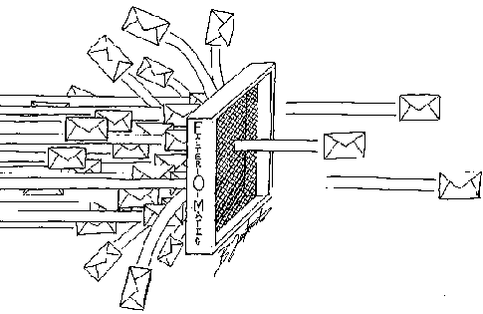

Some applications

Slide 5
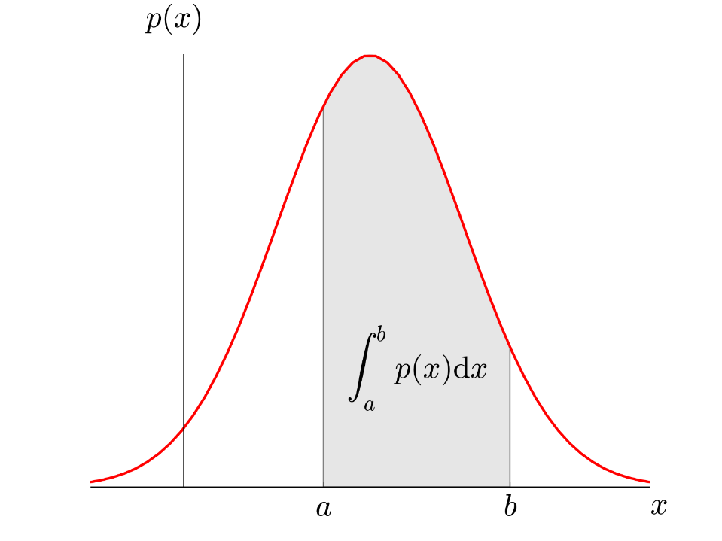


Probability distribution
Discrete
Continuous
X
P(X)
PDF
Height
2
1
1/100
1
…
2
1/100
UK POPULATION
100
…
…
100
1/100
P(X)
PMF
$$\sum_{X}{PMF\left(X\right)=1}$$
X
P(X)
1.8 m
0
1/100
P given by the area
X
$$1.75≤X≤1.85$$
1
2
…
100

Slide 6
Probability
Probability of A occurring: P(A)
Probability of B occurring: P(B)
Joint probability (A AND B both occurring): P(A,B)
Notes:
So, you can have frequentist, or traditional, statistics which will calculate probability based on data without taking into account any previous data or knowledge. Prior knowledge is therefore ignored.
6

Slide 7
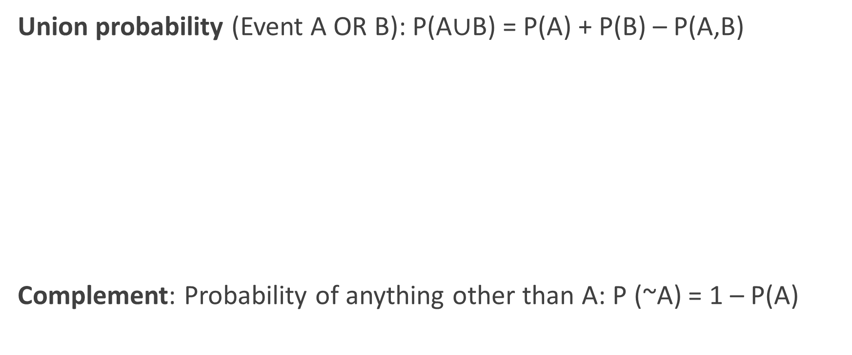

Slide 8



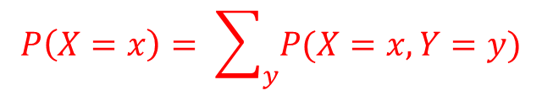

Marginal probability
joint probability :
$$P\left(X=0,Y=1\right)=0.1$$
disease
disease
x
x
$$\sum_{x,y}{P\left(X=x,Y=y\right)=1}$$
0
1
0
0.5
0.1
Y
Y
$$P\left(Y=1\right)=0.1+0.3=0.4$$
symptoms
symptoms
1
0.1
0.3
$$P\left(X=0\right)=0.1+0.5=0.6$$
$$P\left(X=x\right)= \sum_{y}{P(X=x,Y=y)}$$

Slide 9
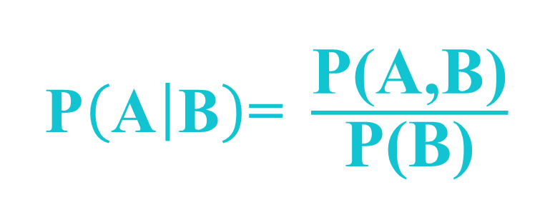
Conditional probability
What is the probability of A occurring, given that B has occurred?
Probability of A given B?
Notes:
I.E you calculate the joint probability of A and B occurring
9

Slide 10



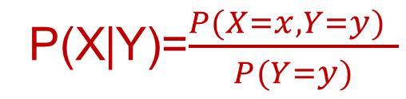






Conditional Probability
joint probability :
joint probability :
$$P\left(X=0,Y=1\right)=0.1$$
$$P\left(X=0,Y=1\right)$$
disease
x
Conditional probability:
0
1
$$P\left(X=1 | Y=1\right)=\frac{0.3}{0.1+0.3}$$
$$P\left(X=1 | Y=1\right)=\frac{0.3}{0.1+0.3}=\frac{3}{4}$$
$$P\left(X=1 | Y=1\right)$$
0.5
$$P\left(X=1 | Y=1\right)=0.3$$
0
0.1
Y
symptoms
$$P\left(X=0 | Y=1\right)=\frac{0.1}{0.1+0.3}$$
1
0.1
0.3
$$P\left(X=0 | Y=1\right)=\frac{0.1}{0.1+0.3}=\frac{1}{4}$$
$$P\left(X=0 | Y=1\right)=0.1$$
$$P\left(X=0 | Y=1\right)$$
P(X|Y)=$\frac{P(X=x,Y=y) }{P(Y=y)}$

Slide 11






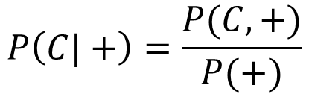
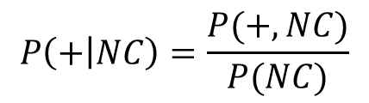



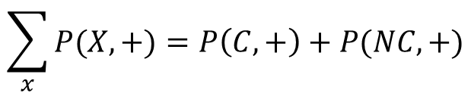


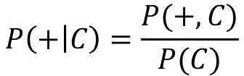

Conditional probability: Example
$$P\left(C\right)=\frac{1}{100}$$
$$P\left(NC\right)=\frac{99}{100}$$
$$P\left(+|C\right)=\frac{90}{100}$$
$$P\left(+|NC\right)=\frac{8}{100}$$
$$P\left(C|+\right)= ???$$
$$P\left(+ | C\right)=\frac{P(+,C)}{P(C)}$$
$$P\left(C,+\right)=P\left(+ | C\right)×P\left(C\right)=\frac{90}{100}×\frac{1}{100}$$
$$P\left(C|+\right)=\frac{P(C,+)}{P(+)}$$
$$P\left(+ | C\right)=$$
$$P\left(C,+\right)=P\left(+ | C\right)×P\left(C\right)=\frac{9}{1000}$$
$$P\left(C,+\right)=P(+|C)×P(C)$$
$$\sum_{x}{P(X,+})=P\left(C,+\right)+P(NC,+)$$
$$\sum_{x}{P(X,+})$$
$$P\left(+\right)=$$
$$P\left(+ | NC\right)=\frac{P(+,NC)}{P(NC)}$$
$$P\left(+,NC\right)=P\left(+ | NC\right)×P\left(NC\right)=\frac{8}{100}×\frac{99}{100}=\frac{792}{10000}$$
$$P\left(+,NC\right)=P(+|NC)×P(NC)$$

Slide 12
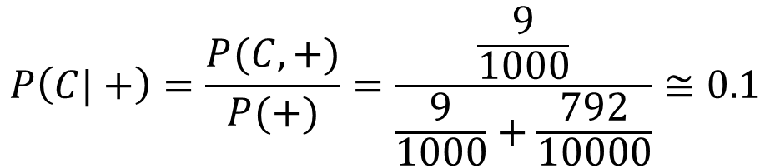
Conditional probability: Example
$$P\left(C\right)=\frac{1}{100}$$
$$P\left(NC\right)=\frac{99}{100}$$
$$P\left(+|C\right)=\frac{90}{100}$$
$$P\left(+|NC\right)=\frac{8}{100}$$
$$P\left(C|+\right)= ???$$
$$P\left(C|+\right)=\frac{P(C,+)}{P(+)}=\frac{\frac{9}{1000}}{\frac{9}{1000}+\frac{792}{10000}}≅0.1$$

Slide 13
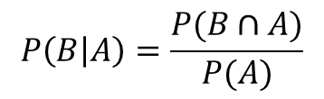
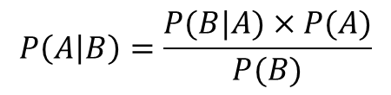

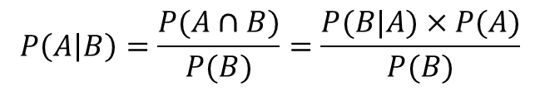
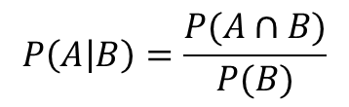

Derivation of Bayes’ theorem
Bayes’ theorem
$$P\left(A | B\right)=\frac{P(B|A)×P(A)}{P(B)}$$
$$P\left(A | B\right)=\frac{P(A∩B)}{P(B)}=\frac{P(B|A)×P(A)}{P(B)}$$
$$P\left(A | B\right)=\frac{P(A∩B)}{P(B)}$$
1
$$P\left(B | A\right)=\frac{P(B∩A)}{P(A)}$$
2
$$P\left(B | A\right)=\frac{P(B∩A)}{P(A)}=\frac{P(A∩B)}{P(A)}$$
$$P\left(A∩B\right)=P\left(B | A\right)×P(A)$$

Slide 14

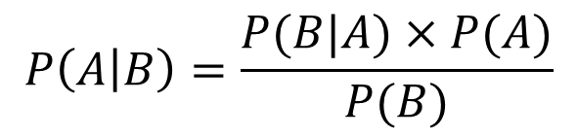
Bayes’ theorem, alternative form
$$P\left(A | B\right)=\frac{P(B|A)×P(A)}{P(B)}$$

Slide 15
Bayes’ theorem problems

Slide 16
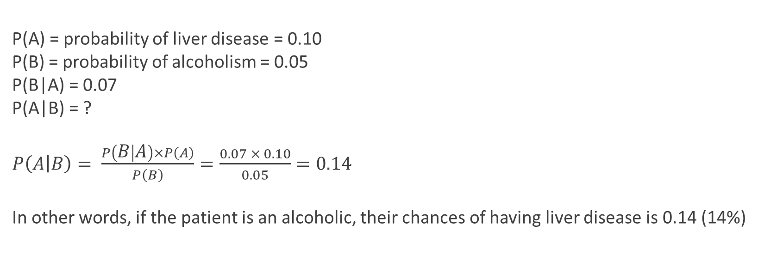
Example 1
10% of patients in a clinic have liver disease. Five percent of the clinic’s patients are alcoholics. Amongst those patients diagnosed with liver disease, 7% are alcoholics. You are interested in knowing the probability of a patient having liver disease, given that he is an alcoholic.
P(A) = probability of liver disease = 0.10
P(B) = probability of alcoholism = 0.05
P(B|A) = 0.07
P(A|B) = ?
$P\left(A | B\right)= \frac{P\left(B | A\right)×P\left(A\right)}{P\left(B\right)}=\frac{0.07 × 0.10}{0.05}=0.14$
In other words, if the patient is an alcoholic, their chances of having liver disease is 0.14 (14%)

Slide 17
Example 2
A disease occurs in 0.5% of the population
A diagnostic test gives a positive result in:
  99% of people with the disease
  5% of people without the disease (false positive)
A person receives a positive result
What is the probability of them having the disease, given a positive result?
Notes:
17

Slide 18
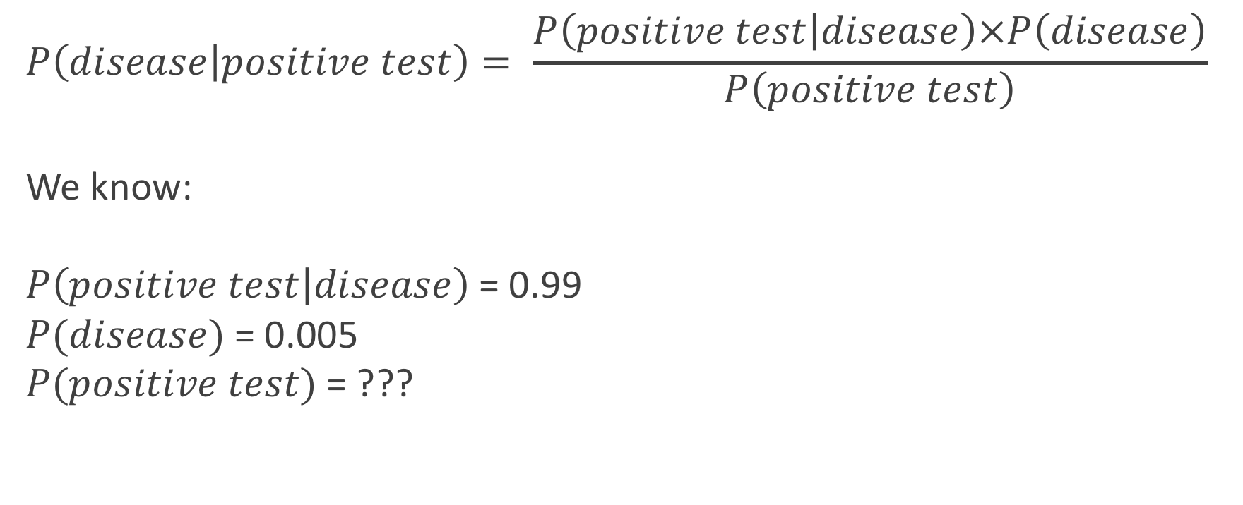
$$P\left(disease | positive test\right)= \frac{P\left(positive test | disease\right)×P\left(disease\right)}{P\left(positive test\right)}$$
We know:
$P\left(positive test | disease\right)$= 0.99
$P(disease)$= 0.005
$P(positive test)$= ???
Notes:
18

Slide 19
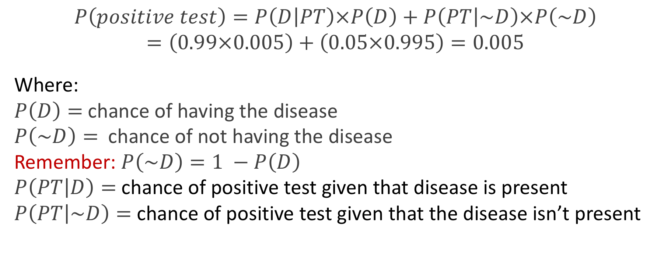
$$P\left(positive test\right)=P\left(D | PT\right)×P\left(D\right)+P\left(PT | \sim D\right)×P\left(\sim D\right)$$
$$=\left(0.99×0.005\right)+\left(0.05×0.995\right)=0.005$$
Where:
$P\left(D\right)=$ chance of having the disease
$P\left(\sim D\right)=$ chance of not having the disease
Remember: $P\left(\sim D\right)=1 −P\left(D\right)$
$P\left(PT | D\right)=$ chance of positive test given that disease is present
$P\left(PT | \sim D\right)=$ chance of positive test given that the disease isn’t present
Notes:
In this case you calculate the denominator using the following variation on Bayes’s theorem.
19

Slide 20
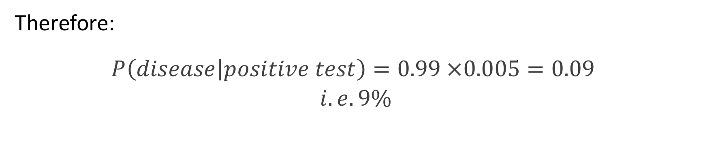
Therefore:
$$P\left(disease | positive test\right)=0.99 ×0.005=0.09$$
$$i.e. 9\%$$
Notes:
20

Slide 21
Frequentist vs. Bayesian statistics

Slide 22
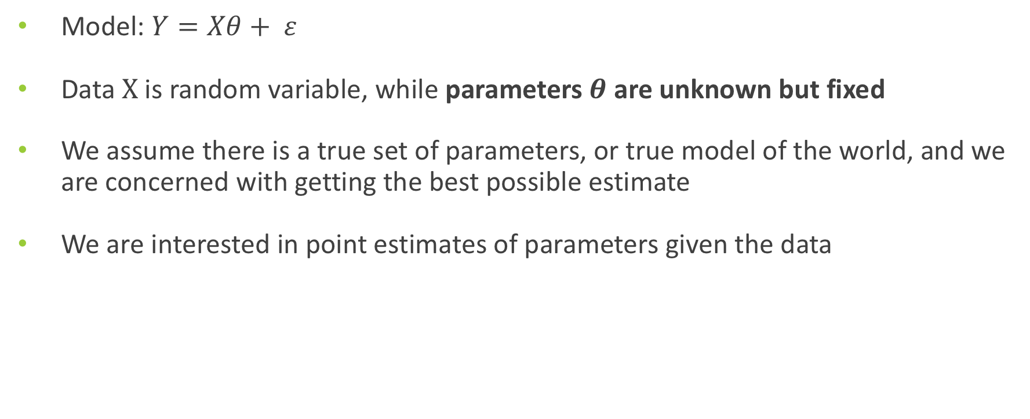
Frequentist models in practice
Model: $Y=Xθ+ ε$
Data$X$ is random variable, while parameters $θ$ are unknown but fixed
We assume there is a true set of parameters, or true model of the world, and we are concerned with getting the best possible estimate
We are interested in point estimates of parameters given the data
Notes:
22

Slide 23
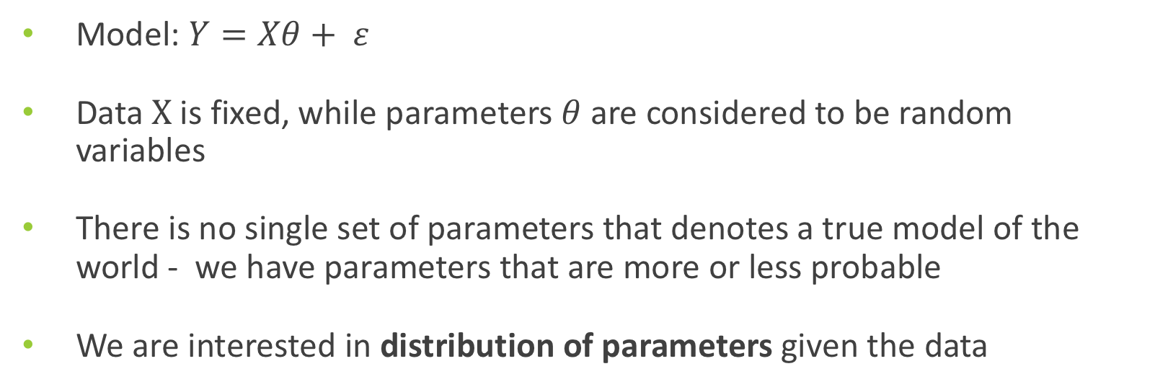
Bayesian models in practice
Model: $Y=Xθ+ ε$
Data$X$ is fixed, while parameters $θ$ are considered to be random variables
There is no single set of parameters that denotes a true model of the world - we have parameters that are more or less probable
We are interested in distribution of parameters given the data
Notes:
23

Slide 24
Bayesian Inference
Provides a dynamic model through which our belief is constantly updated as we add more data
Ultimate goal is to calculate the posterior probability density, which is proportional to the likelihood (of our data being correct) and our prior knowledge
Can be used as model for the brain (Bayesian brain), history and human behaviour

Slide 25
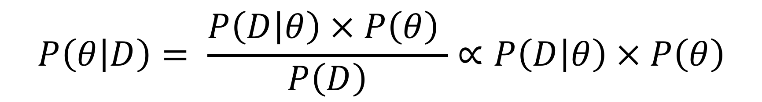
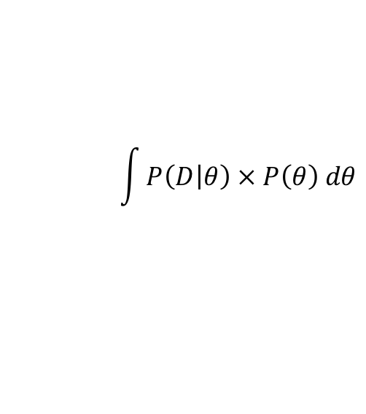
Bayes rule
Likelihood
Prior
Posterior
$$P\left(θ | D\right)= \frac{P\left(D | θ\right) × P\left(θ\right) }{P\left(D\right)}∝P\left(D | θ\right) × P\left(θ\right)$$
$$\int{P\left(D | θ\right) × P\left(θ\right) dθ}$$
Evidence
How good are our parameters given the data
Prior knowledge is incorporated and used to update our beliefs about the parameters
Notes:
25

Slide 26
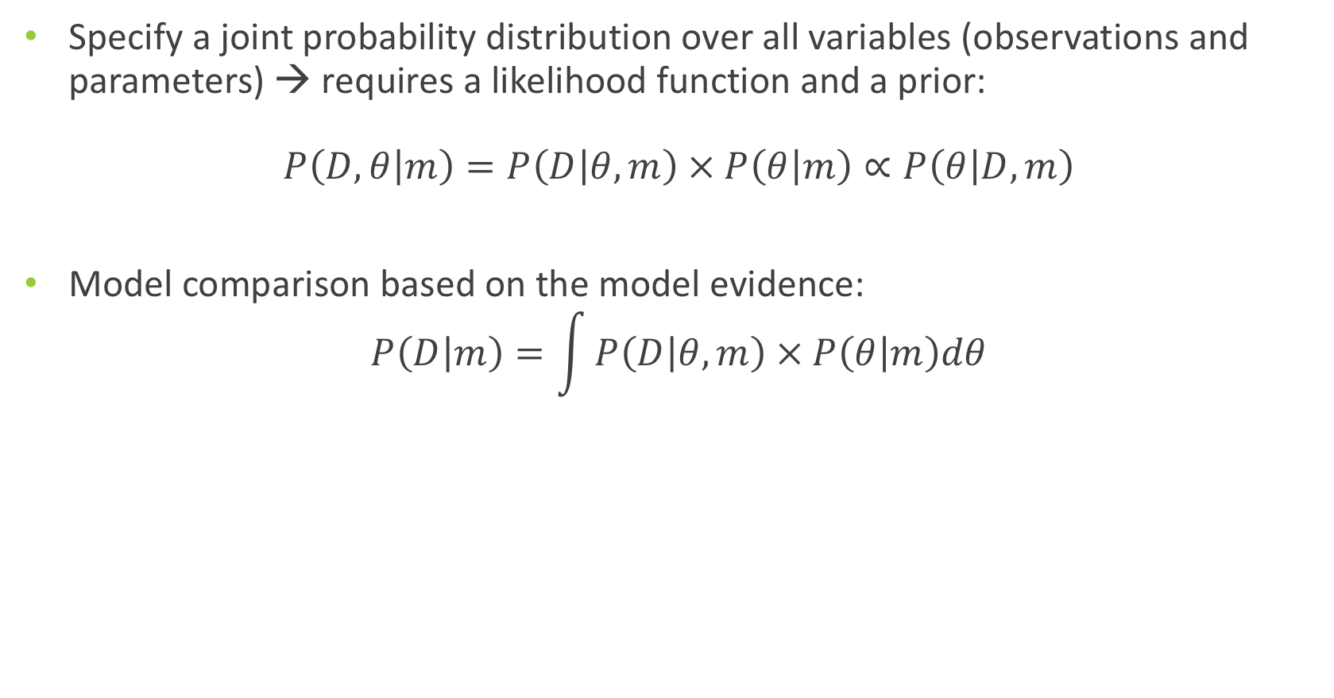
Generative models
Specify a joint probability distribution over all variables (observations and parameters) → requires a likelihood function and a prior:
$$P\left(D, θ | m\right)=P\left(D | θ, m\right) × P\left(θ | m\right)∝P\left(θ | D,m\right)$$
Model comparison based on the model evidence:
$$P\left(D | m\right)=\int{P\left(D | θ, m\right) × P\left(θ | m\right)dθ}$$

Slide 27



Principles of Bayesian Inference
Formulation of a generative model
Observation of data
Model inversion – updating one’s belief
Likelihood function $P\left(D | θ\right)$
Model
Prior distribution $P(θ)$
Measurement
data D
Posterior distribution
$$P\left(θ | D\right)∝P\left(D | θ\right)×P(θ)$$
Model evidence

Slide 28
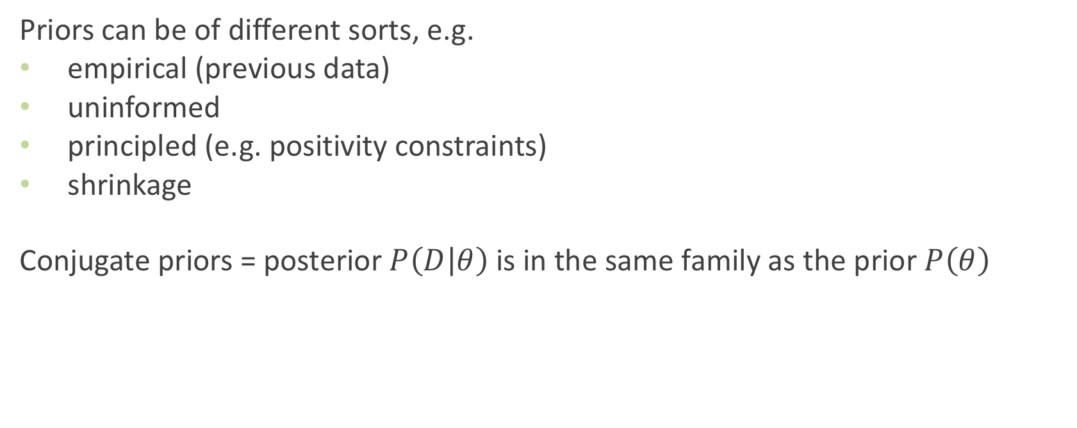
Priors
Priors can be of different sorts, e.g.
empirical (previous data)
uninformed
principled (e.g. positivity constraints)
shrinkage
Conjugate priors = posterior $P\left(D | θ\right)$is in the same family as the prior $P\left(θ\right)$

Slide 29
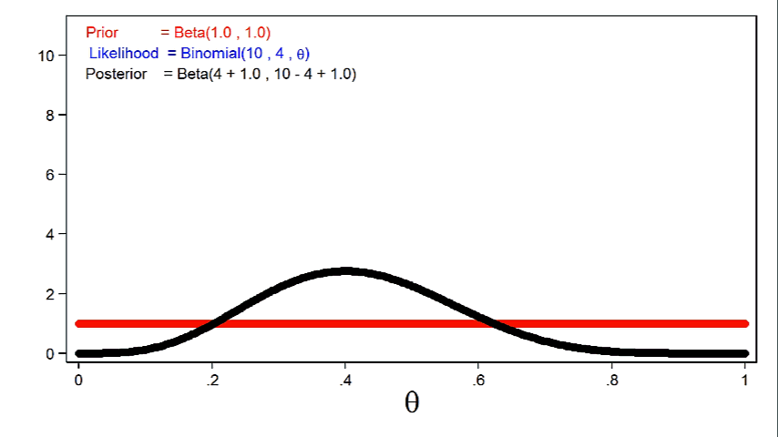
$$P\left(θ | D\right)∝P\left(D | θ\right) × P\left(θ\right)∝likelihood × prior$$
effect of more informative prior distributions on the posterior distribution

Slide 30
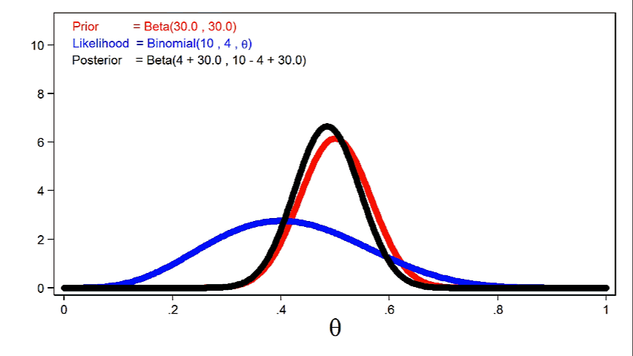
$$P\left(θ | D\right)∝P\left(D | θ\right) × P\left(θ\right)∝likelihood × prior$$
effect of larger sample sizes on the posterior distribution

Slide 31
Example: Coin flipping model
Someone flips a coin
We don’t know if the coin is fair or not
We are told only the outcome of the coin flipping

Slide 32
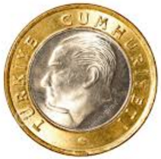

Example: Coin flipping model
1st Hypothesis: Coin is fair, 50% Heads or Tails
2nd Hypothesis: Both sides of the coin are heads, 100% Heads

Slide 33
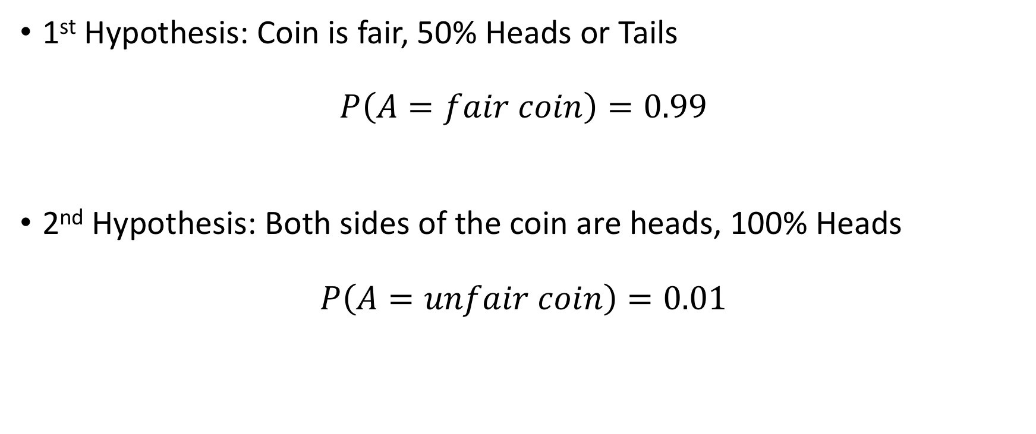
Example: Coin flipping model
1st Hypothesis: Coin is fair, 50% Heads or Tails
$$P\left(A=fair coin\right)=0.99$$
2nd Hypothesis: Both sides of the coin are heads, 100% Heads
$$P\left(A=unfair coin\right)=0.01$$

Slide 34
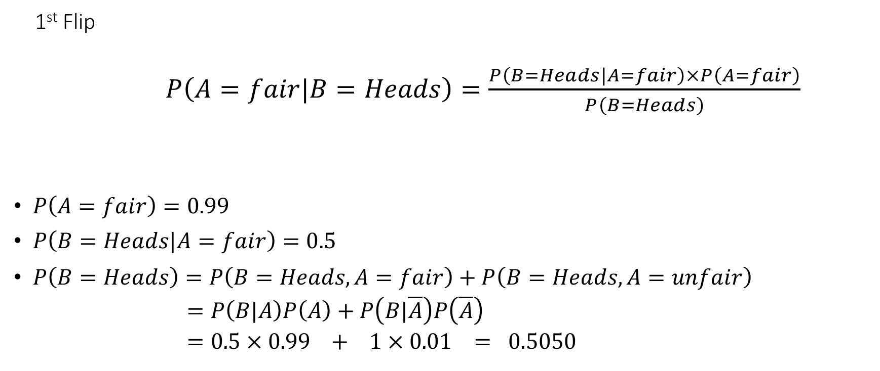
Example: Coin flipping model

Slide 35
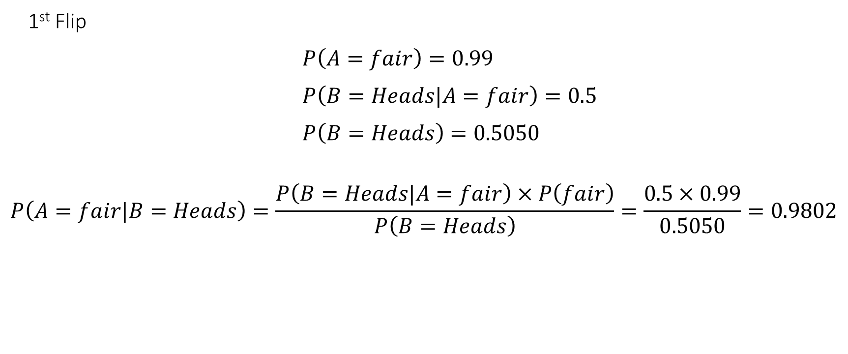
Example: Coin flipping model

Slide 36
Example: Coin flipping model
Coin is flipped a second time and it is heads again
Posterior in the previous time step becomes the new prior!!

Slide 37
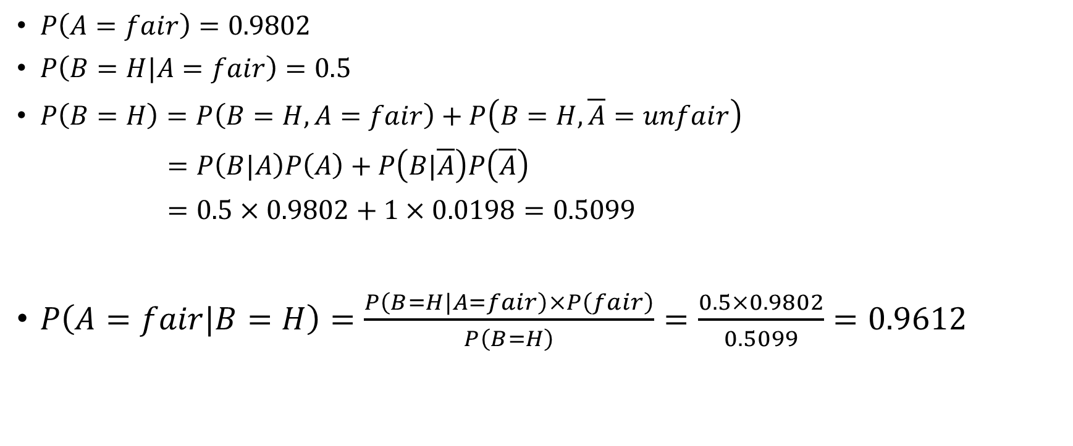
Example: Coin flipping model

Slide 38
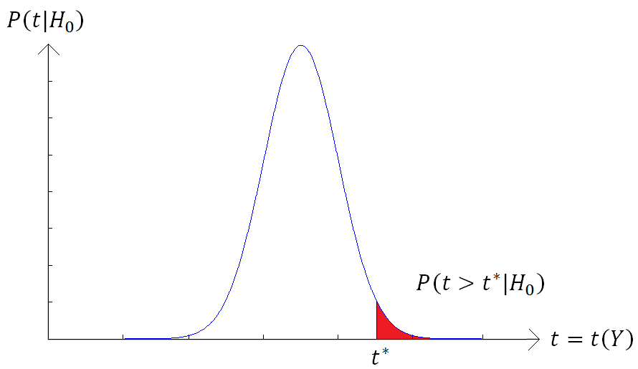
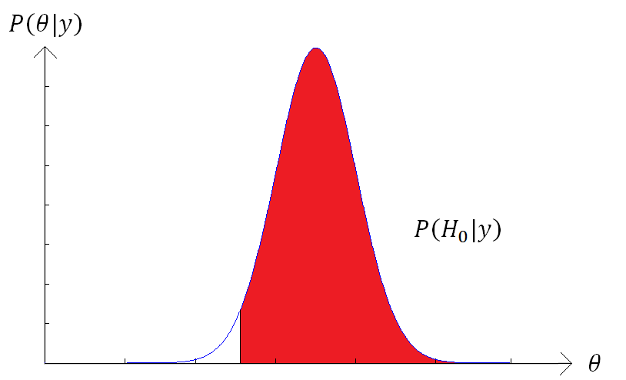
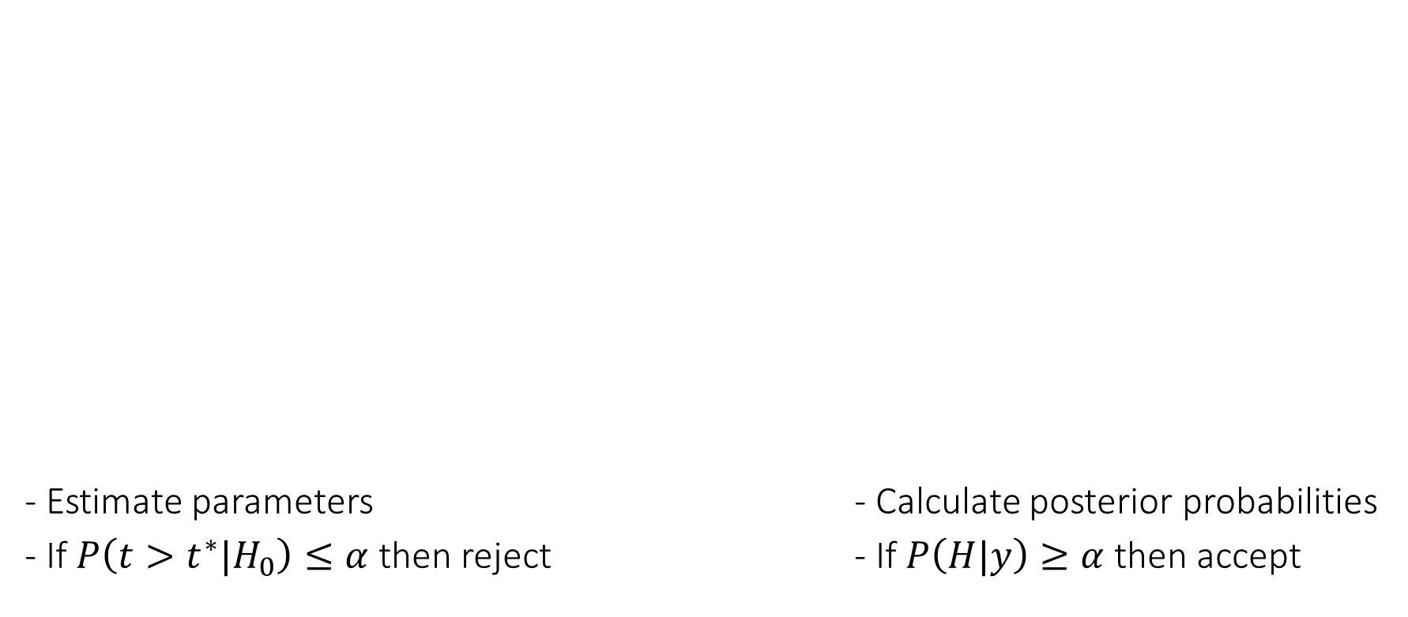

Hypothesis testing
Classical
Define the null hypothesis
H0: Coin is fair θ=0.5
Bayesian Inference
Define a hypothesis
H: θ>0.1
0.1

Slide 39
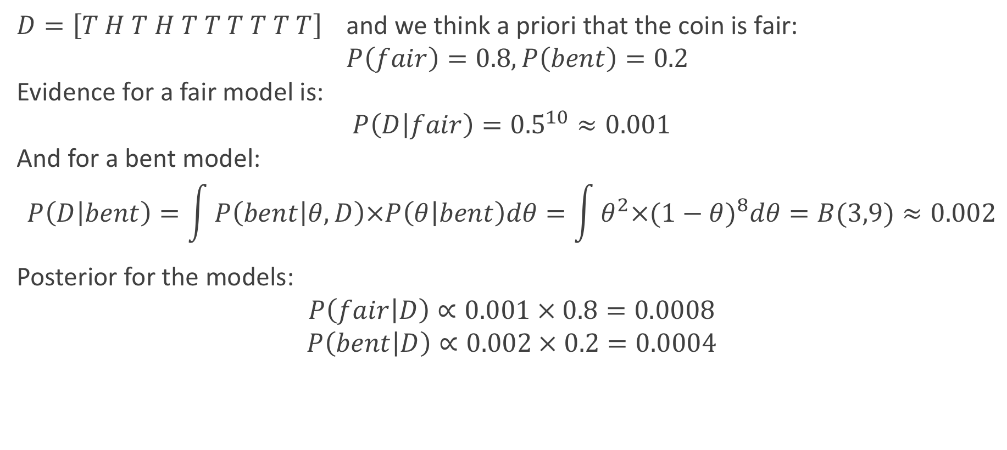
Example: Coin flipping model
$D=\left[T H T H T T T T T T\right]$ and we think a priori that the coin is fair:
$P\left(fair\right)=0.8, P\left(bent\right)=0.2$
Evidence for a fair model is:
$$P\left(D | fair\right)={0.5}^{10}≈0.001$$
And for a bent model:
$$P\left(D | bent\right)=\int{P\left(bent | θ,D\right)×P\left(θ | bent\right)dθ}=\int{θ^{2}×{(1−θ)}^{8}dθ=B(3,9)≈0.002}$$
Posterior for the models:
$$P\left(fair | D\right)∝0.001 × 0.8=0.0008$$
$$P\left(bent | D\right)∝0.002 × 0.2=0.0004$$

Slide 40
"A Bayesian is one who,
vaguely expecting a horse,
and catching a glimpse of a donkey, strongly believes he has seen a mule."

Slide 41
References
Previous MfD slides
Bayesian statistics (a very brief introduction) – Ken Rice
http://www.statisticshowto.com/bayes-theorem-problems/
Slides “Bayesian inference and generative models” of K.E. Stephan
Introslides to probabilistic & unsupervised learning of M. Sahani
Animations: https://blog.stata.com/2016/11/01/introduction-to-bayesian-statistics-part-1-the-basic-concepts/

