Slide 1
Dynamic Causal Modelling for fMRI:
Theory & Practice
Presented by: Pei-chun Tsai & Ruihan Wu
Expert: Dr. Peter Zeidman

Slide 2

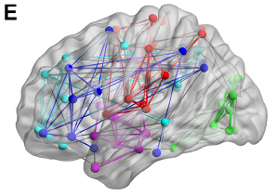
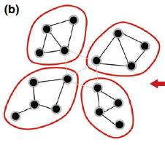
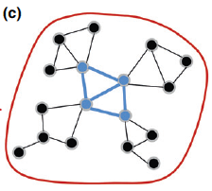
Connectivity Basics
Functional Segregation
Functional Integration
Certain function was carried out by certain areas in the brain, they could be anatomically separated
interactions among specialised neuronal populations

Slide 3
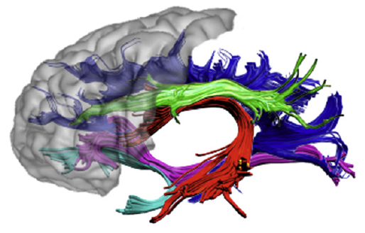
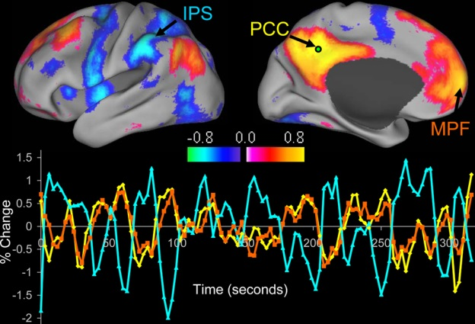
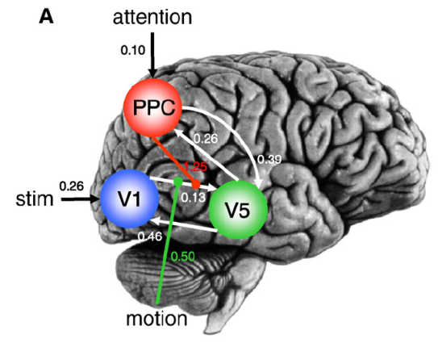
Structural, Functional and Effective Connectivity
large-scale anatomical infrastructures that support effective connections for coupling
Structural connectivity
statistical dependencies among remote neurophysiological events
Functional connectivity
Effective connectivity
influence that one system exerts over another
Notes:
Anatomical connectivity
Anatomical layout of axons and synaptic connections
Which neural units interact directly with each other
Functional connectivity
Correlation among activity in different brain areas
Statistical dependencies between measured time series
Effective connectivity
Causal influence of one neuronal system over another
At synaptic or neuronal population level

Slide 4
Dynamic Causal Modeling
Generic Bayesian framework for inferring hidden neuronal states from measured brain activity
Introduced by Friston, Harrison & Penny (2003), Neuroimage
Part of the SPM package
Notes:
Generative = models how the data was generated = based on given assumptions, which models is most likely to generate this signal?
Can be contrasted with discriminative models, which are not interested in how data was generated but only with categorizing the signal.
We use it to model inversion.
We can describe hidden dynamics - how any particular neuronal state translates into a measurement (BOLD) – if we can describe this, we can invert the model (fit to the data) and reconstruct the posterior distribution i.e. identify parameters which make the best fit to the data

Slide 5
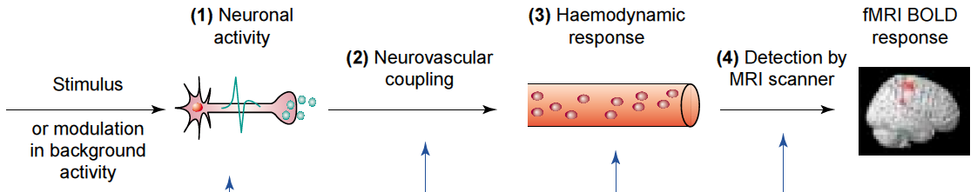
Notes:
Dynamic = using linear or nonlinear differential equations to describe hidden neuronal dynamics
Causal = describe how dynamics in one area cause dynamics in another area, and how these interactions are modulated by experimental manipulations
Neurophysiologically interpretable - Hypotheses are constrained by the underlying biological model
Use a biophysically motivated and parameterized forward model to link the modeled neuronal dynamics to specific features of measured data
Bayesian = each parameter is constrained by prior distribution – see later for how to specify these

Slide 6
Brain as input-state-output system
Inputs: experimental manipulations
  External input on brain, e.g. visual stimuli
  Context, e.g. attention
State variables: neuronal activities in the brain
Outputs: electromagnetic or hemodynamic responses over brain regions
  Measured in scanner
Notes:
Inputs: experimental manipulations
External input on brain, e.g. visual stimuli
Context, e.g. attention
State variables: neuronal activities in the brain
Outputs: electromagnetic or hemodynamic responses over brain regions
Measured in scanner

Slide 7
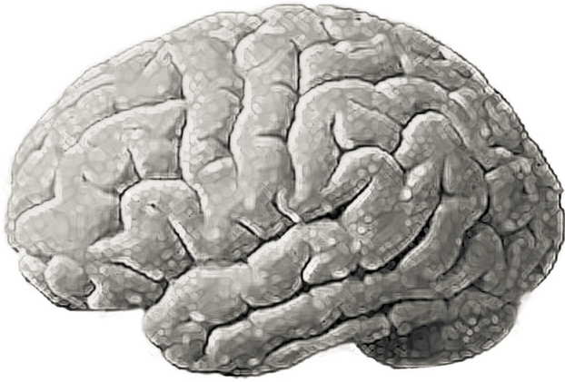


General State Equation
$$\frac{dz}{dt}=F(z,u,θ)$$
z₂
z: current state of system
z₃
u: external input to system
Z₁
θ: intrinsic connectivity
Notes:
For example there is a sound stimulus (u)
Z is the current state of system
Theta is the intrinsic connectivity between involved areas

Slide 8
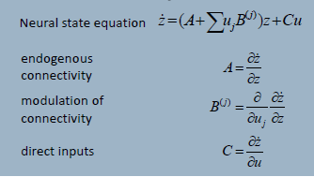
Neural equation

Slide 9
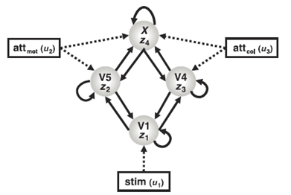
Neural State Equation in DCM
Example: attention to motion or colour of visual stimulus (Chawla, 1999)
Neural system consisting of:
  4 nodes (regions)
  Connections
    Within regions
    Between regions
  External input
    Stimulus
    Context
Taken from: Stephan, 2004

Slide 10
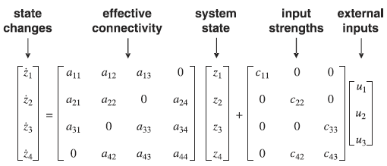

Neural State Equation in DCM (Linear)
Notes:
Self-connectivity = self-decay = always negative - every excitatory neuron sends to inhibitory neurons which feed back and dampen the activity -> self-extinction with some time constant
Dot = derivative in time

Slide 11
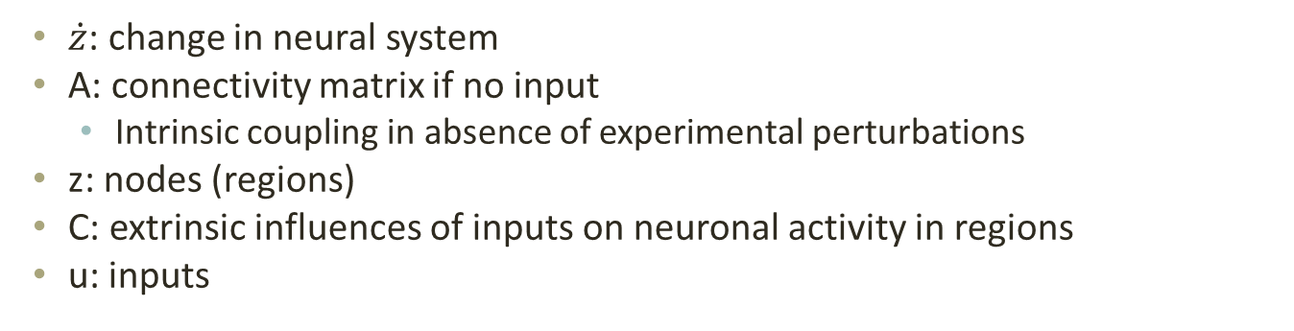
Neural State Equation in DCM
Problem: want to account for changes in connectivity due to input…
$\dot{z}$: change in neural system
A: connectivity matrix if no input
  Intrinsic coupling in absence of experimental perturbations
z: nodes (regions)
C: extrinsic influences of inputs on neuronal activity in regions
u: inputs
Notes:
Linear
Columns: outgoing connections
Rows: incoming connections
Neuronal model does not assume direct connection between regions, just that they are causally connected (so don’t have to model intermediate regions)

Slide 12
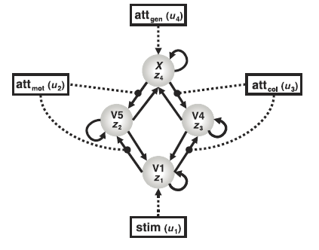
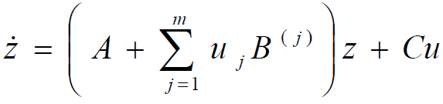
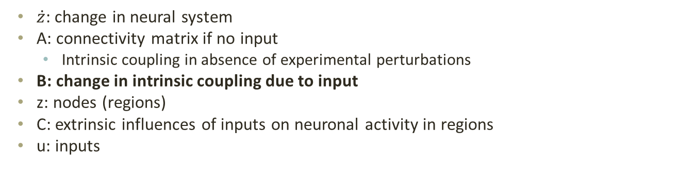
Neural State Equation in DCM (Bilinear)
$\dot{z}$: change in neural system
A: connectivity matrix if no input
  Intrinsic coupling in absence of experimental perturbations
B: change in intrinsic coupling due to input
z: nodes (regions)
C: extrinsic influences of inputs on neuronal activity in regions
u: inputs
Allowing for interactions between input and activity in region (i.e. nonlinearities)
Notes:
We can model additive changes in connectivity strength as a function of some controlled variable - how context variables change this connection?

Slide 13

Neural State Equation in DCM
Having established this neural state equation, we can now specify DCMs to look at:
  Intrinsic coupling between regions (A matrix)
  Changes in coupling due to external input (B matrix)
    Usually most interesting
  Direct influences of inputs on regions (C matrix)
Notes:
m = number of inputs
It’s additive – we add the extra element if modulation predicted to be exerted on that part of the system
A = endogenous coupling
B = bilinear term, modulatory effect – context-dependent change in connectivity
C = driving effect / direct inputs – extrinsic influences of inputs on neuronal activity

Slide 14
Notes:
Dynamic = using linear or nonlinear differential equations to describe hidden neuronal dynamics
Causal = describe how dynamics in one area cause dynamics in another area, and how these interactions are modulated by experimental manipulations
Neurophysiologically interpretable - Hypotheses are constrained by the underlying biological model
Use a biophysically motivated and parameterized forward model to link the modeled neuronal dynamics to specific features of measured data
Bayesian = each parameter is constrained by prior distribution – see later for how to specify these

Slide 15
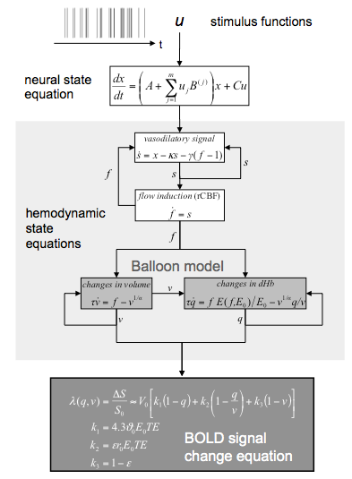
Hemodynamic model
Neural state
Change in vasodilatory signal
Change in blood flow
Change in blood volume and deoxyhemoglobin volume
Bold signal
Notes:
Cognitive system is modelled at its underlying neuronal level (not directly accessible for fMRI). The modelled neuronal dynamics are transformed into area-specific BOLD signals by a hemodynamic model
Combining the neural and hemodynamic states gives the complete forward model.
An observation model includes measurement
error e and confounds X (e.g. drift).
Bayesian parameter estimation
Result:
Gaussian a posteriori parameter distributions, characterised by
mean η_{θ|y} and
covariance C_{θ|y}.

Slide 16
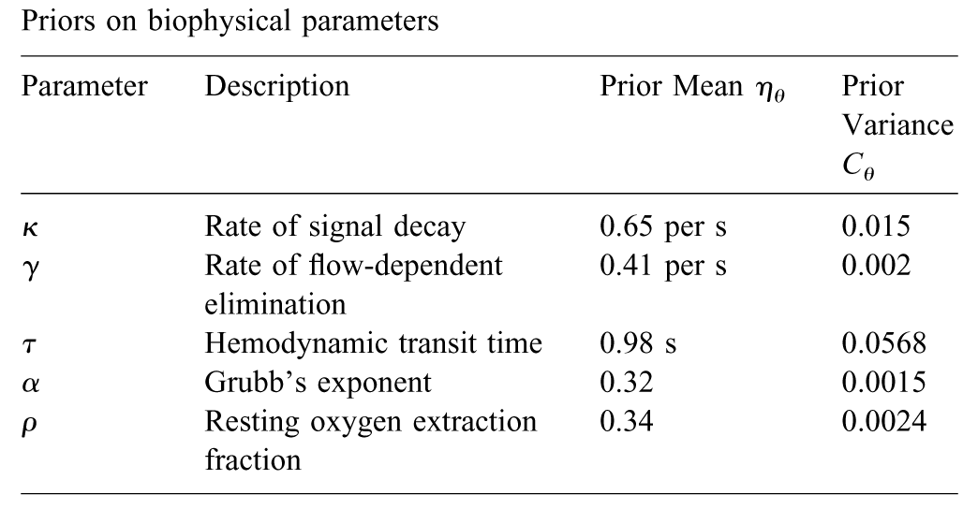
Notes:
Empirically determined a priori distribution
Computed separately for each area (like the neural parameters).

Slide 17
Inference in DCM
Bayesian Inference
Relying on prior knowledge about connectivity parameters
Simple priors or connectivity parameters that say how big the effect size is expected to be (small, medium, large)
Priors on haemodynamic parameters from human and animal experiments
Bayesian model selection to find model with highest model-evidence
  Most likely connections & influences of inputs
Important: trade off between model fit and complexity (e.g., parameters in model)
  Overfitting (i.e., explaining noise as well) if only aiming at best fit
Notes:
How do we estimate the parameters?
Priors = each parameter is constrained by prior distribution which reflects empirical knowledge about the range of possible parameters,
principles considerations (e.g. some parameters can’t have negative values, e.g. blood volume), or a conservative attitude (shrinkage priors = assume that the coupling parameters are zero)
The “posterior” probability of the parameters given the data is an optimal combination of prior knowledge and new data, weighted by their relative precision.

Slide 18
DCM in practice
Notes:
Let’s start to see in practice how to perform DCM

Slide 19
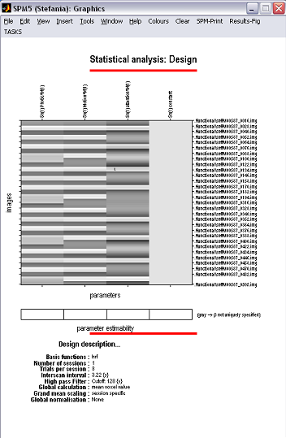
data set available from the SPM web site:
http://www.fil.ion.ucl.ac.uk/spm/data/attention/
1. Starting from standard GLM
4 CONDITIONS FROM THE STANDARD GLM:
F – Fixation
S – Observe static dots
N – Observe moving dots
A – Attend moving dots
Photic = S + N + A
Motion = N + A
Attention = A
Notes:
The first step is starting from the general GLM, so after the general preprocessing you would do to analyse general functional activations of your data.
The subjects are asked for watching some dots on the screen: we have one condition that is attention/non attention, and the other is static/fixation
fMRI block design

Slide 20
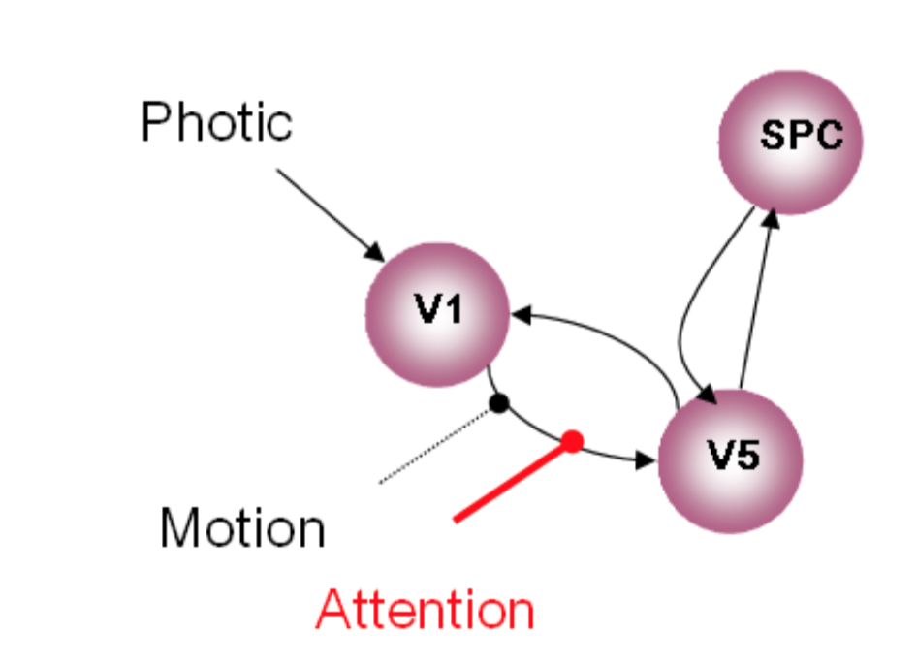
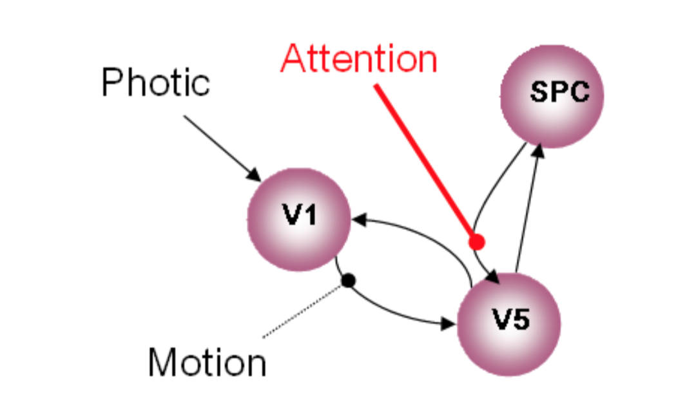
DCM: Comparison of 2 models
1 HP: DCM with attentional modulation of forwards connection
2 HP: DCM with attentional modulation of backwards connection
Which model is optimal?
Notes:
As my colleague said, one of the strength of DCM is that you can test connectivity also in relation to the task, so how actually a specific condition affect connectivity between regions.
These are the two hypothesis that we can test, so whether the attention condition can affect connectivity backwards or forwards

Slide 21
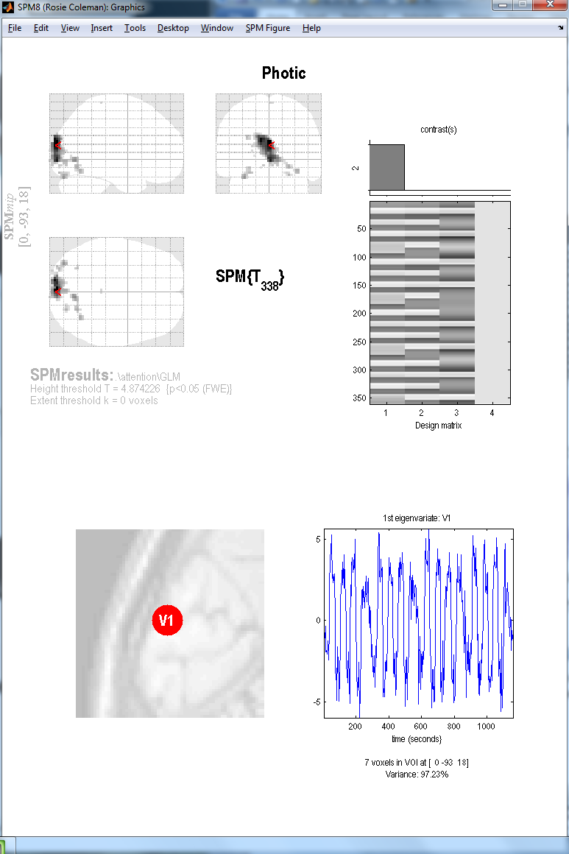
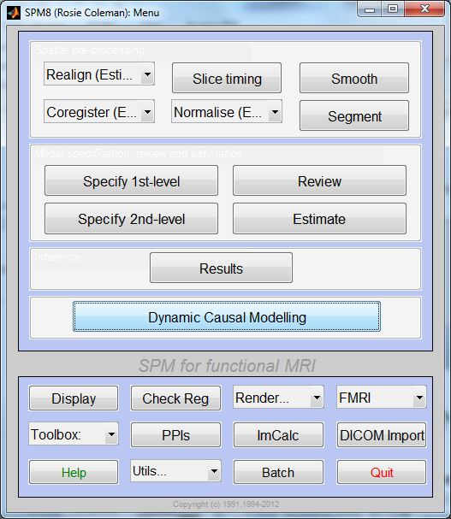
2. Extracting time series
Notes:
From the general GUI of SPM, from the results option we can extract the ROI we want to test in our model, so in this case V1, V5 and the superior parietal cortex.

Slide 22
3. Defining the model space
The models that you choose to define for your DCM depend largely on your hypotheses.
Based on:
Activations from GLM
Literature
Anatomical and computational knowledge
DCM IS NOT AN EXPLORATORY TECHNIQUE!!
Notes:
After defined the ROI that are going to be involved in my network, I have to define my hypothesis f connection between these areas.
The areas you choose and the possible way to connect them should be largely depend on your hypothesis.
We have to bear in mind that DCM is not born to be an exploratory technique, so I can’t explore effective connectivity in one task without no idea of areas involved and how these are related each other.
Generally, it’s good to define the models based on the activation that I got from the standard GLM, from literature, and anatomical knowledge (of course it should be ideal if I can prove all these three sources together).
Of course the more precise and well supported are my prediction, the less number of model I need to specify, and I can focus my interest on the investigation of the structure of the network. On the other hand, if I have less evidence about the structure of the network, I am going to define more possibilites and probably it’s more ideal to focus myself connection strength investigation.

Slide 23
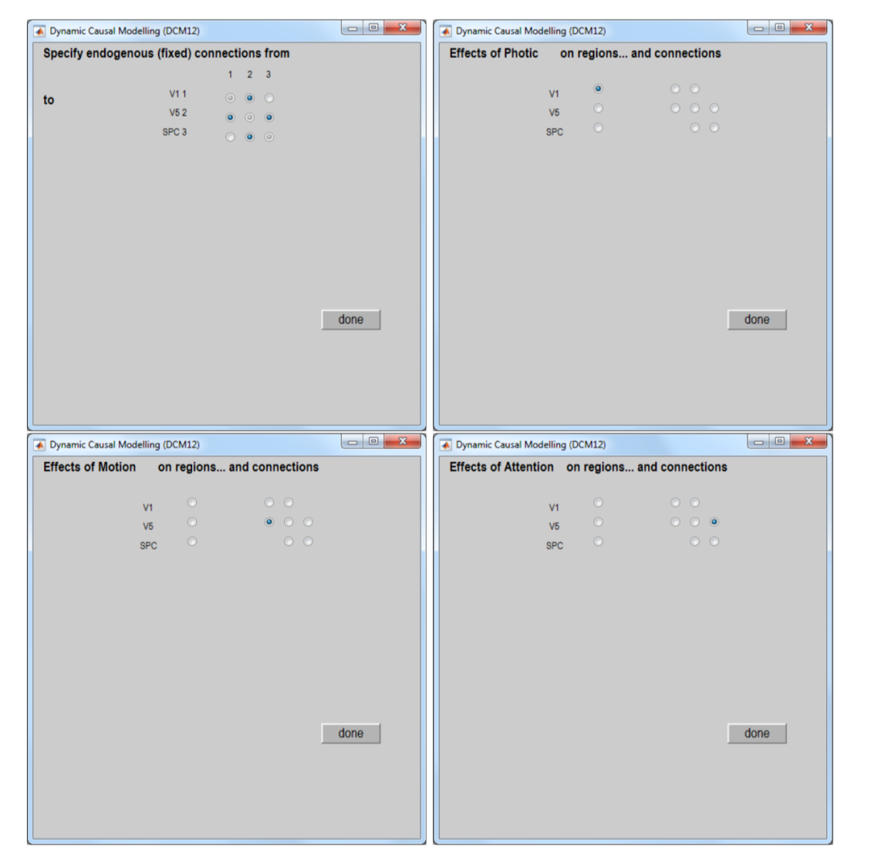
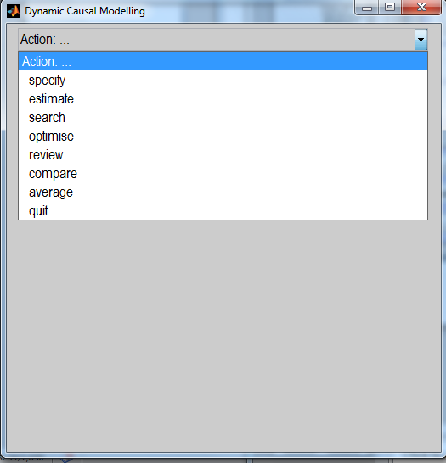
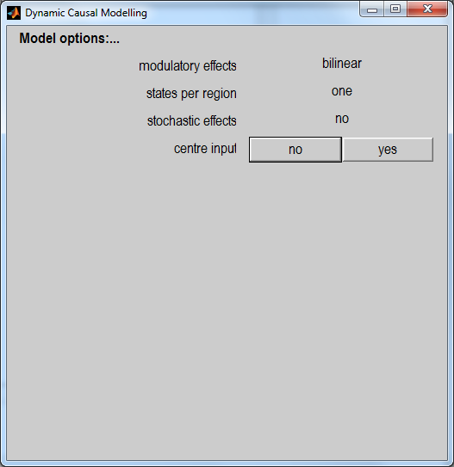
How to specify the model in the DCM toolbox
At this stage, you can specify various options.
MODULATORY EFFECTS: bilinear vs non-linear
STATES PER REGION: one vs. two
STOCHASTIC EFFECTS: yes vs. no
CENTRE INPUT: yes vs. no
Notes:
From the DCM option you can specify the structure of your model, with the connections from – to and also you are asked for defining some parameters that my colleague already a=explained you in theory before (such as…)

Slide 24
4. Model estimation
We fit the predicted model to the data.
The dotted lines represent the real data whereas full lines represent the predicted data from SPM: blue being V1, green V5 and red SPC.
Bottom graph shows your parameter estimations
Notes:
After I specified all the model I think can match all the possible hypothesis to explain the network, I can estimate all of them

Slide 25
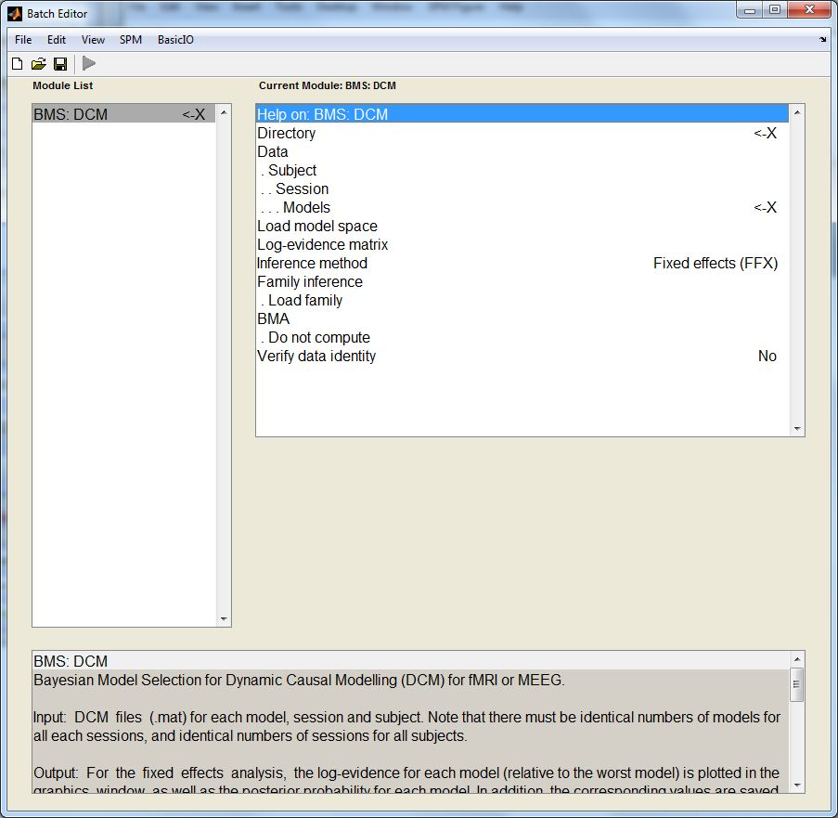
5. BMS
We choose directory
Load all models for all subjects (after being estimated)
Then, choose FFX or RFX – Multiple subjects with possibility for different models = RFX
    Optional:
    Define families
    Compute BMA
Notes:
Now that I have all the possible model created for all the subjects, I can start to compare the structure or the parameters strenght.
As I have already said, with the BMS we compare all the possible structures hypnotised for all the subjects to see whether there is a specific structure that can “win”.
Here I am asked also for specifying if I think that the effect would be fixed or can change across all the subjects (and the default possibility is RFX).
Here I can choose to perform also the BMA, so the estimation of the parameters.

Slide 26
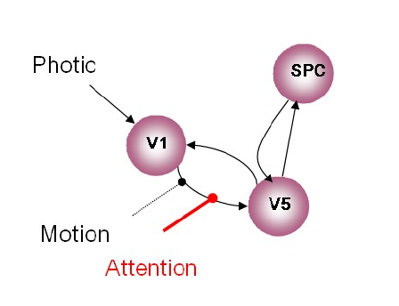
WINNING MODEL
Notes:
After performing the BMS, I got the result of the winning model, that in our case is the model where attention modulate connectivity forwards, so from V1 to V5.

Slide 27
Modulatory Connections
Intrinsic Connections
Notes:
From the review option, you can easily revisit the fit of the model related to both the intrinsic connection and the modulatory effect for example

Slide 28
Notes:
This is the final slide, to remind us how connectivity investigation could be consider as a cycle, as research in general.
So starting with hypothesis, I can arrive at generating model or parameters strength and from here starting again in thinking about hypothesis of network functioning.

Slide 29
Thank you!
And special thanks to our expert: Dr. Peter Zeidman

Slide 30
References
Friston, K.J., Harrison, L., & Penny, W. (2003). Dynamic Causal Modelling. Neuroimage, 19, 1273-1302.
Marreiros, A. C., Kiebel, S. J., & Friston, K. J. (2008). Dynamic causal modelling for fMRI: A two-state model. NeurImage, 39, 269-278.
Stephan, K. E., Penny, W. D., Moran, R. J., den Ouden, H. E. M., Daunizeau, J., & Friston, K. J. (2010). Ten simple rules for dynamic causal modelling. Neuroimage, 49, 3099-3109.
Stephan, K. E., Kasper, L., Harrison, L. M., Daunizeau, J., den Ouden, H. E. M., Breakspear, M., & Friston, K. J. (2008). Nonlinear dynamic causal models for fMRI. NeuroImage, 42, 649-662.
Razi, A.(2017, March). Brain Connectivity. Lecture given in UCL ION.
Stephan, K. E., Penny, W. D., Moran, R. J., Den Ouden, H. E. M., Daunizeau, J., & Friston, K. J. (2010). Ten simple rules for dynamic causal modeling. NeuroImage, 49(4), Stephan, K. E., & Friston, K. J. (2010). Analyzing effective connectivity with fMRI. Wiley interdisciplinary reviews. Cognitive science, 1(3), 446–459. doi:10.1002/wcs.58
Daunizeau, J., Preuschoff, K., Friston, K., & Stephan, K. (2011). Optimizing experimental design for comparing models of brain function. PLoS Computational Biology, 7(11)
Penny, W. D., Stephan, K. E., Daunizeau, J., Rosa, M. J., Friston, K. J., Schofield, T. M., & Leff, A. P. (2010). Comparing families of dynamic causal models. PLoS Computational Biology, 6(3)
Seghier, M. L., Zeidman, P., Neufeld, N. H., Leff, A. P., & Price, C. J. (2010). Identifying abnormal connectivity in patients using dynamic causal modeling of FMRI responses. Frontiers in systems neuroscience, 4(August), 1–14
Campo et al. (2013). Network reconfiguration and working memory impairment in mesial temporal lobe epilepsy. NeuroImage, 72, 48-54.
Previous MfD slides
Notes:
Friston, K.J., Harrison, L., & Penny, W. (2003). Dynamic Causal Modelling. Neuroimage, 19, 1273-1302.
Marreiros, A. C., Kiebel, S. J., & Friston, K. J. (2008). Dynamic causal modelling for fMRI: A two-state model. NeurImage, 39, 269-278.
Stephan, K. E., Penny, W. D., Moran, R. J., den Ouden, H. E. M., Daunizeau, J., & Friston, K. J. (2010). Ten simple rules for dynamic causal modelling. Neuroimage, 49, 3099-3109.
Stephan, K. E., Kasper, L., Harrison, L. M., Daunizeau, J., den Ouden, H. E. M., Breakspear, M., & Friston, K. J. (2008). Nonlinear dynamic causal models for fMRI. NeuroImage, 42, 649-662.
Razi, A.(2017, March). Brain Connectivity. Lecture given in UCL ION.
Stephan, K. E., Penny, W. D., Moran, R. J., Den Ouden, H. E. M., Daunizeau, J., & Friston, K. J. (2010). Ten simple rules for dynamic causal modeling. NeuroImage, 49(4), Stephan, K. E., & Friston, K. J. (2010). Analyzing effective connectivity with fMRI. Wiley interdisciplinary reviews. Cognitive science, 1(3), 446–459. doi:10.1002/wcs.58
Daunizeau, J., Preuschoff, K., Friston, K., & Stephan, K. (2011). Optimizing experimental design for comparing models of brain function. PLoS Computational Biology, 7(11)
Penny, W. D., Stephan, K. E., Daunizeau, J., Rosa, M. J., Friston, K. J., Schofield, T. M., & Leff, A. P. (2010). Comparing families of dynamic causal models. PLoS Computational Biology, 6(3)
Seghier, M. L., Zeidman, P., Neufeld, N. H., Leff, A. P., & Price, C. J. (2010). Identifying abnormal connectivity in patients using dynamic causal modeling of FMRI responses. Frontiers in systems neuroscience, 4(August), 1–14
Campo et al. (2013). Network reconfiguration and working memory impairment in mesial temporal lobe epilepsy. NeuroImage, 72, 48-54.
Previous MfD slides

