Slide 1
Diffusion MRI and applications
24th April 2018
METHODS FOR DUMMIES
Carlos Estevez-Fraga
Paul Zeun

Slide 2
Outline
Diffusivity and diffusion-weighted imaging (DWI)
Diffusion tensor imaging (DTI)
Voxel-wise analysis of diffusion metrics
Tractography
Connectomics

Slide 3
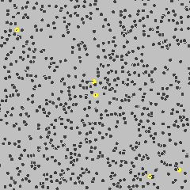
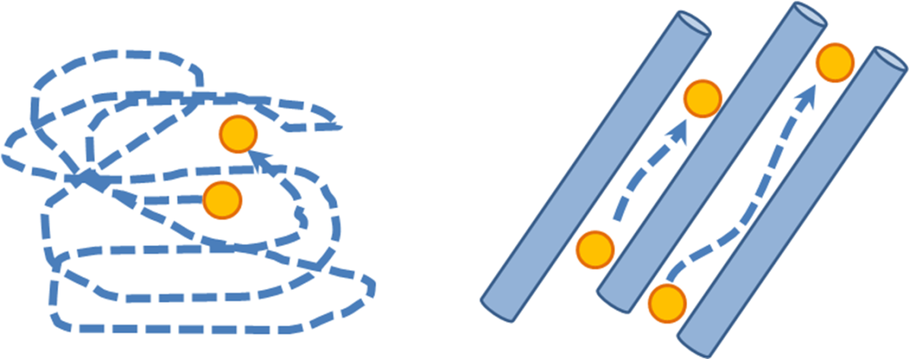
Water molecule movement (diffusivity) occurs inside, outside, around and through cellular structures affected by temperature and viscosity
Mobility affected by barriers and obstacles inc. intracellular, extracellular, axons etc., within a tissue
Notes:
What DWI measures
ly described by Einstein in 1905 (1).
The term molecular diffusion refers to the notion that any type of molecule in a fluid (eg, water) is randomly displaced as the molecule is agitated by
thermal energy (Fig 1). 1). In a glass of water, the motion of the water molecules is completely random and is limited only by the boundaries of the
container.
Measuring diffusion of water molecules where diffusion = thermally-driven random motion
In principle, the diffusion signal is from the dephasing of the spins due to their displacement during a dMRI experiment
Brownian motion or pedesis (from Ancient Greek: πήδησις /pέːdεːsis/ "leaping") is the random motion of particles suspended in a fluid (a liquid or a gas) resulting from their collision with the fast-moving molecules in the fluid.^{[2]}
https://www.youtube.com/watch?v=Peg1yaB2bsk
Diffusion is the movement of a substance from an area of high concentration to an area of low concentration. Diffusion happens in liquids and gases because their particles move randomly from place to place. Diffusion is an important process for living things; it is how substances move in and out of cells

Slide 4
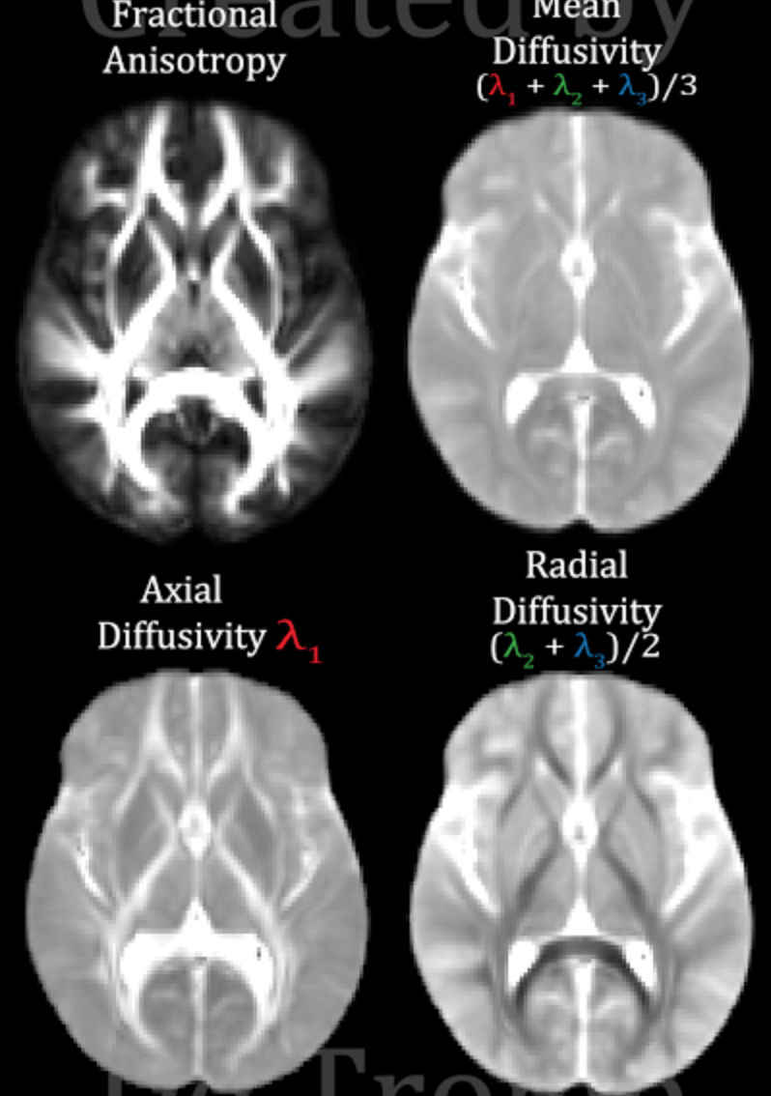
DWI ≠ DTI
DWI
DTI
Notes:
DWI is the MRI image that reflects wáter movement in the brain
Fit a diffusion tensor (represents 3D movement of wáter in every voxel)
Map of diffusion tensor imaging measures

Slide 5
DWI concepts
Diffusion parameter
Diffusion time Δ | Longer Δ results in more attenuation in diffusion signal
Gradient strength G | Stronger G results in more attenuation in diffusion signal
b-value | Summarizes the effect of gradient strength and diffusion time
Shell | Set of volumes with the same b value but different orientation
Single-shell dMRI | Varying gradient directions with a fixed b-value
Multi-shell dMRI | Varying gradient directions multiple b-values.
Notes:
Diffusion time Δ how long are you applying the magnetic field
Gradient strenght how much how strong is you magnetic field
The b-value is a factor that reflects the strength and timing of the gradients used to generate diffusion-weighted images
In Diffusion MRI, lots of reference to b values, b0’s and shells. This slide explains what these mean
In a dMRI experiment, the data we collect are a series of 3D volumes.
Among these volumes, some of them, called B0 images, are generated without the application of diffusion gradients. (bright ones)The rest of the images are acquired with varying diffusion gradients
The diffusion time determines probabilistically how far the distance the water molecules, or the spins, will travel in a dMRI experiment. With the increase of the diffusion time, the spins will likely travel farther away from their original location and thus result in more attenuation in signal (more contrast)
The effect of both increasing diffusion time and gradient strength is summarized in the quantity called b-value so higher b value – more attenuation
In conventional dMRI experiments, the b-value is fixed and only the gradient directions were changed to acquire a series of 3D volumes (single shell Q-ball acquisition)
multi-shell experiments, a small set of different b-values is used in addition to the change of gradient directions. This provides an opportunity of more sophisticated modeling of water diffusion in human brain and will produce more reliable DTI but given more attenuation also lower signal-noise and longer scanning time
In addition to a strong magnetic field different gradient fields are applied to the brain, so that as water moves in different directions these gradient fields can label that movement differentially.
What happens is that water molecules that moved during this magnetization will have a different magnetization than their neighboring water molecules which leads to a change in image contrast. When you do this in more than six directions you will actually be able to calculate the direction of water diffusion
The DW pulse sequence is first run with the DG's turned off or set to a very low value. This generates a set of b0 ("b-zero") images that are T2-weighted and will serve as a baseline for later calculated maps.
The DW sequence is then run with the DG's turned on individually or in combination and at various strengths. This produces DW source images sensitized to diffusion in multiple different directions.
b-value gives the degree of diffusion weighting and is related to the strength and duration of the pulse gradient as well as the interval between the gradients
b changes by lengthening the separation of the 2 gradient pulses and increasing pulse more time for water molecules to move around more signal loss (imperfect rephasing)
Higher the b value the more diffusion contrast But less signal left - exponential decay and more noise
Multishell vs single shell – more b values
the purpose of the B0 images is not only to divide out the baseline T2w signal of tissues, but also to remove these other sources of signal variance listed above.
Because diffusion is anisotropic in WM, applying a gradient G along different directions x, gives different contrast in WM.
more diffusion weighting (as evidenced by the brighter corticospinal tracts) but also more noise
A single b-value conflates the tensor size indicated by the magnitude of its eigenvalues and the partial volume fractions. In contrast, the use of multiple b-values enables a unique solution to be found and disambiguates the estimation of f and D. This allows measurements of the partial volume occupancy of each tensor in addition to the tensor estimation.

Slide 6
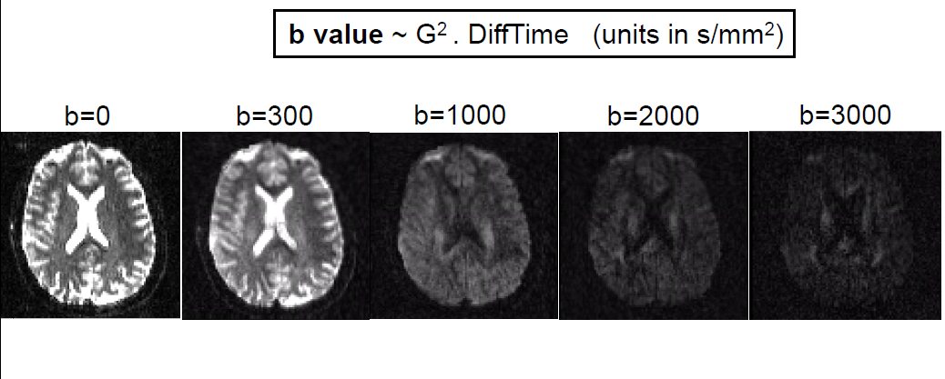
Notes:
FIGURE 5.3 Effect of changing the axis of the diffusion-encoding
gradients on the diffusion-weighted signal intensity. The arrows at the
top of the figure show the orientation of the encoding axis. In (c), the
orientation is perpendicular to the viewing plane. Dark areas have
high apparent diffusivity, lighter areas represent lower apparent
diffusivity. In the area highlighted by the lower (unfilled) arrows,
which forms the midsagittal portion of the splenium of the corpus
callosum, the apparent diffusivity is high along the left–right axis, but
low in the two orthogonal directions

Slide 7
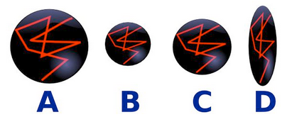
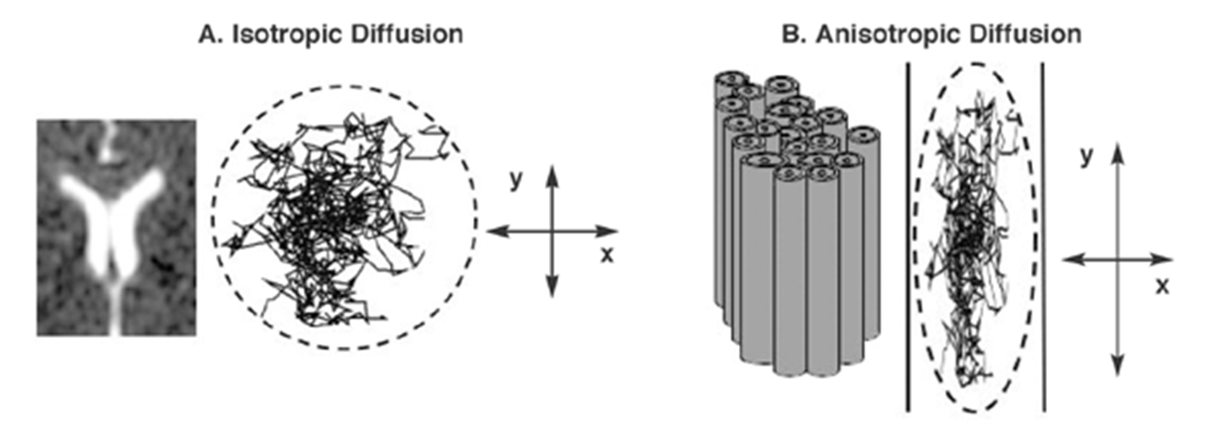
DWI – Raw output
DTI – Tensor reconstruction from raw DWI
In DTI - focus on the impact of microstructural barriers and obstacles
on diffusivity in white matter to understand more about
what is happening in a particular tissue
DTI measurements reflect the amount of hindrance/restriction experienced by water molecules moving with a component of displacement along the axis of an applied gradient, averaged over a voxel.
Notes:
What is DWI and what is DTI?
DWI is raw output, DTI is tensor reconstruction from raw DWI and has been the most popular model of dMRI
Models of water diffusion in white matter will look like ellipsoids that are more anisotropic, as in the picture above. While tensors in gray matter and cerebral spinal fluid are more isotropic (ball shaped). Each point (or volume pixel, aka voxel) has a tensor with a direction and a relative anisotropy.

Slide 8
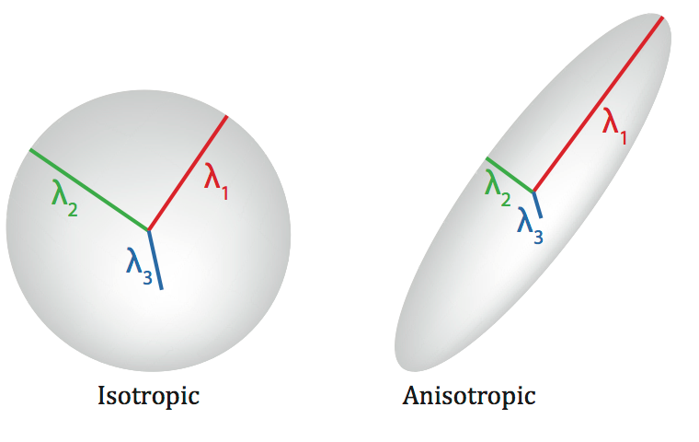
DTI
Fractional anisotropy, FA degree of anisotropy in principal direction
Principal parallel axis
Principal perpendicular axes
Notes:
What is a tensor?
Tensor is a 3x3 matrix that represents water movement in the three dimensions, IT IS RECONSTRUCTED IN EVERY VOXEL it can be represented as three vectors (lambda1, 2 3)
Lambda 1 → diffusivity along the principal axis of diffusion
2&3 diffusivity ortogoal to the principal axis of diffusion
3 the same → isotropic
1 predominates →anisotropic
(FA) quantifies difference between largest eigenvector and others
This tensor reconstruction process can be accomplished by many software packages including AFNI, Camino, DTIStudioand FSL and others
Tensors (3x3 matrix) characterizes three-dimensional displacements. The diagonal elements correspond to diffusivities along three orthogonal axes (need at least 6 gradient directions)
The value of the tensor in each point in the brain can be quantified with different metrics.
i.e. it quantifies the fraction of the tensor that is non-isotropic.
Can now understand why neurodegeneration typically causes higher diffusivity – more CSF (atrophy) and less anisotropy and why FA will decrease as less coherent wm tracts.
Help understand typically neurodegen in WM is low FA and higher MD – less coherent WM tracks
Can do this voxelwise to create MD or FA maps
The tensor matrix and the ellipsoid can be described by the:
Size of the principles axes = Eigenvalue
Direction of the principles axes = Eigenvector

Slide 9
DWI ≠ DTI
DWI
DTI

Slide 10
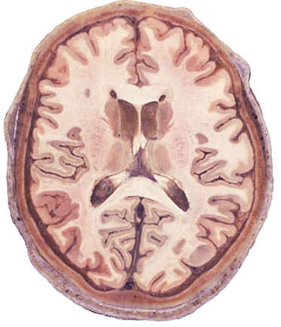
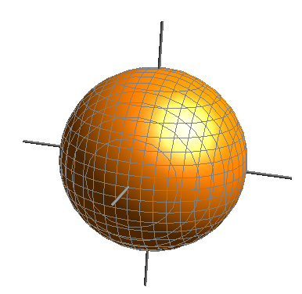
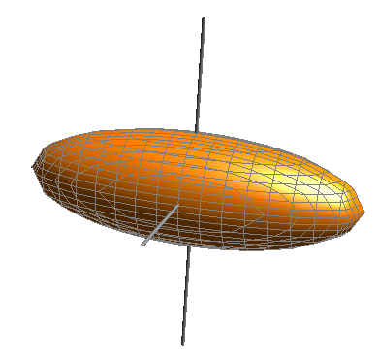
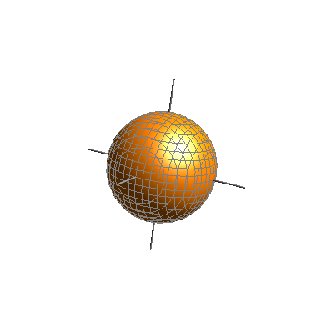
CSF Isotropic
High diffusivity
White matter
Anisotropic
High diffusivity
Grey matter Isotropic
Low diffusivity

Slide 12
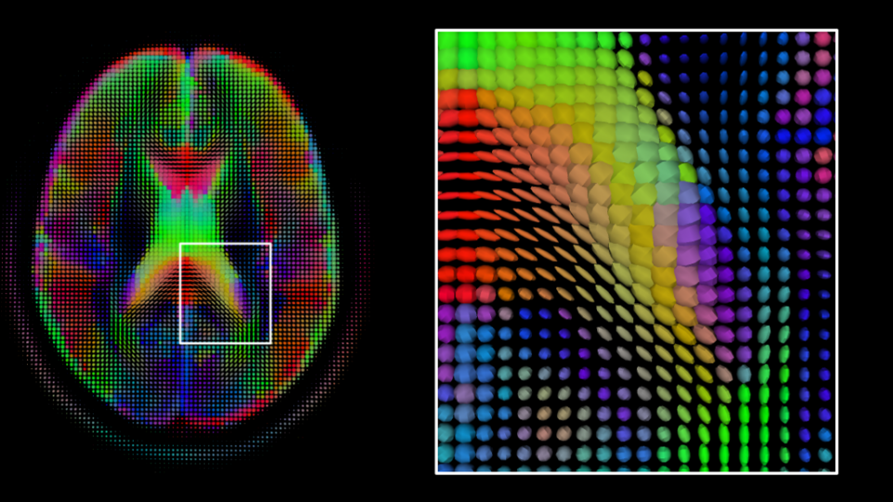
Looking at tensors for sanity checks
Notes:
The appearance of tensors in the brain
Shows tensor map – you can review this to make sure your data makes sense and not misalinged/wonky
Check if the tensors are oriented correctly in the genu and the splenium (front/back) of the corpus callosum in the axial view (shown above). The tensors' major axes should be clearly aligned along the boundary of the genu and the splenium.
Check if the tensors are oriented correctly in the internal capsule and the midbody of the corpus callosum in the coronal view (also shown above). Again, the tensors should be properly aligned with the boundary of these structures. Also can see isotropic tensors in csf space
(A common mistake during tensor reconstruction (the process of constructing tensor volumes from diffusion-weighted images) is using a gradient table that is not corrected for the difference between the coordinate frame in which the gradient table is defined and the one in which the image is defined)

Slide 13
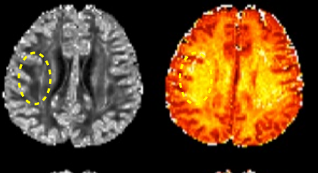
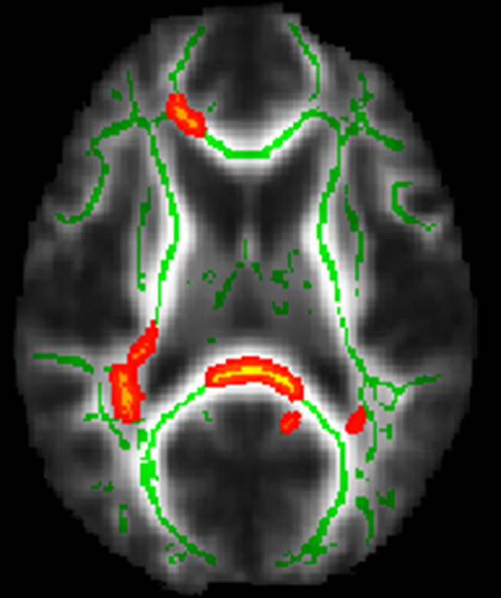
Diffusion Tensor Imaging
Once we have diffusion data we can perform different analyses to answer our questions
1) Testing for changes across the whole-brain
VBM analysis of DTI images
Tract-Based Spatial Statistics (TBSS)
Notes:
How we can use diffusion data
Voxelwise – i.e. same idea as VBM but different approach

Slide 14
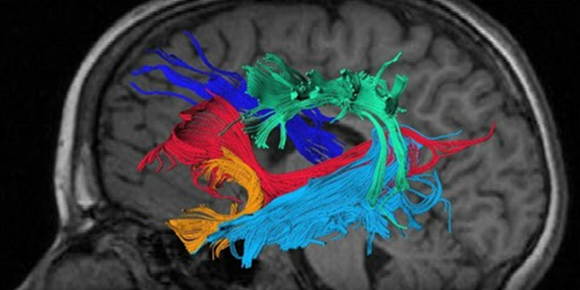
Diffusion Tensor Imaging
Once we have diffusion data we can perform different analyses to answer our questions
2) Hypothesis-driven approach
Investigate microstructural properties of individual tracts
eg. Tractography

Slide 15
Tract-Based Spatial Statistics (TBSS)
For robust cross-subject stats on DTI
Compare FA taken from tract centres (via skeletonisation)
Better alignment and no necessity to smooth
Also with AD/RD/MD
Problem:
Alignment issues confound valid local stats
Crossing fibers
Notes:
Using diffusion measures, need to present results that are unbiased, objective, and anatomically specific.
TBSS pioneered the idea of projecting volumetric data onto a WM skeleton to circumvent the partial volume effect (PVE) and gain statistical power from this dimensionality reduction
The approach does not require data smoothing and could alleviate many concerns that were raised regarding the conventional voxel-based morphometry (VBM) framework that was previously used in many DTI studies - in particular registration difficulties – also increases statistical power
Being a fully automated technique, TBSS is generally considered to be largely user-independent except results (i) the choice of the registration target and (ii) the FA threshold defined in the skeletonization process which can influence results.

Slide 16
TBSS
Calculate diffusion tensor
Non linear alignment of FA images into standard space
Create mean FA image → skeleton
Then project each subject’s aligned FA image onto the mean FA skeleton
Perform voxelwise statistics across subjects, for each point on the common skeleton via GLM
Notes:
In more detail, images have first to be prealigned and corrected for head motion and eddy currents. Then a diffusion tensor is calculated. The next step would be a non-linear alignment that allows the creation of the skeleton with intermediate degrees of freedom. The most typical subject of the cohort (or a template) is used in order to register all the remaining subjects so the less mean displacement is found. Finally all images are warped to a common space, they are averaged to create a mean FA image and the skeleton is created as a line in the centre of the tract. A search is then made perpendicular to the tract and the voxel with maximal FA is chosen as the centre of the tract. The FA skeleton should be then thresholded to exclude non WM voxels. Finally, each participant’s FA image is projected onto the skeleton.
Brief overview of TBSS
This framework has been shown to improve white-matter alignment compared with conventional FA-based registration
Create population-specific tensor template / Create mean FA image (no smoothing)
Can also warp atlas to subject space if need ROI
The following set of commands will register the population template to the standard-space template with a series of registrations, beginning with rigid, then affine, then finally diffeomorphic.
Image mapping to standard space is often required in reporting results from voxel-based analysis
With regard to the choice of the registration target, a recommendation can already be made on the basis of both previous studies and our work: Replace the TBSS registration step with tensor-based, group-wise registration, e.g. using DTI-TK.
Steps
Rigidly register each image to first b0
Tensor based registration from subject space to population-template space (DTI-TK)
Map population template space to standard space e.g. ICBM
Estimate tensor metric (e.g. FA, MD, NDI ect) in e.g. FSL/NODDI toolbox
Create mean FA image and skeletonise it
Project all subjects’ FA data onto the mean FA skeleton
Stats – feed 4D projected FA data into GLM modelling and thresholding to find voxels which correlate with your model

Slide 17
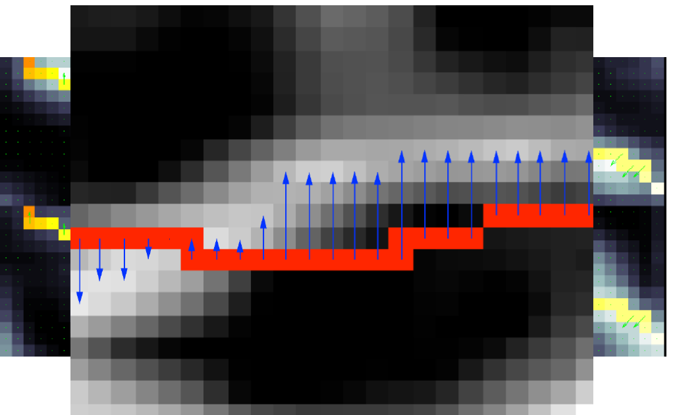
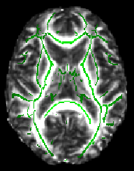
Skeletonise mean FA
Notes:
About the skeletonisation process
The mean FA is now fed into the tract skeleton generation, which aims to represent all tracts which are ‘‘common’’ to all subjects. The skeleton will represent each such tract as a single line (or surface) running down the centre of the tract.
In other words, a search is made along all voxels in the local ‘‘tract perpendicular direction’’, and the voxel with the highest FA is identified as the centre of the tract.
(If the FA value is greater than the neighbouring values, then the voxel is marked as lying on the skeleton.)
We now have an FA skeleton which should represent the different tract structures in the mean FA image.
This is thresholded in order to restrict further analysis to points which are within white matter which has been successfully aligned across subjects. (i.e. excluding CSF/GM voxels)
We now ‘‘project’’ each subject’s aligned FA image onto the mean FA skeleton. The aim here is to account for residual misalignments between subjects after the initial nonlinear registrations.
Should now see the mean FA skeleton on top of each different subject's aligned FA image.
If the registration has worked well you should see that in general each subject's major tracts are reasonably well aligned to the relevant parts of the skeleton.
TBSS includes a skeletonization step that alleviates residual image misalignment and obviates the need for data smoothing. By Projects locally maximal FA values of individual subjects onto the FA skeleton.
First create in a standard-space (MNI) version of each subject's FA image; next these are all merged into a single 4D image file called all_FA, created in a new subdirectory called stats. Next, the mean of all FA images is created, called mean_FA, and this is then fed into the FA skeletonisation program to create mean_FA_skeleton.
the mean FA skeleton on top of each different subject's aligned FA image. If the registration has worked well you should see that in general each subject's major tracts are reasonably well aligned to the relevant parts of the skeleton.
Threshold this to suppress areas of low mean FA and/or high inter-subject variability.
Sets search radius of local voxels for highest FA value – but this might include an adjacent fibre bundle This is a potential source of misassignment (yellow arrow), especially if the neighboring tract has high FA values.

Slide 18
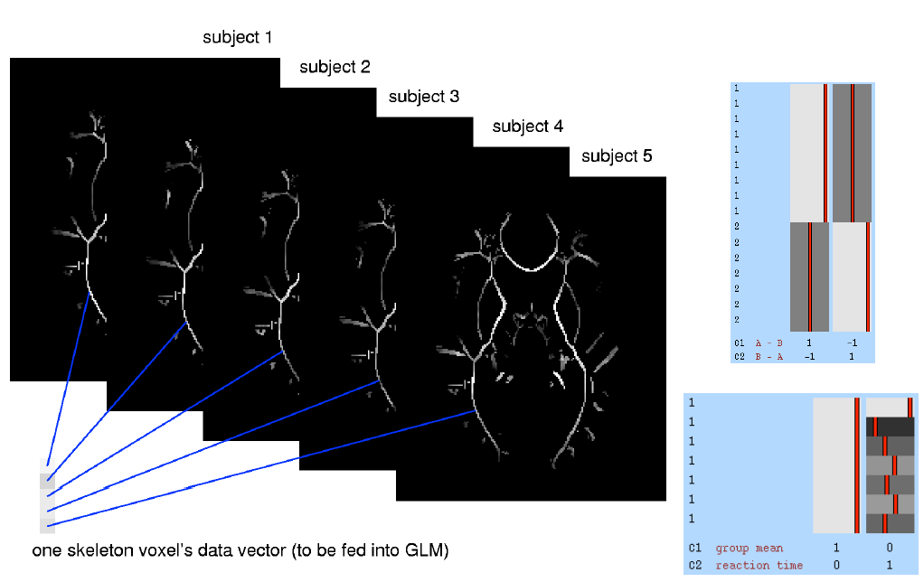
Do cross-subject voxelwise stats on skeleton-projected FA and Threshold, (e.g., permutation testing, including multiple comparison correction)
Notes:
Thus, the data are now in the form of a sparse (skeletonised) 4D image, with the fourth dimension being subject ID.
Where for any given skeleton voxel, we are comparing metric values from the centre of the same point of thesame tract in all subjects
We can now carry out voxelwise statistics across subjects, for each point on the common skeleton via a GLM
corrected for multiple comparisons with Threshold-Free Cluster Enhancement
ROI analysis – by warping ICBM-81 WM atlas to FA map of group tensor template
Why TBSS
Attempting to solve correspondence/smoothing problems
Less ambiguity of interpretation / spurious results than VBM
Easier to test whole brain than ROI / tractography

Slide 19
What do diffusion metrics tell us?
Sensitive to WM tissue microstructure
Typically higher diffusivity seen in neurodegenerative disease. i.e. higher MD/AD/RD and lower FA (= more disorganized WM)
Axial Diffusivity: Axonal integrity
Radial Diffusivity: Myelin integrity
Notes:
Decreased FA and increased MD, AD, and RD together suggest decreased anisotropy that is generally thought to reflect compromise in the WM cell membranes. however, it is generally accepted that such metrics represent a combination of neural fibre density, alignment and coherence, as well as changes to cellular membranes, axonal injury/loss and demyelination — all of which influence the diffusion of water molecules through the brain / surrogate markers of change
E.g. reduction in FA may be caused by a reduction in neurite density, an increase in the dispersion of neurite orientation distribution, as well as various other tissue microstructures

Slide 20
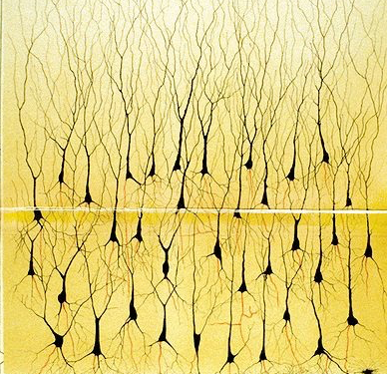
Beyond DTI: Multicompartment diffusion MRI models
A simple model of what we measure in a voxel
Can we determine the specific composition of each voxel?
Intra-
Neurite
Tissue
Extra-
Neurite
CSF
CSF
A voxel
Notes:
DTI’s limitation is it is one dimensional and will factor in contributions of CSF/axons/extra-neurite into the metric
NODDI models all 3 compartments
Neurite orientation dispersion and density imaging NODDI designed to probe tissue microstructure beyond providing composite view of each voxel by modelling water diffusion in multiple comparments - that is diffusion in restricted in the intracellular compartment containing axons and dendrites, hindered in extraneurite space and isotropic in CSF producing respective estimates of neurite density, orientation dispersion (angular variation of neurites) and FISO to be estimated
extra-cellular compartment refers to the space around the neurites, which is occupied by various types of glial cells

Slide 21
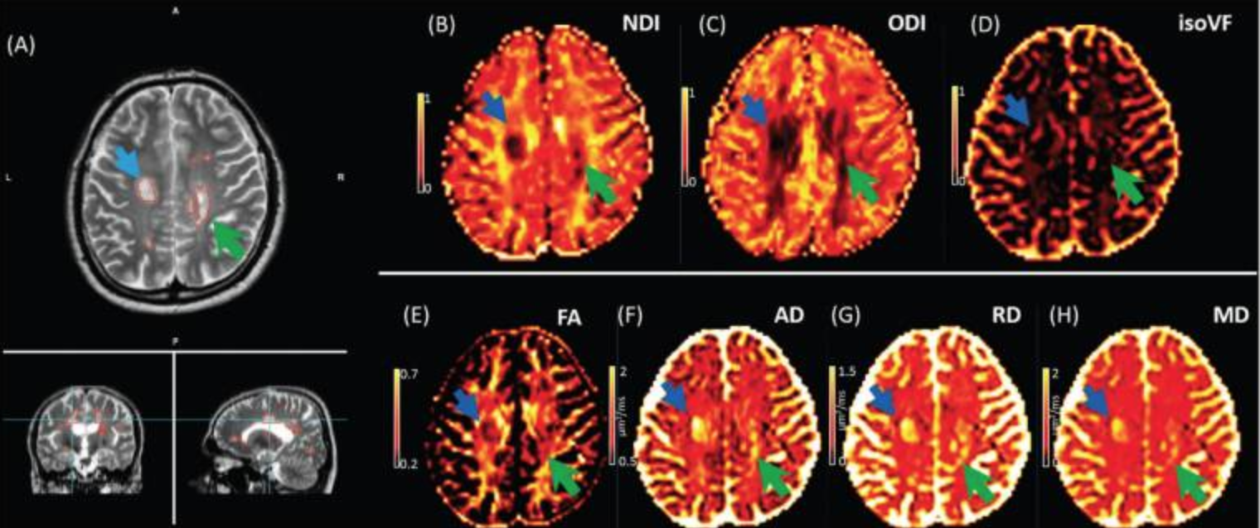
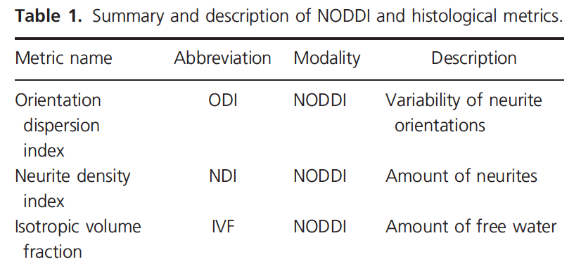
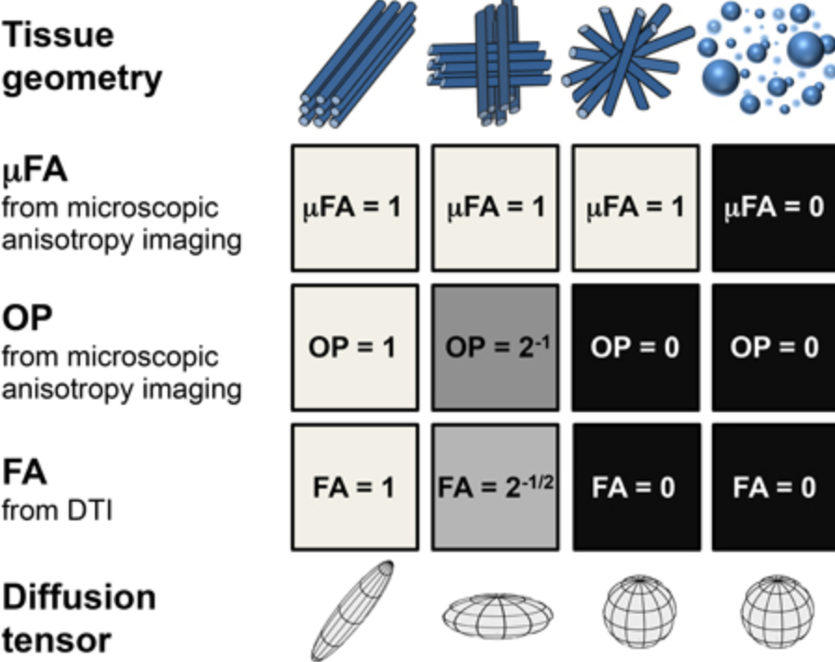
NODDI vs microscopy diffusion anisotropy
Notes:
NODDI
Illustration of NODDI and DTI parameters in one slice of a single MS subject.
The MS lesion tissue in the major white matter tracts is clearly marked in the AD, MD and RD and NDI maps (blue arrow). NDI provides superior contrast to DTI metrics in periventricular lesion (green arrow) especially in regions with CSF partial volume and fiber crossings contributing to the estimated parameter values.
Measures of NDI, ODI and CSF in acquisition time of <10 mins.
Because ND and OD can both contribute to FA, now we can separate the two to see whether such change are underscored by changes in neurite density or from altered patterns of axonal organisation (ODI) providing us with a better understanding of changes occurring within WM.
It is of course important to consider what these measures represent at a neuronal/histiological level. In an ex vivo study in rats, ND correlates with optical staining of myelin and stereological estimates of axonal volume fraction in WM and so we can suggest NDI changes are likely to be influenced by axonal loss and or demylination. Same true of MS spinal cord lesions, demylination does influence NDI by increasing free water.
NODDI introduced 2012 and has been used in YOAD, MS, PD as well as unpublished data from the last timepoint in trackon. Data suggests NDI reduced in premanifest HD, reduced ND/ODI in basal ganglia of PD and in WM of young onset AD. So it follows if the gene carriers in YAS are different, we would hypothesise that would be reductions in ND +/- ODI
in a recent study found reductions in neurite density in (symptomatic) PD where DTI, VBM and cortical thickness analyses did not detect differences suggesting it may be a more sensitive technique in early GM changes.
+/- FISO and its importance
Analysis here using TBSS to evaluate whole brain WM differences and will then do ROI of internal/external capsule, corpus callosum and look to correlate changes in ROI to changes in clinical function.
The intra-cellular compartment refers to the space bounded by the membrane of neurites. We model this space as a set of sticks, i.e., cylinders of zero radius, to capture the highly restricted nature of diffusion perpendicular to neurites and unhindered diffusion along them. The orientation distribution of sticks can range from highly parallel to highly dispersed.
The extra-cellular compartment refers to the space around the neurites, which is occupied by various types of glial cells and, additionally in gray matter, cell bodies (somas). In this spacThe CSF compartment models the space occupied by cerebrospinal fluid and is modeled as isotropic Gaussian diffusion with diffusivity
The, the diffusion of water molecules is hindered by the presence of neurites but not restricted, hence is modeled with simple (Gaussian) anisotropic diffusion.
and in particular the noddi results from trackon, I would predict if we do see differences in young adult gene carriers, this will predominantly a reduction in NDI.
For example a reduction in NDI (lower axonal count, reduced packing density, lower myelination) in WM and GM and we would expect if we see anything, to see changes in NDI (axonal density) although will also be looking to see if ODI decreased around internal capsule/corpus callosum which would suggest less fibre dispersion and selective axonal degeneration.
FA more influenced by orientation than density. Orientation dispersion index quantifies the bending and fanning of axons, which is useful for mapping brain connectivity
Increase in dispersion of neurite orientation associated with development whilst reduction of neurite density associated with aging. E.g. psychosis study found low FA with normal orientation disprsion but reduced NDI postulating developmental cause In gray matter, the index quantifies the pattern of sprawling dendritic processes. This provides a more direct marker of gray matter complexity than, for example, the measure derived from model-based bootstrapping proposed in Haroon et al. (2010), which has the potential in differentiating neurodegenerative disorders of varying severity
Protocol uses FSL fast and then matlab.
Diffusion metrics in HD – reduced FA reflect alterations in fibre coherence and directionality, could be attributed to damaged oligodendrocytes and axonal membranes, disrupted axonal transport due to the presence of mutant huntingtin, and early increases in reactive microglia. Increased MD. Taken together, these findings suggest that both myelin breakdown and axonal damage play an important role in the pathophysiology mof HD by the time the disease manifests and that these
-----------
SMT
NODDI– neurite orientation dispersion and density. Does not account for fiber crossing. Assumes intrinsic diffusivity for nervous tissue
SMT: models the intra voxel fiber orientation distribution (Spherical mean technique)
The key insight of the recently proposed method (Kaden et al., 2016) is that for any fixed gradient magnitude and timing, hence fixed b-value, the spherical mean of the diffusion signal over the gradient directions does not depend on the microdomain orientation distribution. In particular, the
extend SMT-based microscopic diffusion anisotropy imaging and introduce a multi-compartment model that takes the presence of multiple tissue components on the microscopic scale into account. The objective we make no assumptions about the neurite orientation distribution (e.g. single orientations, spherical harmonics or mixtures of Bingham distributions
igure 1. Idealized tissue geometries with corresponding structure parameters. Consecutive rows show values of the microscopic fractional anisotropy, μFA; orientational order parameter, OP; fractional anisotropy, FA; and diffusion tensors. Decreasing values of OP from left to right in columns 1–3 leads to a reduction of FA while μFA remains constant. For isotropic structures (column 4), both FA and μFA vanish.
intra-neurite volume fraction vint (top) and apparent intrinsic diffusivity λ for various slices in the axial plane.

Slide 22
Diffusion Tractography
A technique that allows to identify fiber bundle tracts by connecting voxels based on the similiarities in maximal diffusion direction.
Johansen-Berg & Rushworth, 2009
Notes:
For identifying WM pathways in brain
Rely on assumption that diffusion in preferred directions along axons that correspond to fibre orientation and can finds paths through data field where diffusion least hindered. (tracts)
Streamline (vector) starts from seed point and follows local vector information on step-step basis ‘joining the arrows’
Usually start streamlines randomly throughout WM.
To know how streamline should progress through each voxel need to estimate fibre orientation
In diffusion data, local fibre orientation only one measurement per voxel and interpolates to get other guessing other measurements away from voxel centres
Stop streamline by either threshold (FA or FOD) or curvature threshold (based on low FA suggesting GM or high lack of confidence in direction), and big bends unlikely to be compatable with wm. Other methods might use a T1 image to stop the track when it reaches GM.
the streamline approach is still the most widely applied method for fiber tractography using tensor or FODs.
we can imagine this tractography algorithm is simulating the movement of a water molecule along the axons.
The starting position of this tracking process is called a seed point. At each point of the tracking process, we utilize the FOD or tensor at the current location to generate the next direction
The process is repeated until a stopping criterion is satisfied. The tract is accepted if it meets certain anatomical requirements that are typically problem specific.
Deterministic vs probabalistic – in determ – harsh stopping criteria of either FA or local pathway curvature to prevent streamlines progressing through uncertainty/false positives
Probabalistic aims to acknowledge and quantify uncertainty – it allows progression through uncertain voxels and if takes errant path will disperse quickly, give low probability values and not create false tracks.
The figure illustrates diffusion of a water molecule within a fiber bundle. Diffusion is less restricted along the axis of the fiber bundle than across it.
Tractography is an attempt to connect voxels based on the similarities of their maximal diffusion directions (one of the three measures we get in diffusion images)
Illustration on the right: Simple, streamlining tractography proceeds by tracing a line through the tensor field, following the principal diffusion direction. The schematic shows a grid of voxels; the grayscale reflects FA [ranging from zero (black) to one (white)]. The corresponding tensors are illustrated by the ellipses shown at each voxel.
22

Slide 23
Deterministic Vs. Probabilistic tractography
Deterministic:
A point estimate of the principal diffusion direction at each voxel is used to draw a single line.
Probabilistic:
Provides a probability distribution on the diffusion direction at each voxel which is then used to draw thousands of streamlines to build up a connectivity distribution
Advantages:
- Allows to continue tracking in areas of high uncertainty (with very curvy tracts)
- Provides a quantitative measure of the probability of a pathway being traced between two points
Notes:
2 often mentioned approaches, probabalistic most commonly used.
(the broader the distribution, the higher the uncertainty of connections in that area)

Slide 24
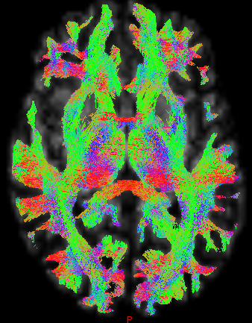
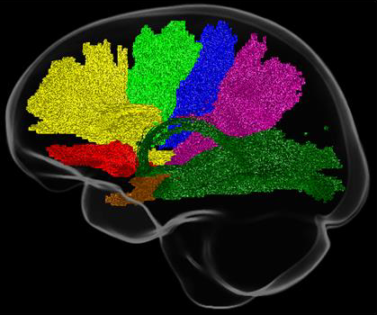
Uses of tractography
Tract of interest
Generate tracts between prespecified regions
Investigate diffusion metric across those tracts
Whole brain
Use tractography to look at whole brain connectivity
Notes:
Can look at connections between specific ROIs – i.e. pre-specified tracts where seed across WM and only measure streamlines that connect the 2 regions.
24

Slide 25
Diffusion analysis tools for tractography
Mrtrix
FSL - Bedpostx
Freesurfer - tracula
Notes:
Among others

Slide 26
1. Preprocessing
Denoising – PCA analysis to supress thermal noise components
Eddy correction – corrects susceptibility distortions and subject movement e.g. FSL eddy
Bias correction – can also help with dwi mask estimation if it is intensity-based e.g. ANTS N4 / FSL
Notes:
correct the susceptibility-induced geometric distortions present in the diffusion images, as well as any eddy current-induced distortions and inter-volume subject motion.
Denoising surpresses local signal fluctuations that solely originate from thermal noise rather than other sources like anatomical detail by exploiting data redundancy in the signal PCA
Eddy corrects susceptibility-induced distortions and subject movement. It also allows detection of outliers, datapoints that have been corrupted by motion-induced signal dropout. Finally, it permits replacement of the outliers with distortion-free data.
Also improves estimation of diffusion parameters and fibre orientations without compromising accuracy and spatial resolution.

Slide 27
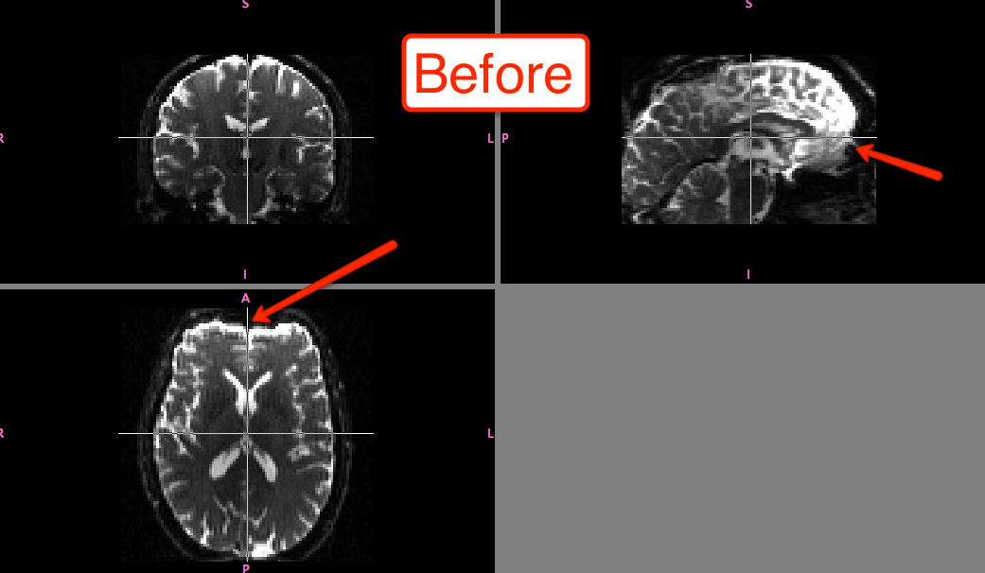
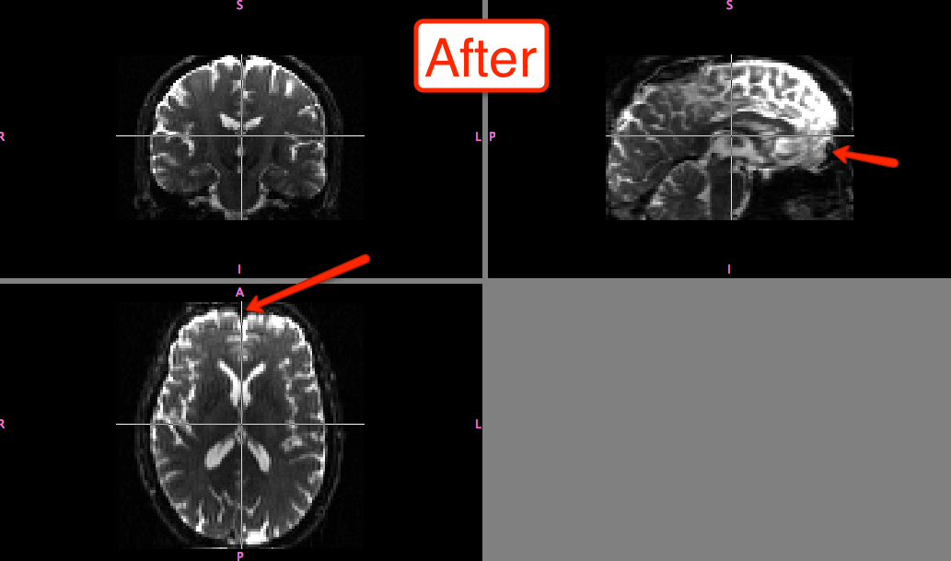
Eddy current distortion
Notes:
Eddy currents generated by rapid gradient switching and can produce wide range of artifacts – including stretch, shear and translation.
Corrected using FSLs eddy which will also correct for patient movement as below.
The first step, distortion correction, can be done with FSL's topup command. Note that this will require two diffusion weighted images, one with the encoding direction in anterior-to-posterior direction (AP) and one encoded in the posterior-to-anterior direction (PA).
performs outlier detection to identify slices where signal has been lost as a consequence of subject movement during the diffusion encoding. These slices are replaced by non-parametric predictions by the Gaussian Process that is at the heart of

Slide 28
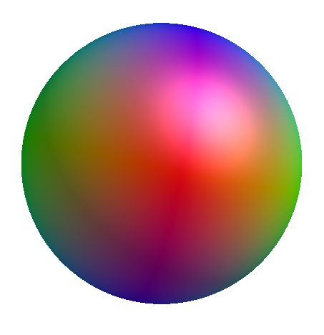
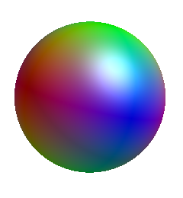
2. Generate response functions
WM
GM
CSF
Notes:
To estimate fibre directions in each voxel, first we need to generate a response function, ideally for each tissue – this can then be used as the kernel(s) by the deconvolution algorithm.
For the white matter, the response function models the signal expected for a voxel containing a single, coherently oriented bundle of axons.
In case of multi-tissue variants of spherical deconvolution, response functions for other tissue types are introduced as well; typically to represent grey matter(-like) and/or CSF(-like) signals
In an example – I use algorithm to estimate multi b-value response functions for the single fibre WM, gret matter and CSF (both isotropic) and uses relative diffusion properties to select most appropriate voxels from which to estimate response functions.
(In my case, it’s automated process and will leverage the relative diffusion properties of the 3 tissue response functions with respect to each other, to select the most appropriate voxels from which to estimate the response functions.
Spherical harmonics surface plots can be visualised.

Slide 29
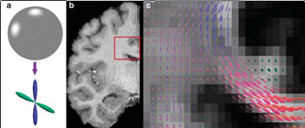
3. Use response function from DWI signal in each voxel to generate fibre orientation distribution (FOD)
Notes:
Use response function to generate FOD by a process of constrained spherical deconvolution
Fibre orientation density function – describes proportion of fibres that lie along each orientation e.g. voxel containing 2 perpendicular fibre bundles will have a fODF in shape of cross
Compared with the tensor mixture models, FOD has the flexibility in representing arbitrary fiber configurations/crossing fibres For these reasons, FOD is becoming increasingly popular and emerging as a standard representation of fiber connectivity.
FOD in multishell able to resolve crossing fibres – b is ROI and C is the visualised FODs – one direction – d showing lateral projections of corpus callosum
On CSD
(The diffusion signal is then modeled by the convolution of the fODF with a kernel that represents the DW signal corresponding to a single fiber orientation. The fODF is then “deconvolved” from the DW signal (hence, spherical deconvolution) using this kernel, coined the response function (RF).
(Constrained spherical deconvolution extracts WM fibre orientation from DWI + fibre tractograms overcoming crossing fibre limitations inherent in DTI model. Relies on principle that DWI signal from various fibres in voxel is given by spherical deconvulition of response function with the fODF)
FOD in multishell able to resolve crossing fibres – b is ROI and C is the visualised FODs – one direction – d showing lateral projections of corpus callosum
Building the connectome
Estimating response function
This can be done without need for co-registered T1 which is advantageous to avoid registration inaccuracies which may affect estimation from ‘pure’ CSF/WM/GM voxels – e.g. CSF under-estimated probably due to registration inaccuracy.
Create FOD
Previous problem with single shell CSD – voxels containing other tissue types such as GM and CSF had unreliable WM response function and noising fODF estimates. Tended to over-estimate WM volume in voxels containing GM and or CSF DTI was unable to account for crossing fibre (90% of voxels) producing unreliable tractography.
Constrained spherical deconvolution extracts WM fibre orientation from DWI + fibre tractograms overcoming crossing fibre limitations inherent in DTI model.
Relies on principle that DWI signal from various fibres in voxel is given by spherical deconvulition of response function with the fODF
Multishell multi-tissue CSD exploits unique b-value dependencies of different tissue types to estimate multi-tissue ODF
Benefits of CSD are that 1) it produces reliavle WM/GM/CSF volume fraction maps (instead of over-estimating WM volume) to serve as quantitative measure for AFDand 2) increases precision of fODF fibre orientations producing more reliable tractrography and apparent fibre density.
Volume fractions maps can also be used for ACT to reject inplausible tracts
Procedure repeated for all cortical targets resulting in vector describing connectivity between striatum and cortex for each subject.
Multi-tissue informed log-domain intensity normalisation
Input any number of tissue components (e.g. from multi-tissue CSD) and outputs corresponding normalised tissue components. Intensity normalisation is performed in the log-domain, and can smoothly vary spatially to accomodate the effects of (residual) intensity inhomogeneities.

Slide 30
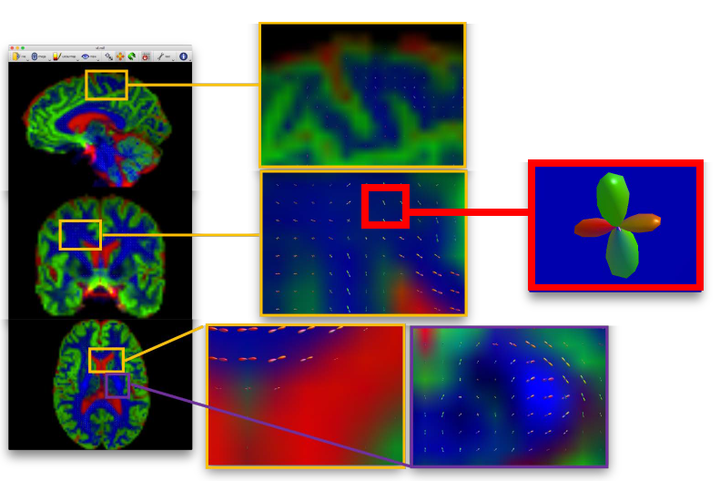
4. QC FOD output
Notes:
Sensible to inspect the FODs on your image to make sure nothing unusual has happened such as flipped axis making the FODs point the wrong way which will then generate erroneous tractography
Good regions include corpus callosum, and a region of crossing fibres – with corpus callosum/corticospinal tract.

Slide 31
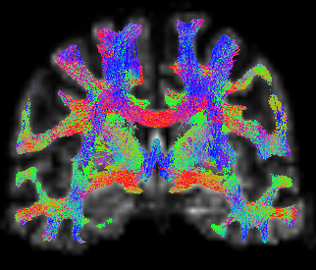
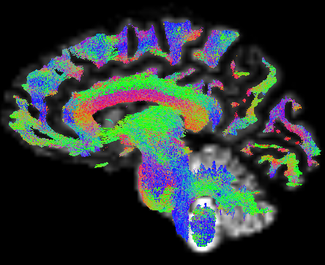
5. Perform streamline tractography from the FODs
Notes:
Use FODs to perform probabalistic tractography.
Usually, algorithm will attemp to seed from new random locations until the target number of streamlines have been selected
Probabilistic algorithm that takes as input a Fiber Orientation Distribution (FOD) image streamline. Paths (based on short curved “arcs”) are drawn, and the underlying (trilinear-interpolated) FOD amplitudes along those arcs are sampled.
A streamline is more probable to follow a path where the FOD amplitudes along that path are large; but it may also rarely traverse orientations where the FOD amplitudes are small, as long as the amplitude remains above the FOD amplitude threshold along the entire path.
Termination criteria can vary but usually FOD threshold based (i.e. cut off when low FOD amplitude reached) or can use anatomical info from T1 to control termination.

Slide 32
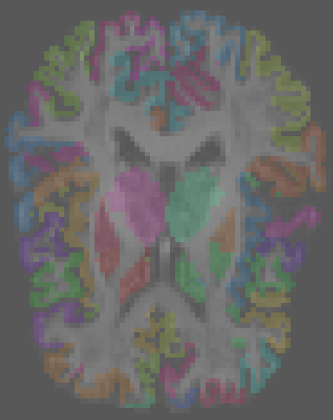
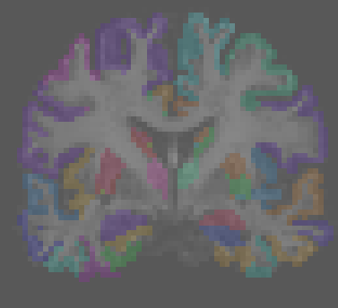
6. Define nodes – e.g. parcellation image from atlas
Register chosen cortical atlas to diffusion space
Notes:
Connectome approaches leverage anatomical templates, others pursue parcellation in a data-driven manner, eg, by boundary detection and clustering patterns of connectivity

Slide 33
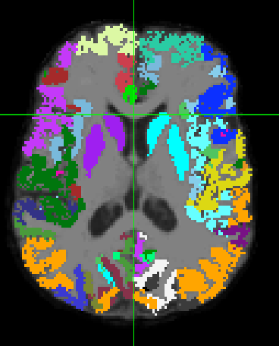
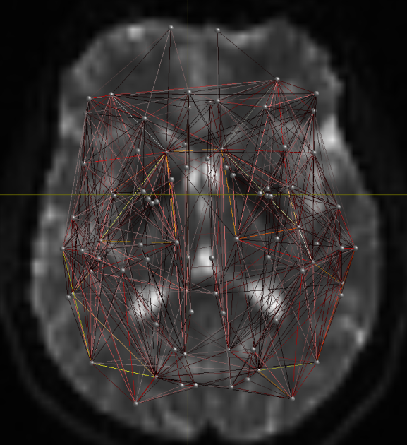
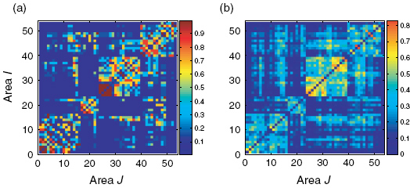
7. Generate connectome matrix from streamline file and node parcellation image
Notes:
Generate a connectome matrix from a streamlines file and a node parcellation image
A graph is composed of a set of nodes and edges. Two nodes are connected if there is an edge between them and each edge can be weighted. To define the nodes for brain connectomes, various approaches have been proposed to parcellate the brain into many smaller regions. A popular choice is to use cortical labels produced from software
Can then use the connectivity matrix for aalysis

Slide 34
Quantitative analysis using tractography
Density of reconstructed connections does not reflect density of underlying axon connections
Options
Assess diffusion metric across a particular tract(s) of interest – FA/Fixel/NOODI/SMT
Use appropriate weights for individual streamlines e.g. measure of fibre density
Notes:
Problem using tractography for quantitative analysis are that measures are typically indirect, and may have limitations on biological interpretability based on the diffusion model used to estimate them.
Tractography can be unreliable in streamlines generated, where they terminate as well as over-reconstruction of streamline density for longer fibre pathways;
Options include only using streamlines to define which tracts to analyse.
Or find appropriate weights for individual streamlines in order tomatch a tractogram to the diffusion image data – e.g. can weight streamlines by a measure of fibre density
SIFT2 determines cross-sectional multiplier
(SMT) = Spherical mean technique

Slide 35
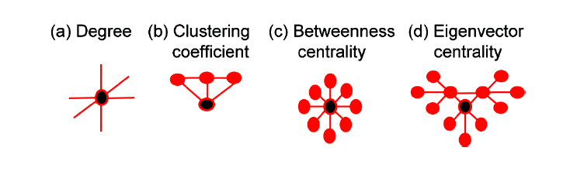
8. Perform statistical analysis on matrix
Graph theory
Local – e.g . Degree or strength
Global e.g. global efficiency
Addressing multiple comparisons problem
Network based statistics
Modularity
Notes:
Graphs can be investigated at different levels of scale, e.g. at local (nodal) and global (network-wide) scales.
Nodal measures include simple statistics such as node degree (number of connections to other nodes) or strength (sum strength of these connections)
Global includes global efficiency, average pathlength to describe measure of network intergation or modularity as network segregation.
(b) Clustering coefficient indicates how highly connected a region is to its neighbours and
(c) Betweeness centrality represents brain region network traffic.
(d) Eigenvector centrality represents network traffic along the brain ‘busiest’ pathways.
Graph theory analysis requires mass univariate testing is undertaken after which FEW rate is controlled with generic procedure like false discovery rate
A test statistic and corresponding p-value is independently computed for each link based on the strength of pairwise association link represents.
Disadvantage is inherent massive number of multiple comparisons with low contrast-noise ratio.
NBSS – to control for multiple comparisons to gain statistical power - exploits the extent to which the connections comprising the contrast or effect of interest are interconnected. The NBS is based on the principles underpinning traditional clusterbased thresholding of statistical parametric maps

Slide 36
Conclusions
DTI is a model of DWI data
In DTI we use anisotropy to estimate the axonal organization of the brain.
Diffusion metrics are sensitive to WM microstructure
Tractography is a useful tool to reconstruct structural connections
Tractography can be used for tract(s) of interest analysis or to perform connectomics using graph theory

Slide 37
Acknowledgements
Previous MfD presenters
Our expert Enrico Kaden!

Slide 38
Selected references
FSL/mrtrix website
Smith 2014. Cross-Subject Comparison of Local Diffusion MRI Parameters
Jones 2014. Gaussian Modeling of the Diffusion Signal
Mori 2006. Principles of Diffusion Tensor Primer Imaging and Its Applications to Basic Neuroscience Research
Jones DK et al. White matter integrity, fiber count, and other fallacies: the do's and don'ts of diffusion MRI. Neuroimage. 2013;73:239-54
Smith et al 2006. Tract-based spatial statistics: Voxelwise analysis of multi-subject diffusion data (Original TBSS paper)
Kaden E et al. Multi-compartment microscopic diffusion imaging. Neuroimage. 2016;130:346-59
Zhang H et al. NODDI: practical in vivo neurite orientation diseprsion and density imaging of the human brain. Neuroimage. 2012;61:1000-16
Mito R et al. Fibre-specific white matter reductions in Alzheimer’s disease and mild cognitive impairment. Brain. 2018;141:888-902

