Slide 1
T-tests, ANOVAs and Regression

Slide 2

General
Assumptions
T
Parametric testing
Normal distribution
There should be no significant outliers
Homogenity of variance
Independence (in most cases)

Slide 3
Testing the assumptions
Independence
Normality of distribution
Similar variance across groups
Data collection & study design
Histogram & Q-Q plot
Levene’s test

Slide 4
T-TESTS

Slide 5

T-tests
The t test is one type of inferential, parametric statistic
Determine whether there is a significant difference between the means of two groups / conditions
There are three main types

Slide 6
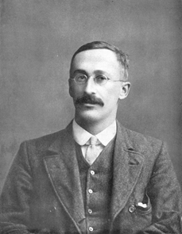
Student's T-test
How can we determine, to a reasonable degree of scientific certainty, if one variety of barley yields more than another?
William Sealy Gosset​
1908

Slide 7

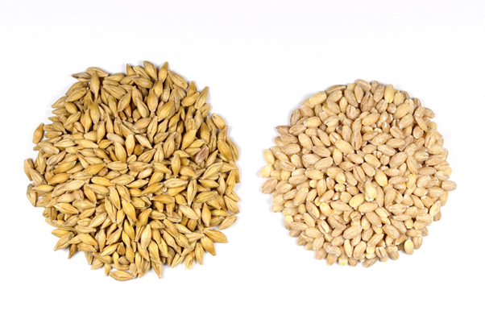
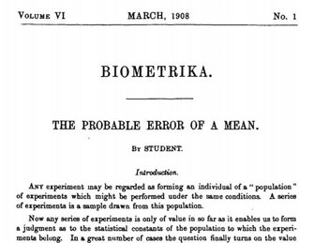

Slide 8

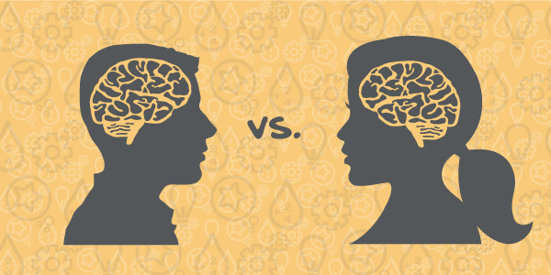
Student's T-test
Determines whether there is a statistically significant difference between the means in two unrelated groups.
It is also known as independent samples t-test, two sample t-tests, between samples t-test and unpaired samples t-test.

Slide 9
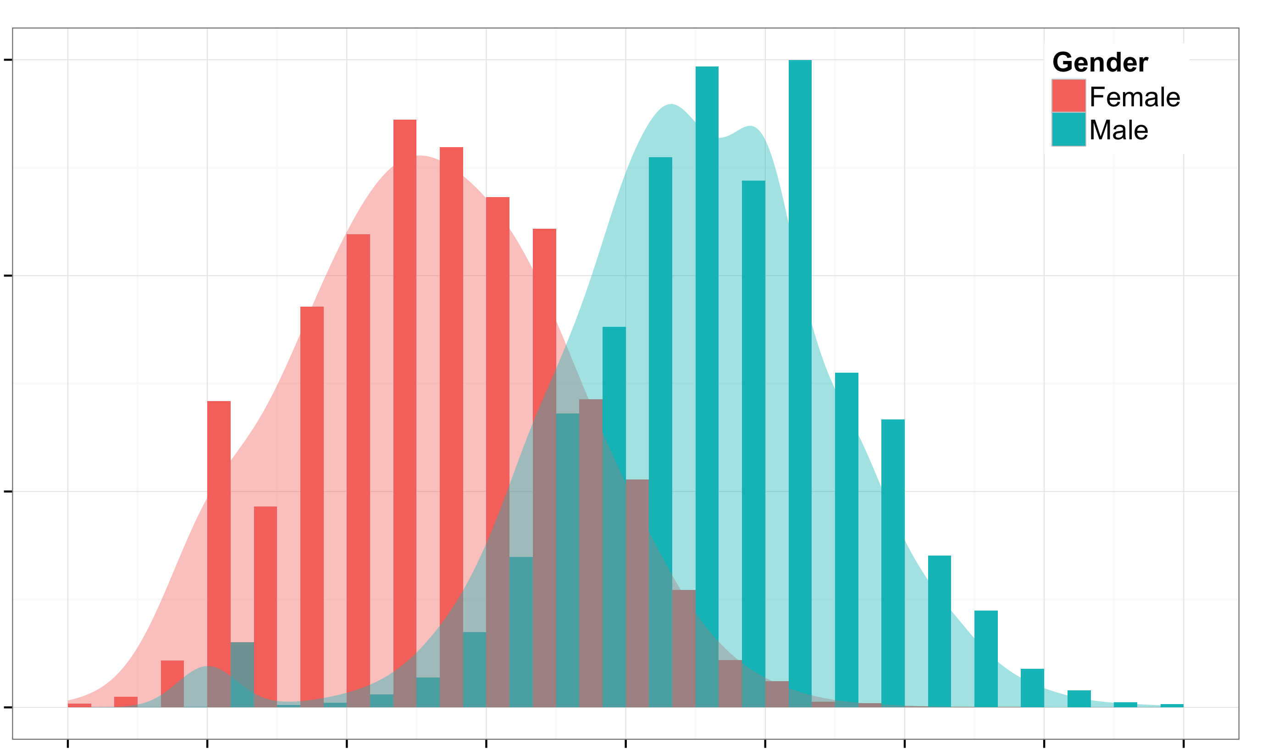
Student's T-test
Independent groups
Independent measurements
One independent, categorical variable that has two levels/groups
One continuous dependent variable

Slide 10
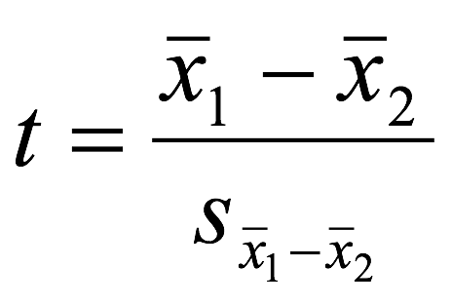
FORMULA
The difference betweent the meand divided by the pooled standard error of the mean.

Slide 11
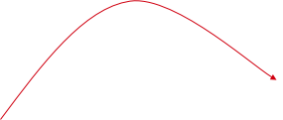
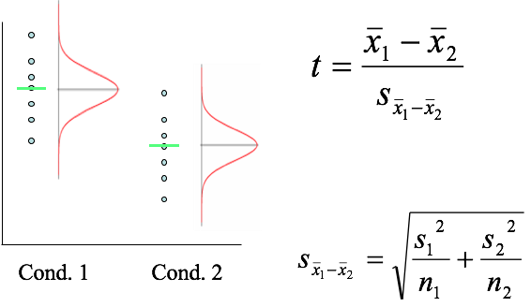
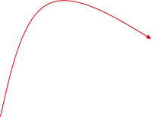
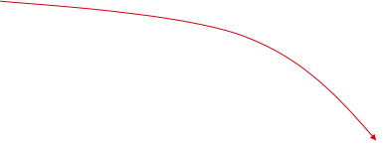
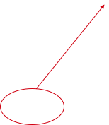
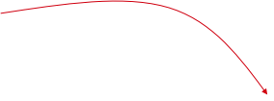

Slide 12
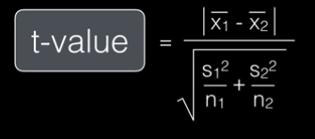
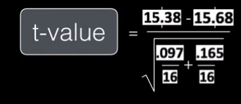

Field 1 | Field 2
15.2 | 15.9
15.3 | 15.9
16.0 | 15.2
15.8 | 16.6
15.6 | 15.2
14.9 | 15.8
15.0 | 16.2
15.4 | 15.6
15.6 | 15.6
15.7 | 15.8
15.5 | 16.2
15.2 | 15.6
15.5 | 15.8
15.2 | 15.5
15.5 | 15.5
15.1 | 15.5
15.3 | 14.9
15.0 | 15.9
15.38125 | 15.68125

Slide 13
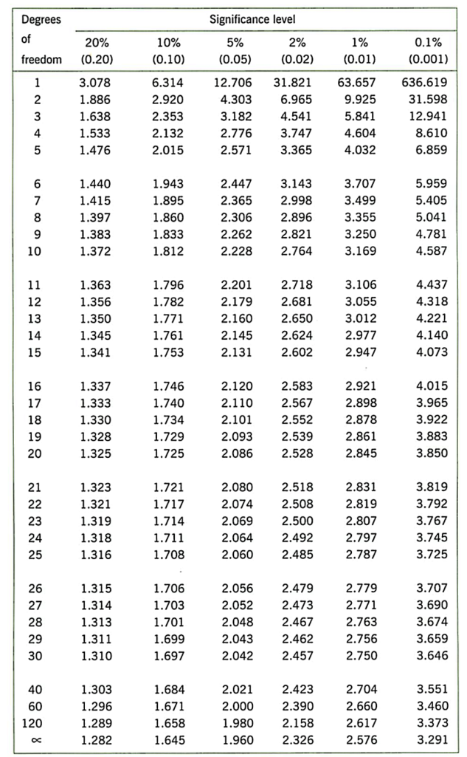
T test
​
Significance level: 0.05
Degrees of freedom: (n1 + n2 ) - 2
Degrees of freedom: (16 + 16 ) - 2 = 30
Critical Value: 2.042
T-Value: 2.3
We reject H₀
​
P-value: .026

Slide 14
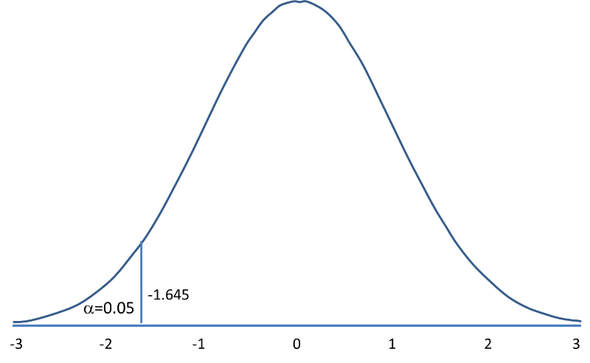
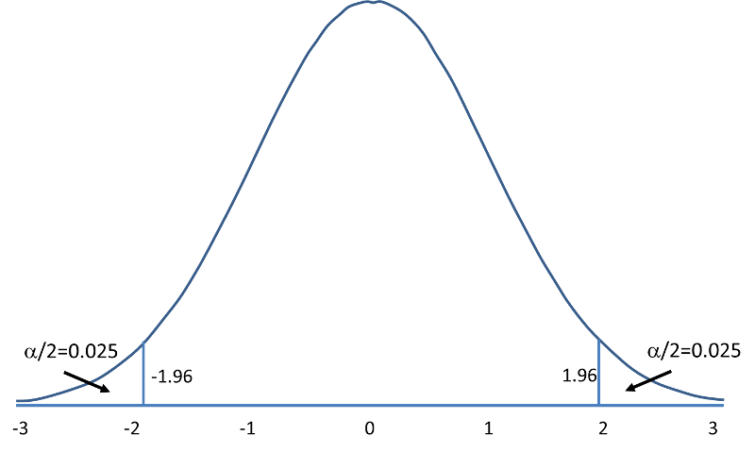
P= ≤ 0.05
One-tailed and two-tailed tests

Slide 15
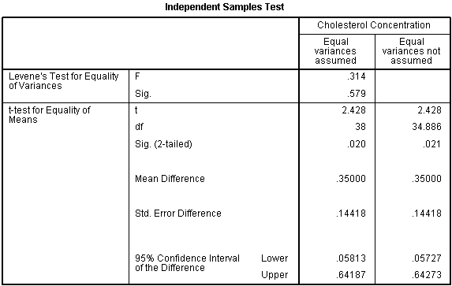

Which intervention is more effective in lowering cholesterol levels in overweight males: Exercise or weight loss?
This study found that overweight, physically inactive male participants had statistically significantly lower cholesterol concentrations (5.80 ± 0.38 mmol/L) at the end of an exercise-training programme compared to after a calorie-controlled diet (6.15 ± 0.52 mmol/L), t(38) = 2.428, p = 0.020.

Slide 16

Paired T-test
Estimate whether the means of two related measurements are significantly different from one another
Used when two continuous variables are related
  Same participant at different times
  Different sites on the same person
  Cases and their matched controls.
Also known as within-subjects, repeated-measures and dependent-samples.

Slide 17


Paired T-test
The outcome variable has a continuous scale
The differences between the pairs of measurements are normally distributed
The interest is on the difference in the outcome measurements between each pair

Slide 18
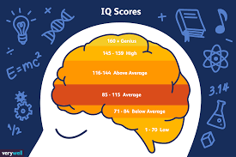
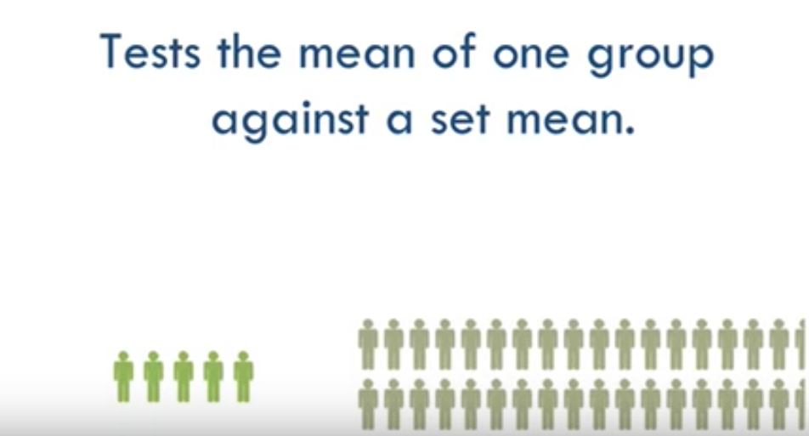
One sample T-test
There is only one group which is to be compared to a set value or a known population mean.

Slide 19
T-tests
Means come from the same group?
Yes
No
Comparing means of 2 groups?
Comparing mean of a group against a known mean?
Paired t-test
Student's T-test
One-sample T-test

Slide 20
ANOVA
One-way ANOVA
Two-way ANOVA

Slide 21
Analysis of Variance - ANOVA
2 Groups
1 Parameter
➔ t-test
3+ groups
2+ parameters
➔ ?
ANOVA

Slide 22
One-way ANOVA
Comparing means between 3+ groups
Does height differ significantly according to origin ?
Height
X₁
X₂
X₃

Slide 23
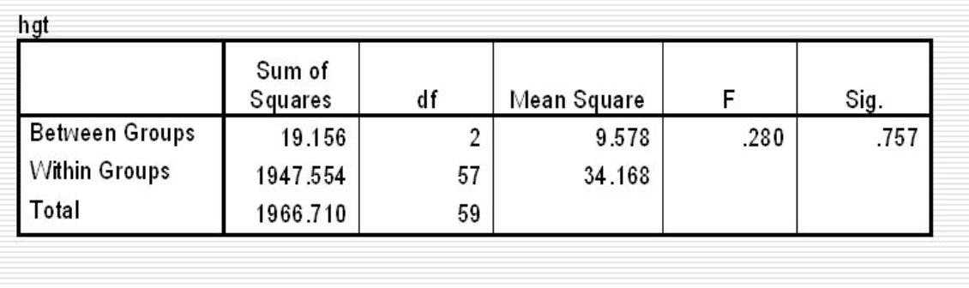
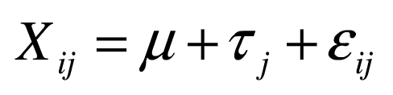
The model
Software output looks like this:
The mathematical model:
General mean
Individual variance
Effect of group

Slide 24
Calculating F
F is the between group variance divided by the within group variance :
We want to check if the between group variance is significantly larger than the within group variance

Slide 25
Factorial ANOVA
Comparing means of groups defined by 2+ parameters
Does height differ significantly according to origin and gender ?
Mean Height | Country #1 | Country #2 | Country #3
Male | X_{1.1} | X_{1.2} | X_{1.3}
Female | X_{2.1} | X_{2.2} | X_{2.3}

Slide 26
The model
Software output looks like this:
The mathematical model:
X_{ijk}=µ+α_{i}+β_{j}+αβ_{ij}+ε_{ijk}
Individual variation
General mean
Effect of interaction between 1 & 2
Effect of variable 1
Effect of variable 2

Slide 27
Post-Hoc tests
If the test proves significant, we can expect an effect, but which one ?
Several tests can be run after the ANOVA :
Conservative tests include Bonferroni correction
Liberal tests include Student-Newman-Keuls test
They tell us which groups are significantly different, and how they are different.

Slide 28
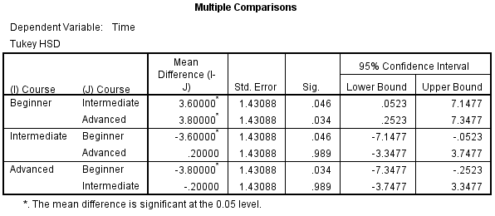
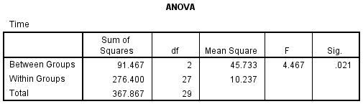
What one-way ANOVAs can tell us
In a paper:
What can we conclude from a one-way ANOVA ?
There was a statistically significant difference between groups as determined by one-way ANOVA (F(2,27) = 4.467, p = .021). A Tukey post hoc test revealed that the time to complete the problem was statistically significantly lower after taking the intermediate (23.6 ± 3.3 min, p = .046) and advanced (23.4 ± 3.2 min, p = .034) course compared to the beginners course (27.2 ± 3.0 min). There was no statistically significant difference between the intermediate and advanced groups (p = .989).
The short way:
The mean value of group #1 is significantly higher than that of population #2 & 3
Notes:
Insert total sentence

Slide 29
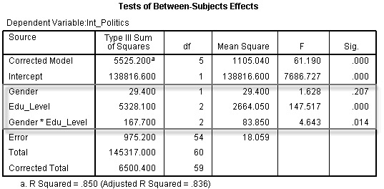
What factorial ANOVAs can tell us
In a paper:
A two-way ANOVA was conducted that examined the effect of gender and education level on interest in politics. There was a statistically significant interaction between the effects of gender and education level on interest in politics, F (2, 54) = 4.643, p = .014.
Simple main effects analysis showed that males were significantly more interested in politics than females when educated to university level (p = .002), but there were no differences between gender when educated to school (p = .465) or college level (p = .793).
The short way:
There is an effect of the interaction between variables #2&3 on the mean value of the continuous variable.
Notes:
First pay attention to interaction effects > simple main effects

Slide 30
Quick recap
If we want to compare …
Mean of 1 continuous variable between 2 levels of a categorical variable
➔ T-TEST
Mean of 1 continuous variable between 3+ levels of a categorical variable
➔ One-Way ANOVA
Mean of 1 continuous variable between 3+ levels of 2+ categorical variables
➔ Factorial ANOVA

Slide 31
REGRESSION

Slide 32
Regression
Creating a more complex model
Is there a relationship between height and weight ?
Is weight a predictor for height ?
Two continuous variables

Slide 33
Correlation
To explore that question, we could use correlation, but …
e.g. Pearson:
Correlation coefficient are descriptive tools
We want to predict, i.e. use inference

Slide 34
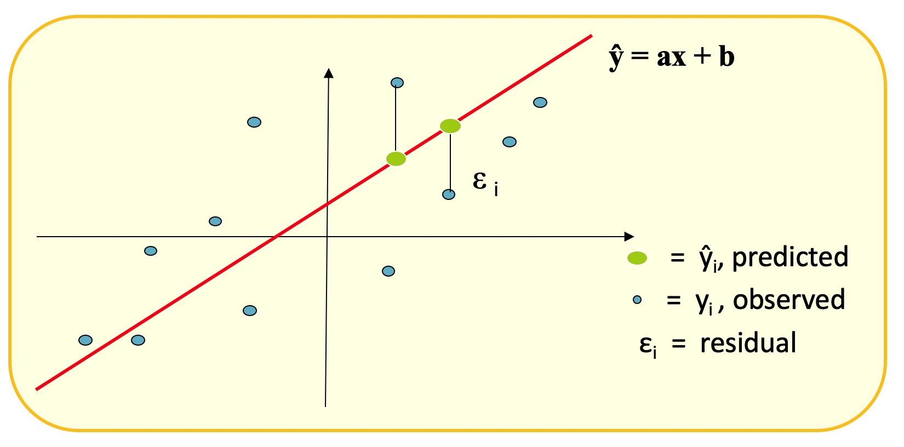
Linear regression: predicting a value
We’re looking for the line minimizing ε_{i}

Slide 35
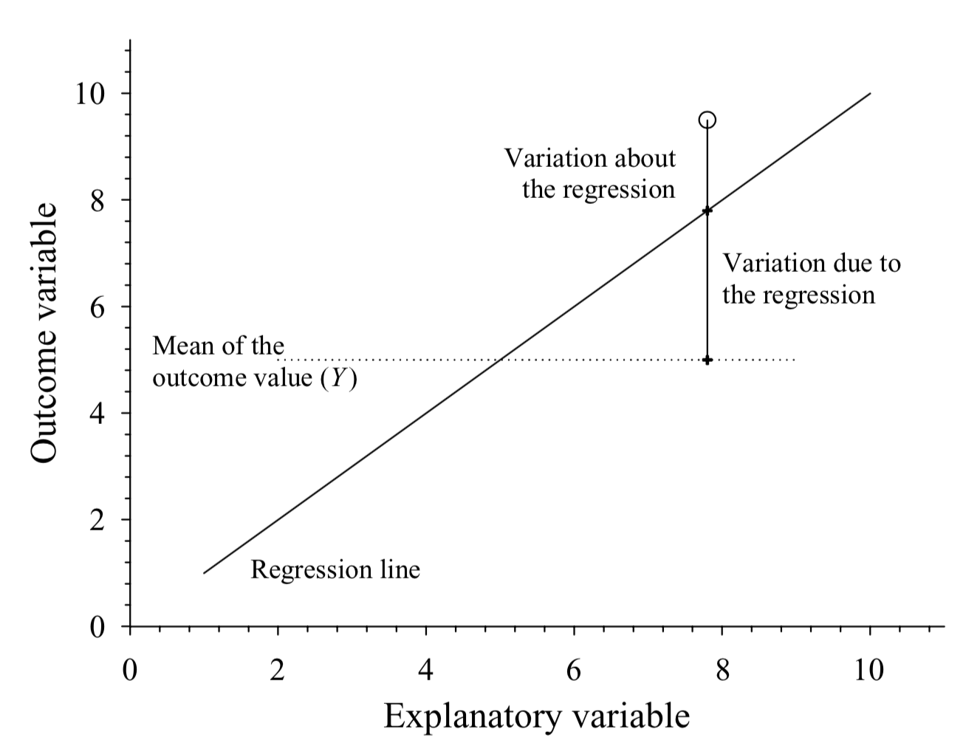
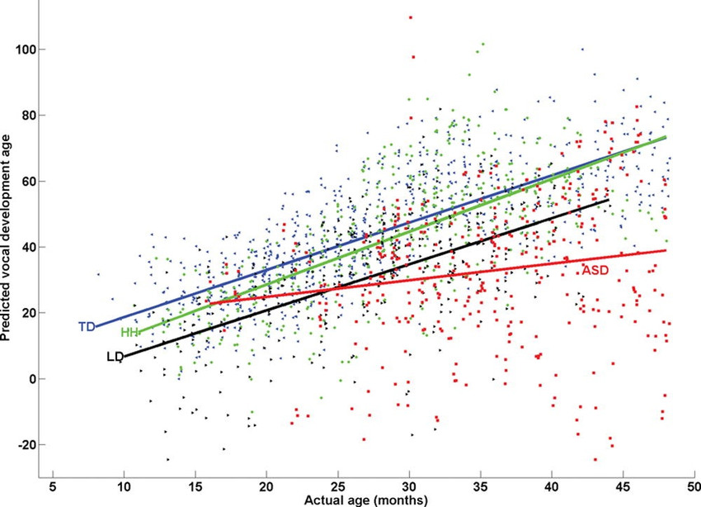
The model
The output looks like this:
The math behind looks like this:
y = a + b₁x₁+ b₂x₂ +…..+ b_{n}x_{n} + ε
Residual value
Intercept
Slopes
Explanatory variables

Slide 36
Linear regression

Slide 37
Multiple regression

Slide 38
The next step
Multiple linear model are very powerful, but we can go further
The General Linear Model (GLM) is even more useful
It’s able to build complex models such as Statistical Parametric Mapping (SPM), which is used to analyze functional imaging data
Next lectures

Slide 39
Short summary
Compare mean of a continuous variable
1 categorical variable with 2 levels
t-tests
One-way ANOVA
2+ categorical variables with 3+ levels each
Factorial ANOVA
2+ categorical variables with 3+ levels
&
2+ continuous variables
Multiple linear regression
1 categorical variable with 3+ levels
Same group
Paired
Different groups
Known mean
One sample
Two means
Unpaired

Slide 40

Questions?

Slide 41
References
Bozeman Science. (2016). Student's t test. [Video]. Available at: https://www.youtube.com/watch?v=pTmLQvMM-1M. (Accessed: 25 October 2018)
Peat, J., & Barton, B.(2005). Medical Statistics. A Guide to Data Analysis and Critical Appraisal. Sydney: Blackwell Publishing.
University of Wisconsin. (2017) T test. Available at: https://researchbasics.education.uconn.edu/t-test/. (Accessed: 22 October 2018)
https://statistics.laerd.com/

