Slide 1
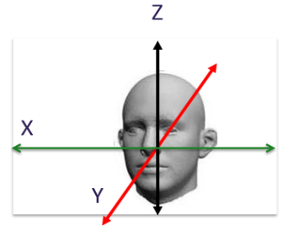
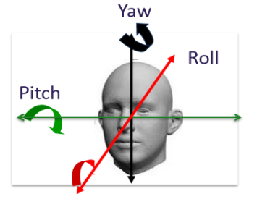
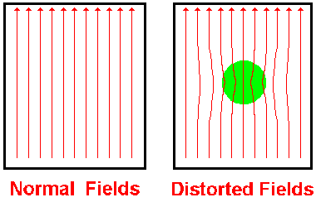
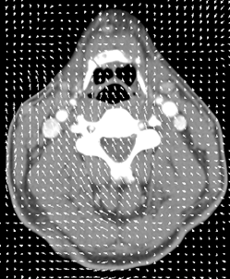
Alysha Chelliah
&
Yuki Shimura
REALIGNING
AND UNWARPING MFD - 2018
Notes:
Intro – both
2-4: Alysha
5-8: Yuki
9-17: Alysha
Rest: Yuki

Slide 2
What this talk covers
Preprocessing in fMRI : Why is it needed?
Motion in fMRI
Realignment
Unwarping
How this all works in SPM
Notes:
Covering the 1st steps of data preprocessing in fMRI. Incl. why it’s needed + dealing w motion (through realigning and unwarping data), and give examples of what this looks like in SPM

Slide 3
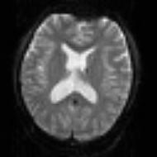
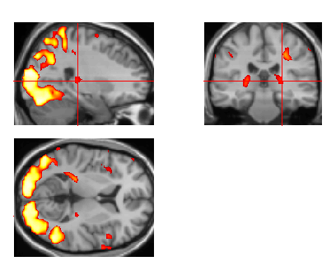
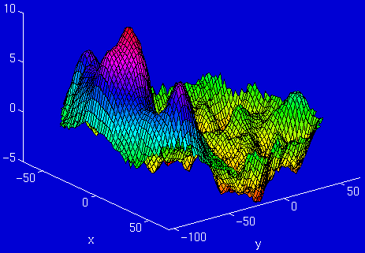
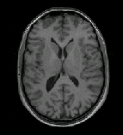
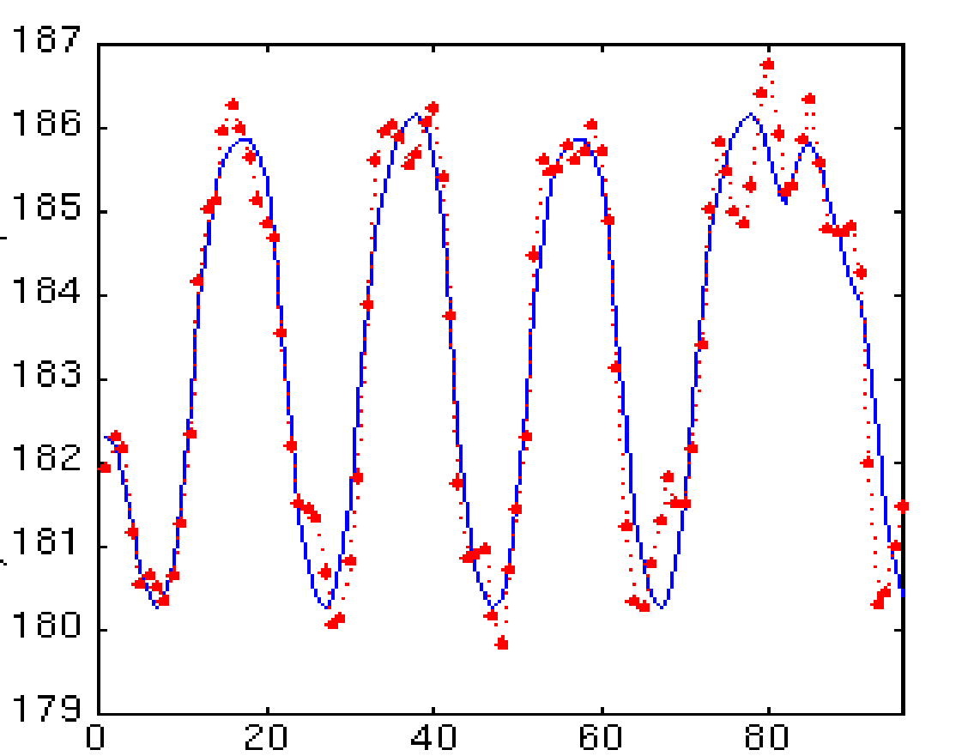
Stages in fMRI analysis
Scanner Output
Preprocessing
Statistical analysis
Motion correction (and unwarping)
Design matrix
fMRI time series
Smoothing
General Linear Model
Statistical Parameter Map
Spatial normalisation (including coregistration)
Structural MRI
Parameter estimates
Notes:
After data collection and prior to statistical data analysis, we conduct preprocessing of fMRI data. Today we are focusing on motion correction, which is usually the 1st step, and we do this regardless of exptl design (other steps incl spatial normalisation, smoothing)

Slide 4
Preprocessing: Why is it needed?
fMRI:
returns a 3D array of voxels repeatedly sampled over time
Changes in activation in each voxel correlated with experimental task
Aim of preprocessing:
to identify and remove artifacts, and validate model assumptions
Key Assumptions:
all voxels must be acquired simultaneously
the voxels need to come from the same part of the brain
Notes:
As we know from last week, in fMRI we look at the intensity of neural activation in voxels sampled over time. If activation in a voxel varies with an exptl task, then we can correlate brain function.
The aim of preprocessing is to remove artifacts and validate some model assumptions. To elaborate, this includes minimising uninteresting variability from the data (i.e., variability not associated with the exptl task, and the influence of physiological artifacts); improving the functional signal-to-noise ratio; and preparing the data for statistical analysis (checking statistical assumptions and transforming data to meet assumptions)
We have two key assumptions: (1) that all voxels are acquired simultaneously, and (2) that voxels come from the same part of the brain.

Slide 5
Violation of assumption 1:
All voxels must be acquired simultaneously?
The last slice is acquired TR seconds after the first slice
→ there can be motion of one slice relative to another
Notes:
In order to maintain these assumptions, we need to address problems associated with each. So the first issue is that the all voxels are not acquired simultaneously. The problem of different slice scanning times stems from the fact that a functional volume, which is a whole brain, is usually not covered at once but with a series of successively measured 2D slices. For a functional volume of 30 slices and a volume TR or repetition time of 3 seconds, for example, the data of the last slice is measured almost 3 seconds later than the data of the first slice.
There can be motion of one slice relative to another due to the delay, and the fact that the realignment model cannot correct this motion is why we want to include realignment parameters in the linear model.
NOTE:
The choice of whether to have STC before or after realignment (or not at all) is still a matter of debate, depending on some subtle things like whether the slices are acquired with an "interleaved" sequence or not, and how much motion there is (probably too much detail to get into in MfD).

Slide 6
Violation of assumption 1:
All voxels must be acquired simultaneously?
The last slice is acquired TR seconds after the first slice
→ there can be motion of one slice relative to another
Solution:
Slice-timing correction: include realignment parameters in the model
Notes:
This issue can be solved by slice time correction which includes realignment parameters in the model.
NOTE:
The choice of whether to have STC before or after realignment (or not at all) is still a matter of debate, depending on some subtle things like whether the slices are acquired with an "interleaved" sequence or not, and how much motion there is (probably too much detail to get into in MfD).

Slide 7
Violation of assumption 2:
- the voxels need to come from the same part of the brain
- small movement (< 5mm) means that voxel location is not stable throughout the time series
Voxel A - Inactive
Voxel A - Active
Notes:
The second issue is that the voxels often do not come from the same part of the brain because of the brain’s small movement. When you do the statistics, you hope that when you look at voxels, it’s the same part of the brain in all time series. However, if the head moves, you can get quite big signal changes that have nothing to do with the bold signal. As you can see in the diagram, if a subject moves, the fMRI image corresponding to voxe A may not be in the same location throughout the entire time series. The aim of pre-processing for motion is to ensure that when we compare voxel activation corresponding to different times (and presumably different cognitive processes), we are comparing activations from the same area of the brain.

Slide 8
Causes of head movement:
Actual movement of the head
Physiological: heart beat, respiration, blinking
Task-related: moving to press buttons
artificially creates variance in voxel activation that correlates with task ➔ serious confound
Notes:
A major cause of head movement is that actually the head moves in the scanner but also it’s important to consider task-related movements such as moving to press buttons. In fact, physiological such as blinking and respiration is a more minor cause of the head movement.

Slide 9
Causes of head movement:
Actual movement of the head
Physiological: heart beat, respiration, blinking
Task-related: moving to press buttons
artificially creates variance in voxel activation that correlates with task ➔ serious confound
Why is this a problem?
This variance is often much larger than experiment- induced variance
→ False activations
lowers the signal-to-noise ratio
Notes:
All these issues are important because this variance, if often much larger than experiment-induced variance, could lead to false activations of the brain and lower the signal-to-noise ratio that we are interested in observing.
To address these issues, we can either try to prevent motion from occurring or correct motion after it’s occurred.
More notes:
Mathematically, the SNR is the quotient of the (mean) signal intensity measured in a region of interest (ROI) and the standard deviation of the signal intensity in a region outside the anatomy of the object being imaged (i.e. a region from which no tissue signal is obtained) or the standard deviation from the noise distribution when known (e.g. the background noise in magnitude data follows a Rician distribution.
Sometimes, there are kinds of artifacts with the scanner that cause the head to move - something like change in temperature of the room can change the drifted position of the subject.

Slide 10
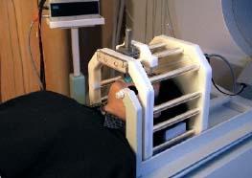
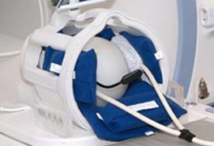
Motion Prevention in fMRI
Constrain the volunteer’s head (soft padding)
Give explicit instructions to lie as still as possible, not to talk between sessions, and swallow as little as possible
Try not to scan for too long*
Make sure your subject is as comfortable
Notes:
To prevent brain movement, you can do few things: (1) you can constrain the subject’s head using the soft padding, (2) you tell the subject to lie as still as possible, (3) you can minimize the scanning time given your experimental design, and (4) you check that he is comfortable in the scanner.
The more you can prevent movement, the better.

Slide 11
Realignment
Aim: find the best possible alignment between an input image and some target image
Rigid body transformation: assume size and shape of brain does not change
Realignment involves two stages:
Registration
Estimate the 6 parameters that describe the rigid body transformation between each image and a reference image
2. Transformation
Re-sample each image according to the determined transformation parameters
Notes:
However despite all this, you cannot prevent all motion in the scanner - participants always move! Therefore motion correction of the data is needed.
The goal is to find the best possible alignment between an input image and some target (reference) image. The target image is usually defined to be the first, or the mean image in the fMRI time series.
We can correct for motion using rigid body transformation. Here we assume that all movements are those of a rigid body, i.e. the assume size and shape of the brain does not change.
Realignment involves two stages. I’ll introduce them now and then go through these in the next slides.
Registration: this involves estimating how the brain has to be moved to fit the reference image.
Transformation: this involves resampling the realigned image, so that the transformation is permanently applied to the image. Also called ‘reslicing’.

Slide 12
Realignment: Registration
To correct for both rotation and translation, we compute 6 parameters that describe the rigid body transformation between each image and a reference image
Translation
Rotation
Notes:
In 3D space, the head can move in 6 directions. Based on the assumption of rigid body transformation, we can superimpose one image over another via these 6 variable parameters.
The parameters consist of 3 sets of translations in the x y and z directions - on the left, and
We have 3 sets of rotations: pitch, yaw, and roll. Pitch is rotation around the x-axis up and down, like nodding ‘Yes’. Yaw is rotation around the z-axis, side to side, like ‘No’. Roll is rotation around the y-axis, like ‘Maybe’
So using these parameters we transform (so move, or realign) the input images to match the chosen reference/target image.
These operations (translation and rotation) are performed by matrices as you can see in the bottom image

Slide 13
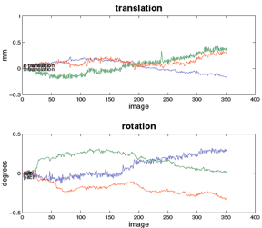
Realignment: Transformation
Apply the transformations to the functional images
Each image is matched to the (e.g.) first image of the time series --> Find mean of these aligned images
Cost function optimisation:
Quantifies how (dis)similar images are after a spatial transformation
Minimise sum of squared difference ‘Least squares’ between consecutive images
Notes:
So let’s say the target image is the first in the fMRI time series. We want to align all subsequent images to that first image to make sure that the voxels are aligned with one another.
Our goal is to identify the set of parameters that provide the best match to the reference volume. This is termed optimisation, where we determine the optimum parameters for the transformation (coordinates). Optimal parameters are those that minimise the sum of squared differences between the image and the reference image (between the transform and the real world data). (cost function = sum of squared difference between consecutive image). After an initial estimate of this cost function, the algorithm will iteratively try different combinations to find the minimum sum of square difference (i.e best match the image to the reference – the perfect co-registration would yield a difference of 0). So if we were looking at the second image in the time series, we want to ask how can we assess how similar or how much overlap there is between the first and second image.
The images below show example output of motion correction, following 3 translations on the left and 3 rotations on the right. On the left, there are translation parameters which estimate how much each image deviates from the first image. The 3 lines representing x, y, and z translations all go through 0,0 because the first image was used as the reference. The images just after it in time don’t need to be moved much to match up to it, unlike the later images in the time series which are further away from 0,0. Likewise you can also see displacement in the pitch, yaw and roll directions.
So, the aim of motion correction is to have similarity between images be as close as possible. We are looking for the best fit option, and we can measure how good a fit is by the sum of squared difference.
Josh’s note:
When we align the images, the idea is to make motion corrected images that are somewhere responsible for each other.
If we measure the sum of square difference (taking twor images > compute the difference > square it), we measure how good of the fit is
We have one image and another image which has moved
That gives a difference
The sum of square differences tells how similar the images are to each other

Slide 14
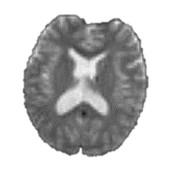
Realignment: Transformation / Interpolation
Original image
Resampled image
After having realigned, we need to determine the intensity of each new voxel in the transformed image (from the intensities in the original image)
Realign
Original voxels
New voxels to determine after realigning
For example, want to determine this voxel
3 types of interpolation possible:
Nearest Neighbour
Trilinear
B-Spline
Original voxel
New voxel to identify
Notes:
After determining a set of realignment parameters, the original data have to be resampled to estimate the values that would have been obtained in case of no head motion. All images are acquired and stored as a collection of discrete points set on a spatial grid. But to carry out the image transformations, the intensity at positions between grid points needs to be calculated. This process is called interpolation.
Interpolation is defined as constructing new data points from a set of known data points (i.e. voxels). Note this is also referred to as reslicing and transformation
The intensity of each voxel in the transformed image must be determined from the intensities in the original image. To realign images with subvoxel accuracy, the spatial transformations will involve fractions of a voxel. This requires an interpolation scheme to estimate the intensity of a voxel, based on the intensity of its neighbours
In SPM there are different interpolation options to choose from. We will consider 3 types: Nearest Neighbour, Trilinear, and B-Spline

Slide 15
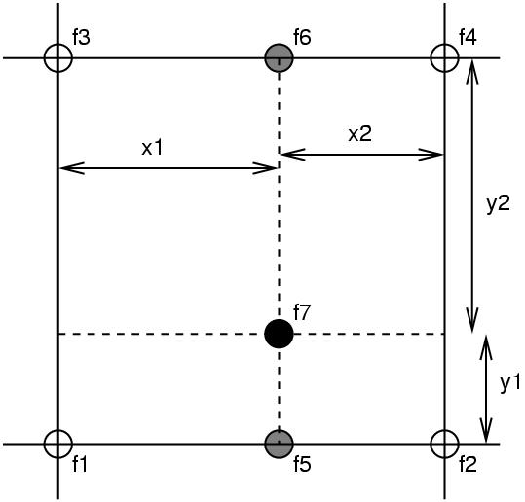
Simple Interpolation
Nearest neighbour
Takes the value of the closest voxel
Tri-linear
Weighted average of the neighbouring voxels
f₅ = f₁ x₂ + f₂ x₁
f₆ = f₃ x₂ + f₄ x₁
f₇ = f₅ y₂ + f₆ y₁
Notes:
The simplest option is to take the value of the nearest neighbour. This is fastest but not recommended for image realignment (and is not included in spm12)
A better option is tri-linear interpolation. It is illustrated here in 2 dimensions, so is rather bi-linear interpolation, but it’s easier to explain this way.
In the image, the white circles represent original voxels (f1, f2, f3, f4) and the black circle (f7) represents the point we’re trying to sample
So, we take the weighted average intensity of these 2 values (f1 and f2) and we get f5 We also take the weighted average of f3 and f4 to get f6. Finally, we take the weighted average of f5 and f6 to get f7.
This would generalize into 3 dimensions
This method is not really optimal because by taking the weighted average of the neighbouring voxel we are losing information and introducing smoothness - blurring- into the resampled image.

Slide 16
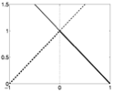
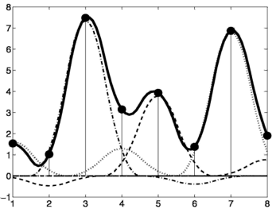
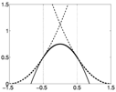
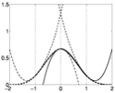
B-spline Interpolation
A continuous function is represented by a linear combination of basis functions
Notes:
A better method is B-spline interpolation, which is the default in SPM. It improves accuracy and has higher spatial frequency.
We have little basis functions sent on each of the original voxels.
In this graph on the left, the perpendicular thin lines represent the value of individual voxels in the original image and the black line is interpolating the smooth function between voxels (this is a linear combination of basis functions – a bit like a localised GLM). When we want to sample a new value, we just take the height of the black line.
There are a few options of B-spline interpolation in SPM. I’ll try to explain some:
(1) On the top right, we have a function that is a little triangle shape and this is a 1st degree b-spline, which is identical to a bilinear / trilinear interpolation. So if you use two closest neighbours, the basis function is a triangle shape.
(2) 2nd degree b-spline is slightly more sophisticated. If we use three closest neighbours, the basis function is a shape that’s a bit closer to Gaussian-shaped
(3) 3rd degree b-spline uses more curves.
This is how they would appear in 2D - so these basis functions are sent on each pixel, but there’s also a 3D version as well.
So if we know coefficients of these basis functions for nearby voxels, which is like a beta value from GLM, we can reconstruct a continuous in space image, fitting images to linear combinations of these basis functions. The basis functions are embedded in SPM.
Bottom line without the maths: B-spline interpolation uses more information in the hope of improving results and the higher the order the more information (neighbouring voxels) is being used to generate accurate interpolation
John:
We have these little basis functions sent on each of original voxels.
They are a bit Gaussian in shape, but not quite Gaussian:
If you use two closest neighbors, the basis function is a triangle shape.
If we use three closest neighbors, the basis function is a shape that’s a bit closer to Gaussian or our neighbors - looks more like Gaussian.
These basis functions are sent on each pixel.
If we know coefficients of these basis functions (which is like a beta value from GLM), then we can reconstruct a continuous in space, image > fitting images to linear combinations of these basis functions.
The basis functions are embedded in SPM.
These dotted lines show the different basis functions scaled by the coefficients.
All the dotted lines are up - you get this continuous black line.
Basis functions are like design matrix: you will find a linear combination of columns of the design matrix that best fit the data. So fitting this is similar - if you find a linear combination of the values of the basis functions of each point to best fit the data, that allows you to interpolate between different values.
For example, triangle shape - tri-linear interpolation.
If you figure coefficients of the basis functions, you can fit the smooth function through the image.
When you need to resample the image, you can take the value of the smooth function each point.
One dotted line for each pixel/voxel.

Slide 17
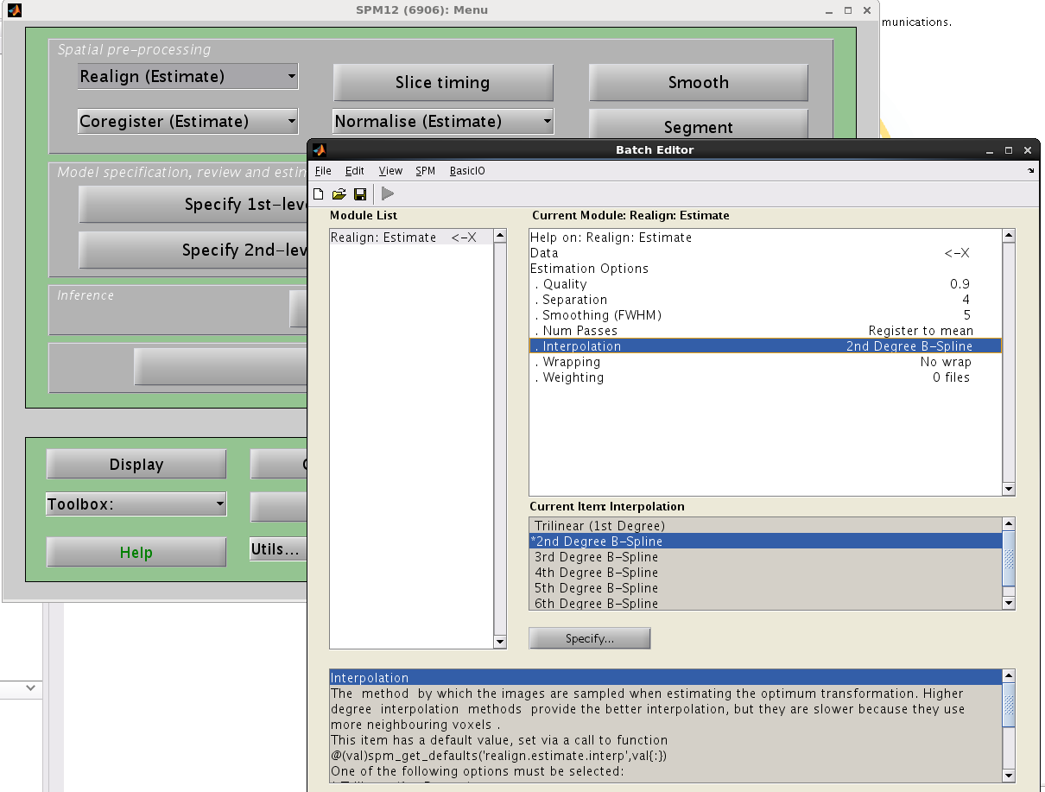
Notes:
So this is what it might look like in SPM12. Realign tab of the Spatial Pre-processing menu; and then select 2nd Degree B-Spline interpolation.
You may have noticed that there is no 1st degree B-spline option. This is because 1st degree B-spline is identical to trilinear interpolation.
The most accurate methods are higher order B-splines, 2-7.
Higher orders provide better results/interpolation, but they are slower because they use more neighbouring voxels.

Slide 18
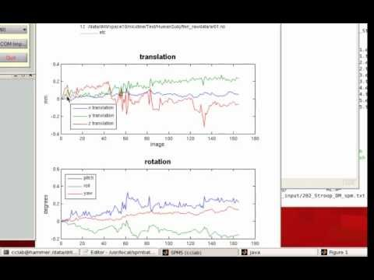
Realigning:
https://www.youtube.com/watch?v=HqcMm1GXn9M
Notes:
I’ve included a summary video of what we have talked about. It shows you the different options that come up when you navigate through SPM and get to the image we saw on the previous slide, as well as the output from realignment where we saw the translation and rotation results.
I’ve left the link here so you can watch it in the future. It’s not a long video. If we have time at the end, we can also watch it as a recap perhaps.

Slide 19
Summary so far
Motion can reduce sensitivity & increase residual variance
Try to minimise movement with practical steps
Motion correction via realignment
Each volume rigidly registered to reference
Least squares objective function
Realigned images must be resliced (interpolation) for analysis
Head movement
Calculate position of the brain for the 1st slice
Estimate transformation parameters based on 1st slice
Apply the transformation parameters on each slice
Notes:
To recap. Motion can reduce sensitivity and increase residual variance. We want to minimise movement with practical steps, but participants always move anyway. We can correct for motion through realignment. Here each volume is rigidly registered to a reference, and we estimate transformation parameters and apply the least squares objective function to minimise sum of squared difference between consecutive images. The realigned images must be resliced for analysis.
The image on the right is a visual summary of this. However you should remember that these images are shown in 2D to make it easier to understand. In reality, we think of volume by volume, not slice by slice.
Because each reslicing slightly degrades the images, this may be postponed until the normalisation step. It is useful, however, to create a mean image to determine parameters from at the normalisation stage or to coregister to a structural MR.

Slide 20
Registration
realignment
= registration that uses a linear transformation
that preserves shape
unwarping
= registration using non-linear transformation that modifies shape
Notes:
Alysha talked about religinemnt but registration or preprocessing has two parts: first part is realignment and the second part is unwarping, which I am going to talk about. While realignment introduces linear transformation that preserves shape, unwarping uses non-linear transformation that modifies it.

Slide 21
Residual Errors in Realigned fMRI
Even after realignment a considerable amount of the variance can be accounted for by effects of movement
This can be caused by e.g.:
Movement between and within slice acquisition
Re-sampling can introduce interpolation errors
Non-linear distortions and drop-out due to inhomogeneity of the magnetic field
Notes:
Earlier Alysha talked about how realignment could address the voxel correspondence problem making the same voxel contain the same bit of the brain over the entire time series. However, this does not solve all movement related problems.
After realignment, a considerable amount of the variance could be introduced by effects of movement for the following reasons:
First, movement between and within slice acquisition: we talked about slice time correction earlier which will come again later in this talk.
Second, interpolation errors introduced by re-sampling: when we resample an image, this can get interpolation artefacts
Finally, interactions between head movement and field inhomogeneity.
– (why should not resample more than once) – (can be minimised by improved cost function techniques).

Slide 22
Residual Errors in Realigned fMRI
Even after realignment a considerable amount of the variance can be accounted for by effects of movement
This can be caused by e.g.:
Movement between and within slice acquisition
Re-sampling can introduce interpolation errors
Non-linear distortions and drop-out due to inhomogeneity of the magnetic field
Incorporate movement parameters as confounds in the statistical model
Notes:
This is where unwarping comes in. In order to address these problems, we incorporate movement parameters as confounds in subsequent analysis.
(This can lead to two problems, especially if movements are correlated with the task. Loss of sensitivity (we might miss “true” activations). Loss of specificity (we might have false positives In particular interactions between movement and field inhomogeneity remain. These artifacts negatively affect the accuracy of registration by producing local optima, altering the gradient, shifting the global optimum, and making rigid registration asymmetries. In fact, in severe cases up to 90% of the variance after realignment can be caused by movement.)

Slide 23
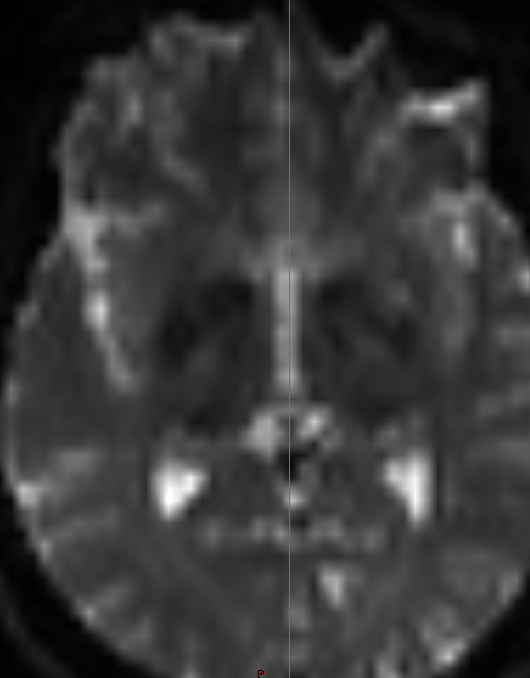
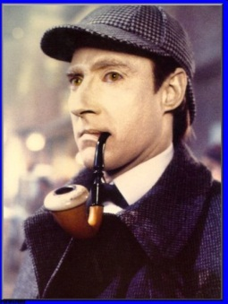
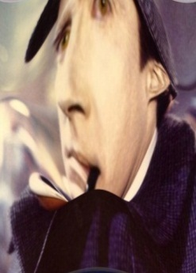
Unwarping tackles non-linear distortion from magnetic field inhomogeneities (movement by inhomogeneity interaction)
Different substances in the brain are differentially magnetised susceptible to magnetization
2) Inhomogeneity of the magnetic field
3) Distortion of the image
Notes:
Problems related to inhomogeneity of the magnetic field are considered because of the nature of brain tissues. The tissues have a thing called magnetic field susceptibility and difference in susceptibility induces changes in magnetic field, which could end up distorting brain images we collect. In other words, if orientation of the head changes, that could cause the slight change in magnetic field, which in turn, distort the brain images.
Is fairground mirror analogy correct -
When placed in a large magnetic field, tissues are temporarily magnetized, with the extent of the magnetization depending on the magnetic susceptibility of the tissue.
The brain has different types such as grey/white matter, and substances such as CSF, Blood and so on which have slightly different magnetization. This alters the local magnetic field.
Local magnetic fields tend to take on different configurations around these interfaces, and introduces geometric distortion into the resultant images.
These distortions occur along the phase encoding direction (A to P)
This distortion is especially noticeable at air-tissue or bone–soft tissue boundaries (e.g.orbitofrontal cortex/anterior medial temporal lobes), because air and bone have much lower magnetic susceptibility.
These distortions will vary with subject position. Thus is known as movement by inhomogeneity interaction
In these areas like a funny mirror at fair ground anlogy where the mirror represents the unevenness of the magnetic field whereby if you move forward the distortion will be different and if we were to take different snapshots at each position then realignment would not suffice to bring into a common space because of the warping.
EPI images are not particularly faithful reproductions of the object, and in particular there are severe geometric distortions in regions where there is an air-tissue interface (e.g. orbitofronal cortex and the anterior medial temporal lobes). In these areas in particular the observed image is a severely warped version of reality, much like a funny mirror at a fair ground. When one moves in front of such a mirror ones image will distort in different ways and ones head may change from very elongated to seriously flattened. If we were to take digital snapshots of the reflection at these different positions it is rather obvious that realignment will not suffice to bring them into a common space.
The situation is similar with EPI images, and an image collected for a given subject position will not be identical to that collected at another. Hence, even after a "successful" realignment there will be residual variance caused by the object having different shape at different time points. We call this effect susceptibility-by-movement interaction. "Unwarp" is predicated on the assumption that the susceptibility-by-movement interaction is responsible for a sizeable part of residual movement related variance.
The situation is similar with EPI images, and an image collected for a given subject position will not be identical to that collected at another. Hence, even after a "successful" realignment there will be residual variance caused by the object having different shape at different time points. We call this effect susceptibility-by-movement interaction. "Unwarp" is predicated on the assumption that the susceptibility-by-movement interaction is responsible for a sizeable part of residual movem nt related variance.

Slide 24
Movement parameters influencing field
Notes:
There is a gui in SPM allowing us to include the movement parameters to address these issues.
Because we would expect the field to depend only on the subject out of plane rotations; in SPM these are the only parameters used in unwarping as standard, 4 and 5, which corresponds to pitch and roll, so we use this default setting unless there is a good reason otherwise. We leave second order effects blank - so you don’t use second order parameters (that is 6)
X+Y+Z + Yaw

Slide 25
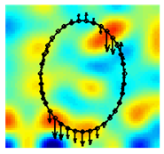
Field Maps
Measure field inhomogeneity using a field map
Using this map derive a deformation field (how voxels in volume are deflected due to distorted field)
Notes:
Unwarping can estimate changes in distortion from movement by estimating how the deformations change when the subject changes position.
We need to have a scan before the start of an experiment to measure field inhomogeneity. Using this field map we can derive a deformation field, which details how the voxels in the volume are deflected due to the distorted field. For example, little vectors at each position in space show how that particular location has been deflected.
By applying the inverse of this deformation field, we can undo voxel displacement due to inhomogeneity. For instance, given the observed variance (after realignment) and known (estimated) movements, we can estimate how deformations change with subject movement.
To do this we iterate: 1) estimate movement parameters, 2) estimate deformation fields, …and so on..
We have made an attempt at formulating such an inverse model, and at solving for the "derivative fields". A deformation field can be thought of as little vectors at each position in space showing how that particular location has been deflected. A "derivative field" is then the rate of change of those vectors with respect to subject movement. Given these "derivative fields" we should be able to remove the variance caused by the susceptibility-by-movement interaction. Since the underlying model is so retricted we would also expect experimentally induced variance to be preserved. Our experiments have also shown this to be true. Indeed one particular experiment even indicated that in some cases the method will reintroduce experimental variance that had been obliterated by movement related variance.

Slide 26
Measure deformation field (FieldMap).
Estimate new distortion fields for each image
Unwarp time series
Estimate rate of change of field with respect to current estimate of pitch & roll
Estimate movement parameters
Δϕ
+Δθ
Notes:
In unwarping we calculate a deformation field from a single field map at the beginning of the series, then use the rigid movement parameters (precaulated from the realign procedure) to estimate the warping of that field map for each time point in the series.
So first, we get subject motion parameters, which we observed from realignment.
And then, we measure deformation field with subject movement estimated via iteration
Finally, we estimate distortion at each time point and unwarp the time series by applying inverse
The equation denotes change in distortion field with respect to change in parameters.
http://www.fil.ion.ucl.ac.uk/spm/toolbox/unwarp/#Rationale
Assume that we know how the deformations change when the subject changes position (i.e. we know the derivatives of the deformations with respect to subject position). That means that for a given time series and a given set of subject movements we should be able to predict the "shape changes" in the object and the ensuing variance in the time series. It also means that, in principle, we should be able to formulate the inverse problem, i.e. given the observed variance (after realignment) and known (esti ated) movements we should be able to estimate how deformations change with subject movement.
We have made an attempt at formulating such an inverse model, and at solving for the "derivative fields". A deformation field can be thought of as little vectors at each position in space showing how that particular location has been deflected. A "derivative field" is then the rate of change of those vectors with respect to subject movement. Given these "derivative fields" we should be able to remove the variance caused by the susceptibility-by-movement interaction. Since the underlying model is so re tricted we would also expect experimentally induced variance to be preserved. Our experiments have also shown this to be true. Indeed one particular experiment even indicated that in some cases the method will reintroduce experimental variance that had been obliterated by movement related variance.
In theory it should be possible to estimate also the "static" deformation field, yielding an unwarped (to some true geometry) version of the time series. In practice that doesn't really seem to work, hence the method deals only with residual movement related variance induced by the susceptibility-by-movement interaction.
Combined use with FieldMap
This means that the time-series will be undistorted to some "average distortion" state rather than to the true geometry. If one wants additionally to address the issue of anatomical fidelity one should combine Unwarp with a measured field-map. A field-map in the format that Unwarp expects can be created using the FieldMap toolbox.
The description above can be thought of in terms of a Taylor expansion of the field as a function of subject movement. Unwarp alone will estimate the first (and optionally second, see below) order terms of this expansion. It cannot estimate the zeroth order term (the distortions common to all scans in the time series) since that doesn't introduce (almost) any variance in the time series. The measured fieldmap takes the role of the zeroth order term. Refer to the FieldMap toolbox and the documents FieldMap.man and FieldMap_principles.man for a description of how to obtain fieldmaps in the format expected by Unwarp.
A deformation field indicates the directions and magnitudes of location deflections throughout the FOV with respect to the real object.

Slide 27
Practicalities of unwarping
Particularly useful when the movements correlate with activation of interest.
Can dramatically reduce variance in areas susceptible to greatest distortion (e.g. orbitofrontal cortex and regions of the temporal lobe).
Useful when high field strength or long readout time increases amount of distortion in images
Notes:
Unwarping is useful when the movements correlate with activation of interests; we can remove unwanted variance without removing true activations using unwarping.
It can also reduce variance in areas susceptible to greatest distortion such as orbitofrontal cortex and regions of the temporal lobe.
It’s also useful when high field strength or long readout time increases amount of distortion in images.
There are several limitations to unwarping: for example, it can also be computationally intensive. It also doesn’t remove movement-related residual variance coming from other sources, such as spin-history effects and slice-to-volume effects

Slide 28
Summary
Importance of motion in fMRI
Corrected by using realignment and rigidly registering each volume to a reference
Then reslice – interpolate images to match reference voxels
Movement by distortion interaction corrected by unwarping
Notes:
In summary, realigning and unwarping of brian images are very critical to our analyses because motion in fMRI could reduce the quality of data.
Realignment corrects for subject movement and unwarping corrects for the movement by distortion interaction.
We could include the movement parameters as confounds in the statistical model of activations. However, this may remove activations of interest if they are (heavily) correlated with the movement, and can only account for linear transformations.
In the end what you get is resliced copies of your images that have been realigned and unwarped accordingly.
These images are then taken forward to the next preprocessing steps (next week!).

Slide 29
References
SPM 12 Manual - www.fil.ion.ucl.ac.uk/spm/doc/manual.pdf
SPM course slides - www.fil.ion.ucl.ac.uk/spm/course/
Previous MfD slides

