Slide 1
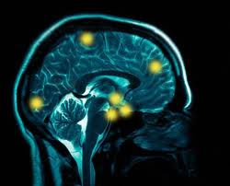
Preprocessing: Coregistration and Spatial Normalisation
Hugo Fleming and Holly Morley
Methods for Dummies 2018
With thanks to our expert John Ashburner

Slide 2
Realign & Unwarp
Coregister
Normalise
Smooth
Raw data
(fct)
Raw data
(str)
MNI
1
fct
fct
fct
fct
str
MNI
fct
fct
2
fct
str
MNI
4
is a blurry version of
3
3
4
fct
str
MNI
Notes:
MNI (Montreal Neurological Institute) – created in a 2-step process based off the Talairach atlas. 1. In a large dataset of brains (n=241), manually defined landmarks and then scaled these to the Talairach atlas. 2. Matched another dataset (n=305) of brains to the average of the brains which had been matched to the Tailarch atlas. Averaged this → the MNI305

Slide 3
Preprocessing Recap: Realignment
Motion Correction
Within subjects
Aligning to a template
fct
fct
fct
fct
fct
fMRI
fMRI

Slide 4
Preprocessing Recap: Unwarping
Adjusts for changes in field strength
Distortions of image resulting from differences in tissue magnetic field susceptibility
Non linear transformations

Slide 5
Preprocessing: Final Steps Coregistration
fct
strMRI
fMRI
Matching modalities in individual subjects
E.g. functional → structural
Normalisation
Matching images to a template (e.g. MNI) across subjects
MNI
Smoothing
fMRI
Adjusts for residual differences and alignment errors

Slide 6
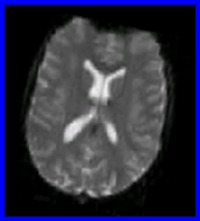
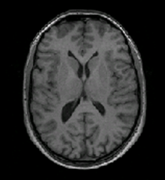
Coregistration
Intrasubject
Intermodal
Link anatomical information of functional images (T2* weighted) with a structural image (T1 weighted)
Why?
Superior anatomical localisation in structural image as acquired slower
More precise spatial normalisation
CO-REGISTRATION
FUNCTIONAL – T2*
– note the poor structural definition
STRUCTURAL – T1

Slide 7
Coregistration – it’s not simple...
Cannot rely on simply using intensity difference
Identifying individual landmarks too labour intensive
Need a measure of similarity…
Notes:
EPI dropout

Slide 8
Coregistration – Approach
Seek to measure shared information
Registration intuitively relies on the concept of aligning images to increase their similarity
Two-step process
Registration
Reslicing (optional)

Slide 9
Registration
Similar to realignment
Fitting source image to reference image (static)
Affine transformation
Estimate parameters
Apply these transformations
Notes:
An affine transformation is an important class of linear 2-D geometric transformations which maps variables into new variables by applying a linear combination of translation, rotation, scaling and/or shearing (all points along a given line remain fixed while other points are shifted parallel to by a distance proportional to their perpendicular distance from) operations.
Fitting structural to function – simplest but sometimes the coregistration doesn't work so well if there are bias artifacts in the anatomical scan
Fitting functional to structural – need to include all the other fMRI images that should be in alignment with the functional image
This option allows the results of the segmentation (used for bias correction etc) to still be used for spatially normalising all the images.

Slide 10
Registration
Fitting structural to function – simplest but sometimes the coregistration doesn't work so well if there are bias artifacts in the anatomical scan
Fitting functional to structural – need to include all the other fMRI images that should be in alignment with the functional image in ‘other images’
This option allows the results of the segmentation (used for bias correction etc) to still be used for spatially normalising all the images.

Slide 11
Reslicing (optional)
Reoriented (1x1x3 mm voxel size)
Resliced
(to 2 mm cubic)
Notes:
Reslicing – images are resliced to match the reference image (after coregistration)

Slide 12
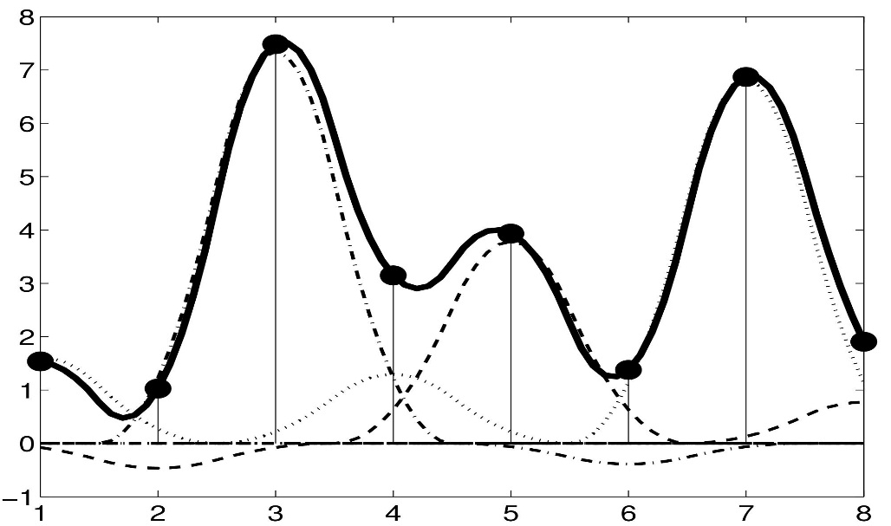
Interpolation
Estimates the intensity of new voxels in source image corresponding to voxels in the reference space
Based off intensity of surrounding voxels in original source image
Notes:
Not advised – run out of disk space

Slide 13
Advised to use ‘Estimate only’
→The algorithm only changes the headers of the images in order to reflect their new orientation/position.
The changed headers are accounted for by the spatial normalisation routines, so if you estimate a deformation from the anatomical scan, then it can be applied to the functional data
!providing the anatomical and functional scans are in rigid alignment!
Notes:
If fitting fcuntional

Slide 14
Measure of similarity
SPM then mathematically measures the similarity of the two images
Images are too different to use mean squared difference
So need measures of image similarity which are more flexible
Use Mutual Information (Information Theory)
Derived from joint histograms
Notes:
Entropy = randomness

Slide 15
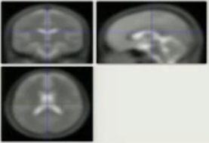
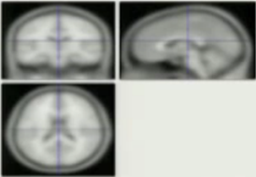
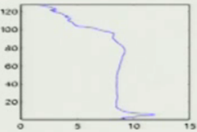
Plotting intensities
T2* (functional) image
T2* (functional) histogram
# voxels
Intensity
T1 (structural) image
T1 (structural) histogram
Intensity
# voxels

Slide 16
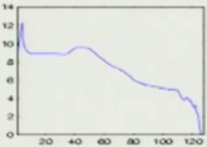
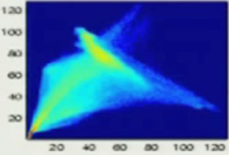
Forming a joint histogram
Brightness = count of paired intensities

Slide 17
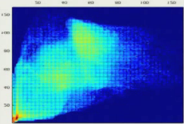
Registered joint histogram
- More sharpness
Mis-registered joint histogram
- Less sharpness

Slide 18
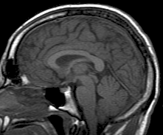
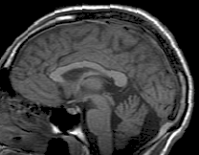
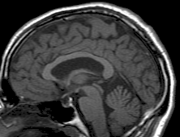
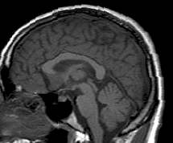
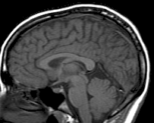
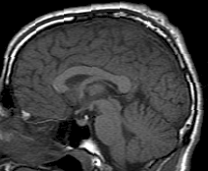
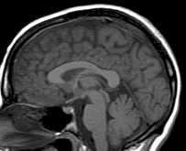
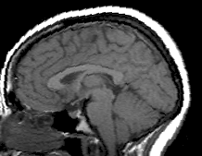
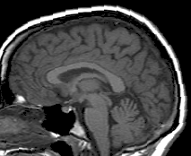
Normalisation: why?
Motivation: A shared space is required to enable us to compare subjects.
Aim: Voxel to voxel correspondence between the brains of subjects
Notes:
The brains of different subjects vary in shape and size. We want to be able to examine homologous regions across subjects.

Slide 19
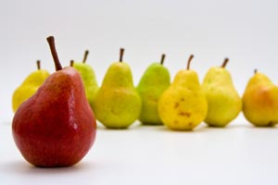
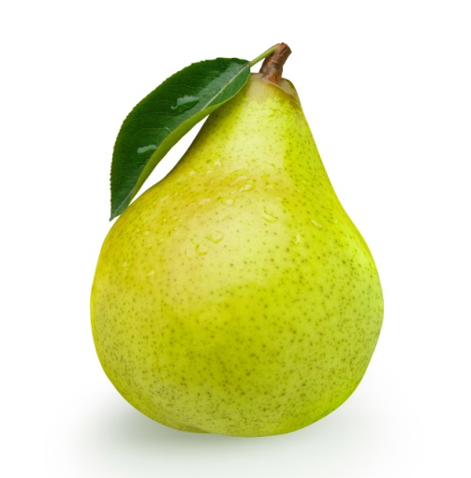
Why normalise? cont’d…
Increases statistical power
Group analysis
Generalise to population level
Allows cross-study comparisons

Slide 20
Normalisation Native Space → Standard Space
Talairach
Montreal Neurological Institute (MNI) Space
SPM uses MNI space!
Notes:
Pooling data to compare activation differences : enables BETWEEN SUBJECTS comparisons to derive group statistics, improve statistical power of analyses, generalise findings to population level, make group analyses: identify similarities and differences between groups; report results in a standard coordinate system
Talairach:
Not representative of population (single-subject atlas)
Slices, rather than a 3D volume (from post-mortem slices)
MNI:
Based on data from many individuals (probabilistic space)
Fully 3D, data at every voxel → representative average template
SPM reports MNI coordinates (can be converted to Talairach)
Shared conventions: AC is roughly [0 0 0], xyz axes = right-left, anterior-post superior-inferior

Slide 21
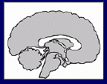
Normalisation: Procedure
Affine registration 12 dof
Translations across axes (3 dof)
Rotations around axes (3 dof)
Scaling or Zooming (3 dof)
Shearing or Skewing (3 dof)
A good start…

Slide 22
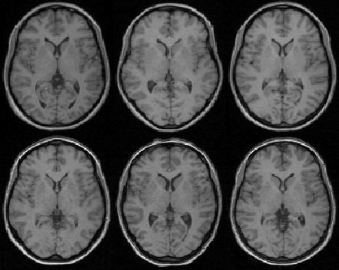
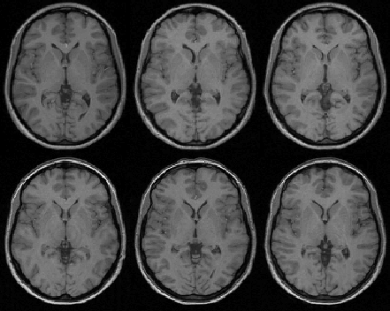
Normalisation: Procedure
Warping
Applies non linear deformations to move voxels from original location to template location
Very flexible, with 1000s of dof’s
Affine Registration
Non-linear Registration

Slide 23
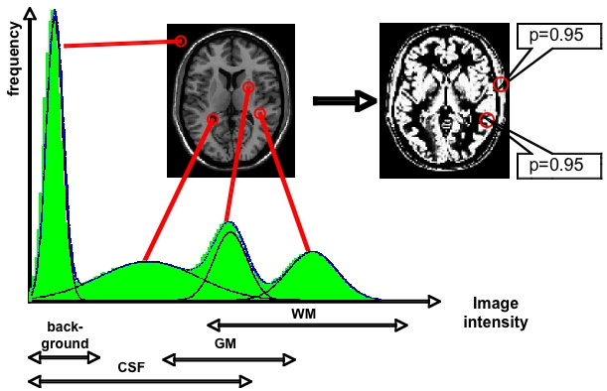
Warping: how does it work?
In SPM12, warping relies on segmenting the source image into tissue types, using a Gaussian mixture model of signal intensities.

Slide 24
Warping: how does it work?
Having identified the features of the image (grey matter, white matter etc.), alignment with the standard Tissue Probability Maps is easier.
+

Slide 25
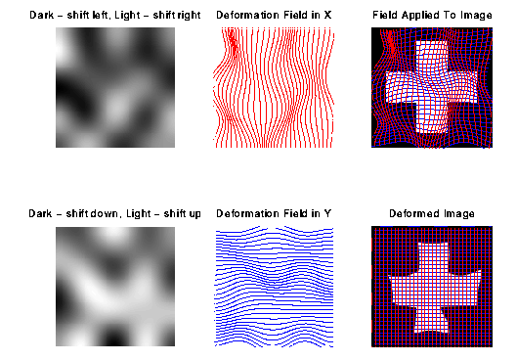
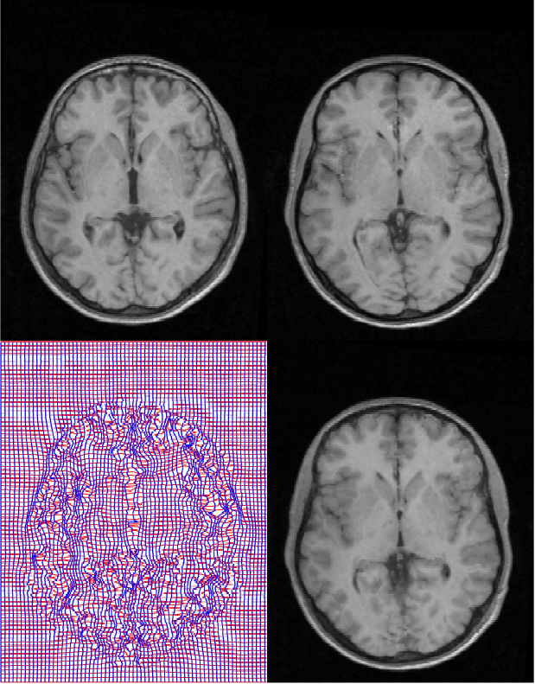
Non-linear basis functions
Warping in more detail
Deformations are modelled with a linear combination of non-linear basis functions

Slide 26
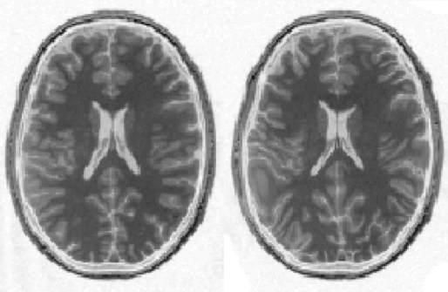
Pitfalls of normalisation: overfitting
Flexibility of warping can lead to unrealistic results
Regularisation applies constraints
Non-linear registration
using regularisation.
Non-linear registration
without regularisation.

Slide 27
Pitfalls of normalisation: overfitting
Regularisation uses priors and constraints to reduce the possibility of overfitting.
Find the best parameters to match the source image to the template whilst simultaneously minimising the deviation of the parameters from expected values.

Slide 28
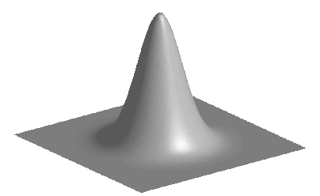
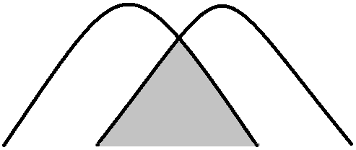
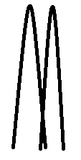
Smoothing
Blurs over residual anatomical differences and registration errors
Why?
Suppresses noise
signal reinforced and noise averaged out
Superior special overlap
Data becomes more normally distributed
Increases sensitivity to effects of similar scale to kernel
VS

Slide 29
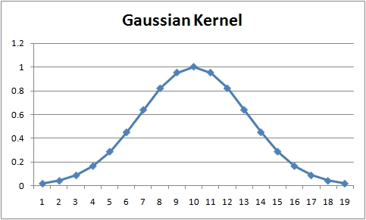
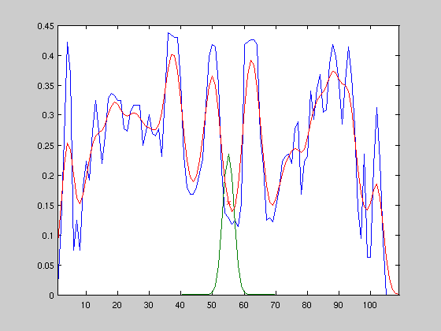
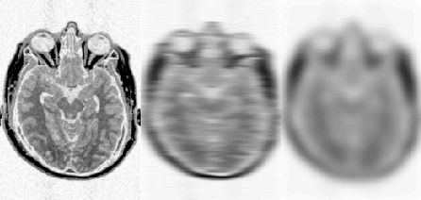
Smoothing
How?
Weighted averaging of neighbouring voxels
→ Each voxel replaced by the weighted average of itself and its neighbours

Slide 30
Smoothing: disadvantages
Reduction of spatial resolution of the data
Edge Artifacts
Merging
Extinction
Mislocalisation of activation peaks

Slide 31
Keep in mind
Multiple data adjustments are made during fMRI analysis, and these alter the raw data considerably
→ Therefore, large sample sizes and appropriate statistical analyses are required for reliable and robust inferences

Slide 32
Summary
Coregistration links functional data with a structural image
→Intrasubject
Normalisation links images from one subject to standardised space
→Intersubject
Smoothing blurs over any residual errors and anatomical differences

Slide 33
SPM
spm fmri (to open)
Ensure you have the correct version! (SPM 12) newest update October 2014
If in doubt start by pressing ‘Batch’
All these tools can be found under Batch→SPM→Spatial
Any images you input make sure are in the correct order (e.g. all prefixed by unique subject identifier, as SPM can’t order your data for you)
Save your batch files so you can retrace your steps
Ensure you have good file structure; SPM spews out tons of files….

Slide 34
SPM
Reference image- (mean functional DEP image) that is assumed to remain stationary while source is moved to match it.
Source- structural MRI
-----------------------------Unless stated use defaults--------------------------

Slide 35
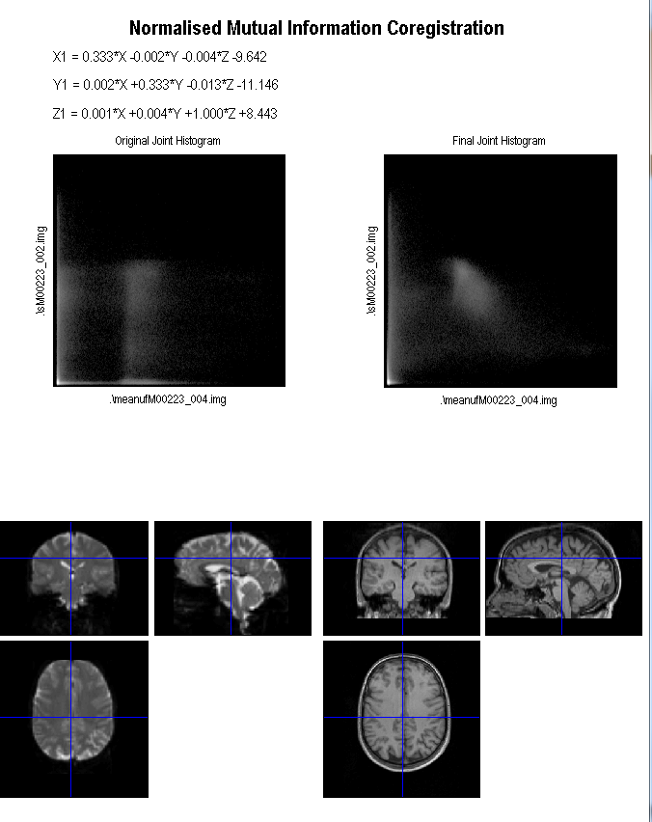
SPM- Coregistration Output
Very important to check your images- it automatically loads these up for you!

Slide 36
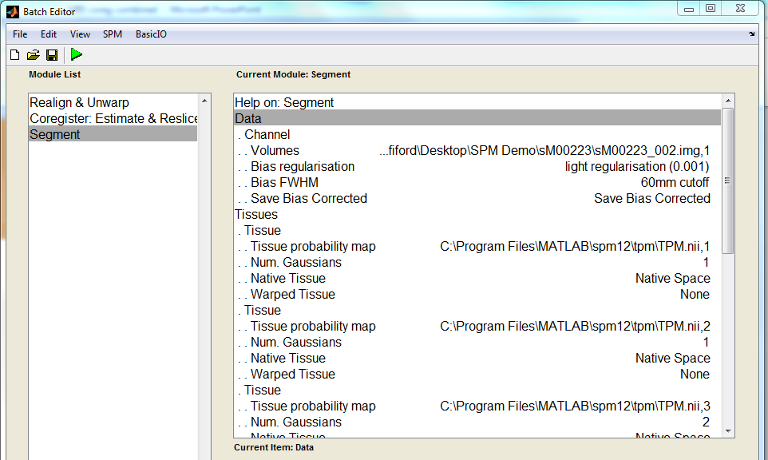
SPM- Segment 1
Data- use your structural image.
If using multiple inputs (e.g. T1 and PD weighted image) then ensure all are entered in in the same order.
Tissue 1=GM
Tissue 2=WM
Tissue 3=CSF
Save Bias Corrected.
TBC next slide
Notes:
A bias field is a smooth low frequency signal that corrupts MRI images due to inhomogeneities in the magnetic fields of MRI machine

Slide 37
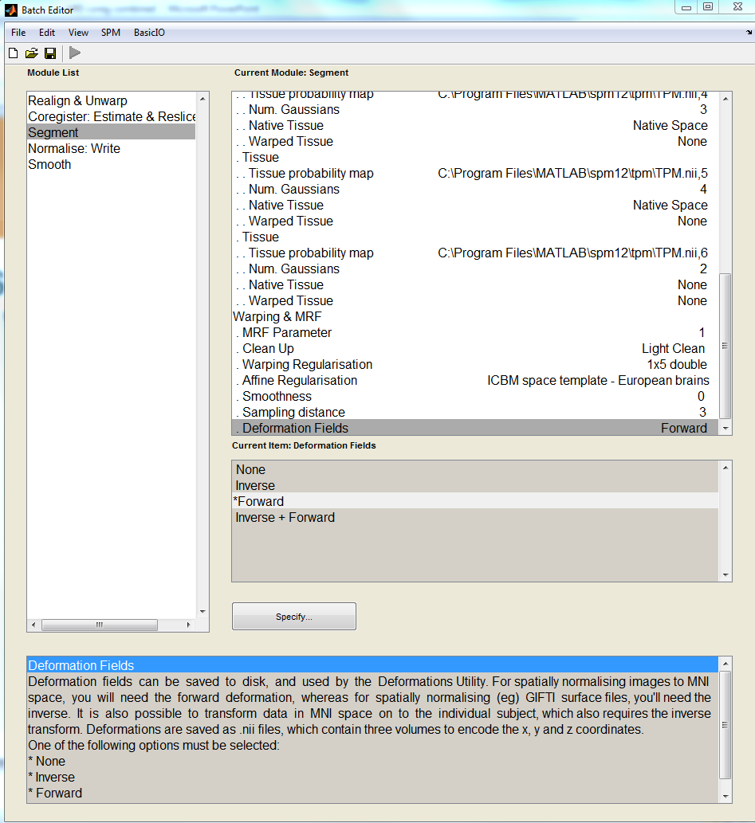
SPM- Segment 2
Scroll down
Data- Forward deformation fields needed for MNI normalisation

Slide 38
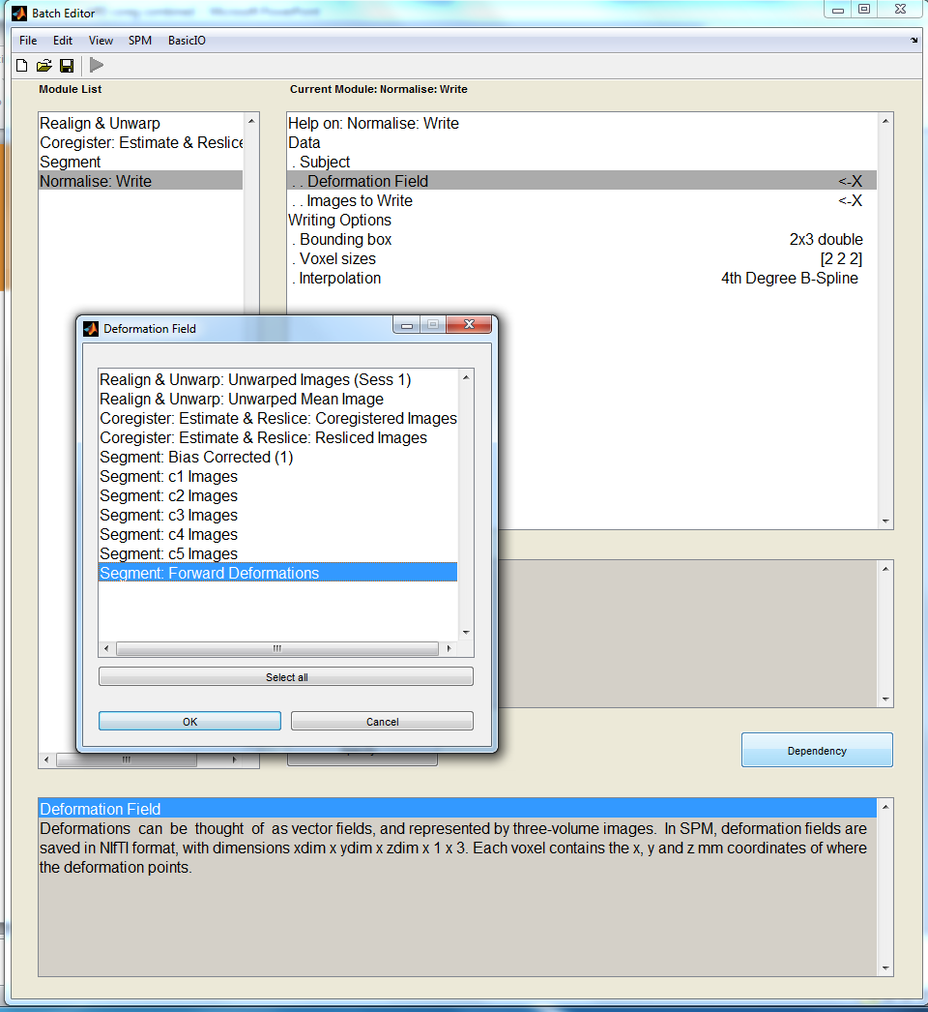
SPM
Use these forward deformations during the normalisation process.
Images to write= co-registered functionals

Slide 39
SPM
Smooth your normalised images
Choose your kernel width here

Slide 40
References John’s Lecture Ged Ridgway’s preprocessing lecture SPM Homepage Mfd Resources 2018

