Slide 1
Methods for Dummies
Second-level Analysis (for fMRI)
Justyna Ekert & Alex Hopkins
Expert: Guillaume Flandin

Slide 2
Overview
Recap of first-level analysis
What is second-level analysis?
Fixed versus random effects
How do we analyse random effects?
Practical demonstration

Slide 3
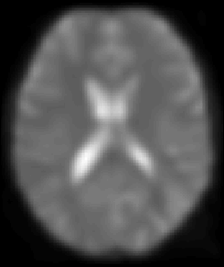
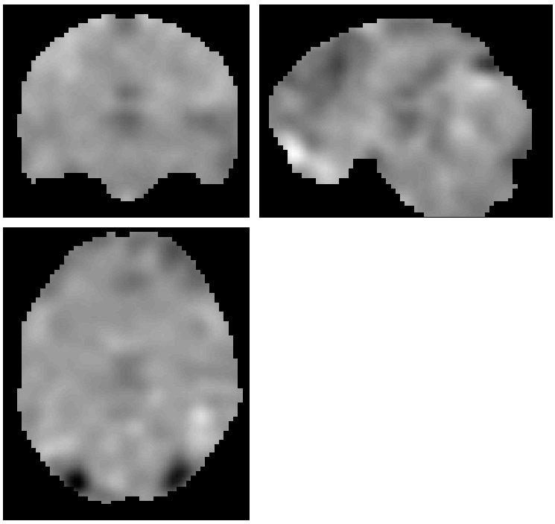
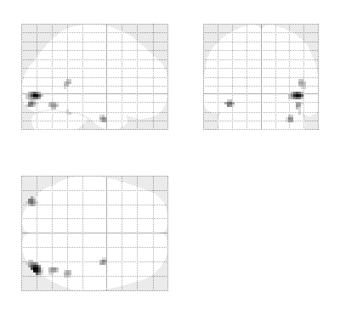
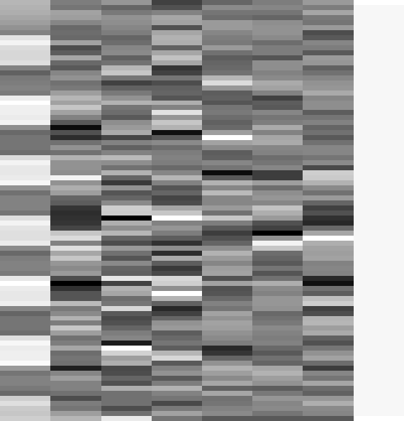
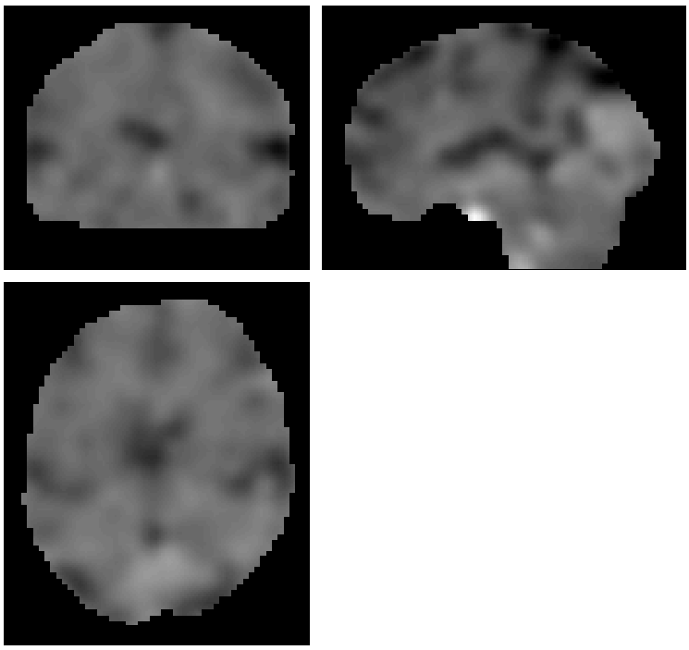
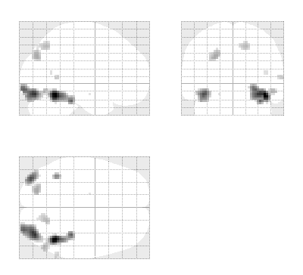
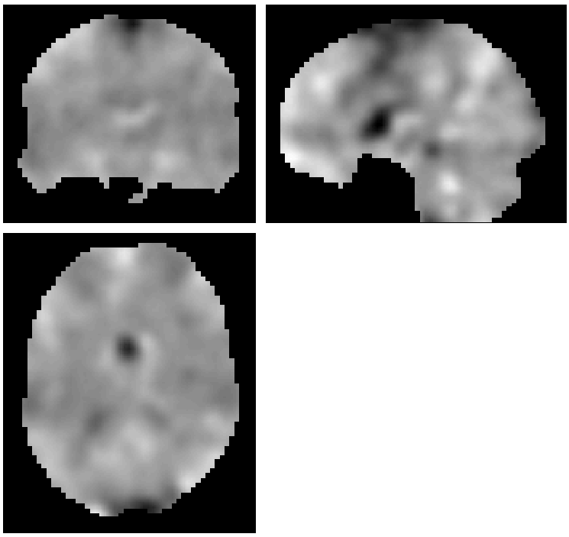
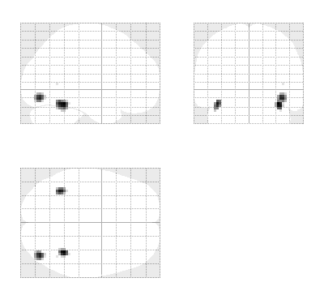
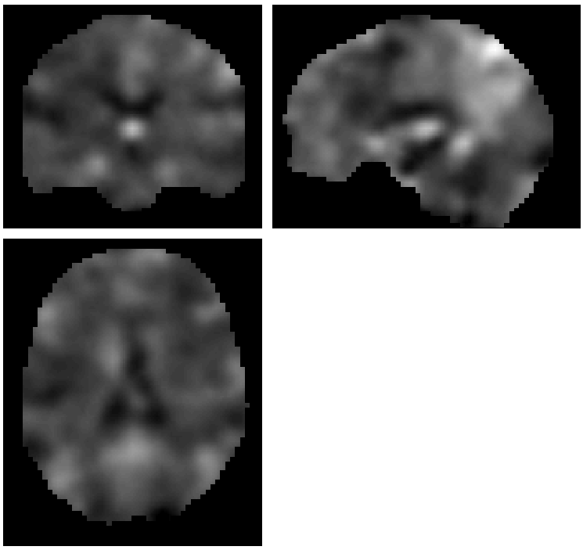
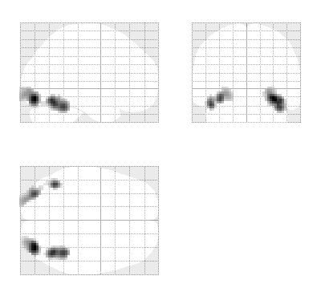
First level
Subject 1
fMRI data
Design Matrix
Contrast Images
SPM{t}
Subject 2
…
Subject N
Notes:
The data we have collected is a time-series for each voxel of the changes in fMRI signal. We want to model this time series. We specify our experimental design and we estimate this design for the parameters. We then define the effect of interest with a contrast vector which produces a contrast image for each person. These contrast images are then taken to the second level to run group analysis containing the contrast of the parameter estimates at each voxel.

Slide 4
Second level analysis
Deals with groups of subjects, e.g.
  Patients vs. control
  Brain activity*trait anxiety
which voxels consistently show significant activity within our group
We would also like to be able to generalise our results to non-tested subjects
Notes:
Second analysis we deal with groups of subjects. In the first level we dealt with individual subjects, so we run a model on each subject.
We want to know which voxels consistently show significant activity within our group
We would also like to be able to generalise our results to non-tested subjects
And that’s something to keep in mind…
Hierarchical structure of the data
First level deals with individual subjects
Second level deals with group of subjects → this can be group comparisons like patient vs. control or correlation relations ships between brain activity and personal level characerisitcs like age or trait anxiety

Slide 5
Overview
Recap of first-level analysis
What is second-level analysis?
Fixed versus random effects
How do we analyse random effects?
Practical demonstration

Slide 6
Fixed versus random effects
Different assumptions about the source of random variation in voxel activity
Notes:
Multilevel have been specifically developed for analysing hierarchically structured data, like this
They allow different variance components to be introduced at each level (e.g. within-subjects and between-subject)

Slide 7
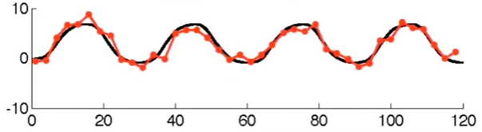
Fixed effect
One source of variation: measurement error
Notes:
Lets start with a single voxel in the brain of one subject, this is time going along the x axis, the y axis is the strength of the bold signal.
Each red dot is the actual measurement of the bold signal
We have fitted a model – which is the black line
This is data from a paradigm with a kind of one off design, so either visual stimulus or not and we can see that this voxel has a response
To explain what fixed effects are, here is a sample fMRI time series with one source of error.
What we see here is a fixed population effect, that’s the black line and the only thing that is varying is the fMRI noise, so all the stuff we can not account for with the experimental design, so for example head motion, scanner noise…
So each time we sample the fMRI data we get the red line, so black line plus error.
So the only source of variation here is the measurement itself.
The true response magnitude is fixed, so the black line which

Slide 8
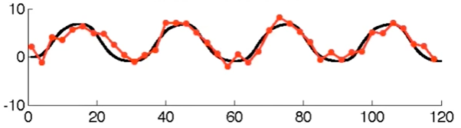
Fixed effect
One source of variation: measurement error

Slide 9
Fixed effects
Only one variation: measurement error (within subject) σ_{w}²
True response magnitude is fixed.

Slide 10
Random effects analysis (RFX)
Synonymous with ‘mixed effects models’.
Assumes our sample is a set of individuals taken at random from the population of interest.
To do this we need to consider the between subject variance, σ_{b}², as well as σ_{w}² – and estimate the likely variance of the population from which our sample is derived.
Notes:
This means that in order to generalise our findings to the wider population, we have to assume that our sample is representative of that population: in essence, that they are a random selection of individuals taken from that population. This is why it’s called random effects analysis.
So, we need to incorporate this assumption into our model: we need to incorporate between subject variance as well as within subject variance.

Slide 11
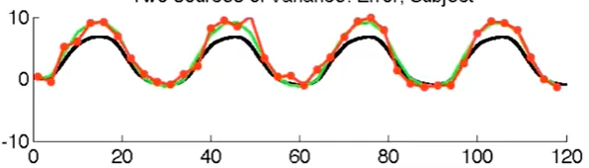
Random effect
Two sources of variation
  measurement error
  Response magnitude
Black line – population mean
Notes:
The green line is the response magnitude for an individual subject which is sampled around the black population mean. And now if we sample the fMRI data, which is the red line, we sample with error around the green line
So now there are two sources of variation, one is the measurement error, again everything we cannot account for in our model, and the random response magnitude. Every subject has a random response magnitude for their true response. So all the subjects are different from one another

Slide 12
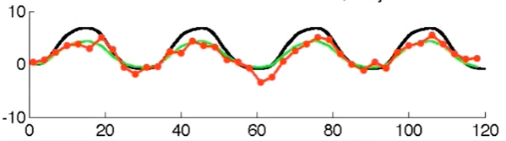
Random effect
Two sources of variation
  measurement error
  Response magnitude
Black line – population mean

Slide 13
Random effect
Two sources of variation
  measurement error
  Response magnitude
Subject as a random factor

Slide 14
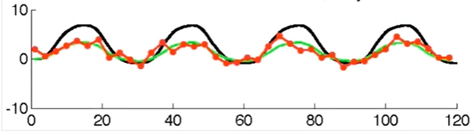
Random effects
Two sources of variation:
  Measurement error (within subject)
  Response magnitude (between-subject)
Response magnitude is random
  each subject/session has random magnitude
  population mean is fixed. → Mixed-effect analysis
Notes:
measurement error (scan to scan variance)
Response magnitude is the individual difference (subject to subject variance)
Now there are two sources of variation, one is the measurement error, again everything we cannot account for in our model, and the random response magnitude. Every subject has a random response magnitude for their true response. So all the subjects are different from one another

Slide 15
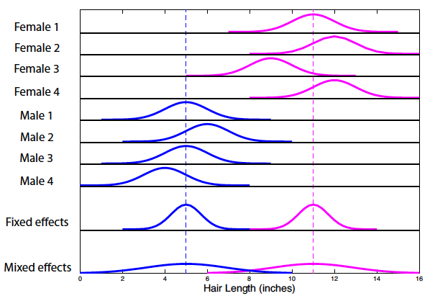
Summary: Fixed vs. mixed effects
(from Poldrack, Mumford and Nichol’s ‘Handbook of fMRI analyses’)
Notes:
– Fixed effects analysis. So with fixed effects we compare the group effect to the within-subject variability. It is not an inference about the population from which the sample is drawn. In the example here, we can see that if comparing males and females, in a FFX analysis, the mean is taken as the peak and the variance is the mean variance among individuals.
- Random effects analysis. With random effects we compare the group effect to the between-subject variability. It is an inference about the population from which the subjects were drawn. If Bob or Fred or Sophie came along and we gave them the same paradigm, we could be confident that they would also show the effect. If we look at the random effects part of the graph on the bottom row, we are estimating the variance of responses across the population – the variance is much greater. This means that our statistical tests are more conservative.
As a general point to note, because the between-subject variance is greater than the within subject variance, scanning time is best used in scanning more subjects rather than scanning individual subjects for longer.

Slide 16
Scan more subjects!
Because the between-subject variance is greater than the within subject variance, scanning time is best used in scanning more subjects rather than scanning individual subjects for longer.

Slide 17
Fixed-effects:
We can only say something about our particular group of subjects
→ No generalisation
→ case studies
Random-effects:
We make inferences about the population from which the subjects were drawn
→ generalisation possible
Notes:
Only by including both sources of variation in my error term can I generalize to unobserved subjects/the general population
Thus, only if I treat subjects as a random factor can I generalize.. if the subject is fixed, I cannot generalize to a new subject, that we of course always want to do in science
An RFX analysis can be implemented using the ‘Summary-Statistic (SS)’ approach as follows

Slide 18
“Mixed effects models should be used whenever data are grouped within certain levels of a population and inferences are to be applied to the entire population.”
- Mumford and Poldrack (2007)

Slide 19
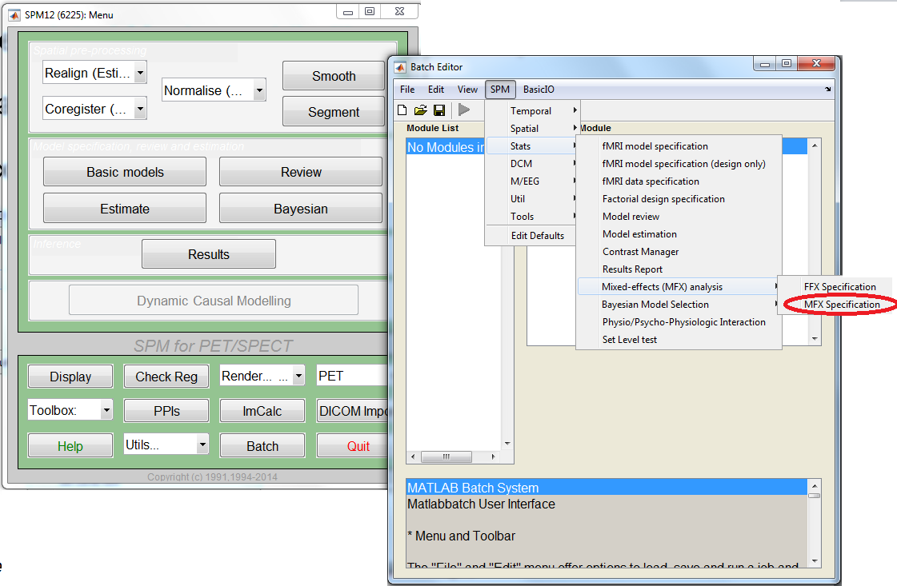

Slide 20
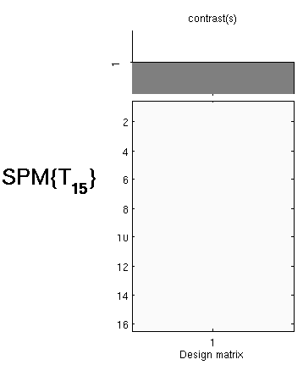
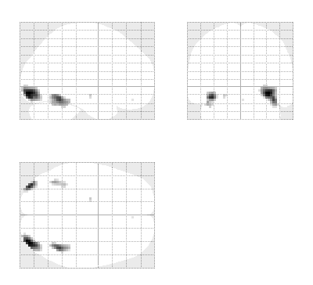
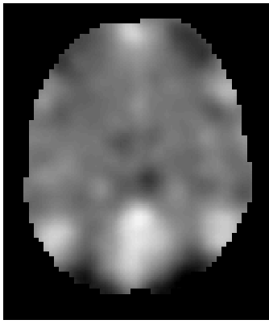
First level
Second level
fMRI data
Design Matrix
Contrast Images
One-sample t-test @ second level
Subject 1
…
Subject N
  Generalisability, Random Effects & Population Inference. Holmes & Friston, NeuroImage,1998.

Slide 21
Methods for Random Effects
Hierarchical
Most accurate method – gold standard
Set up a GLM containing parameters for the effects and variances at both the subject AND group levels, to all be estimated at the same time.
Estimates subject and group statistics via “iterative looping”
Computationally demanding
Notes:
Because it uses this process of iterative looping, it is computationally demanding. This type of procedure is used for example in epilepsy research where the number of seizures experienced in the scanner is not under experimental control and therefore highly variable across subjects.
Alternative is the summary statistics approach, which is quicker because it doesn’t rely on this iterative looping.
This is the typical type of model that is used by most statisticians working with behavioural data. For fMRI, which consist of time series in excess of 100 points for each of 100 000 or more voxels, computationally too difficult.

Slide 22
Methods for random effects
Summary statistics
1st level design for all subjects must be the SAME
Uses the same sample means as in the first level analysis
Gives exact same results as hierarchical model (when the within-subject variance is the same for all subjects)
Validity is undermined by presence of extreme outliers.
Notes:
For example, exactly the same number of trials etc
So…it’s less computationally demanding than a hierarchical approach
So…it’s a good approximation when they’re roughly the same
…this is what SPM uses as default.
Chris

Slide 23
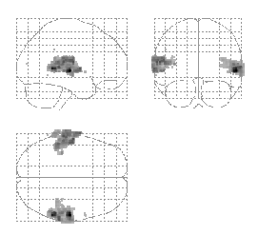

Robustness
Summary
statistics
Hierarchical
Model
Mixed-effects and fMRI studies. Friston et al., NeuroImage, 2005.
Notes:
Task involved listening to words.
Here, Professor Friston used a restrictive maps likelihood method for the hierarchical model, estimating within and between subject in a recursive fashion. It starts off with initial values as to what it thinks the effect size is, and then computes the group effect and then iterates between parameter estimates – eventually estimating the variance components.
What’s shown here on the glass brains is the results of an F contrast testing for the effect of words at the second level.
**Remel** in SPM
Alex

Slide 24
Overview
Recap of first-level analysis
What is second-level analysis?
Fixed versus random effects
How do we analyse random effects?
Practical demonstration
24
Notes:
24

Slide 25
Summary Statistics RFX Approach
First level
Second level
fMRI data
Design Matrix
Contrast Images
One-sample t-test @ second level
Subject 1
…
Subject N
  Generalisability, Random Effects & Population Inference. Holmes & Friston, NeuroImage,1998.
Notes:
In neuroimaging or probably more specific in SPM, RFX is implemented using the computationally efficient ‘summary-statistic’ approach, this is the most commonest approach. A simple kind of random effects modal.

Slide 26
Summary Statistics RFX Approach
fMRI data
Design Matrix
efficient
Contrast Images
One-sample t-test @ second level
Subject 1
Easy to do
Robust !
…
Subject N
  Generalisability, Random Effects & Population Inference. Holmes & Friston, NeuroImage,1998.
Notes:
Why is this so widely used? Its advantages@:
Efficient
easy to use
Most importantly: robust

Slide 27
Overview of today’s talk
Recap of first-level analysis
What is second-level analysis?
Fixed versus random effects
How do we analyse random effects?
Practical demonstration
Questions

Slide 28
Button- pressing
Notes:
Assumes first level analysis has been done correctly.
Alex

Slide 29
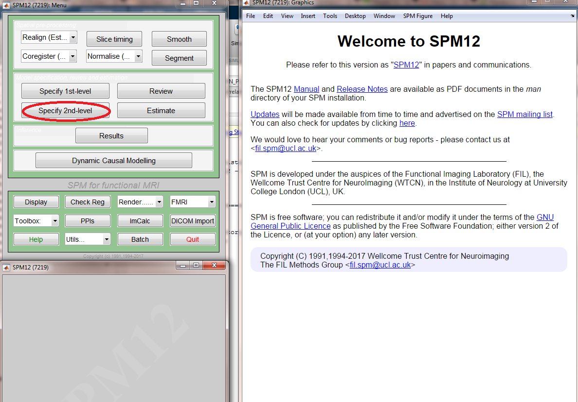

Slide 30
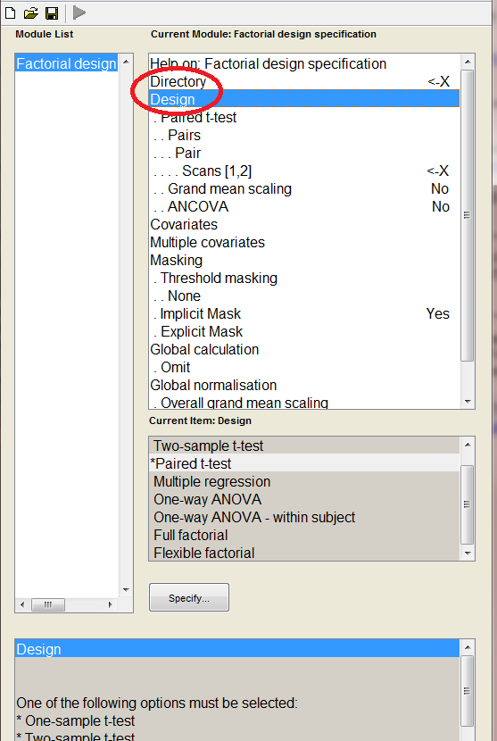
Set-up options
Directory
  To write SPM.mat to
Design
  Scans: select con.*img from 1st level
  Several design options:
    1 sample t-test
    2 sample t-test
    Paired t-test
    Multiple regression
    1 way ANOVA
    Full or flexible factorial (for > 1 way ANOVAs – use FLEXIBLE FACTORIAL to include subjects as a random factor!)

Slide 31
Example flexible factorial model for a 2x2 within subjects ANOVA
Define factors: e.g. subject, conditions
Select scans for each condition per subject
Specify main effects and interactions of interest
Factors:
“Independence” – whether the errors are independent between factor levels
“Variance” – whether the error variances are equal between factor levels

Slide 32
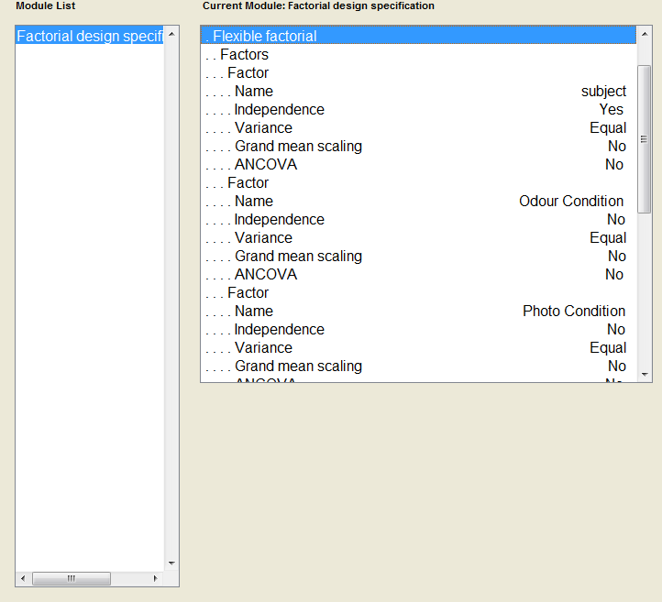
Include ‘subject’ as a factor to account for random variance between subjects.
Independence: yes (different individuals)
Variance: equal (subjects from same population
Specify factor 1 (e.g. odour vs no odour)
Independence: no (assume different factor levels are correlated within a subject)
Variance: equal (do not expect variances between levels of within subjects factors)
Specify factor 2 (e.g. faces vs objects)
Independence: no (assume different factor levels are correlated within a subject)
Variance: equal (do not expect variances between levels of within subjects factors)

Slide 33
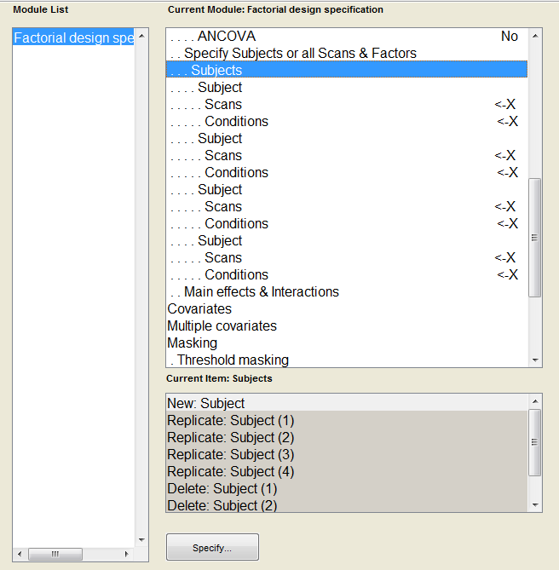
Each subject should have a section with ‘Scans’ and ‘Conditions’ (e.g. 4 subjects)
Input images (con images) for each subject under ‘Scans’ – each subject should have 4 scans
Factor matrix should be specified in ‘Conditions’
E.g. Factor A (2 levels: Odour vs No Odour), and Factor B (2 levels: Flowers vs Objects) = A1 A2 B1 B2
Enter into Conditions: 1 1; 1 2; 2 1; 2 2
Subjects is a ‘special’ factor – no need to specify factor levels

Slide 34
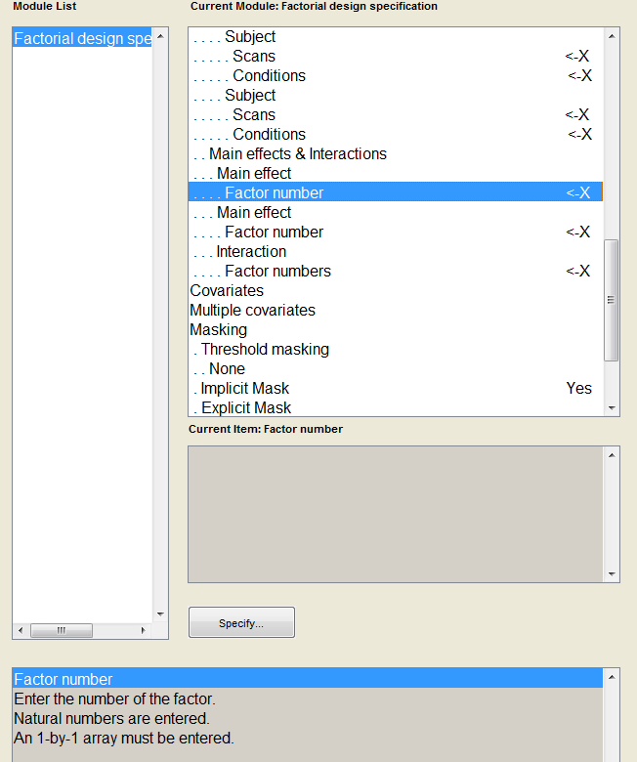
Main effects and interactions
Main effects: e.g. to investigate main effect of the ‘subjects’ factor – enter 1
Interaction effects: e.g. to investigate ALL main effects and interactions of experimental conditions – enter 2 3

Slide 35
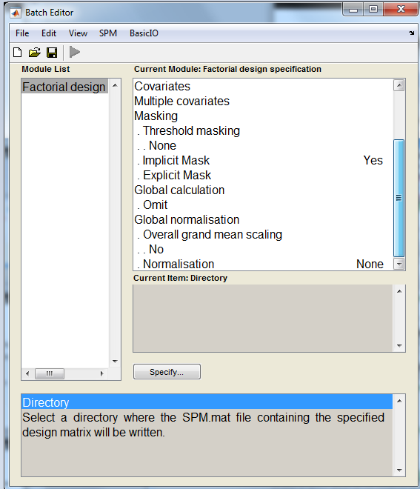
Covariates
  Input covariates (e.g. behavioural ratings) & nuisance variables here
  1 value per con*.img
  Enter per subject, in the order of conditions
Masking
  Specifies voxels within image which are to be assessed
  Implicit is default
  Mostly for VBM/PET
Global calculation/normalisation
  Mostly for VBM/PET

Slide 36
Specify 2nd level Set-Up
↓
Save 2nd level Set-Up (File > save batch)
↓
Run analysis
↓
Look at the RESULTS

Slide 37
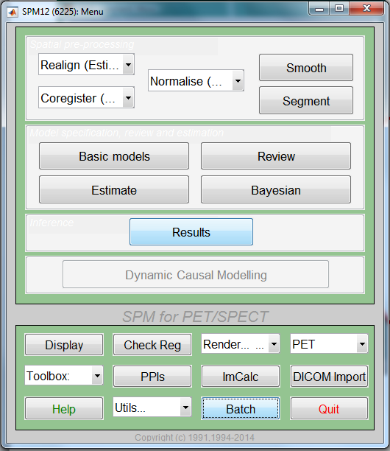
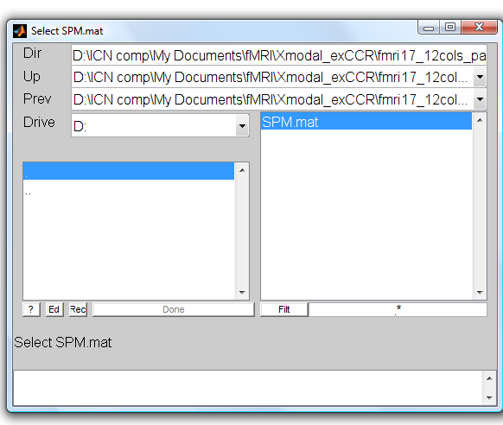
Results
Notes:
Chris

Slide 38
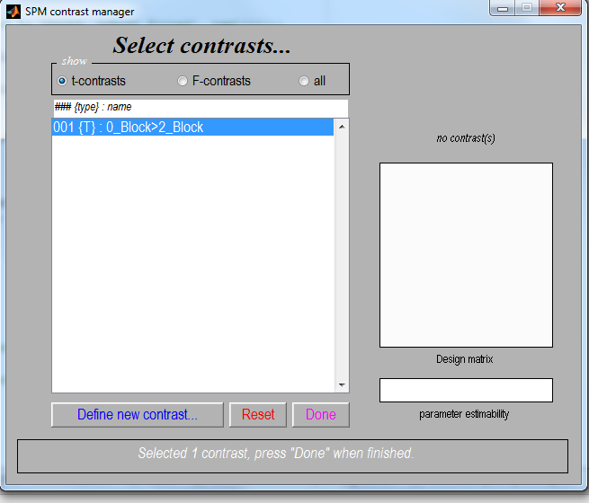
e.g. 2nd level 1-sample t-test
Select t-contrast
Define new contrast
  c = +1 (e.g. A>B)
  c = -1 (e.g. B>A)

Slide 39
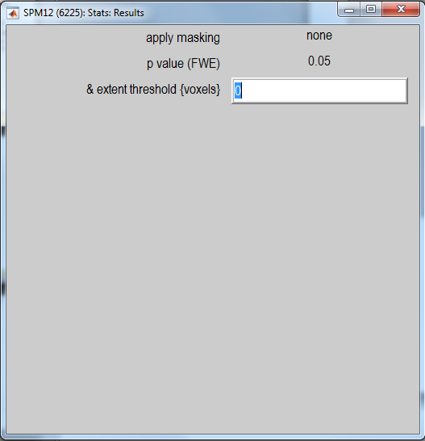
Select options for displaying results:
Correct for multiple comparisons – FWE/FDR
Set p value to 1 first
Then to 0.05, or better, 0.001
Extent threshold voxels: minimum cluster size (k = 20)

Slide 40
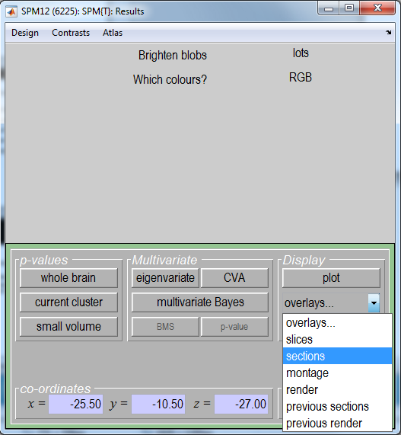

Slide 41
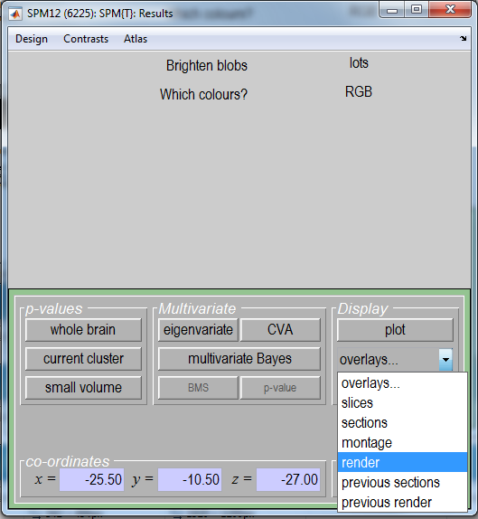

Slide 42
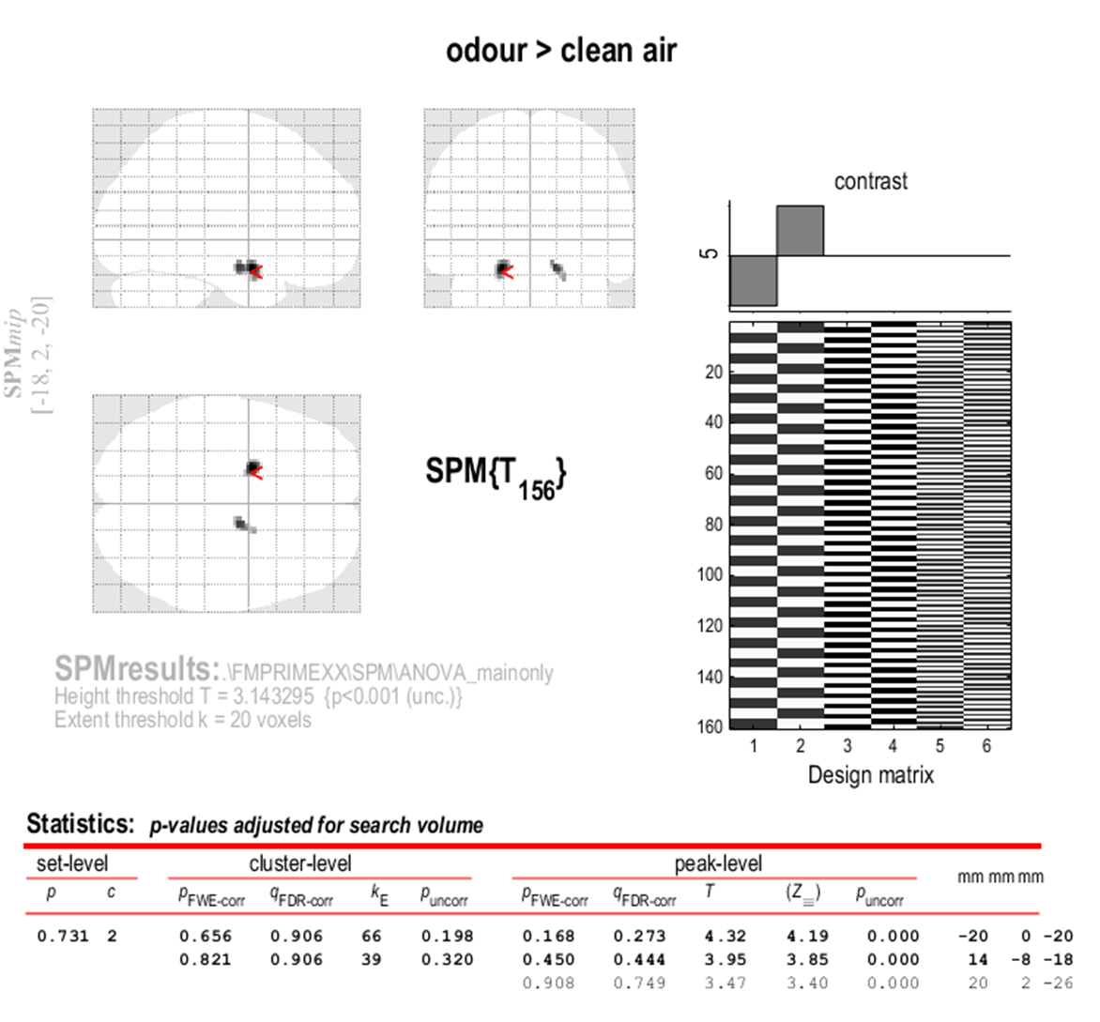
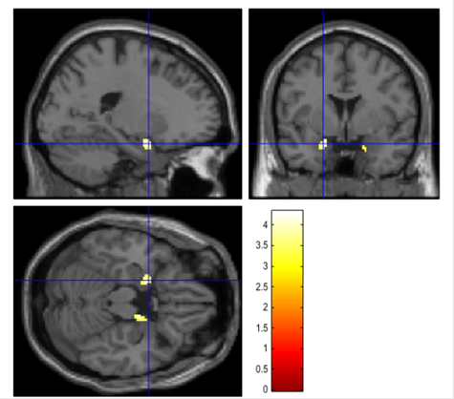

Slide 43
Suggestions
Always also check results at p = 1 uncorrected (you should see a full brain activation -> if not there is a problem)
If no full brain: probably one (or more) participants had a wrong realignment/normalization!

Slide 44
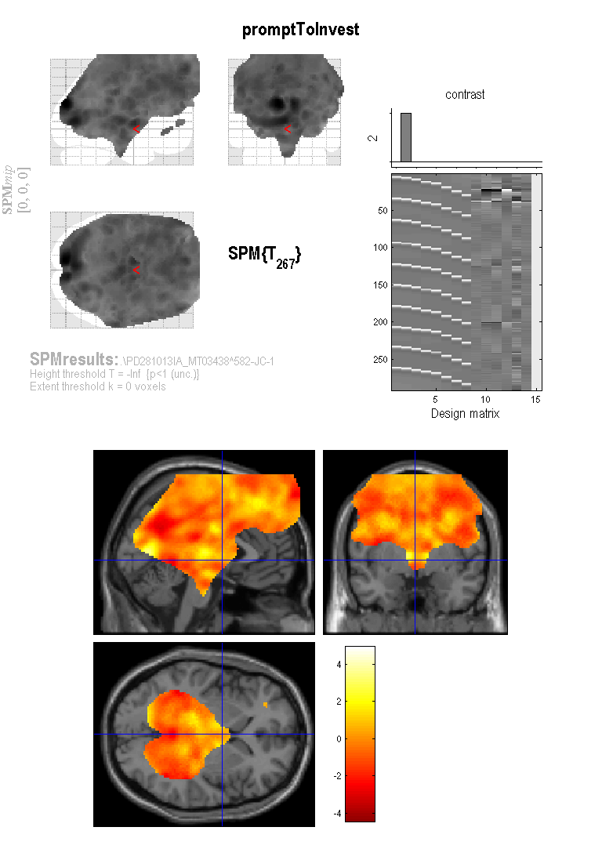
One wrongly aligned subject can take away any possible group-level effects!
If just 1 subject doesn’t have a certain voxel, that the voxel gets discarded at the 2nd level for all.

Slide 45
Summary
For fMRI data, usually preferable to use RFX analysis, not FFX
Hierarchical models provide gold standard for RFX , BUT computationally intensive
Summary statistics = robust method for RFX group analysis

Slide 46
Resources
Previous MfD slides
Glascher, J. & Gitelman, D. (2008) Contrast weights in flexible factorial design with multiple groups of subjects.
Slides from Guillaume Flandin’s talk in Zurich, Feb 2014
Mumford, J. A., & Poldrack, R. A. (2007). Modeling group fMRI data. Social cognitive and affective neuroscience, 2(3), 251-257.
Friston, K. J., Stephan, K. E., Lund, T. E., Morcom, A., & Kiebel, S. (2005). Mixed-effects and fMRI studies. Neuroimage, 24(1), 244-252.

