Slide 1
Issues with analysis & interpretation (2019)
Methods for Dummies (MfD)
16 January, 2019
Leen Hashem &
Siqi Zhang

Slide 2
Outline
Recap: Hypothesis testing
Multiple comparison problem and correction
Non-independent hypothesis testing/Double dipping
Exploratory versus confirmatory analysis
Other ways to analyse fMRI data

Slide 3
Outline
Recap: Hypothesis testing
Multiple comparison problem and correction
Non-independent hypothesis testing/Double dipping
Exploratory versus confirmatory analysis
Other ways to analyse fMRI data

Slide 4
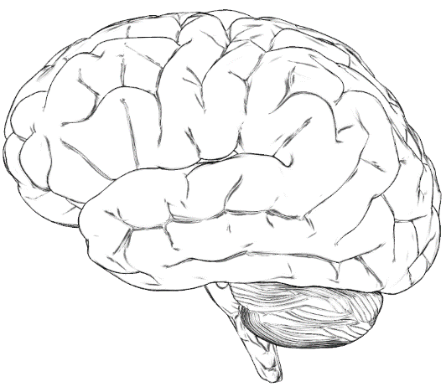
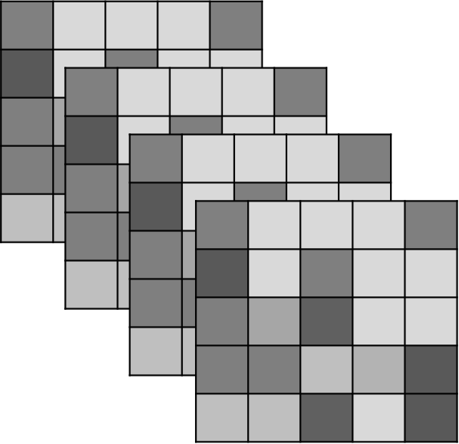
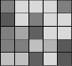
Recap - Hypothesis testing
100.000 voxels in one image
Several hundred images in one experiment
→ Massive data
Notes:
Several hundred images are acquired over the course of an experiment
One way of looking at it is time series, so each voxel has a time series and as there are around 100.000 in the brain, we are studying around 100.000 time series to look for task-related behaviour.

Slide 5
Recap - Hypothesis testing
H₀: con1 = con2
H_{A}: con1 ≠ con2
t
The Test Statistic T
Computed at each voxel
Summarises evidence about H₀
Significance level α
Set a priori (e.g. 0.05)
states probability that differences between conditions arose by chance
Is p(H₀)< α i.e. can we reject the H0?
P-val
Null Distribution of T
Notes:
U of alpha
Research question is framed as a hypothesis.
We are testing difference in BOLD signal between two (or more) conditions.
Threshold u_{α} controls the false positive rate
Test statistic t, a realisation of T
P-value: states probability for test statistics that difference between conditions arose by chance
Is p(H₀)< α i.e. can we reject the H0?

Slide 6
Type I/type II error
 | Truly active | Truly inactive
Declared active | ✔ | Type I error (False positives)
Declared inactive | Type II error (False negative) | ✔

Slide 7
Outline
Recap: Hypothesis testing
Multiple comparison problem and correction
Non-independent hypothesis testing/Double dipping
Exploratory versus confirmatory analysis
Other ways to analyse fMRI data

Slide 8
Multiple comparison problem
Which one of the 100.000 voxels is significant?
α = .05 → 5000 false positives !!
→ Correct for multiple comparison
Notes:
We need to threshold our data…

Slide 9
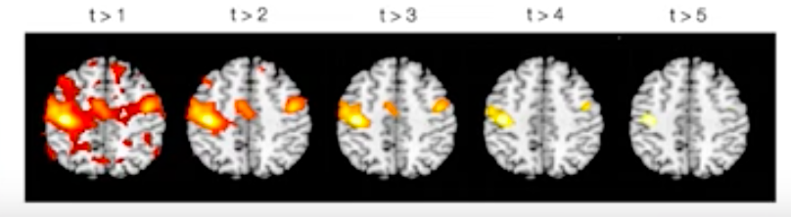
Multiple comparisons correction
Find the balance between sensitivity (true positive rate) and specificity (true negative rate)
  Liebermann 2009
YouTube: Principles of fMRI
Notes:
If too stringend: increase false negatives, Bias towards studying large effects over small, Bias towards sensory/motor processes rather than complex cognitive/affective processes
We need to choose a threshold is a balance between sensitivity (true positive rate) and specificity (true negative rate)

Slide 10
Types of Error-Rates
Per comparison
Controls probability of each observation being a false positive
Family-wise Error-Rate (P_{FWE})
Controls probability of any false positives in a family
False-discovery
Controls ratio of true positives : false positives
Notes:
Bonferroni provides a solid foundation to controlling for family wise error-rate.The threshold does need to be increased to account for the number of independent observations.
However considering the spatial dependency of functional imaging data we have two problems a) We don’t know how many independent observations are in our data. Lots of kinds of spatial dependency, so even if we did have a metric of one (i.e. how much smoothing the data has had) it wouldn’t be useful

Slide 11
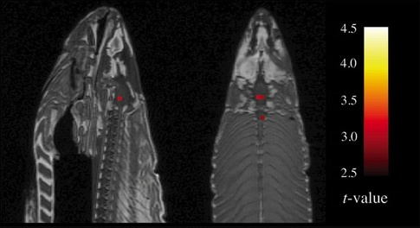
Multiple comparisons correction
Uncorrected
p value
FWER CORRECTION
FDR CORRECTION
Cluster-based
thresholding
Bonferroni
Random field theory
Bennett 2010
Voxel-based thresholding
Notes:
Uncorrected p value, generates too many false positives and should never be used.
FWER correction: probability of making at least one Type I error in a family of tests, there are different controlling methods
Bonferroni ist very strict, and does not take spatial correlation into account
Whereas random field theory does.. RF methods are good for highly-smoothed data only and are best for single-subject data.
For unsmoothed (or low-smoothed), single-subject data, FDR corrections are the best. They have very high sensitivity while still providing good control of false positives, even with low degrees of freedom
FDR: the probability of false positives among rejected tests. Less conservative than FWER
The false discovery rate (FDR) is a method of conceptualizing the rate of type I errors in null hypothesis testing when conducting multiple comparisons. FDR-controlling procedures are designed to control the expected proportion of "discoveries" (rejected null hypotheses) that are false (incorrect rejections).[1] FDR-controlling procedures provide less stringent control of Type I errors compared to familywise error rate (FWER) controlling procedures (such as the Bonferroni correction), which control the probability of at least one Type I error. Thus, FDR-controlling procedures have greater power, at the cost of increased numbers of Type I errors.
.

Slide 12
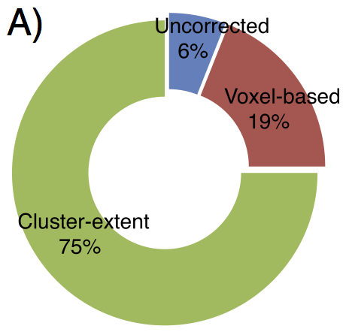
Cluster-extend based thresholding
The proportions of studies using cluster-extent based correction, voxel-based correction, and
uncorrected threshold.
Woo et al., 2013
Notes:
This results shows that cluster-extent based thresholding is the most popular threshold method including fMRI studies from Cerebral Cortex, Nature, Nature Neuroscience, Neuroimage, Neuron, PNAS, and Science (n=814).

Slide 13
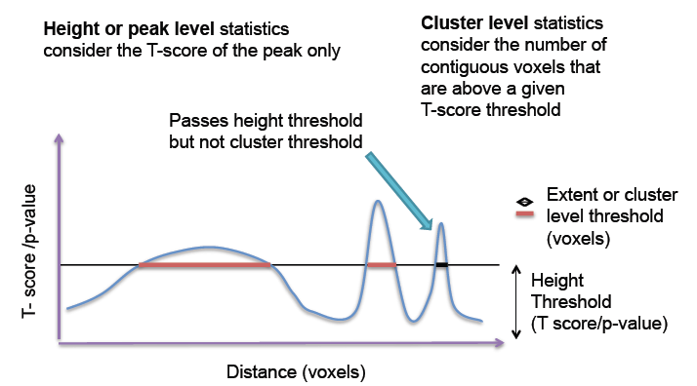
Cluster-extend based thresholding
Notes:
When using voxel-based thresholding, it gives best us good spatial specifity. We reject the H0 at specific voxel
Cluster-based: Not correcting for false positives at cluster level. 2step process:
Voxel level primary threshold defines clusters
cluster-level extent threshold measures units of activated voxels (controls for FWER, i.e. less stringent than voxel based multiple comparison correction – accounts for the fact that individual voxel activations are not spatially independent from neighbours). Better sensitivity but worse spatial specifity

Slide 14
ROI analysis
Notes:
Pitfall with cluster-extend based thresholding: noise is also clustered, thus spatially correlated
Large clusters that span multiple anatomical regions provide us with poor spatial resolution and neuroscientific interpretability. We can only infer that there is true signal “somewhere” in this huge cluster and cannot make an inference about specific anatomical regions.
Problematic if primary voxel level threshold to define clusters is liberal (e.g. p<0.01) hen clusters are big!
Another way: ROI anaylsis where you predefine a region you postulate to be active
Statistics output
Peak vs. cluster
Depending on shape, size..

Slide 15
Some suggestions
Think about choice of thresholding method
(cluster extent based thresholding adequate if moderate effect/sample size. For studies
with good power voxel-wise corrections such as FWER and FDR better, for ROI analyses,
choose cluster or peak-level threshold depending on the size and shape of your ROI)
Primary threshold
Lower threshold as default in analysis package
Reporting strategies
Data sharing
Woo et al., 2013
Notes:
Primary threshold. Uncorrected threshold p<.01 filtering junk
Secondary threshold:
Reporting strategies.. Note all the regions that are in your cluster, report voxel size of respective regions (10voxels or more) discussion
Upload ur uncorrected unthresholded data
Survey by Woo et al. results suggest that the choice of primary thresholds depends strongly on the defaults of the software packages used for analysis.

Slide 16
Outline
Recap: Hypothesis testing
Multiple comparison problem and correction
Non-independent hypothesis testing/Double dipping
Exploratory versus confirmatory analysis
Other ways to analyse fMRI data

Slide 17
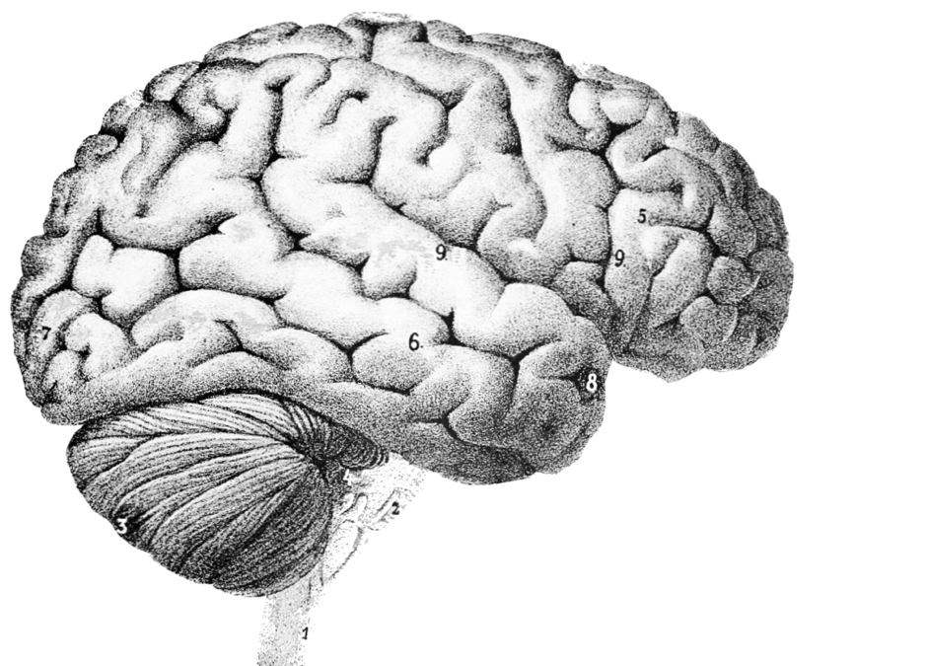
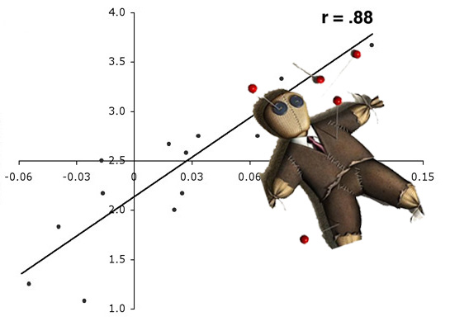
Non-independent selective analysis
Testing H1
2. Find an active region
3. Draw a ROI around
activation
Perform Secondary
Statistical Analysis
5. Correlate with task
Associated beh. measure
Vul et al. (2009); Kriegeskorte et al. (2010)
Notes:
A lot of groups have gone ahead and tried to model the relationship between the strength of activation and a behavioural measure.
So they
1
2
3
4
5 – In our pain example, we could use pain intensity, for example.
This has almost always lead to double dipping. In statistics, circular analysis is the selection of the details of a data analysis using the data that is being analysed. It is often referred to as double dipping

Slide 18
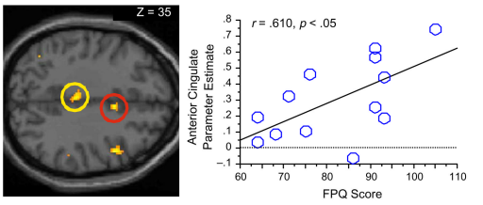
Double dipping / Non-independent selective analysis.
Non-Independent analysis: Activations presented on a blob map are voxels that already correlate with your model!
Double dipping gives the illusion of providing an extra result.
Vul et al. (2009)
Ochsner et al. (2006)
Notes:
So why is this method bad?
Activations from every voxel are present because they have a certain t-statistic score that passes a certain threshold multiple comparison correction. Anything present, including noise, favours the correlation.
Computing secondary statistics on active voxels is problematic due to intrinsic noise favouring the correlation.
Due to this inherent noise you’re secondary correlational analyses are going to represent largely inflated r scores.

Slide 19
Outline
Recap: Hypothesis testing
Multiple comparison problem and correction
Non-independent hypothesis testing/Double dipping
Exploratory versus confirmatory analysis
Other ways to analyse fMRI data

Slide 20
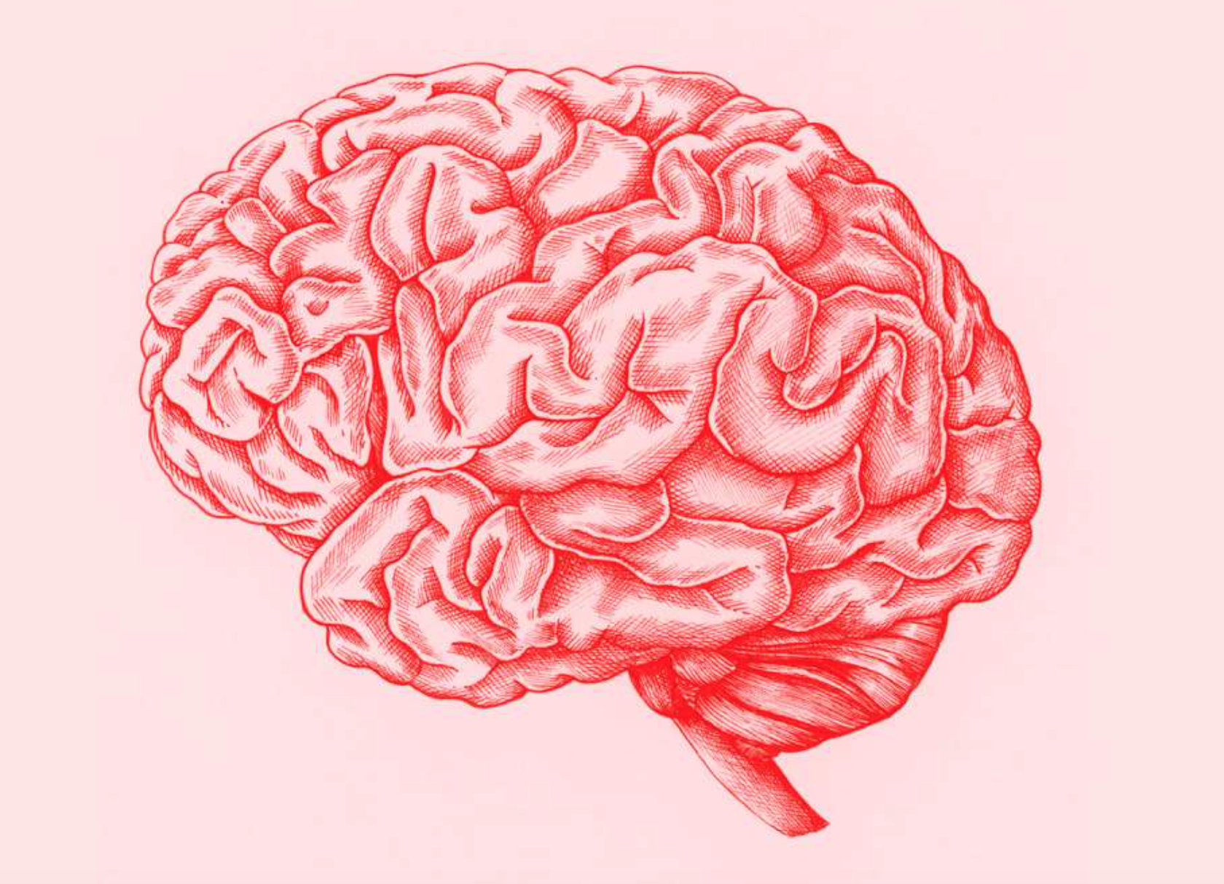
Science vs. Fiction
“Science is humanity’s best effort to approach the truth”
Non-invasive Measures
Invasive Measures
Student Blogs, 2019
Notes:
If science is humanity’s best effort to approach the truth, then in the publication of scientific research we must be careful to separate fact from fiction – and we do that via statisical analysis of research outcomes..
Major scientific developments have allowed scientists to peer into the brain both invasively and non invasively to measure both neurological and behavioural outcomes, however, we must implement statistical methods to ensure that the interpretation of outcomes is sound

Slide 21
Exploratory versus confirmatory analysis
“The only way to obtain clear answers from Nature
is to ask her clear questions”
Waagenmakers, 2015
Notes:
And so the analysis of research outcomes exists on a continuum, and reflects the weight of statistical analysis put into outcome interpretation.
On one end of the continuum, we have exploratory research, which is a form of inductive reasoning – where you find your hypothesis in the resulting data. This prompts confirmation biases and allows inferring causation from correlation – increasing the number of false positives.
On the other end of the continuum, we have confirmatory research, which is an excessively stringent form of data analysis that strictly defines the conditions under which you conduct your experiment, and doesn’t leave much room for outcome exploration and interpretation
… what you want then, is to implement research methods that allow for deductive reasoning, and this exists somewhere in the middle of the spectrum, where the statistics are flexible enough to allow for careful data interpretation. You get here by asking clear questions for your research and defining the hypothesis and the null hypothesis.

Slide 22
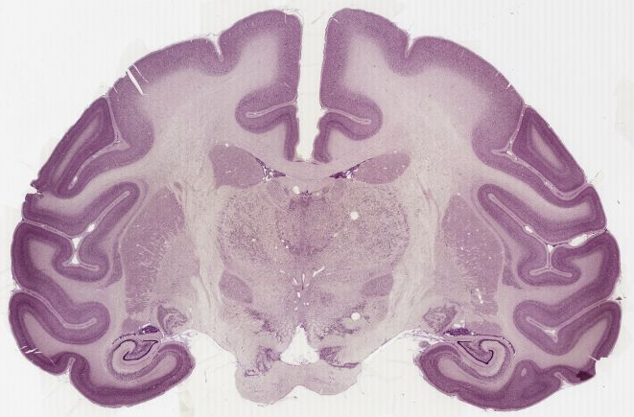
Improving Temporal Resolution in MRI Acquisition
Notes:
So let’s take MRI as an example. Magnetic resonance imaging is a non-invasive mean of peering into the brain, but a fundamental problem with MRI is temporal resolution. We resolve the issue of temporal resolution, however, by developing novel ways to define the specificity and sensitivity of the MRI machines to voxels in the brain. So what is a voxel?

Slide 23
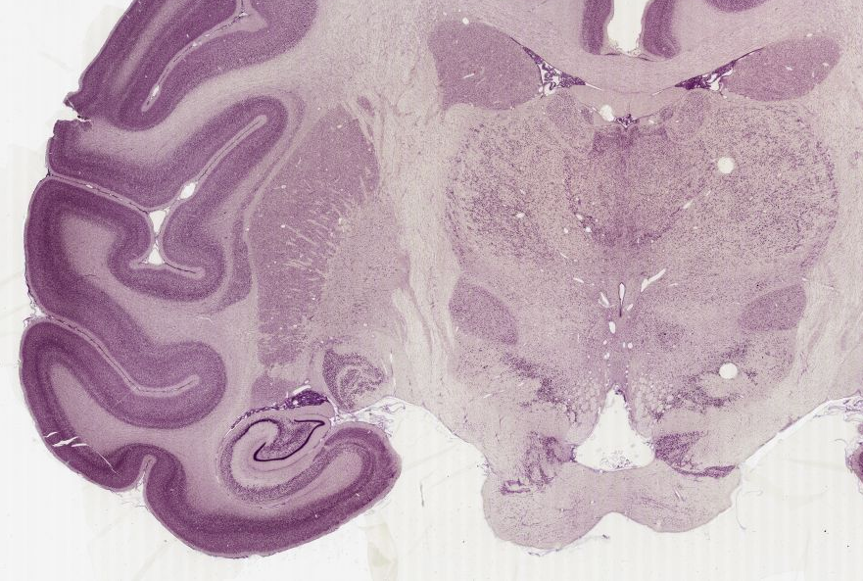

Slide 24
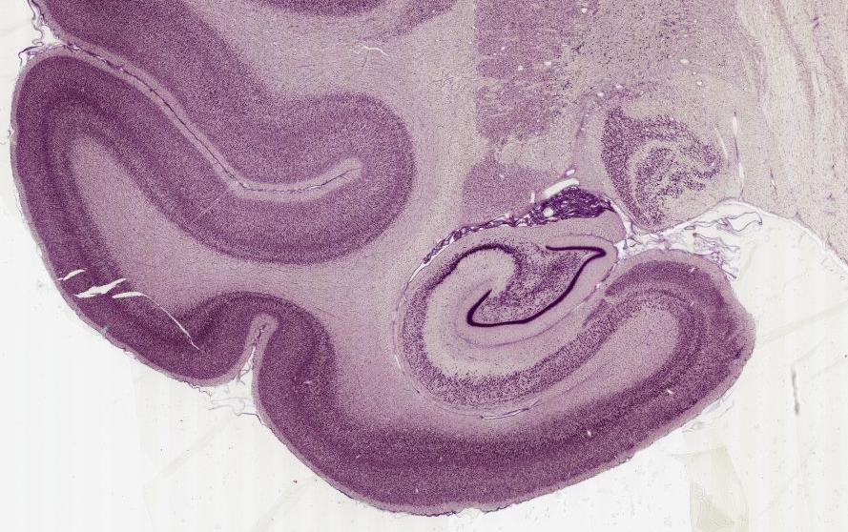

Slide 25
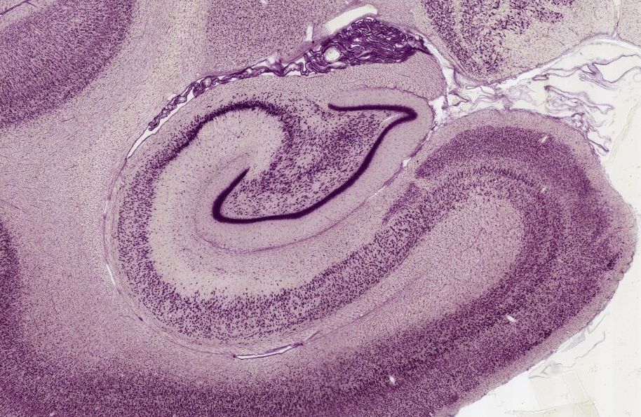
Notes:
If we zoom into the hippocampus

Slide 26
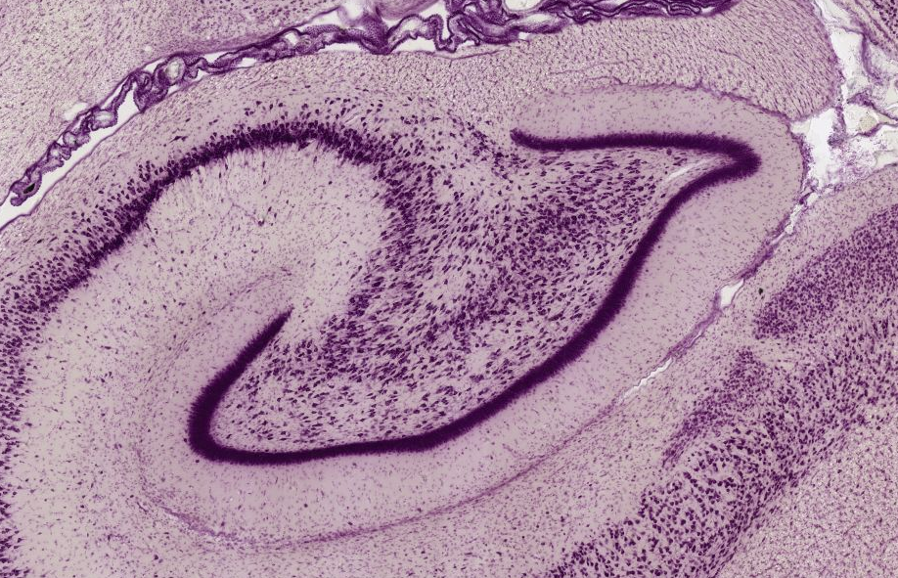

Slide 27
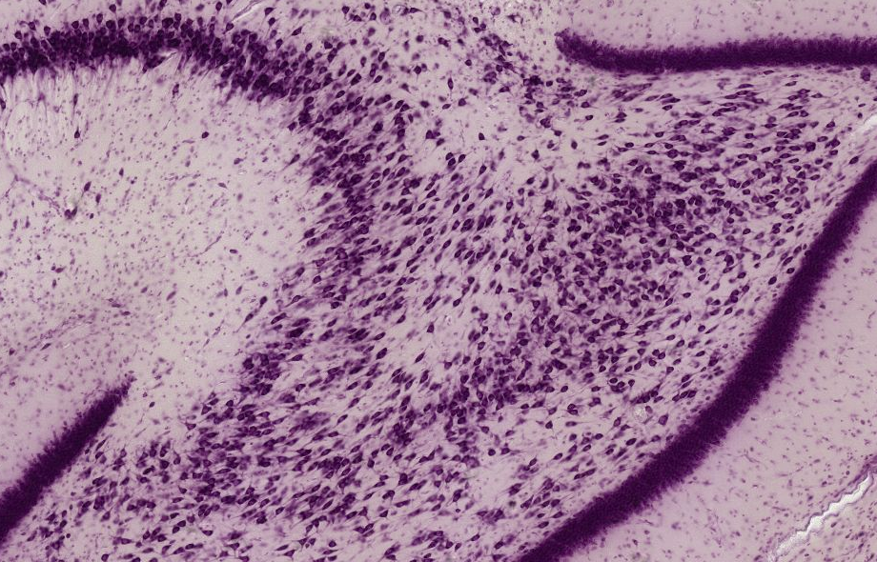

Slide 28
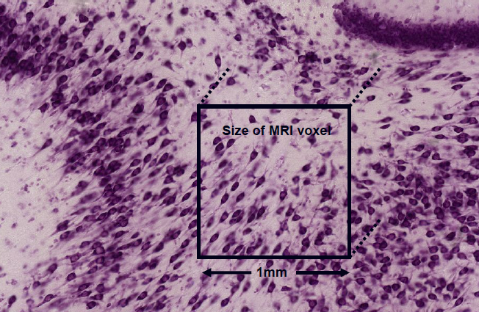
Structural vs. Functional Voxels
Notes:
This relates to a structural image voxel, however a functional voxel is typically much bigger and in the region of 3mm in width. Clearly we are looking at mass action of neuronal populations.

Slide 29
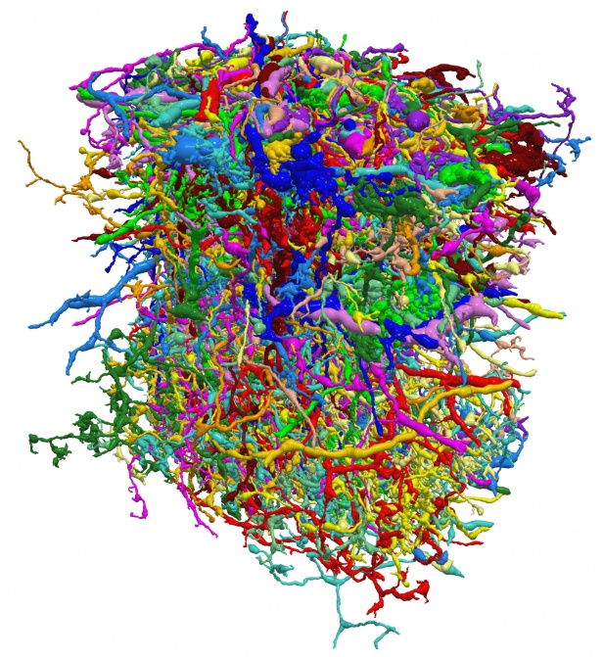
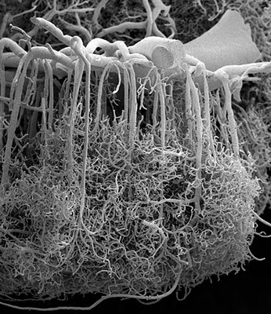
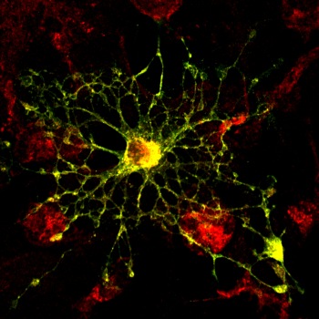
What is inside an fMRI Voxel?
Neurones:
~630,000
~4 x Glial cells:
3 mm
Blood Vessels
3 mm
3 mm
http://miny.ir/EAaZv
Notes:
We already know that what we are measuring but the point here is to remind you that what we measure is the result of a complicated metabolic process and that a voxel is representing the mass action of not just neuronal populations but a large number of supporting cells as well.

Slide 30
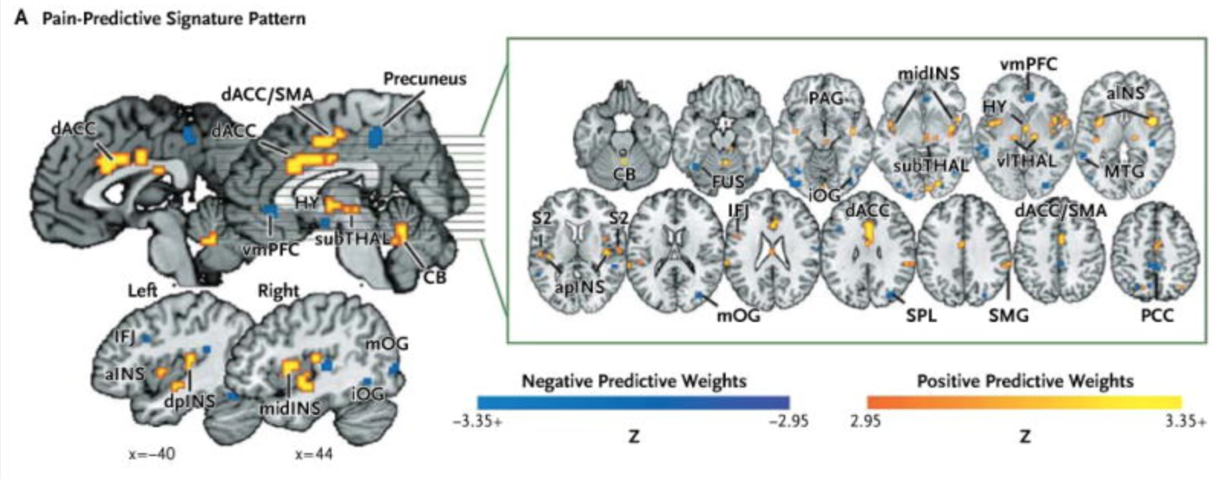
fMRI and the Pain Matrix
Wager et al., 2013
Notes:
To tie this all together, let’s look at how fMRI is used to study the pain matrix – which is thought to be active in pain perception. This next section highlights the importance of hypothesis testing. In this paper by wager and colleagues, the authors introduce non-tactile (imaginary) and tactile stimuli to invoke measurable responses in the brain to pain.

Slide 31
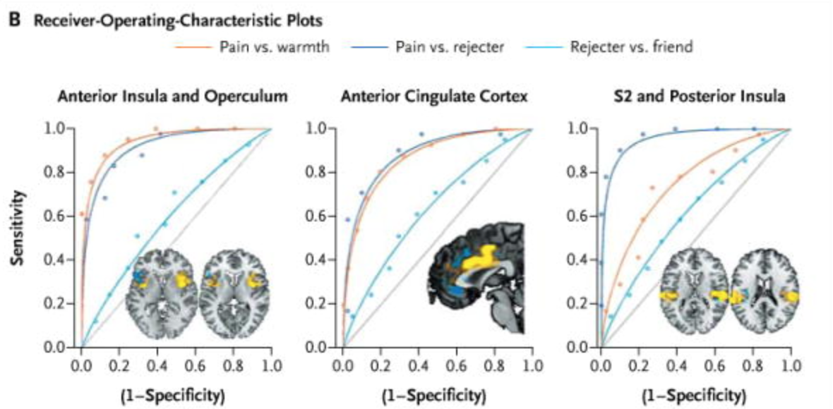
fMRI and the Pain Matrix (2)
Wager et al., 2013
Notes:
The authors then statistically analyze their results and delineate the involvement of brain areas in the pain matrix – the cingulate cortex and the insula…

Slide 32
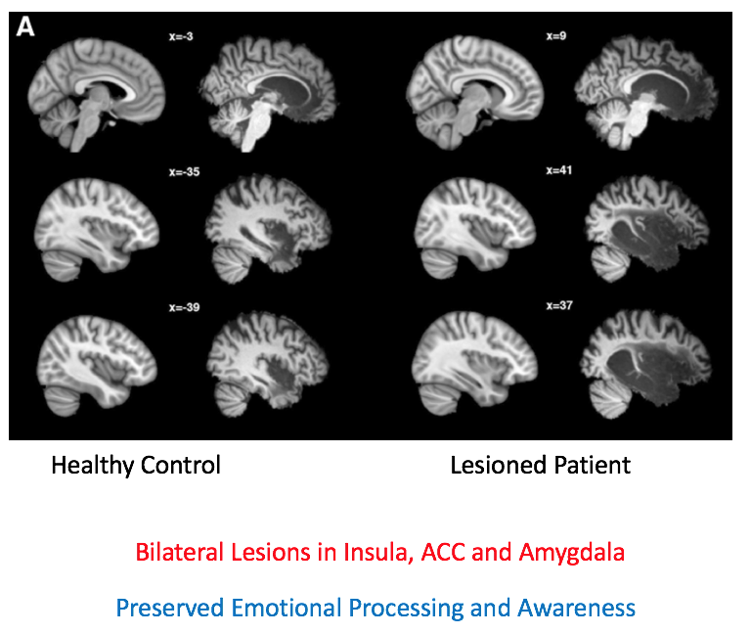
The Dangers of Reverse Inference
Feinstein et al., 2016
Notes:
However, another fundamental problem with fMRI techniques arises- and this is the issue of reverse inference. In this study by feinstein and colleagues, they show that patients with extensive damage to the insula, the cingulate and the amygdala, have preserved emotional processing and awareness of pain.

Slide 33
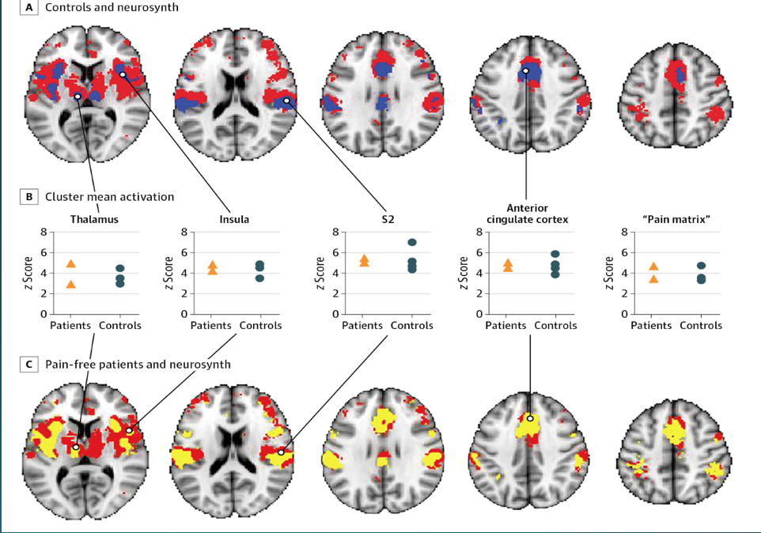
Activation of the ‘Pain Matrix’ in Pain-Free Individuals
Salomons et al., 2016
Notes:
This also goes for another study by alomons and colleagues, where they show that patients with Congenital Insensitivity to Pain also show activation of the pain matrix in response to (salient) painful stimuli. So this all goes to show how important it is to analyse the data contextually… and that results are always part of the whole picture but are not in themselves the whole picture.

Slide 34
Outline
Recap: Hypothesis testing
Multiple comparison problem and correction
Non-independent hypothesis testing/Double dipping
Exploratory versus confirmatory analysis
Other ways to analyse fMRI data

Slide 35
Other ways to analyse fMRI data
“Resting” state (and task-based) Connectivity
Network analyses
Notes:
RS: functional activity of different brain regions is correlated

Slide 36
Take home message
Posing a clear hypothesis
Emphasizing quality and not quantity of the research done
Reporting results transparently and interpret carefully

Slide 37
All models are wrong,
but some are useful.
George Box
Notes:
The results of a study should be appropriately contextualised by the limitations of its methods. This helps to prevent going beyond data’s explanatory power during your interpretations.

Slide 38
References
Bennett, C. M., Miller, M. B., & Wolford, G. L. (2009). Neural correlates of interspecies perspective taking in the post-mortem Atlantic Salmon: An argument for multiple comparisons correction. Neuroimage, 47(Suppl 1), S125.
Bennett, C. M., Wolford, G. L. and Miller, M. B. (2009). "The principled control of false positives in neuroimaging." Soc Cogn Affect Neurosci 4(4): 417-422.
Biswal, B., Zerrin Yetkin, F., Haughton, V. M., & Hyde, J. S. (1995). Functional connectivity in the motor cortex of resting human brain using echo‐planar mri.Magnetic resonance in medicine, 34(4), 537-541.Martin (2013) Blood and the Brain. J Royal Anthropological Institute
Logan, B. R., Geliazkova, M. P. and Rowe, D. B. (2008). "An evaluation of spatial thresholding techniques in fMRI analysis." Hum Brain Mapp 29(12): 1379-1389.
http://imaging.mrc-cbu.cam.ac.uk/imaging/PrinciplesMultipleComparisons
Calculating contents of fMRI voxel http://miny.ir/EAaZv
Lieberman, M. D. and Cunningham, W. A. (2009). "Type I and Type II error concerns in fMRI research: re-balancing the scale." Soc Cogn Affect Neurosci 4(4): 423-428.
Mouraux A, Diukova A, Lee MC, Wise RG, Iannetti GD. A multisensory investigation of the functional significance of the "pain matrix". Neuroimage. 2011 Feb 1;54(3):2237-49.
Nichols & Hayasaka (2003), "Controlling the familywise error rate in functional neuroimaging: a comparative review," Statistical Methods in Medical Research 12, 419-446
Ochsner, K. N., Ludlow, D. H., Knierim, K., Hanelin, J., Ramachandran, T., Glover, G. C., & Mackey, S. C. (2006). Neural correlates of individual differences in pain-related fear and anxiety. Pain, 120(1), 69-77.
PracticalfMRI.blogspot.co.uk
Previous MfD slides
Smith, K. (2012). fMRI 2.0. Nature, 484(7392), 24.
Vul, E., Harris, C. R., Winkielman, P., Pashler, H. (2009) Puzzingly high correlations in fMRI studies of emotion, personality, and social cognition. Perspectives on Psychological Science, 4(3), 274-290.
Wagenmakers, E-J. (2015). A perfect storm: The record of a revolution. The Inquisitive Mind, Issue 25. Retrieved from http://www.in-mind.org/article/a-perfect-storm-the-record-of-a-revolution
Woo, C. W., Krishnan, A. and Wager, T. D. (2014). "Cluster-extent based thresholding in fMRI analyses: Pitfalls and recommendations." Neuroimage.
YouTube: Principles of fMRI Part 1, Module 26: Multiple Comparisons. https://www.youtube.com/watch?v=AalIM9-5-Pk&t=181s

