Slide 1
Methods for Dummies:
M/EEG Study Design and Pre-Processing of Data
Alexis Deighton MacIntyre
With expert Dr. Parr
X

Slide 2
Idealised Experimental Design
Alhazen, كتاب المناظ, 965 – 1040 A.D.
Notes:
First, let’s do a quick review of experimental design in general.
From antiquity on, we have accounts from China, the Middle East, and Greece, for example, demonstrating that people were making observations about natural phenomena, recording them, and using this information, or data, to make inferences about their world. For example, early Chinese proto-astronomers compiled data on comets as early as 500 BC, and, a couple of hundred years later, Aristotle undertook the classification of living things via dissection and in vivo observation.
However, this wasn’t really systematic, empirical work. We have to wait for this polymath Alhazen, born in 965 in what is now Iraq, who was really the first person we know to have adopted the scientific method as a formal practice. Alhazen showed through experiments that light travels in straight lines, and to do so he carried out various experiments with lenses, mirrors, refraction, and reflection. He used maths, especially geometry, to measure and analyse his findings.
Alhazen showed that a hypothesis must be proved by experiments based on confirmable procedures or mathematical evidence. His ideas were eventually translated into Latin and became very influential in early modern European thought during the Renaissance.
So we have the development of experimental design in terms of a basic paradigm, but how we process, analyse, and interpret our data is also of great importance, bringing us to statistics.

Slide 3
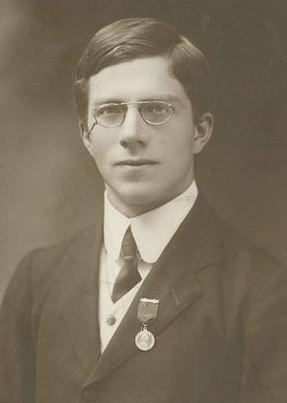
Idealised Experimental Design
Analyse Data to Reach Conclusions
Make an Observation
“Pre-milked tea was not detectable above chance”
“Tea tastes better when you add the milk first”
Design an Experiment and Collect Data
Formulate a Hypothesis
“A seasoned tea drinker should be able to determine the superior tea at a level higher than chance”
“Present a random selection of prepared teas to the expert in a blind test”
Fisher, The Design of Experiments, 1935
Notes:
Ronald Fisher studied maths and astronomy at Cambridge, turning to genetics after graduating. His research brought him to UCL, where he was the founding head of the eugenics department, which had just split from statistics. During his tenure here at UCL, he published a book entitled “The design of Experiments” in 1935.
In this book, we’re introduced to his experiment “the lady tasting tea”, which very simply and elegantly summarises a randomized, controlled experiment.
It tells us how to design, test and analyse data to answer a hypothesis.
How to observe, formalise, design and perform a test.
How to analyse our data, and what we can conclude. If it’s done right, our experiment will hopefully drive the generation of new hypotheses for further testing.

Slide 4
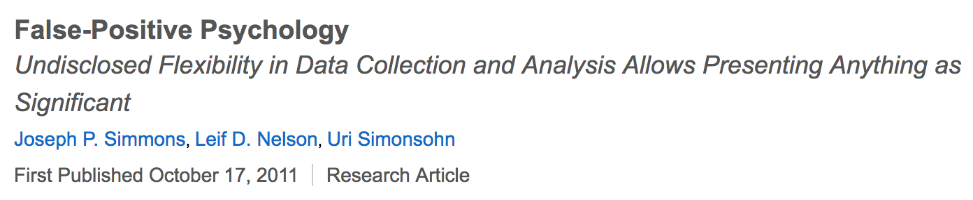
Exploratory Research
Keep potential dimensions for results broad
Run a large battery of tasks, record using multiple modalities
Be wary of spurious results
The nature of the research results in large numbers of tests and the risk of a false positive is high
Set your “researcher’s degrees of freedom” prior to testing
Predesignate sample sizes, criteria for trial rejections, independent variables to test prior to conducting experiments
Exploratory research produces hypotheses
Follow them up by more rigorous, formal testing
Notes:
That was a very linear, hypothesis-based approach. But what if we don’t have a solid foundation of previous research upon which to build our next study?
If we want to just ”see what happens”, we might find out something cool. But there is also a dangerously high chance of a false positive, wherein we fail to reject Fisher’s null hypothesis—there is no experimental effect, or an association of some kind, between two entities.
This is a really important topic in brain sciences at the moment, and there is discourse—like the paper highlighted here--that attempts to guide responsible exploratory investigations.

Slide 5
Experimental Structure
Repeated Measures
Subjects receive all treatments
  Fewer subjects needed
Within subject dependencies
  “Order” effects
Independent Measures
Subjects randomly assigned to groups
  High number of subjects needed
Ensures independence between treatments
  Avoids “order” effects
1
2
3
2
VS.
1
2
3
1
Randomised Block Design
Subjects grouped by characteristics
Treatments randomly applied within each group
2
1
3
3
1
2
3
Notes:
Another dimension to consider, given we usually work with noisy, variable, and expensive participants, is how we sort them into treatment and control groups.
1. A completely randomized design relies on randomization to control for the effects of lurking variables variables. Lurking variables are potential causal variables that were not included explicitly in the study. By randomly assigning subjects to treatments, the experimenter assumes that, on average, lurking variables will affect each treatment condition equally; so any significant differences between conditions can fairly be attributed to the independent variable. You need control subjects, so that pushes up costs.
2. In a repeated measures design, each group member in an experiment is tested for multiple conditions over time or under different conditions. Fewer patients or participants are needed overall.
With independent measures, you would need x patients per experimental group, plus a control; If you had three experimental conditions (e.g. nutrition, exercise, drugs) plus a control, you would need 4x subjects. In a repeated measures design, you would only need one group of patients of size x, because all patients are given all conditions.
Fewer patients are needed to detect an effect size; Higher statistical power: controlling for variability between subjects is built in.
Disadvantages include:
Order effects: the possibility that the position of the treatment in the order of treatments matters. Randomization or counterbalancing can correct for this.
Carryover Effects: administration of one part of the experiment can have trickle down effects to subsequent parts.
3. With a randomized block design, the experimenter divides subjects into subgroups called blocks, such that the variability within blocks is less than the variability between blocks. Then, subjects within each block are randomly assigned to treatment conditions.
Compared to a completely randomized design, this design reduces variability within treatment conditions and potential confounding, producing a better estimate of treatment effects

Slide 6
Choice of Methods
Van Gerven, M., Farquhar, J., Schaefer, R., Vlek, R., Geuze, J., Nijholt, A., ... & Desain, P. (2009). The brain–computer interface cycle. Journal of neural engineering, 6(4), 041001.
Notes:
So far, we’ve covered the basics of the scientific method, with an overview of statistical hypothesis-testing and study design based on what type of analysis we’d like to do in order to answer our research question.
But we still need to choose a suitable methodology to carry out our experiment, and we need to determine our dependent measures. Just like planning our experimental structure, this aspect will inform how and why we analyse and interpret our data in a particular way, once we get there.
Today’s talk is about MEG and EEG. Why would we use these specific techniques to answer our questions about the brain?
There are advantages and drawbacks to using either method. In case you hadn’t noticed by now, experimental design is not a clear-cut, wrong-or-right process! Partly, our options are also limited by access to equipment. MEG is very expensive, like MRI-scale expensive, in comparison to EEG. It requires a huge amount of building infrastructure and it’s a big institutional commitment in comparison to EEG, which certainly benefits from purpose-built rooms, but doesn’t depend on it.
Anyways, assuming we can make the decision for scientific, rather than economic reasons, we can evaluate which method will deliver the data we need to answer our research question. MEG and EEG are usually contrasted with fMRI as tools that deliver temporal, rather than spatial, information. On this diagram, non-invasive techniques are marked blue. You can see that none of them are really great compared to the ones in red, which are employed in animal research, for the most part. But from our available options, we do have better temporal resolution for MEG/EEG, although we sacrifice information about where things are happening in the brain.
We will probably elect for this option if our research question is contingent on millisecond timing accuracy, which is often the case for language or music studies. For example, we might wonder what would happen if familiar tunes, like Happy Birthday, were suddenly changed to a minor key halfway through the song. Based on a literature review, we hypothesize that this experimental treatment will be associated with a mismatch negativity – in this case, a fronto–centrally negative event-related potential (ERP) component elicited by sounds that violate the automatic predictions of the central auditory system – but more on ERPs later. An auditory mismatch negativity usually occurs about 150 to 250 milliseconds following stimulus onset, so we wouldn’t be able to determine whether there was a mismatch negativity using fMRI. It would just be one big wash.
On the other hand, maybe we are instead interested in neural architecture. Saying our mismatch negativity is “fronto-central” is something - an occipital localisation would be at odds with our literature review! But we can’t infer much from an area so broad. Instead of looking for the mismatch negativity, imagine we want to know whether listening to Happy Birthday played on a piano will evoke activation in hand motor areas if the listener is an expert pianist, moreso than if the instrument were a French horn, or the listener an expert horn player. This isn’t something we can answer with EEG, but it may be possible with fMRI.
Spatial Resolution
fMRI 1-2 mm
MEG ~ cm
EEG ~ cm
Temporal Resolution
fMRI 1-2 s
MEG < 1 ms
EEG <1 ms

Slide 7
Choice of Methods
MEG
EEG
Subject preparation time is relatively reduced
The main component of MEG requires no direct contact of the sensors on the skin
Signal is less distorted by the scalp than with EEG
Absolutely not portable
Cap/net preparation takes time, especially for inexperienced researchers
The application of gel or saline solution is inconvenient for many participants
The cap/net is uncomfortable
Somewhat portable
Notes:
Assuming we want temporal resolution, we choose MEG/EEG. We’ve covered the basis of these signals and how the techniques differ in a previous session, so I won’t go into too much detail here.
As far as it matters for experimental design, it’s important to remember that your participants are living people—bodies—you need to take their comfort into account. Here are some points to consider.
…
Magnetic fields recorded by MEG are much less influenced by the electrical conductivity of the tissues surrounding the cerebral cortex than electrical fields, which are measured in EEG.
…
I participated in an overnight EEG sleep study and it was brutally uncomfortable. It’s unfortunately the only way the researchers could accomplish their scientific objectives, and they really did their best to accommodate participants with extra padding. However, I wonder what my sleep data looked like, given how stressful it was. Design your experiment with your participants’ needs in mind!
Also, we’re going to discuss artefacts shortly, but even though MEG is less cumbersome than EEG (from a participant’s point of view), both techniques require that participants remain very still and refrain from blinking or moving their jaw around, et cetera. So it’s still important that you allow participants time to adjust and look around before they fatigue.
Some good news for both is that MEG and EEG do not pose a risk to hearing, unlike fMRI. Some bad news is that neither is great for subcortical regions of interest.

Slide 8
EEG/MEG Analysis
Time Domain: Event Related/ Evoked Potentials
Key-DeLyria, S. E. (2016). Sentence Processing in Traumatic Brain Injury: Evidence From the P600. J Speech Lang Hear Res, 59(4), 759-771.
Notes:
Now that we’ve chosen our method, what are we actually going to do with it? Hopefully, we will have figured this out back when we were formulating our research question and hypothesis. We have multiple approaches to choose from. Let’s start with ERPs, such as the mismatch negativity we expect to find when our subject hears sad Happy Birthday.
Event related or evoked potentials, Magnetic evoked field for MEG are very small voltages generated in the brain structures in response to specific events or stimuli. They are time locked to sensory, motor or cognitive events and are thought to reflect the summed activity of postsynaptic potentials produced when a large number of similarly oriented cortical pyramidal neurons (in the order of thousands or millions) fire in synchrony.
After decades of research in EEG, there is something of a canon of ERPs. The mismatch negativity we talked about earlier is one of them, and it’s relatively early, which is why it’s thought of as a violation of an automatic, or “low-level”, prediction. By contrast, there’s something called the P600, P for positivity, that takes place about 600 milliseconds later than the event. In the literature, it’s associated with syntactic violation or tricky grammatical processing, so you might hypothesize a P600 if you present your participant with a grammatically complicated or impossible sentence. The N400 is associated with semantic violation, such as ”the waitress came over to take their lightbulb”.
You may need lots and lots and lots of trials in order for your ERP to emerge, depending on the effect sizes you anticipate.
– Pros: simple, reliable, quick, very sensitive, big effects
– Cons: averages out ‘non-phased locked’ activity; not suitable for spontaneous or non-phase locked responses. Averaging effectively low pass filters, because high frequencies tend not to be phase-locked

Slide 9
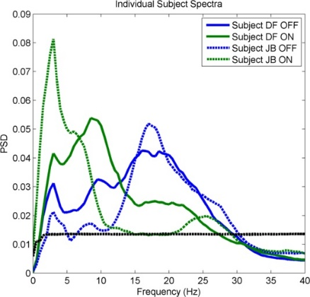
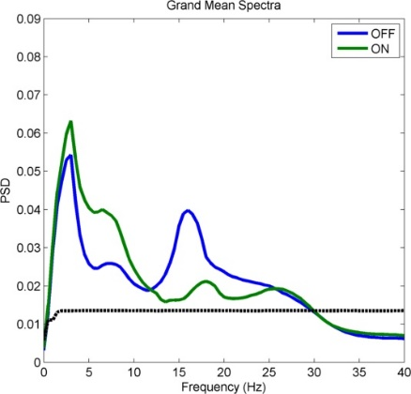
EEG/MEG Analysis
Frequency Domain: Steady-State Oscillations
Notes:
Moving on to Steady State Oscillations. This is the synchronous activity of large populations of neurons to a temporally modulated stimulus. The idea is that neural network oscillations can be probed and assessed by entrainment to some kind of rhythmic sensory stimulation, often auditory or visual. This produces what’s called a steady-state response, meaning that EEG waveforms entrain to the frequency and phase of the presented stimulus. It could be treated as an indicator of the functional state of the neural circuits supporting those synchronized oscillations, as might be the case if you were interested in SSRs of people with schizophrenia, for example, who reportedly show a decreased delta (0.5 - 4 Hz) band EEG under cognitive load, in comparison with controls. You might pick out spectral components, as is done with musical rhythm research, where you would be looking for a frequency peak that matches the beat of the stimulus. Assumes “stationarity” – you have a constant oscillation occurring across trials
– Pros: handles phase- and non-phase locked signals equally well; sensitive; relatively simple and quick, big effects.
– Cons: trade-off between frequency and time resolution

Slide 10
EEG/MEG Analysis
Time and Frequency: Event Related Synchronisation/Desynchronisation
Other Analyses
Connectivity
Microstate analysis
Etc.
Duann J-R, Chiou J-C (2016) A Comparison of Independent Event-Related Desynchronization Responses in Motor-Related Brain Areas to Movement Execution, Movement Imagery, and Movement Observation. PLoS ONE 11(9): e0162546.
Notes:
And there is synchronisation or desynchronisation. This combines elements from both ERP- and SSR-based approaches.
An example of synchronization in EEG is that in periods of rest, EEG frequencies in the range of the alpha band (usually defined in the range of about 8–12 Hz) become dominant in the spectrum. This phenomenon of increased alpha power has been labeled synchronization of EEG.
In contrast, during tasks involving cognitive demands the power in the alpha band usually decreases, often in return of increases of other frequencies in the EEG spectrum, and this phenomenon is called desynchronization of the EEG. As synchronisation of alpha is associated with rest, the EEG desynchronization serves as an indicator of cortical activity or arousal. Both alpha and beta band desynchronisation is associated with the generation, observation, and imagery of movement and so it’s also considered to reflect cortical motor activity and action-perception coupling. In this motor literature, the supression in alpha and beta is called “mu suppression”.
The amount of event-related (de-)synchronization (ERD/S) or change in task-related power (TRP) is usually assessed by contrasting the alpha power during a cognitive task with a preceding reference interval (this reference interval is commonly realized by requesting participants to simply keep looking at a fixation cross or point).
A mu-ERD pattern is seen in the plot, with the main suppression frequency band in the alpha (8–13 Hz) range. The suppression starts, on average, at 500 ms after the onset of execution cue.
Can average across time frequency plots as the activity is not determined by respective phase
Allows you to look across a wide range of frequencies – resolution is determined by the length of your respective windows
Uncertainty principle – trade off between time and frequency resolution
There are also other techniques that I don’t have time to summarise, such as connectivity analysis, which estimate synchronization of distributed EEG/MEG signals. Ideally, this will help us understand how specific regions communicate during cognition. Unfortunately, we know that source localisation is not so great in the present context, and there is literature that covers the technical, mathematical, and interpretive challenges that accompany connectivity analysis. But MEG in particular can be cross-compared with spatially-superior fMRI connectivity, so it is a promising technique as better analytical and interpretive tools come along.
Microstate analysis is contrasted with macrostates, which we derive from the spectral analysis of EEG that we see with SSR or de-synchronisation. Microstates are defined via spatio-temporal segmentation algorithms. I’m not familiar with the inner workings of this method but it seems to be more reliant on feature learning that privileges or emphasizes spatial constraints, moreso than a priori temporal window definitions?

Slide 11
Anticipate Potential Issues During Design
Assume a loss of trials due to artefacts
Predict secondary effects
Avoid confounds, including behavioural compounds
Conduct control studies
Consider your participants’ backgrounds and experience
Consult a guide, e.g., Handy, T. C. (Ed.). (2005). Event-related potentials: A methods handbook. MIT press.
Notes:
Here are a few ideas to research when you’re planning your experiment.
We’ll cover artefacts shortly, when we talk about pre-processing.
Secondary effects may be constituted by some indirect or unintended causal process that makes it seem like your experimental treatment had an effect. Steven Luck, in his “Ten Simple Rules” book chapter on designing ERP studies, gives the example of comparing a hot beaker of water with a cold beaker of water, finding that the cold beaker weighs more, and concluding that heat makes water weigh less. When, in fact, some of the water has escaped from the hot beaker as vapour as a result of being heated. In anticipation of this secondary effect of evaporation, you could seal your container.
Even if you choose a very narrowly defined and isolable mechanism or aspect of cognition to study, participants may employ different cognitive strategies with different neural signatures. Or if you require some sort of an active response, such as pressing a button or giving an answer verbally, this might affect your measures of interest--or maybe the verbal nature response itself is an integral part of what you thought was a purely “mental” process!
Your participants are people with lives outside of your laboratory, and they bring this diversity (or lack thereof) to your study. For instance, the sad Happy Birthday experiment might only work with people from cultures wherein this song, or Western music in general, is familiar. If you only recruit UCL students, can you generalise your results to people of all education or socio-economic levels? Don’t stop at handedness or education if it might make even a remote difference to your study, such as advanced sports or music training, second language, et cetera.

Slide 12
Sources of noise in EEG/MEG
Endogenous EEG
  e.g., alpha waves
  Response related activity
Trial-by-trial variation
Artefactual bioelectric activity
  Saccadic eye movements
  Swallowing
  EMG and ECG contamination
  Muscle tension, e.g., clenched jaw
External electrical activity
  Monitors
  Speakers
  Projectors
  Perspiration, too much gel can cause electrical bridging
Head movement
  Moving EEG leads
  Head location coils track head movements within MEG
Notes:
There are a few things we can do to clean our data up, but ideally, we keep noise to a minimum during the acquisition process. The principle is “garbage in, garbage out”. Budget extra time to do a good job setting your participants up, and do your best to ensure that your experimental space is as shielded from sources of noise as possible. With MEG, this isn’t really in your hands. But because EEG is comparatively cheap and portable, you could conceivably run your study in a really non-optimal situation.
The strategy is to be aware of source of noise.
Minimise noise source if possible
Detect sources of noise – record EOG (electrooculogram – eye-specific), EMG (electromyogram – muscle), ECG (electrocardiogram – heart) and then you can at least know where problems are occurring.
Consider recording some “empty room” data as a tool for gauging baseline background noise.

Slide 13
Technical Considerations
Synchronisation of recording equipment and stimuli presentation is required to ensure everything is precisely time-locked
Event-related studies need ISI for baseline calculations
Sampling frequency should be ~ 2 x the highest frequency of interest
  The Nyquist-Shannon theorem
Source localisation?
Choice of reference electrodes
Notes:
We are converting an analog signal, a sine wave, to a digital representation. According to the Nyquist rate, for lossless digitization, the sampling rate should be at least twice the maximum frequency responses. Indeed, many times more the better – what is your computational affordance? How much data can you handle? This is important if you’re interested in high frequency bands in the EEG.
In terms of event-related experiments. The minimum duration between two stimuli defines the maximum length you can consider analyzing after the stimulus. You should design your experiment so that it always includes the entire evoked response, plus an additional segment that you can use as a baseline for the following epoch. Remember that the baseline of some epochs may contain motor and somatosensory components (if you incorporate button presses, for instance).
For data processing, it is always better to have longer ISI, but it also means increasing the duration of the experiment or decreasing the number of repetitions, so it’s just something to consider.
In source localisation, one applies signal processing techniques to estimate the current sources inside the brain that best fit the EEG data. The accuracy with which a source can be located is affected by a number of factors including head-modelling errors, source-modelling errors and EEG noise (instrumental or biological).
The dipolar fields of each brain region propagate in three dimensions, in a dipolar pattern depending on the orientation of the cortical sources. Activity recorded at any head surface sensor reflects a summation of all active sources in the brain, superposed as a function of their distance, orientation, and the resistivity of the underlying tissues. Therefore, realistic source analysis of EEG potentials requires objective biophysical models that incorporate the exact positions of the sensors as well as the properties of head and brain anatomy, such that appropriate inverse techniques can be applied to map surface potentials to cortical sources. Spatial sampling may be sub optimal with EEG recordings with conventional electrode montages (less than 128 channels)
Referencing. In EEG, voltages recorded at each electrode are relative to voltages recorded at other electrodes. Theoretically, a reference could be anywhere but the reference needs to be carefully chosen because any activity in the reference electrode will reflected in the activity at other electrodes. Often, the mastoids are chosen as reference electrodes, because while being close in distance to the electrodes, they record less signal from the brain. However, the very fact of being close to the brain means that mastoid signal does contain some neural signal, which means that the mastoids are not the ideal references. For high density EEG (100+ electrodes), the average of activity at all electrodes is often chosen as the reference. As a rule of thumb, the position of a reference electrode should not be close to that of an electrode where you expect your main effects to be. For example, the Cz is often used as a reference electrode, but it should not be used as such if you expect task-related activity to be centred around this electrode. It also not advisable to reference your data to an electrode of one hemisphere as this could introduce a laterality bias into your data

Slide 14
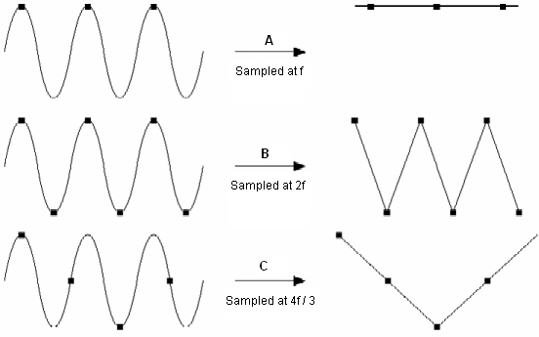
Downsampling
M/EEG signal is usually sampled at 2048 Hz
  64 channels (EEG), ~306 (MEG)
Reduce sampling rate to reduce file size and increase processing speed while preserving data quality
Nyquist frequency: minimum sampling frequency needs to be greater than twice the maximum frequency of any analogue signal likely to be present in the EEG
Notes:
We discussed the Nyquist frequency earlier, so hopefully we’ve chosen an appropriate sampling rate. But perhaps our files are now huge and we would like to downsample the data to around 250Hz (if the original sampling frequency is higher than that). Downsampling is useful to compress the data size. It will cut off very high-frequency information.
Usually, a low-pass filter is necessary before downsampling for anti-aliasing, but toolkits such as EEGLAB apply the anti-aliasing filter automatically.

Slide 15
Filtering
Excludes specific frequencies
Examples include:
  Low-pass filter ~ 30 Hz
    Removes high frequency noise e.g., muscle activity
  High-pass filter .01 - .1 Hz
    Reduces slow drifts e.g., perspiration artefact
  Notch filter 50/60 Hz
    Electrical line noise
  Band-pass
    Passes signal through only at a specific frequency range
The Synthesis of Sound by Computer. Retrieved January 15, 2018, from http://sites.music.columbia.edu/cmc/MusicAndComputers/chapter4/04_03.php
Notes:
Too much filtering can alter the data and lose temporal precision, so we really want to make sure we eliminate as much of this noise as possible before collecting our data.

Slide 16
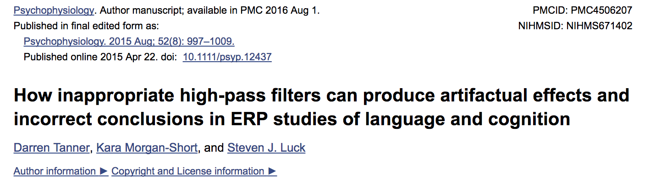
Filtering
Notes:
For example of how filtering can be dangerous, Tanner, Morgan-Short and Luck found that by using a fairly standard high-pass filter setting, at .5 hz (which was actually the recommended setting in older versions of these slides), they could artificially produce an N400 in what was supposed to be a P600 task.

Slide 17
Epoching
Split continuous M/EEG data into fixed epochs of a fixed length
Segment data into pre-stimulus and post-stimulus
Parameters
  When stimulus occurred?
  Predicted time of neural event?
  What type of trial or event?
Baseline correction using pre-stimulus signal
Notes:
Epoching is used for event-related designs. Basically, we need to organise our continuous stream of data into bins.
…
Baseline correction = Subtract the average prestimulus volatage from the voltage that is recorded after the stimulus. This is why we needed the inter-stimulus intervals we discussed back in technical considerations.

Slide 18
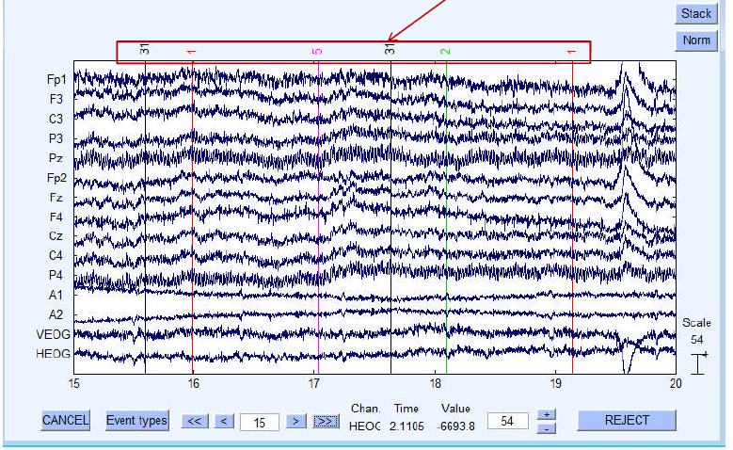
Notes:
Example of continuous EEG data

Slide 19
Epoching
For example:
  We are interested in a P300 ERP component, which has an onset at ~ 300 ms after stimulus presentation.
  Epoch: -200ms baseline, 800ms trial

Slide 20
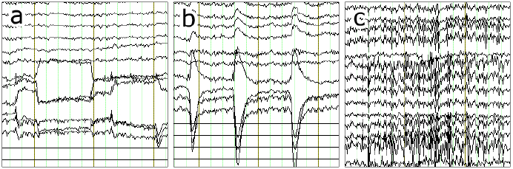
Artefact Detection and Removal
Artefacts are physiological and non-physiological noise that can distort M/EEG signal
  Blinking, eye movement, skin potentials (sweating), muscle movement, heart beat, alpha
Bad channels
Notes:
Artefact detection/rejection is ordinarily performed on epoched EEG data. However, you don’t want a huge bout of movement to interfere with your continuous data, either, of course. Most of the time, eye blinks are very apparent just in visual inspection. But monitor your participants and make a note of the time or trial if you see anything that would impact the integrity of that for that given instance.
eye movement
eye blink
muscle tension
Eyes closed = alpha wave, but they also occur when subject gets sleepy or bored, something that may be of concern, depending on your research question.
Sweating can react with the electrodes, altering their impedance, and producing an unstable baseline.
A faulty or overly noisy channel may show extreme amplitudes, lack of correlation or predictability with or by any other channel, or unusual high frequency noise, and it may be necessary to reject the entire channel outright.

Slide 21
Artefact Detection and Removal
Inspect data and determine a rejection threshold
  Trials that exceed threshold are deleted
‘Moving Window Peak-to-Peak’ function
Independent Component Analysis (ICA)
  Removes artefacts
  Useful for blink-related muscle activity
  Record EOG to remove eye movement artefact from signal
Notes:
You can also make use of automated or semi-automated procedures or algorithms.
Look at your data and determine threshold for rejection.
The Peak-to-Peak amplitude is the difference between the most positive and most negative voltages within a window. A moving window peak-to-peak amplitude function computes the peak-to-peak amplitude within a series of windows within each epoch. The routine would find the largest peak-to-peak amplitude from these windows for a given epoch of data, compare that largest value with a threshold value, and mark the trial for rejection if the largest value exceeds the threshold.
ICA is a computational method for decomposing a complex dataset into independent sub-parts.
Heartbeat artefacts are typically removed using ICA, for instance. In most (but not all) cases, artefacts will have a fixed scalp distribution, such as those involving the eyes. Blinks usually lasts 200ms, so with this spatial and temporal fixedness, they may be easier to clean up. This shouldn’t be an unsupervised process - monitor how many trials have been rejected.

Slide 22
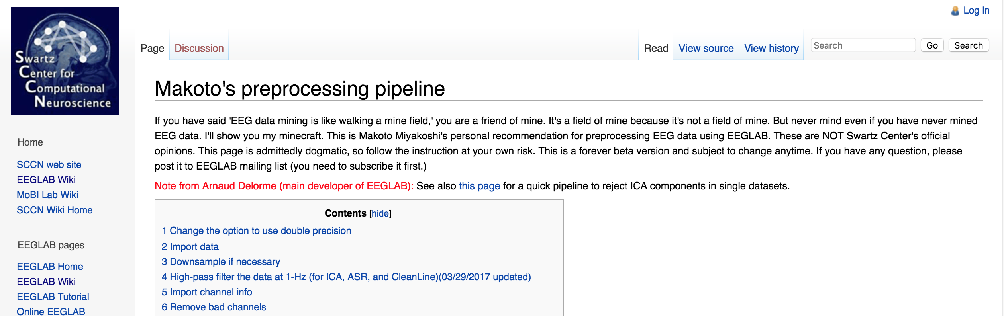
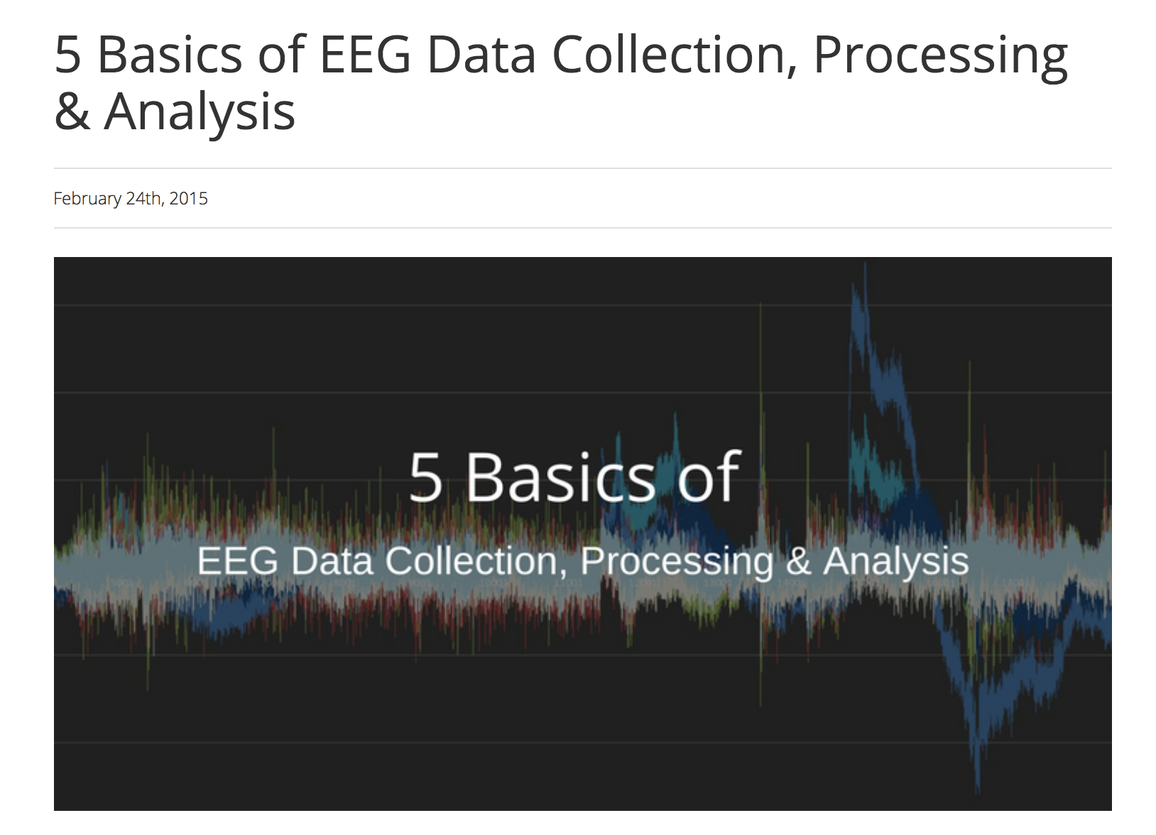

Compare and Contrast Tutorials
Notes:
Different disciplines, different departments, and different PIs will likely state their own best practices, which can result in conflicting advice. If you are careful and thorough with your design and data collection, you’ll have the freedom to elect for the preprocessing pipeline that makes the most sense for you and your project.

Slide 23
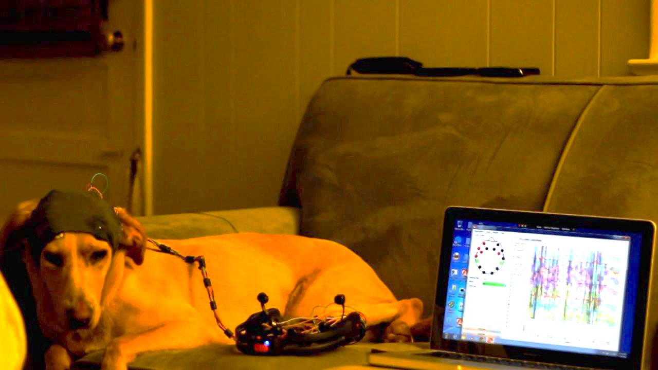
The End
Thanks experts Dr. Cagnan and Dr. Parr!

