Slide 1
Diffusion Tensor Imaging
Davide Bono & Roser Cañigueral
Methods for Dummies – 15th March 2017

Slide 2
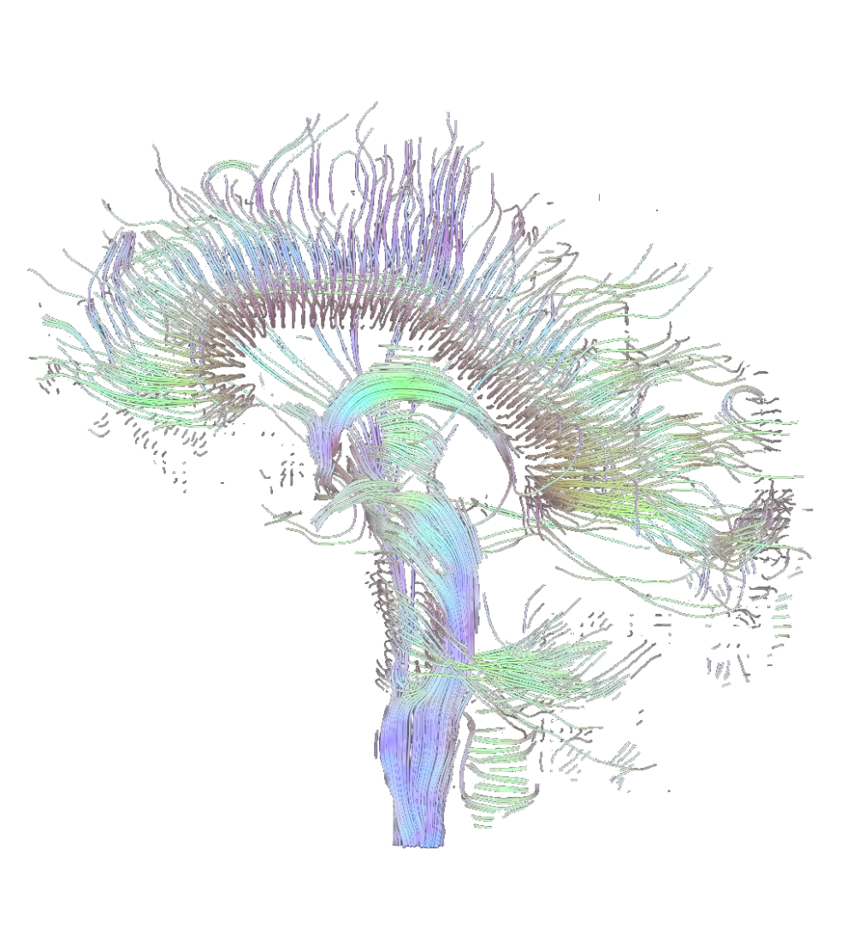
Overview
Theory
The diffusion principle
Diffusion measured by MRI
The tensor model
Imaging of diffusivity
Practice
When do I use DTI?
What do we gain from Diffusion Tensor Imaging?
DTI in FSL and other programs
How do you do DTI?
Tractography

Slide 3
Overview
Theory
The diffusion principle
Diffusion measured by MRI
The tensor model
Imaging of diffusivity
Practice
When do I use DTI?
What do we gain from Diffusion Tensor Imaging?
DTI in FSL and other programs
How do you do DTI?
Tractography

Slide 4
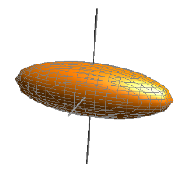
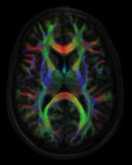
Diffusion Tensor Imaging (DTI) is an anatomical MRI technique that measures macroscopic axonal organization in the brain by using the diffusion of water molecules to generate contrast in MR images.
tensor
imaging
diffusion
Notes:
4

Slide 5
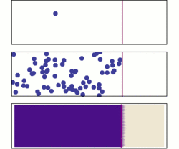
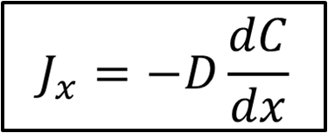
The diffusion principle Diffusion Tensor Imaging
Brownian/translational motion of water molecules.
This motion is influenced by Fick’s Law.
Notes:
5

Slide 6
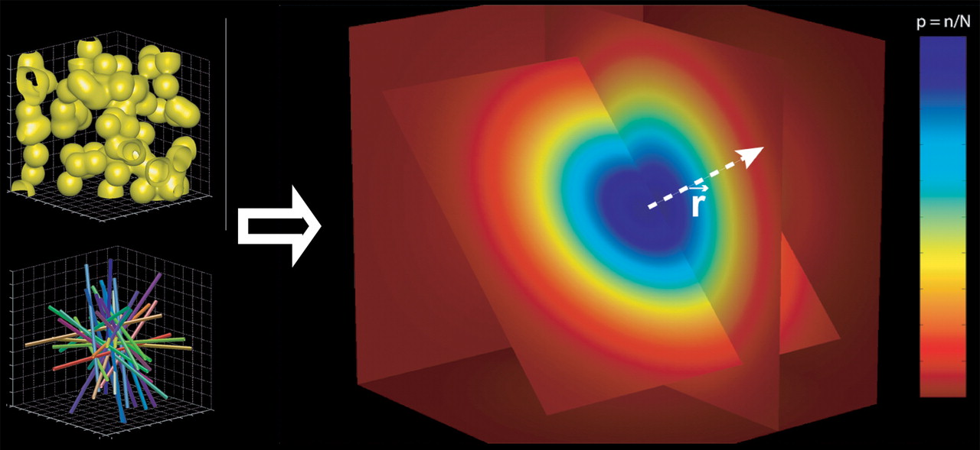
The diffusion principle Diffusion Tensor Imaging
In an unrestricted environment, water molecules move randomly → Isotropy
Notes:
6

Slide 7
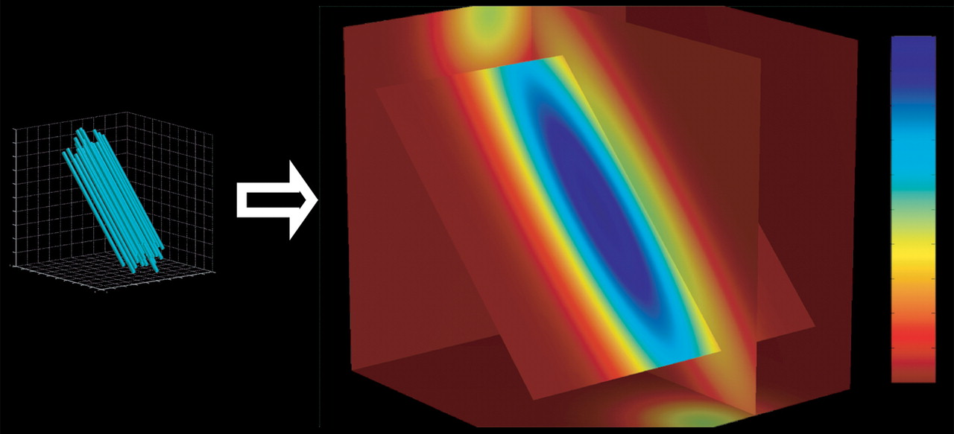
The diffusion principle Diffusion Tensor Imaging
In an unrestricted environment, water molecules move randomly → Isotropy
In a constrained environment, they diffuse more easily along one axis → Anisotropy
Notes:
7

Slide 8
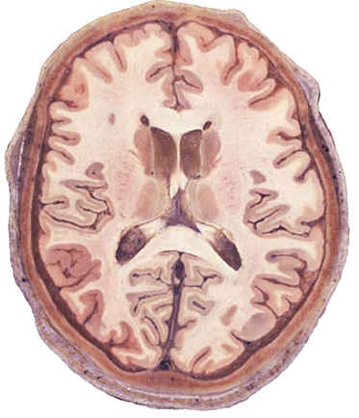
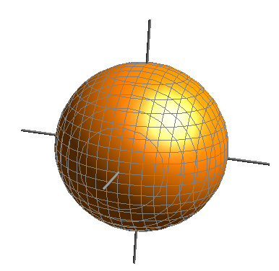
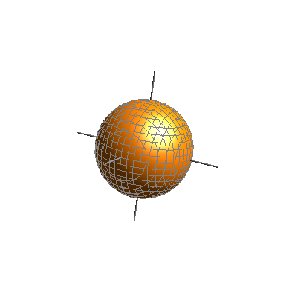
The diffusion principle Diffusion Tensor Imaging
CSF Isotropic
High diffusivity
White matter
Anisotropic
High diffusivity
Grey matter Isotropic
Low diffusivity

Slide 9
Diffusion measured by MRI Diffusion Tensor Imaging
MRI:
Signal from proton nuclei in water molecules.
Grayscale images that have poor contrast.
Notes:
9

Slide 10
Diffusion measured by MRI Diffusion Tensor Imaging
MRI:
Signal from proton nuclei in water molecules.
Grayscale images that have poor contrast.
The contrast/signal (S) can be modified based on the physical properties of water:
PD (proton density)
T₁ relaxation time
T₂ relaxation time
D (diffusion coefficient)
Notes:
10

Slide 11
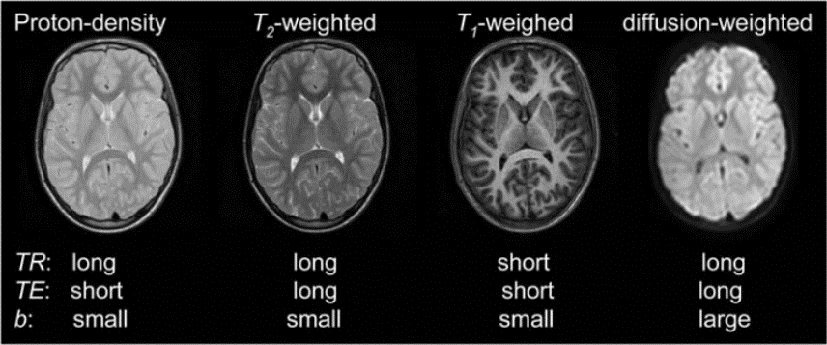
Diffusion measured by MRI Diffusion Tensor Imaging
MRI:
Signal from proton nuclei in water molecules.
Grayscale images that have poor contrast.
The contrast/signal (S) can be modified based on the physical properties of water:
PD (proton density)
T₁ relaxation time
T₂ relaxation time
D (diffusion coefficient)
₁
S₀
1
0
1
0
Notes:
11

Slide 12
Diffusion measured by MRI Diffusion Tensor Imaging
Control the amount of b values by changing the direction, strength and timing of magnetic field gradient pulses → Use phase difference to detect water motion.
Notes:
12

Slide 13
Diffusion measured by MRI Diffusion Tensor Imaging
Control the amount of b values by changing the direction, strength and timing of magnetic field gradient pulses → Use phase difference to detect water motion.
Strength of gradient
Location of molecule along axis
Notes:
13

Slide 14
Diffusion measured by MRI Diffusion Tensor Imaging
Control the amount of b values by changing the direction, strength and timing of magnetic field gradient pulses → Use phase difference to detect water motion.
Signal loss
(higher b or D = lower S)
Strength of gradient
Location of molecule along axis
Notes:
14

Slide 15
Diffusion measured by MRI Diffusion Tensor Imaging
1
1
0
0
0
1
0
T₂-weighted image
(ADC map)
The intensity of each pixel is proportional to the extent of diffusion: water in bright regions diffuses faster than in dark regions.
Measurements along the structures (e.g. axon bundles) leads to higher ADC.
Measurements perpendicular to structures leads to lower ADC.
Notes:
15

Slide 16
The tensor model Diffusion Tensor Imaging
Fiber orientation is not always along X, Y or Z axis, but oblique to these axes.
ADC is a single scalar number, but to explain all possible fiber directions we need to use the 3x3 tensor matrix:
$$ADC=\left[\begin{matrix}D_{xx} & D_{yz} & D_{zx} \\ D_{xy} & D_{yy} & D_{zy} \\ D_{xz} & D_{yz} & D_{zz}\end{matrix}\right] v=\left[\begin{matrix}λ_{1} & 0 & 0 \\ 0 & λ_{2} & 0 \\ 0 & 0 & λ_{3}\end{matrix}\right] + v^{T}=\left[v_{1 }v_{2 }v_{3}\right]$$
Eigenvalues
Eigenvectors
Notes:
16

Slide 17
The tensor model Diffusion Tensor Imaging
Fiber orientation is not always along X, Y or Z axis, but oblique to these axes.
ADC is a single scalar number, but to explain all possible fiber directions we need to use the 3x3 tensor matrix:
$$ADC=\left[\begin{matrix}D_{xx} & D_{yz} & D_{zx} \\ D_{xy} & D_{yy} & D_{zy} \\ D_{xz} & D_{yz} & D_{zz}\end{matrix}\right] v=\left[\begin{matrix}λ_{1} & 0 & 0 \\ 0 & λ_{2} & 0 \\ 0 & 0 & λ_{3}\end{matrix}\right] + v^{T}=\left[v_{1 }v_{2 }v_{3}\right]$$
Eigenvalues
Eigenvectors
Notes:
17

Slide 18
The tensor model Diffusion Tensor Imaging
Fiber orientation is not always along X, Y or Z axis, but oblique to these axes.
ADC is a single scalar number, but to explain all possible fiber directions we need to use the 3x3 tensor matrix:
$$ADC=\left[\begin{matrix}D_{xx} & D_{yz} & D_{zx} \\ D_{xy} & D_{yy} & D_{zy} \\ D_{xz} & D_{yz} & D_{zz}\end{matrix}\right] v=\left[\begin{matrix}λ_{1} & 0 & 0 \\ 0 & λ_{2} & 0 \\ 0 & 0 & λ_{3}\end{matrix}\right] + v^{T}=\left[v_{1 }v_{2 }v_{3}\right]$$
$ADC=v\bigwedge{v^{T}}$
eigendecomposition
Eigenvalues
Eigenvectors
diffusivity of axes (longest, middle and shortest)
orientation of axes
Notes:
18

Slide 19
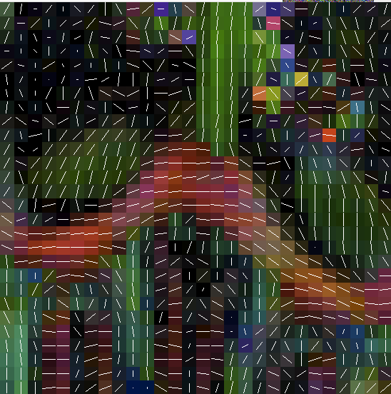
The tensor model Diffusion Tensor Imaging
Fiber orientation is not always along X, Y or Z axis, but oblique to these axes.
ADC is a single scalar number, but to explain all possible fiber directions we need to use the 3x3 tensor matrix:
$$ADC=\left[\begin{matrix}D_{xx} & D_{yz} & D_{zx} \\ D_{xy} & D_{yy} & D_{zy} \\ D_{xz} & D_{yz} & D_{zz}\end{matrix}\right] v=\left[\begin{matrix}λ_{1} & 0 & 0 \\ 0 & λ_{2} & 0 \\ 0 & 0 & λ_{3}\end{matrix}\right] + v^{T}=\left[v_{1 }v_{2 }v_{3}\right]$$
$ADC=v\bigwedge{v^{T}}$
Fit eigenvalues and eigenvectors in 3D ellipsoid and identify primary eigenvalue:
eigendecomposition
Eigenvalues
Eigenvectors
diffusivity of axes (longest, middle and shortest)
orientation of axes
for each pixel
Notes:
19

Slide 20
Imaging of diffusivity Diffusion Tensor Imaging
Two types of images can be obtained with DTI:
Mean diffusivity (MD): average of diffusion at every voxel across trace.
$$MD=\frac{λ_{1}+λ_{2}+λ_{3}}{3}$$
Notes:
20

Slide 21
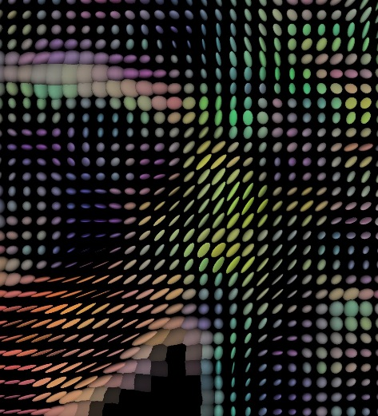
Imaging of diffusivity Diffusion Tensor Imaging
Two types of images can be obtained with DTI:
Mean diffusivity (MD): average of diffusion at every voxel across trace.
$$MD=\frac{λ_{1}+λ_{2}+λ_{3}}{3}$$
Fractional anisotropy (FA): degree of diffusion anisotropy at every voxel estimated by the tensor model. Values are scalar: from 0 (isotropy) to 1 (anisotropy).
Notes:
21

Slide 22
Imaging of diffusivity Diffusion Tensor Imaging
Colour-coded FA map depending on the main gradient/diffusion orientation:
Left/Right
Anterior/Posterior
Superior/Inferior
Notes:
22

Slide 23
Summary Diffusion Tensor Imaging
In DTI we use anisotropy to estimate the axonal organization of the brain.
Changes in the direction, strength and timing of magnetic field gradient pulses cause dephasing of water molecules: this phase difference is used to detect water motion.
The tensor model is used to identify the orientation of axonal fibers that are oblique to the X, Y and Z axes.
Diffusion can be represented as Mean Diffusivity or coloured Fractional Anisotropy maps.
Notes:
23

Slide 24
Overview
Theory
The diffusion principle
Diffusion measured by MRI
The tensor model
Imaging of diffusivity
Practice
When do I use DTI?
What do we gain from Diffusion Tensor Imaging?
DTI in FSL and other programs
How do you do DTI?
Tractography

Slide 25
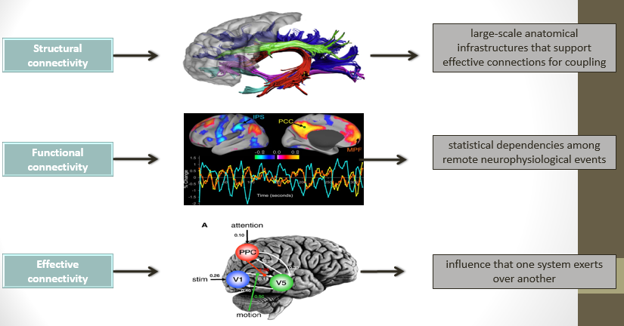
Practice
When do I use DTI?
Anatomical layout of axons and synaptic connections
Notes:
25

Slide 26
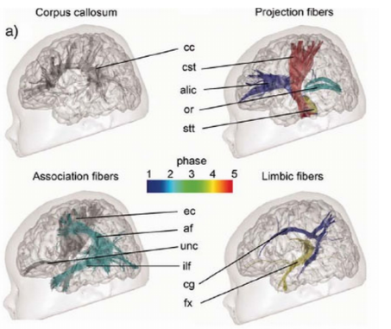
Practice
What do we gain from Diffusion Tensor Imaging?
Applications
Human Connectome; generation of human white matter atlases
Comparing groups (personality traits, diseases, psychological disorders)
Longitudinal studies to investigate age or experience dependent white matter changes
Changes in brain development
Presurgical planning
Marker for pathological States (e.g. brain strokes)
Notes:
Wide range of applications, but do not forget (limitations on next slide)
26

Slide 27
Limitations
Not reflective of individual structures (no measure of individual axons) ➔ rather linked to tracts of structural coherence in the brain
The exact effect of specific structures is not known
No gold standard available

Slide 28
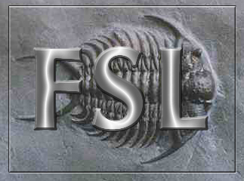
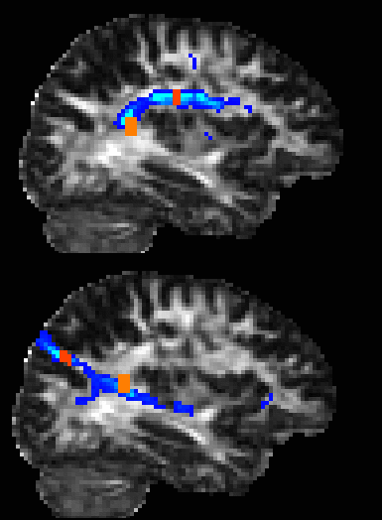
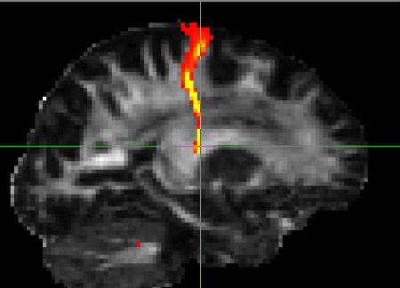
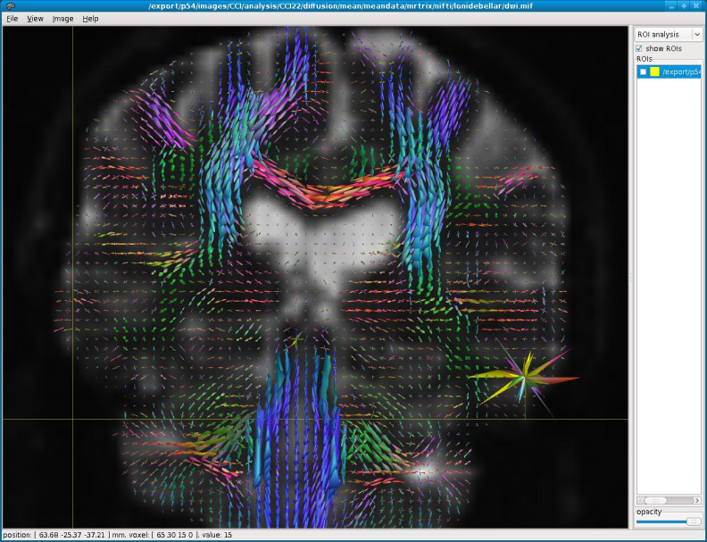
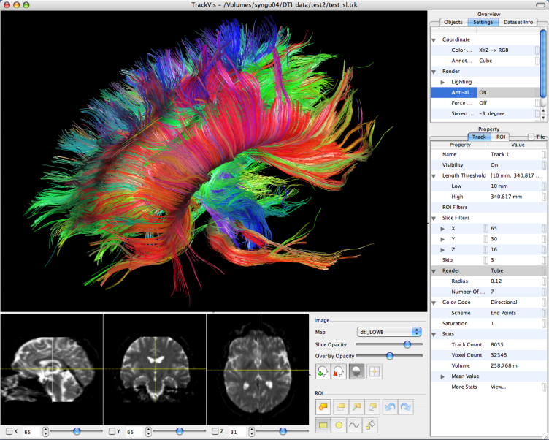
DTI in…
FSL (Oxford)
TrackVis (MGH)
Freesurfer (Harvard)
Mrtrix (BRI, Australia)
Camino (UCL) … and many more!

Slide 29
Practice
How do you do DTI?
Move the data off the scanner and convert it to a usable format.
Deal with distortions common to diffusion images, like EPI and eddy currents.
Remove any non-brain tissues.
Create a gradient directions file.
Fit the tensors.
Check the fit of the tensors.
Notes:
29

Slide 30
Practice
How do you do DTI?
Move the data off the scanner and convert it to a usable format.
Notes:
30

Slide 31
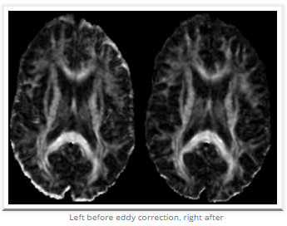
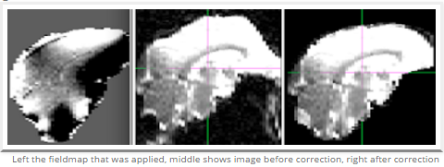
Practice
How do you do DTI?
Deal with distortions common to diffusion images, like EPI and Eddy Currents.
Eddy Currents
EPI (Fieldmap correction)
Notes:
31

Slide 32
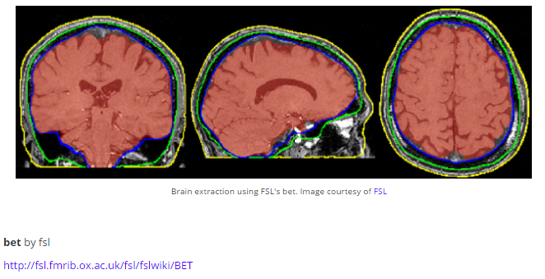
Practice
How do you do DTI?
3. Remove any non-brain tissues.
Notes:
32

Slide 33
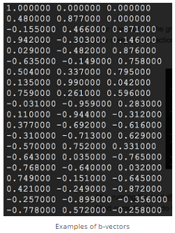
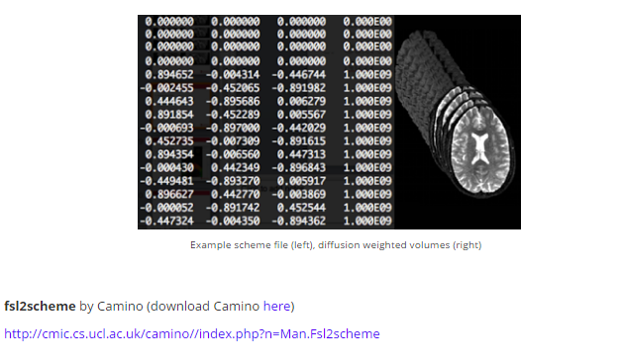
Practice
How do you do DTI?
4. Create a gradient directions file.
Example of b values
Example of b vectors
Notes:
B values : amount of diffusion weighting used for each volume
750~1500 s/m^2, and is most frequently set at 1000s/m^2.
B vectors: gradient direction
33

Slide 34
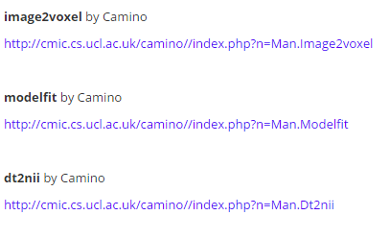
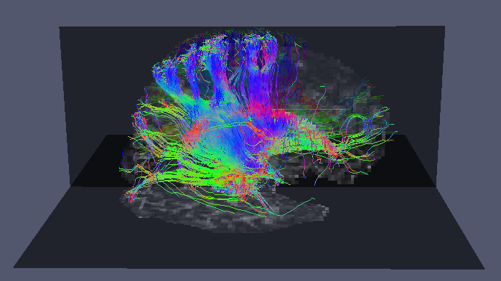
Practice
How do you do DTI?
5. Fit the tensors.
Run the tensor model estimation from the diffusion weighted images
Notes:
Nifti to bfloat
34

Slide 35
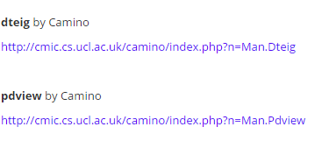
Practice
How do you do DTI?
6. Check the fit of the tensors.
Tensor fitting quality control
Notes:
35

Slide 36
Practice
Tractography
A technique that allows to identify fiber bundle tracts by connecting voxels based on the similiarities in maximal diffusion direction.
Johansen-Berg & Rushworth, 2009
Notes:
The figure illustrates diffusion of a water molecule within a fiber bundle. Diffusion is less restricted along the axis of the fiber bundle than across it.
Tractography is an attempt to connect voxels based on the similarities of their maximal diffusion directions (one of the three measures we get in diffusion images)
Illustration on the right: Simple, streamlining tractography proceeds by tracing a line through the tensor field, following the principal diffusion direction. The schematic shows a grid of voxels; the grayscale reflects FA [ranging from zero (black) to one (white)]. The corresponding tensors are illustrated by the ellipses shown at each voxel.
36

Slide 37
Differences between tractography and DTI
DTI
technique used for the acquisition of images regarding axonal organisation in nervous system tissue
Tractography
technique based on identification of similarities between maximal diffusion direction
≠
VOXEL LEVEL
MULTIPLE VOXELS LEVEL
Notes:
37

Slide 38
Practice
Tractography
Deterministic:
A point estimate of the principal diffusion direction at each voxel is used to draw a single line.
Probabilistic:
Provides a probability distribution on the diffusion direction at each voxel (the broader the distribution, the higher the uncertainty of connections in that area) which is then used to draw thousands of streamlines to build up a connectivity distribution
Advantages:
- Allows to continue tracking in areas of high uncertainty (with very curvy tracts)
- Provides a quantitative measure of the probability of a pathway being traced between two points

Slide 39
Practice
Tractography
Deterministic Probabilistic
Johansen-Berg & Rushworth, 2009
Notes:
The image on the left is created with a deterministic so-called streamline algorithm. The tracts that are identified look nice and smooth.
Probabilistic tractography on the other hand gives less spatially resolved tracts.
39

Slide 40
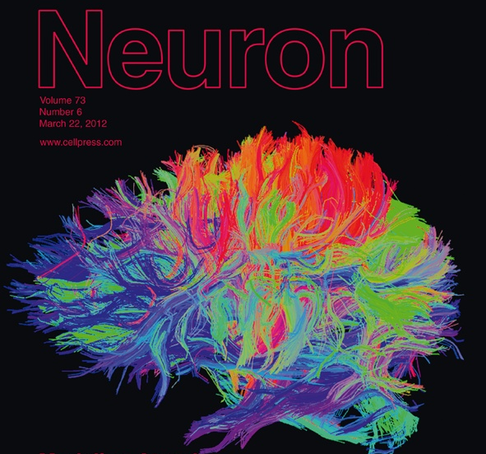
Practice
Tractography
Whole brain versus ROI based approach
(Atlas generation)
Notes:
reduce the severity of correction for multiple tests;
Type I error (false positive) incorrect rejection of a true null hypothesis
40

Slide 41
Software links
FSL’s diffusion toolbox
http://www.fmrib.ox.ac.uk/fsl/fdt/index.html
TrackVis and Diffusion Toolkit
http://trackvis.org/
Freesufer’s TRACULA
http://surfer.nmr.mgh.harvard.edu/fswiki/Tracula MRTrix http://www.brain.org.au/software/mrtrix/ Camino Diffusion MRI toolkit http://cmic.cs.ucl.ac.uk/camino/ TractoR http://www.homepages.ucl.ac.uk/~sejjjd2/software/

Slide 42
Thank you for your attention!! And special thanks to our expert : Dr. Enrico Kaden

Slide 43
References
Hagmann et al. (2006). Understanding diffusion MR imaging techniques: From scalar diffusion-weighted imaging to diffusion tensor imaging and beyond. Radiographics, 26, S205-S223.
Hagmann P, Kurant M, Gigandet X, Thiran P, Wedeen VJ, et al. (2007). Mapping Human Whole-Brain Structural Networks with Diffusion MRI. PLoS ONE, 2(7), e597.
Johansen-Berg and Rushworth (2009). Using Diffusion Imaging to Study Human connectional Anatomy.
Annu. Rev. Neurosci, 32, 75–94
Mori S & Zhang J. (2006) Principles of Diffusion Tensor Imaging and its Applications to Basic
Neuroscience Research. Neuron, 51, 527-39.

