Slide 1
BASIS OF THE BOLD SIGNAL
Nebiyu Kibru & Marte T Jensen

Slide 2
Outline
The Basics of fMRI
A brief introduction to BOLD
The physics of BOLD
Factors affecting the BOLD signal
Applications of BOLD fmri

Slide 3
Measuring/imaging “brain activity”
Metabolic consequence
oxygen consumption
glucose consumption
EEG/MEG
Electrophysiology
FDG PET
autoradiography
13C MRI
Neuroelectric activity
action potential
postsynaptic activity
excitatory/inhibitory
?
BOLD fMRI
ASL/VASO/CA
15O PET
NIRS
optical imaging
Doppler US
Vascular response
blood flow
blood volume
blood oxygenation

Slide 4
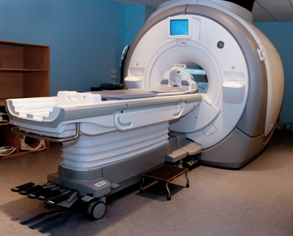
MRI
Underpinned by nuclear magnetic resonance (NMR)
fMRI looks at MRI signal changes associated with functional brain activity.
Notes:
Magnetic resonance imaging (MRI) is a type of scan that uses strong magnetic fields and radio waves to produce detailed images of the inside of the body.
An MRI scanner is a large tube that contains powerful magnets.
The results of an MRI scan can be used to help diagnose conditions, plan treatments and assess how effective previous treatment has been.
The principle behind NMR is that many nuclei have spin and all nuclei are electrically charged. If an external magnetic field is applied, an energy transfer is possible between the base energy to a higher energy level (generally a single energy gap). The energy transfer takes place at a wavelength that corresponds to radio frequencies and when the spin returns to its base level, energy is emitted at the same frequency. The signal that matches this transfer is measured in many ways and processed in order to yield an NMR spectrum for the nucleus concerned.

Slide 5
THE MRI SCANNER
Earth’s magnetic field: 0.00003 Tesla Clinical MRI: 1.5 - 7 Tesla
Notes:
Just to give an idea of how strong the magnet in the MRI machine is . The earth’s magnetic field is measured at 0.00003 Tesla , in comparison to the Clinical MRI machine who’s magnet measures at between 1.5 - 7 tesla.

Slide 6
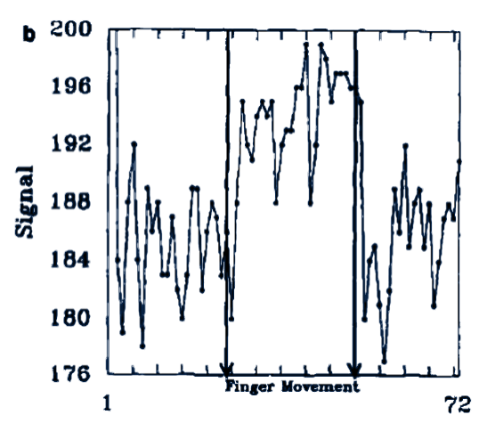
Brief introduction to BOLD imaging
Ogawa et al., 1990: “static” BOLD effect in rat brain
Kwong et al., Bandettini et al., Ogawa et al., 1992: BOLD fMRI in human
Bandettini et al., MRM 1992
Kwong et al., PNAS 1992
Notes:
Famous experiment ( first experiment using the BOLD method in which they measured the bold response in fingertapping ( Bandettini et al ) and second one is a visual one. As you can see from the spikes both tasks initiated a BOLD response .

Slide 7
Brief introduction to BOLD imaging
Functional MRI in brief …
Stimulus
Carefully designed to elicit a specific response from some cognitive system
Neuronal Activity
Requires energy leading to an increase in oxygen demands
Neurovascular Coupling
Vessels dilate
Blood flow increases
The supply of oxygen exceeds demand
BOLD Contrast
The net increase in oxygenated hemoglobin in the vasculature leads to an increase in signal
Notes:
Path from stimuli from stimuli to - initiates neuronal activity initiating the neurovascular coupling system which in turns leaves us with the signal graph.

Slide 8
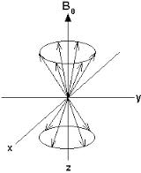
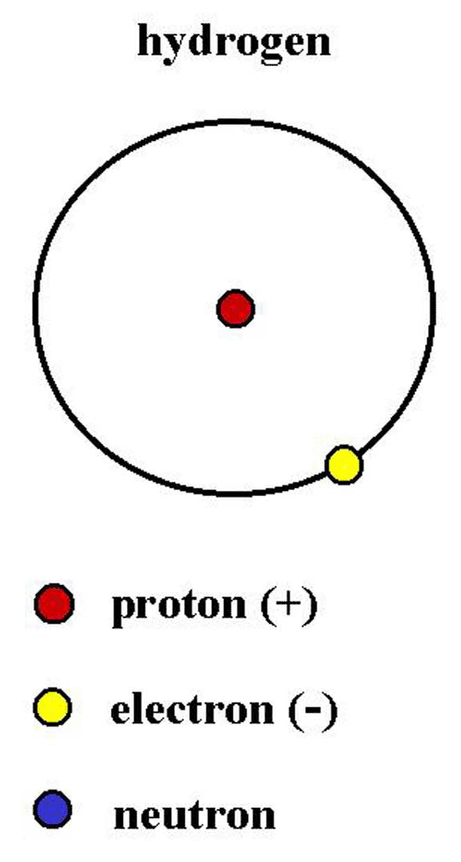
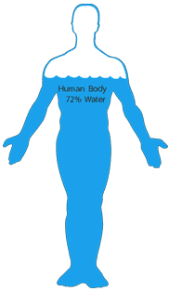
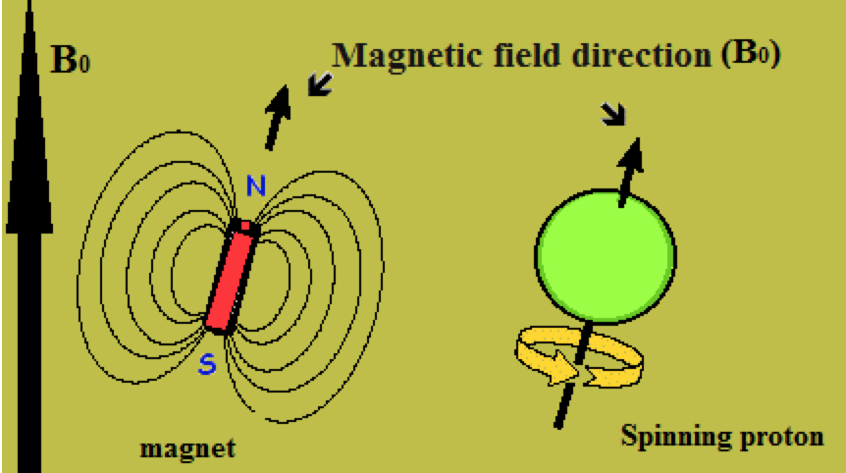
Hydrogen Ions
Human tissue contains many hydrogen ions.
Fat
Water: A trillion, trillion, trillion water molecules in the human body.
Hydrogen atoms are tiny magnets
Notes:
MRI is based on the properties of hydrogen ions. These are found in abundance in the body, for example in water and fat.
Atoms consist of protons, neutrons and electrons.
If there is an uneven number of protons or neutrons or both in an atom, the nuclei possesses nuclear spin. This is it’s natural state, and can be thought of as a tiny magnetic field.
Nuclei that possess a nuclear spin can be pictured as small rotation magnets, which spin around their own axis.
The spin is referenced against axis points, where B0 is the magnetic field (for example the giant magnetic field in the scanner), and Y and X are the transverse planes.
The important thing to remember is that in their natural state, the hydrogen protons spin either in parallel or antiparallel alignment with the Z axis.
So… MRI can essentially be thought of as hydrogen imaging.
copied

Slide 9
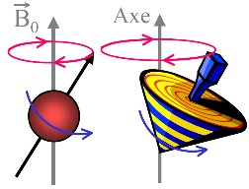
NUCLEAR SPIN: PRECESSION
In nuclear spin, the proton spins around the long axis of the primary magnetic field. Never truly aligned!
The proton gyrates as it spins into alignment.
= precession
Notes:
In addition to spin, the proton also takes another important motion. This is called gyration, and it descrbes how the proton wobbles as it spins around the axis.
Never truly aligned – like spinning top.
This examples shows one proton spinning around its axis.

Slide 10
HTTPS://WWW.YOUTUBE.COM/WATCH?V=0YBUSORH0LW
Notes:
So, what happens to hydrogen ions in the MRI scanner?
As we saw before, the hydrogen ions are randomly aligned normally in earths magnetic field.
Net magnetisation is therefore 0.
Inside the scanner, the magnetic field is very strong.
The spinning atoms align to the strong magnetic field, either into parallel and antiparallel directions with the Z axis..
Remember, they are like little magnets, or like the points of a compass needle.
However, because the up spin direction is energetically more favourable, more protons align in the parallel direction with the B0 axis.
This leads to a net magnetization value, due to the difference in their spin up and spin down states.
The energy difference between the two spin states, Is proportional to the strength of B0.
With a stronger magnetic field, more spins will be in the parallel state, leading to a stronger net magnetisation. This means a stronger signal.
This is why the MRI scanner has a very strong magnetic.

Slide 11
Impact of Magnetic Susceptibility
Sum
MRI signal = amplitude of magnetization vector M
M = the sum of all the magnetization vectors of each proton in one voxel
Every small magnetization vector is rotating about the z axis
The processional frequency is proportional to the amplitude of the magnetic field
Even inside a voxel they may not experience exactly the same magnetic field
So they are dephasing
The sum of non-parallel vectors is smaller than the sum of parallel vectors.
M
Notes:
When you place a subject in an MRI machine ( a large magnet ) all the protons in that subject align with the direction of the magnetic field .
Under normal conditions, nuclear magnetic dipoles in the body are randomly distributed, which results in zero net magnetization. When a strong external magnetic field is applied, the patient becomes polarized and net magnetization appears.
When you apply radio waves (RF pulses) at the appropriate frequency ( Larmor frequency) you can change the orientation of the spins as the protons absorb energy. After you turn off the RF pulse, as the protons return to their original orientations, they emit energy in the form of radio waves.
The precessional path around the magnetic field is circular like a spinning top. The Larmor or precessional frequency in MRI refers to the rate of precession of the magnetic moment of the proton around the external magnetic field ( radiopedia. com)

Slide 12
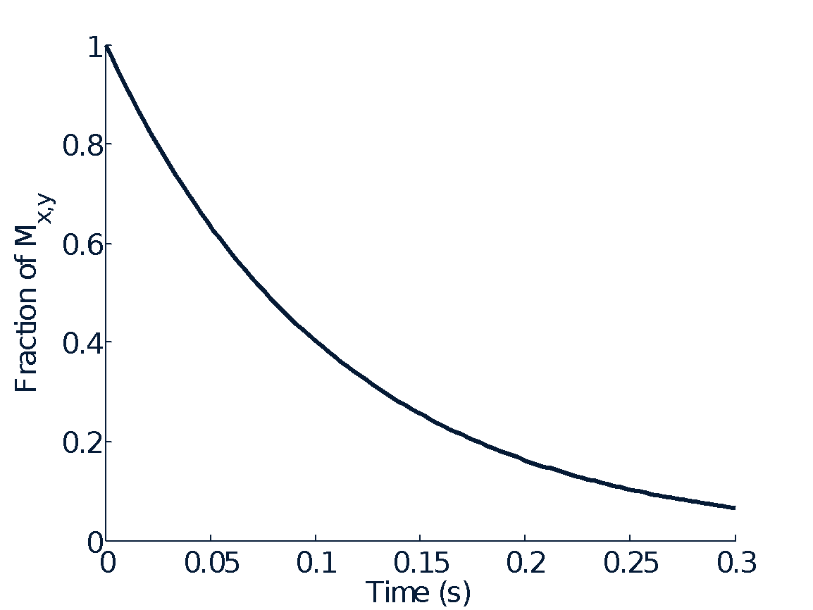
Impact of Magnetic Susceptibility
R2*=1/T2*
T₂ *
Notes:
Exposure to the radio frequency (RF pulse) produces a high signal due to the alignment of protons. As the pulse is « turned off » protons gradually return to their resting state or dispurse as seen in the graph. T2 ?

Slide 13
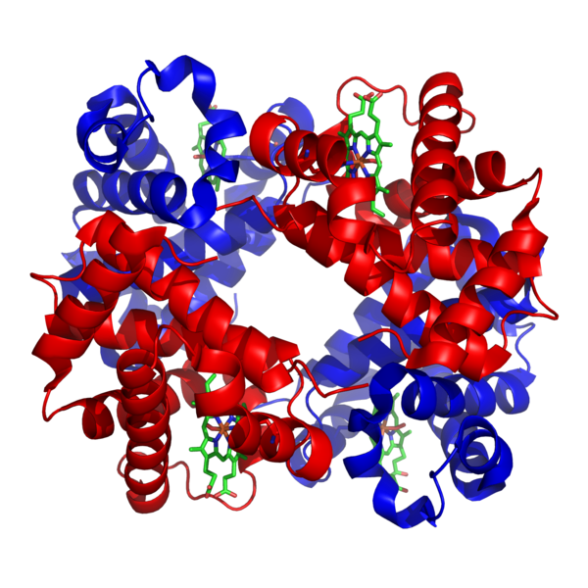
Deoxy-hemoglobin as endogenous contrast agent
Magnetic susceptibility of hemoglobin
Pauling and Coryell, PNAS 1937
Iron-containing Heme groups makes Deoxygenated hemoglobin (Hb)
paramagnetic
different from tissue (H₂O)
Bound oxygen shields the Heme group making Oxygenated Hb:
diamagnetic
same as tissue (H₂O)
Notes:
So , as mentioned previously the BOLD method uses the oxygen levels in the blood to measure brain activity. But how exactly does this work? Well, the magnetic susceptibility of hemoglobin is dependent on the oxygen levels, where hemoglobin with plenty of oxygen ( oxygenated hemoglobin) is diamagnetic ( repelled by a magnetic field ) whereas hemoglobin depleted of oxygen , referred to as deoxygenated hemoglobin , is paramagnetic , attracted by a magnetic field.

Slide 14
Deoxy-hemoglobin as endogenous contrast agent
Rest
Neuron
Oxygen
Capillary
Deoxyhemoglobin
Notes:
You see here an image representing your blood at resting state . So the blood flows through the vessel. The neuron takes up some of the oxygen from some of the blood cells and you get blood cells with less oxygen = deoxygenated haemoglobin / Deoxyhemoglobin.

Slide 15
Deoxy-hemoglobin as endogenous contrast agent
Activity
Oxygen metabolism Deoxyhemoglobin
Notes:
However when performing a task neurons require more oxygen , more oxygen the more demanding the task. So the blood takes up more oxygen as and the neuron takes up more oxygen to exert the activity. As such the oxygen metabolism increases, but the amount of deoxyhemoglobin does not decrease , that also goes up as the blood now has enough oxygen to cover both the need of the neurons and it’s own needs with increases activity.

Slide 16
Deoxy-hemoglobin as endogenous contrast agent
Activity
Oxygen metabolism Deoxyhemoglobin
Blood Flow
Deoxyhemoglobin

Slide 17
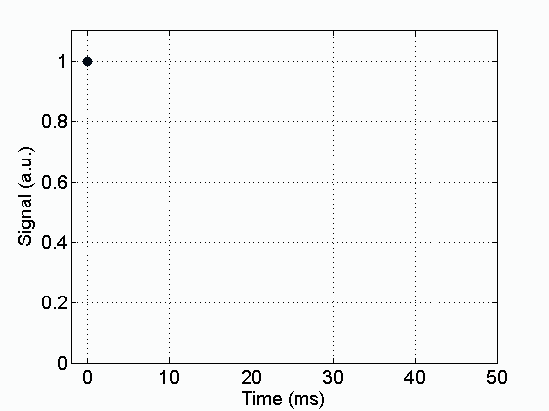
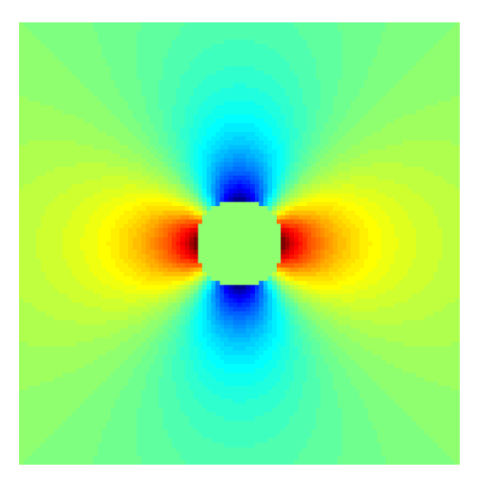
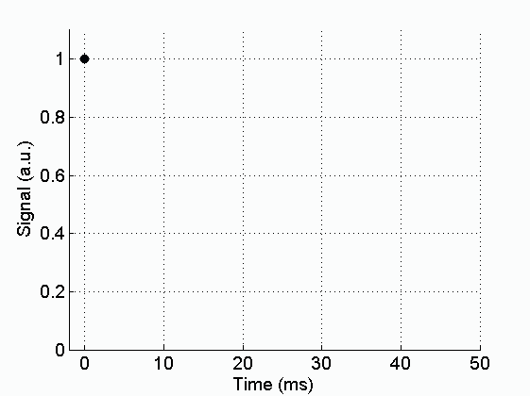
Impact of Magnetic Susceptibility
Oxygenated Hb
B₀
voxel
Vessel
Tissue
Deoxygenated Hb
Notes:
So let’s look at that in a bit more detail. The top image is of a hypothetical vessel near inactive neurons,this is a blood vessel going in and out of the page with some background tissue and the main field going this way, so we looking down into the vessel. so there’s plenty of oxygenated hemoglobin in it. Now you’ve turned on the MRI scanner and you get this green magnetic field. if it is all oxygenated blood it doesn't affect the magnetic field in the surrounding tissue because the susceptibility between the blood and the tissue is roughly the same and there is not a big change, It’s hard to tell but there are very small differences in the field- if you can see it, it’s a bit yellower in some places- however overall, the field around the blood vessel is very uniform.
The image on the bottom is of a vessel that has a large concentration of deoxygenated hemoglobin present in it, which is distorting the field around it and what it is doing essentially is creating magnetic field gradients , so the colour differences represent changes in the strength of the magnetic field because of the presence of dHb. Now we’ll zoom in on one small voxel in each image. You can clearly see the difference in the magnetic field as you can see in the oxygenated case, this is the field that we are looking at smooth and uniform across the area of the vessel where as in the deoxygenated case we see (large concentration of deoxygenated haemoglobin) we are going to get some variations across it essentially a gradient.
So, when we then turn on the mri machine and emit the initial RF pulse, all the protons are lined up and in phase and we have a strong signal.

Slide 18
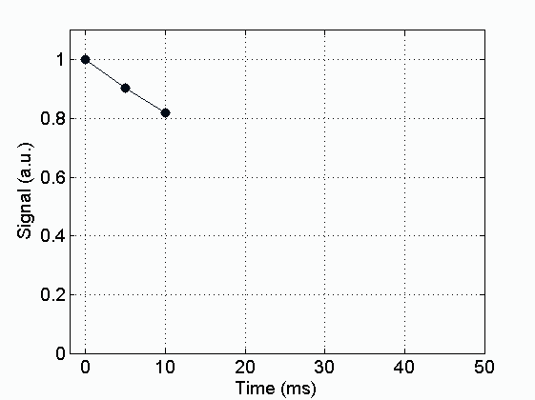
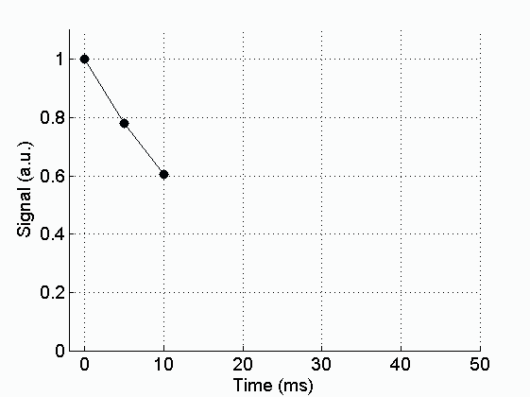
Impact of Magnetic Susceptibility
Oxygenated Hb
B₀
voxel
Vessel
Tissue
Deoxygenated Hb
8
Notes:
Now, if we look a few milliseconds later, in the oxyhemogobin, were the field is relatively uniform the protons will dephase only a little bit and the signal will stay strong. Whereas for the deoxygenated case, there is a variation in the field and so these water molecules are going to spin much faster and so they are going to go out of phase faster and so when we sum these up we are going to get less of a signal.
Rember that the frequency of rotation is proportional to the amplitude / strength of the magnetic field.
If we look a few milliseconds later the protons are coming out of phase with each other and the signal is weakening.

Slide 19
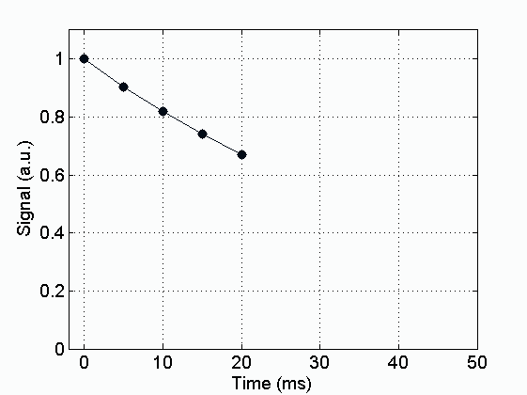
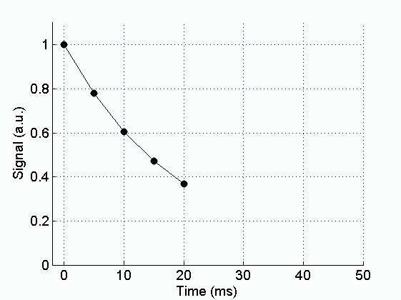
Impact of Magnetic Susceptibility
Oxygenated Hb
B₀
voxel
Vessel
Tissue
Deoxygenated Hb
9
Notes:
The signal as time passes is decreasing faster so if you keep letting it go this signal is going to keep decreasing because of this variation in the field and so they are both exponential decays of the signal that you are looking at in time but in this case the signal decays much faster. ( rephrase)
And even a few milliseconds later and the signal has decayed even more, and as you can see, because the magnetic field is so much more inhomogeneous when there is deoxyhemoglobin around the protons , this will come out of phase much faster and the signal decays a lot faster than in the oxyhemoglobin. And this is how you get a you would expect a weaker BOLD signal when neurons are activated compared to when they’re at rest.

Slide 20
Impact of magnetic susceptibility
TE must be sufficient long to capture the BOLD effect but not too long to have enough MR signal.
1
Rest
Active
0.8
S
0
0.6
/
)
E
T
(
S
0.4
Oxyhaemoglobin
0.2
Deoxyhaemoglobin
BOLD Effect
0
0
20
40
60
80
100
TE (ms)
Notes:
So the BOLD measurement is a measure of the difference in magnetic distortion between oxyhemoglobin and deoxyhemoglobin.
What does the active and rest bit mean ? The formulas?
Echo time (TE)
Signal when active is higher than when at rest.
TE 30- 40 - gives biggest difference between active and rest ( at 3 T) put on slide.
Excation of signal

Slide 21
Impact of magnetic susceptibility
BOLD Sensitivity = TE * S(TE)
TE must be sufficiently short to maintain signal
1
Rest
Active
0.8
S
0
TE must be sufficiently long to have BOLD sensitivity, e.g. > 25ms at 3T
/
0.6
)
E
T
(
BOLD Effect
S
0.4
0.2
Oxyhaemoglobin
Deoxyhaemoglobin
0
0
20
40
60
80
100
TE (ms)
Notes:
?

Slide 22
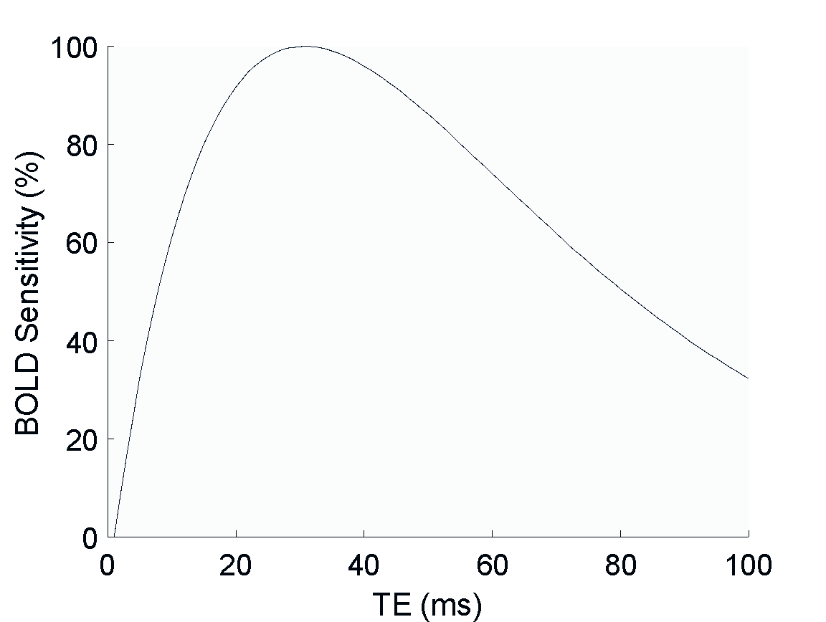
Impact of magnetic susceptibility
BOLD Sensitivity = TE * S(TE)
1
Rest
Active
0.8
S
0
0.6
BOLD Effect
/
)
E
T
(
S
0.4
Oxyhaemoglobin
Max at TE = T₂*
0.2
Deoxyhaemoglobin
0
0
20
40
60
80
100
TE (ms)
Lipshutz et al. Neuroimage 2001
Notes:
?

Slide 23
Dynamic of the BOLD response
Haemodynamic response function (HRF)
5-6s
<1s
4s
10-20s
Notes:
Okay, so this is a typical hemodynamic response to a short stimulus.
In the first 1-2 seconds you see a fast initial drop in signal intensity- that’s due to the increased use of oxygen by activated neurons, so the increase in metabolic consumption, before the blood vessels are able to respond.
Then, after about 2 seconds you get blood flow change and you get a big signal intensity increase that peaks around 5 or 6 seconds post-stimulus which is the main bold signal, lasting about 4 seconds.
And then , eventually that signal fades, as the blood flow/volume/oxygen return to resting and you sometimes see a post-stimulus undershoot which is due to the metabolic consumption remaining elevated after the blood flow has subsided.

Slide 24
Neuroelectric activity and BOLD response
Logothetis et al., Nature 2001
The BOLD signal primarily measures the input and processing of neuronal information within a region and not the output signal transmitted to other brain regions :
Indirect measure of oxygen consumption (Blood flow ≠ Neural activities)
Difficult to differentiate between excitation/inhibition and neuromodulation (all need oxygen and glucose)
LFD: Local Field Potentials (input)
MUA: Multi unit Activity (output)
SDF: Spike Density Function (output)
correlation with local field potentials
Notes:
So , we know that BOLD measures brain activity, but what neuroelectric activity is it actually measuring ? So the Bold signal is primarily measuring the input and processing of neuronal information within a region and not the output signal transmitted to other brain regions: So if we look at the graph we can see the pink field here , which is the BOLD signal. And the the black line represents the Local field potentials or “input” and the grean and blue are representing output activity. So it is clear from this graph that the BOLD signal is more closer related to the input , as you can see it looks quite similar, as opposed to the output which you see here.

Slide 25
Neuroelectric activity and BOLD response
fMRI voxel of 55 ml
5.5 million neurons
5.53*10¹⁰ synapses
22 km of dendrites
220 km of axons.
Be careful with the interpretation !
Logothetis, Nature 2008
Notes:
It’s complex , be carefull what you interpret from one voxel..

Slide 26
FACTORS AFFECTING THE BOLD SIGNAL
Age
Pathology
Drugs
Levels of consciousness
Individual variances
Brain regions
Notes:
Age - vascular system
Disease e.g stroke and neurodegenerative diseases
Frequency --- ?
Drugs --
Levels of consciousness --
Individual variances --
Brain regions --

Slide 27
Why is BOLD fMRI useful / when would you use it?
. Allows for presurgical planning
. Experimental brain mapping tool allowing for understanding of functional anatomy
.
Notes:
fMRI allows for presurgical assessment of functional anatomy around brain lesions and assess possible postoperative functional deficits e.g tumors , level of defects after surgery .
Experiments
Mostly an experimental tool.

Slide 28
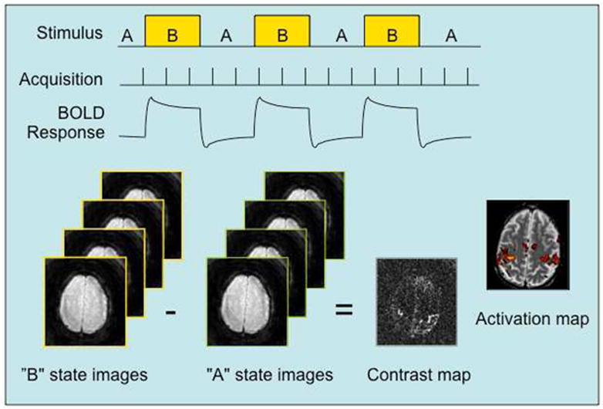
Typical use of fMRI in a study
Notes:
Neural response to the state change from A to B in the stimulus is accompanied by a hemodynamic response that is detected by rapid and continuous acquisition of MR images sensitized to BOLD signal changes. The average signal difference between two states is computed for the scan and a contrast map is generated. A statistical activation map is generated using a suitable threshold for the difference. The map shows the likely possibility that a voxel is activated given the uncertainty due to noise and small BOLD signal differences

Slide 29
Advantages of BOLD
High spatial localisation
Non-invasive
Increasing availability
Enables visualising of entire brain areas/networks engaged in specific activities
Notes:
non -invasive as no intravenous/oral contrast agent is needed (iodine based compounds)
High spatial localisation?

Slide 30
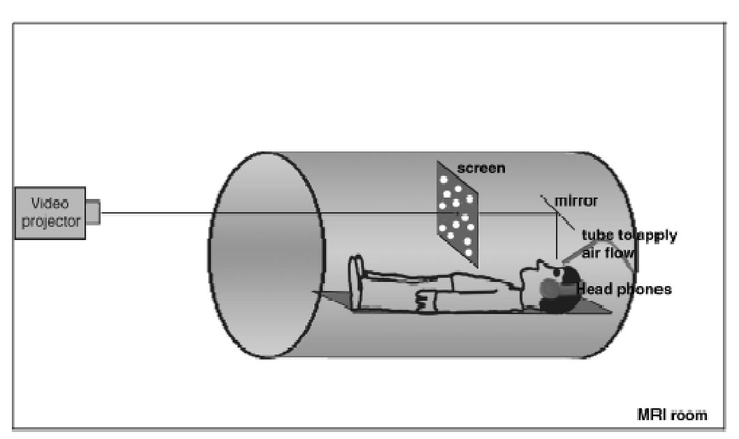
Disadvantages of BOLD
Signal changes due to brain activations are small so Requires sufficient signal to noise ratio to detect a MR signal change
Loud noise of scanner when switching magnetic fields can cause confounding variables in studies of auditory systems
Logistical difficulties in delivering stimuli due to magnetic fields
Notes:
Low temporal resolution due to hemodynamic response ?
Loud noise od scanner when switching magnetic fields can cause confounding variables in studies of auditory systems
Logistical difficulties in delivering stimuli due to magnetic fields
Signal changes due to brain activations are small so Requires suffiecient signal to noise ractio to detect a MR signal change

Slide 31
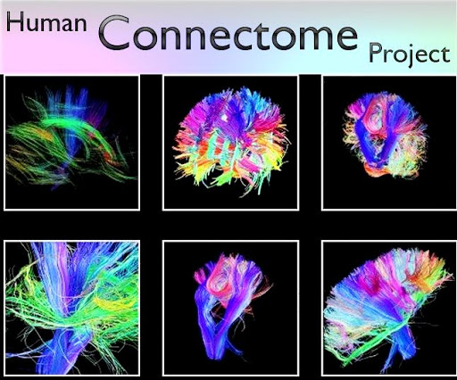
Future of BOLD fMRI
Notes:
Collaborative project that aims to use fmri and other techniques to create a complete neural network of amodel healthy human brain, helping decipher the anatomical and functional connectivity of the human brain. Comparisons of brain maps of patients to controls could allow for more accurate and efficient diagnosis

