Slide 1
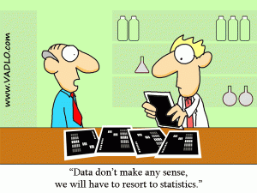
Model Selection/Comparison
David Benrimoh & Rachel Bedder
Expert: Dr Michael Moutoussis
MfD – 14/02/2018
Notes:
INTRODUCTION –
cover some different techniques used

Slide 2
Outline
Frequentist Techniques
Introduction to Models
F test for General Linear Model (GLM)
Likelihood ratio test
Akaike Information Criterion (AIC)
Cross validation
Bayesian Methods
Conjugate priors
Laplace’s method
Bayesian information criterion (BIC)
Sampling
Variational Bayes

Slide 3
All models are wrong, but some are useful
Models are only useful because they are wrong
Notes:
Refered to as binini’s paradox
Models are approximations – if they ac perfectly they would be the thing we are modelling
If we explain all aspects of something – it isn’t very useful as it can’t be generalized to other situation
No one will cite it, if model is not generalizable to other datasets

Slide 4

All models are wrong, but some are useful
Models are only useful because they are wrong
Data:
height, dog or cat preference, age, gender, amount of hair… favourite colour… first pet…
Model:
Taller people prefer dogs
Notes:
DATASET We have some dataset
MODEL we want to build a model of if and how height predicts preference of dogs over cats
We have loads of data in the set – we include these all as predictors.
Also more data dimensions we have not observed that might predict some variance in our height/dog model

Slide 5
All models are wrong, but some are useful
Models are only useful because they are wrong
reduce dimensions = less accurate model
Data:
height, dog or cat preference, age, gender, amount of hair… favourite colour… first pet…
Model:
Taller people prefer dogs
Notes:
DIMENSION REDUCTION – to just height as a predictor, our model will be less accurate than if we used all the possible predictors

Slide 6
All models are wrong, but some are useful
Models are only useful because they are wrong
reduce dimensions = less accurate model
Data:
height, dog or cat preference, age, gender, amount of hair… favourite colour… first pet…
Model:
Taller people prefer dogs
Increase dimensions = model becomes less useful (at extreme is just data again)
Notes:
USE MORE DIMENSIONS – until we capture all of the variance, even tiny amounts of variance
Very accurate – not useful for research question, or science generally
choosing the best wrong model
will discuss the different ways to statistically evaluate models in order to compare between them
always trading off between complexity and generalisability. Underspecified vs. overly complex

Slide 7
…but what really is a model?
Notes:
Before we start comparing models, useful to really get to grips with what models actually are

Slide 8

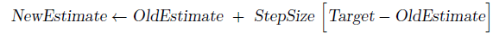
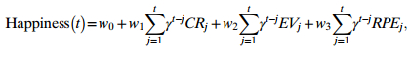
…but what really is a model?
Notes:
FAMILIAR WITH GLM
any way we describe data
Central tendency (most people over 6ft prefer dogs)
No unique to cog neuro
making sensible judgements about which models we want to compare.
don’t ever be convinced that just because someone has some fancy model – it is somehow an objective interpretation of their data.

Slide 9
Model fitting is not Model selection/comparison
Notes:
- There is a difference between model fitting and model selection.

Slide 10
Model fitting is not Model selection/comparison
Model fitting: Tuning the presumed model → best fit to the data.
Finding parameters can be done analytically or using a parameter space search algorithm.
Model selection: Evaluating the balance between goodness of fit and generalisability
Notes:
MODEL FITTING – assume a model is true, and tune parameters until they fit data (change the parameters in some systematic way)
Analytically with statistical package
Or parameter space search using an optimization algorithm (don’t worry, just another method)
MODEL SELECTION – which tuned model best fits the data

Slide 11
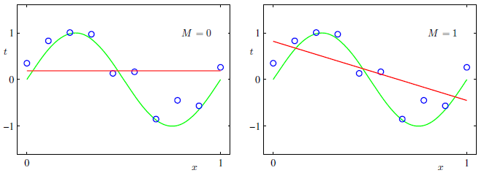
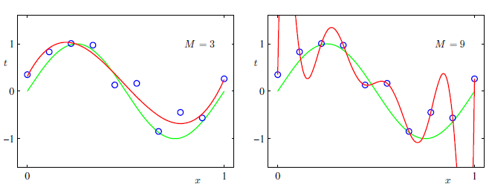
Model fitting is not Model selection/comparison
Model fitting: Tuning the presumed model → best fit to the data.
Finding parameters can be done analytically or using a parameter space search algorithm.
Model selection: Evaluating the balance between goodness of fit and generalisability
Intercept only
Intercept + height
Intercept + height + age
Intercept + height + age + …..
Notes:
INTERCEPT ONLY – model is relationship between variables, so the shape of the red line, and what dimensions it can move it.
Fit this model by changing intercept
INTERCEPT & HEIGHT
INTERCEPT + HEIGHT + AGE add age, fits data pretty well, but not exactly
INTERCEPT + A BUNCH MORE PARAMETERS we capture the data perfectly!
However this overfits the data – which we want to avoid as it makes the model less useful
We will return to this issue a few times

Slide 12
Outline
Frequentist Techniques
Introduction to Models
F test for General Linear Model (GLM)
Likelihood ratio test
Akaike Information Criterion (AIC)
Cross validation
Bayesian Methods
Conjugate priors
Laplace’s method
Bayesian information criterion (BIC)
Sampling
Variational Bayes
Notes:
Now we know what models are, and what it means to fit a model
We can talk about ways to compare them

Slide 13
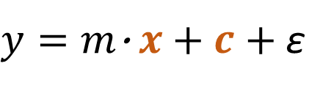
General Linear Model and assumptions
Observed data$=\left(slope\text{ ·} predictor variable\right)+intercept+$ residuals
D$og Preference=\left(slope\text{ ·} height\right)+intercept+$ residuals
$y=m\text{·} x+c+$ ε
Normality: Residuals must be Normally distributed
Unbiasedness: Residual distribution must be centered on 0
Homoscedasticity: Residuals have constant variance σ²
Independence: Residuals are independent
Notes:
GLM – lets start with our favourite model and write it in terms of our height dog preference model
Is foundation for many statistical models (t-test, F-test, ANOVA, MANOVA, linear regression) recap in first MfD lecture
LINEAR REGRESSION – Y, slope,and error are all colunn vectors (vary for each fitted model) it would represent linear regression.
NO DATA ASSUMPTIONS – we make no assumptions about the form of data y (doesn’t necessarily follow a normal distribution)
ERROR ASSUMPTIONS
Or residuals
Error does not mean wrong, they are deviations from fit
Different fitted model, different residuals (all the possible data dimensions we haven’t fit which is arguably infinite)
Thus to compare model fits, we can compare the error.

Slide 14

Model selection for General Linear Model – F test
Define models
Simple Model = Dog preference is predicted well by height.
$$Model \left(S\right)=m\text{·} x+c$$
Augmented Model = Dog preference is predicted better by height and age
$$Model \left(A\right)=m\text{·} x+n\text{·} x2+c$$
Notes:
F-TEST – use to compare models from the GLM,
There is some distribution of F under the null hypothesis, like the t statistic in a t-test
COMPARE TWO NESTEST MODELS – one includes all the parameters from the other, plus a new parameter
we are asking, is the model improved by adding an extra parameter.
Is it worth adding age?

Slide 15
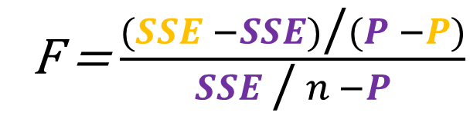
Model selection for General Linear Model – F test
Define models
Simple Model = Dog preference is predicted well by height.
$$Model \left(S\right)=m\text{·} x+c$$
Augmented Model = Dog preference is predicted better by height and age
$$Model \left(A\right)=m\text{·} x+n\text{·} x2+c$$
2. Comparing Error reductions
SSE: the sum of squared error;
P: the number of parameters
n: the number of observations
F = $\frac{(SSE −SSE)\text{/}(P −P)}{SSE \text{/} n −P}$
Notes:
COMPUTE AN F STATISTIC – will unpack this equation in just a moment
Essentially compares the residuals from each model
Just make it clear it is throwing out one statistic

Slide 16
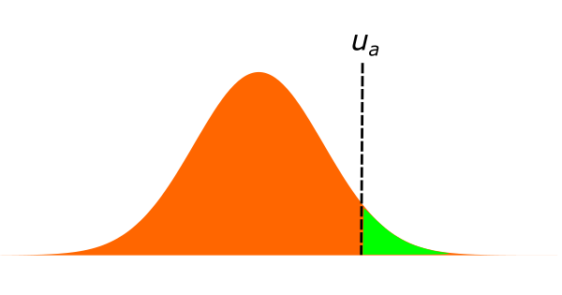
Model selection for General Linear Model – F test
Define models
Simple Model = Dog preference is predicted well by height.
$$Model \left(S\right)=m\text{·} x+c$$
Augmented Model = Dog preference is predicted better by height and age
$$Model \left(A\right)=m\text{·} x+n\text{·} x2+c$$
2. Comparing Error reductions
SSE: the sum of squared error;
P: the number of parameters
n: the number of observations
F = $\frac{(SSE −SSE)\text{/}(P −P)}{SSE \text{/} n −P}$
3. Significance test
Critical Value (df1)
F distribution
Notes:
COMPARE F TO DISTRIBUTION – defined by dof
Determine significance
If sig – accept the augmented model
Works for any nesting (intercept over slope and intercept)
Only add one parameter at a time.

Slide 17
Overfitting? What’s the problem?
Notes:
Using the f test we try and avoid overfitting
USING ONLY SSE FOR MODEL COMP – always select most complex model
Becomes less useful
Furthermore it may not be more accurate, may fit noise when trying to fit small amounts of variance

Slide 18
Overfitting? What’s the problem?
More parameters we have – the more variance in the data we will fit!
Notes:
CAVEAT – complex parameter search has stocasticty/local minimum so may fit worse with more parameters
How does the F test equation actually work?

Slide 19
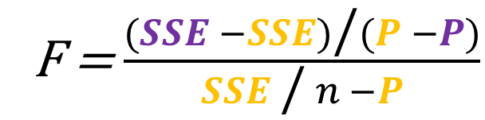
Overfitting? What’s the problem?
More parameters we have – the more variance in the data we will fit!
“What is the average error reduction contributed
by adding x extra parameters?”
Simple Model
Augmented Model
F = $\frac{(SSE −SSE)\text{/}(P −P)}{SSE \text{/} n −P}$
… is the augmented model enough of a better model for the data, that we should use it?
“What is the average remaining estimate error that can potentially be reduced?”
Notes:
Compare simple two para model, and augmented
Visually we can guess this would pass F

Slide 20
Overfitting? What’s the problem?
More parameters we have – the more variance in the data we will fit!
“What is the average error reduction contributed
by adding x extra parameters?”
Simple Model
Augmented Model
F = $\frac{(SSE −SSE)\text{/}(P −P)}{SSE \text{/} n −P}$
… is the augmented model enough of a better model for the data, that we should use it?
“What is the average remaining estimate error that can potentially be reduced?”
Notes:
Now compare this model to next one (change labels)
Probably would not pass F test, as error reduction per parameter does not look worthwhile

Slide 21
Outline
Frequentist Techniques
Introduction to Models
F test for General Linear Model (GLM)
Likelihood ratio test
Akaike Information Criterion (AIC)
Cross validation
Bayesian Methods
Conjugate priors
Laplace’s method
Bayesian information criterion (BIC)
Sampling
Variational Bayes
Notes:
An alternative to the F test is the Likelihood ratio test
Use evidence FOR the model, instead of SSE (evidence against it)

Slide 22
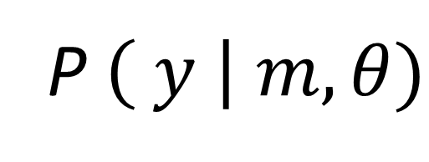
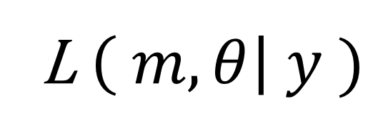
Likelihood is not Probability
P$\left( y \right| m,θ)$
What is the probability of observing the data (y) given the model parameters ($θ$)?
L $\left( m,θ\right| y )$
What is the likelihood of observing the parameter values ($θ$) given the data ($y$)?
Notes:
lets be clear on this – not just another word for probability
Opposite inference to probability
PROBABILITY
However, we have the data, so what we really want to ask is how likely is our model, given the data (we have the data!)
LIKELIHOOD - most plausible model and parameter values given out data
In model fitting, we want to want to find the most plausible parameter values given our data.
WE WANT TO MAXIMISE THIS
Thus we want to find the model, which can generate the more plausible parameter values. We want to find the model with the maximum likelihood.

Slide 23

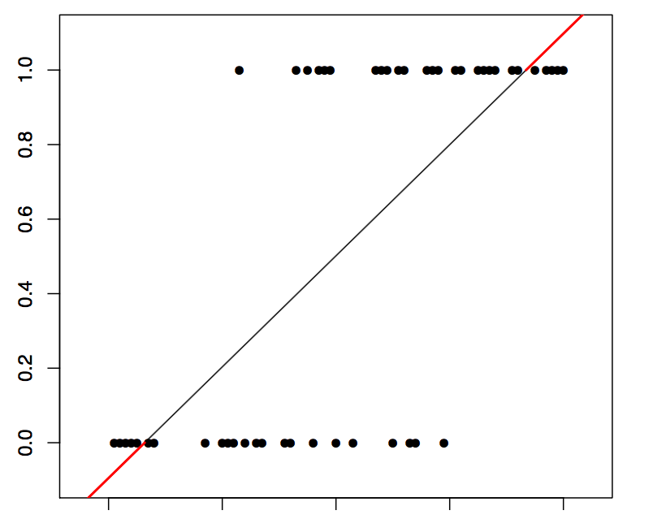


Maximum Likelihood Estimation
P(Dog)
P$\left( data \right| θ)$
Height
Notes:
BINARISE OUR RESEARCH QUESTION – method works for continuous too, just clearer for getting an intuition
Do p prefer D to C, can it be predicted by height
0 or 1
We can see from LR line the probability of the data, given our parameter values
Prob of 5’4” the data (being cat) is .8

Slide 24
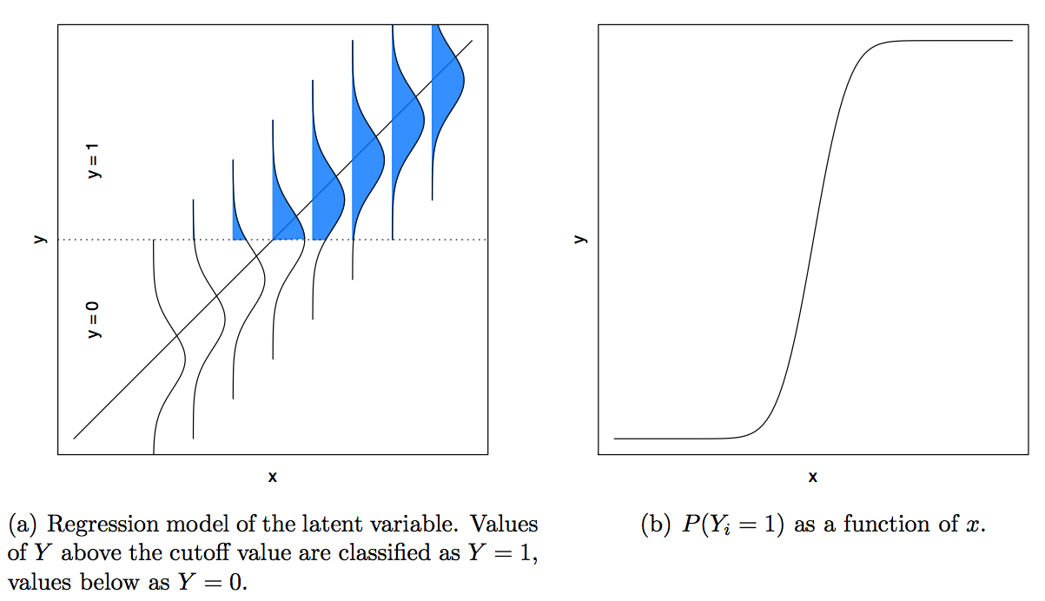
Maximum Likelihood Estimation
P(Dog)
P$\left( data \right| θ)$
Height
Notes:
We want to find the best parameter values
We can move this regression line to find the best fitting model
Blue area is individual probability of selecting dog
SOFTMAX = Next plot transforms blue area into values between 0 and 1
USE LIKELIHOOD TO FIT PARAMETERS -We want to know the joint probability for all these observations

Slide 25
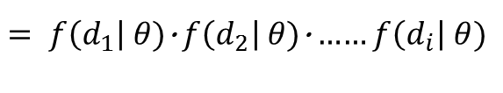
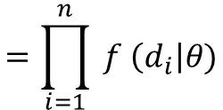
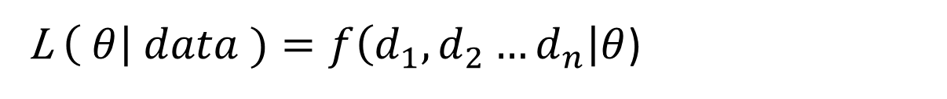
Maximum Likelihood Estimation
L $\left( θ\right| data )=f\left(d_{1},d_{2}…d_{n}\right|θ$)
$$=\prod_{i=1}^{n}{ f \left(d_{i}\right|θ)}$$
P(Dog)
P$\left( data \right| θ)$
$= f\left(d_{1}\right|$ $θ)\text{·}$ $f\left(d_{2}\right|$ $θ)\text{·}$…… $f\left(d_{i}\right|$ $θ)$
Height
Notes:
MULTIPLY PROBABILITY OF ALL DATA POINTS TOGETHER GIVES LIKELIHOOD OF PARAMETERS GIVEN THE DATA
We can use this for model fitting, find parameter values which give us the maximum likelihood

Slide 26
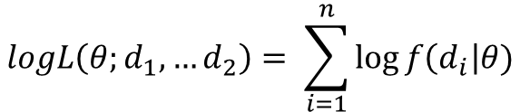

Maximum Likelihood Estimation
L $\left( θ\right| data )=f\left(d_{1},d_{2}…d_{n}\right|θ$)
$$=\prod_{i=1}^{n}{ f \left(d_{i}\right|θ)}$$
P(Dog)
P$\left( data \right| θ)$
$= f\left(d_{1}\right|$ $θ)\text{·}$ $f\left(d_{2}\right|$ $θ)\text{·}$…… $f\left(d_{i}\right|$ $θ)$
Height
“Find the parameter values that maximise this!”
Log transform to make it easier to compute
$$logL\left(θ;d_{1},…d_{2}\right)= \sum_{i=1}^{n}{\log{f\left(d_{i}\right|θ)}}$$
Or the average log-likelihood
$$\hat{l}= \frac{1}{n} logL$$
Notes:
LOG TRANSFORM for easier computation
Or average loglikeood (as long as you only use one)
indexes the likelihood of the model parameter values given the data.
Once maximized, we can use this statistic we can use for model comparison using the maximum likelihood method.
So this is cool as we are using the same method for finding the optimum parameter values, as we are using for hypothesis testing.

Slide 27

Model comparison for Maximum Likelihood
$$Model \left(S\right)=m\text{·} x+c$$
$$Model \left(A\right)=m\text{·} x+n\text{·} x2+c$$
1. Define Models
Notes:
MAXIMISE LIKELIHOOD, NOT MINIMISE SSE

Slide 28
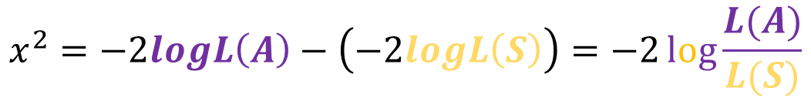
Model comparison for Maximum Likelihood
$$Model \left(S\right)=m\text{·} x+c$$
$$Model \left(A\right)=m\text{·} x+n\text{·} x2+c$$
1. Define Models
2. Comparing Loglikelihood
(Log)likelihood ratio test
“What is the difference between the log likelihood of the two models?”
$$x^{2}=−2logL\left(A\right)−\left(−2logL\left(S\right)\right)=−2\log{\frac{L(A)}{L(S)}}$$
Notes:
CALCULATE SOME STATISTIC compare loglikelihood’s of two models
Don’t worry about the -2 constant
Nice and intrinsicly, chi squared is the difference in likelihood between the simple and augmented models, or really any two models.

Slide 29
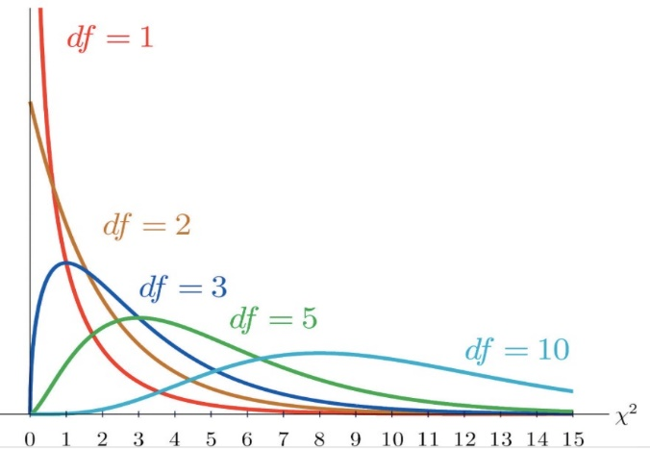
Model comparison for Maximum Likelihood
$$Model \left(S\right)=m\text{·} x+c$$
$$Model \left(A\right)=m\text{·} x+n\text{·} x2+c$$
1. Define Models
2. Comparing Loglikelihood
(Log)likelihood ratio test
“What is the difference between the log likelihood of the two models?”
$$x^{2}=−2logL\left(A\right)−\left(−2logL\left(S\right)\right)=−2\log{\frac{L(A)}{L(S)}}$$
3. Significance test
Critical Value (df1)
x² Distribution
Notes:
COMPARE WITH DISTRIBUTION GIVEN BY DOF Like f test
Don’t penalize for extra parameters
We need tests that don’t reply on penalties, we might be expotential vs power function
Good test but inefficient for many models

Slide 30
Outline
Frequentist Techniques
Introduction to Models
F test for General Linear Model (GLM)
Likelihood ratio test
Akaike Information Criterion (AIC)
Cross validation
Bayesian Methods
Conjugate priors
Laplace’s method
Bayesian information criterion (BIC)
Sampling
Variational Bayes
Notes:
For this we can use AIC

Slide 31

Model Comparison with Akaike Information Criterion (AIC)
Likelihood of model
Corrected/penalised for complexity (i.e. number of parameters)
$$AIC=−2\log{L\left(θ | y\right)}+2P$$
Notes:
PENALISES FOR COMPLEXITY

Slide 32
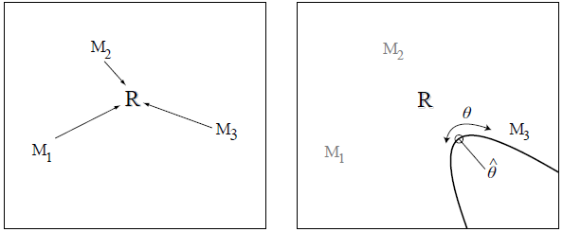
Model Comparison with Akaike Information Criterion (AIC)
Likelihood of model
Corrected/penalised for complexity (i.e. number of parameters)
$$AIC=−2\log{L\left(θ | y\right)}+2P$$
Minimise the information lost between the ‘real’ process (R) and the estimated model (M_{i})
Notes:
GROUNDED IN INFORMATION THEORY – not important but cool
IT – field that studies the quantification, storage and communication of information
Assume some real process which generates the data – want model to minimise info lost between them
Can’t calculate difference as don’t know real model
As different parameters means in different dimensions spaces/not comparable
Correcting for parameters puts them within the same space
Different in info between M1 and M2 can be used in play of difference.

Slide 33
Model Comparison with Akaike Information Criterion (AIC)
Likelihood of model
Corrected/penalised for complexity (i.e. number of parameters)
$$AIC=−2\log{L\left(θ | y\right)}+2P$$
Summed AIC for each participant
Minimise the information lost between the ‘real’ process (R) and the estimated model (M_{i})
Lowest value = Winning model!
Notes:
AIC FOR FULL DATA SET – OR FOR PARTICIPANTS INDIVIDUALLY?
i.e. have free parameters
Sum AIC and chose lowest
Don’t worry about scale, or compare between scales
- Also important to remember AIC is only relevant in comparison to other models with the same data (actual value of AIC is unimportant)

Slide 34
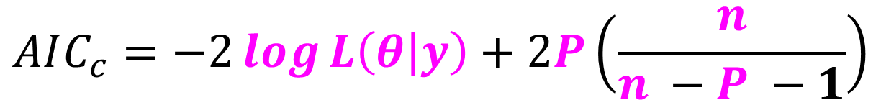
Model Comparison with Akaike Information Criterion (AIC)
Likelihood of model
Corrected/penalised for complexity (i.e. number of parameters)
$$AIC=−2\log{L\left(θ | y\right)}+2P$$
Summed AIC for each participant
Minimise the information lost between the ‘real’ process (R) and the estimated model (M_{i})
Lewandowsky & Farrell (2011)
Adding extra parameters increases maximum log-likelihood, but also increases uncertainty in the model predictions because each parameter is estimated with error.
Lowest value = Winning model!
$$AIC_{c}=−2\log{L\left(θ | y\right)}+2P\left(\frac{n}{n −P −1}\right)$$
Additional penalty when fitting model to small samples
Notes:
AICc – small sample (in comp to parameters) often overfits.
Further penalty for parameters
- AIC only chooses the best of the candidate models – it may not be a good model in an absolute sense if they are all bad!

Slide 35
Overfitting? Still a problem!!?!?
Notes:
Not finished! We could still overfit.
We know best model in model space, but how useful is it overall?
Generalisable - Can it predict parameters in other data sets?

Slide 36
Overfitting? Still a problem!!?!?
Model comparison tells us best/most useful model, but how useful is the model?
How can we really know how well we can fit to future data sets?
Redefine the problem…
…as one of assessing how well a model’s fit to one data sample generalises to future samples generated by the same process”
Pitt & Myung (2002)
Notes:
FOOLS ERRAND – FIND BEST MODEL, IN SET OF MAYBE BAD MODELS, BUT DON’T PICK A MODEL THAT’S TOO GOOD
Modelling is more art than science (sometimes)
One more piece of puzzle – how generalizable?

Slide 37
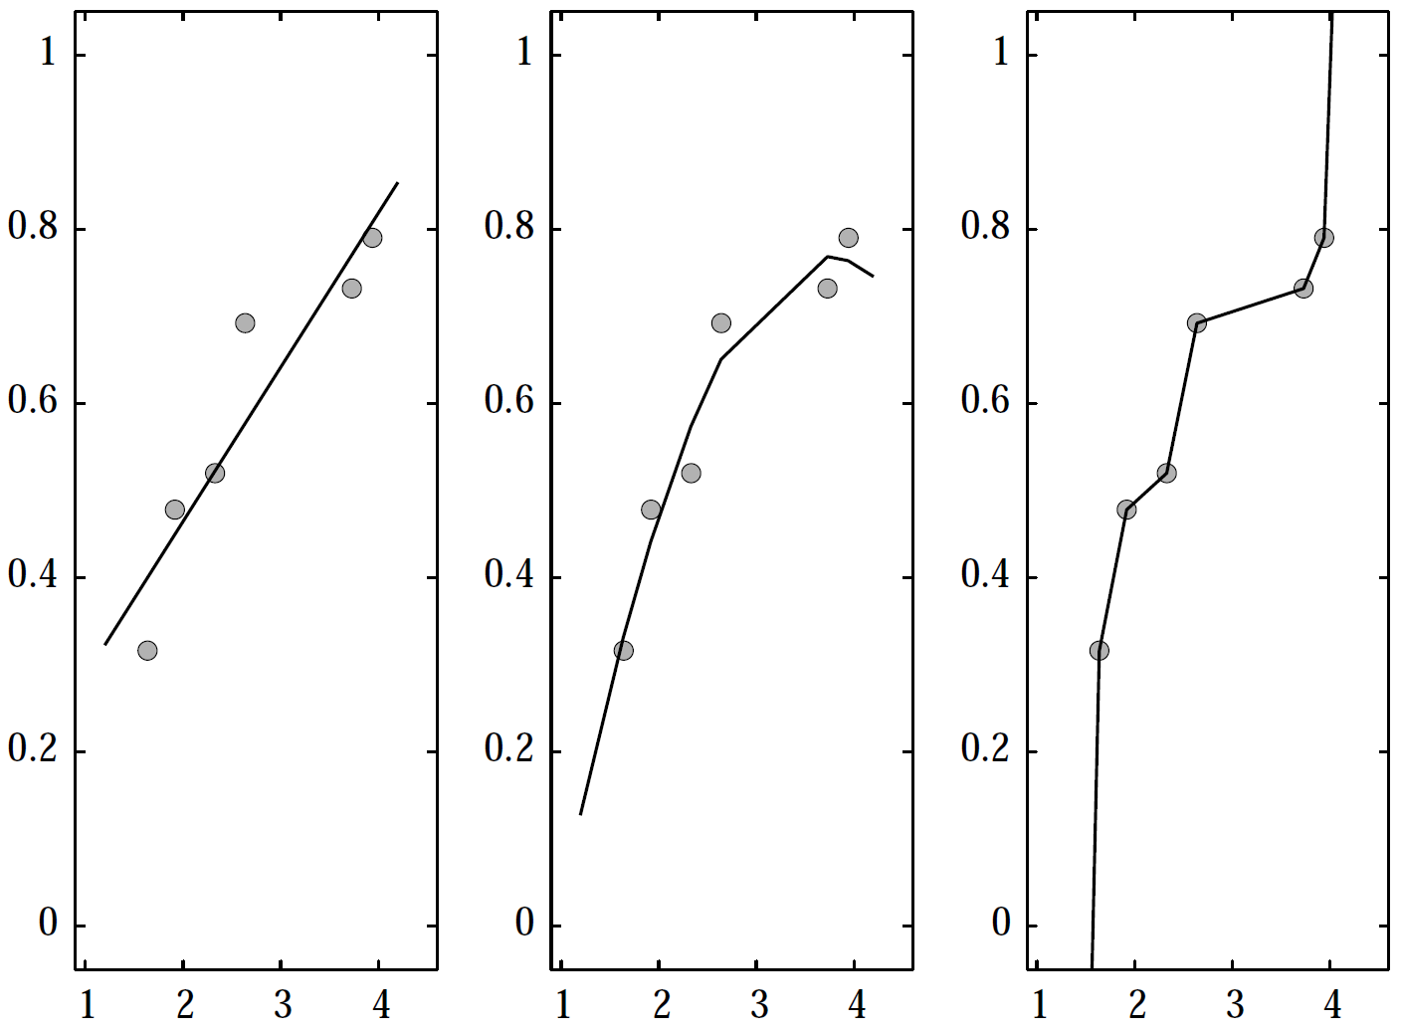
Overfitting? Still a problem!!?!?
Model comparison tells us best/most useful model, but how useful is the model?
How can we really know how well we can fit to future data sets?
Redefine the problem…
…as one of assessing how well a model’s fit to one data sample generalises to future samples generated by the same process”
Pitt & Myung (2002)
Lewandowsky & Farrell (2011)
Notes:
ILLUSTRATION
Generate orange data using some model with simulated noise
Perform model comparison (penalising for complexity) – pink model wins? Some polynomial model
Stopped us chosing green, but not pink.
We have guarded against unnecessary complexity
Only assumed this makes it generalizable – not actually calculated this/done inference
Use cross validation!

Slide 38
Cross-validation
Group of Techniques
Model is fit to a calibration sample and the best fitting model is compared to a validation sample.
New sample = different noise contamination!
Notes:
GROUP OF TECHNIQUES –
Fit to calibration sample, find best model
Compare to validation sample
How predictive is the C model of the V data set?
Under the assumption, a new sample will have a different noise contamination
Systematically construct our calibration and validation samples

Slide 39
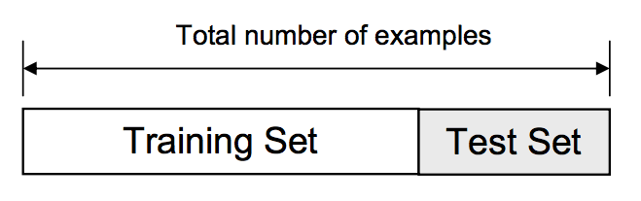
Cross-validation
Group of Techniques
Model is fit to a calibration sample and the best fitting model is compared to a validation sample.
New sample = different noise contamination!
1. The Holdout Method
Notes:
SIMPLEST VERSION – called holdout method
Split the data set into two
How we do this is non-trivial
V sample has to be meaningfully predicted by C sample – it must come from the same generative process.
fit parameters which describe a population (with our height and dog preference example) this will be the same generative process.
Fit parameters which are allowed to vary for each participant, so predict trial by trial behaviour of cats over dogs we would need to split within each participants data.
This is an active research area

Slide 40
Cross-validation
Group of Techniques
Model is fit to a calibration sample and the best fitting model is compared to a validation sample.
New sample = different noise contamination!
1. The Holdout Method
Lewandowsky & Farrell (2011)
Notes:
PLOT Here is a cartoon of this principle – we can see linear regression is the best
C sample says 2nd model is best
Very bad for V sample
Cross validation would have revealed this overfitting, where model comparison may have just stopped you choosing model 3.
HOWEVER
unless you have a massive data set, or maybe you are running an Mturk task this is a waste of data and means you are less likely to find the best fitting model in the first place.
Thus we have more sophisticated cross-validation methods we can use where we systematically construct our calibration and validation samples

Slide 41
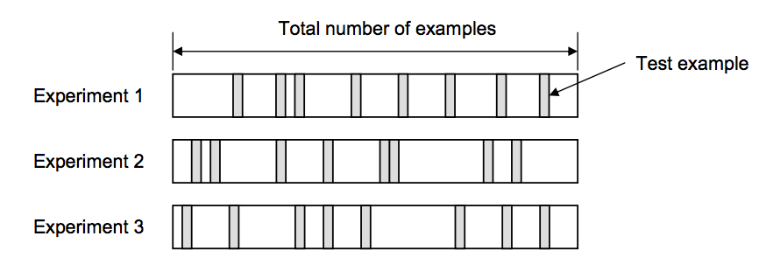
Cross Validation
2. Random Subsampling
Notes:
RANDOM SUBSAMPLING
We select the V samples randomly
Average across the error of all our validation samples
Compute average error across all Folds
Different ways to compute error depending on the kind of model you have
Root mean square for regression
Estimated cross-entrophy for categorical
I won’t go into those today, but there will be some details in the slide notes

Slide 42
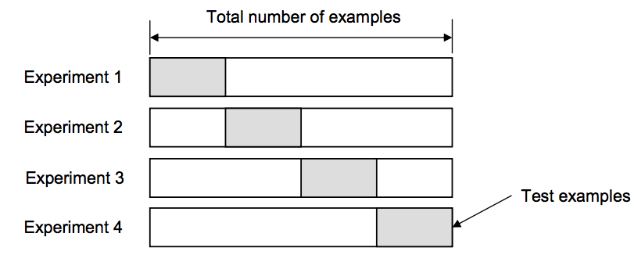
Cross Validation
2. Random Subsampling
3. K-Fold Cross Validation (e.g., K=4)
Notes:
K-FOLD CROSS VALIDATION
Partition original sample into k equal sized subsets.
Retain one sample as C, the remaining subsamples as V
Repeat the holdout method k times.
Each time one k set gets to be the V set.
Every datapoint gets to be in the V set once.

Slide 43
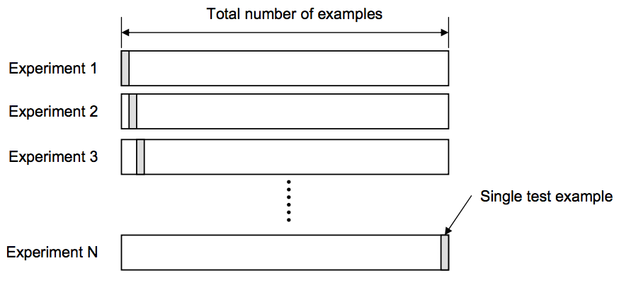
Cross Validation
2. Random Subsampling
3. K-Fold Cross Validation (e.g., K=4)
4. Leave-one-out Cross Validation
Notes:
LEAVE-ONE-OUT CROSS VALIDATION – extreme version of k fold,
K = N (number of data points in a set)
Decision depends on things such as computational cost,
e.g. Leave one out with an N of 100 you can to calibrate and validate 100 times, so do 200 fits.

Slide 44
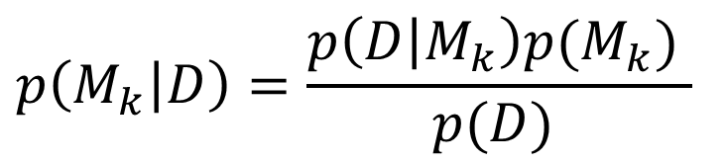

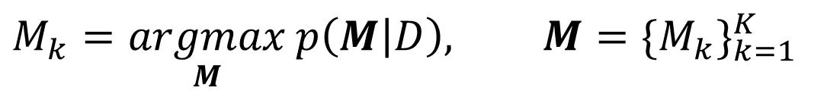
Bayesian model selection
$$p\left(M_{k} | D\right)=\frac{p\left(D | M_{k}\right)p(M_{k}) }{p(D) }$$
$$D$$
$$M_{k}$$
: observed data
(i)
: a model
(ii)
$$M_{k}=\underset{M}{argmax}{p\left(M | D\right), M={\{M_{k}\}}_{k=1}^{K}}$$
Bayesian model selection uses the rules of probability theory to select among different models
Notes:
In Bayesian model selection, Bayes rule is used to formulate the posterior over a model, given observed data
The model that most accurately describes the observed data is then chosen as the model that maximises the posterior probability

Slide 45

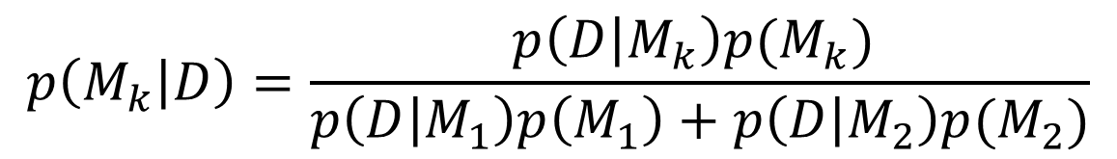

The Bayes factor
$$M_{1}$$
$$M_{2}$$
Assume two models and
The posterior for model k is:
By dividing the two posteriors (model evidence):
$$p\left(M_{k} | D\right)=\frac{p\left(D | M_{k}\right)p(M_{k}) }{p\left(D | M_{1}\right)p\left(M_{1}\right)+p\left(D | M_{2}\right)p(M_{2})}$$
The Bayes factor
$$\frac{p\left(M_{1} | D\right)}{p\left(M_{2} | D\right)}=\frac{p\left(D | M_{1}\right)}{p\left(D | M_{2}\right)}\frac{p(M_{1})}{p(M_{2})}=B_{12}∙\frac{p\left(M_{1}\right)}{p\left(M_{2}\right)}, { B}_{12}=\frac{p\left(D | M_{1}\right)}{p\left(D | M_{2}\right)}$$
The odds ratio
Notes:
Model 1 coul be height predicting dog liking; model 2 could be height and weight
0. In practice one uses something known as the Bayes factor to do Bayesian model comparison
1. Assume that the data has arisen under one of two models, M_1 and M_2
2. The posterior probability of model k, given the observed data, is then given by this expression
3. By dividing the two posteriors, that is…, we arrive at an expression which consists of model evidences and model priors.
4. The Bayes factor is then the ratios of model evicendes, and we can see that the Bayes factor can be used to compare two different models (point at LHS)
5. This shows that for model selection, at least in theory, Bayesians have the advantage. Because through a combination of Bayes Theorem and probability axioms, they can arrive at an expression for the model posterior in terms of computable quantities and priors.

Slide 46
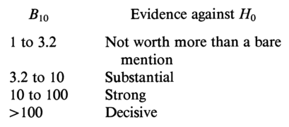



The Bayes factor – use in practice
However, note that this compares models- to each other. If all the models are poor quality, even the best among them will be poor
$$B_{12}$$
$$B_{12}$$
The Bayes factor
$$B_{12}=\frac{p\left(D | M_{1}\right)}{p\left(D | M_{2}\right)}$$
Notes:
The Bayes factor is a summary of the evidence provided by the data in favour of one scientific theory, represented by a statistical model, as opposed to another.
And in a well-known paper on the Bayes factor values were given for when to accept or reject a model, over another, based on the ratio calculated by the Bayes factor.
In the paper the authors write that these categories provides a rough descriptive statement about standards of evidence in a scientific investigation.
However, keep in mind that if all models considered are bad, Bayesian model selection will not make that much sense…
Furthermore, when comparing more than two models the Bayes factor can be defined as B_ij (the Bayes factor for M_i against M_j)

Slide 47
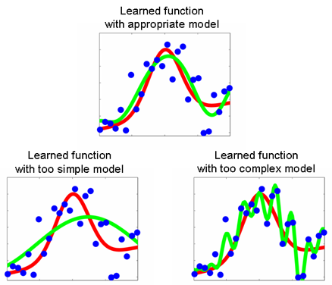
The Bayesian Occam’s razor
Model fit usually increases with more parameters, so does using a comparison based on likelihood of observing data given a model bias us towards more complex models?
Depends on how we approach the problem
If we think about integrating out parameters
We find that the marginal likelihood is not
Necessarily highest for the more complex model
This is the “Bayesian Occam’s Razor”
Remember, we care about the likelihood of
Observing data, given a model
Model too simple- not likely to generate the data
Model too complex- could generate lots of data,
But not necessarily this one in particular (i.e probability of
Generating data is spread out)
Notes:
2. You might think that using p(D|m) to select models would always favour the model with the most parameters. This is true if we use p(D|ˆ
θm) to select models, where ˆ θm is the MLE or MAP estimate of the parameters for model m, because models with more parameters will fit the data better, and hence achieve higher likelihood. However, if we integrate out the parameters, rather than maximizing them, we are automatically protected from overfitting:
models with more parameters do not necessarily have higher marginal likelihood. This is called the Bayesian Occam’s razor effect.
3. Occam’s razor is a problem-solving principle , which says one should pick the simplest model that adequately explains the data
4. In a Bayseian model selection context this means that: “Model classes that are too simple are unlikely to generate the observed data set” and “Model classes that are too complex can generate many possible data sets, so again, they are unlikely to generate that particular “

Slide 48
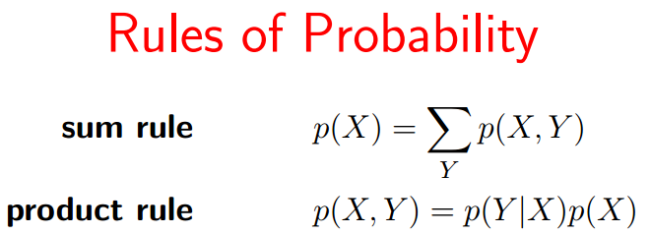
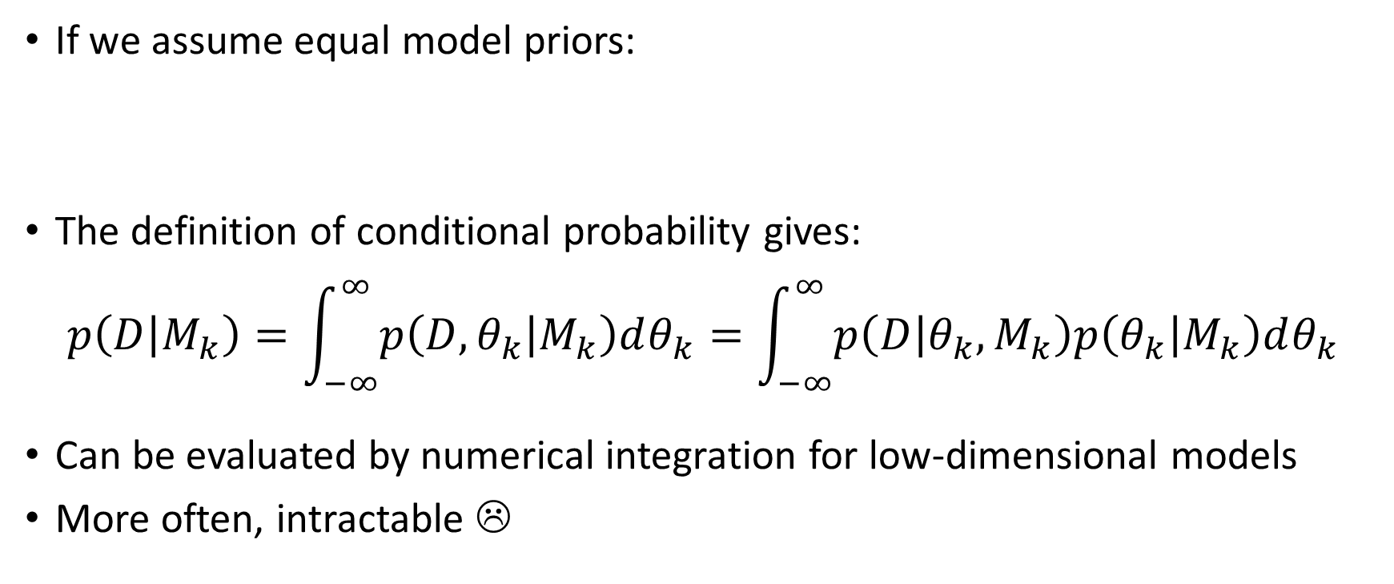
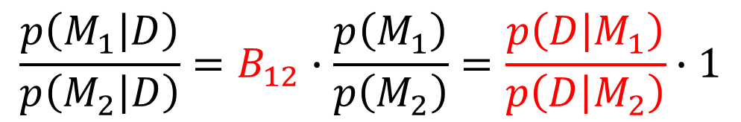
Calculating the Bayes factor
If we assume equal model priors:
The definition of conditional probability gives:
$$p\left(D | M_{k}\right)=\int_{−∞}^{∞}{p\left(D,θ_{k} | M_{k}\right)dθ_{k}}=\int_{−∞}^{∞}{p\left(D | θ_{k},M_{k}\right)p\left(θ_{k} | M_{k}\right)dθ_{k}}$$
Can be evaluated by numerical integration for low-dimensional models
More often, intractable ☹
$$\frac{p\left(M_{1} | D\right)}{p\left(M_{2} | D\right)}=B_{12}∙\frac{p\left(M_{1}\right)}{p\left(M_{2}\right)}=\frac{p\left(D | M_{1}\right)}{p\left(D | M_{2}\right)}∙1$$
Notes:
If we assume equal model priors , meaning that this expression equals one, we get an expression for comparing two models involving solely the Bayes factor, that is a ratio of Bayesian model evidences.
In order to calculate the evidence for model k we have to integrate over all possible parameter values for that particular model (where the rules of probability have been applied)
This integral can be calculated by numerical integration for low-dimensional models, but is more often intractable (meaning that there exist no efficient algorithms to solve the integration)

Slide 49
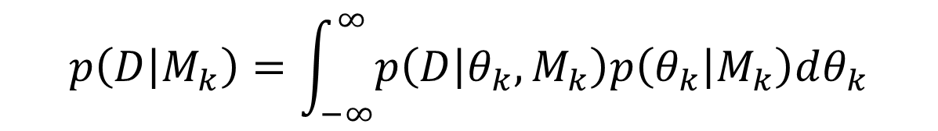
Evaluating the model evidence
$$p\left(D | M_{k}\right)=\int_{−∞}^{∞}{p\left(D | θ_{k},M_{k}\right)p\left(θ_{k} | M_{k}\right)dθ_{k}}$$
Calculating this integral is hard- so how do we go about it?
Conjugate priors
Laplace’s method
Bayesian information criterion (BIC)
Sampling
Variational Bayes
Exact
Approximate
Notes:
Back to calculating the Bayes factor, which means calculating this integral here.
There are numerous ways of doing it, besides numerical and probably intractable integration.
These methods can be separated into exact and approximate.
Exact methods involves using something known as conjugate priors
While approximate methods uses various technqiues...
In this talk we will not cover the junction tree algorithm or loopy belief propagation (-> Gatsby module unsupervised learning)

Slide 50
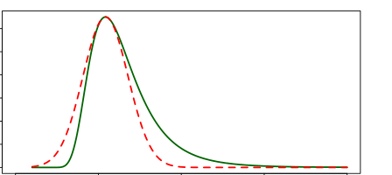
Conceptual overview of different methods:
Conjugate priors:
  Exact, numerical method
  Make the integral tractable using an algebraic trick: conjugate priors
  This means that the prior and posterior come from the same family of distributions
  Therefore only works for some models
Laplace’s Method:
  Approximate
  Assumes that the model evidence is
  highly peaked near its maximum
  (gaussian assumption) so only works for some
  models

Slide 51
Conceptual overview of different methods:
BIC:
  Approximate
  Compares models, similar to AIC
  n must be >> than the number of model parameters
  BIC vs. AIC:
    BIC looks at the posterior, AIC at the likelihood
    More penalization for complex models than the AIC
    AIC- helps avoid false –ve; BIC helps avoid false +ve
    Could use them together
Notes:
AIC is an estimate of a constant plus the relative distance between the unknown true likelihood function of the data and the fitted likelihood function of the model, so that a lower AIC means a model is considered to be closer to the truth. BIC is an estimate of a function of the posterior probability of a model being true, under a certain Bayesian setup, so that a lower BIC means that a model is considered to be more likely to be the true model. Both criteria are based on various assumptions and asymptotic approximations. Each, despite its heuristic usefulness, has therefore been criticized as having questionable validity for real world data. But despite various subtle theoretical differences, their only difference in practice is the size of the penalty; BIC penalizes model complexity more heavily. The only way they should disagree is when AIC chooses a larger model than BIC.
Thus, AIC always has a chance of choosing too big a model, regardless of n. BIC has very little chance of choosing too big a model if n is sufficient, but it has a larger chance than AIC, for any given n, of choosing too small a model.
So what’s the bottom line? In general, it might be best to use AIC and BIC together in model selection. For example, in selecting the number of latent classes in a model, if BIC points to a three-class model and AIC points to a five-class model, it makes sense to select from models with 3, 4 and 5 latent classes. AIC is better in situations when a false negative finding would be considered more misleading than a false positive, and BIC is better in situations where a false positive is as misleading as, or more misleading than, a false negative.
MCMC- The most basic scheme involves sampling parameter values and then taking the mean of the sampled likelihoods.

Slide 52
Conceptual overview of different methods:
Sampling/MCMC:
  Approximate
  Can be used to estimate parameters and parameter spaces by random sampling within and between parameter spaces
  Computationally costly
Notes:
AIC is an estimate of a constant plus the relative distance between the unknown true likelihood function of the data and the fitted likelihood function of the model, so that a lower AIC means a model is considered to be closer to the truth. BIC is an estimate of a function of the posterior probability of a model being true, under a certain Bayesian setup, so that a lower BIC means that a model is considered to be more likely to be the true model. Both criteria are based on various assumptions and asymptotic approximations. Each, despite its heuristic usefulness, has therefore been criticized as having questionable validity for real world data. But despite various subtle theoretical differences, their only difference in practice is the size of the penalty; BIC penalizes model complexity more heavily. The only way they should disagree is when AIC chooses a larger model than BIC.
Thus, AIC always has a chance of choosing too big a model, regardless of n. BIC has very little chance of choosing too big a model if n is sufficient, but it has a larger chance than AIC, for any given n, of choosing too small a model.
So what’s the bottom line? In general, it might be best to use AIC and BIC together in model selection. For example, in selecting the number of latent classes in a model, if BIC points to a three-class model and AIC points to a five-class model, it makes sense to select from models with 3, 4 and 5 latent classes. AIC is better in situations when a false negative finding would be considered more misleading than a false positive, and BIC is better in situations where a false positive is as misleading as, or more misleading than, a false negative.
MCMC- The most basic scheme involves sampling parameter values and then taking the mean of the sampled likelihoods.

Slide 53
Conceptual overview of different methods:
Variational Bayes:
  Instead of trying to solve the posterior exactly, or approximating the true posterior, you exactly solve an approximate posterior
  Then you measure the difference between the true and approximate posteriors (KL divergence)
  The approximation comes from factoring the model into different factors (the real model does not likely behave this way ). These factors are conditionally independent
  We want to maximize the evidence lower bound (constant term) to help minimize the discrepancy between approximate and true posteriors (maximize lower bound, then as KL goes to 0 that is your model evidence)
Notes:
Finally, we will briefly talk about VB.
In VB, the posterior distribution over a set of unobserved variables Z given the observed data is approximated by a variational distribution. These hidden variables include, e.g., model parameters.
The distribution Q is restricted to belong to a family of distributions of simpler form than the true posterior, selected with the intention of making Q similar to the true posterior,
The approximation to P(Z|D) is found through dissimilarity measure, most commonly the KL divergence.
The KL divergence is a measure (but not a metric) of the non-symmetric difference between two probability distributions P and Q.
The KL-divergence can be written as the log evidence equals the KL divergence plus a lower bound
As the log evidence is fixed wrt the distribution Q and the KL divergence is geq to zero, maximising the lower bound minimises the KL divergence between P and Q and therefore finds an approximate posterior. Furthermore, we also get a lower bound for the evidence that is useful in model selection.
Finally, if you have heard the term free energy, it is this lower bound that is meant.
n probability theory, two events R and B areconditionally independent given a third event Y precisely if the occurrence of R and the occurrence of B are independent events in their conditionalprobability distribution given Y.

Slide 54
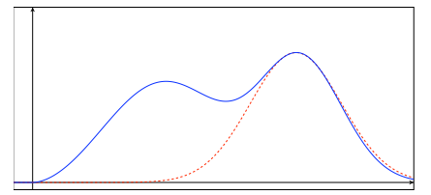
Bayesian model selection - Comparison of methods
Method | Positive | Negative
Exact analytic evaluation | Most accurate and efficient | Feasible for narrow class of models
Laplace’s method | Accurate and efficient | Basis-dependent, Gaussian
BIC | Easy to compute, no prior | DOF, no prior
Sampling | Improves w. samples, any model | Computationally costly
Variational Bayes | Efficient, complex models | Tedious maths
/ MCMC
Notes:
Finally, we like to show some pros and cons of these methods for Bayseian model selection
Conjugate priors: Gives an exact analytical solution that is the most accurate and also often the most efficient. However, conjugate priors are feasible only for a narrow class of models.
Laplace: Usually easy to compute and, if the posterior distribution is reasonably well modeled by a Gaussian, accurate (see the below figure). Additionally, the Laplace approximation is basis-dependent, i.e., if the density is transformed to then in general the approximate normalizing constants ZQ will be different. This can be viewed as both a pro or a con, because we can hunt for a choice of basis in which the Laplace approximation is most accurate
BIC: The BIC is popular because it is easy to compute and requires no prior. However, the lack of including the prior can also cause inaccurasies. Furthermore, if the model has a high number of DOF, it can be also be inaccurate.
Sampling: Requires a burn-in period but then usually improves with the number of samples and will theory equal the true posterior for an infinite number of samples. However it can be computationally infeasible to arrive at such an estimate. Also,
when there are islands of high-probability states, with no paths between them, a sampling method will struggle.
VB: For many applications, variational Bayes produces solutions of comparable accuracy to Gibbs sampling at greater speed. However, deriving the set of equations used to iteratively update the parameters often requires a large amount of work compared with deriving the comparable Gibbs sampling equation

Slide 55
The end! ☺
Questions?

Slide 56
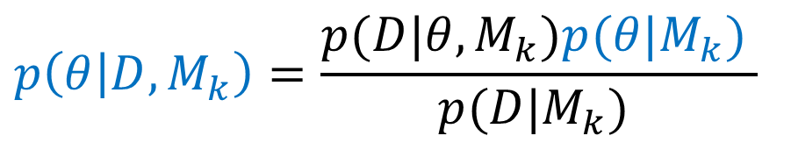

Exact analytic evaluation
If posterior and prior in the same family of distributions then they are conjugate and the prior a conjugate prior to the likelihood function:
A conjugate prior is an algebraic convenience
Gives a closed-form expression for the Bayes factor:
$$p\left(θ | D,M_{k}\right)∝p\left(D | θ,M_{k}\right)p\left(θ | M_{k}\right)$$
$$p\left(θ | D,M_{k}\right)=\frac{p(D|θ,M_{k})p(θ|M_{k}) }{p(D|M_{k}) }$$
$$p\left(D | M_{k}\right)=\frac{Z_{k}^{0}}{Z_{k}^{l}{∙Z}_{k}^{N}}$$
Notes:
The integral of interest can be evaluated analytically when conjugate priors are used
More specifically, if the posterior distributions p(θ|x) are in the same family as the prior probability distribution p(θ), the prior and posterior are then called conjugate distributions, and the prior is called a conjugate prior for the likelihood function
We won’t go into any details about conjugate priors in this talk but you can think of it as an algebraic convenience
That gives a closed-form expression for the model evidence in the form of normalisation constants

Slide 57
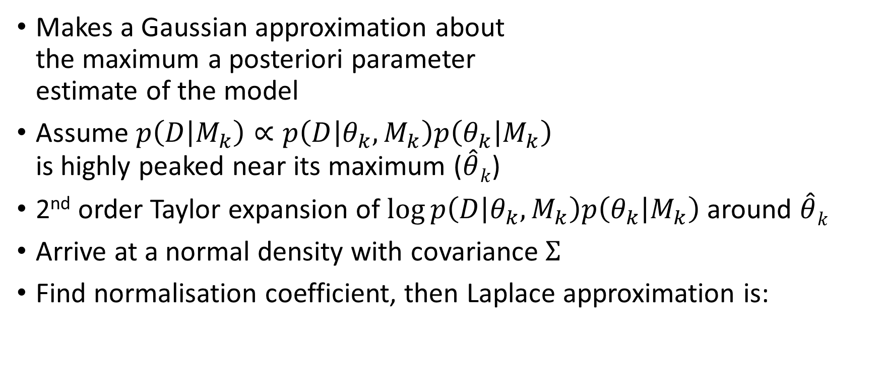
Laplace’s method
Makes a Gaussian approximation about the maximum a posteriori parameter estimate of the model
Assume $p\left(D | M_{k}\right)∝p\left(D | θ_{k},M_{k}\right)p\left(θ_{k} | M_{k}\right)$ is highly peaked near its maximum ($\hat{θ}k$)
2nd order Taylor expansion of $\log{p\left(D | θ_{k},M_{k}\right)p\left(θ_{k} | M_{k}\right)}$ around $\hat{θ}k$
Arrive at a normal density with covariance $Σ$
Find normalisation coefficient, then Laplace approximation is:
$$p\left(D | M_{k}\right)≈N\left(θ_{k} | \hat{θ}k,Σ\right)$$
Notes:
Next, on to the first approximate method, that is, a method that does not directly evaluate the baysian evidence.
Laplace’s method makes a Gaussian approximation about the maximum a posteriori parameter estimate of the model. Positing a Gaussian at the posterior mode is usually a good approximation when usually when the likelihood function is highly peaked around its maximum for large samples.
In practice this involves assuming that the baysian evidence is highly peaked near its maximum
An then performing a 2nd order taylor expansion around this maximum. If the resulting expression is exponentiated a zero mean normal density will pop out, with covariance sigma.
If we then integrate this normal density, we arrive at the Laplace approximation, where d are the DOF.

Slide 58
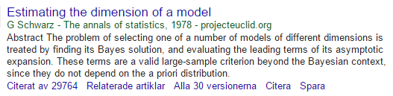


Bayesian information criterion (BIC)
The BIC can be obtained from Laplace’s method in the large sample limit:
As $N\overset{→}{}∞$ we obtain the BIC:
$$p(D|M_{k})≈{\left(2π\right)}^{−\frac{d}{2}}{\left|Σ\right|}^{\frac{1}{2}}p\left(D | θ_{k},M_{k}\right)p\left(θ_{k} | M_{k}\right)$$
$$\log{p(D|M_{k})}≈\log{p\left(D | \hat{θ}k,M_{k}\right)}+\log{\text{p}\text{(}\hat{θ}k\text{,} M_{k}\text{) }}+\frac{d}{2}log{2π}−\frac{2}{2}log{|Σ|}$$
$$\log{p(D|M_{k})}≈\log{p\left(D | \hat{θ}k,M_{k}\right)}−\frac{d}{2}log{N=BIC}$$
$$AIC=\log{p\left(D | \hat{θ}k,M_{k}\right)}−d$$
Notes:
The Bayesian information criterion, or the BIC in short, is another criterion for model selection among a finite set of models proposed by Gideon Schawarz in 1978.
The BIC can be derived from the Laplace approximation in the large sample limit. If we take the logarithm of the Laplace approximation and let the number of samples go to infinity, retaining only terms that grow in N, we arrive at the BIC.
The BIC is a very popular method for model selection because: it is quick and easy to compute and it does not depend on the prior
Compared to the Akaike information criterion you can see that the BIC is penalised, not only by the degress of freedom, but also by the number of samples. The BIC therefore tends to favor simpler models than those chosen by the AIC criterion.

Slide 59

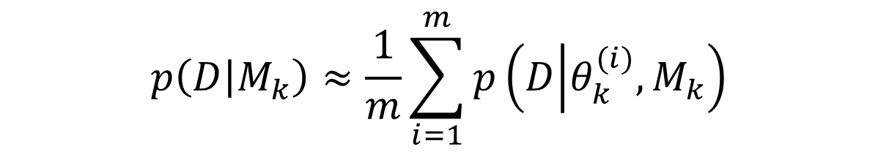
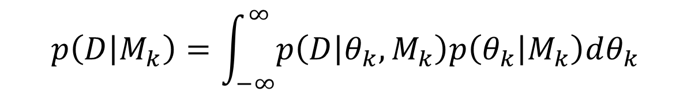
Monte Carlo sampling
$$p\left(D | M_{k}\right)=\int_{−∞}^{∞}{p\left(D | θ_{k},M_{k}\right)p\left(θ_{k} | M_{k}\right)dθ_{k}}$$
Basic Monte Carlo integration estimate:
The average of the likelihoods of the sampled parameter values ($θ_{k}^{(i)}$)
$$p\left(D | M_{k}\right)≈\frac{1}{m}\sum_{i=1}^{m}{p\left(D | θ_{k}^{(i)},M_{k}\right)}$$
Notes:
Monte Carlo methods are a broad class of computational algorithms that rely on repeated random sampling to obtain numerical results, e.g. to compute the Bayesian model evidence.
The most basic scheme involves sampling parameter values and then taking the mean of the sampled likelihoods.

Slide 60
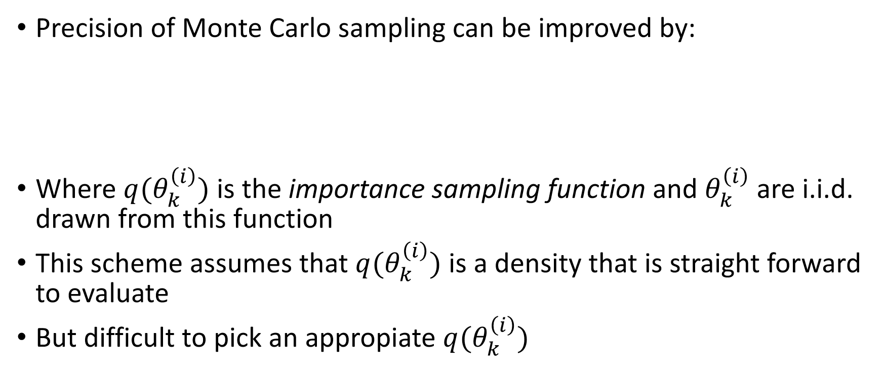
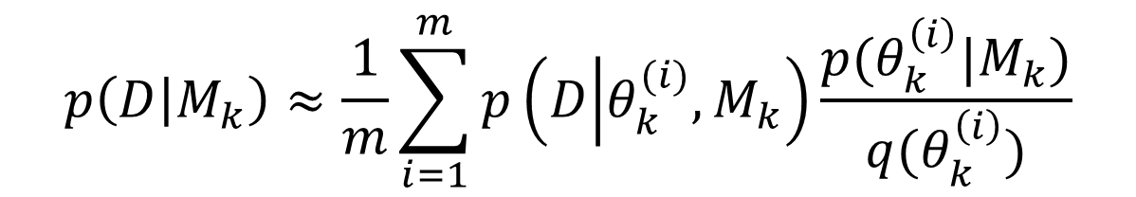
Importance sampling
Precision of Monte Carlo sampling can be improved by:
Where $q(θ_{k}^{\left(i\right)})$ is the importance sampling function and $θ_{k}^{\left(i\right)}$ are i.i.d. drawn from this function
This scheme assumes that $q(θ_{k}^{\left(i\right)})$ is a density that is straight forward to evaluate
But difficult to pick an appropiate $q(θ_{k}^{\left(i\right)})$
$$p\left(D | M_{k}\right)≈\frac{1}{m}\sum_{i=1}^{m}{p\left(D | θ_{k}^{(i)},M_{k}\right)}\frac{p(θ_{k}^{\left(i\right)}|M_{k})}{q(θ_{k}^{\left(i\right)})}$$
Notes:
Monte Carlo sampling can be improved by something known as importance sampling.
2. This essentially involves inclusion of an importance sampling function that samples are
independent and identically drawn from. With a adequatly chosen importance sampling function, a more accurate estimate can be obtained.

Slide 61
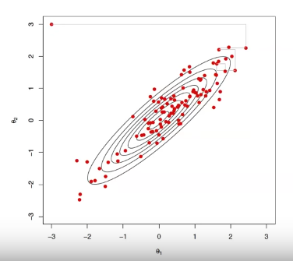


Markov Chain Monte Carlo (MCMC)
Importance sampling works better than basic Monte Carlo, but not well for higher dimensions
Create a Markov chain $Q_{i}\overset{→}{}Q_{i+1}…$ so that:
Popular methods:
  Gibbs sampling
  Metropolis–Hastings algorithm
$$\lim_{i\overset{→}{}∞}{Q_{i}\left(θ_{k}\right)=P(θ_{k}|D,M_{k})}$$
Notes:
1. As importance sampling does not always work well (e.g. for HD) we will now briefly mention another class of Monte Carlo algorithms that are very popular, MCMC, markov chain monte carlo.
2. MCMC methods are a class of algorithms for sampling from a probability distribution based on constructing a Markov chain that has the desired distribution of its equilibrium distribution. The state of the chain after a number of steps is then used as a sample of the desired distribution. The quality of the sample improves as a function of the number of steps.
3. Popular methods include Gibbs sampling and Metropolis Hastings

Slide 62




Variational Bayes
Posterior distribution approximated by a variational distribution:
The approximation to P(Z|D) is found through dissimilarity measure:
$$P\left(Z|D\right)≈Q\left(Z\right),$$
e.g., $Q\left(Z\right)=Q(θ)$
$$KL(Q|\left|P\right)$$
$$logP\left(D\right)=KL(Q|\left|P\right)+L(Q)$$
The free energy!
Notes:
Finally, we will briefly talk about VB.
In VB, the posterior distribution over a set of unobserved variables Z given the observed data is approximated by a variational distribution. These hidden variables include, e.g., model parameters.
The distribution Q is restricted to belong to a family of distributions of simpler form than the true posterior, selected with the intention of making Q similar to the true posterior,
The approximation to P(Z|D) is found through dissimilarity measure, most commonly the KL divergence.
The KL divergence is a measure (but not a metric) of the non-symmetric difference between two probability distributions P and Q.
The KL-divergence can be written as the log evidence equals the KL divergence plus a lower bound
As the log evidence is fixed wrt the distribution Q and the KL divergence is geq to zero, maximising the lower bound minimises the KL divergence between P and Q and therefore finds an approximate posterior. Furthermore, we also get a lower bound for the evidence that is useful in model selection.
Finally, if you have heard the term free energy, it is this lower bound that is meant.

Slide 63
Learning Resources
https://www.youtube.com/watch?v=lEDpZmq5rBw&t=529s
Dienes, Z. (2014). Using Bayes to get the most out of non-significant results. Frontiers in Psychology, 5: 781.
Rouder, J.N., & Morey, R. D. (2012). Default Bayes factors for model selection in regression. Multivariate Behavioral Research, 47, 877–903.
Wagenmakers, E.-J. (2007). A practical solution to the pervasive problems of p-values.Psychonomic Bulletin & Review, 14, 779–804
Judd, C. M., McClelland, G. H., & Ryan, C. S. (2008). Data Analysis: A Model Comparison Approach, Second Edition (2 edition). New York ; Hove: Routledge.
http://www.gatsby.ucl.ac.uk/teaching/courses/ml1-2016.html
http://theanalysisinstitute.com/assumptions-of-the-general-linear-model-and-how-to-check-them/
Zucchini- An Introduction to Model Selection
Notes:
http://www.gatsby.ucl.ac.uk/teaching/courses/ml1-2016.html

