Slide 1
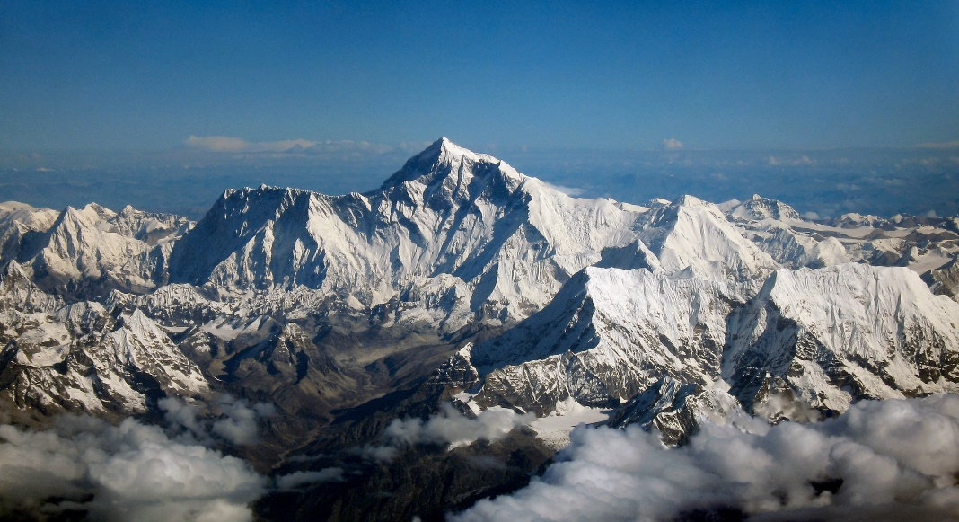
RANDOM FIELD THEORY
Sam Ereira & Rachel Bedder
Methods for Dummies 2017/18
With thanks to Guillaume Flandin

Slide 2
How do we correct for the multiple comparisons problem, when making discrete observations of a highly spatially correlated image?
Notes:
Random field theory is essentially how we correct for the multiple comparisons problem in neuroimaging, when are working with imaging data where we are making discrete observations of a highly spatially correlated image?

Slide 3
How do we correct for the multiple comparisons problem, when making discrete observations of a highly spatially correlated image?
Part 1
Recap of t-statistics and alpha threshold
Multiple Comparisons Problem
Bonferroni – why not?
- Spatial Dependency
Part 2
Motivation for random field theory (RFT)
Estimating smoothness
Using RFT to threshold the SPM

Slide 4



Spatial filter
Design matrix
Statistical Parametric Map
Realignment
Smoothing
General Linear Model
Statistical
Inference
RFT
Normalisation
We are here
Anatomical
reference
p <0.05
Parameter estimates
Notes:
Previously > finished pre-processing (realigned, unwarped, coregistered and spatially normalised, smoothed)
nice statistical maps made up of thousands of voxels
Next step is to fit GLM to our voxels so we can make inferences about where in the brain activation is occurring during different parts of our experimental design

Slide 5
Spatial filter
Design matrix
Statistical Parametric Map
Realignment
Smoothing
General Linear Model
Statistical
Inference
RFT
We need these
Normalisation
We are here
Anatomical
reference
p <0.05
T-test
Parameter estimates

Slide 6
T-test recap
Notes:
Briefly re-cap t-test statistics
We test our hypotheses by constructing test statistics > where we ask how likely is it our data came about by chance given the null hypothesis is true

Slide 7
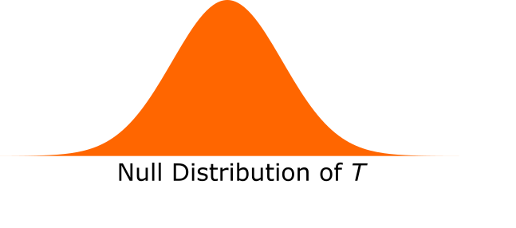
T-test recap
Null hypothesis H₀
No relationship between brain activity and task design matrix
Notes:
Null hypothesis is typically, there is no relationship between our design matrix/task design and observed brain activity.
Imaging data is agnostic to our experimental manipulation.

Slide 8

T-test recap
Null hypothesis H₀
No relationship between brain activity and task design matrix
Test Statistics
Null T-distribution – calculated from degrees of freedom (n -1)
t-statistic - evidence about H₀
u_{a} - accepted % of false positives
t statistic = sample mean – population mean
sample std / sqrt(n)
Notes:
We have a probability distribution of t under the null hypothesis which is defined by the degrees of freedom
We have derived a t-statistic for our selected model (GLM). Importantly, we have one t-statistic per model, so per inference we want to make. So 1 per voxel
how likely our t-statistic to have occurred should the null hypothesis be true (i.e. we want to know where in the distribution it lies)
Therefore Importantly, we need to define the threshold in the t-distribution for rejecting the null hypothesis, this is given as ua

Slide 9
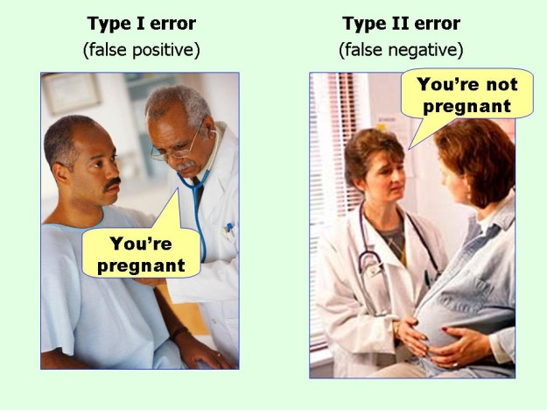
How likely is the t-statistic?
Set significance level – alpha (a)
Acceptable false positive rate
Typically set at .05 (5%)
Notes:
So we define an acceptable false positive rate, the probability of type I errors we are satisfied with.
Alpha is the probability that our t statistic will exceed the threshold (ua) given the null hypothesis.

Slide 10

How likely is the t-statistic?
Set significance level – alpha (a)
Acceptable false positive rate
Typically set at .05 (5%)
P-value summarises evidence against H₀
Probability of t (or greater) being observed given H₀ cannot be rejected.
$$a=p\left(t>u_{a}\right|{ H}_{0} )$$
Notes:
But we have some t-statistic and the area under the curve gives the probability that our t statistic could have occured
If pval exceeds alpha, we can reject the null hypothesis
Okay so this all sounds great, but when we are using imaging data we have thousands of t-statistics to compare with alpha threshold

Slide 11
Multiple Comparisons Problem
Fit one statistical model to each voxel
60,000 voxels = 60,000 t-tests
a = .05 (5%)
Independent tests * a = 3000 false positives
Notes:
If alpha is constant (.05) the more tests you have, the more false positives there will be
3000 is still only 5% of our data but this can still lead to erroneous findings.

Slide 12
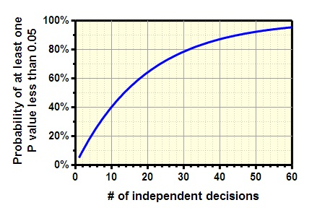
Multiple Comparisons Problem
Fit one statistical model to each voxel
60,000 voxels = 60,000 t-tests
a = .05 (5%)
Independent tests * a = 3000 false positives
Notes:
The probability of having one p value less than .05 grows expotentially with independent tests
This is termed family wise error, briefly explain the different kinds of error, but we will focus on familywise
So we need to adjust our threshold, but what kind of error do we want to guard against when we do this?

Slide 13
Types of Error-Rates
Per comparison
Controls probability of each observation being a false positive
Notes:
Per comparison
5% of null voxels will be false positives

Slide 14
Types of Error-Rates
Per comparison
Controls probability of each observation being a false positive
Family-wise Error-Rate (P_{FWE})
Controls probability of any false positives in a family
Notes:
Family is a group of statistics we want to make inferences about
Family-wise error rate
this means that there is only a 5% chance of the study having ANY false positives. So if you ran 20 null studies, only 1 would have a false positive statistical finding

Slide 15
Types of Error-Rates
Per comparison
Controls probability of each observation being a false positive
Family-wise Error-Rate (P_{FWE})
Controls probability of any false positives in a family
False-discovery
Controls ratio of true positives : false positives
Notes:
False discovery rate
Proportion of false positives, increases statistical power as you make fewer type II errors
FEW probability of making any false positive at all, FDR controls for a lower proportion of false positives, instead of guarding against making any at all

Slide 16
Types of Error-Rates
Per comparison
Controls probability of each observation being a false positive
Family-wise Error-Rate (P_{FWE})
Controls probability of any false positives in a family
False-discovery
Controls ratio of true positives : false positives
Notes:
Bonferroni controls FEW
To illustrate this…

Slide 17
Multiple Comparisons Problem
Bennett et al. 2009
Notes:
Atlantic Salmon where shown pictures of humans in social situations in an experiment to explore the neural correlates with interspecies perspective taking.
Small sample size of one salmon, who was importantly also dead, however groundbreakingly they found neural activation!

Slide 18
Multiple Comparisons Problem
a = .001
16/8064 active voxels
One active cluster 81mm³
Bennett et al. 2009
Notes:
Keeping their individual voxel alpha value at .001 they excitingly found 16 out of 8064 voxels
So the problem is clear > when you make multiple comparisons in a family of statistical tests you are very likely to have many false positives
> but what is the solution? We need to make the threshold higher to decrease the probability of false positives

Slide 19
Multiple Comparisons Problem
a = .001
16/8064 active voxels
One active cluster 81mm³
Using two multiple comparison corrections, no active voxels
Family-wise error-rate
False discovery rate
Bennett et al. 2009
Notes:
These contrasts indicated no active voxels, even when they allowed the individual voxel alpha to be set to .25
One way to solve the MCP, particularly correcting for family wise error is Bonferroni correction

Slide 20
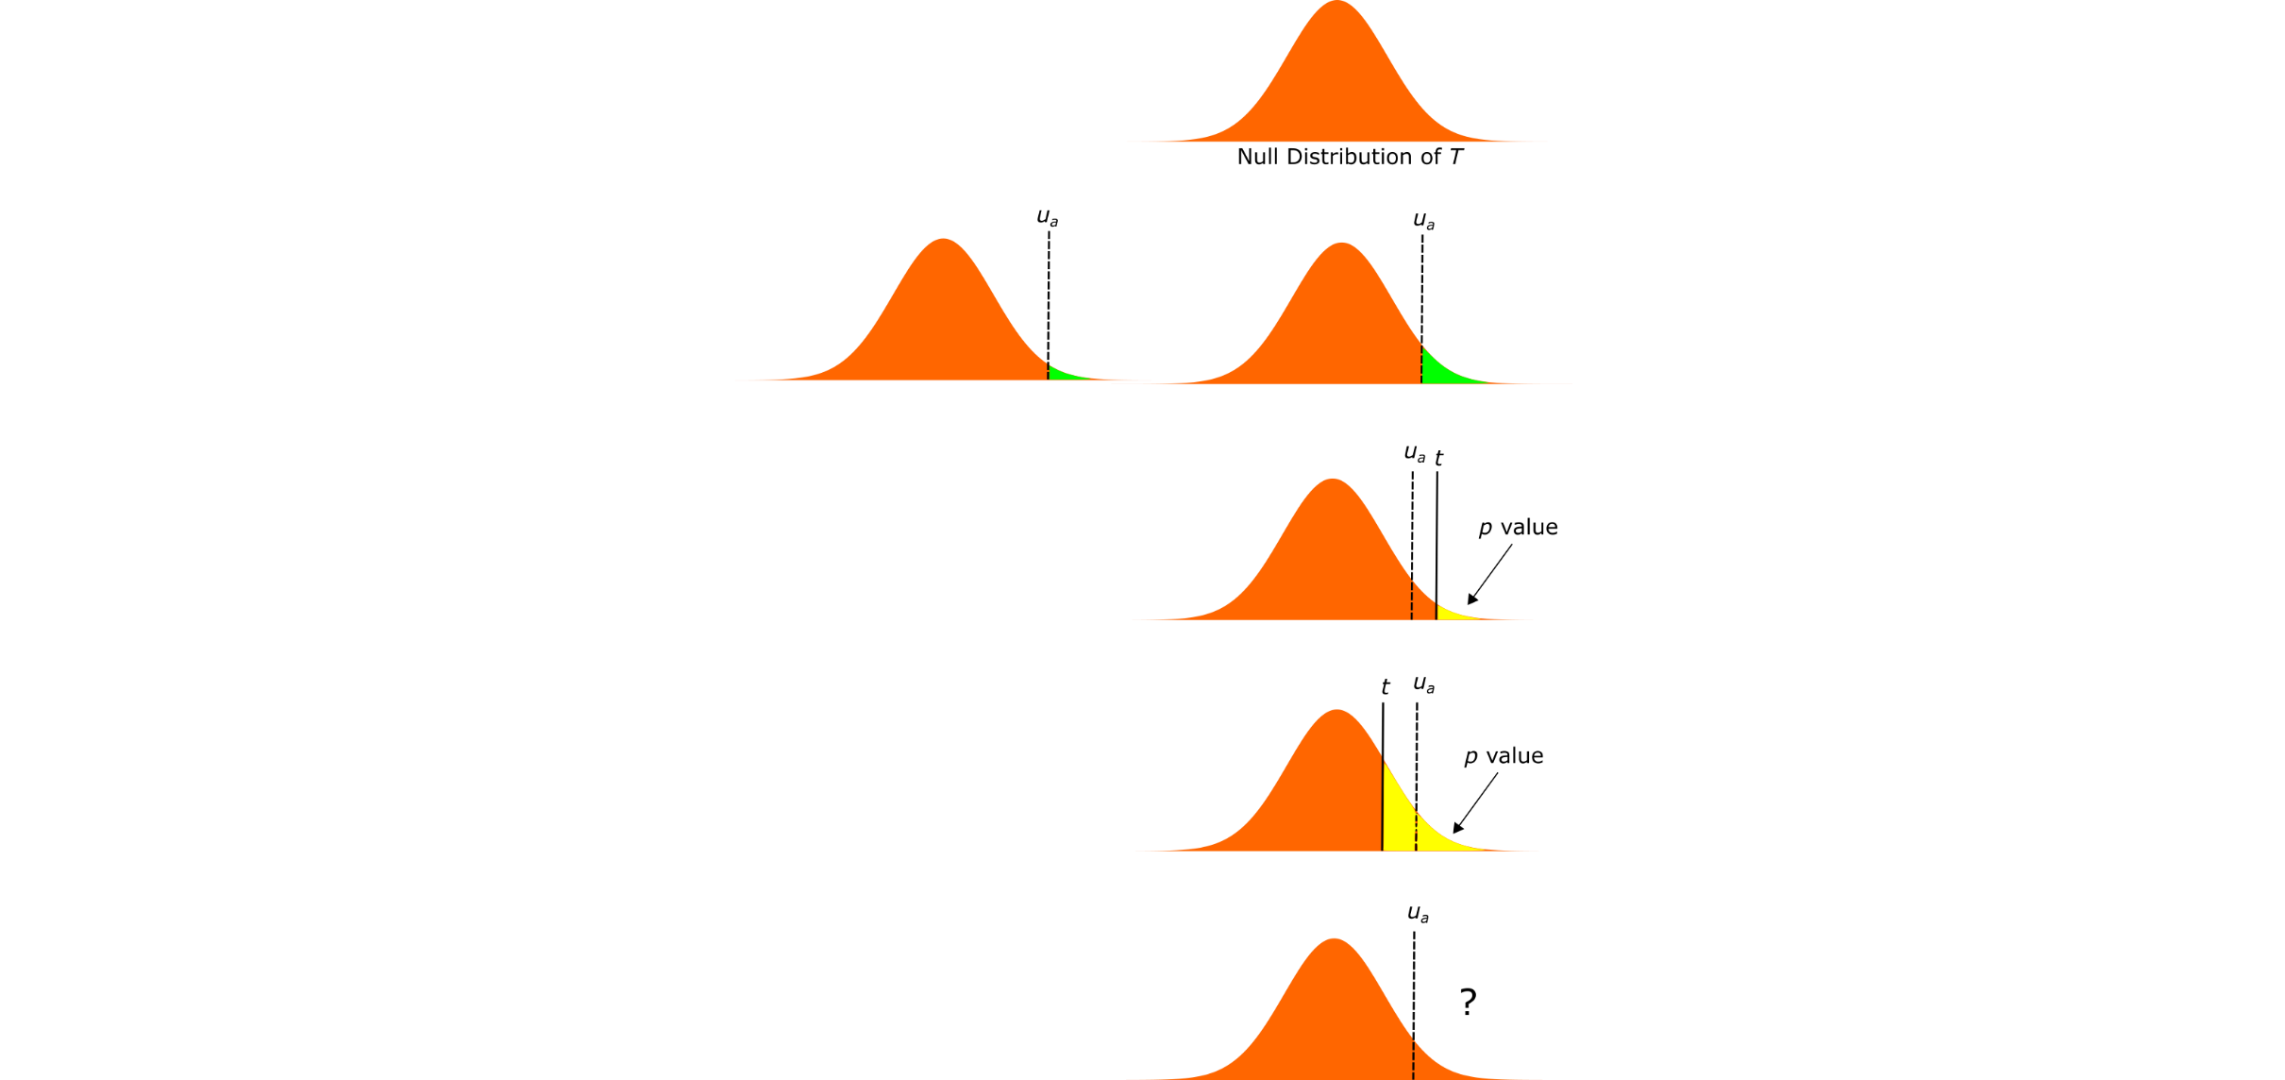
Bonferroni Correction
single-voxel probability threshold
Number of voxels
α = P_{FWE} / n
Family-wise error rate
Notes:
Control FWER by finding an appropriate alpha value for the number of independent t-tests needed to perform.
FWE is scaled by the number of independent tests giving us a new threshold for our t-statistic

Slide 21
Bonferroni Correction
single-voxel probability threshold
Number of voxels
α = P_{FWE} / n
P_{FWE} = .05
60,000 voxels
a = .0000008
Family-wise error rate
Notes:
To show this analytically

Slide 22
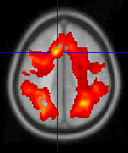
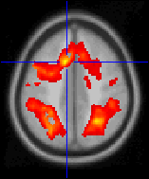
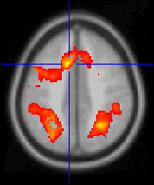
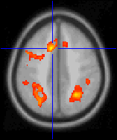
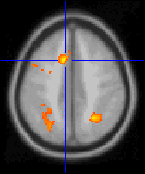
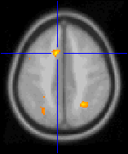
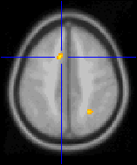
Bonferroni Correction
single-voxel probability threshold
Number of voxels
α = P_{FWE} / n
P_{FWE} = .05
60,000 voxels
a = .0000008
Family-wise error rate
Adjust threshold so finding any values above U_{a} are unlikely under the null hypothesis
Notes:
Statistical map can then be thresholded to only show t Values > than ua
Fewer significant voxels
Adjust threshold so any values above threshold are unlikely under the null hypothesis (height thresholding)
So this sounds logical, so why don’t we use just use this for imaging data, why both with complicated things like random field theory if we have this nice simple correction?

Slide 23
Bonferroni Correction – too conservative!
Individual voxels will not have independent t-statistics
- scanner collects and reconstructs image
- spatially correlated due to regional specificity
- pre-processing increases spatial correlation
Notes:
Critical difference between a set of discrete statistical values
imaging data is that we are essentially discretely sampling from a continuous function, where voxels will be spatially correlated
For many reasons, we don’t know how much each one contributes to the smoothness
Neighbouring t-values are likely to be highly correlated – but how spatially correlated, we don’t know!

Slide 24
Bonferroni Correction – too conservative!
Individual voxels will not have independent t-statistics
- scanner collects and reconstructs image
- spatially correlated due to regional specificity
- pre-processing increases spatial correlation
therefore…
No. of independent values < number of voxels
α = P_{FWE} / ?
Notes:
So we don’t know what to replace n with in the Bonferroni correction
We don’t want to be too conservative else we reduce the sensitivity to identify truly active voxels
increase the amount of false negatives we will be making
To give you an intuition for why bonferroni is not appropriate for spatially correlated data

Slide 25
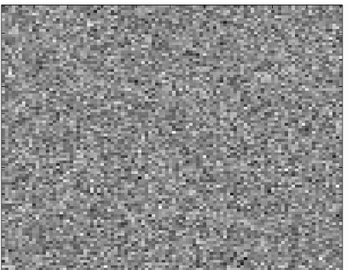
Spatial correlation - intuition
10,000 random values from normal distribution
How many values are more positive than is likely by chance?
Notes:
Voxels here have been assigned random value from normal distribution.
100 x 100 array
We make 10,000 observations of a normal distribution which has some mean, lets say it’s a z-map so the mean is 0 which is some grey colour.
Our alternative hypothesis is that the mean is higher than 0.

Slide 26
Spatial correlation - intuition
10,000 random values from normal distribution
How many values are more positive than is likely by chance?
Uncorrected a
0.05*10,000 = 500 false positives
Notes:
If we used an standard alpha of .05 we would have 500 false positives,
instances of rejecting the null hypothesis which in this case should not be rejected because data is generated from a null distribution

Slide 27
Spatial correlation - intuition
10,000 random values from normal distribution
How many values are more positive than is likely by chance?
Uncorrected a
0.05*10,000 = 500 false positives
Corrected a
.000005 = .05/10,000
0.00005*10,000 = 0.05 <1 False Positive
α = P_{FWE} / n
Notes:
If we use Bonferroni to correct alpha, we would only have false positives less than once overall/i.e. for the entire family
This seems intuitive – why can’t we do this for imaging data?
The example here has no spatial correlation, as each observation has been sampling randomly

Slide 28
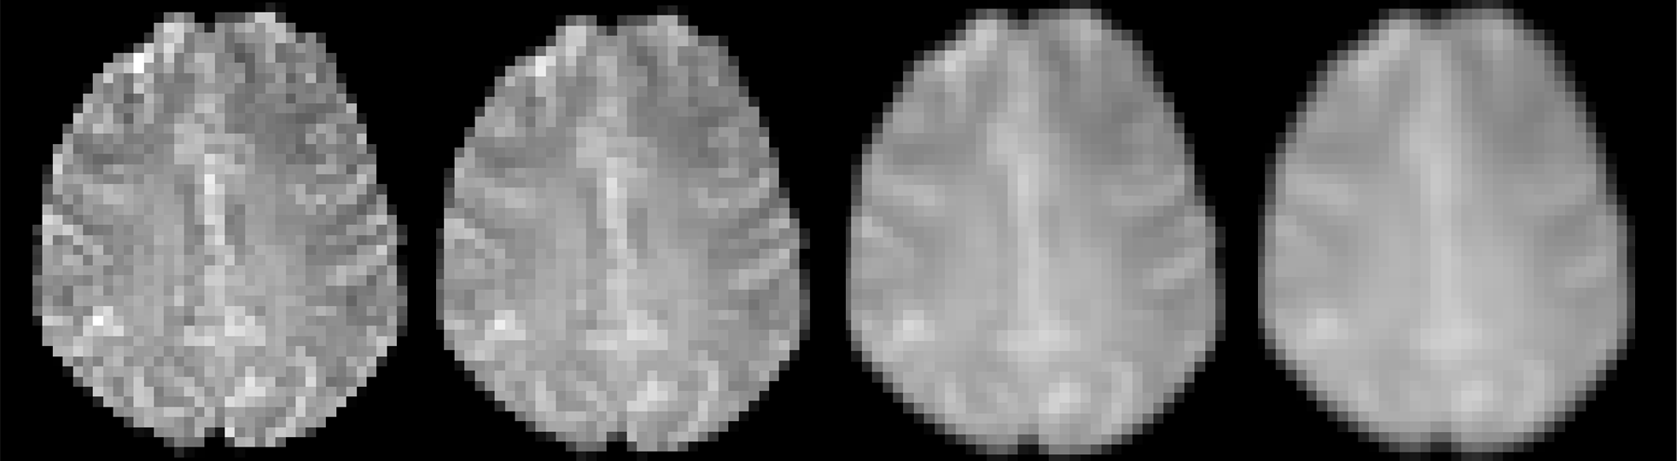
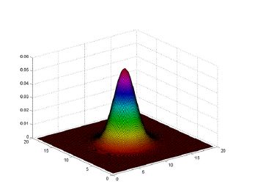
Smoothing increases spatial dependency
Increased smoothing
Increased spatial correlation
Smoothing: each value replaced by a weighted average of itself and its neighbours
Notes:
During pre-processing we smooth the data, by replacing the value of each voxel of the image with a weighed sum of it’s neighbours.
This increases the signal to noise ratio, and necessarily reduced the number of independent values are the neighbours are highly spatially correlated
Example of a Gaussian kernel
Original pixel receives heaviest weight, neigjbouring pixels receive smaller weights as a function of their distance from the original pixel
Spatial correlation cause by many things, this is just one example

Slide 29
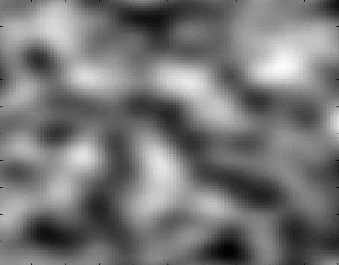
Smoothing increases spatial dependency
Increased smoothing
Increased spatial correlation
Smoothing: each value replaced by a weighted average of itself and its neighbours
Notes:
During pre-processing we smooth the data, by replacing the value of each voxel of the image with a weighed sum of it’s neighbours.
This increases the signal to noise ratio, and necessarily reduced the number of independent values are the neighbours are highly spatially correlated
Example of a Gaussian kernel
Original pixel receives heaviest weight, neigjbouring pixels receive smaller weights as a function of their distance from the original pixel
Spatial correlation cause by many things, this is just one example

Slide 30
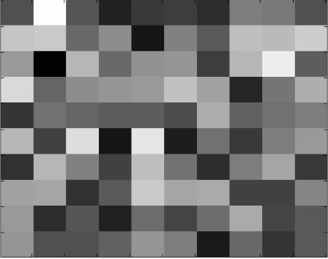
Add spatial dependency (average across 10 x 10 squares)
Bonferroni correction for 10,000 voxels now x100 too conservative!
…but we don’t know how spatially dependent our data really is?
Notes:
Average data points across 10x10 squares, so essentially smoothing it.
Now there was only 100 independent values.
Bonferroni correction of for 10,000 is 100 times too conservative

Slide 31
How do we solve spatial dependency problem?
How smooth is the data?
How many independent observations?
Notes:
Bonferroni provides a solid foundation to controlling for family wise error-rate.
The threshold does need to be increased to account for the number of independent observations.
However considering the spatial dependency of functional imaging data we have two problems
a) We don’t know how many independent observations are in our data. Lots of kinds of spatial dependency, so even if we did have a metric of one (i.e. how much smoothing the data has had) it wouldn’t be useful

Slide 32
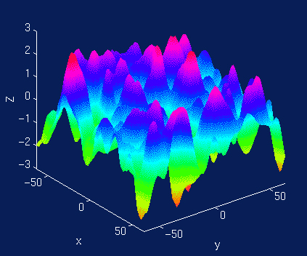
Random Field Theory: topological inference
Notes:
RFT allows us to model data as coming from a continuous process.
And this is important because the fact that our data are generated by a continuous process means that we have this smooth spatially correlated structure.
There are hundreds of individual spatial locations but only a few independent regions.
In terms of statistical inference in brain imaging, we have thousands of voxels but only a few independent statistical tests.
RFT controls the expected number of false positive topological regions, not voxels (like in Bonferroni). We will treat the data as a discretisation of a continuous random field
So we’re going to turn our statistical inference problem into a topological inference problem. We’re going to interrogate the shape of this field
N.B. Here we only have x and y but in brain it’s x, y and z!
Everything I’m going to show you is in 2 dimensions or occasionally 1 dimension. We can’t visualise 3 dimensions

Slide 33
Topological inference
Set level inferences
  Is the number of clusters significantly above chance?
Cluster level inferences
  Is the the spatial extent (volume) of the cluster significantly above chance?
Peak level inferences
  Is the peak of the cluster significantly above chance
  We’ll use this example today!
More sensitivity
More specificity
intensity
t_{α}
t_{clus}
space
Notes:
Topological feature could be the magnitude of activation or the number of clusters or the size of clusters?

Slide 34
How is RFT used?
Inputs
  Desired FWER
  Information about the topology (size, shape, smoothness)
Output
  Statistical threshold (e.g. t-stat, z-stat, etc.)

Slide 35
Smoothness: from voxels to “resels”
SPM looks at the residuals from your model and estimates the smoothness of this random field

Slide 36
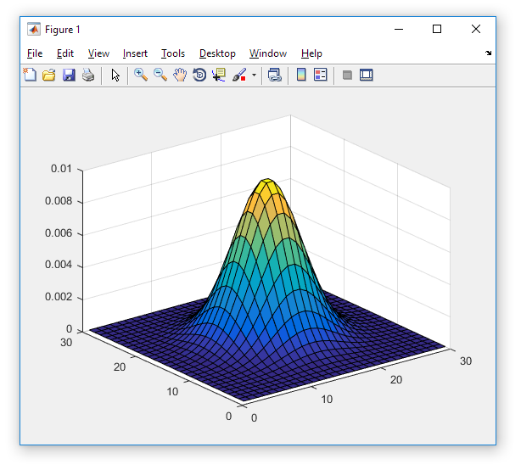
Smoothness: from voxels to “resels”
Notes:
But how do we quantify smoothness It’s basically just a degree of spatial correlation.
It’s helpful to think about how you might make data smooth yourself. And we can make data smooth by introducing local spatial correlations by convolving the data with a Gaussian kernel.
So in here we’ve got three dimensions. 2 of them are spatial and the other dimension is the degree of activation.
And we’re going to apply this kernel at every spatial point in this map and replace the activation value with a new number that also contains some information about the neighbouring points. (averaging with neighbour) So if this kernel is very wide with shallow sides, the data will become very very smooth. If it’s very tall and pointy it won’t incorporate much information from neighbouring locations so the data won’t be as smooth.
the question we’re really asking is what does this smoothing function look like? What does this gaussian kernel look like?

Slide 37
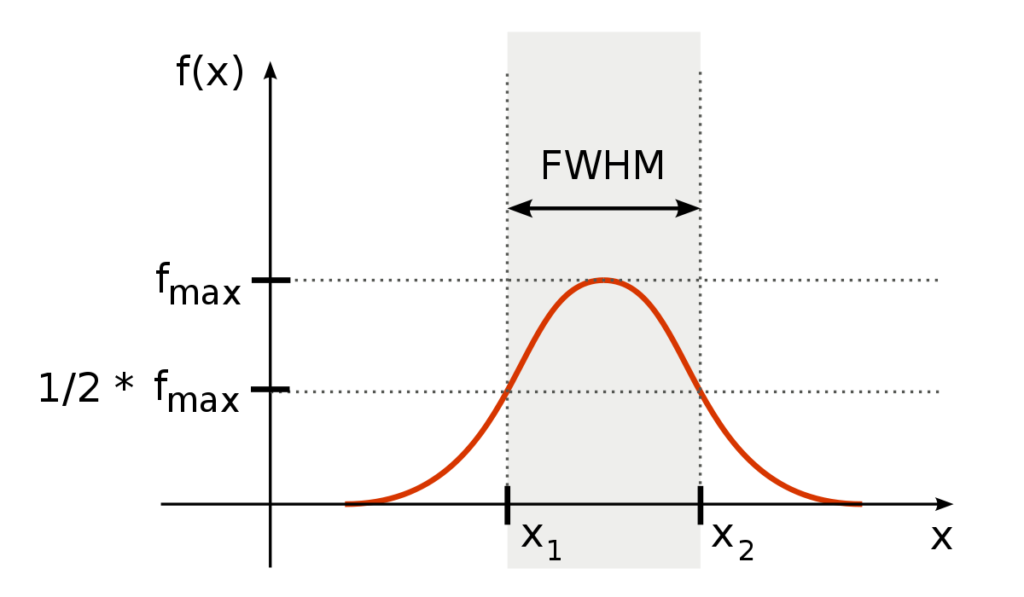
Smoothness: from voxels to “resels”
Notes:
And more specifically we want to know how wide the kernel is
So here we’re looking at a kernel with one spatial dimension on the x axis. On the y axis is our activation. And the feature of our kernel we’re interesed in is something called the FWHM which stands for FULL WIDTH AT HALF MAXIMUM.
To derive the FWHM we first take the peak and get our fmax.
Then we half that value to get ½ * fmax
And then we see what is the width here, so x2- x1.
So this basically tells us how wide is our kernel.
Now in our brain data we don’t have 1 spatial dimension

Slide 38
Smoothness: from voxels to “resels”
FWHM_{x} = 3
FWHM_{y} = 3
FWHM_{z} = 3
A Resel (Resolution element) is a block of values that is the same size as the FWHM
R = search volume/smoothness
R = 10,000/(3*3*3) = 370.4
27 voxels
1 Resel
Notes:
The number of resels depends on the smoothness (FWHM) and the number of voxels (volume)

Slide 39
Smoothness: from voxels to “resels”
What do Resels buy us?
  An approximation to the number of independent observations
  BUT NOT IDENTICAL…YOU CAN’T JUST USE BONFERRONI USING NUMBER OF RESELS
Don’t we already know the smoothness?
  No! There are other sources of smoothness, in addition to what we added ourselves.
Notes:
Bonferroni assumes a discrete process. But the whole point is that we’re modelling our data as being generated from a continuous process

Slide 40
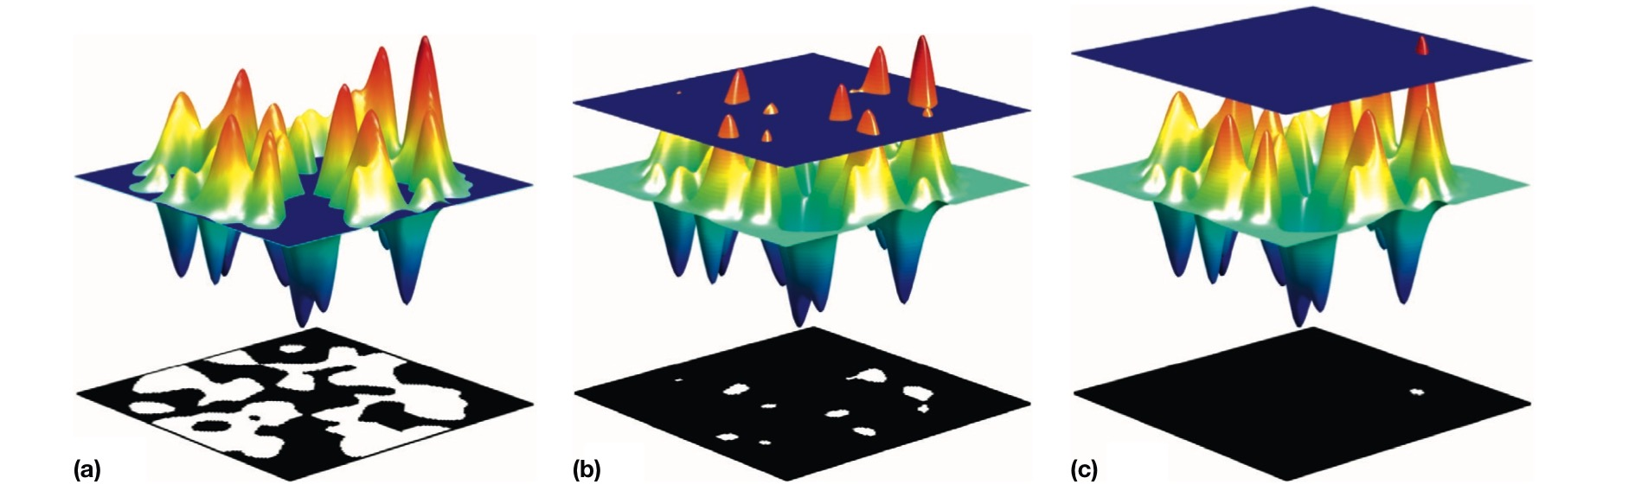
Thresholding the random field (the expected Euler characteristic)
E[EC] = N(blobs) – N(holes)
Notes:
We’ve got our random field and we’re going to take this blue rectangle and slice our random field at different tresholds.
So on the left we’re slicing with a threshold which is a fairly low z-statistic, in the middle we’ve got a fairly high z-statistic and on the right we’re slicing it with a very high z-statistic.
And underneath each image there’s a shadow. The white bits show the blobs that you’re left with after slicing.
So on the right we’re just left with one little red bit up here which corresponds to one little blob on the shadow.
And you can see not only are there white blobs but there are also black holes (only in the one on the left)
And we’re interested in a statistic called the expected Euler characeristic which is the number of blobs minus the number of holes.
Again we’re limited in that we can only show a 2d example. This topological definition is only true in this case of a 2dimensional field. It’s a bit more complicated in 3 dimensions but the concept is essentially the same.
So an Euler characerstic only makes sense in the context of a thresholded image you need a threshold first.
If our threshold is high enough we only have blobs we don’t have any holes. And at extremely high thresholds the number of blobs is 0 or 1

Slide 41
E[EC] is an approximation of p_{fwe}
Notes:
And in this kind of range, the E[EC] is a good approximation of the probability of observing a blob by chance, and this is the p value that we’re after.

Slide 42
Using RFT to find a threshold
Set this to your desired p_{fwe}
The number of resels in your volume
Output: The relevant threshold
Notes:
This is an example of a 2 dimensional field where we’re using z-statistics.
In our cases the formula will be a different to this but it’s all under the hood in SPM anyway. The formula will be different because there’s another spatial dimension, also we probably won’t be using a z-statistic we’ll be using an F-statistic or a t-statistic or chi-squared. Also if we’re looking at a small-volume of the brain then the shape of the field will change and this euler characteristic also depends not only on volume but also on the surface area and the diameter of the field so that will all get included whether you’re looking at the whole brain or a specific mask.

Slide 43
Assumptions
Error fields are a reasonable lattice approximation to an underlying random field
  (….with a multivariate Gaussian distribution, if using cluster-extent)
These fields are continuous, with twice-differentiable autocorrelation function
Assumptions may not be met if:
  RFX analysis with small sample because result error fields might not be very smooth.
Solutions:
  Subsample your voxels to increase smoothness?
  Use non-parametric method instead?
  Control FDR instead of FWER?
YOUR CLUSTER-FORMING THRESHOLD NEEDS TO BE STRINGENT ENOUGH
  “A useful rule of thumb here is that if clusters have more than one peak, then the cluster-forming threshold is probably too low”
Notes:
Cluster-forming threshold:
basically you need to specify your own uncorrected p value threshold to to identify your clusters in your dataset. And then we’re assuming that there’s a null distribution of cluster sizes that we use RFT to generate corrected p values. But the assumptions that we use to make that null distribution break down if the cluster-forming threshold is not high enough

Slide 44
Assumptions
t_{cus}
t_{cus}
space

Slide 45
Assumptions
Error fields are a reasonable lattice approximation to an underlying random field
  (….with a multivariate Gaussian distribution, if using cluster-exstent)
These fields are continuous, with twice-differentiable autocorrelation function
Assumptions may not be met if:
  RFX analysis with small sample because result error fields might not be very smooth. You could subsample your voxels or use non-parametric method instead or control FDR?
YOUR CLUSTER-FORMING THRESHOLD NEEDS TO BE STRINGENT ENOUGH
  “A useful rule of thumb here is that if clusters have more than one peak, then the cluster-forming threshold is probably too low”
  “A sufficiently high threshold is usually guaranteed with the standard cluster forming threshold of p = 0.001 (uncorrected)”
  (Flandin and Friston, 2017)
Notes:
Cluster-forming threshold:
basically you need to specify your own uncorrected p value threshold to to identify your clusters in your dataset. And then we’re assuming that there’s a null distribution of cluster sizes that we use RFT to generate corrected p values. But the assumptions that we use to make that null distribution break down if the cluster-forming threshold is not high enough

Slide 46
Resources
An introduction to random field theory (Brett, Penny and Kiebel, 2003)
Topological inference (Flandin and Friston, 2015)
Analysis of family-wise error rates in statistical parametric mapping using random field theory (Flandin and Friston, 2017)
Previous MfD slides
Mumfordbrainstats youtube channel

