Slide 1
Statistical analysis
Student’s t-test, and Linear regression

Slide 2
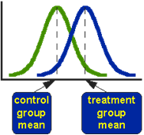
Student’s t-test
Does a drug treatment provide the typical time to symptoms relief or is it different?
Does a new drug treatment differ in time to relief from the standard treatment?
Compare the means of two sets of data and assess if they are significantly different from each other
Small size

Slide 3
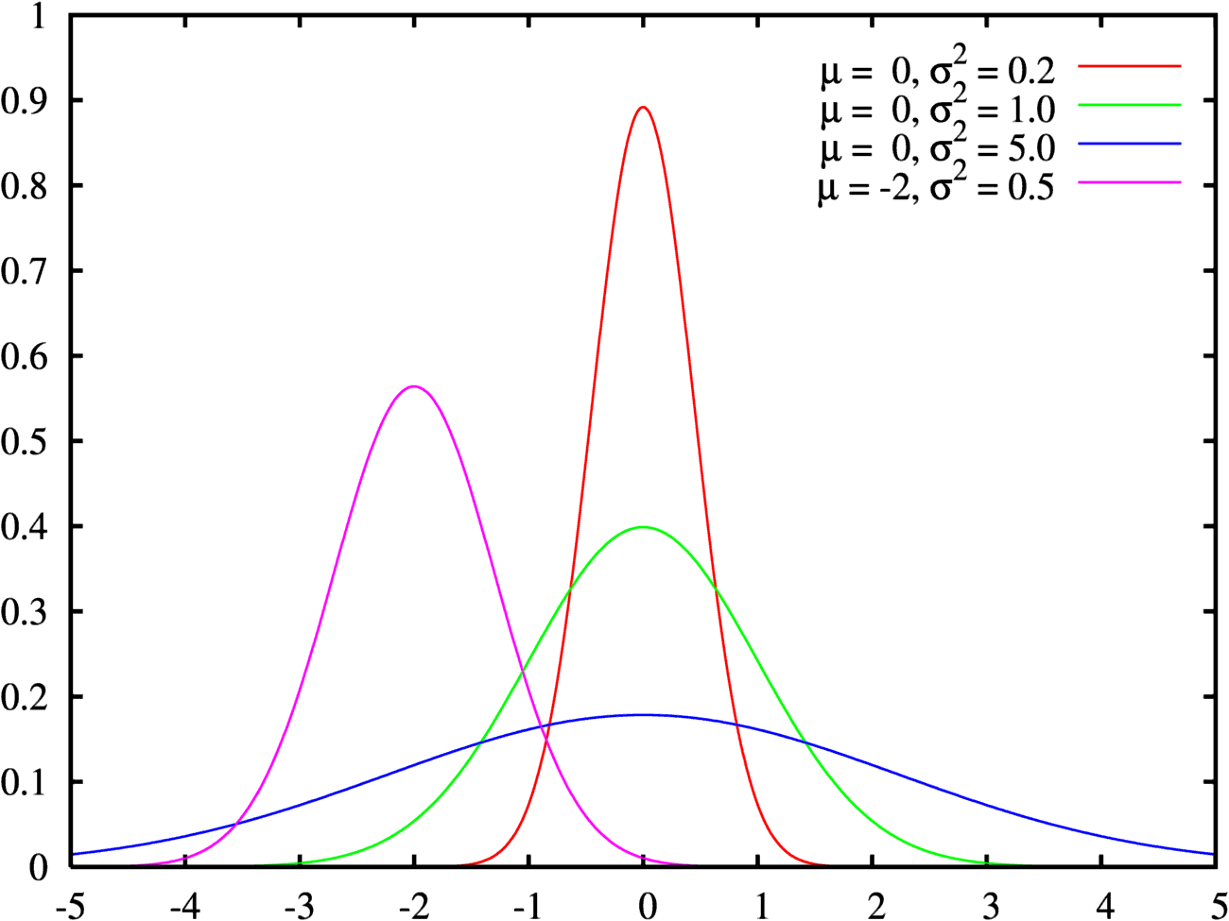
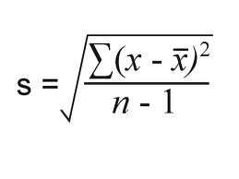
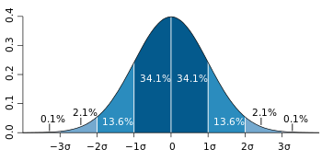
Assess the difference of means in relevance to the spread of the variability of their scores
μ → mean
σ or s → standard deviation

Slide 4
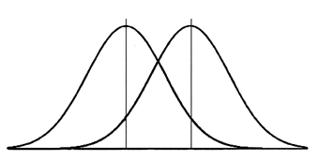
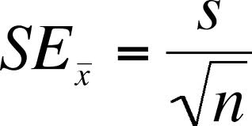
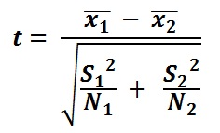
Signal to noise ratio
$$t=\frac{signal}{noise}=\frac{difference between group means}{variabiliy of groups}$$
Variability of groups
standard error

Slide 5
How do we use it?
Compute the t-value
Compare with known distributions to check the statistical significance
Choose level of significance(p=0.05) and accept or reject null hypothesis
Samples
Tails
Assumptions
Notes:
α, is the probability of rejecting the null hypothesis when it is true
EXAMPLES! Imaging examples

Slide 6
One/paired/independent samples
T-TEST | COMPARISON | RESEARCH QUESTION
One-sample | comparison of the sample mean to the population mean | Is the brain activity in the prefrontal cortex in patients that suffer from depression abnormal?
Paired samples | Comparison of repeated measures in the same sample | Does treatment change the activity in the prefrontal cortex of patients suffering from depression?
Independent samples | two separate sets of independent and identically distributed samples | Do treatments A and B have different effects on the activity of the prefrontal cortex of patients suffering from depression?
Notes:
α, is the probability of rejecting the null hypothesis when it is true
EXAMPLES! Imaging examples

Slide 7
One/two-tailed tests
Two tailed-test: test both if mean1 is significantly greater than mean2 and if the mean significantly less than mean2
→ Drug A and drug B
One-tailed test: testing differences among many different experimental conditions
→ Drug A is cheaper than the standard drug B

Slide 8
Assumptions
Normally distributed samples
Normality tests: Shapiro-Wilk or Kolmogorov-Smirnov
Same variances
If not: Welch’s t-test
Independent samples

Slide 9
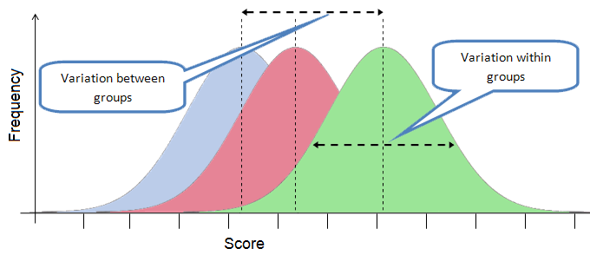
Analysis of Variance (ANOVA)
Do drugs (A, B and C) have different effects on the activity of the prefrontal cortex of patients suffering from depression?
Compare the means of more than two samples of data and assess if they are significantly different from each other
Same as t-test, but more samples!

Slide 10
Linear regression
What is it used for?
What are the possible experiments?
How do I calculate it?

Slide 11
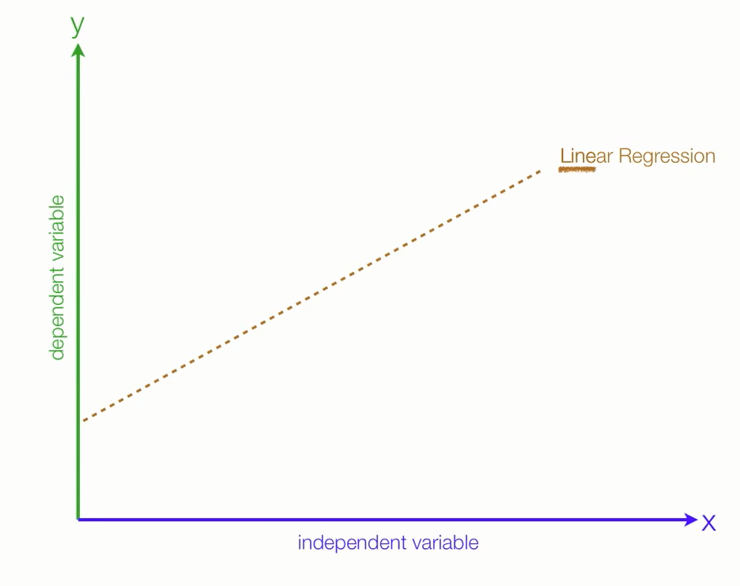

Slide 12
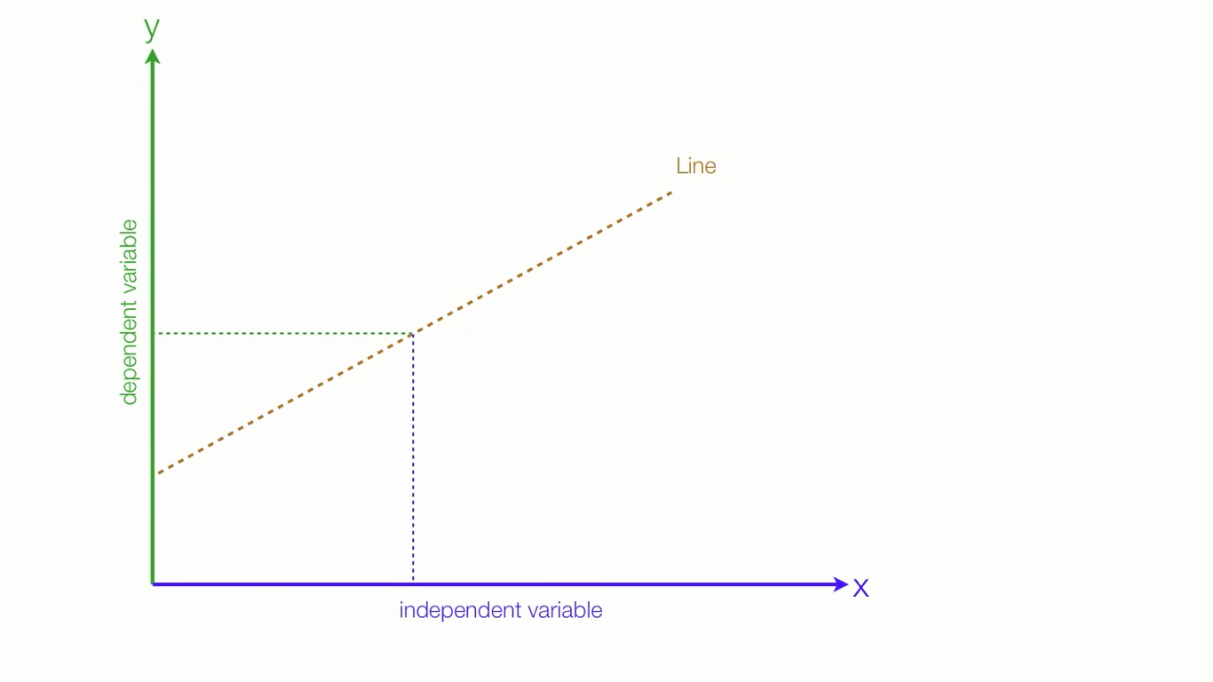
WHY is it used for : to define most accurately the relationship between two variable → if the most accurate model is a linear regression, the equation will enable us to predict the dependent variable with the independant variable.
X Independant variable (e.g. : time spent studying/time spent on instagram)
Y Dependant variable (e.g. : GPA).

Slide 13
WHEN ?
2 variables
Y is continuous/numeric/’scale’ (SPSS)
X is ‘’same’’ or ordinal
the variables must fit a coordinate form (have a linear relationship)
independant observations
the residuals must follow a normal distribution → Kolmogov smirnoff

Slide 14
How to know if the linear regression is the best model? Is there a correlation going on ? (r : coefficient of correlation)
- COMPACT MODEL : Yi = β0 + εai
The best way to predict Y is its mean . There is no linear relationship
- AUGMENTED MODEL : Yi = β0 + β1 Xi + εai
There is a linear relationship between X and Y

Slide 15
THE LEAST SQUARE METHOD :
The best model / the best « line » is the one that has the least « sum of squares » that minimise the errors between the estimated value and the actual observation. → Rsquare : looking at the distances between the regression line estimated values and the observed values.

Slide 16
How to calculate the equations with the sum of squares ?
B0 : the intercept the value of Y when X equals O → the starting point
B1 : the slope (can be positive or negative)

Slide 17
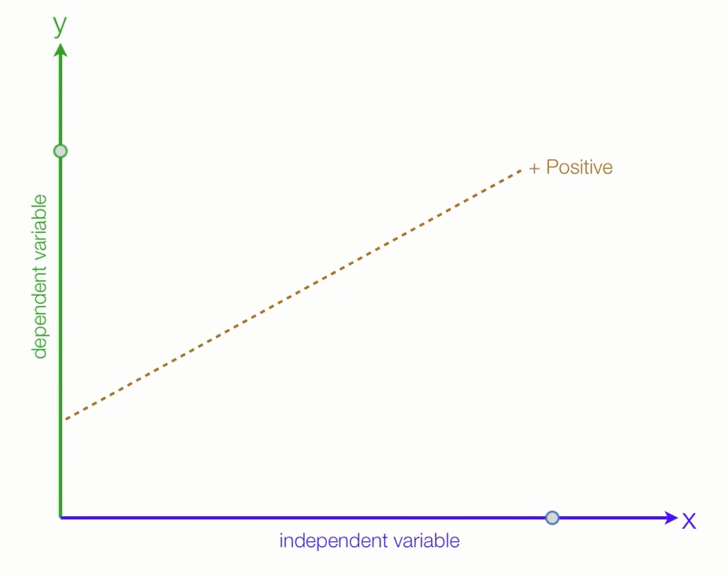
This linear relationship can be POSITIVE (e.g. : as time spent studying increases, GPA increases

Slide 18
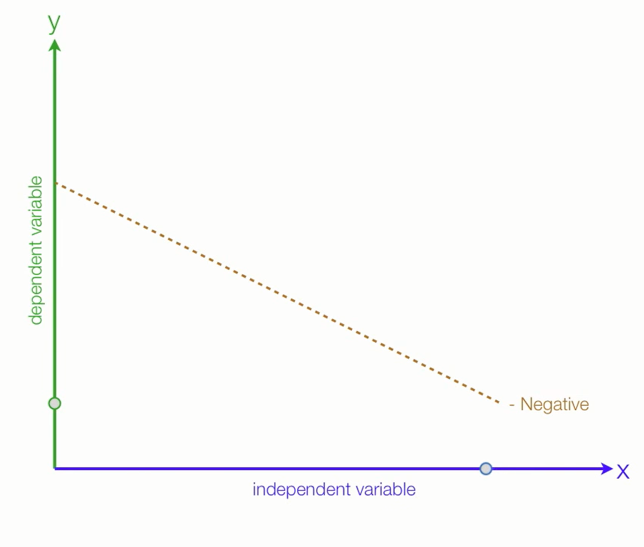
Or NEGATIVE (e.g. : as time spent on instagram increases, GPA decreases).

Slide 19
Hypothesis and models
H0 : there is no linear correlation between the two variables | H1 : the augmented model : the linear model predicts well Y
Y : the predicted variable/predicted point B0 : independant term (mean) E : error | Y : the predicted variable/predicted point B0 : independant term B1 : slope X : predictive variable E : error

Slide 21
Considerations
Attention: the linear regression is correct only on the used interval, any other prediction is mere speculation. For example, the correlation on height and age on children between 2 and 8 does not apply for teenagers and adults. Speculation is evil, pay attention!

