Slide 1
Voxel–Based Morphometry
- Methods for Dummies 2018-
25th April 2018
Isobel Green
Carlos Estevez Fraga

Slide 2
CONTENTS
1.- Introduction
2.- Preprocessing
3.- Preprocessing tutorial
4.- Analysis
5.- Other issues in VBM (BSI, Fluid registration)
6.- Analysis tutorial
7.- Summary
8.- Useful references

Slide 3
Introduction
Voxel-wise comparison of regional GM / WM density (density=VOLUME) between groups.
Output
  Whole-brain approach
  Map of parametric statistics (SPM)
    Between groups
    Correlation region - measure
Notes:
Picture output of SPM
Actually thanks to MODULATION
SUITABLE FOR STUDYING FOCAL VOLUMETRIC DIFFERENCES OF WM
Aim is identifying differences in the local composition of brain tissue (Gm, WM, or CSF)
Autoated. Unbiased. Exploratoru.

Slide 4
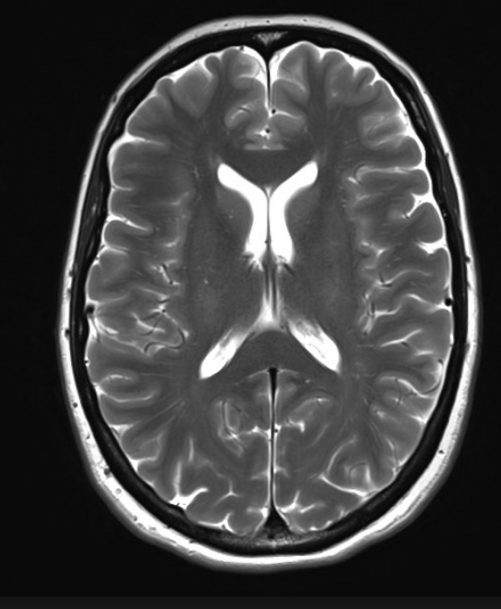



ANALYSIS + INFERENCES
PREPROCESSING
MRI
Design matrix
Statistical Parametric Map
Spatial filter
Realignment
Smoothing
General Linear Model
Statistical
Inference
RFT
Normalisation
Anatomical
reference
p <0.05
Parameter estimates

Slide 5
Preprocessing
Segmentation
Group-wise Normalisation
(DARTEL)
Modulation
Smoothing
Voxel-wise statistical analysis
Notes:
HIGH RESOLUTION T1

Slide 6
SEGMENTATION

Slide 7
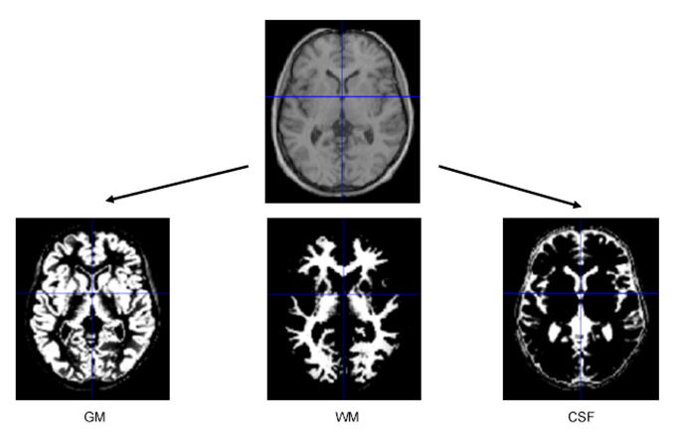
Preprocessing: Segmentation
    Classifies tissues into GM, WM, CSF
    Models the intensity distributions by a mixture of Gaussians, but using tissue probability map (TPM) to weight the classification
Notes:
MIXTURE OF GAUSSIANS?
TPMs are affine registered or are warped??

Slide 8
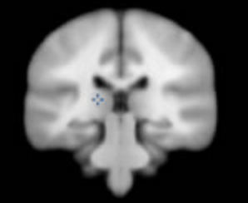
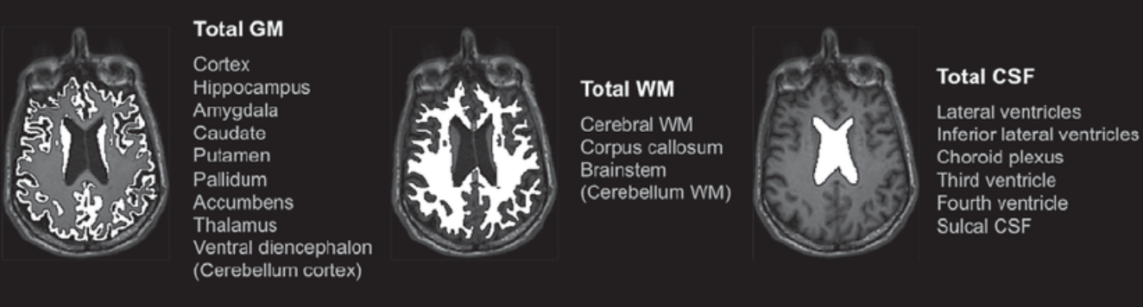
Segmentation: Tissue probability maps (Bayesian priors)
  Each TPM indicates the prior probability for a particular tissue at each point in MNI space
  TPMs are warped to match the subject

Slide 9
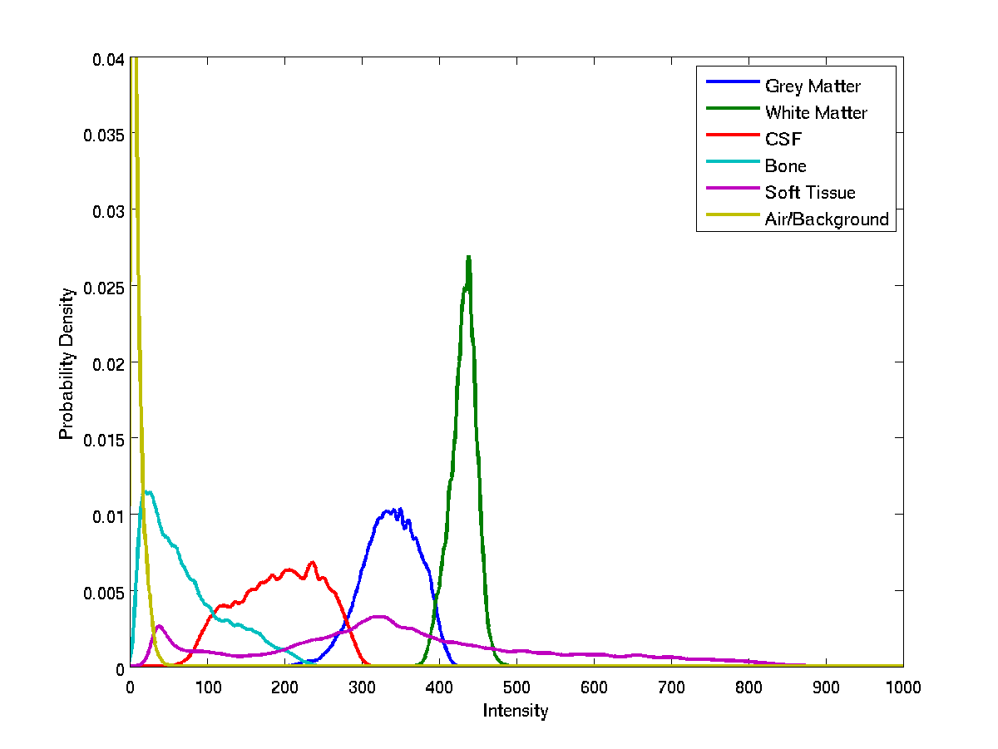
Segmentation: Voxel intensity distribution

Slide 10
Preprocessing: Segmentation

Slide 11
Frequency
Image Intensity

Slide 12
DARTEL NORMALIZATION

Slide 13
Preprocessing: DARTEL normalization
1st Takes the parameter files from previous segmentation
2nd Rigid registration of images to be aligned with TPM
3rd Mean of all images created as initial template
4th Deformations of each image to the template are computed
5th Template is regenerated and averaged
6th Warped images are generated
Notes:
Constructs a flow field so one image can slowly ‘flow’ into another
The amount of distortion is computed by summing up distortion measures from small displacement
Register images computin a “flow-field “ which is exponentiated creatinn forward and backward deviations
THEN TEMPLATE WITH ALL THE IMAGES (mean) The information from the template to each of the individual images is computed and template is then re-generated by applying the inverses of the
deformations to the images and averaging. This procedure is repeated a number of times.Then nvolves the simultaneous registration of e.g. GM with GM, WM with WM and 1-(GM+WM) with 1-(GM+WM) (when needed, the 1-
(GM+WM)
http://www.neurometrika.org/node/34

Slide 14
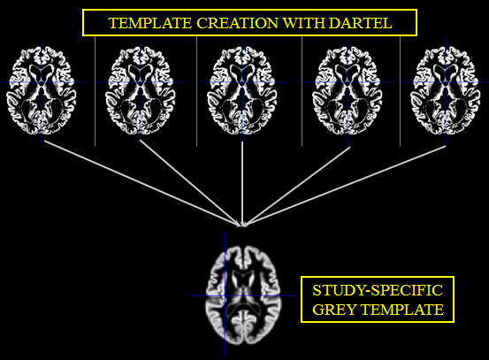
Preprocessing: DARTEL normalization
Better inter-subject alignment
More accurate localization
Notes:
More precise inter-subject alignment (multiple iterations: more than 6.000.000 registrations rather than 1.000 registration parameters from the previous model).
More sensitive to identify more accurate localization

Slide 15
MODULATION

Slide 16
Preprocessing: Modulation (preserved amount)
Voxel intensities can be further modulated by determinant of Jacobean of warps
During modulation voxel intensities are multiplied by the local value in the deformation field from normalisation, so that total GM/WM signal remains the same
Comparisons
  Grey matter density/concentration (unmodulated)
  Volume (modulated).
CHANGE IN INTENSITY = CHANGE IN VOLUME

Slide 17
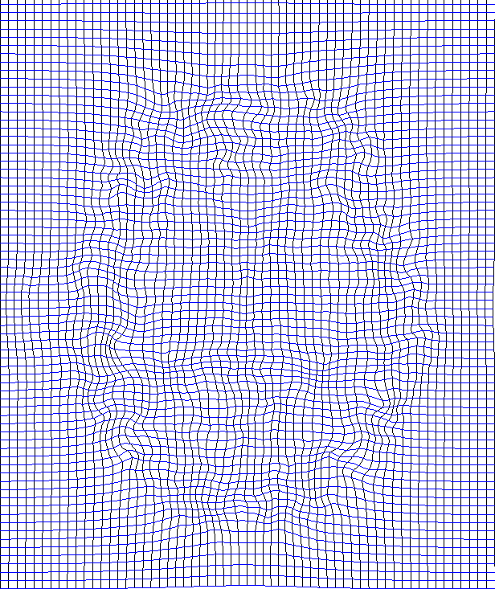
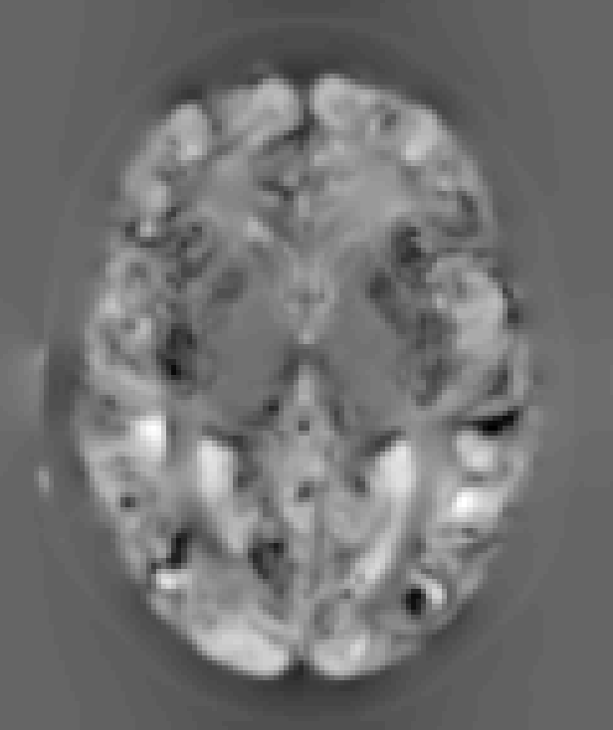
Deformation Field
Jacobians determinants
Dark →deformation lines closer.

Slide 18
Preprocessing: Modulation (preserved amount)
Involves multiplying the spatially normalized GM by its relative volume before and after normalization.
BEFORE MODULATION
AFTER MODULATION
Notes:
concentration—>mean of GM and WM in each voxel in the spatially normalized images.
modulation—>The important thing is the VOLUME (does not matter GM or WM). Involves multiplying the spatially normalizedGM by its relative volume before and after normalization.
[for instance, if spatial normalisation results in a subject's temporal lobe doubling its volume, then the correction will halve the intensity of the signal in this region]
SO, WITHOUT MODULATION YOU SEE ONLY THE AMOUNT OF GM, WM, the relative concentration that they have. WITH MODULATION YOU CHECK THE VOLUME
--------
Voxel intensities can be further modulated by determinant of Jacobean of warps: i.e, whether want to compare gray matter density (unmodulated) or volume (modulated).
During modulation voxel intensities are multiplied by the local value in the deformation field from normalisation, so that total GM/WM signal remains the same
Change of intensity now represents volume relative to template
Multiplication of the warped (normalised) tissue intensities so that their regional or global volume is preserve

Slide 19
SMOOTHING

Slide 20
Preprocessing: Smoothing
Each voxel is replaced by the weighted average (of GM and WM) with its neighbours
Convolves images with a 3D Gaussian kernel
Notes:
By the central limit theorem smoothing also renders errors normal in the distribution, ensures the validity of the data
Produces data in a more normal distribution
Gets rid of roughness and noise to produce data in a more normal distribution
Removes some registration errors
Kernel defined in terms of FWHM (full width at half maximum) of filter
7-14mm kernel
Analysis is most sensitive to effects that match the shape and size of the kernel
Match Filter Theorem
Kernel takes weighted average of the surrounding intensities
Smaller kernels mean results can be localised to a more precise region
Less smoothing needed if DARTEL used
In an ideal world this would not be needed

Slide 21
BEFORE SMOOTHING
AFTER SMOOTHING

Slide 22
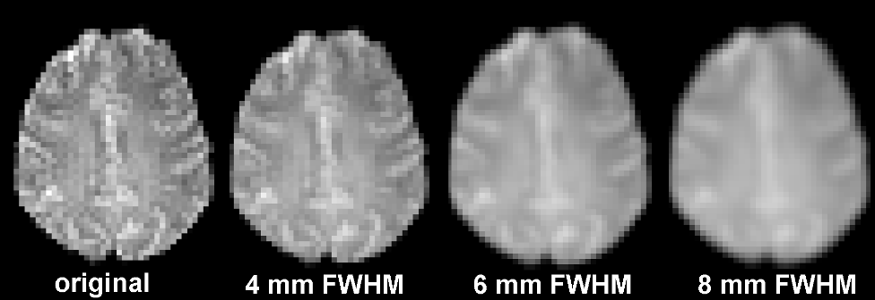
Smoothing – FWHM -
Full-width at half maximum (FWHM) 4-16 mm
Bigger FWHM → More blurring→ Worse localization
Degree of blurring should relate to:
  The accuracy with which the data can be registered, more blurring if the intersubject registration is less accurate
  Size of the region we are looking to
fmax
Fmax/2
Notes:
FWHM full width at half maximum of the gaussian kernel required to smooth independent white noise data required to smooth independent white noise data
The degree of blurring should relate to the accuracy with which the data can be registered, more blurring if the intersubject registration is less accurate.
More blurring if more FWHM
Degree of blurring should be related to the accuracy of registration with more blurring if regitration is less accurate.
More FWHMore blurring -->
DARTEL →better registration
Kernel depends on the size of the expected effect
Excessive smoothing difficults anatomical localization
Allows Gaussian RFT threshold
6 compared with 12 mm is anticonservative
12 mm is conservative
While reduced smoothing should increase sensitivity to effects of smaller size by “Matched Filter” arguments, cluster size tests are most sensitive to effects that are larger than the noise smoothness. Hence, to the extent that large scale anatomical effects are present after either low- or high-resolution warping, high-resolution results may be more sensitive as effects will be larger in units of resels.
In the present study, differing amounts of smoothing were found to have a pronounced effect on rejection rates. Tests on images smoothed with a 6 mm Gaussian kernel were highly anticonservative at all thresholds including the highest (α_{c} = 0.001), and were consistently more anticonservative when compared with 12 mm smoothing results.

Slide 23
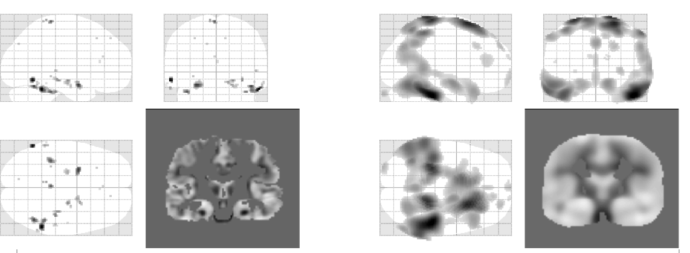
Smoothing – FWHM -
FWHM = 5
FWHM = 16

Slide 24
Preprocessing - Smoothing
GOOD | NOT SO GOOD
Improves signal to noise ratio | Reduced spatial resolution
Makes the error distribution more normal | Edge artifacts
Increased validity of parametric tests | Merging
 | Extinction
 | Mislocalization of activation peaks
Notes:
WHY INCREASES S/N Ratio??
Compensates for inexact nature of spatial normalisation =Improves SNR = Blurs residual errors
Makes the distribution more normal →central limit theorem
http://support.brainvoyager.com/functional-analysis-preparation/27-pre-processing/279-spatial-smoothing-in-preparation.html
DARTEL GREATER PRECISSION ALLOWS LESS SMOOTHING
SCHEME PROCESSING NEW
According to the matched filter theorem, the SNR reaches its maximum when the filter width matches the expected signal width
Matched filter theorem
his theorem states that the filter that will give optimum resolution of signal from noise is a filter that is matched to the signal. In the case of smoothing, the filter is the Gaussian kernel. Therefore, if we are expecting signal in our images that is of Gaussian shape, and of FWHM of say 10mm, then this signal will best be detected after we have smoothed our images with a 10mm FWHM Gaussian filter.The next few images show the matched filter theorem in action. First we can generate a simulated signal in a one dimensional set of data, by creating a Gaussian with FWHM 8 pixels, centered over the 14th data poi

Slide 25
TUTORIAL

Slide 26
VBM – Tutorial
http://www.fil.ion.ucl.ac.uk/~john/misc/VBMclass15.pdf

Slide 27
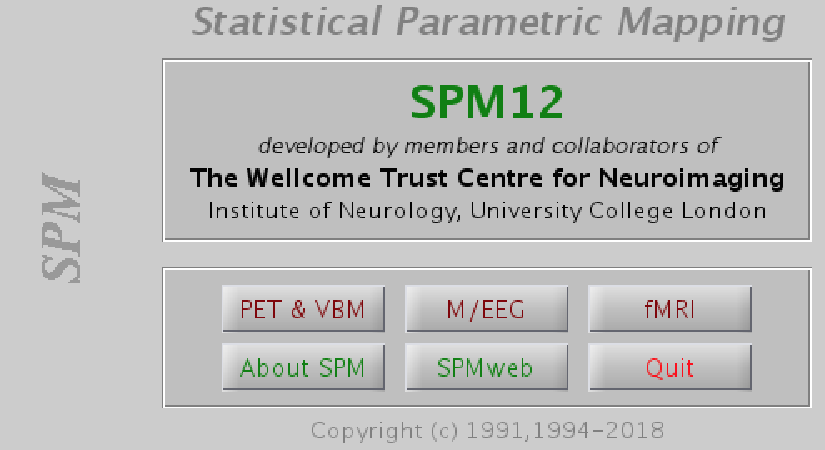
VBM Preprocessing – Tutorial

Slide 29
VBM Tutorial
example.nii
Notes:
DISPLAY –>if images need to be rotated or traslated (shifted)

Slide 30
Notes:
To check if the position is the same

Slide 32
Tutorial – Segmentation
example.nii
c1example.nii
c2example.nii
rc1example.nii
rc2example.nii
Notes:
Generate rigid body aligned GM and WM of subjecy
C1 GM
C2 WM
Rc1 dartel GM
Rc2 dartel WM

Slide 33
example.nii
change to “native Space + Dartel imported”
Notes:
Change to “native space + Dartel imported” in tissues 1, 2 which are GM and WM

Slide 35
c1example.nii
c2example.nii
GM
WM
c3example.nii
CSF

Slide 36
rc1example.nii
rc2example.nii
GM
WM

Slide 37
Tutorial – DARTEL normalization
rc1example.nii
rc2example.nii
Template_x.nii
u_rc1example.nii
Notes:
DARTEL aligns GM and WM simulateously generating its own average template data to which the data are iteraativelu aligned a
Generates Template0.nii; Template1.nii (…) Template_6.nii

Slide 38
rc1example.nii
rc2example.nii

Slide 39
u_rc1example.nii
Template_x.nii
Notes:
U_rc
Right →

Slide 40
Tutorial – Normalize to MNI + Modulation
Template_6.nii
c1example.nii
u_rc1example.nii
smwcexample.nii
Notes:
This uses u_rc1 files to generate smoothed spatially normalized jacobian scaled GM images in MNI space

Slide 41
Template_6.nii
u_rc1example.nii
c1example.nii
Preserve Amount
Notes:
Template_6 registered to the MNI
C1 and u_rc1 in the same order
PRESERVE AMOUNT == MODULATION

Slide 42
smwcexample.nii

Slide 43
PREPROCESSING
MRI
ANALYSIS + INFERENCES
Spatial filter
Design matrix
Statistical Parametric Map
Realignment
Smoothing
General Linear Model
Statistical
Inference
RFT
Normalisation
Anatomical
reference
p <0.05
Parameter estimates

Slide 44
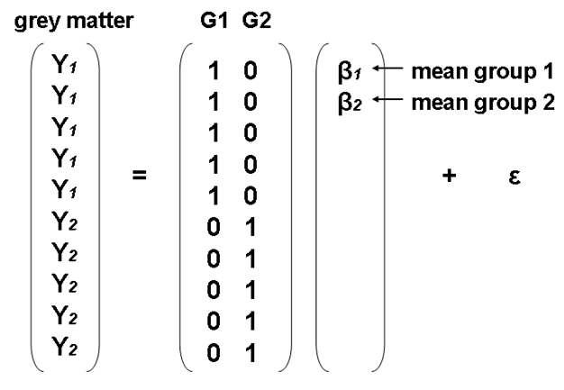
Statistical Analysis: General Linear Model
Statistical Analyses are performed by fitting a GLM
Y = Xβ + ε
Mass-Univariate approach: independent statistical test for every voxel!
Voxel Intensity (DV)
Error term
Predictor variables
H0: there is no difference between
these groups
β: other covariates, not just the mean
Notes:
Statistical analyses are conducted through a General Linear Model with voxel intensity as the dependent variable and independent variables of interest as the predictors
Many different options for what to include as IVs. Common use of VBM is to compare two groups, so a relevant IV could be Group. Sometimes will have a continuous variable of interest, so can enter that as a covariate. e.g., in the difference in GM volume between old and young individuals, is there an effect of lifetime stress?
Will get a beta weight for each factor

Slide 45
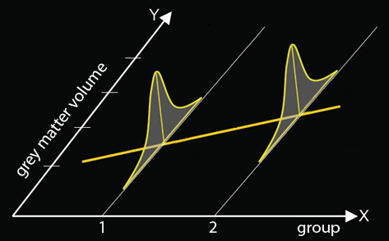
Statistical Analysis: General Linear Model
Intensity for each voxel (V) is a function that models the different things that account for differences between scans
Two-Group Comparison
V = β₁(G1) + β₂(G2) + β₃(covariates) + β₄(global volume) + μ + ε
V = β₁(AZ) + β₂(HC) + β3(life stress) + β4(global volume) + μ + ε
Q of interest: is voxel intensity significantly different between group 1 and group 2?
Notes:
From MfD 2009
Imagine that we are looking at a group of patients with Alzheimer’s vs. healthy controls; we want to understand how their GM volume differs. Here, G1 = Alzheimer’s (AZ), G2 = healthy controls (HC). We add a predictor variable for each to the GLM to assess whether there is a significant difference based on group.
Now, there are many covariates that could affect the level of GM in the brain. Imagine we are also interested in looking at whether any difference in GM volume between individuals with AZ and healthy controls exists above and beyond the effects of the covariate of “life stress.” To do this, we can add life stress to the model as well.
Note here that global volume is also included is a covariate. This is one, but not the only, way of accounting for total brain volume in the GLM. Generally, the “Global normalisation” tab during the second-level model building is use to specify this covariate. However, an alternative way of incorporating information re: global volume is to perform “proportional scaling,” which scales all voxels of the brain based on the total incranial volume.

Slide 46
Statistical Analysis: General Linear Model
Intensity for each voxel (V) is a function that models the different things that account for differences between scans
Continuous Predictor
V = β₁(predictor1) + β₂(covariates) + β₃(global volume) + μ + ε
V = β₁(dementia score) + β₂(life stress) + β₃(global volume) + μ + ε
Q of interest: is the association between intensity & test score significantly different from zero?
Notes:
From MfD 2009
Now imagine that instead of looking at group differences in GM, we want to look across people with AZ and healthy controls to see if a common, dimensional factor accounts for changes in GM volume. We can use that common factor as a continuous predictor (here, we use life stress) across groups.

Slide 47
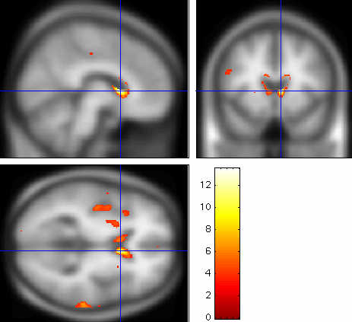
Statistical Analysis: SPM
SPM
Mass univariate independent
statistical tests for every voxel
~ 1000,000
Regions of significantly less grey
matter intensity between
subjects and controls
Regions showing a significant
correlation with test score or
clinical measure
Notes:
From MfD 2013
SPM output: clusters showing significant differences based on the group specification or variable of interest. Note that the regions that emerge are entirely dependent on the correction for multiple comparisons used (100,000 independent tests creates many false positives). Rigorous correction should be used (see next slide).

Slide 48
Statistical Analysis: Multiple Comparisons
Introducing false positives when you deal with more than one statistical comparison
One t-test with p < .05
  a 5% chance of (at least) one false positive
3 t-tests, all at p < .05
  All have 5% chance of a false positive
  So actually you have 3*5% chance of a false positive
  = 15% chance of introducing a false positive with 3 tests…VBM is conducting 1,000,000
Read: Brett, Penny & Kiebel (2003): An Introduction to Random Field Theory Or see http://imaging.mrc-cbu.cam.ac.uk/imaging/PrinciplesRandomFields They’re the same guys ☺
Notes:
From MfD 2009, Suz Prejawa
When the whole brain is sampled, introduce a high chance of false positives! MUST correct for multiple comparisons.

Slide 49
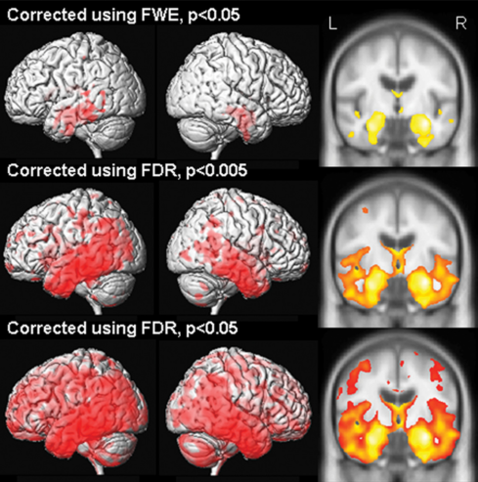
Statistical Analysis: Multiple Comparisons
Several different strategies to correct for multiple comparisons:
  Bonferroni Correction
  False Discovery Rate
  Random Field Theory/ Family-wise error
Which one to choose??
Notes:
From MfD 2009, Suz Prejawa, and MfD 2013

Slide 50
Statistical Analysis: Multiple Comparisons
Bonferroni
  Set the p-value threshold equal to (alpha) / (# of tests run)
  Assumes that all tests are independent
  Does not apply well to SPMs as voxels are often highly correlated with neighbors & this increases with smoothing
False Discovery Rate
  Like Bonferroni, treats each voxel separately
  Instead of the expected false positives in voxels, calculates the expected false positives within the uncorrected, alread—detected positives
  More sensitive, less specific
Random Field Theory
  Looks at pixels the width of the smoothing kernel (“resels”), rather than voxels More appropriate for the highly correlated voxels of a VBM SPM; treats data as a continuous measurement vs. independent observations
Notes:
See the following links for very helpful comparisons of Bonferroni / Random Field Theory, and thresholding
http://www.fil.ion.ucl.ac.uk/spm/course/slides10-vancouver/05_Thresholding.pdf
http://imaging.mrc-cbu.cam.ac.uk/imaging/PrinciplesRandomFields#How_does_the_Random_Field_maths_compare_to_the_Bonferroni_correction.3F

Slide 51
Statistical Analysis: Multiple Comparisons
Must base corrections on peak heights (voxel-wise) vs. cluster extent as smoothness of residuals is not uniformly distributed in VBM (Mechelli, Price, Friston & Ashburner, 2005)
Why not uniformly distributed?
  Underlying neuroanatomy is non-stationary
  Smoother regions will have larger clusters, and less-smooth regions will have smaller clusters
  Therefore, bigger blobs expected in smoother regions, purely by chance
Notes:
Mechelli, Price, Friston & Ashburner, 2005: discuss the necessity of looking at peak-level corrections rather than cluster-wise corrections. Important consideration for SPM analyses.

Slide 52
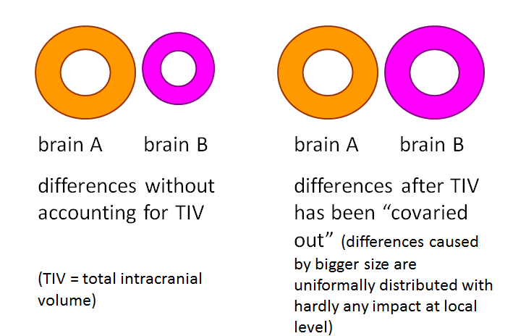
Statistical Analysis: Global Effects
Model global effects during statistical analysis?
  Regional volumes are likely to vary as a function of the whole brain volume
  In regional studies, need to correct for “global brain volume”
    Total GM volume
    Total intra-cranial volume
Which one to use?
Depends on question of interest.
Notes:
From MfD 2009, Suz Prejawa, and MfD 2013

Slide 53
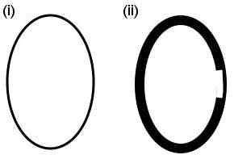
Statistical Analysis: Global Effects
(ii) is globally thinner, but locally thicker than (i); which effect do we care about? Regional studies, likely the latter
Fig. (2). Global and localized inferences may identify different brain regions. In the example, images (i) and (ii) differ at both global and local levels. Without modelling some kind of “global'' value as a confounding effect, the comparison would identify greater volume for image (ii) relative to image (i) in all voxels apart from the thinner area on the right side of image (ii). When global differences are discounted, however, the same comparison will detect greater volume for image (i) relative to image (ii) in the thinner area on the right side of image (ii) only.
(Mechelli, Price, Friston, and Ashburner, 2005)
Notes:
* From MfD 2009, Suz Prejawa, and MfD 2013

Slide 54
Additional Considerations: Maintaining Statistical Validity
VBM relies upon assumption that the error terms in the voxel intensity error terms are normally distributed
Supposedly ensured via Gaussian smoothing
However, smoothed image residuals are not always normally distributed, especially with smaller kernels
Especially problematic for single subject vs. group studies: inflates false positives
As long of groups are of equal size, false positive rate does not seem to be inflated
Scarpazza et al., 2015
Notes:
From MfD 2014

Slide 55
TUTORIAL

Slide 56
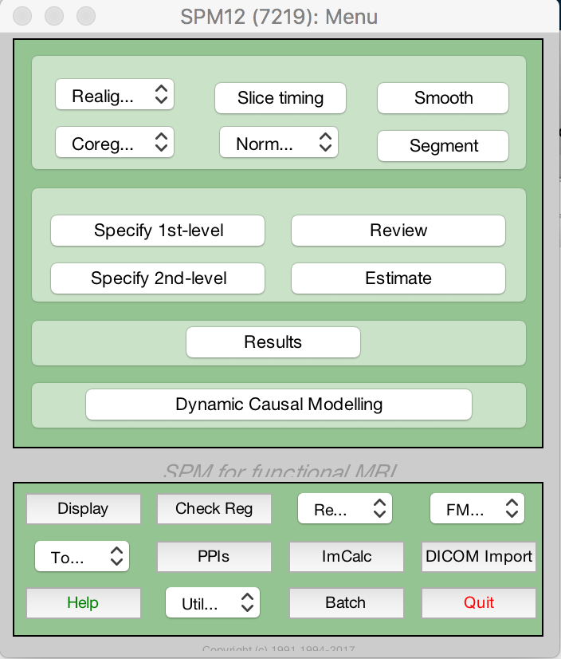
VBM Statistical Analyses – Tutorial
Notes:
With VBM, go straight to second level analyses

Slide 57
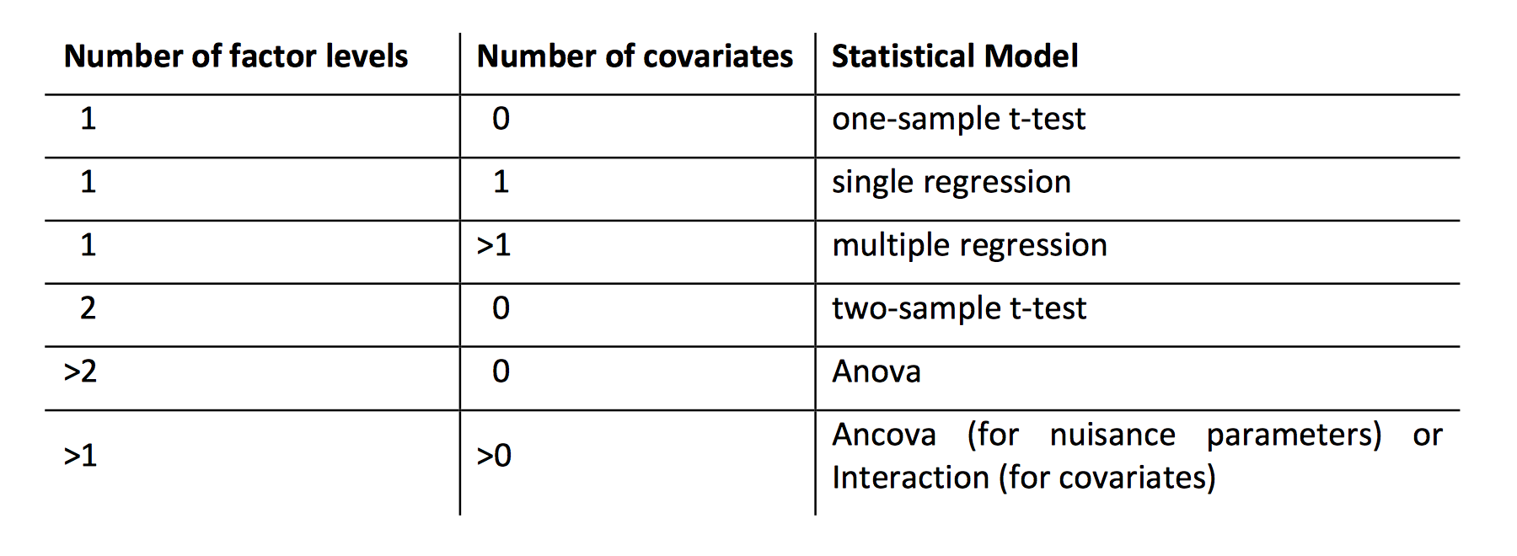
VBM Statistical Analyses – Tutorial
2 factors: gender, handedness
** all slides in the statistical analyses tutorial taken from:
dbm.neuro.uni-jena.de/vbm8/vbm8-manual.pdf
Notes:
Many options for statistical tests of interest. Here we will focus on the groupwise ANOVA, but by no means the only analysis possible.

Slide 58
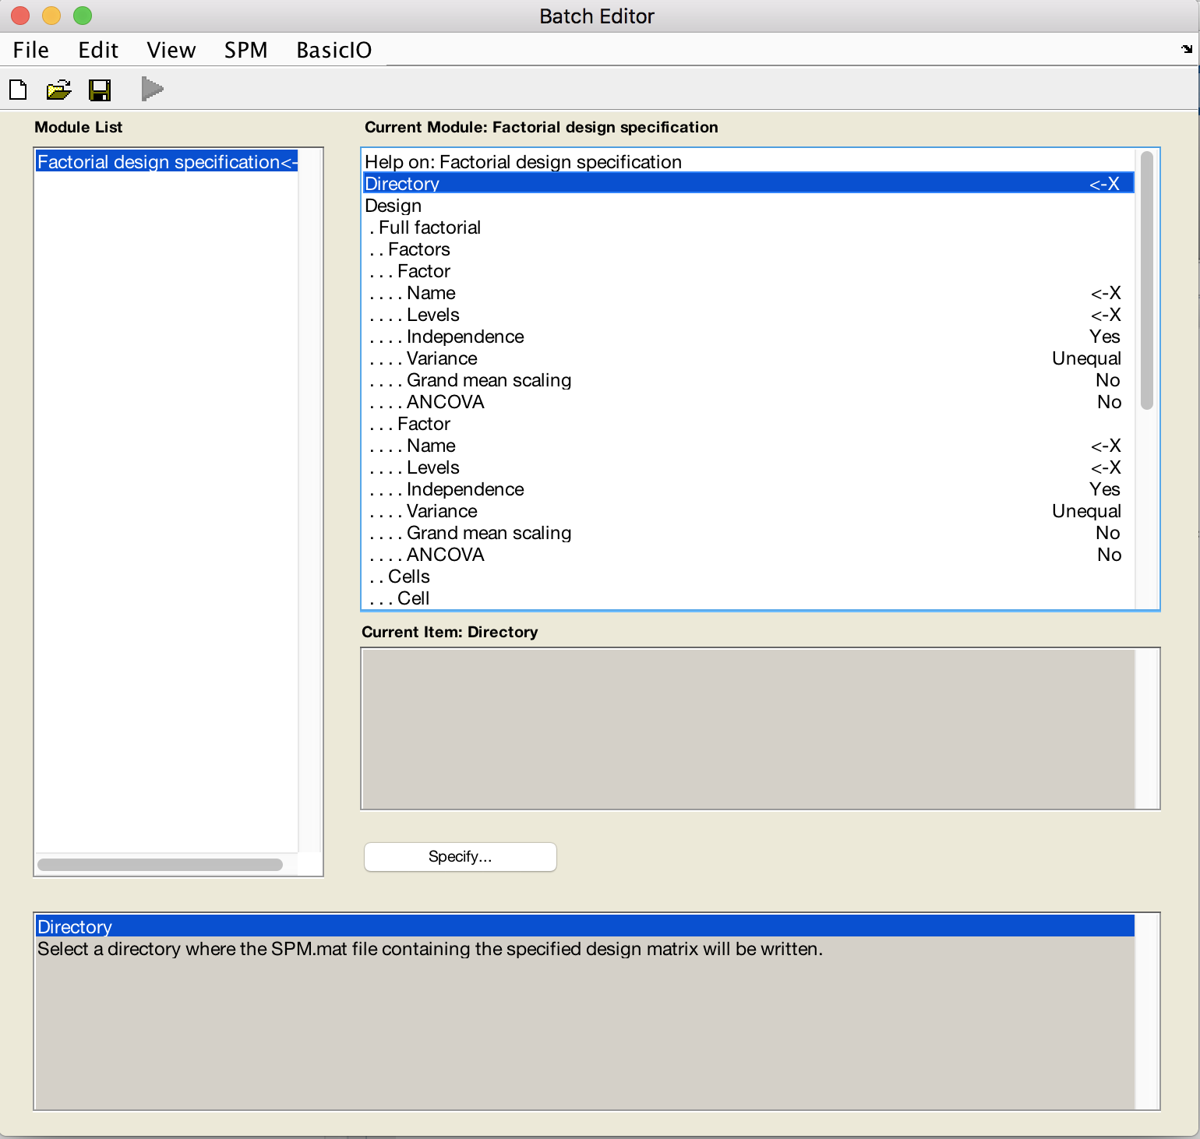
VBM Model Design – Tutorial
[specify text (e.g., ”sex”)]
2
[specify text (e.g., ”handedness”)]
2
Notes:
In our analyses we will imagine that we have a participant pool consisting of 40 men and 40 women. Half of each gender group is right-handed, and half of each group is left-handed.

Slide 59
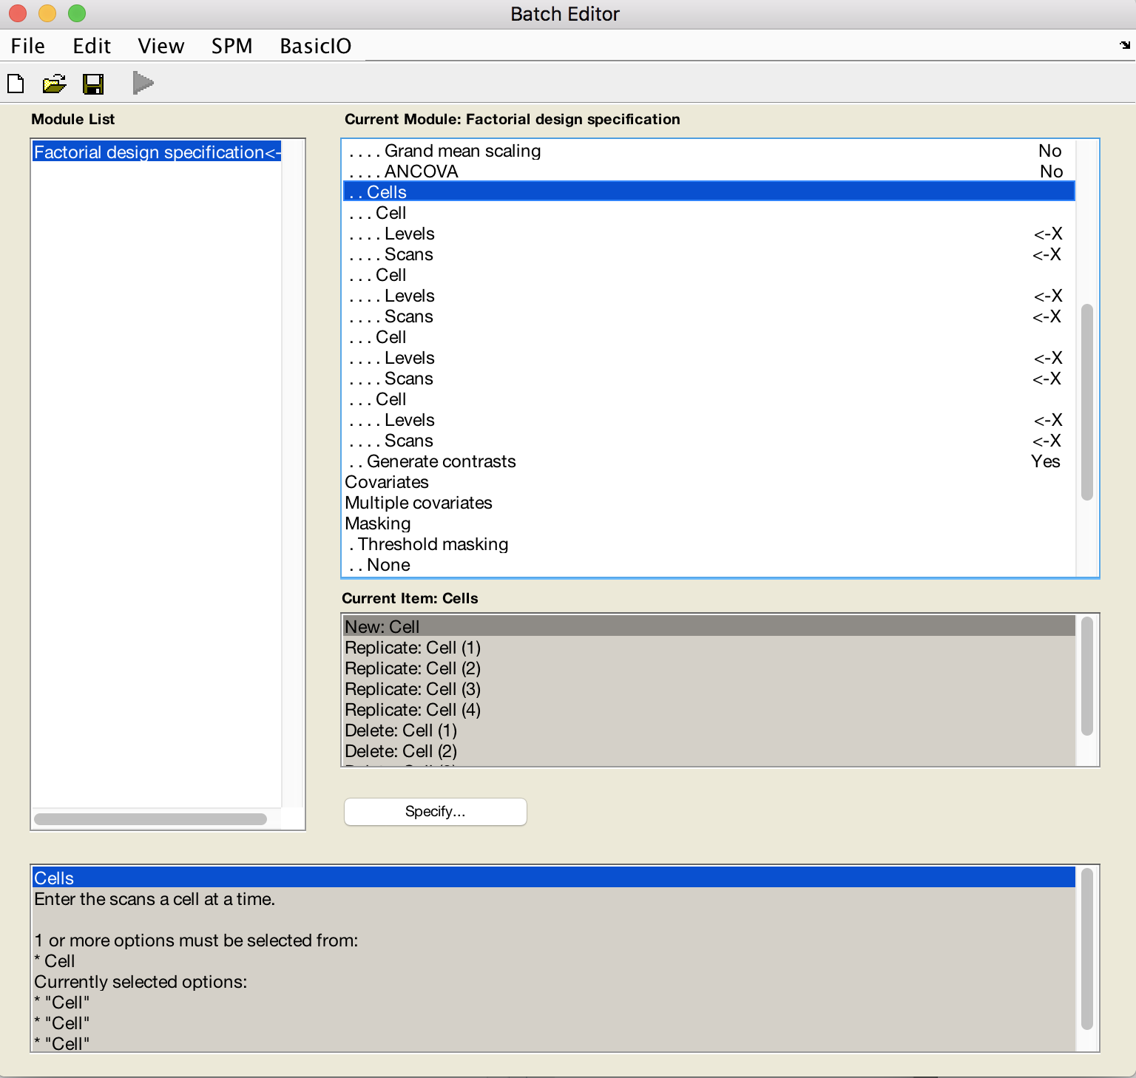
VBM Model Design – Tutorial
[specify text (e.g., “1 1”)]
[select files (e.g., the smoothed
GM volumes of LH males)]
[specify text (e.g., “1 2”)]
[select files (e.g., the smoothed
GM volumes of RH males)]
[specify text (e.g., “1 2”)]
[select files (e.g., the smoothed
GM volumes of LH females)]
[specify text (e.g., “2 2”)]
[select files (e.g., the smoothed
GM volumes of RH females)]
Notes:
In SPM, each factor/level combination is called a “cell” --

Slide 60
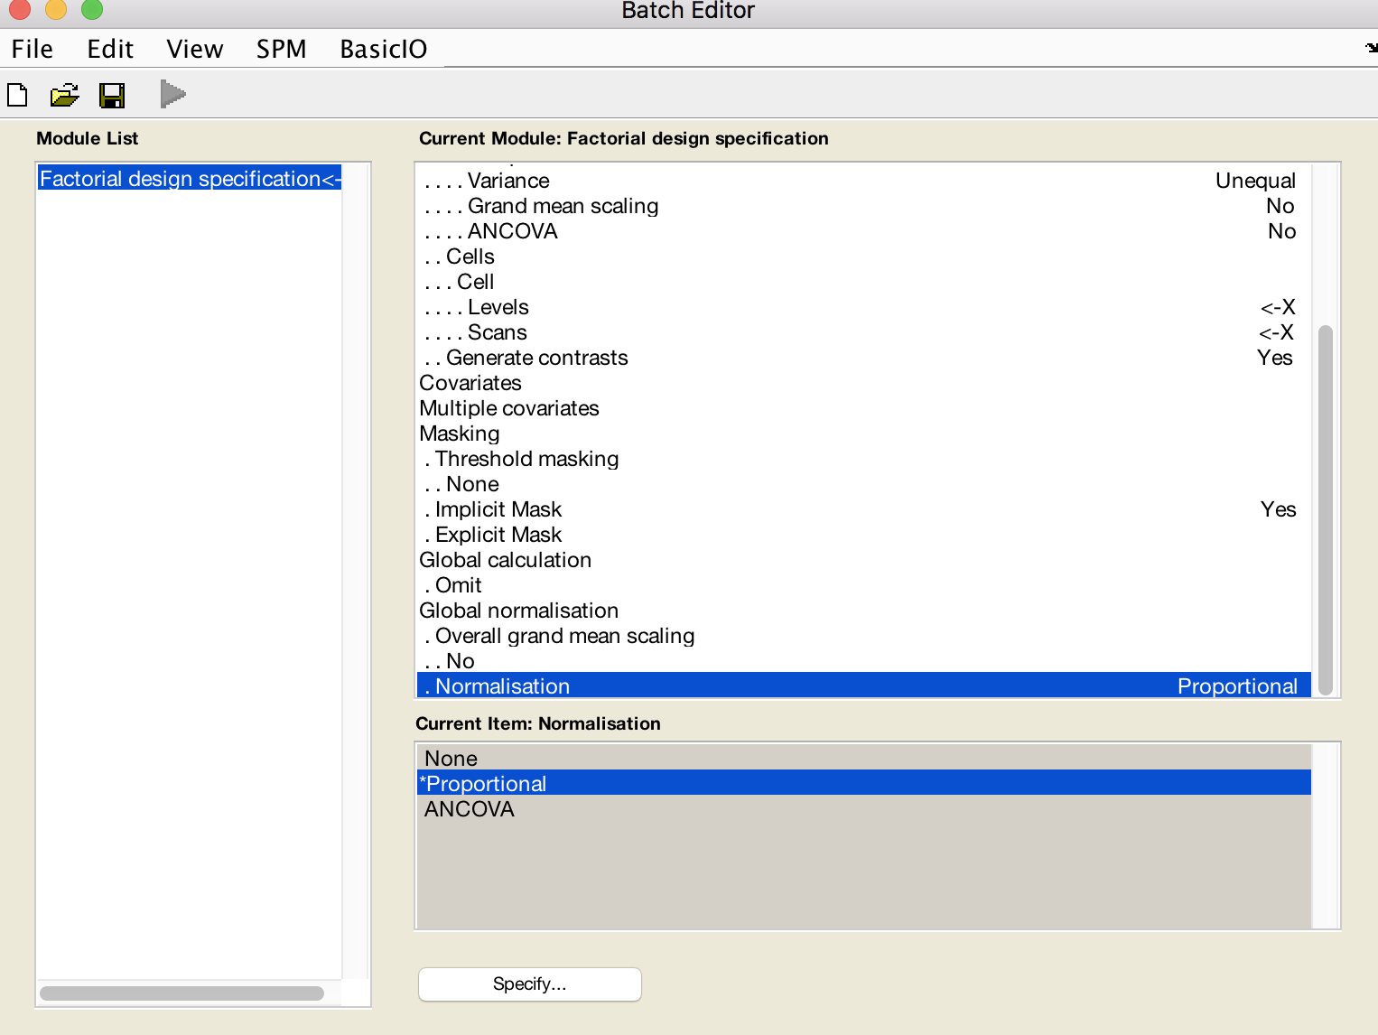
VBM Model Design– Tutorial
[specify value (e.g., “0.1”)]
Yes
None
Select proportional
* Note: After this step would be a great time to “review” the design matrix!
Notes:
Threshold

Slide 61
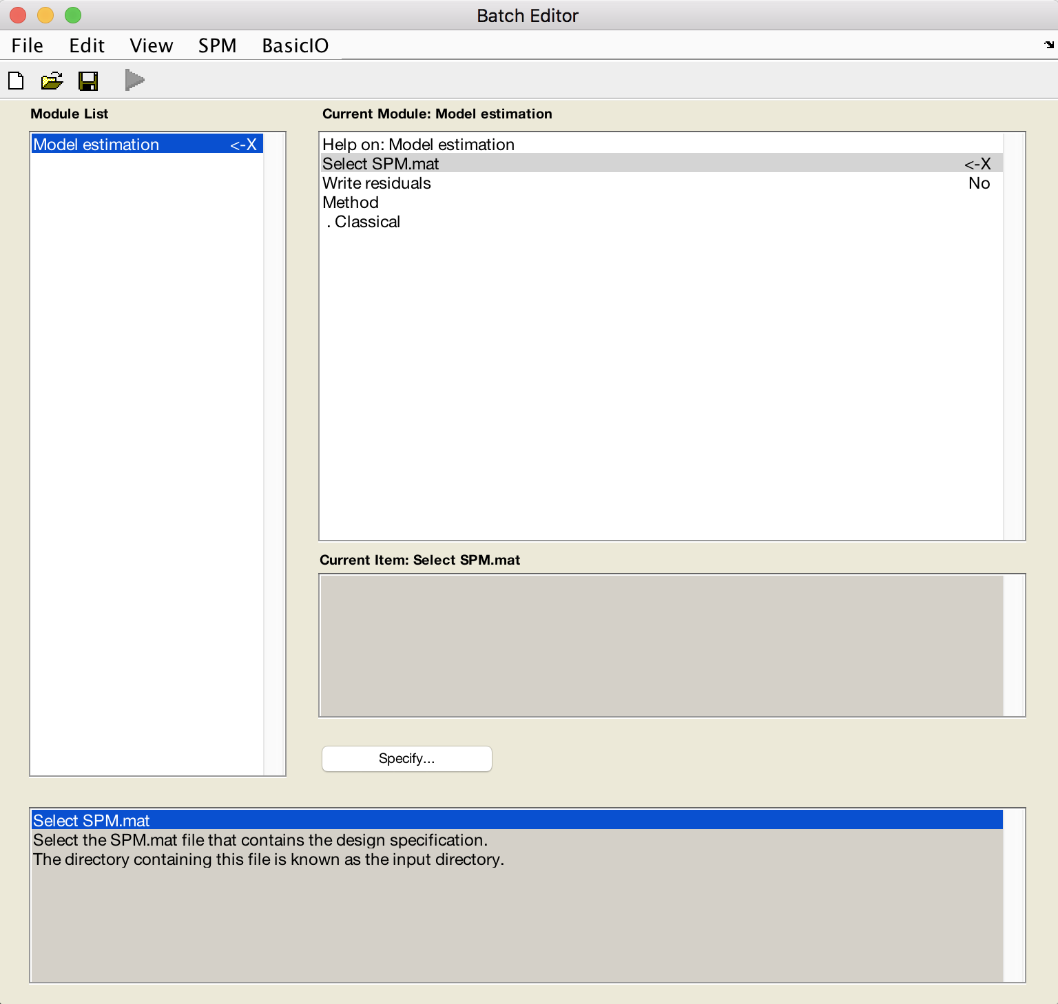
VBM Model Estimation – Tutorial
[select the SPM.mat which you just built]

Slide 62
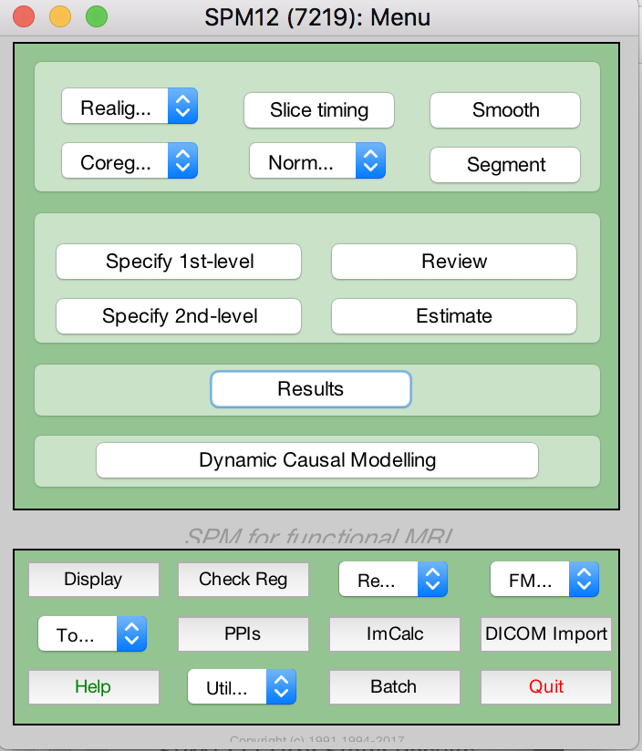
VBM Defining Contrasts – Tutorial
Select recently estimated SPM.mat
Contrast Manager
For the 2 x2 Gender x Handedness ANOVA:
For left-handed males > right-handed males: specify “1 -1 0 0”
For left-handed females > right-handed females: specify “0 0 1 -1”
For left-handed males > left-handed females: specify “1 0 -1 0”
For right-handed males > right-handed females: specify “0 1 0 -1”

Slide 63
VBM Defining Contrasts – Tutorial
Critical – remember to correct for multiple comparisons!!
** note: image for visualization only – not relevant to handedness/gender (though see Jan et al., 2017, for VPM study of brain morphology & handedness!)

Slide 64
LONGITUDINAL ANALYSIS
smwcexample.nii

Slide 65
Longitudinal analysis
Two serial MRIs of the same subject are registered Boundary shift integral (brain atrophy)
  Rigid body registration
  Shift into brain-CSF boundaries
Fluid registration
  Non-rigid registration
  Voxels at later time-point warped to voxels at start
  Jacobian determinants→Voxel compression maps.
Notes:
Not useful for structures without brain-CSF boundary
Voxels at follow-up are
warped to voxels at baseline
Represented visually as
a voxel compression map
showing regions of contraction
and expansion

Slide 66
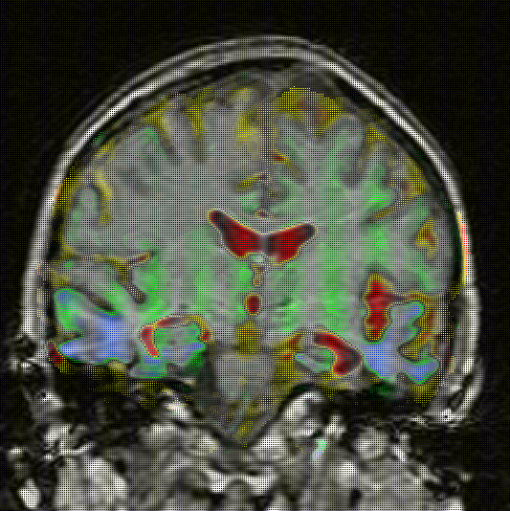
contracting
expanding
Notes:
Visualisation and quantification of rates of atrophy in Alzheimer’s disease
Evaluation of local and global atrophy measurement techniques with simulated Alzheimer’s disease data
gure 2. Gold standard deformation field (left) and zoom into the lateral ventricles (middle, top) and both hippocampi (middle, bottom). The corresponding Jacobian map (right) is also shown (yellow: volume gain; red: volume loss; blue: small volume change).

Slide 67
Additional Considerations: Rules to Live By
10 Rules for reporting VBM studies (Ridgway et al., 2008)
  set out rationale of study and describe data fully
  explain how brain segmentations are produced
  describe method of inter-subject spatial normalization
  make your statistical design transparent
  be clear about the significance of your findings
  present results unambiguously
  clarify and justify any non-standard statistical analysis
  guard against common pitfalls
  recognize the limitations of the technique
  interpret your results cautiously and in context
Notes:
From MfD 2014

Slide 68
SUMMARY
Automated voxel-wise analysis of differences in brain volume.
Requires segmentation, DARTEL normalization, modulation and smoothing.
Uses statistical parametric mapping.
Requires correction for multiple comparisons.
Differences in global and local scale.
Changes over time →BSI, Fluid registration.
Notes:
ALSO

Slide 69
ACKNOWLEDGEMENTS
Much gratitude to the former MfDs presenters, whose work is heavily represented here
A big thank-you to John Ashburner for guidance and expertise!
Notes:
ALSO

Slide 70
References
Slides from previous MfD courses
http://www.fil.ion.ucl.ac.uk/spm
http://support.brainvoyager.com/functional-analysis-preparation/27-pre-processing/279-spatial-smoothing-in-preparation.html
dbm.neuro.uni-jena.de/vbm8/vbm8-manual.pdf\Jang H, Lee JY, Lee KI, Park KM. Are there differences in brain morphology according to handedness?. Brain Behav. 2017;7(7):e00730.
Ashburner J, Friston KJ. Voxel-based morphometry--the methods. Neuroimage 2000; 11: 805-821 (the original VBM paper)
Good CD, Johnsrude IS, Ashburner J, Henson RN, Friston KJ, Frackowiak RS. A voxel-based morphometric study of ageing in 465 normal adult human brains. Neuroimage 2001; 14: 21-36 (the optimised VBM paper)
Ridgway GR, Henley SM, Rohrer JD, Scahill RI, Warren JD, Fox NC. Ten simple rules for reporting voxel-based morphometry studies. Neuroimage 2008.
Peelle JE, Cusack R, Henson RN. Adjusting for global effects in voxel-based morphometry: gray matter decline in normal aging. Neuroimage. 2012;60(2):1503-16.

