Slide 1
Issues with analysis & interpretation
MfD, January 17th, 2018 Anika Sierk

Slide 2
Outline
Recap: Hypothesis testing
Multiple comparison problem and correction
Non-independent hypothesis testing/Double dipping
Exploratory versus confirmatory analysis
Other ways to analyse fMRI data

Slide 3
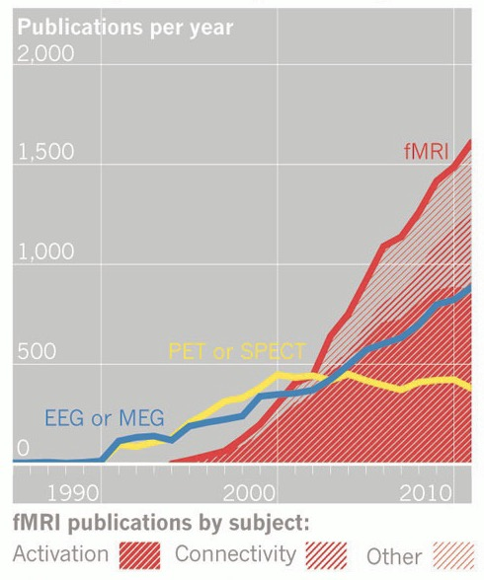

Smith, K. (2012). fMRI 2.0. Nature
Notes:
fMRI is very popular, it is amazing technology. In comparison, the number of papers published using EEG is near negligible. Of interest is the slights rise, which a friend of mine commented that this is due to the combined EEG/fMRI studies.

Slide 4
Outline
Recap: Hypothesis testing
Multiple comparison problem and correction
Non-independent hypothesis testing/Double dipping
Exploratory versus confirmatory analysis
Other ways to analyse fMRI data

Slide 5
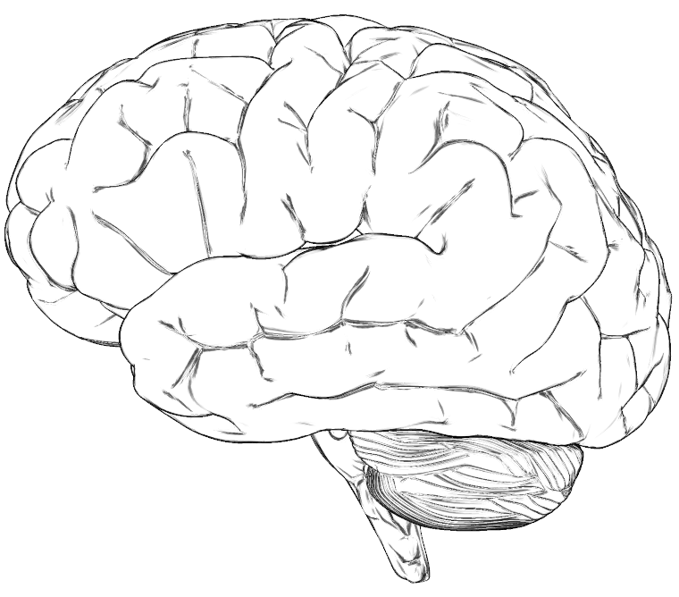
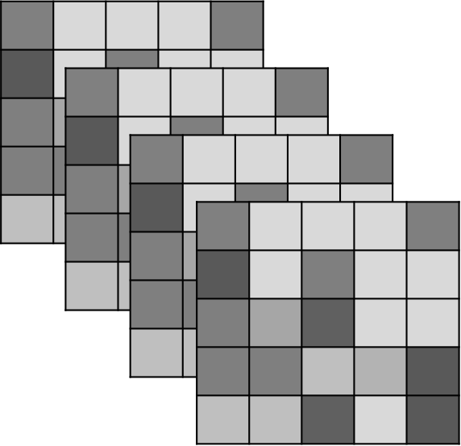
Recap - Hypothesis testing
100.000 voxels in one image
Several hundred images in one experiment
→ Massive data
Notes:
Several hundred images are acquired over the course of an experiment
One way of looking at it is time series, so each voxel has a time series and as there are around 100.000 in the brain, we are studying around 100.000 time series to look for task-related behaviour.

Slide 6
Recap - Hypothesis testing
H₀: con1 = con2
H_{A}: con1 ≠ con2
t
The Test Statistic T
Computed at each voxel
Summarises evidence about H₀
Significance level α
Set a priori (e.g. 0.05)
states probability that differences between conditions arose by chance
Is p(H₀)< α i.e. can we reject the H0?
P-val
Null Distribution of T
Notes:
U of alpha
Research question is framed as a hypothesis.
We are testing difference in BOLD signal between two (or more) conditions.
Threshold u_{α} controls the false positive rate
Test statistic t, a realisation of T
P-value: states probability for test statistics that difference between conditions arose by chance
Is p(H₀)< α i.e. can we reject the H0?

Slide 7
Type I/type II error
 | Truly active | Truly inactive
Declared active | ✔ | Type I error (False positives)
Declared inactive | Type II error (False negative) | ✔

Slide 8
Outline
Recap: Hypothesis testing
Multiple comparison problem and correction
Non-independent hypothesis testing/Double dipping
Exploratory versus confirmatory analysis
Other ways to analyse fMRI data

Slide 9
Multiple comparison problem
Which one of the 100.000 voxels is significant?
α = .05 → 5000 false positives !!
→ Correct for multiple comparison
Notes:
We need to threshold our data…

Slide 10
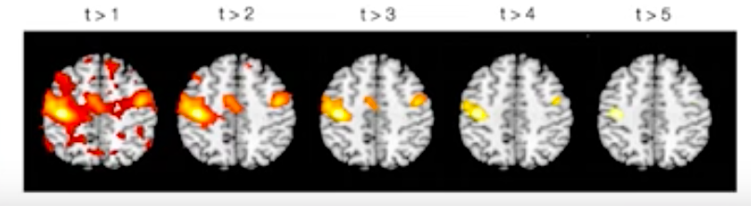
Multiple comparisons correction
Find the balance between sensitivity (true positive rate) and specificity (true negative rate)
  Liebermann 2009
YouTube: Principles of fMRI
Notes:
If too stringend: increase false negatives, Bias towards studying large effects over small, Bias towards sensory/motor processes rather than complex cognitive/affective processes
We need to choose a threshold is a balance between sensitivity (true positive rate) and specificity (true negative rate)

Slide 11
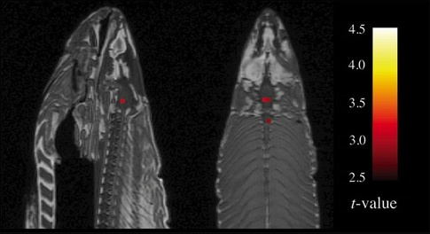
Multiple comparisons correction
Uncorrected
p value
FWER CORRECTION
FDR CORRECTION
Cluster-based
thresholding
Bonferroni
Random field theory
Permutation tests
Bennett 2010
Voxel-based thresholding
Notes:
Uncorrected p value, generates too many false positives and should never be used.. Dead salmon example
FWER correction: probability of making at least one Type I error in a family of tests, there are different controlling methods
Bonferroni ist very strict, and does not take spatial correlation into account
Whereas random field theory does.. RF methods are good for highly-smoothed data only and are best for single-subject data.
For unsmoothed (or low-smoothed), single-subject data, FDR corrections are the best. They have very high sensitivity while still providing good control of false positives, even with low degrees of freedom
FDR: the probability of false positives among rejected tests. Less conservative than FWER
.

Slide 12
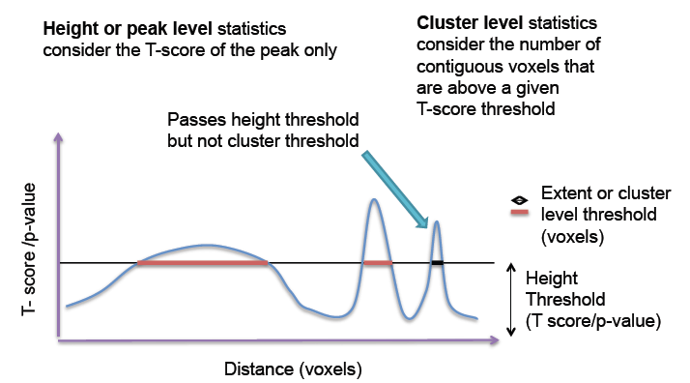
Cluster-extend based thresholding
Notes:
When using voxel-based thresholding, it gives best us good spatial specifity. We reject the H0 at specific voxel
Cluster-based: Not correcting for false positives at cluster level. 2step process:
Voxel level primary threshold defines clusters
cluster-level extent threshold measures units of activated voxels (controls for FWER, i.e. less stringent than voxel based multiple comparison correction – accounts for the fact that individual voxel activations are not spatially independent from neighbours). Better sensitivity but worse spatial specifity

Slide 13
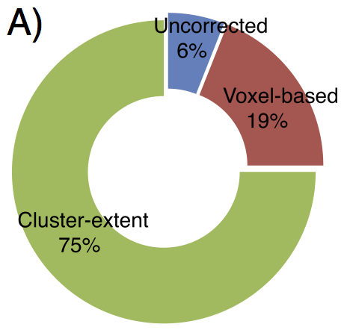
Cluster-extend based thresholding
Woo et al., 2013
Notes:
Pitfall with cluster-extend based thresholding: noise is also clustered, thus spatially correlated

Slide 14
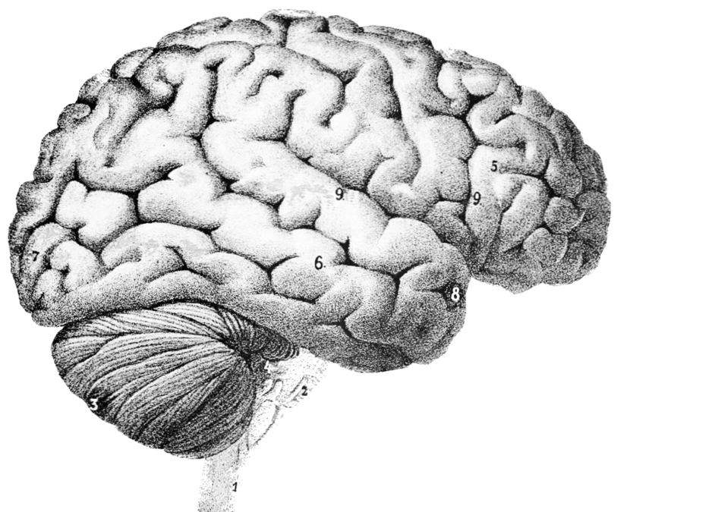
Pitfalls of cluster-extend based thresholding
Woo et al., 2013
Notes:
Large clusters that span multiple anatomical regions provide us with poor spatial resolution and neuroscientific interpretability. We can only infer that there is true signal “somewhere” in this huge cluster and cannot make an inference about specific anatomical regions.
Problematic if primary voxel level threshold to define clusters is liberal (e.g. p<0.01) hen clusters are big!
Another way: ROI anaylsis where you predefine a region you postulate to be active

Slide 15
ROI analysis
Notes:
Statistics output
Peak vs. cluster
Depending on shape, size..

Slide 16
Some suggestions
Think about choice of thresholding method
(cluster extent based thresholding adequate if moderate effect/sample size. For studies
with good power voxel-wise corrections such as FWER and FDR better, for ROI analyses,
choose cluster or peak-level threshold depending on the size and shape of your ROI)
Primary threshold
Lower threshold as default in analysis package
Reporting strategies
Data sharing
Woo et al., 2013
Notes:
Primary threshold. Uncorrected threshold p<.01 filtering junk
Secondary threshold:
Reporting strategies.. Note all the regions that are in your cluster, report voxel size of respective regions (10voxels or more) discussion
Upload ur uncorrected unthresholded data
Survey by Woo et al. results suggest that the choice of primary thresholds depends strongly on the defaults of the software packages used for analysis.

Slide 17
Outline
Recap: Hypothesis testing
Multiple comparison problem and correction
Non-independent hypothesis testing/Double dipping
Exploratory versus confirmatory analysis
Other ways to analyse fMRI data

Slide 18
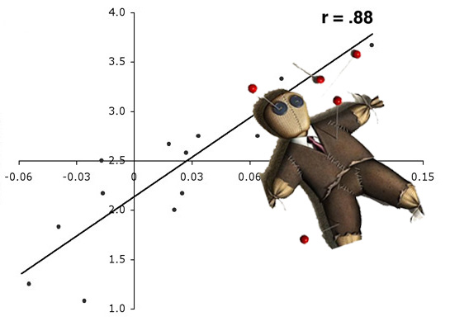
Non-independent selective analysis
Testing H1
2. Find an active region
3. Draw a ROI around
activation
Perform Secondary
Statistical Analysis
5. Correlate with task
Associated beh. measure
Vul et al. (2009); Kriegeskorte et al. (2010)
Notes:
What to do now you have your blob maps? A lot of groups have gone ahead and tried to model the relationship between the strength of activation and a behavioural measure.
So they
1
2
3
4
5 – In our pain example, we could use pain intensity, for example.
This has almost always lead to double dipping.

Slide 19
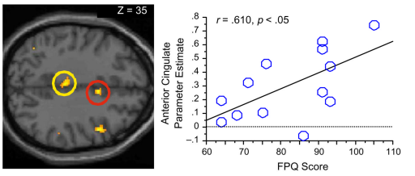
Double dipping / Non-independent selective analysis.
Non-Independent analysis: Activations presented on a blob map are voxels that already correlate with your model!
Double dipping gives the illusion of providing an extra result.
Vul et al. (2009)
Ochsner et al. (2006)
Notes:
So why is this method bad?
Activations from every voxel are present because they have a certain t-statistic score that passes a certain threshold multiple comparison correction. Anything present, including noise, favours the correlation.
Computing secondary statistics on active voxels is problematic due to intrinsic noise favouring the correlation.
Due to this inherent noise you’re secondary correlational analyses are going to represent largely inflated r scores.

Slide 20
Outline
Recap: Hypothesis testing
Multiple comparison problem and correction
Non-independent hypothesis testing/Double dipping
Exploratory versus confirmatory analysis
Other ways to analyse fMRI data

Slide 21
Exploratory versus confirmatory analysis
“The only way to obtain clear answers from Nature
is to ask her clear questions”
Waagenmakers, 2015
Notes:
A continuum of experimental exploration and the corresponding continuum of statistical wonkiness (Wagenmakers et al., 2012). “On the far left of the continuum, researchers find their hypothesis in the data by post hoc theorizing, and the corresponding statistics are ‘wonky’, dramatically overestimating the evidence for the hypothesis. On the far right of the continuum, researchers preregister their studies such that data collection and data analyses leave no room whatsoever for exploration; the corresponding statistics are ‘sound’ in the sense that they are used for their intended purpose. Much empirical research operates somewhere in between these two extremes, although for any specific study the exact location may be impossible to determine. In the grey area of exploration, data are tortured to some extent, and the corresponding statistics are somewhat wonky.”

Slide 22
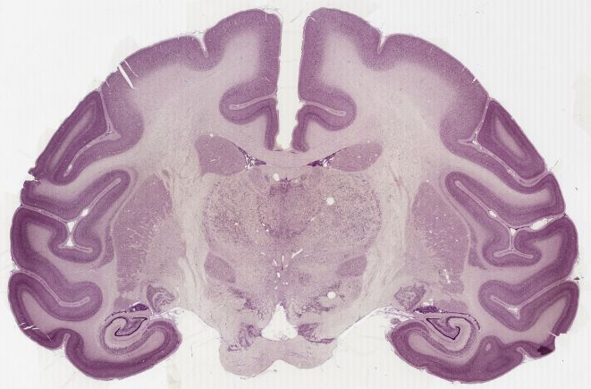
Notes:
What is a voxel? This monkey brain to show an example of the scale of voxels used in MRI acquisition.

Slide 23
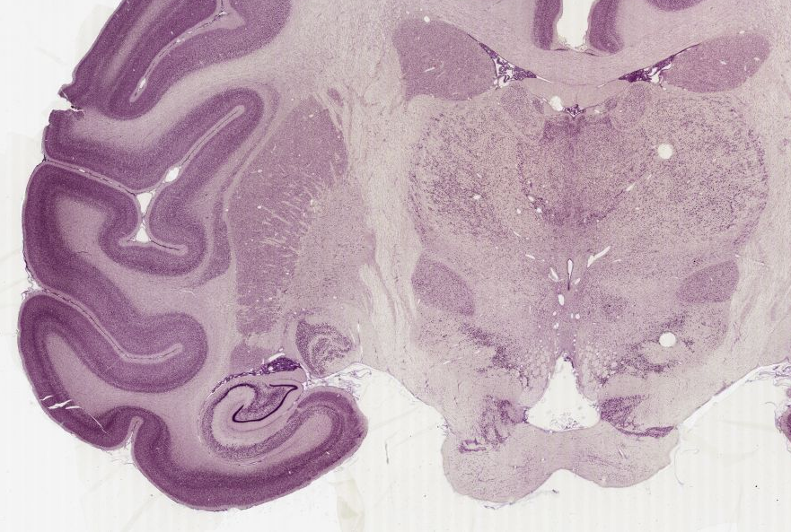

Slide 24
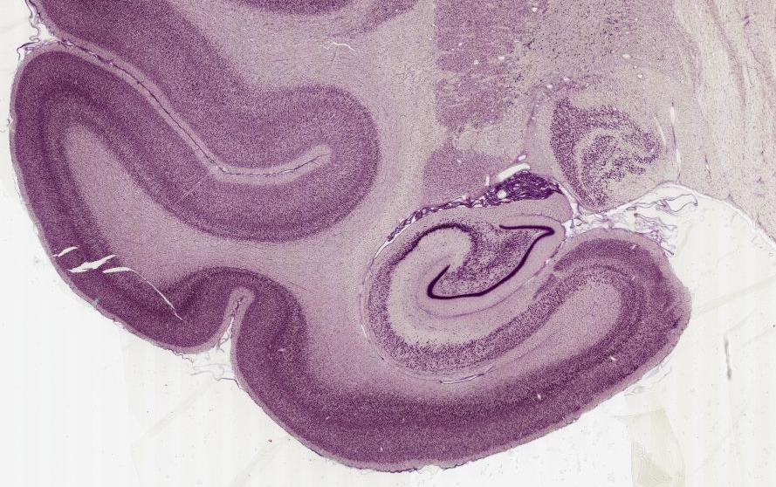

Slide 25
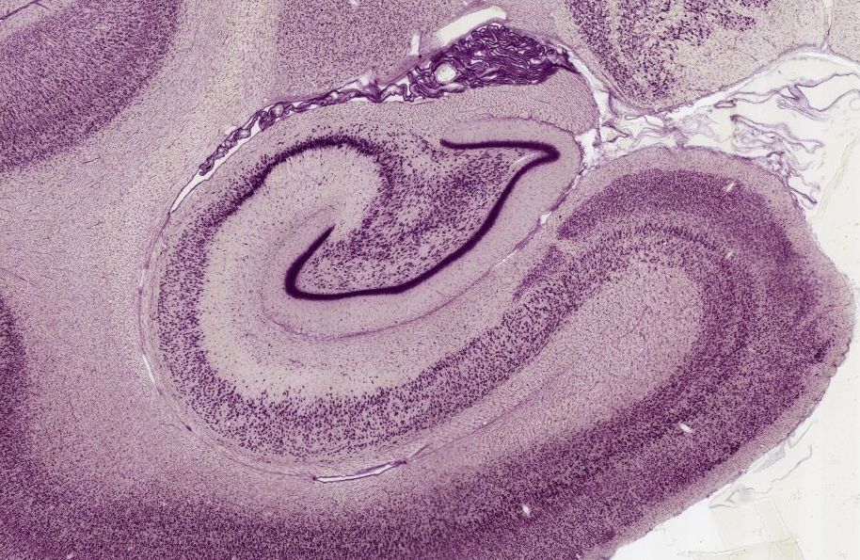
Notes:
If we zoom into the hippocampus

Slide 26
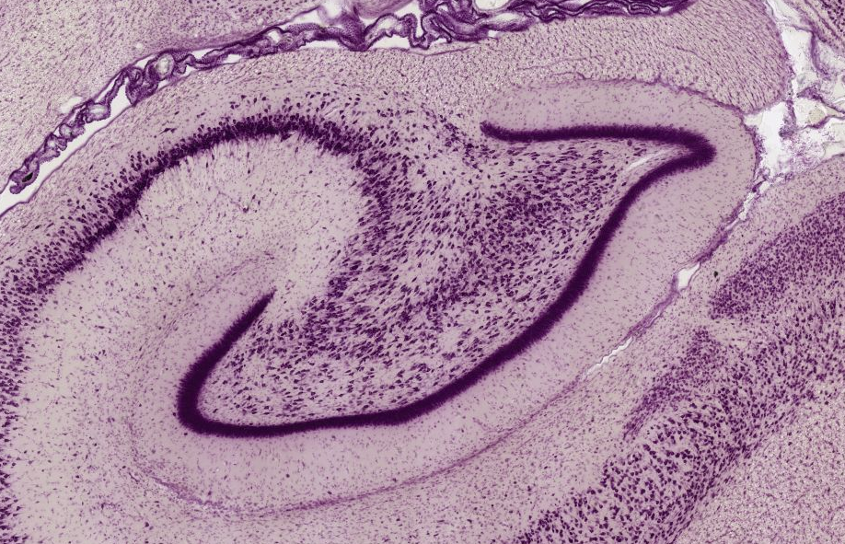

Slide 27
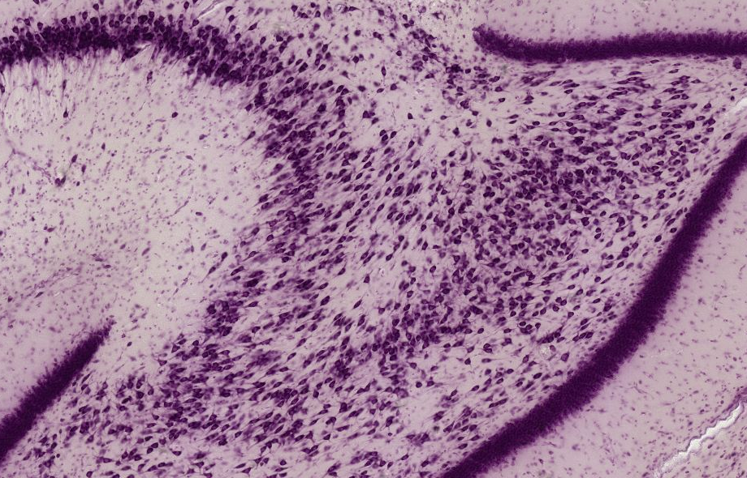

Slide 28
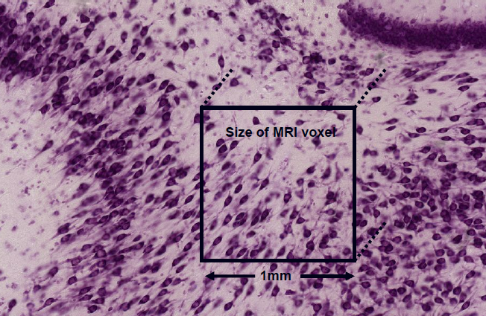
3mm fMRI Voxel
Notes:
This relates to a structural image voxel, however a functional voxel is typically much bigger and in the region of 3mm in width. Clearly we are looking at mass action of neuronal populations.

Slide 29
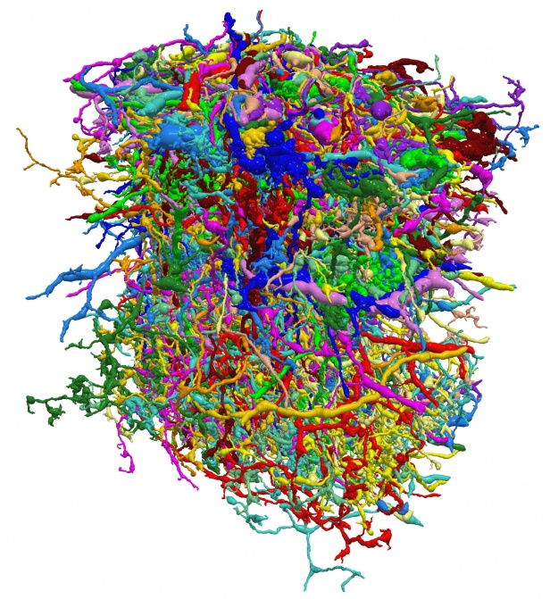
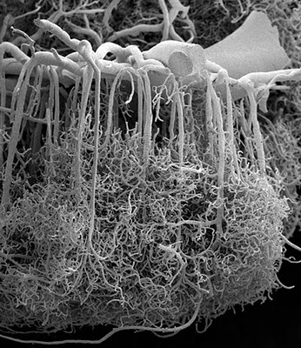
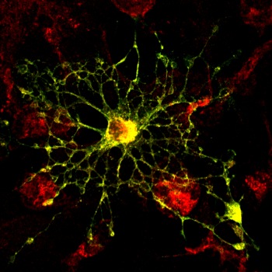
What is inside an fMRI Voxel?
Neurones:
~630,000
~4 x Glial cells:
3 mm
Blood Vessels
3 mm
3 mm
http://miny.ir/EAaZv
Notes:
We already know that what we are measuring but the point here is to remind you that what we measure is the result of a complicated metabolic process and that a voxel is representing the mass action of not just neuronal populations but a large number of supporting cells as well.
But this sort of detail is like reading a newspaper with a microscope, so lets zoom out a little bit
Multislice???

Slide 30
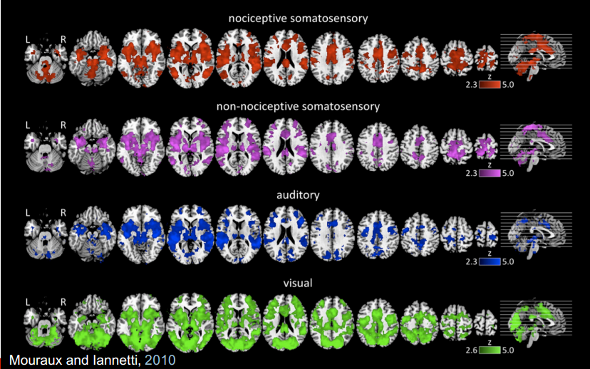
What are we seeing?
Notes:
This highlights the importance of hypothesis testing. This figure is taken from a paper investigating the pain matrix
Each of these four colours represents brain activations evoked from four different stimuli. Can you tell me which is a response evoked from a painful stimuli?
Painful stimuli, Non painful tactile, Auditory, Visual
So: clearly defining your hypotheses because it is your hypothesis that contextualise your brain activations.

Slide 31
Outline
Recap: Hypothesis testing
Multiple comparison problem and correction
Non-independent hypothesis testing/Double dipping
Exploratory versus confirmatory analysis
Other ways to analyse fMRI data

Slide 32
Other ways to analyse fMRI data
“Resting” state (and task-based) Connectivity
Multi-voxel pattern analysis (MVPA)
Network analyses
Notes:
RS: functional activity of different brain regions is correlated
MVPA: Multi-voxel pattern analysis (MVPA) allows to detect differences between conditions by focusing on the comparison of distributed patterns of activity. MVPA tools stem from the field of machine learning or machine learning classifiers
Here: No correction/thresholding needed, just active pattern or percentage of classifier
Mention Simulteneous multislice acquisition…

Slide 33
Take home message
Clear H1 or clearly exploratory
Appropriate fit: analysis and H₁
Report transparently and interpret carefully
Notes:
This refers to checking your sample size or your regions of interest, the power your study has, whether you are looking for large or small effects, motor functions or cognitive processes? And based on this choose your analysis pipeline, which can already start with adjusting your pre-processing steps, but also refers to the correction method used for multiple comparison
report all your results, for instance if you corrected on a cluster level, report all regions in a cluster, e.g. in the supplementary material, it might be useful for other studies or meta analyses. The results of a study should be appropriately contextualised by the limitations of its methods. This helps to prevent going beyond data’s explanatory power during your interpretations

Slide 34
All models are wrong,
but some are useful.
George Box
Notes:
The results of a study should be appropriately contextualised by the limitations of its methods. This helps to prevent going beyond data’s explanatory power during your interpretations.

Slide 35
References
Bennett, C. M., Miller, M. B., & Wolford, G. L. (2009). Neural correlates of interspecies perspective taking in the post-mortem Atlantic Salmon: An argument for multiple comparisons correction. Neuroimage, 47(Suppl 1), S125.
Bennett, C. M., Wolford, G. L. and Miller, M. B. (2009). "The principled control of false positives in neuroimaging." Soc Cogn Affect Neurosci 4(4): 417-422.
Biswal, B., Zerrin Yetkin, F., Haughton, V. M., & Hyde, J. S. (1995). Functional connectivity in the motor cortex of resting human brain using echo‐planar mri.Magnetic resonance in medicine, 34(4), 537-541.Martin (2013) Blood and the Brain. J Royal Anthropological Institute
Logan, B. R., Geliazkova, M. P. and Rowe, D. B. (2008). "An evaluation of spatial thresholding techniques in fMRI analysis." Hum Brain Mapp 29(12): 1379-1389.
http://imaging.mrc-cbu.cam.ac.uk/imaging/PrinciplesMultipleComparisons
Calculating contents of fMRI voxel http://miny.ir/EAaZv
Lieberman, M. D. and Cunningham, W. A. (2009). "Type I and Type II error concerns in fMRI research: re-balancing the scale." Soc Cogn Affect Neurosci 4(4): 423-428.
Mouraux A, Diukova A, Lee MC, Wise RG, Iannetti GD. A multisensory investigation of the functional significance of the "pain matrix". Neuroimage. 2011 Feb 1;54(3):2237-49.
Nichols & Hayasaka (2003), "Controlling the familywise error rate in functional neuroimaging: a comparative review," Statistical Methods in Medical Research 12, 419-446
Ochsner, K. N., Ludlow, D. H., Knierim, K., Hanelin, J., Ramachandran, T., Glover, G. C., & Mackey, S. C. (2006). Neural correlates of individual differences in pain-related fear and anxiety. Pain, 120(1), 69-77.
PracticalfMRI.blogspot.co.uk
Previous MfD slides
Smith, K. (2012). fMRI 2.0. Nature, 484(7392), 24.
Vul, E., Harris, C. R., Winkielman, P., Pashler, H. (2009) Puzzingly high correlations in fMRI studies of emotion, personality, and social cognition. Perspectives on Psychological Science, 4(3), 274-290.
Wagenmakers, E-J. (2015). A perfect storm: The record of a revolution. The Inquisitive Mind, Issue 25. Retrieved from http://www.in-mind.org/article/a-perfect-storm-the-record-of-a-revolution
Woo, C. W., Krishnan, A. and Wager, T. D. (2014). "Cluster-extent based thresholding in fMRI analyses: Pitfalls and recommendations." Neuroimage.
YouTube: Principles of fMRI Part 1, Module 26: Multiple Comparisons. https://www.youtube.com/watch?v=AalIM9-5-Pk&t=181s

