Slide 1
1st Level Analysis
Design Matrix, General Linear Modelling, Contrasts and Inference
Carlos Escalante & Eddie Kane
Dr Guillame Flandin

Slide 2



Overview
Spatial filter
Design matrix
Statistical Parametric Map
Realignment
Smoothing
General Linear Model
Statistical
Inference
RFT
Normalisation
Anatomical
reference
p <0.05
Parameter estimates
Notes:
Overview of the SPM data processing. In the previous presentations we covered the preprocessing step that realigned the date to be consistent over time. Now we are ready to start the statistical analysis on the data.
This analysis is based on the General Linear Model.

Slide 3



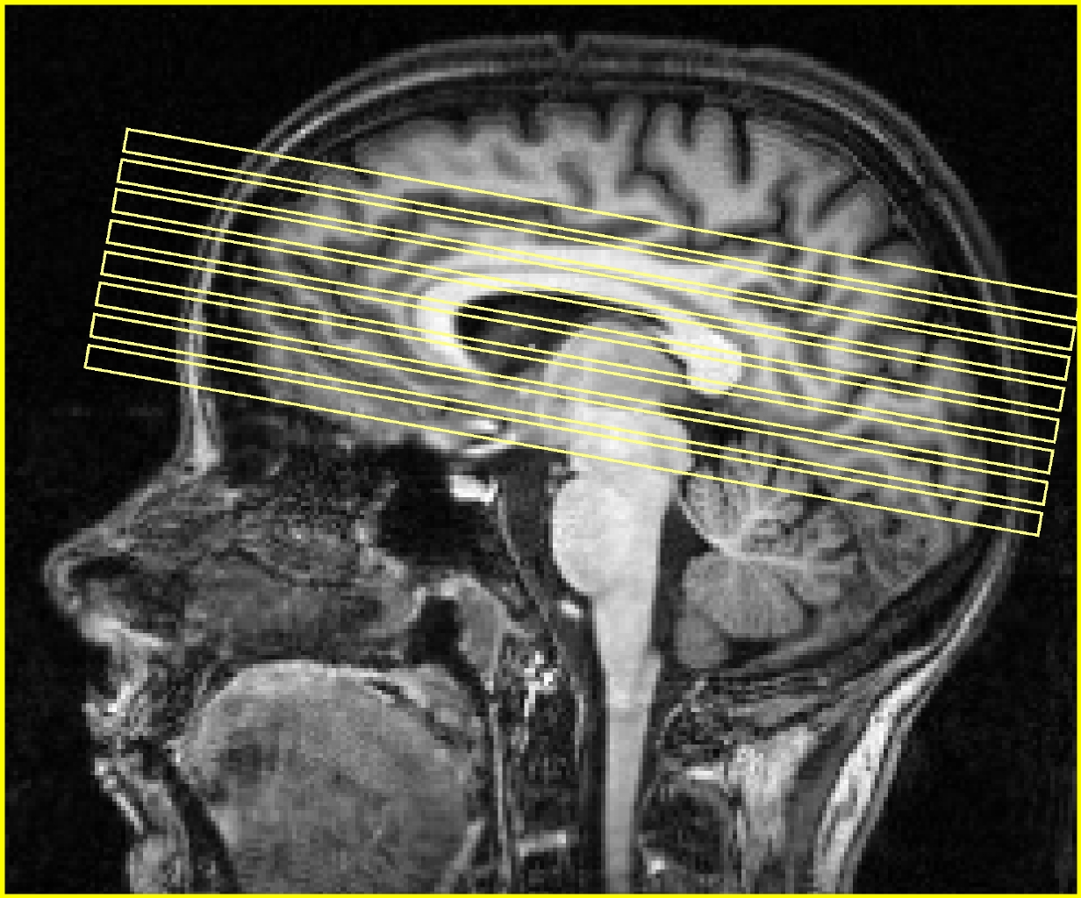
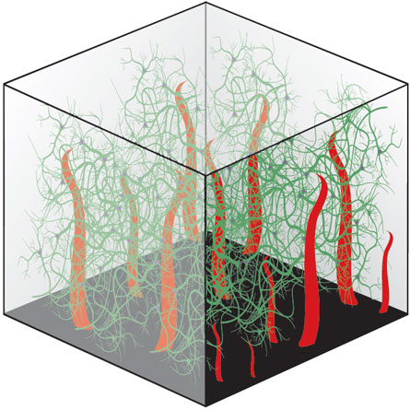
Data Acquisition
Subject A
Subject B
…
Session 1
Session 2
…
…
…
Volume
…
2nd level analysis: between-subject analysis
Slice
…
1st level analysis: within-subject analysis
analysing the time course of the fMRI signal for every
single subject separately
Voxel
…
Notes:
For each subject, we have collected data in different scanning period, namely a session. For each of the session, we collect several 3D volumes of brain regions, organized in slices, which again consist of many voxels.
So a voxel corresponds to a particular location in space and its represented by its activation intensity.
In SPM analysis is divided in two stages, the first one which is the one we ll consider is referred as the 1st level analysis and is a within subject analysis. It means extracting a value across scans over a session for an individual subject. Later on we will make inferences on the population with a between subject analysis.

Slide 4
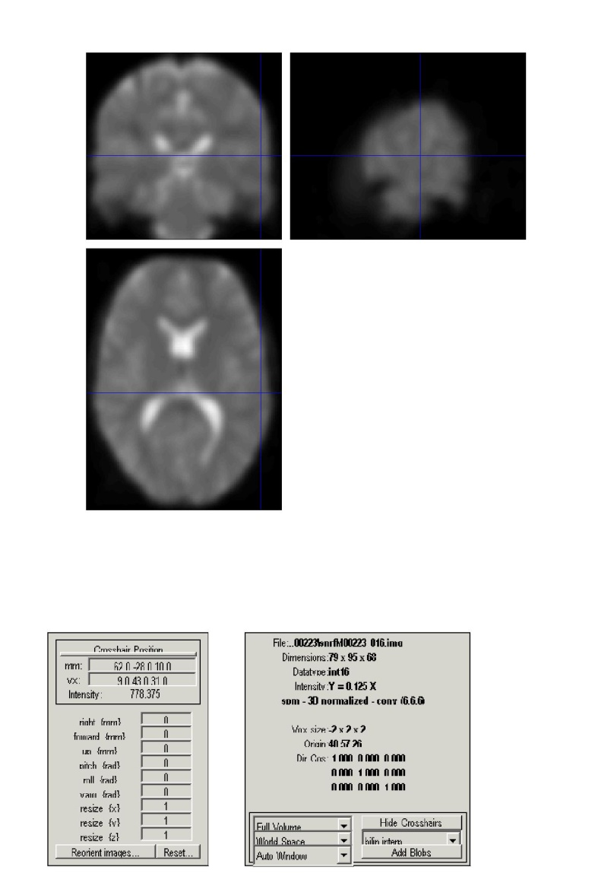
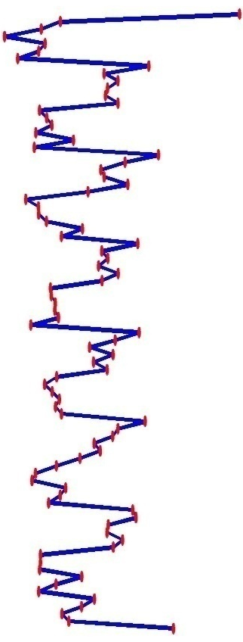
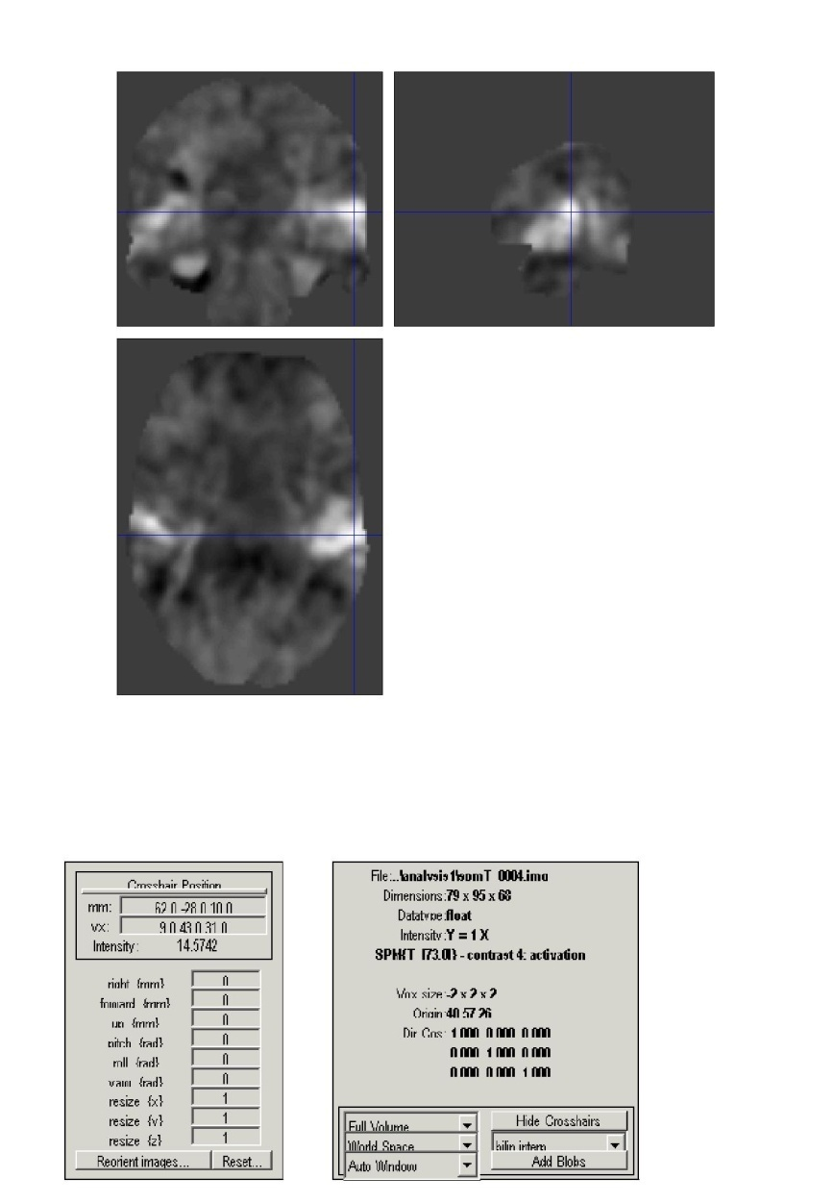
1st Level Analysis: voxel-wise time series
Model specification
Parameter
estimation
Time
Hypothesis
Time
Statistic
Pre-processing made sure a single voxel location is consistent over time
For each voxel we have a time-series capturing changes in the BOLD signal.
BOLD signal
SPM
Notes:
Pre-processing made sure that the each voxel is consistent over time by putting them in the same anatomical space and for each one of them we have collected a time-series of the changes in fMRI through the experiment. These changes consists on measuring the blood oxygen level dependent (BOLD) signal.
We want to model the time series to make an inference on the effect of interests, by testing hypothesis on this particular voxel.
Statistical parametric map representing the results of our statistical inference.

Slide 5
General Linear Model
Key Factors:
Quantify the effect of the experimental variable on BOLD signal.
  Y is the dependent variable (BOLD signal)
  X is the independent variable (design matrix) build on our experiment (manipulations, external effects)
  ε take into account what we cannot model
Mass univariate approach: same model will be fitted in each voxel independently
Y = X * β + ε
Observed data
Design matrix (Regressors)
Parameters Matrix
Error Matrix (residuals)
Time
Time
Regressors
Time
Voxels
Voxels
Regressors
Voxels
Notes:
How to define the model. We want to measure the effect of our experiment on the observed data (Y), our dependent variable, by using a combination of independent variables, called regressors, that reflects the conditions or manipulations in our experiment.
When doing this we will assume that there are errors depending on the noise, which is something we cannot control in the experiments.
SPM will perform this analysis in each single voxel (mass univariate approach), by fitting the same model to each voxel indipendentely.
The result of our model is calculation the Beta parameters.

Slide 6
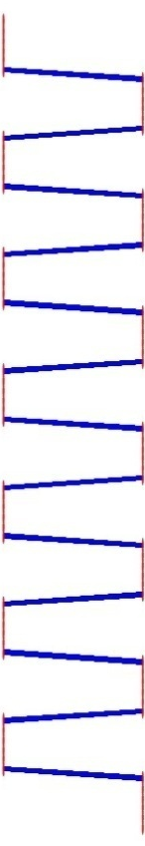

Single voxel regression model
Simple experiment
One session
Listening to words vs rest
Question: is there a change in the BOLD response between listening and rest?
error
Time
=
β₁
+
β₂
+
Modelling the condition:
On and Off state (boxcar)
Modelling the constant:
BOLD signal values are not absolute, but relative
BOLD signal
x₁
x₂
ε
Notes:
We know we alternate between conditions, so we can have one regressor to model this condition. For each volume we will then know if the subject was listening or waiting for the signal. We wll add a constant model the average signal. Fmri are relative measures and not absolute. We add the error term. This simple experiment can be modeled it by using two regressors.

Slide 7



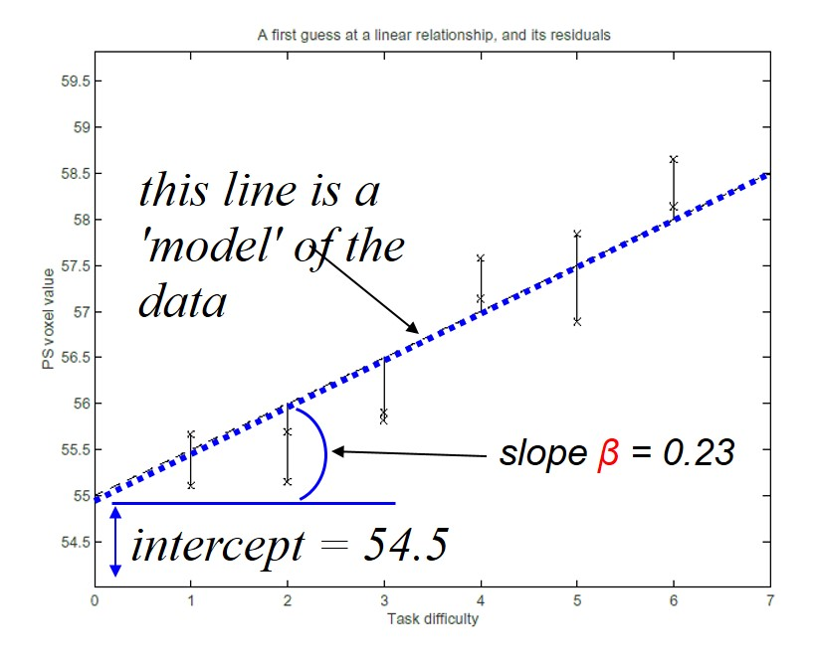
Estimating the parameters (β)
=
+
these are the squared errors for each observation
Assumptions about residuals:
The parameters are estimated on the model that minimizes the sum of squared errors (SSE)
Notes:
To have the general linear model we then have to make assumptions on the random term, our noise. We assume a Gaussian distribution with indepent at each a time point and identical means the variance is constant over time.

Slide 8
Problems with the fMRI time series
The BOLD response has a delayed and dispersed shape.
The acquired signal includes low-frequency noise (e.g. scanner drifts)
Due to physiological factors, the errors are usually serially correlated.
  Violation of main GLM assumption for the residuals
Notes:
BOLD signal does not change quickly. It has a specific shape and the duration is about 20 seconds.
The acquired signal can have additional components, and it has to do with the experimental setup. Usually this additional components have the form of a low noise frequencies.
Subjects have physiological activity, like the heart beat and our acquisition is relatively slow comparing to these factors, we are actually measuring also those.

Slide 9
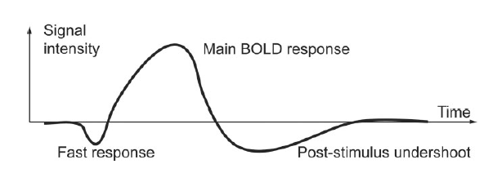
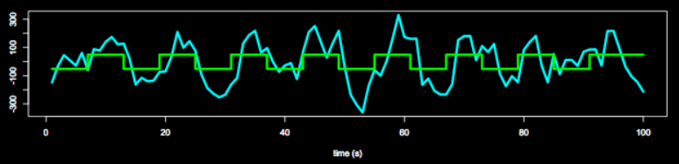
Problem 1 - Haemodynamic
Neural activity (delta function) elicits a BOLD signal change which is our fMRI collected data
Haemodynamic response function (HRF)
Notes:
As discussed in a prevuious lecture in the fMRI we acquire a the correlate of a neural activity. So if we see a spark in the neuronal response, what we measure is the release of oxygen to the neurons, the BOLD signal.
Duration is around 30 seconds
We need to take that into account. In our simple experiment our activation give as a response which is similar to the one shown.

Slide 10
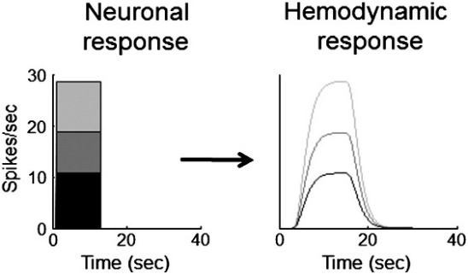
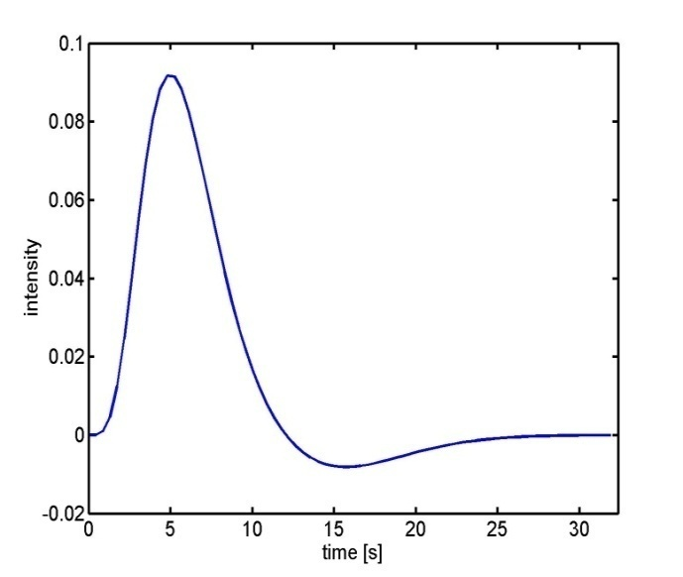
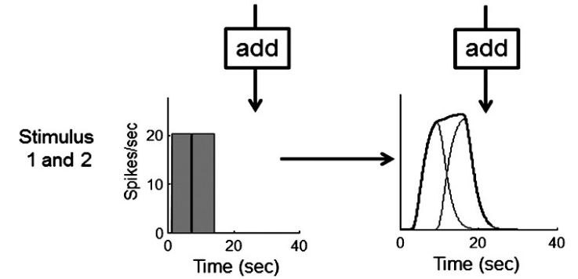

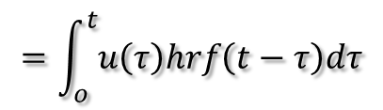

Problem 1 – HRF Convolution
Hemodynamic response function (HRF):
Scaling
Additivity
Linear time-invariant (LTI) system:
u(t)
hrf(t)
x(t)
Convolution operator:
Shift
invariance
$$x\left(t\right)=u\left(t\right)∗hrf\left(t\right)$$
$$=\int_{o}^{t}{u\left(τ\right)hrf\left(t−τ\right)dτ}$$
Boynton et al, NeuroImage, 2012.
Notes:
We take into account by convolving the input function with the Hemondynamic response function and we can do that because this function is linear time-invariant meaning that is scales with the neuronal response, its additive meaning that two stimulation in time will lead to a reponse which is the sum of the two responses and it is shift invariant so a stimuli presented at later stage shift the response accordingly

Slide 11
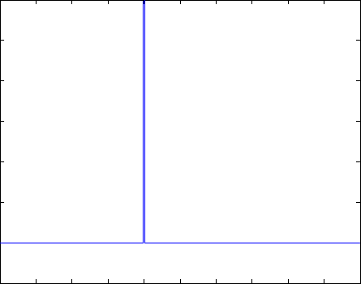
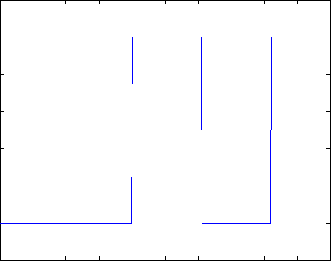
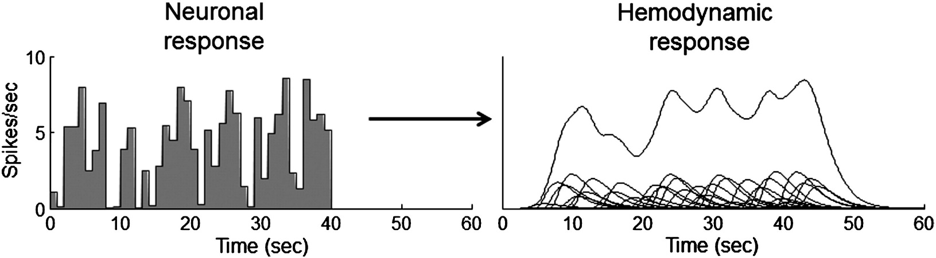
HRF Convolution
Notes:
Illustrate convolution as well as the 3 assumed properties of linear model transformation. Calculating all the single HRF and summing them.

Slide 12
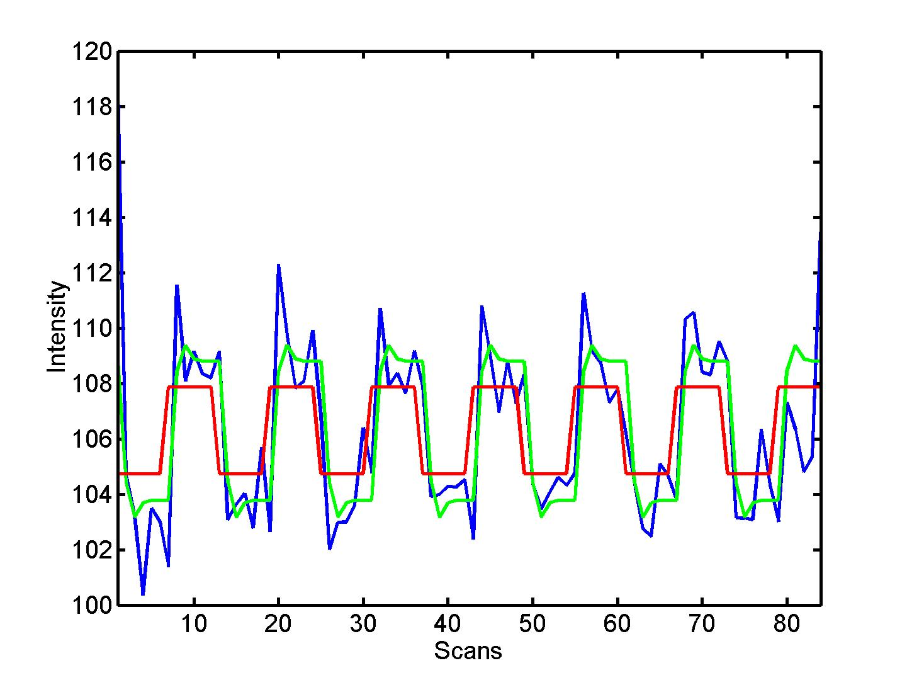


Problem 1 - Convolution model
https://www.youtube.com/watch?v=OyLKMb9FNhg&index=19&list=PLfXA4opIOVrGHncHRxI3Qa5GeCSudwmxM
⊗ HRF
Original design matrix
Convolved design matrix
Notes:
So the expected BOLD signal is done by SPM. IN our example we get something that better shape our response. We have a peak and then a plateu on the green line

Slide 13
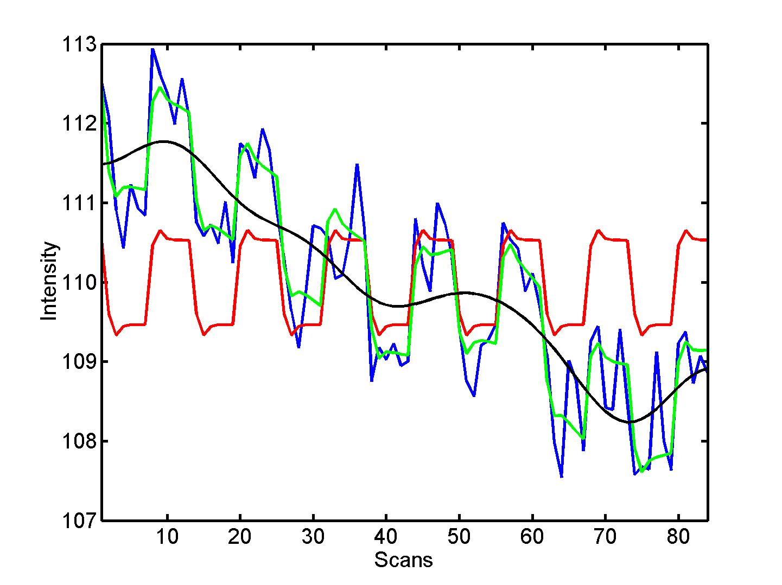

Problem 2 – Low frequency noise
Intensity drifts are due to setup issues
Using an high pass filter (SPM)
Add nuisance regressors that models the low frequency
  A series of cosine functions
discrete cosine transform (DCT) set
blue = data
black = mean + low-frequency drift
green = predicted response, taking into account low-frequency drift
red = predicted response, NOT taking into account low-frequency drift
Notes:
Second problem. We have low frequency modulating our signal, depending for example on the machine heating up. We can use some high pass filter to reduce the low frequencies (SPM does that) or we can add regressors that take slow frequencies. If we do that then our model will look like the green line in the graph.

Slide 14
Improving model - Design Matrix - Regressors
X
Regressors are hypothesised contributors in experiment.
Regressor of interest: intentionally manipulated
Regressor of no interest: not manipulated, potential confound – e.g. head movement (6 regressors)
Conditions
  ‘dummy codes’ identifying levels of experimental factor
    E.g. 0 or 1 for ‘off’ and ‘on’
Covariates
  Parametric modulation of independent variable
    E.g. task difficulty
Time
Regressors
Notes:
So we arrived to a very complex design matrix, but we can go a little step further. When modelling the design matrix it s always having a balance between, what we think will contribute to the actual observed signal, thus reducing the error term. If we exclude also regressors of no interest we may end up to have bigger noise. So to improve the model we can think to add to the design matrix also regressors that are not dependent from manipulation.

Slide 15
Interim Summary
Quantify the effect of the experimental factors on BOLD signal, by building a General Linear Model
The design matrix informs on how the BOLD signal should change with respect to each experimental variable
  Regressors build our predicted model and can be used to model predicted errors in the setup
Design matrix is convolved with the HRF to make the predicted model more representative of the observed data
SPM calculates the parameters (β) for each regressor by minimizing the SSE

Slide 16
Overview
Spatial filter
Design matrix
Statistical Parametric Map
Realignment
Smoothing
General Linear Model
Statistical
Inference
RFT
Normalisation
Anatomical
reference
p <0.05
Parameter estimates
Notes:
Overview of the SPM processing.
After the preprocessing step, where all of the data has been realigned to be consistent over time, we are ready to start the statistical analysis on the data. This analysis is based on the General Linear Model.

Slide 17

Statistical inference: contrasts
WHAT:
We want to know if there is a significant activation in a particular voxel due to our experiment conditions
  Evaluating whether the experimental manipulation caused a significant change in the parameter weights
HOW:
We use contrasts
  Specify effects of interest
  Perform statistical evaluation of hypothesis
Contrasts used and their interpretation depends on the model specification, therefore on the design of the experiment
Notes:
Once we have the model we want to see if there is any significant activation in a particular brain region due to our experimental conditions. Asking this question means asking if any of parameter weights of interest we calculated with our model justify the signal changes.
In order to do that we use contrasts. So in general contrast specify effect of interest by weighting our parameters and selecting regressors of interest. Our inference will be performed on a linear combination of regression coefficeints (beta) c^{T}β

Slide 18
T Contrasts
c^{T} = [1 0 0 0 0 …]
  Vector length is # regressors
Linear combination:
c^{T} β = 1x β1 + 0x β2 + 0x β3 + 0x β4 + 0x β5 + . . .
Contrast is a statistical assessment of c^{T} β
Is β1 > 0?
c^{T} = [1 0 0 0 0 0 0 0 0]
Time
Regressors
Notes:
We have the on and off regressor modelling our experimental factors and we are interested if it affects the signal in all the voxel
So our question is if b1 > 0?
We can do that by adding weights to the paramaters by using a contrast vector

Slide 19
Hypothesis Testing
To test an hypothesis, we construct a “test statistics”.
Null Hypothesis H₀
We want to disprove → Accept the Hypothesis H_{a}
Test Statistic T
The test statistic summarises evidence about H0.
Typically, test statistic is small in magnitude when the hypothesis H0 is true and large when the contrary
We need to know the distribution of T under the null hypothesis.
Null Distribution of T
Notes:
How do we build a test statistics?
We have to test against a null hypothesis, which is what we want to disprove. In this case assuming that there is no effect, and having a very small p value that can discard it.
We have already done some assumptions on our errors to we know what a null hypothesys distribution should look like.
If there is no effect we assume that the value of T is very small, not exactly zero, but just explained by the variability represented under the null hypothesis

Slide 20
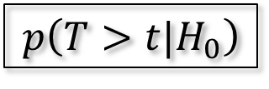
Hypothesis Testing
u_{α}
Significance level α:
Acceptable false positive rate α
⇨ threshold u_{α}
Threshold u_{α} controls the false positive rate
α
Conclusion about the hypothesis:
We reject the null hypothesis in favour of the alternative hypothesis if t > u_{α}
Null Distribution of T
t
p-value:
A p-value summarises evidence against H₀.
This is the chance of observing value more extreme than t under the null hypothesis.
p-value
$$p\left(T>t|H_{0}\right)$$
Null Distribution of T
Notes:
We accept a risk of accepting the false positive. Claiming an effect where there is not. To recap the risk is represented by alpha which is the probability of observing a value which is bigger than the threshold given the null hypothesis.
If we get a T which is bigger or alternative a p value that is smaller we can reject the null hypothesis, and so we can accept our hypothesis.

Slide 21
T statistics
Question:
box-car amplitude > 0 ?
=
b₁ = c^{T}b> 0 ?
c^{T} = [1 0 0 0 0 0 0 0 0]
Null hypothesis:
H₀: c^{T}β=0
Time
contrast of
estimated
parameters
Test statistic:
T =
variance
estimate
Regressors
Notes:
T test is doing a signal to noise measure, meaning that we divide the estimated paramaters by the standard deviation or the variance. The variation is composed by the estimated variance of the residuals and then something that depends on the model , the design matrix and the weight just choosed.

Slide 22
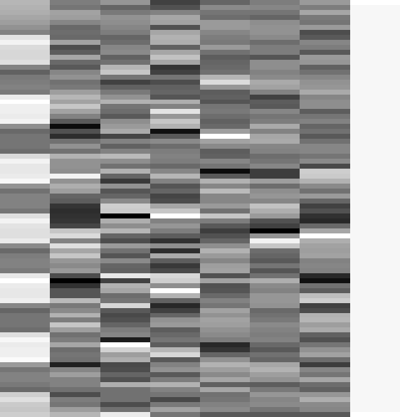
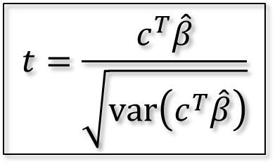
T-test: simple example
Passive word listening versus rest
Q: activation during listening ?
c^{T} = [ 1 0 0 0 0 0 0 0]
1
Null hypothesis:
SPMresults:
Height threshold T = 3.2057 {p<0.001}
voxel-level
mm mm mm
T
(
Z
≡
)
p
uncorrected
13.94
Inf
0.000
-63 -27 15
$$t=\frac{c^{T}\hat{β}}{\sqrt{\text{var}\left(c^{T}\hat{β}\right)}}$$
12.04
Inf
0.000
-48 -33 12
11.82
Inf
0.000
-66 -21 6
13.72
Inf
0.000
57 -21 12
12.29
Inf
0.000
63 -12 -3
9.89
7.83
0.000
57 -39 6
7.39
6.36
0.000
36 -30 -15
6.84
5.99
0.000
51 0 48
6.36
5.65
0.000
-63 -54 -3
6.19
5.53
0.000
-30 -33 -18
5.96
5.36
0.000
36 -27 9
5.84
5.27
0.000
-45 42 9
5.44
4.97
0.000
48 27 24
5.32
4.87
0.000
36 -27 42
Notes:
So we apply the t statistics in each voxel of the brain and so SPM can get our image with the brain regions that had major effects

Slide 23
T-test summary
T-test is a signal-to-noise ratio measure
  Estimate over standard deviation of the estimate
Unidimensional
  C^{T} is a vector
Directional
  H₀: C^{T} β=0 vs H₁: C^{T} β>0 or C^{T} β<0
Assess the effect of one parameter (c^{T} = [1 0 0 0 …])
OR
compare combinations of parameters (c^{T} = [-1 1 0 0 …])
How can we test multiple linear hypothesis?

Slide 24
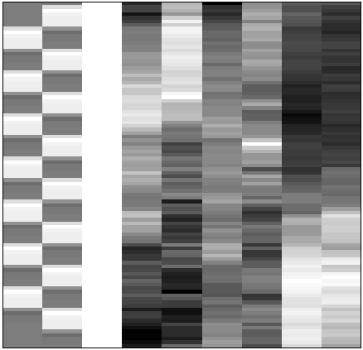

F Contrasts
Null Hypothesis H₀: True model is X₀ (reduced model)
Model comparison →
X₀
X₁
X₀
Test statistic: ratio of explained variability and unexplained variability (error)
RSS
RSS₀
$$F∝ \frac{RSS0 −RSS}{RSS}$$
Full model ?
or Reduced model?
Notes:
Testing for multiple linear hypothesis means testing between two models. Consider this design matrix have a model with X0 and X1 as a full model. We want to know if the added variance can better justify the variability in the error term. So in this case we use an F test is a comparison of reduced sum of square divided by the unexplained variance.
WE compute the two residuals, full model wull have a less error. In F statistics variance of the noise is approximated by full model. The numerator represents the variance added by X1

Slide 25
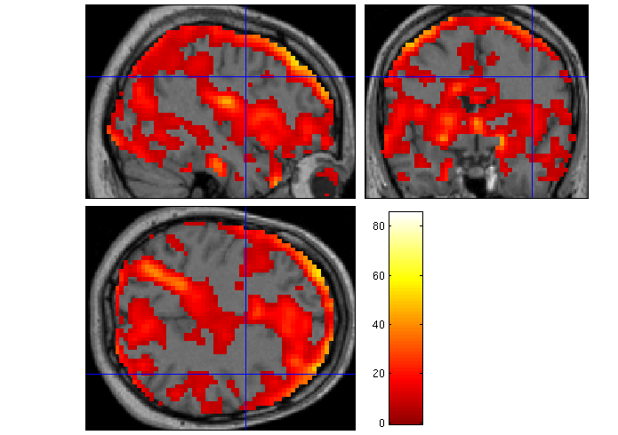
F Contrasts
H₀: True model is X₀
H₀: β₄ = β₅ = ... = β₉ = 0
test H₀ : c^{T}β = 0 ?
X₀
X₁ (β₄₋₉)
X₀
0 0 0 1 0 0 0 0 0
0 0 0 0 1 0 0 0 0
0 0 0 0 0 1 0 0 0
0 0 0 0 0 0 1 0 0
0 0 0 0 0 0 0 1 0
0 0 0 0 0 0 0 0 1
c^{T} =
Full model?
Reduced model?
Notes:
How do we build that in SPM. We define a contrast matrix instead of a vector so we can test the regressors simultaneously.

Slide 26
F test summary
F test tests for additional variance explained by larger model comparing to a simpler model → model comparison
H₀: C^{T} β=0 vs H₁: C^{T} β≠0
Non directional
  Can tell existence of significant contrasts. It does not tell which contrast drives the effect nor the direction of it
If the contrast matrix is a vector, we are implementing a two-sided T-test

Slide 27
Resources
UCL SPM website
Previous MfD slides
Thank you! Questions?

