Slide 1
fMRI 1st Level Analysis:
Basis functions, parametric modulation and correlated regression
MfD 04/12/18
Alice Accorroni – Elena Amoruso

Slide 2



Overview
Preprocessing
Data Analysis
Spatial filter
Design matrix
Statistical Parametric Map
Realignment
Smoothing
General Linear Model
Statistical
Inference
RFT
Normalisation
Anatomical
reference
p <0.05
Parameter estimates

Slide 3
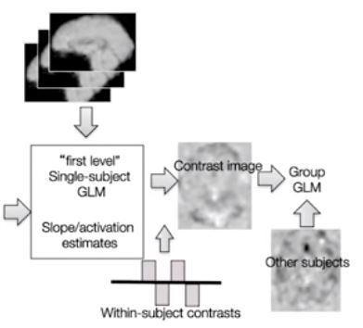
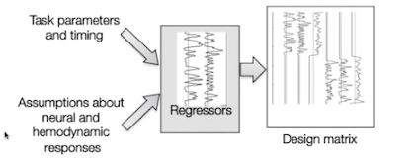
Estimation
(1st level)
Group Analysis
(2nd level)

Slide 4
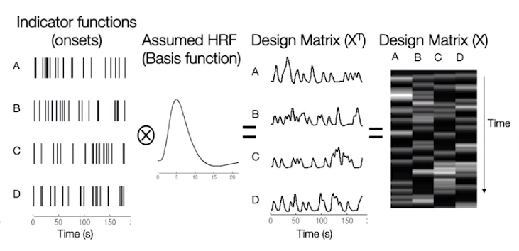
The GLM and its assumptions
Neural activity function is correct
HRF
is correct
Linear time-invariant system

Slide 5
The GLM and its assumptions
HRF
is correct

Slide 6
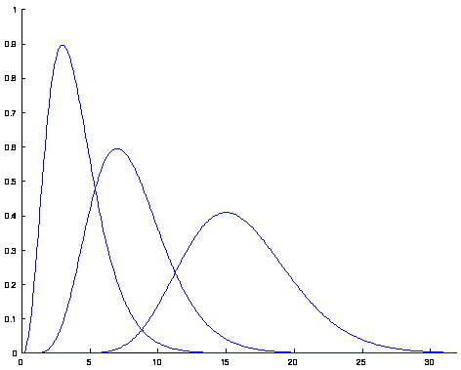
The GLM and its assumptions
Gamma functions
2 Gamma functions added

Slide 7
The GLM and its assumptions
HRF
is correct

Slide 8
The GLM and its assumptions
Neural activity function is correct
HRF
is correct
Linear time-invariant system
Aguirre, Zarahn and D’Esposito, 1998; Buckner, 2003; Wager, Hernandez, Jonides and Lindquist, 2007a;

Slide 9


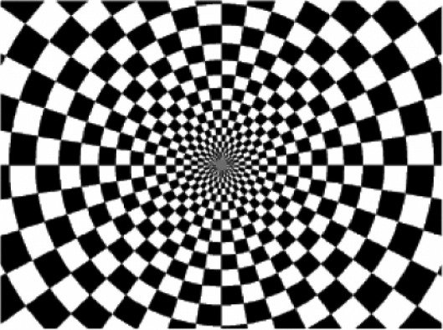
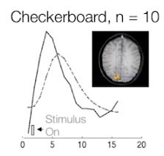
Brain region differences in BOLD
+

Slide 10
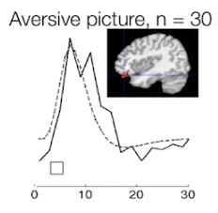
Brain region differences in BOLD
+
Aversive Stimulus

Slide 11
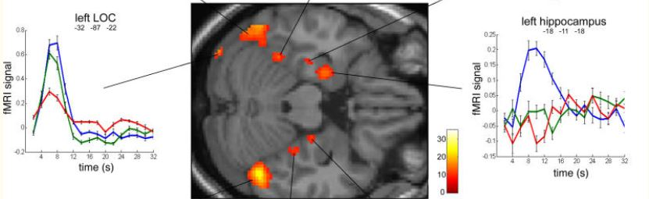
Brain region differences in BOLD
Sommerfield et al 2006

Slide 12
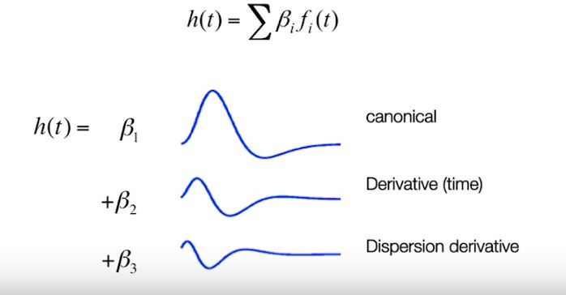
Temporal basis functions

Slide 13
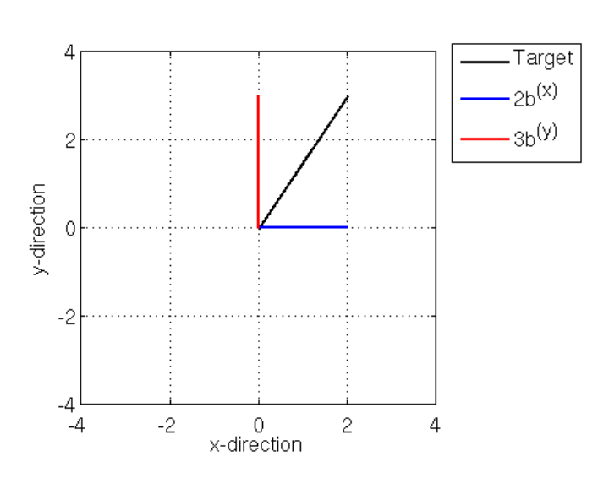

Slide 14
Temporal basis functions

Slide 15
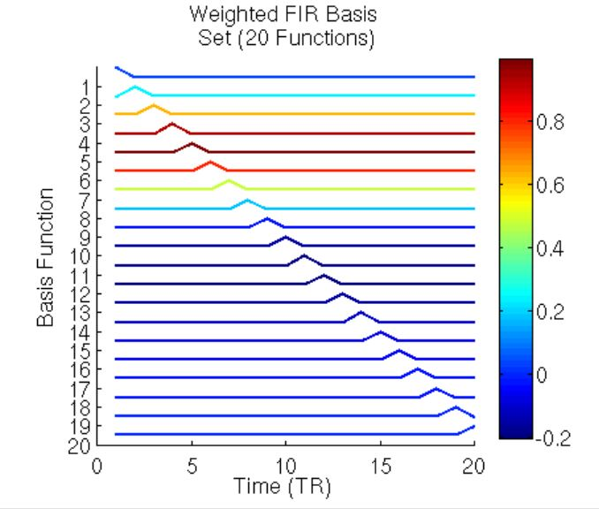
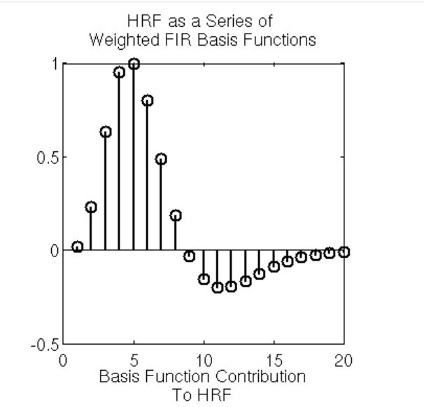
Temporal basis functions: FIR

Slide 16
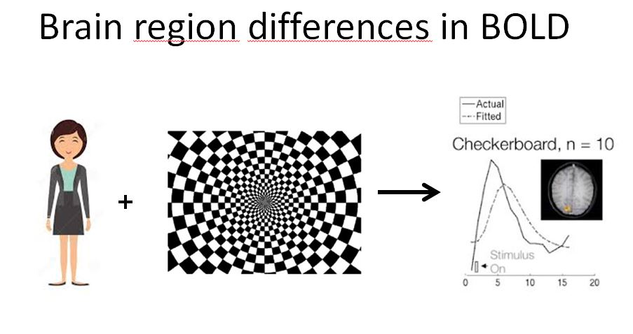
Temporal basis functions

Slide 17
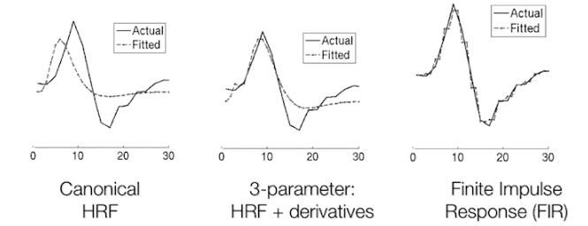
Temporal basis functions

Slide 18
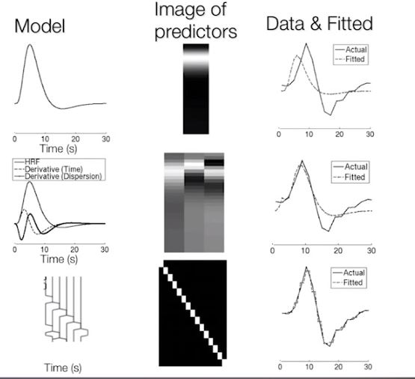
Temporal basis functions
Canonical HRF
HRF + derivatives
Finite Impulse Response

Slide 19
Temporal basis functions
Canonical HRF
HRF + derivatives
Finite Impulse Response

Slide 20
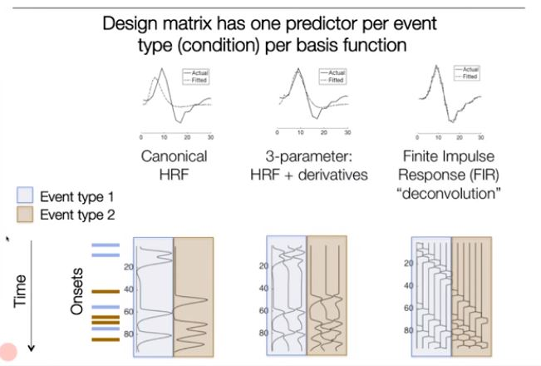
Temporal basis functions

Slide 21
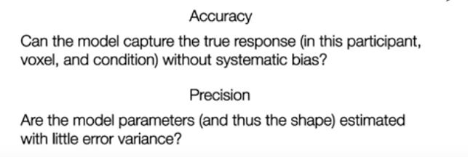
What is the best basis set?

Slide 22
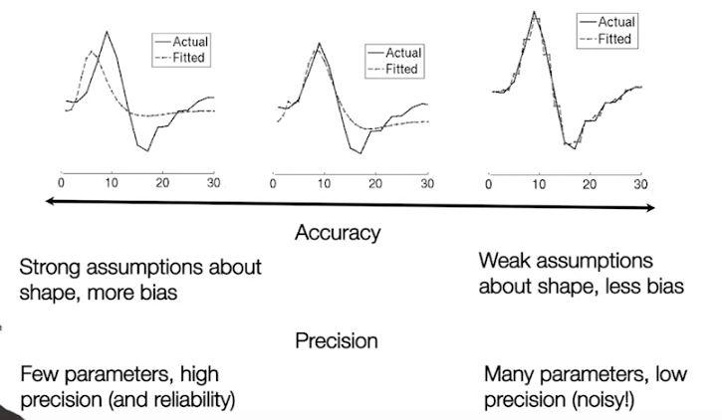
What is the best basis set?

Slide 23
Correlated Regressors

Slide 24
Regression analysis
Regression analysis examines the relation of a dependent variable Y to a specified independent variables X:
Y = a + bX
  if the model fits the data well:
  R² is high (reflects the proportion of variance in Y explained by the regressor X)
  the corresponding p value will be low

Slide 25
Multiple Regression
Multiple regression characterises the relationship between several independent variables (or regressors), X1, X2, X3 etc, and a single dependent variable, Y:
Y = β₁X₁ + β₂X₂ +…..+ β_{L}X_{L} + ε
The X variables are combined linearly and each has its own regression coefficient β (weight)
βs reflect the independent contribution of each regressor, X, to the value of the dependent variable, Y
i.e. the proportion of the variance in Y accounted for by each regressor after all other regressors are accounted for

Slide 26
Multicollinearity
Multiple regression results are sometimes difficult to interpret:
  the overall p value of a fitted model is very low
    i.e. the model fits the data well
  but individual p values for the regressors are high
    i.e. none of the X variables has a significant impact on predicting Y.
How is this possible?
Caused when two (or more) regressors are highly correlated: problem known as multicollinearity

Slide 27
Multicollinearity
Are correlated regressors a problem?
No
  when you want to predict Y from X1 and X2
    Because R² and p will be correct
Yes
  when you want assess impact of individual regressors
    Because individual p values can be misleading: a p value can be high, even though the variable is important

Slide 28
Multicollinearity - Example
Question: how can the perceived clarity of a auditory stimulus be predicted from the loudness and frequency of that stimulus?
Perception experiment in which subjects had to judge the clarity of an auditory stimulus.
Model to be fit:
Y = β1X1 + β2X2 + ε
Y = judged clarity of stimulus
X1 = loudness
X2 = frequency

Slide 29
Regression analysis: multicollinearity example
What happens when X1 (frequency) and X2 (loudness) are collinear, i.e., strongly correlated?
Correlation loudness & frequency : 0.945 (p<0.000)
High loudness values correspond to high frequency values
FREQUENCY

Slide 30
Regression analysis: multicollinearity example
Contribution of individual predictors (simple regression):
X1 (loudness) is entered as sole predictor:
  Y = 0.859X₁ + 24.41
  R² = 0.74 (74% explained variance in Y)
  p < 0.000
X2 (frequency) entered as sole predictor:
  Y = 0.824X₁ + 26.94
  R² = 0.68 (68% explained variance in Y)
  p < 0.000

Slide 31
Collinear regressors X1 and X2 entered together (multiple regression):
Resulting model:
Y = 0.756X1 + 0.551X2 + 26.94
R2 = 0.74 (74% explained variance in Y)
p < 0.000
Individual regressors:
X1 (loudness): R2 = 0.850 , p < 0.000
X2 (frequency): R2 = 0.555, p < 0.594

Slide 32
GLM and Correlated Regressors
The General Linear Model can be seen as an extension of multiple regression (or multiple regression is just a simple form of the General Linear Model):
Multiple Regression only looks at one Y variable
GLM allows you to analyse several Y variables in a linear combination (time series in voxel)
ANOVA, t-test, F-test, etc. are also forms of the GLM

Slide 33
General Linear Model and fMRI
Y = X . β + ε
Observed data
Y is the BOLD signal at various time points at a single voxel
Design matrix
Several components which explain the observed data Y:
Different stimuli
Movement regressors
Parameters
Define the contribution of each component of the design matrix to the value of Y
Error/residual
Difference between the observed data, Y, and that predicted by the model, Xβ.

Slide 34
fMRI Collinearity
If the regressors are linearly dependent the results of the GLM are not easy to interpret
Experiment:
  Which areas of the brain are active in visual movement processing?
  Subjects press a button when a shape on the screen suddenly moves
Model to be fit:
Y = β₁X₁ + β₂X₂ + ε
Y = BOLD response
X1 = visual component
X2 = motor response

Slide 35
How do I deal with it? Ortogonalization
y
y = β₁X₁ + β₂*X₂ *
β₁ = 1.5
β₂ * = 1
x₂
x₂*
x₁

Slide 36
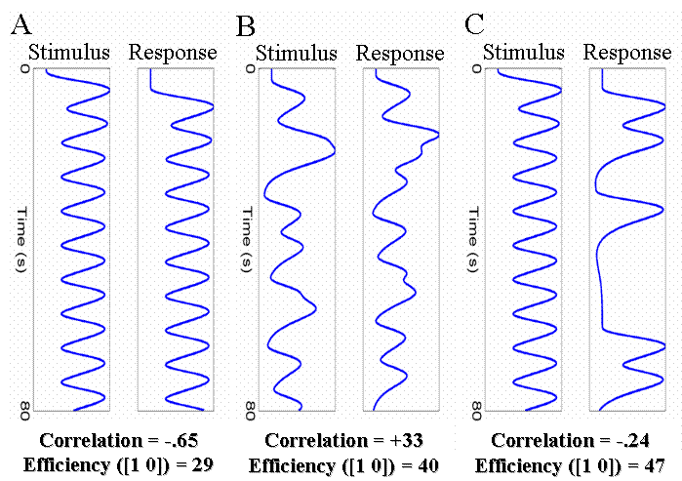
How do I deal with it? Experimental Design
Carefully design your experiment!
When sequential scheme of predictors (stimulus – response) is inevitable:
  inject jittered delay (see B)
  use a probabilistic R₁-R₂ sequence (see C))
Orthogonalizing might lead to self-fulfilling prophecies
(MRC CBU Cambridge,
http://imaging.mrc-cbu.cam.ac.uk/imaging/DesignEfficiency)

Slide 37
Parametric Modulations

Slide 38
Types of experimental design
Categorical - comparing the activity between stimulus types
Factorial - combining two or more factors within a task and looking at the effect of one factor on the response to other factor
Parametric - exploring systematic changes in BOLD signal according to some performance attributes of the task (difficulty levels, increasing sensory input, drug doses, etc)

Slide 39
Parametric Design
  Complex stimuli with a number of stimulus dimensions can be modelled by a set of parametric modulators tied to the presentation of each stimulus.
  This means that:
    Can look at the contribution of each stimulus dimension independently
    Can test predictions about the direction and scaling of BOLD responses due to these different dimensions (e.g., linear or non linear activation).

Slide 40
Parametric Modulation
Example: Very simple motor task - Subject presses a button then rests. Repeats this four times, with an increasing level of force.
Hypothesis: We will see a linear increase in activation in motor cortex as the force increases
Model: Parametric
Contrast: 0 1 0
Linear effect of force
Time (scans)
Regressors: press force mean

Slide 41
Parametric Modulation
Example: Very simple motor task - Subject presses a button then rests. Repeats this four times, with an increasing level of force.
Hypothesis: We will see a linear increase in activation in motor cortex as the force increases
Model: Parametric
Contrast: 0 0 1 0
Quadratic effect of force
Time (scans)
Time (scans)
Regressors: press force (force)² mean

Slide 42
Thanks to…
Rik Henson’s slides:
www.mrc-cbu.cam.ac.uk/Imaging/Common/rikSPM-GLM.ppt
Previous years’ presenters’ slides
Guillaume Flandin

