Slide 1
Study design & EFFICIENCY
By Innocent Aforlabi-Logoh & Alex Hopkins
MfD18-01-2018

Slide 2
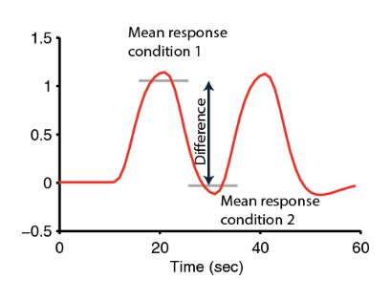
Goal of design
Isolate functional processes of interest
BOLD signal is relative – choose stimulus conditions and timings that maximise BOLD signal contrast
Avoid confounding physiological and psychological artifacts
Collect as much data as possible
Measure behaviour
Based on Huettel (Chapter 9)

Slide 3
Study Design Overview
Subtraction
Conjunction
Factorial
Parametric
Stimulus presentation strategies
Blocked
Event-related
Mixed

Slide 4
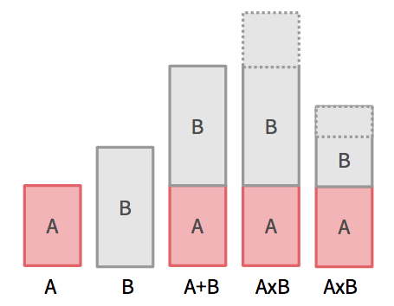
Subtraction
Two task conditions differing in the process of interest
Task condition 1: evokes process of interest
Task condition 2: evokes all but the process of interest
Challenge -> Finding a good control task
Assumption of ‘pure insertion’
Two (or more) conditions can be cognitively added with no interactions among the cognitive components of a task (Amaro & Barker, 2006)

Slide 5
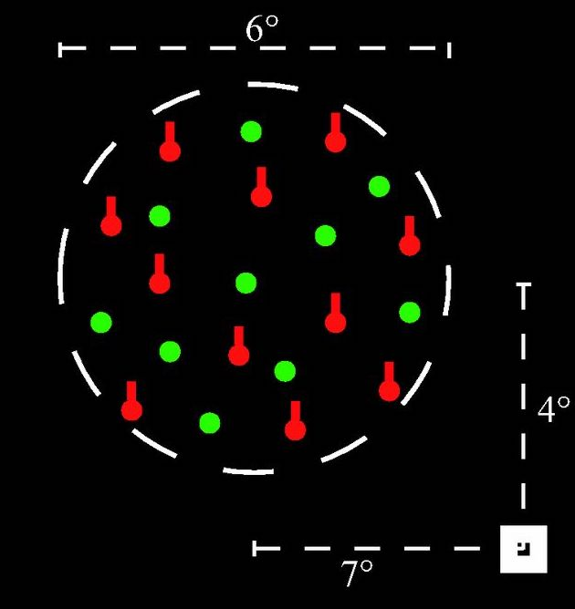
Problem with Subtraction
Example (taken from Friston et al., 1996)
V5 activation in response to motion; enhanced by selectively attending to motion.
Imagine an experiment…
-> Motion presented with and without
selective attention
-> Found V5 activation!
-> Conclude V5 role in selective attention for
motion (when it actually represents an interaction)
Notes:
Selectively attending to just one attribute ‘motion’, as opposed to divided attention among many attributes (e.g. colour, shape, motion)
Fallaciously conclude V5 role in selective attention for motion though it represents an interaction
Image taken from:
Effects of task and attentional selection on responses in human visual cortex (Runeson et al., 2013)

Slide 6
Conjunction
Isolate process of interest by finding commonalities between task conditions
Task pair 1: subtraction isolating A & B
Task pair 2: subtraction isolating A & C
For example:
‘Which structure support selective attention network regardless of sensory modalities?’
Task pairs:
Visual stimulus with/without selective attention
Auditory stimulus with/without selective attention
… etc
A = process of interest
Notes:
Example

Slide 7
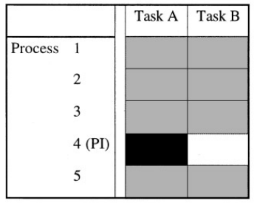
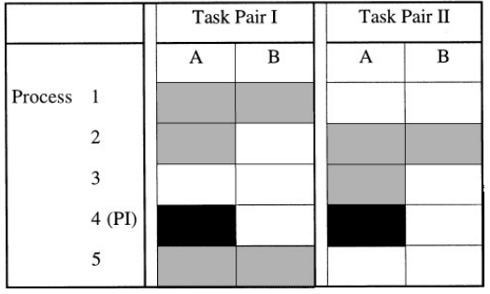
Conjunction
Subtraction
Conjunction
A = activation task; B = baseline task; PI = process of interest
Minimise baseline problem with subtraction
Area identified = jointly significant in all subtraction pairs & not significantly different (discounts interaction)
Too conservative?
(Price & Friston, 1997)
Notes:
- Baseline challenge for substraction (left)
Context-sensitive effect (i.e. interactions) will not come up; conjunction identifies context-insensitive activations
Subtraction assumes interaction does not exist; conjunction discounts interaction
(Conjunction does assume different interactions do not activate the same area to the same degree)
- Too conservative – what if only partial overlap?

Slide 8
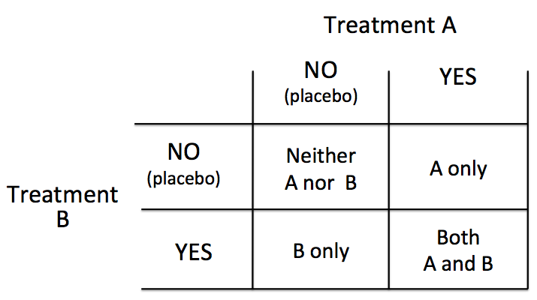
Factorial
Two or more variables (or factors) and the different levels of each variable are matched
Test for interactions explicitly
‘…perform a task where the cognitive components are intermingled in one moment, and separated in another instance of the paradigm’ (Amaro & Barker, 2006)
2 factors x 2 levels = 4 conditions

Slide 9
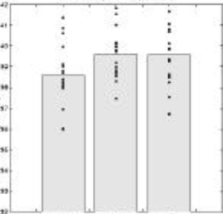
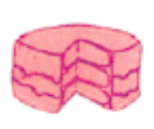
Subtraction approach
Slides from 2016 SPM course
‘Is the inferotemporal region implicated in object recognition and phonological retrieval during object naming?’ (Friston et al., 1997)
[1] Say ‘yes’ when you Results:
see an abstract image
(visual analysis, speech)
[2] Say ‘yes’ when you see
an object (visual analysis,
speech, object recognition)
[3] Name the object
(visual analysis, speech,
object recognition, phonological retrieval)
Subtraction: [2] – [1] = object recognition
[3] – [2] = phonological retrieval
[1]
[2]
[3]
Assumes object recognition activates IT to the same degree independent of phonological retrieval
Notes:
Conclude IT is involved in object recognition, but not in phonological retrieval

Slide 10
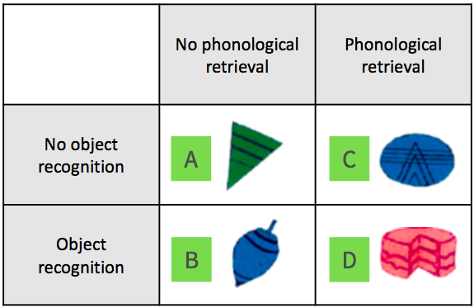
Factorial approach
Slides from 2016 SPM course
Vary object recognition & phonological retrieval independently
Add condition: [4] Name the colour of the presented shape (visual analysis, speech, phonological retrieval)
Main effect:
Object recognition
Phonological retrieval
Interaction:
IT responses (to object recognition) change depending on the presence of phonological retrieval
Notes:
Does phonological retrieval modulate IT activation by object recognition? ([D] – [C]) > ([B] – [A])
Does object recognition modulate IT activation by phonological retrieval? ([D] – [B]) < ([C] – [A]) -> in the absence of object recognition, phonological retrieval deactivates IT
Check interaction by comparing: Activation due to object recognition in the absence of phonological retrieval (B-A)
VERSUS
Activation due to object recognition in the presence of phonological retrieval (D-C)
(Pure insertion requires them to be the same)
- - -
(C-A) vs. (D-B) if object recognition modulates phonological retrieval
In the absence of object recognition, phonological retrieval deactivates IT

Slide 11
Parametric
Based on the idea that cognitive demand of task vary systematically with BOLD signal
Incrementally increase difficulty of task; relate to BOLD signal
Allow dissociation between areas functionally associated with task & other ‘maintenance’ areas
e.g. Working memory task (Seidman et al., 1998)
Baseline: respond to all letters
Task 1: respond if A preceded by Q (e.g. QA)
Task 2: respond if A preceded by Q, separated by three letters (e.g. QrctA)
However, other circuits may be recruited at higher cognitive demand
Notes:
Parametric with factorial

Slide 12
Summary
Amaro & Barker (2006)

Slide 13
Study Design Overview
Subtraction
Conjunction
Factorial
Parametric
Stimulus presentation strategies
Blocked
Event-related
Mixed

Slide 14
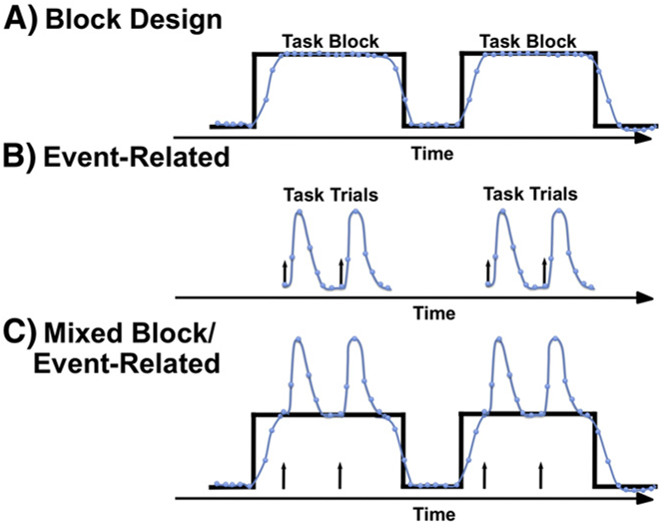
Presenting stimulus
How to present your stimulus?
Detection: knowing which voxel is active (spatial resolution)
Estimation: time course of active voxel (temporal resolution)
Petersen & Dubis (2012)

Slide 15
Block design
Alternating between task conditions
e.g. [ Task A rest Task B rest Task A rest Task B rest ]
Strong detection/statistical power
Maximise data variability due to experimental manipulation (between-conditions variability)
Minimise other sources of data variability (within-conditions variability)
However…
Insensitive to shape and timing of hemodynamic response
Expectancy effect
Based on Huettel (Chapter 9)
Notes:
Easy to analyse

Slide 16
Event-related design
Evoke process of interest transiently by brief presentation of individual stimuli
Task order randomised
Better estimation of HRF shape and timing
Allow trial-by-trial sorting based on subject response (e.g. subsequent memory effect)
However…
Evoke smaller changes in BOLD signal
Larger switching cost between tasks?
Based on Huettel (Chapter 9)
Notes:
Block -> reflect brain state
Event-related -> measure transient changes associated with a discrete stimuli

Slide 17
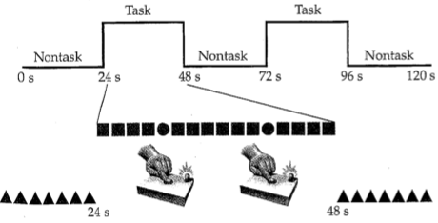
Mixed designs
Combination of blocked and event-related designs
Stimulus present in regular blocks; >1 types of events per block
Analysis of IVs on different time scale
Block -> state-related processes (e.g. attention)
Event -> item-related processes (e.g. button press)
Memory retrieval: Donaldson et al. (2001) found brain areas associated with ‘retrieval mode’ (state) and ‘retrieval success’ (item).
Example of a mixed design:
Within task block, subject pressed button in response to infrequent target circles, ignoring non-target square.

Slide 18
References
SPM course slides (2016)
Scott A. Huettel. (2004). Functional Magnetic Resonance Imaging. Chapter 9.
Friston, K. J., Price, C. J., Fletcher, P., Moore, C., Frackowiak, R. S., & Dolan, R. J. (1996). The trouble with cognitive subtraction. NeuroImage, 4(2), 97–104.
Price, C. J., & Friston, K. J. (1997). Cognitive conjunction: a new approach to brain activation experiments. NeuroImage, 5(4 Pt 1), 261–70.
Amaro, E., & Barker, G. J. (2006). Study design in fMRI: Basic principles. In Brain and Cognition (Vol. 60, pp. 220–232).
Seidman, L. J., Breiter, H. C., Goodman, J. M., Goldstein, J. M., Woodruff, P. W., O’Craven, K., et al. (1998). A functional magnetic resonance imaging study of auditory vigilance with low and high information processing demands. Neuropsychology, 12, 505–518.
Petersen, S. E., & Dubis, J. W. (2012). The mixed block/event-related design. NeuroImage.
Donaldson, D. I., Petersen, S. E., Ollinger, J. M., & Buckner, R. L. (2001). Dissociating state and item components of recognition memory using fMRI. NeuroImage, 13(1), 129–142.

Slide 19
Design Efficiency

Slide 20
General advices
For group-level inference larger sample sizes are better If you have 40 hours of scanning: rather 40 person 1 hour than 10 person 4 hours
Run each scan as long as possible (40-60 min)
Keep subject as busy as possible
Fewer conditions/contrasts are better
Efficiency is not the same for every contrast!!!!! (optimize efficiency for the most important contrast)
Notes:
The greater the between subject variance in comparison to within subject variance, the more important sample size becomes. But depends on question, for example if you are interested in individual differences the within subject variability is more important
Of course not scanning longer than the subject can show satisfactory behavior

Slide 21
Technical considerations
A good fMRI experiment needs 2 things:
Induce subject to do or experience the psychological state that you want to study (psychological)
Effectively detect brain signals related to those psychological states (statistical)
You can have a great psychological experiment with huge neuronal response, but be completely unable to detect this in fMRI-signal

Slide 22
Reminder GLM
General Linear Model:
Y = X . β + ε
Data Design Matrix Parameters error
Efficiency(e) is the ability to estimate β, given the design matrix (X) for a particular contrast (c) and the given noise variance (σ²)
e (c, X) = inverse (σ² c^{T} Inverse(X^{T}X) c)
The efficiency for each contrast is different
We can calculate the efficiency just based on the contrast and design matrix before we have seen any data!
Notes:
We can directly influence our efficiency by spacing and sequencing our events

Slide 23
Timing Issues

Slide 24
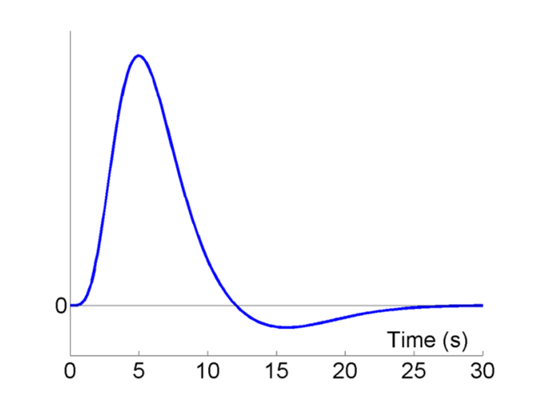
BOLD response
HRF
The relation between a burst of neuronal activity and the BOLD signal is captured by Haemodynamic Response Function (HRF)
2 difficulties for design timing:
BOLD response is very sluggish
Low frequency drifts in fMRI signal, need to be filtered out by high-pass filter
Peak
Undershoot
Rik Henson’s SPM guide:
http://imaging.mrc-cbu.cam.ac.uk/imaging/DesignEfficiency
Alessandro G. Allievi et al. Cereb. Cortex 2015
Notes:
The relation between a burst of neuronal activity and the BOLD signal is captured by Haemodynamtic Response Function (HRF)the max BOLD signal peaks after 6 seconds, returns to baseline, and then undershoots between 10-25 s, and goes back to 0 after 25-30 sec; it’s a very slow response.
So we have some difficulties. Firstly that the BOLD response is sluggish
Because the BOLD is delayed and spread out relative to the underlying neuronal activity and that means that the regressors you want to put in design matrix must be delayed and spread out as well or they won’t fit the data.
and secondly, due to noise artefacts, we get low frequency drifts in fMRI signal, need to be filtered out by high-pass filter
HRF ACTS AS FILTER

Slide 25
Fixed stimulus onset asychrony (SOA)= 16s
Detection of signal in background noise works best if variability of neural signal is maximised
Signal that varies little will be difficult to detect → not particularly efficient design
To obtain predicted fMRI time series: Convolve stimulus function with a haemodynamic response
Rik Henson’s SPM guide:
http://imaging.mrc-cbu.cam.ac.uk/imaging/DesignEfficiency
Notes:
So keeping in mind our HRF, how should we present our stimuli in order to maximise efficiency? Manipulate the stimulus onset asynchrony - the time between the onsets of stimuli.
To be best able to detect the signal in the presence of background noise, we want to maximize the variability of that signal. Maximising efficiency is maximising the signal variance.
A signal that varies little will be difﬁcult to detect BECAUSE THERE WONT BE ANY CONTRAST BETWEEN HIGH AND LOW ACTIVITY. Larger signal variance has larger signal amplitude.
This example (with a ﬁxed SOA of 16 s) is not particularly efﬁcient, although there is some variability in the signal, we might get a more efficient design faster
To obtain predicted fMRI time series: Convolve stimulus function with a haemodynamic response
Maximizing the efﬁciency of a design is equivalent to maximizing the ‘energy’ of the predicted fMRI time-series, i.e. the sum of squared signal values at each scan (equal to the variance of the signal, after mean correction).

Slide 26
Fast event presentation-> not efficient
Fixed SOA 4s
HRF
Low variance → cannot contrast with baseline
→ Signal lost after high-pass filtering
Notes:
Although overall signal is high, the variance is low, so that most of the signal will be lost after high-pass filtering
Because the IRs to successive events now overlap considerably, we end up an initial build-up (transient) followed by small oscillations around a "raised baseline".

Slide 27
Stochastic and blocked event presentation ->very efficient
Random SOA minimum 4s e.g. event-related: larger variability in signal
HRF
Blocked, SOA 4s: larger variability in signal
HRF
Notes:
Though we only use half as many stimuli as in Fig 3, this is a more efficient design. This is because there is a much larger variability in the signal (and we know how this signal varies, even though we generated the event sequence randomly, because we know the specific sequence that resulted).

Slide 28
Fourier Transformation
FT converts time function into sum of sine waves of different frequencies – represent signal in frequency space
FT helps to see which components will pass the HRF filter
Notes:
Stimulus function can be seen as original data and the HRF as a temporal filter. Too high frequencies are filtered out, since the BOLD response is not that fast. Low pass filter.
What we want is that the majority of the signal is ‘passed’ by the HRF and not filtered out
To achieve this, the used stimulus frequency should be best aligned with the dominant frequency of the HRF (.04 Hz).
The frequency of change of the stimulus should correspond to the dominant frequency of change of the HRF

Slide 29
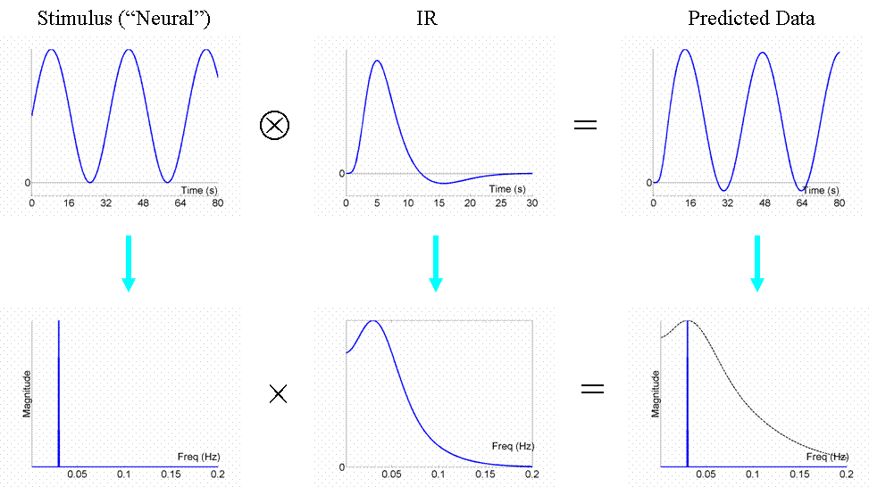
Most efficient design
The optimal design would be to modulate the neural activity in a sinusoidal fashion (e.g, sinusoidally varying the luminance of a visual stimulus), with a frequency that matches the peak of the amplitude spectrum of the IR filter
This places all the stimulus energy at this single frequency, shown by the single line in frequency
Notes:
A sinusidoial function of .03 Hz (30 seconds) is perfect for retaining most of the signal

Slide 30
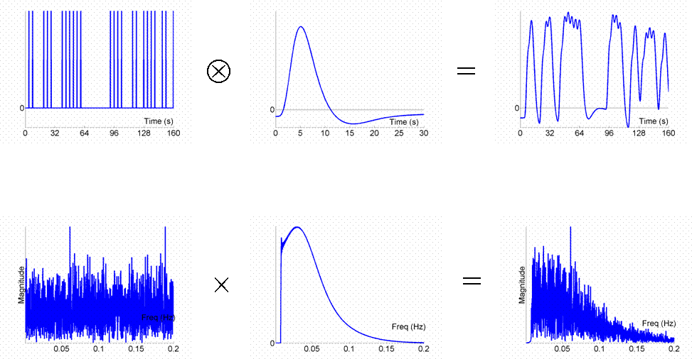
Stochastic design -> efficient
Stochastic designs spread frequency energy across wide range of frequencies, from which much is passed through

Slide 31
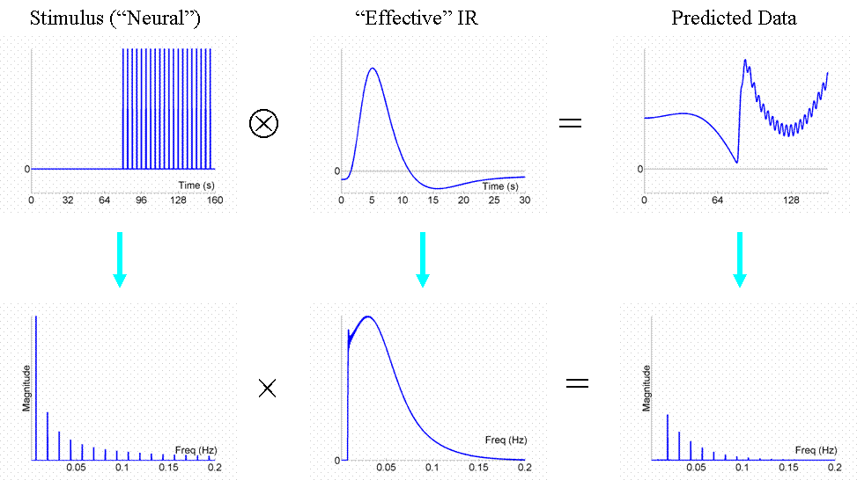
High-pass filtering
Low frequency noise in fMRI (e.g. scanner drifts)
High-pass filter cut-off in SPM 0.01Hz (100s)
Don’t design blocks of too much length (not longer than 50 sec), because high pass filtering would remove most of the signal
Don’t contrast conditions too separate in time
High-pass filter

Slide 32
2 or more conditions
Things get more complicated….

Slide 33
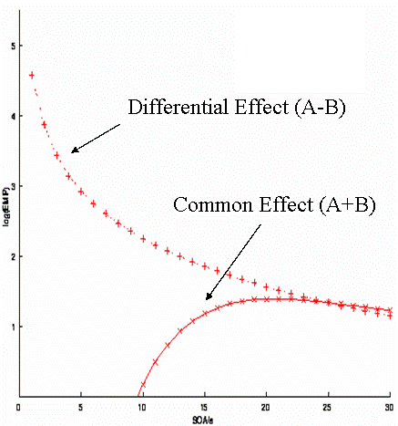
Different efficiency for different contrasts
Randomised design 2 events:
Common effect e.g. faces vs baseline
Differential effect e.g. sad vs happy faces
Optimal SOA for main effect (A+B): long SOA
Optimal SOA for differential effect (A-B): short SOA
Trade off!
Rik Henson’s SPM guide:
http://imaging.mrc-cbu.cam.ac.uk/imaging/DesignEfficiency
Notes:
A fully randomized design with two event-types (A and B, let’s say happy and sad faces).
We may want to ask
where in the brain is there a response to faces vs. Baseline (regardless of expression) --> common effect (the +1+1 contrast), and
where, within those regions responsive to faces (i.e., using a mask or functionally defined ROIs from the first contrast), is there a difference between happy and sad faces --> differential effect (the +1-1 contrast).
For this randomised design, the efficiency for both the differential and the common effect is shown in this figure. The SOA clearly differs for the two contrasts.
As I mentioned earlier, efficiency depends on the contrast of interest. Short SOA’s are optimal for the differential effect (A-B). But they are really bad for the main effect (A+B). We have a trade off.
WHY – BECAUSE WITH A SHORT SOA, THE SIGNAL NEVER RETURNS TO BASELINE, THEREFORE THERE WILL BE NO CONTRAST BETWEEN HIGH AND LOW ACTIVITY DUE TO LOW VARIABILITY. WE CAN STILL COMPARE BETWEEN CONDITIONS THOUGH, AND BECAUSE WE HAVE HIGH SIGNAL HERE, THIS IS OPTIMAL.

Slide 34
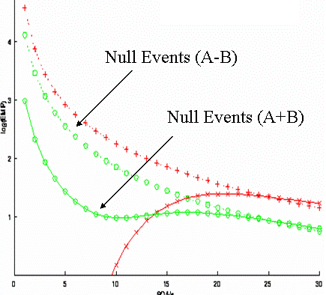
Timing: Null events
Convenient way of creating a stochastic design by randomising the SOA between the components of interest
Null events not different from baseline
Efficient for main AND differential effects at short SOAs – reduces trade off between contrasts
(A-B)
Efficiency
(A+B)
SOA (s)
Rik Henson’s SPM guide:
http://imaging.mrc-cbu.cam.ac.uk/imaging/DesignEfficiency
Notes:
Null events are a convenient way of creating a stochastic design by randomising the SOA between the components of interest. They are essentially like a fixation cross. Here you can see that this reduces the trade off between the two contrasts. Slightly impairs differential effect but at least can look at main effect now.
A further design concept concerns ‘null events’. These are not real events, in that they do not differ from the baseline and hence are not detectable by subjects (so are not generally modelled in the design matrix).
They were introduced by Dale and Buckner (1997) as ‘ﬁxation trials’, to allow ‘selective averaging’.
In fact, they are simply a convenient means of creating a stochastic design by shufﬂing a certain proportion of null events among the events of interest (producing an exponential distribution of SOAs).
In other words, null events provide a convenient way of randomising the SOA between the events of interest.
From the perspective of multiple event-type designs, the reason for null events is to buy efﬁciency for both the main effect and differential effect at short SOAs (at a slight cost to the efﬁciency for the differential effect).

Slide 35
Jitter or Null-events for good trade-off
Introduce Null-events helps to estimate the baseline-> better efficiency for main effect (A+B)
Not ‘real’ events – do not differ from baseline and are not detectable by subjects
Efficient for differential and main effects at short SOA
(A-B)
Efficiency
(A+B)
SOA (s)
Notes:
A further design concept concerns ‘null events’. These are not real events, in that they do not differ from the baseline and hence are not detectable by subjects (so are not generally modelled in the design matrix).
They were introduced by Dale and Buckner (1997) as ‘ﬁxation trials’, to allow ‘selective averaging’.
In fact, they are simply a convenient means of creating a stochastic design by shufﬂing a certain proportion of null events among the events of interest (producing an exponential distribution of SOAs).
NEED TO THINK ABOUT NOT JUST THE STIMULUS JITTER, BUT THE CONDITION JITTER

Slide 36
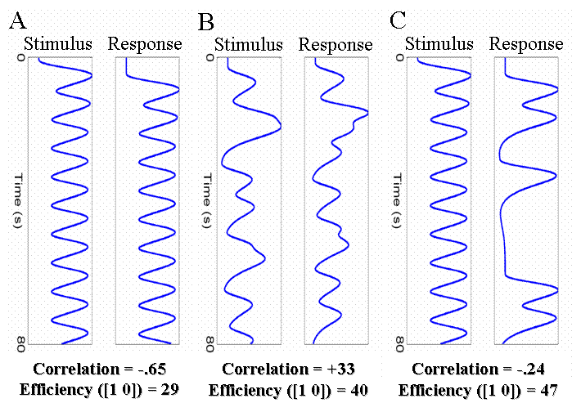
Correlation between regressors
Fixed SOA
Jittered SOA
Fixed with half of trials
High correlation between regressors can reduce efficiency
If 2 events (e.g. stimulus and response) are highly correlated, you can’t determine which of both caused the BOLD signal
Notes:
In some cases we need to design experiments where there is necessarily some degree of correlation between regressors. For example, when trials consist of two events, one of which must follow the other as in a working memory design (a trial consists of stimulus, short retention interval and a response). With short SOAs between each event type, the regressors for the stimulus and response will be negatively correlated as shown in A. Solutions could be: B -- Randomly vary (jitter) the time between successive stimuli and responses (assuming this is possible). C -- Keep stimulus-response interval fixed at 4s, but only require a response on a random half of trials. Effect of both: Reduced correlation between the regressors, increases efficiency for separating the brain’s activity to stimuli and to responses.

Slide 37
Conclusion
Optimal design for one contrast might not be optimal for another
Block design (short block length ~16sec) are most efficient
Block designs are often psychological not possible: stochastic designs with jittered SOA or null-events are also very efficient
Don’t have too long blocks/ contrast too separate in time, since it will be filtered out by high-pass filter

Slide 38
References
SPM course slides (2016)
Scott A. Huettel. (2004). Functional Magnetic Resonance Imaging. Chapter 9.
Friston, K. J., Price, C. J., Fletcher, P., Moore, C., Frackowiak, R. S., & Dolan, R. J. (1996). The trouble with cognitive subtraction. NeuroImage, 4(2), 97–104.
Price, C. J., & Friston, K. J. (1997). Cognitive conjunction: a new approach to brain activation experiments. NeuroImage, 5(4 Pt 1), 261–70.
Amaro, E., & Barker, G. J. (2006). Study design in fMRI: Basic principles. In Brain and Cognition (Vol. 60, pp. 220–232).
Seidman, L. J., Breiter, H. C., Goodman, J. M., Goldstein, J. M., Woodruff, P. W., O’Craven, K., et al. (1998). A functional magnetic resonance imaging study of auditory vigilance with low and high information processing demands. Neuropsychology, 12, 505–518.
Petersen, S. E., & Dubis, J. W. (2012). The mixed block/event-related design. NeuroImage.
Donaldson, D. I., Petersen, S. E., Ollinger, J. M., & Buckner, R. L. (2001). Dissociating state and item components of recognition memory using fMRI. NeuroImage, 13(1), 129–142.
https://mediacentral.ucl.ac.uk/Player/2897
https://www.coursera.org/learn/functional-mri-2/lecture/zVWBb/module-7a-advanced-experimental-design-i-fundamentals-of-design-efficiency
http://imaging.mrc-cbu.cam.ac.uk/imaging/DesignEfficiency

