Slide 1
1st Level Analysis
Design Matrix, Contrasts and Inference, GLM
16 November 2016
Benjamin Chew and Rani Moran

Slide 2
Overview
Introduction
GLM
Design Matrix
Contrasts
Inference
Methodology

Slide 3
Overview
Introduction
GLM
Design Matrix
Contrasts
Inference
Methodology

Slide 4
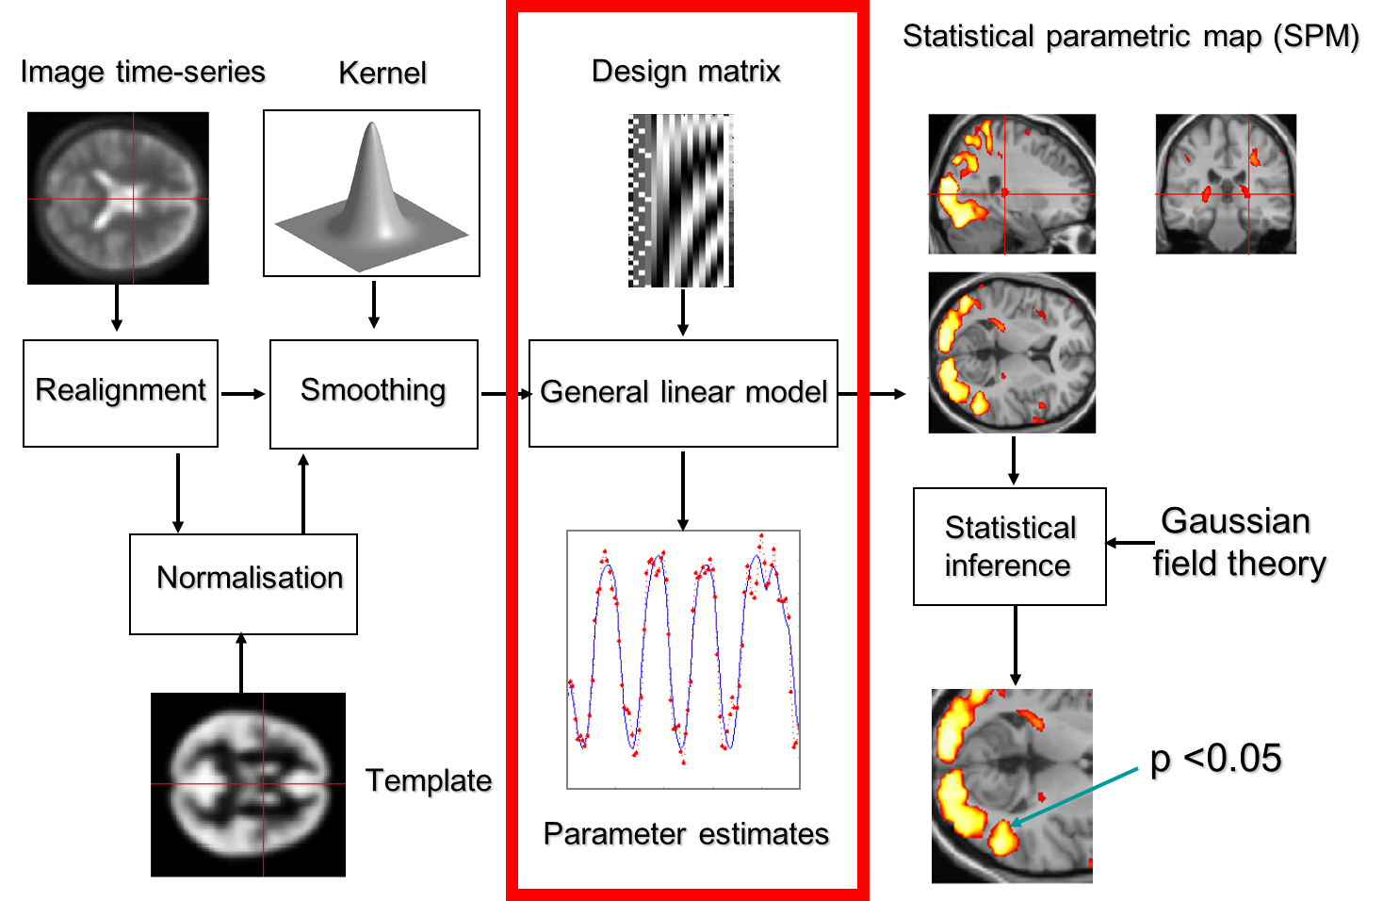
Notes:
This slide illustrates what SPM does when we ‘feed’ it our raw data, from the original time-series of images to the beautiful Statistical Parametric Map. The previous two presentations have already covered the pre-processing steps we need to let SPM carry out on our data, to put all our images into the same anatomical space.
This presentation covers the next step. We are now beginning our statistical analysis of the data. All of this is based on the General Linear Model.

Slide 5



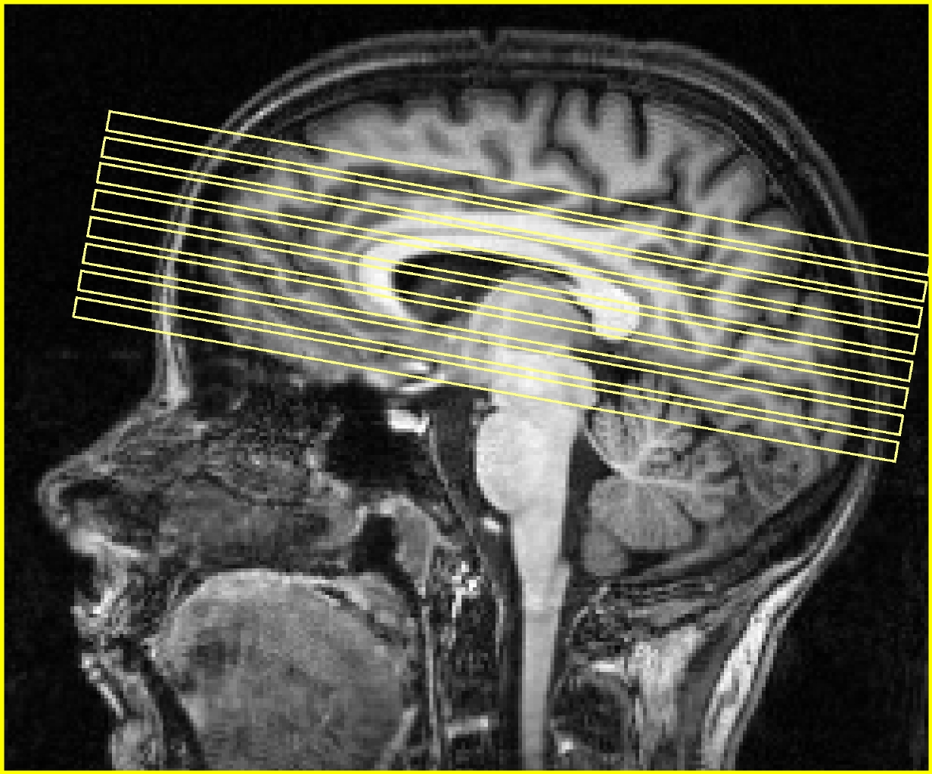
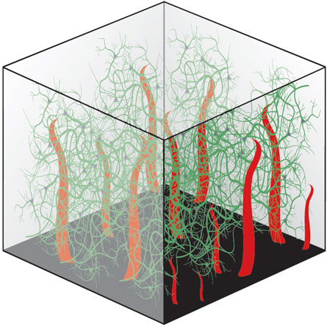
Our data
Subject A
Subject B
…
Session 1
Session 2
…
…
…
Volume
…
Slice
…
Voxel
…
Notes:
For each of our subjects, we collect data in different scanning periods, called ‘sessions’. In each session, we collect several 3D volumes of their whole brain, each of which consists of multiple slices. And each slice consists of many voxels. Each of these voxels corresponds to a particular location in space and comes with a value that represents its activation intensity.
We collect hundreds of brain volumes of about 100,000 voxels each from each of our subjects. So overall, we are dealing with A LOT of data.

Slide 6
Our data
Subject A
Subject B
…
Session 1
Session 2
…
…
…
Volume
…
Slice
…
1st level analysis: within-subject analysis
analysing the time course of the fMRI signal for every
single subject separately
Voxel
…
Notes:
In SPM, we analyse data from multiple subjects in two stages.
First, we do a within-subject analysis. So typically, we will have to do as many first-level analyses as we have participants. What we want from this step are contrast images (more about this later) for every single subject. We could use these images individually as case studies, but usually we are interested in some sort of aggregate measure between participants, in order to make inferences about the population from which our participants were drawn.

Slide 7
Our data
Subject A
Subject B
…
Session 1
Session 2
…
…
…
Volume
…
2nd level analysis: group level analysis
Slice
…
Voxel
…
Notes:
This is what we do in a second step. Our second-level analysis is a between-subject, or group-level analysis. This will be covered later in the course.

Slide 8
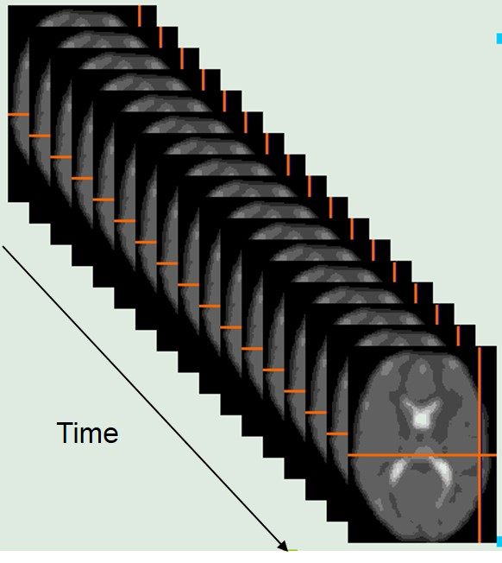
What are we looking at?
Our data is a time-series capturing changes in blood oxygenation (fMRI signal intensities) in each voxel, tracked over the time of our experiment
Notes:
The data we have collected is a time-series for each voxel of the changes in fMRI signal throughout our experiment.
The effects we’re interested in, + noise or errors that are not fit by the model

Slide 9
Dealing with this data statistically
Mass univariate approach: using the same statistical analysis on every single voxel
We are looking at the relationship between:
Y = dependent variable (BOLD signal)
X = regressor (experimental manipulation)
Null hypothesis: our experimental manipulation has no effect on Y
Our results are SPMs (Statistical Parametric Maps)
Notes:
SPM deals with this data using a mass-univariate statistical approach. All this means is that the statistical steps we use are the same for each and every voxel. For each voxel, we want to see whether our experimental manipulation (expressed as a regressor called X) has an effect on brain activity (the dependent variable Y).
Our Null Hypothesis is that our experimental condition does not affect Y. The data we put into SPM is a single time-series on a voxel, which we want to transform into a single statistical value. SPM does this simultaneously at all of our voxels.
The result we get is a Statistical Parametric Map, with one of these statistics for each voxel.

Slide 10
The General Linear Model
observed data
regressor
parameter
error (noise)
fMRI time course in a particular voxel
Adjust for the arbitrary units of the observed data (Y)
component of our model which explains the observed data to some degree
defines the contribution of X to the value of Y;
it can be viewed as the slope of our regression line
the proportion of the variance
in our data Y which is not explained by X
Notes:
Ben Edit: Rani and I think that the interpretation of the constant is a bit nuanced, in the sense that it could be the mean signal if the other regressors were mean-centered. Hence we did not mention it being the mean signal. Future participants may prefer sticking to the conventional interpretation.
We are trying to find a good way of PREDICTING the dependent variable (the fMRI signal), using everything we know about our own experimental manipulation and more general things that affect such a signal.
This model simply tries to fit a line that describes the relationship between the dependent variable Y and the predictor variable, or regressor, X.
So our model tries to predict Y, our dependent variable. This is the fMRI time course in a particular voxel, i.e. the intensity value of our voxel for a single scan/observation.
The intercept is a constant, and in our case, it is the mean level of fMRI signal over time, and across all conditions, for our particular voxel.
The regressor is a component of our model which explains the observed data Y to some degree.
The regressor comes with an associated parameter beta, which defines the contribution of X to the value of Y. As seen before, it can be viewed as the slope of our regression line
The GLM expresses the dependent variable Y in terms of a linear combination of some regressors X plus a well-defined error term. We want this linear combination of regressors to be able to explain all possible responses to our experiment, up to the level of error. The error is noise in the data, which explains some additional variance in our observed data, but has not been controlled by us in our experiment.

Slide 11
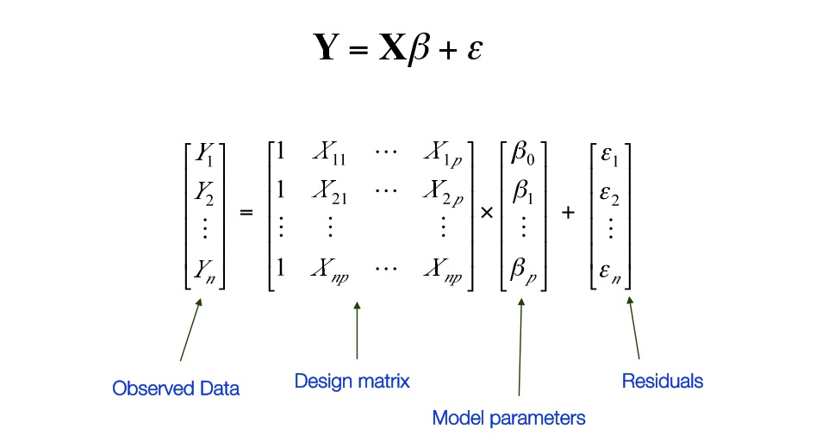
Mass univariate approach
Matrix of BOLD signals
Regressors
Notes:
Remember that we want to model each and every voxel. What we would then get is rows and rows of these equations, one for each voxel. So really our model contains matrices. We can save ourselves from having to look at this horrible mess of equations by simply rewriting all of this as a simple, matrix model, where:
- Y stands for a matrix of BOLD signals. We know this: it is the data files that we got out of the scanner, which we then put into SPM.
Our constant or intercept is simply the mean level of fMRI signal over time across all of our conditions. In SPM, this constant is included as a regressor automatically, so it is not shown in this equation explicitly.
All our regressors X makes up the so-called design matrix. We know this too (expected time course of reactions to our experimental conditions).
What we do not know:
The exact error in our model
The values of our parameters for each regressor. Luckily, SPM will estimate them for us.
Ben Edit: This matrices represent the equations for ONE voxel. Each line does not correspond to a different voxel.

Slide 12
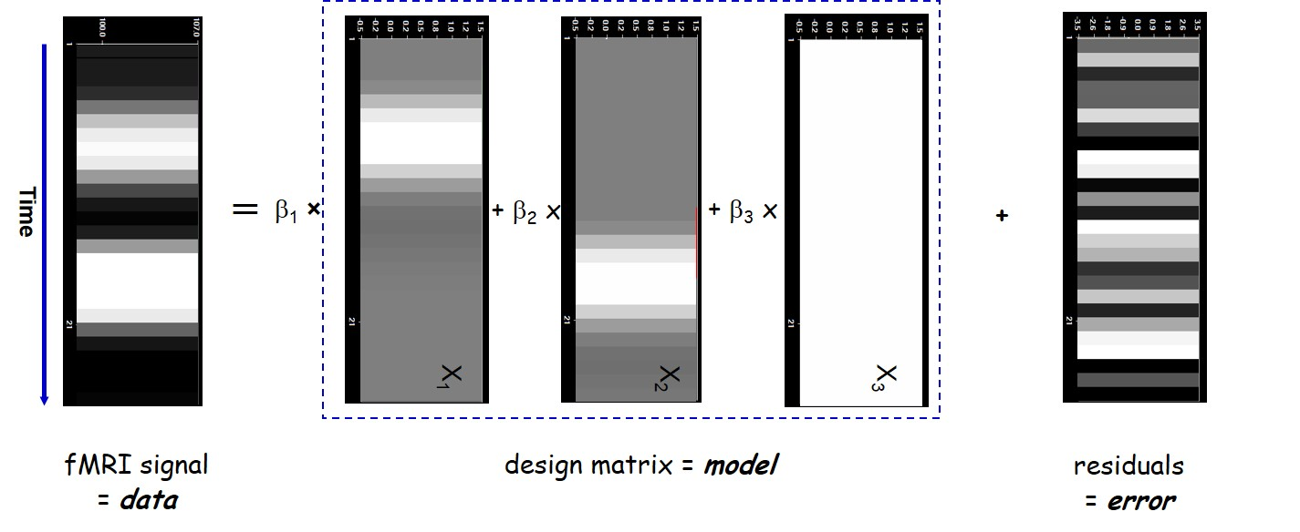
What is the Design Matrix?
Notes:
The Design Matrix is a neat graphical representation of your experimental design. It embodies all available knowledge about experimentally controlled factors and potential confounds.

Slide 13


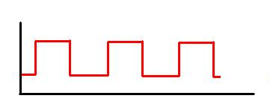
Regressor
Constant
Modelling the condition:
Observation 1
Modelling the constant:
Notes:
We want SPM to know which bits of fMRI signal are associated with which condition.
SPM visualises our Design Matrix as a grey-scale table where each row represents an observation, and each column represents a regressor. Take a simple block design, with a condition of listening to words, with periods of rest in between. The regressor column here is the column that codes for the listening condition. SPM visually codes for whether the condition is “on” or “off” by assigning a colour value (white vs. black). The white column is how SPM codes for our constant regressor, the mean BOLD signal level over time.
We are modelling the listening condition as a so-called boxcar function. In this function, the line goes “up” (i.e. where the condition is on) and “down” again (where the condition is off) in neat jumps. The constant is the mean signal over time, while the condition model shows where the signal deviates from the mean.

Slide 14
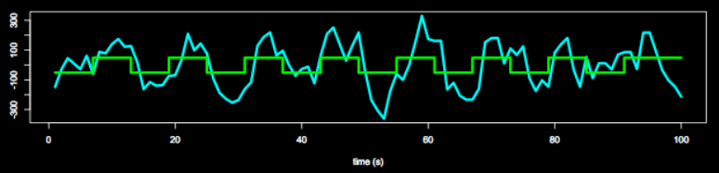
The problem with our data
Notes:
We have tried to model our data with a simple box-car function, where the signal simply reacts (it is either on of off) to a condition. The actual haemodynamic response function (HRF), however, doesn’t quite work like this.

Slide 15
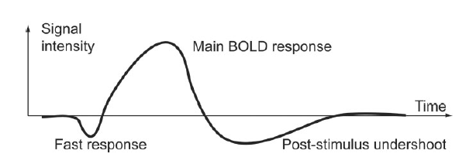
The problem with our data
We know that a stimulus looking like this (Delta Function):
will elicit a BOLD signal change like this:
WE NEED TO ADJUST OUR MODEL FOR THIS!
Notes:
Haemodynamic response function = changes in the fMRI signal triggered by neuronal activity. It peaks at 4-6s post-stimulus, and goes back to baseline after 20-30s. So, as we have seen in a previous presentation, BOLD responses are delayed and dispersed (blurred). We need to adjust our model for this.
If all trials were of the same duration however, and that duration were below ~2s, then they can be effectively modelled as events (i.e, delta functions with zero duration). This is because, after convolution with the IR, a difference in the duration of a trial causes a difference in the scaling of the predicted response, but has little effect on its shape. Since it is the scaling of the predicted response that is being estimated in the statistical models discussed above, changing the duration of all trials simply changes the size of the resulting parameter estimates, with little effect on the statistical inferences.

Slide 16
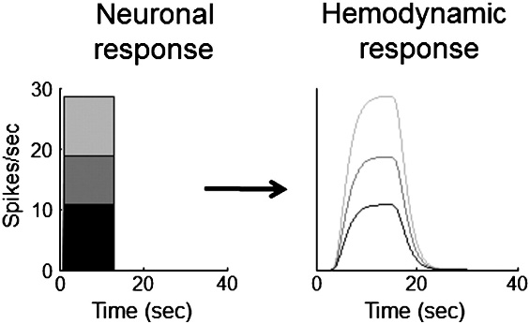
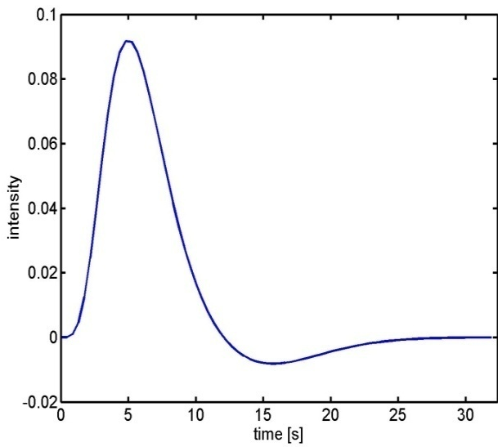
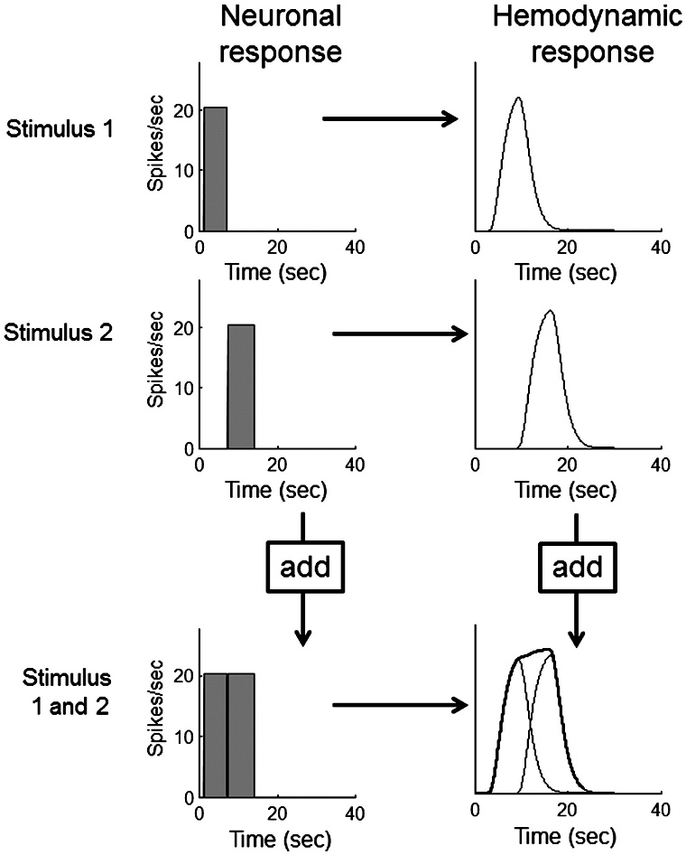
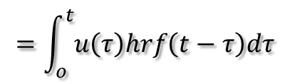

HRF convolution
Hemodynamic response function (HRF):
Scaling
Additivity
Linear time-invariant (LTI) system:
u(t)
hrf(t)
x(t)
Convolution operator:
Shift
invariance
$$x\left(t\right)=u\left(t\right)∗hrf\left(t\right)$$
$$=\int_{o}^{t}{u\left(τ\right)hrf\left(t−τ\right)dτ}$$
Boynton et al, NeuroImage, 2012.
Notes:
We can model this using the HRF (If you mix your input function with the response function, you can derive the expected BOLD response) with some assumptions:
Scaling
For a system operating in the time domain, scaling means that the time-course of the output directly scales with the strength of the input. If this system shows scaling, then when the input is scaled the shape of the output will always remain the same except that it is scaled by the same factor.
Additivity
The property of additivity states that given two inputs, the response to the sum of the inputs is equal to the sum of the responses to each of the inputs alone.
For the hemodynamic response, the additivity property is best illustrated for two neuronal responses that follow closely in time. If they fall within a few seconds of each other, the output hemodynamic response to the first input will still be ongoing when the hemodynamic response to the second input begins. The additivity principal says that this second hemodynamic response should simply add to the first response, without interacting in any way.
Shift Invariance
The additional property of shift invariance is also assumed in the linear transform model. Shift invariance means that the hemodynamic response to a later input neuronal response should look just like the response to an earlier, identical input, but shifted in time by the delay between the two inputs.

Slide 17
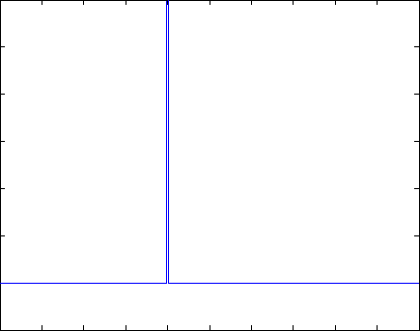
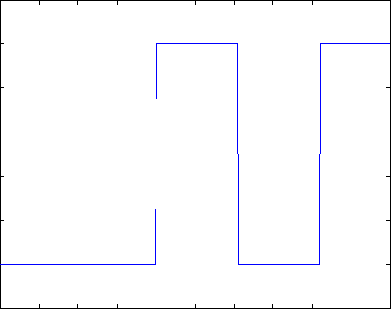
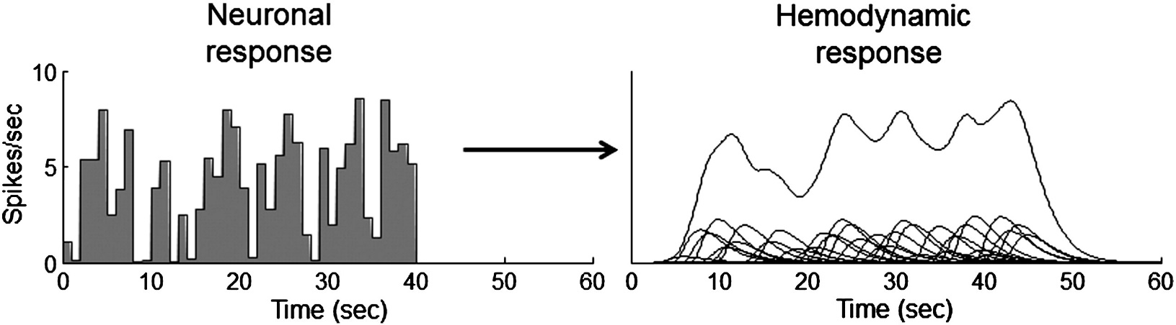
Problem 1: BOLD response
Solution: Convolution model
Notes:
Illustrate convolution as well as the 3 assumed properties of linear model transformation.

Slide 18
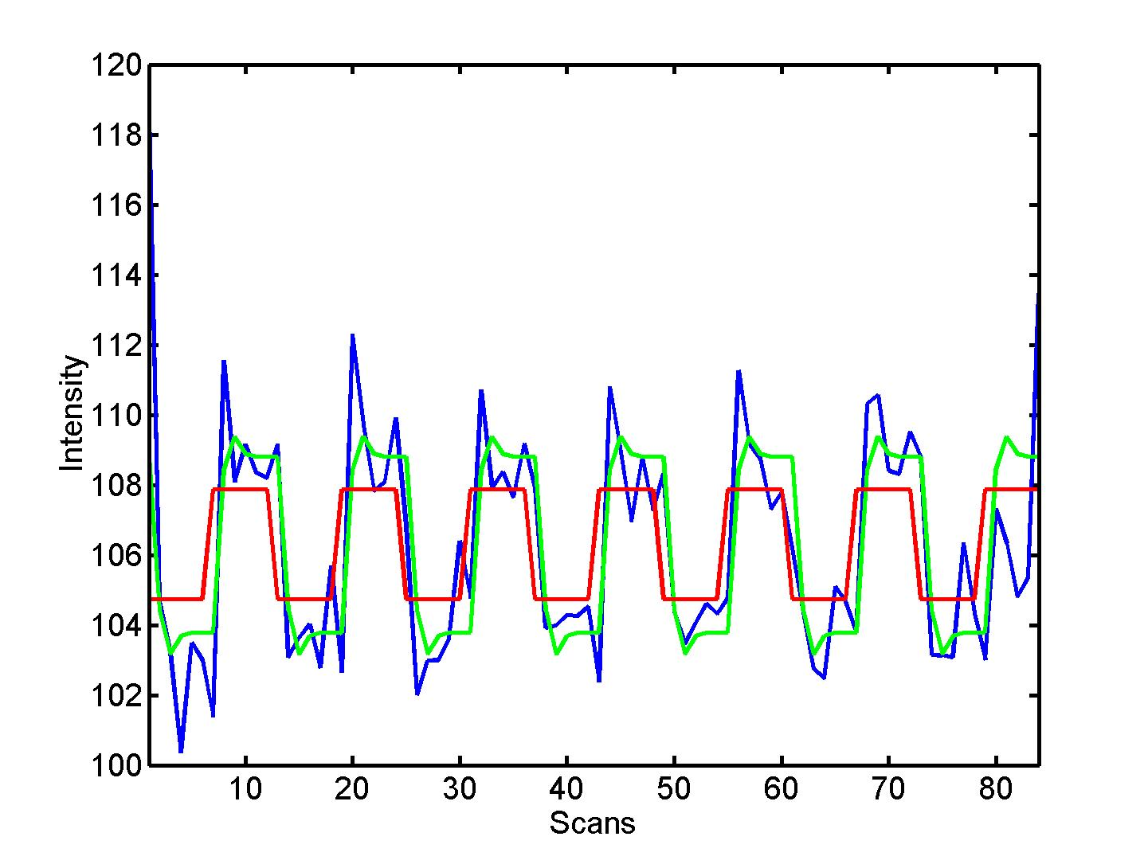


Convolution model of the BOLD response
Convolve stimulus function with a canonical hemodynamic response function (HRF):
⊗ HRF
Notes:
Slight delay, and also not completely flat. This is more representative of the actual signal that is being recorded (i.e. Improve your model)

Slide 19
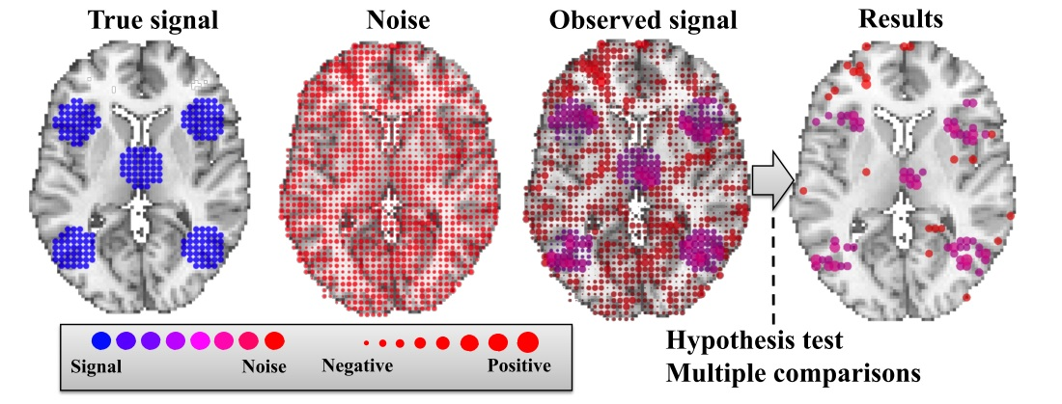
The problem with our data
We have collected noisy data!
The signal we are interested in is relatively weak
The data has a complicated temporal and spatial noise structure
Notes:
The signal that we are measuring from the brain is notoriously noisy! So while you are collecting your data, you are not only capturing task-related activation, but also some other rubbish that you are not particularly interested in. This can be due to physical sources to do with the scanner itself, or physiological sources from the subject (like heart beat or breathing), or residual movement effects.
When our subject is performing our task, signal components are added on top of this generic noise, and these additional signals are what we are interested in. We want to get through all the noise, to the true signal.
However, this true signal is relatively weak compared to all the other noise going on in the fMRI signal. Signal changes in the haemodynamic response function (HRF) are very small. So it may be difficult to detect our desired signal against the background noise when we’re averaging over all frequencies.
Additionally, the data is structurally very complicated. As we have seen, we want to convolve our boxcar model with the expected HRF.

Slide 20
The problem with our data
Many types of noise in our data
  E.g. head movement, physiological noise like heart beat/breathing or any non-modelled neural activity, scanner physics, susceptibility artefacts/dropout, …
The noise is not identically distributed or independent, but may affect some frequencies more than others
Much of this can be avoided by good quality acquisition, and by pre-processing
However, some of it may remain and has to be dealt with during analysis
Notes:
Apart from the problem with the HRF, there are also other types of noise in our data. We can try to minimise the noise by e.g. making sure our subject doesn’t move. As we have heard in the previous two presentations, much of this kind of noise can also be “factored out” in pre-processing steps. However, some of may still remain.
If the scanner warms up a little bit, some drift in intensity of signal over time – nothing to do with the brain but with the equipment. Subjects are usually alive in the scanner, so you have physiological noise.

Slide 21
Dealing with noise
Include nuisance regressors, e.g. for motion
High-pass filter to filter out low frequencies
  We assume that most of the lower frequencies in our signal are due to noise, e.g. signal drift, so okay to exclude them
  SPM default: 128s
Notes:
So what do we do with the remaining noise?
We can add regressors to our model that capture the expected signal associated with the noise, e.g. particular regressors to deal with motion artefacts, to explain some additional variance in our data.
We can also apply a high-pass filter to try and get to the true signal (increasing the signal: noise ratio).. Over time, there may be slow changes in voxel intensity, not to do with our experiment, but with the scanner itself. It is bad for us because experimental conditions could be confused with simple scanner drift. We need to deal with drift in pre-processing steps, but also during our analysis.
In SPM, we can select a high-pass filter to deal with this type of noise that disproportionately affects low-frequencies. Because we assume that most of the lower frequencies in our signal are due to noise (scanner drift), we can filter them out. In SPM the default high-pass filter is set at 128s, which should be okay for many experimental designs.
(Because we cannot distinguish signal from noise on the basis of this frequencies criterion alone, we need to be okay with losing some of our signal-of-interest when we apply a filter!)
Maybe need to change the HPF if the trial lengths are too long.

Slide 22
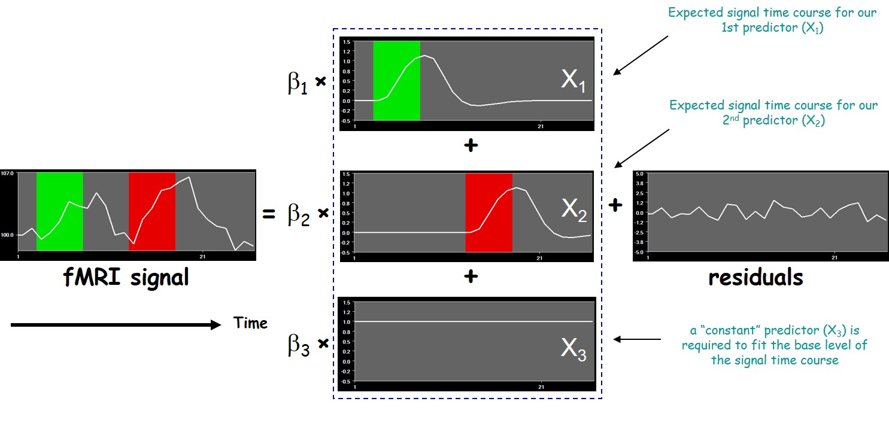
Our model
Our design matrix includes all available knowledge about experimentally controlled factors and potential confounds that may affect our data
Notes:
In summary, we want to include in our model:
Expected time course for our experimental conditions (called X1 here)
Expected time course for any potential confounds (X2)
Time course for a constant (X3), i.e. the mean level of fMRI signal over time
We specify our conditions and additional regressors in the design matrix, which should include everything we know about our conditions and confounds that may additionally affect our data.

Slide 23
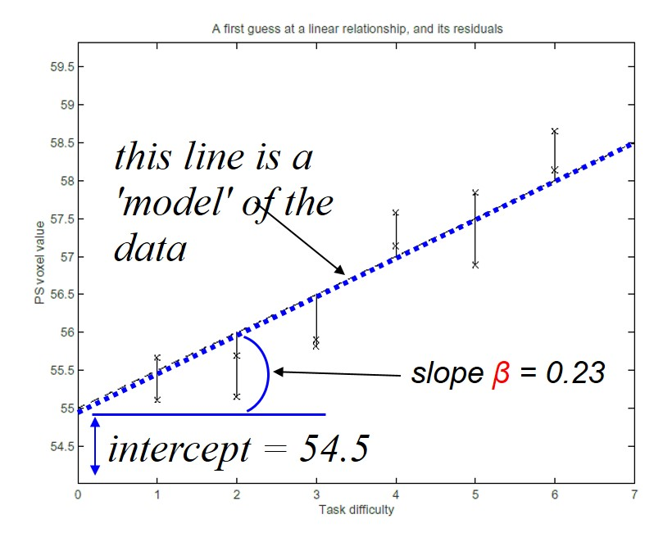
Parameter estimation
Assumptions about population error values ε:
  expected value of 0 at each time point
  constant variance σ²
  independent
  normally distributed
Ordinary least squares estimation
  Parameter estimates that minimise the sum of squared errors
these are the squared errors for each observation
Notes:
Once we have specified our design matrix, SPM estimates our parameters, or slopes, such that our estimated slope best fits, or describes, the relationship between our regressors X and the observed data Y. The good thing is that our model for one voxel will fit the whole time-series (but with different parameter values for each voxel). This is the mass-univariate approach.
In order to estimate the parameters, we use the method of ordinary least squares. This means that we are estimating parameter values that will minimise the sum of squared errors (so the sum of the squared differences between the actual value and the predicted value).
And now we are ready to test our hypotheses!

Slide 24
Overview
Introduction
Design Matrix
GLM
Contrast
Inference
Methodology

Slide 26
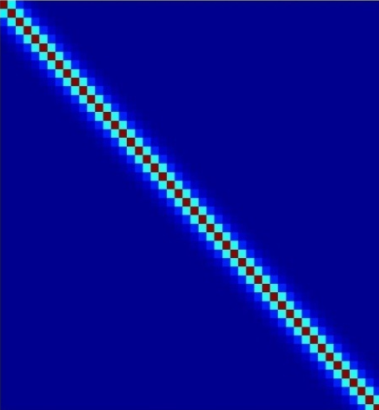

Inference
After fitting the GLM we use the estimated parameters to determine whether there is significant activation present in the voxel
Inference is based on the fact that:
V accounts for temporal noise correlations
Use t and F procedures to perform tests on effects of interest

Slide 27
Hypothesis Testing
To test a hypothesis, we construct “test statistics”
Null Hypothesis H₀
Typically what we want to reject (no effect)
⇨ The Alternative Hypothesis H_{A} expresses outcome of interest
Test Statistic T
The test statistic summarises evidence about H₀
Typically, test statistic is small in magnitude when the hypothesis H₀ is true and large when false
⇨ We need to know the distribution of T under the null hypothesis
Null Distribution of T

Slide 28
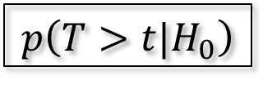
Hypothesis Testing
Significance level α:
Acceptable false positive rate α.
⇨ threshold u_{α}
Threshold u_{α} controls the false positive rate
u_{α}
α
Null Distribution of T
Conclusion about the hypothesis:
We reject the null hypothesis in favour of the alternative hypothesis if t > u_{α}
t
p-value:
A p-value summarises evidence against H₀
This is the chance of observing value more extreme than t under the null hypothesis
p-value
$$p\left(T>t|H_{0}\right)$$
Null Distribution of T

Slide 29

Contrasts
It is often of interest to see whether a linear combination of the parameters are significant
The term cTβ specifies a linear combination of the estimated parameters, i.e.
Here c is called a contrast vector

Slide 30
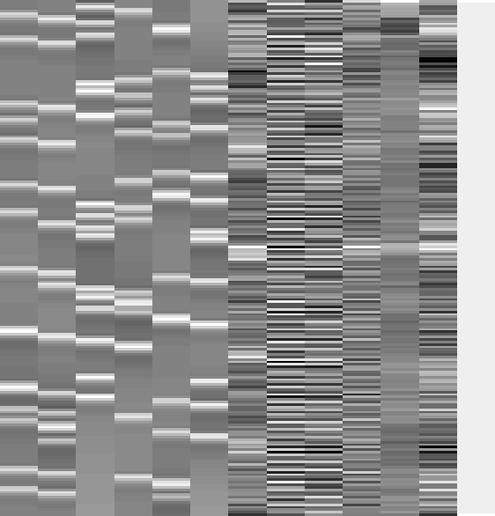
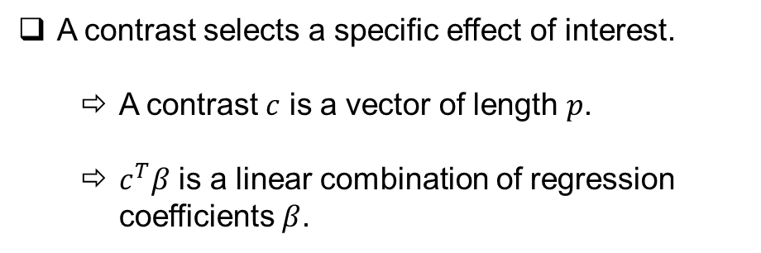
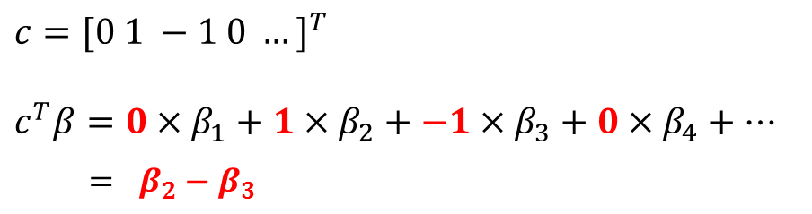
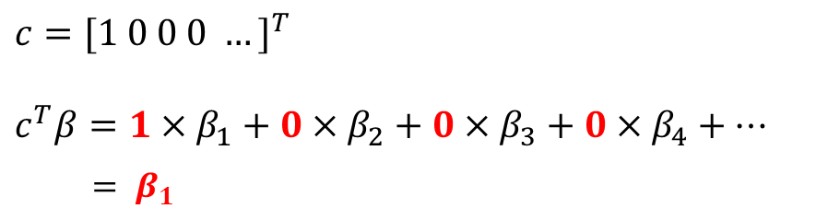
Contrasts
A contrast selects a specific effect of interest.
  A contrast $c$ is a vector of length $p$.
  $c^{T}β$ is a linear combination of regression coefficients $β$.
[1 0 0 0 0 0 0 0 0 0 0 0 0 ]
[0 1 -1 0 0 0 0 0 0 0 0 0 0 ]
$$c={[1 0 0 0 …]}^{T}$$
$$c^{T}β=1×β_{1}+0×β_{2}+0×β_{3}+0×β_{4}+…$$
$= β_{1}$
$$c={[0 1 −1 0 …]}^{T}$$
$$c^{T}β=0×β_{1}+1×β_{2}+−1×β_{3}+0×β_{4}+…$$
$$= β_{2}−β_{3}$$

Slide 31
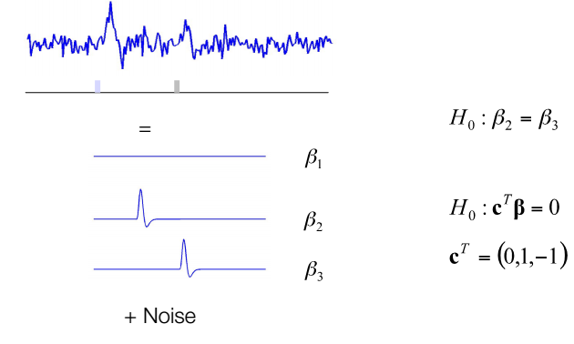
Example
Event-related experiment with two types of stimuli.

Slide 32
T-contrast
One-dimensional and directional
  eg c^{T} = [ 1 0 0 0 ... ] tests β₁ > 0, against the null hypothesis H₀: β₁=0
  Equivalent to a one-tailed / unilateral t-test
Function:
  Assess the effect of one parameter (c^{T} = [1 0 0 0])
  OR
  Compare specific combinations of parameters
  (c^{T} = [-1 1 0 0])

Slide 33
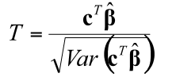
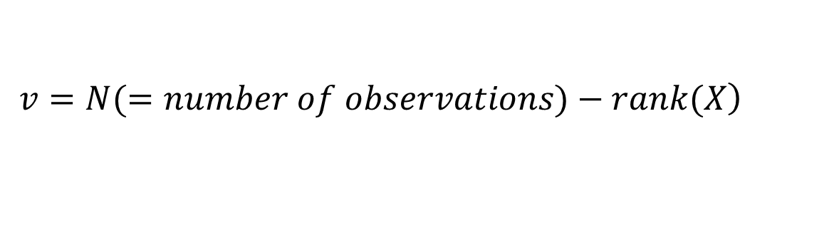
T-test
To test
use the t-statistic:
Under H0, T is approximately t(ν) with:
$$H_{0}:c^{t}β=0; H_{1}:c^{t}β>0$$
contrast of
estimated
parameters
T =
variance
estimate
$$\left.v=N(=number of observations)−rank(X\right)$$

Slide 34
T-test summary
T-test is a simple signal-to-noise ratio measures
H₀: C^{T} β=0 vs H₁: C^{T} β>0
“One” linear hypothesis testing
We can’t test both β₁=0 and β₂=0 at a same time
What if we have many interrelated experimental conditions, e.g. factorial design?
How can we test multiple linear hypothesis?
Y = X1 * β1 + X2 * β2 + β3 + ε

Slide 35


Multiple Contrasts
We often want to make simultaneous tests of
several contrasts at once
Now c is a contrast matrix
• Assume
Then

Slide 36
F-contrast
Multi-dimensional and non-directional
  Tests whether at least one β is different from 0, against the null hypothesis H₀: β₁=β₂=β₃=0
  Equivalent to an ANOVA
Function:
  Test multiple linear hypotheses, main effects, and interaction
  But does NOT tell you which parameter is driving the effect nor the direction of the difference (F-contrast of β₁-β₂ is the same thing as F-contrast of β₂-β₁)

Slide 37
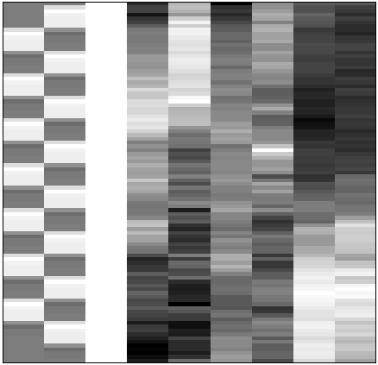
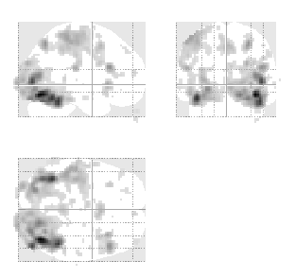
F-test - multidimensional contrasts – SPM{F}
Tests multiple linear hypotheses:
H₀: True model is X₀
H₀: β₄ = β₅ = ... = β₉ = 0
test H₀ : c^{T}β = 0 ?
X₀
X₁ (β₄₋₉)
X₀
0 0 0 1 0 0 0 0 0
0 0 0 0 1 0 0 0 0
0 0 0 0 0 1 0 0 0
0 0 0 0 0 0 1 0 0
0 0 0 0 0 0 0 1 0
0 0 0 0 0 0 0 0 1
c^{T} =
SPM{F_{6,322}}
Full model?
Reduced model?

Slide 38
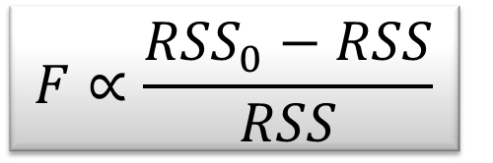
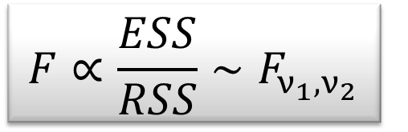
F-test - the extra-sum-of-squares principle
Model comparison:
Null Hypothesis H₀: True model is X₀ (reduced model)
X₀
X₁
X₀
Test statistic: ratio of explained variability and unexplained variability (error)
RSS
RSS₀
ν₁ = rank(X) – rank(X₀)
ν₂ = N – rank(X)
Full model ?
or Reduced model?

Slide 39
F-test summary
The F-test evaluates whether any combination of contrasts explains a significant amount of variability in the measured data
H₀: C β=0 vs H₁: C β≠0
More flexible than T-test
F-test can tell the existence of significant contrasts. It does not tell which contrast drives the significant effect or what is the direction of the effect.
For a single contrast, F will implement a two sided T-test

Slide 40
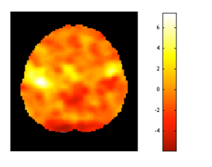
Statistical Images
For each voxel a hypothesis test is performed. The
statistic corresponding to that test is used to create a statistical image over all voxels.

Slide 41
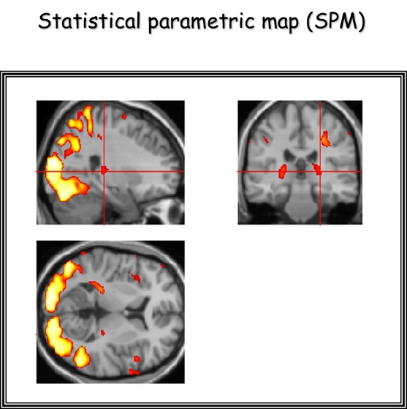
SPM Practical
Specify model: choose data files and set up design matrix
Estimate parameters using the GLM (either in the ‘traditional’ way or with Bayseian approaches) for every single voxel
Test hypotheses using contrast vectors. This produces a Statistical Parametric Map (or Posterior Probability Map in Bayesian models)
Interpretation
Notes:
In SPM, we need to specify our model, and then let the program estimate our parameters.
The next step is defining contrast vectors to test hypotheses, which produces SPMs.

Slide 42
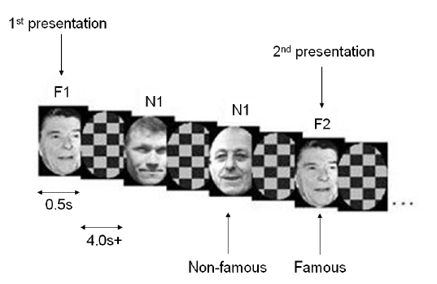
SPM Practical
Brief Example:
2 x 2 Factorial Design
  Factor 1: Fame
  Factor 2: Repetition
TE: 40ms
TR: 2s
24 descending slices, 3mm thick, 1.5mm gap
Notes:
Ben Edit: Live demonstration of 1st-Level Analysis (Leave past year’s slides in case future participants prefer not to do the demo)

Slide 43
SPM Practical
Simple example:
2 conditions: listening to auditory stimuli, rest
Blocks alternated between listening and rest
Each acquisition consisted of 64 slices (3 x 3 x 3 mm³ voxels)
Acquisition took 6s
Scan repetition time (TR): 7s
(see SPM12 Manual: Auditory fMRI data)

Slide 44
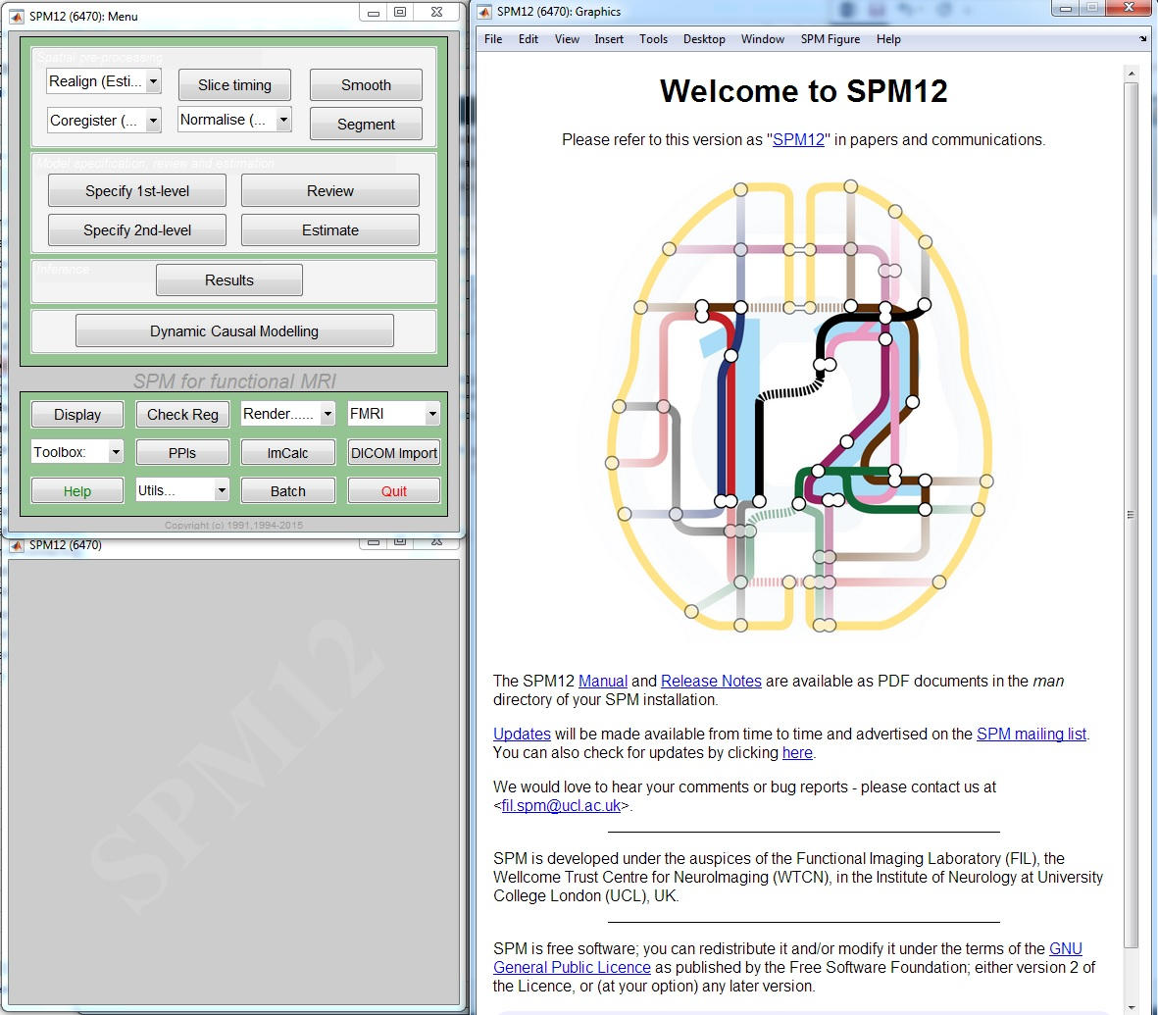
SPECIFY 1st LEVEL
After the pre-processing steps: Model specification
Press SPECIFY 1ST LEVEL

Slide 45
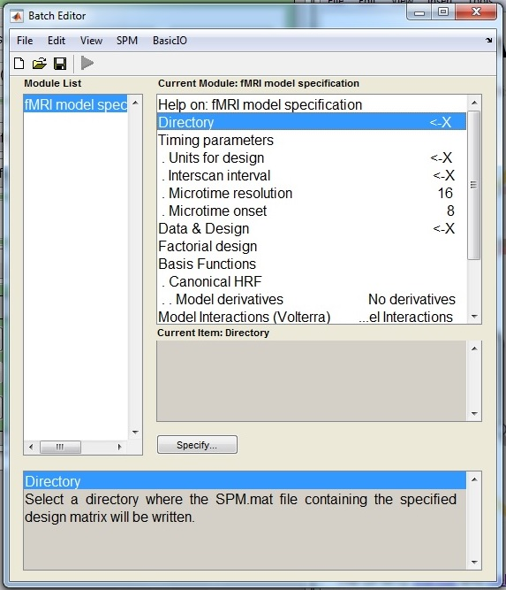
SPECIFY 1st LEVEL
In the batch editor, highlight “Directory” and select the location in which you want to save your results

Slide 46
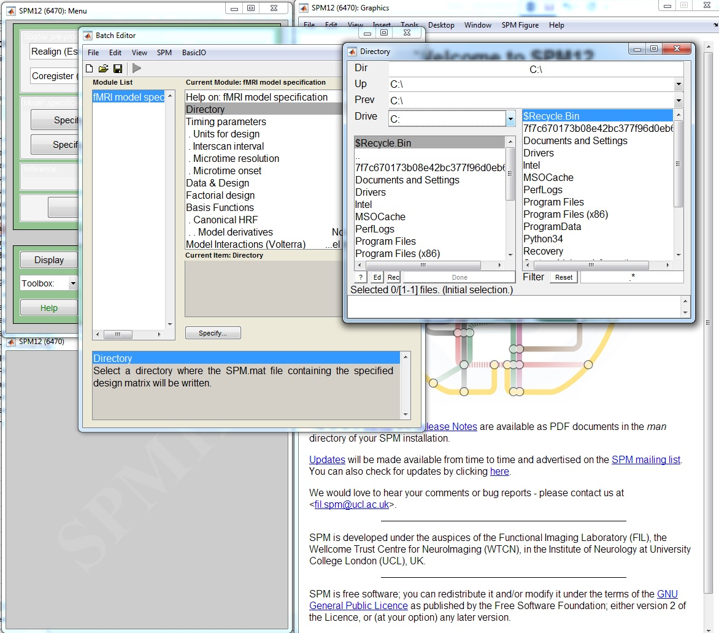
SPECIFY 1st LEVEL
In the batch editor, highlight “Directory” and select the location in which you want to save your results

Slide 47
SPECIFY 1st LEVEL
Open “Timing Parameters”

Slide 48
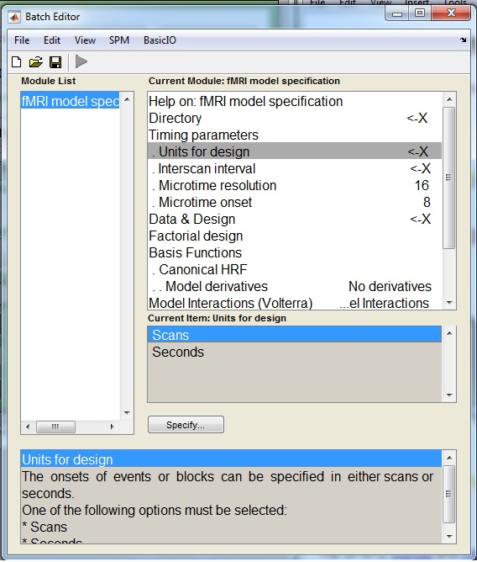
SPECIFY 1st LEVEL
Open “Timing Parameters”
  Highlight “Units for Design” and select “Scans” (rather than “Seconds”)
  Highlight “Interscan Interval” and enter your TR in seconds, e.g. 7

Slide 49
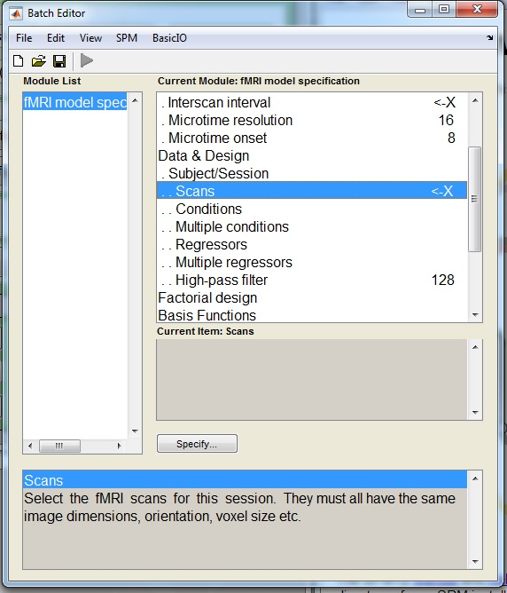
SPECIFY 1st LEVEL
Highlight “Data and Design” and select “New Subject/Session”
Open the newly created “Subject/Session” option
Highlight “Scans” and select the smoothed, normalised functional images, e.g. swfM00*_00*.img

Slide 50
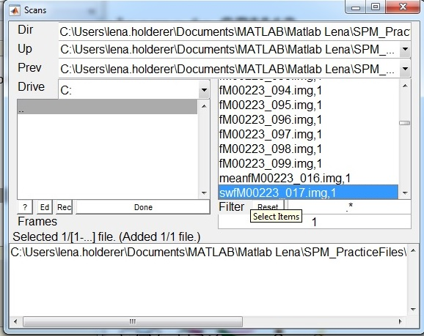
SPECIFY 1st LEVEL
Highlight “Data and Design” and select “New Subject/Session”
Open the newly created “Subject/Session” option
Highlight “Scans” and select the smoothed, normalised functional images, e.g. swfM00*_00*.img

Slide 51
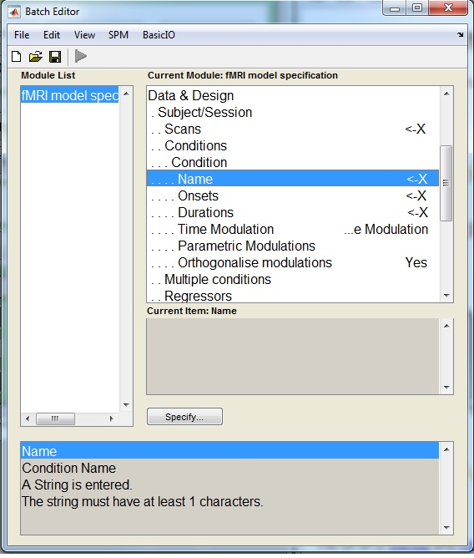
SPECIFY 1st LEVEL
Highlight “Condition” and select “New Condition
Open the newly created “Condition” option
  Highlight “Name” and enter the condition’s name, e.g. “Listening”

Slide 52
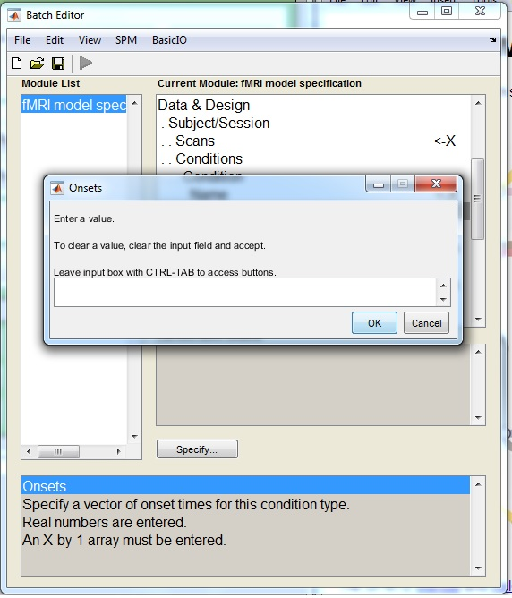
SPECIFY 1st LEVEL
Highlight “Condition” and select “New Condition
Open the newly created “Condition” option
  Highlight “Name” and enter the condition’s name, e.g. “Listening”
  Highlight “Onsets” and enter the onset times of your condition, e.g. “6:12:84”

Slide 53
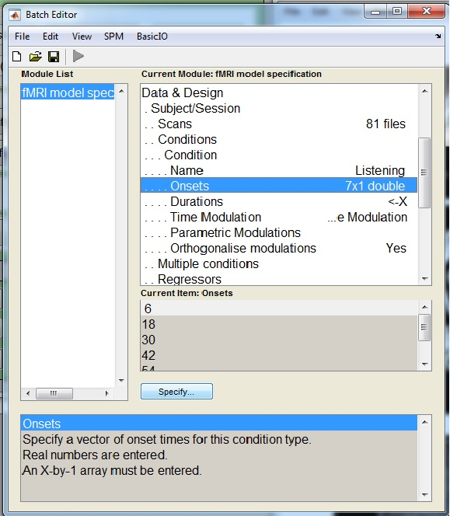
SPECIFY 1st LEVEL
Highlight “Condition” and select “New Condition
Open the newly created “Condition” option
  Highlight “Name” and enter the condition’s name, e.g. “Listening”
  Highlight “Onsets” and enter the onset times of your condition, e.g. “6:12:84”
  Highlight “Durations” and enter the duration of your condition in seconds, e.g. “6”
Save the batch as specify.mat
Press the RUN button

Slide 54
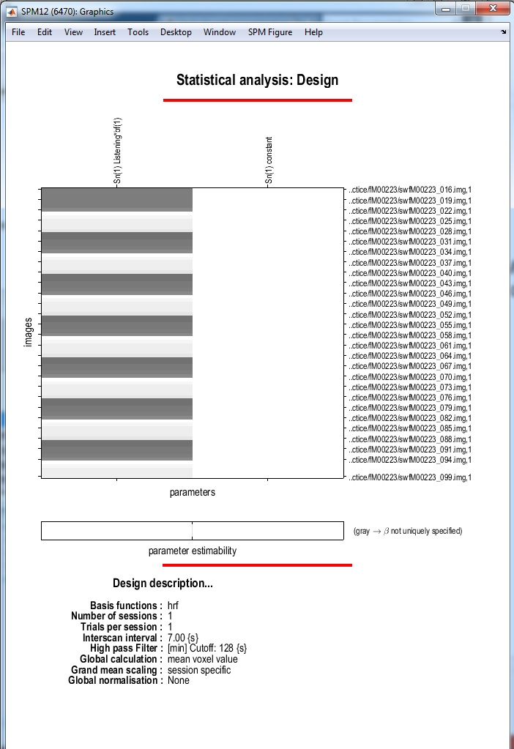
SPECIFY 1st LEVEL
SPM will write an SPM.mat file to your directory
SPM will also plot the design matrix in the Graphics window
You can use the REVIEW button to check your model specification

Slide 55
ESTIMATE
After model specification: parameter estimation
Press the ESTIMATE button

Slide 56
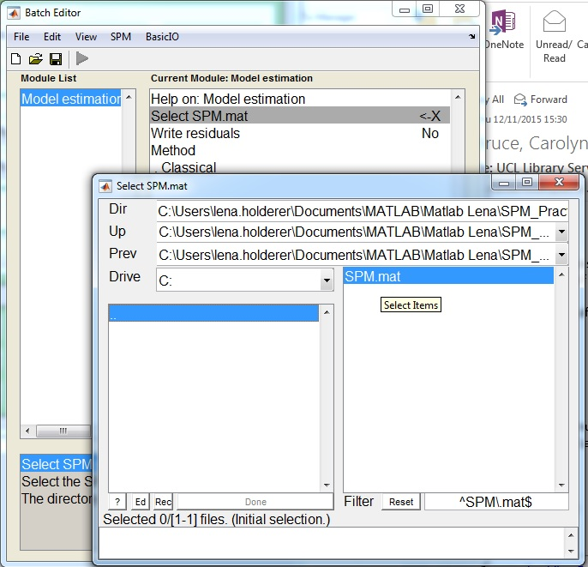
ESTIMATE
Highlight the “Select SPM.mat” option and select the SPM.mat file you have saved earlier
Save the batch as estimate.mat
Press the RUN button
SPM will create a number of files in the selected directory, including a new version of the SPM.mat file

Slide 57
RESULTS
After parameter estimation: hypothesis testing
Press the RESULTS button

Slide 58
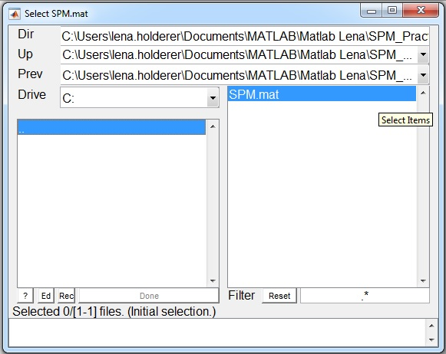
RESULTS
After parameter estimation: hypothesis testing
Press the RESULTS button
Select the SPM.mat file created by estimation

Slide 59
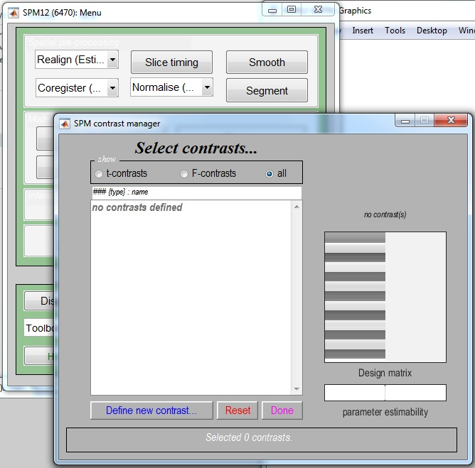
RESULTS
Select “Define new contrast”
List of contrasts
Surfable design matrix

Slide 60
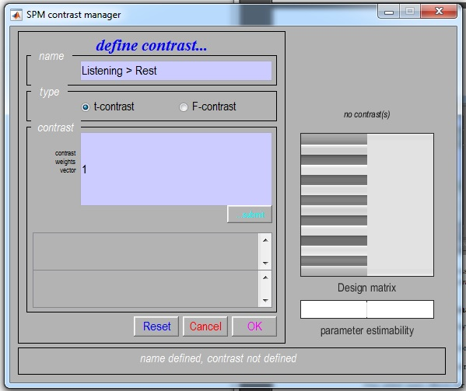
RESULTS
Select type of contrast
Select “Define new contrast”
Name your contrast, e.g. “Listening > Rest”
Select type of contrast: “t-contrast” or “F-contrast”
Use a numerical code to define your contrast, e.g. “[1 0]”
Code your contrast

Slide 61

RESULTS
Select “Define new contrast”
Define a complementary contrast, e.g. “Rest > Listening”, and use the complementary code, e.g. “[-1 0]”

Slide 62

RESULTS
To view a contrast, select the name of the desired contrast, e.g. “Listening > Rest”
Press “Done”

Slide 63

RESULTS
Do you want to mask your results with a particular contrast?
  By masking your results, you are only selecting those voxels which have been specified by the masking contrast (not applicable in our example)
In this case, select “none”

Slide 64

RESULTS
How do you want to set your statistical thresholds?
Select “FWE”
  A family-wise error is a false positive anywhere in our SPM. This thresholding option uses “FWE-corrected” p-values

Slide 65

RESULTS
How do you want to set your statistical thresholds?
Select “FWE”
  A family-wise error is a false positive anywhere in our SPM. This thresholding option uses “FWE-corrected” p-values
  Select the default value of “0.05”

Slide 66

RESULTS
What do you want your cluster extent threshold k to be?
Accept the default value, “0”
  This will produce SPMs with clusters containing at least k (in our case, 0) voxels

Slide 67

RESULTS
SPM will show those voxels which reach our threshold in the “Listening > Rest” contrast in the Graphics window

Slide 68

RESULTS
SPM will also display a statistical table for our results

Slide 69

RESULTS
In SPM’s interactive window we can produce different statistical tables and visualisations of our data
Statistical tables
Visualisations

Slide 70



RESULTS
You can experiment with overlays to display your data

Slide 71
Take-home message
The contrasts we can choose and the interpretation of results depend on our model specification, which in turn depends on our experimental design!
Notes:
It is important to realise that the hypotheses we can test, and how we interpret our results, depends on the way we specify our model in SPM. The model specification in turn depends on our initial experimental design. This is why it is very important to have a well thought-out experiment from the get-go. If we have a well-designed experiment, we can easily see which questions we can ask of our data.
We should always think about which contrasts we want to use when we design our experiment.

Slide 72
References
SPM12 Manual: http://www.fil.ion.ucl.ac.uk/spm/doc/manual.pdf (Ashburner et al., 2015)
Introduction to Statistical Parametric Mapping: http://www.fil.ion.ucl.ac.uk/spm/doc/intro/ (Friston, 2003)
Human Brain Function 2nd edition: http://www.fil.ion.ucl.ac.uk/spm/doc/books/hbf2/ (Ashburner, Friston, & Penny), especially The general linear model (Kiebel & Holmes), Analysis of fMRI timeseries: Linear time-invariant models, event-related fMRI and optimal experimental design (Rik Henson), and Contrasts and classical inference (Poline, Kherif & Penny)
http://editthis.info/scnlab/Analysis
Principles of Analysis: http://imaging.mrc-cbu.cam.ac.uk/imaging/AnalysisPrinciples (Rik Henson)
Example Data Set from http://www.fil.ion.ucl.ac.uk/spm/data/auditory/
Slides from previous MfD presentations, inc. Elliot Freeman, Hugo Spiers, Beatriz Calvo & Davina Bristow, Ramiro & Sinead, Rebecca Knight & Lorelei Howard, Clare Palmer & Misun Kim
Slides from coursera SPM course
Joe Devlin’s slides from fMRI Analysis course 2013-14
http://www.anc.ed.ac.uk/CFIS/projects/prosody/material/slice8.jpg
https://www.sciencenews.org/sites/default/files/11543
http://www.brainvoyager.com/bvqx/doc/UsersGuide/StatisticalAnalysis/TheGeneralLinearModel.html
Pernet, C. R. (2014). Misconceptions in the use of the General Linear Model applied to functional MRI: a tutorial for junior neuro-imagers. Frontiers in Neuroscience, 8, 1.
Guillaume Flandin SPM Course slides
Christophe Phillips Contrasts and statistical inference

