Slide 1
Methods for Dummies Overview and Introduction
Magdalena Kachlicka & Joseph Ogle

Slide 2
What is Methods for Dummies
Aim: provide a basic introduction to human brain imaging analysis methods (fMRI and M/EEG)
Wednesdays 1200-1300 hrs in 4th Floor Seminar Room
Register online
Each talk:
2 presenters
Lasts about 40 minutes + 20 minutes for questions.
Should introduce the relevant theory and be followed by a demo using SPM12 interface.

Slide 3
How to Prepare
Read the Presenter’s Guide
Prepare the slides with your partner
Meet with your expert
Remember your audience are not experts
Email us if you have any questions!

Slide 4
Where to find information
MfD website: http://www.fil.ion.ucl.ac.uk/mfd/
Previous years’ slides
Human Brain Function Textbook (online)
SPM course slides
Cambridge CBU homepage (Rik Henson’s slides)
Methods Group Experts

Slide 5
SPM
Statistical Parametric Mapping
Invented at the FIL
A software package designed for the analysis of brain imaging data in fMRI, PET, SPECT, EEG & MEG
Just type SPM in MATLAB and all will be revealed…
SPM website has a manual + datasets available to play around
Softwares:
MATLAB: https://swdb.ucl.ac.uk/
SPM12: http://www.fil.ion.ucl.ac.uk/spm/software/

Slide 6
fMRI

Slide 7
fMRI analysis overview

Slide 8
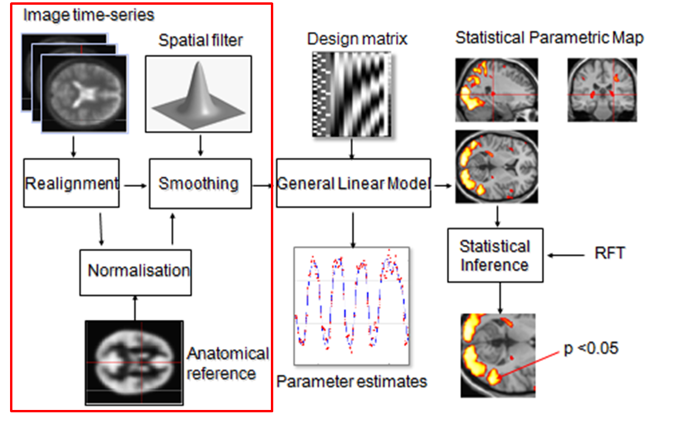
fMRI analysis - preprocessing

Slide 9
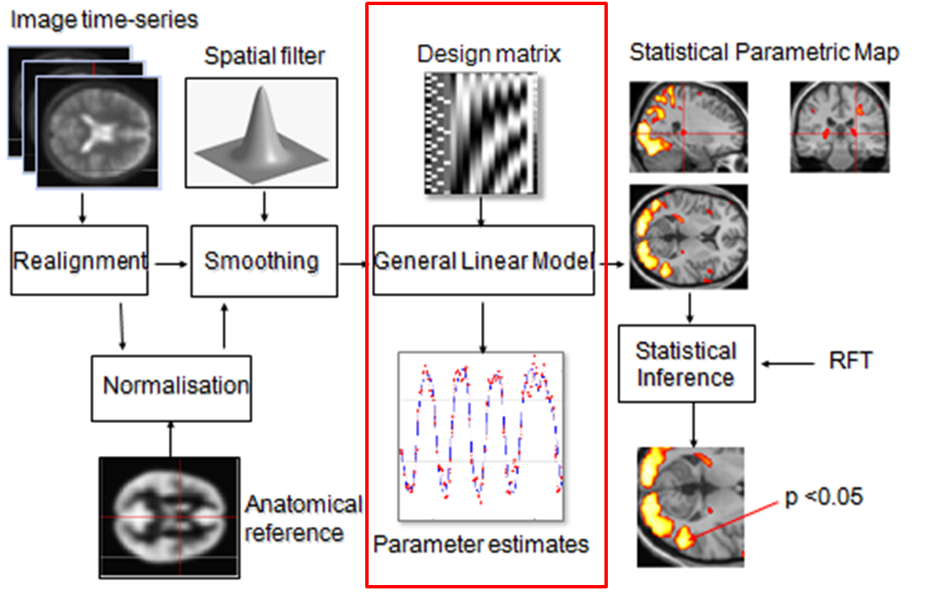
fMRI overview - GLM

Slide 10
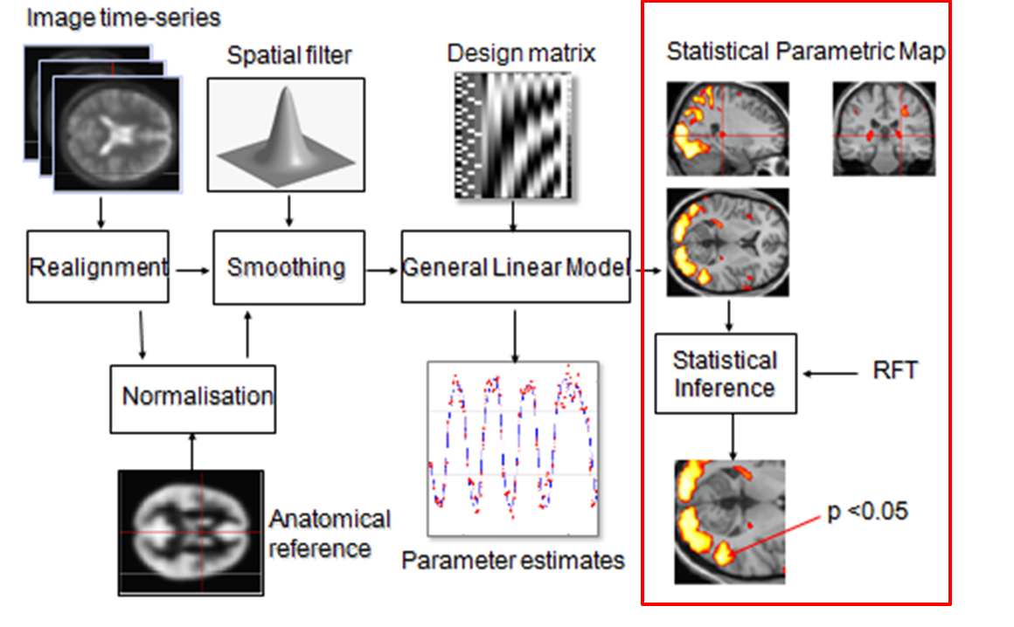
fMRI overview – statistical inferences

Slide 11
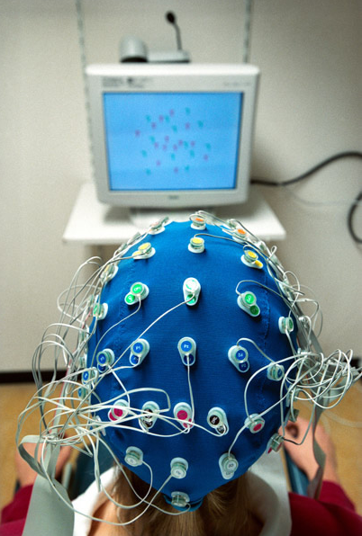
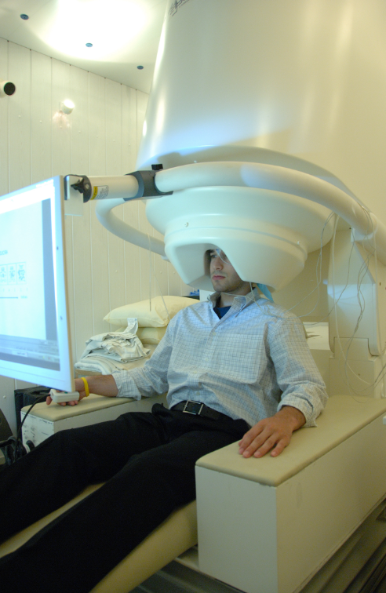
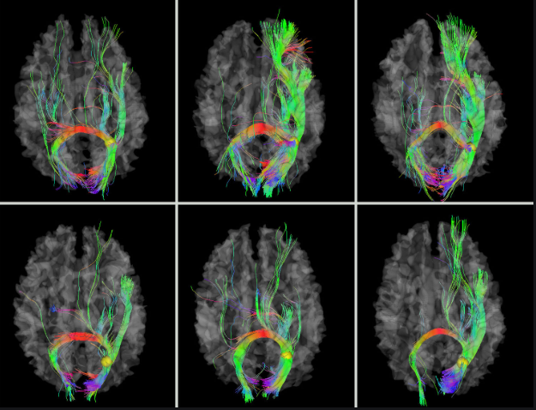
Other Techniques

Slide 12
Other Techniques

Slide 13
Final Points
Course only works if everyone chips in
Requirement for the MfD certificate: 70% attendance
Please sign the attendance sheet
E-mail us back to confirm your allocations or in case of any changes
Rules for swaps: Ask your friends or e-mail the mailing list
Some of the topics seem hard but please don’t worry
“I have no idea what 90% of these words mean” (Anonymous, 2017)
Send us the slides so we can post them
Enjoy!

Slide 14
Enjoy the course!
Magdalena Kachlicka
magdalena.kachlicka.18@ucl.ac.uk
UCL Institute for Environmental Design and Engineering, The Bartlett
Department of Psychological Sciences, Birkbeck University of London
Joseph Ogle
joseph.ogle.17@ucl.ac.uk
XXX affiliation

