Slide 1
Statistical analysis
T-Test, ANOVA and Linear regression

Slide 2
Contents
Introduction to statistics
T-Test
ANOVA
Linear regression
Notes:
Intro slide

Slide 4
Introduction
Statistics is the science of data
Inferences made from statistics allow us to learn about our populations
Statistics allow us to quantify results through hypothesis testing
H₀ = There is no difference between the groups
H₁ = There is a difference between the groups
Notes:
Intro – need for these tests, why we do these tests

Slide 5
T-test
T-tests allows us to identify differences between our data and a known mean or between two groups
This is useful to see if the data is statistically significantly different from a previous result or if two groups differ from each other
Notes:
Explain t-test and its purpose

Slide 6
Descriptive statistics
Before jumping into the T-test, it is important to understand how we describe our data.
Mean: $μ$ (population) or $\overline{x}$ (sample)
Standard deviation: $\sqrt{Σ\frac{{\left(x−\overline{x}\right)}^{2}}{n}}$ (represented by $σ$)
Standard error of the mean: $\frac{σ}{\sqrt{n}}$

Slide 8
T-test
Inferential statistics: allows us to draw conclusions from the data
$$Tstatistic= \frac{Variance between groups}{Variance within groups}$$

Slide 9
T-test
One sample T-test
Two sample T-test
Paired samples
Independent samples
Notes:
We can calculate this t-statistic for different types of samples depending on what we are interested in. A one-sample

Slide 10
T-test
Compute the t-value
Check t-value against known distribution
Choose significance level and number of tails
Accept or reject null hypothesis
Notes:
α, is the probability of rejecting the null hypothesis when it is true

Slide 11
Compute the t-value

Slide 12
2. Check t-value against known distribution
3. Choose significance level and number of tails
4. Accept or reject null hypothesis
Two tailed One tailed
Notes:
Talk about 1 or 2 tailed

Slide 13
T-test: Example
Two interventions were tested to determine whether an exercise-training programme or calorie-controlled diet is more effective in lowering cholesterol levels.
https://statistics.laerd.com/spss-tutorials/independent-t-test-using-spss-statistics.php

Slide 14
T-test: Example
“This study found that overweight, physically inactive male participants had statistically significantly lower cholesterol concentrations (5.80 ± 0.38 mmol/L) at the end of an exercise-training programme compared to after a calorie-controlled diet (6.15 ± 0.52 mmol/L), t(38)=2.428, p=0.020.”
https://statistics.laerd.com/spss-tutorials/independent-t-test-using-spss-statistics.php

Slide 15
T-test: Assumptions
Continuous dependent variable
One sample and paired:
Differences normally distributed
Two independent samples:
Similar size groups
Normally distributed
Variances equal
Non-parametric tests:
Mann-Whitney U (independent)
Wilcoxon signed ranks (paired)

Slide 16
Analysis of Variance (ANOVA)
An ANOVA allows us to test the differences between 2+ groups.
Independent: One-way or two-way ANOVA
Dependent: Repeated measures ANOVA

Slide 18
One way ANOVA
Used to compare means from 2+ independent groups

Slide 19
Two way ANOVA
Two factors, e.g. Treatment and sex
Male or female

Slide 20
Repeated measures ANOVA
Used to measure the difference in 2+ related groups

Slide 21
ANOVA assumptions
Continuous dependent variable
Normally distributed
Equal variances
One and two way:
Independent groups
Repeated measures:
Related groups

Slide 22
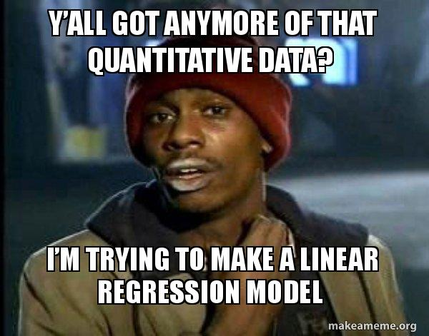
Linear regression

Slide 23
Regression
Regression is closely related to correlation
Can be used to predict values of one of the two variables measured from the other
Linear regressions are the most common type of regression; testing for a linear relationship between variables.

Slide 24
Single Linear Regression
useful for testing for a relationship between two variables when one of the variables can be controlled and measured (‘independent’ variable) and we wish to use these measures to predict the other variable (‘dependent’ variable).
Regression not only tests for a relationship but also describes what that relationship is.
The ‘dependent’ variable is measured on the y axis and the ‘independent’ variable on the x axis.
It is best to collect data such that the regression has a fairly even spread of points all the way along the line, rather than a lot of points at one end.

Slide 25
Notes:
The phrase 'correlation does not imply causation' is used in science, sociology, psychology, economics, and philosophy to show the distinction between the causal relation of two variables. PsycholoGenie explains the phrase 'correlation does not imply causation' with its meaning and examples.

Slide 26
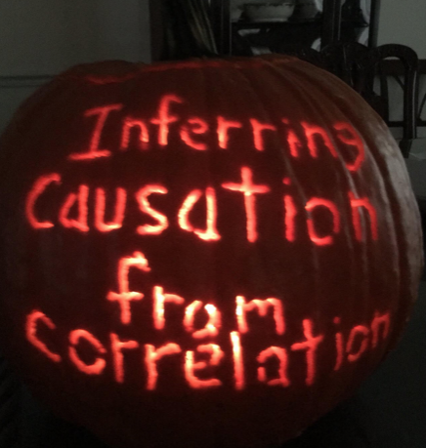

Slide 27
As with correlations – a regression does not imply causation
Reality
Sleeping with shoes Degree of headache
Amount of alcohol drunk
correlation
Wrong conclusion, which is based on correlation
Sleeping with shoes Degree of headache
= causality

Slide 28
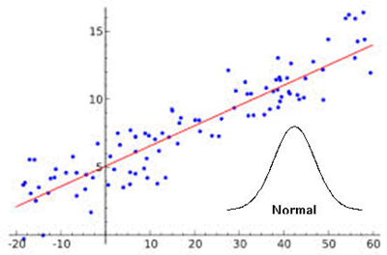
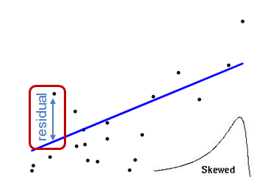
Assumptions of regression analysis
Regression analysis is parametric. The following assumptions should be met to undertake such analysis:
1) Normal distribution of residuals
Residuals are normally distributed
Residuals are not normally distributed
The residuals can be output in SPSS as a new column of data and then tested for normality with KS tests and/or QQ plots

Slide 29
Single linear regression
Regression analysis produces an equation in the form:
y = a + bx, where
y and x are the ‘dependent’ and ‘independent’ variables,
the variables must fit a coordinate form (have a linear relationship)

Slide 30
R² : coefficient of determination, denoted R² or r² and pronounced "R squared", is the proportion of the variance in the dependent variable that is predictable from the independent variable(s)

Slide 32
Notes:
looking at the distances between the regression line estimated values and the observed values.
R-squared evaluates the scatter of the data points around the fitted regression line. It is also called the coefficient of determination, or the coefficient of multiple determination for multiple regression. For the same data set, higher R-squared values represent smaller differences between the observed data and the fitted values.

Slide 33
How do you calculate a coefficient of determination ?
Notes:
Put your own example

Slide 35
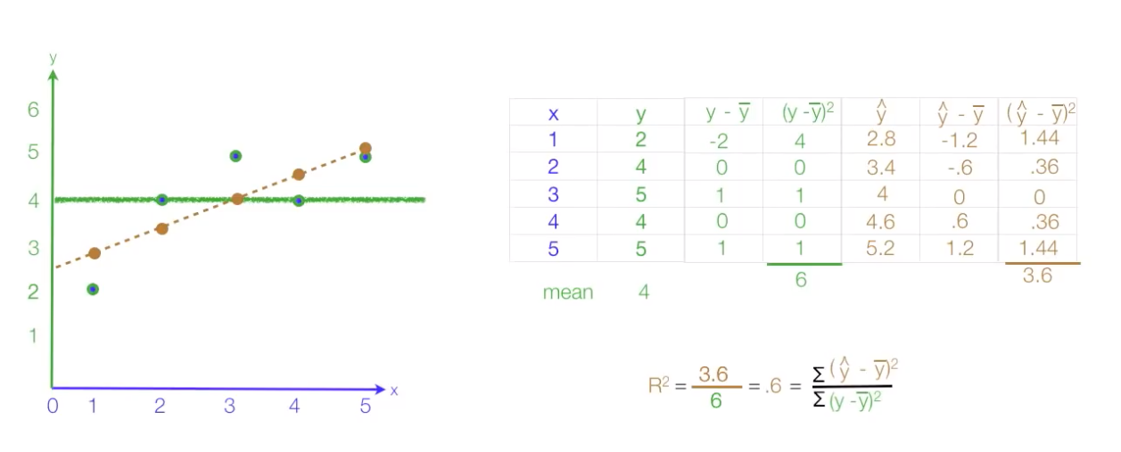

Slide 36
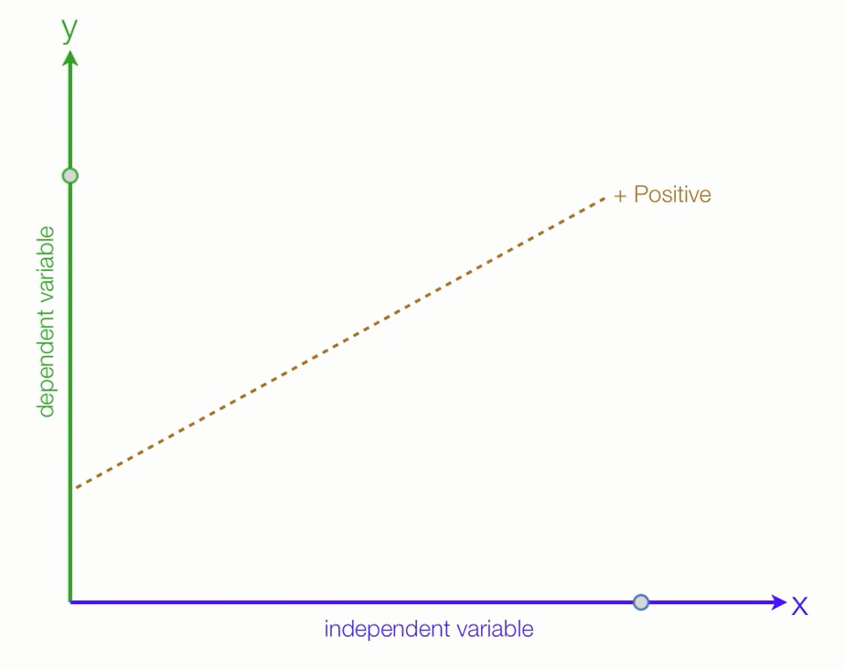
time spent studying increases, grades increases
Slope is positive: y = B₀ + B₁ X
Notes:
This linear relationship can be POSITIVE

Slide 37
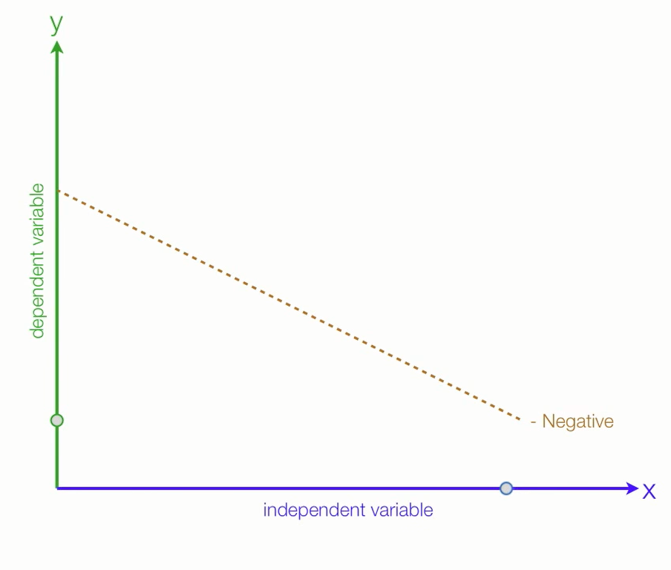
Time spent on netflix increases, grades decreases.
Slope is negative: y = B₀ - B₁ X
Notes:
Or NEGATIVE

Slide 39
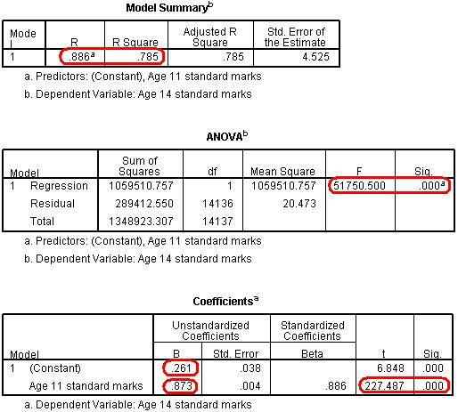
Notes:
SPSS OUTPUT
The Model Summary provides the correlation coefficient and coefficient of determination (r²) for the regression model. As we have already seen a coefficient of .886 suggests there is a strong positive relationship between age 11 and age 14 exam scores while r² = .785 suggests that 79% of the variance in age 14 score can be explained by the age 11 score. In other words the success of a student at age 14 is strongly predicted by how successful they were at age 11.
The ANOVA tells us whether our regression model explains a statistically significant proportion of the variance. Specifically it uses a ratio to compare how well our linear regression model predicts the outcome to how accurate simply using the mean of the outcome data as an estimate is. Hopefully our model predicts the outcome more accurately than if we were just guessing the mean every time! Given the strength of the correlation it is not surprising that our model is statistically significant (p < .0005).
The Coefficients table gives us the values for the regression line. This table can look a little confusing at first. Basically in the (Constant) row the column marked B provides us with our intercept - this is where X = 0 (where the age 11 score is zero – which is the mean). In the Age 11 standard marks row the B column provides the gradient of the regression line which is the regression coefficient (B). This means that for every one standard mark increase in age 11 score (one tenth of a standard deviation) the model predicts an increase of 0.873 standard marks in age 14 score. Notice how there is also a standardised version of this second B-value which is labelled as Beta (β). This becomes important when interpreting multiple explanatory variables so we'll come to this in the next module. Finally the t-test in the second row tells us whether the ks2 variable is making a statistically significant contribution to the predictive power of the model - we can see that it is! Again this is more useful when performing a multiple linear regression.

Slide 41
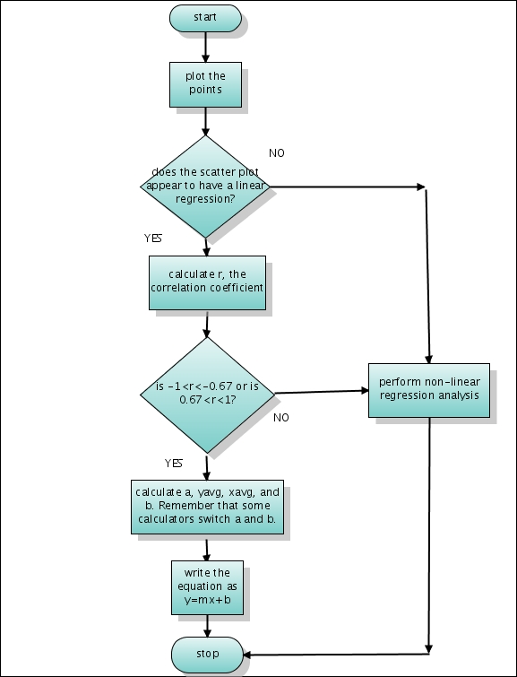
Notes:
SUMMARY: flow chart

Slide 42
Notes:
SUMMARY

