Slide 1
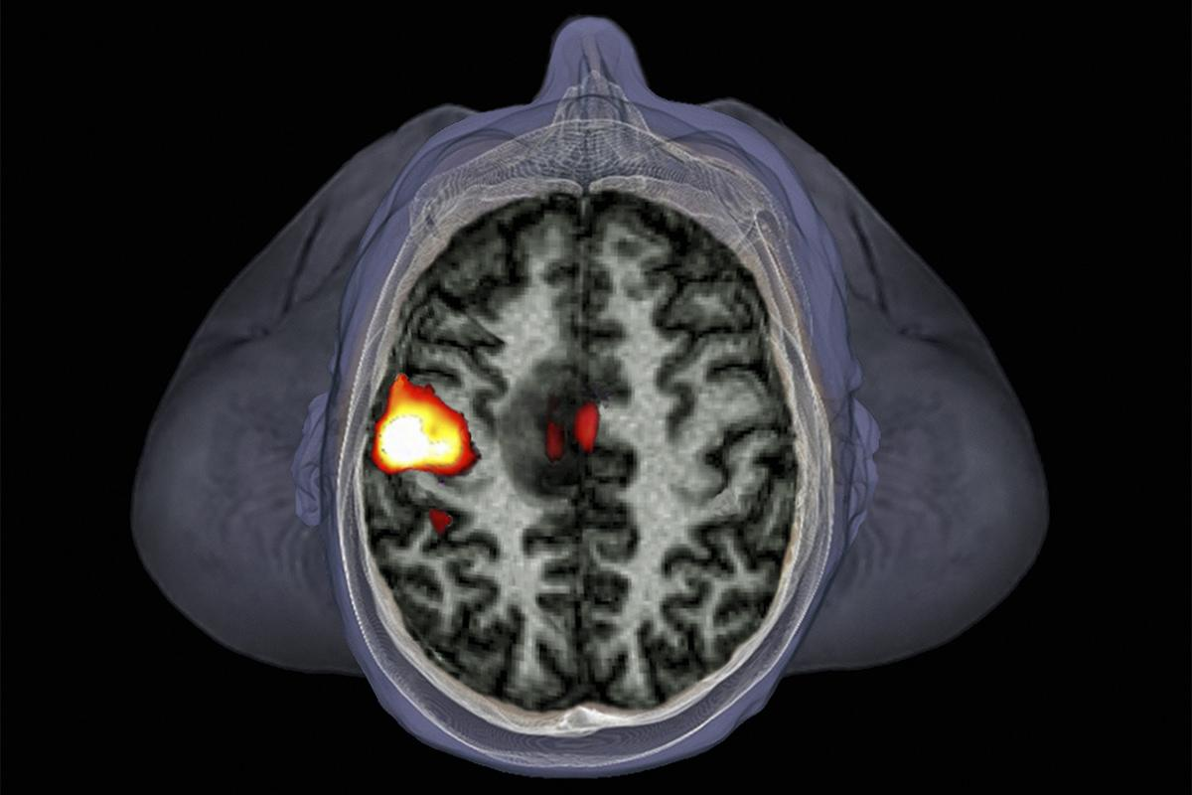
Basis of the BOLD signal
Zephyr/Science Photo Library
Maria Molina Sanchez
Ivan Ezquerra Romano

Slide 2
⚡ MRI BASICS
⚡ fMRI - BOLD SIGNAL
Notes:
I’ll start by explaining a little bit the basics of the MRI which is mainly the physical properties on which its based (the physics of the magnetic resonance imaging) and after me Ivan will go through the BOLD signal in depth.
Big picture: the ability of the MRI to create magnetic fields and how hydrogen nuclei of our body respond to magnetic fields.

Slide 3
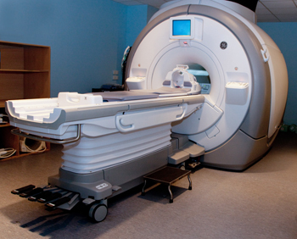
The MRI Scanner
Earth’s magnetic field: 0.00003 Tesla Clinical MRI: 1.5 - 7 Tesla
Notes:
An MRI scanner is a giant magnet which produces a magnetic field much stronger than Earth’s magnetic field. The streght of this magnetil field is measured in Teslas. A typical clinical MR system will have a magnetic field strength of 1.5-3 T .
The scanner is in a specially shielded room which blocks out Radiofrequency energy, e.g. from radio stations, which would otherwise drown out the energy emitted by the protons you want to capture.

Slide 4
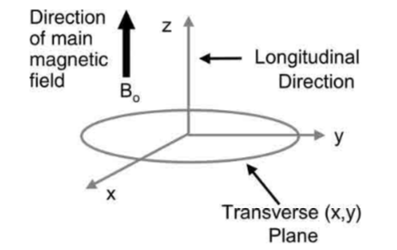
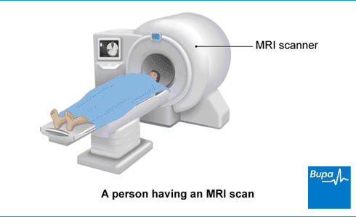
Z B₀ longitudinal axis
X
Y
X, Y transverse plane
Notes:
Inside the MRI tube there is this 3-D space represented by these X, Y and Z axes. The z axis (longitudinal direction) is often aligned with the main magnetic field; the plane perpendicular to this is called the transverse plane.

Slide 5
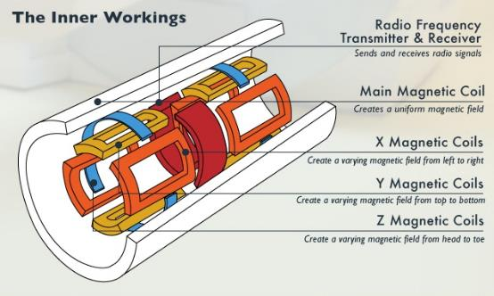
WHAT ARE THE COMPONENTS OF THE MRI?
MAIN MAGNETIC COIL (THE MAGNET)
THE RF TRANSMITTER / RF RECEIVER
GRADIENT COILS
SHIMMING COILS
COMPUTER/MONITOR
Notes:
The MRI scanner is made up of 4 key components:
The magnet or the main magnetic coil: which is creates a uniform and constant magnetic field. The field it creates is known as B0, and aligns longitudinally on the z axis of the scanner.
The RF transmitter: generates pulses of radio frequency energy. This pulses basically generate another intermiten magnetic field (called B1) that is perpendicular to the static and permanent main magnetic field (Bo). The body who is introduced in the MRI scan will absorbe this energy and then release it. This release of energy is captured by the RF receiver.
Shimming coils: they make the main magnetic field (B0) more homogenous.
There are three further magnetic coils, that are called the gradient coils, which produce magnetic fields in the x, y, and z directions.

Slide 6
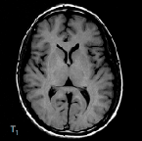
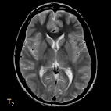
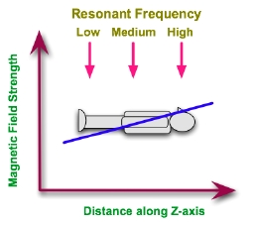
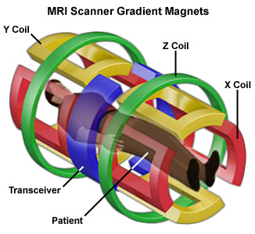
Gradient coils: x, y, z
Alter the strength of the primary magnetic field
Change the precession frequency between slices
Allow Spatial encoding for MRI images
Notes:
The gradient coils are placed in the direction of these three axes X,Y and Z, and are used to modify the strenght of the main magnetic field over the x, y and z dimensions. They also create magnetic fields but these magnetic fields are not constant like B0. Instead, they produce a gradient in each axes. This basically means that the strenght of the magnetic field changes depending on where the atoms are in the body.
They are encoding for spatial localisation.
With such a gradient applied along the patient's Z-axis, we can expect the resonant frequency of hydrogen protons to be different for planes along this axis,
So that if the magnetic field varies across space, the precession frequency of the protons will vary as well.

Slide 7
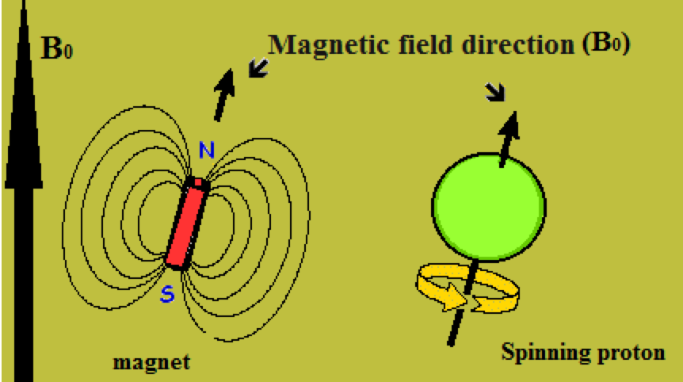
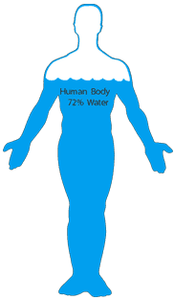
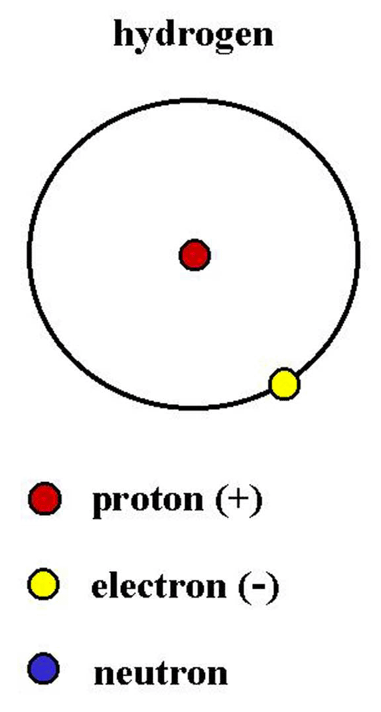
Hydrogen atoms
Human tissue contains water molecules with hydrogen atoms.
Hydrogen atoms are positively charged.
They are tiny magnets.
Notes:
To say it very simple what an MRI does is taking pictures of different parts of our body that contain water. The water molecules have 2 atoms of hydrogene that produce very small electromagnetic fields. So they act as little magnet.
The MRI does is just first it excites water molecules into releasing waves, and then records the locations of those waves with high accuracy.
Putting these basic elements together, there are protons in the body, positively charged and spinning about their axes, that act like tiny magnets.

Slide 8
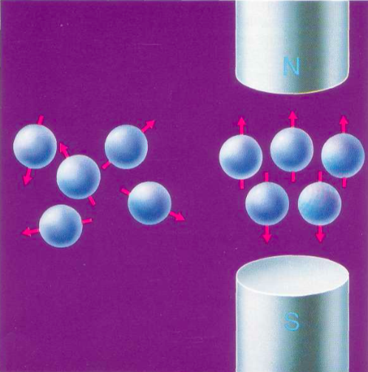
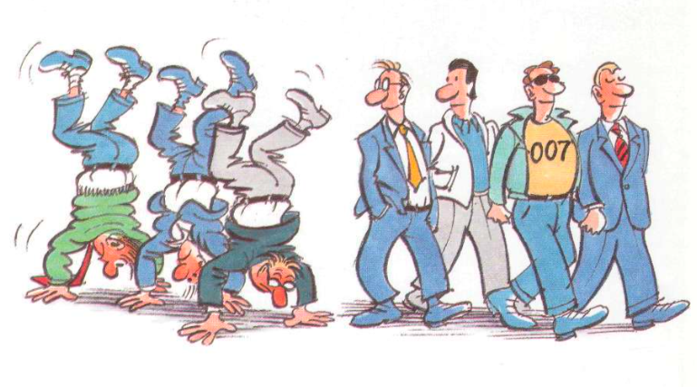
NUCLEAR SPIN
Normally protons are aligned in a random fashion.
When they are exposed to a strong external magnetic field (B0) they align in only two ways: parallel or antiparallel.
Net magnetitation parallel to the magnetic field (Z)
Notes:
In addition to spin, the proton also takes another important motion. This is called gyration, and it descrIbes how the proton wobbles as it spins around the axis.
Never truly aligned – like spinning top.
This examples shows one proton spinning around its axis.

Slide 9
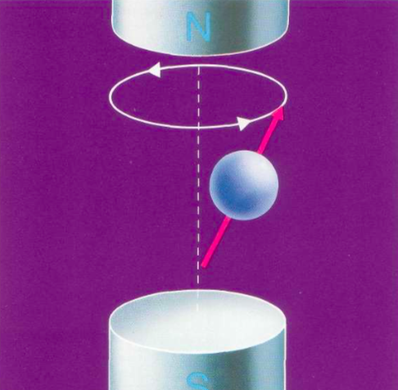
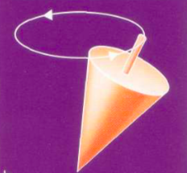
PRECESSION
The axis of the spinning top circles forming a cone shape.
How fast the protons precess?
Precession frequency depends upon the strength of the magnetic field.

Slide 10
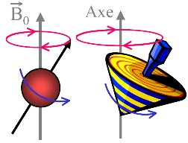
Larmor Equation
Precession frequency is calculated by the Larmor equation:
ω₀ = γ Β₀
ω₀ resonant frequency (e.g., 63.87 Hz for 1.5 T scanner)
γ gyromagnetic ratio (42.58Hz for Hygegon)
Β₀ magnetic field strength (1.5-7 T)
Notes:
The process of precession is defined by the Lamour Frequency equation, which is a very important concept in MR imaging.
This describes the rate at which spins wobble when placed in a magnetic field.
The Larmor requency is directly proportional to the strength (B0) of the magnetic field.
The precessional frequency ω(omega)0= B0 x λ (lambda)
Where B0 is the magnetic field strength And λ is the gyro magnetic ratio

Slide 11
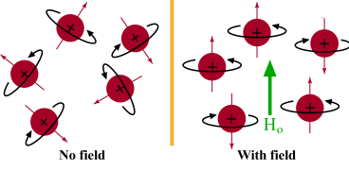
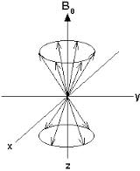
Normally:
Magnetic fields are randomly aligned
In magnetic field of MRI:
Spinning nuclei align to B₀ field
Notes:
As we saw before, the hydrogen ions are randomly aligned normally in earths magnetic field.
Net magnetisation is therefore 0.
Inside the scanner, the magnetic field is very strong.
The spinning atoms align to the strong magnetic field, either into parallel and antiparallel directions with the Z axis..
However, because the up spin direction is energetically more favourable, more protons align in the parallel direction with the B0 axis.
This leads to a net magnetization value, due to the difference in their spin up and spin down states.
The energy difference between the two spin states, Is proportional to the strength of B0. With a stronger magnetic field, more spins will be in the parallel state, leading to a stronger net magnetisation. This means a stronger signal.
This is why the MRI scanner has a very strong magnetic.
To recap: the magnetic field is used to align the tiny hydrogen atoms so they are in the same direction, and they align to the longitudianal axis of the scanner. The net difference in magnetisation between the two up/down alignments is what creates the MR signal.

Slide 12
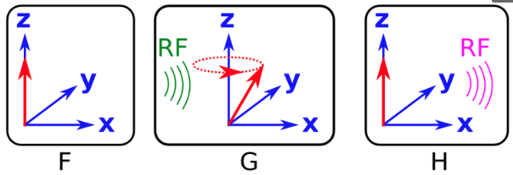
WHAT HAPPENS WHEN WE APPLY A RF PULSE?
Spinning nuclei align to B field(Z-axis)
RF "kick" the nuclei to an excitation state
Nuclei flip back
RF is applied → The protons get in RESONANCE with the RF pulse.
Magnetization rotates away from the longitudinal direction.
RF is over → protons release the energy they absorbed.
Notes:
Protons only exchange energy efficiently if the frequency of the energy matches their precession frequency. pulses must be sent at the Larmor frequency of the proton

Slide 13
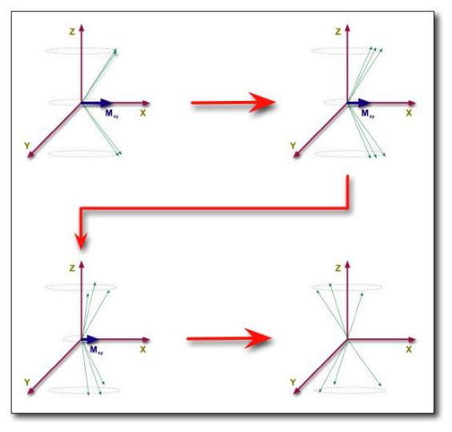
WHAT HAPPENS WHEN THE RF PULSE CESES?
Longitudinal relaxation: Precession back towards B0 longitudinal field (T1)
Transversal relaxation:
Dephasing of spins (T2)
Notes:
When the RF pulse ceases, we can look to what happens along both the Z and XY planes.
Along the Z axis, there is longitudinal relaxation, also known as spin recovery. The protons emit the RF energy they have absorbed, returning to their natural lower energy state.
This diagram represents what happens to phase coherenece:
Along the transverse plane, transverse relaxation occurs, also known as phase decay. Previously, the protons were precessing in phase with each other. Now, they gradually lose their coherence, and the XY magnetisation returns to 0.
Each individual spin is a little ‘magnet’ that creates its own magnetic field.
Each spin therefore experiences a specific field due to the influence of its neighbors: spin-spin interactions
Since spins precess at a frequency given by the local value of the magnetic field, they gradually get out of phase: the detected MR signal is reduced with time due to T2 relaxation

Slide 14
Relaxation
time
Switch off RF pulse
Receive signal
Notes:
So literally the relaxation time is the difference between the RF pulse ceses and you receive the signal

Slide 15
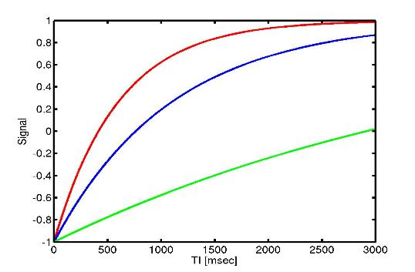
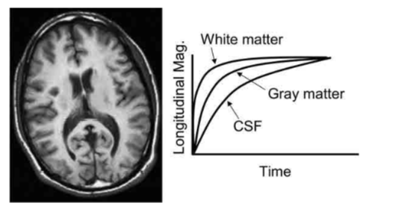
T1 recovery
WM
GM
CSF
Different tissue types have different T1 and T2 dinamics.
This creates contrast in imaging.
Notes:
These forms of relaxation are also known as T1 and T2 characteristics.
These are important in MRI, because they are crucial for producing contrast in imaging.
Different tissue types have different T1 and T2 characteristics, because the rate at which the protons release their absorbed energy depends on the tissues composition.
This means that you can create high contrast images of brain strucutres.
Here you can see the T1 recovery curve for different tissue types.
white matter indeed gives us the highest signal, which is shown bright in the image,
and CSF (Cerebrospinal fluid) a low signal, shown dark in the image.

Slide 16
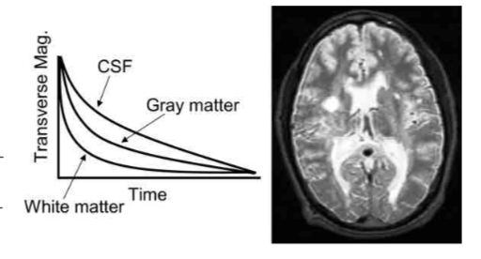
T2 decay
Different tissue types have different T1 and T2 characteristics.
This creates contrast in imaging.
Notes:
For fMRI, we are most interested in T2 relaxation, of loss of phase coherence.
Here you can see the T2 recovery curve of different tissue types and the resulting T2 image
because spins dephase slower in CSF, CSF has a higher and brighter value
Gray and white matter have a much lower value.
De-phasing is affected by:
External magnetic effects (I.E. scanner)
Spin Echo imaging corrects for this
Internal magnetic effects (I.E. interactions with neighbouring molecules)
T2 = the true ‘natural’ decay time of the tissues
T2* = predicted decay based on natural atomic and molecular mechanisms (an ‘observed’ T2).
Is faster than T2 decay due to natural inhomogeneities in the main magnet

Slide 17
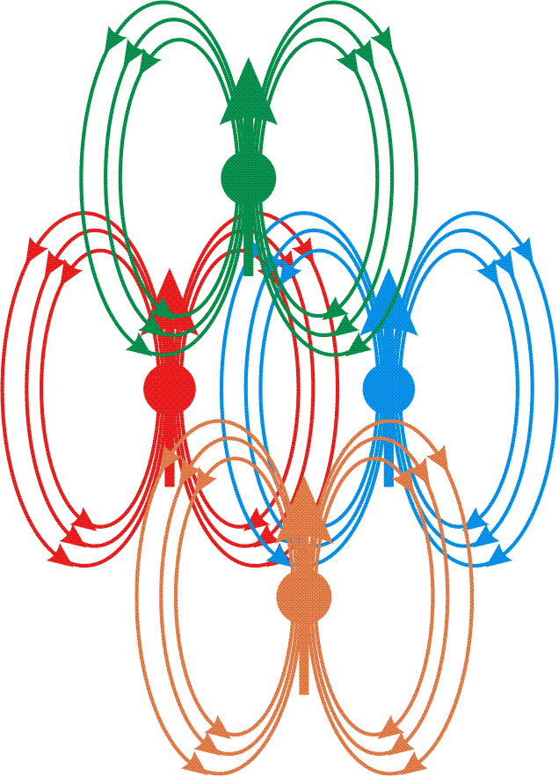
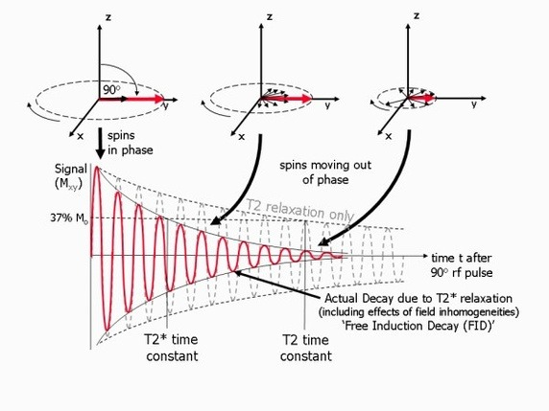
T2 and T2*
B
B
B
B
B
B
B
B
B
B
B
T2 = the true ‘natural’ decay time of the tissues (perfect homogeneous environment)
T2* = dephasing is faster than T2 due to inhomogeneities, which affect spin dephasing, and lead to signal decrease.
In BOLD fMRI:
T2* changes in relation to brain activity.
B
Notes:
T2 and T2* represent slightly different things in MRI
T2 is the natural decay time of tissues which would occur in a perfect homogenous environment.
T2* reflects the decay which is impacted by inhomogeneities in magnetisation.
T2* is the time for the transverse component of the magnetization to lose 63% of its maximum value,
This is particularly relevant for fMRI.
The reasons are twofold:
firstly, there are natural scanner wide variations in the giant magnet of the scanner.
Secondly, there are inhomogenties due to spin-spin interactions. Spin spin is where the phases begin to spin out pf phase with each other due to interactions with neighbouring protons.
This is particularly relevent for the BOLD response. This is because there are things like iron present in the blood, which can locally alter magnetic fields.

Slide 18
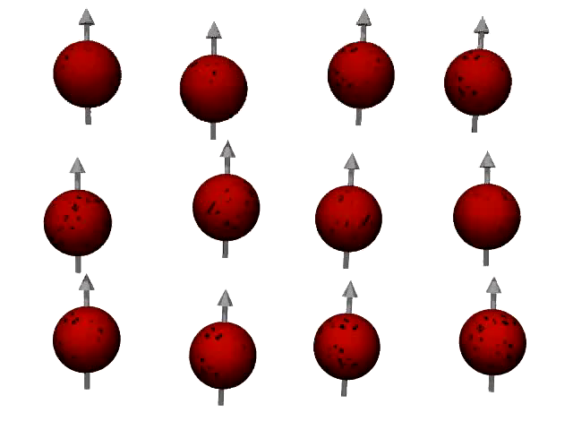
https://www.youtube.com/watch?v=0YBUSOrH0lw

Slide 19
The BOLD Signal

Slide 20
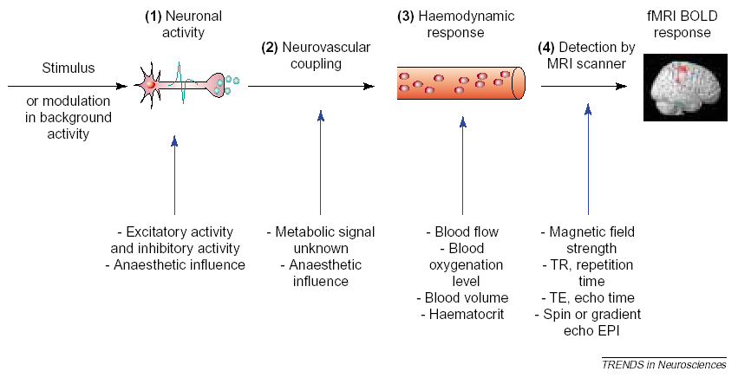
Stimulus to BOLD
Source: Arthurs & Boniface, 2002, Trends in Neurosciences

Slide 21
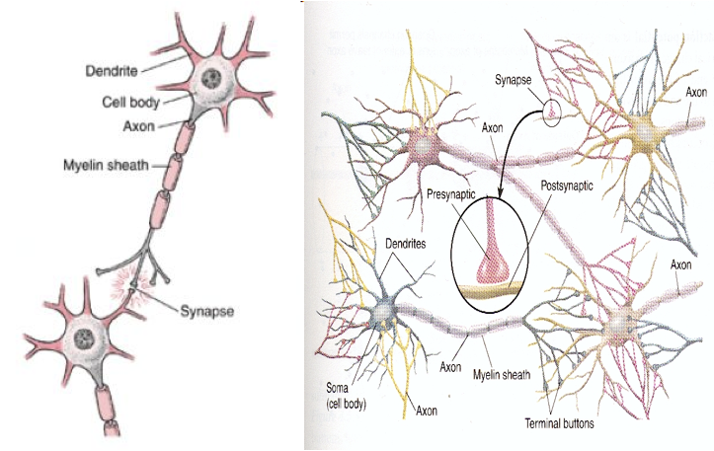
Neurons and neural networks

Slide 22
Stimulus to BOLD
Source: Arthurs & Boniface, 2002, Trends in Neurosciences

Slide 23
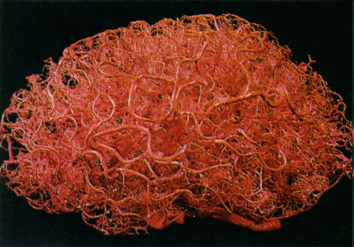
Capillary network and blood flow
Blood flow = volume of moving blood per unit time
Blood flow is proportional to:
the Pressure Gradient divided by the Vessel Flow Resistance
Vessel resistance depends primarily on vessel diameter
Vessels
Notes:
Brain is full of vessels that provide oxygen and nutrients to the different cells in the nervous system
Blood flow around the brain
Blood flow = volume of moving blood per unit time
Blood flow is proportional to pressure gradient divided by the vessel flow resistance
Animal studies have shown that blood pressure is constant and what changes is the diameter, so if the diameter increases there is less resistance and there is more blood flow
Levels of cerebral blood flow control
Central autoregulation
regulatory mechanisms of the autonomous nervous system that maintain a constant perfusion of the brain
Functional hyperemia
Increase of blood flow in response to local increases in neural activation
Important to consider when doing experiments cos if you challenge people the blood supply will vary

Slide 24
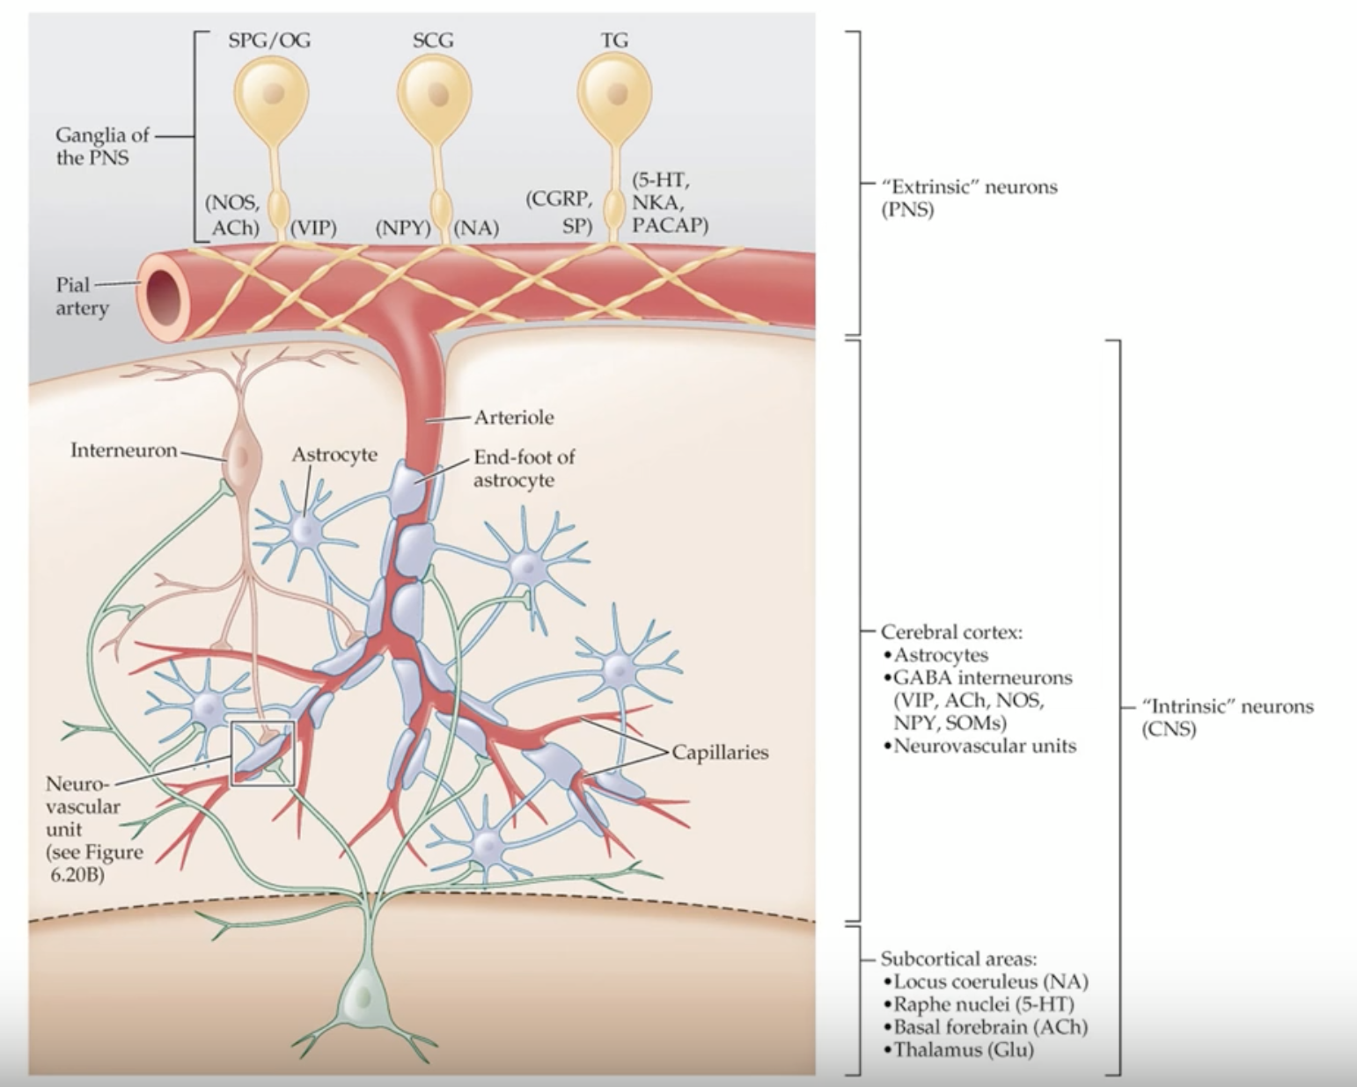
Mechanisms of blood flow control

Slide 25
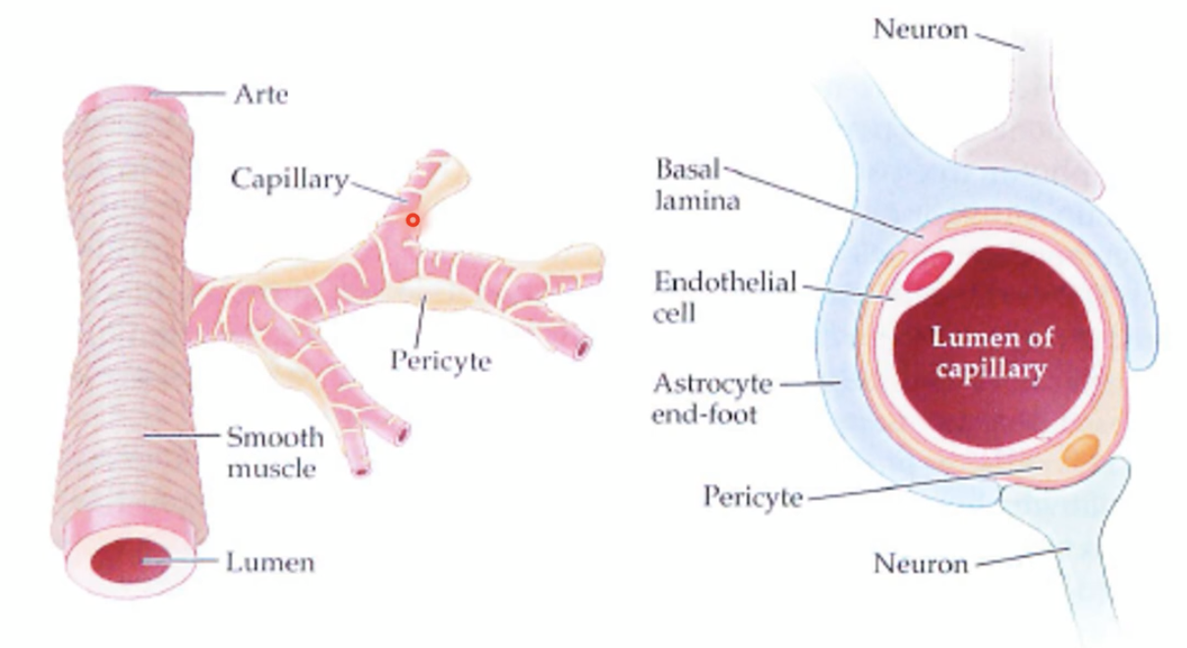
Neurovascular unit
Neurovascular unit = neuron + astrocyte + pericyte and endothelium
Neural activation → Astrocyte Ca²⁺ influx → Vasoactive substance release

Slide 26
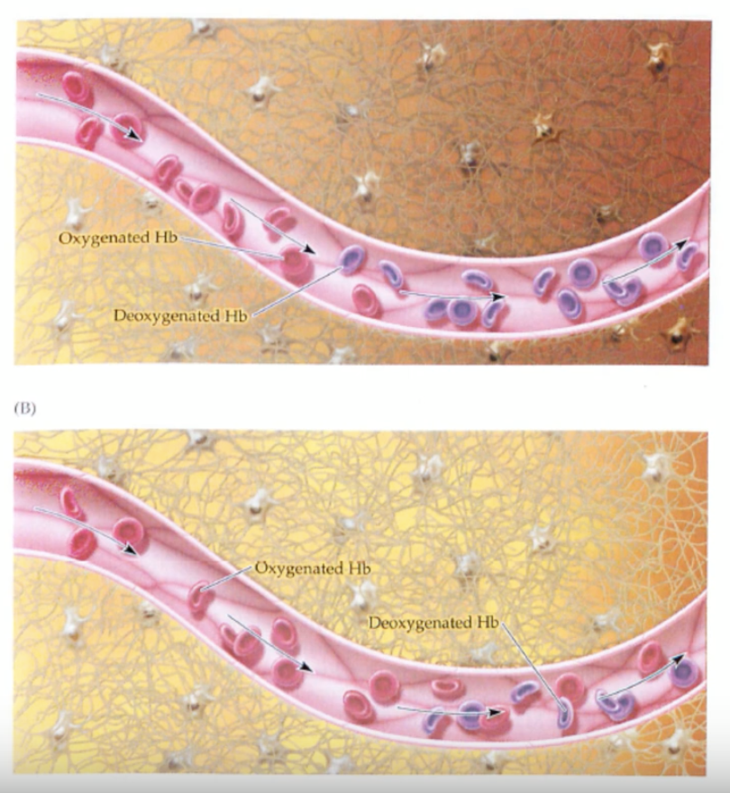
The Haemodynamic Response
Resting state
Oxygenated = Deoxygenated Hb
MR (T2*) Signal loss
Active state
Oxygenated > Deoxygenated Hb
Less MR (T2*) Signal loss

Slide 27
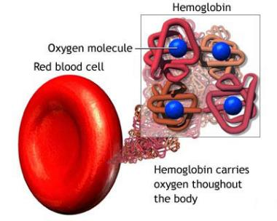
Blood-Oxygen-Level-Dependent signal
Deoxyhaemoglobin (dHb) -> Paramagnetic
Oxyhaemoglobin (Hb) -> Diamagnetic
Notes:
Haemoglobin has two states: deoxygenated and oxygenated
Main molecule in erythrocytes (blood cells)
4 aminoacid chains: 2 alfa and two beta. It has two heme groups which contains iron
Oxygen molecule binding results in a conformational change of the aminoacids
changes position of the heme group which changes the magnetic properties of the molecule
Deoxy —> paramagnetic —> MR signal loss
Oxy —> diamagnetic —> no MR signal loss

Slide 28
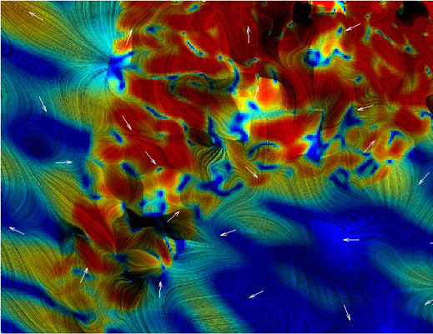
Hemoglobin magnetic properties
DeoxyHb paramagnetic
strong field inhomogeneities
Fast dephasing
Fast T2*
OxyHb diamagnetic
weak field inhomogeneities
Slower dephasing
slower T2*

Slide 29
T2 and T2*
Blood with oxygen
-> slower decay
Blood without oxygen
-> faster decay
Source: www.jcmr-online.com - Figure.
Notes:
Blood oxygenation affects T2 relaxation time but not T1 relaxation time
At resting state, there is roughly the same level of oxygenated and deoxygenated Hb
At active state, there is more oxygenated so there is less MR signal loss. MR signal goes up, because there is less MR signal loss. More Hb
Counterintuitive, but what happens is that the blood flow increases due to functional hyperaemia. However, the cerebral metabolic rate of oxygen doesn’t increase as much. So there’s is an uncoupling of the cerebral flow and the cerebral metabolic rate of oxygen
Help from Maria to link what I have explained with the MRI

Slide 30
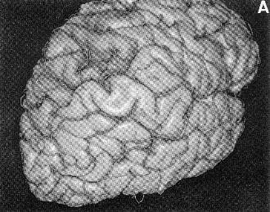
“Brain vs. Vessels”
Large vessels produce BOLD activation further from the true site of activation
Large vessels line the sulci and make it hard to tell which bank of a sulcus the activity arises from
The % signal change in large vessels can be considerably higher than in small vessels (e.g., 10% vs. 2%)
Activation in large vessels occurs up to 3 s later than in small ones(time lag)
Source: Ono et al., 1990, Atlas of the Cerebral Sulci

Slide 31
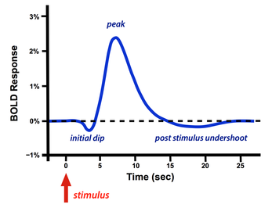
Neurophysiology
Typical haemodynamic response to single short stimulus
Fast response: increase in metabolic consumption
Main BOLD response: increased local blood flow
Post-stimulus undershoot: ballon model or increased metabolic consumption with low blood flow
Notes:
Okay, so this is a typical hemodynamic response to a short stimulus.
Haemodynamic response: homeostatically adjusting its blood flow to deliver nutrients such as oxygen and glucose to stressed tissues and allow them to function
In the first 1-2 seconds you see a fast initial drop in signal intensity- that’s due to the increased use of oxygen by activated neurons, before the blood vessels can respond.
Then, after about 2 seconds you get blood flow change and you get a big signal intensity increase that peaks around 5 or 6 seconds post-stimulus
Eventually that signal fades, as the neurons return to resting and you sometimes see a post-stimulus undershoot, that’s poorly understood.
Balloon model:
This is for a brief stimulation

Slide 32
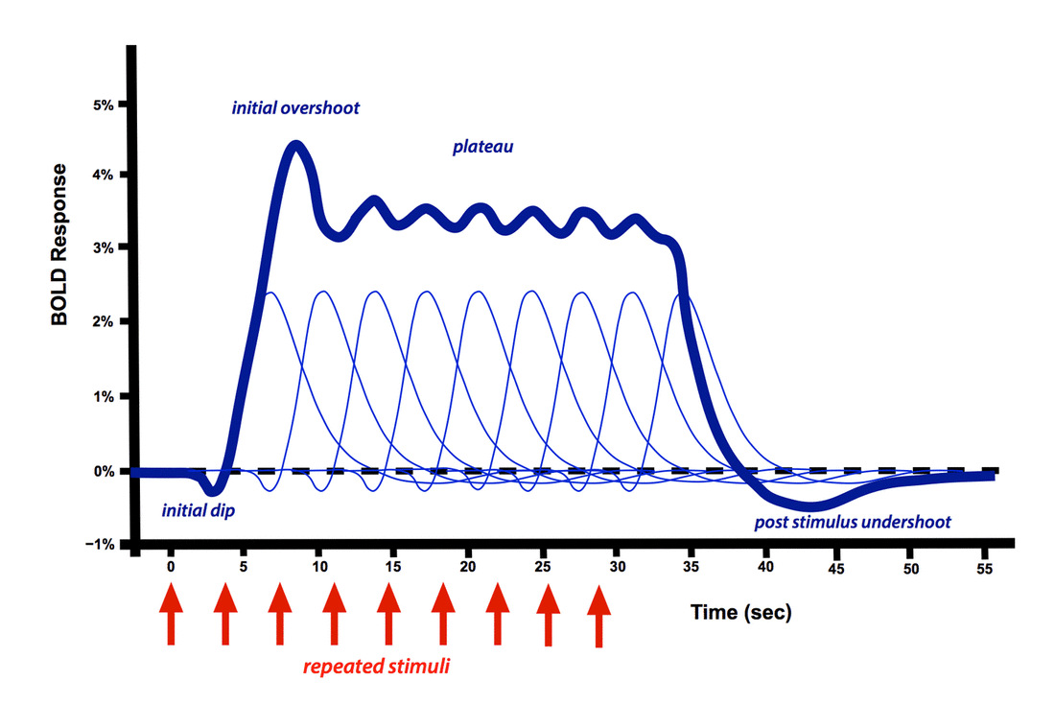
Neurophysiology
Notes:
Repetitive stimulation

Slide 33
Stimulus to BOLD
Source: Arthurs & Boniface, 2002, Trends in Neurosciences

Slide 34
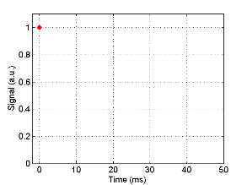
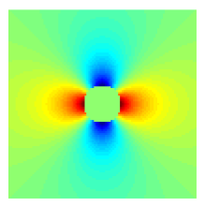
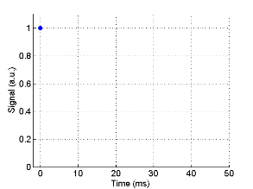
Oxygenated Hb
B₀
voxel
Vessel
Tissue
Deoxygenated Hb
34
Dr. Samira Kazan
Notes:
So let’s look at that in a bit more detail.
The top image is of a hypothetical vessel near inactive neurons, so there’s plenty of oxygenated hemoglobin in it. Now you’ve turned on the MRI scanner and you get this green magnetic field. It’s hard to tell but there are very small differences in the field- if you can see it, it’s a bit yellower in some places- however overall, the field around the blood vessel is very uniform.
The image on the bottom is of a vessel that has lots of deoxyhemoglobin present in it. The color differences represent changes in the strength of the magnetic field because of the presence of dHb.
Now we’ll zoom in on one small voxel in each image. You can clearly see the difference in the magnetic field in the deoxygenated case.
So, with the initial RF pulse, all the protons are lined up and in phase and we have a strong signal.
If we look a few milliseconds later the protons are coming out of phase with each other and the signal is weakening.
And even a few milliseconds later and the signal has decayed much more
Because the magnetic field is so much more inhomogeneous when there is deoxyhemoglobin around the protons come out of phase much faster and the signal decays a lot faster.

Slide 35
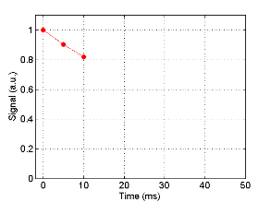
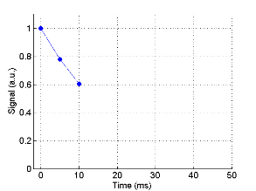
Oxygenated Hb
B₀
voxel
Vessel
Tissue
Deoxygenated Hb
35
Dr. Samira Kazan

Slide 36
Oxygenated Hb
B₀
voxel
Vessel
Tissue
Deoxygenated Hb
36
Dr. Samira Kazan

Slide 37
How does this relate to neural activity?
T2* decay is quicker with dHbO
Brain areas with increased blood flow → there is an increase in HbO (during main signal phase)
Inhomogeneities in the field due to Δ O₂ → Δ signal
M_{xy}
Signal
Take-home message:
BOLD is a T2*-weighted contrast
We are measuring a signal from hydrogen but the signal we get from hydrogen atoms is weaker when less oxygen (Oxyheamoglobin) is present
M_{o} sinθ
T₂* task
T₂* control
S_{task}
S_{control}
ΔS
TE_{optimum}
time
Notes:
More or less deoxyhemoglobin distorts the signal more or less, but we still measure protons and their T2* decay. T2* is just decaying faster or slower depending on how much deoxyhemoglobin is around!
Task: relatively more oxyhaemoglobin; less field inhomogeneity; slower T2* contrast decay; stronger signal Control: relatively more deoxyhaemoglobin; more field inhomogeneity; faster T2* contrast decay; weaker signal

Slide 38
Stimulus to BOLD
What we want to measure but can’t
What we actually measure with fMRI
Source: Arthurs & Boniface, 2002, Trends in Neurosciences

Slide 39
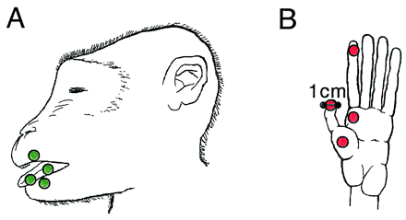
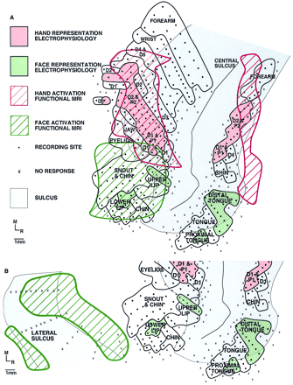
Comparing Electrophysiology and BOLD
Disbrow et al., 2000, PNAS
Notes:
A comparison of the blood oxygenation level-dependent signal and electrophysiology
we have compared cortical maps generated based on the indirect blood oxygenation level-dependent signal of fMRI with maps from microelectrode recording techniques, which directly measure neural activity.
Identical somatosensory stimuli were used in both sets of experiments in the same anesthetized macaque monkeys.
Our results demonstrate that fMRI can be used to determine the topographic organization of cortical fields with 55% concordance to electrophysiological maps.
The variance in the location of fMRI activation was greatest in the plane perpendicular to local vessels.
to map the somatosensory areas located in anterior parietal cortex (4).
This region includes the primary somatosensory area (SI or 3b) and areas 3a, 1 and 2.
We used a simple calibrated reproducible tactile stimulus applied to the hand or the lips and tongue

Slide 40
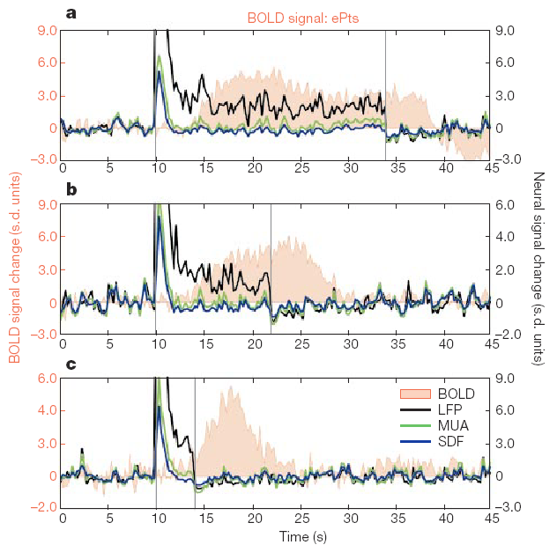
BOLD Correlations
24 s stimulus
Local Field Potentials (LFP)
reflect post-synaptic potentials
Multi-Unit Activity (MUA)
reflects action potentials
Logothetis et al. (2001)
found that BOLD activity is more closely related to LFPs than MUA
12 s stimulus
4 s stimulus
Source: Logothetis et al., 2001, Nature
Notes:
Anaesthetised monkeys. Occipital visual cortex put electrodes
Electrical activity could be recorded, inside a home-made MRI scanner so could measure BOLD response
They presented visual stimuli
for 10 seconds
Recorded raw electrocal signal and BOLD signal, centred around electrode tip
When you do invasive recordings you look at different frequency bands.
Decomposed the signal into multiple unit activity, output of neural population within a couple of hundred microns of the electrode tip
average spiking of small neuronal populations close to the vicinity of the placed microelectrode
Local Field potentials: synchronised dendro-somatic neural input components within mms of the electrode tip. Same what is observed with EEG
LFPs are slowly changing voltages recorded from large populations of brain cells with a much longer time course than depolarization "spikes".
High frequency
MCU spiking output of neural population: high frequency
What of these two signals correlates more with fMRI
Temporal profile that they observed
Different stimulation set-ups
Describe the graphs, essentially LFP and BOLD stay around for longer
Low frequency stuff sticks around
Main contributor is LFP
BOLD activity reflects input processing rather than the spiking output. Similar to what EEG reflects

Slide 41
What does the BOLD signal represent?
Lower tier area
(e.g., thalamus)
gray matter (dendrites, cell bodies
& synapses)
white matter
(axons)
Middle tier area
(e.g., V1, primary visual cortex)
Will BOLD activation from the blue voxel reflects:
output of the black neuron (action potentials)?
excitatory input (green synapses)?
inhibitory input (red synapses)?
inputs from the same layer (which constitute ~80% of synapses)?
feedforward projections (from lower-tier areas)?
feedback projections (from higher-tier areas)?
Higher tier area
(e.g., V2, secondary visual cortex)
…

Slide 42
Advantages of BOLD
High spatial resolution
Non-invasive
Increasing availability
Enables visualising of entire brain areas/networks engaged in specific activities
Notes:
EEG / MEG – Poor spatial localisation, high number of electrodes needed
PET – Invasive and need to use potentially toxic contrast

Slide 43
Disadvantages of BOLD
Indirect-indirect measure of neural activity (T2* weighted decay → blood oxygenation → neural activity)
Measuring Local Field Potential and not Spiking activity
Can’t differentiate between excitation/inhibition and neuromodulation (all need oxygen and glucose)
Signal intensity does not accurately differentiate between:
Different brain regions
Different tasks within the same region
Notes:
Signal intensity does not accurately differentiate between:
Different brain regions
Different tasks within the same region
the fact that haemodynamic responses are sensitive to the size of the activated population, which may change as the sparsity of neural representations varies spatially and temporally
volume transmission (see Supplementary Information)— which probably underlies the altered states of motivation, attention, learning and memory—may dominate haemodynamic responses and make it impossible to deduce the exact role of the area in the task at hand

Slide 44
Thanks!
Any questions?

Slide 45
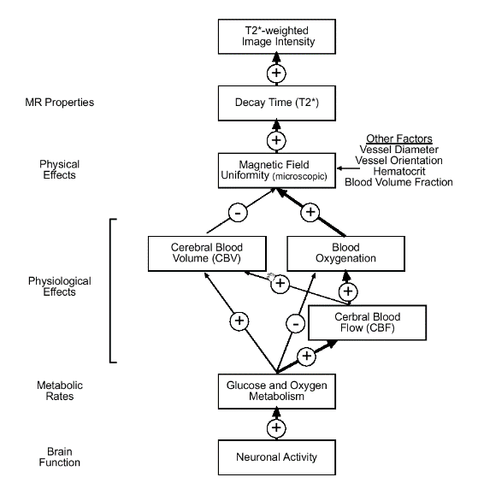
Overview: What are we measuring with BOLD?
the inhomogeneities introduced into the magnetic field of the scanner…
changing ratio of oxygenated:deoxygenated blood...
via their effect on the rates of dephasing of hydrogen nuclei
Notes:
This diagram shows just how far the distance is between neuronal activity, which is what we are trying to measure, and the intensity of the T2* weighted image we record. (Discuss diagram)

Slide 46
Should it be BDLD? Blood DE-oxygenation level-dependent signal?
Technically, “BOLD” is a misnomer
The fMRI signal is dependent on deoxygenation rather than oxygenation per se
The more deoxy-Hb there is the lower the signal
Time
fMRI Signal
Amount of deoxy-Hb

