Slide 1
PREPROCESSING II:
COREGISTRATION, SPATIAL NORMALISATION & SMOOTHING
Baihan Wang
Mathew Kollamkulam
Expert: Prof John Ashburner
Methods for Dummies
2019-2020

Slide 2
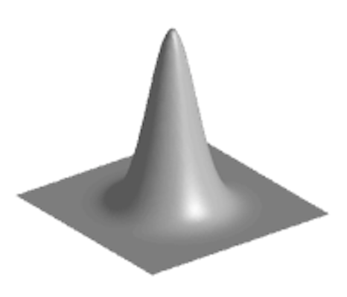
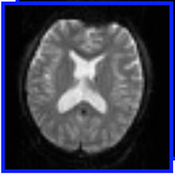
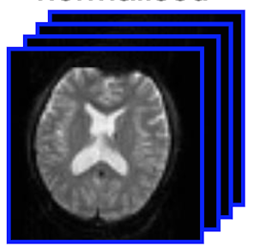
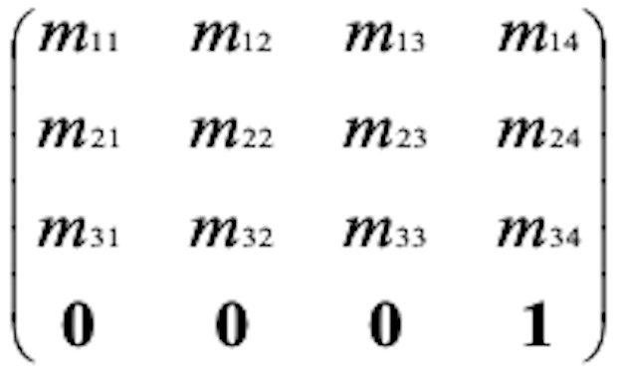
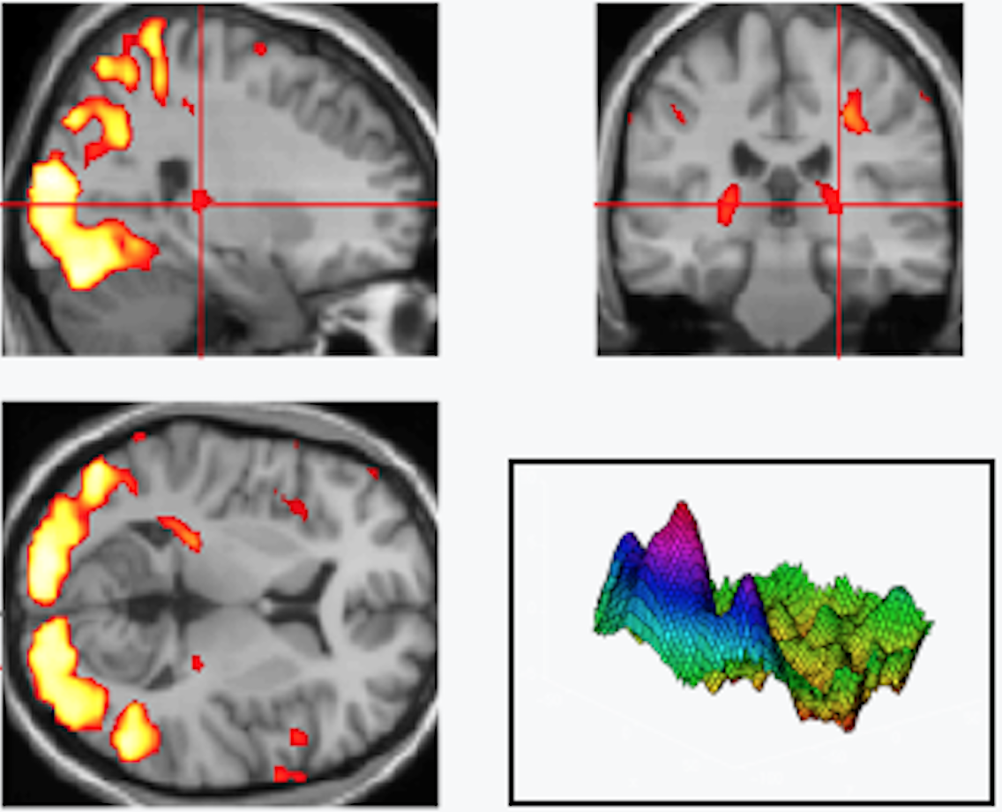
PREPROCESSING
fMRI time-series
Motion correction
= REALIGNMENT
Distortion correction
= UNWARPING
1
6
MNI space
= spatially normalised
SMOOTH
2
Reference volume/image
Moving “
SPATIAL
NORMALISATION
+ Design matrix
+ Parameter estimates
Anatomical MRI
/Structural
5
General Linear
Model
Mean functional
4
STATISTICAL ANALYSIS
3
COREGISTRATION
3’
Segmentation
Transformation
4’
ESTIMATE SPATIAL NORM
TPM
Statistical Parameter Map

Slide 3
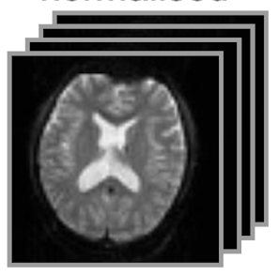
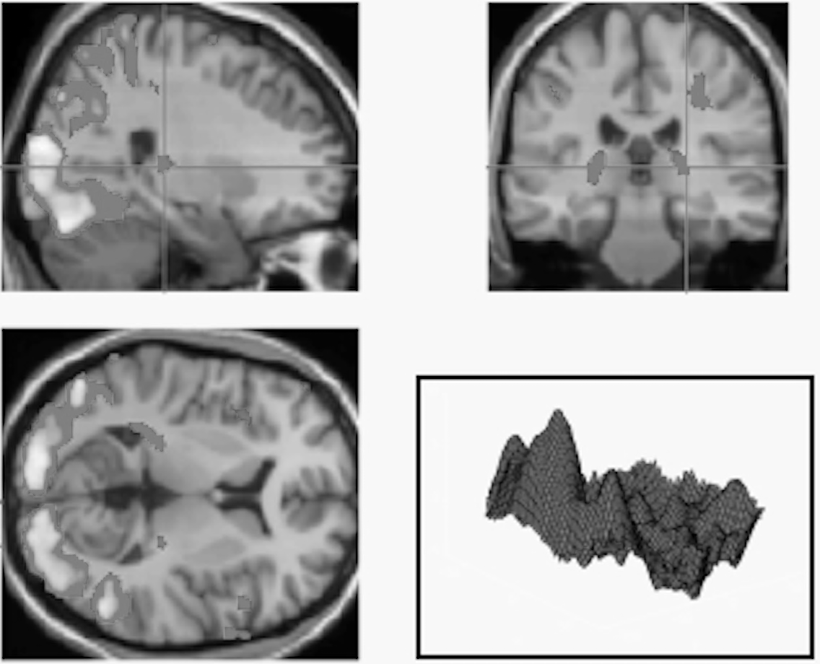
PREPROCESSING
fMRI time-series
5 STAGES of PREPROCESSING
Motion correction
= 1. REALIGNMENT
Distortion correction
= 2. UNWARPING
1
6
MNI space
= spatially normalised
5. SMOOTHING
2
Reference volume/image
Moving “
4. SPATIAL
NORMALISATION
+ Design matrix
+ Parameter estimates
Anatomical MRI
/Structural
5
General Linear
Model
Mean functional
4
STATISTICAL ANALYSIS
3
3. COREGISTRATION
3’
Segmentation
Transformation
4’
ESTIMATE SPATIAL NORM
TPM
Statistical Parameter Map

Slide 4
PREPROCESSING
fMRI time-series
5 STAGES of PREPROCESSING
Motion correction
= 1. REALIGNMENT
Distortion correction
= 2. UNWARPING
1
6
MNI space
= spatially normalised
5. SMOOTHING
2
Reference volume/image
Moving “
4. SPATIAL
NORMALISATION
+ Design matrix
+ Parameter estimates
Anatomical MRI
/Structural
5
General Linear
Model
Mean functional
4
STATISTICAL ANALYSIS
3
3. COREGISTRATION
3’
Segmentation
Transformation
4’
ESTIMATE SPATIAL NORM
TPM
Statistical Parameter Map

Slide 5
Lecture structure:
Recap
Coregistration
Spatial Normalisation
Smoothing
SPM Demo

Slide 6
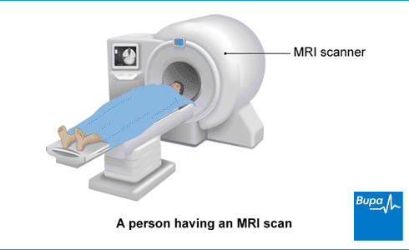
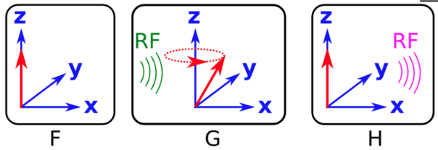
RECAP
MRI Physics | Slice-timing correction | Head Motion Correction | Field Distortion Correction
Notes:
MRI scanner – aligns precessing H protons with B0 in z direction. RF pulse at resonant frequency flips protons to x-y plane; RF pulses ceases, RF signal is released by protons
Loss of transverse magnetisation - T2/T2*; time constant associated with regaining of longitudinal magnetisation – T1
T2* - sensitive to inhomogeneities in magnetic field, such as those created by changing ratios of deoxy and oxy haemoglobin
By changing TR (time between consecutive RF pulses) and TE (time before RF pulses are received), images can be weighted to maximise T1, T2 or T2* contrast

Slide 7
RECAP
MRI Physics | Slice-timing correction | Head Motion Correction | Field Distortion Correction
Almost all fMRI data is collected in slices (an array of voxels)
A scan of the whole brain may include 33 or more slices.
TR (eg: 2.5 seconds) is the time taken to collect all slices and the time difference between the first and the last slice. This can compromise our statistical methods.
SOLUTIONS:
1) Slice-Timing Correction during Preprocessing
- using some form of temporal interpolation, i.e, use the observed values to predict what BOLD response was at the beginning of the TR
OR
2) Slice-Timing Correction during Task-Related Statistical Analysis
TR seconds

Slide 8
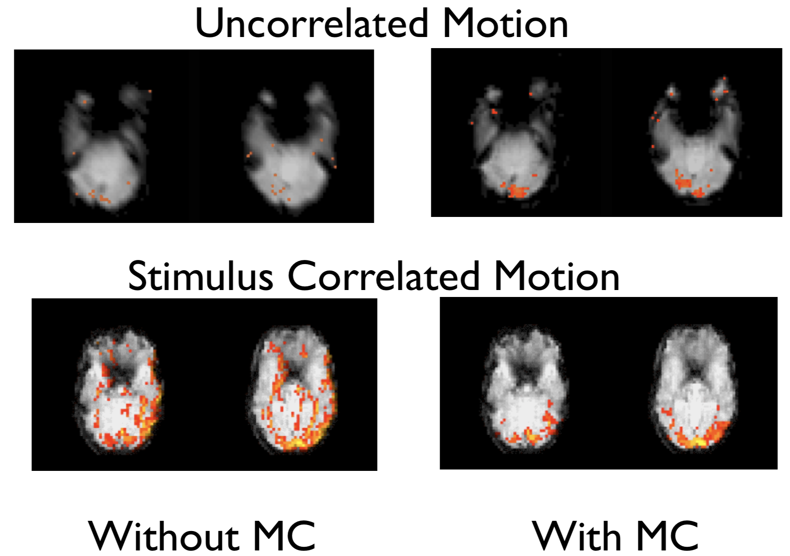
RECAP
MRI Physics | Slice-timing correction | Head Motion Correction | Field Distortion Correction
Small or large motion of the participants head in the scanner due to physiological factors (breathing, blinking, swallowing), fatigue, task/stimulus related motion (pressing a button, speaking etc.).
Even smallest head movements of around 5mm increases activation values in a voxel by a factor of 5 (Huettel et al., 2004).

Slide 9
RECAP
MRI Physics | Slice-timing correction | Head Motion Correction | Field Distortion Correction
SOLUTION:
Registration – done within subjects with reference to a template (first/middle image)
Realigment: LINEAR rigid body transformation preserving shape
Aim: to minimise cost function, i.e, maximise similarity between images
Total 6 DOF ( 3 translations along x, y and z + 3 rotations along the axes)
fct
fct
fct
fct
fct
fMRI
fMRI

Slide 10
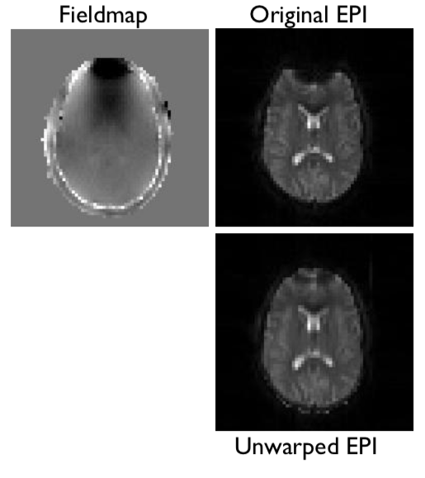
RECAP
MRI Physics | Slice-timing correction | Head Motion Correction | Field Distortion Correction
SOLUTION:
Not a perfectly homogenous magnetic field
Distortions can be caused by the presence of the object, tissues, scanner-related inhomogeneities etc.
Acquire a fieldmap image
Unwarp (non-linear) to correct the fieldmap distortions
No Object in scanner
Object in scanner
This helps further preprocessing steps

Slide 11
COREGISTRATION
Objective | Obstacles | Methods
Coregistration – aligning the structural image (T1 weighted) with the functional images (T2* weighted)
The spatial resolution of functional data is poor, due to the speed-accuracy tradeoff made.
Mean functional
Image
(source)
Anatomical
Image
(reference)
Coregister
Why coregister?
Allows better anatomical localisation – eg: difficult to tell from functional image if a specific task related activation is localised in SMA or pre-SMA (neighbouring regions with different projections)
More precise spatial normalisation

Slide 12
COREGISTRATION
Objective | Obstacles | Methods
Can’t we use rigid body registration we used for head motion correction?
Here, we only need to align 2 images, while head motion correction needed to align all functional images – so it must be easier than head motion correction?
NO!
T1 weighted image
Scan could take 6-10 minutes to complete
Voxel size – around 0.86 mm x 0.86 mm x 0.89 mm
T2* weighted image
Whole brain is scanned every 2-3 seconds (TR)
Voxel size – around 3 mm x 3 mm x 3.5 mm
Notes:
Voxel sizes are different so there is no 1-to-1 correspondence between voxels in the two images
So usual cost function won’t work since there are more voxels in the sMRI image
Also, the contrasts are different (T1 vs T2*) – so we can’t look to maximise similarity as in the cost function for head motion correction

Slide 13
COREGISTRATION
Objective | Obstacles | Methods
1) Landmark identification (eg: anterior commissure)
Difficult to automate
Time-consuming
Lack of consensus among researchers among locations of the same landmark
2) Mutual Information Cost Function
Notes:
First we need to find out how well the images are aligned. This is how… Joint histogram/feature space from mutual information theory allows registration across modalities

Slide 14
COREGISTRATION
Objective | Obstacles | Methods
2) Mutual Information Cost Function
Estimating the intensity of surrounding voxels in functional image to correspond to structural voxels using interpolation (eg: nearest neighbour, linear, B-spline interpolation)
Higher Mutual Information (MI) -> greater association between the variables, here, alignment between the images
Notes:
Registration is assumed to correspond to maximizing mutual information: the images have to be aligned in such a manner that the amount of information they contain about each other is maximal.
Maximizing mutual information is related to minimizing joint entropy. In the figure above, the joint histogram of two images' gray values disperses with misregistration and that joint entropy is a measure of dispersion.

Slide 15
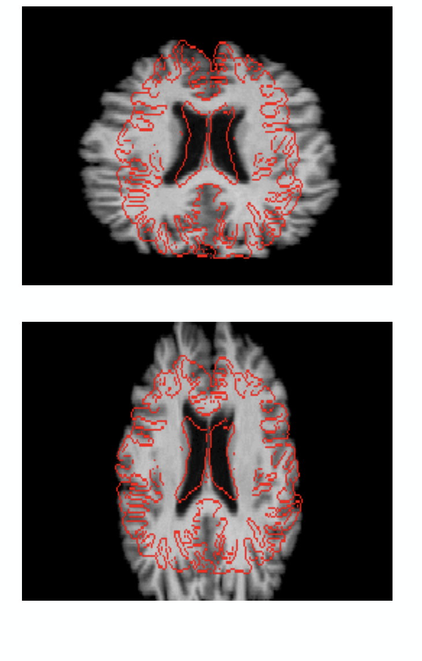
COREGISTRATION
Objective | Obstacles | Methods
Generally, affine transformations are used in coregistration to maximise mutual information
Upto 12 DOF (translation, rotation, shearing/skewing and scaling/zooming along the each of the 3 axes)
Notes:
Then, we need to maximise this alignment by performing some spatial transformations

Slide 16
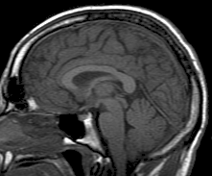
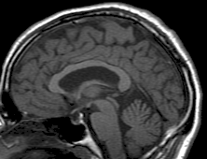
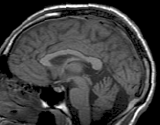
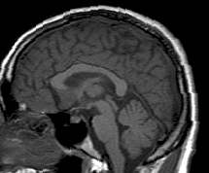
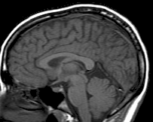
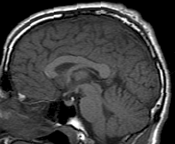
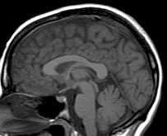
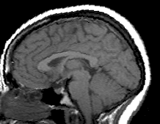
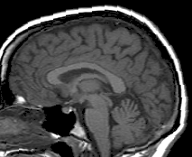
SPATIAL NORMALISATION
Objective
Methods
Huge variability in sizes and shapes of brains make it difficult to attribute activation in a particular region to a specific anatomic structure.
Normalisation – registering our image to the structural scan of a standard brain, i.e, we are spatially transforming our data into a common space for analysis.
Advantages:
Allows us to compare between subjects and groups
Improves statistical power
Generalisability
Across study comparisons

Slide 17
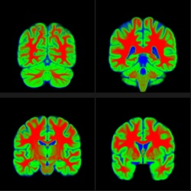
SPATIAL NORMALISATION
Objective
Methods
Talaraich atlas (Talaraich & Tournoux, 1988)
Montreal Neurological Institute (MNI) template
Used by SPM!
Notes:
Talaraich atlas – based entirely on the detailed dissection of one hemisphere of the brain of a 60-year old French woman – (0,0,0) = midpoint of AC
The atlas is a look-up table with major brain areas and their (x,y,z) coordinates
MNI template was created by averaging the results of high-resolution scans from 152 different brains – the coordinate system was constructed to match the Talairach system (same axes and coordinates)

Slide 18
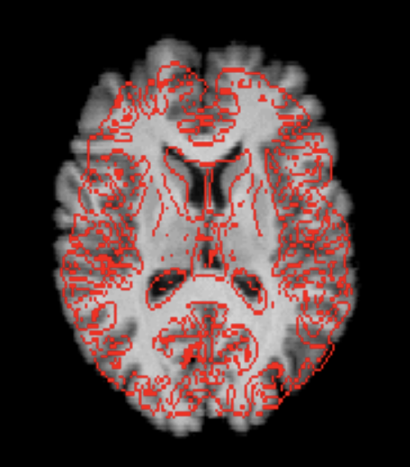
SPATIAL NORMALISATION
Objective
Methods
Normalisation is more complex than coregistration and head motion correction due to the differences in size and shape of individual brains.
Therefore linear (affine transformations) are used first and then non-linear transformations (warping etc.) for spatial normalisation. Regularisation is used in SPM to prevent unreasonable warping.
Non-linear - More than 12 DOF
Affine - 12 DOF
Notes:
All complex transformations result in having to interpolate the intensity values of the newly defined voxels created by the transformation
Regularisation (applied in SPM) limites excessive use of warping – it adds a penalty on more complex warps.

Slide 19
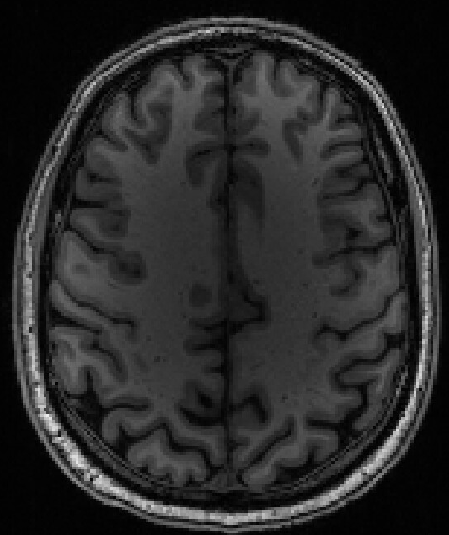
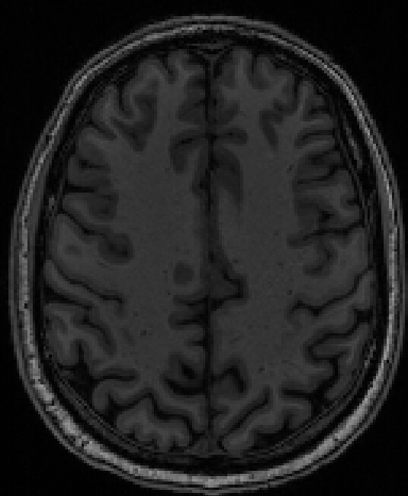
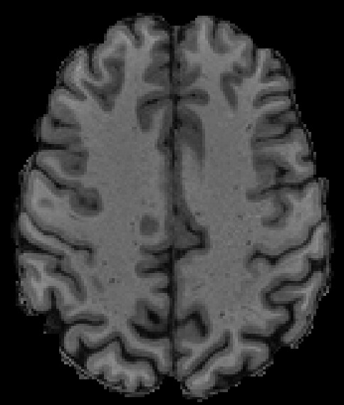
SPATIAL NORMALISATION
Objective
Methods
A few preprocessing steps are usually done before normalisation:
Bias field correction
2) Brain extraction
Original
Bias
Corrected
Brain extracted
Notes:
Bias field correction – image at higher field strengths (3T and above) often show broad variations in intensity (due to inhomogeneities) that are pronounced in high resolution T1 weighted images. This can be corrected by applying a high-pass filter or more complex methods of combining this with tissue segmentation (SPM)
Brain extraction is done as a part of tissue segmentation in SPM

Slide 20
SPATIAL NORMALISATION
Objective
Methods
3) Tissue segmentation
Obstacles:
Noisy – intensity values of white and gray matter may overlap though mean intensity is different
Partial volume effect – many voxels contain a mixture of tissues
Scanner inhomogeneities (bias field)
SOLUTION:
Unified Segmentation Approach (Ashbuner & Friston, 2005) applied in SPM
- Combines spatial normalisation and bias field correction with tissue segmentation so that the probability that a given voxel contains a certain tissue type (GM, WM, CSF) can be determined using a probabilistic atlas of tissue types.
- Normalising segmented tissue maps to a template much easier than a matching image to template
Notes:
Tissue segmentation (separating GM, WM and CSF) facilitates the normalisation process
Based on Unified Segmentation approach, two voxels with identical intensities may be classified as different tissue types (eg: if one is in a location that is strongly expected to be gray matter and the other white matter).
So the approach looks at both intensity and prior spatial knowledge to make the normalisation process easier to solve!

Slide 21
COREGISTRATION & SPATIAL NORMALISATION
SUMMARY
Coregistration – aligning structural and functional images using linear affine transformations
It permits superior anatomical localisation and easier spatial normalisation
Due to differences in structural and functional images, we need to use other measures such as mutual information to align the images
Spatial normalisation – registering our data to standard space to allow between subjects comparison and anatomical localisation of activation
Atlases such as Talairach and MRI templates are used as the standard space
Registration requires both linear and non-linear transformations due to variations in shape and size
Tissue segmentation makes normalisation easier – the Unified Segmentation approach combines spatial normalisation and bias field correction with tissue segmentation

Slide 22
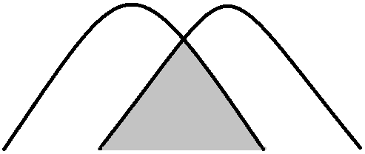
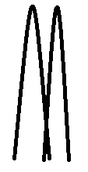
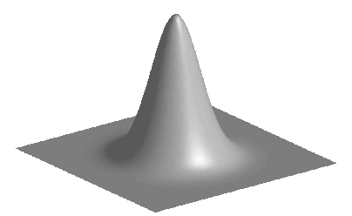
SMOOTHING
Objective | Methods | Disadvantages
To Blur over residual anatomical differences and registration errors by applying a kernel
Why?
Suppresses noise
signal reinforced and noise averaged out
Superior special overlap
Data becomes more normally distributed
VS

Slide 23
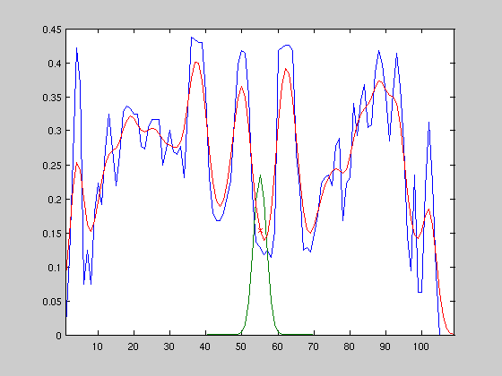
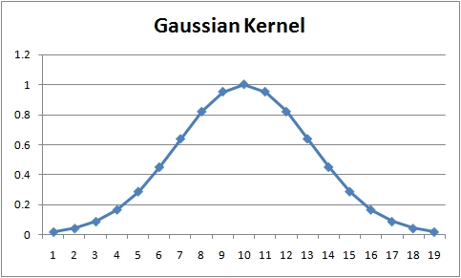
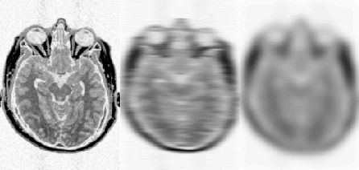
SMOOTHING
Objective | Methods | Disadvantages
Weighted averaging of neighbouring voxels
→ Each voxel replaced by the weighted average of itself and its neighbours

Slide 24
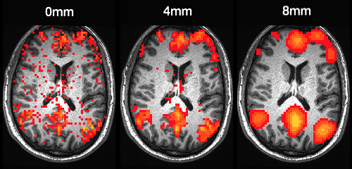
SMOOTHING
Objective | Methods | Disadvantages
Reduction of spatial resolution of the data
Edge Artifacts
Extinction
Mislocalization of activation peaks

Slide 25
SMOOTHING
Objective | Methods | Disadvantages
Reduction of spatial resolution of the data
Edge Artifacts
Extinction
Mislocalization of activation peaks

Slide 26
SMOOTHING
Keep in mind
Multiple data adjustments are made during fMRI analysis, and these alter the raw data considerably
→ Therefore, large sample sizes and appropriate statistical analyses are required for reliable and robust inferences

Slide 27
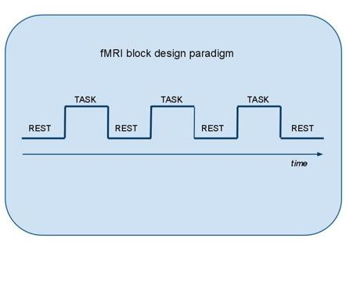
SPM DEMO
Task | Coregistration | Segmentation | Normalisation | Smoothing
Auditory fMRI data
Single subject
TR = 7
16 42s blocks
Blocks alternated between rest and auditory stimulation

Slide 28
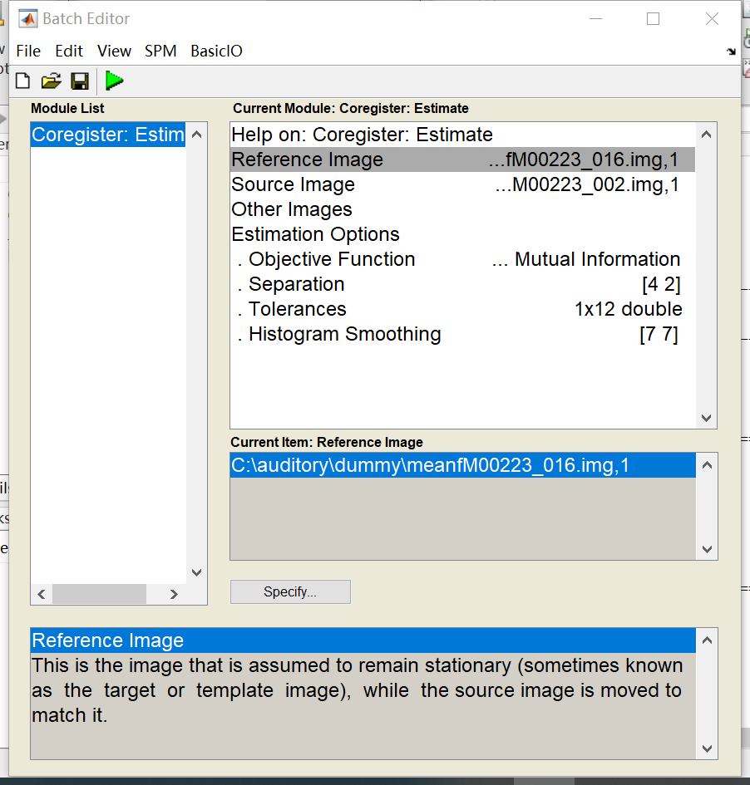
SPM DEMO
Task | Coregistration | Segmentation | Normalisation | Smoothing
Notes:
Coregister: Estimate
Reference image: mean functional image after realignment
Source image: structural image

Slide 29
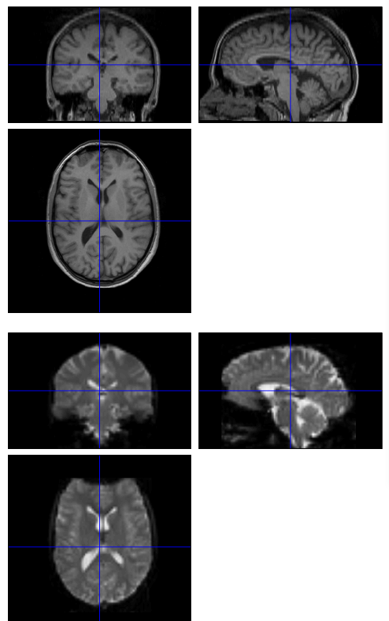
SPM DEMO
Task | Coregistration | Segmentation | Normalisation | Smoothing
Notes:
Check reg
Select the mean functional image and the structural image

Slide 30
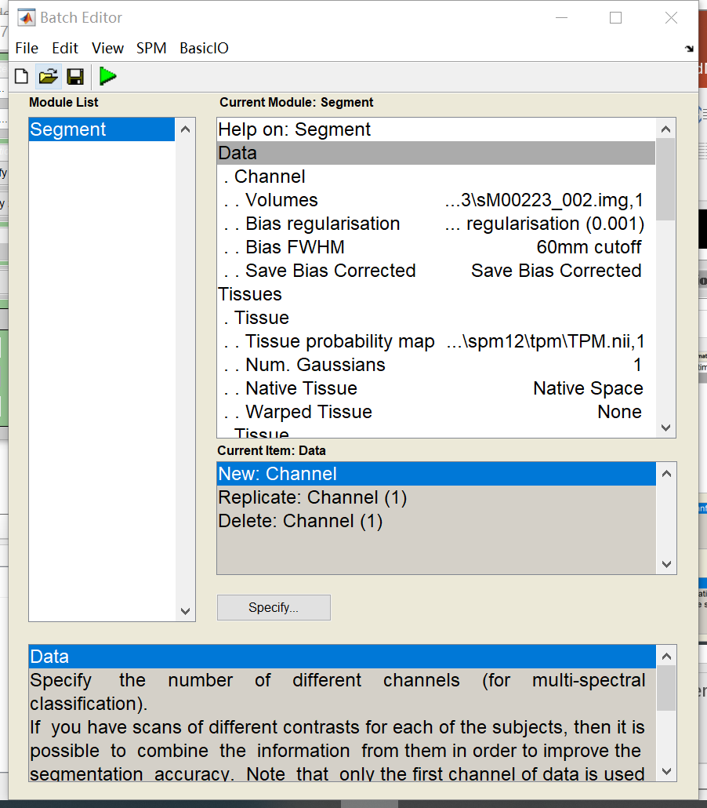
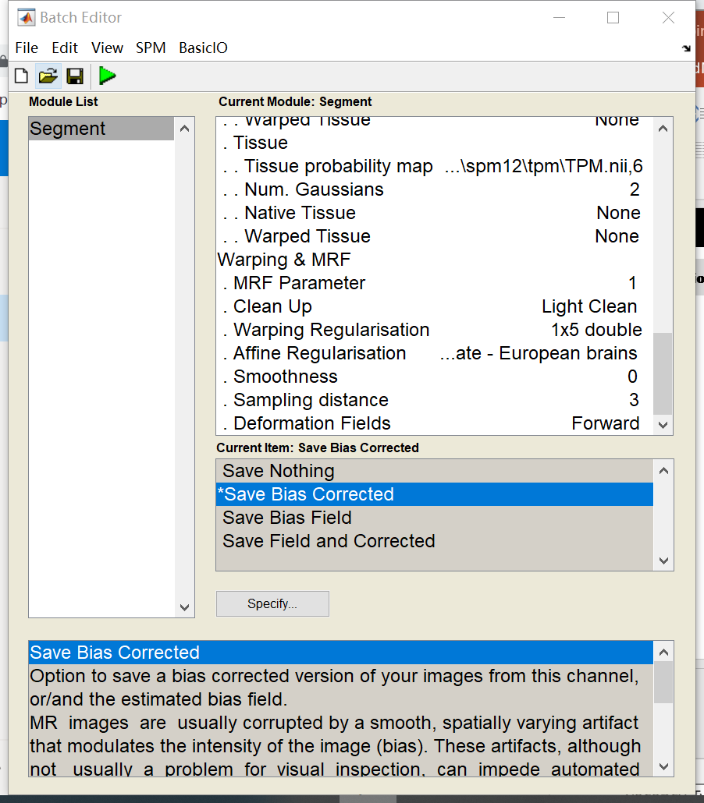
SPM DEMO
Task | Coregistration | Segmentation | Normalisation | Smoothing
Notes:
Volumes: registered structural image
Save bias corrected: save bias corrected (bias artifact due to the physics of MR scanning)
Deformation fields: forward

Slide 31
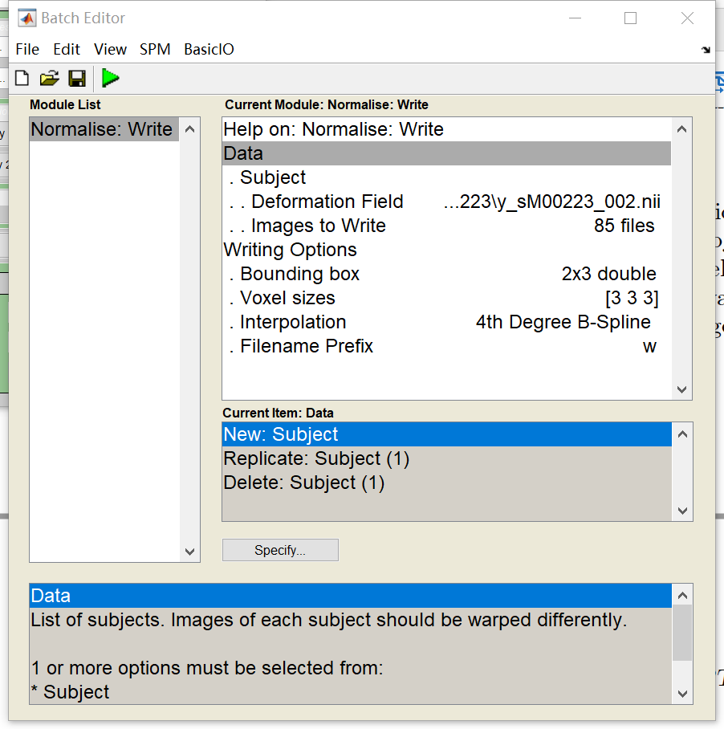
SPM DEMO
Task | Coregistration | Segmentation | Normalisation | Smoothing
Notes:
Deformation field: generated from last step
Images to write: all functional images
Voxel sizes: change according to the scanner

Slide 32
SPM DEMO
Task | Coregistration | Segmentation | Normalisation | Smoothing
Notes:
Deformation field: generated from last step
Images to write: all functional images
Voxel sizes: change according to the scanner

Slide 33
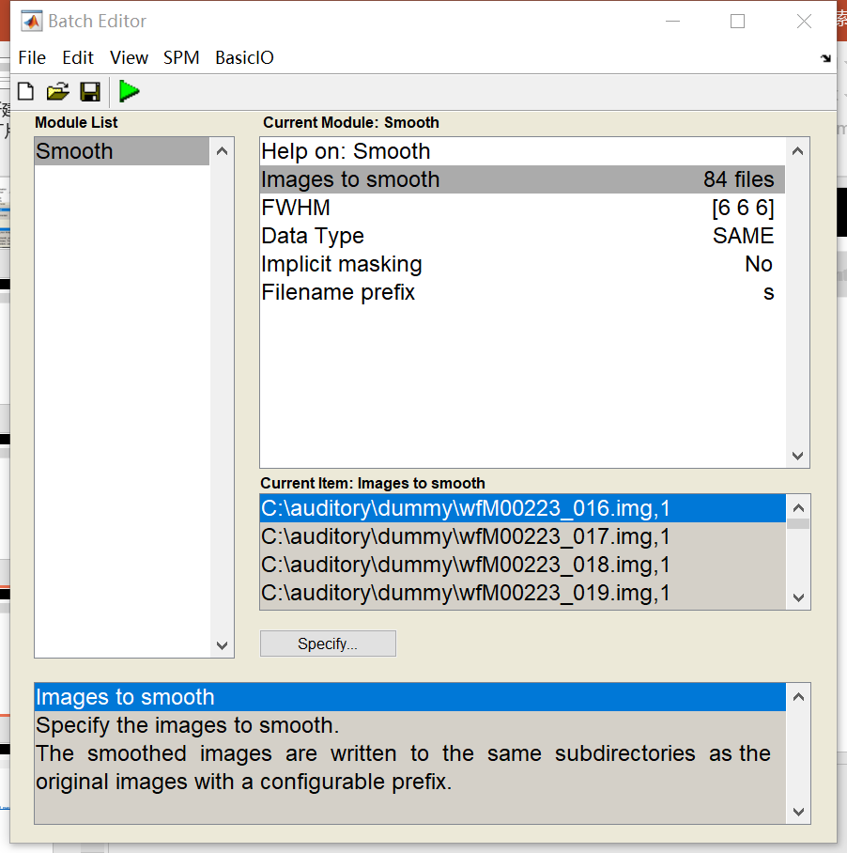
SPM DEMO
Task | Coregistration | Segmentation | Normalisation | Smoothing
Notes:
Images to smooth: all functional images from last step
FWHM: change to 666 (1-3 times the voxel size)

Slide 34
COREGISTRATION, NORMALISATION & SMOOTHING
References & further reading
Slides from previous years of the MfD course
(http://www.fil.ion.ucl.ac.uk/mfd/)
Ashby, G. (2011). Statistical analysis of fMRI data. The MIT Press.
Poldark, R., Mumford, J., Nichols, T. (2011). Handbook of Functional MRI Data Analysis. Cambridge University Press.
Andy’s Brain blog
(https://www.andysbrainblog.com/)
SPM12 Manual
(https://www.fil.ion.ucl.ac.uk/spm/doc/spm12_manual.pdfhttps://www.fil.ion.ucl.ac.uk/spm/doc/spm12_manual.pdf)

Slide 35
THANK YOU!
Methods for Dummies
2019-2020
Notes:
Sean & Laura, John Ashburner, Dollyane

