Slide 1
1st Level Analysis:
Design Matrix, GLM, Contrasts & InferencE
Emily Thomas & Joao Santos

Slide 2
Overview
Introduction
GLM
Design Matrix
Contrasts
Inference
Methodology
Notes:
I’m going to be talking about how to fit General Linear Models to our data and use this to form design matrices for analyses.

Slide 3



Spatial filter
Design matrix
Statistical Parametric Map
Realignment
Smoothing
General Linear Model
Statistical
Inference
RFT
Normalisation
Anatomical
reference
p <0.05
Parameter estimates
Notes:
The previous two presentations have already covered the pre-processing steps we need to let SPM carry out on our data, to put all our images into the same anatomical space.
This presentation covers the next step. We are now beginning our statistical analysis of the data. This step is looking at how data in our different experimental conditions can predict the fMRI data. Reflects a linear combination of multiple variables encoded with a design matrix. All of this is based on the General Linear Model, which estimates parameters voxel by voxel.

Slide 4



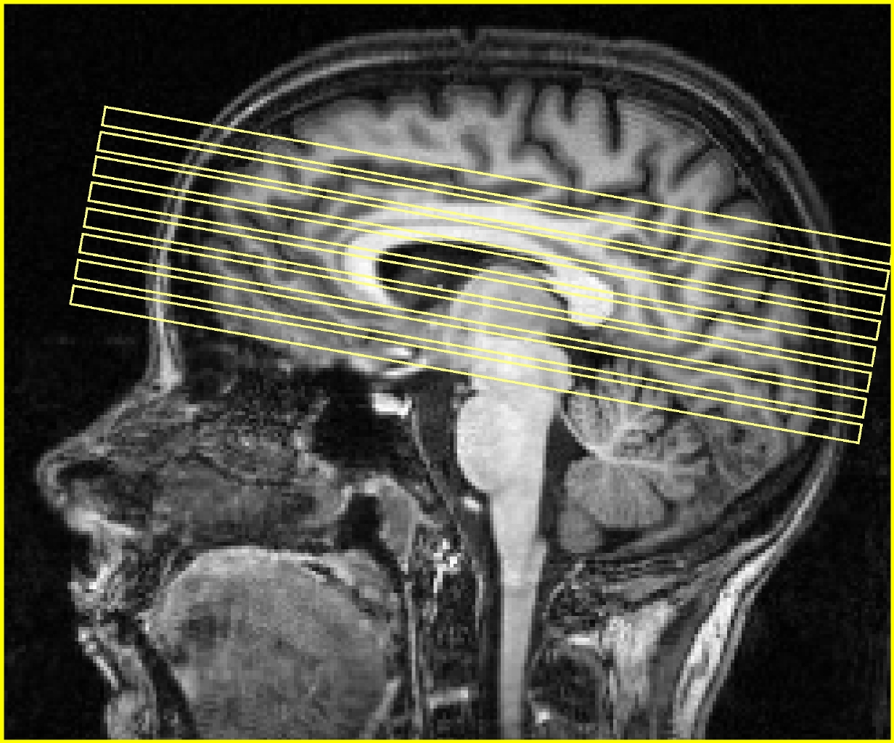
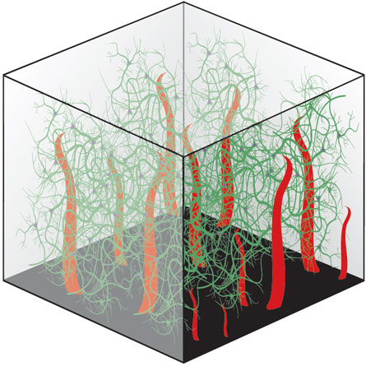
Our data
Subject A
Subject B
…
Session 1
Session 2
…
…
…
Volume
…
Slice
…
1st level analysis: within-subject analysis
analysing the time course of the fMRI signal for every single subject separately
Voxel
…
Notes:
In SPM, we analyse data from multiple subjects in two stages. For each subject, we have collected data in sessions (aka scanning periods). For each session, we collect several 3D volumes of brain regions, organized in slices, which again consist of many voxels.
First, we do a within-subject analysis. So typically, we will have to do as many first-level analyses as we have participants, thus every analysis is run independently for each voxel in each subject. What we want from this step are contrast images (more about this later) for every single subject.
Thus at this level (1st level) all we can conclude is that if the exact same person does the same task we would expect to see the same activity.

Slide 5
Our data
Subject A
Subject B
…
Session 1
Session 2
…
…
…
Volume
…
2nd level analysis: group level analysis
Slice
…
Voxel
…
Notes:
We could use these images individually as case studies, but usually we are interested in some sort of aggregate measure between participants, in order to make inferences about the population from which our participants were drawn. This is what we do in a second step. Our second-level analysis is a between-subject, or group-level analysis. This will be covered next week
Later on we will make inferences on the population with a between subject analysis.

Slide 6
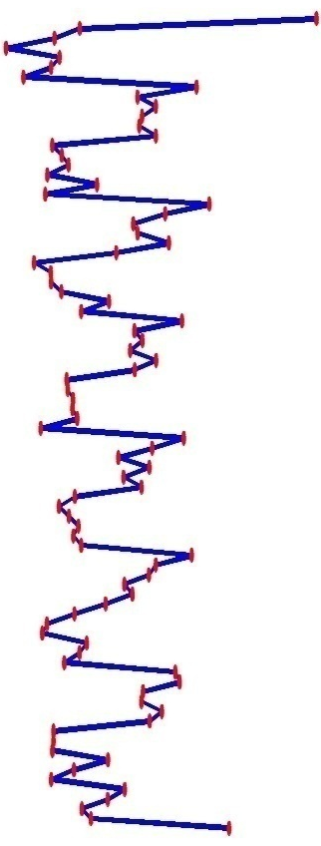
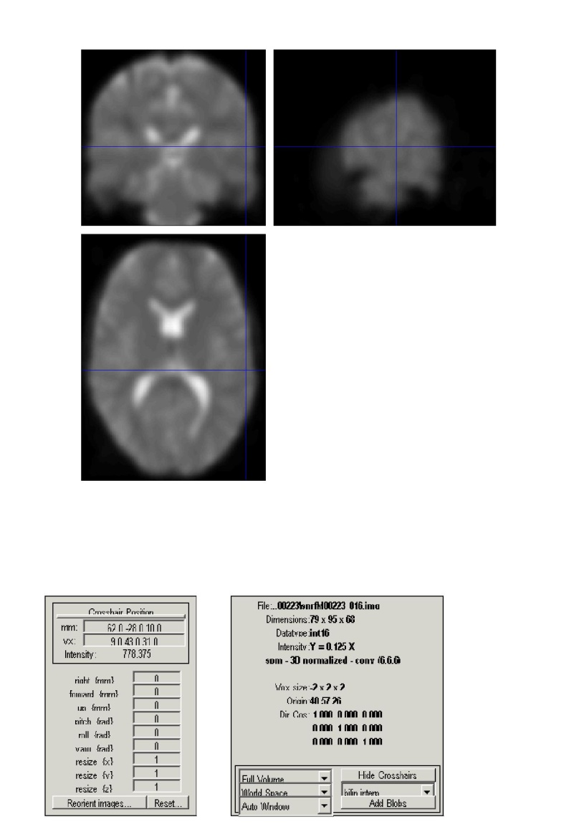
What are we looking at? Voxel-wise time series
Pre-processing made sure voxel locations are consistent over time
Our data is represented as a time-series for each voxel capturing changes in the BOLD signal, tracked over the duration of our experiment.
Time
Time
BOLD signal
Notes:
Pre-processing made sure that the each voxel is consistent over time by putting them in the same anatomical space. So for each voxel we now have a time-series of the changes in BOLD signal throughout the experiment. 1 time series = for 1 voxel.
We want to model the time series so that we can make an inference (later on) about the effect of interests, by testing hypothesis on this particular voxel. The effects we’re interested in, + noise or errors that are not fit by the model

Slide 7
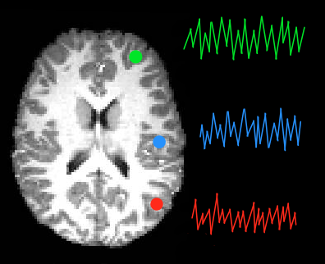
Modelling the data statistically
Mass univariate approach: using the same
statistical analysis on every single voxel
We are looking at the relationship between:
Y = dependent variable (BOLD signal)
X = regressor (experimental manipulation/condition)
Do this using a General Linear Model…
Notes:
First we want to model the data before we can make any inferences about it. SPM deals with this data using a mass-univariate statistical approach. All this means is that the statistical steps we use are the same for each and every voxel. So this data for the whole brain is our Y or dependent variable. For each voxel, we want to see whether our experimental manipulation e.g. condition (expressed as a regressor called X) has an effect on this brain activity, using a GLM.
The data we put into SPM is a single time-series on a voxel, which we want to transform into a single statistical value. SPM does this simultaneously at all of our voxels. The result we will get is a Statistical Parametric Map, with one of these statistics for each voxel.

Slide 8

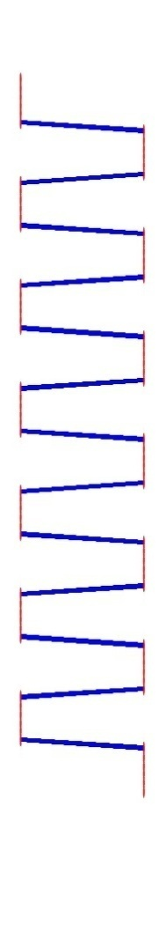
The General Linear Model
x
parameter
error (noise)
Time
defines the contribution of X to the value of Y - slope of our regression line
proportion of variance
in our data (Y) which is not explained by regressor/s (X)
BOLD signal
regressor
observed data – time course for a particular voxel
Mean signal over time for particular voxel
component of model which explains observed data to some degree
Notes:
We are trying to find a good way of PREDICTING the dependent variable (the fMRI signal), using everything we know about our own experimental manipulation and more general things that affect such a signal. Thus, this model simply tries to fit a line that describes the relationship between the dependent variable Y and the predictor variable, or regressor, X. If you remember that X is the experimental manipulation or condition we are using to predict the fMRI data (Y), in this example we have a boxcar function which represents a block design for example where a stimulus goes on and off. As mentioned before, we will fit this model to each voxel independently.
Y = this is the fMRI time course in a particular voxel, i.e. the intensity value of our voxel for a single scan/observation.
C = The intercept is a constant, and in our case, it is the mean level of fMRI signal over time, and across all conditions, for our particular voxel.
X = The regressor is a component of our model which explains the observed data Y to some degree.
B = The regressor comes with an associated parameter beta, which defines the contribution/weighting of X to the value of Y. As seen before, it can be viewed as the slope of our regression line
The GLM expresses the dependent variable Y in terms of a linear combination of some regressors X plus a well-defined error term. We want this linear combination of regressors to be able to explain all possible responses to our experiment, up to the level of error. The error is noise in the data, which explains some additional variance in our observed data, but has not been controlled by us in our experiment.
The result of our model is calculation the Beta parameters.

Slide 9
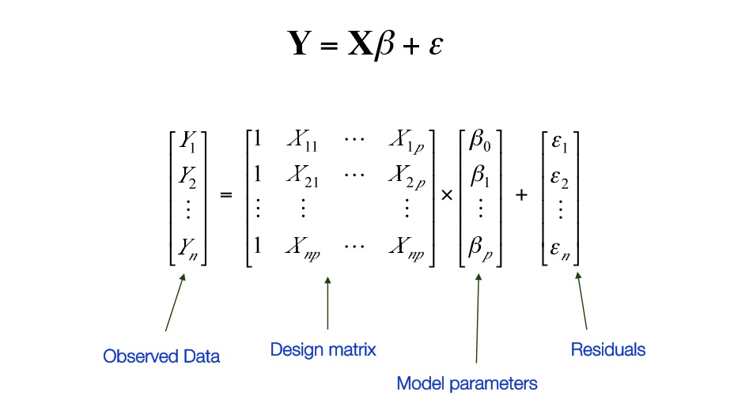
Mass univariate approach
Constant
Regressors
Design Matrix (X)
Notes:
Remember that we want to model each and every voxel using the mass univariate approach. What we would then get in a similar way to the previous equation is rows and rows of these equations, one for each time point e.g. scans over time for the same voxel. So really our model contains matrices, of these equations. We can save ourselves from having to look at this horrible mess of equations by simply rewriting all of this as a simple, matrix model at the top, where:
Y stands for a matrix of BOLD signals for a single voxel. (AKA from our data files that we feed into SPM)
Our constant or intercept is simply the mean level of fMRI signal over time across all of our conditions. In SPM, this constant is included as a regressor automatically, so it is not shown in this equation explicitly.
All our regressors X makes up the so-called design matrix. We know this too (expected time course of reactions to our experimental conditions).
What we do not know:
The exact error in our model
The values of our parameters for each regressor. Luckily, SPM will estimate them for us.

Slide 10
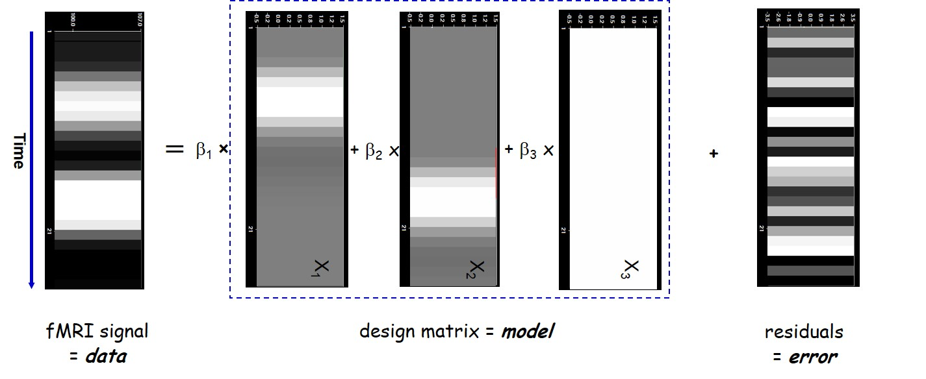
What is the Design Matrix?
It embodies all available knowledge about experimentally controlled factors and potential contributions to the data
Notes:
The Design Matrix is a neat graphical representation of your experimental design. It embodies all available knowledge about experimentally controlled factors and potential confounds.
Here we have 2 regressors which each predict activity at different points in time (the white proportion) as well as a constant (all white – mean signal) and an error term which could represent any other factors not accounted for by our conditions (noise) which shows very varied activation. You can see how our two regressors might be able to predict the actual fMRI signal.

Slide 11

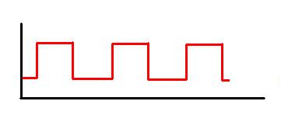

Design Matrix in spm
Modelling the condition:
Regressor
Constant
Stimulus “on”
Stimulus “off”
=
Modelling the constant:
Notes:
We want SPM to know which bits of fMRI signal are associated with which condition. We can represent our experimental condition with this kind of boxcar function modelling when the stimulus is “on” or “off” as I showed before.
SPM visualises our Design Matrix as a grey-scale table where each row represents an observation, and each column represents a regressor. Take a simple block design, with a condition of listening to words, with periods of rest in between. The regressor column here is the column that codes for the listening condition. SPM visually codes for whether the condition is “on” or “off” by assigning a colour value (white vs. black). The white column is how SPM codes for our constant regressor, the mean BOLD signal level over time.
We are modelling the listening condition as a so-called boxcar function. In this function, the line goes “up” (i.e. where the condition is on) and “down” again (where the condition is off) in neat jumps. The constant is the mean signal over time, while the condition model shows where the signal deviates from the mean.

Slide 12
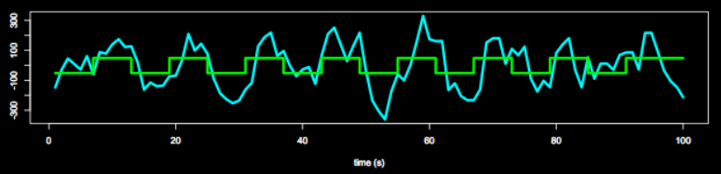
The problem with our data
The BOLD response has a delayed and dispersed shape
So the box-car function used to model our data in previous steps won’t fit the actual data very well
Notes:
We have tried to model our data with a simple box-car function, where the signal simply reacts (it is either on of off) to a condition. The actual haemodynamic response function (HRF), however, doesn’t quite work like this.

Slide 13
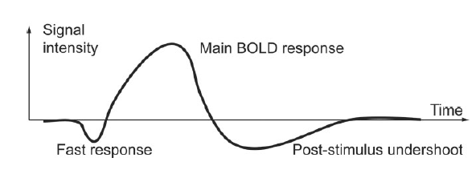
Problem 1 - HRF
Neural activity (delta function) elicits a delayed and dispersed BOLD signal change which looks like this:
Peaks 4-6s post stimulus
Goes back to baseline after 20-30s
So we need to adjust our box-car function for this!
Haemodynamic response function (HRF)
Notes:
As discussed in a previous lecture in fMRI we acquire a correlate of a neural activity – blood oxygenation levels. So if we see a spike in the neuronal response, what we measure is the release of oxygen to the neurons, the BOLD signal.
Haemodynamic response function = changes in the fMRI signal triggered by neuronal activity. It peaks at 4-6s post-stimulus, and goes back to baseline after 20-30s. So, as we have seen in a previous presentation, BOLD responses are delayed and dispersed (blurred). We need to adjust our model for this.
If all trials were of the same duration however, and that duration were below ~2s, then they can be effectively modelled as events (i.e, delta functions with zero duration). This is because, after convolution with the IR, a difference in the duration of a trial causes a difference in the scaling of the predicted response, but has little effect on its shape. Since it is the scaling of the predicted response that is being estimated in the statistical models discussed above, changing the duration of all trials simply changes the size of the resulting parameter estimates, with little effect on the statistical inferences.

Slide 14
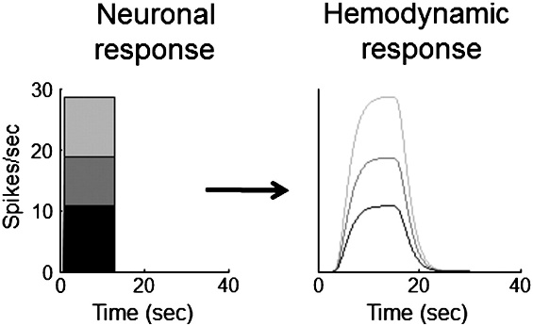
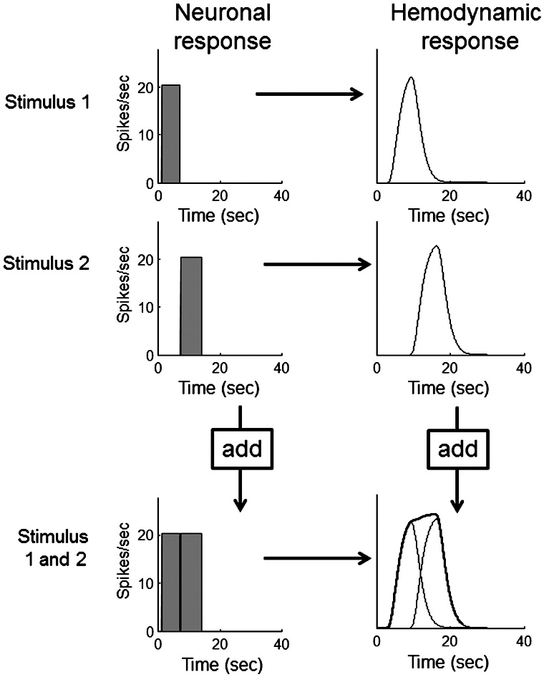
Solution – HRF convolution
We can convolve a neural input function with HRF using a LTI system in three steps:
Scaling
Linear time-invariant (LTI) system:
u(t)
hrf(t)
x(t)
Additivity
Scaling means that the time-course of the output directly scales with the strength of the input.
Additivity is that the sum of inputs is equal to the sum of the hemodynamic responses.
Shift invariance is a shifted in time hemodynamic response by the delay between the two inputs.
Shift
invariance
Boynton et al, NeuroImage, 2012.
Notes:
We can model this using the HRF (If you mix your input function with the HRF, you can derive the expected BOLD response). We take into account by convolving the input function with the Hemondynamic response function and we can do that because this function is linear time-invariant and it does this by 3 steps: scales with the neuronal response, its additive meaning that two stimulation in time will lead to a reponse which is the sum of the two responses and it is shift invariant so a stimuli presented at later stage shift the response accordingly
Scaling
For a system operating in the time domain, scaling means that the time-course of the output directly scales with the strength of the input. If this system shows scaling, then when the input is scaled the shape of the output will always remain the same except that it is scaled by the same factor.
Additivity
The property of additivity states that given two inputs, the response to the sum of the inputs is equal to the sum of the responses to each of the inputs alone.
For the hemodynamic response, the additivity property is best illustrated for two neuronal responses that follow closely in time. If they fall within a few seconds of each other, the output hemodynamic response to the first input will still be ongoing when the hemodynamic response to the second input begins. The additivity principal says that this second hemodynamic response should simply add to the first response, without interacting in any way.
Shift Invariance
The additional property of shift invariance is also assumed in the linear transform model. Shift invariance means that the hemodynamic response to a later input neuronal response should look just like the response to an earlier, identical input, but shifted in time by the delay between the two inputs.
When a linear relationship is assumed between the stimulus onset and BOLD response such that if I present a stimulus every 2 seconds you would observe a BOLD signal every 2 seconds, then you can convolve the box car function to look more like a BOLD response. It is not linear if a second stimuli is presented too close to the first one, as likely influences the activity of the first. = Linear time-invariant system

Slide 15
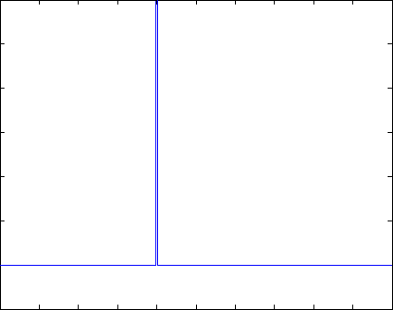
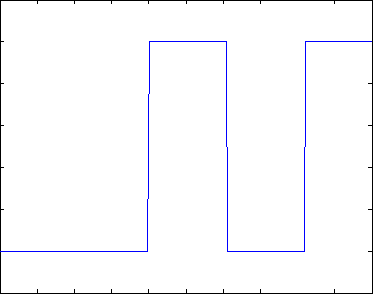
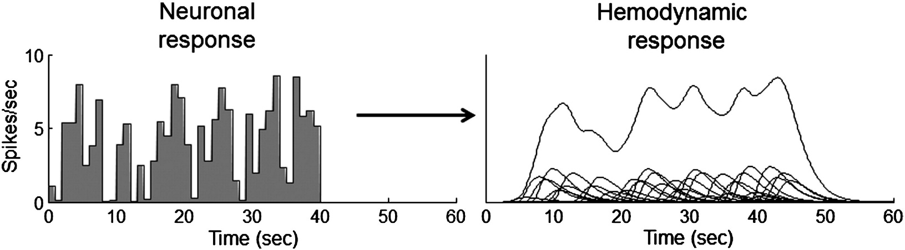
Solution – HRF convolution
Notes:
In the animation = the blue singular line is reflecting one event (stimulus onset) and the green line here is the predicted HRF, therefore when you merge the two you get the red solution which is the convolution.
On the bottom line we can see how actual neural response may be convolved into a HRF as here the sum of the HRFs on the bottom (of right figure) is taken to form the convolution of the higher line.

Slide 16
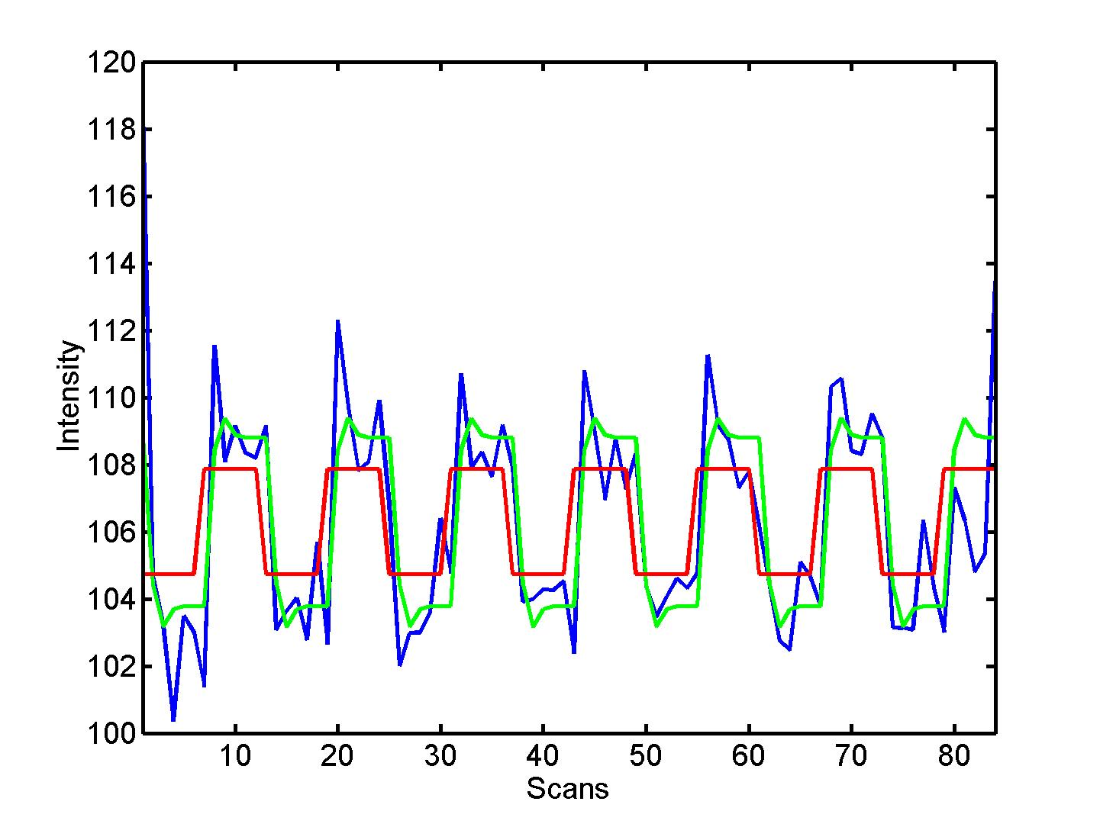


Solution – convolution in SPM
Original design matrix
Convolved design matrix
⊗ HRF
Notes:
Here is an example of a design matrix now convolved to match a HRF more closely. This is done by SPM. Now we get something that better shape our response. There is a slight delay, and also not completely flat which reflects some noise. This is more representative of the actual signal that is being recorded (i.e. Improve your model). On the right you can see the neuronal activity in blue and in red what would be predicted from a simple boxcar style model, but these two merged creates the green convolved function which accounts more closely for the shape of the HRF.

Slide 17
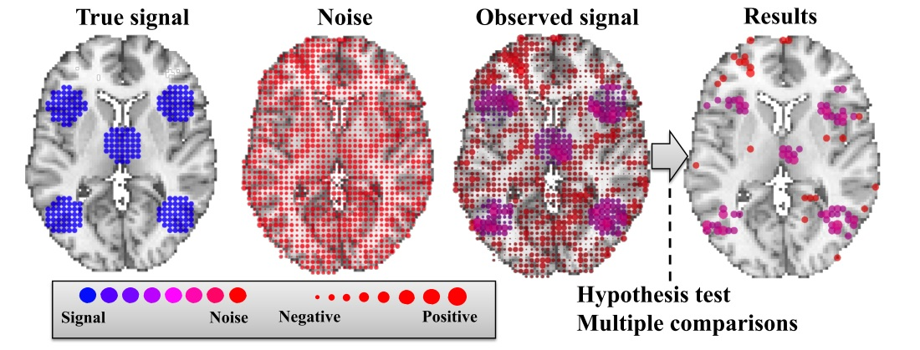
Problem 2 – Low frequency noise
Many types of noise in data e.g. due to physical things like scanner heating up, artefacts, physiological noise like heart beat or breathing
The noise is not identically distributed or independent, and may affect some frequencies more than others
HRFs are therefore relatively weak amongst all the noise
Notes:
The signal that we are measuring from the brain is notoriously noisy! So while you are collecting your data, you are not only capturing task-related activation, but also some other things from physical sources to do with the scanner itself (If the scanner warms up a little bit, some drift in intensity of signal over time – nothing to do with the brain but with the equipment), or physiological sources from the subject (like heart beat or breathing), or residual movement effects.
As we have heard in the previous two presentations, much of this kind of noise can also be “factored out” in pre-processing steps. However, some of still remains.
We want to get through all the noise, to the true signal. Signal changes in the haemodynamic response function (HRF) can be very small, so it may be difficult to detect our desired signal against the background noise when we’re averaging over all frequencies.

Slide 18

Solution 1 – Noise regressors
Include nuisance regressors (e.g. motion) in Design Matrix to explain additional variance and reduce noise of model
Regressors can be any hypothesised contributors in experiment
Time
  Regressors of interest = intentionally manipulated
  Regressors of no interest = not manipulated, potential confound – e.g. head movement (6 regressors)
Regressors
Notes:
So what do we do with the remaining noise?
We can add regressors to our model that capture the expected signal associated with the noise, e.g. particular regressors to deal with motion artefacts, to explain some additional variance in our data, because the model doesn’t know how movement might happen over time for example.

Slide 19
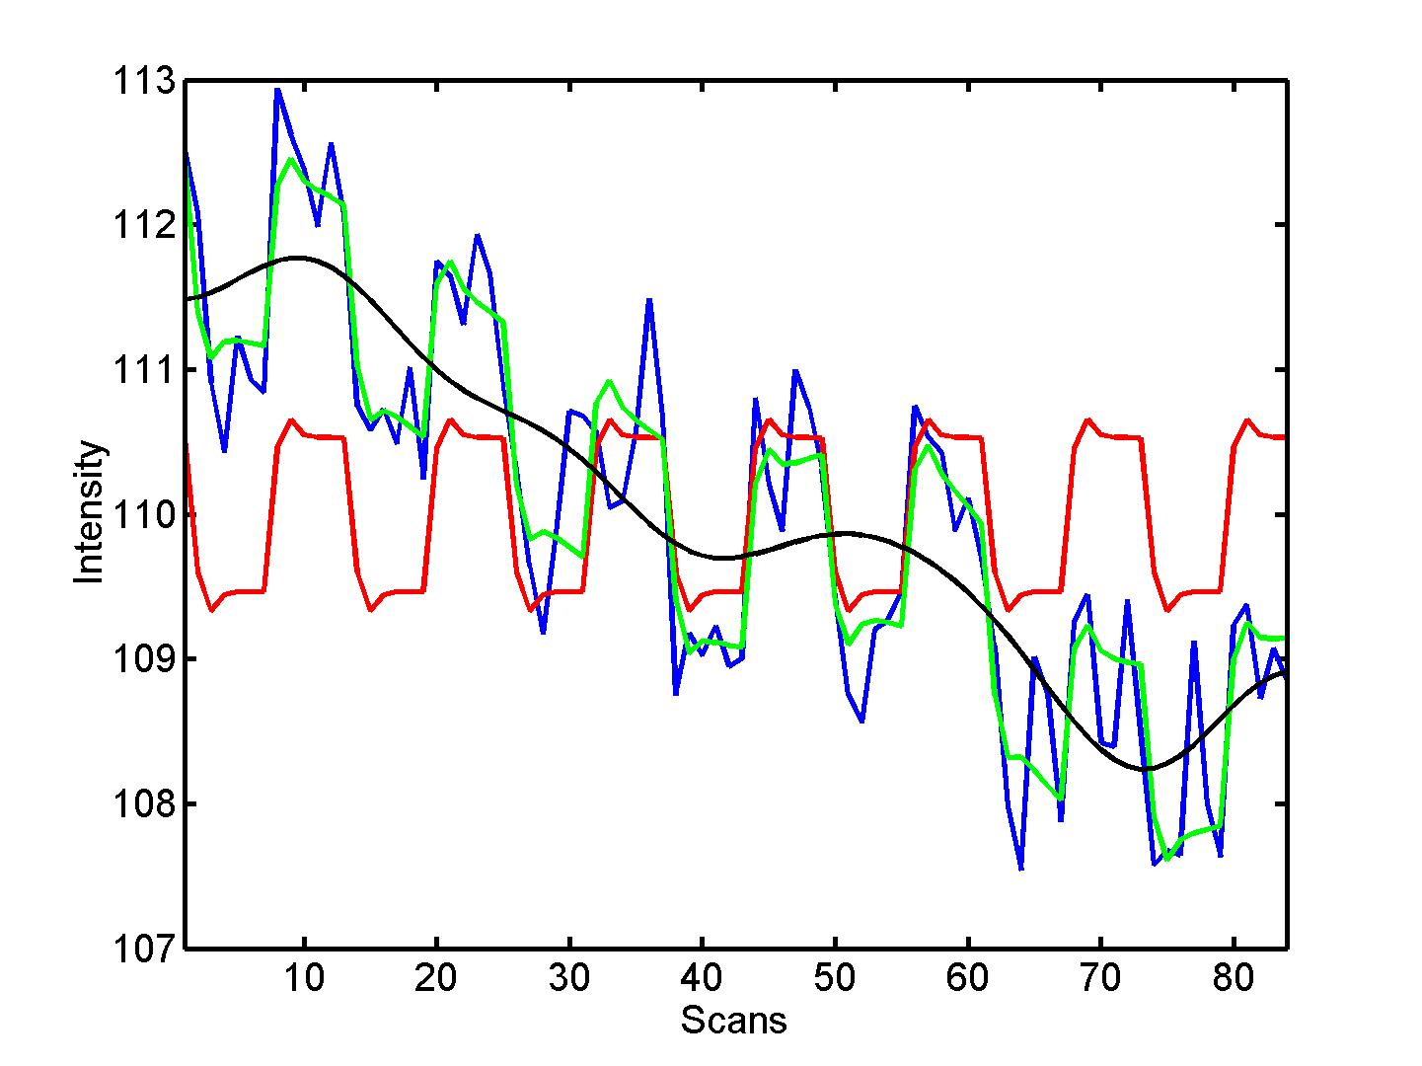
Solution 2 – Low frequency filter
High-pass filter to filter out low frequencies
Over time slow signal
drift in voxel
intensity e.g. due to
scanner heating
(black)
SPM default: filters
out signals longer
than 128s long
blue = data
black = mean signal + low-frequency drift
red = predicted response, NOT taking into account low-frequency drift
green = predicted response, taking into account low-frequency drift
Notes:
We can also apply a high-pass filter to try and get to the true signal (increasing the signal: noise ratio).. Over time, there may be slow changes in voxel intensity, not to do with our experiment, but with the scanner itself (when it heats up over time). It is bad for us because experimental conditions could be confused with simple scanner drift. We need to deal with drift in pre-processing steps, but also during our analysis.
In SPM, we can select a high-pass filter to deal with this type of noise that disproportionately affects low-frequencies. Because we assume that most of the lower frequencies in our signal are due to noise (scanner drift), we can filter them out. In SPM the default high-pass filter is set at 128s, which filters out signals which last for longer than 128 seconds, which should be okay for many experimental designs.
(Because we cannot distinguish signal from noise on the basis of this frequencies criterion alone, we need to be okay with losing some of our signal-of-interest when we apply a filter!)
Maybe need to change the HPF if the trial lengths are too long.

Slide 20
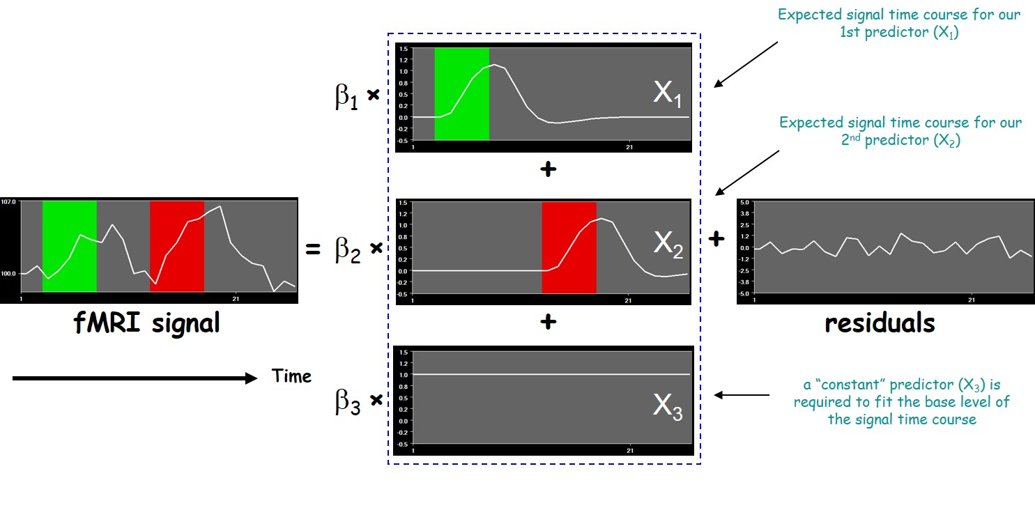
Summary of our model
(experimental condition regressor)
(nuisance regressors)
Our design matrix includes all available knowledge about experimentally controlled factors and potential confounds that may affect our data
Notes:
In summary, we want to include in our model:
Expected time course for our experimental conditions (called X1 here)
Expected time course for any potential confounds (X2)
Time course for a constant (X3), i.e. the mean level of fMRI signal over time
We specify our conditions and additional regressors in the design matrix, which should include everything we know about our conditions and confounds that may additionally affect our data.

Slide 21
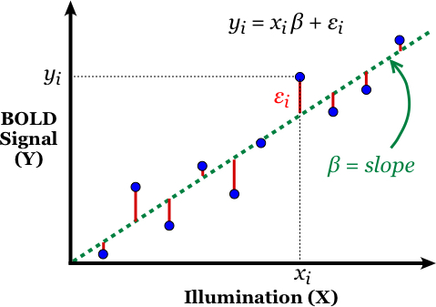
Parameter estimation – method of least squares
Once the design matrix is specified, SPM calculates the parameters (β) for each regressor by minimizing the Sum of Squared Errors (SSE)
Remember is still just for 1 voxel, so data on the graph represents different observations in the time-series
The beta value for a specific voxel is the “slope” of the model fit and reflects the relationship between regressor X1 and the BOLD signal Y
Regressor (X1)
Notes:
Once we have specified our design matrix, SPM estimates our parameters, or slopes, such that our estimated slope best fits, or describes, the relationship between our regressors X and the observed data Y. The good thing is that our model for one voxel will fit the whole time-series (but with different parameter values for each voxel). This is the mass-univariate approach.
In order to estimate the parameters, we use the method of ordinary least squares. This means that we are estimating parameter values that will minimise the sum of squared errors (so the sum of the squared differences between the actual value and the predicted value).
And now we are ready to test our hypotheses!

Slide 22
Overview
Introduction
Design Matrix
GLM
Contrast
Inference
Methodology

Slide 23
Spatial filter
Design matrix
Statistical Parametric Map
Realignment
Smoothing
General Linear Model
Statistical
Inference
RFT
Normalisation
Anatomical
reference
p <0.05
Parameter estimates
Notes:
We have created our design matrix based on experimental conditions and additional noise regressors and estimates parameters. Now is time to run some statistical tests and we can use these to make inferences about how well our regressors predict the fMRI data.

Slide 24

Statistical inference: Contrasts
WHAT:
We want to know if there is a significant activation in a particular voxel due to our experiment conditions
  Evaluating whether the experimental manipulation caused a significant change in the parameter weights
HOW:
We use contrasts
  Specify effects of interest
  Perform statistical evaluation of hypothesis
Contrasts and their interpretation depend on the model specification and design of the experiment
Notes:
Once we have the model we want to see if there is any significant activation in a particular brain region/voxel due to our experimental conditions. Asking this question means asking if any of parameter weights of interest we calculated with our model justify the signal changes.
In order to do that we use contrasts. So in general contrast specify effect of interest by weighting our parameters and selecting regressors of interest. Our inference will be performed on a linear combination of regression coefficeints (beta) c^{T}β. Where c represents the contrast vector we are using to determine which conditions we want to compare/test.

Slide 25
T Contrasts
C is a contrast vector = length no. of regressors
E.g. c^{T} = [1 0 0 0 0 …]
Linear combination:
c^{T} β = 1 (β1) + 0 (β2) + 0 (β3) + 0 (β4) + 0 (β5) + . . .
Contrast is a statistical assessment of c^{T} β
Is β1 > 0? In other words, is there a significant effect for our experimental condition?
c^{T} = [1 0 0 0 0 0 0 0 0]
Time
Convolved regressor (experimental condition)
Constant
Noise regressors e.g. Movement parameters
Regressors
Notes:
Here is the design matrix again. We can see that we have the regressor modelling our experimental condition (aka box car model), the constant and some other noise related/movement regressors. We need to specify which regressors we want to contrast aka run tests on.
We have the on and off regressor modelling our experimental factors and we are interested if it affects the signal in all the voxel significantly more than chance.
So our question is if b1 > 0? We can specify that in the contrast vector by placing a 1 in this position and a 0 for every other regressor we are not interested in.
In doing this we are adding weights to the paramaters by using a contrast vector.
This is relevant for the block related design.
Ct = c transposed

Slide 26
Hypothesis Testing
To test an hypothesis, we construct “test statistics”.
Null Hypothesis H₀
We want to disprove → Accept the Hypothesis H_{a}
Test Statistic T
The test statistic summarises evidence about H0.
Typically, test statistic is small in magnitude when the hypothesis H0 is true and large when the contrary
We need to know the distribution of T under the null hypothesis.
Null Distribution of T
Notes:
How do we build a test statistics?
We have to test against a null hypothesis, which is what we want to disprove. In this case assuming that there is no effect, and having a very small p value that can discard it.
We have already done some assumptions on our errors to we know what a null hypothesys distribution should look like.
If there is no effect we assume that the value of T is very small, not exactly zero, but just explained by the variability represented under the null hypothesis

Slide 27
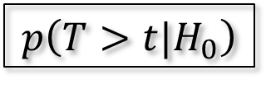
Hypothesis Testing
Significance level α:
Acceptable false positive rate α
⇨ threshold u_{α}
Threshold u_{α} controls the false positive rate
u_{α}
α
Conclusion about the hypothesis:
We reject the null hypothesis in favour of the alternative hypothesis if t > u_{α}
Null Distribution of T
t
p-value:
A p-value summarises evidence against H₀.
This is the chance of observing value more extreme than t
under the null hypothesis.
p-value
$$p\left(T>t|H_{0}\right)$$
Null Distribution of T
Notes:
We accept a risk of accepting the false positive. Claiming an effect where there is not. To recap the risk is represented by alpha which is the probability of observing a value which is bigger than the threshold given the null hypothesis.
If we get a T which is bigger or alternative a p value that is smaller we can reject the null hypothesis, and so we can accept our hypothesis.

Slide 28
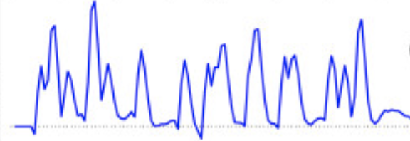
T statistics
Question:
box-car amplitude > 0 ?
=
b₁ = c^{T}b> 0 ?
c^{T} = [1 0 0 0 0 0 0 0 0]
Null hypothesis:
H₀: c^{T}β = 0
contrast of
estimated
parameters
Test statistic:
T =
variance
estimate
Regressors
Notes:
T test is doing a signal to noise measure, meaning that we divide the estimated paramaters by the standard deviation or the variance. The variation is composed by the estimated variance of the residuals and then something that depends on the model, the design matrix and the weight just chosen.

Slide 29
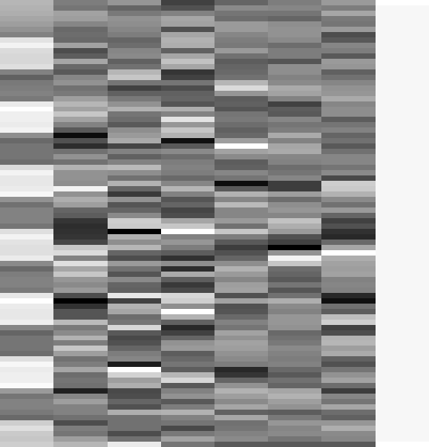
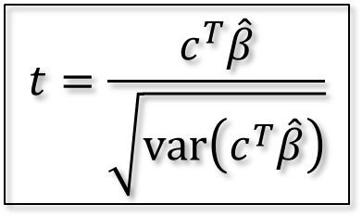
T-test: simple example
Passive word listening versus rest
Q: activation during listening ?
c^{T} = [ 1 0 0 0 0 0 0 0]
1
Null hypothesis:
SPMresults:
Height threshold T = 3.2057 {p<0.001}
voxel-level
mm mm mm
T
(
Z
≡
)
p
uncorrected
13.94
Inf
0.000
-63 -27 15
$$t=\frac{c^{T}\hat{β}}{\sqrt{\text{var}\left(c^{T}\hat{β}\right)}}$$
12.04
Inf
0.000
-48 -33 12
11.82
Inf
0.000
-66 -21 6
13.72
Inf
0.000
57 -21 12
12.29
Inf
0.000
63 -12 -3
9.89
7.83
0.000
57 -39 6
7.39
6.36
0.000
36 -30 -15
6.84
5.99
0.000
51 0 48
6.36
5.65
0.000
-63 -54 -3
6.19
5.53
0.000
-30 -33 -18
5.96
5.36
0.000
36 -27 9
5.84
5.27
0.000
-45 42 9
5.44
4.97
0.000
48 27 24
5.32
4.87
0.000
36 -27 42
Notes:
So we apply the t statistics in each voxel of the brain and so SPM can get our image with the brain regions that had major effects.
SPM then gives you the t statistics for each voxel and their location, with higher t’s indicating a larger significant difference from 0.

Slide 30
T-contrast types
One-dimensional and directional
  E.g. c^{T} = [ 1 0 0 0 ... ] tests β₁ > 0, against the null hypothesis H₀: β₁=0
  Equivalent to a one-tailed / unilateral t-test
Functions:
  Assess the effect of one parameter (c^{T} = [1 0 0 0])
  OR
  Compare specific combinations of parameters (c^{T} = [1 -1 0 0])
Notes:
Examples we have gone over before are to compare the prediction of one parameter/regressor on the fMRI with chance where B>0 or B<0. However if you do not have a block related design but instead an event related design, you might want to compare specific combinations of parameters so you can chose a two-dimensional contrast.
In this case you are interested in whether B1 is a better predictor of the fMRI data than B2 by inserting a 1 into the c vector for the b1 regressor and a -1 into the b2 regressor slot.

Slide 31
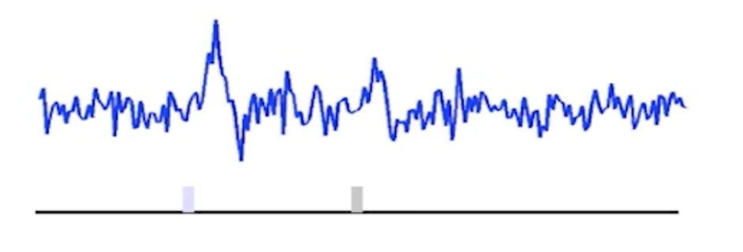
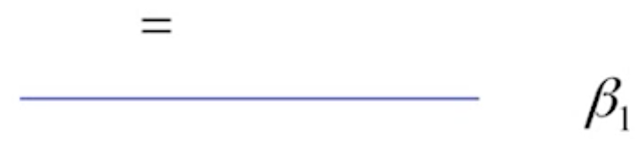
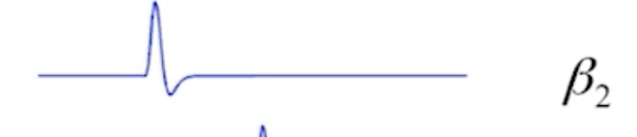
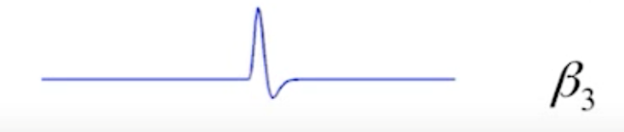
Example
Event-related experiment with two types of stimuli.
‘In what areas of the brain is there a difference between condition A(β₂) and B(β₃)?’
Statistical equivalent:
H₀: β₂ = β₃ = 0
H₀: C^{T} (β) = 0
C^{T} = [0, 1, -1]
β₂(1) > β₃(-1)
Notes:
Here is an event related example where two stimuli are presented a separate points in time. We have 3 parameters, the first is the constant (mean of the signal) and the 2nd and 3rd are our regressors for each stimulus presented, plus noise.
Our vector is written [0 1 -1] if we want to compare one parameter against another
Or [ 0 1 0 ] for the contribution of B2
Or [ 0 0 1 ] for the contribution of B3

Slide 32
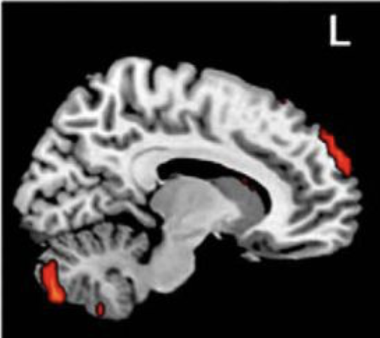
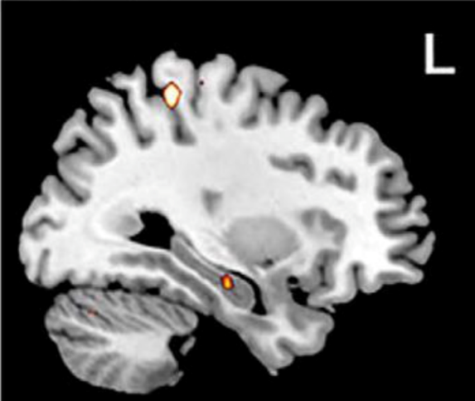

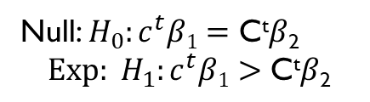
T-test
You can test the assumption that the activation in event 1($β1$) significantly greater than in event 2($β$₂). This means that your Null/Experimental
hypothesis would look like this
contrast of
estimated
parameters
Null: $H_{0}:c^{t}β1=\text{C}\text{t}β\text{2}$
$${Exp: H}_{1}:c^{t}β1>\text{C}\text{t}β\text{2}$$
T =
variance
estimate
C^{t} = [1, -1, 0, 0, 0,] - Comparing two conditions. In other words, you are asking SPM to show you the voxels in the brain where mean signal of C^{t}$β$₁ are greater than the mean signal of those in C^{t}$β$₂
Notes:
For example expected to find a difference in the mean activation of the cerebellum between the two conditions. For example one condition included a higher level cognitive task and the other was a simple cognitive task. You want to assess the question, is the cerebellum involved in higher cognitive thinking?
The experimental hypothesis would produce a ‘colourful blob’ on the cerebellum, meaning, there’s a significant difference in the activation of the voxels of the brain in this regions, between these two tasks
The null hypothesis on the other hand would show no such activation pattern, suggesting that there is no significant difference (therefore no difference in the contribution of the cerebellum between the two tasks).

Slide 33
T-test summary
T-test is a simple signal-to-noise ratio measure
H₀: C^{T} β=0 vs H₁: C^{T} β>0
“One” linear hypothesis testing
We can’t test both β₁=0 and β₂=0 at a same time
What if we have many interrelated experimental conditions, e.g. factorial design?
How can we test multiple linear hypothesis?
Y = X1 * β1 + X2 * β2 + β3 + ε

Slide 34


Multiple Contrasts
We often want to make simultaneous tests of
several contrasts at once
In this instance ‘C’ becomes a ‘design matrix’
If these are the parameters:
Then that is the equivalent to:
H₀: c^{T}β1=0
H₀: c^{T}β2=0
Notes:
Now we are able to test the hypothesis that parameter b1 is equal to 0 at the same time as b2 = 0. We are effectively doing the same thing as an ANOVA here where you are testing for multiple main effects at the same time.
The number of rows in your matrix is the number of contrasts you are making whereas the number of columns is the number of regressors.

Slide 35
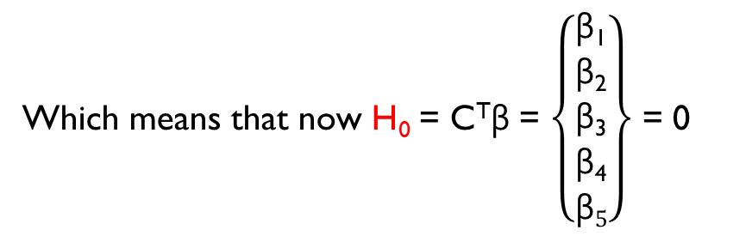

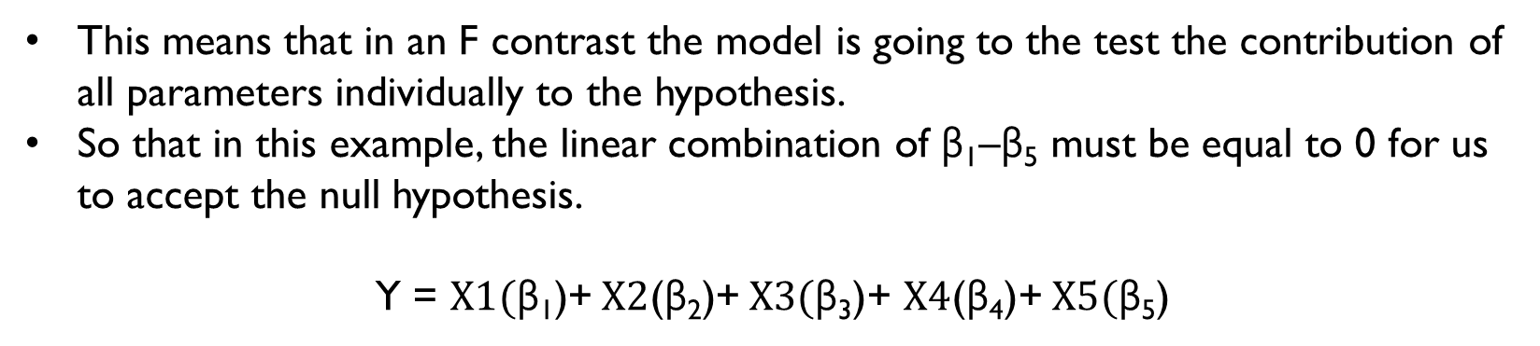
Design Matrix
C = $\left\{\begin{matrix}1 & 0 & 0 & 0 & 0 \\ 0 & 1 & 0 & 0 & 0 \\ 0 & 0 & 1 & 0 & 0 \\ 0 & 0 & 0 & 1 & 0 \\ 0 & 0 & 0 & 0 & 1\end{matrix}\right\}$ = C^{T}β = $\left\{\begin{matrix}\text{β}\text{1} \\ \text{β}\text{2} \\ \text{β}\text{3} \\ \text{β}\text{4} \\ \text{β}5\end{matrix}\right\}$
Which means that now H₀ = C^{T}β = $\left\{\begin{matrix}\text{β}\text{1} \\ \text{β}\text{2} \\ \text{β}\text{3} \\ \text{β}\text{4} \\ \text{β}5\end{matrix}\right\}$ = 0
This means that in an F contrast the model is going to the test the contribution of all parameters individually to the hypothesis.
So that in this example, the linear combination of $\text{β}\text{1}$–$\text{β}\text{5}$ must be equal to 0 for us to accept the null hypothesis.
Y = $X1(\text{β}\text{1}\text{)}$+ $X2$($\text{β}\text{2}\text{)}$+ $X3(\text{β}\text{3}\text{)}$+ $X4$($\text{β}\text{4}$)+ $X5(\text{β}\text{5}\text{)}$

Slide 36
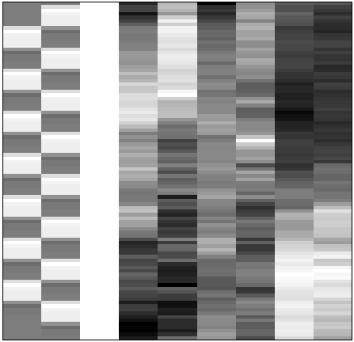
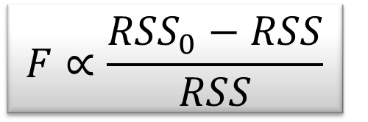
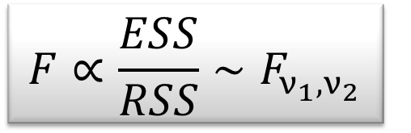
F-test - the extra-sum-of-squares principle
Model comparison:
Null Hypothesis H₀: True model is X₀ (reduced model)
X₀
X₁
X₀
Test statistic: ratio of explained variability and unexplained variability (error)
RSS
RSS₀
ν₁ = rank(X) – rank(X₀)
ν₂ = N – rank(X)
Full model ?
or Reduced model?
Notes:
Testing for multiple linear hypothesis means testing between two models. Consider this design matrix have a model with X0 and X1 as a full model. We want to know if the added variance can better justify the variability in the error term. So in this case we use an F test as a comparison of reduced sum of square divided by the unexplained variance.
WE compute the two residuals, full model will have a less error, as a lot of the noise has already been predicted in the model. In F statistics variance of the noise is approximated by full model. The numerator represents the variance added by X1

Slide 37
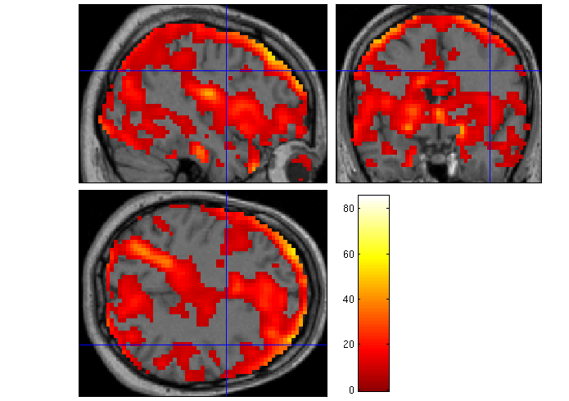
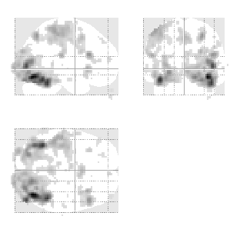
F-test - multidimensional contrasts – SPM{F}
Tests multiple linear hypotheses:
H₀: True model is X₀
H₀: β₄ = β₅ = ... = β₉ = 0
test H₀ : c^{T}β = 0 ?
X₀
X₁ (β₄₋₉)
X₀
0 0 0 1 0 0 0 0 0
0 0 0 0 1 0 0 0 0
0 0 0 0 0 1 0 0 0
0 0 0 0 0 0 1 0 0
0 0 0 0 0 0 0 1 0
0 0 0 0 0 0 0 0 1
c^{T} =
SPM{F_{6,322}}
Full model?
Reduced model?
Notes:
This is effectively like doing multiple contrasts or t-tests simultaneously. Here we are testing for influences of movement regressors on the fMRI activity.

Slide 38
F-contrast
Multi-dimensional and non-directional
  Tests whether at least one β is different from 0, against the null hypothesis
  H₀: β₁=β₂=β₃=0
  Equivalent to an ANOVA
Function:
  Test multiple linear hypotheses, main effects, and interaction
  But does NOT tell you which parameter is driving the effect nor the direction of the difference (F-contrast of β₁-β₂ is the same thing as F-contrast of β₂-β₁) – like in ANOVA main effect.
Notes:
So how do you test a directional effect? Do you have to do a separate t afterwards?

Slide 39
F-test summary
The F-test evaluates whether any combination of contrasts explain a significant amount of variability in the measured data
H₀: C β=0 vs H₁: C β≠0
More flexible than T-test
F-test can tell the existence of significant contrasts. It does not tell which contrast drives the significant effect or what is the direction of the effect.

Slide 40
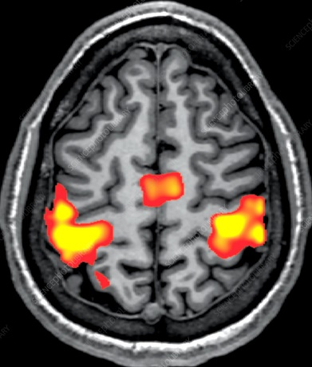
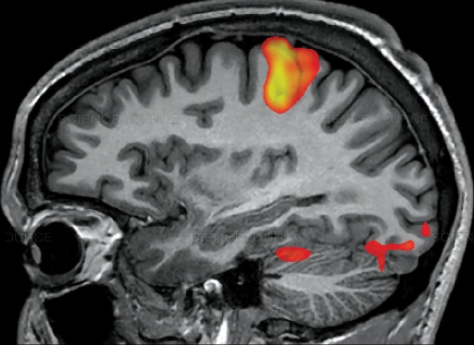
Statistical Images
For each voxel a hypothesis test is performed.
The statistic corresponding to that test is used to create a statistical image over all voxels.
Notes:
Therefore you will end up with a t or F value for each voxel in the brain for the particular contrast you ran. These heat maps show the size of the t/F values over voxels. On the left you can see that F values above 40 are starting to turn yellow and on the right t values higher than 2, which would indicate that these voxels show significant activation for the contrast selected.
https://www.fil.ion.ucl.ac.uk/spm/doc/papers/NicholsHayasaka.pdf – How SPM deals with familywise error
https://www.youtube.com/watch?v=NRunOo7EKD8 – GLM

Slide 41
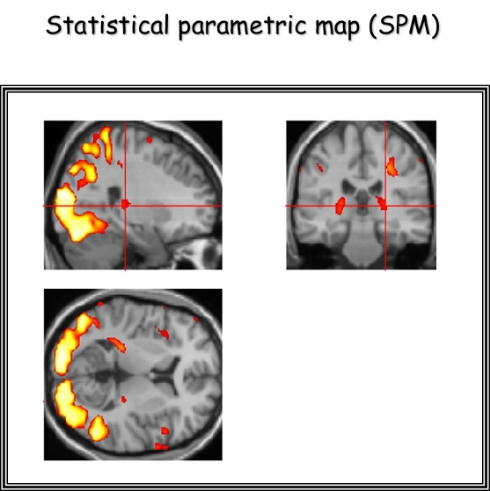
SPM Practical
Specify model: choose data files and set up design matrix
Estimate parameters using the GLM for every single voxel
Test hypotheses using contrast vectors. This produces a Statistical Parametric Map for the activation in each voxel.
Interpretation
Notes:
In SPM, we need to specify our model, and then let the program estimate our parameters.
The next step is defining contrast vectors to test hypotheses, which produces SPMs.

Slide 42
SPM Practical
Simple example:
2 conditions: listening to auditory stimuli, rest
Blocks alternated between listening and rest
Each acquisition consisted of 64 slices (3 x 3 x 3 mm³ voxels)
Acquisition took 6s
Scan repetition time (TR): 7s
(see SPM12 Manual: Auditory fMRI data)

Slide 43
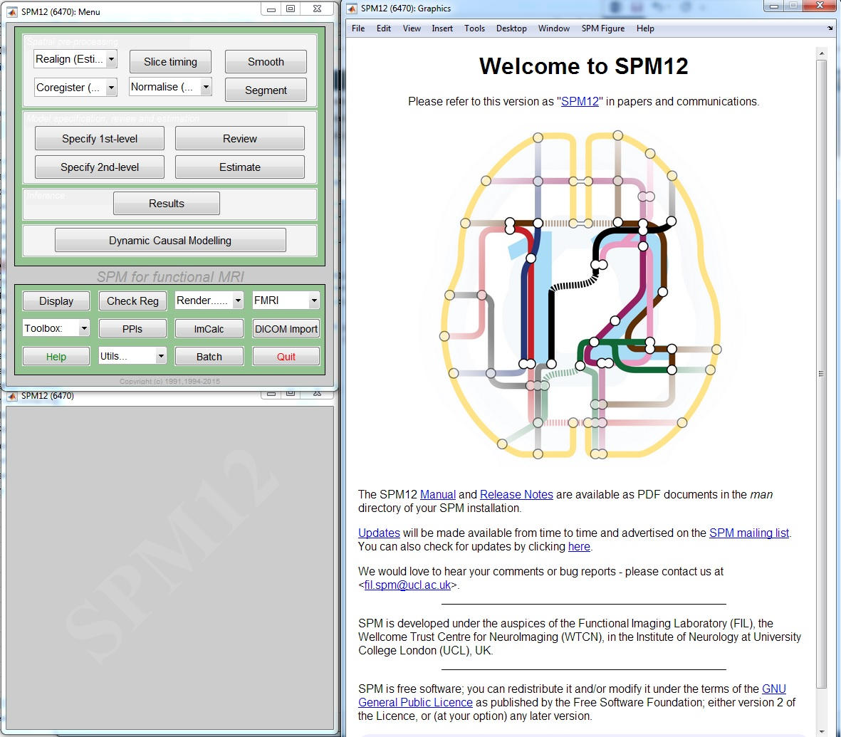
SPECIFY 1st LEVEL
After the pre-processing steps: Model specification
Press SPECIFY 1ST LEVEL

Slide 44
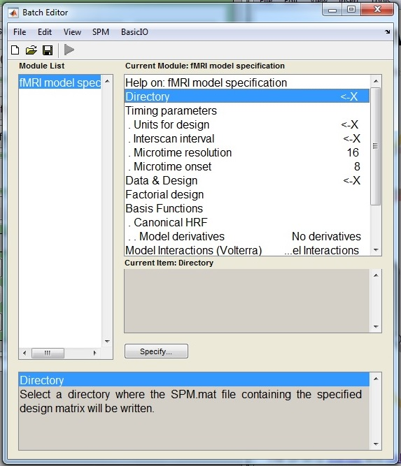
SPECIFY 1st LEVEL
In the batch editor, highlight “Directory” and select the location in which you want to save your results

Slide 45
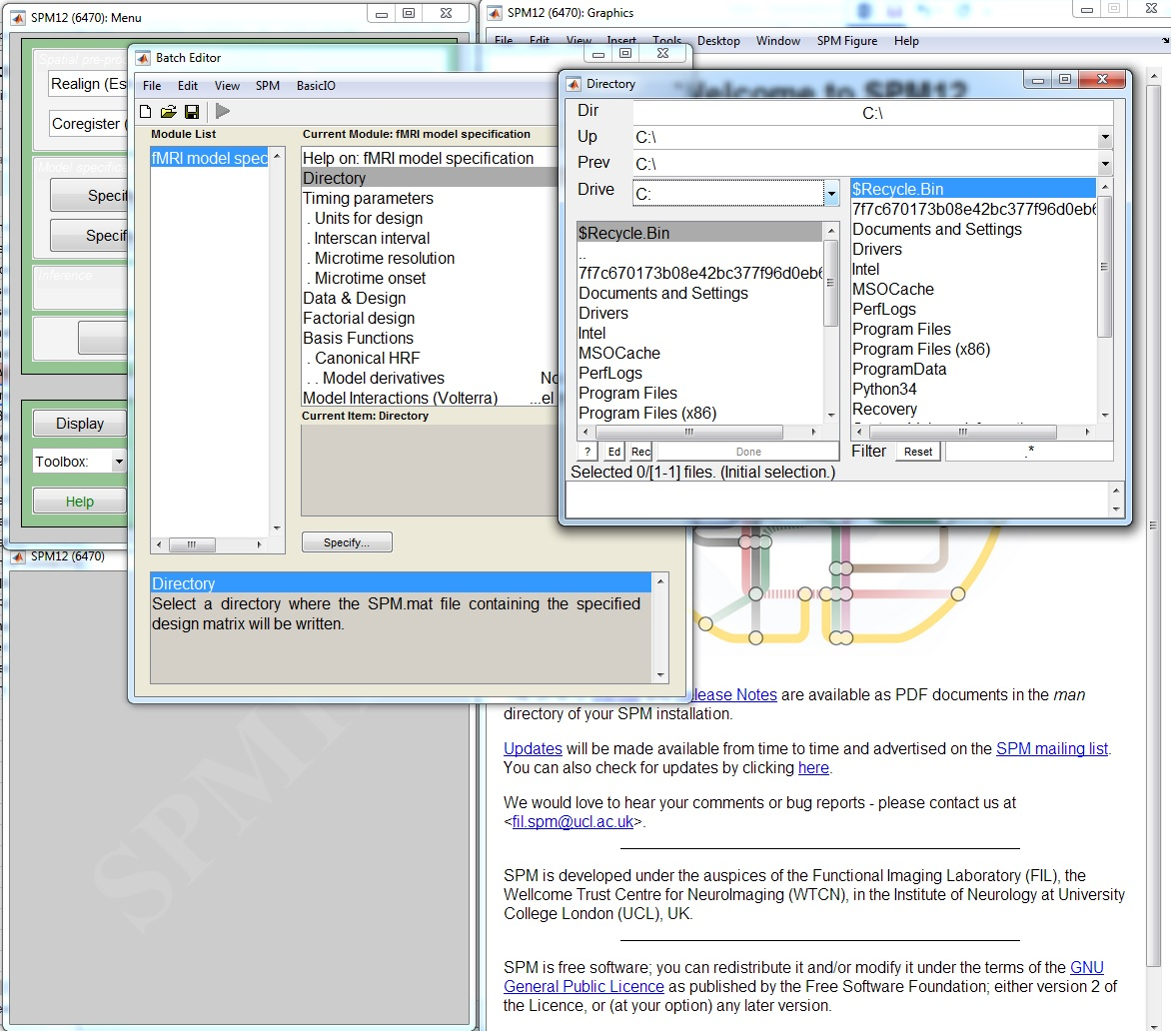
SPECIFY 1st LEVEL
In the batch editor, highlight “Directory” and select the location in which you want to save your results

Slide 46
SPECIFY 1st LEVEL
Open “Timing Parameters”

Slide 47
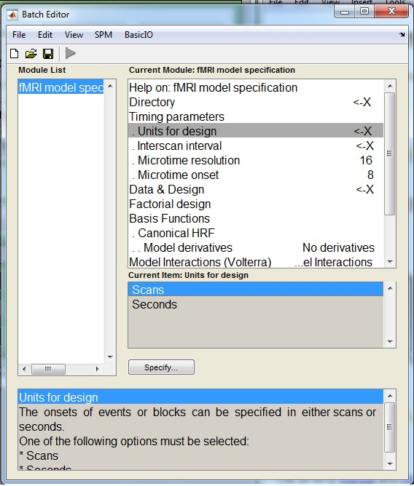
SPECIFY 1st LEVEL
Open “Timing Parameters”
  Highlight “Units for Design” and select “Scans” (rather than “Seconds”)
  Highlight “Interscan Interval” and enter your TR in seconds, e.g. 7

Slide 48
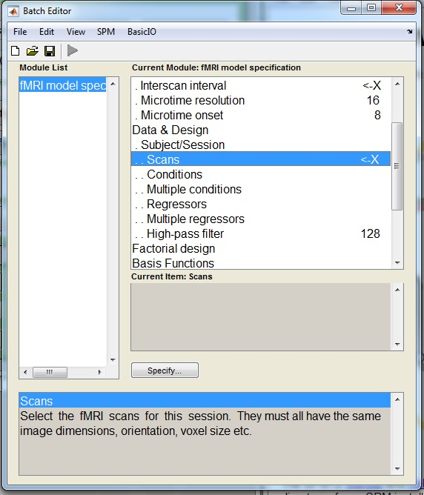
SPECIFY 1st LEVEL
Highlight “Data and Design” and select “New Subject/Session”
Open the newly created “Subject/Session” option
Highlight “Scans” and select the smoothed, normalised functional images, e.g. swfM00*_00*.img

Slide 49
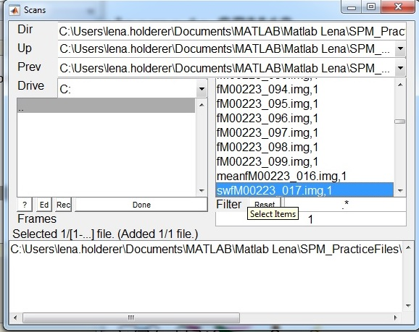
SPECIFY 1st LEVEL
Highlight “Data and Design” and select “New Subject/Session”
Open the newly created “Subject/Session” option
Highlight “Scans” and select the smoothed, normalised functional images, e.g. swfM00*_00*.img

Slide 50

SPECIFY 1st LEVEL
Highlight “Condition” and select “New Condition
Open the newly created “Condition” option
  Highlight “Name” and enter the condition’s name, e.g. “Listening”

Slide 51

SPECIFY 1st LEVEL
Highlight “Condition” and select “New Condition
Open the newly created “Condition” option
  Highlight “Name” and enter the condition’s name, e.g. “Listening”
  Highlight “Onsets” and enter the onset times of your condition, e.g. “6:12:84”

Slide 52

SPECIFY 1st LEVEL
Highlight “Condition” and select “New Condition
Open the newly created “Condition” option
  Highlight “Name” and enter the condition’s name, e.g. “Listening”
  Highlight “Onsets” and enter the onset times of your condition, e.g. “6:12:84”
  Highlight “Durations” and enter the duration of your condition in seconds, e.g. “6”
Save the batch as specify.mat
Press the RUN button

Slide 53

SPECIFY 1st LEVEL
SPM will write an SPM.mat file to your directory
SPM will also plot the design matrix in the Graphics window
You can use the REVIEW button to check your model specification

Slide 54
ESTIMATE
After model specification: parameter estimation
Press the ESTIMATE button

Slide 55

ESTIMATE
Highlight the “Select SPM.mat” option and select the SPM.mat file you have saved earlier
Save the batch as estimate.mat
Press the RUN button
SPM will create a number of files in the selected directory, including a new version of the SPM.mat file

Slide 56
RESULTS
After parameter estimation: hypothesis testing
Press the RESULTS button

Slide 57

RESULTS
After parameter estimation: hypothesis testing
Press the RESULTS button
Select the SPM.mat file created by estimation

Slide 58

RESULTS
Select “Define new contrast”
List of contrasts
Surfable design matrix

Slide 59

RESULTS
Select type of contrast
Select “Define new contrast”
Name your contrast, e.g. “Listening > Rest”
Select type of contrast: “t-contrast” or “F-contrast”
Use a numerical code to define your contrast, e.g. “[1 0]”
Code your contrast

Slide 60

RESULTS
Select “Define new contrast”
Define a complementary contrast, e.g. “Rest > Listening”, and use the complementary code, e.g. “[-1 0]”

Slide 61

RESULTS
To view a contrast, select the name of the desired contrast, e.g. “Listening > Rest”
Press “Done”

Slide 62

RESULTS
Do you want to mask your results with a particular contrast?
  By masking your results, you are only selecting those voxels which have been specified by the masking contrast (not applicable in our example)
In this case, select “none”

Slide 63

RESULTS
How do you want to set your statistical thresholds?
Select “FWE”
  A family-wise error is a false positive anywhere in our SPM. This thresholding option uses “FWE-corrected” p-values

Slide 64

RESULTS
How do you want to set your statistical thresholds?
Select “FWE”
  A family-wise error is a false positive anywhere in our SPM. This thresholding option uses “FWE-corrected” p-values
  Select the default value of “0.05”

Slide 65

RESULTS
What do you want your cluster extent threshold k to be?
Accept the default value, “0”
  This will produce SPMs with clusters containing at least k (in our case, 0) voxels

Slide 66

RESULTS
SPM will show those voxels which reach our threshold in the “Listening > Rest” contrast in the Graphics window

Slide 67

RESULTS
SPM will also display a statistical table for our results

Slide 68

RESULTS
In SPM’s interactive window we can produce different statistical tables and visualisations of our data
Statistical tables
Visualisations

Slide 69



RESULTS
You can experiment with overlays to display your data

Slide 70
Take-home message
The contrasts we can choose and the interpretation of results depend on our model specification, which in turn depends on our experimental design!
Notes:
It is important to realise that the hypotheses we can test, and how we interpret our results, depends on the way we specify our model in SPM. The model specification in turn depends on our initial experimental design. This is why it is very important to have a well thought-out experiment from the get-go. If we have a well-designed experiment, we can easily see which questions we can ask of our data.
We should always think about which contrasts we want to use when we design our experiment.

Slide 71
References
SPM12 Manual: http://www.fil.ion.ucl.ac.uk/spm/doc/manual.pdf (Ashburner et al., 2015)
Introduction to Statistical Parametric Mapping: http://www.fil.ion.ucl.ac.uk/spm/doc/intro/ (Friston, 2003)
Human Brain Function 2nd edition: http://www.fil.ion.ucl.ac.uk/spm/doc/books/hbf2/ (Ashburner, Friston, & Penny), especially The general linear model (Kiebel & Holmes), Analysis of fMRI timeseries: Linear time-invariant models, event-related fMRI and optimal experimental design (Rik Henson), and Contrasts and classical inference (Poline, Kherif & Penny)
http://editthis.info/scnlab/Analysis
Principles of Analysis: http://imaging.mrc-cbu.cam.ac.uk/imaging/AnalysisPrinciples (Rik Henson)
Example Data Set from http://www.fil.ion.ucl.ac.uk/spm/data/auditory/
Slides from previous MfD presentations, inc. Elliot Freeman, Hugo Spiers, Beatriz Calvo & Davina Bristow, Ramiro & Sinead, Rebecca Knight & Lorelei Howard, Clare Palmer & Misun Kim
Slides from coursera SPM course
Joe Devlin’s slides from fMRI Analysis course 2013-14
http://www.anc.ed.ac.uk/CFIS/projects/prosody/material/slice8.jpg
https://www.sciencenews.org/sites/default/files/11543
http://www.brainvoyager.com/bvqx/doc/UsersGuide/StatisticalAnalysis/TheGeneralLinearModel.html
Pernet, C. R. (2014). Misconceptions in the use of the General Linear Model applied to functional MRI: a tutorial for junior neuro-imagers. Frontiers in Neuroscience, 8, 1.
Guillaume Flandin SPM Course slides
Christophe Phillips Contrasts and statistical inference

