Slide 1
Issues with Analysis and Interpretation
Methods for Dummies (MfD)
Julia Rodriguez-Sanchez & Chiara Scarampi
MfD, 22nd January 2020

Slide 2
Outline
Recap: Localising Activation
Recap: Hypothesis testing
Multiple comparisons problem and correction
Non-independent hypothesis testing/Double dipping
Exploratory versus confirmatory analysis

Slide 3
Outline
Recap: Localising Activation
Recap: Hypothesis testing
Multiple comparisons problem and correction
Non-independent hypothesis testing/Double dipping
Exploratory versus confirmatory analysis

Slide 4
Recap – Localising Activation
Construct a model for each voxel of the brain
  “Massive univariate approach”
  Regression models (GLM) commonly used
Perform a statistical test to determine whether task related activation is present in the voxel
Choose an appropriate threshold for determining statistical significance
Statistical image
Statistical parametric map
Notes:
When we want to localize areas that are active in response to a task, we begin by constructing a model for each voxel of the brain.
This is typically done in the massive univariate approach, where every voxel has a separate model. And we usually use a GLM type approach.
Here is just a diagram showing how we can create a Design Matrix for two different conditions, A and B. And then put this into the GLM model.

Slide 5
Outline
Recap: Localising Activation
Recap: Hypothesis testing
Multiple comparisons problem and correction
Non-independent hypothesis testing/Double dipping
Exploratory versus confirmatory analysis

Slide 6
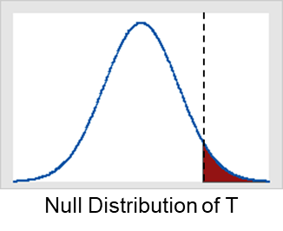
Recap – Hypothesis Testing
Null Hypothesis H₀
  Statement of no effect (No activation)
Test Statistic T summarises evidence about H₀
  measures compatibility between H₀ and the data
p-value: probability of getting a value of t at least as extreme as that actually observed if H₀ is true
Significance Level 𝛂
  If 𝛂 is small we reject the null hypothesis
  We can choose u to ensure a voxel-wise significance level of 𝛂
t
p-value
u_{α}
α
Notes:
Inference at a single voxel
P-value = probability that differences between conditions arose by chance
Significance level = theoretical p-value that acts as a reference to identify significant results
With 𝛂 = .05 we expect 5% of voxels being false positive.

Slide 7
Recap – Type I/Type II Error
The probability that a hypothesis test will correctly reject a false null hypothesis is the power of the test.
 |  | Actual condition
 |  | H₀ true | H₀ false
Test result | Reject H₀ | False positive (Type I error) | True positive
 | Failure to reject H₀ | True negative | False negative (Type II error)
 |  | Specificity: proportion of actual negatives which are correctly identified | Sensitivity (power): proportion of actual positives which are correctly identified
Notes:
There are two types of errors that we can make:
- Type I error: H₀ is true, but we mistakenly reject it (False positive); Controlled by significance level α.
- Type II error: H₀ is false, but we fail to reject it (False negative)

Slide 8
Outline
Recap: Localising Activation
Recap: Hypothesis testing
Multiple comparisons problem and correction
Non-independent hypothesis testing/Double dipping
Exploratory versus confirmatory analysis

Slide 9
Multiple Comparisons Problem
Choosing an appropriate threshold is complicated by the fact we are dealing with a family of tests.
If more than one hypothesis test is performed, the risk of making at least one Type I error is greater than the α value for a single test.
The more tests one performs, the greater the likelihood of getting at least one false positive.
Which of 100,000 voxels are significant?
  α=0.05 ⇒ 5,000 false positive voxels

Slide 10
Multiple Comparisons Problem
Choosing a threshold is a balance between sensitivity (true positive rate) and specificity (true negative rate)
Poor Specificity
Good Power
(risk of false positives)
Good Specificity
Poor Power
(risk of false negatives)
Notes:
With a low threshold, you get a lot of active voxels (but risk of false positives)
With a high threshold, pretty sure active regions are truly active (but risk of false negatives)

Slide 11
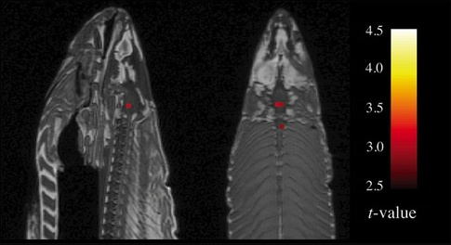
Multiple Comparisons Correction
Uncorrected
p value
Family-Wise Error Rate
False Discovery Rate
Bennett et al. (2010)
N/A | It generates too many false positives and should not be used.

Slide 12
Multiple Comparisons Correction
Uncorrected
p value
Family-Wise Error Rate
Controls probability of any false positives in a family
- Bonferroni
- Random field theory
- Permutation tests
False Discovery Rate
Proportion of active voxels that are false positives
Notes:
There are several ways of quantifying the likelihood of obtaining false positives.
FWER = probability of making one (or more) Type I error under the null hypothesis (Null hypothesis wrongly rejected)

Slide 13
Family-Wise Error Rate
The family-wise null hypothesis states that the activation is zero everywhere in the brain.
If we reject a single voxel null hypothesis, we reject the family-wise null hypothesis.
A false positive at any voxel (i.e., anywhere in the image of the brain) gives a Family-Wise Error (FWE).
Family-Wise Error (FWE) rate = ‘corrected’ p-value.
Notes:
For each voxel we define the null hypothesis as the hypothesis that there is no activation in the voxel.
FWER: we want to control the probability that any test statistic across the brain is above a certain threshold
(if it is above the threshold we reject the null hypothesis and get a false positive).

Slide 14

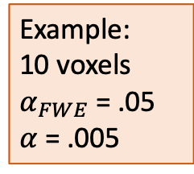
Bonferroni correction
To ensure a particular FWER, we can use:
      $$α =\frac{α_{FWE}}{N}$$
$α$ = single-voxel probability threshold
$α_{FWE}$ = family-wise error rate
$N$ = number of voxels
Example:
10 voxels
$α_{FWE}$ = .05
$α$ = .005
- It provides a strong control over the number of false positives. | - It is very conservative; - It decreases the power of a test; - It is not optimal for correlated data.
Notes:
The Bonferroni correction is a classic way of doing that.
We choose a threshold so that the probability of any test statistic being above tis threshold is less than alpha over the total number of voxels
Reduced sensitivity (risk of type II errors)
We might be able to chose a more appropriate threshold by using information about the spatial correlation present in the data.

Slide 15
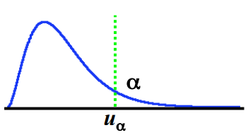
Random Field Theory
Random field theory allows us to incorporate the spatial correlation into the calculation of the appropriate threshold.
It is based on approximating the distribution of the maximum statistic over the whole image.
Link between FWER and max statistic:
  FWER = P(FWE)
  = P(one or more voxels ≥ u | H0)
  = P(max voxel ≥ u | H0)
Choose the threshold u such that the max only
exceeds it α% of the time
Notes:
If the maximum statistics is above u, then there is at least a t statistic that is above the threshold
In order to control for the FWER, we need to find the distribution for the max statistic and threshold using that.
We choose a threshold such that the probability of the max statistic being larger than the threshold under the null hp is α
Random filed theory is a way of approximating the tail of the max statistic.

Slide 16
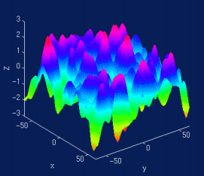
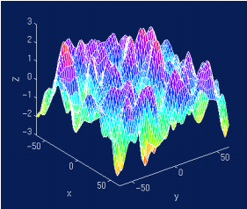
Random Field Theory
A random field is a set of random variables defined at every point in D-dimensional space.
A Gaussian random field has a Gaussian distribution at every point and every collection of points.
Consider a statistical image to be a lattice representation of a continuous random field.
Random field methods are able to:
  approximate the upper tail of the maximum distribution, which is the part needed to find the appropriate thresholds;
  account for the spatial dependence in the data.
Discretisation
(lattice approximation)

Slide 17
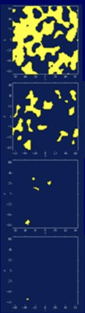
Euler Characteristic
Euler Characteristic (χ_{u})
  Topological measure
  χ_{u} = #blobs - #holes
At high thresholds, just counts blobs
Link between FWER and max statistic:
FWER = P(max voxel ≥ u | H₀)
= P(one or more blobs | H₀)
≈ P(χ_{u} ≥ 1| H₀)
≈ E(χ_{u} | H₀)
Threshold
Random Field
No holes
Never more than 1 blob
Suprathreshold Sets
Notes:
When we work with random field theory, we have to define something called the Euler Characteristic.
EC is a property of a random field after it has been thresholded.
FWER = probability that the max voxel exceeds some threshold under the null hypothesis = we must have one or more blobs (significant!)
= (approximation) we don’t have any holes = (approximation) expected value of the χ_{u}.

Slide 18
Random Field Theory
Closed form results exist for E(χ_{u}) for Z, t, F and χ² continuous random fields.
  It depends on the smoothness of the image;
  You must quantify the smoothness (and report it).
E(χ_{u}) ≈ mathy stuff *Volume/Smoothness
  E(χ_{u}) is our p-value
Properties:
  As u increases, FWER decreases (Note u large)
  As Volume increases, FWER increases
  As Smoothness increases, FWER decreases

Slide 19
Random Field Theory
Recent body of mathematics defining theoretical results for smooth statistical maps;
It allows to find a threshold in a set of data where it’s not easy (or even impossible) to find the number of independent variables;
- It takes special correlations into account; - Less stringent than Bonferroni correction (though not always); - It adapts to volume searched and smoothness. | - Good for highly-smoothed data only; - It requires estimating a lot of parameters; - Multivariate normality assumption difficult to check; - Several layers of approximation.

Slide 20
Multiple Comparisons Correction
Uncorrected
p value
Family-Wise Error Rate
Controls probability of any false positives in a family
- Bonferroni
- Random field theory
- Permutation tests
False Discovery Rate
Proportion of active voxels that are false positives
Notes:
While the FWER controls the probability of any false positives, the FDR controls the proportion of false positives among all rejected tests.
Advised to use random field theory as they dont depend on your design

Slide 21
False Discovery Rate (FDR)
While the FWER controls the probability of any false positives,
FDR = proportion of activated voxels that are false positives.
 | Declared inactive | Declared active
Truly inactive | ✔ | Type I error
Truly active | Type II error | ✔
Notes:
FWER = probability that false positives > 1
FDR = expected number of false positive over the number of voxels declared active

Slide 22
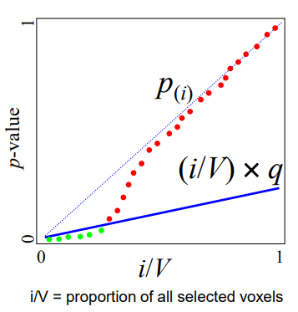
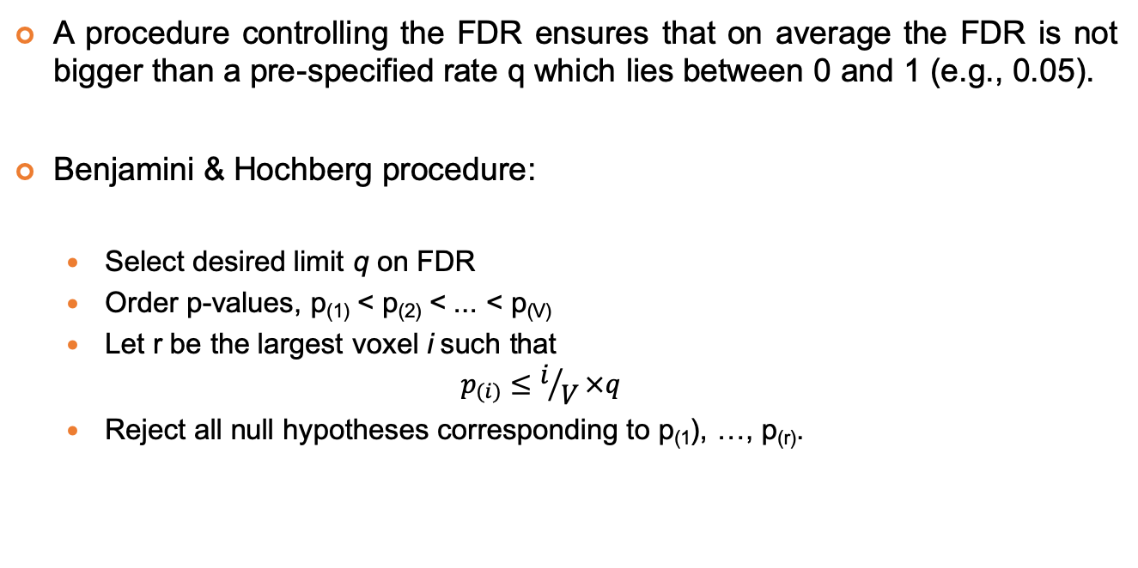
False Discovery Rate (FDR)
A procedure controlling the FDR ensures that on average the FDR is not bigger than a pre-specified rate q which lies between 0 and 1 (e.g., 0.05).
Benjamini& Hochberg procedure:
  Select desired limit q on FDR
  Order p-values, p₍₁₎< p₍₂₎< ... < p_{(V)}
  Let r be the largest voxel i such that
  $$p_{(i)}≤i/V×q$$
  Reject all null hypotheses corresponding to p₍₁), …, p_{(r)}.
Benjamini & Hochberg (1995)
Notes:
$i/V×q$ is a straight line going from 0 to q/V
We reject all the null hypotheses whose corresponding p-values are between p(1) and p(r).

Slide 23
False Discovery Rate (FDR)
If all null hypotheses are true, the FDR is equivalent to the FWER.
Any procedure that controls the FWER also controls the FDR. A procedure that controls the FDR only can be less stringent and lead to a gain in power.
- Less conservative than FWER; - It can be applied to any valid statistical test; - Good for unsmoothed (or low-smoothed), single-subject data; - very high sensitivity while still providing good control of false positives. | - Questionable if suitable for neuroimaging data; - Chumbley & Friston (2009): the fMRI signal is spatially extended, inference should therefore not be about single voxels, but about topological features of the signal (e.g. peaks or clusters).

Slide 24
Voxel-level Inference
Retain voxels above 𝛂-level threshold u_{α}
Gives best spatial specificity
  H₀ at a single voxel can be rejected
u_{𝛂}
Notes:
So far we have talked about voxel-level inferences based on height thresholds to ask whether the activation at a given voxel is significantly non-zero
We have seen how to derive a threshold that pertain the p-value for each voxel.

Slide 25
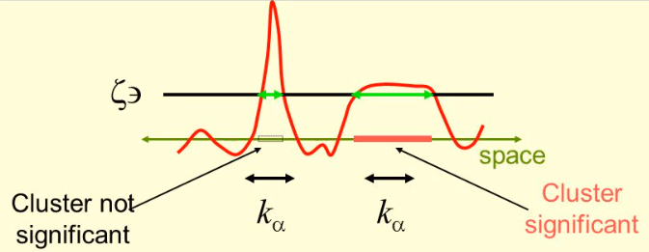
Cluster-Extend based Thresholding
Two-stage procedure:
  Define clusters by arbitrary threshold u_{clus}
  Retain clusters larger than α-level threshold k_{α}
u_{clus}
Notes:
Two steps:
An arbitrary voxel-level primary threshold defines clusters by retaining groups of suprathreshold voxels.
A cluster-level extent threshold measures units of activated voxels. We are going to keep all the clusters that are larger in terms of contiguous voxels than a threshold k_{α}. K is a cluster size parameter.

Slide 26
Cluster-Extend based Thresholding
Typically better sensitivity but worse spatial specificity
  H₀ of the entire cluster is rejected
  Only means that one or more voxels in the cluster are active
u_{clus}
Notes:
It controls for FWER, i.e. less stringent than voxel-based multiple comparison correction – accounts for the fact that individual voxel activations are not spatially independent from neighbours.
Better sensitivity but worse spatial specificity

Slide 27
Cluster-Extend based Thresholding
Which regions are activated?
Woo et al., 2013
Notes:
Large clusters that span multiple anatomical regions provide us with poor spatial resolution and neuroscientific interpretability.
We can only infer that there is true signal “somewhere” in this huge cluster and cannot make an inference about specific anatomical regions.
Dont make conclusions about activuty in cluster, there is only a region within the clusrter which is active.

Slide 28
Cluster-Extend based Thresholding
- High sensitivity; - It accounts for the fact that individual voxel activations are not independent of the activations of their neighbouring voxels, especially when the data are spatially smoothed. | - Low spatial specificity when clusters are large; - Problematic if primary voxel level threshold to define clusters is liberal (e.g. p<0.01).

Slide 29
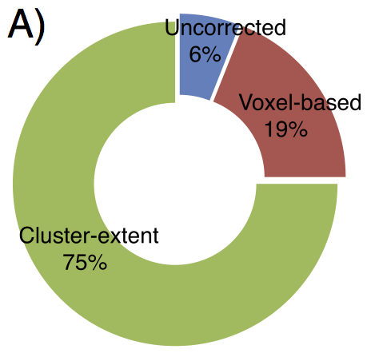
Multiple Comparisons Correction
Woo et al., 2013
Proportions of studies using cluster-extent based correction, voxel-based correction, and uncorrected threshold (N=814).
Notes:
The proportions of studies using cluster-extent based correction, voxel-based correction, and uncorrected threshold. This result shows that cluster-extent based thresholding isthe most popular threshold method among the correction methods. The survey included fMRI studies from Cerebral Cortex, Nature, Nature Neuroscience, NeuroImage, Neuron, PNAS, andScience (N=814).

Slide 30
Pitfalls
Some researchers use arbitrary (uncorrected) height thresholds (e.g., p<0.001), but it is problematic when interpreting conclusions from individual studies, as many activated regions may be false positives.
  Null findings are hardly published, hence it is difficult to refute false positives established in the literature.
Some researchers use arbitrary extent thresholds when reporting results but, imaging data are spatially smooth and false positives may appear in clusters.
  Voxels are not independent. There might be whole areas of contiguous voxels that are false positive blobs.
Imposing arbitrary height and extent thresholds does not provide correction for multiple comparisons at the level that we'd like.

Slide 31
Pitfalls of cluster-extent based correction
Low spatial specificity and inappropriate inferences:
  with cluster-extent based thresholding methods, we can only infer that there is true signal somewhere within the large cluster.
Detrimental effects of liberal primary thresholds on the spatial localization of true-signal regions
The level of primary threshold is crucial to the size of significant clusters:
  People often choose the primary threshold depending on the defaults of the software package used for analysis.
  Most (45-70%) activated voxels in map are not truly active high false discovery rate
Liberal primary thresholds do not control over cluster-based FWER adequately
  Anti-conservative bias: cluster-extent based thresholding can become anti-conservative when the data violate the assumptions of GRD theory
Eklund et al., 2016; Woo et al., 2013

Slide 32
Suggestions
Which thresholding method?
  For studies with good power, voxel-wise corrections such as FWER and FDR are preferable;
  For studies with moderate effect/sample size (Cohen’s d < .8 / N < 50), cluster-extent based thresholding is adequate;
  For ROI analyses, choose cluster or peak-level threshold depending on the size and shape of your ROI.
Which primary threshold?
  For cluster-extent based thresholding, primary thresholds more liberal than p < .001 are not recommended.
Visualisation of cluster extent and reporting strategies
  Mark the boundaries of each cluster clearly in figures to reduce problems with mis-interpretation of cluster-extent thresholded results;
  The neuroanatomical descriptors used to report and discuss results should be consistent with the level of spatial specificity of the results.

Slide 33
Outline
Recap: Localising Activation
Recap: Hypothesis testing
Multiple comparisons problem and correction
Non-independent hypothesis testing/Double dipping
Exploratory versus confirmatory analysis

Slide 34
Non-independent selective analysis
In fMRI studies, the goal is:
to identify voxels that contain a particular effect
  For example: Which voxels respond more to faces than houses?
  Multiple comparison problem
to estimate the size of the effect, typically within a region of interest (ROI)
  For example: How strongly do these voxels respond to faces?
  “Double dipping”
Double dipping: The use of the same data set for selection and selective analysis.
Notes:
In fMRI, the goal is typically twofold:
To identify voxels that contain a particular effect.
The first goal is finding brain regions that contain a particular effect. For example, we may wish to answer questions like: Which voxels respond more to faces than houses? The use of many null-hypothesis tests across brain locations presents a multiple-comparison problem (see above).
(2) To estimate the size of the effect, typically within a region of interest (ROI).
The second goal is estimating the size of the effect. For example we may wish to answer questions like: How strongly do these voxels respond to faces? This is typically done within an ROI by means of a statistical mapping that highlights voxels more strongly active during one condition than another. The effect-size statistics need to be independent of the selection criterion; otherwise the results will be affected by “selection bias”.

Slide 35
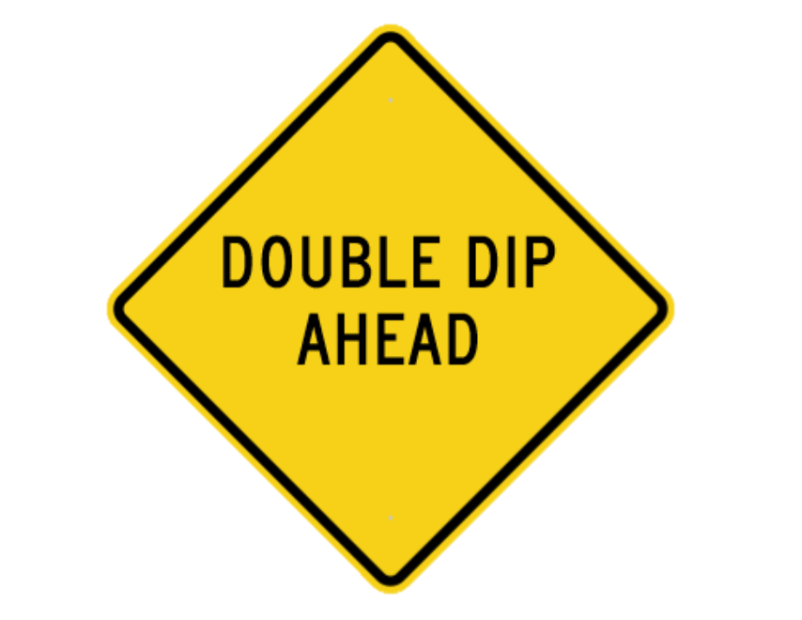
Non-independent selective analysis
Double dipping (or non-independent selective analysis) occurs when data are first analysed to select a subset and then the subset is reanalysed to obtain results.
For example:
Hypothesise that there is a region responding more
strongly to stimulus A than B.
Select voxels showing this effect to define an ROI.
Selectively analyse that ROI to test the hypothesis.
Notes:
Imagine the data were pure noise. If we select voxels by some criterion, those voxels are going to better conform to that criterion than expected by chance (for randomly selected voxels). Double dipping would not be an issue if selection was determined only by true effects in the data. However, selection is affected by noise. Even if the selected voxels truly contain the effect of interest, the noise in the data will typically have pushed some voxels into the selected set and some others out of it. For example, the voxels included at the fringe of an ROI tend to reflect the noise to some extent – even if the ROI highlights a truly active brain region.
The problem of double dipping arises so frequently because the desired selection criterion is often identical with or related to the desired results statistics for the selective analysis. For example, we may hypothesize that there is a region responding more strongly to stimulus A than B, select voxels showing this effect to define an ROI, and then selectively analyse that ROI to test our hypothesis.

Slide 36
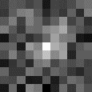
Example
Simulated fMRI experiment:
Neuroimaging data set of 30 x 30 x 20 voxels and 200 time points
Block design with 4 conditions (A, B, C, D)
100-voxel (5 x 5 x 4 voxels) region at the centre of the volume simulated to be active during conditions A and B but not C and D
Resulting data set added to independent Gaussian noise and spatially smoothed.
True region
Kriegeskorte et al. (2009)
Notes:
Resulting data set added to independent spatiotemporal Gaussian noise and spatially smoothed by convolution with a 3-voxel-wide cubic kernel

Slide 37
Example
Analysis:
Construct a model for each voxel of the brain
  Voxel-wise univariate linear model (GLM)
Perform a statistical test to determine whether task-related activation is present in the voxel
  Contrast [A > D]
Choose an appropriate threshold for determining statistical significance
  Threshold corresponding to p < 0.0001 (uncorrected)
  FWE-corrected at p < 0.05
True region
Kriegeskorte et al. (2009)
Notes:
The data were analysed by means of a general linear model using the same design matrix as used to simulate the effects, with one predictor per condition. The data set was mapped by voxel-wise univariate linear modelling using the contrast A-D. The resulting t map was thresholded using a primary threshold corresponding to p<0.0001, uncorrected. The size of each contiguous cluster exceeding this primary threshold was then assessed and highlighted all clusters whose size exceeded a cluster-size threshold that controlled the familywise error rate at p<0.05, thus correcting for multiple tests.

Slide 38
Example
Analysis:
Construct a model for each voxel of the brain
  Voxel-wise univariate linear model (GLM)
Perform a statistical test to determine whether task-related activation is present in the voxel
  Contrast [A > D]
Choose an appropriate threshold for determining statistical significance
  Threshold corresponding to p < 0.0001 (uncorrected)
  FWE-corrected at p < 0.05
Overfitted ROI
Kriegeskorte et al. (2009)
Notes:
The ROI defined by the mapping analysis (red contour) correctly highlights the activated region (blue contour). However, the ROI is somewhat affected by noise. Some voxels at the fringe of the ROI will be included because their noise component makes them look as though they conformed slightly better to the selection criterion; others will be excluded because their noise makes them look as though they did not conform as well to the selection criterion. This can be interpreted as overfitting of the ROI.

Slide 39


Example
True region
Overfitted ROI
Notes:
Averaging all time courses within the ROI (same data as used for mapping) and fitting the linear model. The resulting bar graph reflects the activation of the region during conditions A and B as well as the absence of activation during conditions C and D. However, it is substantially distorted by the non-independent selection: recall that the mapping was based on the contrast A-D. Although the region is equally activated during conditions A and B, it appears to be more activated during condition A than B; and this effect is significant (p<0.01 in the particular example run shown).

Slide 40
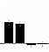


Example
Independent-data ROI
True region
Overfitted ROI
Notes:
When we use independent data to define the ROI (green contour), no distortion is observed.

Slide 41
Example
What went wrong?!
Selection contrast: A - D
c_{selection}= [1 0 0 -1]^{T}
Test contrast: A - B
c_{test}= [1 -1 0 0]^{T}
Non-orthogonal contrast vectors
c _{selection}^{T} · c_{test} ≠ 0
ROI defined by a contrast favouring condition A: voxels with higher signals during condition A are more likely to be selected by chance
Any subsequent ROI search using the same data would find stronger effects for A > B: test contrast A - B will be biased

Slide 42
Non-independent selective analysis
Double dipping is a common issue:
Out of 134 fMRI studies published in five prestigious journals in 2008,
42% contained at least one non-independent selective analysis.
Kriegeskorte et al., 2009
Auctioneering
  “The winner’s curse”
Machine learning
  “Data snooping”
Modelling
  “Overfitting”
Survey sampling
  “Selection bias”
Logic
  “Circularity”
Meta-analysis
  “Publication bias”
Notes:
Out of 134 fMRI studies published in five prestigious journals (Nature, Science, Nature Neuroscience, Neuron, Journal of Neuroscience) in 2008, 42% (57 papers) contained at least one non-independent selective analysis (not considering supplementary materials). Another 14% (20 papers) may contain non-independent selective analyses, but the methodological information given was insufficient to reach a judgment (Kriegeskorte et al., 2009).

Slide 43
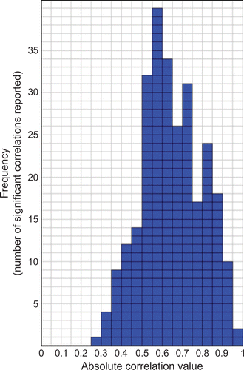
“Voodoo correlations”
Literature review:
Keyword “fMRI” with a list of social terms (e.g. jealousy, altruism, personality)
55 articles reporting 274 significant across-subject correlations between a trait measure and evoked BOLD signal activity
Very high (e.g. > 0.8) correlations between brain activation and personality measures reported in some fMRI studies of emotion, personality, and social cognition
How?!
Vul et al., 2009
Notes:
Vul et al. (2009) explored mysteriously high correlations between individual measures of personality or emotionality and evoked BOLD activity.

Slide 44
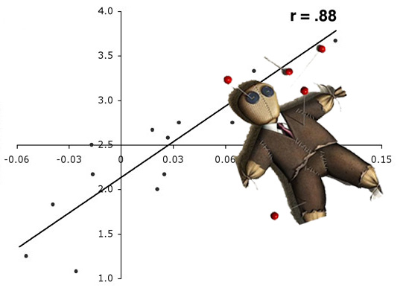
Example
fMRI study looking at social rejection:
Game created to expose individuals to social rejection in the laboratory.
Brain activity in 13 individuals measured while the actual rejection took place.
Self-report measure of how much distress the subject had experienced.
Distress was correlated at r = .88 with activity in the anterior cingulate cortex (ACC).
Eisenberger, Lieberman and Williams, 2003
Notes:
Eisenberger, Lieberman, and Williams (2003), writing in Science, described a game they created to expose individuals to social rejection in the laboratory. The authors measured the brain activity in 13 individuals while the actual rejection took place, and they later obtained a self-report measure of how much distress the subject had experienced. Distress was correlated at r = .88 with activity in the anterior cingulate cortex (ACC).

Slide 45
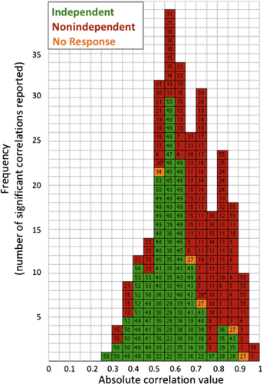
“Voodoo correlations”
What went wrong?!
Analysis:
Compute a correlation of the behavioural measure of interest with each of the voxels.
Select those voxels that exhibit a sufficiently high correlation.
Compute the mean correlation of the voxels over the threshold and report this as the “true” correlation.
With enough voxels, such a biased analysis is guaranteed to produce high correlations even if none are truly present.
Vul et al., 2009

Slide 46
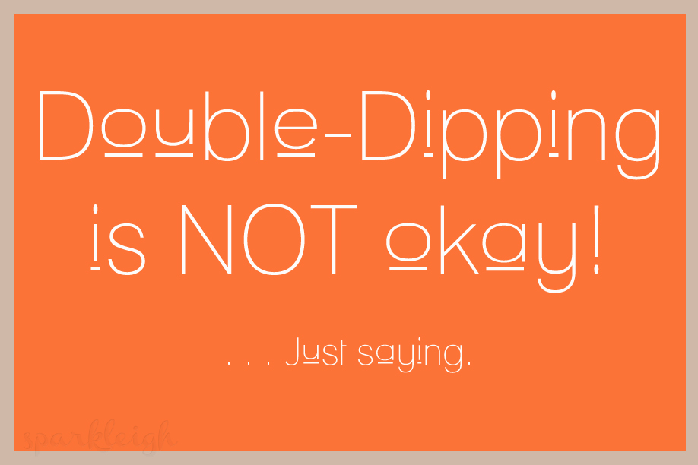
Non-independent selective analysis

Slide 47
Suggestions
How do we avoid selection bias?
Perform a non-selective analysis
OR
Make sure that selection and selective statistics
are independent under the null hypothesis
  Use independent data sets
  Use inherently independent statistics
e.g. whole-brain mapping (no ROI analysis)
e.g. independent contrasts
Note: Using orthogonal contrast vectors does NOT ensure independence!
Notes:
The desired selection criterion is often identical to the desired results statistics for the selective analysis. What do we do to avoid double dipping?
Separate dataset for ROI definition!

Slide 48
A note on orthogonal contrast vectors
How do we avoid selection bias?
  Use inherently independent statistics
Example:
Selection contrast: A + B
c_{selection}= [1 1]^{T}
Test contrast: A - B
c_{test}= [1 -1]^{T}
e.g. independent contrasts
Note: Using orthogonal contrast vectors does NOT ensure independence!
Orthogonal contrast vectors
c _{selection}^{T} · c_{test} = 0

Slide 49
A note on orthogonal contrast vectors
How do we avoid selection bias?
  Use inherently independent statistics
Example:
c _{selection}^{T} · c_{test} = 0
c _{selection}^{T} · (X^{T}X) ⁻¹ · c_{test} = 0
e.g. independent contrasts
Note: Using orthogonal contrast vectors does NOT ensure independence!
not sufficient
still not sufficient
The design and noise dependencies matter.
c _{selection}^{T} · (X^{T}X) ⁻¹ · X^{T} · S · S^{T} · X · (X^{T}X) ⁻¹ · c_{test} = 0
Notes:
Contrast-vector orthogonality does not ensure independent statistics. For example, consider the selection contrast A+B and the test contrast A-B. These are orthogonal contrast vectors in that their inner product is zero. However, whether selecting with cselection biases testing with ctest also depends on the design matrix X.
For the two condition example, selecting by the contrast A+B can bias testing the contrast A-B if the design is not balanced with respect to A and B. For an intuitive understanding of this, consider the case when there is more data for condition A than for condition B. Condition B will be less stably estimated. As a result selecting by contrast A+B will favour voxels having high positive noise in condition B. High positive noise in condition A will not be favoured equally since the noise is more strongly reduced by averaging for condition A. As a result, the contrast A-B will be negatively biased.
For an ordinary-least-squares analysis, the effect of the design matrix can be taken into account by using the criterion cselectionT ⋅ (XTX)-1 ⋅ ctest = 0. However, if the errors are temporally dependent (as is the case for fMRI data), small biases can still arise. The temporal dependence can be characterized by a time-point mixing matrix S. Taking temporal dependence into account yields the criterion cselectionT ⋅ (XTX)-1 ⋅ XT ⋅ S ⋅ ST ⋅ X ⋅ (XTX)-1 ⋅ ctest = 0.

Slide 50
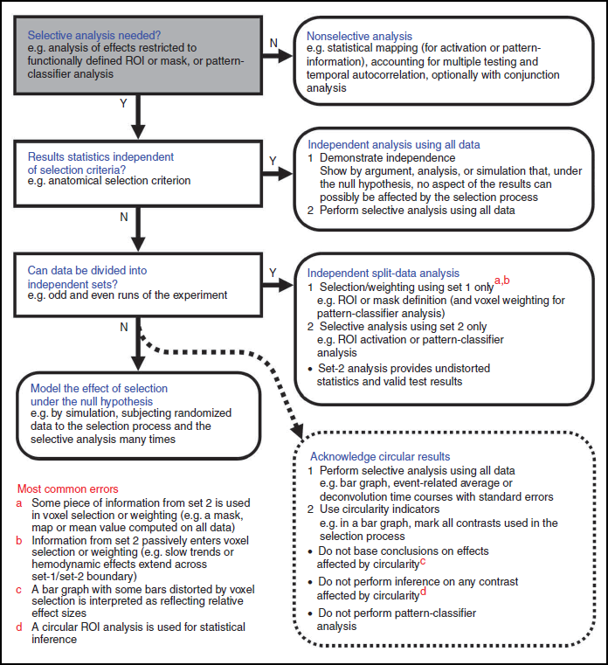
Non-independent selective analysis
Circular analysis in systems neuroscience: the dangers of double dipping
Kriegeskorte et al. (2009).

Slide 51
Outline
Recap: Localising Activation
Recap: Hypothesis testing
Multiple comparisons problem and correction
Non-independent hypothesis testing/Double dipping
Exploratory versus confirmatory analysis

Slide 52
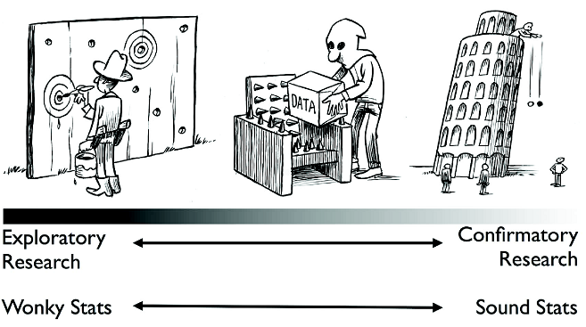
Exploratory versus confirmatory analysis
Types of data analysis:
Exploratory analysis
  Aimed at formulating
  hypotheses
Confirmatory analysis
  Aimed at testing
  hypotheses
“The only way to obtain clear answers from Nature is to ask her clear questions.” Waagenmakers (2015).
Notes:
There is a key distinction between research that is exploratory (i.e., hypothesis-generating) versus confirmatory (i.e., hypothesis-testing).
The core of the problem is that hypothesis testing requires predictions. The problem is not with exploratory research itself. Rather, the problem is with dishonesty, that is, pretending that exploratory research was instead confirmatory.
The cycle of exploration and confirmation in science provides a useful perspective on the problem of circular analysis. Hypotheses generated by exploring the data require confirmation by means of independent data, because a relationship observed in a data set will be consistent with that data set, whether or not it reflects a true relationship or just the noise.
The figure illustrates the continuum from exploratory to confirmatory research and highlights the need to cleanly separate the two. On the far left of the continuum, researchers find their hypothesis in the data by post hoc theorizing, and the corresponding statistics are ‘wonky’, dramatically overestimating the evidence for the hypothesis. On the far right of the continuum, researchers preregister their studies such that data collection and data analyses leave no room whatsoever for exploration; the corresponding statistics are ‘sound’ in the sense that they are used for their intended purpose. Much empirical research operates somewhere in between these two extremes, although for any specific study the exact location may be impossible to determine. In the grey area of exploration, data are tortured to some extent, and the corresponding statistics are somewhat wonky.

Slide 53
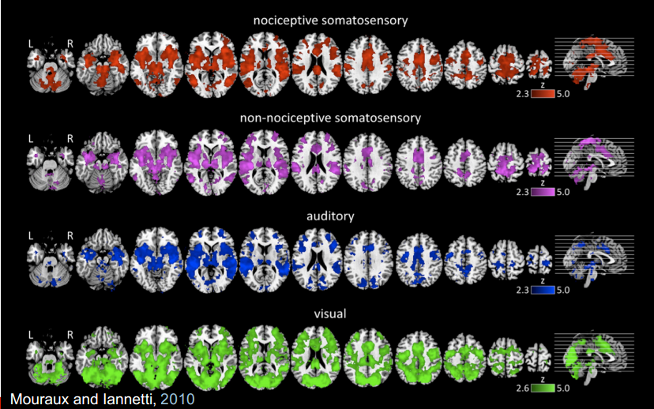
Exploratory versus confirmatory analysis
Notes:
This highlights the importance of hypothesis testing in fMRI studies. This figure is taken from a paper investigating the pain matrix. Each of these four colours represents brain activations evoked from four different stimuli. Can you tell which one is a response evoked from a painful stimulus?
It is important to clearly define your hypothesis as it contextualises brain activation.

Slide 54
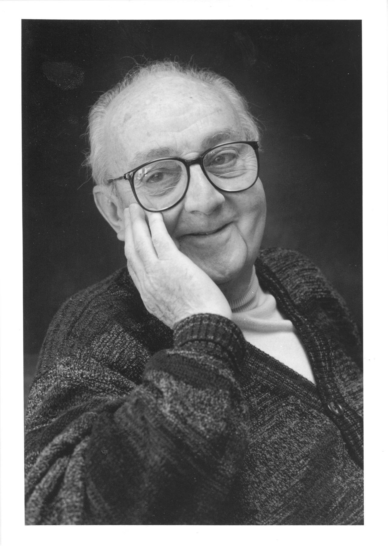
...all models are approximations.
Essentially, all models are wrong,
but some are useful.
However, the approximate nature of the model
must always be borne in mind...
George E. P. Box
Notes:
Box, G. E., & Draper, N. R. (1987). Empirical model-building and response surfaces. John Wiley & Sons.

Slide 55
References
Benjamini, Y., & Hochberg, Y. (1995). Controlling the False Discovery Rate: A Practical and Powerful Approach to Multiple Testing. Journal of the Royal Statistical Society. Series B (Methodological), 57(1), 289-300
Bennett, C. M., Miller, M. B., & Wolford, G. L. (2009). Neural correlates of interspecies perspective taking in the post-mortem Atlantic Salmon: An argument for multiple comparisons correction. Neuroimage, 47(Suppl 1), S125.
Bennett, C. M., Wolford, G. L., & Miller, M. B. (2009). The principled control of false positives in neuroimaging. Social Cognitive and Affective Neuroscience, 4(4), 417-422.
Box, G. E., & Draper, N. R. (1987). Empirical model-building and response surfaces. John Wiley & Sons.
Chumbley, J. R., & Friston, K. J. (2009). False discovery rate revisited: FDR and topological inference using Gaussian random fields. Neuroimage, 44(1), 62-70.
Eklund, A., Nichols, T., & Knutsson, H. ( 2016). Cluster failure: Why gMRI inferences for spatial extent have inflated false-positive rates. Proceedings of the National Academy of Sciences, 113(28), 7900-7905.
Kriegeskorte, N., Simmons, W. K., Bellgowan, P. S., & Baker, C. I. (2009). Circular analysis in systems neuroscience: the dangers of double dipping. Nature Neuroscience, 12(5), 535.
Lieberman, M. D., & Cunningham, W. A. (2009). Type I and Type II error concerns in fMRI research: re-balancing the scale. Social Cognitive and Affective Neuroscience, 4(4), 423-428.
Lindquist, M. (2015). Principles of fMRI Part 1, Module 26: Multiple Comparisons. Retrieved from https://www.youtube.com/watch?v=AalIM9-5-Pk&t=181s
Logan, B. R., Geliazkova, M. P. and Rowe, D. B. (2008). An evaluation of spatial thresholding techniques in fMRI analysis. Human Brain Mapping, 29(12), 1379-1389.
Mouraux, A, Diukova, A, Lee, M. C, Wise, R. G., & Iannetti, G. D. (2011). A multisensory investigation of the functional significance of the "pain matrix". Neuroimage, 54(3), 2237-2249.
Nichols, T., & Hayasaka, S. (2003). Controlling the familywise error rate in functional neuroimaging: a comparative review. Statistical Methods in Medical Research, 12(5), 419-446.
Previous MfD slides
Vul, E., Harris, C., Winkielman, P., & Pashler, H. (2009). Puzzlingly high correlations in fMRI studies of emotion, personality, and social cognition. Perspectives on Psychological Science, 4(3), 274-290.
Wagenmakers, E-J. (2015). A perfect storm: The record of a revolution. The Inquisitive Mind, 25. Retrieved from http://www.in-mind.org/article/a-perfect-storm-the-record-of-a-revolution
Woo, C. W., Krishnan, A., & Wager, T. D. (2014). Cluster-extent based thresholding in fMRI analyses: Pitfalls and recommendations. Neuroimage, 91, 412-419.

