Slide 1
M/EEG Statistical Analysis & Source Localisation
2020
Pei chun tsai & hamad khan
Expert: Professor Vladimir Litvak

Slide 2
EEG/MEG
Stage 1
EEG/MEG Signal Capture
Stage 2
Pre-processing
Stage 3
Statistical Analysis
Notes:
the EEG/MEG data need to be pre-processed first and then we could analyse it .

Slide 3
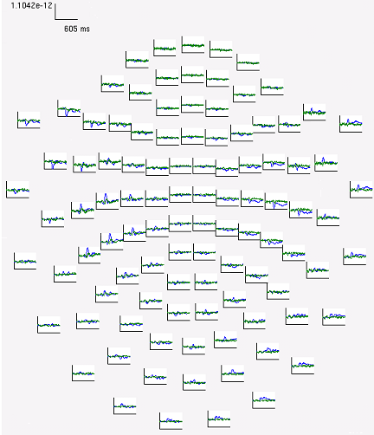
Multiple comparison problem
How many sets of EEG data will be collected for a 30 minutes recording?
Number of electrodes? 10-256 sites
Time Window? Hundred milliseconds
Experimental Design? Event-related design
Notes:
In previous fmri lecture, we have discuss multiple comparison problem which will also happen to EEG MEG data.
Take EEG as an example, there are many sets of EEG data

Slide 4
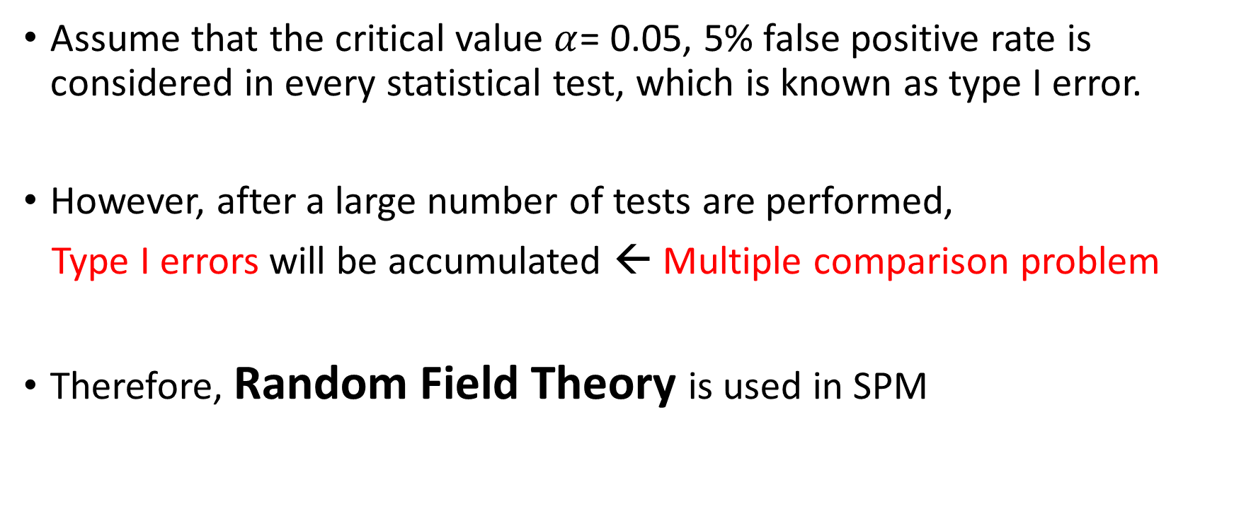
Multiple comparison problem
Assume that the critical value $α$= 0.05, 5% false positive rate is considered in every statistical test, which is known as type I error.
However, after a large number of tests are performed,
Type I errors will be accumulated ← Multiple comparison problem
Therefore, Random Field Theory is used in SPM

Slide 5
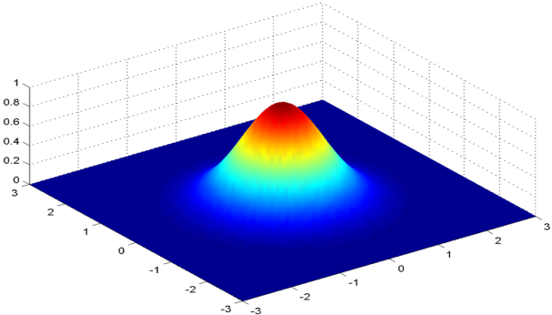
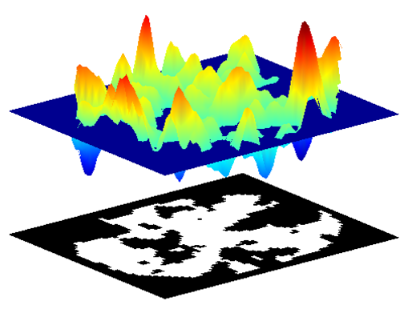
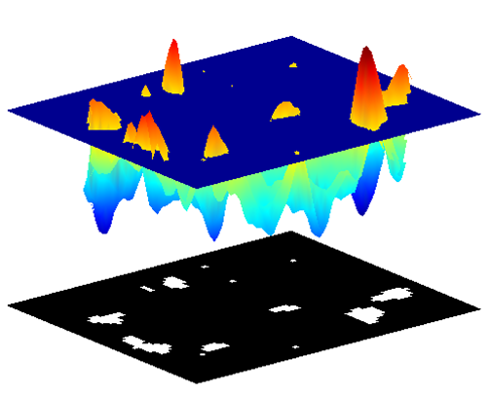
Topological Inference
Random Field Theory (RFT)
Step 1: Smoothing by the weighted average of all images
Step 2: Calculate Euler characteristic with setting up a height threshold
Multi-dimensional convolution with Gaussian kernel

Slide 6
Random Field Theory
Random Field Theory (RFT) is a method for correcting for multiple statistical comparisons with N-dimensional spaces (for parametric statistics, e.g., Z-, T-, F- statistics). In SPM up to 3 dimensions are supported.
RFT correction depends on the search volume. If you can restrict the search volume based on prior knowledge or independent data or orthogonal contrast, that can make the analysis more sensitive.
One should be careful to not bias the statistical comparison based on the same data and contrast (double dipping). Example: finding the channel with the largest effect by eye-balling and then only testing for that channel

Slide 7
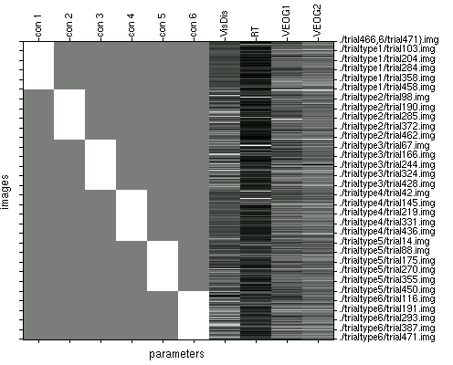
GLM: Condition Effects after removing variance due to confounds
Each trial-type (6)
Confounds (4)
Each trial
W/in Subject
(1st-level) model
-> one image per trial
-> one covariate value
per trial
Also: Group Analysis
(2nd-level)
-> one image per subject
per condition
-> one covariate value per
subject per condition
beta_00* image volumes reflect (adjusted) condition effects
Henson et al., 2008, NImage

Slide 8
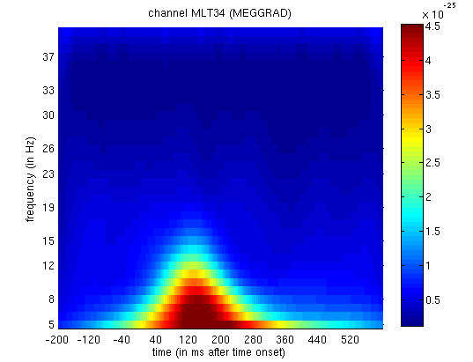
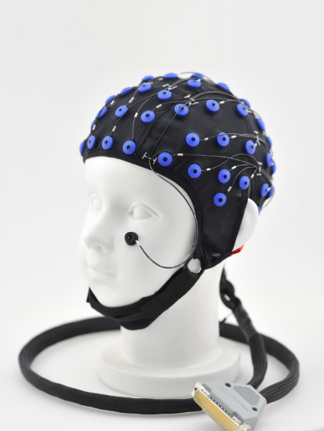
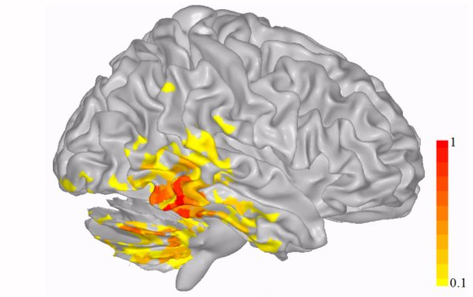
Statistical Analysis in M/EEG
Sensor-space Analysis
Source-space Analysis
Kilner et al., 2005, Nsci Letters
Notes:
The analysis can be divided into two level.

Slide 9
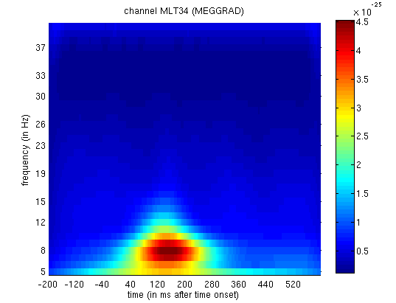
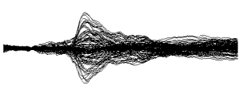

Sensor-space analysis
When is there
an effect in time
e.g., GFP (1D)?
->When/at what frequency
is there an effect
in time/frequency
(2D)?
Frequency
time
time

Slide 10
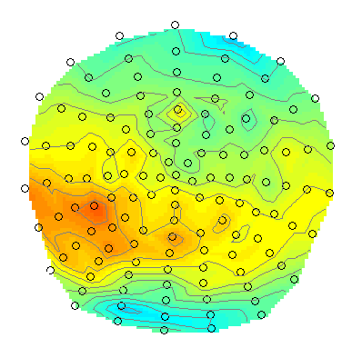
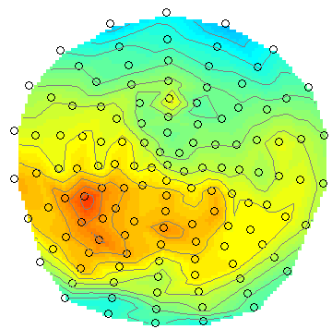
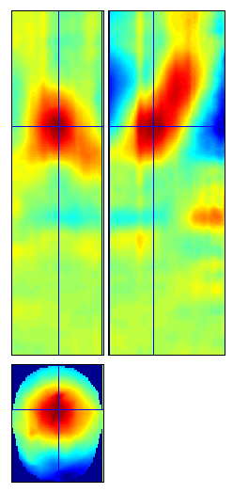
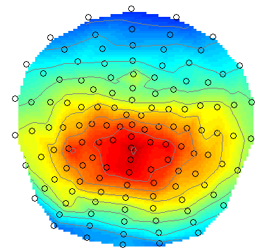
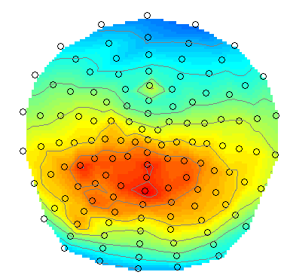
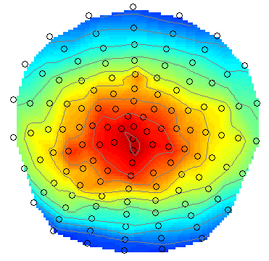
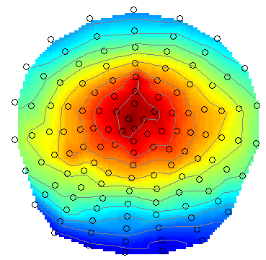
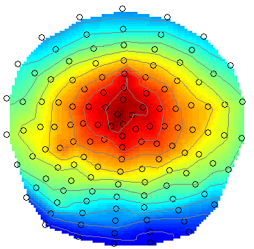
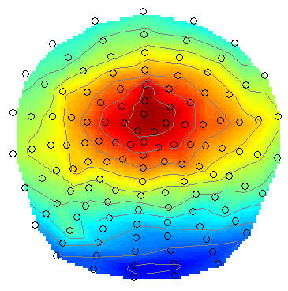
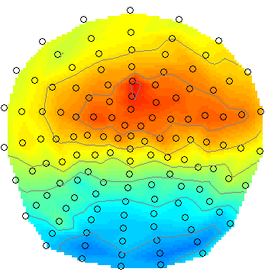
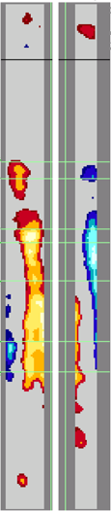
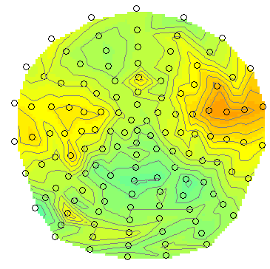
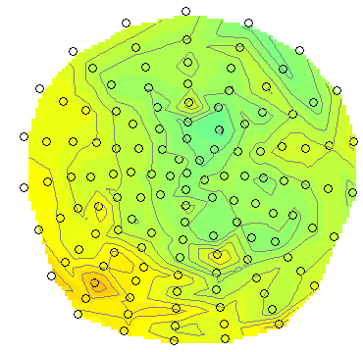
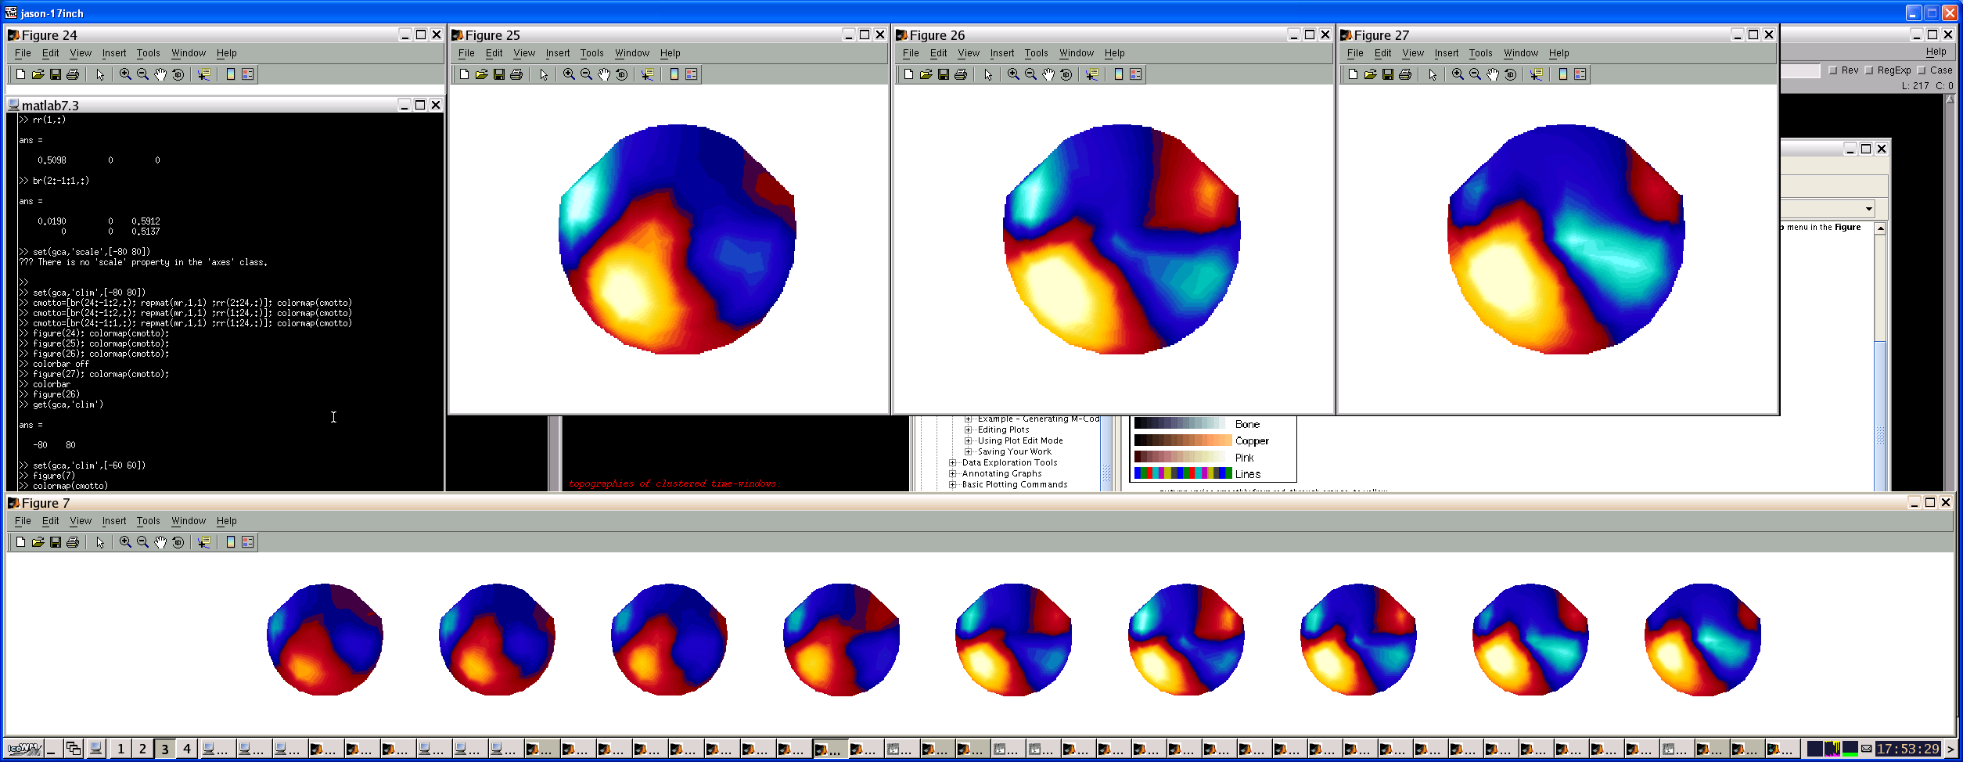
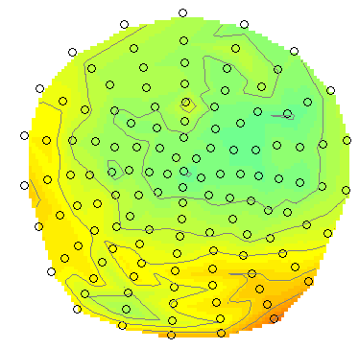
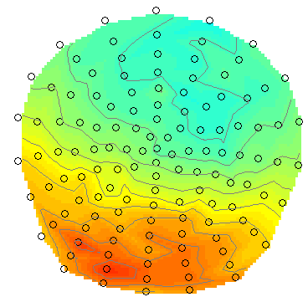
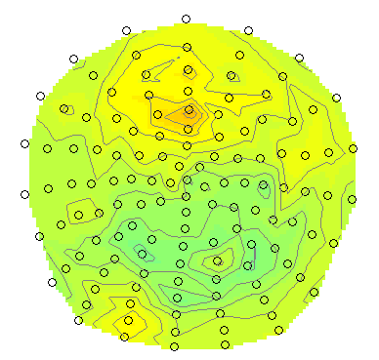
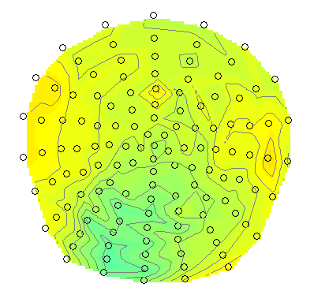
Sensor-space analysis
-> When/where
is there an effect
in sensor-topography
space/time (3D)?
x
y
time

Slide 11
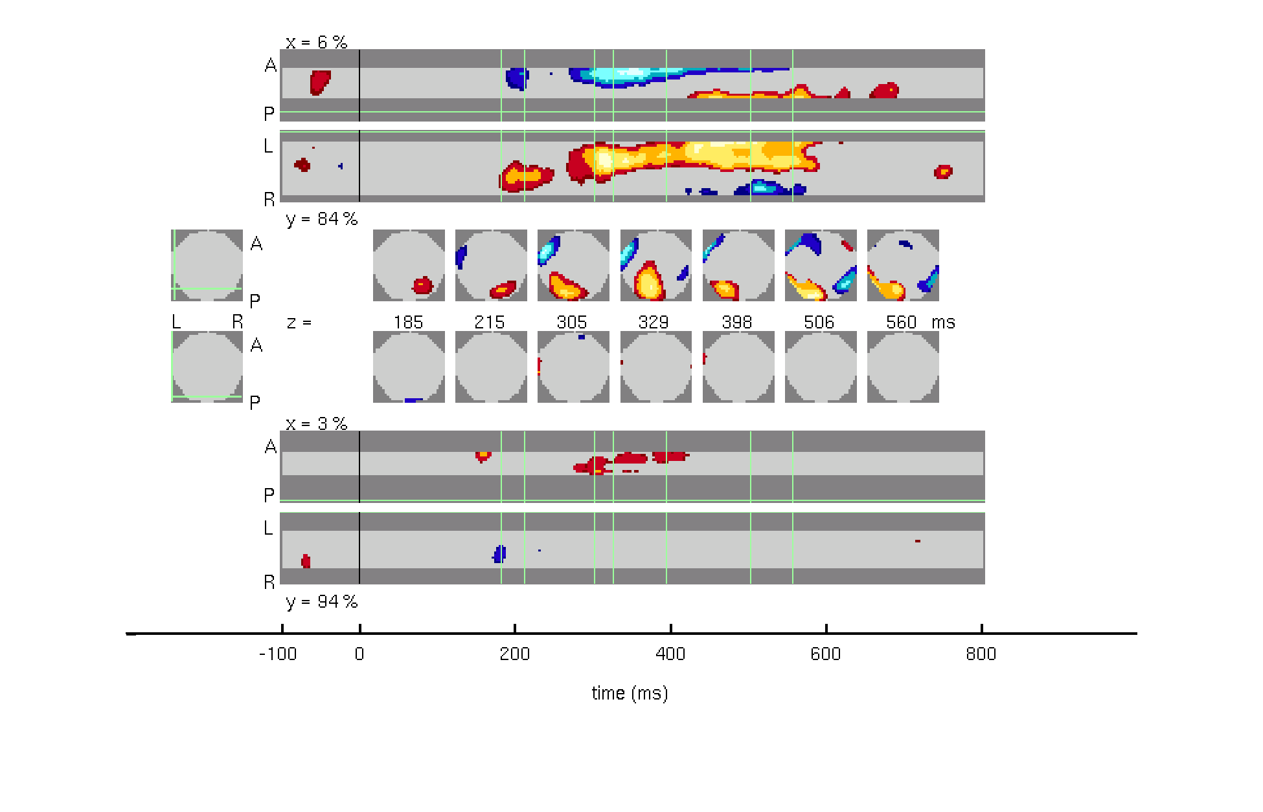
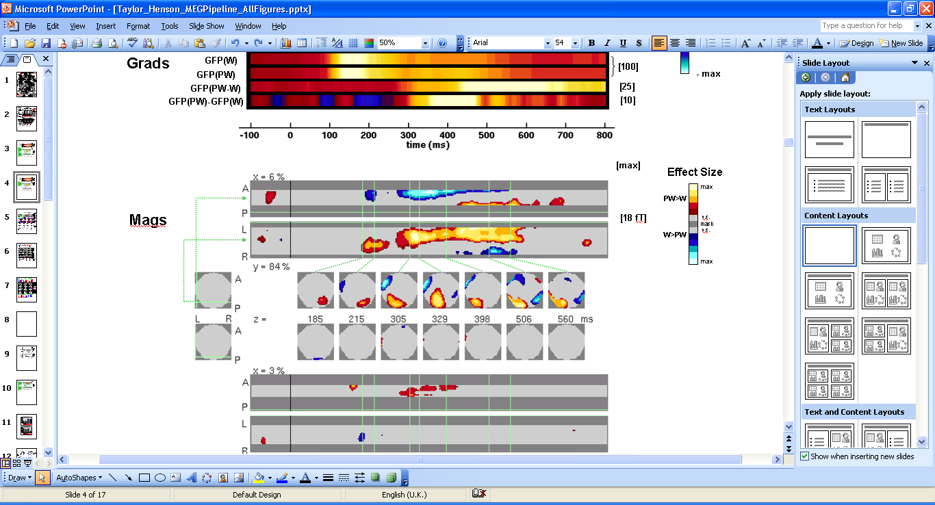
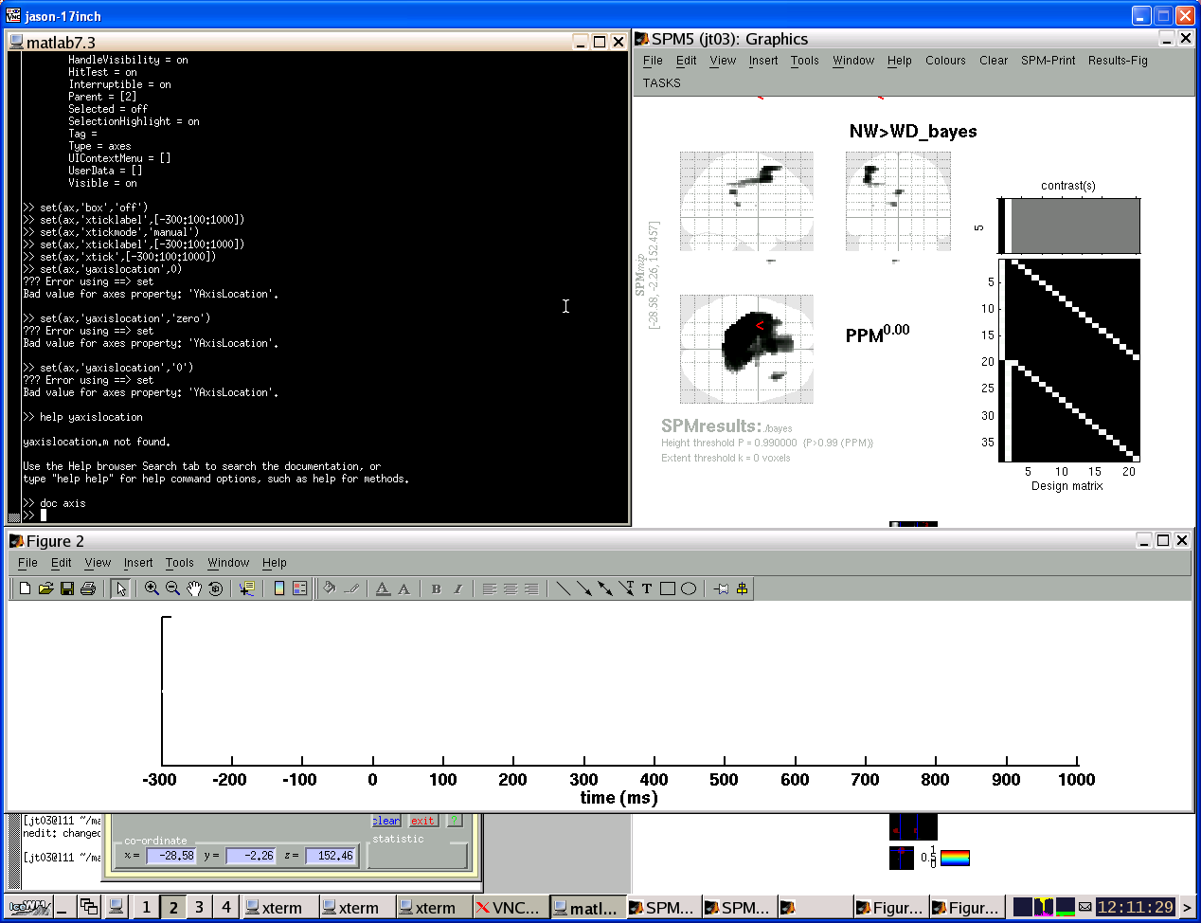
Where is an effect in sensor-time space?
Analysis over subjects (2nd Level):
NOTE for MEG: Complicated by variability in head-position
SOLUTION(?): Virtual transformation to same position (sessions, subjects)
- using Signal Space Separation (SSS; Taulu et al, 2005; Neuromag systems)
Magnetometers: Pseudowords vs Words PPM (P>.95 effect>0)
Effect Size
18
fT
-18
Taylor & Henson (submitted)
Neuromag Lexical Decision
Notes:
11

Slide 12
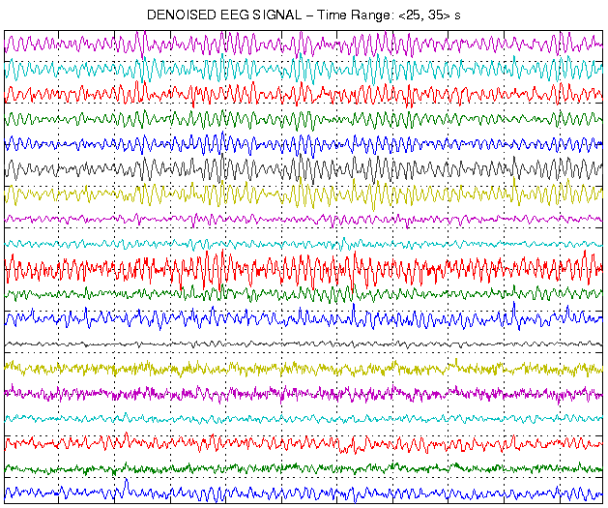
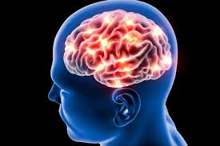
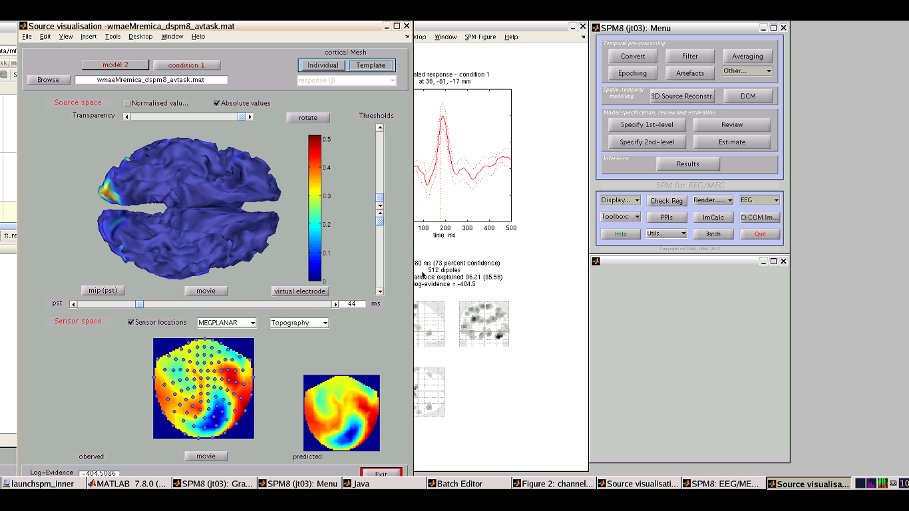
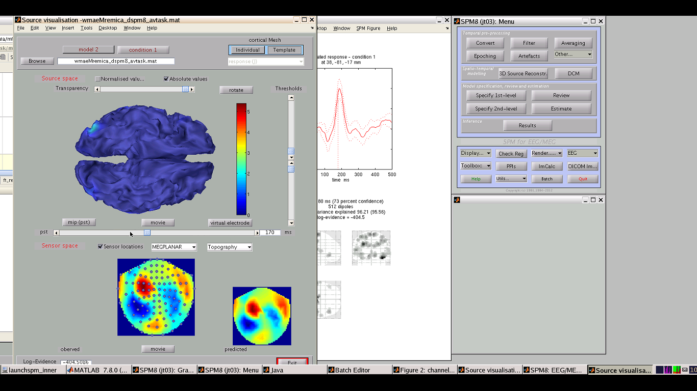
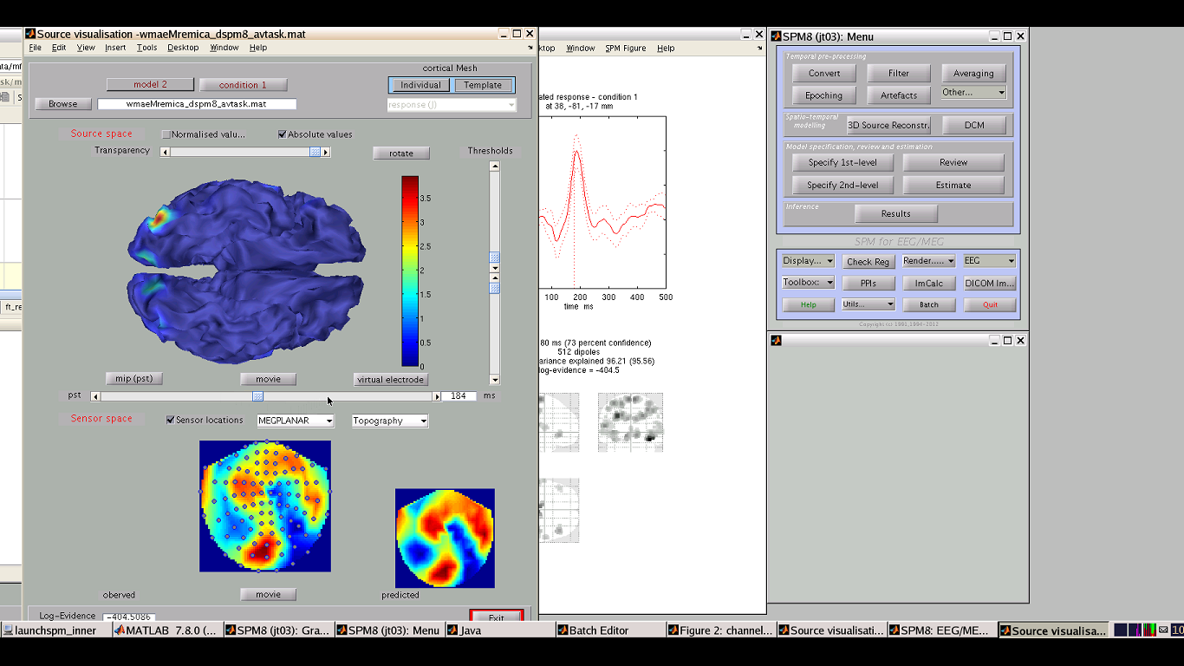
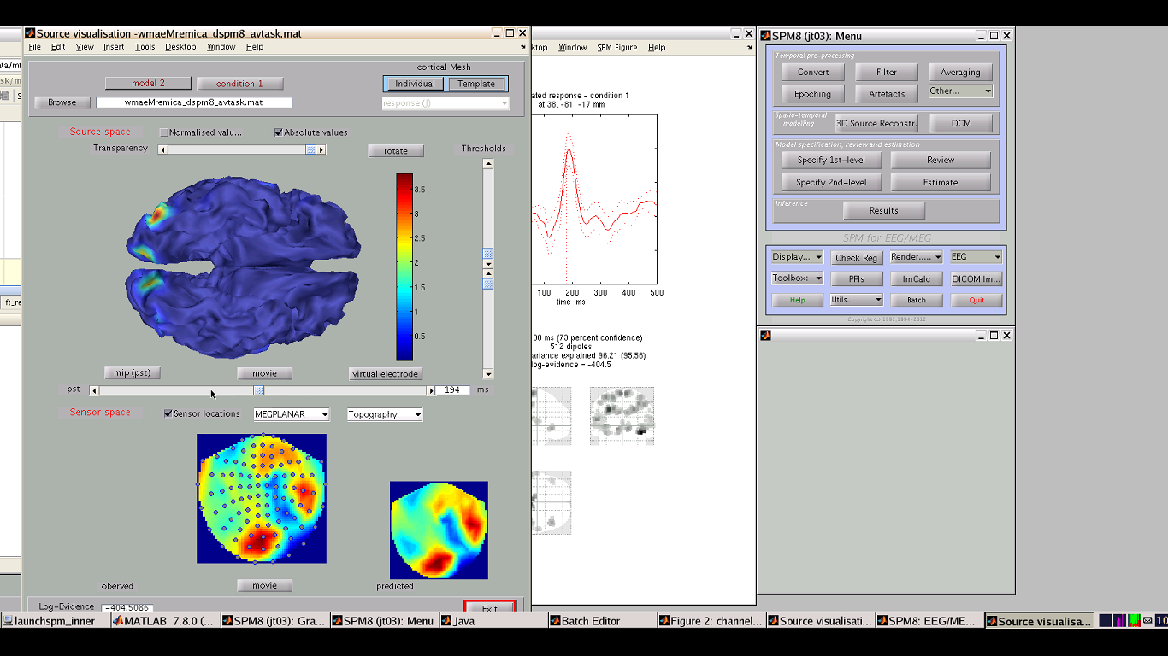
All Channels
-> When/where
is there an effect
in source space/time
(4-ish-D)?
Forward Problem
Cognitive Mechanism
Inverse Problem
x
z
Brain Activity
y
time

Slide 13
EEG/MEG source localisation

Slide 14
What can signal localisation be useful for?
Novel Application of EEG Source Localization in the Assessment of the Penumbra
Recently, authors have described the use of continuous electroencephalography (EEG) as an alternative method to monitor the ischemic penumbra.
This method has the drawback of not providing an image of the penumbra. In this case report, they describe a novel application of EEG source localisation, using routine EEG data, to provide a topographical image of the ischemic penumbra.
Further reading: https://www.karger.com/article/FullText/336332

Slide 15
1 ) Motivation for source localisation in the context of EEG & MEG:
Provides rich information on neural activity through:
> Good temporal resolution (1ms) almost real time response
>Allows characterisation of specific event related potentials e.g. an activity undertaken by the human body (the event) and its related response on M/EEG as a series of potentials.
>Describes oscillatory activity and hence provides information on patterns potentials
>This therefore allows us to disentangle the dynamics of cortical networks
However, there are issues in these methods that need addressing:
Provides poor:
>Poor/low spatial resolution therefore preventing us from extrapolating the exact source (anatomical structure). This is important if you have a research question or treatment target in mind. You can see there is an aberrant signal or rather the signal of interest but you have NO CLUE where it is actually coming from.
>Signals overlap further adding to the confusion

Slide 16
2) Motivation for source localisation in the context of EEG & MEG:
Event related potentials (ERP): If you find a point of interest in your EEG data such as a specific ERP then you want to characterise it in its physiological terms which can be done through time/frequency shifts in potentials. However, localising the signal requires an interpretation of the scalp topography.
Methods known as ‘forward’ and ‘inverse’ modelling are used to help you interpret this scalp topography.

Slide 17
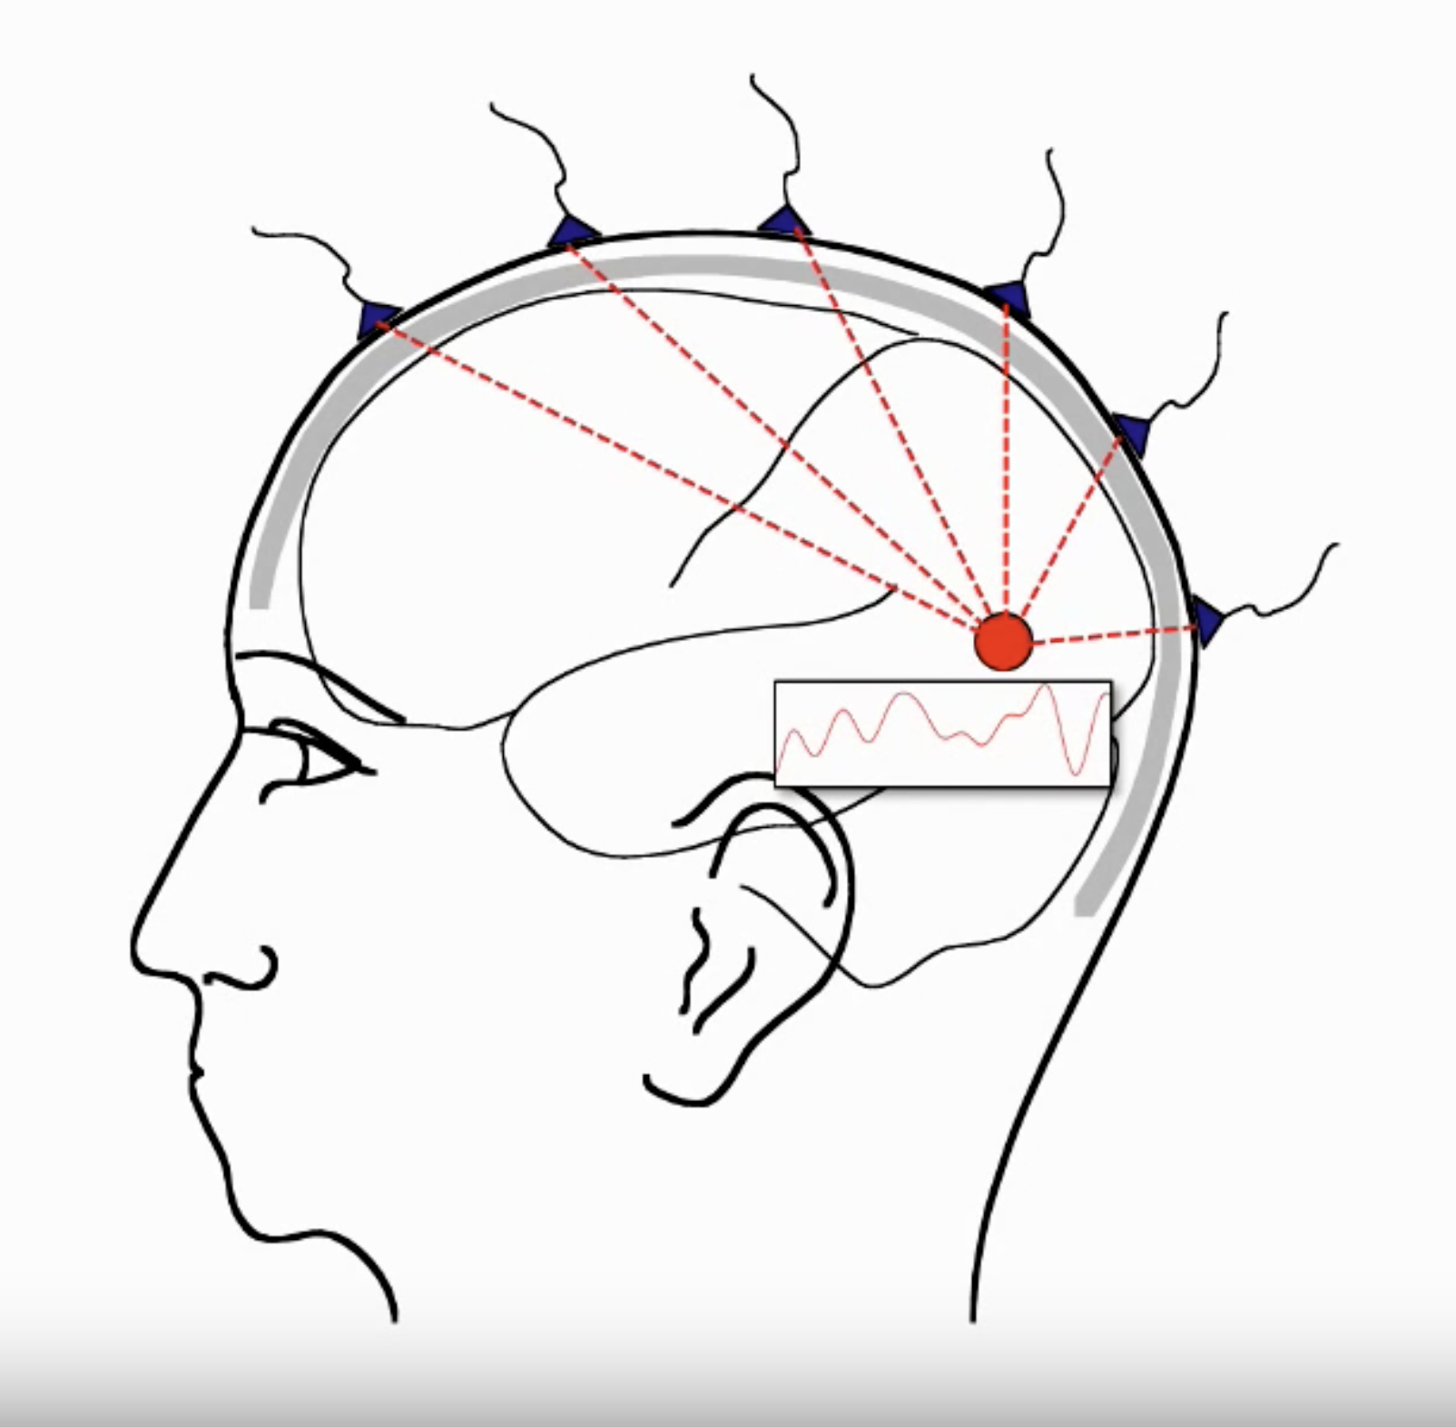

Slide 18
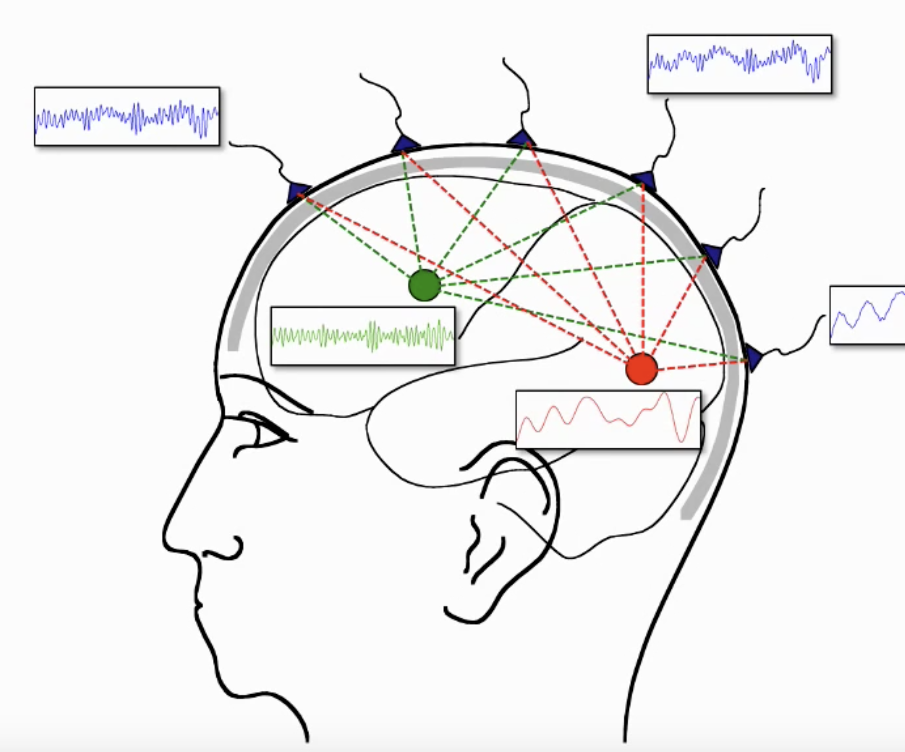

Slide 19
Issues with M/EEG data upon acquisition: Superposition of source activity
Key concepts:
Overlap of and thus variable visibility of each source to each channel being recorded. If two source of signal are present simultaneously (and this does happen all the time in the brain) the channels from the front will pick up signals mainly from the front source whereas the middle will pick up front and back whilst back source will be picked up by occipital channels. This creates noise in the signal preventing access of our rich information.
The time course of each source contributes to each channel
Importantly, the contribution of each source depends on its ‘visibility’ which is initially occluded by various source to channel acquisition.
Essentially, multiple signals including EPR/point of interest is clouded by other sources at the same channels as a result of superposition of signals at each channel.

Slide 20
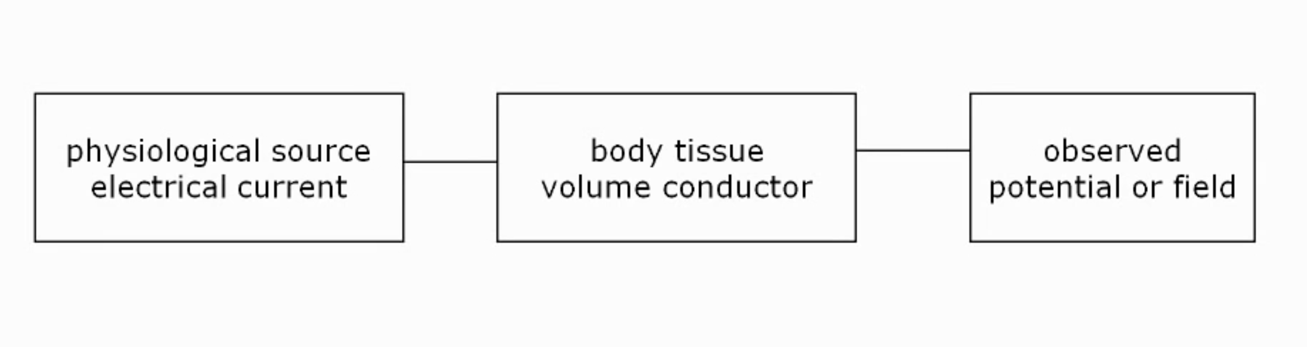
Source modelling
Key concepts:
Forward modelling >>>>>>>>>>>>>>>>>>>>>>>>>>>>>>>>>>>>>>>>>>>>>>>>>>>>>>>>>>
Is to start from source and make predictions of what the how the observation will look like
1) The neurons> produce electrical currents
2) The currents flow through> the brain/the tissue of the head.
3) >Produce the observed potentials
Inverse modelling <<<<<<<<<<<<<<<<<<<<<<<<<<<<<<<<<<<<<<<<<<<<<<<<<<<<<<<<<< <<<<<<
Is to start from the OBSERVATION and try to infer/predict what the underlying physiological might be.
Inverse modelling is the MAIN point of interest for most researchers as they start from observations and work
backwards to identify the source. However, you CANNOT do inverse modelling before doing the forward model.

Slide 21
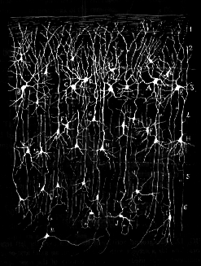
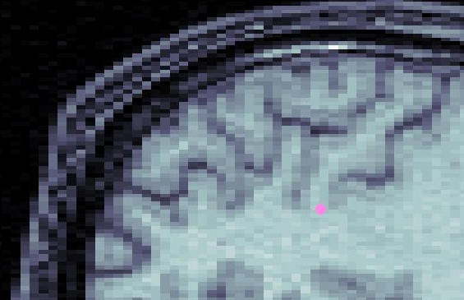
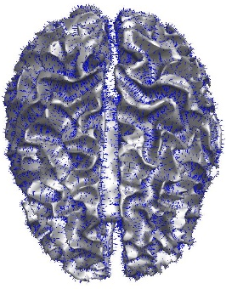
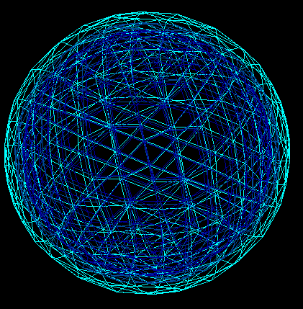
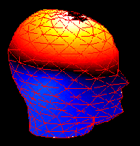
Key concepts:
Components of the source reconstruction process
Source model
‘ECD’
‘Imaging’
1) The neurons> produce electrical currents
2) The currents flow through> the brain/the tissue of the head.
Forward model
Mesh/housing required = BEM, FEM & FDM
Registration
3) >Produce the observed potentials
Inverse method
Data
Anatomy

Slide 22
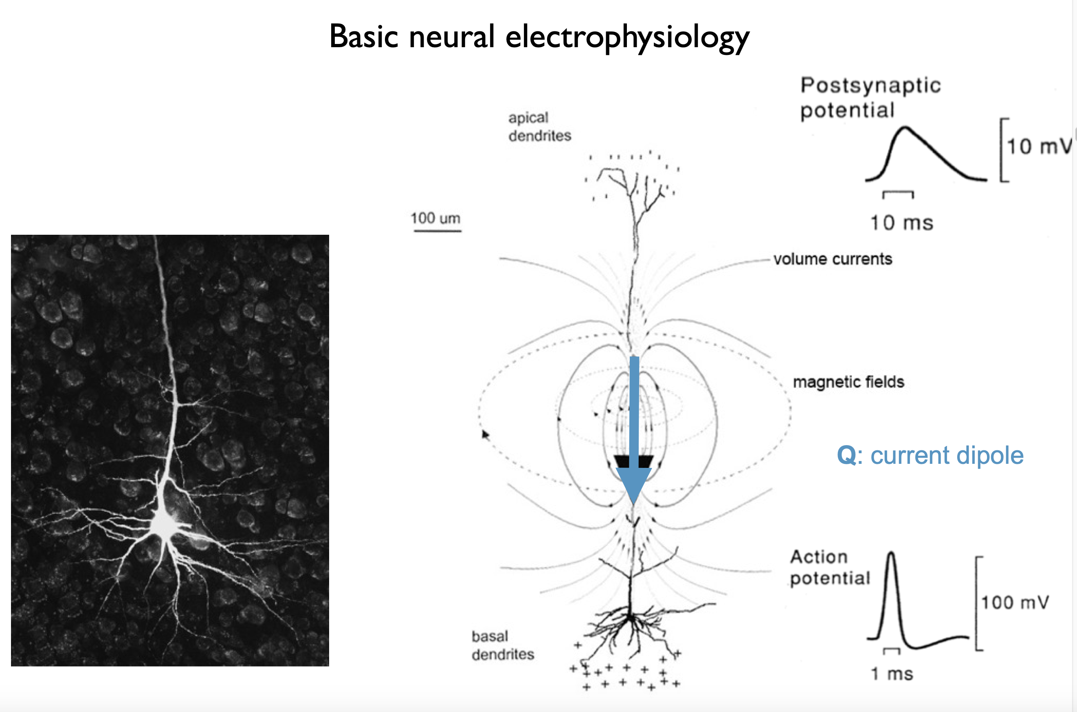

Slide 23
SMALL PEAKS= PSP
LARGE PEAK= AP

Slide 24
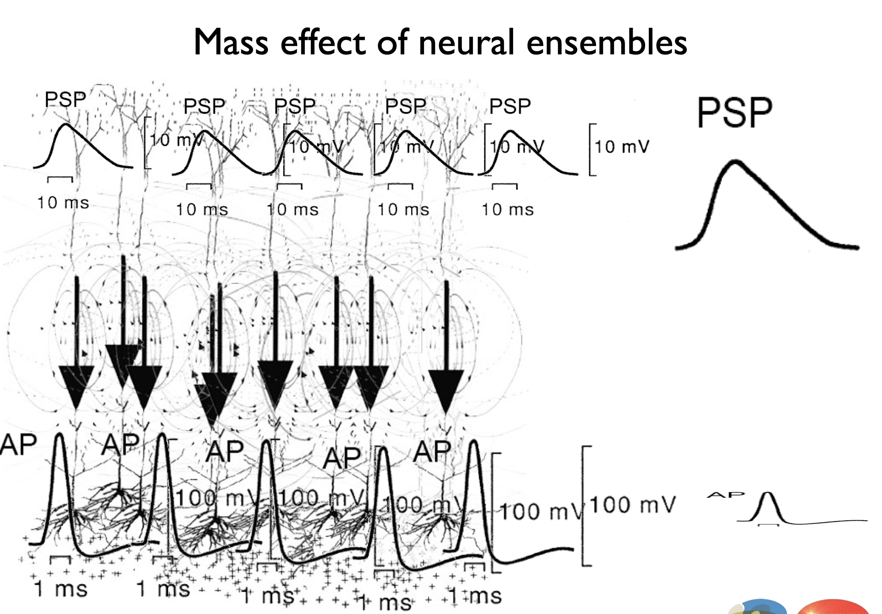

Slide 25
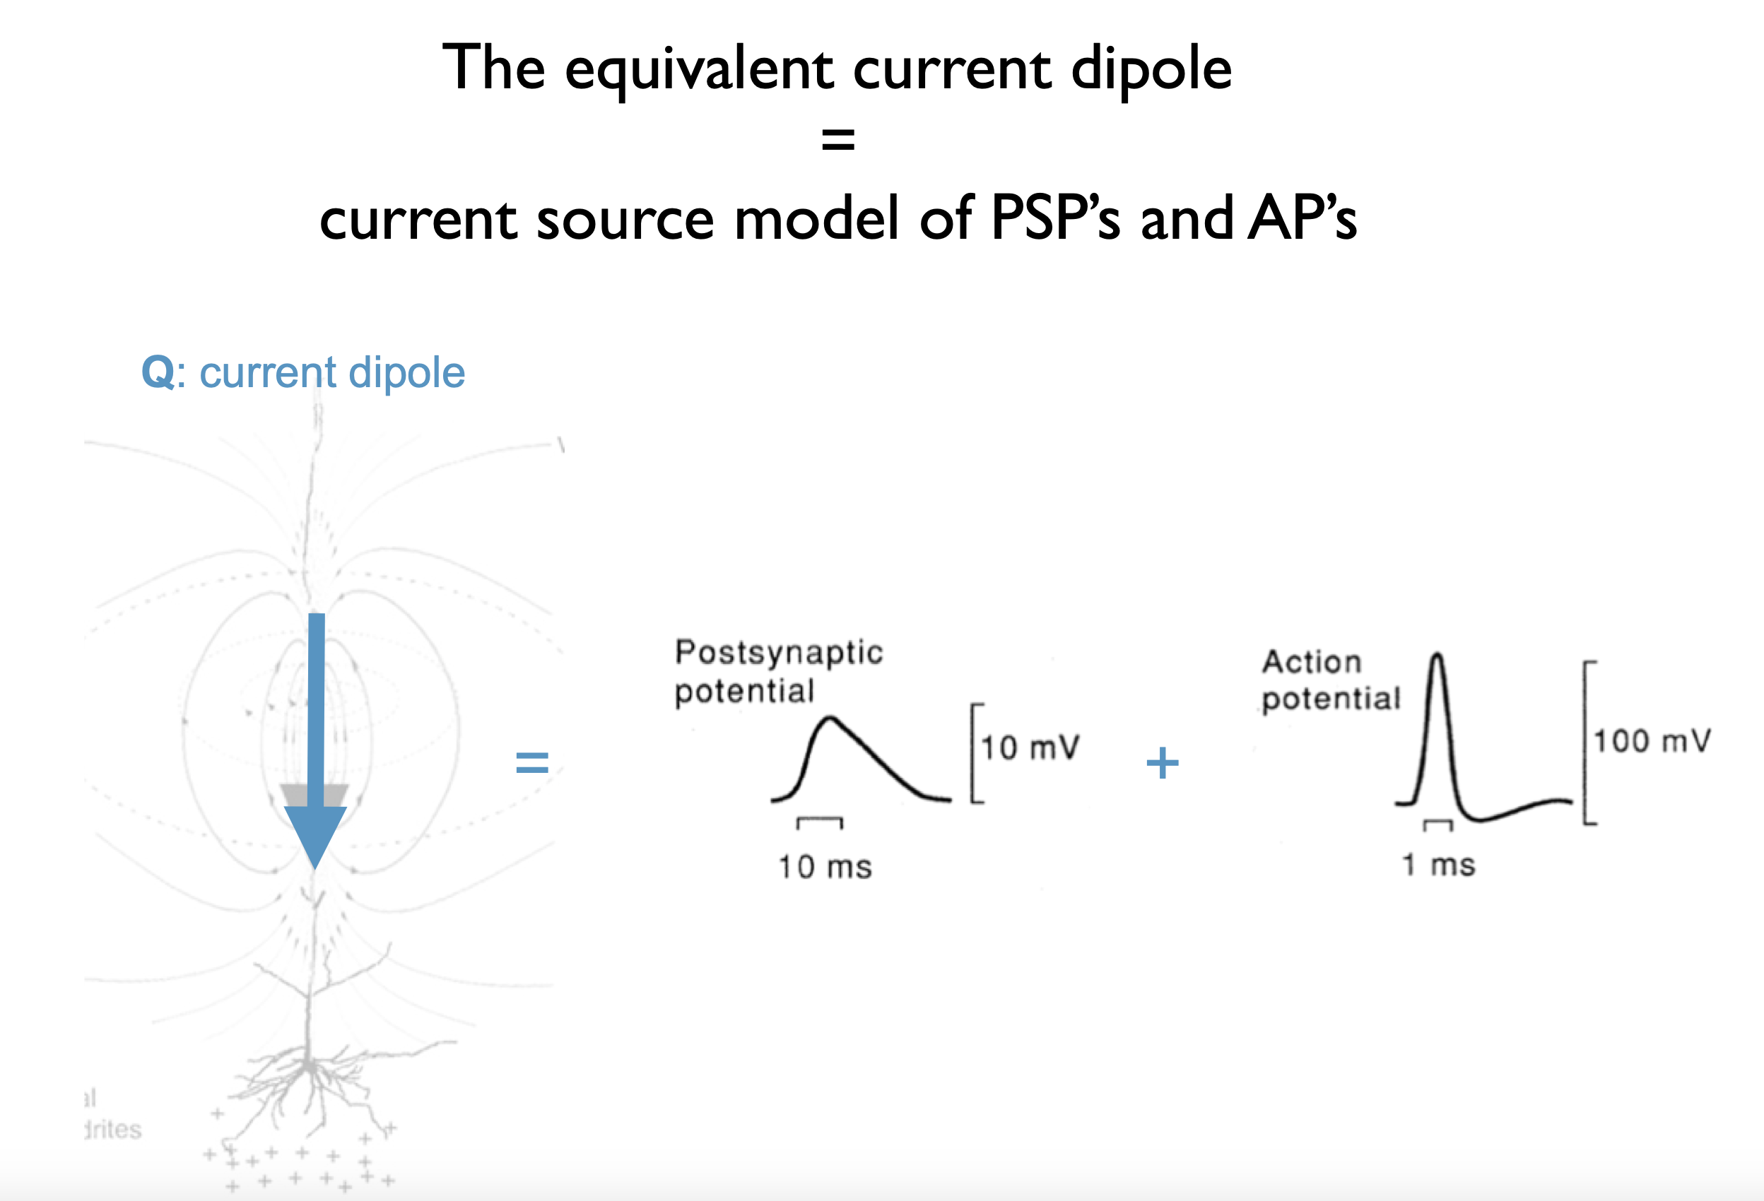
ECD
PSP’s= Post synaptic potential
Ap’s=Action potential

Slide 26
Dipoles
Dipoles

Slide 27
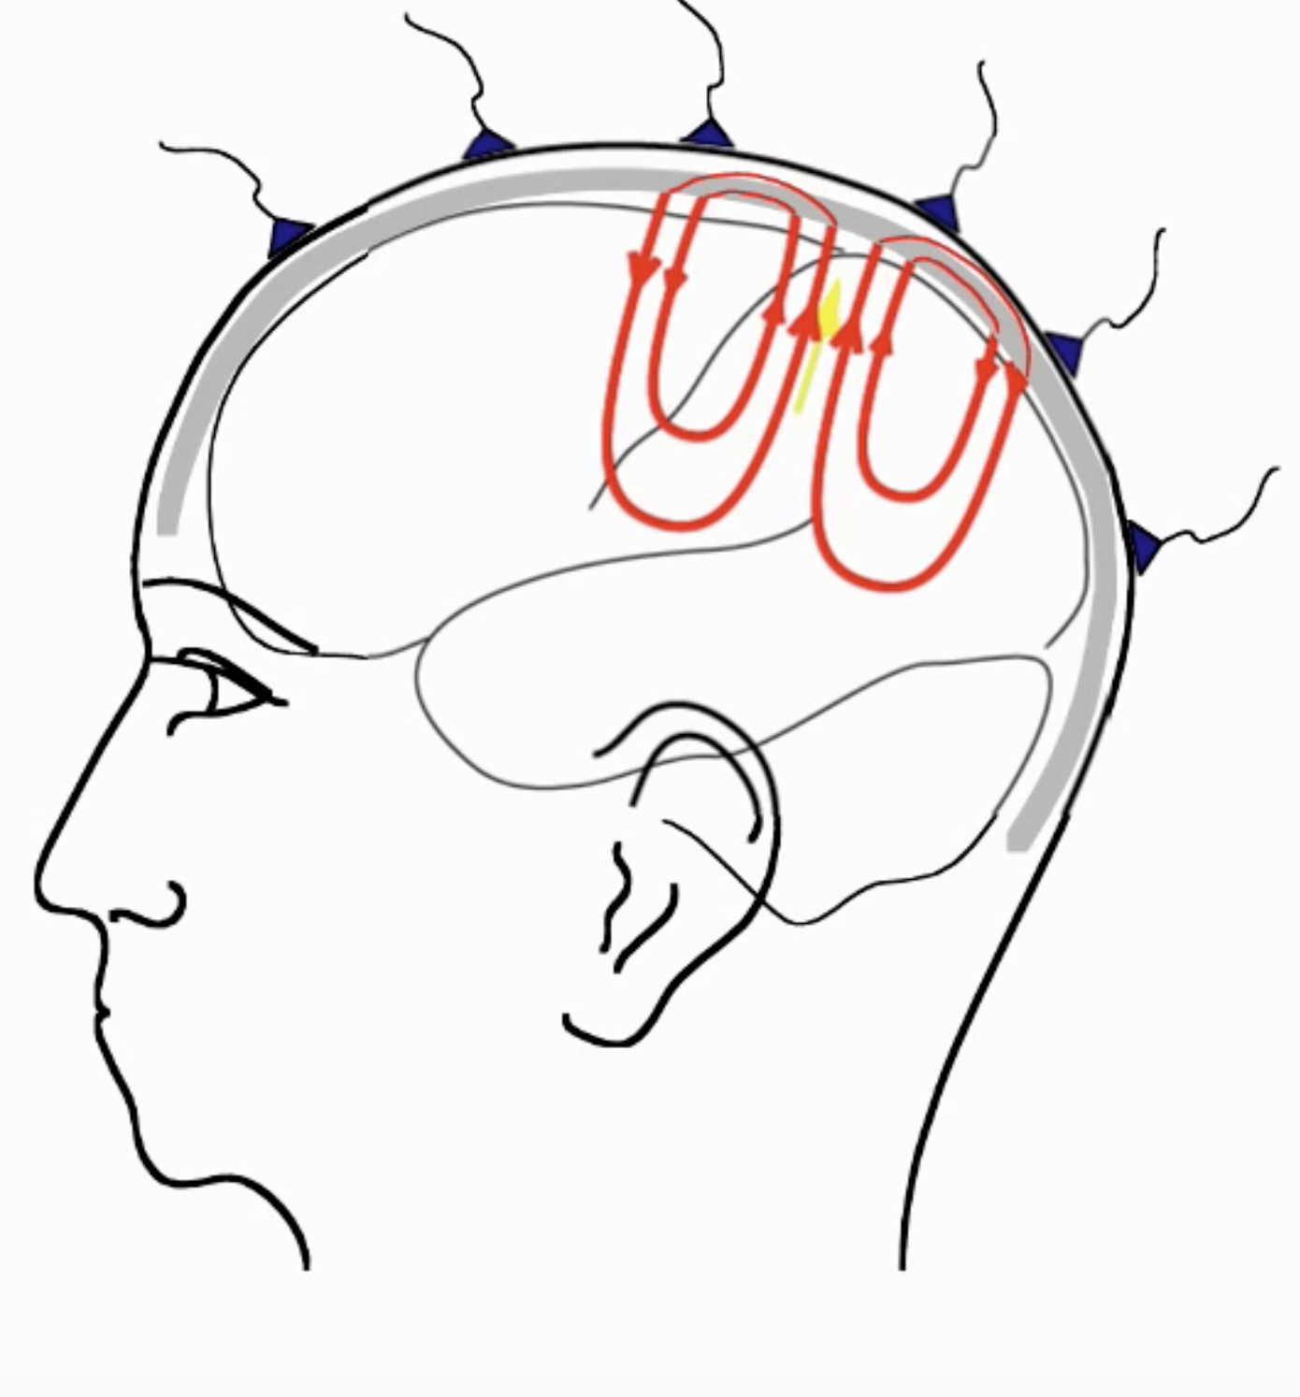
EEG Volume conduction
Cortical tissue produces current upon activation, volume currents flow through
the tissue of the brain into the skin and then into the electrodes recorded as potential distribution. Thus EEG records the potential of current as a result of volume currents

Slide 28
The potential difference between the electrodes corresponds to to the current flowing through the skin. HOWEVER, the skull is a very poor conductor and therefore only a very small portion of the current will flow through the skin.
Therefore, in order to accurately understand the current flowing into the EEG electrodes, we need to model the skin and skull as accurately as possible.

Slide 29

MEG
The same activity that triggers electrodes also in
primary currents produces a magnetic field around the head.
The magnetic field of the secondary currents is also recorded. The secondary currents are what we need volume conduction models.
Only tiny fraction of the current passes through the poorly conductive skull. Therefore the skull and the skin are neglected in the MEG model.
Therefore with MEG we can use a simple volume conduction model.
Similarities with EEG:
Identical source model
Similar volume conductor model
IDENTICAL inverse methods apply!

Slide 30
ECD = Source model
Key concepts:
A summation of currents of many neurons with the same positive-negative direction can be mimicked as one strong dipole. This is termed the equivalent current dipole (ECD).
Simplification of action potentials are used to mimic activity of neuronal dendritic trees (image focusing on a piece of tissue with many dendrites) through a mathematical model termed ‘Equivalent current dipole’ or ECD. The ECD is a description of + and – poles much like a battery. The process cannot use a single neuron as the resolution is to low therefore a column of tissue is taken into though and given a larger overall ECD instead as a representative. Depending on the focus this can and usually is further simplified as an even larger ECD representative.

Slide 31
Components of the source reconstruction process
Source model
‘ECD’
‘Imaging’
Dipole fitting assumes that a small number of point-like equivalent current dipoles (ECDs) can describe the measured topography.
It optimises the location, the orientation and the amplitude of the model dipoles in order to minimise the difference between the model and measured topography.
1) The neurons> produce electrical currents
2) The currents flow through> the brain/the tissue of the head.
Forward model
Mesh/housing required = BEM, FEM & FDM
Registration
3) >Produce the observed potentials
Inverse method
Data
Anatomy

Slide 32
1) Forward modelling
Key concepts:
1) Source model (ECD) and Volume reconstruction model (the head model) required (for interpretation of scalp topographies). Forward modelling is interpretation of scalp topography.
2) Volume reconstruction model= volume conductor model needed (the mesh of the head (realistic ‘numerical’ model) or it’s already modelled template from SPM12 known as the analytical spherical model).

Slide 33
2) Forward modelling: The passive conductive device (Volume conductor model)
The volume conductor model describes 1) the electrical properties of tissues 2) describes the geometrical model of the head 3) it describes HOW the current flows BUT NOT where they originate from (source).
The spherical conductor model is the simplest but lacks the finer degree of accuracy that you may find in other more computed models such as: 1) Boundary Element Method (BEM), 2) Finite Elemental Method (FEM) & Finite Difference Method (FDM).
What are the differences?

Slide 34

What are the differences?
Key concepts:
BEM uses boundaries/surfaces and these are based on small triangles
FEM uses small tetraeders, small volume element
FED uses hexaheders (cubes)
BEM assume there are compartments and each of these compartments are homogenous, identical connectivity & isotropic, conductivity flowing in any direction.
Important tissues to consider: 1) Skin 2) Skull 3) Brain 4) CSF = different electrical properties ‘assume all have homogenous conductivity’. Triangles allow a surface like the one on the left to form.

Slide 35

1 ) More on Boundary Element Method
Constructing the geometry:
Start with an anatomical MRI, segment this MRI in the different tissue types,
assigning an integer to the skin, skull and brain.
Extract surface descriptions (triangles) describing the boundaries and down size them to a reasonable amount.
Computational model:
This is independent of source model (EEG sensors and their placement doesn’t matter)

Slide 36
2 ) More on Boundary Element Method
Approximates the different compartments of volume conductor models by closed triangle meshes with a limited number of nodes. The shielding effect of the weakly conducting skull layer of the human head leads to decreasing potential gradients from the inside to the outside.

Slide 37
Another model: Finite Element Model (FEM)
FEM for the volume conductor. Tesselate (arrange without gaps) 3D tetraedrs. In this model we describe the whole volume and not just the surfaces.
Simplification of tessellation allows larger volumes to form where less accuracy is required, like the skull.
Most accurate numerical method for computing the forward problem, we could have as it allows direction specific connectivity tetraeders.
These FEM models enable the realistic modelling of complex geometries and important conductive features particularly due to their accounting for anisotropic conductivities. Different values for different directions of conduction.

Slide 38
1) Inverse modelling
Dipole fitting assumes that a small number of point-like equivalent current dipoles (ECDs) can describe the measured topography.
It optimises the location, the orientation and the amplitude of the model dipoles in order to minimise the difference between the model (ECD model)and measured topography (EEG data).
Single vs multiple dipole fitting
Distributed sources
Spatial filtering
The idea is to explain what the potential would look like given the observation sources (EEG data). Aim try to minimise error between model and measured potential. This is done by fitting our forward model and its ASSUMPTIONS our our EEG data.

Slide 39
2) Inverse modelling
Alternatively, distributed source models also exist perfect fit of model to measured potential, this requires assumptions to be made about smoothness and or power of the model or amplitude.
Or Spatial filtering (not to fully explain surface topography)

Slide 40
3) Final thoughts on inverse modelling
Mathematical approaches
Dipole fitting (linear=strength and non linear=position)
Linear estimation (regularisation) Only explaining point of interest in data not noise

Slide 41


Slide 42
Forward model solution
Key concepts:
Source Model (e.g. ECD) + Head Model (e.g. boundary-element):
Origins to signal
^^^^^^^^^^^
Make model assumptions for the volume conductor
Make model assumptions for the source i.e. dipole (ECD description)
Additional assumption about the source:
Only a single point source
Multiple (but not many) sources
Distributed source (many source and focusing on strength calculation instead)

Slide 43
Key concepts:
Inverse Solution
Model fitting
  Minimize the sum of squares error between the data and the model by adjusting model FREE parameters (dipole location, orientation, magnitude, time-course).
  This is done to match the data with some expectations, usually additional hypotheses or information might be required

Slide 44
In the end
Source modelling is about disentangling the superpositions; scalp measurements are a superposition of the source activity
Ultimately answers using these methods allows us to identify where the sources (localisation) are & what their time course is

Slide 45


Slide 46


Slide 47


Slide 48


Slide 49


Slide 50


Slide 51


Slide 52


