Slide 1
Bayes for Beginners
MfD – 19th February 2020
Ingrid Martin and Isla Jones
Expert: Peter Zeidman

Slide 2
Outline
Background on Bayes
Probability
Bayes theorem and Examples
Worked example - Coin flipping model
Classical vs Bayesian approaches

Slide 3
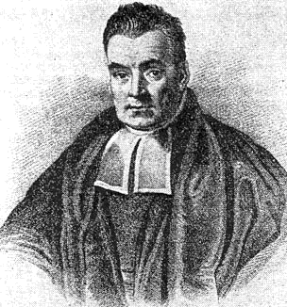
Bayesian Statistics
Prior Belief
&
New Information
Posterior Belief
=
Bayesian statistics is a mathematical procedure that applies probabilities to statistical problems. It provides people the tools to update their beliefs in the evidence of new data
Can be used as model for the brain (Bayesian brain), history and human behaviour.
Can be used to compare evidence for multiple theories (Bayes Factor)

Slide 4
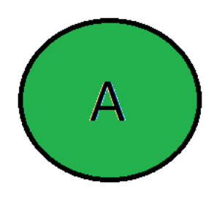
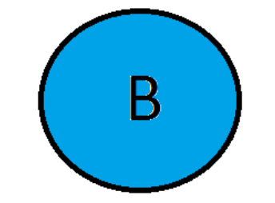
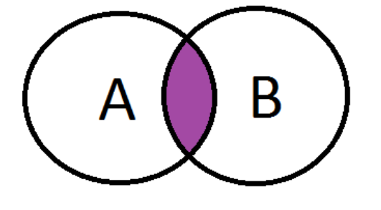
Probability of A occurring: P(A)
Probability of B occurring: P(B)
Joint probability (A AND B both occurring): P(A,B)

Slide 5
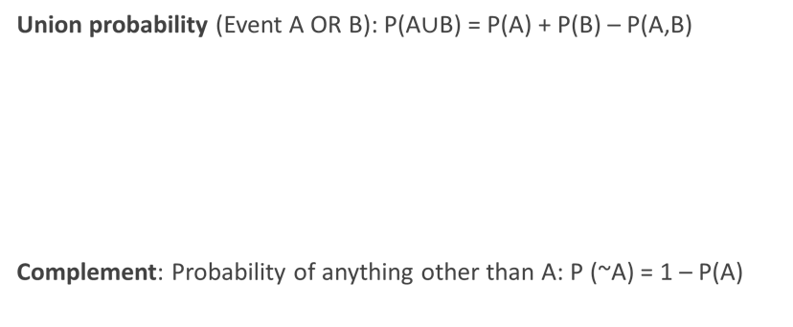
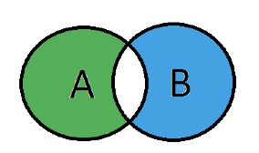
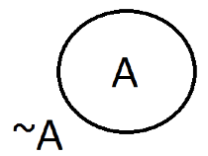

Slide 6
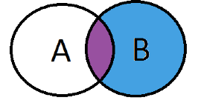
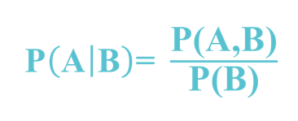
Conditional probability Probability of A given B - P(A|B)
Set A represents one set of events and Set B represents another. We wish to calculate the probability of A given B has already happened

Slide 7
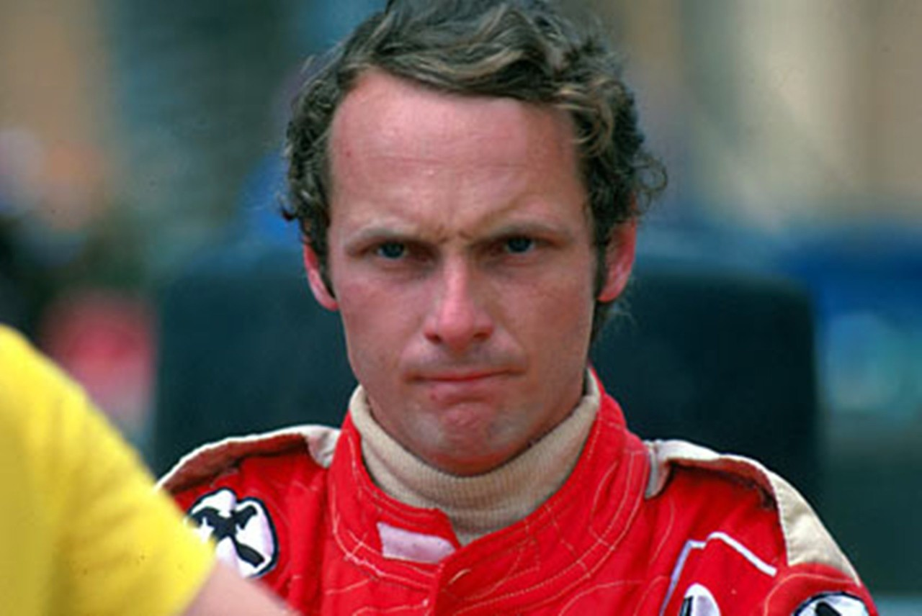




An example:

Slide 8
An example:
Suppose, B be the event of James Hunt winning
and
Let A be the event of raining.
P(A) =1/2, since it rained twice out of four days.
P(B) is 1/4, since James won only one race out of four.
P(A|B)=1, since it rained every time when James won.
P(JH Win|Rain) = (1 x 0.25) = 50%
/0.5

Slide 9
An example:
Substituting the values in the conditional probability formula, we get the probability to be around 50%, which is almost the double of 25% when rain was not taken into account
This further strengthened our belief of James Hunt winning in the light of new evidence i.e rain.

Slide 10
Another example: Routine disease screening
10% of people over sixty who participate in the routine screening have disease X.
Out of those who have disease X, 70% will get a positive result.
However, out of all of those who do not have disease X, 20% will also get a positive result.
A person in this age group goes for screening and receives a positive test result. What is the probability that she actually has disease X? (i.e. the probability of her having disease X, given the positive test result)

Slide 11
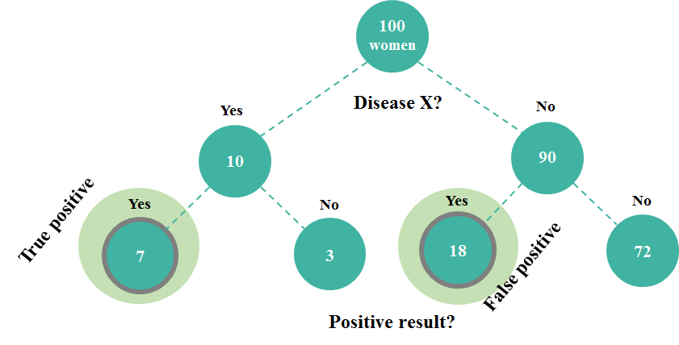
Another example:
However, 20% of those without the disease will also get a positive result from the screening
10% over 60 have disease X
70% of those with disease will get positive result

Slide 12
Another example:
Probability of having disease X given the positive result = True positives / Total positives
= 7/(7+18)
=0.28
So the probability of the patient having disease X given their positive test result is 28%

Slide 13
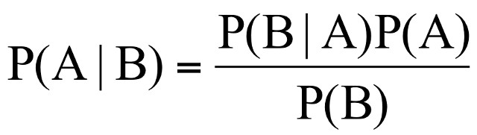
Bayes Theorem:
Likelihood
Prior
Posterior
Denominator

Slide 14
In another form:
P(DX|Po) = prob of disease given pos result
P(Po│DX) = prob of pos result given disease
P(DX) = prob of disease
P(Po│¬DX) = prob of pos result given NO disease (false positive)
P(¬DX) = prob of NO disease
Likelihood
Prior
Posterior
Denominator

Slide 15
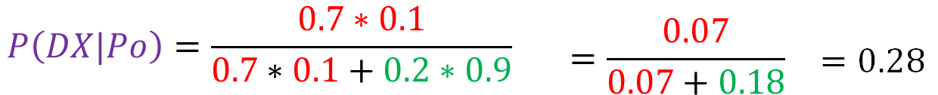
Using the formula:
P(DX|Po) = prob of disease given pos result
P(Po│DX) = prob of pos result given disease
P(DX) = prob of disease
P(Po│¬DX) = prob of pos result given NO disease (false positive)
P(¬DX) = prob of NO disease

Slide 16
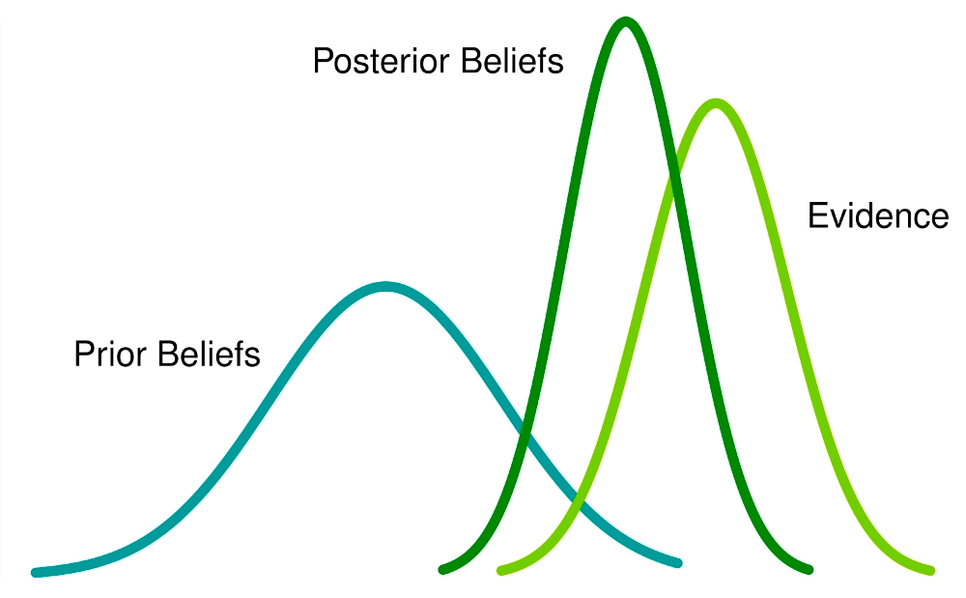
Bayes Theorem:
Ultimate goal is to calculate the posterior probability density, which is proportional to the likelihood (of our data being correct) and our prior knowledge.

Slide 17
The transposed conditional fallacy
P(A|B) is NOT the same as P(B|A).
This is often confused, leading people to make incorrect inferences. For example:
P(Data|NotTheory) is represented by the p value (i.e. how likely are your data if the null hypothesis is true).
This is NOT the same as the probability of the null hypothesis being true, given your data - P(NotTheory|Data).
If your p value is 0.01, that does NOT necessarily mean that there is a 0.01 probability that the null hypothesis is true.

Slide 18
Prosecutor’s fallacy
E = Forensic evidence against a suspect
I = innocent
P(E|I) is unlikely - it is unlikely that there would be forensic evidence against an innocent person.
However, this does not necessarily mean that P(I|E) - the probability that the person is innocent, given the forensic evidence against them - is equally unlikely. But this is a common logical fallacy.

Slide 19

If it is still a little confusing..
P (eaten by a shark| dead)
is not the same as
P (dead| eaten by a shark)

Slide 20
Coin flipping model:
•Someone flips coin.
•We don’t know if the coin is fair or not.
•We are told only the outcome of the coin flipping.

Slide 21


Coin flipping model:
1st Hypothesis: Coin is fair, 50% Heads or Tails
2nd Hypothesis: Both side of the coin is heads, 100% Heads

Slide 22
Coin flipping model:
1st Hypothesis: Coin is fair, 50% Heads or Tails
P(A = Fair Coin) = 0.99
2nd Hypothesis: Both side of the coin is heads, 100% Heads
P(A = Unfair Coin) = 0.01

Slide 23
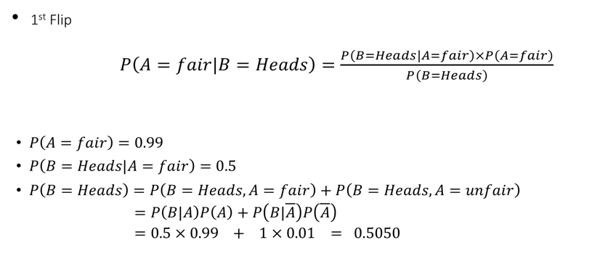

Coin flipping model:

Slide 24
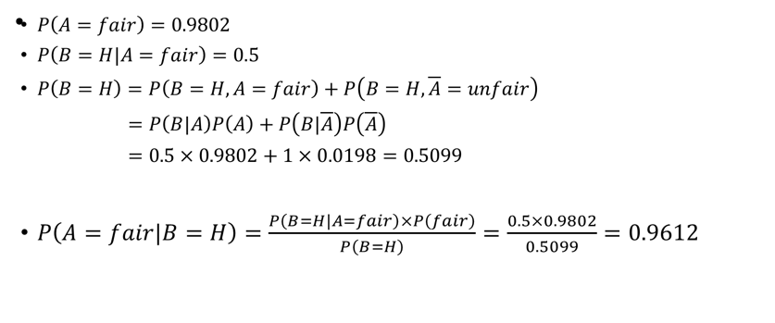
Coin flipping model:

Slide 25
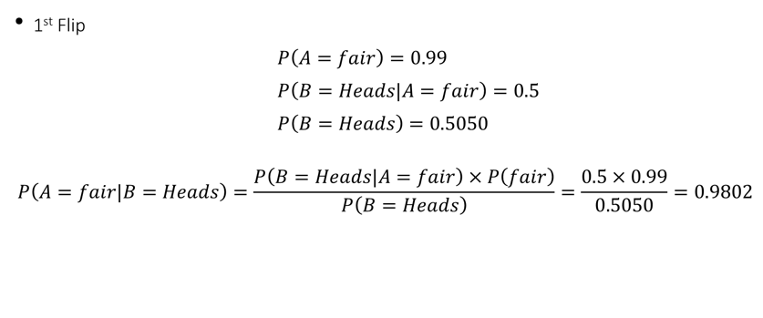
Coin flipping model:

Slide 26
Coin flipping model:
Coin is flipped a second time and it is heads again.
Posterior in the previous time step becomes the new prior!!

Slide 27
Coin flipping model:

Slide 28
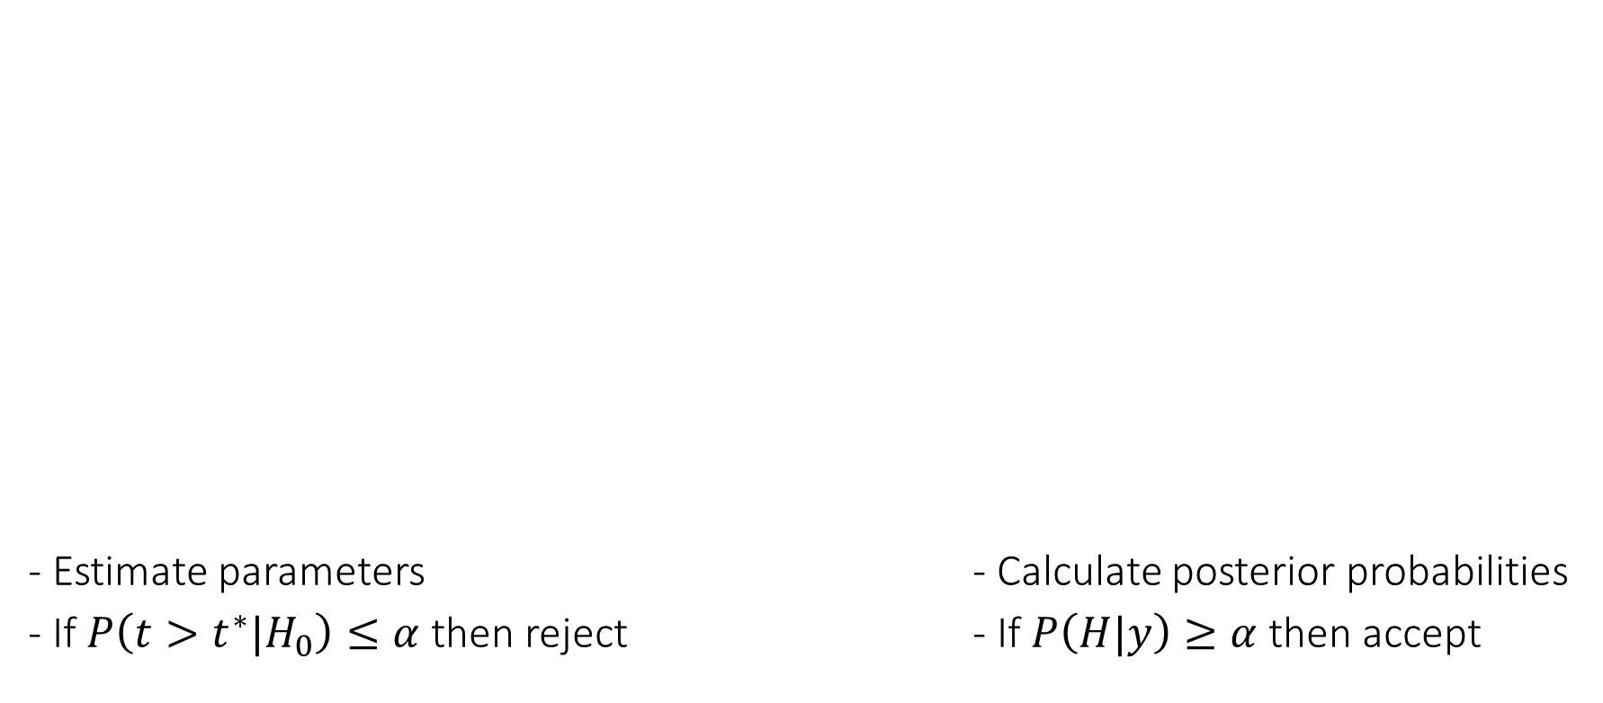
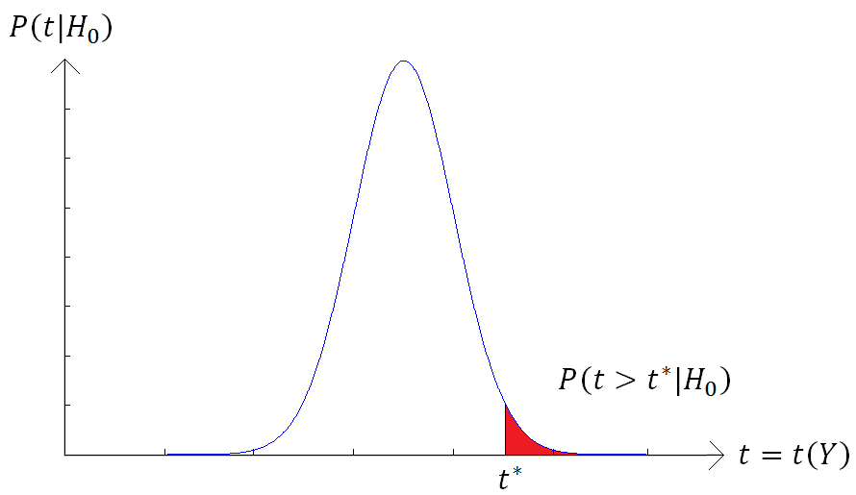
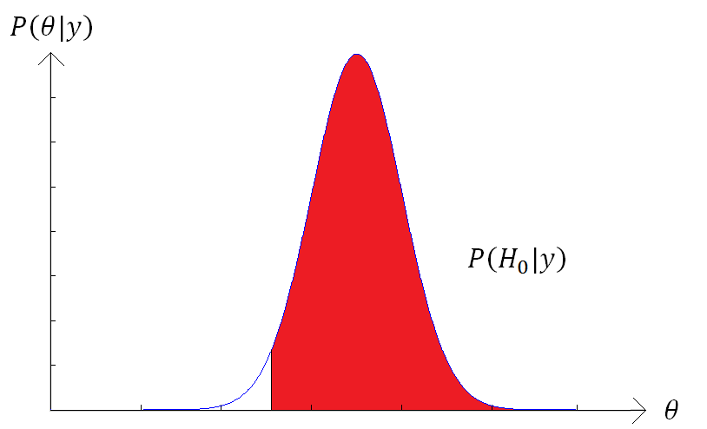

Hypothesis testing: Classical vs Bayes
Classical
Define the null hypothesis
H0: Coin is fair θ=0.5
Bayesian Inference
Define a hypothesis
H: θ>0.1

Slide 29
Bayesian vs Frequentist
Bayesian Inference:
• uses probabilities for both hypotheses and data.
• depends on the prior and likelihood of observed data.
• requires one to know or construct a ‘subjective prior’.
• dominated statistical practice before the 20th century.
• may be computationally intensive due to integration over many parameters.

Slide 30
Bayesian vs Frequentist
Frequentist Inference:
never uses or gives the probability of a hypothesis (no prior or posterior).
• depends on the likelihood P(D | H)) for both observed and unobserved data.
• does not require a prior.
• dominated statistical practice during the 20th century.
• tends to be less computationally intensive.

Slide 31
Bayesian Inference -
Critique:
A subjective prior is subjective. There is no single method for choosing a prior, so different people will produce different priors and may therefore arrive at different posteriors and conclusions.
Philosophical objections to assigning probabilities to hypotheses, as hypotheses do not constitute outcomes of repeatable experiments in which one can measure long-term frequency. In contrast to a hypothesis which is either true or false i.e. treatment 1 is better than treatment 2 or its not.

Slide 32
Bayesian Inference -
Defense:
The probability of hypotheses is exactly what we need to make decisions. When the doctor tells me a screening test came back positive I want to know what is the probability this means I’m sick. That is, I want to know the probability of the hypothesis “I’m sick”
Using Bayes’ theorem is logically rigorous. Once we have a prior all our calculations have the certainty of deductive logic.
By trying different priors we can see how sensitive our results are to the choice of prior.
It is easy to communicate a result framed in terms of probabilities of hypotheses.

Slide 33
Conclusion
Bayesian statistics is a mathematical procedure that applies probabilities to statistical problems. It provides people the tools to update their beliefs in the evidence of new data
Bayes theorem and bayesian inference are based on conditional probability P(Hypothesis|Data)
Ultimate goal is to calculate the posterior probability density, which is proportional to the likelihood (of our data being correct) and our prior knowledge.

Slide 34
THANK YOU!
To our expert Peter
To previous MfD course slides
Questions?

Slide 35
References
Previous MfD slides
Bayesian statistics - a comprehensive course https://www.youtube.com/watch?v=U1HbB0ATZ_A&list=PLFDbGp5YzjqXQ4oE4w9GVWdiokWB9gEpm&index=1
https://www.analyticsvidhya.com/blog/2016/06/bayesian-statistics-beginners-simple-english/
Bayesian statistics (a very brief introduction) – Ken Rice
http://www.statisticshowto.com/bayes-theorem-problems/
Dr. Stephen Dewitt - Introduction to Statistics for Psychology course
https://ocw.mit.edu/courses/mathematics/18-05-introduction-to-probability-and-statistics-spring-2014/class-slides/

