Slide 1
Introduction to Connectivity: resting-state and PPI
Annamaria Balogh and Karel Kieslich
Expert: Dr Sarah Gregory
Slides adapted from MfD 2018
Wednesday 11th March 2020

Slide 2
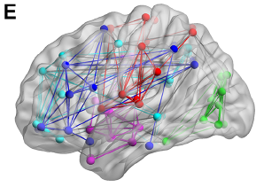
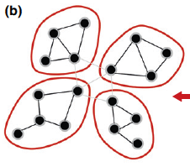
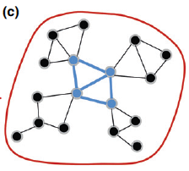
How is brain activity localized?
How do brain areas interact?
‘Connectivity’ analysis

Slide 3
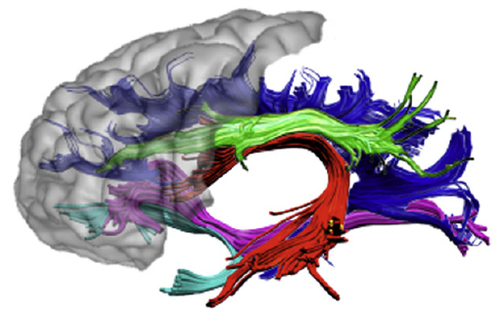
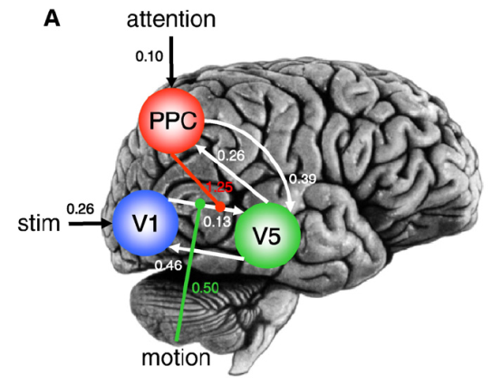
Structural connectivity
physical presence of axons (DTI)
a
b
Functional connectivity
statistical dependency of neurophysiological events (temporal correlations)
a
b
r = 0.78
Effective connectivity
influence of one system over another, directed causality (DCM, PPI)
a
b
Definitions from Roerbroek, Seth, & Valdes-Sosa (2011)

Slide 4
Functional connectivity
Notes:
Katharina

Slide 5
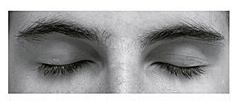
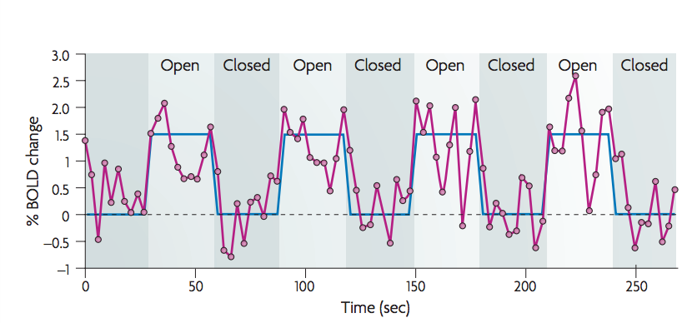
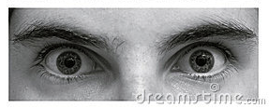
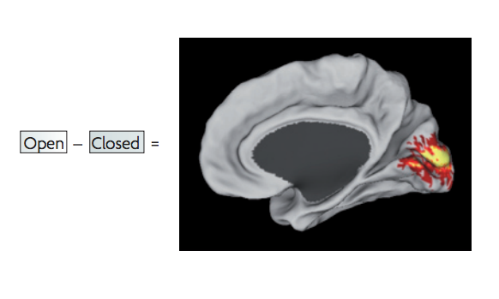
× task-evoked fMRI paradigms
Fox & Raichle, 2007

Slide 6
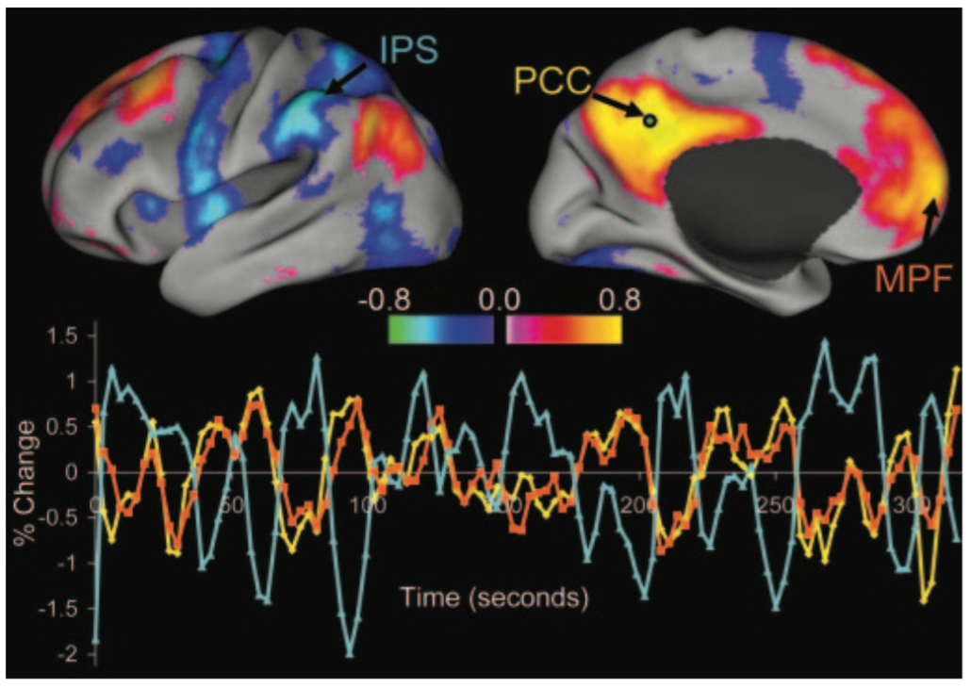
Resting-state fMRI:
subject is at rest: fixation on a crosshair; eyes closed; instructed to lie still and refrain from falling asleep.
Fox & Raichle, 2007
Notes:
Only for few minutes, doesnt require attention

Slide 7
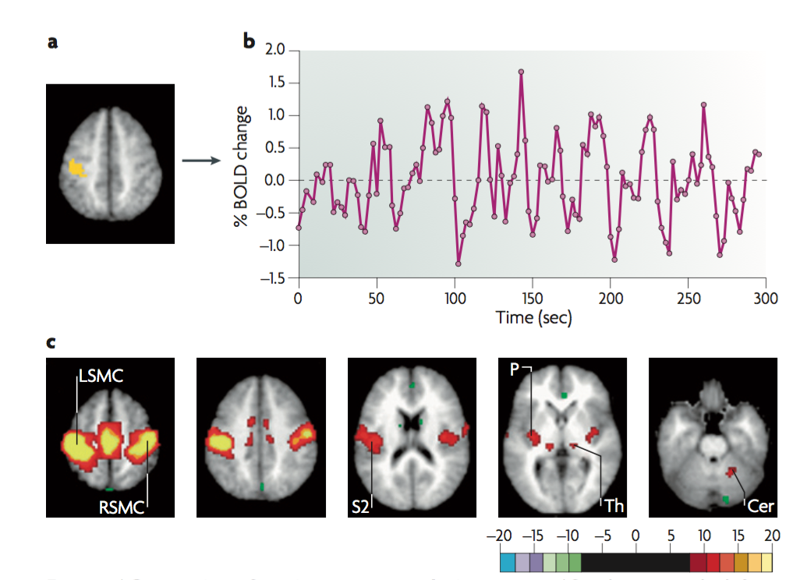
Seed-based analysis
Time course of spontaneous BOLD signal in the seed region
Somatomotor cortex
Fox & Raichle, 2007
Notes:
Seed – you need to decide, different results

Slide 8
Independent component analysis
Fox & Raichle, 2007

Slide 9
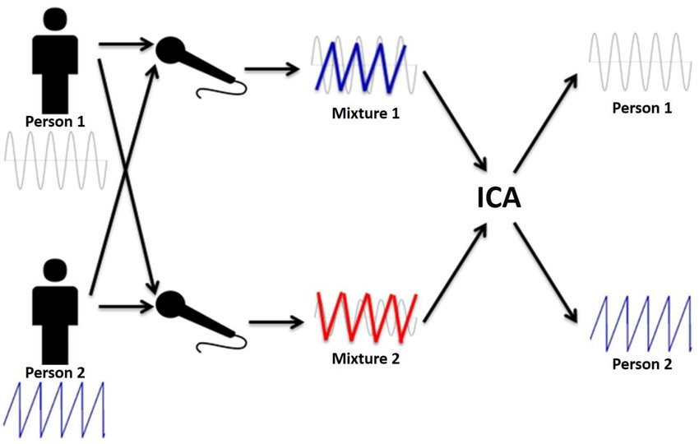
Independent component analysis
Fox & Raichle, 2007

Slide 10
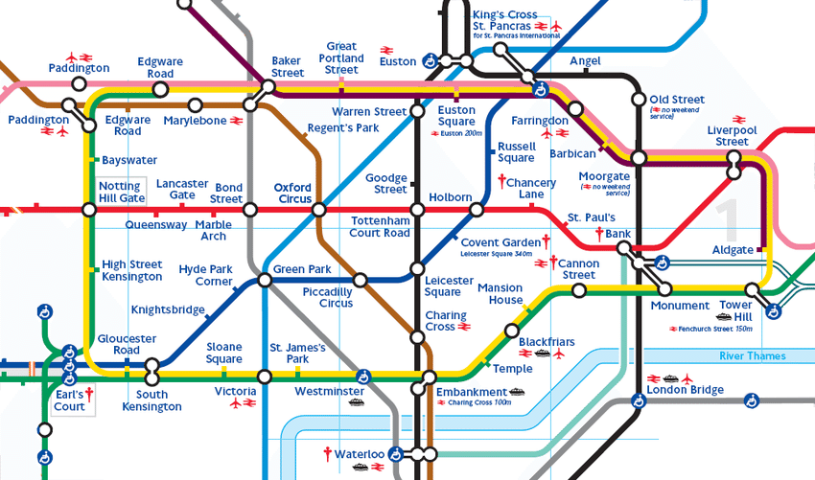
Independent component analysis
Fox & Raichle, 2007

Slide 11
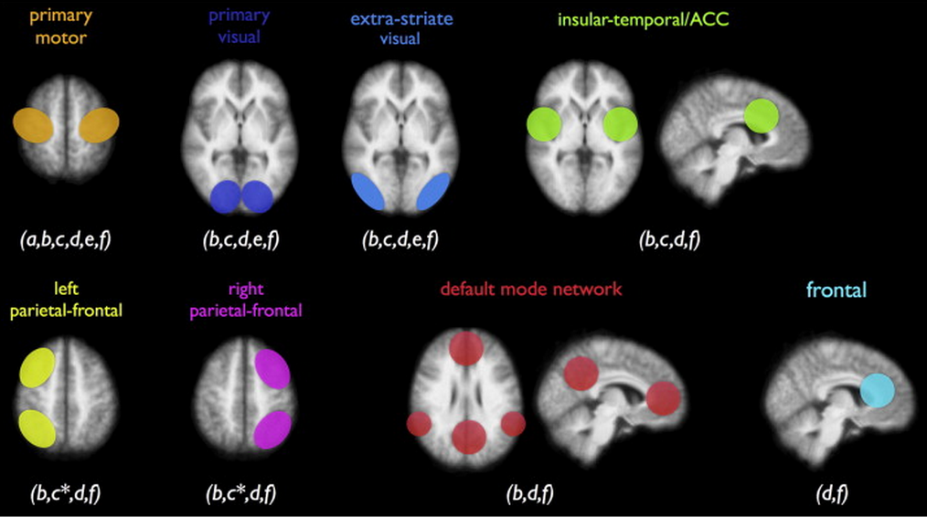
Notes:
criticism of networks

Slide 12
Accounting for noise
removing physiological fluctuations (cardiac or respiratory activity) through linear regression
isolating sources of noise through:
eliminating global signal
eliminating signals emerging in areas likely to produce physiological artefacts (e.g. ventricles)
independent component analysis (ICA)
Fox & Raichle, 2007
Notes:
how it’s done

Slide 13
pros
cons
easy to acquire
ideal for patients who cannot perform certain tasks
one data set allows to study different functional networks in the brain
good for exploratory analyses
(potentially) helpful as a clinical diagnostic tool (e.g. epilepsy, Alzheimer’s disease)
establishes correlations, not causal relationships

Slide 14
Functional connectivity
Effective Connectivity
Temporal correlations between spatially remote areas
Whole brain connectivity
Data Driven (exploratory)
Correlation analysis
MODEL-FREE
No Causation
The influence of one neuronal system over another
Reduced set of regions
Hypothesis Driven (Confirmatory)
Regression analysis
MODEL-DEPENDENT
Causal (based on a model)

Slide 15
Functional connectivity
Effective Connectivity
Correlation
Regression
Are two datasets related?
Continuous data
Assumes constant relationship between two variables
Observational data
No directionality
Can we predict activity in region A from activity in region B?
Continuous data
Tests influence of explanatory variable on dependent variable
Data from an experimental manipulation
Directional

Slide 16
Psychophysiological Interaction
(PPI)
Notes:
Katharina

Slide 17
PPI
Is the correlation in activity between two distant brain areas different in different psychological contexts?
Measures effective connectivity: how psychological variables or external manipulations change the coupling between regions Psychological regressor Area A Area B

Slide 18
PPI
Example:
How can brain activity in V5 (motion detection area) be explained by the interaction between
attention to visual motion & V1/V2 (primary visual cortex) activity?
PSYCHOLOGICAL VARIABLE
PHYSIOLOGICAL VARIABLE
ATTENTION
V5
V1/V2
Friston et al., Neuroimage 1997; Dolan et al., Nature 1997

Slide 19
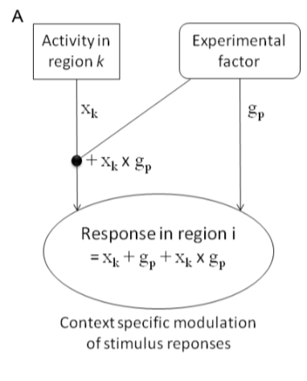
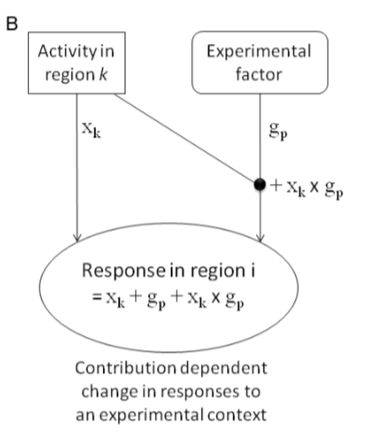
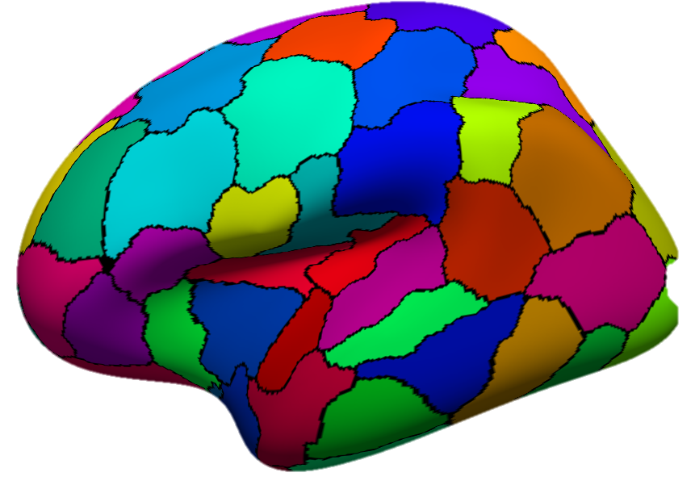
PPI
Two possible questions:
A. How contribution of one region to another is influenced by the experimental context
B. How an area’s response to an experimental context is modulated by input from another region
Mathematically equivalent! But… one may be more neurobiologically plausible
Attention

Slide 20
PPI: Practical Example
Connectivity between V2 and V5 while subject observes visual movement
Experimental manipulation: attention vs. no attention
Stimuli:
SM = Radially moving dots
SS = Stationary dots
Task:
TA = Attention
TN = No attention

Slide 21
PPI: Experimental Design
Is there a brain area whose responses can be explained by the interaction between attention and V2 (primary visual cortex) activity?
1.
Before starting ‘playing around’, we need:
Factorial Design: two different types of stimuli (motion/stationary), two different task conditions (attention/no attention)
Plausible anatomically driven hypothesis: V5 might show an attention-dependent coupling with V2…
attention
attention
V5
V1
V2
V5
V2
V1
Notes:
The contribution of the source area to the target area response depends on experimental context e.g. V2 input to V5 is modulated by attention
Target area response (e.g. V5) to experimental variable (attention) depends on activity of source area (e.g. V2) e.g. The effect of attention on V5 is modulated by V2 input

Slide 22
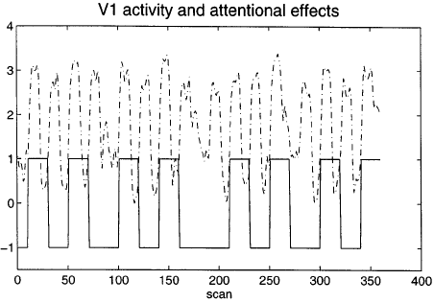
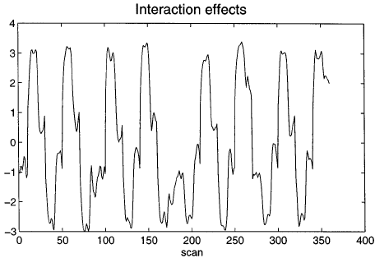
PPI: How it works?
PHYSIOLOGICAL VARIABLE
PSYCHOLOGICAL VARIABLE
Now... Remember the GLM equation for fMRI data?
Y = X1 * β1 + X2 * β2 + β0 + ε
Observed BOLD response
Regressor 1
Coefficient 1
Regressor 2
Coefficient 2
Constant
Error

Slide 23
PPI: How it works?
Observed BOLD response
In this case…
Y = (V₁) β₁ + (Att-NoAtt) β₂ + [(Att-NoAtt) * V1] β₃ + β0 + ε
Physiological Variable:
V1/V2 Activity
Psychological Variable:
Attention – Non-attention
Interaction: the effect of attention vs no attention on V1/V2 activity

Slide 24
PPI: How it works?
Y = (V₁) β₁ + (Att-NoAtt) β₂ + [(Att-NoAtt) * V1] β₃ + β0 + ε
= β₁ + β₂ + β₃ + β0 + ε

Slide 25
PPI: How it works?
Y = (V₁) β₁ + (Att-NoAtt) β₂ + [(Att-NoAtt) * V1] β₃ + β0 + ε
CONTRAST VECTOR:
[
0
0
1
0
]

Slide 26
PPI: Analysis
Standard GLM analysis (same preprocessing, first and second level analyses)
Extracting BOLD signal from a source region identified in the GLM and for which we want to investigate connectivity
Forming the interaction term
Performing a second GLM including the interaction term, the source region’s extracted term and the experimental vector in the design

Slide 27
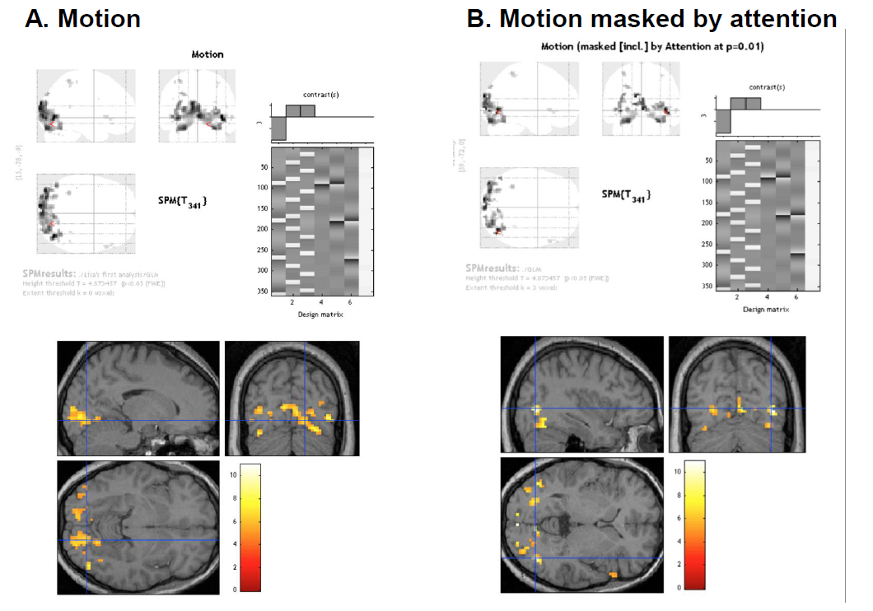
PPIs in SPM
1. Perform Standard GLM Analysis to determine regions of interest and interactions

Slide 28
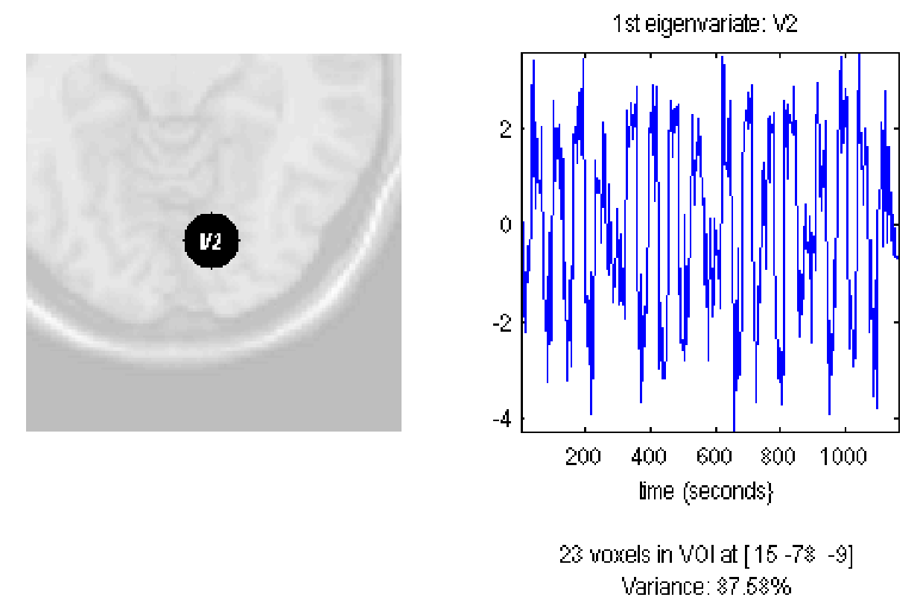
PPIs in SPM
2. Define source region and extract BOLD SIGNAL time series (e.g. V2)
Use Eigenvariates (there is a button in SPM) to create a summary value of the activation across the region over time.
This saves the extracted VOI data in the file VOI V2 1.mat in the working directory, and displays the figure above.

Slide 29
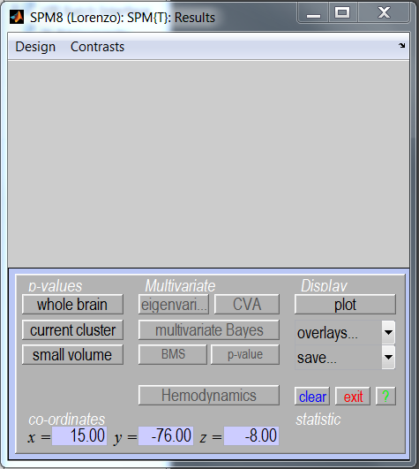
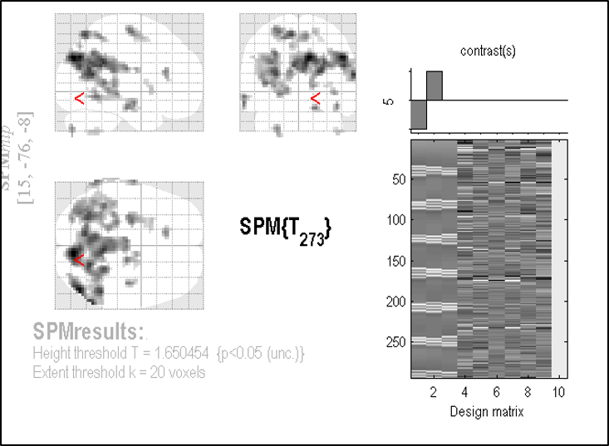
PPIs in SPM
2. Define source region and extract BOLD SIGNAL time series (e.g. V2)
Use Eigenvariates (there is a button in SPM) to create a summary value of the activation across the region over time.

Slide 30
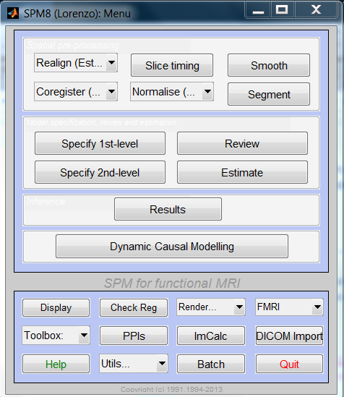
PPIs in SPM
4. Select PPI in SPM…

Slide 31
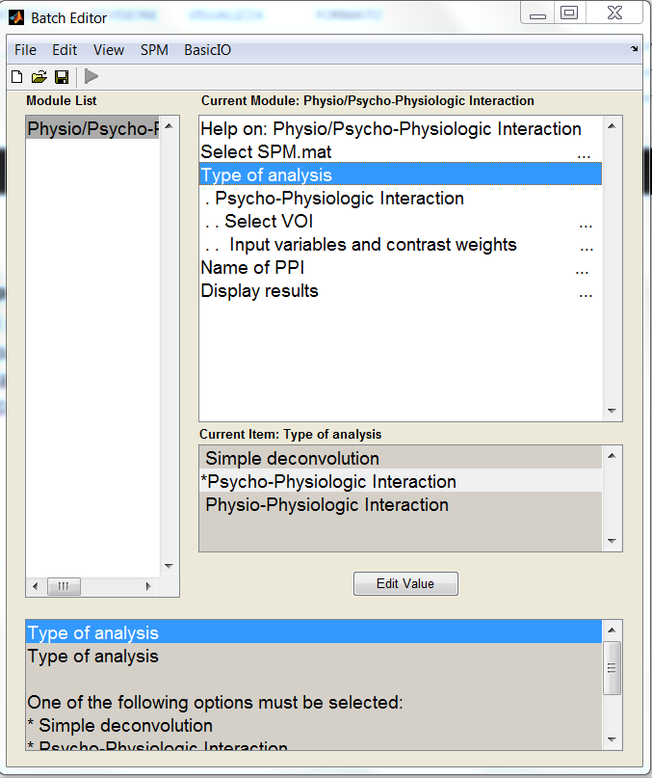
PPIs in SPM
4. Select PPI in SPM and form the Interaction term (source signal x experimental manipulation)
• Select the parameters of interest from the original GLM
• Physiological condition: Activity in V2
• Psychological condition: Attention vs. No attention

Slide 32
PPIs in SPM
4. Select PPI in SPM and form the Interaction term (source signal x experimental manipulation)
n x 3 Matrix n =number of conditions including in the PPI, in this case attention vs. no attention (2 rows)
Column #1: Index into SPM.Sess.U. U's are the list of your conditions for a particular session. So SPM.Sess.U(1)
Column #2: name of the condition. Always 1unless parametric effect
Column #3: parametric weight
SPM mat from the original design
Select the mat file created containing the Eigenvariate
No Attention
Attention
2 1 -1
3 1 1
Weights
2 and 3 Column #1 depend on the order of the conditions in the GLM design for the SPM.mat chosen
Notes:
weights

Slide 33
PPIs in SPM
4. Select PPI in SPM and form the Interaction term (source signal x experimental manipulation)
• Select the parameters of interest from the original GLM
• Physiological condition: Activity in V2
• Psychological condition: Attention vs. No attention
Deconvolve & Calculate & Convolve

Slide 34
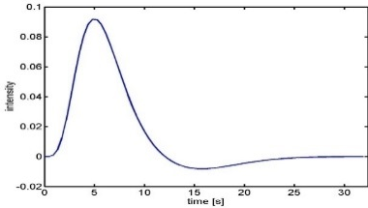
PPIs in SPM
4.
(a) Deconvolve physiological regressor (V1/V2) 🡪 transform BOLD signal
into neuronal activity
(b) Calculate the interaction term V1/V2x (Att-NoAtt)
(c) Convolve the interaction term V1/V2x (Att-NoAtt) with the HRF
BOLD signal in V1/V2
Neural activity in V1/V2
X
Psychological variable
Interaction term reconvolved
HRF

Slide 35
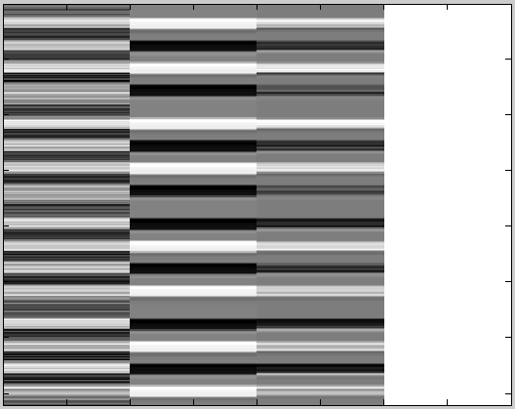
At this point a file ppiname.mat is created
It contains the
PPI.Y (original VOI eigenvariate)
PPI.P (Attention vs. no attention vector)
variable PPI.ppi (interaction term)
V1/V2 Att-NoAtt V1 * Att/NoAtt Constant

Slide 36
PPIs in SPM
5. Create PPI-GLM using the Interaction term – seen before!
Y = V1 β₁ + (Att-NoAtt) β₂ + (Att-NoAtt) * V1 β₃ + β_{i}Xi + e
H₀: β₃ = 0
0 0 1 0
6. Determine significance!
Based on a change in the regression
slopes between source region and another region during
condition 1 (Att) as compared to condition 2 (NoAtt)
V1/V2 Att-NoAtt V1 * Att/NoAtt Constant

Slide 37
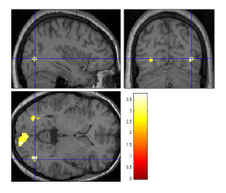
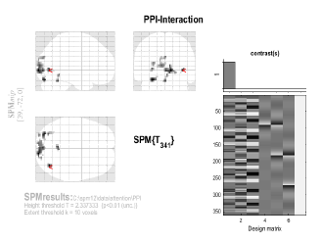
PPI results
Mismatch from previous 2 slides. Here this model interaction term is in the 1st column (not 3rd), so specify positive weight for the interaction term to see signifcant connectivity between original VOI as function of the experimental context

Slide 38
PPI: Pros and Cons
Pros:
Given a single source region, PPI can test for regions exhibiting context-dependent connectivity across the entire brain
“Simple”
Based on regressions and assume a dependent and independent variables (i.e., causality in the statistical sense)
Cons:
Simplistic: Only allows modelling contributions from a single area
Need DCM to elaborate a mechanistic model!
Adapted from D. Gitelman, 2011

Slide 39
The End
Many thanks to Sarah Gregory
& to Federica Biotti, Matilde Vaghi, Dana Boebinger, Lisa Quattrocki Knight and Josh Kahan for previous years’ slides!

Slide 40
References
previous years’ slides, and…
Biswal, B., Yetkin, F.Z., Haughton, V.M., & Hyde, J.S. (1995). Functional connectivity in the motor cortex of resting human brain using echo-planar MRI. Magnetic Resonance Medicine, 34(4), 537-41.
Buckner, R. L., Andrews-Hanna, J. R., & Schacter, D. L. (2008). The brain’s default network: anatomy, function, and relevance to disease. Annals of the New York Academy of Sciences, 1124, 1–38. doi:10.1196/annals.1440.011
Damoiseaux, J. S., Rombouts, S. A. R. B., Barkhof, F., Scheltens, P., Stam, C. J., Smith, S. M., & Beckmann, C. F. (2006). Consistent resting-state networks, (2).
De Luca, M., Beckmann, C. F., De Stefano, N., Matthews, P. M., & Smith, S. M. (2006). fMRI resting state networks define distinct modes of long-distance interactions in the human brain. NeuroImage, 29(4), 1359–67. doi:10.1016/j.neuroimage.2005.08.035
Elwell, C. E., Springett, R., Hillman, E., & Delpy, D. T. (1999). Oscillations in Cerebral Haemodynamics. Advances in Experimental Medicine and Biology, 471, 57–65.
Fox, M. D., & Raichle, M. E. (2007). Spontaneous fluctuations in brain activity observed with functional magnetic resonance imaging. Nature reviews. Neuroscience, 8(9), 700–11. doi:10.1038/nrn2201
Fox, M. D., Snyder, A. Z., Vincent, J. L., Corbetta, M., Van Essen, D. C., & Raichle, M. E. (2005). The human brain is intrinsically organized into dynamic, anticorrelated functional networks. Proceedings of the National Academy of Sciences of the United States of America, 102(27), 9673–8. doi:10.1073/pnas.0504136102
Friston, K. J. (2011). Functional and effective connectivity: a review. Brain connectivity, 1(1), 13–36. doi:10.1089/brain.2011.0008
Greicius, M. D., Krasnow, B., Reiss, A. L., & Menon, V. (2003). Functional connectivity in the resting brain: a network analysis of the default mode hypothesis. Proceedings of the National Academy of Sciences of the United States of America, 100(1), 253–8. doi:10.1073/pnas.0135058100
Greicius, M. D., Supekar, K., Menon, V., & Dougherty, R. F. (2009). Resting-state functional connectivity reflects structural connectivity in the default mode network. Cerebral cortex (New York, N.Y. : 1991), 19(1), 72–8. doi:10.1093/cercor/bhn059
Marreiros, A. (2012). SPM for fMRI slides.
Smith, S. M., Miller, K. L., Moeller, S., Xu, J., Auerbach, E. J., Woolrich, M. W., Beckmann, C. F., et al. (2012). Temporally-independent functional modes of spontaneous brain activity. Proceedings of the National Academy of Sciences of the United States of America, 109(8), 3131–6. doi:10.1073/pnas.1121329109
Friston, K. (1998). Modes or models: a critique on independent component analysis for fMRI, TICS, 373-375. Lee, M.H., Smyser, C.D., & Shominy, J.S. (2013). Resting-state fMRI: A review of methods and clinical applications. American Journal of Neuroradiology, 1866-1872.
Roerbroek, A., Seth, A., & Valdes-Sosa, P. (2011). Causal Time Series Analysis of functional Magnetic Resonance Imaging Data. JMLR: Workshop and Conference Proceedings 12 (2011) 65–94 .
Friston KJ, Buechel C, Fink GR et al. Psychophysiological and Modulatory Interactions in Neuroimaging. Neuroimage (1997) 6, 218-229.
Büchel C, Friston KJ, Modulation of connectivity in visual pathways by attention: cortical interactions evaluated with structural equation modelling and fMRI. Cereb Cortex (1997) 7, 768-78.
Dolan RJ, Fink GR, Rolls E, et al., How the brain learns to see objects and faces in an impoverished context, Nature (1997) 389, 596-9.
Gitelman DR, Penny WD, Ashburner J et al. Modeling regional and neuropsychologic interactions in fMRI: The importance of hemodynamic deconvolution. Neuroimage (2003) 19; 200-207.
http://www.fil.ion.ucl.ac.uk/spm/data/attention/
http://www.fil.ion.ucl.ac.uk/spm/doc/manual.pdf
http://www.neurometrika.org/resources
Graphic of the brain is taken from Quattrocki Knight et al., submitted.
Several slides were adapted from D. Gitelman’s presentation for the October 2011 SPM course at MGH

