Slide 1
Introduction to Connectivity: resting-state and PPI
Federica Biotti and Matilde Vaghi
Expert: Dr Sarah Gregory
Slides adapted from MfD 2015
Wednesday 28th February 2018

Slide 2
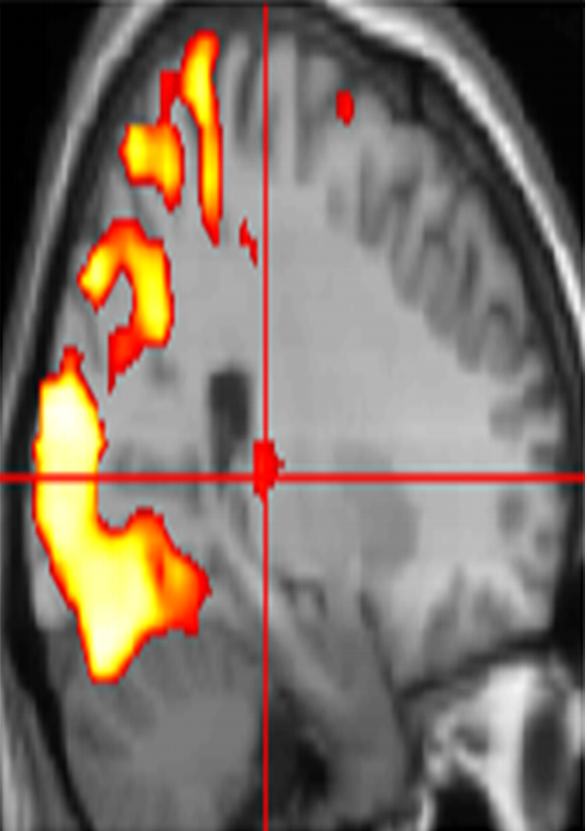
Two fundamental properties of brain architecture
Functional Segregation
LOCALIZATIONISM
Functional Integration
CONNECTIONISM
Different areas of the brain are specialised for different functions
Interactions among specialised areas/neuronal populations
What is the neural correlate of… ?
How do cortical areas interact … ?
‘Connectivity’ analysis

Slide 3
Types of Connectivity
Structural/Anatomical Connectivity: physical presence of axonal projections from one brain area to another, axon bundles detected e.g. by DTI, tract-tracing
Functional Connectivity: statistical dependency among remote neurophysiological events. Expressed as temporal correlation of activity across different brain areas in resting state fMRI
Effective Connectivity: refers to the influence that one neural system exerts over another. It measures the directed influence and causality within networks e.g. PPI and DCM
a
b
a
b
r = 0.78
a
b
Definitions from Roerbroek, Seth, & Valdes-Sosa (2011)

Slide 4
“Resting-state” fMRI
Notes:
Katharina

Slide 5

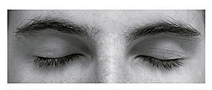
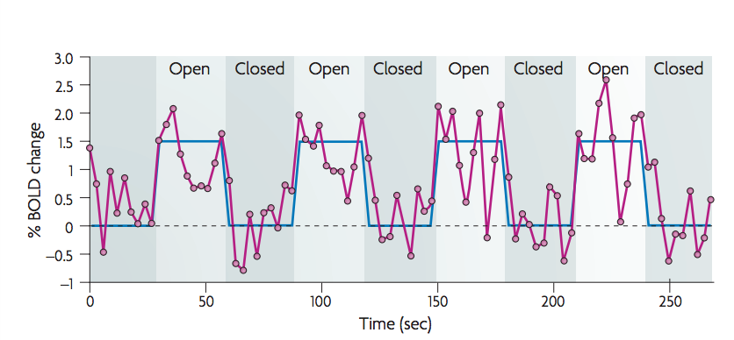
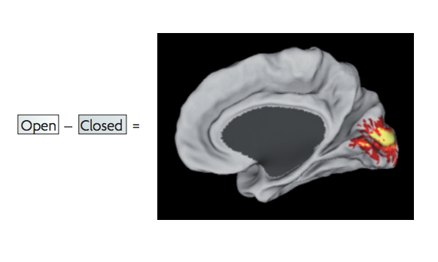
Task-evoked fMRI paradigm
task-related activation paradigm
  changes in BOLD signal attributed to experimental paradigm
  brain function mapped onto brain regions
Fox & Raichle, 2007

Slide 6
Spontaneous BOLD activity
The brain is always active, even in the absence of explicit input
  task-related changes in neuronal metabolism are only about 5% of brain’s total energy consumption
This spontaneous modulation of BOLD signal is not random, but reflects the functional organization of a number of networks.
The ‘noise’ of standard activation studies
  faster frequencies related to respiratory and cardiac activities
  spontaneous, neuronal oscillations between 0.01 – 0.10 Hz
  How do we analyse spontaneous BOLD activity?
  RS-fMRI measures synchronous activations between regions that are spatially distinct, occurring in the absence of a task or a stimulus
Fox & Raichle, 2007

Slide 7
Spontaneous BOLD activity
Subject is at rest: fixation on a crosshair; eyes closed. They are instructed to lie still in the scanner and refrain from falling asleep.
Accounting for non-neuronal noise: in RSfMRI we analyse part of the ‘noise’ that we try to eliminate in task-evoked studies. This noise could be an artefact of scanner instability or physiological fluctuations (cardiac or respiratory activity)
Physiological parameters can be measured during BOLD acquisition and removed through linear regression.
Noise sources can be isolated through:
a) ICA (independent components analysis)
b) eliminating the global signal (signals that are common to all voxels)
c) eliminating signals emerging in areas likely to produce physiological artefacts (e.g. ventricles or WM)
Fox & Raichle, 2007

Slide 8
Spontaneous BOLD activity
3) Identifying spatial patterns
Seed-based analyses (compatible with SPM) – functional connectivity, hierarchical clustering
vs
Independent Components Analysis – ICA (not compatible with SPM)
Seed-based analyses
Hypothesis driven. They are based on a priori definition of seed regions (regions of interest). Extraction of BOLD time course from seed region and measure of the temporal correlation between this signal and time course of
a) all other voxels (functional connectivity)
b) other seed regions (hierarchical clustering)
Independent Component Analysis (ICA)
It is data driven. It does not require a priori definition of seed regions but analyses the entire BOLD and decomposes it into independent components. Each component is associated with a spatial map and some maps reflect neuro-anatomical systems. Limitations include: a) user has to manually select the components and distinguish noise from physiological signals.

Slide 9
Spontaneous BOLD activity
3) Identifying spatial patterns
Seed-based analyses
Time course of spontaneous BOLD signal in the seed region
Somatomotor cortex
Fox & Raichle, 2007

Slide 10
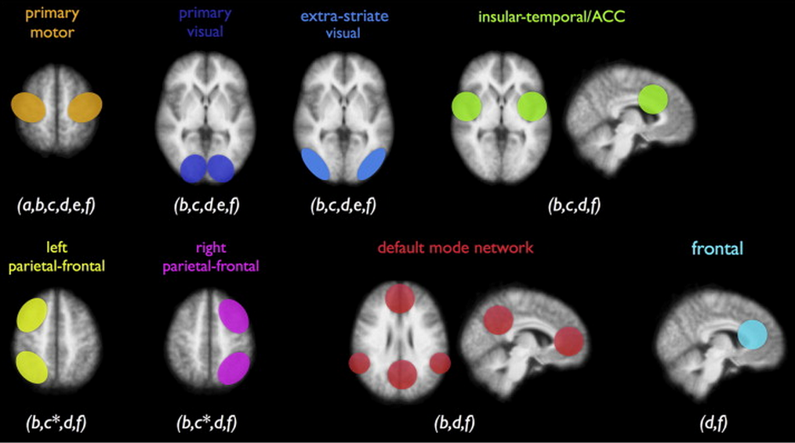
Resting-state networks (RSNs)
multiple resting-state networks (RSNs) have been found
  all show activity during rest and during tasks
  one of the RSNs, the default mode network (DMN), shows a decrease in activity during cognitive tasks

Slide 11
Task-positive and task-negative networks
E.g. attention-demanding cognitive tasks are associated with increases in activity of fronto-parietal areas, and decreases in activity of posterior cingulate and medial prefrontal cortex.
The same activation/deactivation dichotomy is observed in the resting human brain, in the absence of any attentional-demanding task or behaviour.
Regional distribution of correlation coefficients.
Time courses for PCC seed region, MPF (+) and IPS (-)
Seed region (PCC)
Positive association (MPF)
Negative association (IPS)
Fox et al., 2005
Notes:
IPS = intraparietal sulcus
PCC = posterior cingulate cortex
MPF = medial prefrontal cortex

Slide 12
Spontaneous BOLD activity
Does it reflect conscious mental activity?
Similar topography of BOLD correlations can be seen in different resting conditions, even in sleep and anesthesia
Spontaneous cognition (e.g. mental imagery) generates patterns of visual activity in visual cortex which are different from patterns observed in spontaneous activity
How about mental wondering?
Spontaneous activity is present at the same time in many different neuro-anatomical systems → unlikely that one behaviour modulates multiple systems at the same time.
Fox & Raichle, 2007

Slide 13
Pros & Cons of Resting state fMRI
pros
cons
easy to acquire
ideal for patients who cannot perform certain tasks
one data set allows to study different functional networks in the brain
good for exploratory analyses
(potentially) helpful as a clinical diagnostic tool (e.g. epilepsy, Alzheimer’s disease)
establishes correlations, not causal relationships
→ Effective connectivity

Slide 14
Functional Integration
Functional connectivity
Effective Connectivity
Temporal correlations between spatially remote areas
Based on correlation analysis
MODEL-FREE
Exploratory
Data Driven
No Causation
Whole brain connectivity
The influence that one neuronal system exerts over another
Based on regression analysis
MODEL-DEPENDENT
Confirmatory
Hypothesis Driven
Causal (based on a model)
Reduced set of regions

Slide 15
Functional Integration
Correlation
Regression
Continuous data
Assumes relationship between two variables is constant
Use observational data
No directionality
Are two datasets related?
Continuous data
Tests for influence of an explanatory variable on a dependent variable
Uses data from an experimental manipulation
It’s directional
Is dataset 1 a function of dataset 2? i.e. can we predict 1 from 2?

Slide 16
Functional Integration
Psychophysiological Interaction (PPI)
Measures effective connectivity: how psychological variables or external manipulations change the coupling between regions.
Psychological regressor
Area A Area B
PPI is a method for finding out whether the correlation in activity between two distant brain areas is different in different psychological contexts

Slide 17
Psychophysiological Interaction
  Example: How can brain activity in V5 (motion detection area) be explained by the interaction between:
  Attention to visual motion
  (b) V1/V2 (primary visual cortex) activity?
PSYCHOLOGICAL VARIABLE
PHYSIOLOGICAL VARIABLE
ATTENTION
V5
V1/V2
Friston et al., Neuroimage 1997; Dolan et al., Nature 1997

Slide 18
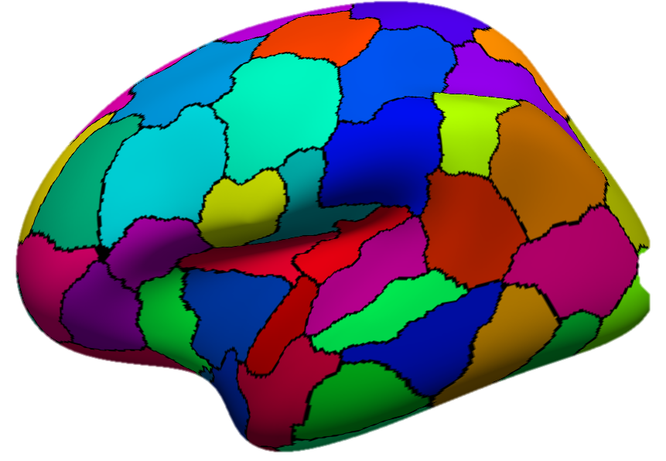
DIRECTIONALITY
Functional connectivity
temporal correlation between spatially neurophysiological events
Effective connectivity
influence of one neural unit on another

Slide 19
DIRECTIONALITY
Effective connectivity
influence of one neural unit on another
PPI is limited models of EC

Slide 20
DIRECTIONALITY
Effective connectivity
influence of one neural unit on another
PPI is limited models of EC
1. How contribution of one region to another is influenced by the experimental context
Attention

Slide 21
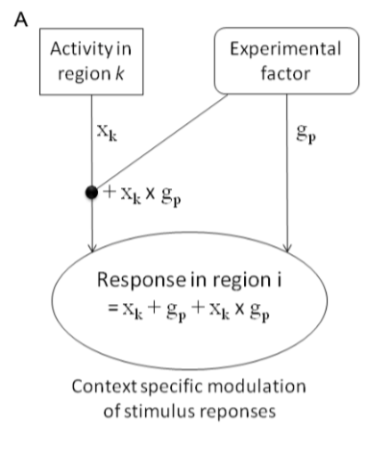
DIRECTIONALITY
Effective connectivity
influence of one neural unit on another
PPI is limited models of EC
1. How contribution of one region to another is influenced by the experimental context
No attention

Slide 22
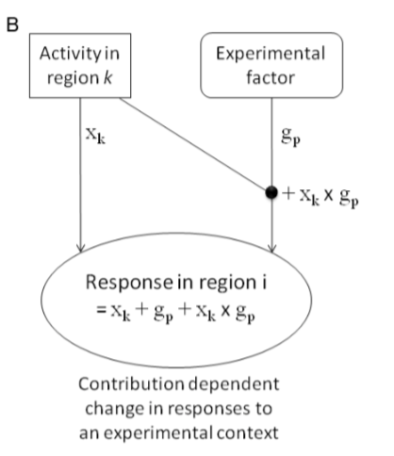
DIRECTIONALITY
Effective connectivity
influence of one neural unit on another
PPI is limited models of EC
2. How an area’s response to an experimental context is modulated by input from another region
Attention

Slide 23
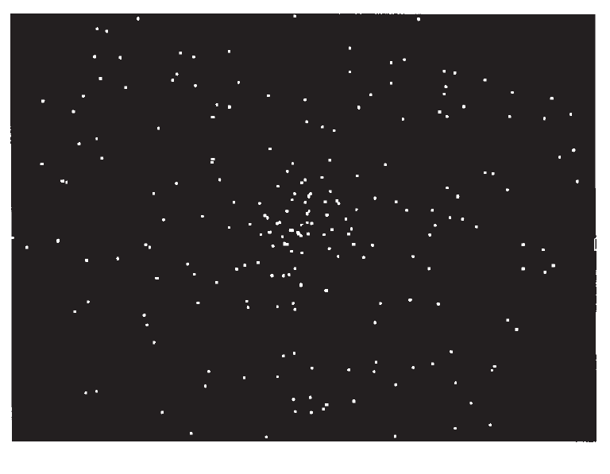
Practical Example
Stimuli:
SM = Radially moving dots
SS = Stationary dots
Task:
TA = Attention
TN = Passive viewing
Change in connectivity between V2 and V5 while subject observes visual moving under the experimental contexts (experimental manipulation)
of attending vs. no attending

Slide 24
PPI: Experimental Design
  Is there a brain area whose responses can be explained by the interaction between attention and V2 (primary visual cortex) activity?
  Before starting ‘playing around’, we need:
  Factorial Design: two different types of stimuli (eg., motion/no-motion), two different task conditions (attention vs. non-attention)
  Plausible conceptual anatomical model or hypothesis: I would think that V5 (human equivalent of MT) might show an attention-dependent coupling with V2…

Slide 25
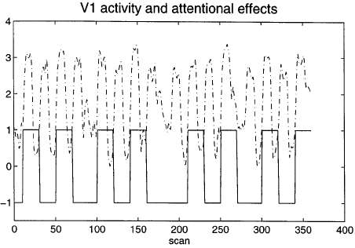
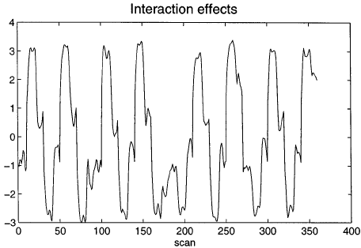
PPI: how it works?
PHYSIOLOGICAL VARIABLE
PSYCHOLOGICAL VARIABLE
Now - Remember the GLM equation for fMRI data?
Y = X1 * β1 + X2 * β2 + β0 + ε
Observed BOLD response
Regressor 1
Coefficient 1
Regressor 2
Coefficient 2
Constant
Error

Slide 26
PPI: how it works?
Observed BOLD response
In this case…
Y = (V₁) β₁ + (Att-NoAtt) β₂ + [(Att-NoAtt) * V1] β₃ + β0 + ε
Physiological Variable:
V1/V2 Activity
Psychological Variable:
Attention – No attention
Interaction: the effect of attention vs no attention on V1/V2 activity

Slide 27
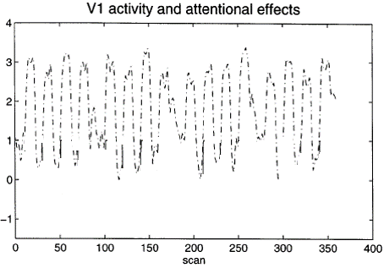
PPI: how it works?
Y = (V₁) β₁ + (Att-NoAtt) β₂ + [(Att-NoAtt) * V1] β₃ + β0 + ε
= β₁ + β₂ + β₃ + β0 + ε

Slide 28
PPI
Standard GLM analysis (same preprocessing, first and second level analyses)
Extracting BOLD signal from a source region identified in the GLM and for which we want to investigate connectivity
Forming the interaction term
Performing a second GLM including the interaction term, the source region’s extracted term and the experimental vector in the design

Slide 29
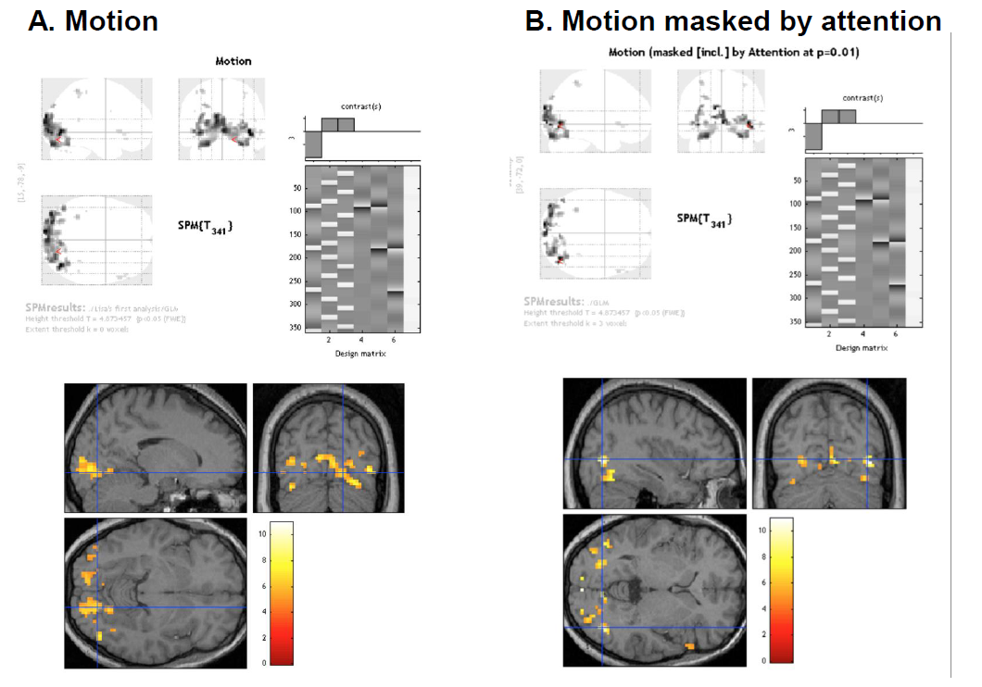
PPIs in SPM
1. Perform Standard GLM Analysis to determine regions of interest and interactions

Slide 30
PPIs in SPM
2. Define source region and extract BOLD SIGNAL time series (e.g. V2)
  Use Eigenvariates (there is a button in SPM) to create a summary value of the activation across the region over time.
This saves the extracted VOI data in the file VOI V2 1.mat in the working directory, and displays the figure above.

Slide 31
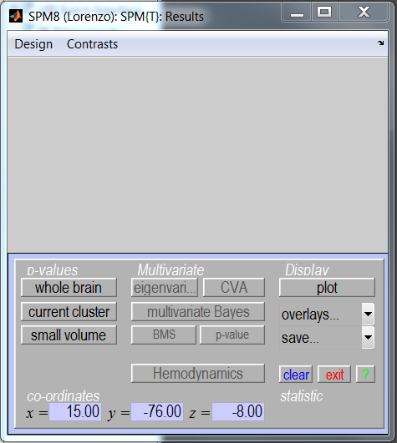
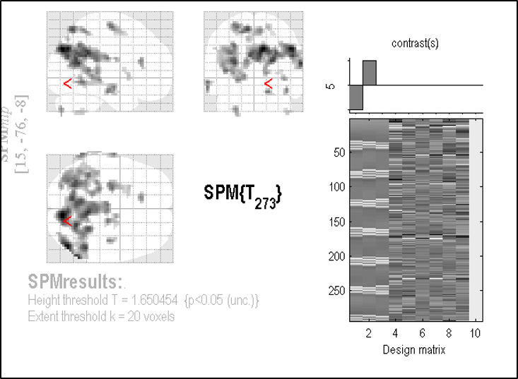
PPIs in SPM
2. Define source region and extract BOLD SIGNAL time series (e.g. V2)
  Use Eigenvariates (there is a button in SPM) to create a summary value of the activation across the region over time.

Slide 32
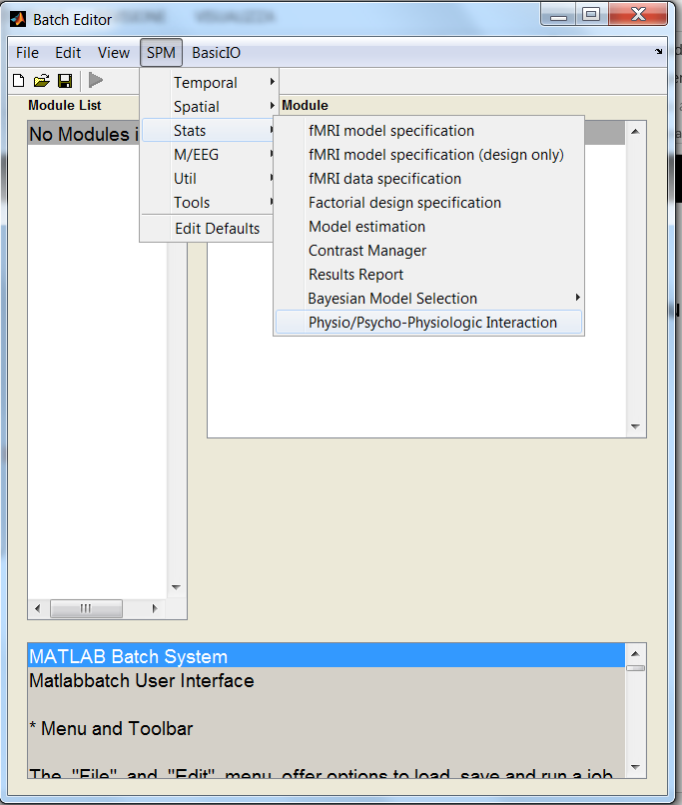
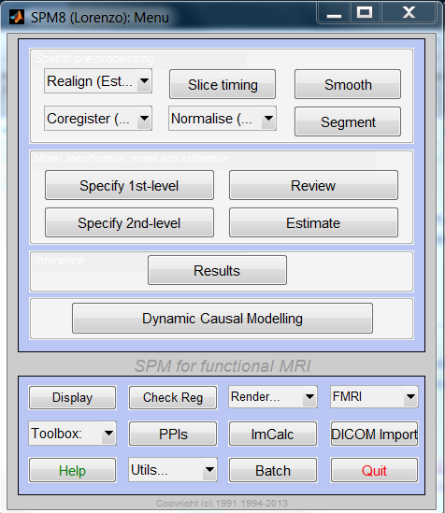
PPIs in SPM
4. Select PPI in SPM…

Slide 33
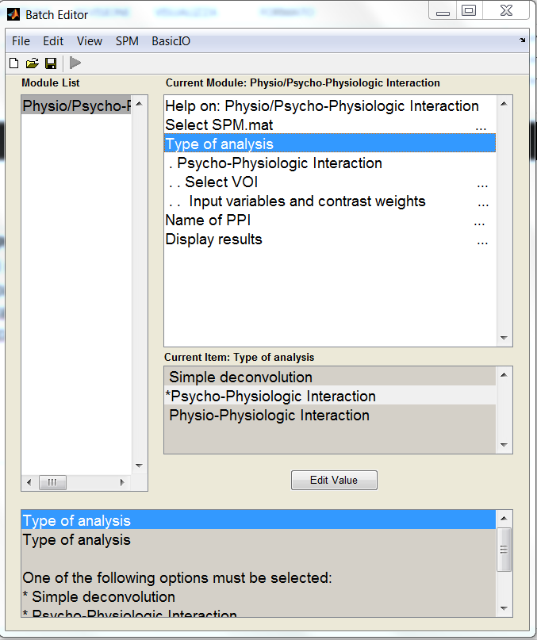
PPIs in SPM
4. Select PPI in SPM and form the Interaction term (source signal x experimental manipulation)
• Select the parameters of interest from the original GLM
• Physiological condition: Activity in V2
• Psychological condition: Attention vs. No attention

Slide 34
PPIs in SPM
4. Select PPI in SPM and form the Interaction term (source signal x experimental manipulation)
• Select the parameters of interest from the original GLM
• Physiological condition: Activity in V2
• Psychological condition: Attention vs. No attention

Slide 35
PPIs in SPM
4. Select PPI in SPM and form the Interaction term (source signal x experimental manipulation)
n x 3 Matrix
n =number of conditions including in the PPI, in this case attention vs. no attention (2 rows)
Column #1: Index into SPM.Sess.U. U's are the list of your conditions for a particular session. So SPM.Sess.U(1)
Column #2: name of the condition. Always 1unless parametric effect
Column #3: parametric weight
SPM mat from the original design
Select the mat file created containing the Eigenvariate
No Attention
Attention
2 1 -1
3 1 1
Weights
2 and 3 Column #1 depend on the order of the conditions in the GLM design for the SPM.mat chosen

Slide 36
PPIs in SPM
4. Select PPI in SPM and form the Interaction term (source signal x experimental manipulation)
• Select the parameters of interest from the original GLM
• Physiological condition: Activity in V2
• Psychological condition: Attention vs. No attention
Deconvolve & Calculate & Convolve

Slide 37
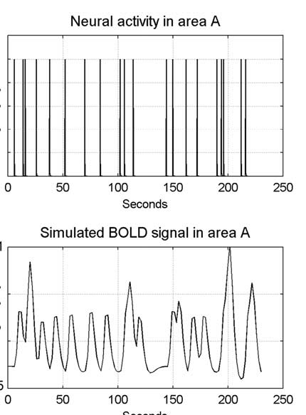
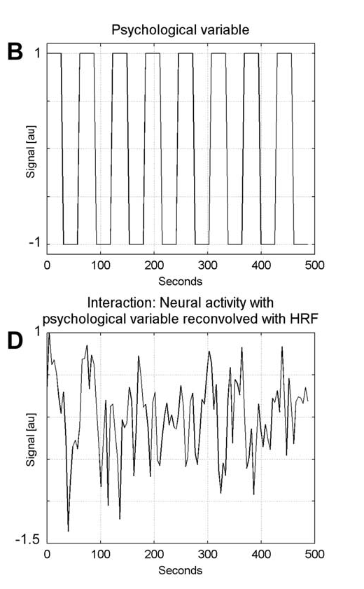
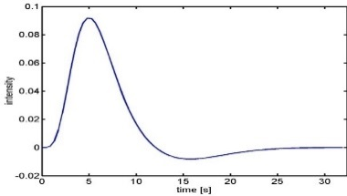
PPIs in SPM
4.
(a) Deconvolve physiological regressor (V1/V2) → transform BOLD signal
into neuronal activity
(b) Calculate the interaction term V1/V2x (Att-NoAtt)
(c) Convolve the interaction term V1/V2x (Att-NoAtt) with the HRF
BOLD signal in V1/V2
Neural activity in V1/V2
X
Psychological variable
Interaction term reconvolved
HRF

Slide 38
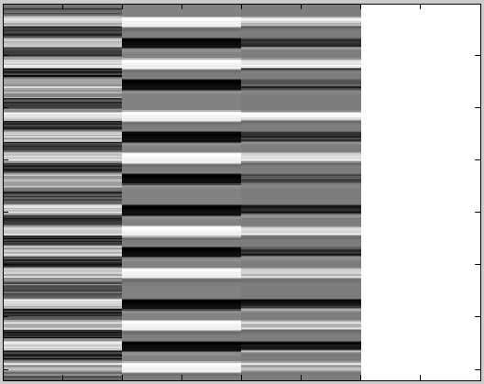
At this point a file ppiname.mat is created
It contains the
PPI.Y (original VOI eigenvariate)
PPI.P (Attention vs. no attention vector)
variable PPI.ppi (interaction term)
V1/V2 Att-NoAtt V1 * Att/NoAtt Constant

Slide 39
PPIs in SPM
5. Create PPI-GLM using the Interaction term – seen before!
Y = V1 β₁ + (Att-NoAtt) β₂ + (Att-NoAtt) * V1 β₃ + β_{i}Xi + e
H₀: β₃ = 0
0 0 1 0
6. Determine significance!
Based on a change in the regression
slopes between source region and another region during
condition 1 (Att) as compared to condition 2 (NoAtt)
V1/V2 Att-NoAtt V1 * Att/NoAtt Constant

Slide 40
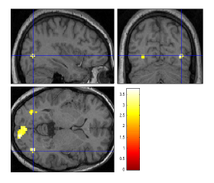
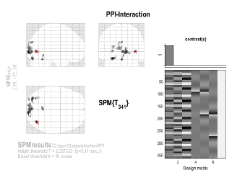
PPI results
Mismatch from previous 2 slides. Here this model interaction term is in the 1st column (not 3rd), so specify positive weight for the interaction term to see signifcant connectivity between original VOI as function of the experimental context

Slide 41
PPI: How should we interpret our results?
Two possible interpretations:
  The contribution of the source area to the target area response depends on experimental context
    e.g. V2 input to V5 is modulated by attention
  Target area response (e.g. V5) to experimental variable (attention) depends on activity of source area (e.g. V2)
    e.g. The effect of attention on V5 is modulated by V2 input
attention
1.
V2
V5
V1
attention
2.
Mathematically, both are equivalent!
But… one may be more neurobiologically plausible
V1
V5
V2

Slide 42
Pros & Cons of PPIs
Pros:
  Given a single source region, PPIs can test for regions exhibiting context-dependent connectivity across the entire brain
  “Simple” to perform
  Based on regressions and assume a dependent and independent variables (i.e., they assume causality in the statistical sense).
Cons:
  Very simplistic model: only allows modelling contributions from a single area
  Ignores time-series properties of data (can do PPIs on PET and fMRI data)
    Interactions are instantaneous for a given context
Need DCM to elaborate a mechanistic model!
Adapted from D. Gitelman, 2011

Slide 43

The End
Many thanks to Sarah Gregory!
& to Dana Boebinger, Lisa Quattrocki Knight and Josh Kahan for previous years’ slides!
thanks for your attention!

Slide 44
References
previous years’ slides, and…
Biswal, B., Yetkin, F.Z., Haughton, V.M., & Hyde, J.S. (1995). Functional connectivity in the motor cortex of resting human brain using echo-planar MRI. Magnetic Resonance Medicine, 34(4), 537-41.
Buckner, R. L., Andrews-Hanna, J. R., & Schacter, D. L. (2008). The brain’s default network: anatomy, function, and relevance to disease. Annals of the New York Academy of Sciences, 1124, 1–38. doi:10.1196/annals.1440.011
Damoiseaux, J. S., Rombouts, S. A. R. B., Barkhof, F., Scheltens, P., Stam, C. J., Smith, S. M., & Beckmann, C. F. (2006). Consistent resting-state networks, (2).
De Luca, M., Beckmann, C. F., De Stefano, N., Matthews, P. M., & Smith, S. M. (2006). fMRI resting state networks define distinct modes of long-distance interactions in the human brain. NeuroImage, 29(4), 1359–67. doi:10.1016/j.neuroimage.2005.08.035
Elwell, C. E., Springett, R., Hillman, E., & Delpy, D. T. (1999). Oscillations in Cerebral Haemodynamics. Advances in Experimental Medicine and Biology, 471, 57–65.
Fox, M. D., & Raichle, M. E. (2007). Spontaneous fluctuations in brain activity observed with functional magnetic resonance imaging. Nature reviews. Neuroscience, 8(9), 700–11. doi:10.1038/nrn2201
Fox, M. D., Snyder, A. Z., Vincent, J. L., Corbetta, M., Van Essen, D. C., & Raichle, M. E. (2005). The human brain is intrinsically organized into dynamic, anticorrelated functional networks. Proceedings of the National Academy of Sciences of the United States of America, 102(27), 9673–8. doi:10.1073/pnas.0504136102
Friston, K. J. (2011). Functional and effective connectivity: a review. Brain connectivity, 1(1), 13–36. doi:10.1089/brain.2011.0008
Greicius, M. D., Krasnow, B., Reiss, A. L., & Menon, V. (2003). Functional connectivity in the resting brain: a network analysis of the default mode hypothesis. Proceedings of the National Academy of Sciences of the United States of America, 100(1), 253–8. doi:10.1073/pnas.0135058100
Greicius, M. D., Supekar, K., Menon, V., & Dougherty, R. F. (2009). Resting-state functional connectivity reflects structural connectivity in the default mode network. Cerebral cortex (New York, N.Y. : 1991), 19(1), 72–8. doi:10.1093/cercor/bhn059
Marreiros, A. (2012). SPM for fMRI slides.
Smith, S. M., Miller, K. L., Moeller, S., Xu, J., Auerbach, E. J., Woolrich, M. W., Beckmann, C. F., et al. (2012). Temporally-independent functional modes of spontaneous brain activity. Proceedings of the National Academy of Sciences of the United States of America, 109(8), 3131–6. doi:10.1073/pnas.1121329109
Friston, K. (1998). Modes or models: a critique on independent component analysis for fMRI, TICS, 373-375.
Lee, M.H., Smyser, C.D., & Shominy, J.S. (2013). Resting-state fMRI: A review of methods and clinical applications. American Journal of Neuroradiology, 1866-1872.
Roerbroek, A., Seth, A., & Valdes-Sosa, P. (2011). Causal Time Series Analysis of functional Magnetic Resonance Imaging Data. JMLR: Workshop and Conference Proceedings 12 (2011) 65–94 .
Friston KJ, Buechel C, Fink GR et al. Psychophysiological and Modulatory Interactions in Neuroimaging. Neuroimage (1997) 6, 218-229.
Büchel C, Friston KJ, Modulation of connectivity in visual pathways by attention: cortical interactions evaluated with structural equation modelling and fMRI. Cereb Cortex (1997) 7, 768-78.
Dolan RJ, Fink GR, Rolls E, et al., How the brain learns to see objects and faces in an impoverished context, Nature (1997) 389, 596-9.
Gitelman DR, Penny WD, Ashburner J et al. Modeling regional and neuropsychologic interactions in fMRI: The importance of hemodynamic deconvolution. Neuroimage (2003) 19; 200-207.
http://www.fil.ion.ucl.ac.uk/spm/data/attention/
http://www.fil.ion.ucl.ac.uk/spm/doc/manual.pdf
http://www.neurometrika.org/resources
Graphic of the brain is taken from Quattrocki Knight et al., submitted.
Several slides were adapted from D. Gitelman’s presentation for the October 2011 SPM course at MGH

Slide 45
PPI: how it works?
Y = (V₁) β₁ + (Att-NoAtt) β₂ + [(Att-NoAtt) * V1] β₃ + β0 + ε
CONTRAST VECTOR:
[
0
0
1
0
]

