Slide 1
Methods for Dummies
Second-level Analysis (for fMRI)
Dan Bang, Iris Vilares
Expert: Guillaume Flandin

Slide 2
Overview
Recap of first-level analysis
What is second-level analysis?
Fixed versus random effects
How do we analyse random effects?
Practical demonstration

Slide 3
Overview
Recap of first-level analysis
What is second-level analysis?
Fixed versus random effects
How do we analyse random effects?
Practical demonstration

Slide 4
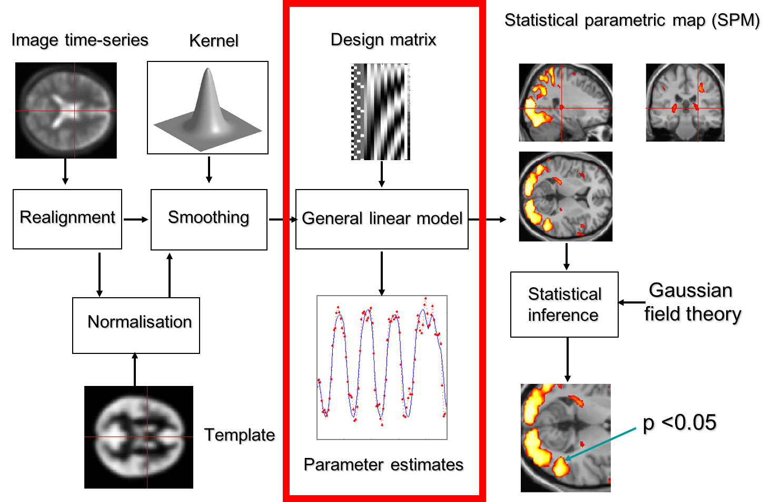

Slide 5
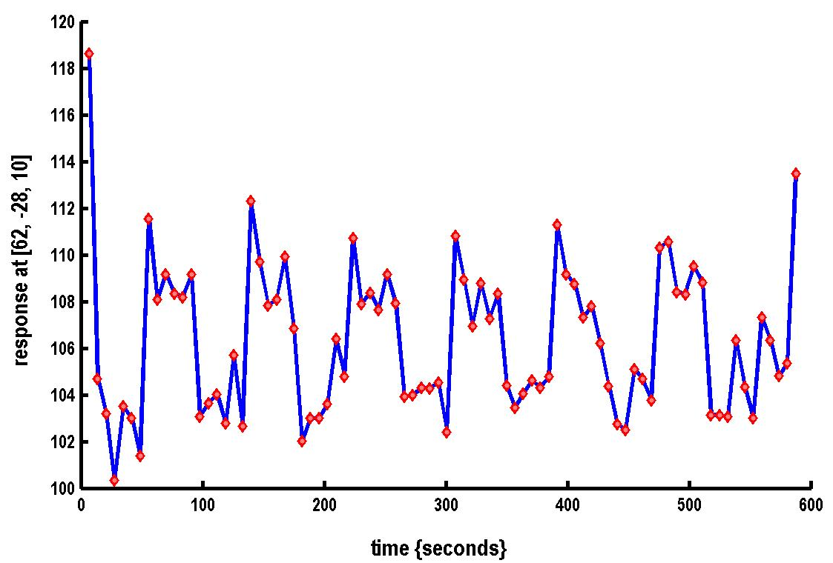

A very simple fMRI experiment
Is there a change in the BOLD response between listening and rest?
Stimulus function

Slide 6
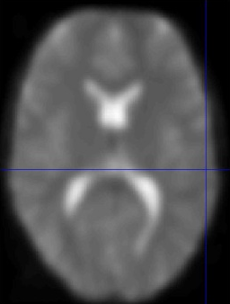
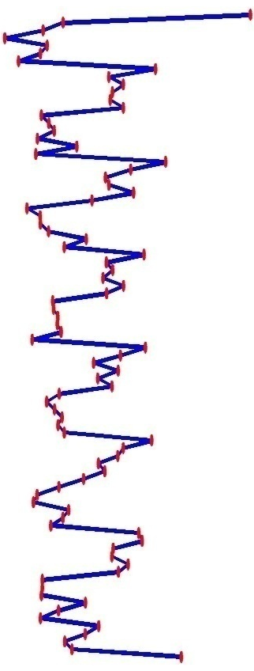
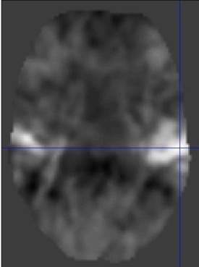
Voxel-wise time series analysis
Model
specification
Parameter
estimation
Time
Hypothesis
Statistic
Time
BOLD signal
single voxel
time series
SPM

Slide 7

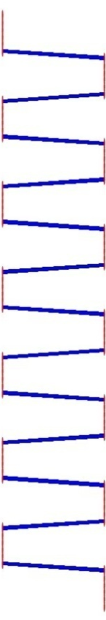

Single voxel regression model
error
=
β₁
+
β₂
+
Time
x₁
x₂
e
BOLD signal

Slide 8
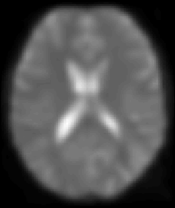
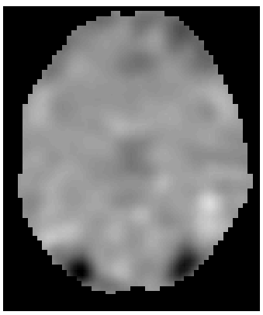
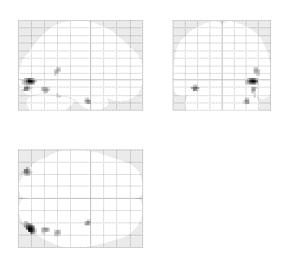
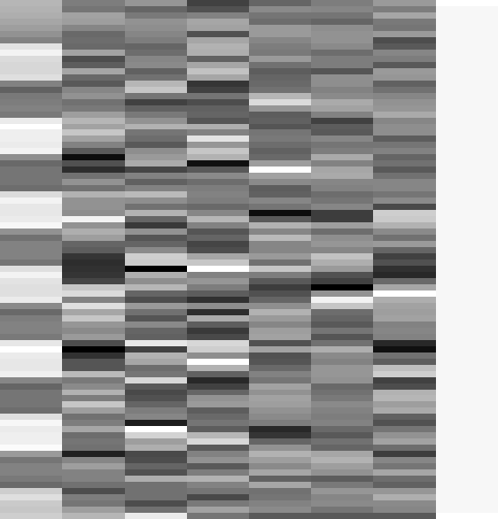
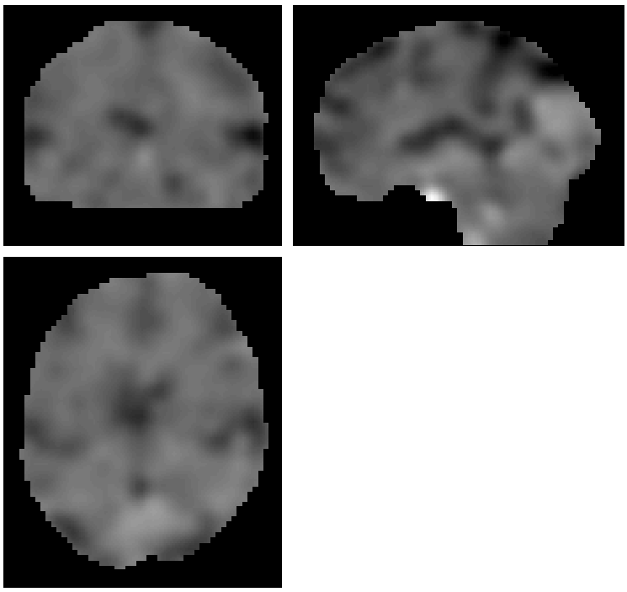
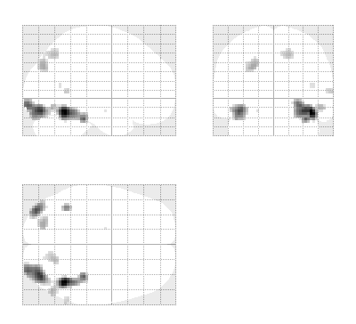
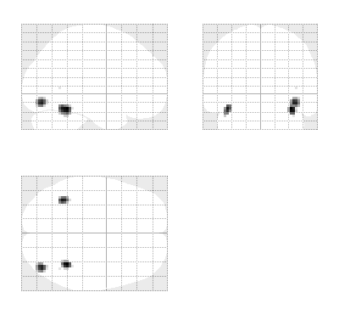
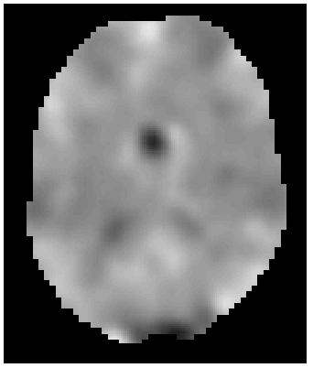
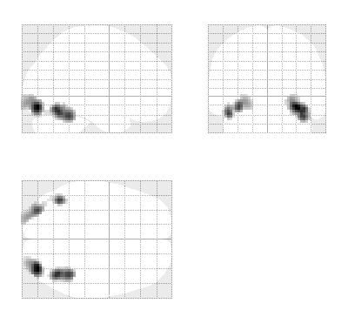
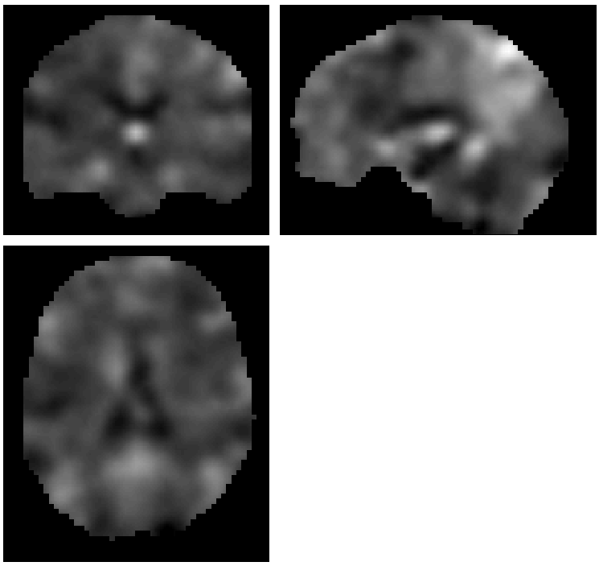
fMRI data
Design Matrix
Contrast Images
SPM{t}
Subject 1
Subject 2
…
Subject N

Slide 9
Overview
Recap of first-level analysis
Second-level analysis
Fixed versus random effects
How do we analyse random effects?
Practical demonstration

Slide 10
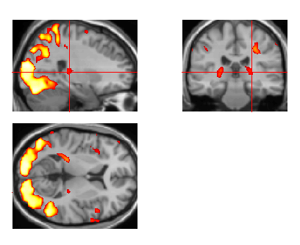

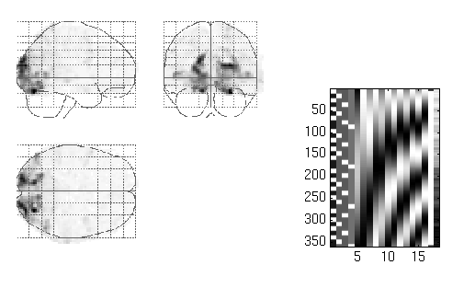
Statistical parametric map (SPM)
Kernel
Design matrix
Realignment
Smoothing
General linear model
Statistical
inference
Gaussian
field theory
Normalisation
p <0.05
Template
Parameter estimates

Slide 11
Second-level analysis: across subjects
We want to know which voxels consistently show significant activity within our group
We would also like to be able to generalise our results to non-tested subjects

Slide 12
Overview
Recap of first-level analysis
What is second-level analysis?
Fixed versus random effects
How do we analyse random effects?
Practical demonstration

Slide 13
Fixed versus random effects
Different assumptions about source of random variation in voxel activity

Slide 14
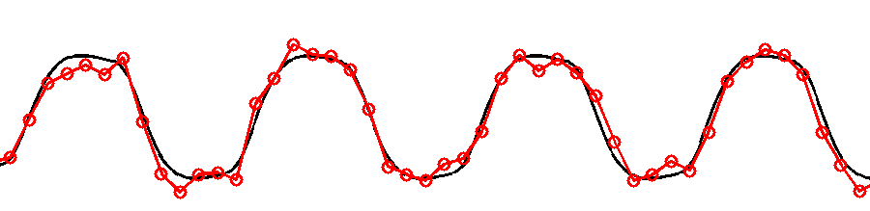
Fixed effects
Only one source of random variation (over subjects):
  measurement error
True response magnitude is fixed.
Within-subject Variance

Slide 15
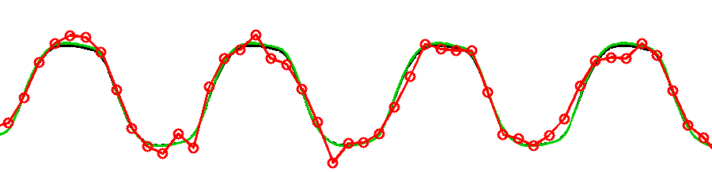
Random effects
Two sources of random variation:
  measurement error
  response magnitude (over subjects)
Response magnitude is random
  each subject/session has random magnitude
Within-subject Variance
Between-subject Variance

Slide 16
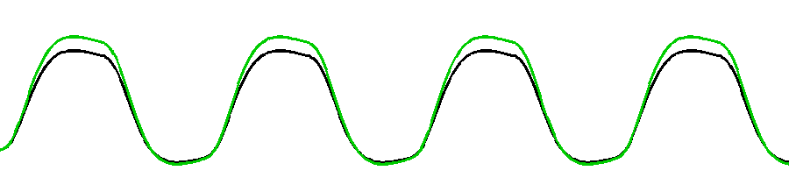
Random effects
Two sources of random variation:
  measurement errors
  response magnitude (over subjects)
Response magnitude is random
  each subject/session has random magnitude
  but population mean magnitude is fixed.
Within-subject Variance
Between-subject Variance

Slide 17
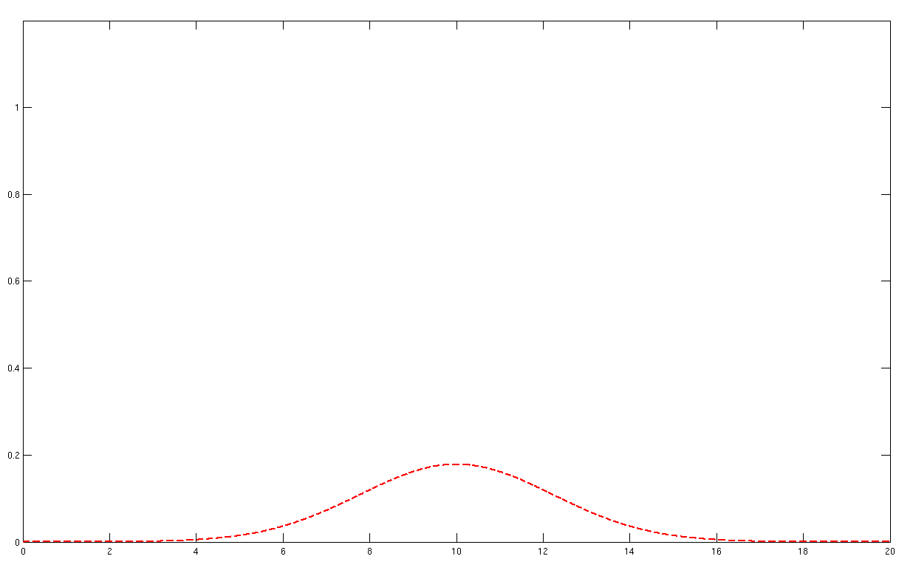
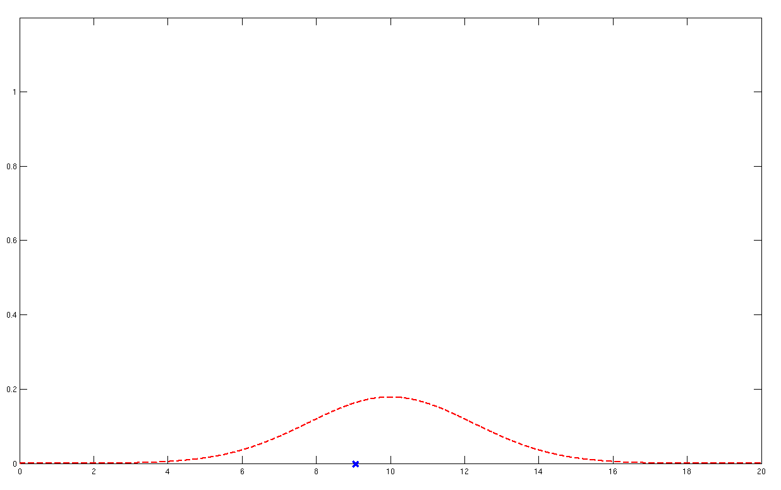
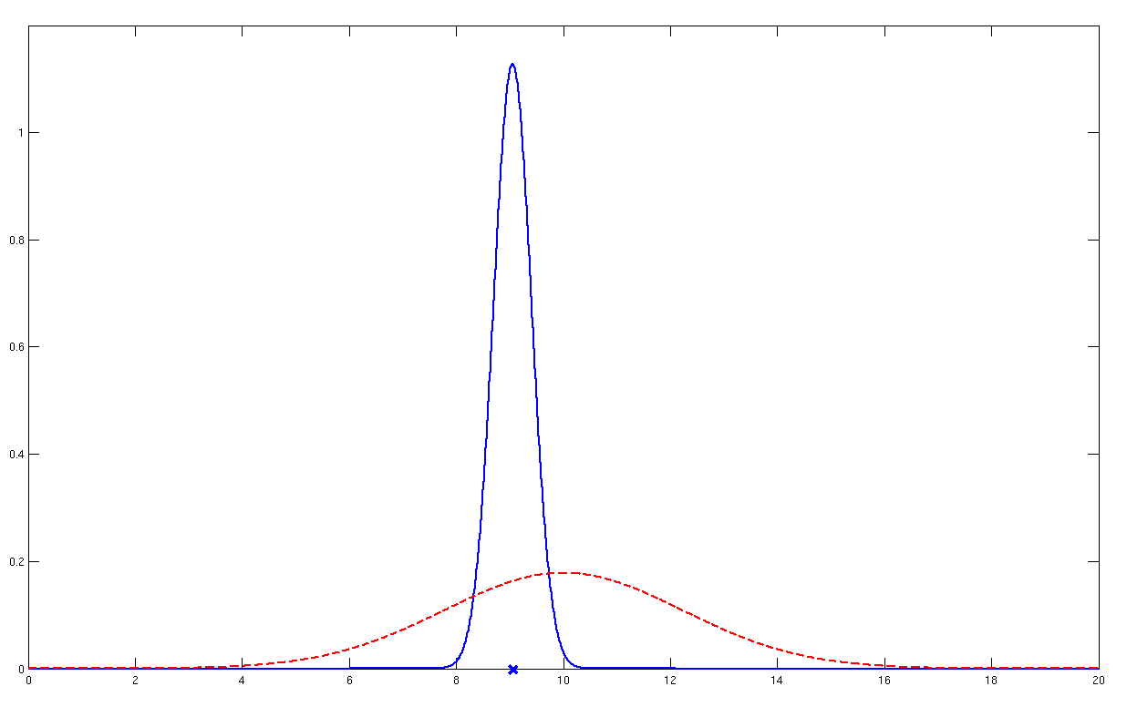
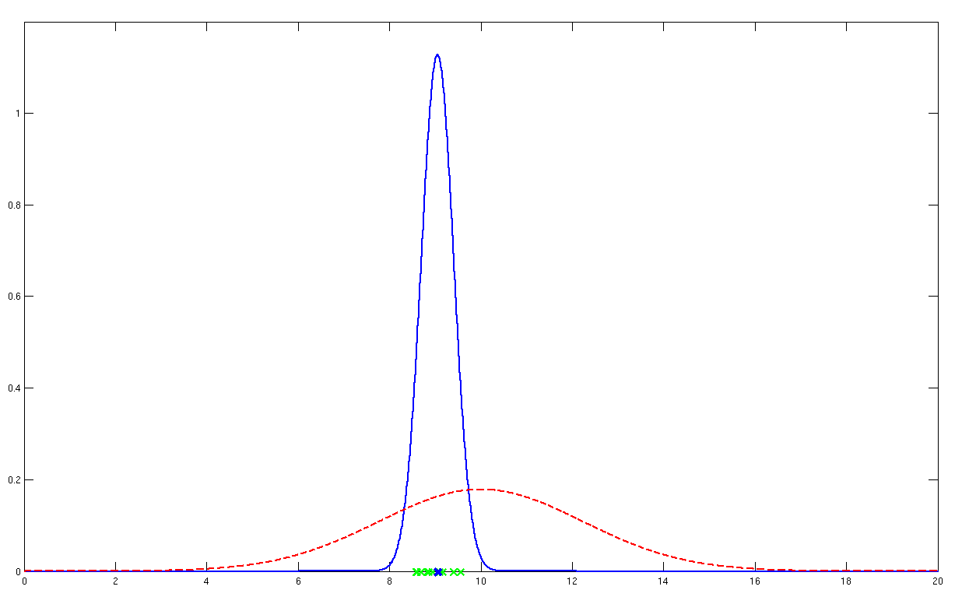
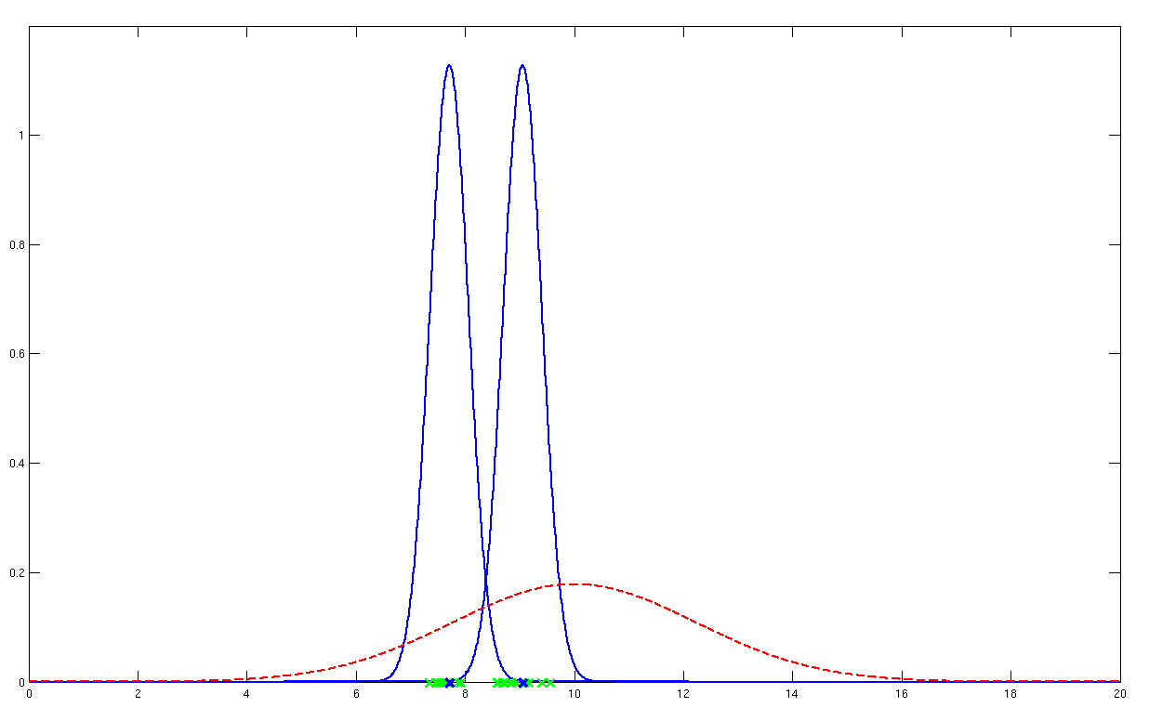
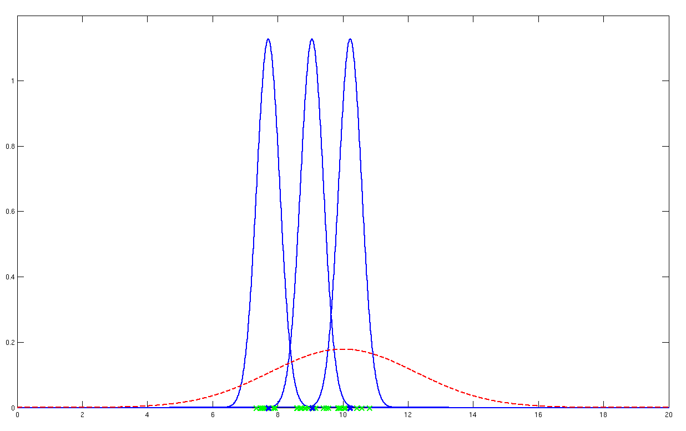
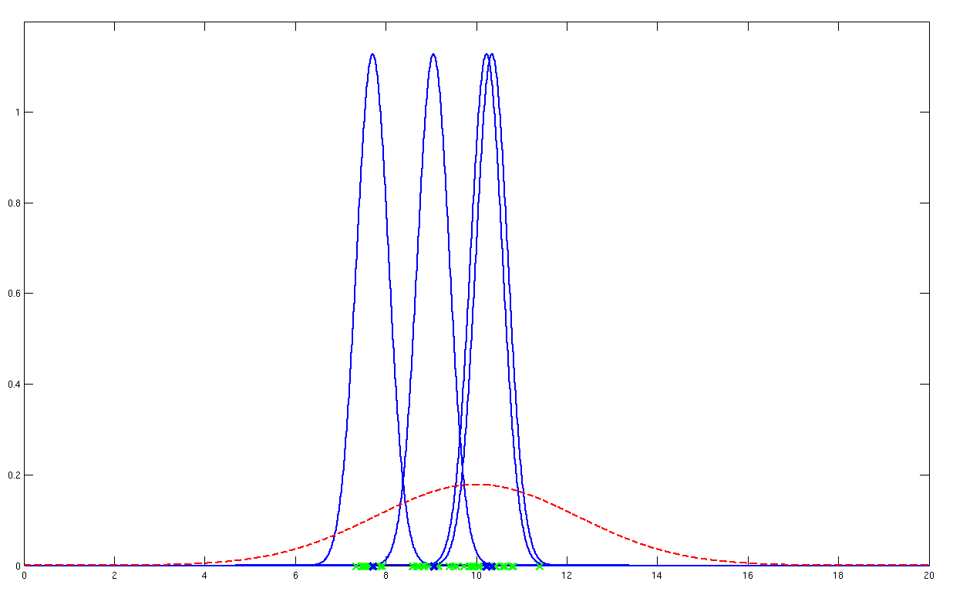
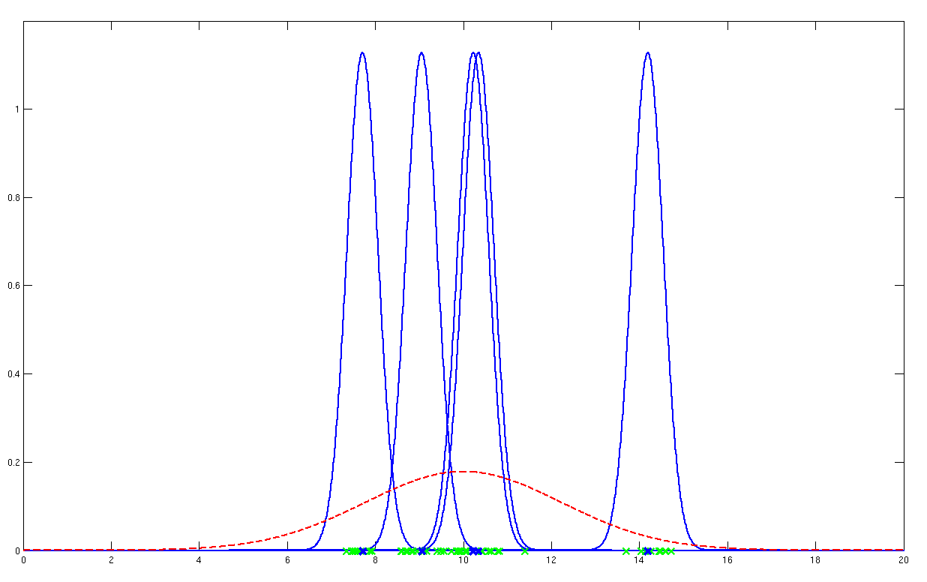


Random effects
$σ_{w}^{2}$
$σ_{b}^{2}$
Probability model underlying random effects analysis

Slide 18
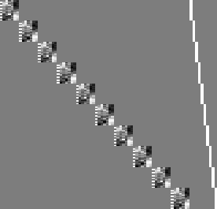
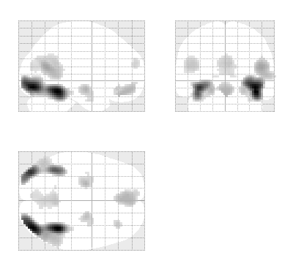
Fixed-effects analysis (FFX)
Subject 1
modelling all subjects at once
Subject 2
Subject 3
…
Subject N

Slide 19
FFX calculation
N subjects = 12
Within-subject effect size = [4,3,2,5…]
Within-subject variability = [0.2,0.4,0.3,0.3, …]
Mean group effect = 2.67
Mean variability = .31
Standard Error Mean (SEM) = σ_{w}² /(sqrt(N))=0.087
t=M/SEM = 30.69, p=10⁻¹⁶

Slide 20
Within- versus between-subject variability
$σ_{w}^{2}$
$σ_{b}^{2}$

Slide 21
What is the consequence of ignoring between-subject variability?
We can only say something about our particular group of subjects – we cannot generalise our results to non-tested subjects

Slide 22
Random effects analysis (RFX)
We consider both within-subject variance, σ_{w}², and between-subject variance, σ_{b}²
Treats our subjects as a random samples from the wider population
We make inferences about the population from which the subjects were drawn

Slide 23

Hierarchical models
Example: Two level model
=
+
=
+
Second level
First level

Slide 24
Random effects
Two sources of random variation:
  measurement error
  response magnitude (over subjects)
Response magnitude is random
  each subject/session has random magnitude
Within-subject Variance
Between-subject Variance

Slide 25
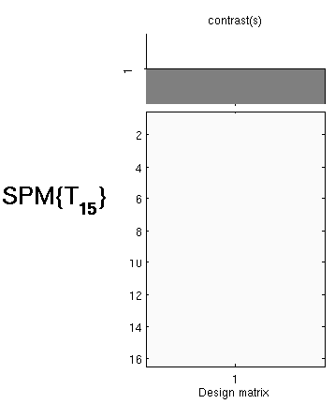
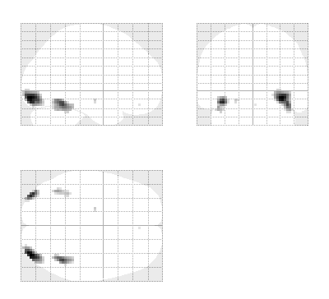
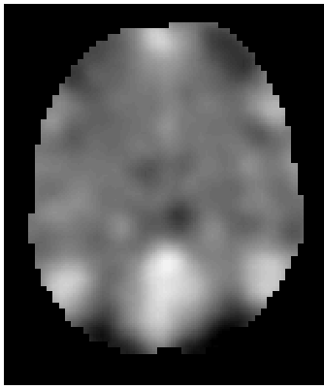
Summary Statistics RFX Approach
First level
Second level
fMRI data
Design Matrix
Contrast Images
One-sample t-test @ second level
Subject 1
…
Subject N
  Generalisability, Random Effects & Population Inference. Holmes & Friston, NeuroImage,1998.

Slide 26
RFX calculation
N subjects = 12
Within-subject effect size = [4,3,2,5…]
Mean group effect = 2.67
Between-subject variability = 1.07
Standard Error Mean (SEM) = σ_{w}² /(sqrt(N))=0.31
t=M/SEM = 8.61, p=10⁻⁶

Slide 27
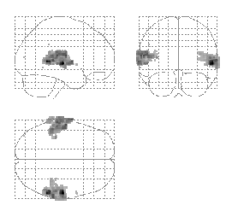
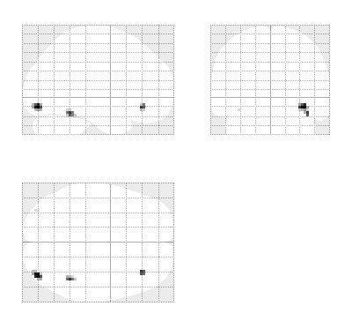

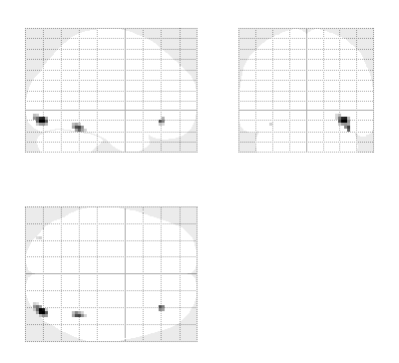
Summary Statistics RFX Approach
Robustness
Summary
statistics
Hierarchical
Model
Listening to words
Viewing faces
Mixed-effects and fMRI studies. Friston et al., NeuroImage, 2005.

Slide 28
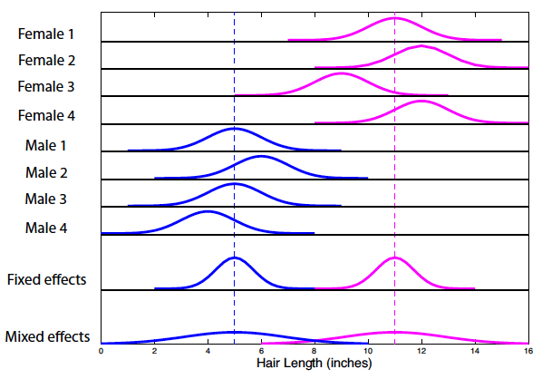
Driving home difference
(from Poldrack, Mumford and Nichol’s ‘Handbook of fMRI analyses’)

Slide 29
Overview of today’s talk
Recap of first-level analysis
What is second-level analysis?
Fixed versus random effects
How do we analyse random effects?
Practical demonstration
Questions

Slide 30
Button- pressing
Notes:
Assumes first level analysis has been done correctly.
Alex

Slide 31
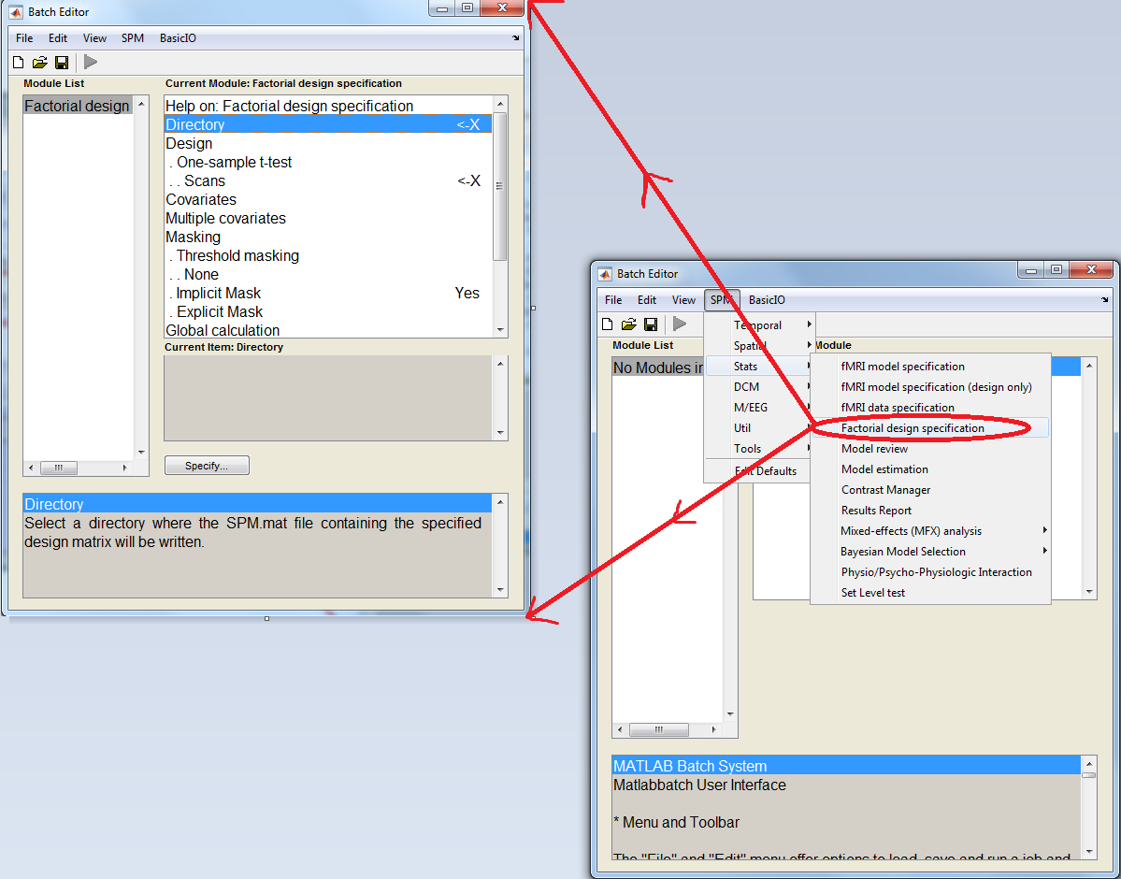

Slide 32
Set-up options
Directory
  To write to
Design
  Scans: select con.*img from 1st level
  Several design options:
    1 sample t-test
    2 sample t-test
    Paired t-test
    Multiple regression
    1 way ANOVA
    Full or flexible factorial

Slide 33
Set-up options
Covariates
  Input covariates & nuisance variables here
  1 value per con*.img
Masking
  Specifies voxels within image which are to be assessed
  Implicit is default

Slide 34
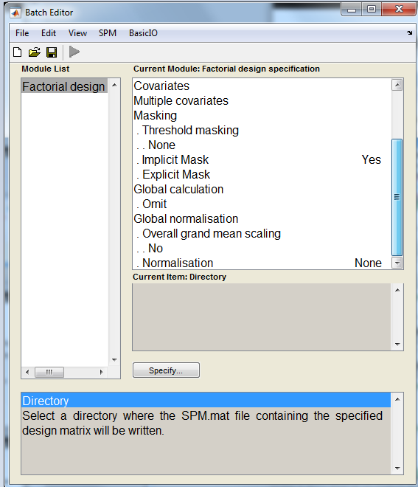
(scroll down…)
(For PET only)
Specify 2nd level Set-Up
↓
Save 2nd level Set-Up
↓
Run analysis
↓
Look at the RESULTS

Slide 35
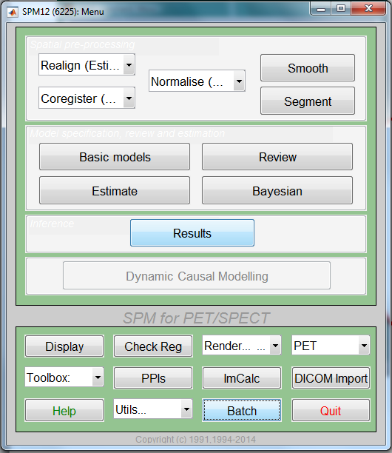
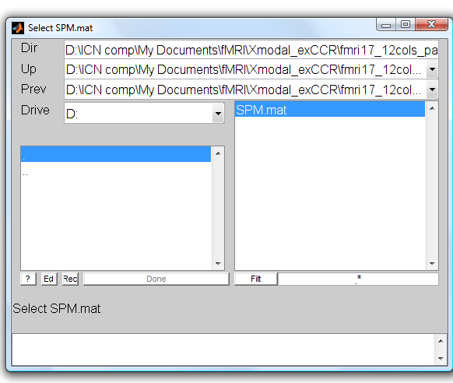
Results
Notes:
Chris

Slide 36
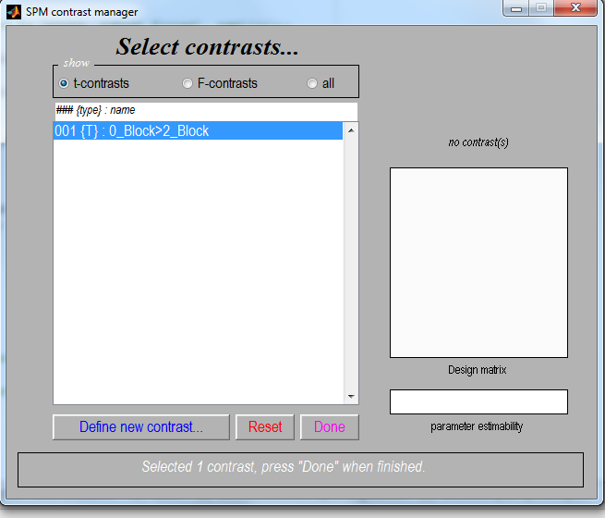
e.g. 2nd level 1-sample t-test
Select t-contrast
Define new contrast
  c = +1 (e.g. A>B)
  c = -1 (e.g. B>A)

Slide 37
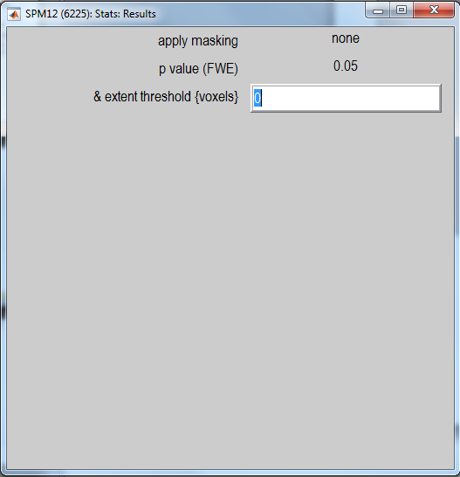
Select options for displaying results:
Correct for multiple comparisons – FWE/FDR.

Slide 38
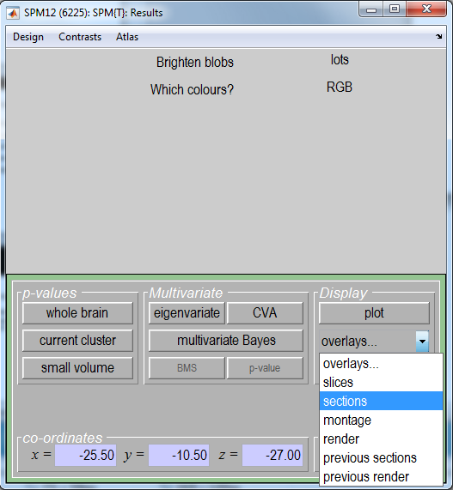

Slide 39
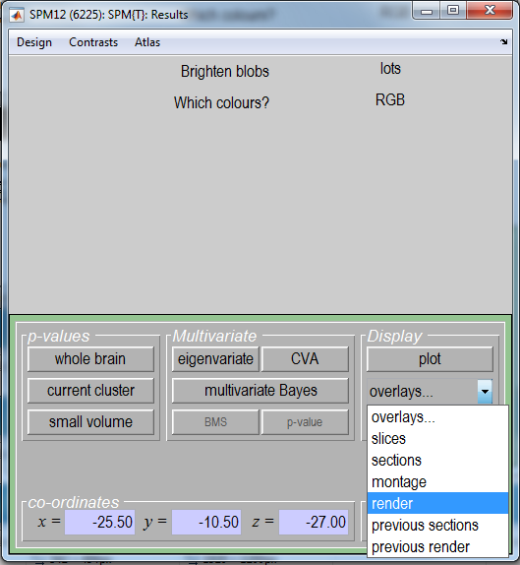

Slide 40
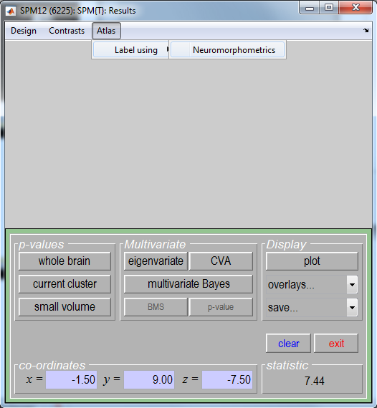

Slide 41
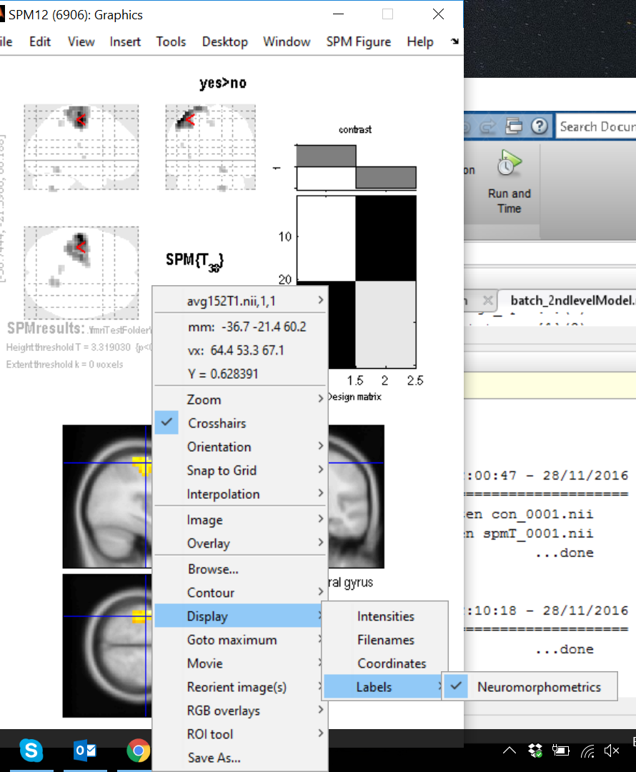

Slide 42
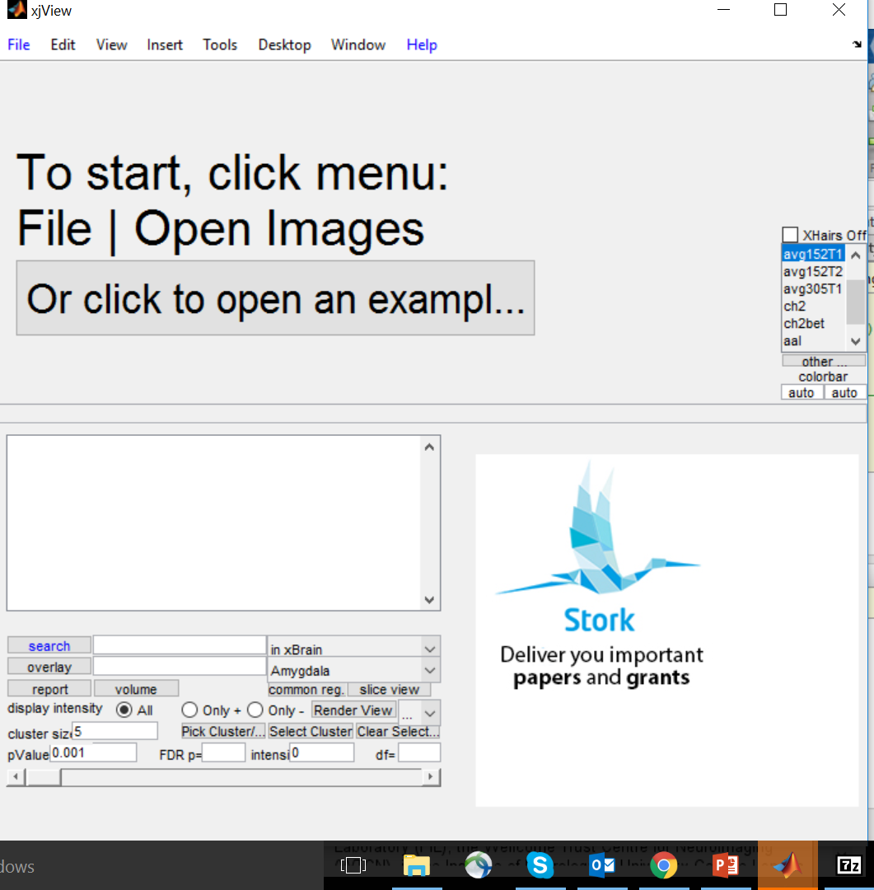
Seeing results: Xjview

Slide 43
Seeing results: Xjview
Easy fit with matlab and SPM
Allows to see positive and negative
Easy brain area labelling
Allows to superimpose 2 images and find common area(s)

Slide 45
Suggestions
Always also check results at p = 1 uncorrected (you should see a full brain -> if not there is some problem)
If no full brain: probably one (or more) participants had a wrong realignment/normalization!

Slide 46
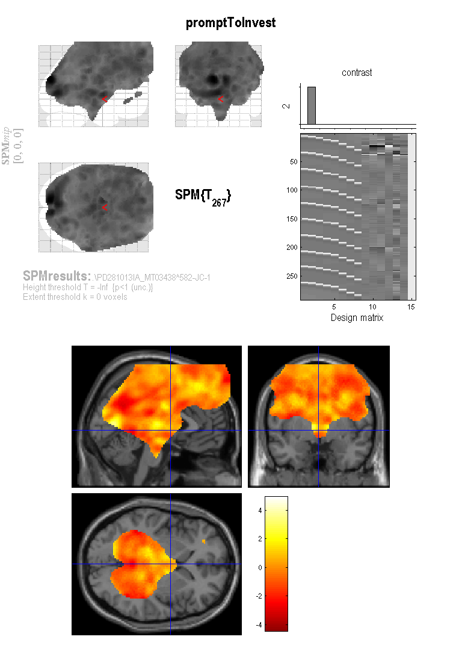
One wrongly aligned subject can take away any possible group-level effects!
Is enough that 1 subject doesn’t have a certain voxel, that the voxel gets discarded at the 2nd level for all.

Slide 47
Suggestions
After: Use as a threshold at least p<0.001 (or even lower) -> less than that doesn’t work
Use matlab code for faster analyses!
  Specially important if you have 50+ subjects…

Slide 48
Use matlab code for faster analyses
%%% Starts SPM
spm('Defaults','fMRI');
spm_jobman('initcfg');
%%% Specifies SPM parameters for factorial design
clear matlabbatch
% Specifies general output and filename dir:
matlabbatch{1}.spm.stats.factorial_design.dir = {modelOutputDir}; % specifies output dir
% Specifies input files
if ~isempty(covariateName) && divideIn2groups == 1
matlabbatch{1}.spm.stats.factorial_design.des.t2.scans1 = ...
filenames(idxLowGroup);
matlabbatch{1}.spm.stats.factorial_design.des.t2.scans2 = ...
filenames(idxHighGroup);
else
matlabbatch{1}.spm.stats.factorial_design.des.t1.scans = filenames; % specifies full name of contrasts
end

Slide 49
Use matlab code for faster analyses
% If you are dividing your data in 2 groups, specifies additional things:
if ~isempty(covariateName) && divideIn2groups == 1
matlabbatch{1}.spm.stats.factorial_design.des.t2.dept = 0;
matlabbatch{1}.spm.stats.factorial_design.des.t2.variance = 1;
matlabbatch{1}.spm.stats.factorial_design.des.t2.gmsca = 0;
matlabbatch{1}.spm.stats.factorial_design.des.t2.ancova = 0;
end
% Specifies potential covariates
if ~isempty(covariateName) && divideIn2groups == 0%because otherwise you will be using the covariate just to divide the group
matlabbatch{1}.spm.stats.factorial_design.cov.c = currCovariate;
matlabbatch{1}.spm.stats.factorial_design.cov.cname = covariateName;
matlabbatch{1}.spm.stats.factorial_design.cov.iCFI = 1;
matlabbatch{1}.spm.stats.factorial_design.cov.iCC = 1;
else
matlabbatch{1}.spm.stats.factorial_design.cov = struct('c', {}, 'cname', {}, 'iCFI', {}, 'iCC', {});
end
matlabbatch{1}.spm.stats.factorial_design.multi_cov = struct('files', {}, 'iCFI', {}, 'iCC', {});%no multicov

Slide 50
Use matlab code for faster analyses
% Specifies if to do masking
matlabbatch{1}.spm.stats.factorial_design.masking.tm.tm_none = 1;
matlabbatch{1}.spm.stats.factorial_design.masking.im = 1;
matlabbatch{1}.spm.stats.factorial_design.masking.em = {''};%no mask name for now
matlabbatch{1}.spm.stats.factorial_design.globalc.g_omit = 1;
matlabbatch{1}.spm.stats.factorial_design.globalm.gmsca.gmsca_no = 1;
matlabbatch{1}.spm.stats.factorial_design.globalm.glonorm = 1;
%estimates the model
matlabbatch{2}.spm.stats.fmri_est.spmmat(1) = cfg_dep;
matlabbatch{2}.spm.stats.fmri_est.spmmat(1).tname = 'Select SPM.mat';
matlabbatch{2}.spm.stats.fmri_est.spmmat(1).tgt_spec{1}(1).name = 'filter';
matlabbatch{2}.spm.stats.fmri_est.spmmat(1).tgt_spec{1}(1).value = 'mat';
matlabbatch{2}.spm.stats.fmri_est.spmmat(1).tgt_spec{1}(2).name = 'strtype';
matlabbatch{2}.spm.stats.fmri_est.spmmat(1).tgt_spec{1}(2).value = 'e';
matlabbatch{2}.spm.stats.fmri_est.spmmat(1).sname = 'Factorial design specification: SPM.mat File';
matlabbatch{2}.spm.stats.fmri_est.spmmat(1).src_exbranch = substruct('.','val', '{}',{1}, '.','val', '{}',{1}, '.','val', '{}',{1});
matlabbatch{2}.spm.stats.fmri_est.spmmat(1).src_output = substruct('.','spmmat');
matlabbatch{2}.spm.stats.fmri_est.method.Classical = 1;

Slide 51
Use matlab code for faster analyses
% Makes contrast at the second level
matlabbatch{3}.spm.stats.con.spmmat(1) = cfg_dep;
matlabbatch{3}.spm.stats.con.spmmat(1).tname = 'Select SPM.mat';
matlabbatch{3}.spm.stats.con.spmmat(1).tgt_spec{1}(1).name = 'filter';
matlabbatch{3}.spm.stats.con.spmmat(1).tgt_spec{1}(1).value = 'mat';
matlabbatch{3}.spm.stats.con.spmmat(1).tgt_spec{1}(2).name = 'strtype';
matlabbatch{3}.spm.stats.con.spmmat(1).tgt_spec{1}(2).value = 'e';
matlabbatch{3}.spm.stats.con.spmmat(1).sname = 'Model estimation: SPM.mat File';
matlabbatch{3}.spm.stats.con.spmmat(1).src_exbranch = substruct('.','val', '{}',{2}, '.','val', '{}',{1}, '.','val', '{}',{1});
matlabbatch{3}.spm.stats.con.spmmat(1).src_output = substruct('.','spmmat');
matlabbatch{3}.spm.stats.con.consess{1}.tcon.name = ...
[nameContrasts{contrastNo} '(+1)'];
matlabbatch{3}.spm.stats.con.consess{1}.tcon.convec = 1;
matlabbatch{3}.spm.stats.con.consess{1}.tcon.sessrep = 'none';
matlabbatch{3}.spm.stats.con.delete = 0;
%%% Runs the 2nd level group analysis
if ~debbug
spm_jobman('run', matlabbatch)
end

Slide 52
Summary
For fMRI data, usually preferable to use RFX analysis, not FFX
Hierarchical models provide gold standard for RFX , BUT computationally intensive
Summary statistics = robust method for RFX group analysis

Slide 53
Resources
Previous MfD slides
Slides from Guillaume Flandin’s talk in Zurich, Feb 2014
Mumford, J. A., & Poldrack, R. A. (2007). Modeling group fMRI data. Social cognitive and affective neuroscience, 2(3), 251-257.
Friston, K. J., Stephan, K. E., Lund, T. E., Morcom, A., & Kiebel, S. (2005). Mixed-effects and fMRI studies. Neuroimage, 24(1), 244-252.

