Slide 1
PREPROCESSING:
REALIGNING AND UNWARPING
Sean Risoli
Laura Pradini-Santos
Methods for Dummies
2019-2020

Slide 2
Lecture structure:
Place in Preprocessing
fMRI voxel
Key assumptions
Head movements
Registration: 4 steps
REALIGNING
Laura
UNWARPING
Recap and extension of basic physics
Magnetic field inhomogeneities and image distortion
Magnetic field inhomogeneities and movement interactions
Sean

Slide 3

Place in MfD 2019/20 course:

Slide 4
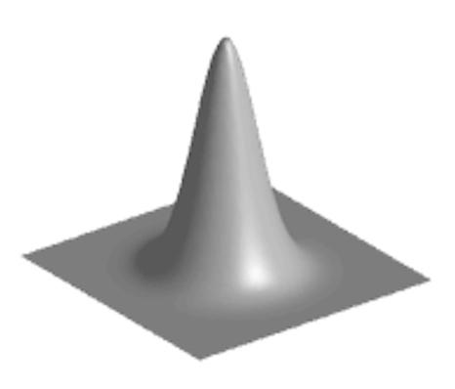
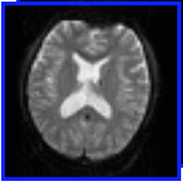
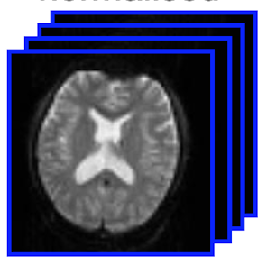
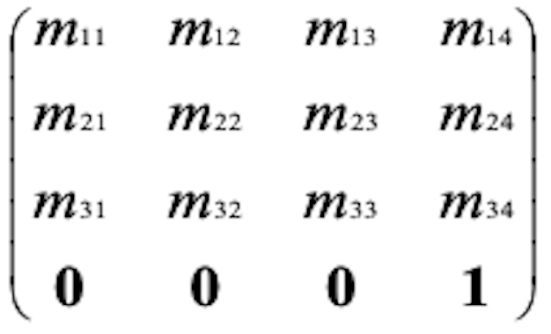
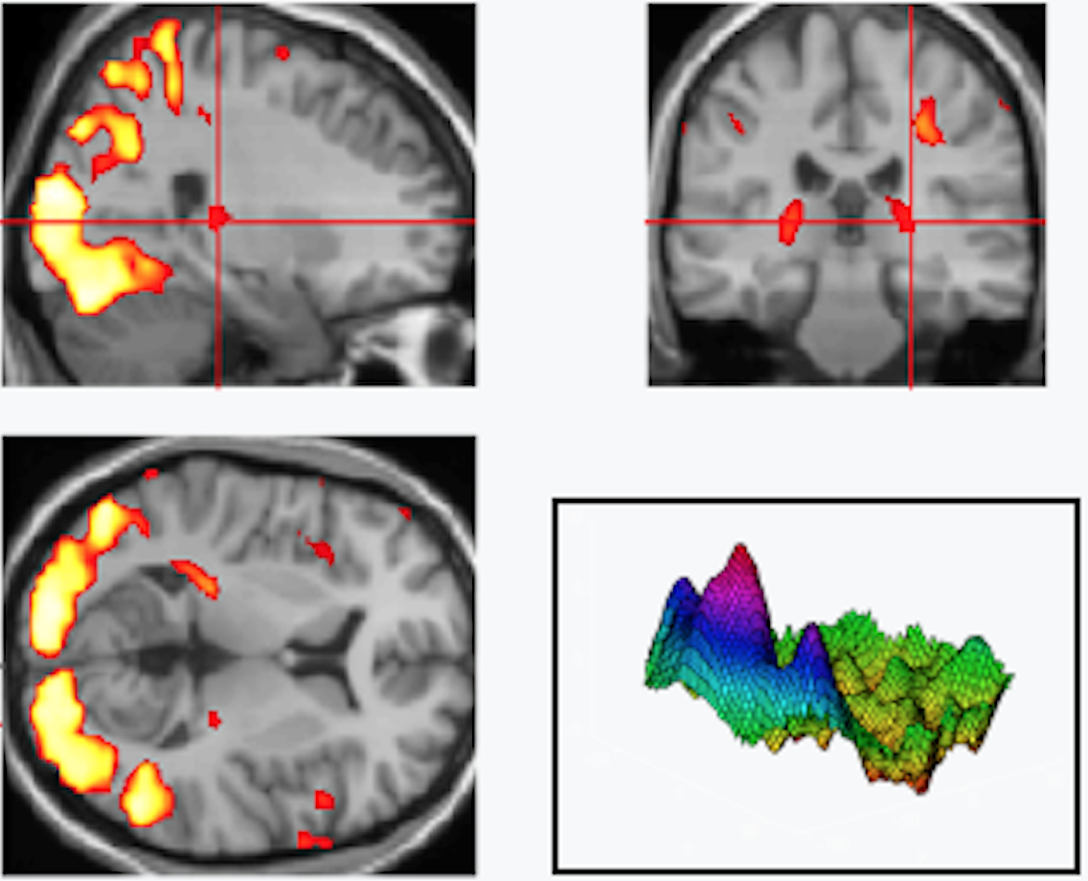
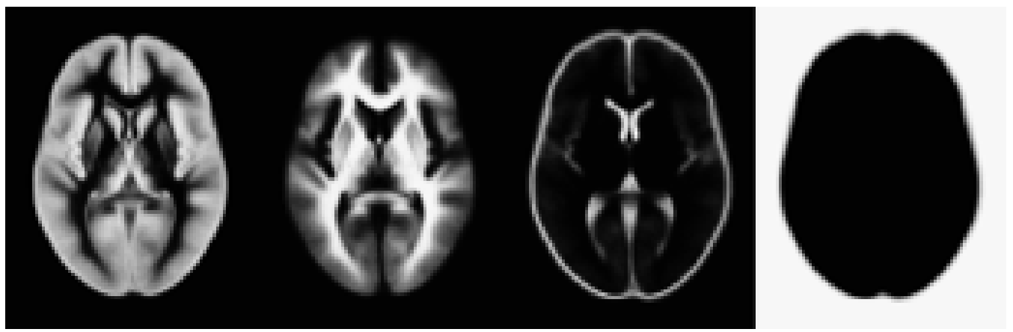
Place in preprocessing | fMRI voxel | Key assumptions | Head movements | Registration
fMRI time-series
Motion correction
= REALIGNMENT
Distortion correction
= UNWARPING
1
6
MNI space
= spatially normalised
SMOOTH
2
Reference volume/image
Moving “
SPATIAL
NORMALISATION
+ Design matrix
+ Parameter estimates
Anatomical MRI
/Structural
5
General Linear
Model
Mean functional
4
STATISTICAL ANALYSIS
3
COREGISTRATION
3’
Segmentation
Transformation
4’
ESTIMATE SPATIAL NORM
TPM
Statistical Parameter Map

Slide 5
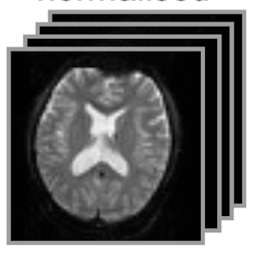
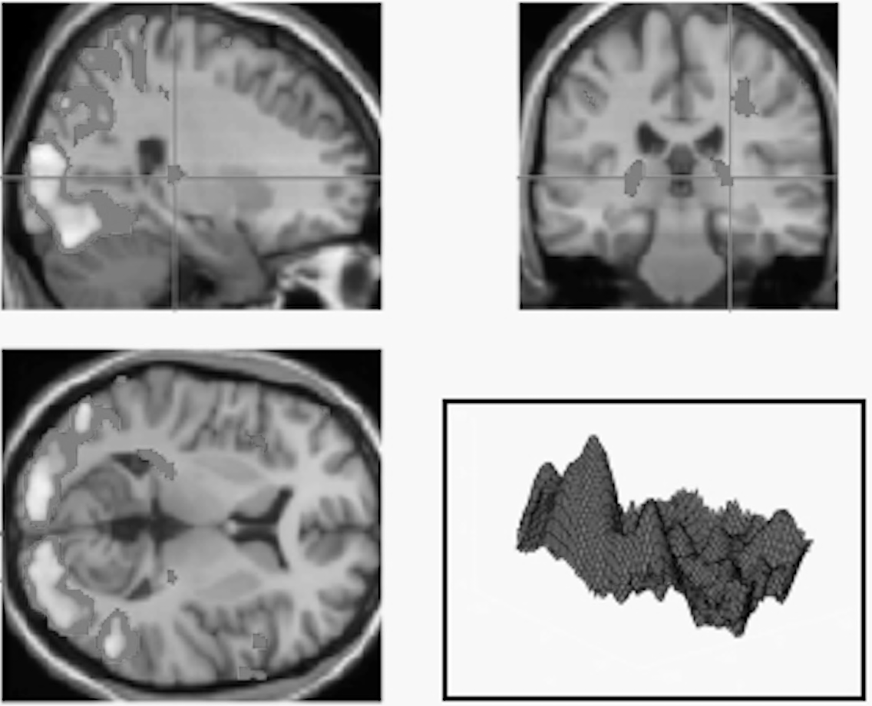
Place in preprocessing | fMRI voxel | Key assumptions | Head movements | Registration
fMRI time-series
4 STAGES of PREPROCESSING
Motion correction
= 1. REALIGNMENT
Distortion correction
= 2. UNWARPING
1
6
MNI space
= spatially normalised
SMOOTH
2
Reference volume/image
Moving “
4. SPATIAL
NORMALISATION
+ Design matrix
+ Parameter estimates
Anatomical MRI
/Structural
5
General Linear
Model
Mean functional
4
STATISTICAL ANALYSIS
3
3. COREGISTRATION
3’
Segmentation
Transformation
4’
ESTIMATE SPATIAL NORM
TPM
Statistical Parameter Map

Slide 6
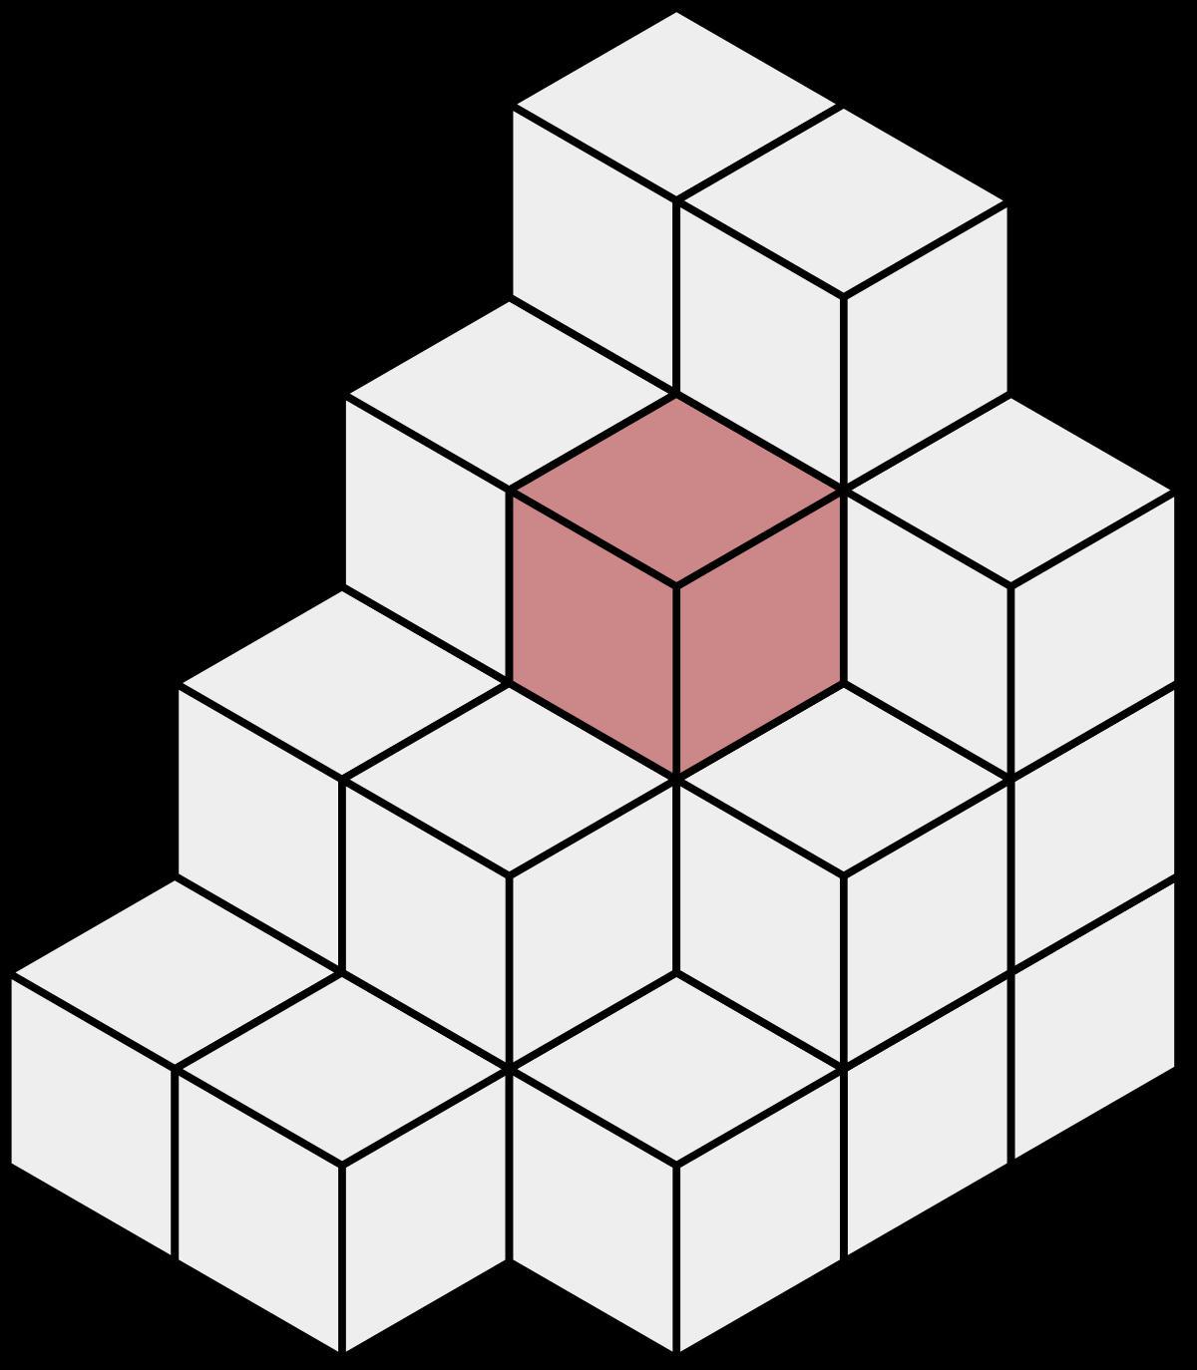
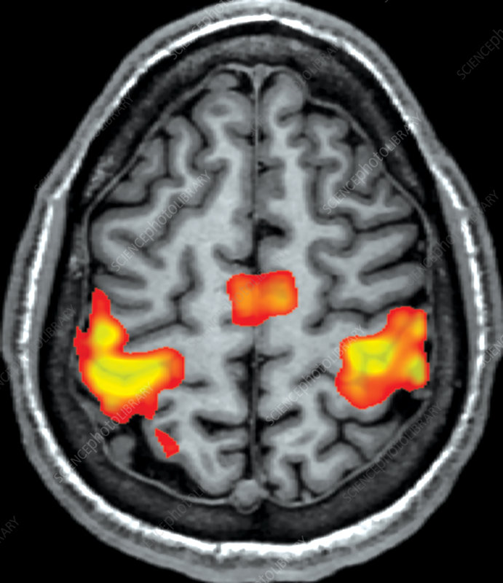
REALIGNING
Place in preprocessing | fMRI voxel | Key assumptions | Head movements | Registration
y
y
fMRI time-series
x
z
x
Array of voxels
Repeatedly sampled over time
MRI output: 2D images
As they are stacked: 3D volume
VOXEL
Single sample, or data point,
on a regularly spaced, 3D grid
Minimum element
of 3D volume
=
fMRI
Changes in voxel activation
=
Experimental task

Slide 7

REALIGNING
Place in preprocessing | fMRI voxel | Key assumptions | Head movements | Registration
KEY ASSUMPTIONS
All voxels are acquired SIMULTANEOUSLY
All voxels need to come from the SAME PART of the brain
Head/Brain move in the scanner
Last slice acquired TR seconds after 1st
5mm
5mm
Motion of 1 slice relative to another
Voxel A: inactive
Voxel B: active
SOLUTION:
Small movements = voxel location not stable
STC: slice-timing correction
= include realignment parameters in the model
Why the small movements?

Slide 8
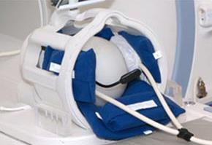
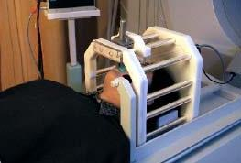
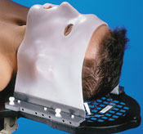


REALIGNING
Place in preprocessing | fMRI voxel | Key assumptions | Head movements | Registration
HEAD MOVEMENT due to:
Solutions?
Comfortable
Short sessions
Instruct keep still
Constrain
1. Physiological: heart beat, respiration, blinking
2. Actual movement of the head
3. Task-related to press buttons
  ! Serious confound
  as creates variance in voxel activation to task
FALSE ACTIVATIONS
due to variance in voxel activation
↓ Signal-to-noise ratio
Most variance still remains

Slide 9
REALIGNING
Place in preprocessing | fMRI voxel | Key assumptions | Head movements | Registration
REGISTRATION
= to take two images and align them
= spatially reshape one to match the other
= NEEDS a mapping of each voxel from source to reference
TYPES:
REALIGNMENT
UNWARPING
LINEAR transformation
NON-LINEAR transformation
Preserves shape
Modifies shape

Slide 10
REALIGNING
REALIGNMENT: stages
1.
Specifying the transformations
2.
Measuring the similarity
between transformed images
3.
Transformation function parameters
to maximise the similarity
4.
Transformation

Slide 11
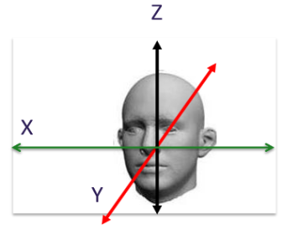
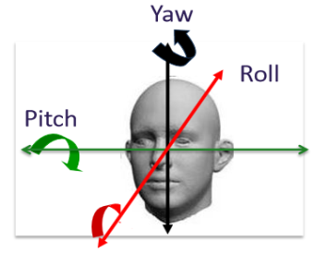
REALIGNING
Specifying | Measuring similarity | Transformation function parameters | Transformation
SPECIFYING the transformations:
Characterised by degrees of freedom (DOF)
TRANSFORMATION function
INTERPOLATION function
Subject shape and size of brain don’t change
Constructing new data points based on known data
Reference image chosen
Distance between any 2 pts preserved
Simple interpolation
B-Spline interpolation
Improves accuracy SPM
Nearest neighbour
Tri-linear
Estimate 6 parameters
minimise the sum of
squared differences
Each scan
Reference
Info beyond neighbouring voxels
Closest voxel
Weighted average of
neighbouring voxels
3 translations
3 rotations
6 DOF
x, y, z
degrees
Notes:
To what references you are referencing
How you preserve the difference between the 2 points?
Based on what you decide which interpolation do you use?

Slide 12
REALIGNING
Specifying | Measuring similarity | Transformation function parameters | Transformation
Choosing a way of MEASURING SIMILARITY between transformed images:
COST FUNCTION
QUANTIFICATION
similar
How the images are after a spatial transformation has been applied
dissimilar

Slide 13

REALIGNING
Specifying | Measuring similarity | Transformation function parameters | Transformation
Find the TRANSFORMATION FUNCTION PARAMETERS that maximise similarity:
Mathematical optimisation problem
No easy analytical solution
Robustness
Speed of processing
Trade-off:
Notes:
1. How you select this transformation function?
2. Do you change any parameters and based on what?

Slide 14
REALIGNING
Specifying | Measuring similarity | Transformation function parameters | Transformation
Conduct the TRANSFORMATION:
 | Raw data | After re-alignment
Brain area
Scanned slices
t = 1
t = 2
t = 3
t = 4
t = 5
t = 6
Apply the TRANSFORMATION FUNCTION
by resampling the data
using interpolation.
Set of mathematical equations
that relate the old image coordinates
to the new ones.
Missing data

Slide 15
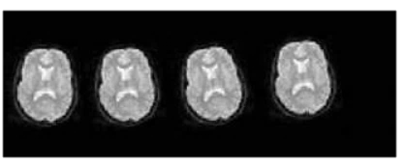
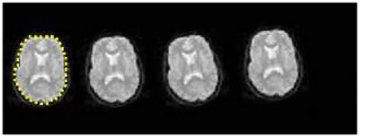
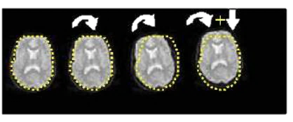
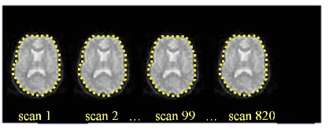
REALIGNING
REALIGNMENT: stages SUMMARY
1.
2.
Series of scans
with head movement
Calculate position of brain
for first slice = reference image
3.
4.
Estimate transformation parameters
based on reference image
Apply transformation parameters
on each slice – using interpolation

Slide 16
REALIGNING
References & further reading
Taken from MfD 2016/2017 slides
Slides from previous years (particularly 2016/17) of the MfD course
(http://www.fil.ion.ucl.ac.uk/mfd/)
MRC CBU Cambridge, Imaging Wiki
(http://imaging.mrc-cbu.cam.ac.uk/imaging)
Nipype Beginner’s guide to neuroimaging
(http://miykael.github.io/nipype-beginner-s-guide/neuroimaging.html)
Andy’s Brain blog
(http://andysbrainblog.blogspot.co.uk/2012/10/fmri-motion-correction-afnis-3dvolreg.html)
Also has cool video showing the 3 translations and 3 rotations.
Huettel, S. A., Song, A. W., & McCarthy, G. (2004). Functional magnetic resonance imaging. Sunderland: Sinauer Associates.

Slide 17
Lecture structure:
Place in Preprocessing
fMRI voxel
Key assumptions
Head movements
Registration: 4 steps
REALIGNING
Laura
UNWARPING
Recap and extension of basic physics
Magnetic field inhomogeneities and image distortion
Magnetic field inhomogeneities and movement interactions
Sean

Slide 18
UNWARPING
Recap and extension of basic physics | MFI + image distortion | MFI + movement interactions
Pre-Processing: UNWARPING
Within-subject: Realignment
Within-subject: EPI Distortion Correction (unwarping)
Within-subject: Co-registration
Between-subject: Normalise/Segment
Notes:
The fact that its within-subject is important, since it means that no group-level/inter-subject information is being used in any of the pre-processing techniques.
The correspondence problem is now mostly solved (The correspondence problem refers to if the voxels across all scans within each participant are representing the same neural tissue).

Slide 19
UNWARPING
Recap and extension of basic physics | MFI + image distortion | MFI + movement interactions
Why does this matter?
Correspondence problem is not completely solved by registration
    Because within trial/scan movement is not modelled as well
Other issues are also present (Friston, Williams, Howard, Frackowiak and Turner, 1996a), including but not limited to:
    Image distortions caused by magnetic field inhomogeneities
    Movement/motion-by-MF inhomogeneity interactions
    Spin-excitation history effects
    Within-scan movement
Consequence:
    Mostly a loss of sensitivity (decreased SNR), reducing power and increasing the chance of false negatives
    Sometimes a loss of specificity (if movements are correlated with the task), resulting in false positives
Distortion correction is also essential for the analysis of simultaneously collected f(MRI)-EEG data.
Notes:
By scan I mean the acquisition of whole-brain 3D volumes (which is what are usually obtained) within each trial, which takes a couple of seconds depending on the MR pulse sequences used.
I define scans as the 3D volumes measured within each trial.
The mechanism by which these factors affect the sensitivity or specificity of your study are all different.

Slide 20
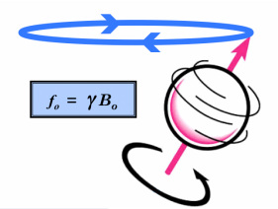
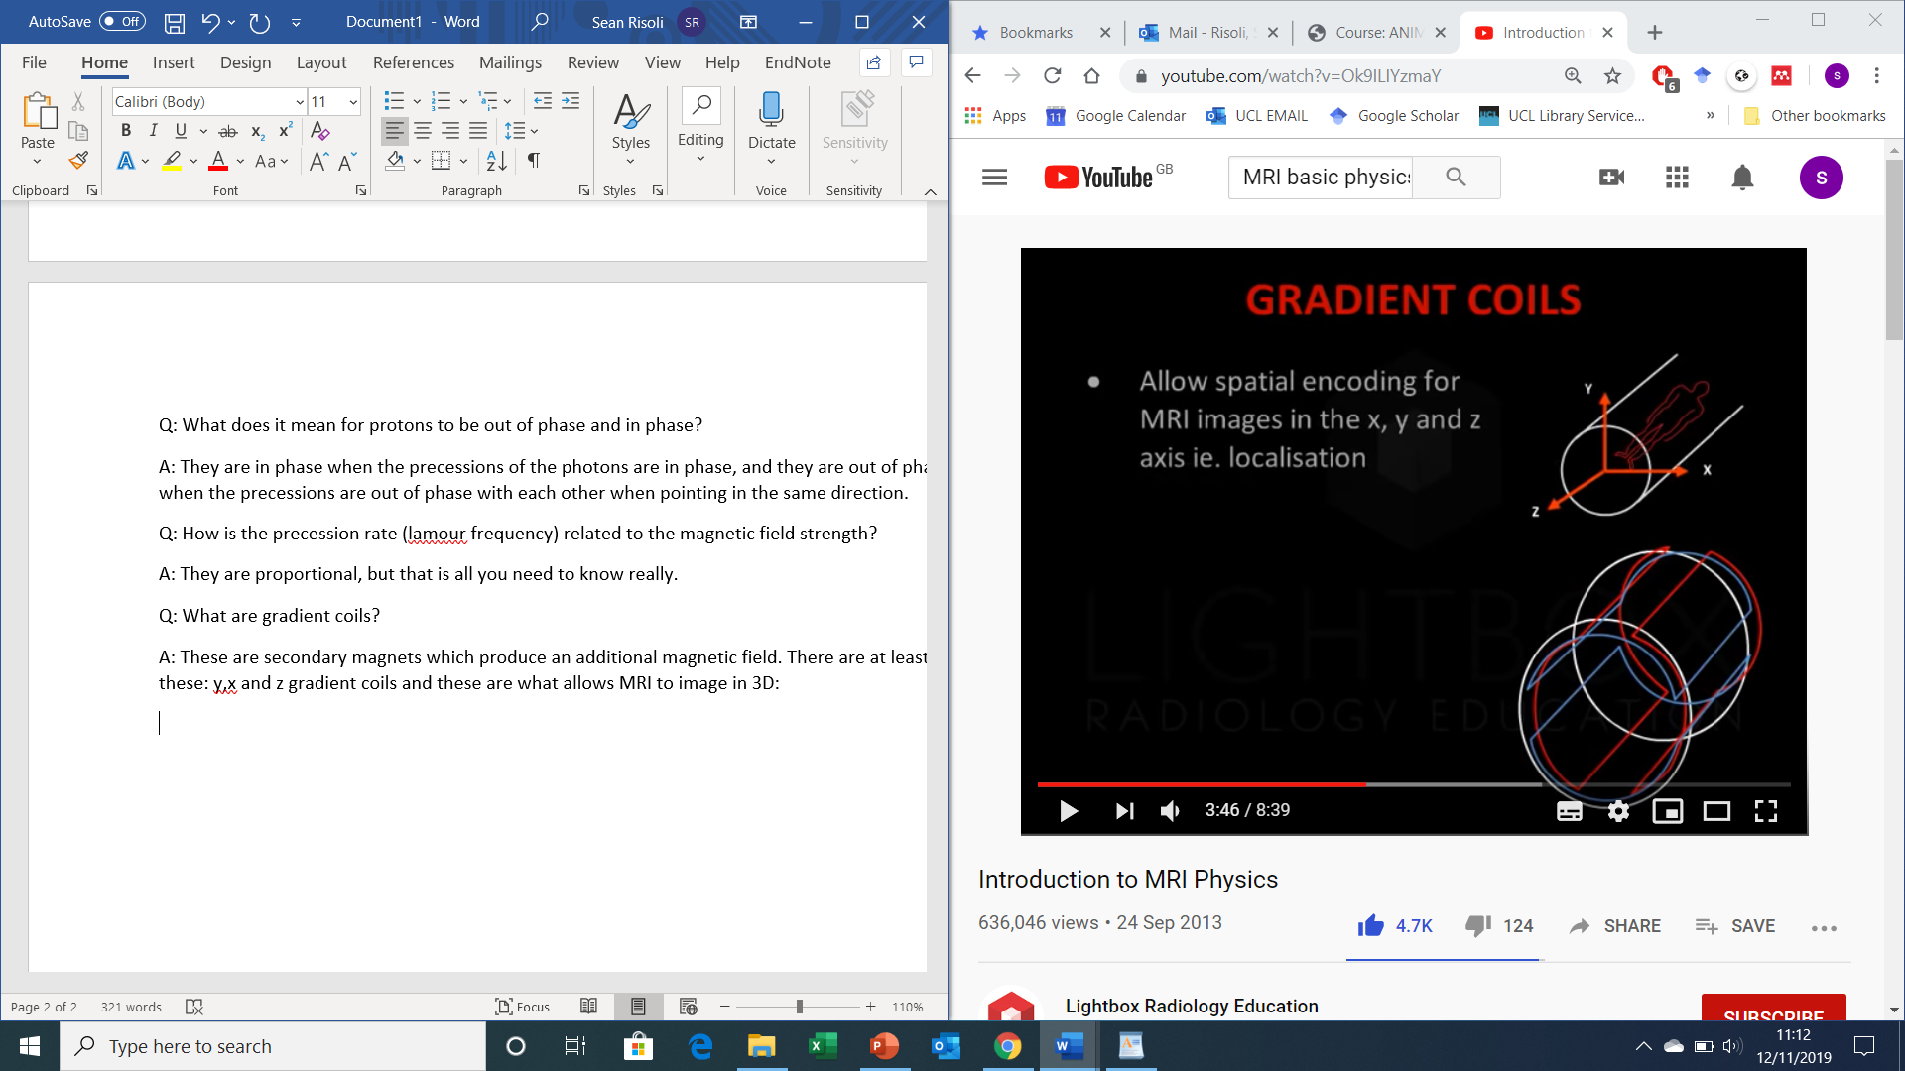
UNWARPING
Recap and extension of basic physics | MFI + image distortion | MFI + movement interactions
Basics of spatial encoding in MRI:
The spatial origin of the recorded signals in MRI is non-obvious
The hydrogen precession rate (Lamour frequency) and phase is indirectly used to infer the spatial location of the recorded signals
    - Forget about phase-encoding for now
ω₀ = γ Β₀
Lamour equation
3D-Coordinates reminder
Notes:
This is due to the physical set-up of MRI machines (e.g. gradient coils, transceiver ect). This level of detail is sufficient for the scope of this lecture series. Moreover this means that the spatial locations of your signals within each whole-brain volume (within trial scan) cannot be directly inferred from your receiver without the use of further techniques and processing. Gradient coils are what are used to solve this issue.
Recap: Explain Lamour equation: W0 = precession rate (the number of full cycles per second), y = a constant which relates the strength of the main magnetic field to the rate of precession (it is different for different particles, but in f(MRI) we are only interested in hydrogen atoms and so the value of this constant stays the same).*correct. The value of this constant per tesla = 42.575 MHz/Tesla, which means for a 3T scanner the precession rate for hydrogen would be 127.725MHz (if the main field was completely homogeneous, which it isn’t but this is very close).
- The phase of the hydrogen atoms is a very important information source used to infer the spatial position of the signal, however for simplicity we are ignoring this factor. The way in which phase encoding is obtained and used for spatial localisation is very similar to that of the frequency information however (see the following link for more information http://mriquestions.com/hellipmaking-an-image.html). This level of detail is unlikely to be practically useful however.

Slide 21
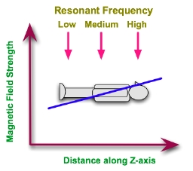
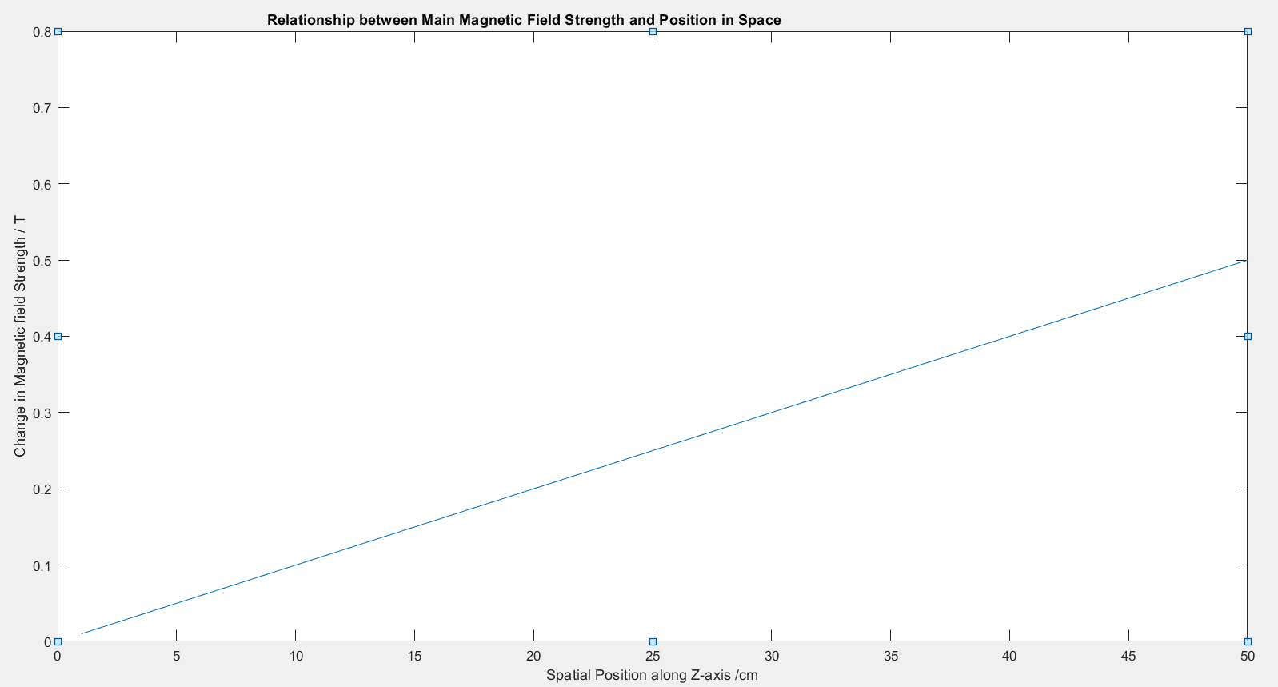
UNWARPING
Recap and extension of basic physics | MFI + image distortion | MFI + movement interactions
Using Gradient Coils for Infer Spatial Position
The gradient coils modulate the B₀ field strength in a highly predictable manner
  This causes a highly predictable shift in the Lamour frequency as a function of spatial position (because: ω₀ = γ Β₀ )
2. This information allows spatial encoding when combined with other principles and techniques
Notes:
1. Give a very basic description of spatial localisation using frequency-encoding in MRI using gradient coils. Mention that phase-encoding is also important for this purpose and works in a similar way, but that I’m not covering this.

Slide 22
UNWARPING
Recap and extension of basic physics | MFI + image distortion | MFI + movement interactions
Issue 1
Image distortions caused by magnetic field inhomogeneities
Movement/motion-by-MF inhomogeneity interactions

Slide 23
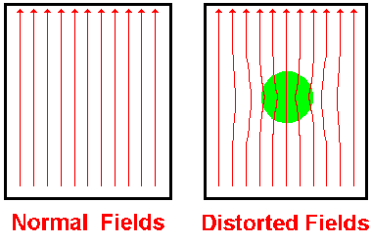
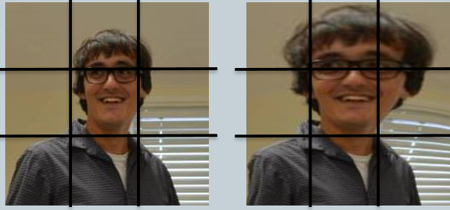
UNWARPING
Recap and extension of basic physics | MFI + image distortion | MFI + movement interactions
No Object in scanner
Object in scanner
Why does this matter?
The Β₀ field is never precisely what you would expect
Multiple reasons
2. This results in distorted spatial localisation
2. Linear solution: estimate bias fields and correct for these
Notes:
1. This is because the beta field strength is never exactly as you would expect. Many reasons for this. One simple reason is that when you have objects in then scanner (e.g. someone's head), the main field is will become distorted. Other reasons include: scanner related inhomogeneities (objects in the room or scanner effect the main magnetic field e.g. electronics equipment, EEG equipment for simultaneous recordings), artefacts due to differences in magnetic susceptibility between tissue types (big, rapid changes in magnetic susceptibility result larger local magnetic fields in that local, which interact with the main magnetic field and cause it to change direction slightly), when the gradient coils do not produce a linear distortion.
.Xx The reason the signal is misplaced is because the Lamour precession is proportional to the beta field strength. Since the beta field strength is altered via its interaction with physical objects (which themselves have magnetic properties [e.g. magnetic moments], although the magnitude of these properties is massively lower than that of the main magnetic field), the precession rates will be different than predicted, resulting in a misallocation of the recorded signal. The recorded signal (voltage, don’t need to understand how the ADC does this) is a function of precession frequency, but this is not what is actually measured. Voltages are what is actually recorded, but there are many processes in between which I am not covering.
2. In an ideal world with no movement, you can use linear algebra to solve this problem. Simply acquire a voxel-wise estimate of the magnetic field distortion in the scanner, and use this to remove the artefacts produced in each of your 3D-brain volumes acquired each trial.

Slide 24
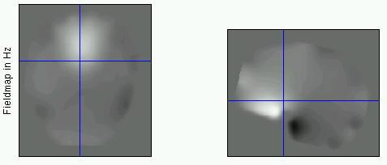
UNWARPING
Recap and extension of basic physics | MFI + image distortion | MFI + movement interactions
Fieldmap Image

Slide 25
UNWARPING
Recap and extension of basic physics | MFI + image distortion | MFI + movement interactions
Issue 2
Image distortions caused by magnetic field inhomogeneities
Movement/motion-by-MF inhomogeneity interactions

Slide 26
UNWARPING
Recap and extension of basic physics | MFI + image distortion | MFI + movement interactions
Movement-Magnetic field inhomogeneity interactions
This refers to how magnetic field inhomogeneities change as a function/result of movement
  This means the magnetic field distortions change as a result of the spatial position of the head
Modelling this is more difficult but involves estimating the magnetic field inhomogeneities within each image in the time-series.
  Try and predict how the magnetic
  field changes with movement.
  Regress out these effects
Notes:
Important point: The cause for these interactions is that when the head is in a different position, the local magnetic field created by the tissue in the presence of the scanner will have its direction changed, since the angle between the main magnetic field vector and the local magnetic field will be different (you can calculate the resultant magnetic field inhomogeneity as the dot product of these two vectors). This will therefore also cause the main magnetic field to change direction slightly (which is more or less what magnetic field inhomogeneities are) as a result of what position the person is in. Therefore for the same reasons as previously mentioned (precession frequency will be different to expected), this will cause spatial localisation of the signals to be incorrectly estimated.
Software achieves this. You also use an objective function, similar to the realignment process, in order to minimise the variance in signal intensities introduced by the movement. Since usually you only have a couple of fieldmaps (which represents the magnetic field inhomogeneities throughout the image at that point in time), the software has to infer how this will change as a result of movement.

Slide 27
UNWARPING
Recap and extension of basic physics | MFI + image distortion | MFI + movement interactions
REFERENCES:
http://mriquestions.com/index.html
Friston KJ Williams S Howard R Frackowiak RSJ and Turner R. (1996a) Movement related effects in fMRI time series. Mag. Res. Med. 35:346-355
Andersson, J. L., Hutton, C., Ashburner, J., Turner, R., & Friston, K. (2001). Modeling geometric deformations in EPI time series. Neuroimage, 13(5), 903-919.
Hutton, C., Bork, A., Josephs, O., Deichmann, R., Ashburner, J., & Turner, R. (2002). Image distortion correction in fMRI: a quantitative evaluation. Neuroimage, 16(1), 217-240.

Slide 28
UNWARPING
How: Using SPM software
For a full guide, see section 24 of the SPM Manuel titled (FieldMap Toolbox)

Slide 29
THANK YOU!
PREPROCESSING:
REALIGNING AND UNWARPING
Sean Risoli
Laura Pradini-Santos
Methods for Dummies
2019-2020

