Slide 1
Methods for Dummies
2nd level analysis
Dummies: Fraser Aitken & Lara Gregorians
Expert: Guillaume Flandin

Slide 2
Structure
1st level analysis recap
What is 2nd level analysis?
Fixed and random effects
How to carry out random effects analysis

Slide 3
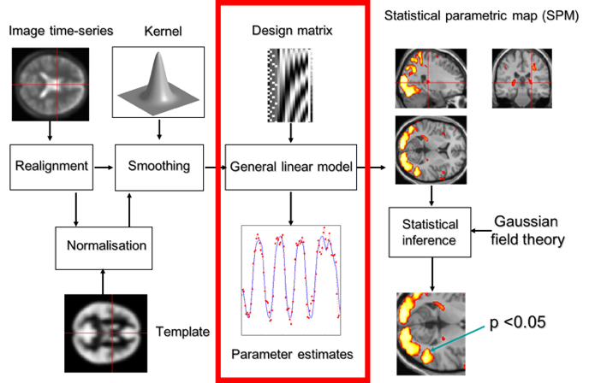
Notes:
This is the within subject statistical analysis that we’ve previously looked at.
This step is looking at how data in our different experimental conditions can predict the fMRI data.
This is done for every subject - so you have as many 1st level analyses as subjects.

Slide 4
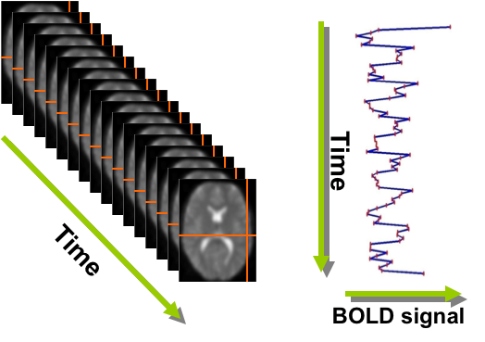
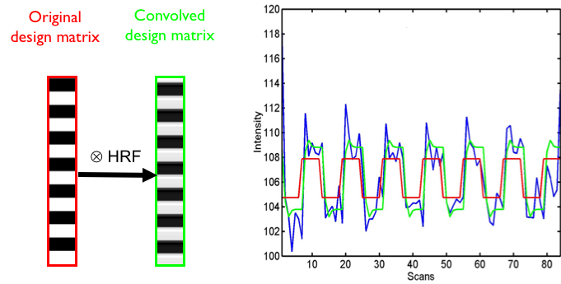
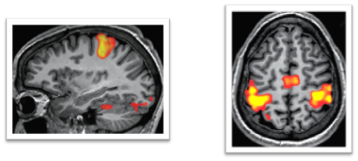
Y= β₀+β₁X₁+ ϵ
Time-series per voxel, per participant GLM:
Convolution:
Contrasts:
Notes:
The data at this point is a time-series for each voxel, per participant, showing the changes in BOLD signal at that voxel throughout the experiment.
For each voxel series, you’re combining a model with the actual image data, to eventually amalgamate to create contrast images that estimate activation for every subject.
We do this by using the GLM, which treats our data as a linear combination of regressors and errors or noise. The slopes of the regressors, B, need to be estimated.
The mass univariate approach means that we’re using a separate model for every voxel.
So the outcome is the BOLD signal, and the predictors are the series of regressors based on the task and conditions - the predictors/regressors and intercept make up the design matrix.
HRF convolution, filters and noise regressors all considered in the design matrix to have our model better fit the data.
Once we have the model we want to see if there is any significant activation in a particular voxel/region due to our experimental conditions, and we do this by calculating contrasts.
We develop a contrast vector to determine which conditions we want to compare/test.
And then we calculate a t or F value for each voxel, and heat maps show areas of activation.

Slide 5
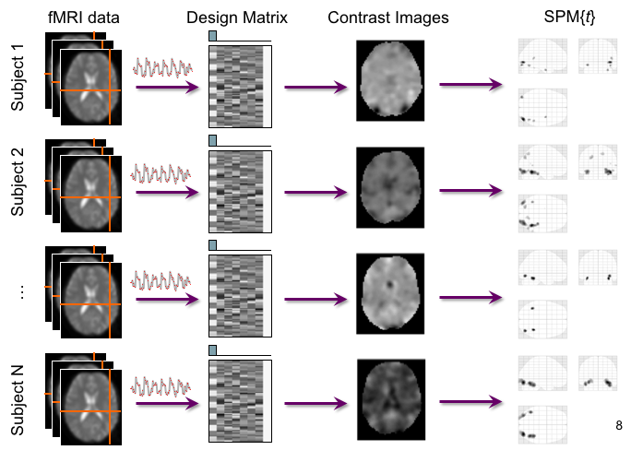
Notes:
We end 1st level analysis with a contrast image per participant, and identified areas of activation.

Slide 6
What is 2nd level analysis?
2nd level analysis = looking at across subject effects as opposed to single subject effect
Significant differences in activation between different levels of X are unlikely to be manifest identically in all individuals. Therefore, we might ask:
  Is this contrast in activation different on average between groups? e.g. males vs. females?
  Is this contrast in activation seen on average in the population?
Notes:
Ok so what is 2nd level analysis. Essentially, 2nd level analysis is when we try to see how often the effects we see in individual participants are observed across a group. This is important as we cannot generalise findings from individuals that might simply be due to non experimental effects or noise.
We could ask if contrast in activations are different within sample groups such as males or females, but really we almost always want to see if the effects are likely to be found in the population generally.

Slide 7
What is 2nd level analysis?
We need to look at which voxels are showing a significant activation difference between levels of X consistently within a group. To do this, we need to consider:
  The average contrast effect across our sample
  The variation of this contrast effect
  T-tests involve mean divided by standard error of mean
Notes:
To see how strong these effects are beyond a single participant, we need to consider the average effect in our sample (the beta I showed you earlier), and how much the effect varies and what are the sources of these effects - this is generally looked at in 3 ways. Fixed effects, random effects or mixed effects.
This will determine how we conduct t-tests to see where, across subjects, there is statistically significant activation.

Slide 8
Fixed vs. Random effects
Fixed effects model | Random effects model
Comparing effect size to within subject variability (i.e. not an inference about the pop.). | Comparing group effect to between subject variability (i.e. an inference about the pop.).
Only one source of variation - measurement error (true response magnitude is fixed). | Models multiple sources of variation - measurement error AND true response magnitude (i.e. individual difference, which is random).
Levels not drawn from random sample; always the same e.g. Drug use Y/N. | Levels randomly sampled from population e.g. participant selected at random.
CANNOT generalise to unobserved subjects. | CAN generalise to unobserved subjects.
Notes:
First of all we’ll look at fixed effects.
If we we just want to examine how large an effect is within our sample, we can analyse the mean effect across participants in relation to the within subject variance. To recap, if the GLM from each participant is basically an activation response model derived from many trial repetitions, then we get within subject variance from the fact that their responses to trials will vary over time .
So fixed effects models can tell us on average which voxels show a significant difference in activation for levels of X - but this only applies to our sample group.
Measurement error = scan to scan variability.
Response magnitude = each subject/session has a random magnitude for their true response i.e. all subjects are different.

Slide 9
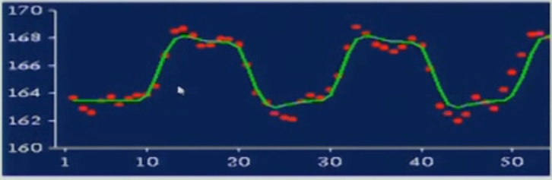
Worked example
For group of N = 12 subjects x 50 scans = 600
Effect sizes c = [4,3,2,1,1,2,3,3,3,2,4,4]
Within subject variability = [0.9,1.2,1.5,0.5,0.4,0.7,0.8,2.1,1.8,0.8,0.7,1.1]
Mean group effect M = 2.67
Average within subject variability (SD) σ_{w}² = 1.04
Standard Error Mean (SEM) = σ_{w}² /(sqrt(N))=0.04
t=M/SEM = 62.7, p=10⁻⁵¹
Subject 1
Effect size c = 4 for given voxel
Within subject variability = 0.9
Notes:
Here’s a worked example, assuming we have 12 subjects, each with 50 scans.
We concatenate the time series from all the different subjects. So 50 scans for one subject x 12 = 600 scans in the whole study, which becomes our N.
We have the effect size and within subject variability (i.e. how well the model fits the data) per participant, and from these numbers can calculate the following figures, which feed into our t test.
As you can see, the inference about the mean is very strong, but you have to remember that this is comparing the group effect to within subject effect.

Slide 10
Fixed vs. Random effects
Fixed effects model | Random effects model
Comparing effect size to within subject variability (i.e. not an inference about the pop.). | Comparing group effect to between subject variability (i.e. an inference about the pop.).
Only one source of variation - measurement error (true response magnitude is fixed). | Models multiple sources of variation - measurement error AND true response magnitude (i.e. individual difference, which is random).
Levels not drawn from random sample; always the same e.g. Drug Y/N. | Levels randomly sampled from population e.g. participant selected at random.
CANNOT generalise to unobserved subjects. | CAN generalise to unobserved subjects.
Notes:
This is all well and good for a limited analysis but it cannot generalise to a larger population, and likely story is that we want to extrapolate our findings to the general population. This is where random effects comes in. We assume that our sample is a random set of individuals from the population of interest, hence the name.
To do this extrapolation, we need to consider how our individual participants differ from one another, and the likely variance of the population that we have recruited our sample from (which is the key bit).
The population variance will be greater than the variance within our sample, so to make these generalised inferences we need to use an estimate of the population variance to test the significance of the mean differences in activation that we see in our sample.

Slide 11
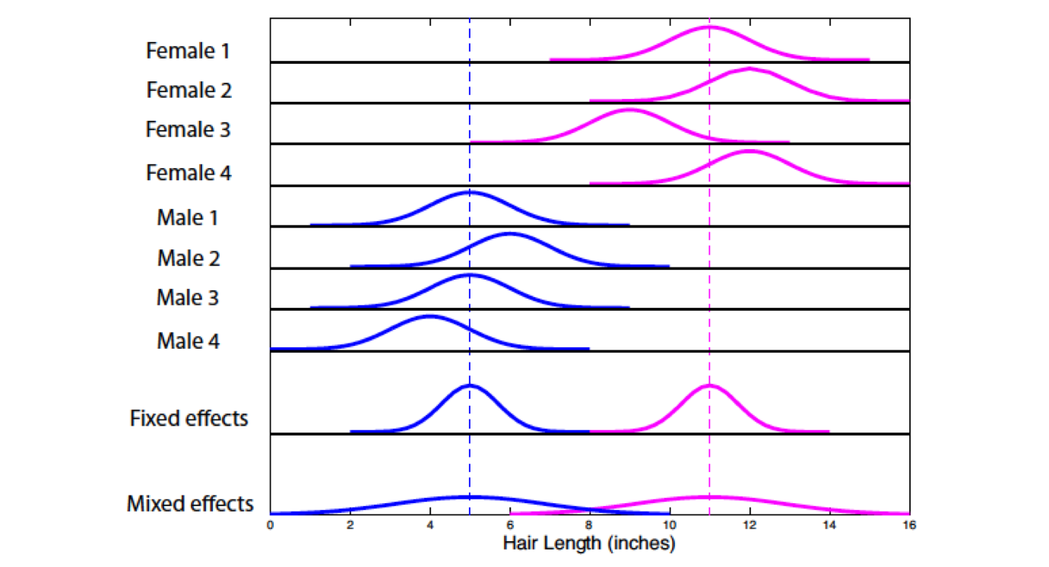
Notes:
Here’s an illustration of fixed and random effects.
For the first 8 rows, we can see the distribution of each individual’s responses – the mean is at the peak, and the width of the curve indicates the within-subject variance. So, in the fixed effects analysis, the mean of the individuals is taken as the peak, and the variance is the mean variance among the individuals [check this].
If we look at the random (aka mixed) effects bit at the bottom, which estimates the variance of responses across the population, we can see that the variance is much greater. This means that our statistical tests will be more conservative – we will only infer that an effect is a likely true population effect if it is large enough to be seen when the distributions of the two populations, males and females, overlap more.

Slide 12
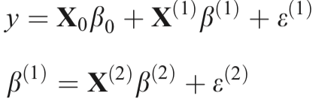
How to carry out random effects analysis?
Synonymous with ‘mixed effects models’.
Assumes our sample is a set of individuals taken at random from the population of interest.
To do this we need to consider the between subject variance AND within subject variance – and estimate the likely variance of the population from which our sample is derived.
Notes:
At this point it’s worth pointing out that, depending on what your sources are, random effects can also be referred to as mixed effects i.e. some effects are fixed and others are random. But, for example, in SPM they are considered the same.
With random effects analysis, as mentioned, we’re able to make inferences about the general populace based on the sample we’ve measured, because we’ve assumed that they are a random selection from the greater population.
To do this, we need to consider the between subject variance and the within subject variance. Mathematically speaking, we have GLMs nested within one another - where y is the variability of the individual, e(1) accounts for within-subject variance, and e(2) (part of B) accounts for between-subject variance. We don’t need to worry about these equations specifically too much, but this is quite a complicated relationship to unfold.

Slide 13
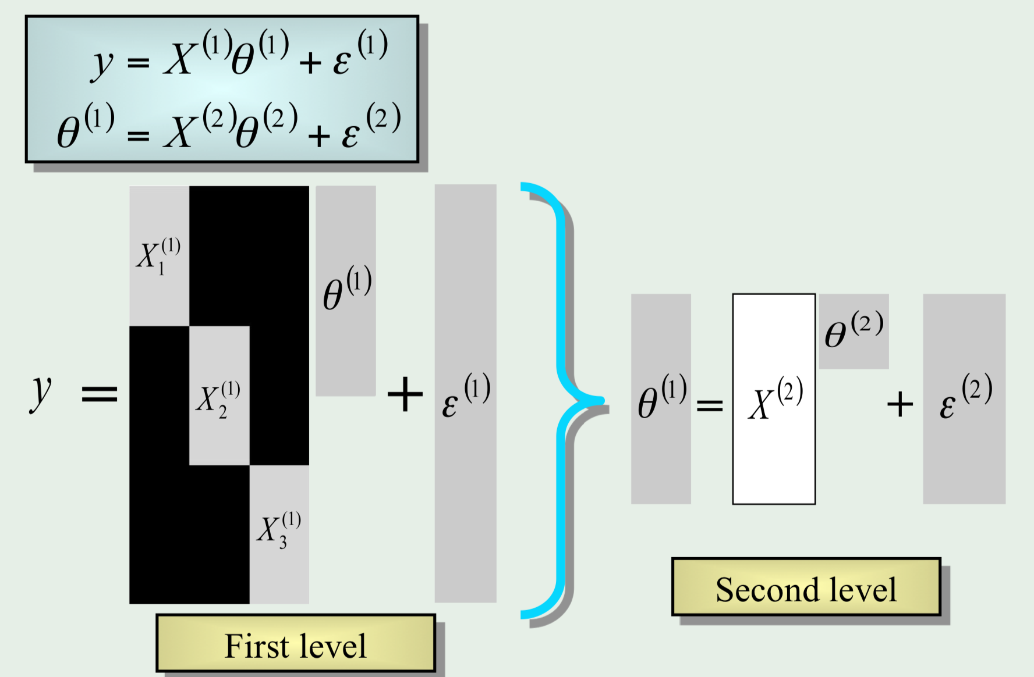
Hierarchical models
Estimate subject and group
stats at the same time via
iterative looping
Gold standard in terms of
accuracy but…...
Computationally intensive,
and not always practical!
(e.g. adding in subjects means
the entire estimation process
has to start from scratch again)
Notes:
One way of doing this is with hierarchical models.
In hierarchical models, at each level, the distribution of parameters is given by the level above, and we estimate subject and group level effects and variance at the same time via iterative looping. This is really computationally demanding though and can take a long time.

Slide 14
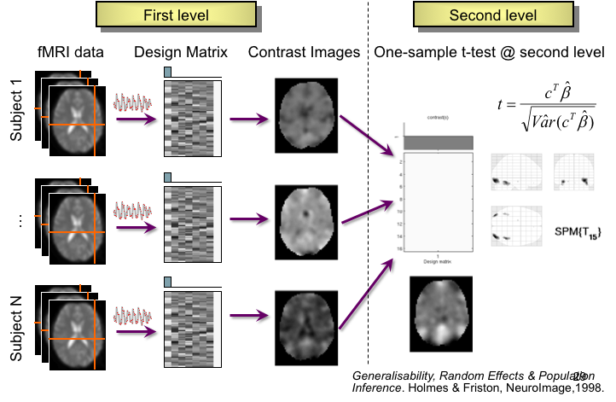
Summary stats
Notes:
An alternative approach which is less demanding, and provides the same results (a lot of the time), is using summary statistics.
Generally, this method is preferred, unless for example you have an experiment where one participant has 2 trials and another 2000, then you’d opt for hierarchical model. To use the summary statistic, the 1st level design must be the same for all participants.
It’s much simpler and straight forward, in 2 separate parts rather than an iterative process. The first level analysis takes place as we’ve described previously to produce contrast images per participant. Per voxel, you summarise the response of each subject by a single summary statistic (the effect size).
Then you conduct a one-sample t-test at each voxel, using the between subject variability as your standard deviation & to calculate the standard error. As a result, you can see at which voxels there’s a t-value showing a non-zero effect across the group.

Slide 15
Worked example
For group of N = 12 subjects
Effect sizes c = [4,3,2,1,1,2,3,3,3,2,4,4]
Mean group effect m = 2.67
Between subject variability (SD) σ_{b}² = 1.07
Standard Error Mean (SEM) = σ_{b}² /(sqrt(N))=0.31
t=M/SEM = 8.61, p=10⁻⁶
Subject 1
Effect size c = 4 for given voxel
Notes:
Here’s another worked example to demonstrate the second part of the summary statistic.
As before, we have the effect sizes per participant, except this time our N remains the number of subjects.
In contrast to the fixed effects example, wwe use the between subject variability in our calculations, and produce a t value for this voxel, which is significant, but weaker than our previous fixed example.

Slide 16
Overview
2nd level analysis = looking at effects across subjects.
Between-subject variance is much greater than within-subject variance. We need to consider both aspects of variance to make any inferences about the wider population, rather than just our sample.
As the population variance is much greater than the within-subjects variance, fixed effects analysis ‘overestimates’ the significance of effects – random effects analysis is more conservative, highlighting the greater effects that may be seen across the population.
Using fixed effects isn’t necessarily wrong, but might not be useful.
Notes:
Read slide

Slide 17
Thank you

Slide 18
Helpful resources
SPM course videos https://www.fil.ion.ucl.ac.uk/spm/course/video/#Group
Principles of fMRI [series] https://www.youtube.com/watch?v=ZL-Tr1KSMKY&list=PLfXA4opIOVrGHncHRxI3Qa5GeCSudwmxM

