Slide 1
Model Selection
Anahita Talwar
Millie Lowther

Slide 2
Outline
Introduction to Models
What are models and why might we want to use them?
Model Fitting
We assume a model is true and tune parameters
Model Comparison
Assess which tuned model best fits the data

Slide 3
Outline
Introduction to Models
What is a model?
Example task and models
Model Fitting
Estimating parameters
Parameter recovery
Model Comparison
Things to consider
Measures of fit
Predictive accuracy

Slide 4
Outline
Introduction to Models
What is a model?
Example task and models
Model Fitting
Estimating parameters
Parameter recovery
Model Comparison
Things to consider
Measures of fit
Predictive accuracy

Slide 5
What is a model?
A way to describe data

Slide 6
What is a model?
A way to describe data
Reduce dimensions

Slide 7
What is a model?
A way to describe data
Reduce dimensions
Abstract representation of process of interest

Slide 8
What is a model?
A way to describe data
Reduce dimensions
Abstract representation of process of interest
Represent hypotheses about data generation

Slide 9
What is a model?
A way to describe data
Reduce dimensions
Abstract representation of process of interest
Represent hypotheses about data generation
“All models are wrong, but some are useful”

Slide 10
Outline
Introduction to Models
What is a model?
Example task and models
Model Fitting
Estimating parameters
Parameter recovery
Model Comparison
Things to consider
Measures of fit
Predictive accuracy

Slide 11


Task
Notes:
Example task to understand modelling approaches
See 2 stimuli – hip hop dancer (L) or ballet dancer (R), have to select one
See outcome
Goal is to maximize reward over task

Slide 12

Task
Notes:
Here participant has selected ballet dancer

Slide 13
Task
- £1 ☹
Notes:
See outcome of their choice

Slide 14
Task
Notes:
New trial – which stimulus would you select next?

Slide 15
Task
70% : + £1 ☺
30% : - £1 ☹
30% : + £1 ☺
70% : - £1 ☹
Notes:
Example task – here are the probabilities of reward given the stimulus choice
For hip hop – 0.7 of the time you get +1, 0.3 of the time you get -1
For ballet – the opposite
Experimenter variables – number of stimuli, probabilities and other features in task like reversal or shifts, design according to experimental question

Slide 16
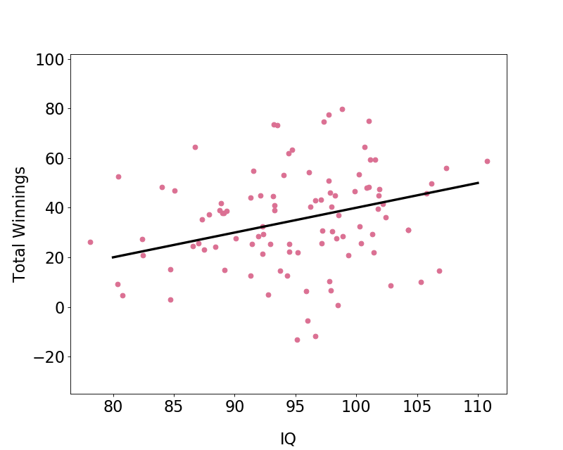
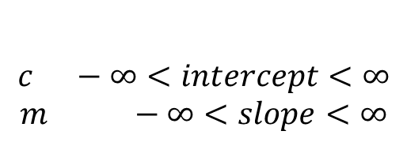

Design models
  Linear Relationship
$$Total Winnings=m×IQ+c$$
Model parameters
$$c −∞<intercept<∞$$
$$m −∞<slope<∞$$
Notes:
Data: e.g. 100 participants do 100 trials
Typical model that people may be more familiar with – modelling relationship between variables
Might hypothesise that people with higher IQ perform better on this task
2 parameters – reduction in dimensions of data

Slide 17



Design models
  Constant Bias
$$p(choose hip hop)=b$$
$$p\left(choose ballet\right)=1−b$$
Model parameters
b $0<Bias<1$
Notes:
In neuroscience/psychology, we also want to understand WHY people won more or less – what influenced their choices, and how did they learn from feedback over the trials
Models to take into account full richness of dataset – trial by trial participant choices
Give a few examples now: key thing that all of these models will have in common is that they give us a probability of each choice of the participant
1st model, simple, constant bias, probability of choosing an option is fixed throughout the task, independent of the outcome
1 parameter that determines this bias

Slide 18
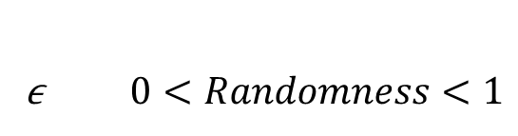
Design models
  Win Stay, Lose Shift (with noise)
$$p\left(choose hip hop\right)=\left\{\begin{aligned}1−\frac{ε}{2}, if {choice}_{t−1}=hip hop &\text{&}{ outcome}_{t−1}= +£1 OR {choice}_{t−1}=ballet \text{&}{ outcome}_{t−1}=−£1 \\ \frac{ε}{2}, if {choice}_{t−1}=ballet \text{&}{ outcome}_{t−1}= +£1 OR{ choice}_{t−1}=hip hop \text{&}{ outcome}_{t−1}=−£1\end{aligned}\right.$$
Model parameters
ϵ $0<Randomness<1$
Notes:
Slightly more complicated as now choices depend on previous choice and outcome
If won on last trial > stick
If lose on last trial > switch
1 parameter that now influences how noisy/random this process is
If this parameter e is high or 1, participants behavior will be deterministic (100% determined by this above rule)
If low, their behavior will be slightly influenced by this rule but more random
Other extreme if e = 0, choice is completely random p(hip hop) = 0.5

Slide 19
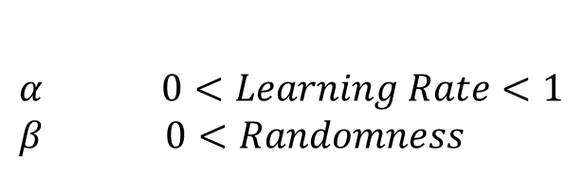

Design models
  Learn Stimulus Values From Experience (Rescorla-Wagner)
$$V(hip hop)={V(hip hop)}_{t−1}+α (Outcome −{V(hip hop)}_{t−1})$$
$$p(choose hip hop)=\frac{e^{β V(hip hop)}}{e^{β V\left(hip hop\right)}+e^{β V(ballet)}}$$
Model parameters
$α$ $0<Learning Rate<1$
$$β 0<Randomness$$
Notes:
Learn stimulus values from experience, common modelling algorithm from RL literature
Estimate value for stimulus that gets updated based on the difference between the outcome and the previous estimate
Learning rate that influences how much this feedback is taken into account
Decision rule that uses makes a choice based on these stimulus values
Beta determines the influence of the stimulus values on the choice
High beta, always choose higher valued stimulus
Low beta, choose at random
In between – higher probability of choosing higher value stimulus

Slide 20
Outline
Introduction to Models
What is a model?
Example task and models
Model Fitting
Estimating parameters
Parameter recovery
Model Comparison
Things to consider
Measures of fit
Predictive accuracy

Slide 21
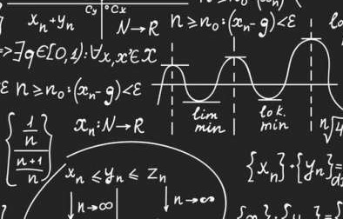



Model Simulations
$$known parameters: θ$$
$$data:y$$
Notes:
Can use these models, fix parameters at some known value
And use this to generate example data on our task
Result – datasets

Slide 22

Estimating Parameters
$$unknown parameters: θ$$
$$data:y$$
Notes:
In the real world what we want to be able to do is describe peoples task behaviour in terms of their parameters
We aren’t given their parameters but have to estimate it from the data
For example in a Linear model , we find the slope and intercept that best describes all data
For Generative models , we want to find parameters that best describe individuals task performance
How do we do this?

Slide 23
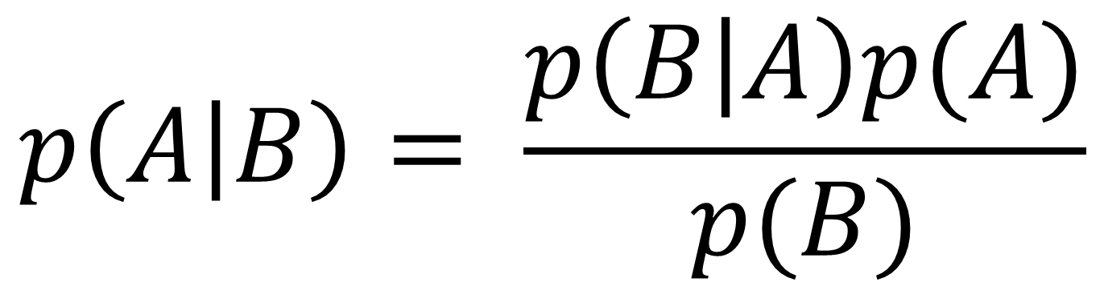
Back to Bayes
$$p\left(A | B\right)= \frac{p\left(B | A\right)p(A)}{p(B)}$$
Notes:
Revisit bayes theorem
We saw this formula last week and discussed how the likelihood is combined with prior to give posterior
Diagram shows this nicely too

Slide 24
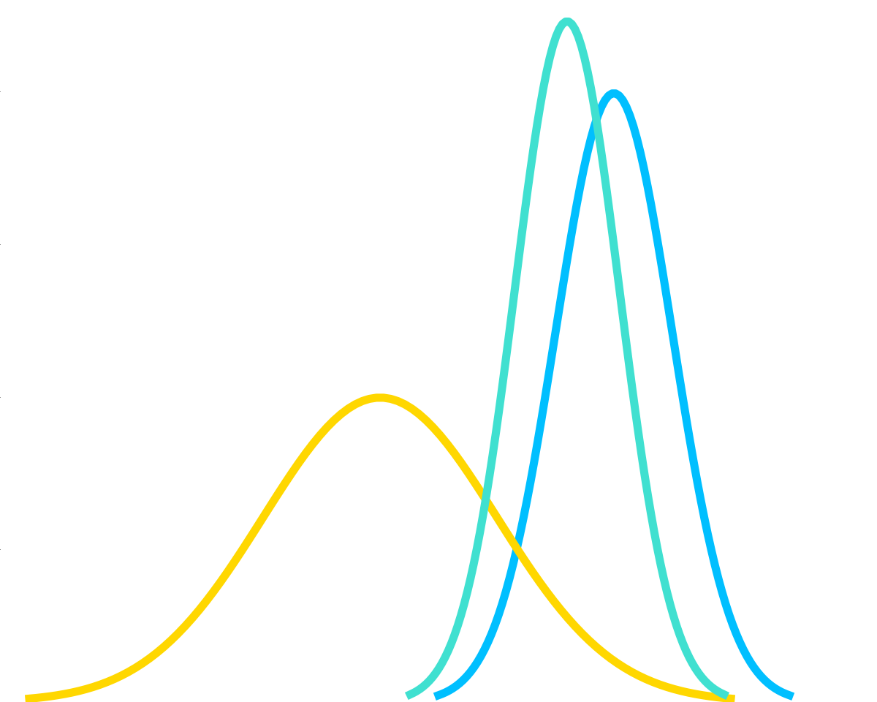
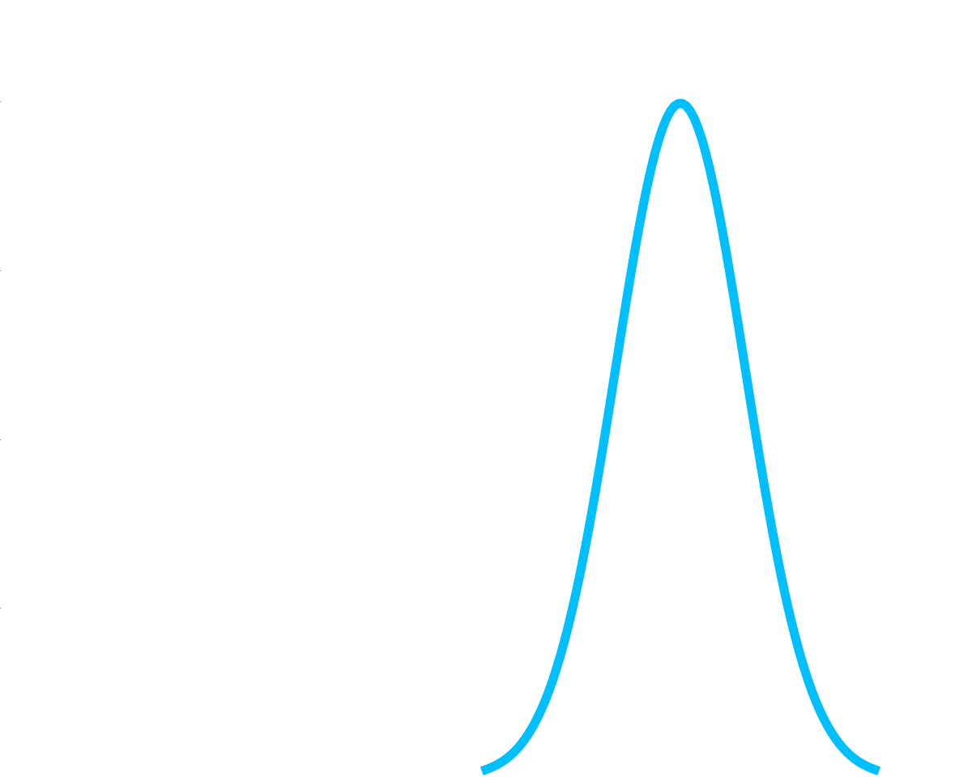
Back to Bayes
prior
$$p\left(A | B\right)= \frac{p\left(B | A\right)p(A)}{p(B)}$$
Notes:
Prior – how probable was our hypothesis before observing the evidence?

Slide 25
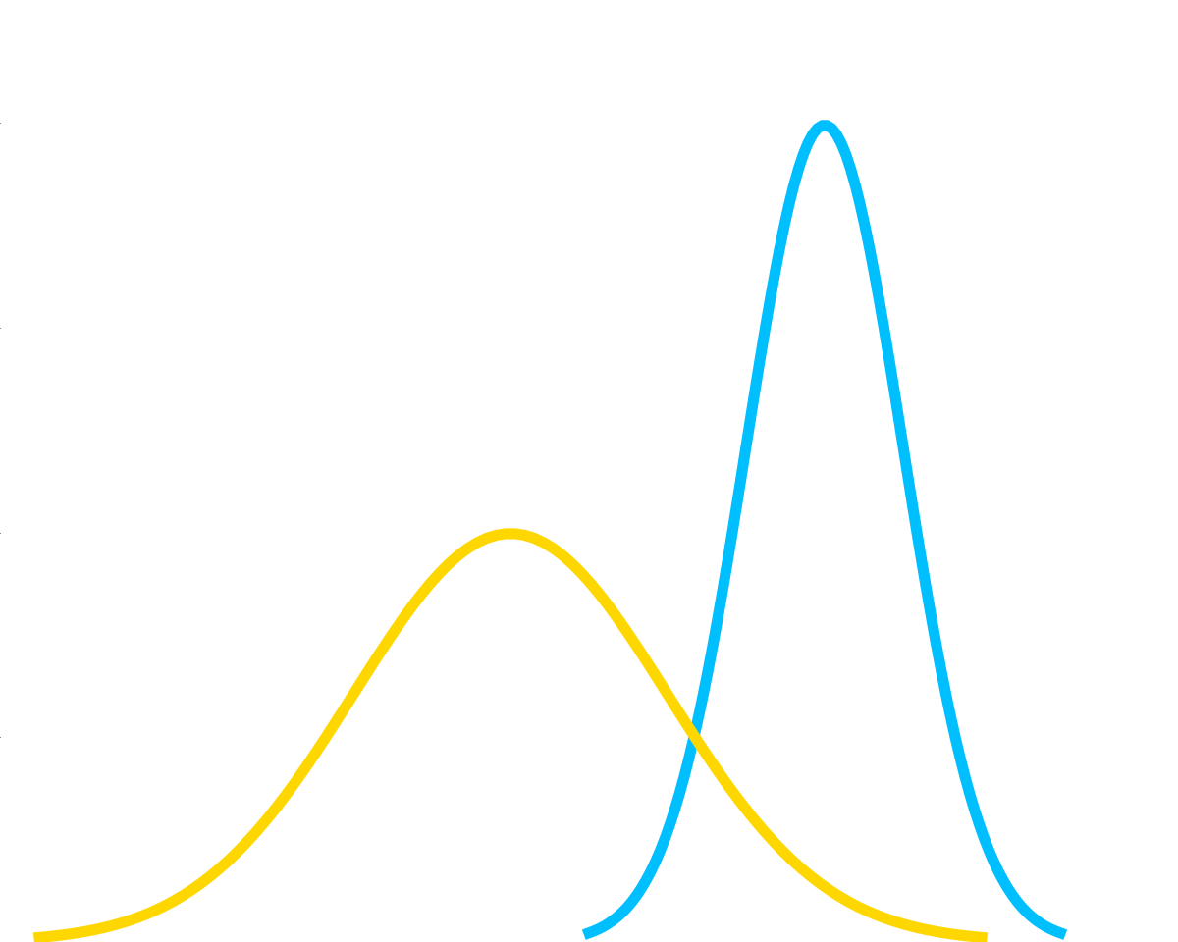
Back to Bayes
prior
likelihood
$$p\left(A | B\right)= \frac{p\left(B | A\right)p(A)}{p(B)}$$
Notes:
Likelihood – how probable is the evidence given that the hypothesis is true?

Slide 26
Back to Bayes
prior
likelihood
$$p\left(A | B\right)= \frac{p\left(B | A\right)p(A)}{p(B)}$$
posterior
Notes:
Posterior – how probable is the hypothesis given the observed evidence

Slide 27
Back to Bayes
prior
likelihood
$$p\left(A | B\right)= \frac{p\left(B | A\right)p(A)}{p(B)}$$
posterior
marginal likelihood
Notes:
Marginal – how probable is the evidence (taking into account all hypothesis)
Normaliser, ensures valid probability distribution

Slide 28
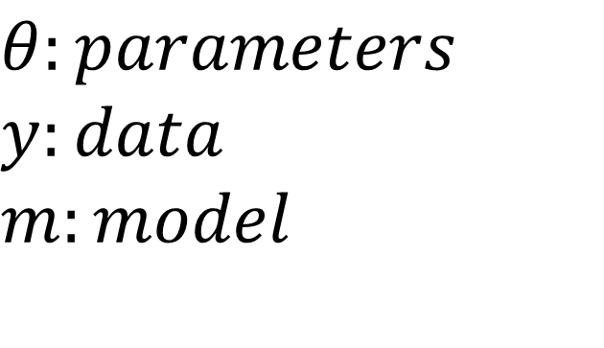
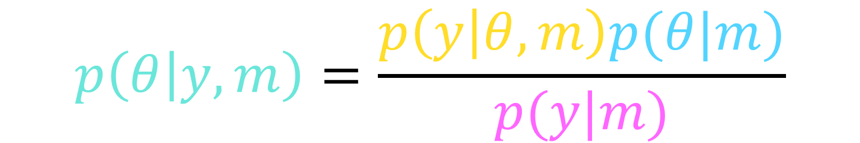
Back to Bayes
prior
likelihood
$$p\left(θ | y,m\right)=\frac{p\left(y | θ,m\right)p(θ|m)}{p(y|m)}$$
posterior
marginal likelihood
$$θ:parameters$$
$$y:data$$
$$m:model$$
Notes:
Prior probability of model parameters
Probability of data given model and its parameters
/ probability of data given model over all sets of parameters
Probability of parameters given data and model
Important probabilities we will use to estimate parameters

Slide 29
The Likelihood
$$p\left(y | θ,m\right)$$
$$p\left(data\right|parameters,model)$$
Notes:
In reality, we are concerned with calculating the probability of the whole data set, so not just one choice on one trial, but all of the choices made throughout the task
our models are almost always designed to be markovian, which basically means that we can treat the trials as if they were independent of one other
To calculate the joint probability of events if they are independent you simply multiply them together
So the likelihood of our whole data – is a multiplication over all of the likelihoods of the individual choices – say they chose hip hop then ballet then hip hop

Slide 30
The Likelihood
$$p\left(y | θ,m\right)$$
$$p\left(data\right|parameters,model)$$
$$p(choices at each trial|parameter setting of model)$$
Notes:
In reality, we are concerned with calculating the probability of the whole data set, so not just one choice on one trial, but all of the choices made throughout the task
our models are almost always designed to be markovian, which basically means that we can treat the trials as if they were independent of one other
To calculate the joint probability of events if they are independent you simply multiply them together
So the likelihood of our whole data – is a multiplication over all of the likelihoods of the individual choices – say they chose hip hop then ballet then hip hop

Slide 31


The Likelihood
$$p\left(y | θ,m\right)$$
$$p\left(data\right|parameters,model)$$
$$p(choices at each trial|parameter setting of model)$$
  Constant Bias
$$p(choose hip hop)=b$$
$$p\left(choose ballet\right)=1−b$$
Notes:
In reality, we are concerned with calculating the probability of the whole data set, so not just one choice on one trial, but all of the choices made throughout the task
our models are almost always designed to be markovian, which basically means that we can treat the trials as if they were independent of one other
To calculate the joint probability of events if they are independent you simply multiply them together
So the likelihood of our whole data – is a multiplication over all of the likelihoods of the individual choices – say they chose hip hop then ballet then hip hop

Slide 32
The Likelihood
$$p\left(y | θ,m\right)$$
$$p\left(data\right|parameters,model)$$
$$p(choices at each trial|parameter setting of model)$$
  Constant Bias
$$p(choose hip hop)=b$$
$$p\left(choose ballet\right)=1−b$$
$$p\left(choices at each trial | constant bias model with b=0.8\right)$$
Notes:
In reality, we are concerned with calculating the probability of the whole data set, so not just one choice on one trial, but all of the choices made throughout the task
our models are almost always designed to be markovian, which basically means that we can treat the trials as if they were independent of one other
To calculate the joint probability of events if they are independent you simply multiply them together
So the likelihood of our whole data – is a multiplication over all of the likelihoods of the individual choices – say they chose hip hop then ballet then hip hop

Slide 33
The Likelihood
$$p\left(y | θ,m\right)$$
$$p\left(data\right|parameters,model)$$
$$p(choices at each trial|parameter setting of model)$$
  Constant Bias
$$p(choose hip hop)=b$$
$$p\left(choose ballet\right)=1−b$$
$$p\left(choices at each trial | constant bias model with b=0.8\right)$$
= $p\left({hip hop}_{1},{ballet}_{2},{hip hop}_{3…..} | constant bias model with b=0.8\right)$
Notes:
In reality, we are concerned with calculating the probability of the whole data set, so not just one choice on one trial, but all of the choices made throughout the task
our models are almost always designed to be markovian, which basically means that we can treat the trials as if they were independent of one other
To calculate the joint probability of events if they are independent you simply multiply them together
So the likelihood of our whole data – is a multiplication over all of the likelihoods of the individual choices – say they chose hip hop then ballet then hip hop

Slide 34
The Likelihood
$$p\left(y | θ,m\right)$$
$$p\left(data\right|parameters,model)$$
$$p(choices at each trial|parameter setting of model)$$
  Constant Bias
$$p(choose hip hop)=b$$
$$p\left(choose ballet\right)=1−b$$
$$p\left(choices at each trial | constant bias model with b=0.8\right)$$
= $p\left({hip hop}_{1},{ballet}_{2},{hip hop}_{3…..} | constant bias model with b=0.8\right)$
= $p\left({hip hop}_{1} | θ,m\right)×p\left({ballet}_{2} | θ,m\right)$ $×p\left({hip hop}_{3} | θ,m\right)$ $×$…
Notes:
In reality, we are concerned with calculating the probability of the whole data set, so not just one choice on one trial, but all of the choices made throughout the task
our models are almost always designed to be markovian, which basically means that we can treat the trials as if they were independent of one other
To calculate the joint probability of events if they are independent you simply multiply them together
So the likelihood of our whole data – is a multiplication over all of the likelihoods of the individual choices – say they chose hip hop then ballet then hip hop

Slide 35
The Likelihood
$$p\left(y | θ,m\right)$$
$$p\left(data\right|parameters,model)$$
$$p(choices at each trial|parameter setting of model)$$
  Constant Bias
$$p(choose hip hop)=b$$
$$p\left(choose ballet\right)=1−b$$
$$p\left(choices at each trial | constant bias model with b=0.8\right)$$
= $p\left({hip hop}_{1},{ballet}_{2},{hip hop}_{3…..} | constant bias model with b=0.8\right)$
= $p\left({hip hop}_{1} | θ,m\right)×p\left({ballet}_{2} | θ,m\right)$ $×p\left({hip hop}_{3} | θ,m\right)$ $×$…
= 0.8 $× 0.2 × 0.8$ $×$…
Notes:
In reality, we are concerned with calculating the probability of the whole data set, so not just one choice on one trial, but all of the choices made throughout the task
our models are almost always designed to be markovian, which basically means that we can treat the trials as if they were independent of one other
To calculate the joint probability of events if they are independent you simply multiply them together
So the likelihood of our whole data – is a multiplication over all of the likelihoods of the individual choices – say they chose hip hop then ballet then hip hop

Slide 36

The Likelihood
$$p\left(y | θ,m\right)$$
$$p\left(data\right|parameters,model)$$
$$p(choices at each trial|parameter setting of model)$$
  Learn Stimulus Values From Experience (Rescorla-Wagner)
$$V(hip hop)={V(hip hop)}_{t−1}+α (Outcome −{V(hip hop)}_{t−1})$$
$$p(choose hip hop)=\frac{e^{β V(hip hop)}}{e^{β V\left(hip hop\right)}+e^{β V(ballet)}}$$
Notes:
In reality, we are concerned with calculating the probability of the whole data set, so not just one choice on one trial, but all of the choices made throughout the task
our models are almost always designed to be markovian, which basically means that we can treat the trials as if they were independent of one other
To calculate the joint probability of events if they are independent you simply multiply them together
So the likelihood of our whole data – is a multiplication over all of the likelihoods of the individual choices – say they chose hip hop then ballet then hip hop

Slide 37
The Likelihood
$$p\left(y | θ,m\right)$$
$$p\left(data\right|parameters,model)$$
$$p(choices at each trial|parameter setting of model)$$
  Learn Stimulus Values From Experience (Rescorla-Wagner)
$$V(hip hop)={V(hip hop)}_{t−1}+α (Outcome −{V(hip hop)}_{t−1})$$
$$p(choose hip hop)=\frac{e^{β V(hip hop)}}{e^{β V\left(hip hop\right)}+e^{β V(ballet)}}$$
$$p\left(choices at each trial | agent states under RWmodel with α=0.3,β=5\right)$$
Notes:
In reality, we are concerned with calculating the probability of the whole data set, so not just one choice on one trial, but all of the choices made throughout the task
our models are almost always designed to be markovian, which basically means that we can treat the trials as if they were independent of one other
To calculate the joint probability of events if they are independent you simply multiply them together
So the likelihood of our whole data – is a multiplication over all of the likelihoods of the individual choices – say they chose hip hop then ballet then hip hop

Slide 38
The Likelihood
$$p\left(y | θ,m\right)$$
$$p\left(data\right|parameters,model)$$
$$p(choices at each trial|parameter setting of model)$$
  Learn Stimulus Values From Experience (Rescorla-Wagner)
$$V(hip hop)={V(hip hop)}_{t−1}+α (Outcome −{V(hip hop)}_{t−1})$$
$$p(choose hip hop)=\frac{e^{β V(hip hop)}}{e^{β V\left(hip hop\right)}+e^{β V(ballet)}}$$
$p\left({hh}_{1},b_{2},{hh}_{3…..} | s_{1},s_{2},s_{3…..},RWmodel,α=0.3,β=5\right)$
Notes:
In reality, we are concerned with calculating the probability of the whole data set, so not just one choice on one trial, but all of the choices made throughout the task
our models are almost always designed to be markovian, which basically means that we can treat the trials as if they were independent of one other
To calculate the joint probability of events if they are independent you simply multiply them together
So the likelihood of our whole data – is a multiplication over all of the likelihoods of the individual choices – say they chose hip hop then ballet then hip hop

Slide 39
The Likelihood
$$p\left(y | θ,m\right)$$
$$p\left(data\right|parameters,model)$$
$$p(choices at each trial|parameter setting of model)$$
  Learn Stimulus Values From Experience (Rescorla-Wagner)
$$V(hip hop)={V(hip hop)}_{t−1}+α (Outcome −{V(hip hop)}_{t−1})$$
$$p(choose hip hop)=\frac{e^{β V(hip hop)}}{e^{β V\left(hip hop\right)}+e^{β V(ballet)}}$$
$p\left({hh}_{1},b_{2},{hh}_{3…..} | s_{1},s_{2},s_{3…..},RWmodel,α=0.3,β=5\right)$
= $p\left({hh}_{1} | θ,m\right)×p\left(b_{2} | {choice}_{1}=hh, {outcome}_{1}=−1,θ,m\right)$
Notes:
In reality, we are concerned with calculating the probability of the whole data set, so not just one choice on one trial, but all of the choices made throughout the task
our models are almost always designed to be markovian, which basically means that we can treat the trials as if they were independent of one other
To calculate the joint probability of events if they are independent you simply multiply them together
So the likelihood of our whole data – is a multiplication over all of the likelihoods of the individual choices – say they chose hip hop then ballet then hip hop

Slide 40
The Likelihood
$$p\left(y | θ,m\right)$$
$$p\left(data\right|parameters,model)$$
$$p(choices at each trial|parameter setting of model)$$
  Learn Stimulus Values From Experience (Rescorla-Wagner)
$$V(hip hop)={V(hip hop)}_{t−1}+α (Outcome −{V(hip hop)}_{t−1})$$
$$p(choose hip hop)=\frac{e^{β V(hip hop)}}{e^{β V\left(hip hop\right)}+e^{β V(ballet)}}$$
$p\left({hh}_{1},b_{2},{hh}_{3…..} | s_{1},s_{2},s_{3…..},RWmodel,α=0.3,β=5\right)$
= $p\left({hh}_{1} | θ,m\right)×p\left(b_{2} | {choice}_{1}=hh, {outcome}_{1}=−1,θ,m\right)$
$×p\left({hh}_{3} | {choice}_{1}=hh, {outcome}_{1}=−1,{{choice}_{2}=b,outcome}_{2}=−1,θ,m\right)$…..
Notes:
In reality, we are concerned with calculating the probability of the whole data set, so not just one choice on one trial, but all of the choices made throughout the task
our models are almost always designed to be markovian, which basically means that we can treat the trials as if they were independent of one other
To calculate the joint probability of events if they are independent you simply multiply them together
So the likelihood of our whole data – is a multiplication over all of the likelihoods of the individual choices – say they chose hip hop then ballet then hip hop

Slide 41
The Likelihood
$$p\left(y | θ,m\right)$$
$$p\left(data\right|parameters,model)$$
$$p(choices at each trial|parameter setting of model)$$
  Learn Stimulus Values From Experience (Rescorla-Wagner)
$$V(hip hop)={V(hip hop)}_{t−1}+α (Outcome −{V(hip hop)}_{t−1})$$
$$p(choose hip hop)=\frac{e^{β V(hip hop)}}{e^{β V\left(hip hop\right)}+e^{β V(ballet)}}$$
$p\left({hh}_{1},b_{2},{hh}_{3…..} | s_{1},s_{2},s_{3…..},RWmodel,α=0.3,β=5\right)$
= $p\left({hh}_{1} | θ,m\right)×p\left(b_{2} | {choice}_{1}=hh, {outcome}_{1}=−1,θ,m\right)$
$×p\left({hh}_{3} | {choice}_{1}=hh, {outcome}_{1}=−1,{{choice}_{2}=b,outcome}_{2}=−1,θ,m\right)$…..
$c_{1}=hh;$ $o_{1}=−1 →V_{1}\left(hh\right),V_{1}(b$)
Notes:
In reality, we are concerned with calculating the probability of the whole data set, so not just one choice on one trial, but all of the choices made throughout the task
our models are almost always designed to be markovian, which basically means that we can treat the trials as if they were independent of one other
To calculate the joint probability of events if they are independent you simply multiply them together
So the likelihood of our whole data – is a multiplication over all of the likelihoods of the individual choices – say they chose hip hop then ballet then hip hop

Slide 42
The Likelihood
$$p\left(y | θ,m\right)$$
$$p\left(data\right|parameters,model)$$
$$p(choices at each trial|parameter setting of model)$$
  Learn Stimulus Values From Experience (Rescorla-Wagner)
$$V(hip hop)={V(hip hop)}_{t−1}+α (Outcome −{V(hip hop)}_{t−1})$$
$$p(choose hip hop)=\frac{e^{β V(hip hop)}}{e^{β V\left(hip hop\right)}+e^{β V(ballet)}}$$
$p\left({hh}_{1},b_{2},{hh}_{3…..} | s_{1},s_{2},s_{3…..},RWmodel,α=0.3,β=5\right)$
= $p\left({hh}_{1} | θ,m\right)×p\left(b_{2} | {choice}_{1}=hh, {outcome}_{1}=−1,θ,m\right)$
$×p\left({hh}_{3} | {choice}_{1}=hh, {outcome}_{1}=−1,{{choice}_{2}=b,outcome}_{2}=−1,θ,m\right)$…..
$c_{1},c_{2}=hh,b;$ $o_{1},o_{2}=−1,−1 →V_{2}\left(hh\right),V_{2}(b$)
Notes:
In reality, we are concerned with calculating the probability of the whole data set, so not just one choice on one trial, but all of the choices made throughout the task
our models are almost always designed to be markovian, which basically means that we can treat the trials as if they were independent of one other
To calculate the joint probability of events if they are independent you simply multiply them together
So the likelihood of our whole data – is a multiplication over all of the likelihoods of the individual choices – say they chose hip hop then ballet then hip hop

Slide 43
The Likelihood
$$p\left(y | θ,m\right)$$
$$p\left(data\right|parameters,model)$$
$$p(choices at each trial|parameter setting of model)$$
  Learn Stimulus Values From Experience (Rescorla-Wagner)
$$V(hip hop)={V(hip hop)}_{t−1}+α (Outcome −{V(hip hop)}_{t−1})$$
$$p(choose hip hop)=\frac{e^{β V(hip hop)}}{e^{β V\left(hip hop\right)}+e^{β V(ballet)}}$$
$p\left({hh}_{1},b_{2},{hh}_{3…..} | s_{1},s_{2},s_{3…..},RWmodel,α=0.3,β=5\right)$
= $p\left({hh}_{1} | θ,m\right)×p\left(b_{2} | {choice}_{1}=hh, {outcome}_{1}=−1,θ,m\right)$
$×p\left({hh}_{3} | {choice}_{1}=hh, {outcome}_{1}=−1,{{choice}_{2}=b,outcome}_{2}=−1,θ,m\right)$…..
$c_{1},c_{2}=hh,b;$ $o_{1},o_{2}=−1,−1 →V_{2}\left(hh\right),V_{2}(b$)
= $p\left({hh}_{1} | θ,m\right)×p\left(b_{2} | V_{1}\left(hh\right),V_{1}(b),θ,m\right)×p\left({hh}_{3} | V_{2}\left(hh\right),V_{2}(b),θ,m\right)$…
Notes:
In reality, we are concerned with calculating the probability of the whole data set, so not just one choice on one trial, but all of the choices made throughout the task
our models are almost always designed to be markovian, which basically means that we can treat the trials as if they were independent of one other
To calculate the joint probability of events if they are independent you simply multiply them together
So the likelihood of our whole data – is a multiplication over all of the likelihoods of the individual choices – say they chose hip hop then ballet then hip hop

Slide 44
Maximum Likelihood Estimate
$$p\left(y | θ,m\right)$$
$p\left({hh}_{1} | θ,m\right)×p\left(b_{2} | V_{1}\left(hh\right),V_{1}(b),θ,m\right)×p\left({hh}_{3} | V_{2}\left(hh\right),V_{2}(b),θ,m\right)$…
Notes:
The first way to estimate parameters from data is called the maximum likelihood estimate
This means that the ML parameters are those that maximise the likelihood of the data
In practise we tend to use the log likelihood which means that we can sum the log likelihood of each trial
And many pre written functions work on minimisation so we also tend to minimize the NEGATIVE log likelihood function
If the likelihood distribution is multimodal, you will have to use multiple start points to avoid finding a local minima as they usually stop at first stationary point
Downside of ML mentioned last week
Can give unrealistic parameter estimates

Slide 45
Maximum Likelihood Estimate
$$p\left(y | θ,m\right)$$
$p\left({hh}_{1} | θ,m\right)×p\left(b_{2} | V_{1}\left(hh\right),V_{1}(b),θ,m\right)×p\left({hh}_{3} | V_{2}\left(hh\right),V_{2}(b),θ,m\right)$…
Find the set of parameters $\hat{θ}$ of the model m that maximise the likelihood of the data
Notes:
The first way to estimate parameters from data is called the maximum likelihood estimate
This means that the ML parameters are those that maximise the likelihood of the data
In practise we tend to use the log likelihood which means that we can sum the log likelihood of each trial
And many pre written functions work on minimisation so we also tend to minimize the NEGATIVE log likelihood function
If the likelihood distribution is multimodal, you will have to use multiple start points to avoid finding a local minima as they usually stop at first stationary point
Downside of ML mentioned last week
Can give unrealistic parameter estimates

Slide 46
Maximum Likelihood Estimate
$$p\left(y | θ,m\right)$$
$p\left({hh}_{1} | θ,m\right)×p\left(b_{2} | V_{1}\left(hh\right),V_{1}(b),θ,m\right)×p\left({hh}_{3} | V_{2}\left(hh\right),V_{2}(b),θ,m\right)$…
Find the set of parameters $\hat{θ}$ of the model m that maximise the likelihood of the data
In practice, maximising the log likelihood is better:
$$log⁡[p\left({hh}_{1} | θ,m\right)×p\left(b_{2} | V_{1}\left(hh\right),V_{1}\left(b\right),θ,m\right)×p\left({hh}_{3} | V_{2}\left(hh\right),V_{2}\left(b\right),θ,m\right)…]$$
Notes:
The first way to estimate parameters from data is called the maximum likelihood estimate
This means that the ML parameters are those that maximise the likelihood of the data
In practise we tend to use the log likelihood which means that we can sum the log likelihood of each trial
And many pre written functions work on minimisation so we also tend to minimize the NEGATIVE log likelihood function
If the likelihood distribution is multimodal, you will have to use multiple start points to avoid finding a local minima as they usually stop at first stationary point
Downside of ML mentioned last week
Can give unrealistic parameter estimates

Slide 47
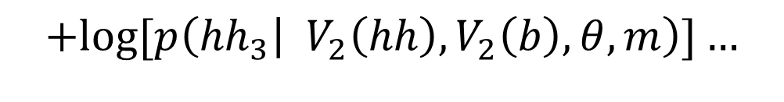
Maximum Likelihood Estimate
$$p\left(y | θ,m\right)$$
$p\left({hh}_{1} | θ,m\right)×p\left(b_{2} | V_{1}\left(hh\right),V_{1}(b),θ,m\right)×p\left({hh}_{3} | V_{2}\left(hh\right),V_{2}(b),θ,m\right)$…
Find the set of parameters $\hat{θ}$ of the model m that maximise the likelihood of the data
In practice, maximising the log likelihood is better:
$$log⁡[p\left({hh}_{1} | θ,m\right)×p\left(b_{2} | V_{1}\left(hh\right),V_{1}\left(b\right),θ,m\right)×p\left({hh}_{3} | V_{2}\left(hh\right),V_{2}\left(b\right),θ,m\right)…]$$
$$\log\left[p\left({hh}_{1} | θ,m\right)\right]+\log\left[p\left(b_{2} | V_{1}\left(hh\right),V_{1}\left(b\right),θ,m\right)\right]$$
$$+log⁡[p\left({hh}_{3} | V_{2}\left(hh\right),V_{2}\left(b\right),θ,m\right)]…$$
Notes:
The first way to estimate parameters from data is called the maximum likelihood estimate
This means that the ML parameters are those that maximise the likelihood of the data
In practise we tend to use the log likelihood which means that we can sum the log likelihood of each trial
And many pre written functions work on minimisation so we also tend to minimize the NEGATIVE log likelihood function
If the likelihood distribution is multimodal, you will have to use multiple start points to avoid finding a local minima as they usually stop at first stationary point
Downside of ML mentioned last week
Can give unrealistic parameter estimates

Slide 48
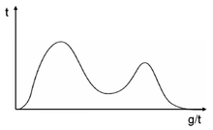
Maximum Likelihood Estimate
$$p\left(y | θ,m\right)$$
$p\left({hh}_{1} | θ,m\right)×p\left(b_{2} | V_{1}\left(hh\right),V_{1}(b),θ,m\right)×p\left({hh}_{3} | V_{2}\left(hh\right),V_{2}(b),θ,m\right)$…
Find the set of parameters $\hat{θ}$ of the model m that maximise the likelihood of the data
In practice, maximising the log likelihood is better:
$$log⁡[p\left({hh}_{1} | θ,m\right)×p\left(b_{2} | V_{1}\left(hh\right),V_{1}\left(b\right),θ,m\right)×p\left({hh}_{3} | V_{2}\left(hh\right),V_{2}\left(b\right),θ,m\right)…]$$
$$\log\left[p\left({hh}_{1} | θ,m\right)\right]+\log\left[p\left(b_{2} | V_{1}\left(hh\right),V_{1}\left(b\right),θ,m\right)\right]$$
$$+log⁡[p\left({hh}_{3} | V_{2}\left(hh\right),V_{2}\left(b\right),θ,m\right)]…$$
Use different starting points to avoid local minima
Notes:
The first way to estimate parameters from data is called the maximum likelihood estimate
This means that the ML parameters are those that maximise the likelihood of the data
In practise we tend to use the log likelihood which means that we can sum the log likelihood of each trial
And many pre written functions work on minimisation so we also tend to minimize the NEGATIVE log likelihood function
If the likelihood distribution is multimodal, you will have to use multiple start points to avoid finding a local minima as they usually stop at first stationary point
Downside of ML mentioned last week
Can give unrealistic parameter estimates

Slide 49
Maximum Likelihood Estimate
$$p\left(y | θ,m\right)$$
$p\left({hh}_{1} | θ,m\right)×p\left(b_{2} | V_{1}\left(hh\right),V_{1}(b),θ,m\right)×p\left({hh}_{3} | V_{2}\left(hh\right),V_{2}(b),θ,m\right)$…
Find the set of parameters $\hat{θ}$ of the model m that maximise the likelihood of the data
In practice, maximising the log likelihood is better:
$$log⁡[p\left({hh}_{1} | θ,m\right)×p\left(b_{2} | V_{1}\left(hh\right),V_{1}\left(b\right),θ,m\right)×p\left({hh}_{3} | V_{2}\left(hh\right),V_{2}\left(b\right),θ,m\right)…]$$
$$\log\left[p\left({hh}_{1} | θ,m\right)\right]+\log\left[p\left(b_{2} | V_{1}\left(hh\right),V_{1}\left(b\right),θ,m\right)\right]$$
$$+log⁡[p\left({hh}_{3} | V_{2}\left(hh\right),V_{2}\left(b\right),θ,m\right)]…$$
Use different starting points to avoid local minima
High variance
Notes:
The first way to estimate parameters from data is called the maximum likelihood estimate
This means that the ML parameters are those that maximise the likelihood of the data
In practise we tend to use the log likelihood which means that we can sum the log likelihood of each trial
And many pre written functions work on minimisation so we also tend to minimize the NEGATIVE log likelihood function
If the likelihood distribution is multimodal, you will have to use multiple start points to avoid finding a local minima as they usually stop at first stationary point
Downside of ML mentioned last week
Can give unrealistic parameter estimates

Slide 50
Maximum a posteriori Estimate
Lower variance – gives more sensible parameter estimates
High bias - depends on prior
Point estimate – doesn’t reflect uncertainty
Notes:
MAP incorporates Bayesian approach and introduces a prior
Posterior distribution is calculated by combining likliehood with prior
Benefits discussed last week – avoid unrealistic parameter estimates unless certainty is very strong
Disadvantage – subjective
Don’t use whole distribution , just point estimate which could be argued mode isn’t reflective summary statistic of distribution
In practise only used for simple situations where prior is conjugate for example, otherwise posterior is very difficult to calculate

Slide 51
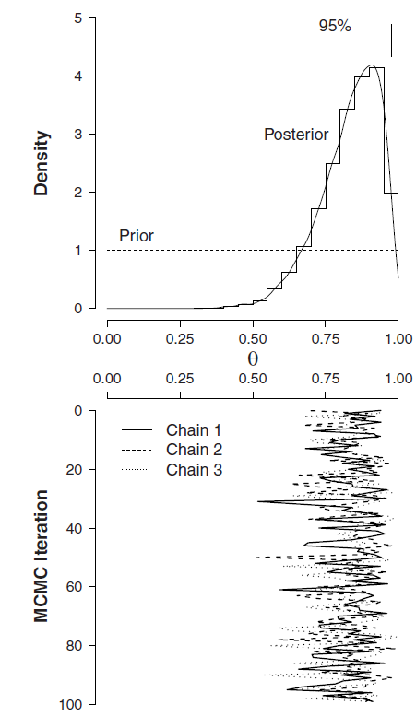

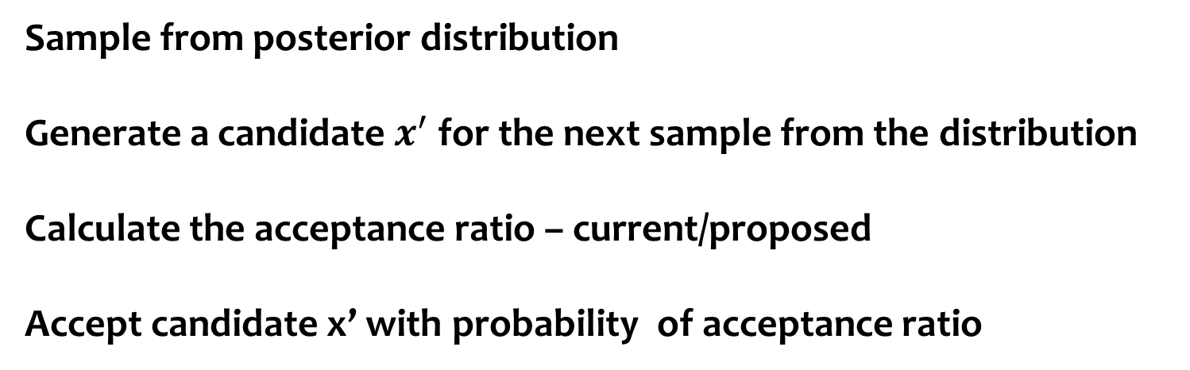
Estimating the posterior by sampling
Sample from posterior distribution
Generate a candidate $x^{′}$ for the next sample from the distribution
Calculate the acceptance ratio – current/proposed
Accept candidate x’ with probability of acceptance ratio
Notes:
Sampling – sample from posterior distribution
Generate candidate for next sample – accept candidate with probability according to acceptance ratio
Interactive demo: https://chi-feng.github.io/mcmc-demo/app.html?algorithm=HamiltonianMC&target=banana

Slide 52
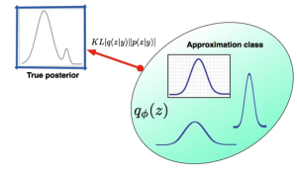
Estimating the posterior by variational methods
Approximating the integral with a more simpler and more tractable form
Choose approximation that minimises a dissimilarity function
e.g., the Kullback-Leibler divergence

Slide 53
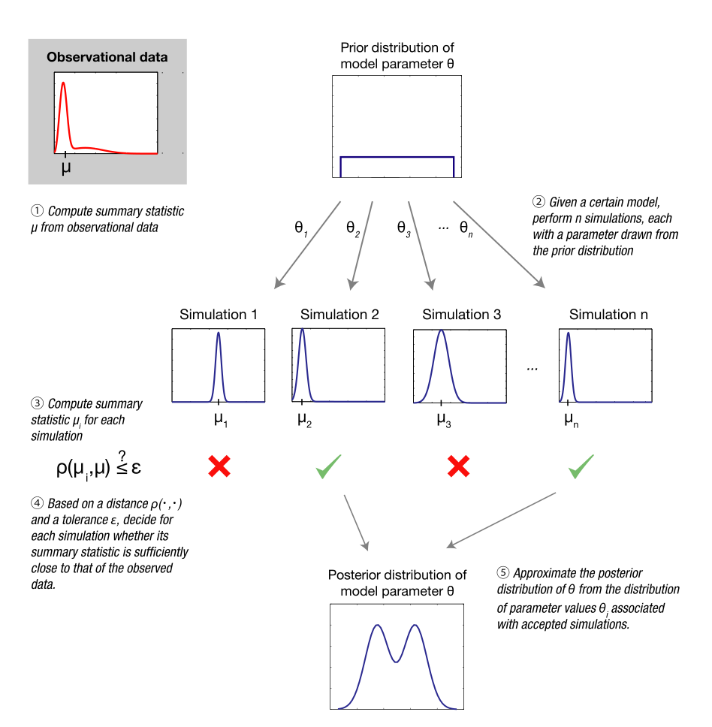
Estimating the posterior by ABC
ABC = approximate Bayesian computation
Sample parameters from prior distribution
Use these parameters to generate dataset
Calculate the ‘distance’ of this dataset from your true dataset
Accept these parameters if distance is less than a certain threshold
Likelihood free – can be difficult to compute likelihood if many parts of model are noisy

Slide 54
Outline
Introduction to Models
What is a model?
Example task and models
Model Fitting
Estimating parameters
Parameter recovery
Model Comparison
Things to consider
Measures of fit
Predictive accuracy

Slide 55
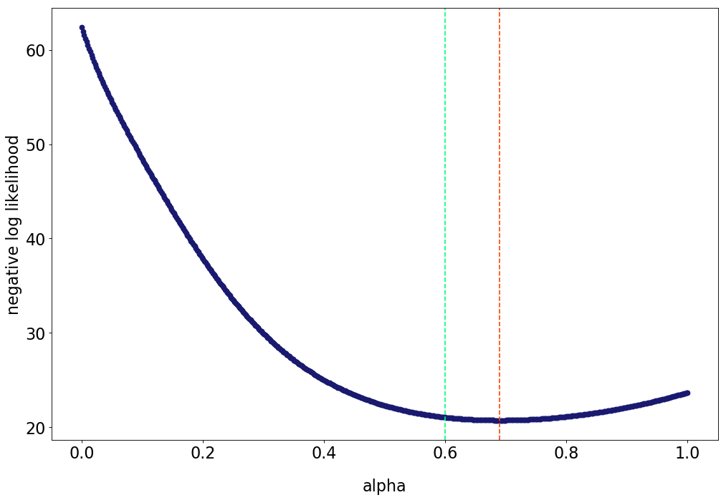

Parameter Recovery
Simulate parameters from an appropriate range
$$α\sim U\left(0,1\right) and β\sim Exp(10)$$

Slide 56
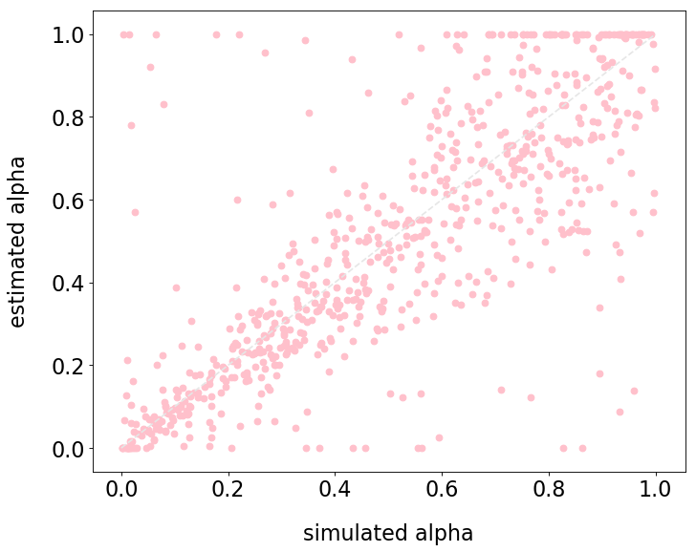
Parameter Recovery
Plot the correlations between simulated and recovered parameters

Slide 57
Parameter Recovery
Plot the correlations between estimated parameters

Slide 58
Outline
Introduction to Models
What is a model?
Example task and models
Model Fitting
Estimating parameters
Parameter recovery
Model Comparison
Things to consider
Measures of fit
Predictive accuracy
Notes:
Going to start off model comparison part by running through things we need to consider with regard to model comparison and selection

Slide 59
Model selection considerations
Overfitting:
This generally occurs when the model is too complex. If a model describes a dataset perfectly, we’re fitting the noise (random variation in the data) as well as the signal (relationships between the variables). It’s unlikely overfitted models will generalize to other datasets and thus not be useful for explaining behaviour in most scenarios.

Slide 60
Model selection considerations
Overfitting:
This generally occurs when the model is too complex. If a model describes a dataset perfectly, we’re fitting the noise (random variation in the data) as well as the signal (relationships between the variables). It’s unlikely overfitted models will generalize to other datasets and thus not be useful for explaining behaviour in most scenarios.

Slide 61
Model selection considerations
Overfitting:
This generally occurs when the model is too complex. If a model describes a dataset perfectly, we’re fitting the noise (random variation in the data) as well as the signal (relationships between the variables). It’s unlikely overfitted models will generalize to other datasets and thus not be useful for explaining behaviour in most scenarios.

Slide 62
Model selection considerations
Overfitting:
This generally occurs when the model is too complex. If a model describes a dataset perfectly, we’re fitting the noise (random variation in the data) as well as the signal (relationships between the variables). It’s unlikely overfitted models will generalize to other datasets and thus not be useful for explaining behaviour in most scenarios.

Slide 63
Model selection considerations
Overfitting:
This generally occurs when the model is too complex. If a model describes a dataset perfectly, we’re fitting the noise (random variation in the data) as well as the signal (relationships between the variables). It’s unlikely overfitted models will generalize to other datasets and thus not be useful for explaining behaviour in most scenarios.
Simplicity:
Simpler, more parsimonious models are easier to interpret. Occam’s razor
Notes:
Occam’s Razor is a principle of scientific philosophy: of two explanations adequate to explain the same set of observations, the simpler should always be preferred.

Slide 64
Outline
Introduction to Models
What is a model?
Example task and models
Model Fitting
Estimating parameters
Parameter recovery
Model Comparison
Things to consider
Measures of fit
Predictive accuracy
Notes:
Lets look at some of the ways to quantify how well a model appears to be fitting the data, relative to other models

Slide 65

F-test
SSE = sum of squared errors
k = number of parameters
n = number of observations
H₀: $y=β0+β1x1+\text{ε}$ vs H₁: $y=β0+β1x1+β2x2\text{+ }\text{ε}$
Notes:
An example most of you will be familiar with.. The F test

Slide 66

F-test
SSE = sum of squared errors
k = number of parameters
n = number of observations
H₀: $y=β0+β1x1+\text{ε}$ vs H₁: $y=β0+β1x1+β2x2\text{+ }\text{ε}$
Calculate F test statistic = $\frac{\frac{SSE−SSE}{k −k}}{\frac{SSE}{n −k}}$
Notes:
Calculate the F statistic which quantifies the relationship between the relative increase in sum of squares and the relative increase in degrees of freedom, i.e. the increase in accuracy versus the increase in complexity.
SSE = sum of the squares of residuals (difference between data and model estimate) → small SSE indicates that the model tightly fits the data.
The F-test is used to determine whether the increase in the sum of squared residuals between H₀ and H₁ is large enough to provide evidence against H₀. “Large enough” is determined by the quantiles of the F distribution.

Slide 67

F-test
SSE = sum of squared errors
k = number of parameters
n = number of observations
H₀: $y=β0+β1x1+\text{ε}$ vs H₁: $y=β0+β1x1+β2x2\text{+ }\text{ε}$
Calculate F test statistic = $\frac{\frac{SSE−SSE}{k −k}}{\frac{SSE}{n −k}}$ F statistic > 1 → H₁ is a better model than H₀
OR H₀ is correct but randomness led H₁ to fit better
Notes:
If the simpler model is a better model by this measure, the F statistic should be near 1. If the ratio is much greater than 1, there are two possibilities:
1) The more complicated model is correct.
2) The simpler model is correct, but random scatter led the more complicated model to fit better

Slide 68

F-test
SSE = sum of squared errors
k = number of parameters
n = number of observations
H₀: $y=β0+β1x1+\text{ε}$ vs H₁: $y=β0+β1x1+β2x2\text{+ }\text{ε}$
Calculate F test statistic = $\frac{\frac{SSE−SSE}{k −k}}{\frac{SSE}{n −k}}$ F statistic > 1 → H₁ is a better model than H₀
OR H₀ is correct but randomness led H₁ to fit better
Compare to F_{n-k,n-k;1-ɑ}
Notes:
In order to quantify how rare this coincidence would be, we use a significance test to see: if the simpler model is correct, what is the chance that you would randomly obtain data that fits H₁ much better?

Slide 69
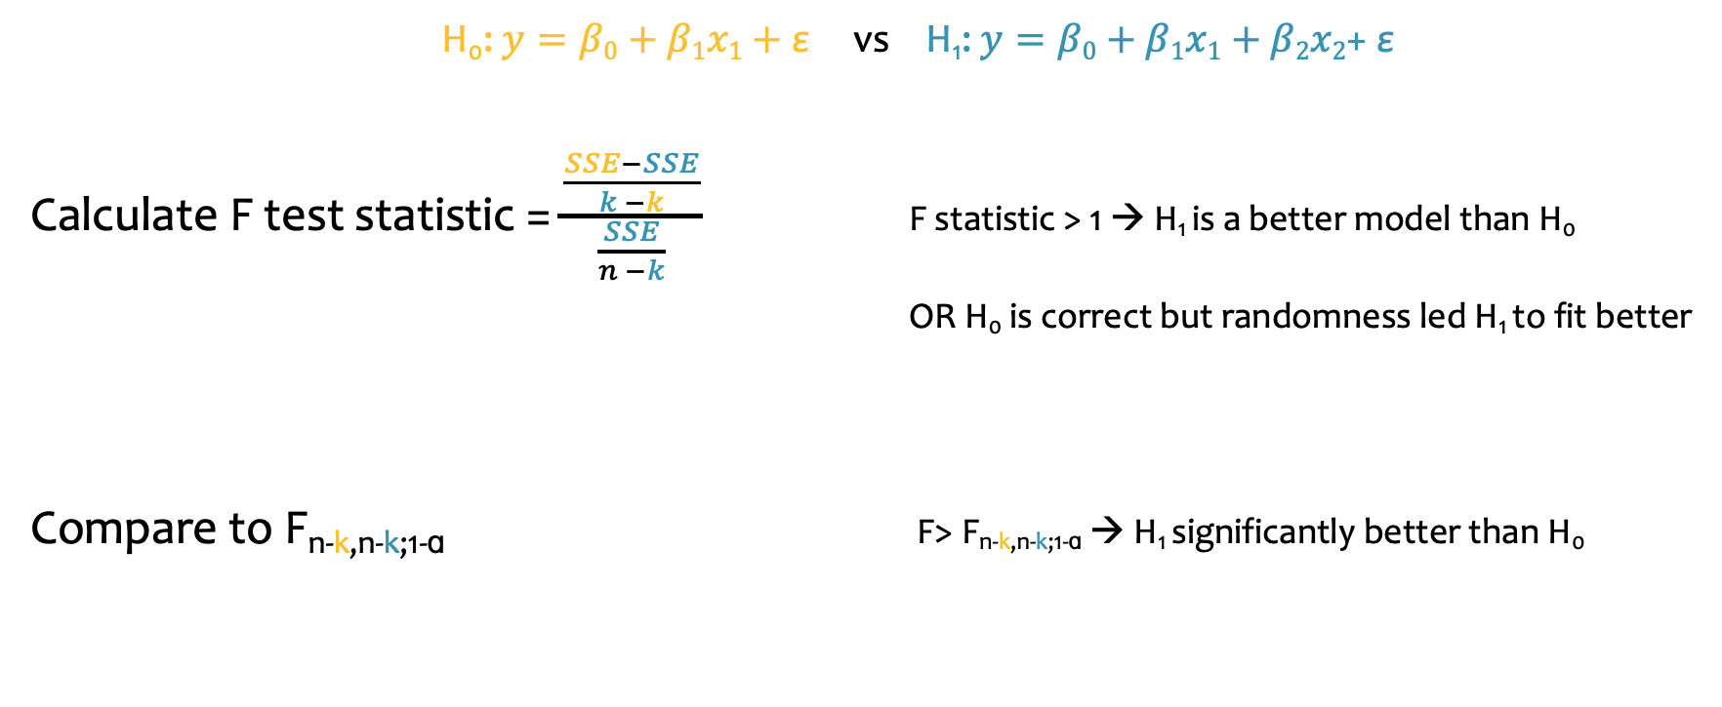
F-test
SSE = sum of squared errors
k = number of parameters
n = number of observations
H₀: $y=β0+β1x1+\text{ε}$ vs H₁: $y=β0+β1x1+β2x2\text{+ }\text{ε}$
Calculate F test statistic = $\frac{\frac{SSE−SSE}{k −k}}{\frac{SSE}{n −k}}$ F statistic > 1 → H₁ is a better model than H₀
OR H₀ is correct but randomness led H₁ to fit better
Compare to F_{n-k,n-k;1-ɑ} F> F_{n-k,n-k;1-ɑ} → H₁ significantly better than H₀
Notes:
If the p-value is low, conclude that H₁ is the better model

Slide 70

F-test
SSE = sum of squared errors
k = number of parameters
n = number of observations
H₀: $total winnings=β0+β1IQ+\text{ε}$vs H₁: $total winnings=β0+β1IQ+β2age\text{+ }\text{ε}$
Notes:
If we think about this with the task example we’ve been using, we could have a model with 2 parameters, the intercept and the slope fit to the influence IQ has on total winnings (plus noise), and another model with 3 parameters where we fit a slope to the influence that age has on total winnings.

Slide 71

F-test
SSE = sum of squared errors
k = number of parameters
n = number of observations
H₀: $total winnings=β0+β1IQ+\text{ε}$vs H₁: $total winnings=β0+β1IQ+β2age\text{+ }\text{ε}$
Calculate F test statistic = $\frac{\frac{SSE−SSE}{k −k}}{\frac{SSE}{n −k}}$ = $\frac{\frac{70−60}{3 −2}}{\frac{60}{100 −3}}$= 16.16
Notes:
It might be that the SSE for H₀ is calculated to be 70, while the SSE for H₁ is 60. The simpler model has 2 parameters, while the other has 3 so those are our k numbers. If we have 100 observations, n is 100. So, the F statistic would be 16.16

Slide 72

F-test
SSE = sum of squared errors
k = number of parameters
n = number of observations
H₀: $total winnings=β0+β1IQ+\text{ε}$vs H₁: $total winnings=β0+β1IQ+β2age\text{+ }\text{ε}$
Calculate F test statistic = $\frac{\frac{SSE−SSE}{k −k}}{\frac{SSE}{n −k}}$ = $\frac{\frac{70−60}{3 −2}}{\frac{60}{100 −3}}$= 16.16
F statistic > 1 → H₁ is a better model than H₀ OR H₀ is correct but randomness led H₁ to fit better
Notes:
This suggests H₁ is a better model, but we do a significance test to check whether this is a false positive

Slide 73
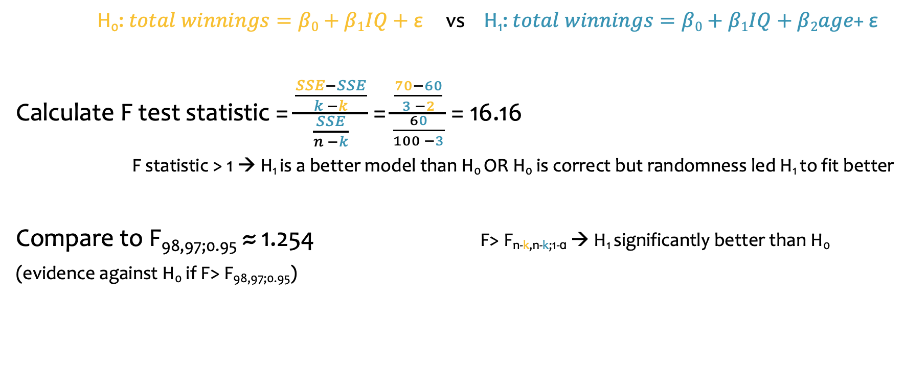
F-test
SSE = sum of squared errors
k = number of parameters
n = number of observations
H₀: $total winnings=β0+β1IQ+\text{ε}$vs H₁: $total winnings=β0+β1IQ+β2age\text{+ }\text{ε}$
Calculate F test statistic = $\frac{\frac{SSE−SSE}{k −k}}{\frac{SSE}{n −k}}$ = $\frac{\frac{70−60}{3 −2}}{\frac{60}{100 −3}}$= 16.16
F statistic > 1 → H₁ is a better model than H₀ OR H₀ is correct but randomness led H₁ to fit better
Compare to F_{98,97;0.95} ≈ 1.254 F> F_{n-k,n-k;1-ɑ} → H₁ significantly better than H₀
(evidence against H₀ if F> F_{98,97;0.95})
Notes:
Compare this to the lookup table for the F distribution. 16 is clearly bigger than 1 so we conclude that the model with age in it is better than the model with just IQ
Importantly, we can only use this method for nested models, i.e. we wouldn’t have been able to compare H₁ to H₀ if it didn’t have an intercept and an IQ parameter

Slide 74
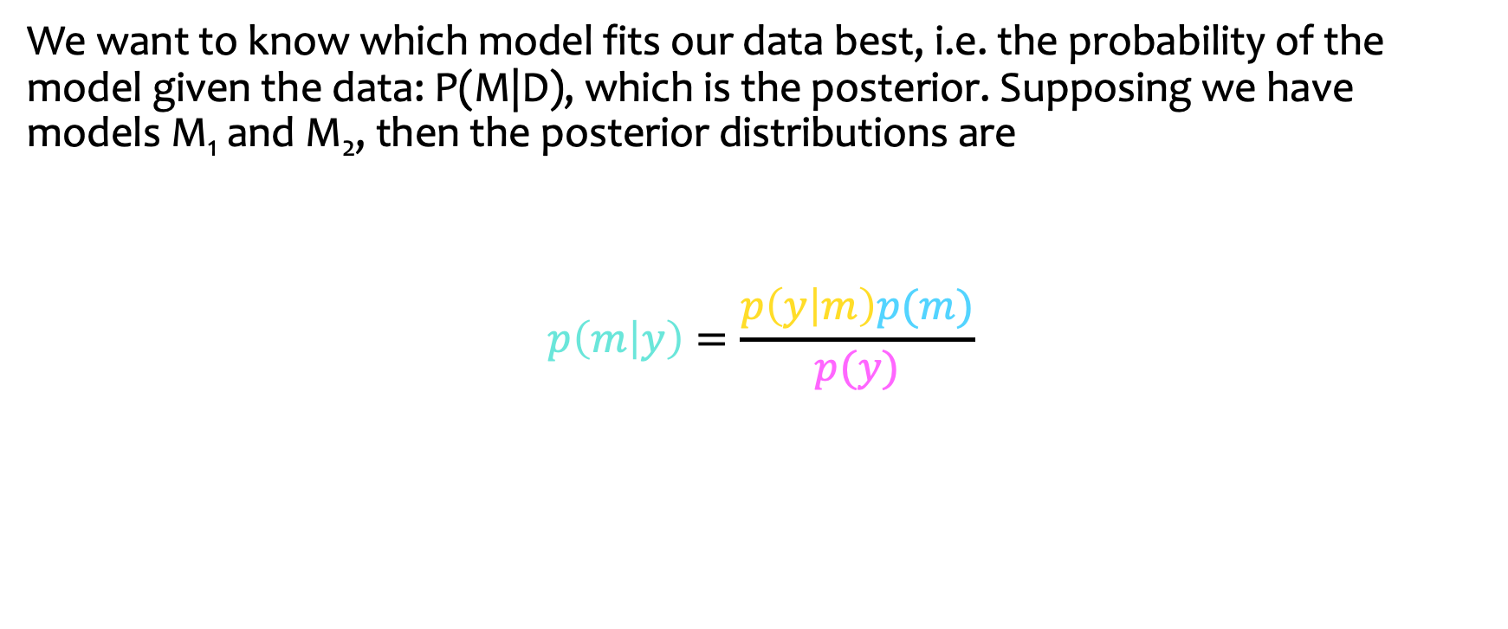
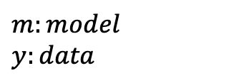
Bayes Factor
We want to know which model fits our data best, i.e. the probability of the model given the data: P(M|D), which is the posterior. Supposing we have models M₁ and M₂, then the posterior distributions are
$$p\left(m | y\right)=\frac{p\left(y | m\right)p(m)}{p(y)}$$
marginal likelihood
prior
$$m:model$$
$$y:data$$
posterior
evidence
Notes:
We can also use Bayesian methods to compare how well models are fitting the data. The biggest difference is that Bayesian analysis is concerned with minimizing the error in the model, rather than minimizing the chance of a false positive (as in frequentist methods). If we want to compare two models, M1 and M2, we can use the following equation to get the posterior distributions, i.e. probability of model given the data
Prior probability of model being true
Probability of data given model
/ Probability of data over all models

Slide 75
Bayes Factor
We want to know which model fits our data best, i.e. the probability of the model given the data: P(M|D), which is the posterior. Supposing we have models M₁ and M₂, then the posterior distributions are
$$p\left(m | y\right)=\frac{p\left(y | m\right)p(m)}{p(y)}$$
marginal likelihood
prior
$$m:model$$
$$y:data$$
posterior
evidence
Notes:
So we’ve got the posterior equal to the likelihood multiplied by the prior, divided by the probability of the data given the model.

Slide 76

Bayes Factor
We want to know which model fits our data best, i.e. the probability of the model given the data: P(M|D), which is the posterior. Supposing we have models M₁ and M₂, then the posterior distributions are
$$p\left(m | y\right)=\frac{p\left(y | m\right)p(m)}{p(y)}$$
Dividing these gives
$\frac{P\left(m1 | y\right)}{P\left(m2 | y\right)}$ = $\frac{P\left(y | m1\right)}{P\left(y | m2\right)}$ $\frac{P(m1)}{P(m2)}$
marginal likelihood
prior
$$m:model$$
$$y:data$$
posterior
evidence
Prior odds
Posterior odds
Bayes Factor
Notes:
If we divide these two equations for M1 and M2, we get the following:
The p(y) gets cancelled in the division as it is the same for both models.
the ratio of the posteriors, or posterior odds, the ratio of the likelihoods, which is the Bayes factor, and the ratio of the priors, or the prior odds.
Generally, our prior for the models would be equal, so in this case 0.5 for each model, so they also essentially cancel out.

Slide 77

Bayes Factor
$p\left(m | y\right)=\frac{p\left(y | m\right)p(m)}{p(y)}$ $\frac{P\left(m1 | y\right)}{P\left(m2 | y\right)}$ = $\frac{P\left(y | m1\right)}{P\left(y | m2\right)}$ $\frac{P(m1)}{P(m2)}$
Notes:
So, to recap:
The probability of the model given the data is what we’re trying to calculate
We calculate this using this equation, so multiplying the probability of the data given the model with our prior belief about the model and dividing this by the probability of the data
In order to compare two models, we can look at the ratio of these equations, which cancel to be the ratio of the likelihoods of the models, also known as the Bayes factor

Slide 78

Bayes Factor
$p\left(m | y\right)=\frac{p\left(y | m\right)p(m)}{p(y)}$ $\frac{P\left(m1 | y\right)}{P\left(m2 | y\right)}$ = $\frac{P\left(y | m1\right)}{P\left(y | m2\right)}$ $\frac{P(m1)}{P(m2)}$
$P\left(y | m\right)$= $\int{P\left(y | θ\right)P\left(θ | m\right)}dθ$
Notes:
To calculate the Bayes factor, we need to calculate the marginal likelihood for each model, which is given by this equation. We need to compute this integral, which can be difficult depending on the combinations of prior and likelihood distributions in purple.

Slide 79
Bayes Factor
$p\left(m | y\right)=\frac{p\left(y | m\right)p(m)}{p(y)}$ $\frac{P\left(m1 | y\right)}{P\left(m2 | y\right)}$ = $\frac{P\left(y | m1\right)}{P\left(y | m2\right)}$ $\frac{P(m1)}{P(m2)}$
$P\left(y | m\right)$= $\int{P\left(y | θ\right)P\left(θ | m\right)}dθ$
Conjugate prior:
Calculate the integral exactly
Notes:
If the prior is conjugate to the likelihood function then the posterior distribution will be the same as the prior distribution with different parameters, which makes the integral easy to compute.

Slide 80
Bayes Factor
$p\left(m | y\right)=\frac{p\left(y | m\right)p(m)}{p(y)}$ $\frac{P\left(m1 | y\right)}{P\left(m2 | y\right)}$ = $\frac{P\left(y | m1\right)}{P\left(y | m2\right)}$ $\frac{P(m1)}{P(m2)}$
$P\left(y | m\right)$= $\int{P\left(y | θ\right)P\left(θ | m\right)}dθ$
Conjugate prior:
Calculate the integral exactly
Non-Conjugate prior:
Need to approximate. Methods include AIC and BIC
Notes:
If the prior is not conjugate to the likelihood, then because calculating this integral involves computing over all possible parameter settings, we approximate it instead. There are various methods for doing this, including Akaike information criterion and Bayes Information Criterion. These methods essentially re-write the model evidence, i.e. probability of data given the model, using the log likelihood of the model to remove the parameter dependency. AIC and BIC both penalize for the number of parameters in different ways.

Slide 81
Bayes Factor
$p\left(m | y\right)=\frac{p\left(y | m\right)p(m)}{p(y)}$ $\frac{P\left(m1 | y\right)}{P\left(m2 | y\right)}$ = $\frac{P\left(y | m1\right)}{P\left(y | m2\right)}$ $\frac{P(m1)}{P(m2)}$
$P\left(y | m\right)$= $\int{P\left(y | θ\right)P\left(θ | m\right)}dθ$
Conjugate prior:
Calculate the integral exactly
Non-Conjugate prior:
Need to approximate. Methods include AIC and BIC
Bayes Factor > 1, then model 1 is a better fit to the data
Notes:
Choose the model with the highest likelihood, so if the Bayes Factor is greater than 1, then model 1 is a better fit to the data. If the Bayes Factor is less than 1, then model 2 is a better fit to the data. If the Bayes Factor was 1, the models fit the data equally well. In practice, we want Bayes Factor to be above about 20 in order to be convincing that model 1 is a better fit. Arbitrary way of deciding

Slide 82
Approximate Bayesian Computation
Estimate posterior:
Rejection method: posterior is approximated as the proportion of accepted simulations for the model, and whichever model has a higher proportion of accepted simulations is considered a better fit.
Notes:
We can also use the ABC framework to get measures of fit, without needing to calculate the likelihood.
One method of measuring the fit of a model which is used in the ABC framework is the rejection method.
Using this method, the posterior probability of a given model is approximated by the proportion of accepted simulations given this model. So, as Ani mentioned earlier, the ABC method is to sample a parameter value from the prior distribution to simulate a dataset. Informed by the real observed dataset, we can set a rejection threshold for how similar the simulated should be to the observed data, and then estimate the posterior as the proportion of simulations from that model which are accepted under the threshold set.

Slide 83
Approximate Bayesian Computation
Estimate posterior:
Rejection method: posterior is approximated as the proportion of accepted simulations for the model, and whichever model has a higher proportion of accepted simulations is considered a better fit.
Hypothesis testing:
Can also do formal hypothesis testing where the test statistic is the median of the distance between the accepted summary statistics and the observed summary statistics.
Notes:
We can also do a more formal, traditional style hypothesis test using the simulated data. The test statistic is the median distance between the accepted and observed summary statistics.

Slide 84
Outline
Introduction to Models
What is a model?
Example task and models
Model Fitting
Estimating parameters
Parameter recovery
Model Comparison
Things to consider
Measures of fit
Predictive accuracy
Group level selection
Notes:
We’ve looked at some of the methods for measuring how well the model fits the data. However, this only tells us so much, so it’s useful to test how well the model is able to predict the data too.

Slide 85
Validation
Pick the model which predicts the data best.
Notes:
As well as wanting a model which fits the data well, we want a model which predicts the data well.

Slide 86
Validation
Pick the model which predicts the data best.
Can fit the models from our dataset to a separate dataset which used the same hip-hop vs ballet dancer task and see how well our models fit this new dataset.
Our dataset
Separate dataset
Calibration sample
Validation sample
Notes:
To check this, we can take a separate dataset which also used our hip-hop vs ballet dancer choice task, and test our models on that new sample. So, we call our dataset that we used to train the models, the calibration sample, and the new sample is the validation sample. We’re making the assumption that this validation set comes from the same generative process as the calibration set but has different noise pollution, so the model that best fits the validation set has obtained the right balance between under- and overfitting the data.

Slide 87
Validation
Pick the model which predicts the data best.
Can fit the models from our dataset to a separate dataset which used the same hip-hop vs ballet dancer task and see how well our models fit this new dataset.
Our dataset
Separate dataset
Calibration sample
Validation sample
Notes:
In reality, we tend not to have this second dataset and use cross-validation instead

Slide 88
Cross-Validation
Pick the model which predicts the data best.
Split the dataset into a calibration set and a validation set, train the model on the calibration set and then see how well it predicts the validation set.
Our dataset
Calibration
Validation
Notes:
We can evaluate this by splitting the data into a calibration and validation set, whereby we hold the validation set aside while we fit the model to the calibration data, and then see how well the model generalises to the validation set. Again, we’re assuming here that the validation set comes from the same generative process as the calibration set but has different noise pollution so the model that best fits the validation set has obtained the right balance between under- and overfitting the data.

Slide 89
Cross-Validation
Pick the model which predicts the data best.
Split the dataset into a calibration set and a validation set, train the model on the calibration set and then see how well it predicts the validation set.
Methods:
Holdout
Dataset
Notes:
Holdout method: wasteful because essentially halving the sample size

Slide 90
Cross-Validation
Pick the model which predicts the data best.
Split the dataset into a calibration set and a validation set, train the model on the calibration set and then see how well it predicts the validation set.
Methods:
Holdout Random subsampling
Dataset
Dataset
Notes:
Random subsampling: select the validation samples randomly and repeat

Slide 91
Cross-Validation
Pick the model which predicts the data best.
Split the dataset into a calibration set and a validation set, train the model on the calibration set and then see how well it predicts the validation set.
Methods:
Holdout Random subsampling K-fold
Dataset
Dataset
Dataset
Notes:
K-fold: partition original samples into k equal sized subsets and hold one as the calibration set and the rest as validation sets, then repeat k times

Slide 92
Cross-Validation
Pick the model which predicts the data best.
Split the dataset into a calibration set and a validation set, train the model on the calibration set and then see how well it predicts the validation set.
Methods:
Holdout Random subsampling K-fold Leave-one-out
Dataset
Dataset
Dataset
Dataset
…
Notes:
Leave-one-out: similar to k-fold but with each data point

Slide 93
Cross-Validation
Pick the model which predicts the data best.
Split the dataset into a calibration set and a validation set, train the model on the calibration set and then see how well it predicts the validation set.
Methods:
Holdout Random subsampling K-fold Leave-one-out
Whichever model predicts the validation set best is a better model of the process
Dataset
Dataset
Dataset
Dataset
…

Slide 94
Predictive accuracy
Pick the model which predicts the data best.
Notes:
We can take this concept a step further and do a similar thing but hold out choices and see how well the model predicts an individual choice.

Slide 95
Predictive accuracy
Pick the model which predicts the data best.
Choices: …hip-hop, ballet, ballet, hip-hop, ballet, hip-hop, ballet, ballet, ballet…
Notes:
So, going back to our task example, we can see a series of choices from one participant.

Slide 96
Predictive accuracy
Pick the model which predicts the data best.
Choices: …hip-hop, ballet, ballet, hip-hop, ballet, hip-hop, ballet, ballet, ballet…
Hide one of the choices, e.g.
Choices: …hip-hop, ? , ballet, hip-hop, ballet, hip-hop, ballet, ballet, ballet…
Notes:
We can hide one of these choices,

Slide 97
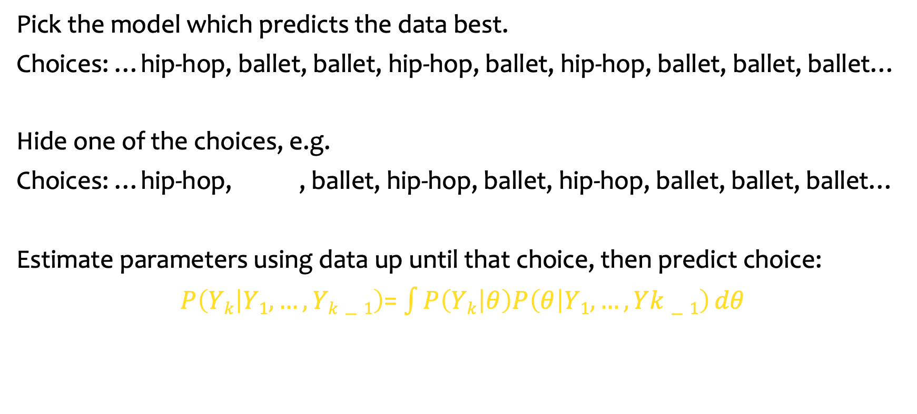

Predictive accuracy
Pick the model which predicts the data best.
Choices: …hip-hop, ballet, ballet, hip-hop, ballet, hip-hop, ballet, ballet, ballet…
Hide one of the choices, e.g.
Choices: …hip-hop, ? , ballet, hip-hop, ballet, hip-hop, ballet, ballet, ballet…
Estimate parameters using data up until that choice, then predict choice:
$P\left(Yk | Y1, …,Yk−1\right)$= $\int{P\left(Yk | θ\right)P\left(θ | Y1, …,Yk−1\right)}dθ$
$$Yk$$
Notes:
then estimate the parameters using the data up until that choice and then predict the observation of that choice.

Slide 98
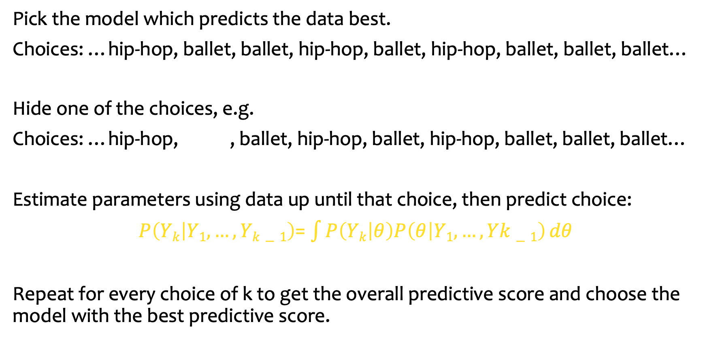
Predictive accuracy
Pick the model which predicts the data best.
Choices: …hip-hop, ballet, ballet, hip-hop, ballet, hip-hop, ballet, ballet, ballet…
Hide one of the choices, e.g.
Choices: …hip-hop, ? , ballet, hip-hop, ballet, hip-hop, ballet, ballet, ballet…
Estimate parameters using data up until that choice, then predict choice:
$P\left(Yk | Y1, …,Yk−1\right)$= $\int{P\left(Yk | θ\right)P\left(θ | Y1, …,Yk−1\right)}dθ$
Repeat for every choice of k to get the overall predictive score and choose the model with the best predictive score.
$$Yk$$
Notes:
If we do this over the whole dataset we can evaluate how well the model is predicting choices

Slide 99
Outline
Introduction to Models
What is a model?
Example task and models
Model Fitting
Estimating parameters
Parameter recovery
Model Comparison
Things to consider
Measures of fit
Predictive accuracy
Group level selection
Notes:
The models we’ve talked about so far have been looking at fitting the whole sample, i.e. we’ve assumed that the same model generated the data of all subjects. Now we’ll briefly talk about the idea that perhaps different models fit different people better.

Slide 100
Between-Group Model Comparison
Model with highest frequency (fits the most participants) in the population is best model
Protected exceedance probabilities (PEPs) measure how likely it is that any given model is more frequent than all other models in the comparison set, corrected for the possibility that observed differences in model evidences (over subjects) are due to chance
Notes:
We can treat models as random effects that could differ between subjects, and see which model fits the most participants. Protected exceedance probabilities measure this

Slide 101
Between-Group Model Comparison
Model with highest frequency (fits the most participants) in the population is best model
Protected exceedance probabilities (PEPs) measure how likely it is that any given model is more frequent than all other models in the comparison set, corrected for the possibility that observed differences in model evidences (over subjects) are due to chance
We can use this principle to test whether groups of participants are using different models, e.g. whether their choices on the task by a patient group and a control group are generated by different models
H₀: groups have same model frequency (i.e. choices generated by same model)
H₁: groups have different model frequencies (i.e. choices generated by different models)
Calculate PEPs for each model under H₀ and H₁ and compare
Notes:
Use this to test whether groups of participants are using different models
Important: H0 still assumes parameter values are different across subjects

Slide 102
Useful Resources
Overview of Bayesian Inferance and most of these methods: Mathematical Monk Youtube Videos
Sampling demo
Approximate Bayesian Computation
Exceedance probabilities
Notes:
Useful resources

