Slide 1


Computational modelling
Kirsten Thomas, Laura Convertino, Juho Aijala
Expert: Dr Michael Moutoussis

Slide 2
Outline
Introduction to computational modelling
What is computational modelling?
Why is it useful?
Steps to modelling
Steps 1-4 - Framing the question
Steps 5-7 - Implementing the model
Steps 8-9 - Model testing
Steps 10 – Publishing
Example - Neural signals encoding shifts in beliefs (Schwartenbeck et al., 2016)

Slide 3
What is computational modelling?
The use of computers to simulate and study behaviour of complex systems
Three kinds of models in neuroscience (Dayan & Abbott, 2001):
Descriptive – what
Mechanistic - how
Interpretive – why
Types of modelling include: Machine learning, Bayesian modelling, neural networks

Slide 4
Why is this useful?
Describe large amounts of data
Obtain causal claims about relationships
Make predictions
Real-life applications
Overall, computational modelling saves time, money, and materials…

Slide 5

Why is this useful?
Imagine baking a cake with 20 ingredients
How much does each ingredient contribute to the outcome of the cake?
Change 2 ingredients – 190 cakes
Change 3 ingredients – 1140 cakes
Change 4 ingredients – 4845 cakes… etc
National Institute of Biomedical Imaging and Bioengineering (2019)
Notes:
Instead of baking thousands of cakes, we can create a model instead:
Ingredients as variables – interactions and purpose of each ingredient modelled – run simulation

Slide 6
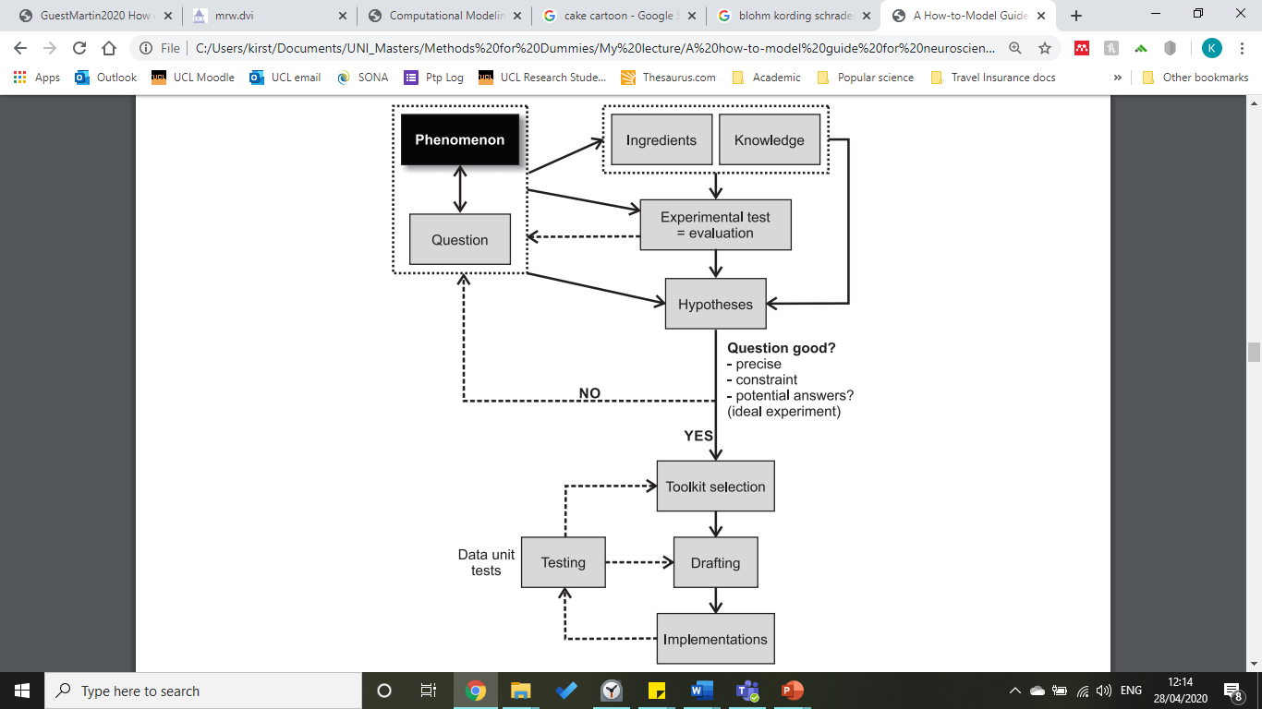
Blohm, Kording & Schrater (2020)
10 steps to modelling, split into four sections:
Framing the question
Implementing the model
Model testing
Publishing
Notes:
Not a linear process – involves iterations of the steps

Slide 7
Blohm, Kording & Schrater (2020)
10 steps to modelling, split into four sections:
Framing the question
Implementing the model
Model testing
Publishing

Slide 8
Blohm, Kording & Schrater (2020)
10 steps to modelling, split into four sections:
Framing the question
Step 1: Define the goal
Step 2: Literature review
Step 3: Identify ingredients
Step 4: Quantify hypotheses

Slide 9
Step 1 – Define the goal
Step 1
PURPOSE: Find a phenomenon and ask a question
Define meaningful modelling question
What should the model do and not do?
Demarcate aspects of data
Identify observations that model will not address
Define stopping criteria
Determine evaluation criteria
Be clear
Be precise
Be specific
Notes:
Computational models force scientists to make their theories and predictions explicit

Slide 10
Step 1 – Define the goal
Step 1
PURPOSE: Find a phenomenon and ask a question
Example – Neural signals encoding shifts in beliefs (Schwartenbeck et al., 2016)
Phenomenon: Psychosis involves deficits in belief updating
Question: What is the role of dopamine in belief updating (encoding of meaningful information content)?
Goal: Develop a model to derive neuroimaging regressors for belief updating

Slide 11
Step 2 – Literature review
Step 2
PURPOSE: To gain important theoretical and experimental insight
Background of phenomenon
Previous questions
Previous hypotheses
Previous models used
Example
Previous research:
Dopamine involved in range of cognitive functions and belief formation
Previous models:
Reward Prediction Error – related to dopamine signalling

Slide 12
Step 3 – Identify ingredients
Step 3
PURPOSE: To set up elements required and specific conditions to be satisfied
Variables and parameters
Concepts that need to be represented as variables (e.g. value, utility, cost)
Observable and latent variables
Inputs and outputs
Example
Surprise (information-theoretic) | Epistemic value (Bayesian surprise)
Unexpectedness of observation | Actual shifts in belief, model updating
Uninformative surprise | Meaningful information

Slide 13
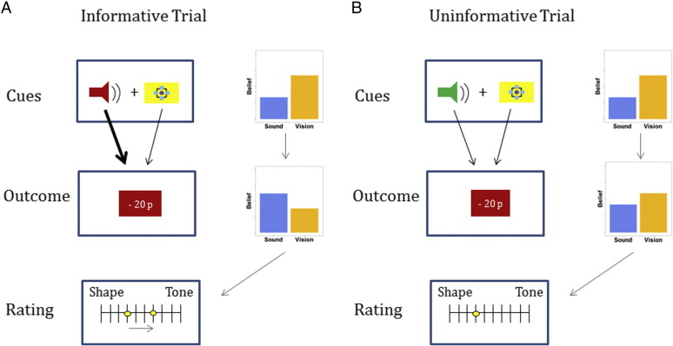
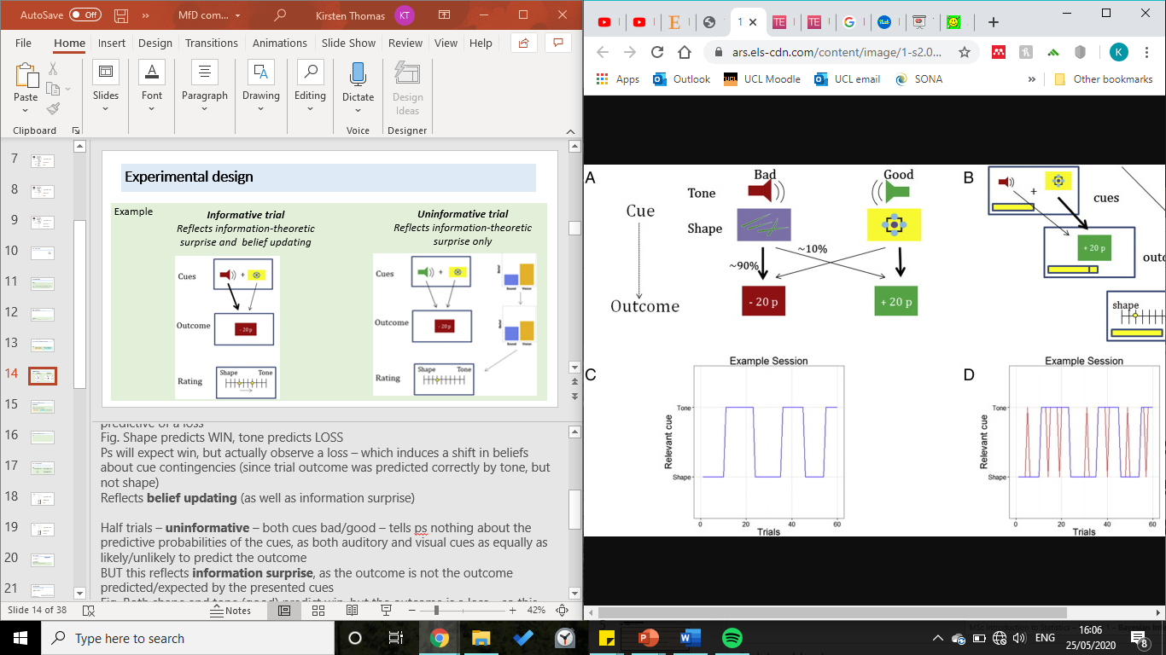
Experimental design
Example
Informative trial
Reflects surprise and belief updating
Uninformative trial
Reflects surprise only
Notes:
Ps presented with a visual cue and an auditory cue and asked to infer which currently determined probability of observing specific trial outcome
Some cues were ‘good’ (predictive of win), some were ‘bad’ (predictive of loss)
Ps had to rate their belief on scale
Informative trial – one cue is predictive of a win, while other cue is predictive of a loss
These trials induce a meaningful shift in beliefs about cue contingencies
Reflects belief updating
Uninformative trials – both cues bad/good
These trials do not provide meaningful information - both auditory and visual cues as equally as likely/unlikely to predict the outcome

Slide 14
Step 4 – Quantify hypotheses
Step 4
PURPOSE: Mathematical quantification of verbal hypothesis
Map out intuitions and proposals about mechanisms and variables into precise mathematical language
Example
Hypothesis: Dopamine regions encode meaningful information content of observations (Bayesian surprise)
Surprise (information-theoretic) | Epistemic value (Bayesian surprise) | Reward prediction error
-lnP(o|θ,m) | KL[P(θ|o,m)||P(θ|m)]) | Mismatch between expected and observed reward
Notes:
Full KL divergence equation from prior to posterior belief that the authors used:
KL[Pθ|o_{t},m) || P(θ,m)] = ΣP(θ,o_{t},m)*log(Pθ|o_{t},m/P(θ,m)
-ln negative log probability
o observation
m model
Θ agents’ model parameters

Slide 15
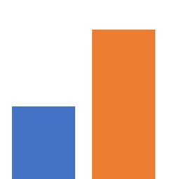
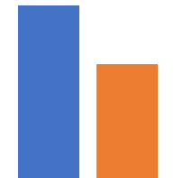
Step 4 – Quantify hypotheses
Step 4
PURPOSE: Mathematical quantification of verbal hypothesis
Prior P(θ|m)
Posterior P(θ|o,m)
KL divergence quantifies the difference between one probability distribution to another
Sound
Vision
Sound
Vision
Notes:
In our example, this is the difference between the Bayesian prior and the posterior
Computational model that performs Bayesian belief-updating on a trial-by-trial basis and analysed participants performance based on this

Slide 16
Blohm, Kording & Schrater (2020)
10 steps to modelling, split into four sections:
Framing the question
Implementing the model
Model testing
Publishing
Notes:
We are now ready to move to the next step , and to implement the model.

Slide 17
Blohm, Kording & Schrater (2020)
10 steps to modelling, split into four sections:
Implementing the model
Step 5: Toolkit selection
Step 6: Drafting
Step 7: Implementation
Notes:
Model Implementation is made od 3 steps: toolkit selection, drafting, implementation.
These central steps help us expressing our ideas in mathematical, quantifiable, terms, and to control that the core elements of the model are not missing. Once we have a solid structure, we can build on it to detail the model with additional features

Slide 18
Step 5 - Toolkit Selection
PURPOSE: Select the best approach to answer the questions
What tools? (MECHANICS)
What level of abstraction?
As abstract as possible
As detailed as possible
How to select a Toolkit?
Knowledge of the toolkit strength and limitations is necessary.
There is not a right or wrong toolkit, but we need background knowledge to select the more appropriate tools to answer our questions.
Example (Encoding shift in beliefs)
Toolkit of choice: Bayesian Brain Theory: Bayesian statistics and Beliefs updating.
Why?
Optimal toolkit to deal with differences between sensory surprise and information for beliefs update.
Neurobiological plausibility of Dopamine as responsible for beliefs updating and its pathology
Notes:
Toolkit selection is fundamental to chose what set of mathematical instruments is the best approach to answer to the model questions.
To do so, we need to ask what tools we need and what level of abstraction, trying to be as abstract as possible and as detailed as possible.
The necessary element to select the best toolkit is knowledge. We need to know strength and limitation of each toolkit, and be able to navigate the field to compare different possibilities. It is particularly difficult to have knowledge of any possible toolkit, especially for researchers without a mathematical background, but you can do whatever you can to develop the strongest expertise on the toolkit, or on the most used series of toolkit before choosing the best one for your own model .
An important thing to keep in mind is that there is no perfect toolkit, and no wrong toolkit; the goal is to select the most appropriate.
In our example, the toolkit of choice is the Bayesian Brain Theory framework, which involves Bayesian statistics and beliefs updating.
Why was this toolkit selected?
I can find 2 main reasons. The first one is that it is the best toolkit to deal with differences between sensory surprise and information for beliefs update; the second one is that the Bayesian brain theory implies and supports the neurological plausibility of Dopamine as responsible neurotransmitter for beliefs updating and its pathology.

Slide 19
Step 6 – Planning the Model
PURPOSE: assemble the different components of the hypothesized explanations and relationships
GRAPHICAL representation of the model, as SIMPLE as possible
Include the different components of the model and their relationships
The nature of the model can change the aspect of the diagram
Each individual element (variables and their relationships) should be associated with its mathematical equations for further implementation
Explicit the related measurements to each variable of the model
Notes:
The next step, ‘Planning the Model’, is the core step to assemble the different components of the hypothesized explanations and relationships.
To do so, we need a simple graphical representation of the model. This can change depending on the nature of the model.
The graph has to include all the different components of the model , and their relationships. The goal is to associate each individual element of the model with the correspondent mathematical equation. An element is made of both variables and their relationship, and can be implemented in further steps.
Another important role of the graphical representation is to explicit the measurements of each variable.
This step is fundamental to clarify our hypothesis and to make sure that each element of the model is associated with its own quantifiable measure. It is extremely useful to check that our model is complete, not too complex, and that we are not missing important mathematical relationships.

Slide 20
Example (Encoding shift of Beliefs)
Surprise of an Observation:
Information (Epistemic value) of an observation:
lnP = log probability
o = observation
m = model
θ = model parameters
KL = Kullback–Leibler divergence (difference between two probability distributions). In this case prior and posterior beliefs about of the world.
Notes:
In the Example of Encoding shift of beliefs, the core two elements are the surprise of an observation, which does not have informative value in the context of the task, ,and epistemic value of an observation (with informative value). The first , surprise, is expressed as negative log probability of an observation, given model parameters under the model m. The second, epistemic value, is expressed in mathematical terms as KL divergence between the prior probability distribution and the posterior probability distribution of the beliefs about the world. The posterior probability is expressed as probability of the model parameters given the observation, under the model. The prior probability is given by the probability of the model parameters given the model.

Slide 21


Bayesian Rule
x = quantity of interest
P(x) = Beliefs about the likely values of x (prior probability distribution)
Bayesian Inference: updating of our belief about x, after a new observation y.
How?
Bayesian Rule:
Define the Likelihood: p(y|x)
New belief about x (posterior probability distribution) – Bayesian rule
Dynamic over time (‘yesterday’s posteriors are today’s priors’)
P(o_{t}|θ ,m) P(θ|m)
P(o_{t}|m)
P(θ|o_{t} ,m) =
Notes:
To understand the basic of the toolkit used in the example, we need to introduce the concept of Bayesian rule.
The Bayesian rule says that the probability of a variable x given another variable y is equal to the probability of the variable y given x , multiplied by probability of x , all divided by the probability of y. This basic expression is extremely powerful to solve a number of mathematical problems, which can be applied to different models.
For instance, moving back to our example, Bayesian inference allows us to update our belief about the variable x, after a new observation y. It is enough to define the likelihood of y given x to compute the probability of x given y. If we introduce the dynamic over time, we can see that probability of x at time n, given all the observation of y until time n is equal to probability of y at time n given x at time n, multiplied by probability of x given the observations of y up to time n -1 (the time point before the present one), divided by probability of y up to the current time n. This is really important because is telling us that the posterior probability of the previous time point is the prior probability of the present.

Slide 22
Step 7 – Implementing the Model
PURPOSE: run the computer simulation
Implement each element of step 6 (model planning) individually (‘unit test’)
Start with the simplest version of the model and build on top of it to avoid errors
Understand which components of the model are crucial
Analyse the behaviour of the model
Compare the model with other models behaviours
Notes:
Finally, we can move to model implementation, namely to run the computer simulation.
With the model implementation we first have to implement each element of the model planning (each element of the graphical representation ) individually, to perform the so called ‘unit test’.
To avoid errors, it is always better to start from the simplest version of the model and to build on it in a progressive manner. This is also important to understand which components of the model are crucial, and to analyse the behaviour of the model.
Finally , we can also compare the model with other models behaviours. This can help us understanding the specificity of our model, and assure that the selected model is the most appropriate for our purposes.

Slide 23
Step 7 – Implementing the Model
Example (Encoding shift in beliefs)
t = 1: P(θ|m) = [vision sound] = [0.5 0.5]
Beginning of the session: prior beliefs
P(o_{t}|θ ,m)
Beginning of the experiment: likelihood of an outcome, dependent on the cue and a free parameter
Posterior belief about cue contingencies (Bayesian rule)
Posterior belief at the end of a trial (prior for the consequent trial)
E = subjects' expectations about the frequency of contingency reversal (how likely the subjects belief that the stimulus switch from one modality – visual or sound - to the other)
Notes:
In this slide you can see how the model implementation has been carried for the example.
At the beginning of the session we can define the prior beliefs , the probability of the model parameters given the model. In this case, we have two input (cue) modalities (vision and sound) , both equally probable.
We can also define the likelihood of an outcome as the probability of outcome given the model parameters.
The expression of this is too complex for the purpose of our discussion, but it is important to understand that the likelihood of an outcome is dependent on the cue and on a free parameter, subject-specific.
The posterior belief of the model parameter (the contingency in this case) , given the observation is expressed by the Bayesian rule as probability of model parameters given the model , multiplied by the probability of the observation given the model parameters, divided by the sum over time of the probability of the model parameters times the probability of the observation given the model parameters.
The posterior belief at the end of a trial, which is the prior probability for the next trial, is given by the probability of the parameters of the model given the observation, multiplied by E.
I won’t get into details about the expression of E, but the key element is that E represents the subjects’ expectation about the frequency of contingency reversal, and affect the dynamics of beliefs updating. E quantifies how likely the subjects belief that the stimulus switch from sound to visual. (Theta is model parameter of the subject.)
Now that we went through the main equations of our example, we can move to the next step and learn how to test the model.

Slide 24
Blohm, Kording & Schrater (2020)
10 steps to modelling, split into four sections:
Framing the question
Implementing the model
Model testing
Publishing

Slide 25
Blohm, Kording & Schrater (2020)
10 steps to modelling, split into four sections:
Model testing
Step 8: Completing the model
Step 9: Model testing and evaluating

Slide 26

Step 8 – Completing the model
PURPOSE: Completing the model
When is the model ready?
Does the model efficiently answer the questions set in Step 1: Defining the questions
What about the hypotheses defined in Step 4: Defining the hypotheses.
Hypothesis: Dopamine regions encode meaningful information content of observations
(Bayesian surprise)
Purpose: identify regressors for an imaging study
Is the model answering these questions?
Example: Neural signals encoding shifts in beliefs
Notes:
It can be hard to decide when the model is ”ready”. It’s always possible to redo something. So there are a couple of questions you should ask when deciding when to move on to model testing.
Firstly, reverring back to Step 1: Defining the question. We have to ask whether the model we’ve build efficiently answers the questions we’ve asked. So let’s think of our model. The questions we asked were:
What is the role of dopamine in belief updating?
Can we differentiate between information theoretic surprise and belief updating (epistemic value)
We have mathematically defined our hypotheses with our models.
We have one model that defines information-theoretic surprise, + one model that defines belief updating model by looking at the divergence of prior and posterior probability functions
Before completing the models, we should consider whether they work conceptually. (of course to see how well our models actually work we have to test them).
Lets start with our model for information-theoretic surprise. It’s just the negative log of the probability of an observation. So the higher the probability of an observation, the lower the surprise. This seems to be a mathematically and conceptually valid definition of surprise.
Then our model for belief updating (epistemic value). We’ve made a couple of assumptions. For example, that people start with a 50/50 belief in the validity of both cues. We also know from past literature and our stats knowledge that the Bayes theorem gives us pretty much the optimal model for updating beliefs. Does that seem like valid assumption to make, do people update their beliefs optimally?
The point is that before moving on, it is important to critically think about and evaluate your model and question whether the assumptions make sense.

Slide 27
Step 8 – Completing the model
PURPOSE: Completing the model
Beware of overfitting!
  “Everything should be made as simple as possible – but no simpler!”
  -Einstein
Notes:
Our models for information-theoretic surprise and belief updating seem at least conceptually sound. So we can move to model testing.
At this point of finishing the models, it might be tempting to just keep adding and adding parameters to the models. However as always, you should BEWARE OF OVERFITTING.
Adding too many parameters to your model just reduces it’s explanatory power. As you know, adding an own parameter for every observation essentially just makes any model useless. This is of course true for computational modelling as well. Remember Occams Razor, aim to keep our model as simple as possible.

Slide 28
Step 9 – Testing the model
PURPOSE: Comparing the model to experimental data (and other models)
We have:
1. Finished building our model
2. Conceptually evaluated whether it is decent
What’s next?
Run an experiment and compare to real data!
Notes:
Now we have:
1. Finished building our model
2. Thought about it critically and conceptually evaluated whether its decent, i.e. whether it captures the elements we want it to capture and whether the approuch we employed and the parameters we used were justified.
So whats next?
We see how well our model compares with actual human behavior.

Slide 29
Experimental design (brief reminder)
Example
Informative trial
Reflects surprise and belief updating
Uninformative trial
Reflects surprise only
Notes:
Ps presented with a visual cue and an auditory cue and asked to infer which currently determined probability of observing specific trial outcome
Some cues were ‘good’ (predictive of win), some were ‘bad’ (predictive of loss)
Ps had to rate their belief on scale
Informative trial – one cue is predictive of a win, while other cue is predictive of a loss
These trials induce a meaningful shift in beliefs about cue contingencies
Reflects belief updating
Uninformative trials – both cues bad/good
These trials do not provide meaningful information - both auditory and visual cues as equally as likely/unlikely to predict the outcome

Slide 30
Step 9 – Testing the model
PURPOSE: Comparing the model to experimental data (and other models)
Example: Neural signals encoding shifts in beliefs
Fitting the model to data:
Free parameter = A subject Specific parameter that we that captures the individual preferences of the participant
In our model we use the free parameter Tau
Τau = The individual belief the participant holds about the validity of the cue
This is estimated using maximum likelihood estimation for each session for each participant
Based on this parameter, we can then estimate trial-to-trial shifts in beliefs for each participant.
Shifts in belief = Bayesian surprise, defined as the “difference” between posterior and prior belief. (Kullback-Leibler divergence of probability distributions)
We also estimate measures of information-theoretic surprise for each participant
Notes:
So we have collected the data from all the participants. Now we’ll try to estimate their beliefs based on our model, i.e. w fit the model to the data.
The first step is estimating the free parameter Tau for each participant and each session in this case.
With our example model, this is done with maximum likelihood estimation. No need to worry about the details here, maximum likelihood estimation is essentially a computational method for estimating parameters for any given data based on their probability function. In simple terms this just means asking “what is the most likely value for this parameter given this data and our model?”
Now that we have the values for tau (the individual belief the participant has in the validity of the cue)
We can plug these values into our model and estimate how the participant’s beliefs would shift according to our model.
Remember that in our model, a shift in belief is defined as the Kullback-Leibner divergence (you can think of it as just the difference of probability functions) of the posterior and the prior belief. Again don’t worry about the “Kullback-Leibner” part. It is just a measure of measuring the difference between two probability functions. This is the “epistemic value” of the observation.
And as you remember, we can also estimate the information-theoretic surprise, which is defined as the negative log probability of an observation.

Slide 31
Experimental design (brief reminder)
Example
Informative trial
Reflects surprise and belief updating
Uninformative trial
Reflects surprise only
Notes:
What would our model(s) predict?
With informative trials, our model would estimate that the participants belief will shift towards the correct cue-type. How much it will shift, depends on the past trials (”yesterdays posteriors are today’s priors”)
With uninformative trials the belief will stay static, as there is no new information with epistemic value.
However, the model will still estimate a high value for information-theoretic surprise, if both cues are positive, and the reward is negative (or vice versa) as though it does not contain information with epistemic value, it is still surprising.

Slide 32
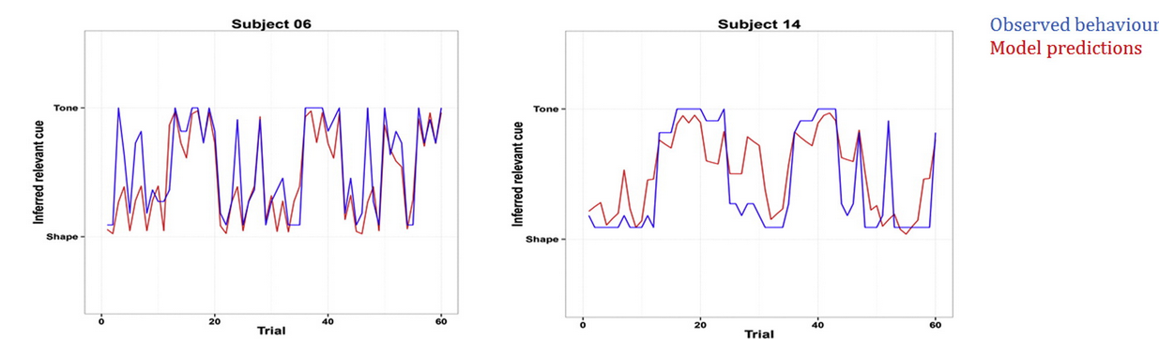
Step 9 – Testing the model
PURPOSE: Comparing the model to experimental data (and other models)
Example: Neural signals encoding shifts in beliefs
Fitting the model to data:
Compare our fitted model estimations to behavioural data:
The model accounted for a significant portion of the variance participants confidence ratings (R² = 0.82)
(Schwartenbeck, Fitzgerald & Dolan, 2016)
Based on our belief updating model and information-theoretic model, we can construct regressors and see whether there are different patterns of brain activation for epistemic value and surprise!
Notes:
Next, of course, we will compare the estimations we made with our model to the actual performance of the participants in the experiment., trial by trial.
So here are two examples, from two different participants. The y-axis on the graph here is the belief rating the participants did after each trial, higher up indicating more belief that the tune is the valid cue, lower down indicating the the picture is the valid cue.
As you can see the model predictions worked our quite well, with the model explainign 82% of the variance in confidence rating in total.
Now we know that our model fits the data quite well, i.e. it approximates real behaviour well. Based on our model we can also make a distinction between trials with information theoretic value, (the trials that are only surprising but have no epistemic value) and trials with epistemic value (trials that carry informataion for belief updating)
This means we can see whether high values of information theoretic surprise correlate with different brain activity than belief updating. We have used the model to construct regressors for an imaging study!

Slide 33

Step 9 – Testing the model
PURPOSE: Comparing the model to experimental data (and other models)
So we can use the model as intended!
Reached the goals set in the beginning!
But one more thing...
Notes:
So we’ve used the model to do what we set up as it’s goal in the beginning and we can construct regressors!
(To see the results of the neuroimaging study check out the original paper)
However, theres one more thing…

Slide 34
Step 9 – Testing the model
PURPOSE: Comparing the model to experimental data (and other models)
Model Comparison:
Schartenbeck, Fitzgerald and Dolan (2016) didn’t perform model comparison.
However, usually essential.
Refer to the earlier MfD-lecture to refresh your mind on model comparison!
Notes:
Because the main point of the example study was to identify regressors for the imaging study, the authors did not perform any model comparison. For their study, the main point was to identify the regressor, not to find the exact model with the best explanatory power. So what kind of evalation is necessary depends on the purpose of the model.
Often models are used for the describing data, or predicting data. If the purpose of the model is to describe or predict data, model comparison is essential
In this case it is essential to compare your model to other models in the literature .
Refer to earlier lecture on model comparison for info!

Slide 35
Blohm, Kording & Schrater (2020)
10 steps to modelling, split into four sections:
Framing the question
Implementing the model
Model testing
Publishing
Publishing

Slide 36
Blohm, Kording & Schrater (2020)
10 steps to modelling, split into four sections:
Publishing
Step 10: Publishing
Publishing

Slide 37
Step 10 – Publishing
PURPOSE: Sharing the model with the scientific community
Rule no. 1:
  Convey all the steps covered here (1-9) in a clear, structured and precise manner in a way your selected audience can understand.
To succeed:
  Make clear graphical presentations of the model
  Use clear commenting on the code for the model, and stick to commonly used programming conventions
  Share the code (e.g. Github)
  Publish/Share the data (e.g. crcns.org, figshare, OSF.io)
Notes:
Rule number one of publishing: Do what we’ve tried to do here: clearly explain all the steps you took for building your model in a way your audience can understand.

Slide 38
“All models are wrong, but some are useful”
(Box, 1976)

Slide 39

References and thank you
Thank you to our expert Dr Michael Moutoussis!
Blohm, G., Kording, K., & Schrater (2020). A How-to-Model Guide for Neuroscience. eNeuro, 7(1), 1-12. DOI: https://doi.org/10.1523/ENEURO.0352-19.2019
Dayan, P. & Abbott, L. F. (2001). Theoretical Neuroscience: Computational and Mathematical Modelling of Neural Systems. The MIT Press.
National Institute of Health/Biomedical Imaging and Bioengineering (2019). Computational Modelling, https://www.nibib.nih.gov/sites/default/files/Computational_Modeling_Fact_Sheet.pdf
Schwartenbeck, P., FitzGerald, T., & Dolan, R. (2016). Neural signals encoding shifts in beliefs. NeuroImage, 125, 578-586. DOI: https://doi.org/10.1016/j.neuroimage.2015.10.067

